Slide 1
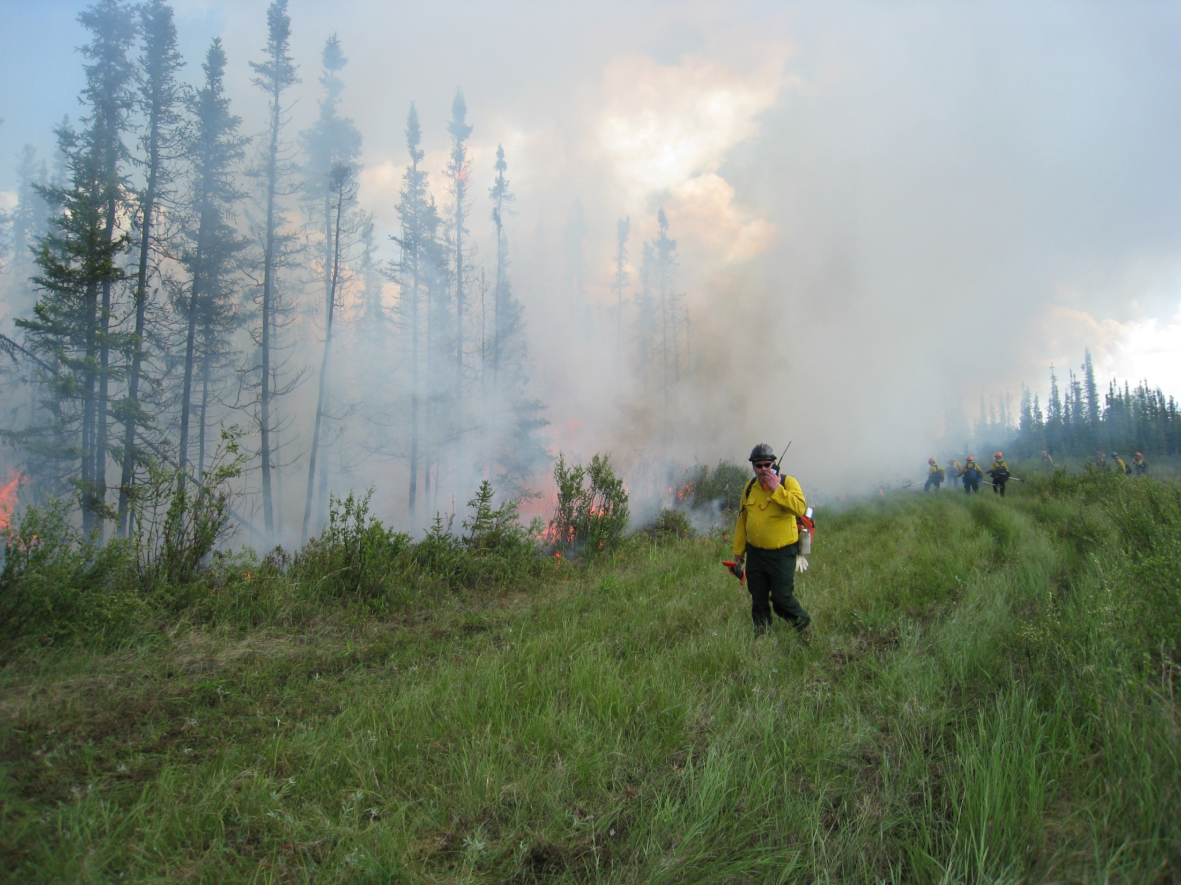
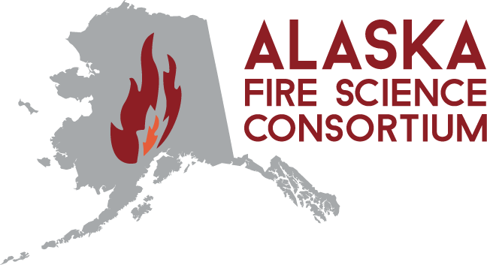
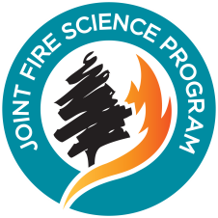

A boundary organization supporting collaboration with decision-makers
2009 Nenana Ridge Rx burn—Skip Theisen
Photo by Dale Haggstrom, ADF&G retired
Alison York ABoVE STM8 May 9, 2022
http://akfireconsortium.uaf.edu

Slide 2
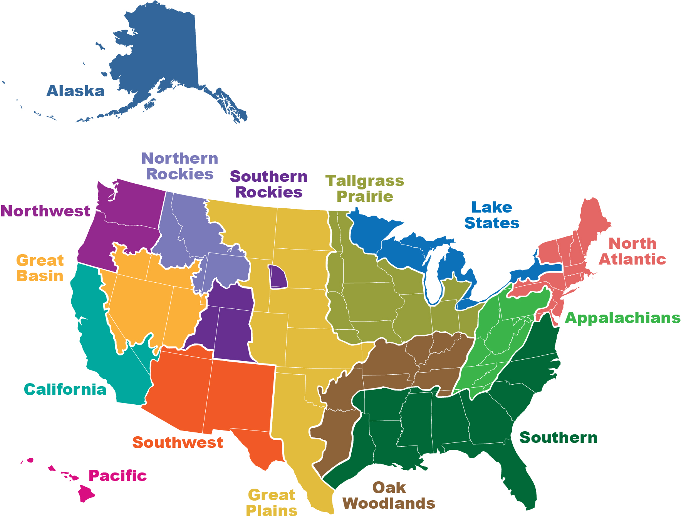
Joint Fire Science Program (JFSP)
JFSP provides funding and science delivery for studies associated with managing wildland fire, fuels, and fire-impacted ecosystems to respond to needs of managers, practitioners, and policymakers
Connecting to managers:
Fire Science Exchange Network
Started in 2009 following evaluation of other science delivery approaches. Research shows long-term effectiveness in awareness and adoption of new science by decision-makers

Slide 3
Joint Fire Science Program (JFSP)
Fire Science Exchange Network
Key program elements that support collaboration with decision-makers
Place based: understanding of regional issues and tools
Long-term funding and stability: continuity for end users
Open mandate: not just JFSP research
Evaluation is routine: evidence of long-term impact
Embedded in the end users community
Subject matter specialists are key!

Slide 4
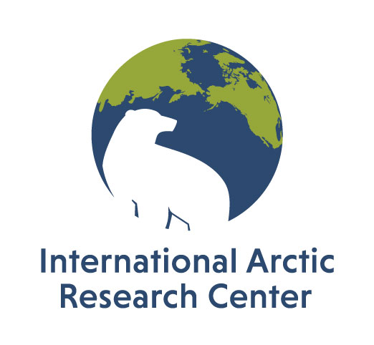
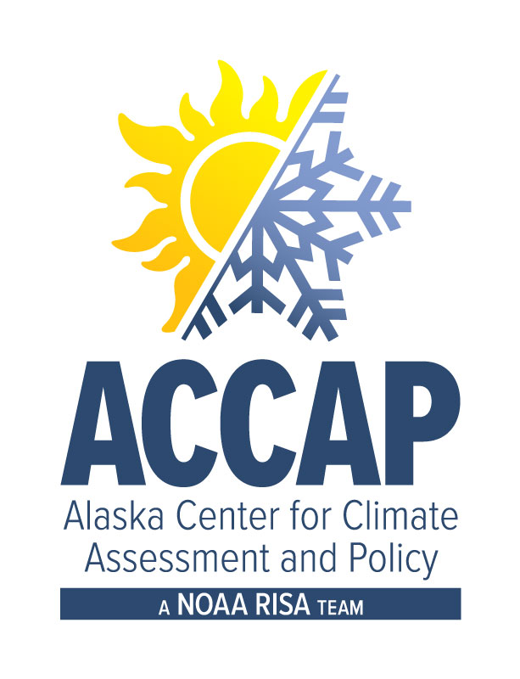

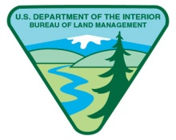


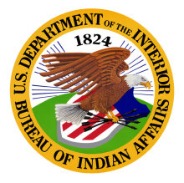
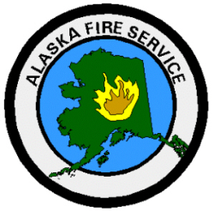
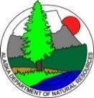
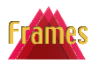

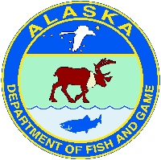

Advisory Board
Jennifer Barnes, NPS
Regional Fire Ecologist
Mike Butteri, DOF
Fire Planner
Tom Heinlein, BLM
Anchorage District Manager
Teresa Hollingsworth, USFS
Research Ecologist
Jennifer Hrobak, BLM-AFS
Fire Management & Program Analyst
Rachel Loehman, USGS
Research Landscape Ecologist
Mary Lynch, BLM-AFS, retired
Planning & Environmental Coordinator
Eric Miller, BLM-AFS
Fire Ecologist
Chris Moore, BLM-AFS
Fire Analyst
Diana Olson, UI-FRAMES
FRAMES Project Manager
Sue Rodman, ADFG
Program Coordinator
Bobette Rowe, USFS
AK Fire Operations
Scott Rupp, UAF
Scenarios Network for Alaska
& Arctic Planning
Lisa Saperstein, USFWS
Regional Fire Ecologist
Tom St. Clair, BIA
Fire Management Officer
Heidi Strader, NPS
Fire Weather Program Manager
Graham Worley-Hood, BLM-AFS
Fuels Specialist

Slide 5
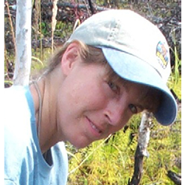
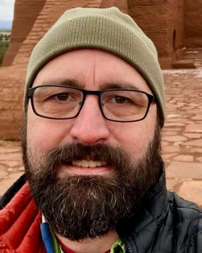
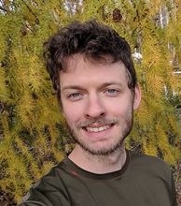
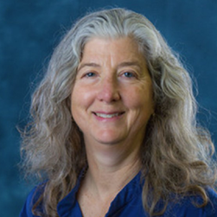
AFSC staff
Subject matter specialists* are key to collaborating with decision-makers
Randi Jandt*, Fire Ecologist
Mitch Burgard*, Fire Analyst
Zav Grabinski, Science Communication Specialist
Alison York, Coordinator
Not here: Sarah Trainor, PI and Director; Kristi Bulock*, Southcentral Liaison; Robert (Zeke) Ziel*, Fire Analyst Emeritus

Slide 6
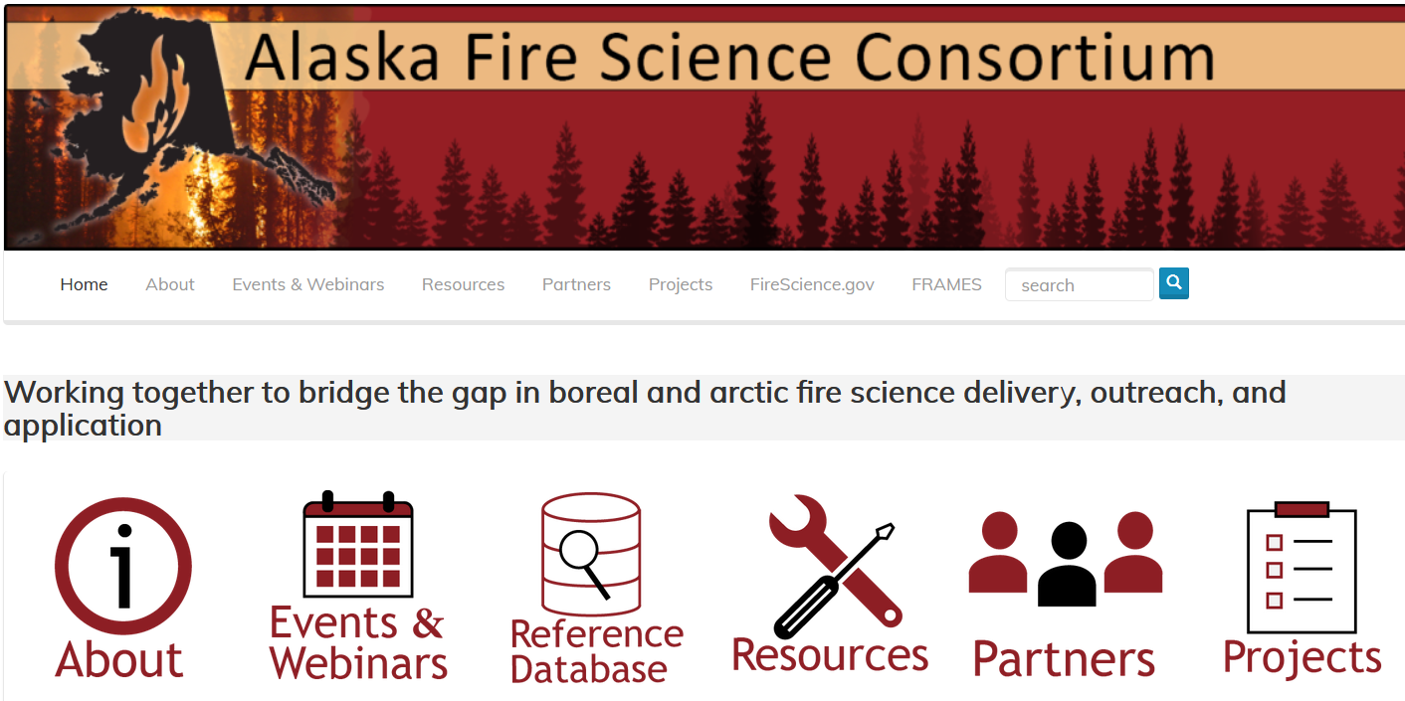
What does AFSC do?
Science delivery: webinars, workshops, interpreted products, direct communication, Alaska Reference Database
Research development: educating and connecting researchers with management priorities, keeping tabs on national programs and research, promoting manager involvement in projects, advancing international (esp Canada) collaboration
Support to relevant interagency committees, especially:
  Fire Research Development and Applications Committee
  Education and Prevention Committee
  Fire Modeling and Analysis Committee
Evaluation: users indicate AFSC is having a
long-term impact on how science is used
and applied in fire management decisions
in Alaska
http://akfireconsortium.uaf.edu

Slide 7
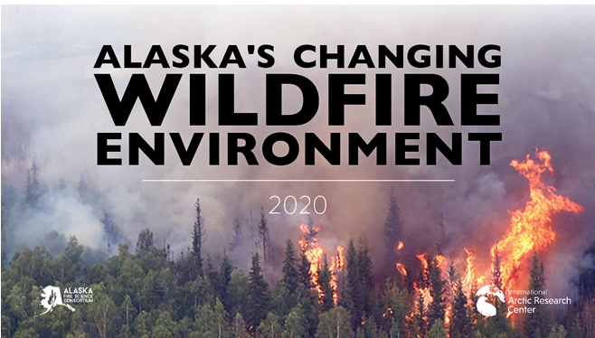
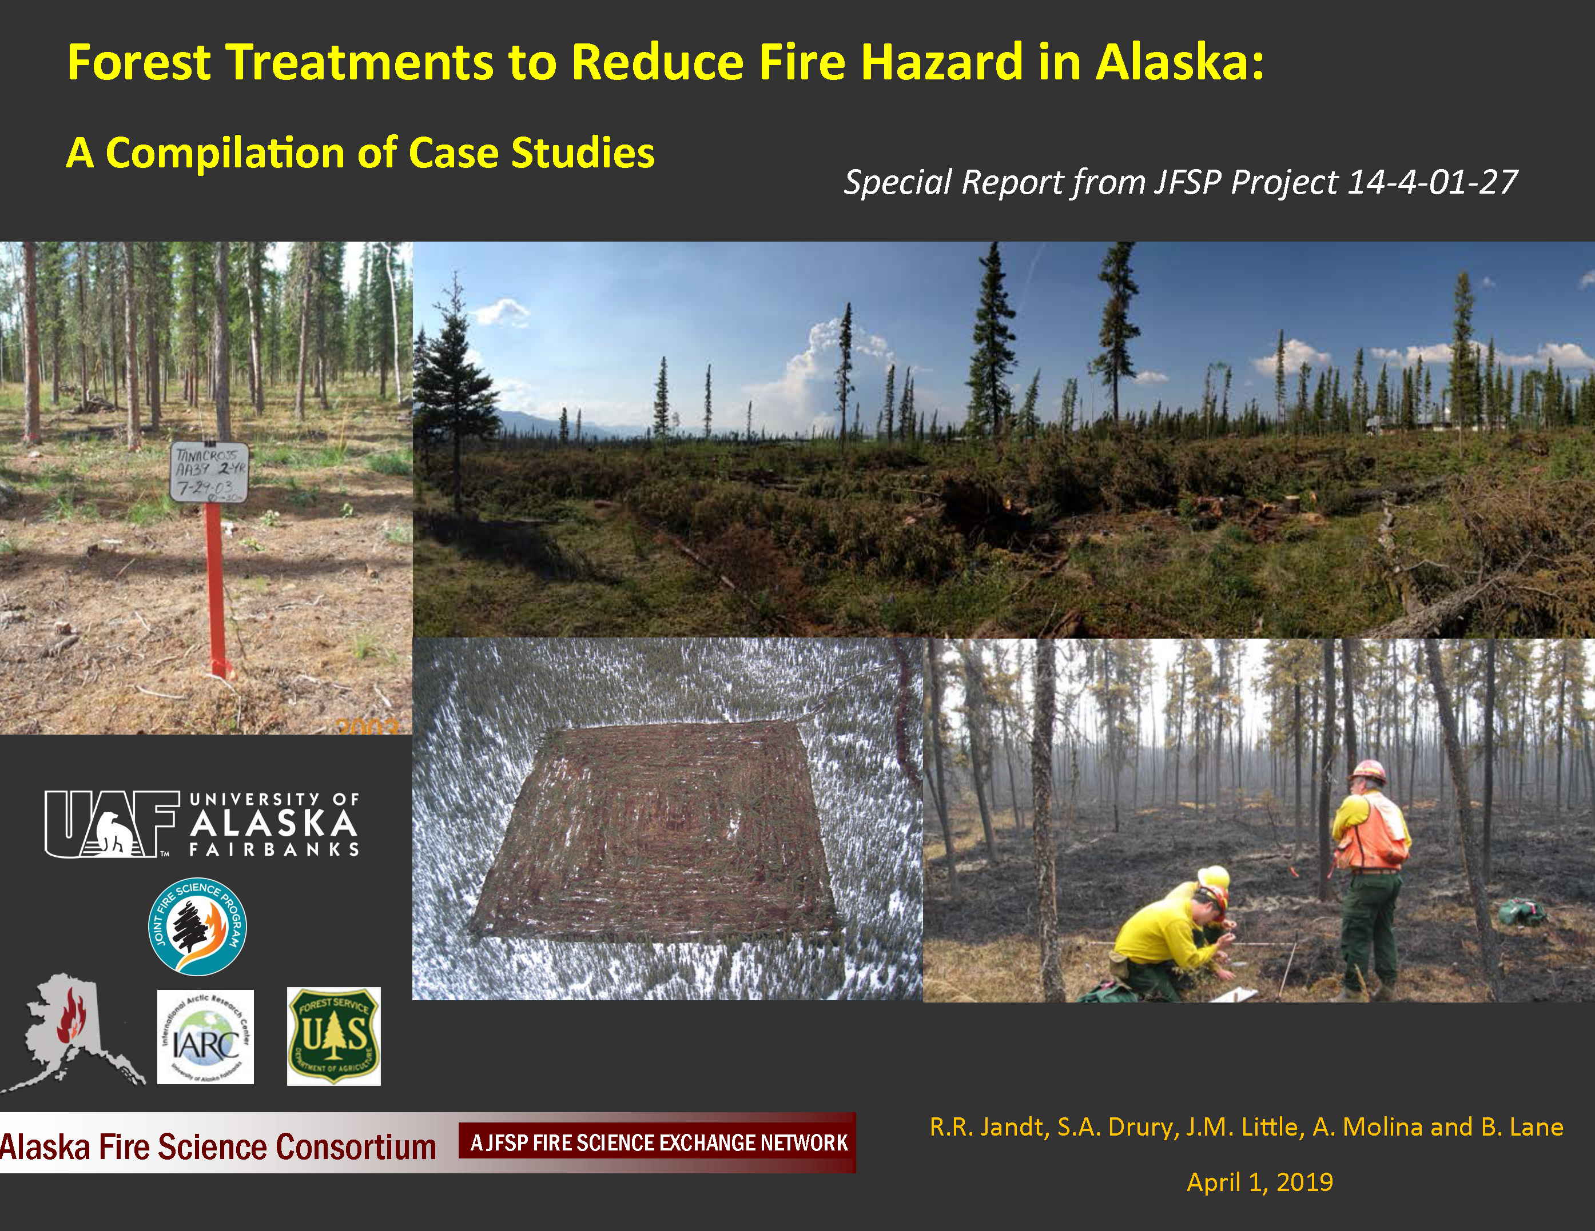
Priority topics:
climate change, fuels treatments, and
using remotely sensed data
2017 Remote Sensing workshop
Alaska’s Changing Wildfire Environment. Grabinski, Z. & H. R. McFarland. (2020).
Forest Treatments to Reduce Fire Hazard in Alaska: A Compilation of Case Studies. Jandt, RR, SA Drury, JM Little, A Molina & B Lane (2019)
Opportunities to Apply Remote Sensing in Boreal/Arctic Wildfire Management & Science: A Workshop Report. York, A.D. & Jandt, R. R. (2019).

Slide 8
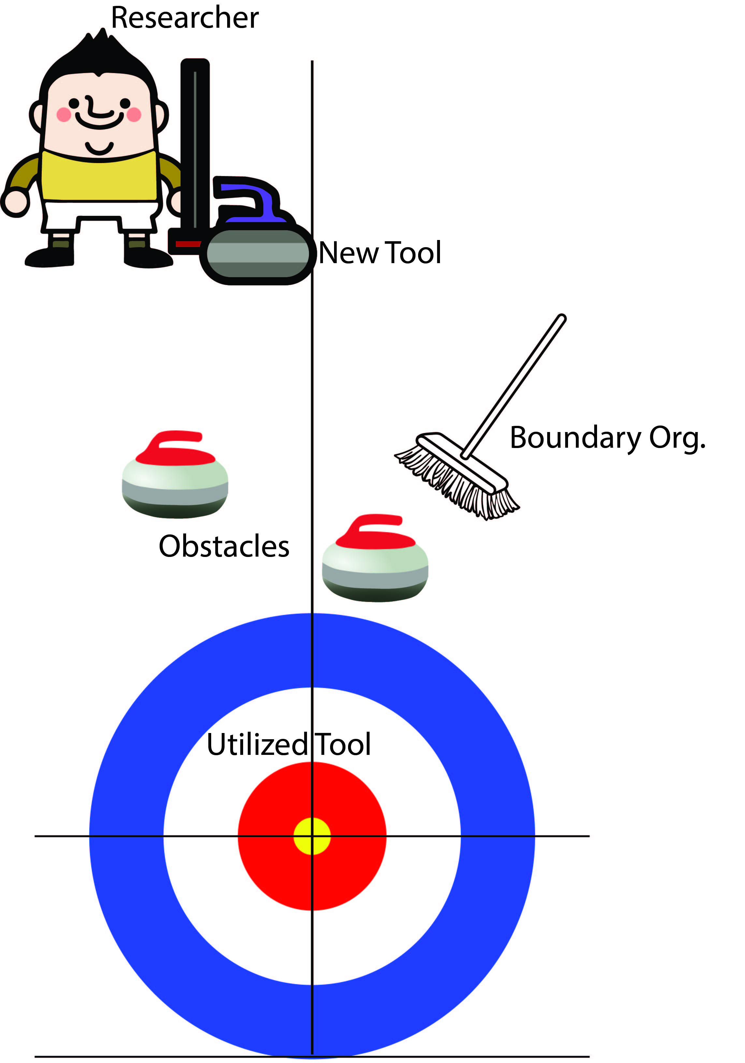


Research to Operations as curling
Boundary spanners help keep the process moving
Obstacles: data incompatibility, security issues, limited data sets, etc
Happy knowledge brokers!

