Slide 1
ABoVE – Partnership Update
^{9th} Annual Science Team Meeting
January 23-26, 2023, San Diego

Slide 2
POLAR’s vision
A sustainable future guided by knowledge and collaboration

Slide 3
POLAR’s Science & Technology Framework 2020-2025
Goal 1
Goal 2
Goal 3
Improving knowledge of dynamic northern terrestrial, freshwater and marine ecosystems in the context of rapid change
Increasing understanding of the connections between northern community wellness and environmental health
Advancing sustainable energy, technology and infrastructure solutions for the unique environmental, social and cultural conditions in the North

Slide 4
POLAR’s mandate
Advance knowledge of the Canadian North in order to improve: 1) economic opportunities 2) environmental stewardship 3) quality of life of its residents & Canadians
Promote the development and dissemination of knowledge of the other circumpolar regions, including the Antarctic
Strengthen Canada’s leadership on Northern issues
Operate a hub for scientific research at the Canadian High Arctic Research Station (CHARS) campus in Cambridge Bay, NU

Slide 5
POLAR Update
POLAR-NASA Cooperation
Renewed POLAR-NASA MOU for 5 years in 2021
Ongoing support for Canadian researchers and ABoVE partners
Coordinating access to RADARSAT data and flight planning
Interest in data analysis, use, and application
Renewed focus on data management
Funding for Indigenous partners
Open Science Roadmap, science integrity policy

Slide 6
POLAR-NASA ABoVE CHARS

Slide 7
POLAR-NASA ABoVE CHARS
AVIRIS (August 1, 2017)
Working with data streams collected during the ABoVE campaigns (e.g., L-VIS & exploiting spectral features for atmospheric monitoring)

Slide 9
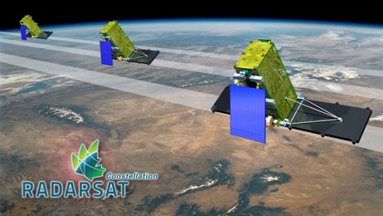
Future Research Directions
Terrestrial, marine and atmospheric monitoring to ensure long term base-line data
Establishment of monitoring instruments
Gas fluxes
Atmospheric composition
Phenology of seasonal snow and vegetation
Permafrost interactions with terrestrial and marine environments
Terrestrial and marine ecology (e.g., snow geese colony monitoring)
Test bed for distributed sensor technology scaled to remote observing technology

Slide 10
Future ABoVE Opportunities
Undertake and support locally relevant and globally significant knowledge creation
Highlight existing connections between ABoVE and other POLAR-funded projects
Understand the targeted role POLAR can play in facilitating data analysis and use
Interest in data from Indigenous governments and communities
Ensure data is available to northerners to pursue northern priorities

Slide 11
Knowledge Mobilization and Data Application
How can NASA and other ABoVE partners facilitate enhanced access to data by northern and Indigenous organizations?
What mechanisms can be implemented to ensure northern and Indigenous organizations have the support needed to analyze and use data according to their priorities?

Slide 12
Notes:
https://www.canada.ca/en/polar-knowledge/videos/chars-tour.html

Slide 13
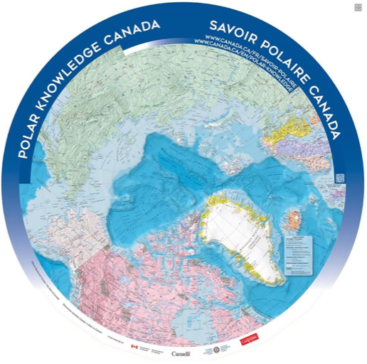
Notes:
Thank you / Merci / Quana

Slide 14
Indigenous Research Governance and Ethics in Canada
1998 | Ownership, Control, Access, and Possession - First Nations Information Governance Centre
2018 | National Inuit Strategy on Research - Inuit Tapiriit Kanatami (ITK)
2019 | Setting new directions to support Indigenous research and research training in Canada - Canadian Tricouncils
2021 | UN Declaration on the Rights of Indigenous People Act - Received royal assent and came into force
2022 | Inuit Nunangat Policy - Endorsed by Canada & ITK
“Geopolitical, cultural, socioeconomic, industrial, and climate challenges throughout Inuit Nunangat require innovative solutions informed by Inuit Qaujimajatuqangit and research developed in partnership with Inuit.
Supporting Inuit self-determination in research is necessary to improve its efficacy, pertinence and acceptability across Inuit Nunangat.”

