Slide 1
Where are we now?
A Summary of research using airborne SAR
Kevin Schaefer, Laura Bourgeau-Chavez,
The Cecil B DeMille cast of the SAR Working Group

Slide 2
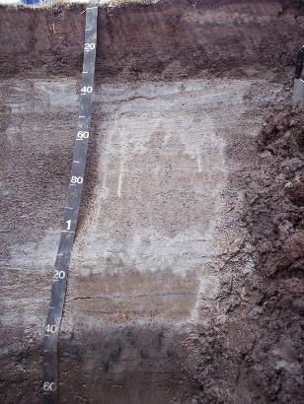
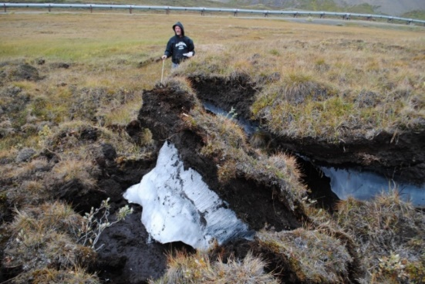
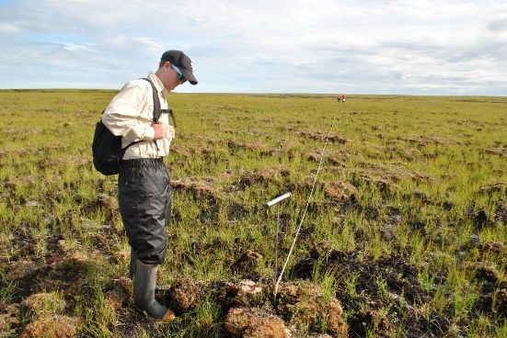
SAR Applications
Interferometry
Backscatter
Seasonal Subsidence
Subsidence Trends
Coherence
Lakes
Wetlands
Double Bounce
Thaw Depth
Surface Change
Reflection
Thermokarst
Soil Moisture
Biomass
Scattering Absorption
Volume Scattering
Notes:
Exploring the ABoVE SAR Data
https://doi.org/10.3334/ORNLDAAC/2150

Slide 3
Soil Moisture (Dann et al.)
h
Z₁
ALT
Z₂
Julian Dann
Airborne P-band
Notes:
Solid SAR VWC
lines predicted
Dann, J.; Bennett, K.E.; Bolton,W.R.;Wilson, C.J. Factors Controlling a Synthetic Aperture Radar (SAR) Derived Root-Zone Soil Moisture Product over The Seward Peninsula of Alaska. Remote Sens. 2022, 14, 4927. https://doi.org/ 10.3390/rs14194927

Slide 4
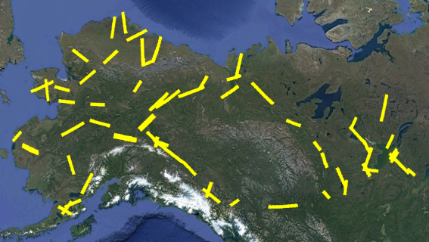
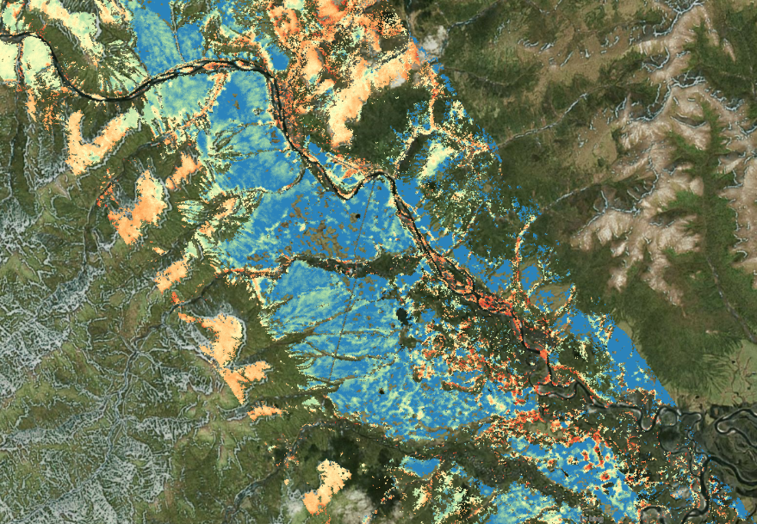
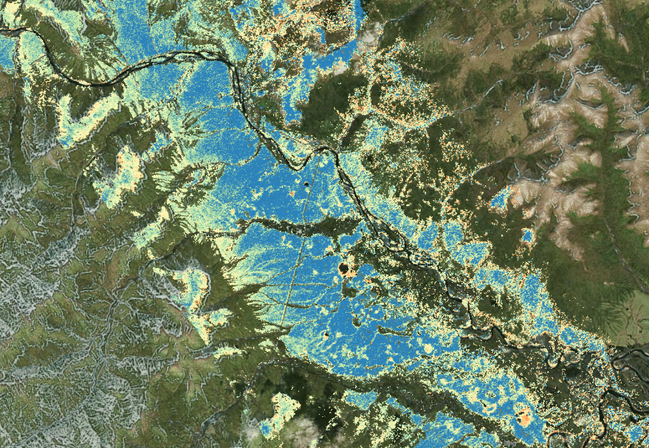


Soil Moisture and Active Layer Thickness (ALT)
ALT (m)
VWC (-)
High and Dry
Low and Wet
Kevin Schaefer
Airborne L-band, P-band
Notes:
Dataset: Schaefer, K., L.K. Clayton, M.J. Battaglia, L.L. Bourgeau-Chavez, R.H. Chen, A.C. Chen, J. Chen, K. Bakian-Dogaheh, T.A. Douglas, S.E. Grelick, G. Iwahana, E. Jafarov, L. Liu, S. Ludwig, R.J. Michaelides, M. Moghaddam, S. Natali, S.K. Panda, A.D. Parsekian, A.V. Rocha, S.R. Schaefer, T.D. Sullivan, A. Tabatabaeenejad, K. Wang, C.J. Wilson, H.A. Zebker, T. Zhang, and Y. Zhao. 2021. ABoVE: Soil Moisture and Active Layer Thickness in Alaska and NWT, Canada, 2008-2020. ORNL DAAC, Oak Ridge, Tennessee, USA. https://doi.org/10.3334/ORNLDAAC/1903

Slide 5
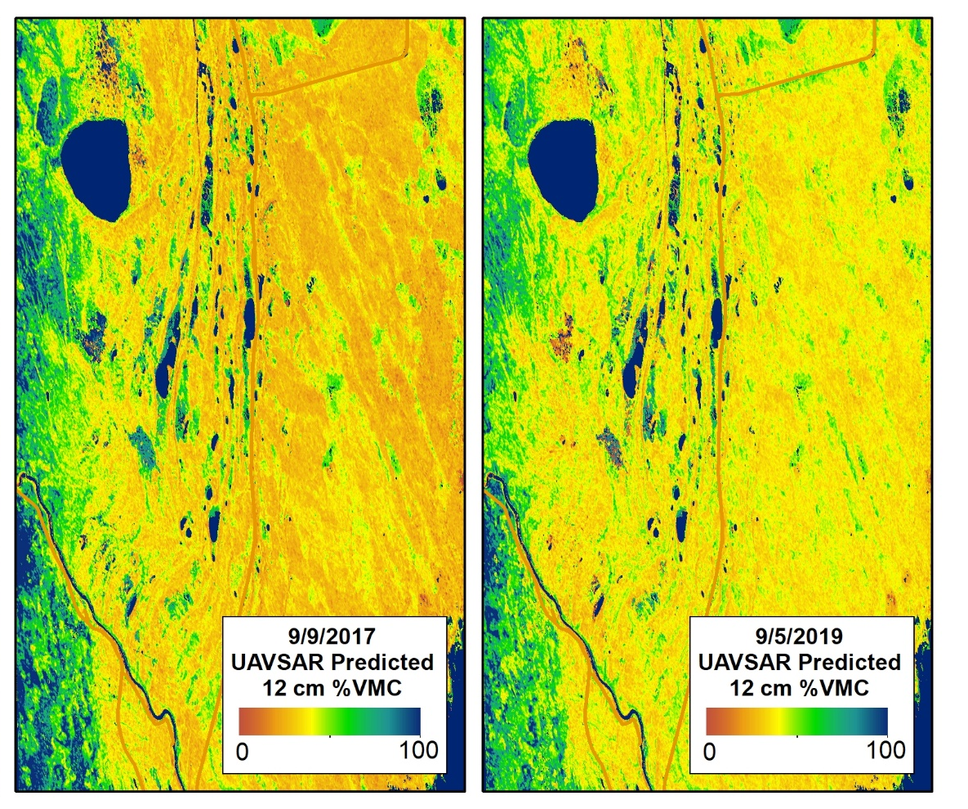
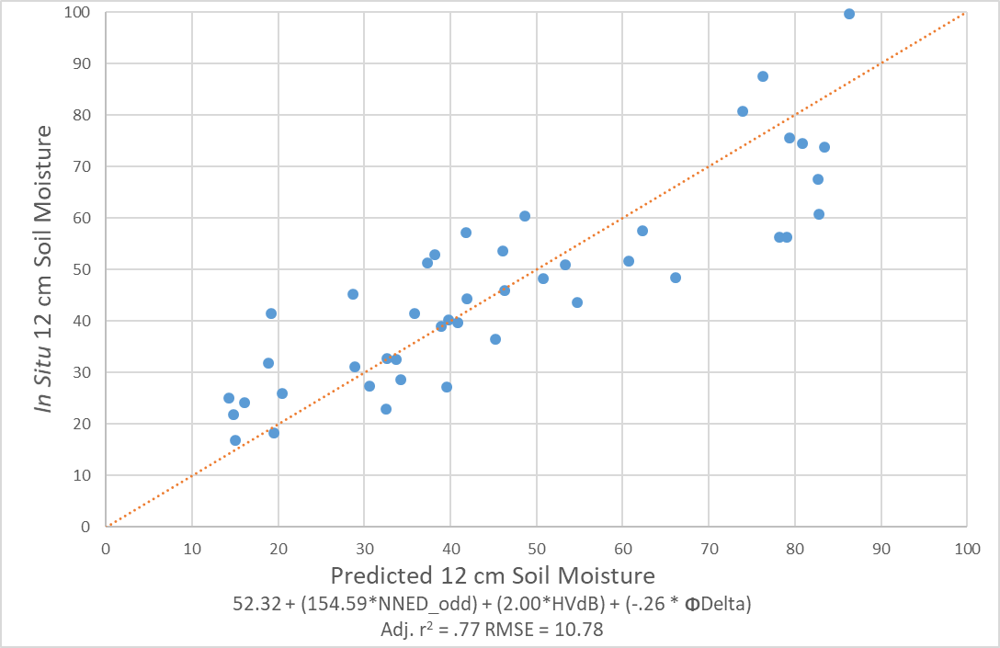
Soil Moisture in prep for NISAR
Laura Bourgeau-Chavez
Airborne L-band

Slide 6
ALT and VWC Validation Data
100 sites, 20 teams, 50 km of surveys, 350,000 measurements
As VWC increases, Active Layer Thickness decreases
Leah Clayton
in situ
Notes:
100 sites, 20 teams, 50 km of surveys, 350,000 measurements
Clayton, LK, K Schaefer, MJ Battaglia, L Bourgeau-Chavez, J Chen, RH Chen, A Chen, K Bakian-Dogaheh, S Grelik, E Jafarov, L Liu, RJ Michaelides, M Moghaddam, AD Parsekian, AV Rocha, SR Schaefer, T Sullivan, A Tabatabaeenejad, K Wang, CJ Wilson, HA Zebker, T Zhang, and Y Zhao (2021), Active layer thickness as a function of soil water content, Env Res Lett, 16, 055028, doi:https://doi.org/10.1088/1748-9326/abfa4c
Dataset: stacks.iop.org/ERL/16/055028/mmedia

Slide 7
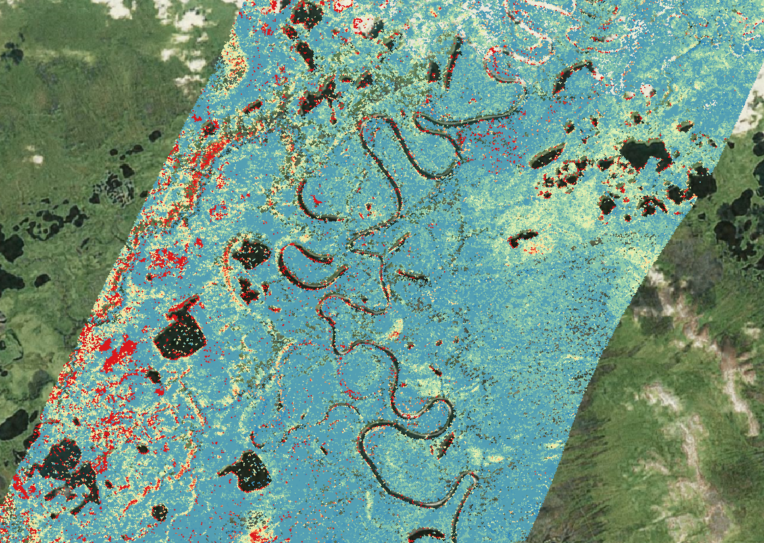

Water Table Depth
Old Crow Flats
WTD (m)
Drained Soils
Standing water
Kevin Schaefer
Airborne L-band, P-band
Notes:
Dataset: Schaefer, K., L.K. Clayton, M.J. Battaglia, L.L. Bourgeau-Chavez, R.H. Chen, A.C. Chen, J. Chen, K. Bakian-Dogaheh, T.A. Douglas, S.E. Grelick, G. Iwahana, E. Jafarov, L. Liu, S. Ludwig, R.J. Michaelides, M. Moghaddam, S. Natali, S.K. Panda, A.D. Parsekian, A.V. Rocha, S.R. Schaefer, T.D. Sullivan, A. Tabatabaeenejad, K. Wang, C.J. Wilson, H.A. Zebker, T. Zhang, and Y. Zhao. 2021. ABoVE: Soil Moisture and Active Layer Thickness in Alaska and NWT, Canada, 2008-2020. ORNL DAAC, Oak Ridge, Tennessee, USA. https://doi.org/10.3334/ORNLDAAC/1903

Slide 8
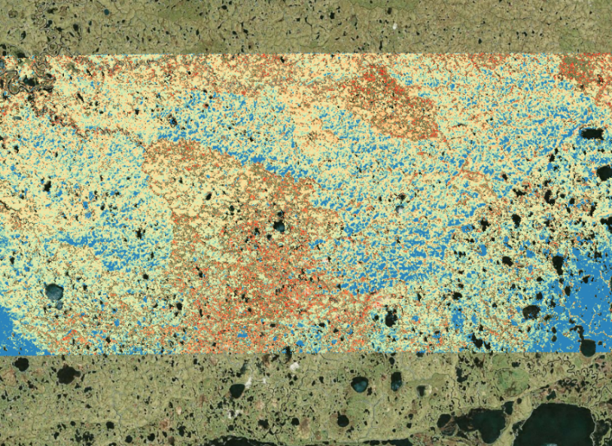
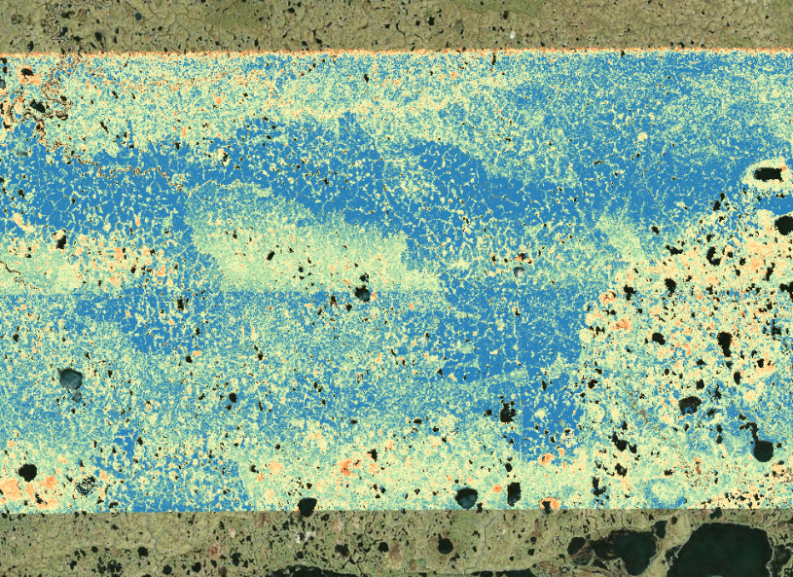


Fire in the Yukon-Kuskokwim Delta
ALT (m)
2015 Fires
VWC (-)
Unburned
Burned
Deeper active layers and wetter soils in burned areas
Kevin Schaefer
Airborne L-band, P-band

Slide 9
Impacts of the Anaktuvuk Fire
Anaktuvuk Fire
LIDAR DEM
UAVSAR Subsidence
Satellite Subsidence
Fire triggered high subsidence on edge of yedoma hill
Go Iwahana
Airborne/Satellite L-band

Slide 10
Comparing Satellite and Airborne Subsidence
Seasonal Subsidence (cm)
Same
Different
Lin Liu
Airborne/Satellite L-band
Notes:
Compare Interferograms
The two UAVSAR swaths yield consistent results
2 cm RMSE between ALOS and UAVSAR
Xu, X., Liu, L., Schaefer, K., & Michaelides, R. (2021). Comparison of surface subsidence measured by airborne and satellite InSAR over permafrost areas near Yellowknife Canada. Earth and Space Science, 8, e2020EA001631. https://doi.org/10.1029/2020EA001631

Slide 11
Inundation Dynamics in the Peace-Athabasca Delta
Double Bounce (Inundated Veg)
Volume Scatter (Forrest)
Reflection (water)
Bruce Chapman
Airborne L-band
Notes:
Chapman

Slide 12
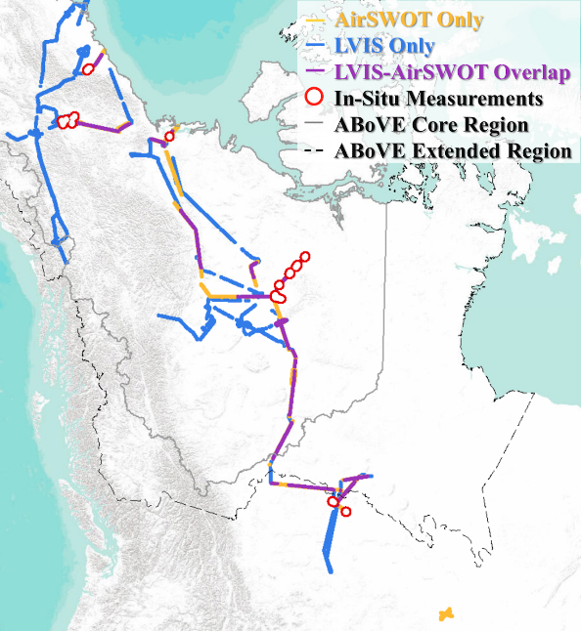
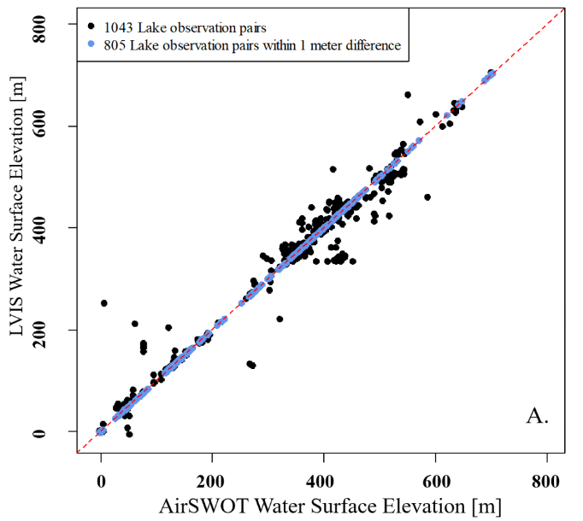
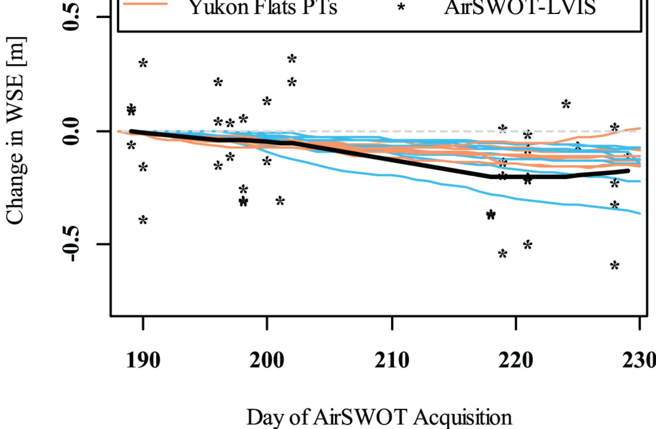
Water Surface Elevations (WSE) from AirSWOT
LIDAR vs. AirSwot WSE
WSE Trends
WSE Key
AirSWOT
Canadian Shield
Yukon Flats
AirSWOT-LVIS
*
Laurence Smith
Airborne Ka-band, Lidar
Notes:
UPPER Right: With 130 flight lines covered across 23,000 km2, the dataset represents the largest known collection of airborne Ka-band InSAR and is now freely available on ORNL: https://doi.org/10.3334/ORNLDAAC/1646
LEFT: AirSWOT WSE are compared with LVIS WSEs for 1043 lakes with coincident AirSWOT-LVIS observations. Of these, 80% percent of the AirSWOT WSEs were within 1 meter of the LVIS measurement.
RIGHT: Using the LVIS WSE as a reference, AirSWOT WSEs identified the seasonal hydrologic drawdown measured by in situ pressure
Fayne JV, Smith LC, Pitcher LH, Kyzivat ED, Cooley SW, Cooper MG, Denbina MW, Chen AC, Chen CW, Pavelsky TM, Environ. Res. Lett.15 (2020) 105005, https://doi.org/10.1088/1748-9326/abadcc

Slide 13
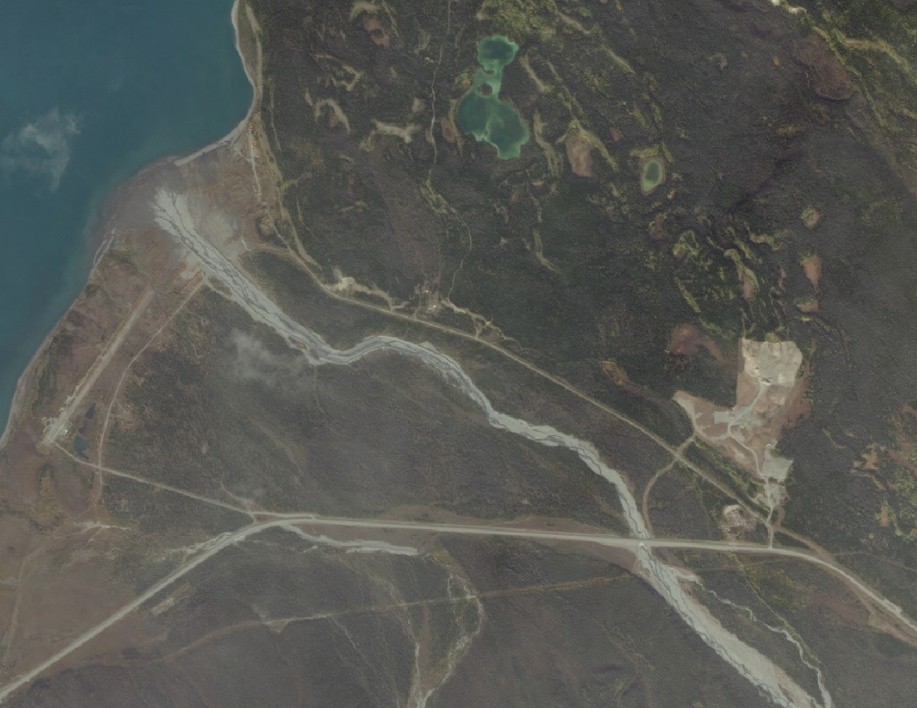
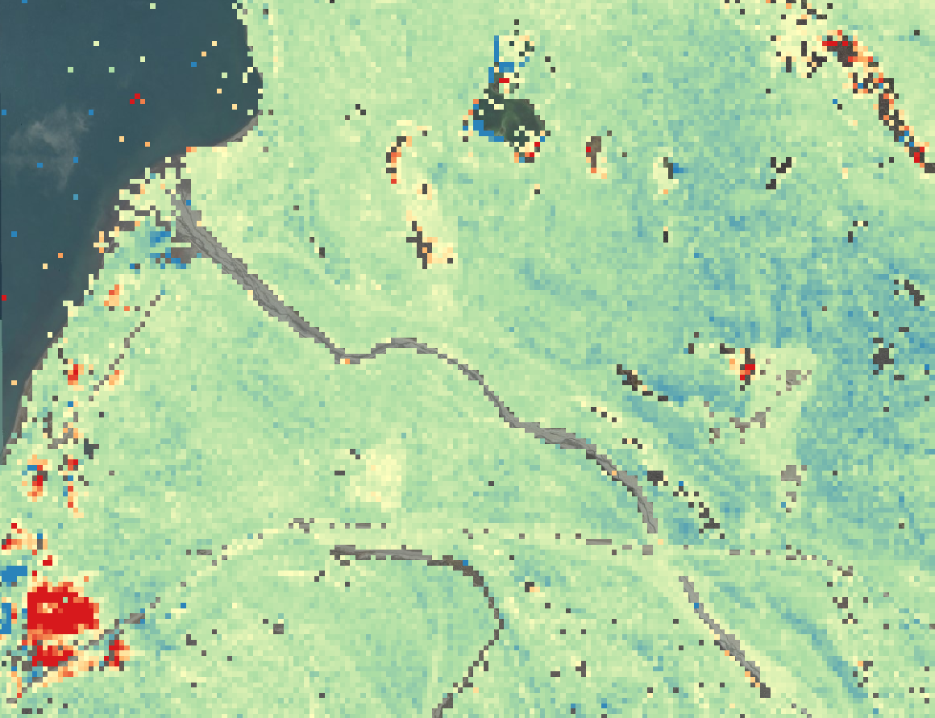

Monitoring Infrastructure
South Kluane Lake
Silver City
Fire scar
Mine
Runway
Road
Subsidence (m)
Seasonal Subsidence reveals threats to infrastructure
Kevin Schaefer
Airborne L-band, P-band

Slide 14
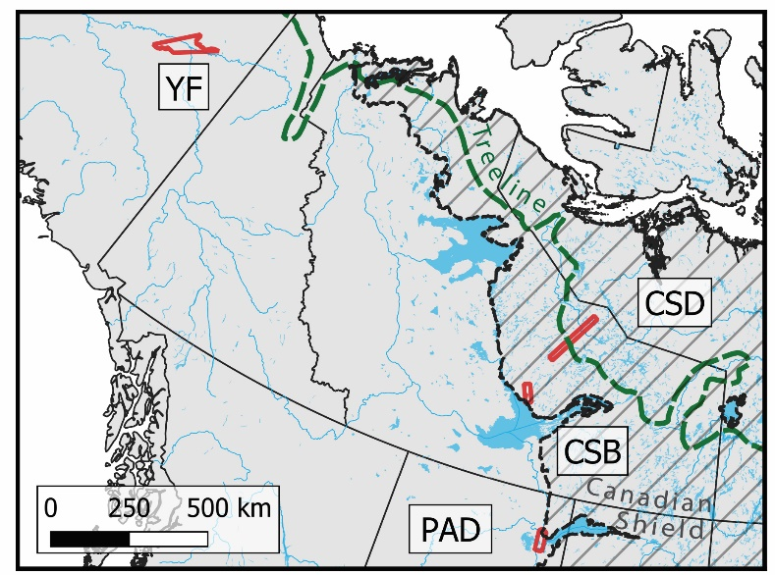
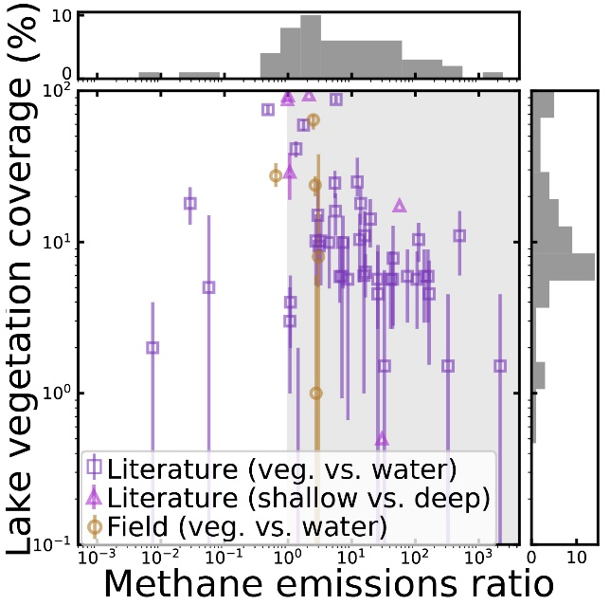
Lake Vegetation and Methane Emissions
Lake vegetation could increase emissions estimates by +21%.
Equivalent to 9% of all natural emissions
Laurence Smith
Airborne L-band, in situ
Notes:
Kyzivat, E.D., Smith, L.C., Garcia-Tigreros, F. et al. (2022), JGR:Biogeosciences, doi:10.1029/2021JG006635
Findings
We provide a first mapping of emergent aquatic vegetation in 4,572 Arctic-boreal lakes using airborne radar remote sensing.
Lake vegetation extent varies regionally from 1 to 59% of lake area and seasonally to a lesser degree, with a mean of ~16%.
Aquatic vegetation emits 6x more methane than open water per unit area, or 16x from Arctic-boreal regions only.
Significance
Accounting for vegetation could increase emissions estimates from Arctic-boreal lakes by +21%.
These uncounted emissions are equivalent to 9% of all natural emissions from these Arctic-boreal landscapes, a significant source of methane to the atmosphere.

Slide 15
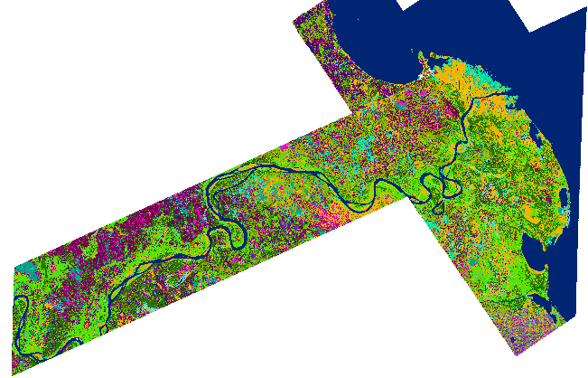
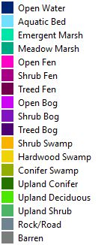
Wetland Mapping
Peace-Athabasca Delta
Nancy French
Airborne L-band
Notes:
Slave River Delta & Peace-Athabasca Delta Wetland Mapping With UAVSAR

Slide 16
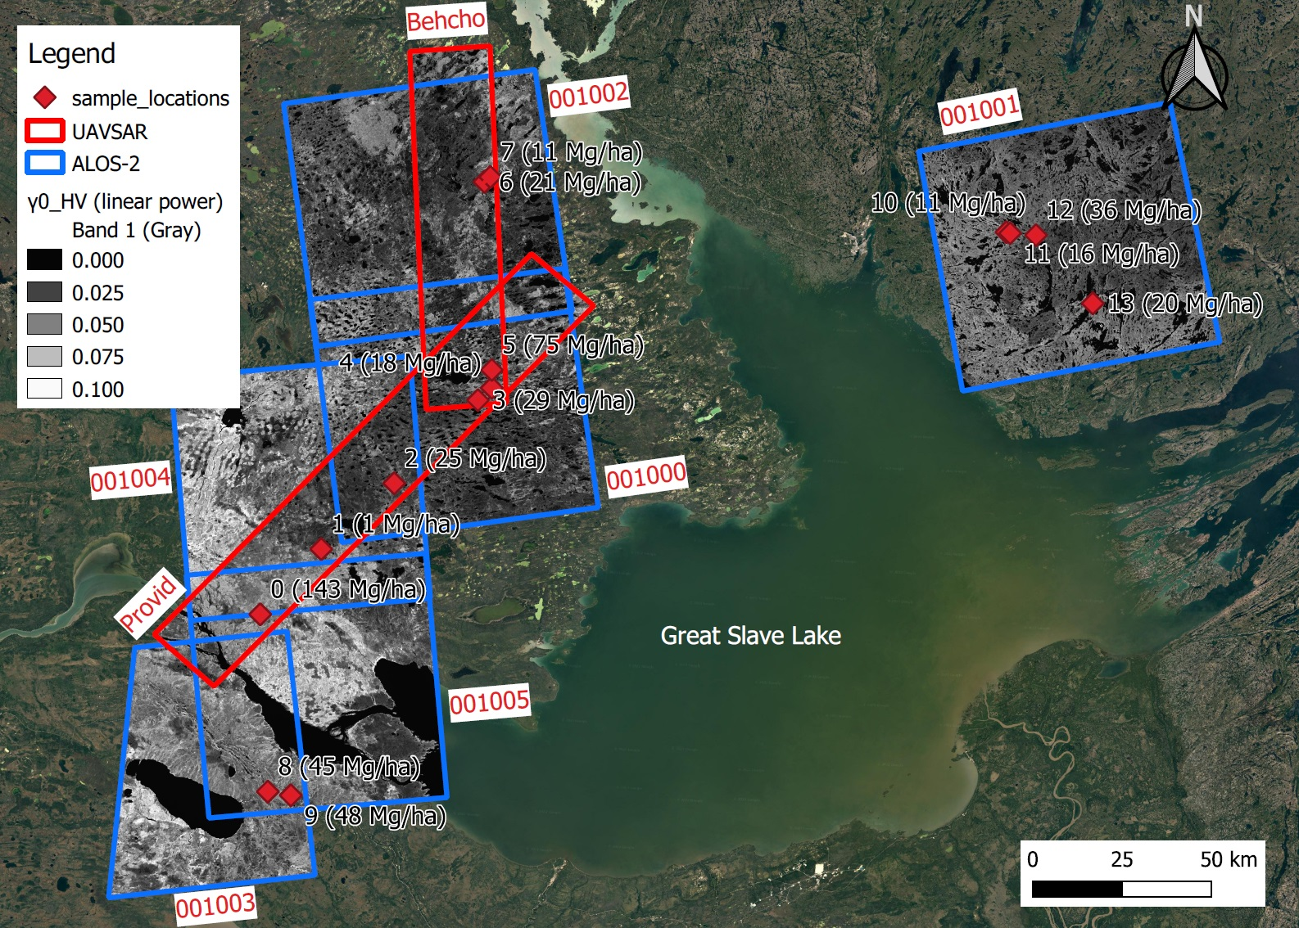
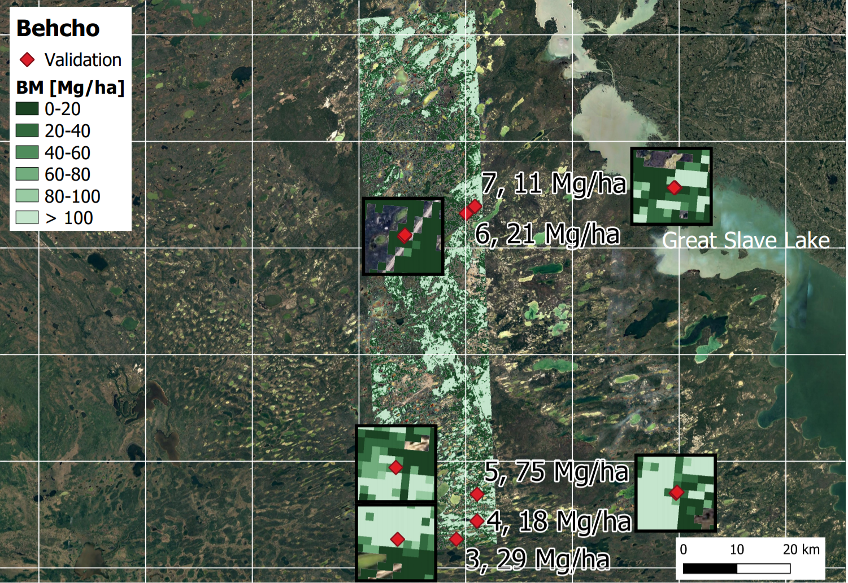
Above Ground Biomass
Laura Bourgeau-Chavez
Airborne/Satellite L-band, in situ
Notes:
We conducted a scaling experiment to assess under what conditions the NISAR science requirement can be met in the boreal Great Slave Lake region, which presents a challenge due to its dynamic hydrology.
Radar data were aggregated at three different scales and evaluated over <<1 ha, ~4 and ~16 ha ROIs to the evaluate scaling-correspondence between in situ, SAR and landscape-scale processes.
Kraatz S, Bourgeau-Chavez LL, Battaglia M, Poley A, Siqueira P (Dec. 2022). Earth and Space Science. doi: 10.1029/2022EA002431

Slide 17
See the Forest for the trees
RADAR
LIDAR
Trees
Ground
Elizabeth Wig
Airborne L-band, Lidar
Notes:
When do we see the ground and when do we see the canopy? We assumed a radar optical depth greater than one is canopy rather than ground. Based on lidar data, this corresponds to a fractional cover of 0.7. We related this to a radar veg index of 0.85

Slide 18
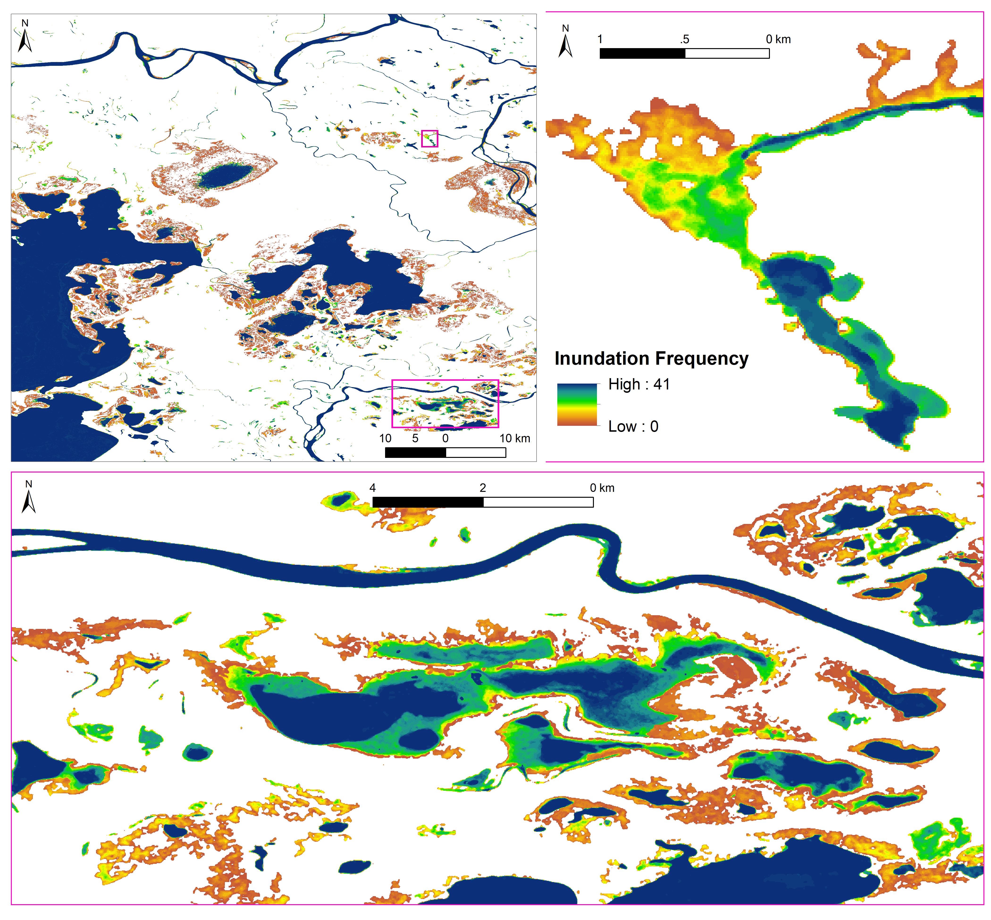
Inundation dynamics from Sentinel-1
Peace-Athabasca Delta 2017-2019
Laurence Smith
Satellite C-band
Notes:
We developed a two-step modified decision-tree method that employs time series of Sentinel-1 C-band SAR to map and monitor ABR wetland inundation, including open water bodies, aquatic vegetation, and flooded vegetation types
Validation with contemporaneous in situ field mapping, and a multi-temporal Landsat-derived surface water product at two ABoVE sites (PAD and Yukon Flats) suggests reliability of the method
Spatiotemporal dynamics of transient wetland inundation are presented in forms of inundation frequency maps and statistical charts.
Huang, C., Smith, L.C., Kyzivat, E.D., Fayne, J.V., Ming, Y., Spence, C. Tracking transient boreal wetland inundation with Sentinel-1 SAR: Peace-Athabasca Delta, Alberta and Yukon Flats, Alaska GIScience & Remote Sensing 59:1, 1767-1792, DOI: 10.1080/15481603.2022.2134620

Slide 19
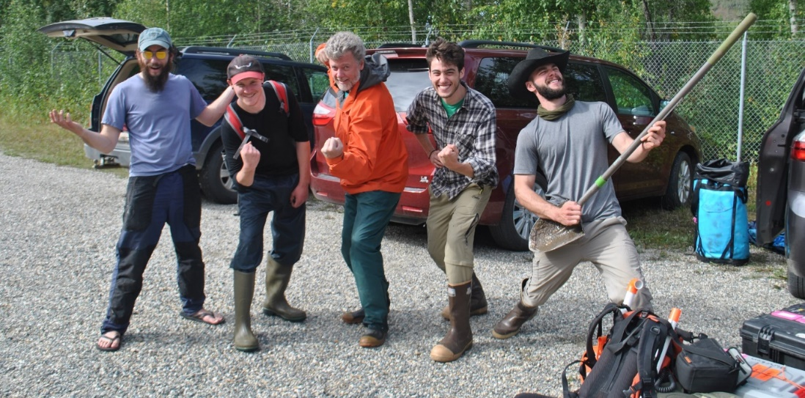
Thank You!

