Slide 1
Research Guidance for GHG Inventory Improvements
NASA CMS | High-Level Stakeholder Panel on CMS Cross-Cutting Themes
Kenna Rewcastle, PhD
U.S. Environmental Protection Agency | Office of Atmospheric Protection
Rewcastle.Kenna@epa.gov
September 17, 2024

Slide 2
Research Guidance Proposal – Develop “living” Guidance for researchers on GHG inventory research needs
Motivation: Develop guidance on GHG emissions research topics and data characteristics that can streamline the process of incorporating the latest science into the Inventory to improve GHG emissions estimates.
Guidance will cover:
Process for prioritizing Inventory improvements for specific emissions estimates from priority sectors, sources, activities and equipment
  Prioritize key categories, data inputs with high uncertainty, missing sources, sources with high levels of policy interest, and under-researched sources
Clarity on how new observation and activity data are incorporated into the US GHGI, including through direct use, indirect use (to develop country-specific emission factors), and for QA/QC
Context of Inventory methodology– empowering research community to engage in developing GHG estimates through application of IPCC Guidelines to enable international comparability and global ability to track progress towards achieving climate change mitigation goals
Examples of “success stories” featuring recent emissions estimates improvements, supported through interagency collaboration, in the agriculture and land-use sectors that highlight successful integration of novel data into Inventory estimation processes

Slide 3
Research Guidance: Development and Communication Timeline
Currently:
Refining RG Outline/Content
November 2024:
First Draft for Review by USG Partners
Early 2025:
Release of USG White Paper
Spring 2025:
Public and USG Presentations on RG
Summer 2025:
Submit Sci. Journal Publication on RG
Currently: Refining research guidance (RG) outline with USG partners, gathering feedback from research community on elements that they would like to see included in document
November 2024: First draft of RG that can be reviewed by other USG partners (US GCRP, GHGMMIS Steering Committee)
Early 2025: Release RG white paper, begin giving presentations to USG research community, broader academic research community, commence public outreach
Summer 2025: Submit RG as a concept piece in a scientific journal

Slide 4
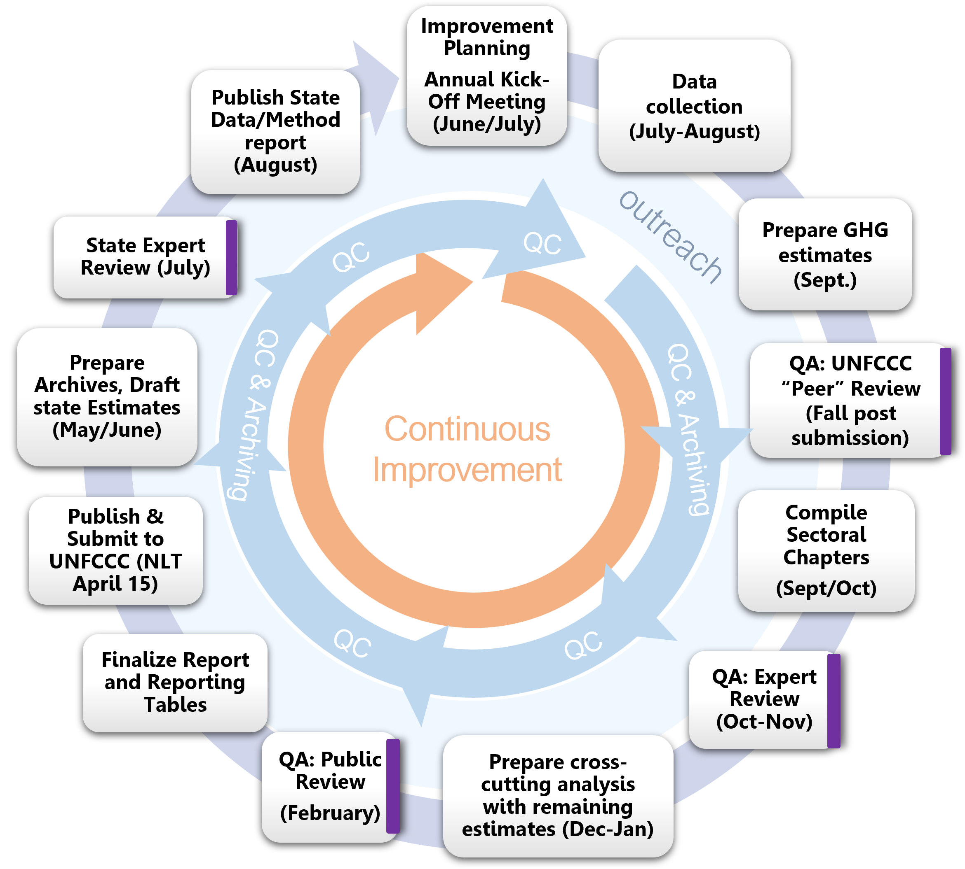
How to Put Guidance Into Practice?
The National GHG Inventory Development Cycle
Per IPCC Good Practice Guidelines, the GHGI is a living document that reflects continuous improvements
Refresh research guidance annually with a call for data to support high-priority improvements identified by experts, UN reviewers, interagency partners
Key Cycle Dates:
May-July: Improvement/planning
June-September: Annual data updates
~Fall: review of previously submitted GHGI by UNFCCC expert review team
Late October-November: 30-day expert review
February-early March: 30-day public review, via federal register notice
Mid-April: Publish and submit to UNFCCC (>900 page report w/ 500 data tables + 600 page Annex w/ 252 tables)
May-June: compile next draft of state-level GHGI
  July: 30-day state-expert review
  August: Publish state-level GHGI data and methods report
  *winter*: (goal) publish gridded methane GHGI
Question: how to best incorporate guidance for researchers into the annual cycle?
GHGI Coordinator
contracted team
EPA Sector Leads
Energy: combustion
Energy:
coal mining
Energy:
oil and gas
Agriculture
LULUCF
Waste:
wastewater
Waste:
landfills
IPPU
HFCs
Gridded GHGI Coordinator
team
team
team
team
team
team
team
team
team
contracted team
Contracted Teams
Notes:
Understand that this is a living document, demanding annual update cycle, need to understand this cycle and structure to understand where and when improvements can be considered and implemented
Not a static document, continuously updated and improved, very structured development cycle –
Inventory improvements are often identified at least one cycle before implemented and would likely need to be the case with results from inverse analysis modeling

