Slide 1
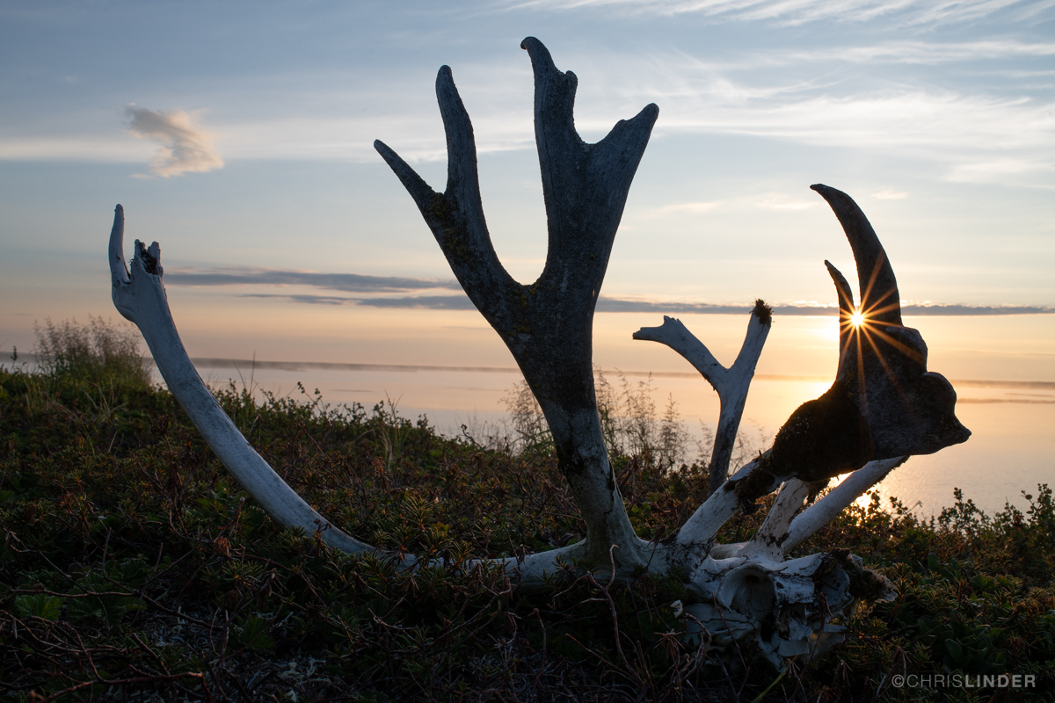
Meaningful research for meaningful impact: Arctic researchers and Indigenous communities working together to combat global climate change
Darcy L. Peter
dpeter@woodwellclimate.org
she / her / hers
Twitter: @DarcyPeter1
Instagram: @DarcyLPeter

Slide 2
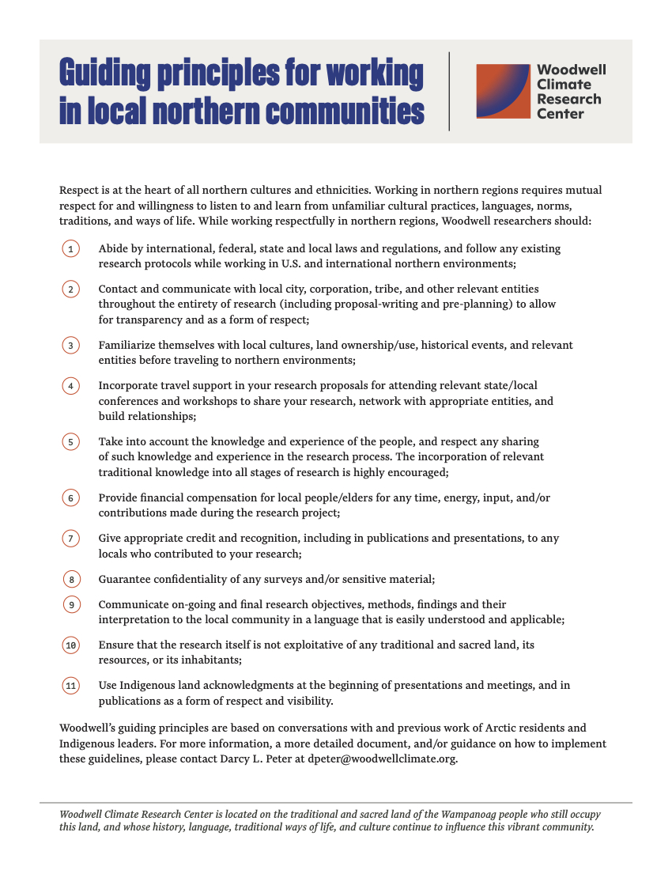
Map by: Greg Fiske (@g_fiske)

Slide 3
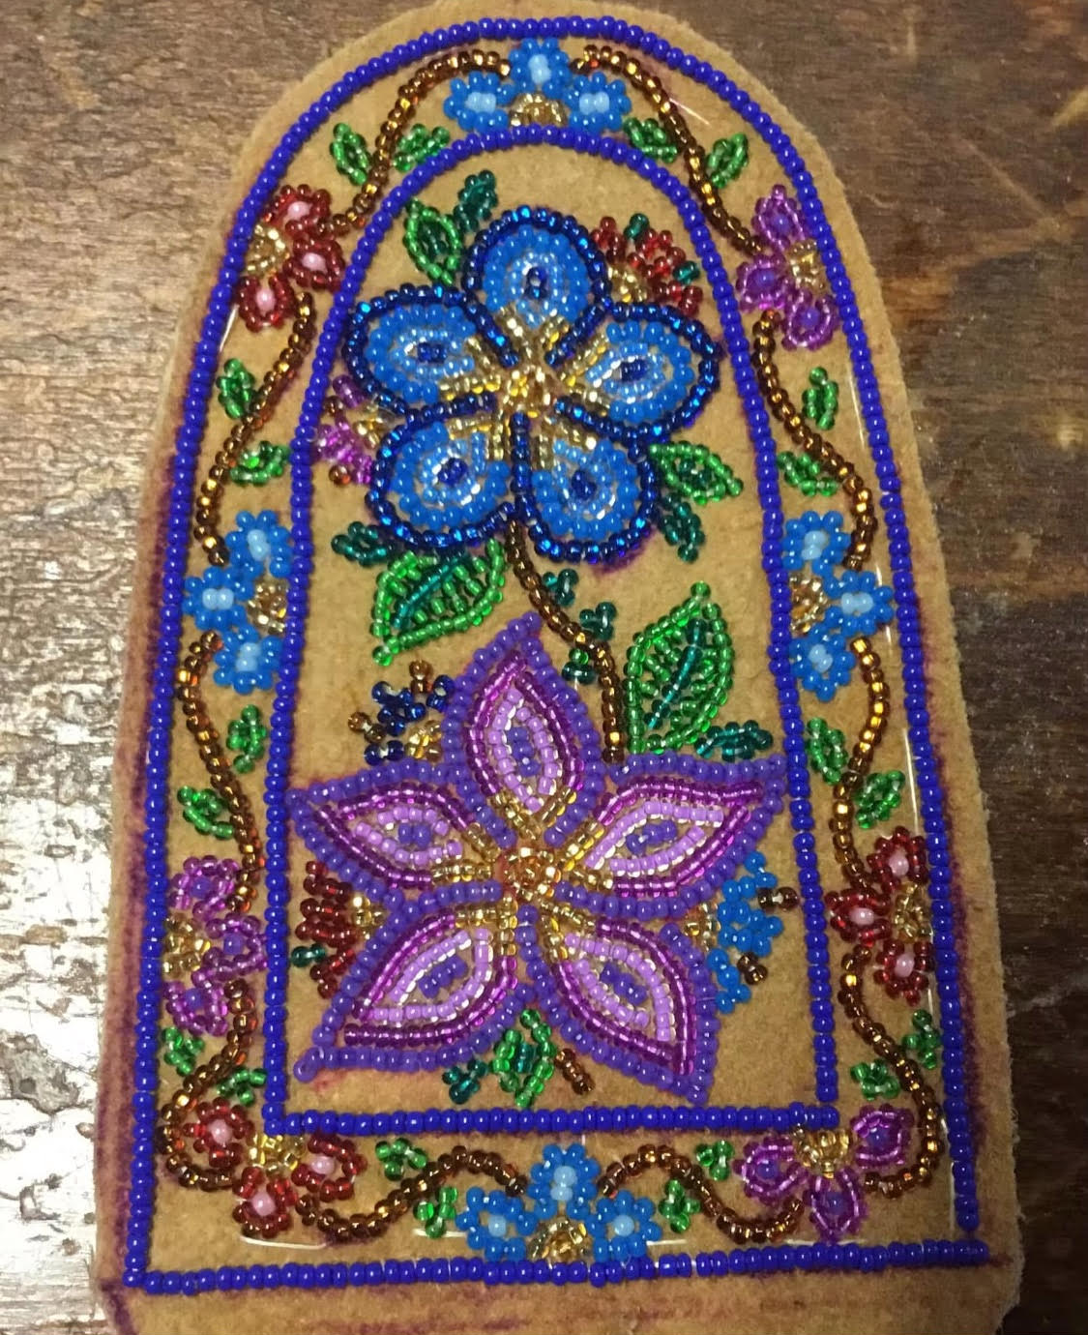
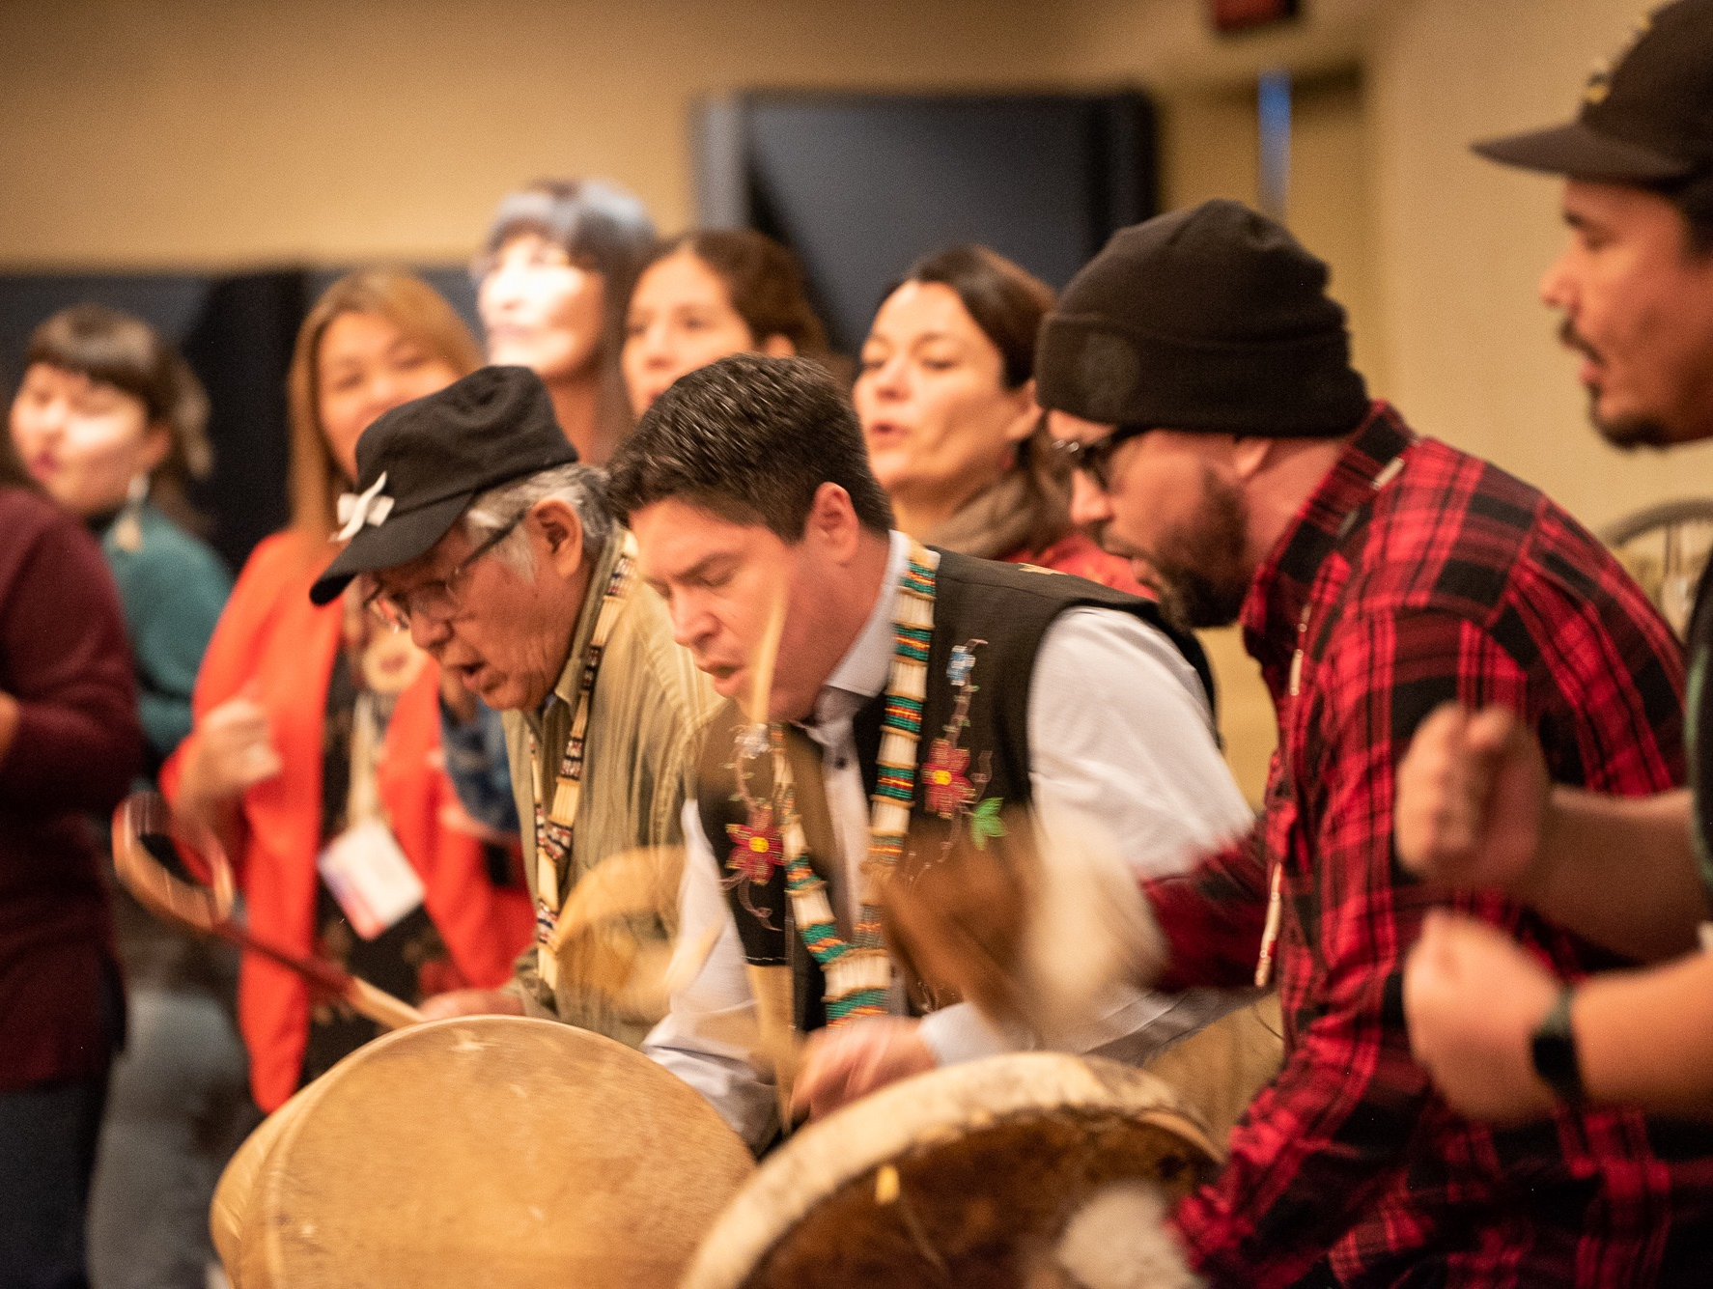
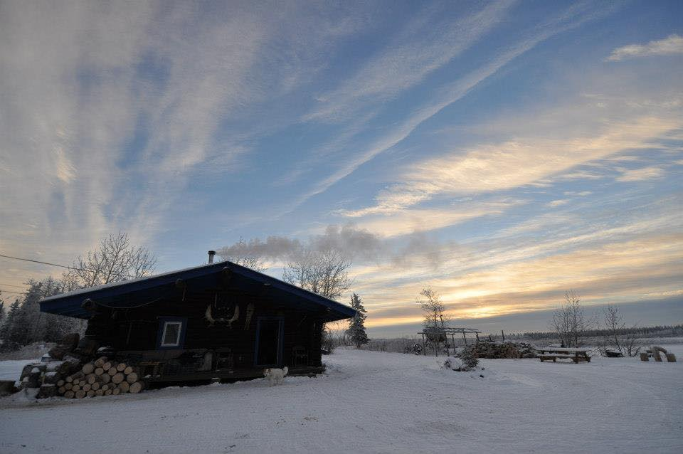
“Respect is at the heart of all northern cultures and
ethnicities. Working in northern regions requires mutual
respect for and willingness to listen to and learn from
unfamiliar cultural practices, languages, norms, traditions,
and ways of life”
Meaningful
research for
meaningful
impact:
Guiding principles
for working in
northern
communities

Slide 4
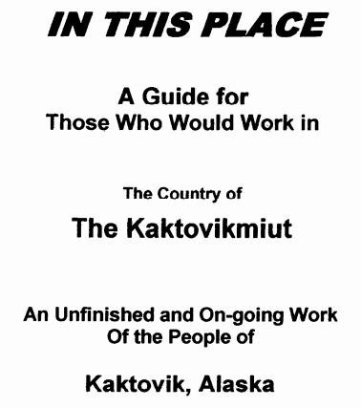
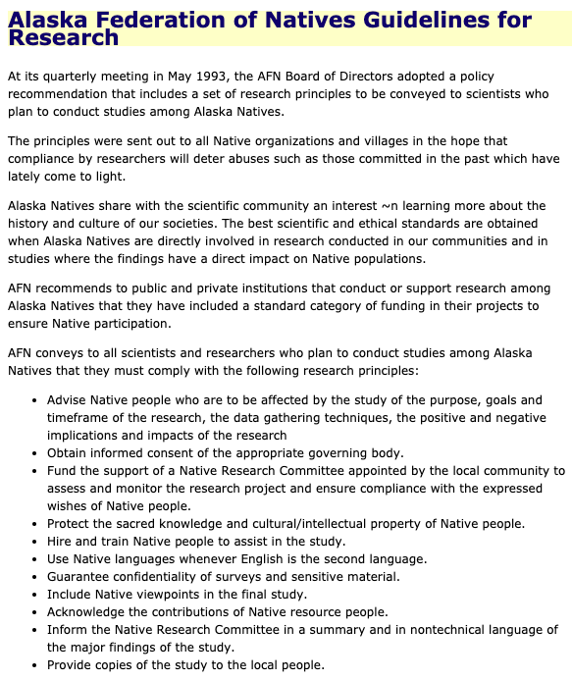
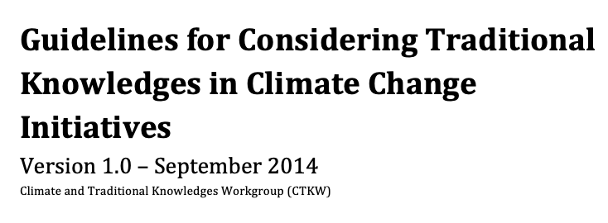
1.
“Abide by international, federal, state and local laws and
regulations, and follow any existing research protocols
while working in U.S. and international northern
environments”
Meaningful
research for
meaningful
impact:
Guiding principles
for working in
northern
communities

Slide 5
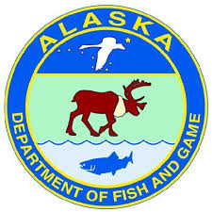
2.
“Contact and communicate with local city, corporation,
tribe, and other relevant entities throughout the entirety of
research (including proposal-writing and pre-planning) to
allow for transparency and as a form of respect”
Meaningful
research for
meaningful
impact:
Guiding principles
for working in
northern
communities
1. Alaska Native regional
nonprofit tribal consortium
2. State
3. Native corporation
4. Community-based services program
5. Tribe
Notes:
“Intentional”

Slide 6
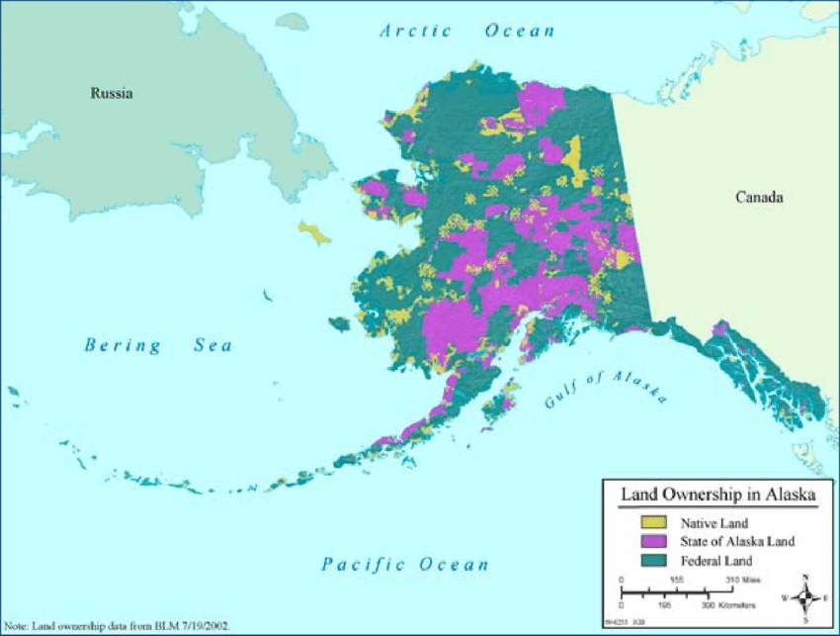
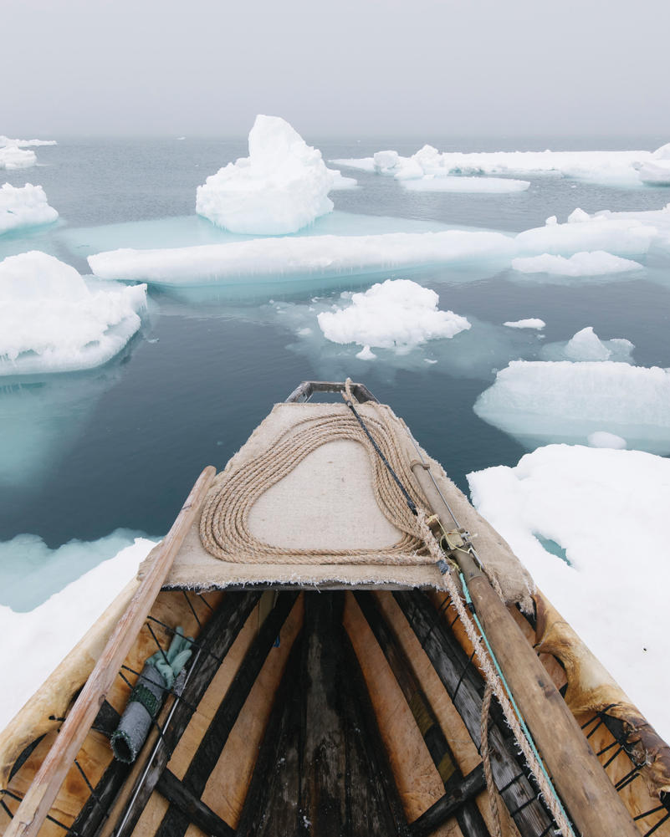
3.
“Familiarize themselves with local cultures, land
ownership/use, historical events, and relevant entities
before traveling to northern environments”
Meaningful
research for
meaningful
impact:
Guiding principles
for working in
northern
communities

Slide 7
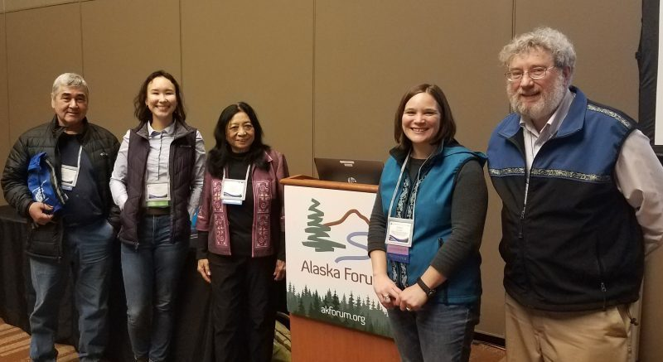
4.
“Incorporate travel support in their research proposals for
attending relevant state/local conferences and workshops to
share research, network with appropriate entities, and build
relationships”
Meaningful
research for
meaningful
impact:
Guiding principles
for working in
northern
communities

Slide 8
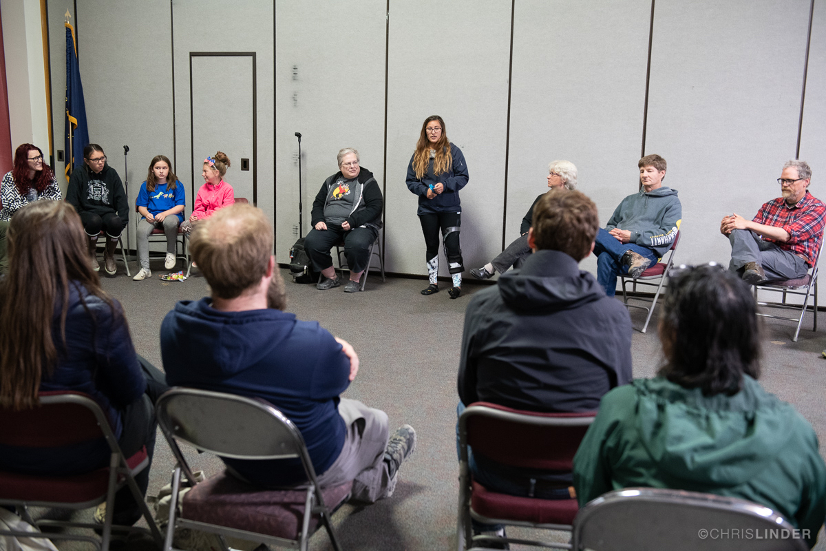
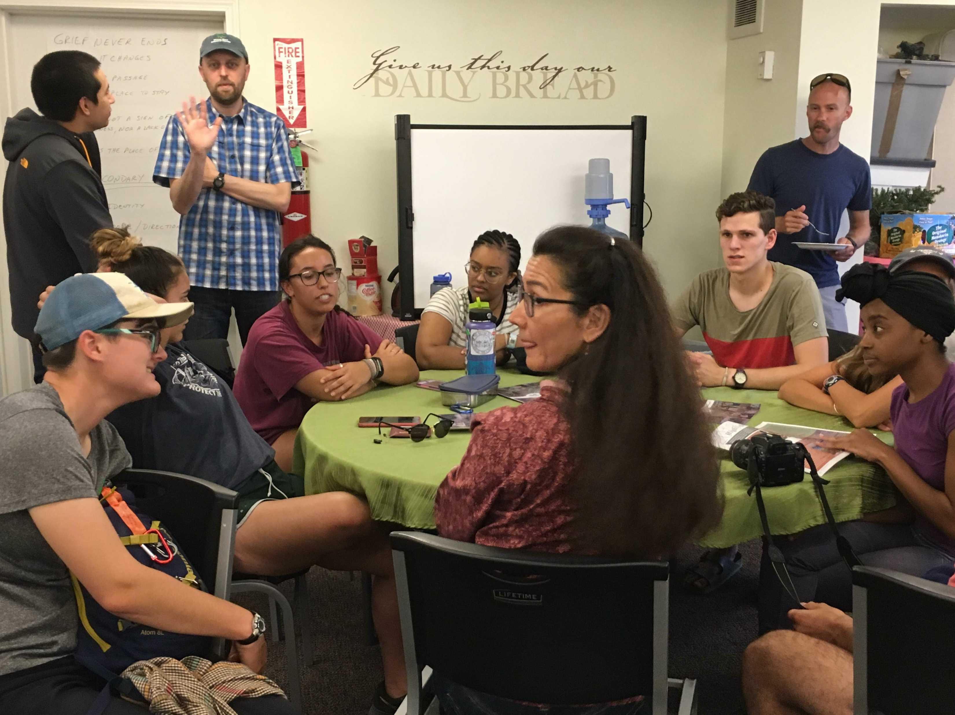
5.
“Take into account the knowledge and experience of the local
people, and respect any sharing of such knowledge and
experience in the research process. The incorporation of
relevant traditional knowledge into all stages of research is
highly encouraged”
Meaningful
research for
meaningful
impact:
Guiding principles
for working in
northern
communities

Slide 9
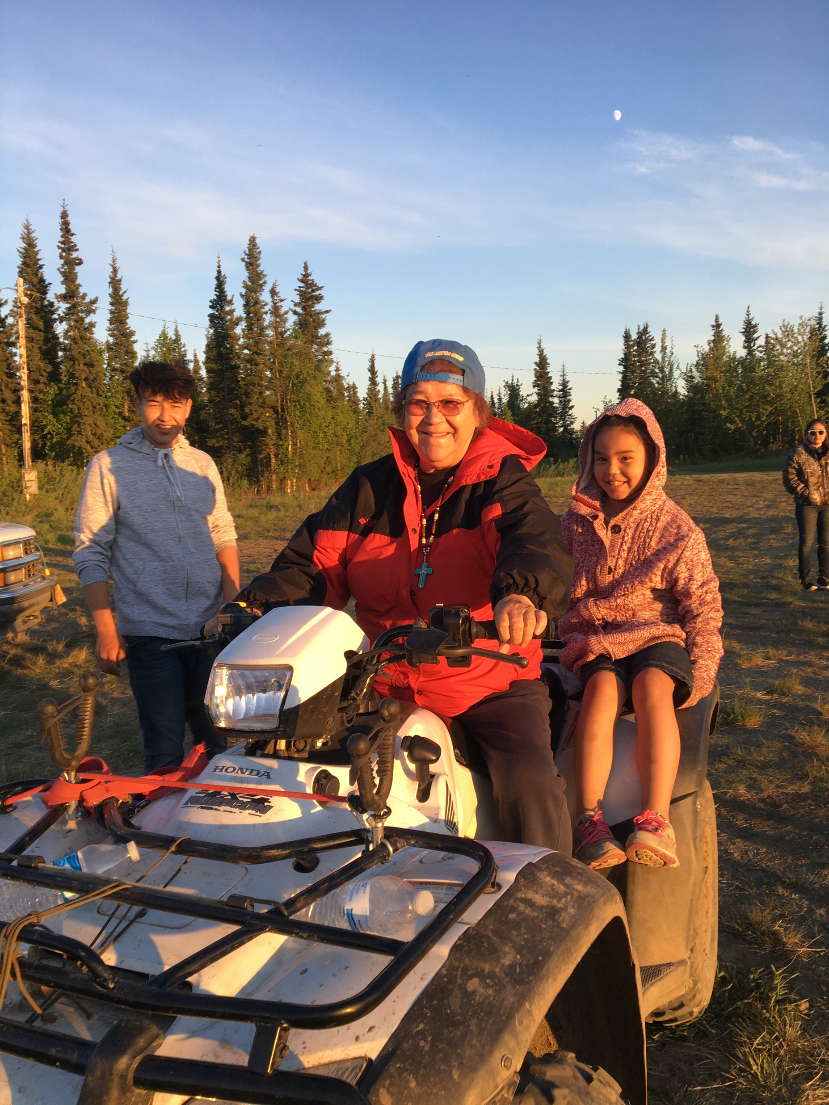
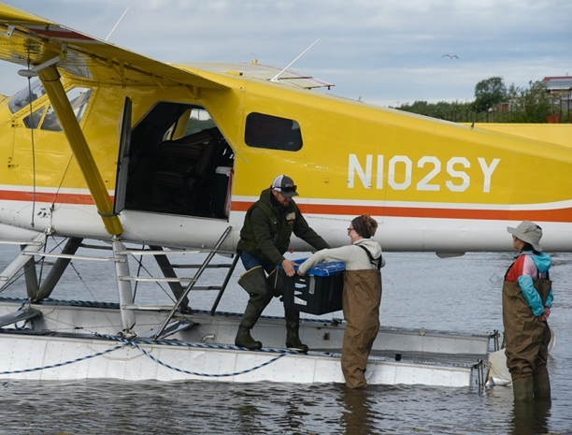
6.
“Provide financial compensation for local people/elders for
any time, energy, input, and/or contributions made during
the research project”
Meaningful
research for
meaningful
impact:
Guiding principles
for working in
northern
communities

Slide 10
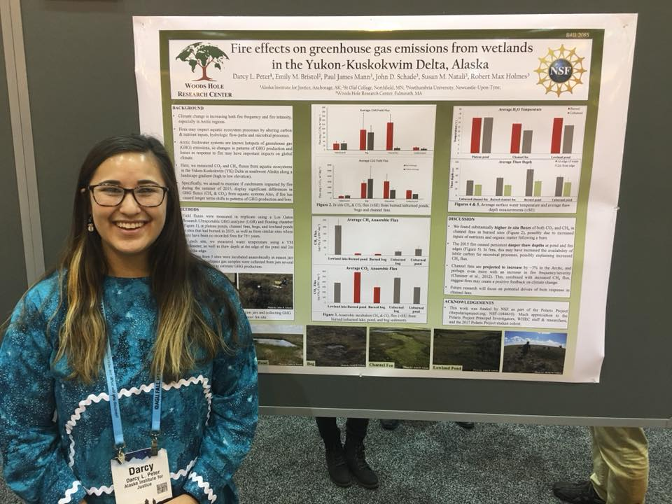
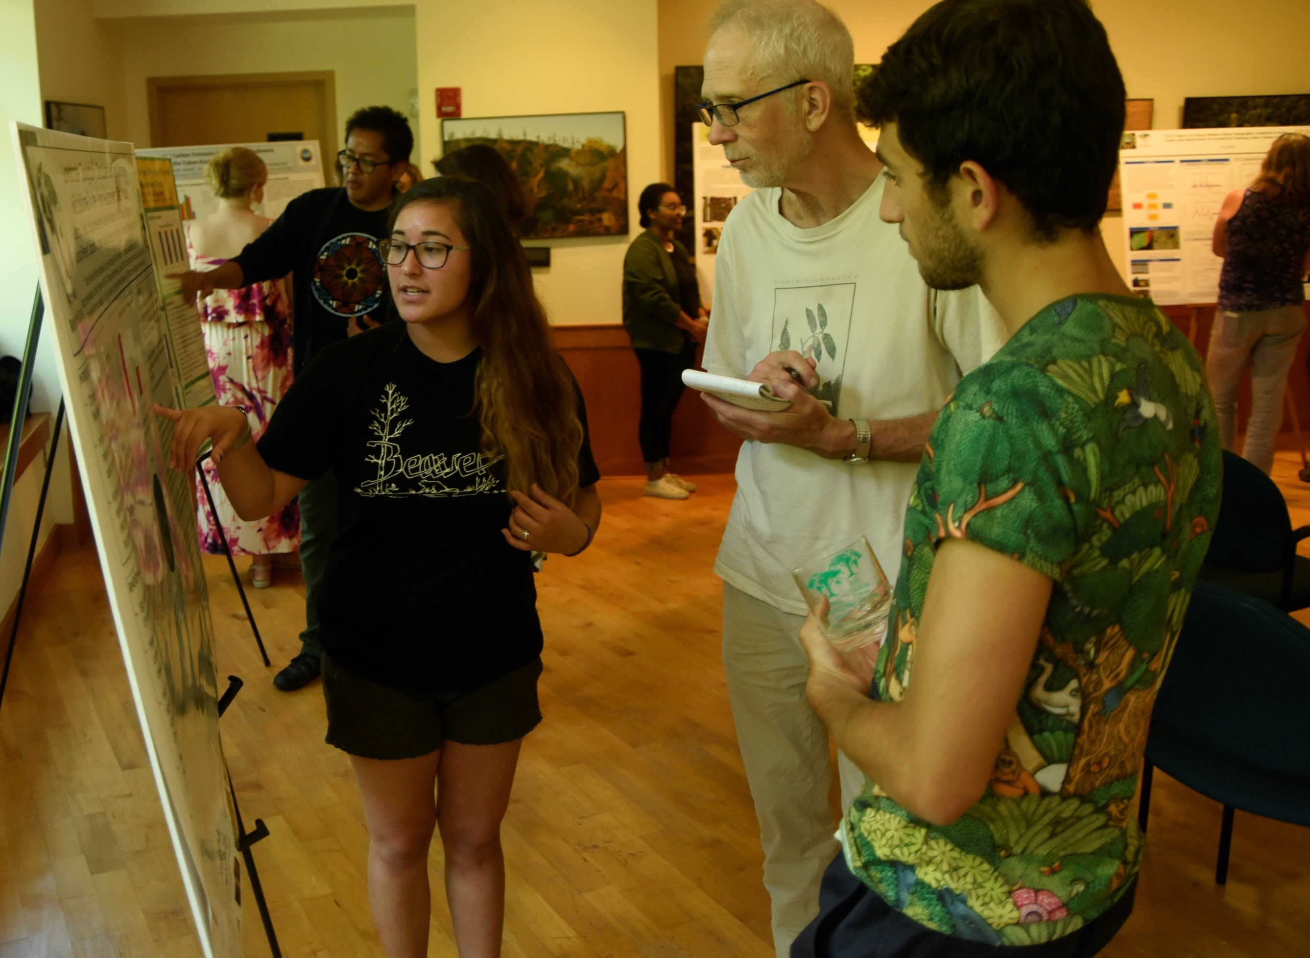
7.
“Give appropriate credit and recognition, including in
publications and presentations, to any locals who
contributed to your research”
Meaningful
research for
meaningful
impact:
Guiding principles
for working in
northern
communities

Slide 11
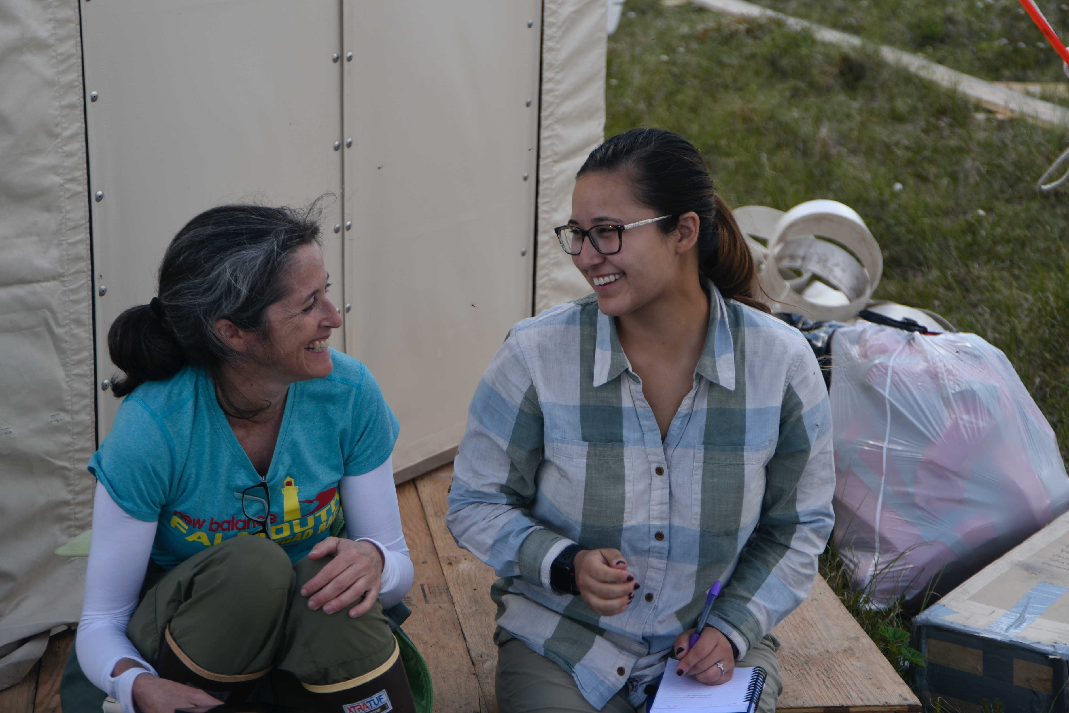
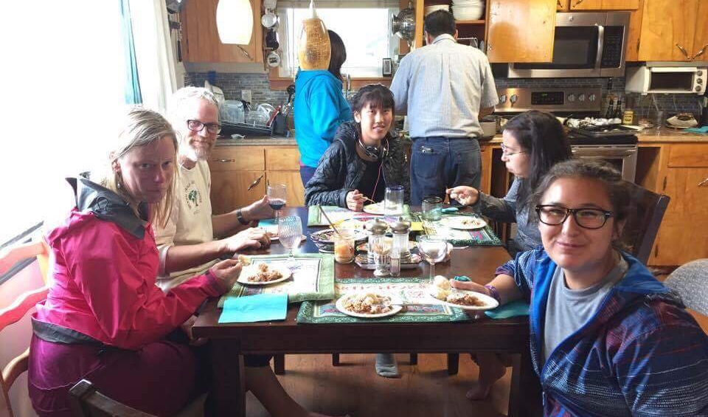
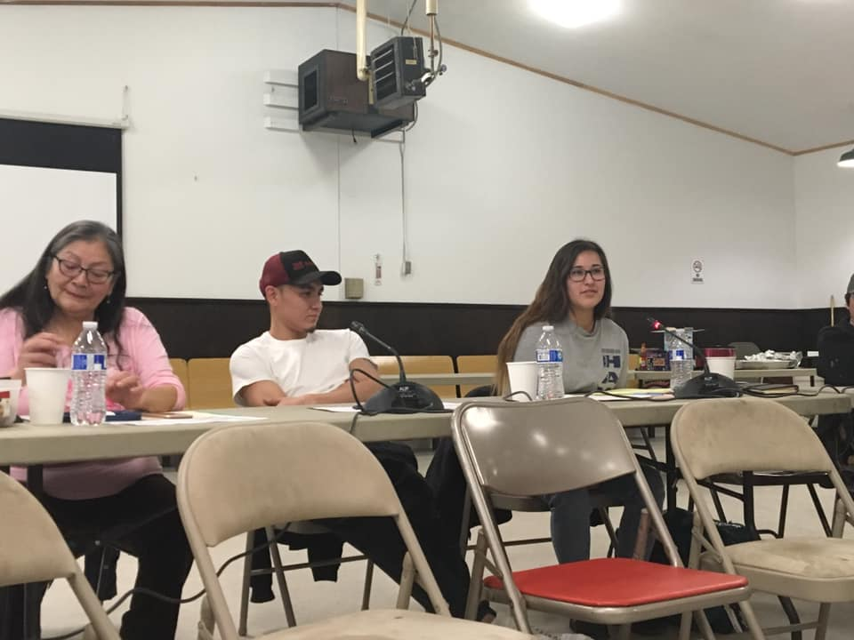
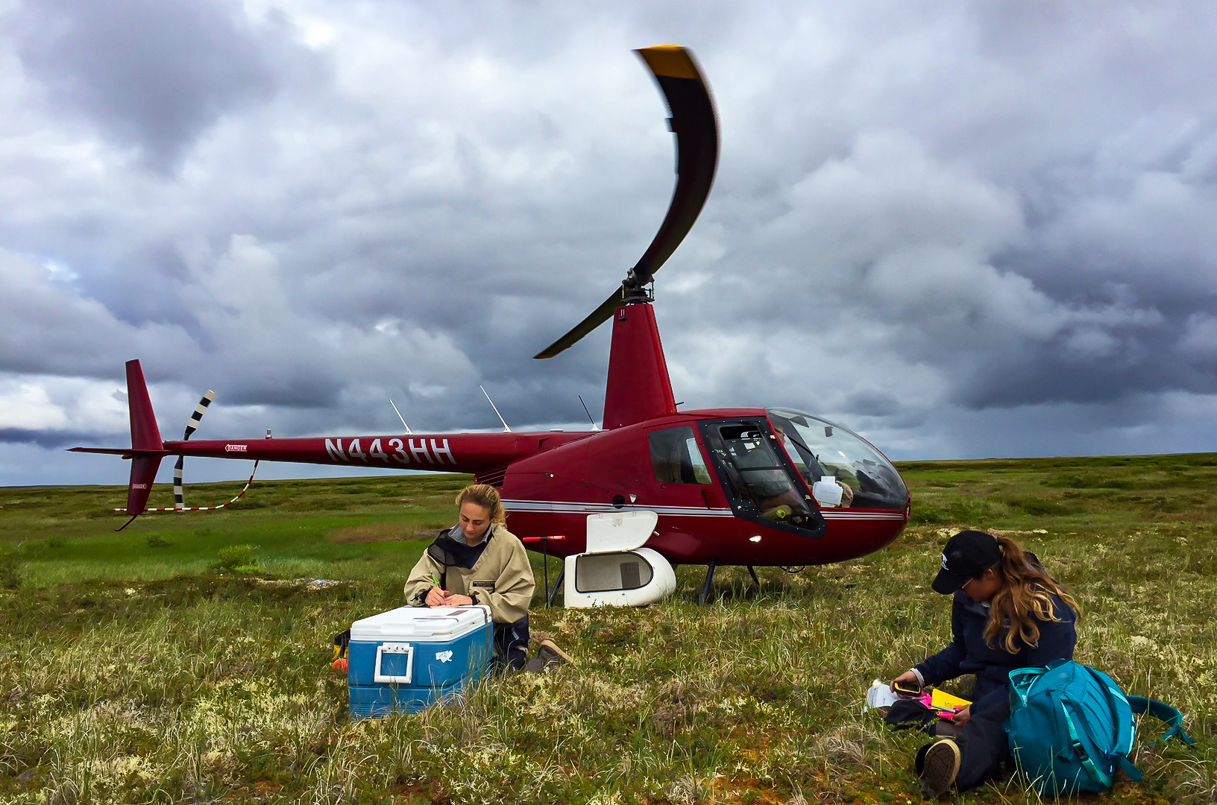
8.
“Guarantee confidentiality of any surveys, interviews,
and/or sensitive material”
Meaningful
research for
meaningful
impact:
Guiding principles
for working in
northern
communities

Slide 12
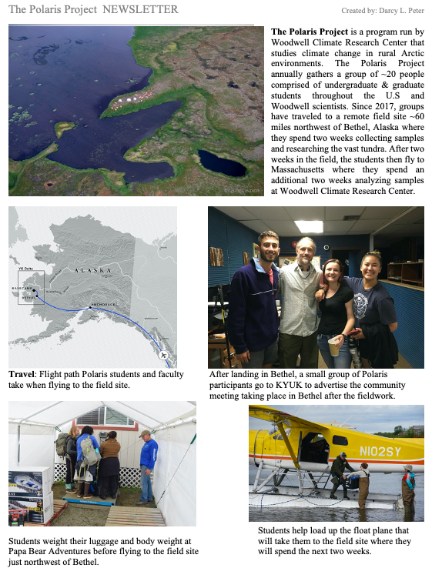
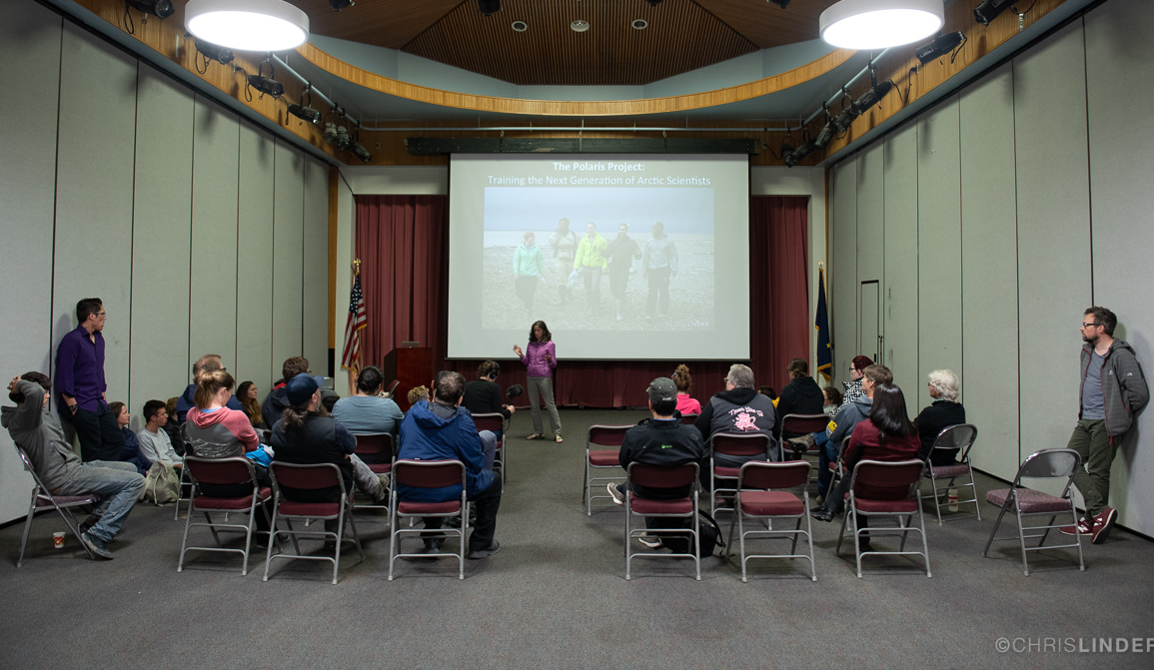
9.
“Communicate on-going
and final research
objectives, methods,
findings and their
interpretation to the local
community in a language
that is easily understood
and applicable”
Meaningful
research for
meaningful
impact:
Guiding principles
for working in
northern
communities

Slide 13
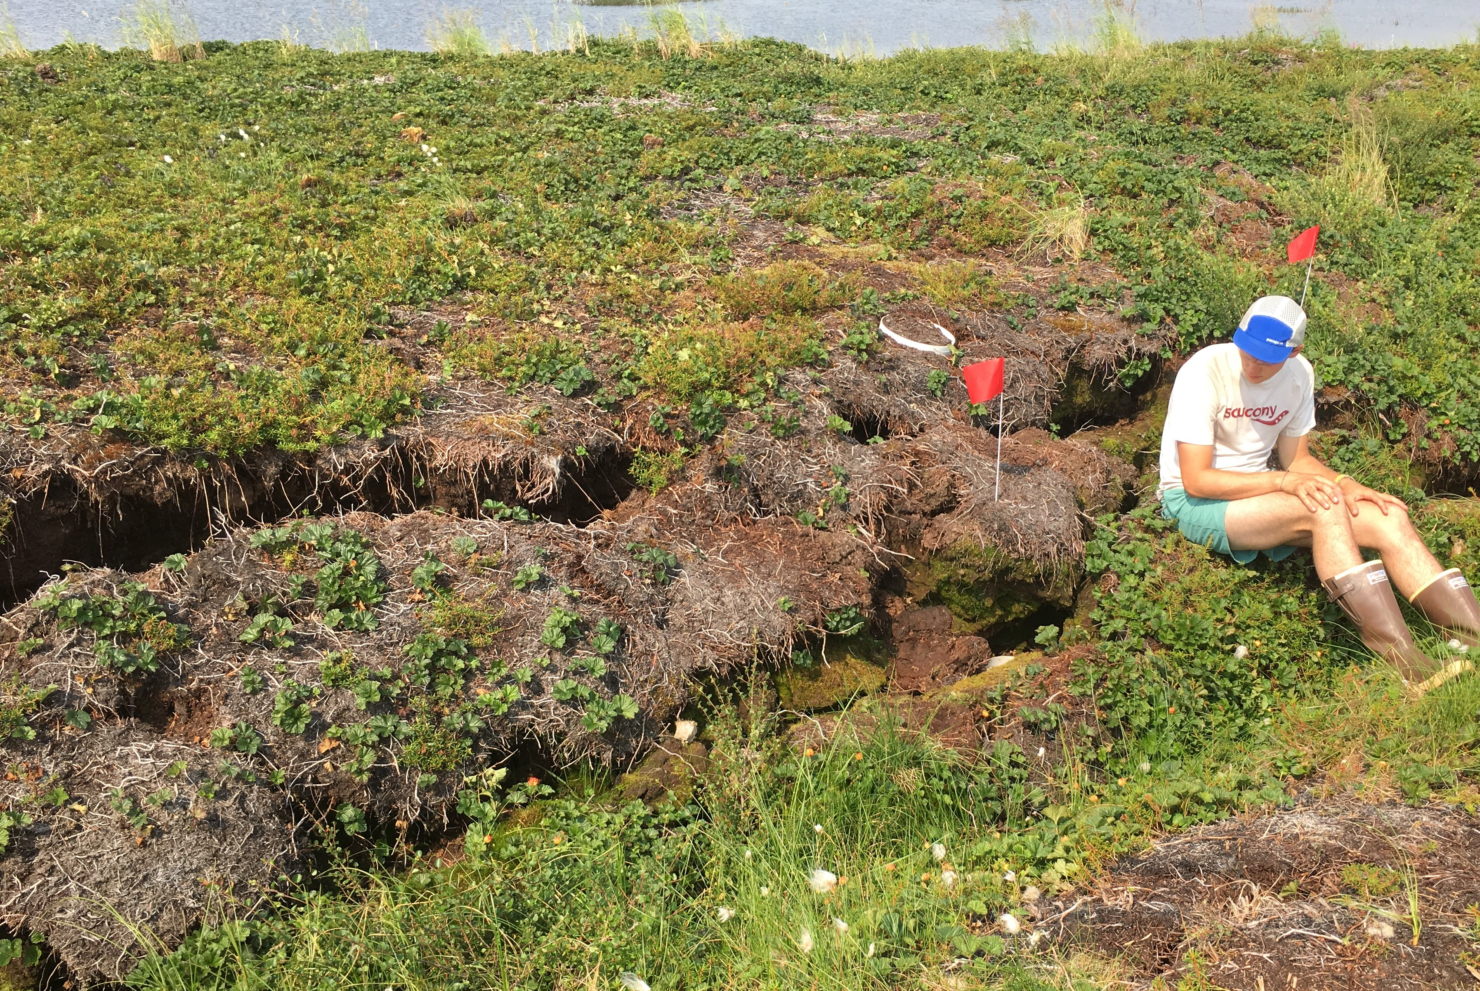
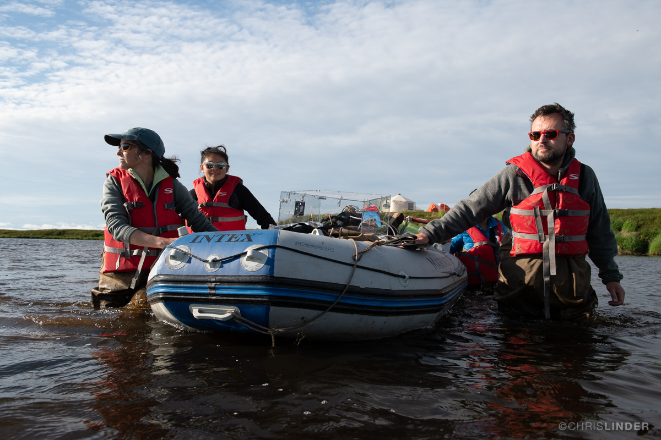
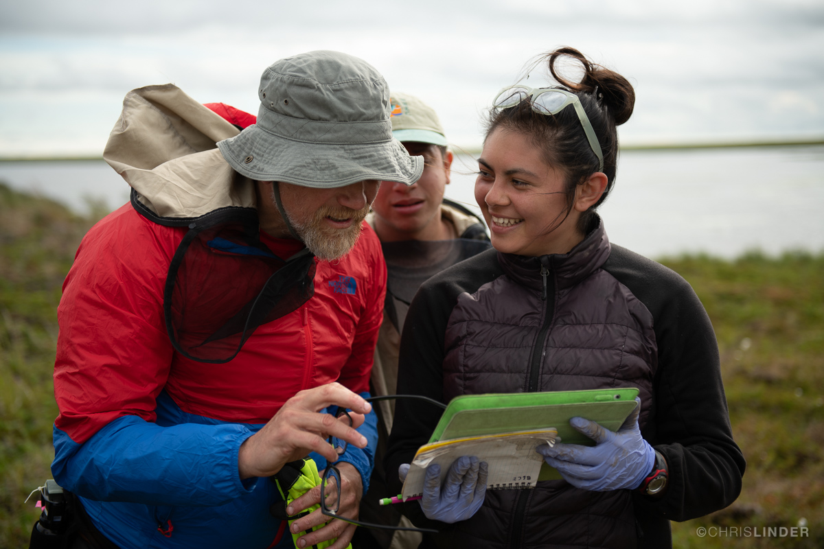
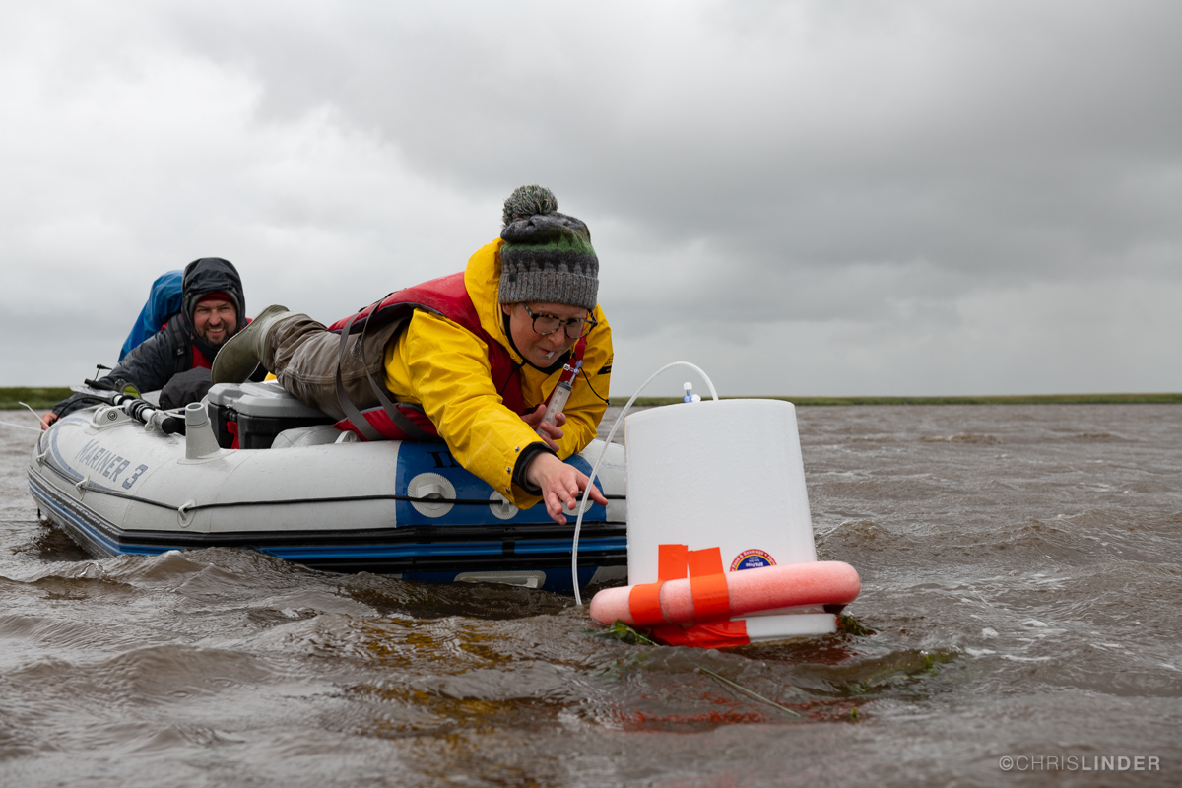
10.
“Ensure that the research itself is not exploitative of any
traditional and sacred land, its resources, or its inhabitants”
Meaningful
research for
meaningful
impact:
Guiding principles
for working in
northern
communities

Slide 14
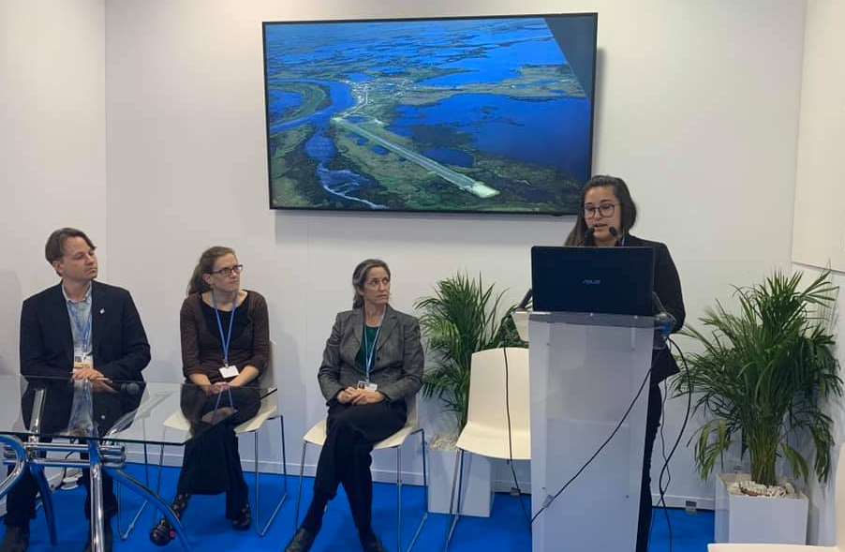
11.
“Use Indigenous land acknowledgments at the beginning
of presentations and meetings, and in publications as a
form of respect and visibility”
Meaningful
research for
meaningful
impact:
Guiding principles
for working in
northern
communities

Slide 15
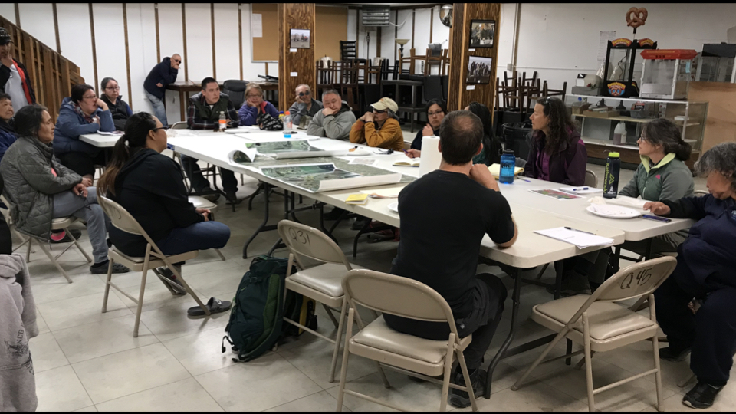
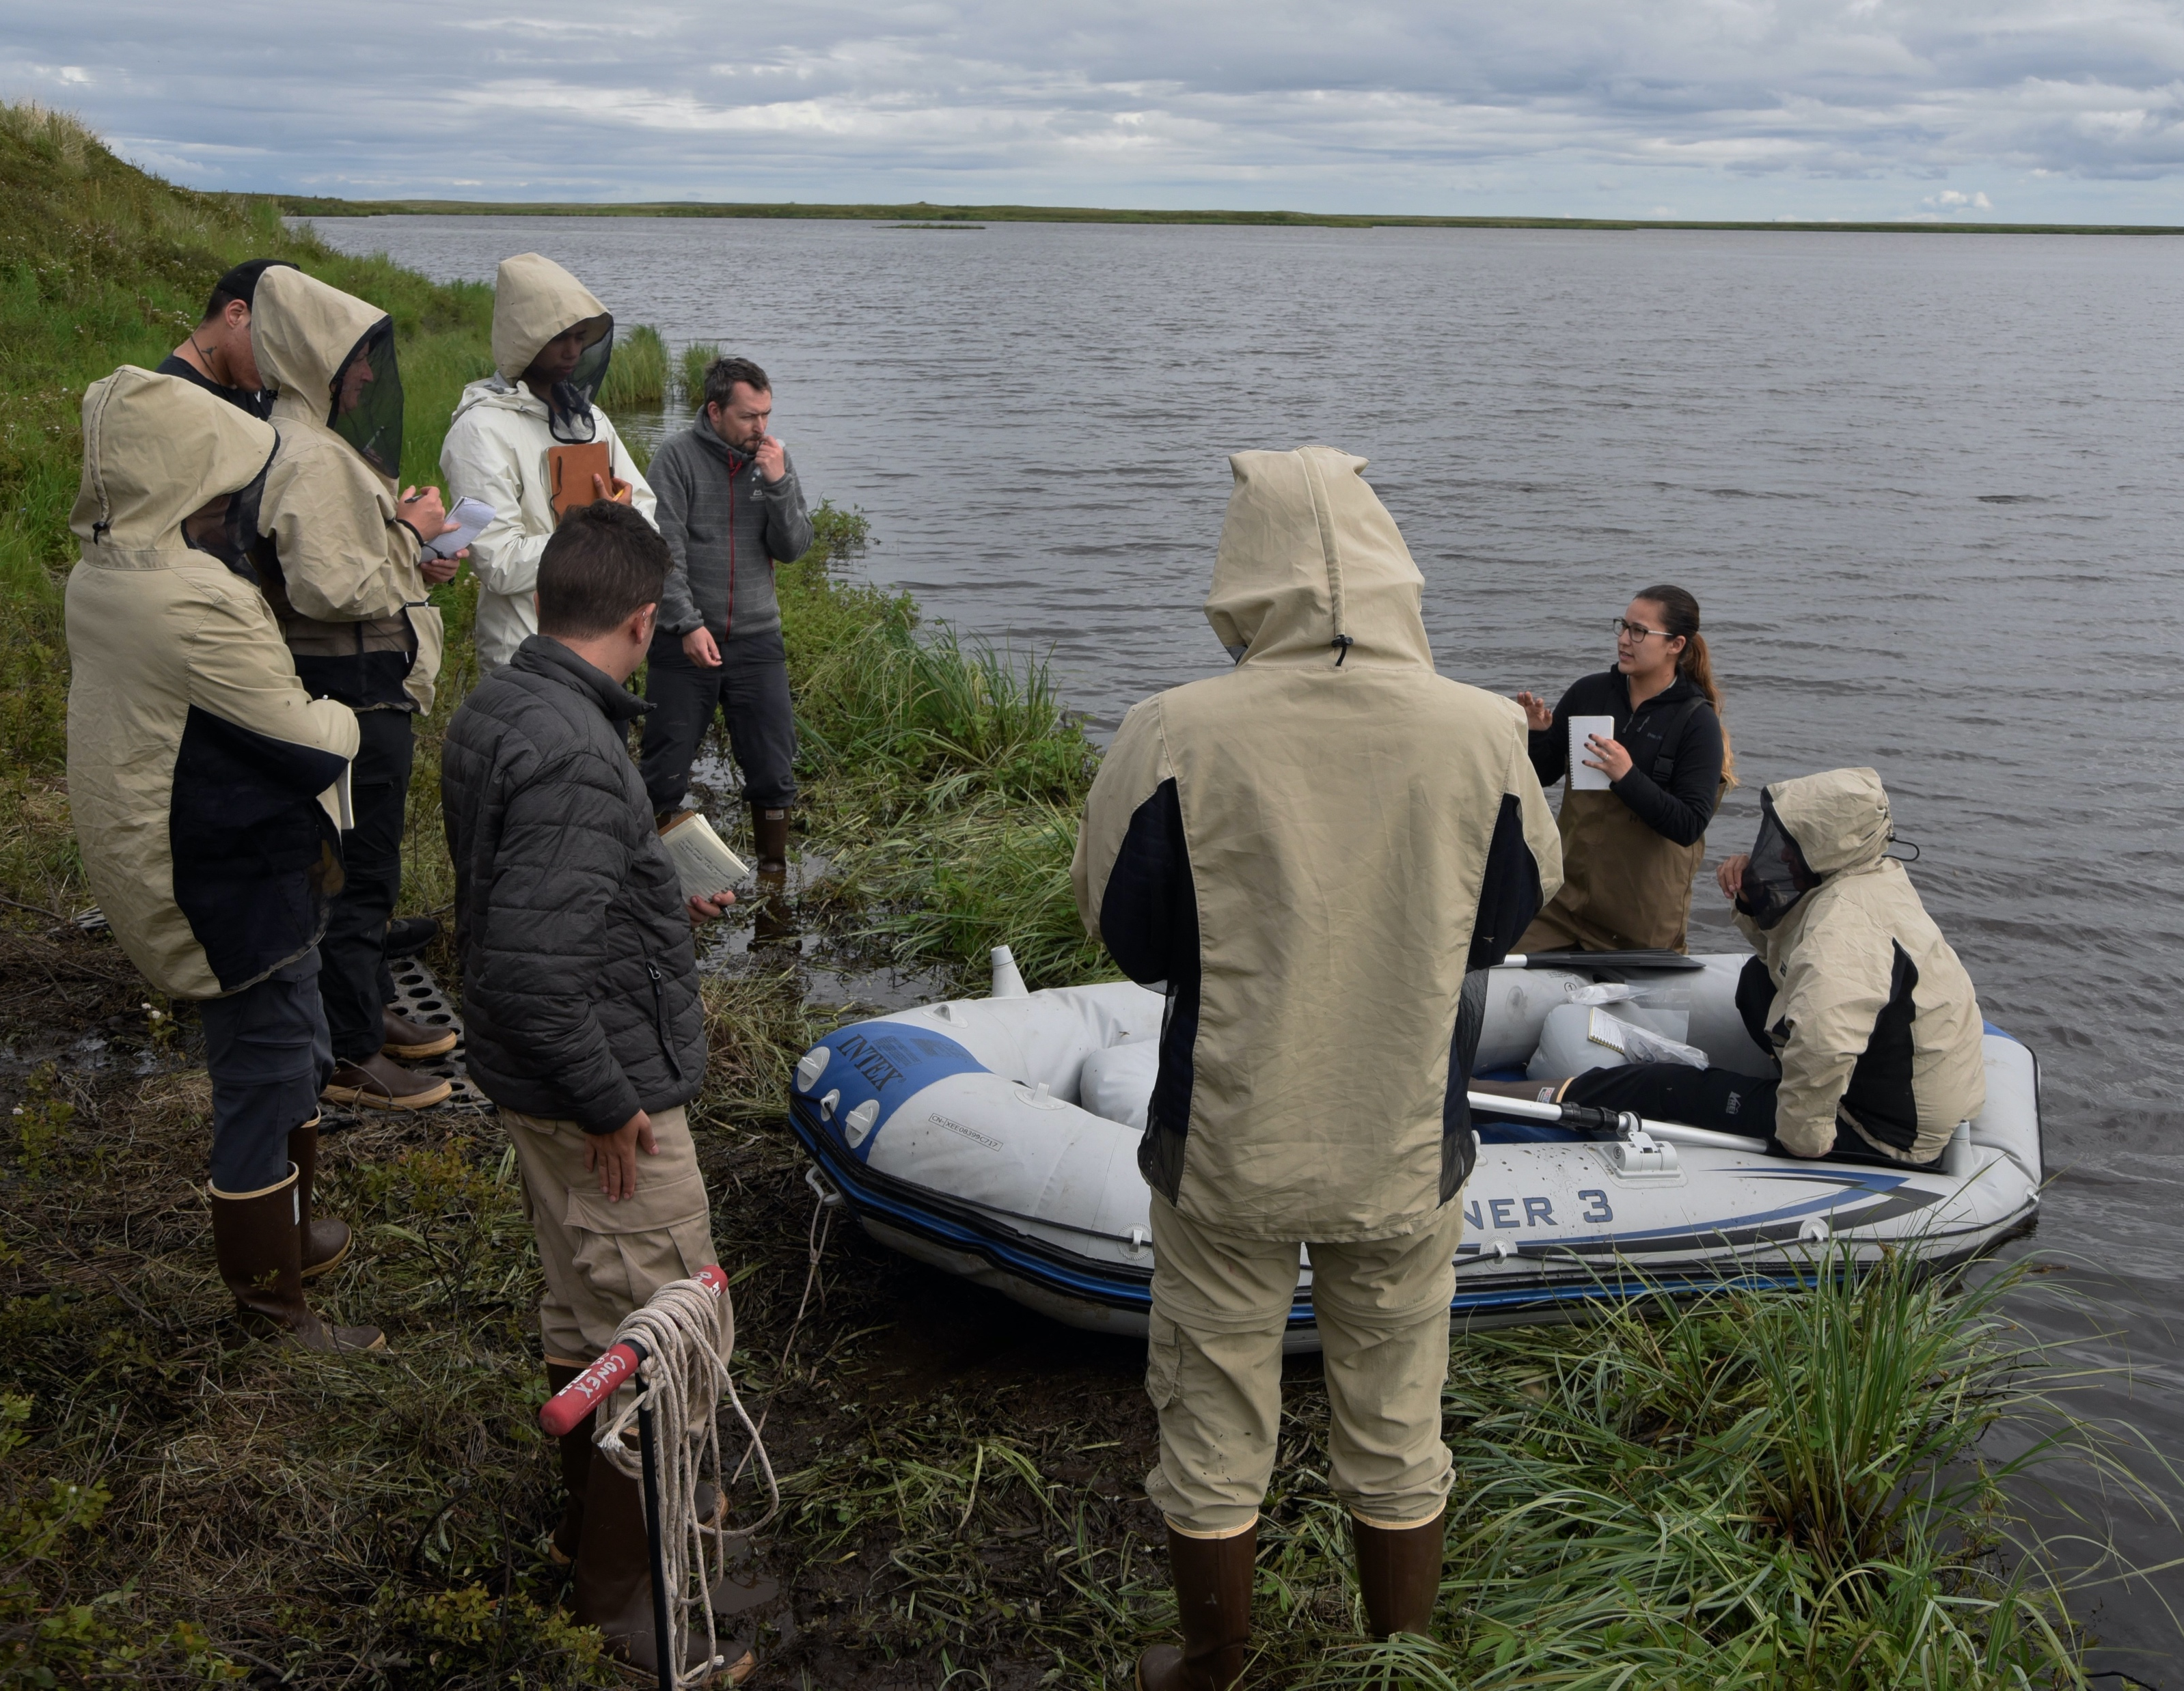
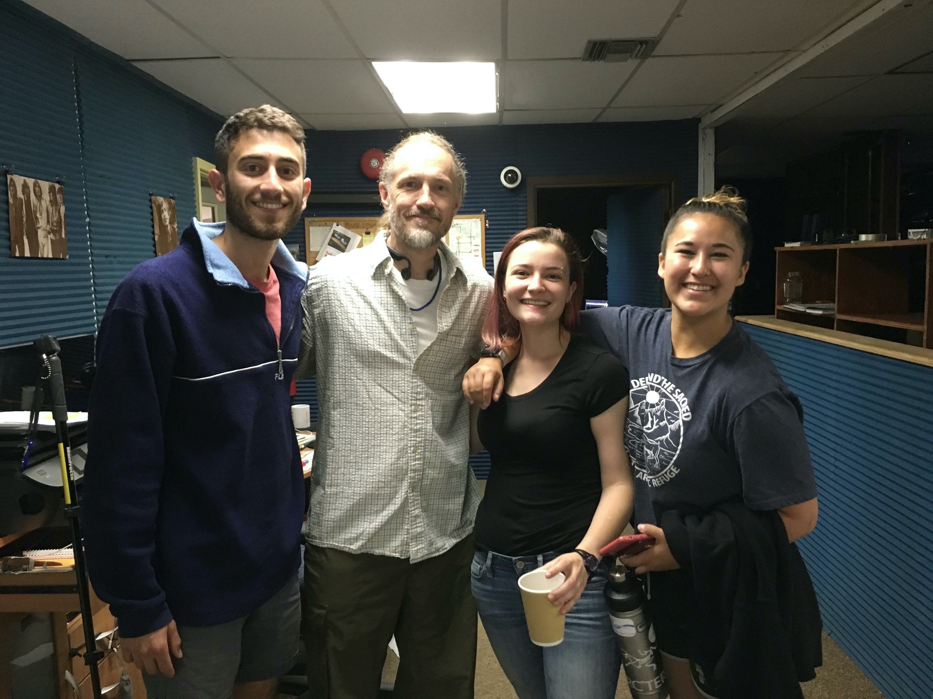
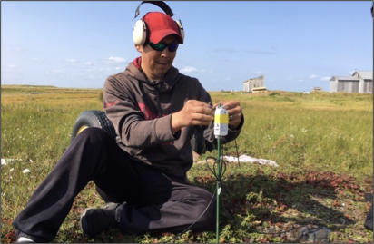
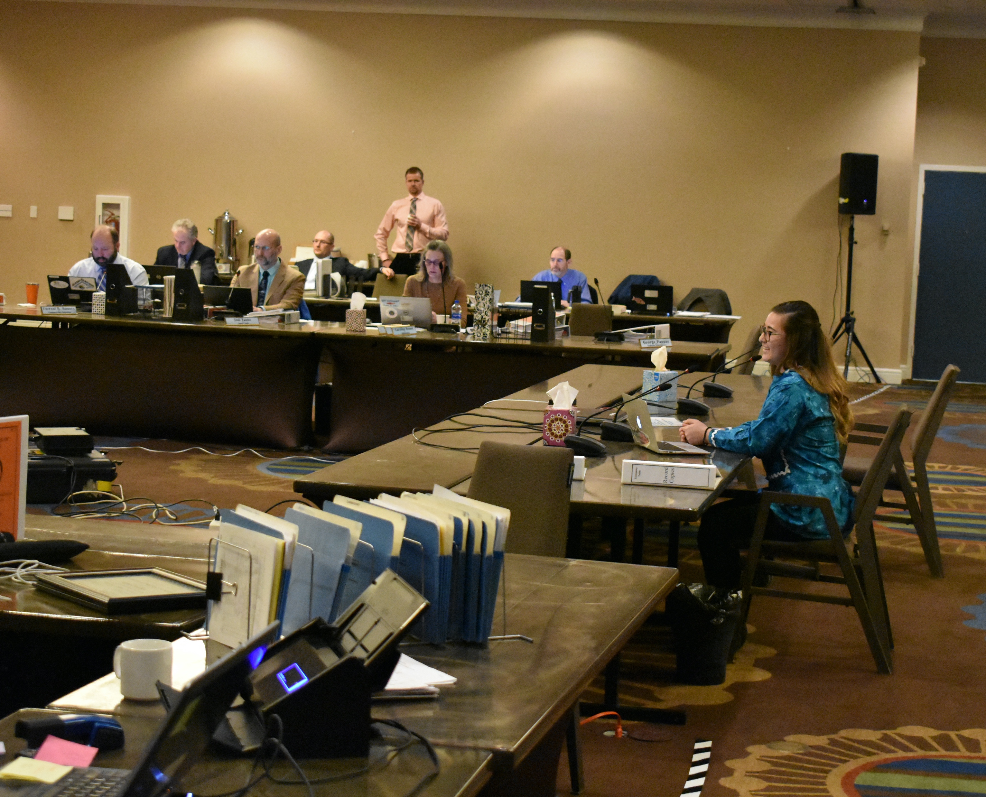
Meaningful
research for
meaningful
impact
Talking with locals and incorporating traditional knowledge
into western science.
Teaching the next generation of Arctic
Scientists.
Talking on local radio stations
Actively bringing indigenous community members into
the research itself.
Engaging policy-makers

Slide 16
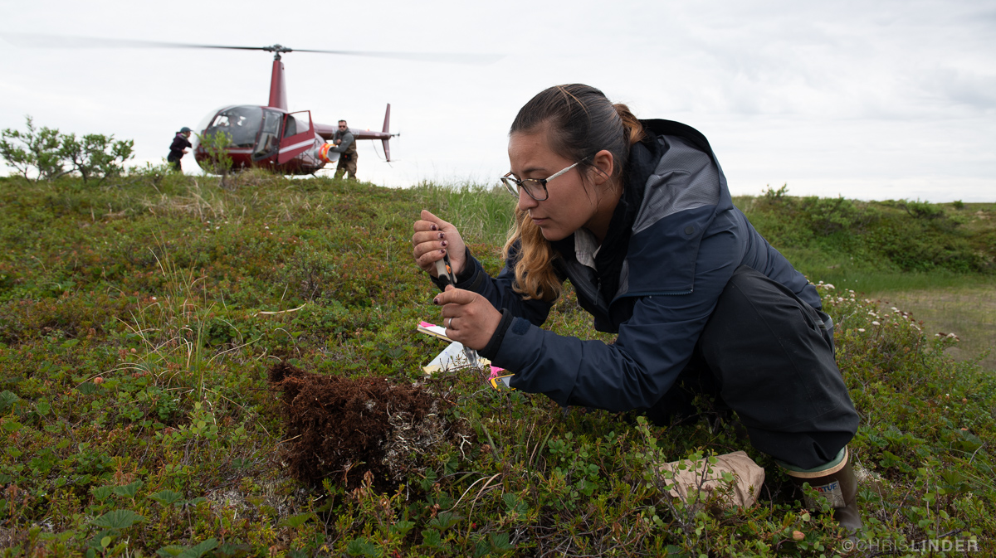
Mahsí’ choo (thanks so much)
Darcy L. Peter
dpeter@woodwellclimate.org
she / her / hers
Twitter: @DarcyPeter1
Instagram: @DarcyLPeter

