Slide 1
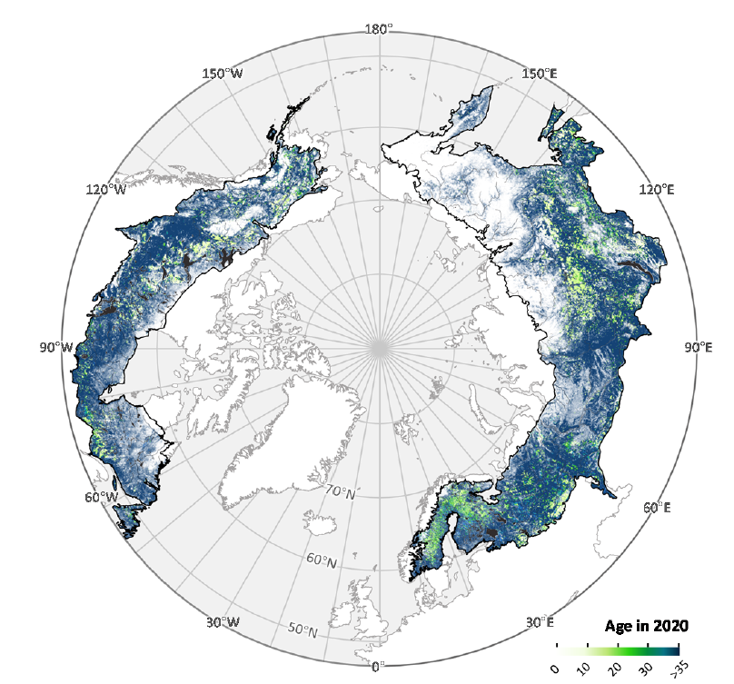
Vegetation Structure Working Group:
synthesizing remote sensing observations to examine patterns of growth
Paul Montesano | NASA Goddard Space Flight Center
Laura Duncanson | University of Maryland
Matt Macander | Alaska Biological Research, Inc.
Other active participants: Amanda Armstrong, Liz Hoy, Chris Neigh, Chip Miller, Nathan Thomas, Tony Feng, Howie Epstein, Amy Neuenschwander, Joanne White

Slide 2
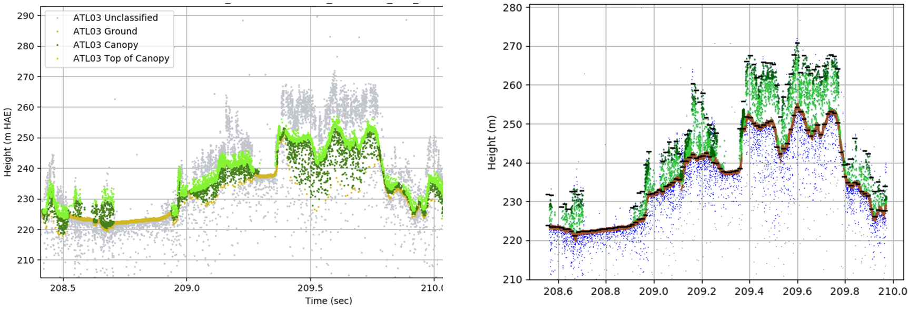
Improvements coming for ICESat-2 Vegetation Heights (ATL03, ATL08)
Photon classification blunders in v005
Photon classification corrections in v006+
top-of-canopy
unclassified
canopy
top-of-canopy
canopy
corrected ground finding
ground finding blunders
Releases 006 and 007 (upcoming) improve:
ground-finding
identification of top-of-canopy
Resulting in improved:
terrain heights
relative canopy height metrics
Amy Neuenschwander

Slide 3
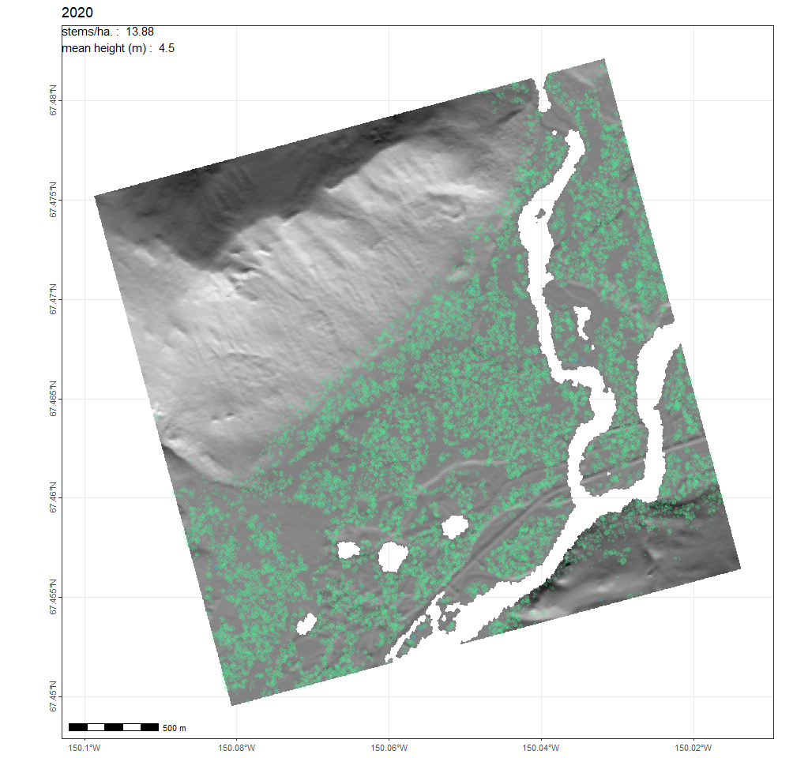
A synthesis of ABoVE activities associated with boreal forest structure & growth
LVIS vegetation structure grids
Vegetation Structure Working Group
Montesano, Macander et al.
Vegetation height
along airborne flightlines
An opportunity to operate at fine scales across broad extents and:
examine current growth patterns
improve handling of growth in individual-based forest growth models
Through:
the integration of recent remote sensing archives
updated parameterization of high-resolution simulations
Forest structure
Boreal biomass density map
Operational approach to map 30m biomass from spaceborne data
Duncanson (PI) et al.
Biomass density
across circumpolar boreal
ABoVE-related activities
ABoVE-related results through Phase 2
Observations of past forest growth
(empirical)
Remote sensing chronosequence; spaceborne site index
Neigh (PI) et al.
Stand age & site index
across circumpolar boreal
Forest growth
Simulations of future forest growth
(process-based)
Individual-based forest growth model (SIBBORK-TTE)
Armstrong (PI) et al.
High-resolution forest growth simulations
at sites along boreal’s cold edge

Slide 4
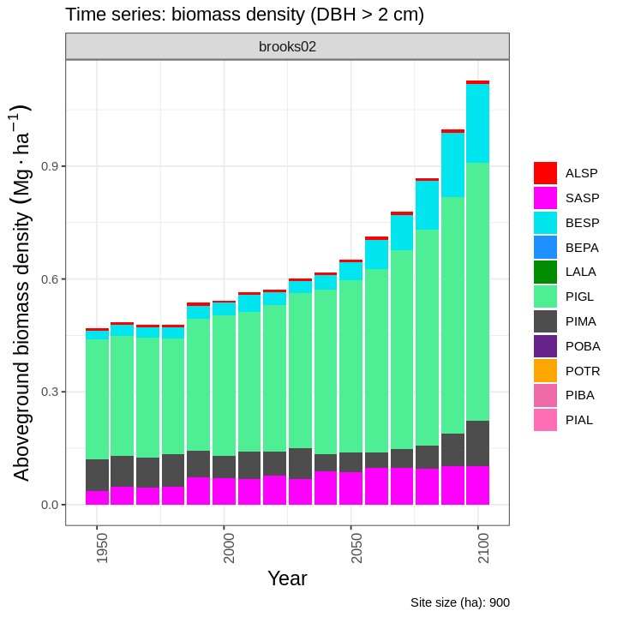
Recent forest growth simulations have incorporated key remote sensing data
An example of a simulation of taiga-tundra ecotone change from the individual-based model “SIBBORK-TTE”
Individual tree growth is simulated with remotely sensed:
terrain (using a DEM)
vegetation configurations (using land cover)
A time-series of forest growth simulations are for built for each site
9 km² site
White spruce (P. glauca) increase over time
DEM & land cover maps help impose vegetation heterogeneity across sites
Simulated distribution of P. glauca trees
The remote sensing updates enable forest growth simulations across broad & heterogeneous extents.
These simulations are examined through time to make predictions of change in structure & composition.
Individual tree growth is constrained in part by general growth equations that are applied to any site.
Montesano, Armstrong, Epstein et al. in prep

Slide 5
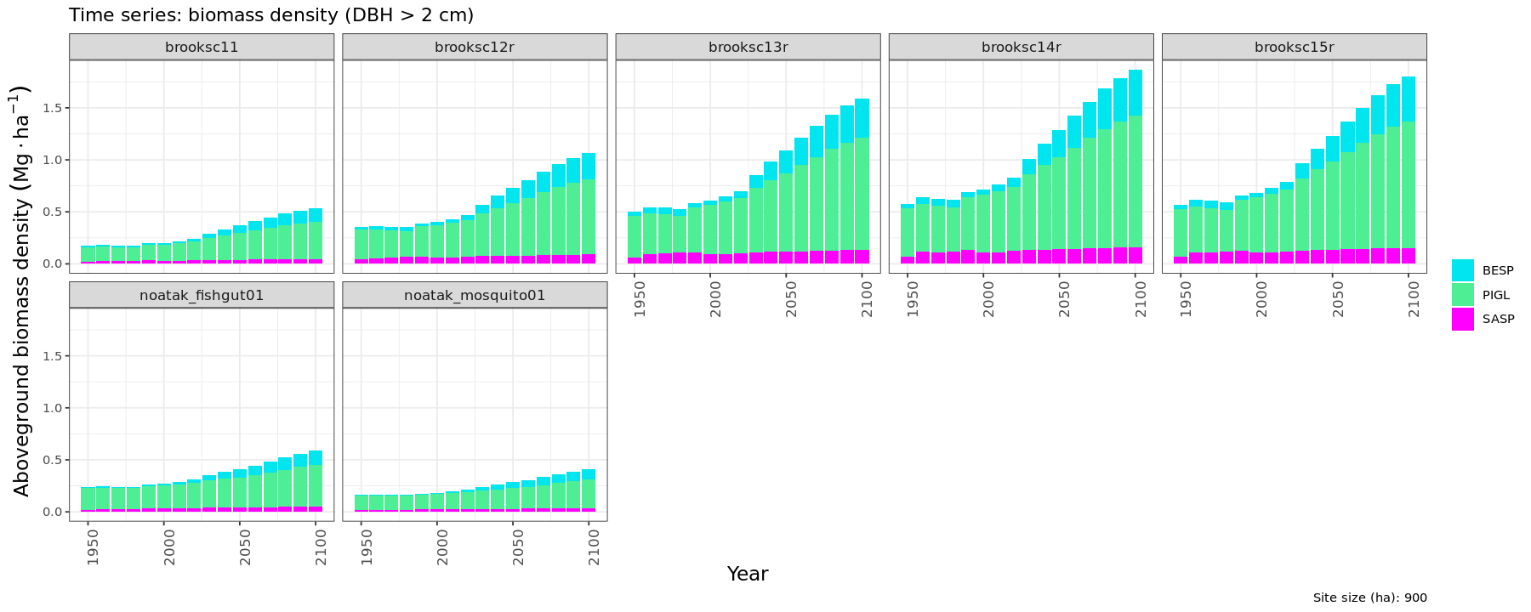
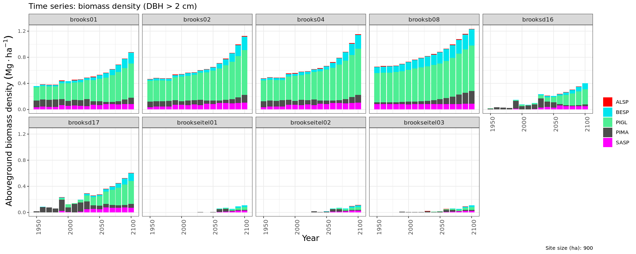
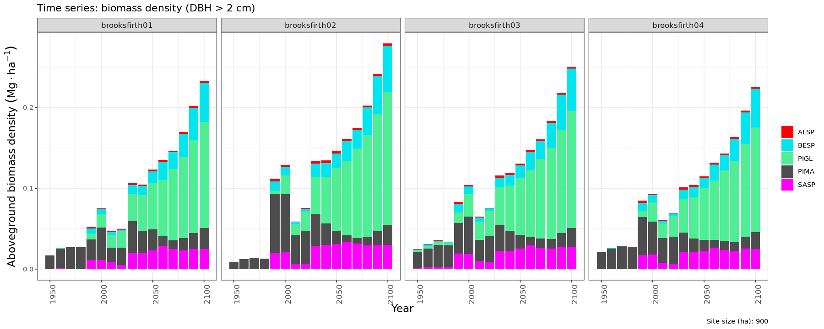
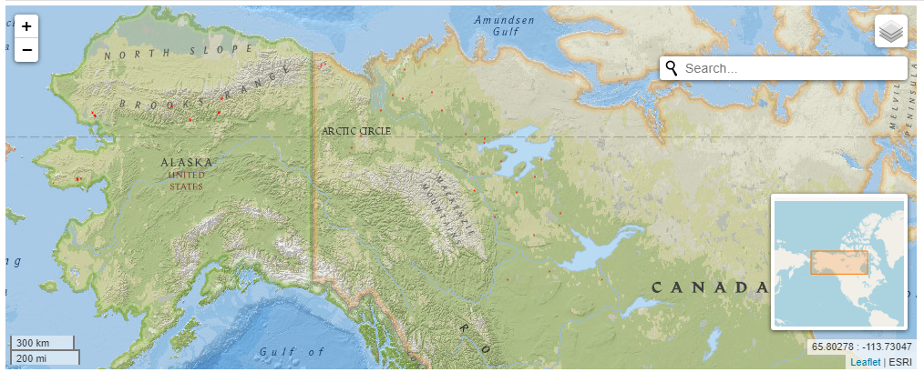
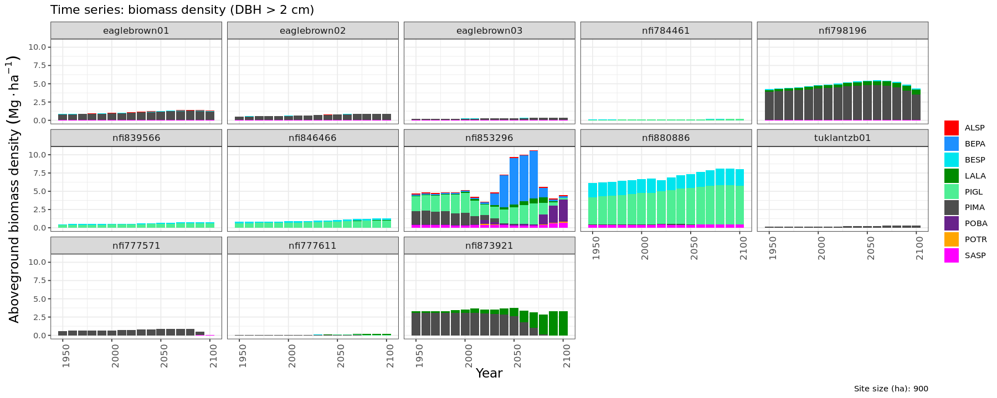
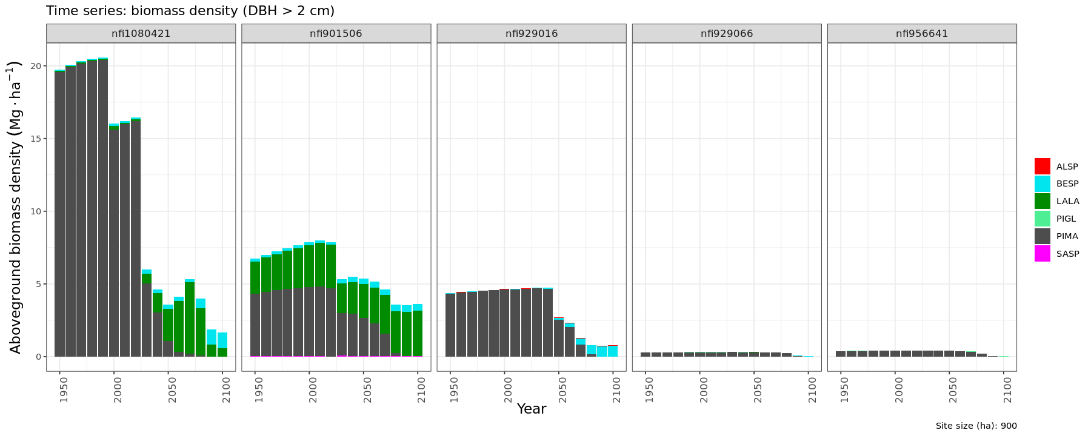
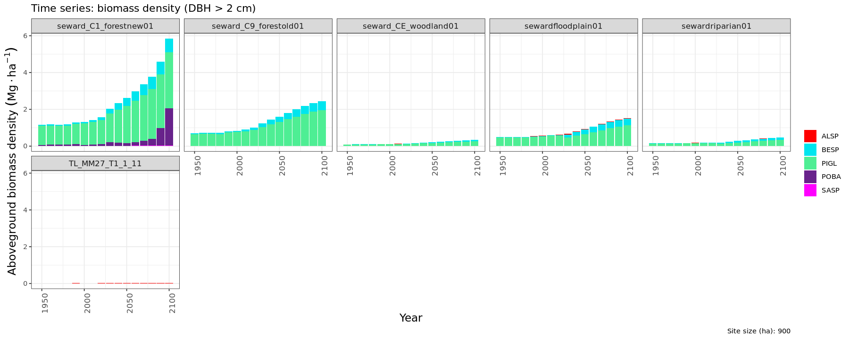
Simulations of growth across regions show changes across an ecotone
Simulations of biomass density through 2100 show patterns of structure & species composition change.
Remote sensing derived-growth may provide important updates to the geographic variation handled by models.
Montesano, Armstrong, Epstein et al. in prep
Notes:
We want to inform the next generation of forest change predictions using current “big data repositories”

Slide 6
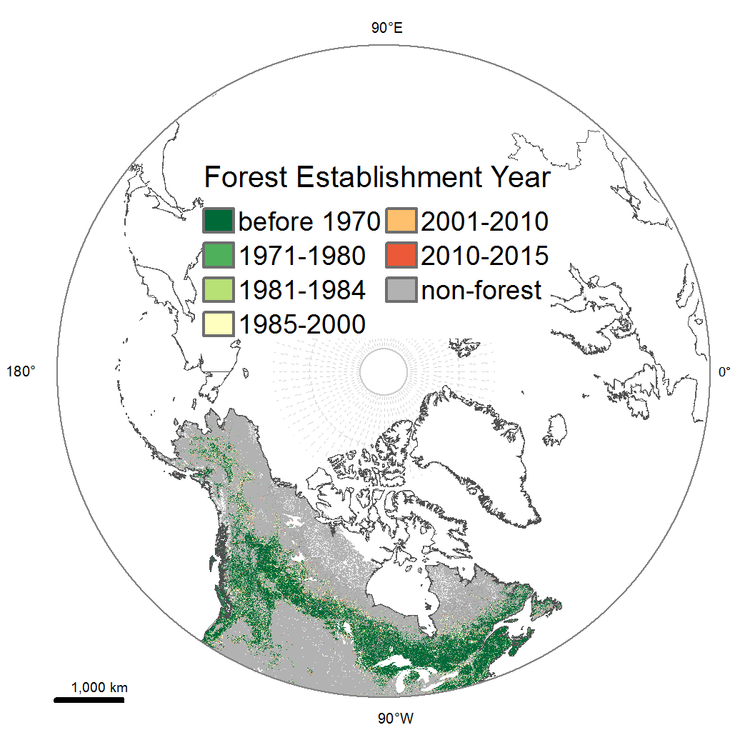
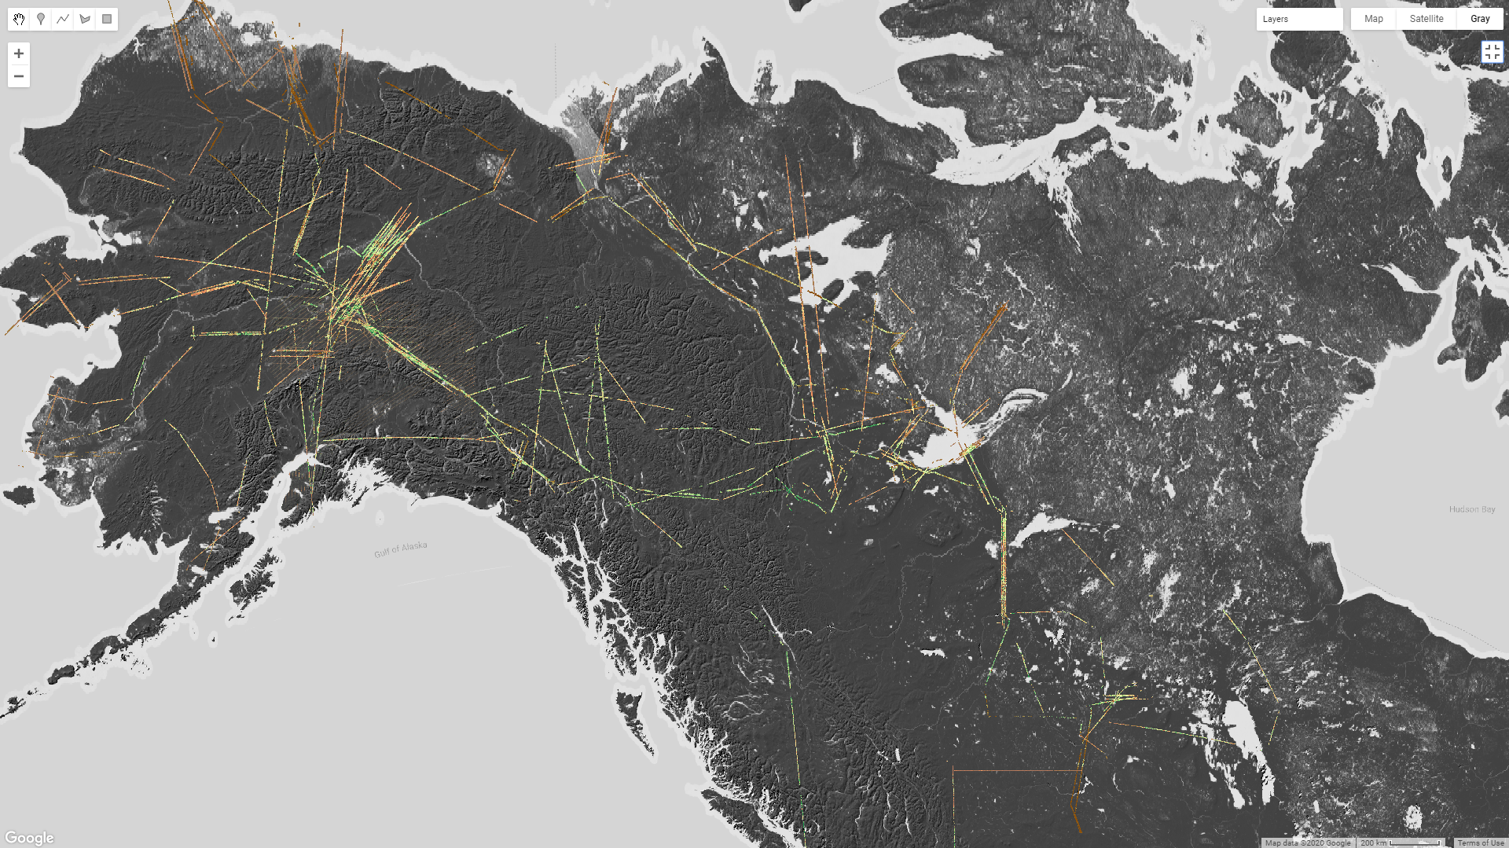
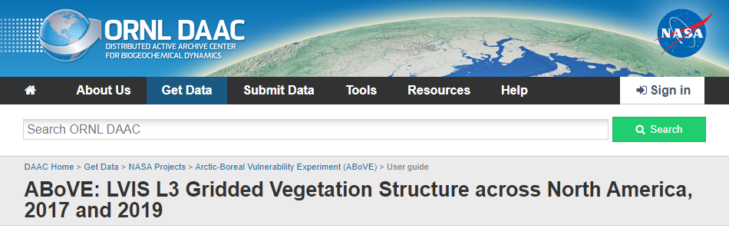
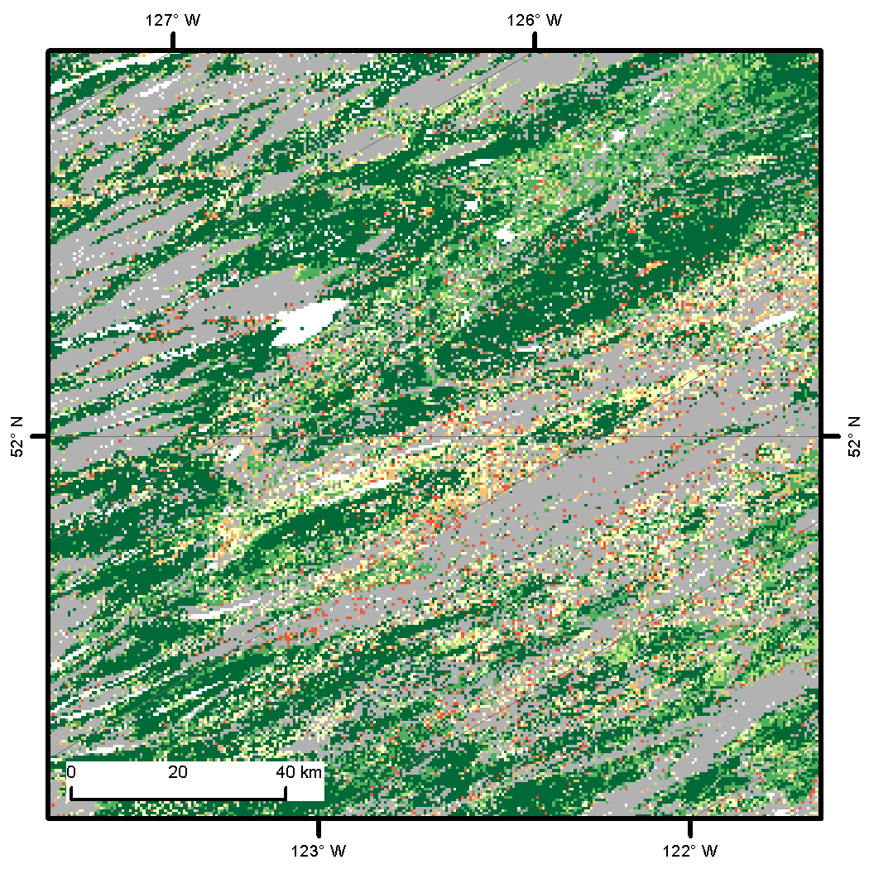
Current stand height is captured from regional sampling with airborne lidar
Site history from Landsat time-series: assessing boreal forest stand age
Stand age is assessed by first identifying a forest establishment year.
Derived from forest cover estimated from the multi-decadal Landsat time-series (yearly from 1984-2020; twice prior to 1984).
Continuous coverage across the boreal domain.
Estimates of age for young forests (< 50 yrs).
Provides the basis for chronosequence analyses with current remote sensing estimates of structure.
Swaths of 30 m lidar forest structure estimates sampled across a broad boreal extent
Canopy height maps derived from LVIS airborne lidar acquisitions across the North American boreal forest in 2017, 2019
Collected for NASA’s ABoVE campaign.
Gridded, stacked, & archived at ORNL DAAC
Montesano et al. 2016, Remote Sensing
Feng, Sexton, Wang, Montesano, Macander, Neigh et al. 2022, in review
Montesano, Macander, Hoy 2022 https://doi.org/10.3334/ORNLDAAC/1923

Slide 7
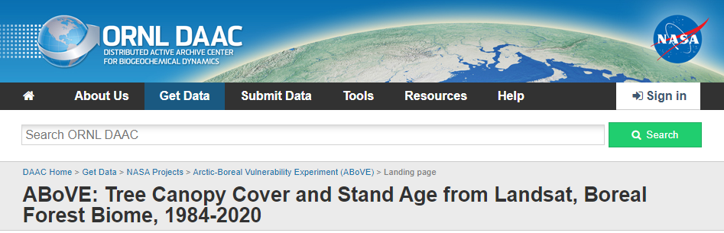
Site history from Landsat time-series: assessing boreal forest stand age
Stand age is assessed by identifying a disturbance, then a subsequent forest establishment year.
Derived from boreal forest-calibrated tree canopy cover estimated from the multi-decadal Landsat time-series (yearly from 1984-2020).
Continuous coverage across the boreal domain.
Estimates of age for young forests (< 36 yrs).
Provides the basis for chronosequence analyses with current remote sensing estimates of forest structure.
Age in 2020
Montesano et al. 2016, https://doi.org/10.3390/rs8070551
Feng et al. 2022, https://doi.org/10.3334/ORNLDAAC/2012

Slide 8
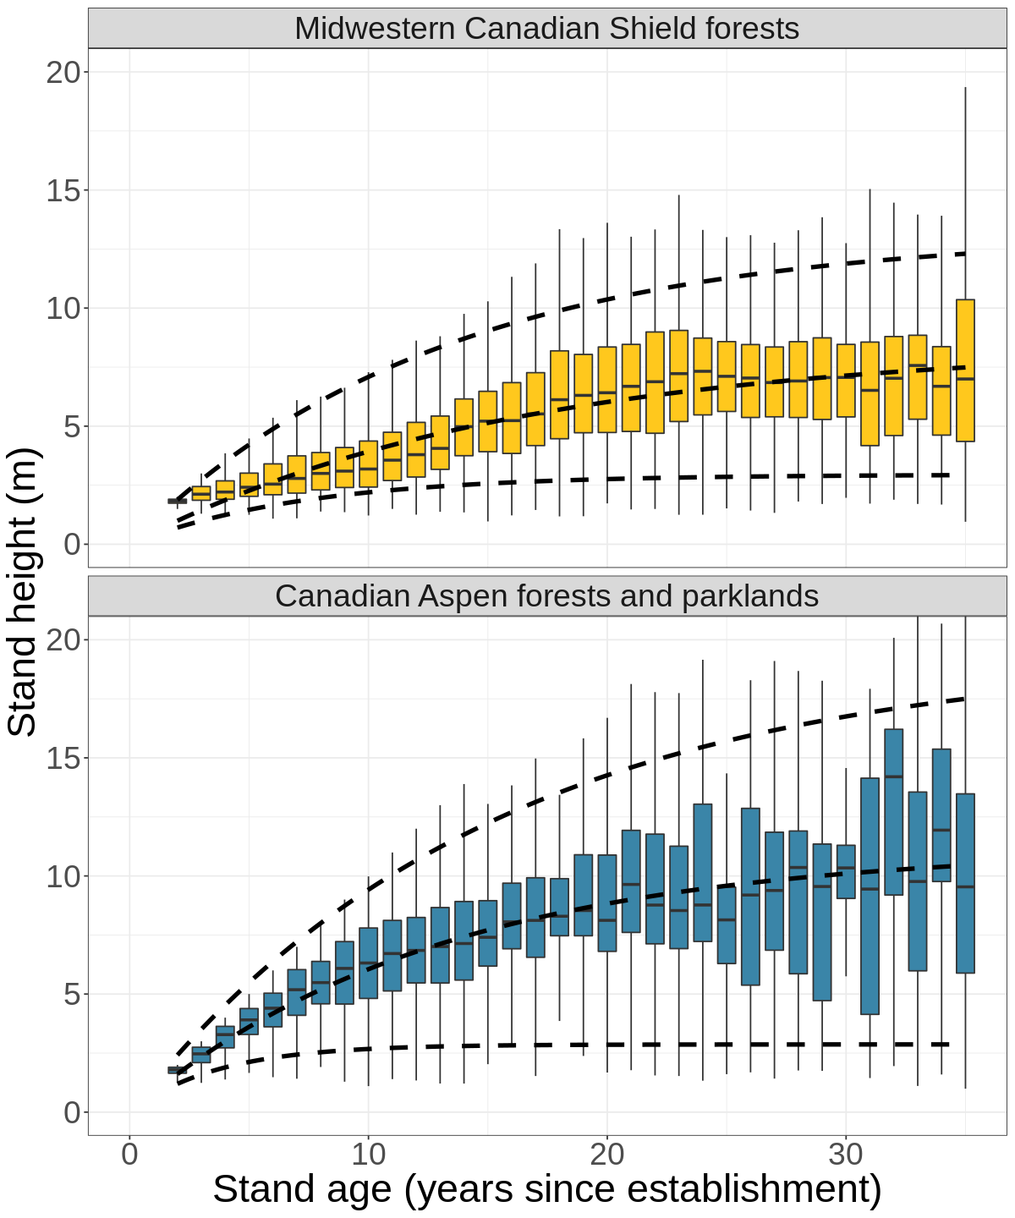
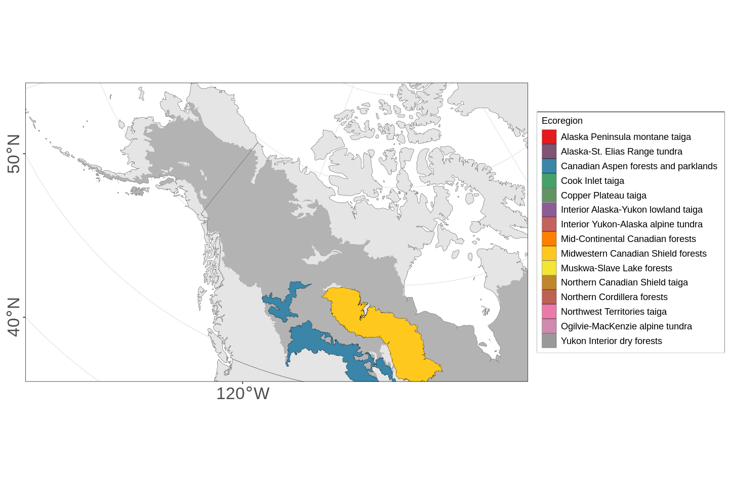
Current structure is linked with site history (stand age) in common regions
Filtered distributions of stand heights for each 1 yr age class of the 1984-2020 Landsat record
Example from 2 ecoregions sampled in the boreal
95th
50th
5th
95th
fast
50th
moderate
slow
5th
Distributions show a pattern of increasing stand height with age for young forests (< 36 yrs).
The percentiles of these distributions (5th, 50th, 95th) approximate varying growth at sites with a range of environmental conditions .
Montesano et al 2022 in review

Slide 9
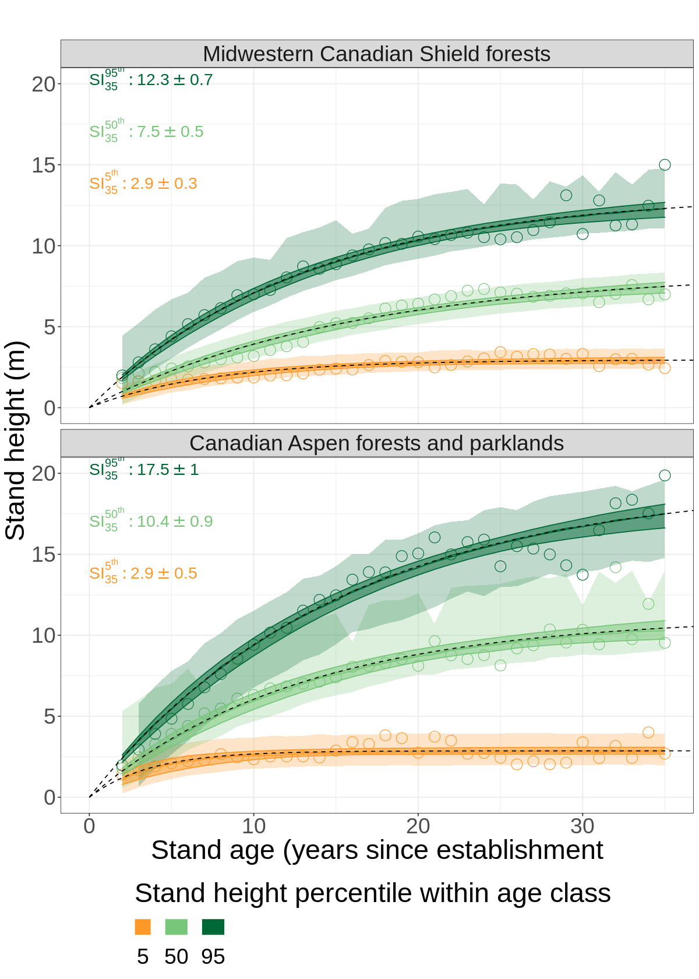
Current structure is linked with site history (stand age) in common regions
Uncertainties quantified with prediction & confidence intervals
Example from 2 ecoregions sampled in the boreal
95th
50th
5th
95th
50th
5th
Non-linear growth models are fit to 3 percentiles of each regional distribution.
These models provide statistical means & uncertainties of growth rates for young forests.
Montesano et al 2022 in review
SI₃₅ quantifies site height (m) at 35 years

Slide 10
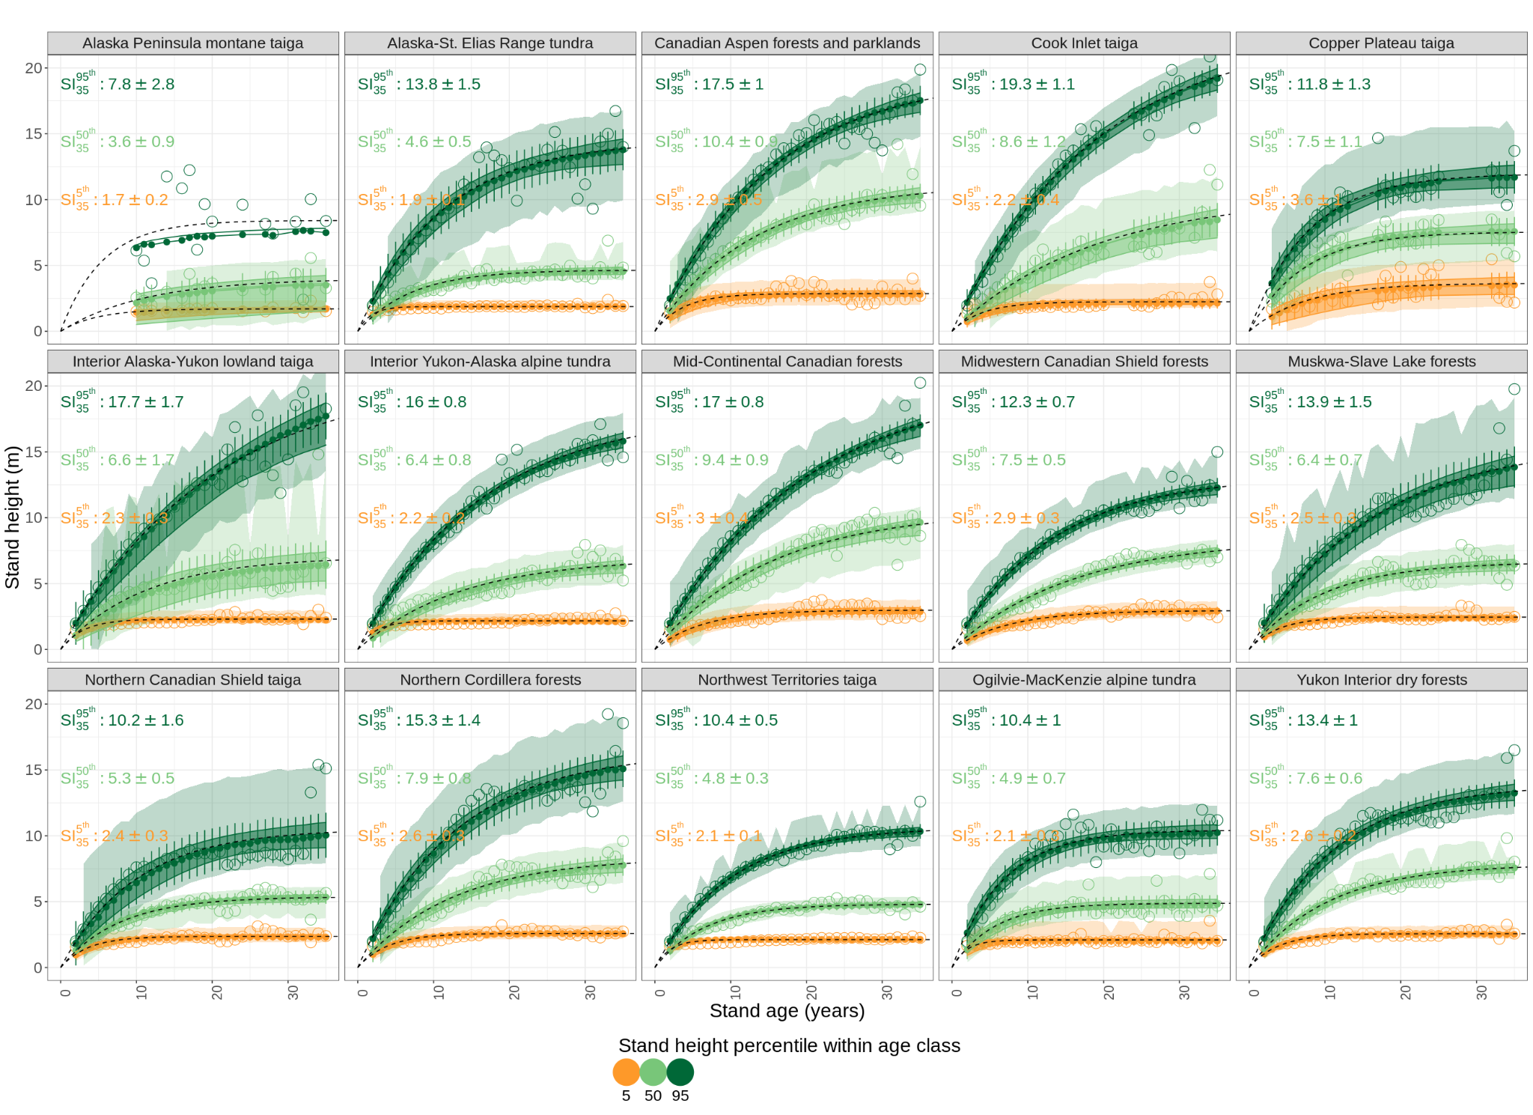
Across boreal ecoregions, current structure & site history estimate growth rates and their variation
Statistical summaries of forest growth
Within each region, the range of growth includes variation from environmental heterogeneity:
forest / vegetation type
soil type
belowground properties
hydrology
topography
This heterogeneity represented by differences in:
stand height percentile models,
their uncertainty bounds (confidence & prediction intervals)
This may help forest growth models improve representation of regional growth variation.
Obs poorly distributed across age classes
Montesano et al 2022 in review
Notes:
We will advance these methods for examining growth in Phase 3, using boreal biomass results from Phase 2 work led by Laura Duncanson that she’ll now discuss.

Slide 11
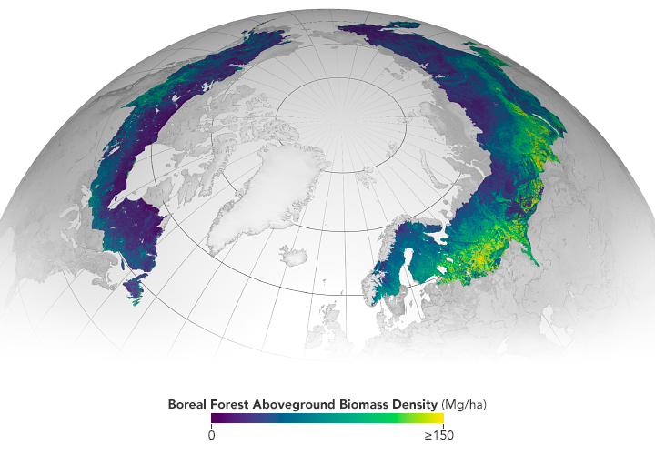
These synthesis activities can be advanced in Phase 3 using Phase 2 biomass mapping results…

Slide 12
Recall: NASA’s ICESat-2 data fill GEDI’s northern data gap for global lidar mapping
Open science product created on the NASA-ESA MAAP (scimaap.net). Explore this map here:
https://earthdata.nasa.gov/maap-biomass

Slide 13
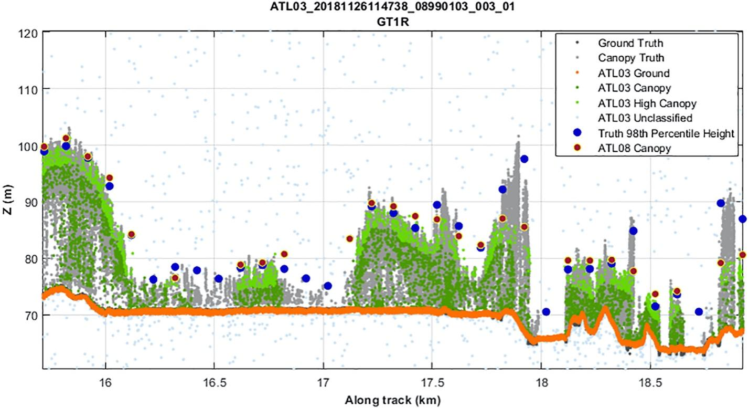
Recall: ICESat-2 Approach to Biomass Estimation
Collate field and
airborne lidar
b) Simulate ICESat-2
(100-m, 30-m)
c) Compute ICESat-2 RH metrics
(with + without ground photons)
d) Fit empirical models

Slide 14
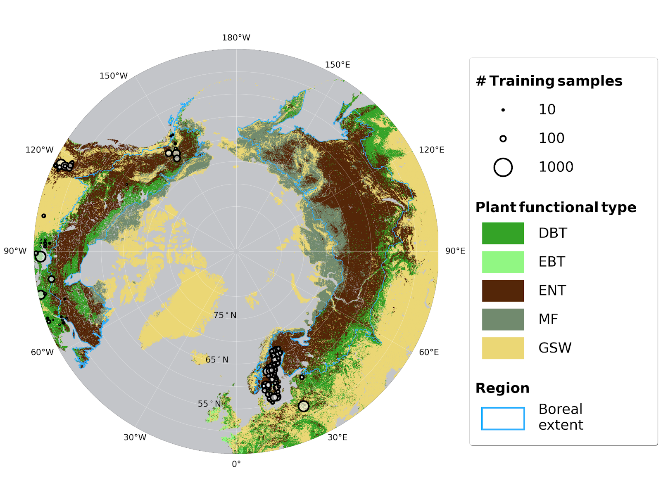
Boreal-wide ICESat-2 30 m Biomass Model
Models using simulated 30-m ICESat-2 perform comparably to GEDI models.
ICESat-2 occasionally misses the top of canopies
Notes:
Laura

Slide 15
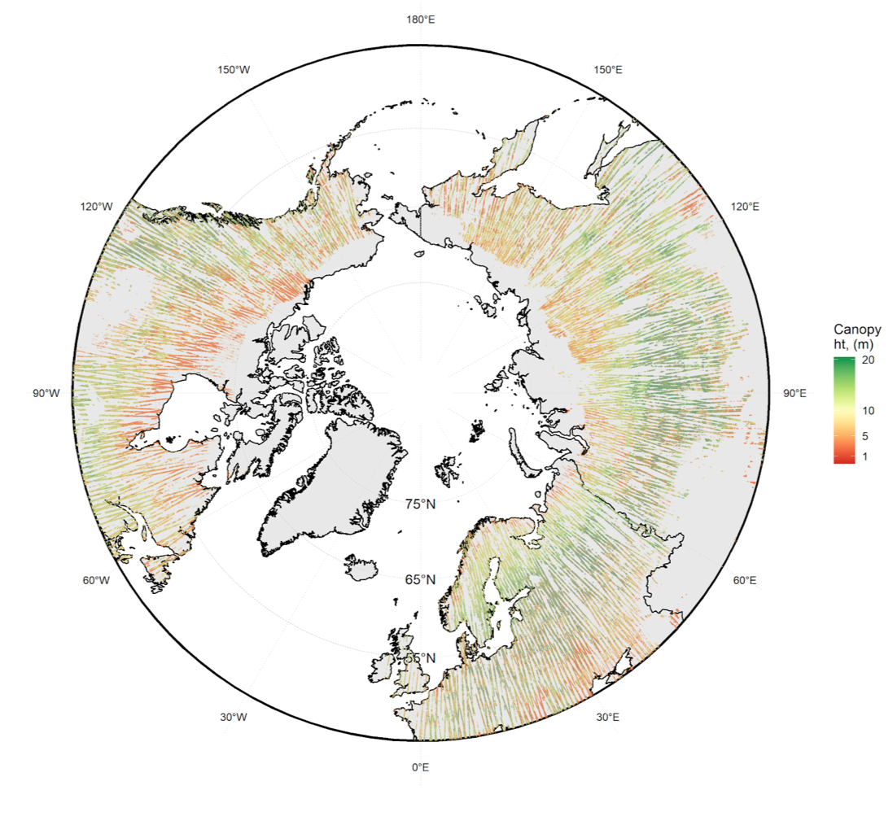
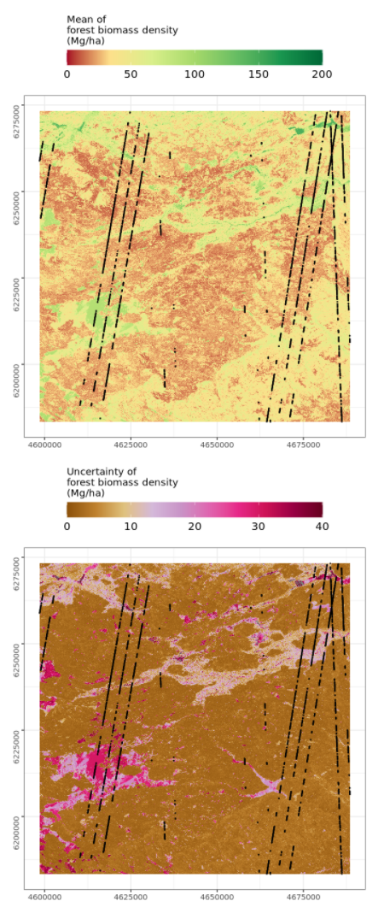
ICESat-2 Estimates → Wall-to-Wall Maps

Slide 16
Updates since May 2022
Validation of 30-m ICESat-2 heights (Tuo Feng et al., in revision at RSE)
Testing of AGB models including ground photons (a la GEDI) or excluding them (a la ATL08)
We are not including ground photons (after 6 months of debate!)
Swapped Landsat 8 composites for HLS composites (better temporal resolution for e.g. cloud masking)
Applied ESA Worldcover for masking non-vegetation
Removed issues with shallow water bodies being assigned biomass, urban areas, etc.
Refined uncertainty estimation
Spent way too much $ on compute…
MAAP
Joint access to data and algorithms
Data and Computing
Data and Computing
NASA-ESA MAAP platform provides storage, compute, and a development environment

Slide 17
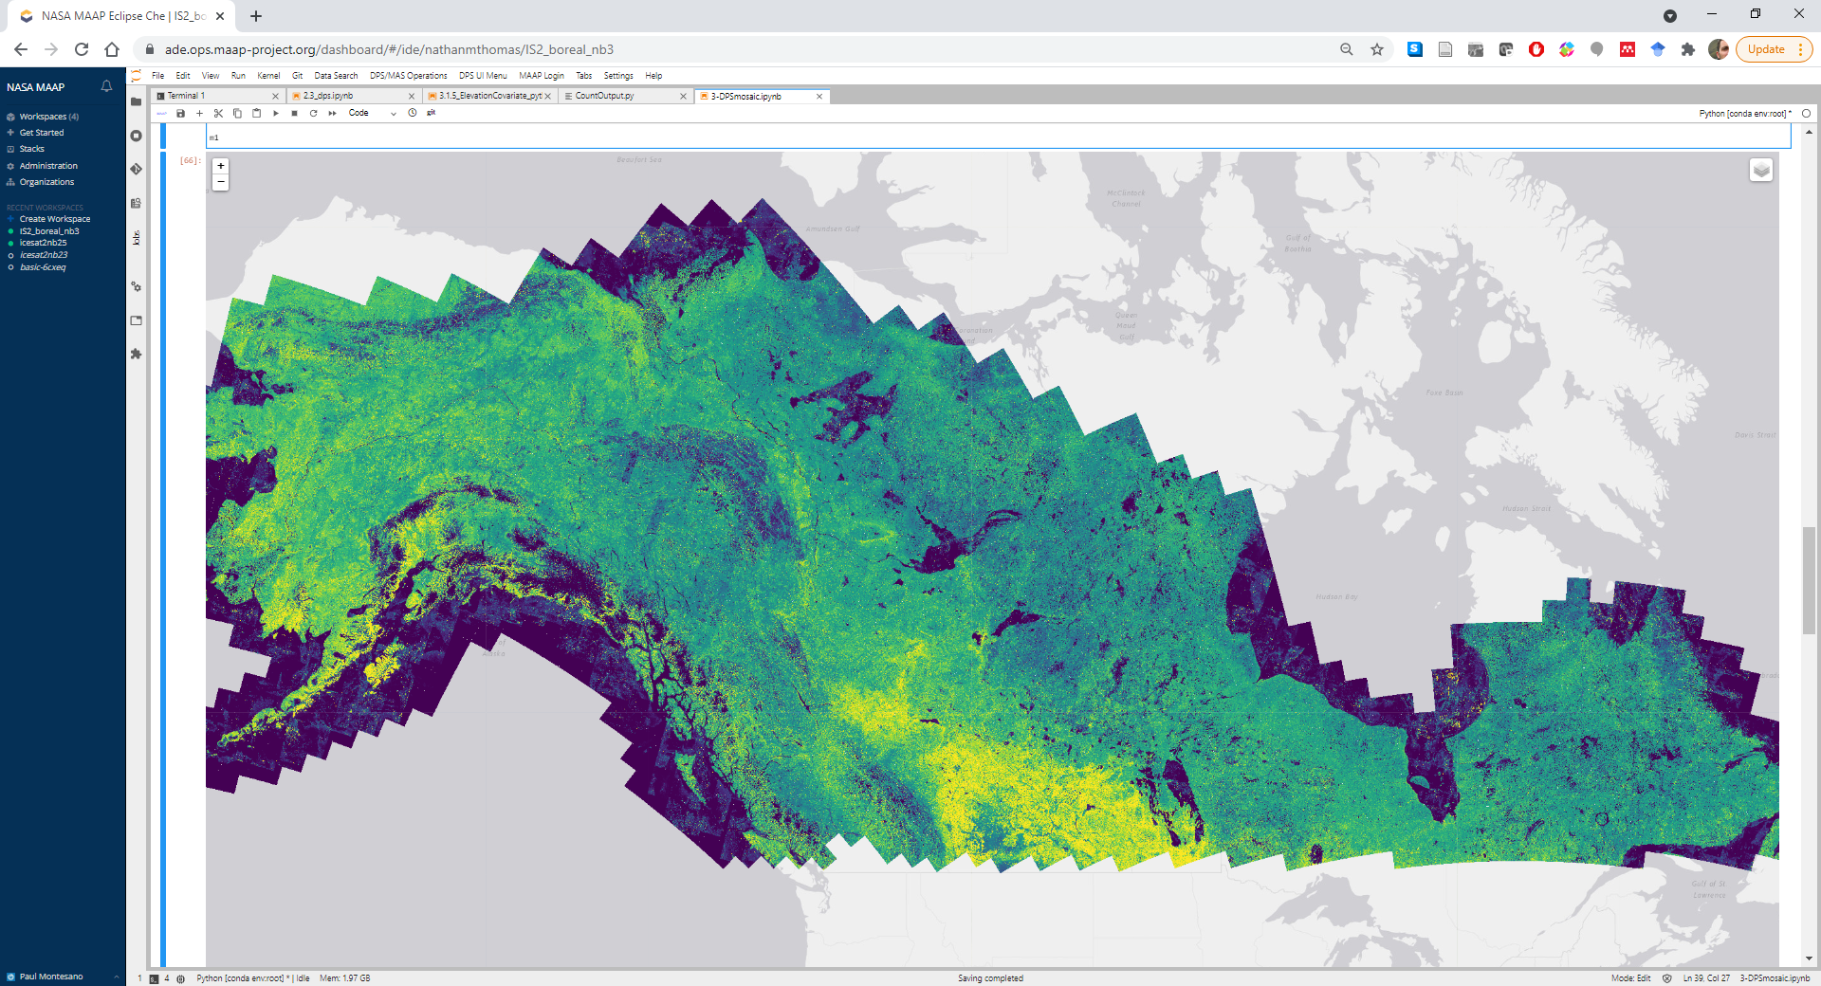
Update: swapped Landsat for Harmonized Landsat Sentinel-2 (HLS)

Slide 18
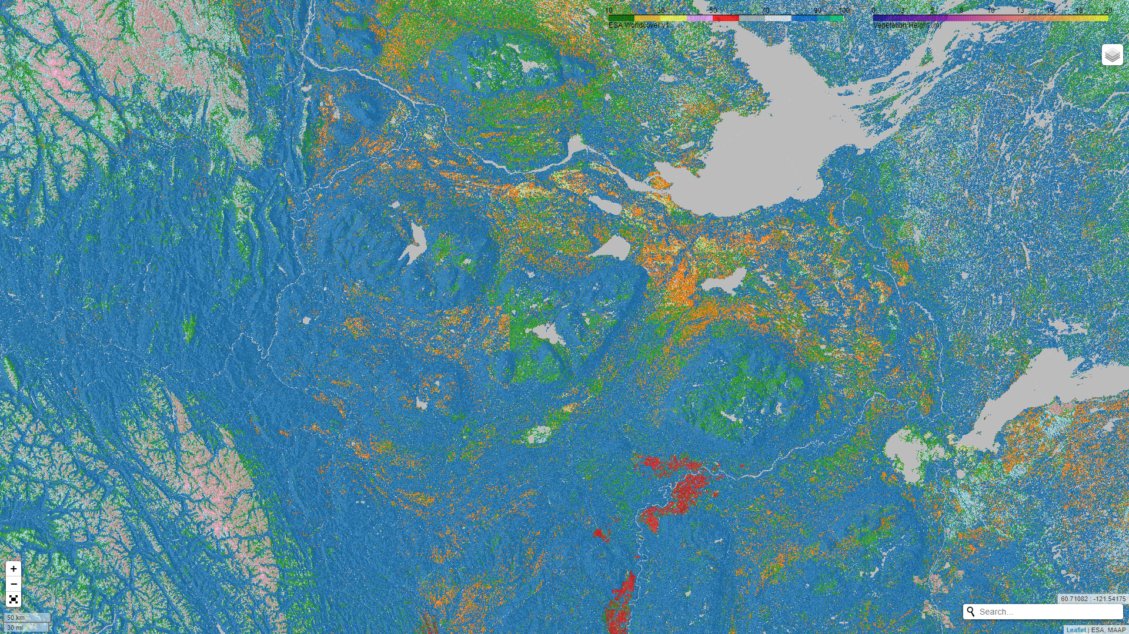
Update: used ESA Worldcover 2020 for masking non-vegetation

Slide 19
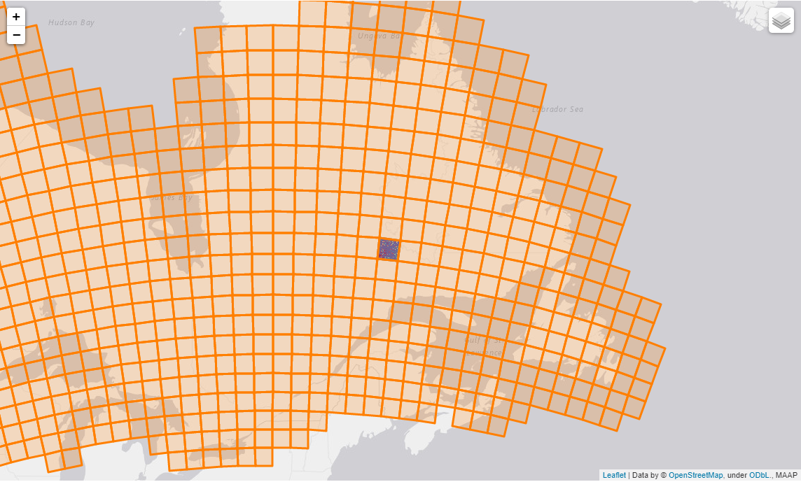
Mean of forest biomass density (Mg ha⁻¹)
Uncertainty of forest biomass density (Mg ha⁻¹)
AGB boreal-wide map
circa 2020
30 m resolution
Cloud-optimized geotiffs help to:
explore results,
tune models,
iterate over workflow
Quality-filtered ICESat-2 obs

Slide 20
How much biomass was there in the boreal in 2020?
81 Pg +/- 0.3 Pg in boreal domain
Comparable to 2010 estimates (Neigh et al., Santoro et al.)
~15% global AGB is found in boreal
Notes:
Laura

Slide 21
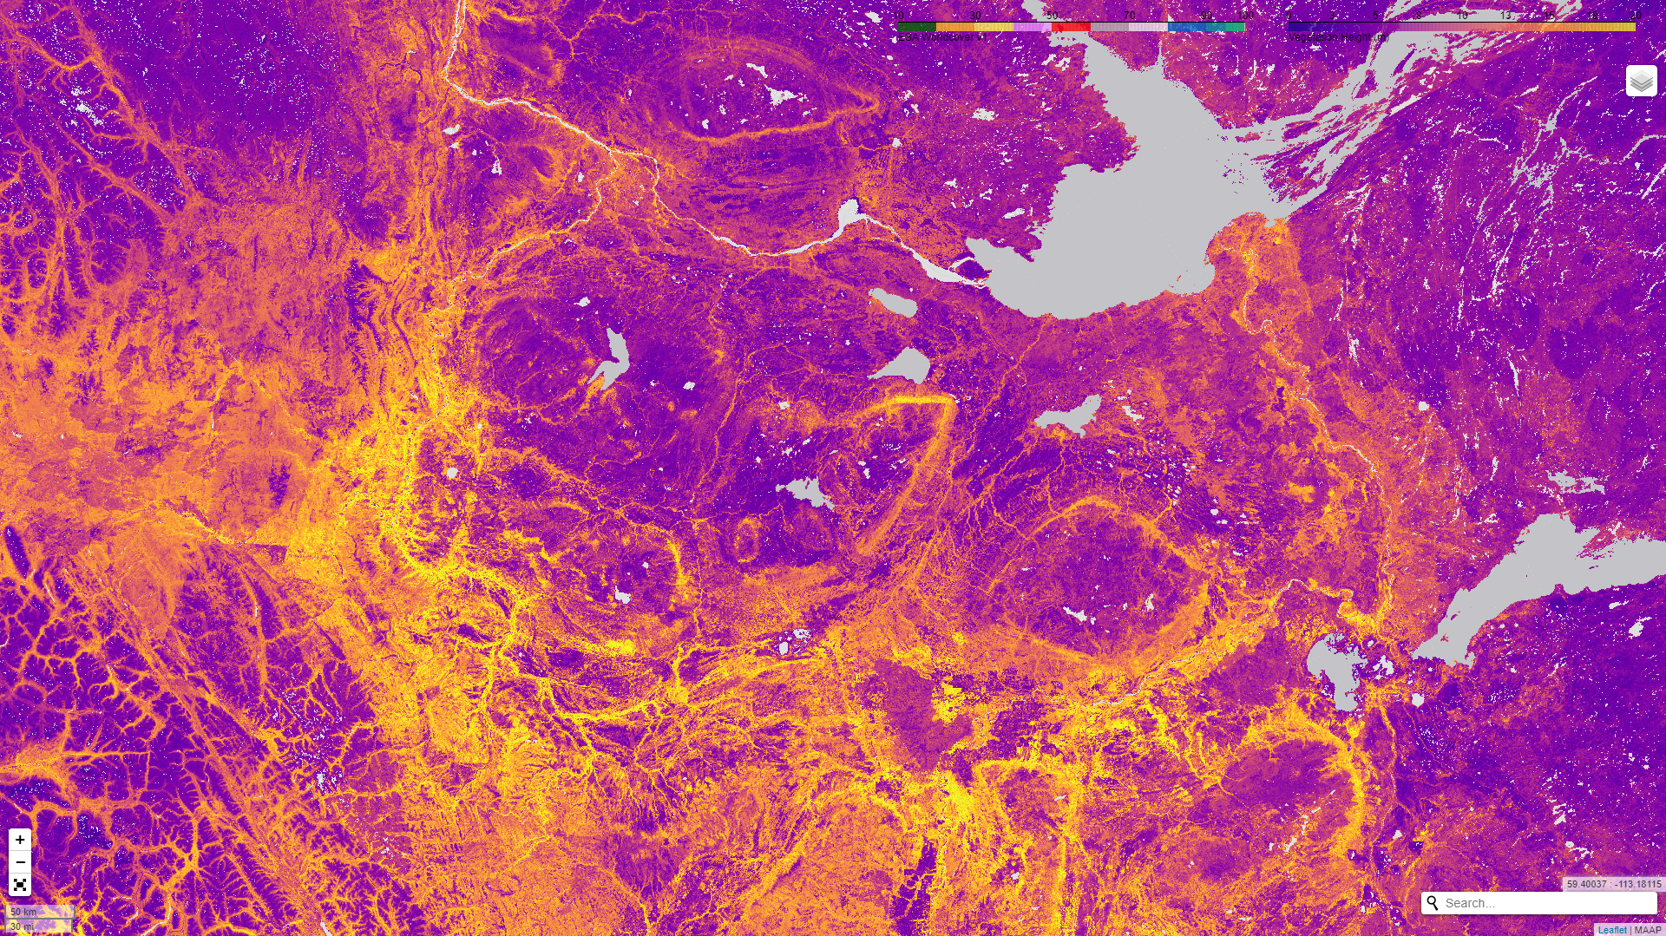
We have a preliminary boreal-wide height map! 30 m resolution, same methods as AGB but predicting ICESat-2 ATL08 max canopy height!
Both biomass and height products are in S3 buckets and we are working with ORNL DAAC and MAAP team for their publication
NASA-ESA MAAP platform provides storage, compute, and a development environment

Slide 22
Summary
Vegetation structure WG synthesis activities have:
linked veg structure data from across multiple projects
summarized regional growth rates in a way that integrates key airborne & spaceborne data into individual-based modelling
produced gridded vegetation structure datasets delivered (or on their way) to ORNL DAAC

