Slide 1
A S T M 8+
Jim Lawler
National Park Service
Ecological Inventory and Monitoring Program
May 9, 2022

Slide 2
National Park Service
Organic Act of 1916 established the purpose of National Parks to “conserve the scenery and the natural and historic objects and the wildlife therein and to provide for the enjoyment of the same in such manner and by such means as will leave them unimpaired for the enjoyment of future generations.”

Slide 3
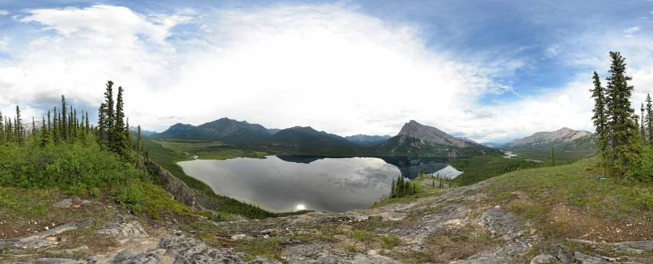
Inventory . . . Provide baseline information about park natural resources, including species diversity, distribution and abundance.
. . . and Monitoring Determine the current condition of resources and how they change over time (Monitoring Vital Signs).
Notes:
Long term program to measure and report on status (condition) and trend of a subset of measures of the ecological health of parks
It is also a way of doing business, organizing and reporting on condition of resources regardless of who collected the data
Inventory the natural resources to determine current condition.
Monitor park ecosystems to determine status and trend in condition.
Establish natural resource inventory and monitoring as a standard practice throughout the National Park system that transcends traditional program, activity, and funding boundaries.
Integrate natural resource inventory and monitoring information into NPS planning, management, and decision making.
Share NPS information and products with other natural resource organizations and form partnerships for attaining common goals and objectives.

Slide 4
Who we are
Geology
Hydrology
Wildlife Biologists
Ecologists
Aquatic Ecologists
Science communicators
Physical Scientists
Data managers
Fisheries Biologists

Slide 5
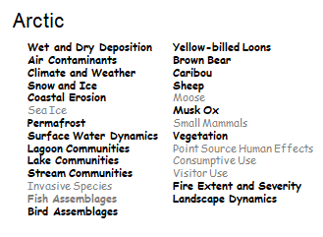
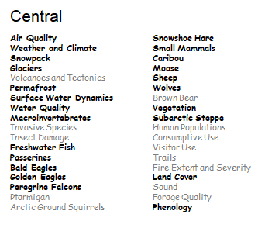
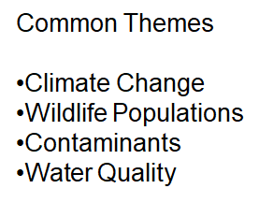
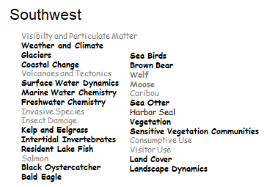
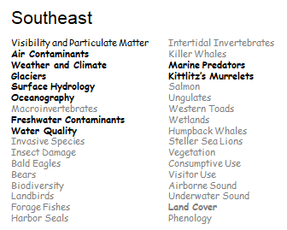
Vital Signs: Alaska’s Inventory and Monitoring Networks

Slide 6
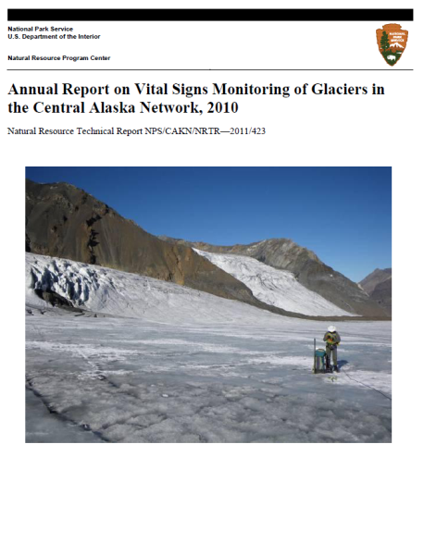
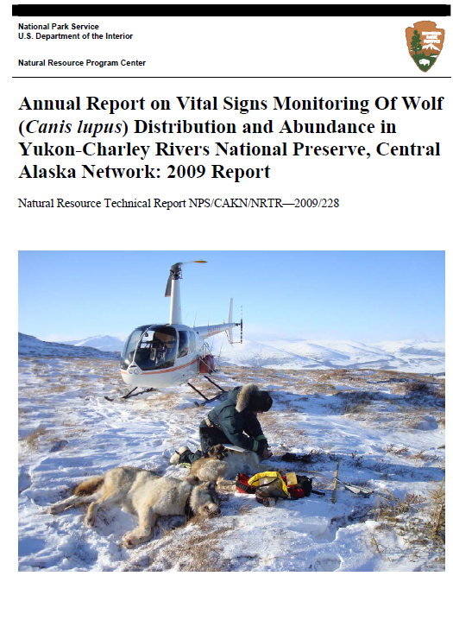
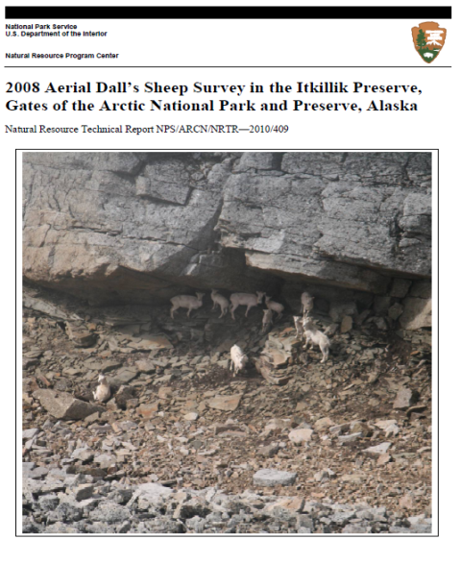
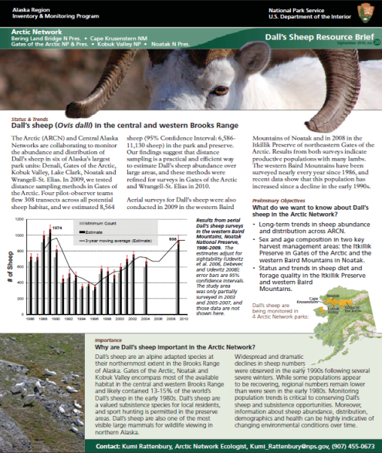
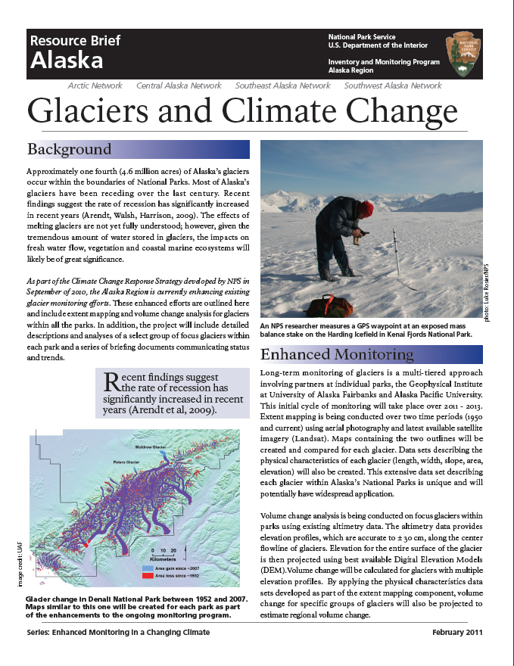
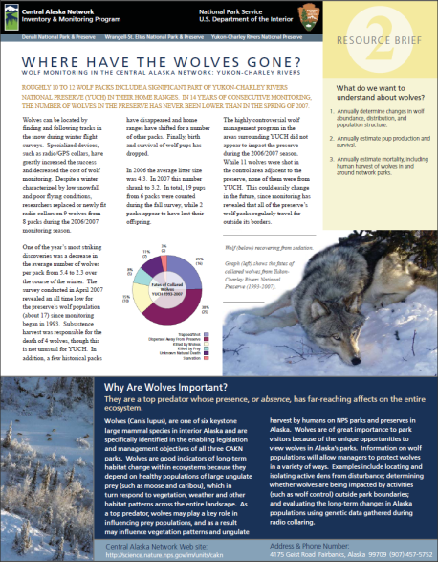
Science communication
Technical Information
irma.nps.gov/Portal/

Slide 7
Questions? Thank you!
National Park Service
U.S. Department of the Interior

