Slide 1
Arctic co-production of knowledge
Kimberley R. Miner and Libby Larson

Slide 2
A Sense of Place
This place is politically designated as San Diego, CA, and is on the unceded and ancestral lands of the Kumeyaay people, with 4 tribal groups in San Diego County: Kumeyaay/Diegueño, the Payoomkawichum (Quechnajuichom/Luiseño and Acjachemen/Juaneño), the Kuupiaxchem/Cupeño, and the Cahuilla.
San Diego County has the largest number of reservations in the US (18), though most of them are very small.
California has the largest number of federally recognized tribes (110), with another 81 groups seeking Federal recognition.
California has the largest Indigenous population of all states in the United States (631,016, ~17% of Indigenous peoples in the US).

Slide 3
A Sense of Place
In 2020, San Diego had a population of 1,386,932, the eighth-most populous city
The Kumeyaay may have migrated into the area around 1000 C.E.
The Kumeyaay established villages included Kosa'aay that became today's Old Town. The village of Kosa'aay was made up of thirty to forty families living in pyramid-shaped housing structures and was supported by a freshwater spring from the hillsides.
Juan Rodríguez Cabrillo from Cabrillo came in 1542 and colonization, forced assimilation and conversion began in earnest in 1602.
1769-1797 more Spaniards and missionaries came, and in 1822-1840 battles with Mexican and Spanish governments bled into the city
In 1850, California became a state in the United States territory and the ‘gold rush’ began as the railroad expanded

Slide 4
Place based resources
The State Water Project moves water from the western Sierra Nevada through the Sacramento-San Joaquin River Delta before delivering supplies—via the California Aqueduct to Southern California.
Strong defense and tourism industries, as well as international trade and education
The city has the seventh-highest population of gay residents in the U.S.
25% of the population are native or fluent Spanish speakers
Native plants include beach evening primrose, coast monkey flower, yellow mariposa lily, and matilija poppy
The tall ship across from the hotel is the Californian: built from the ground up in 1984 at Spanish Landing in San Diego Bay.

Slide 5
Back to the Arctic…
Across scales, collaboration is important for monitoring and understanding Arctic change
Prioritize good relationship building equally with data breakthroughs
NASA ABoVE data are phenomenal resource for a changing Arctic… but partnerships and data user communities are critical to decision making

Slide 6
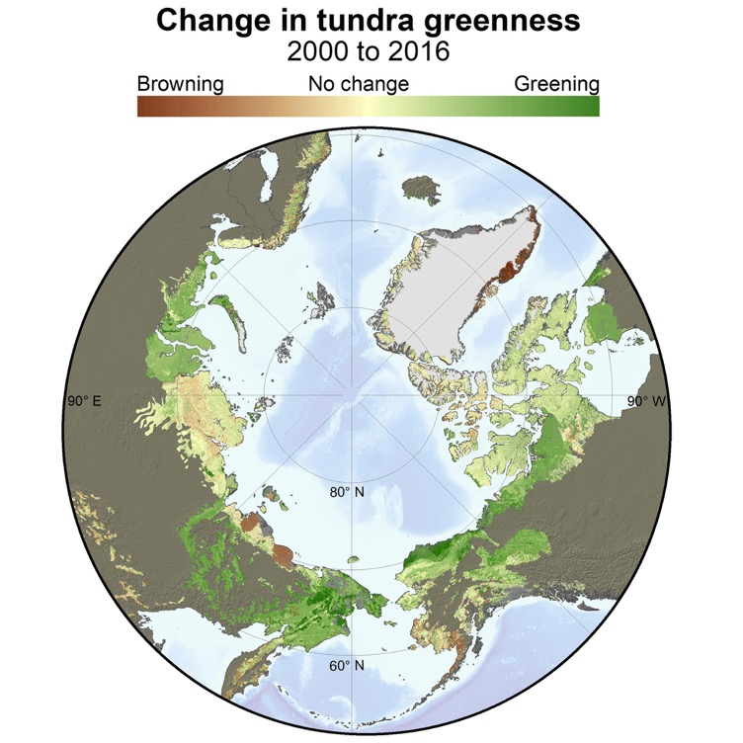
Vegetation and hydrology changes threaten systems and security

Slide 7
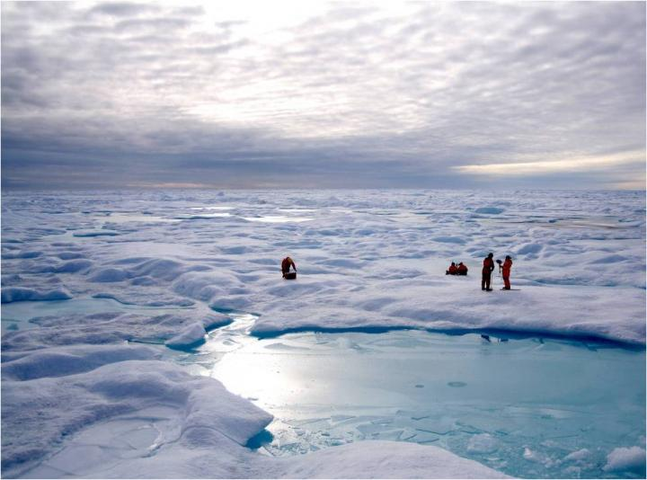
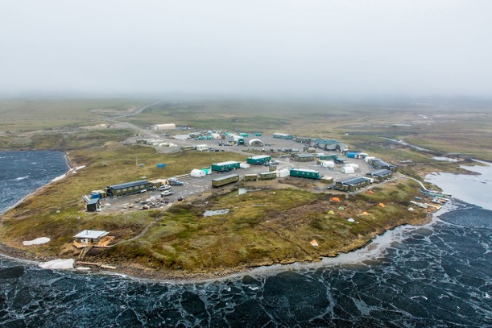
Research requires Land knowledge and values
Collaboration with local people, decision-makers, and rights-holders is critical
First Nations
Residents
Research Institutions
The responsibility is with ABoVE researchers to practice good relations with all Arctic residents
Co-producing science needs and results
Co-monitoring research activities and instruments
Equally valuing all forms of knowledge

Slide 8
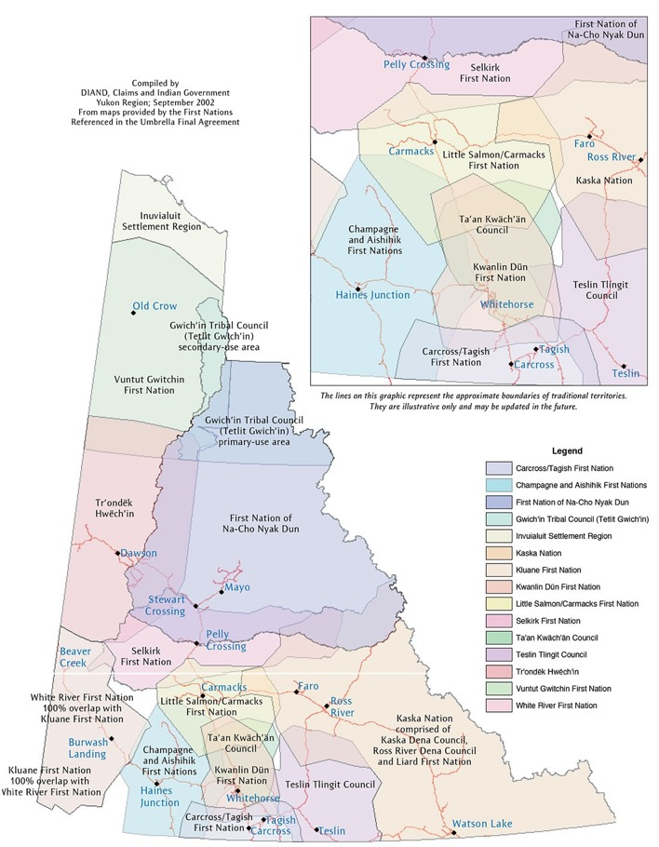
ABoVE Yukon collaborations
Collaboration considerations
Proprietary data
Intellectual Property
How does sharing knowledge and relationships benefit the community?
Is everyone allocated equal time, space and weight?
Forms of knowledge
“Holistic, include observations, oral histories and years of knowledge” (Nature Climate Change, In Review)
Recent ABoVE collaboration-building
First Nations
Yukon University
Yukon Government

Slide 9
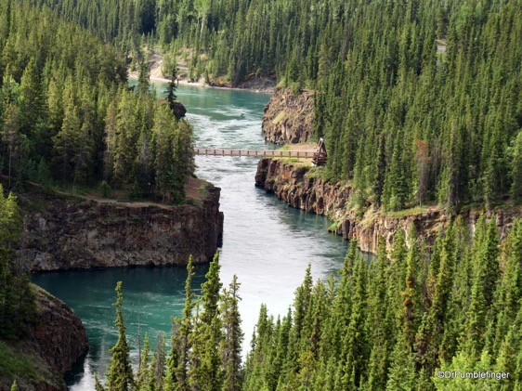
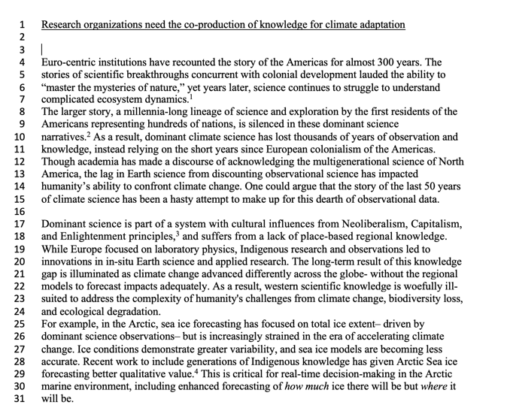
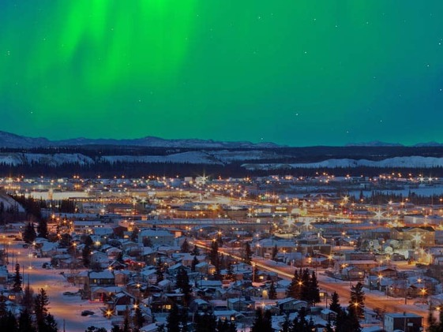
ABoVE Yukon collaborations
Deliverables
Synthesis document of climate change and ecosystems
Ongoing partnership and consultation
Attendance at STM
ROSES proposal
Hg monitoring paper
Water health metrics
Data products
Flight lines
Cognizance from ABoVE of resource mapping limitations
Aishihik watershed/lake imagery
Permafrost distribution map
Vegetation map
Snow coverage map
Beaver dams
Hg, dioxin, selenium pollution
Beetle death maps
Sheep maps
Landslide risk map

Slide 10
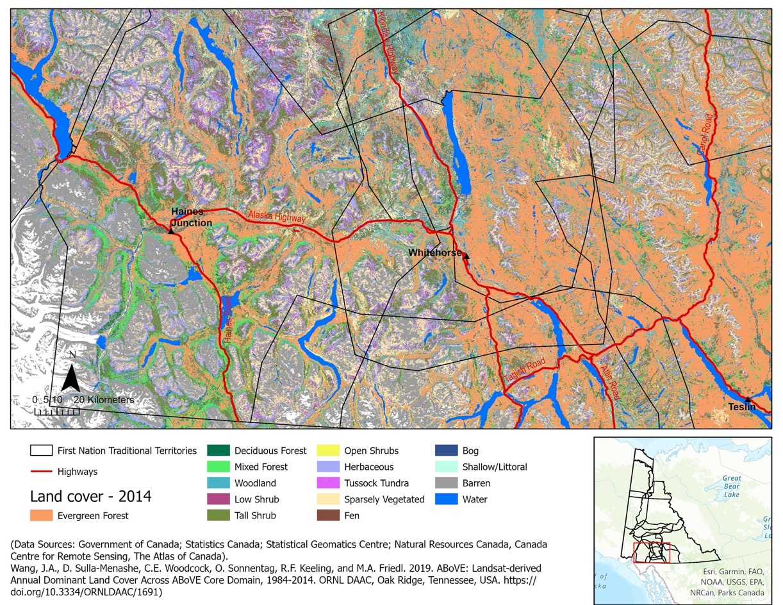
ABoVE Yukon collaborations
Maps by Dr. Latha Baskaran

Slide 11
Ways of knowing and language
Respecting and valuing all forms of knowledge
Acknowledge historical context and past injustice
This principle is highlighted in the OSTP-CEQ “Guidance for Federal Departments and Agencies on Indigenous Knowledge”
Educate yourself first, don’t just say “teach me”
Impact of word choice:
Militaristic: campaign, target
Extractive: ecosystem services
Erasing: stakeholders, Arctic regions as “edge of the Earth”, new, foreign, using ‘Indigenous’ as catch all for many nations, other than

Slide 12
Building good relations
National Inuit Strategy on Research
Together…
Notes:
Mention SBG collabs group and ABoVE collabs group
JPL Nebula group and NASA Indigenous leaders

Slide 13
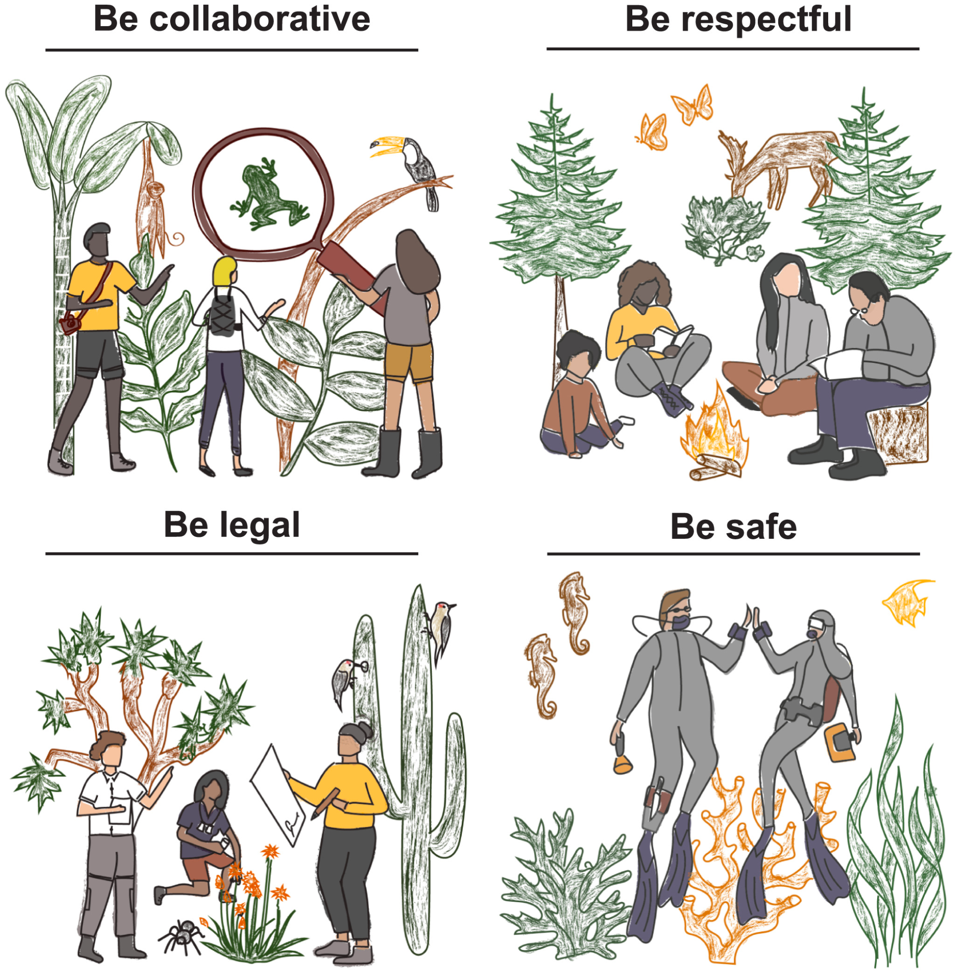
Good relations in action
Learn about histories and current concerns
Be humble in building relationships
Do not expect or rely on free labor
Dedicate time to engage with communities throughout the project
Formulation of research question and approach
Implementation
Results, synthesis, impacts
Figure from: Ramírez-Castañeda, V., et al. 2022. A set of principles and practical suggestions for equitable fieldwork in biology. Proceedings of the National Academy of Sciences 119, e2122667119. https://doi.org/10.1073/pnas.2122667119
Notes:
Since projects are already funded with a specific research question, consider if there might be opportunities to expand or reframe to incorporate communities needs

Slide 14
Good relations in action
Know the land: territorial history, treaties, current legal status
START NOW for any field work:
Contact local tribes, hunters and trappers associations, councils, communities, governments
Describe interest and request feedback
Ask about any required permits
Getting permits can take several months
Language translation may be required
Employ local people
Treaties, as shown on https://native-land.ca/

Slide 15
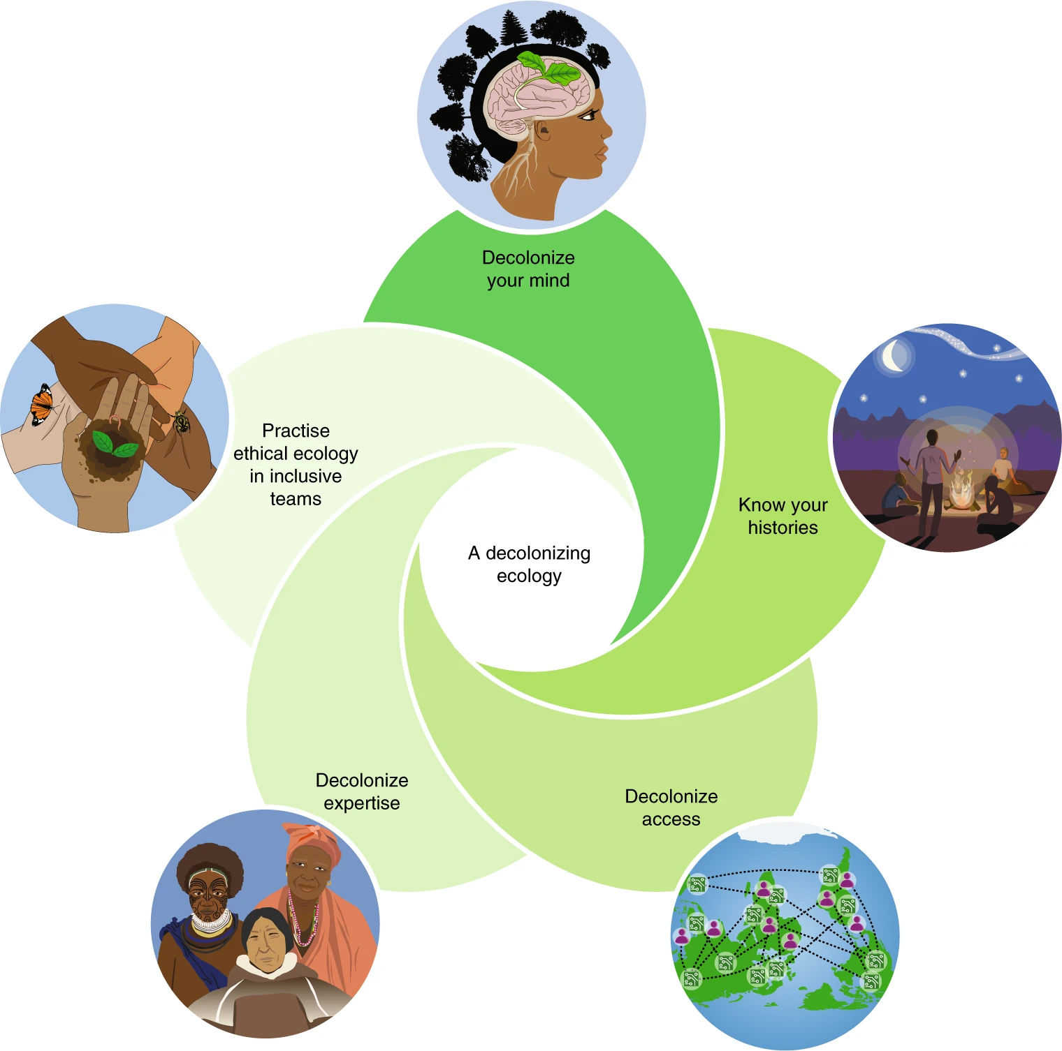
Consider your role in decolonizing science
Illustrations by Keren Cooper. Figure from:
Trisos, C.H., Auerbach, J., Katti, M., 2021. Decoloniality and anti-oppressive practices for a more ethical ecology. Nat Ecol Evol 5, 1205–1212. https://doi.org/10.1038/s41559-021-01460-w
Notes:
These shifts are not exhaustive or a checklist, but are presented as positive interventions to promote ways of knowing and practising ecology that are more creative, reflective, equitable, inclusive and effective in aiding a just transition to a more sustainable world: ‘decolonize your mind’ to include multiple ways of knowing and communicating science; ‘know your histories’ to acknowledge our discipline’s role in enabling colonial and ongoing violence against peoples and nature, and begin processes of restorative justice; ‘decolonize access’ by going beyond open access journals and data repositories to address issues of data sovereignty and the power dynamics of research ownership; ‘decolonize expertise’, by amplifying diverse expertise in ecologies and giving due credit and weight to that knowledge; and ‘practice ethical ecology in inclusive teams’, by establishing diverse and inclusive research teams that actively deconstruct biases so all team members are empowered participants in developing new knowledge. These actions support reformulating research questions and processes for a decolonizing ecology. Credit: Keren Cooper (illustrations).

Slide 16
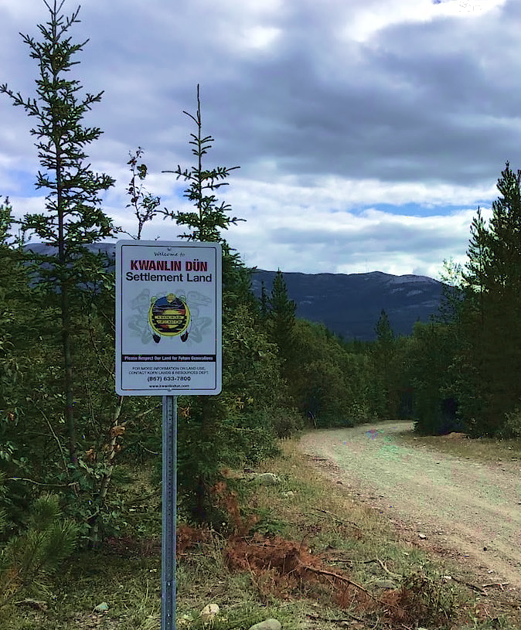
Guiding thoughts for ABoVE
﻿Colonialism is not a historical event,
but an ongoing set of relations that still characterize the common sense of professional science.
As more scientists come to realize that science has power relations that do not serve all people equally, we are left trying to understand how we might change the way science is done….
﻿
Treat Indigenous knowledge as expertise, rather than culture.
Cite us.
Pay us as experts when you need us in your classrooms and panels. Talk to us before you complete a grant application as full collaborators, rather than as unfunded additions at the end.
-Liboiron 2021

Slide 17
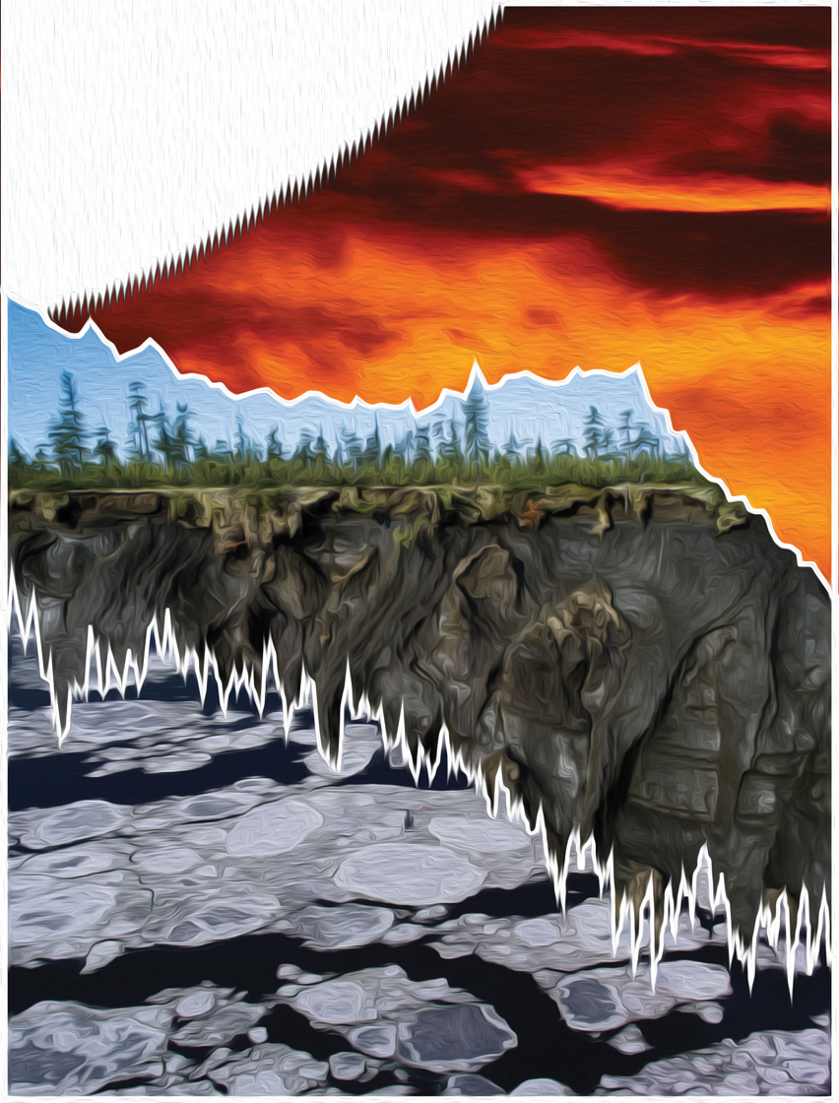
Resources to start with:
Liboiron, M. Decolonizing geoscience requires more than equity and inclusion. doi:10.1038/s41561-021-00861-7.
Canavera, L. Blue Economy Solutions to the Challenges in Our Food System. in Arctic Circle Assembly (2021).
McGregor, D. Indigenous Knowledge Systems in Environmental Governance in Canada. KULA Knowl. Creat. Dissemination, Preserv. Stud. 5, 1–10 (2021).
Mazzocchi, F. Western science and traditional knowledge Despite their variations, different forms of knowledge can learn from each other. EMBO Rep. 7, (2006).
Ermine, W. The Ethical Space of Engagement. Indig. Law J. 6, 193–203 (2007).
NASEM. Advancing Diversity, Equity, Inclusion, and Accessibility in the Leadership of Competed Missions. Advancing Diversity, Equity, Inclusion, and Accessibility in the Leadership of Competed Missions (2022). doi:10.17226/26385.
Yifeng Chen, C., Kahanamoku, S. S., Tripati, A., Andrade, K. & Morris, V. Decades of systemic racial disparities in funding rates at the National Science Foundation.
Figure: Heather Clifford

Slide 18
Tuck, E. & Yang, K. W. Decolonization is not a metaphor York at New Paltz. Decolonization Indig. Educ. Soc. 1, 1–40 (2012).
Simpson, L. R. Anticolonial Strategies for the Recovery and Maintenance of Indigenous Knowledge. Am. Indian Q. 373-384 (12 pages) (2004).
National Inuit Strategy on Research https://www.itk.ca/wp-content/uploads/2018/04/ITK_NISR Report_English_low_res.pdf
OSTP/CEQ, 2022. Guidance for Federal Departments and Agencies on Indigenous Knowledge. https://www.whitehouse.gov/wp-content/uploads/2022/12/OSTP-CEQ-IK-Guidance.pdf
Ramírez-Castañeda, et al. 2022. A set of principles and practical suggestions for equitable fieldwork in biology. Proceedings of the National Academy of Sciences 119, e2122667119. https://doi.org/10.1073/pnas.2122667119
Trisos, C.H., Auerbach, J., Katti, M., 2021. Decoloniality and anti-oppressive practices for a more ethical ecology. Nat Ecol Evol 5, 1205–1212. https://doi.org/10.1038/s41559-021-01460-w
Figure: Heather Clifford

