Slide 1
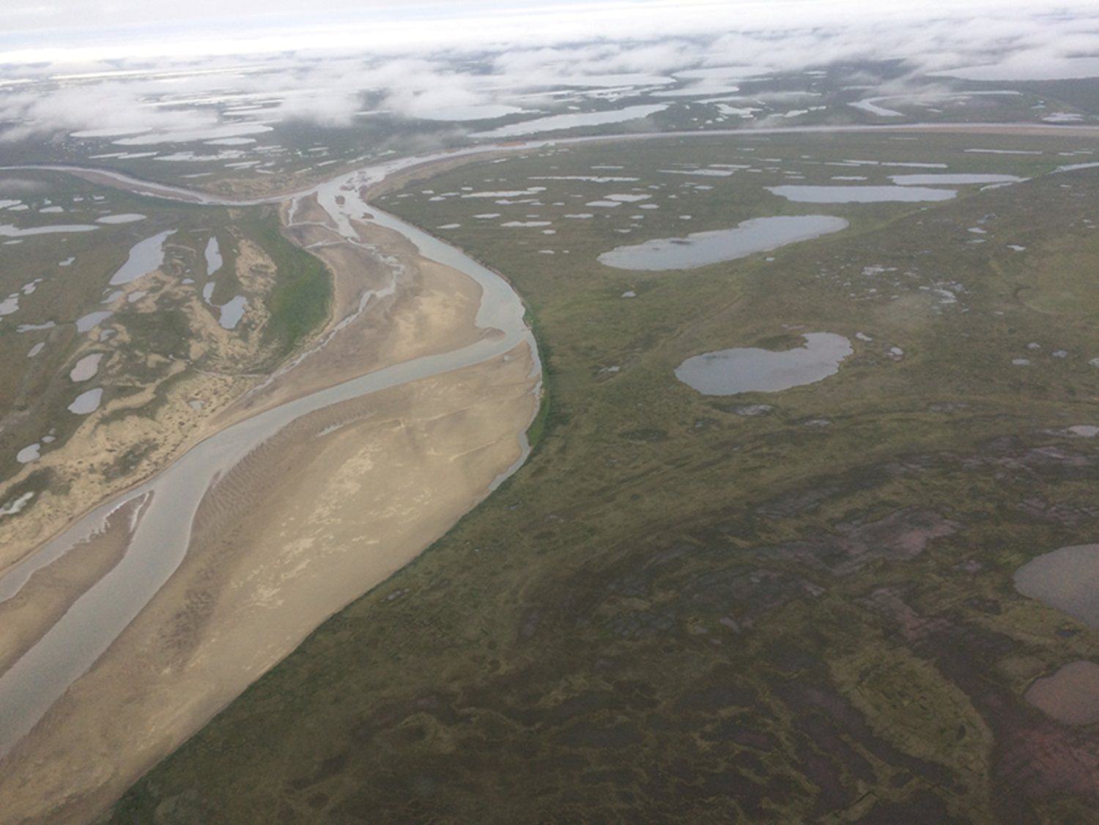
Hydrology & Permafrost Working Group Projects & Synthesis Updates
70+ members, John Kimball, David Butman (WG leads), Torre Jorgenson, Tamlin Pavelsky, John Mallard, Mahta Moghaddam (synthesis sub-group leads)
Notes:
Working Group & Synthesis activity reports: Updates from WG Leads & reports from ongoing Synthesis Activities
Tues, May 11, 1:45-2:30pm
Thurs, May 13, 1:05-2:30pm
~15 min time slot (7 slides); Thurs afternoon (May 13) ~1:05PM

Slide 2
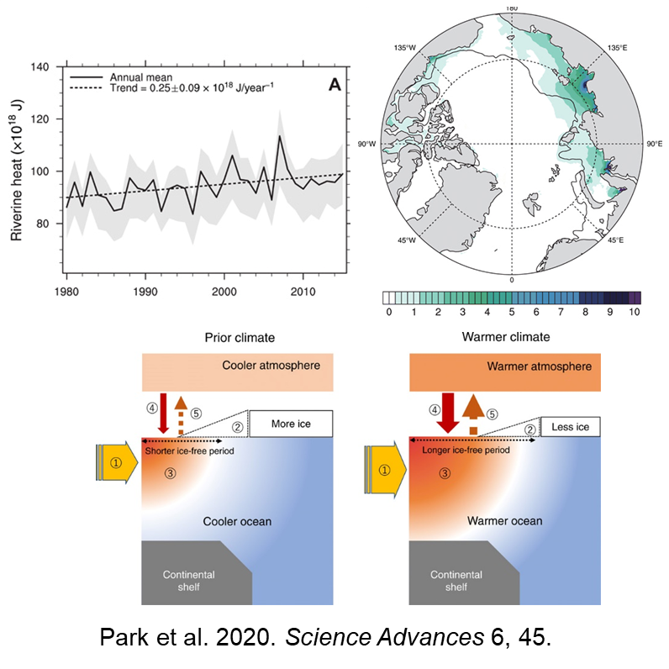
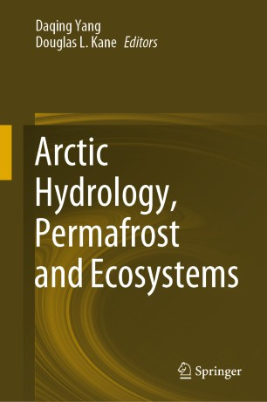
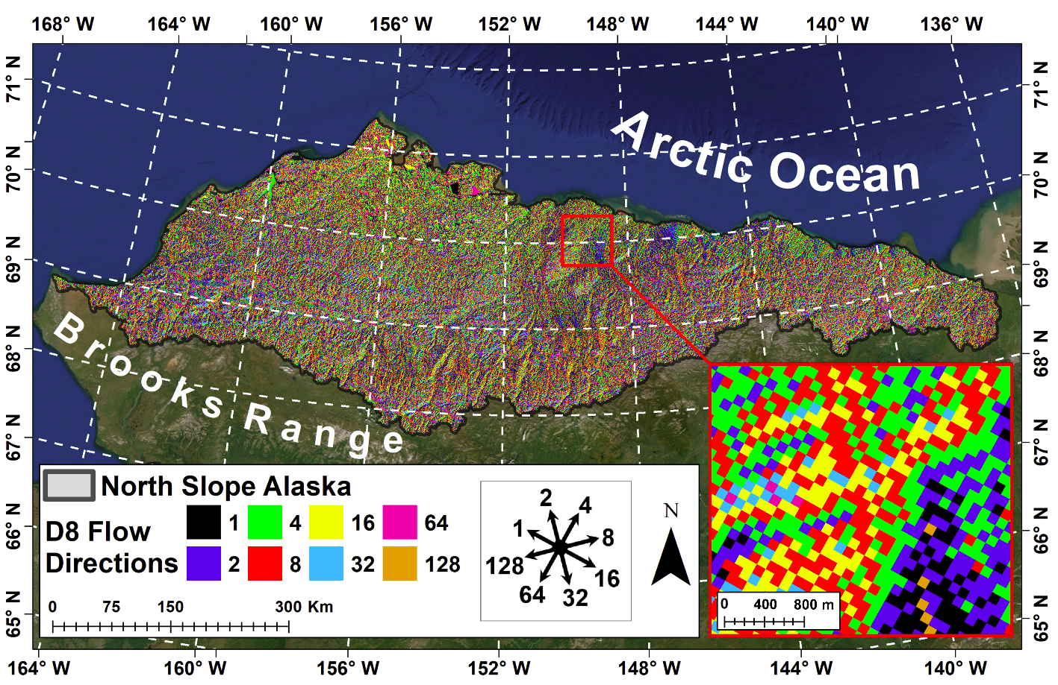
Recent WG accomplishments:
Increasing Riverine Heat Influx Triggers Arctic Sea Ice Decline
~11 active projects (2021); larger number of affiliated projects
>25 papers published (2020/21)
>6 new geospatial datasets archived (2020/21)
1-km North Slope Flow Direction Grid
Rawlins et al. 2020. https://doi.org/10.1007/978-3-030-50930-9_6
https://link.springer.com/book/10.1007/978-3-030-50930-9
Notes:
1 kilometer resolution flow direction grid derived for AK North Slope terrestrial drainage. Used for regional model (PWBM) simulations of surface/subsurface flow trends and DOC lateral transport in coastal basins
Book: 30 chapters: arctic climate climate trends and future trajectories; changing hydrology and biogeochemistry; permafrost features, hydrology linkages and feedbacks; ecological impacts; hydro models and applications
Publications over a range of scales, incl. integrated observations and coupled land-ocean-atmosphere model simulations
- Increasing riverine heat transport over land contributing to arctic sea ice decline (thinner ice cover and longer ice-free season) along coastal ocean shelf regions, which is reinforcing regional warming

Slide 3
HPWG Synthesis activities
Three sub-group activities underway:
Patterns, trends, & drivers of thermokarst in Alaska & Northwest Canada [T Jorgenson].
Temporal & spatial variations of active layer properties over foundational flight lines & upscaling to the ABoVE domain [M. Moghaddam, J. Kimball].
Changing hydrologic connectivity in boreal rivers, lakes, & wetlands of Arctic-boreal North America [T. Pavelsky, J. Mallard].
Activities address HPWG science ¹priorities to clarify:
Processes controlling changes in PF distribution & properties, & their impacts.
Nature, causes & consequences of hydrologic changes, Incl. water storage, mobility & distribution.
Water/energy/carbon cycle & ecosystem linkages.
Crosscutting with other WG activities, incl.:
Snowscapes, Disturbance, Modeling, Wetlands, & Carbon dynamics.
¹ABoVE Implementation Plan

Slide 4
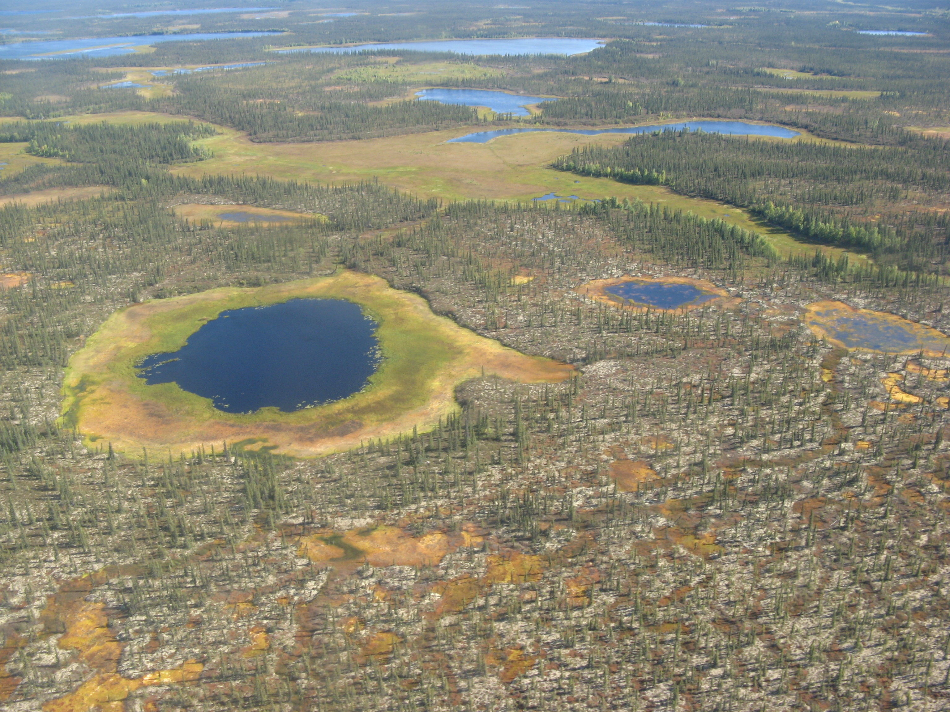
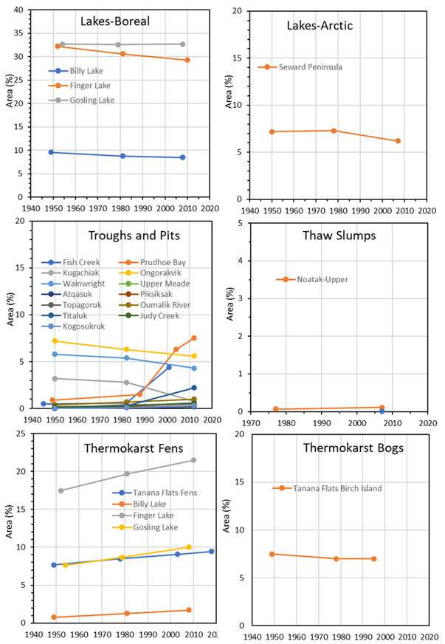
Thermokarst Patterns and Processes
Example TK trends from geodatabase
Objectives:
Characterize TK landforms from hydrology perspective;
Quantify extent & decadal trends of dominant TK features;
Synthesize key TK drivers & integrate into conceptual models;
Review assessment & monitoring methods;
Identify priorities for multiscale monitoring;
Showcase ABoVE projects & data;
Recent accomplishments:
Geodatabase of TK types, locations & trends (areal, vertical, & lateral rates)
6 process overview publications, incl:
Review of TK landforms (Jorgenson, 2021. Ref. Module in Earth Syst. and Environ. Sci.)
Climate, succession, hydrology and PF interactions in Alaska Fens (Jorgenson, et al. 2020. JGR Biogeosci.)
Climate influenced land cover change in PF peatland and wetland complexes (Carpino et al. 2021. HESS; Haynes et al. 2020. Ecohydrol.; Devoie et al. 2021. JGR)

Slide 5
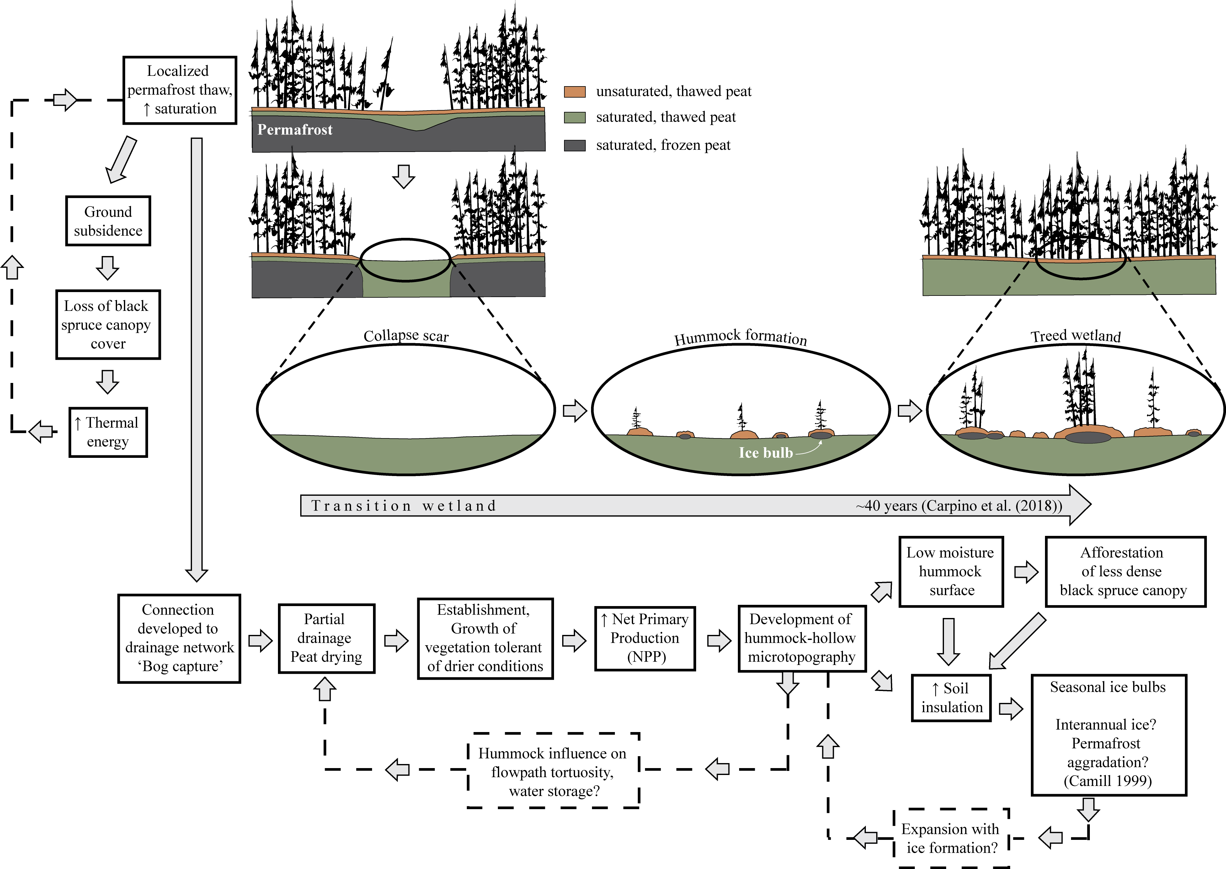
Thermokarst Patterns and Processes
Trajectory of wetland transition during permafrost thaw
Scotty Creek and Taiga Plains, NT
Selected Findings:
Seven distinct land cover stages identified during PF degradation in taiga peatland complexes, along with associated energy, hydrologic and ecological linkages;
Clarification of talik development, groundwater flow and mechanistic trajectory of transitioning wetlands;
Improved numerical model of PF thaw and talik development.
Courtesy: W. Quinton (CRRC), O. Carpino, E. Gala Devoie, K. Haynes, R. Connon, and J. Craig
Haynes et al. 2020. Ecohydrology.
Notes:
Seven PF thaw stages: PF thaw, Talik expansion, Bog Capture, Expidited drainage, Hummock Growth, Forest Establishment
Above: The mechanistic trajectory of transitioning wetlands illustrates that as collapse scars become connected to the basin drainage network, partial drainage promotes the development of hummock microtopography. The aerobic surfaces of hummocks facilitate the re-establishment of black spruce, catalyzing the formation of treed wetlands, and ultimately the return of low-lying black spruce forests with no underlying permafrost likely due to warming air temperatures.
The conceptual model of the wetland transition over the different stages of permafrost thaw and vegetation response can explain both temporal and spatial successional patterns in the landscape
Source: Haynes, K., J. Smart, O. Carpino, B. Disher, W. Quinton, 2020. The role of hummocks in re-establishing black spruce forest following permafrost thaw. Ecohydrology. https://doi.org/10.1002/eco.2273

Slide 6
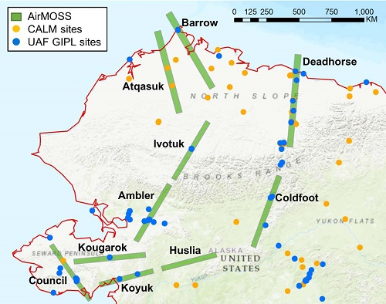
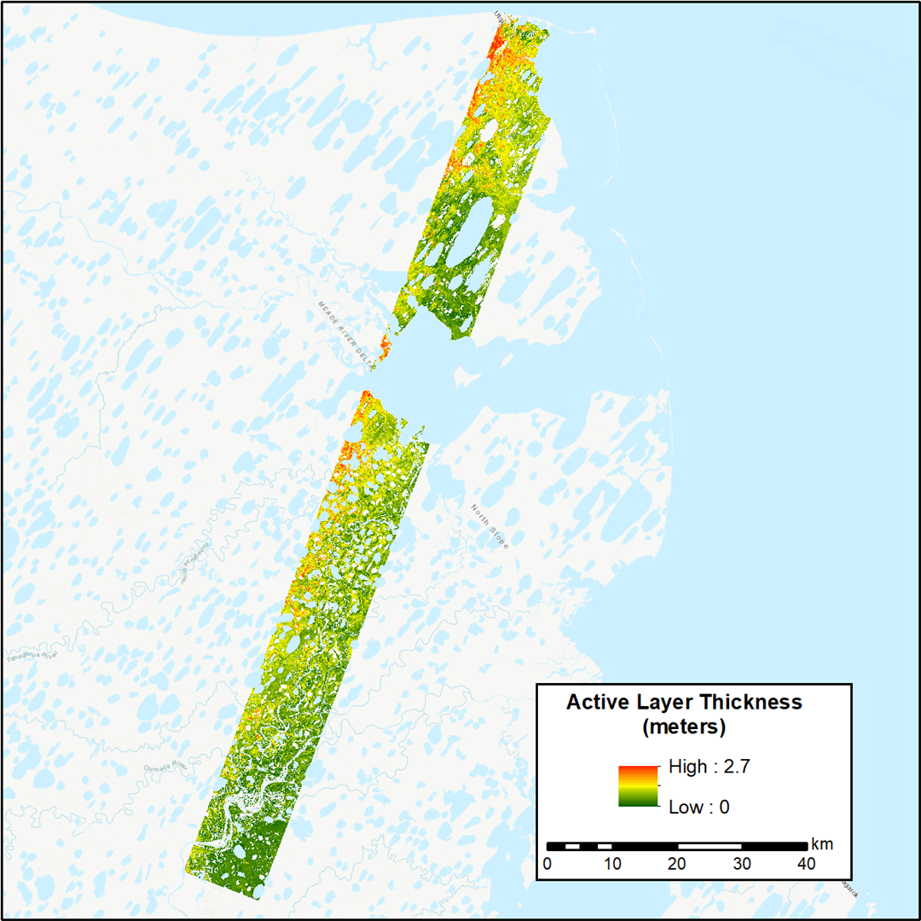
Active Layer Properties & Upscaling
Objectives:
Link field measurements, airborne SAR snapshots, continuous satellite observations, & other landscape geospatial data for upscaling active layer properties;
ID key drivers & controls affecting active layer trends;
Develop organizational protocols for optimal upscaling;
Recent accomplishments:
SAR informed Machine learning (RF) models developed for ALT upscaling;
30m ALT maps derived over Northern Alaska for 2014, 2015, 2017;
Sensitivity analysis of Multi-scale/freq. PolSAR (C/L/P-band) to surface, vegetation & active layer properties in Alaska tundra;
Publications:
Multi-freq. PolSAR assessment of Anaktuvuk tundra fire recovery (Yi et al. TGRS, In-review)
SAR and ML based ALT upscaling and validation (Whitcomb et al. In-prep.)
Notes:
ML upscaling activity primarily using airborne P-band SAR retrievals (obtained over 3-years; Aug and Oct)
Sensitivity analysis using C-/L-/P-band PolSAR data from airborne and satellite (Sentinel-1)

Slide 7
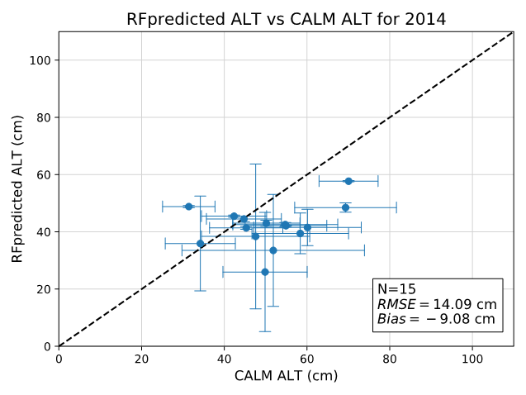
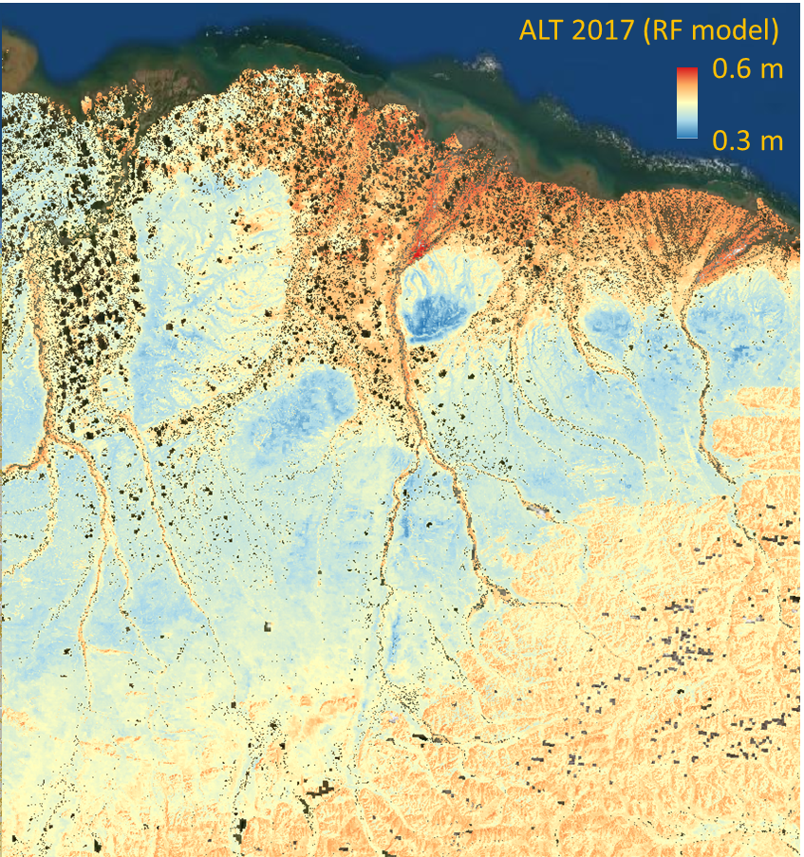
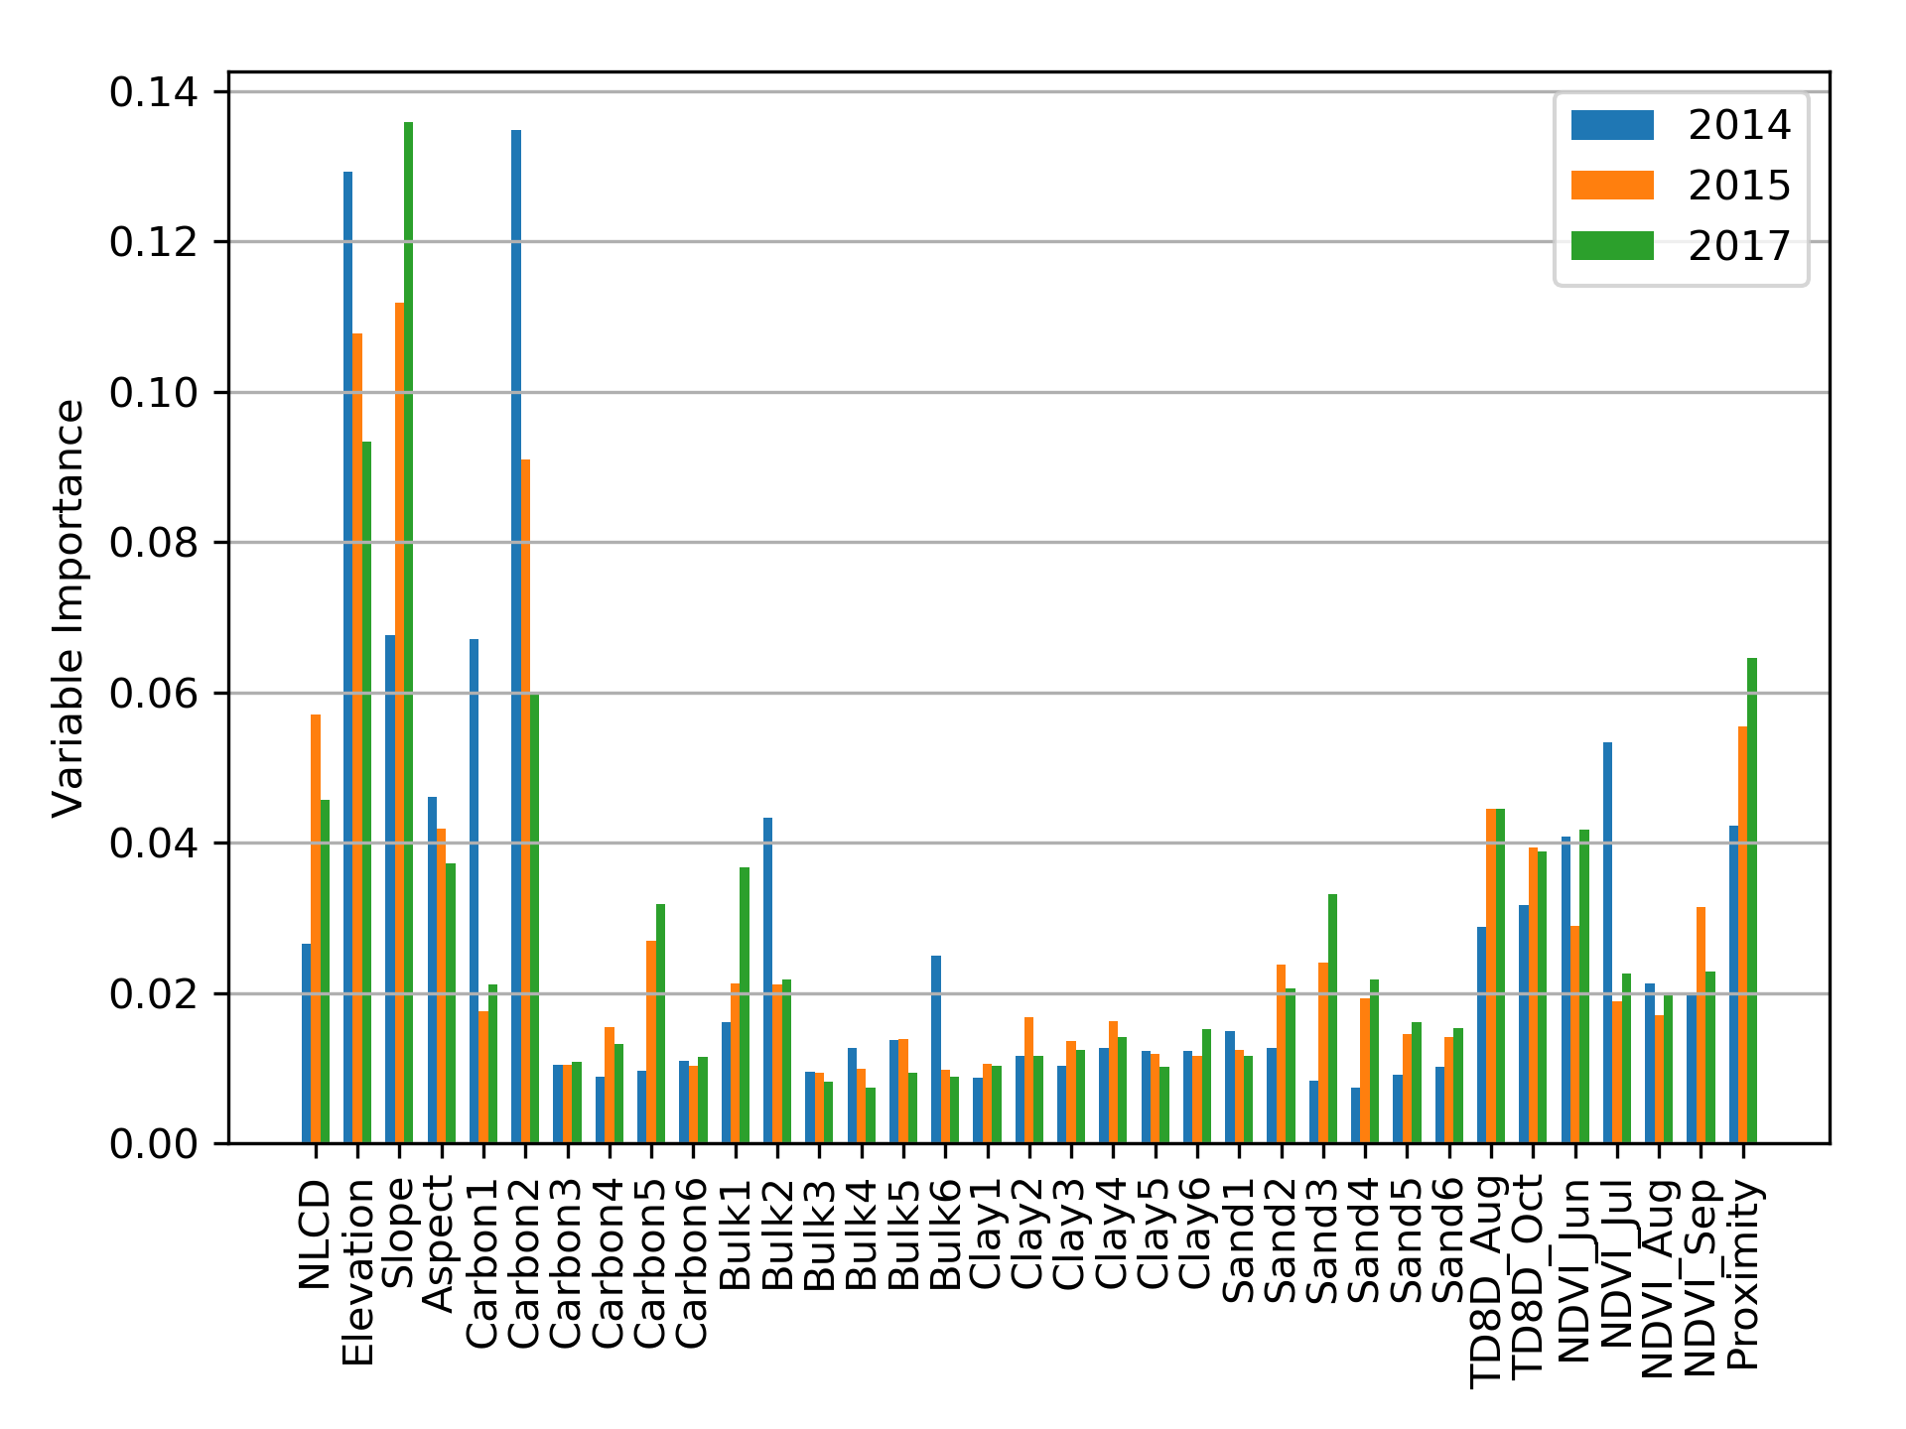
Active Layer Properties & Upscaling
Selected Findings:
Stable multi-year performance: RMSE range from 12-16cm (CALM) to 6-8cm (SAR validation);
Key RF predictors (35): Topography (elevation, slope), SOC (5-15cm), Land cover, TDD, NDVI (Jun-Jul), proximity to open water;
ALT sensitivity to ~70cm depth determined by airborne P-band SAR data used for model training.
Next steps:
Revisit SAR processing
PolSAR+InSAR joint retrievals
Expand model training & data libraries
Test other physical & ML model approaches
Notes:
Elevation influential for ALT at regional scale; whereas, proximity to water bodies and land cover are more important in explaining local scale ALT patterns
SAR processing includes P-band cross-talk removal to improve SNR;
Potential revisit of models to incorporate forest.
5m GeoSAR Alaska DTM
MODIS LST 1km TDD
MODIS 8-d 1km NDVI
SoilGrids SOC
No spatially consistent temporal trends across years

Slide 8
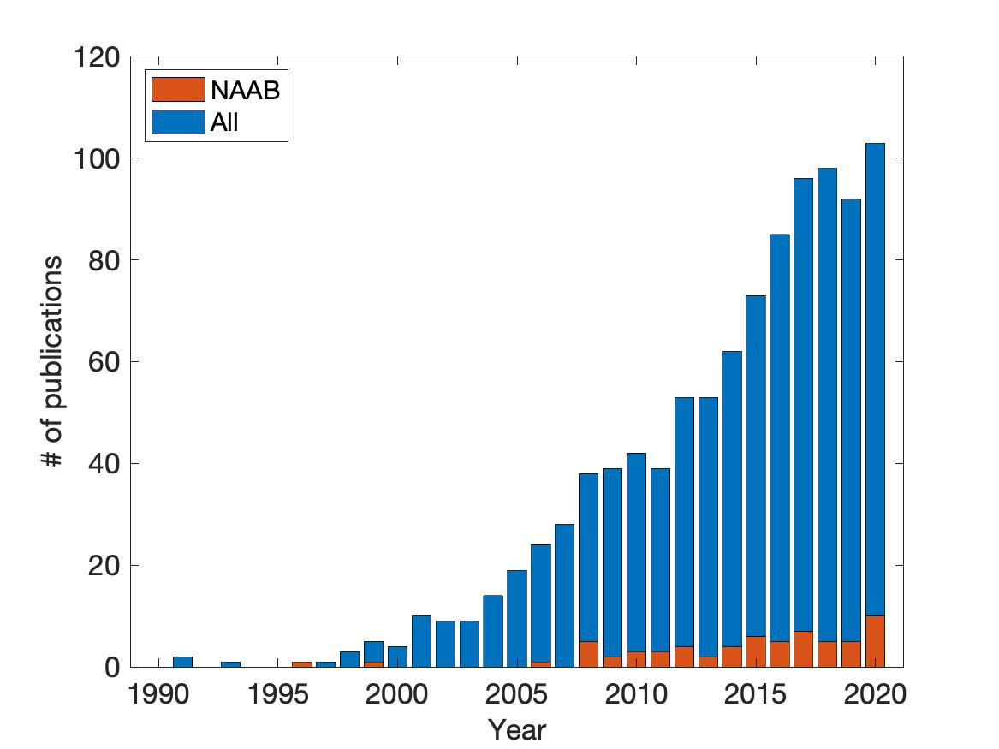
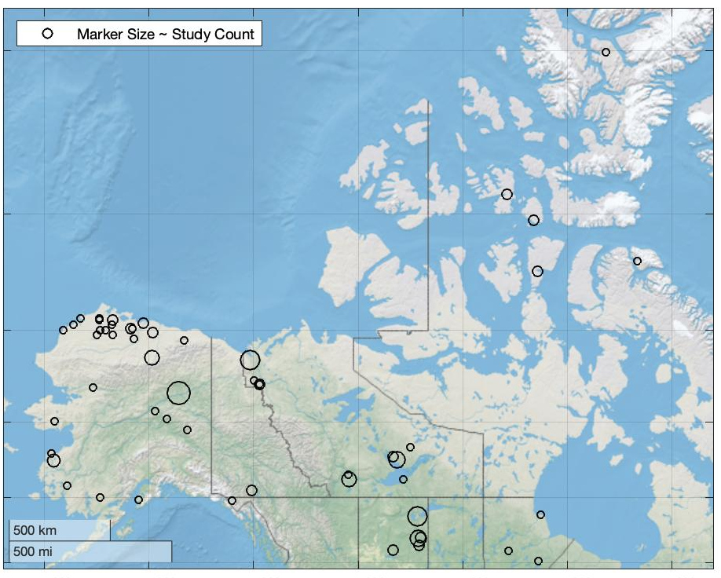
Review: Changing Hydrologic Connectivity in ABoVE domain
100
ABoVE Domain
Overall Lit
Team: Tamlin Pavelsky, John Mallard [leads], Laura Bourgeau-Chavez, David Butman, Wayana Dolan, Neal Pastick, Larry Smith, Michelle Walvoord, Kim Wickland
Objectives:
Synthesize literature findings to qualitatively describe hydrologic connectivity in the ABoVE domain and, where possible, how it is changing;
Identify opportunities for future study based on distributions of study location, scale, and sub-discipline;
Initial Findings:
A: Minimal increase in studies of hydrologic connectivity in the study area (orange) relative to overall literature (blue);
B: Studies focused in 1) non-mountainous regions and 2) at a few, heavily-studied areas (e.g., Yukon Flats, Peace-Athabasca Delta, etc);
Deliverable: Publication synthesizing these findings in prep for submission to ABoVE ERL special issue early to mid Summer.
# of studies published
50
0
1990
2000
2010
2020
Notes:
Minimal increase in regional studies of hydro connectivity relative to overall lit
Studies largely focused in a few areas; mountainous regions underrepresented

Slide 9
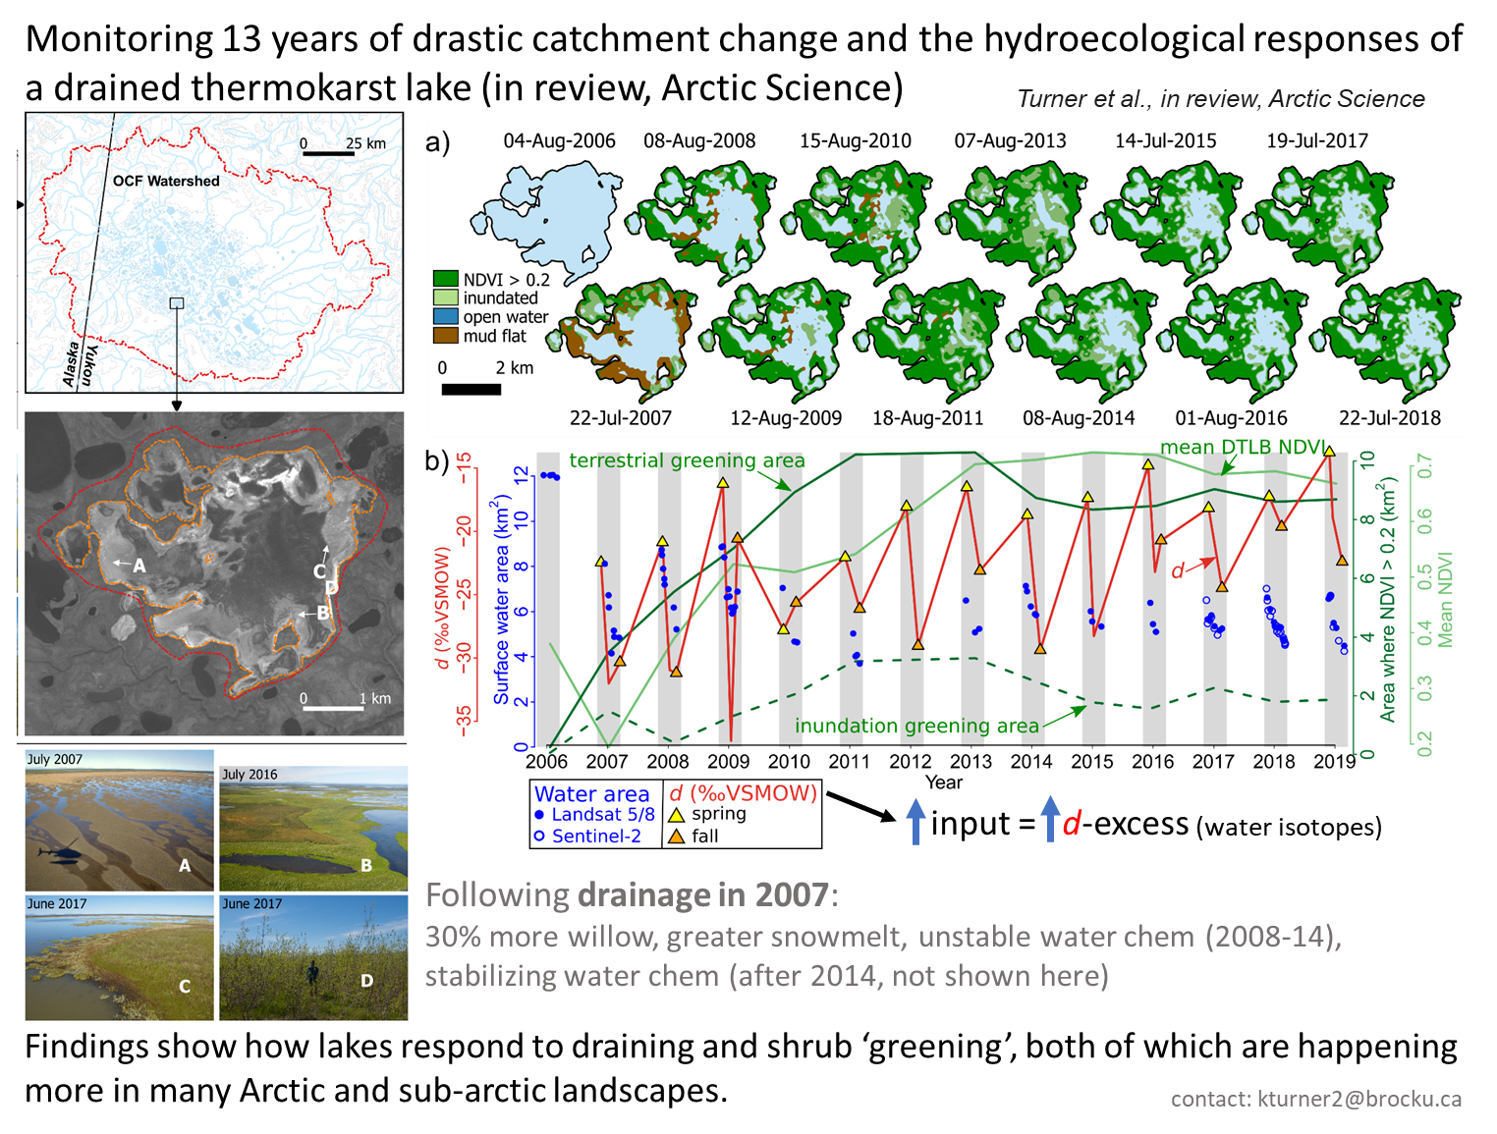
Notes:
Old Crow Flats watershed, Yukon (OCF)
Isotopic evidence of increasing water abundance and greater rainfall dominance in the watershed, which tends to promote PF thaw and associated lake hydrological changes.
Changing Hydrologic Connectivity
Old Crow Flats

Slide 10
Other recent WG publications:
Beaufort Lagoon Ecosystems LTER, Afshari, and Rawlins. 2020. Flow direction grid at 1 kilometer resolution for North Slope drainage basins, Alaska ver 1. Environmental Data Initiative. https://doi.org/10.6073/pasta/9cb127ebaaa85a2a79e4e3e72d71efe0.
Carpino, Haynes, Connon, Craig, Devoie, Quinton, 2021. Long-term climate-influenced land cover change in discontinuous permafrost peatland complexes. HESS.
Devoie, Dominico, Carpino, Connon, Craig, Rudy, Quinton. 2021. Patterns of discontinuous permafrost thaw in Peatlands. JGR.
Haynes, Smart, Carpino, Disher, Quinton, 2020. The role of hummocks in re-establishing black spruce forest following permafrost thaw. Ecohydrology. https://doi.org/10.1002/eco.2273 .
Jorgenson, Douglas, Liljedahl, Roth, Cater, Davis, Frost, Miller, Racine, 2020. The roles of climate extremes, ecological succession, and hydrology in repeated permafrost aggradation and degradation in fens on the Tanana Flats, Alaska. JGR Biogeosci. 125.
Jorgenson, M.T., and J.C. Jorgenson, 2021. Arctic Connections to Global Warming and Health. Climate Change and Global Public Health, Chapter 5, Pinker, K.E. and W.N. Rom (eds.), Springer Nature.
Iwahana, Busey, Saito. “Seasonal and Interannual Ground-Surface Displacement in Intact and Disturbed Tundra along the Dalton Highway on the North Slope, Alaska.” Land 10, no. 1 (January 2021): 22. https://doi.org/10.3390/land10010022.
Mekonnen, Riley, Berner, Bouskill, Torn, Iwahana, Breen, et al., 2021. Arctic Tundra Shrubification: A Review of Mechanisms and Impacts on Ecosystem Carbon Balance. ERL 16, 5, 053001. https://doi.org/10.1088/1748-9326/abf28b.
Rawlins M., Yang D., Ge S., 2021. Regional and Basin Streamflow Regimes and Changes: Climate Impact and Human Effect. In: Yang D., Kane D.L. (eds) Arctic Hydrology, Permafrost and Ecosystems. Springer, Cham. https://doi.org/10.1007/978-3-030-50930-9_6.

