Slide 1
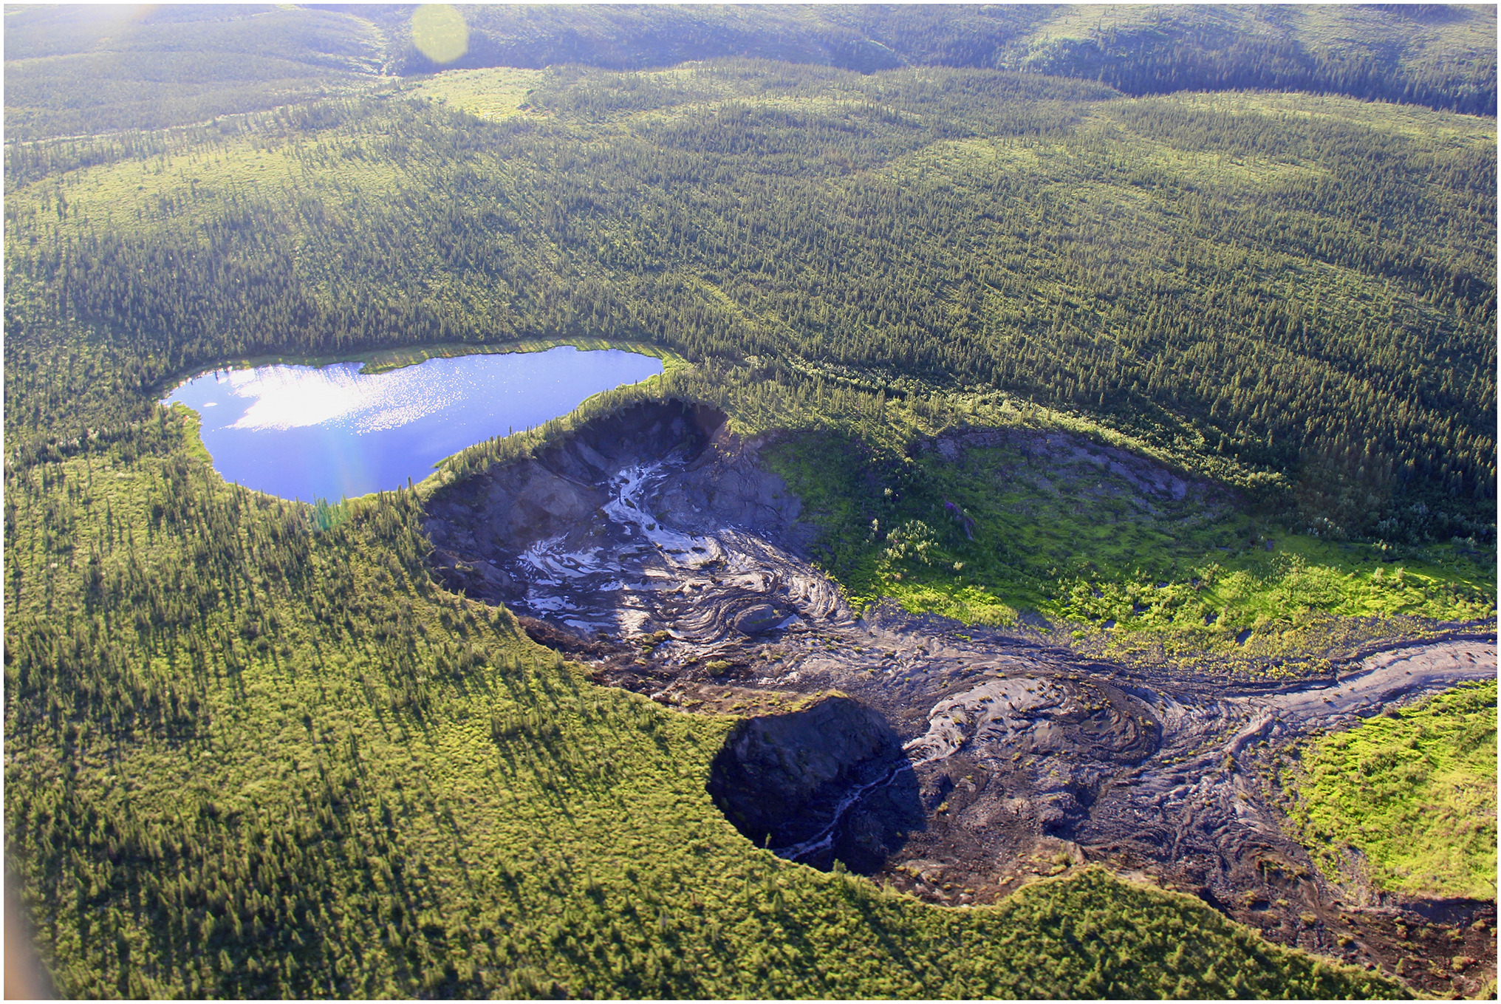
Hydrology & Permafrost Working Group Projects & Synthesis Updates
70+ members
John Kimball, David Butman (WG leads)
Photo credit: Scott Zolkos; In: Natalli et al. 2021. PNAS 118 (21)

Slide 2
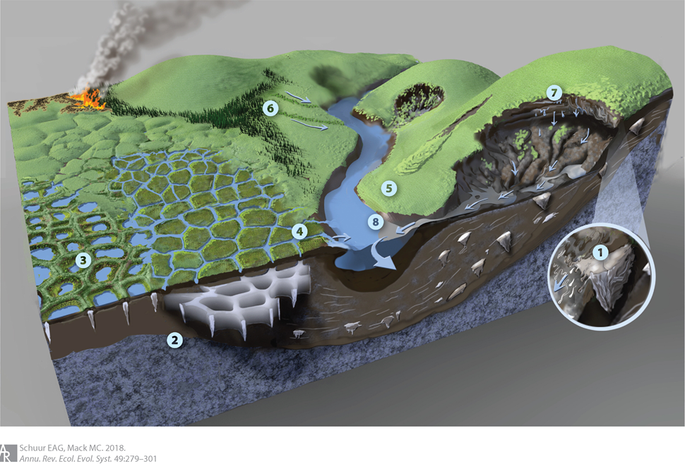
Activities address ABoVE Hydrology & Permafrost ¹objectives:
Processes controlling changes in PF distribution & properties, & their impacts.
Nature, causes & consequences of hydrologic changes, Incl. water storage, mobility & distribution.
Water/energy/carbon cycle & ecosystem linkages.
Crosscutting with other WGs, incl.:
Snowscapes, Disturbance, Modeling, Wetlands, & Carbon dynamics.
Permafrost thaw driven geomorphological and ecological changes
¹ABoVE Implementation Plan

Slide 3
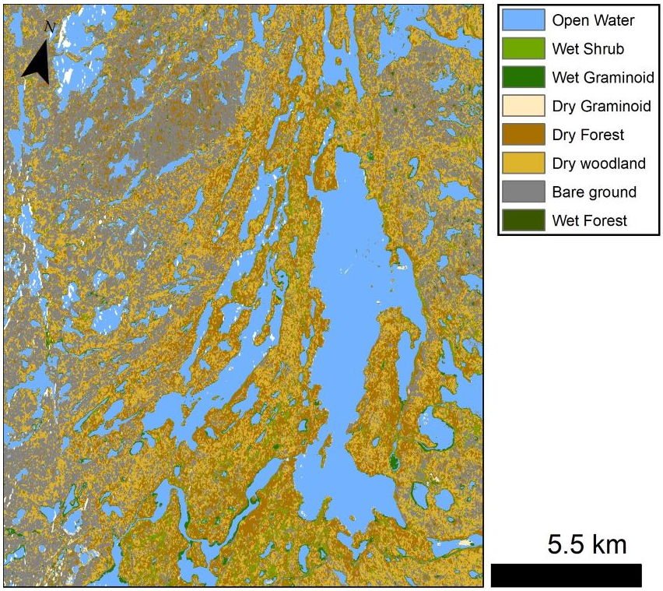
Recent WG accomplishments (2021-22):
~15 active projects, incl. both NASA and affiliated
~7 new geospatial datasets archived
>26 papers published
Kyzivat et al. 2021. L-band SAR Lake and wetland classification, 2017-1019.
(https://doi.org/10.3334/ORNLDAAC/1883)
https://www.nature.com/collections/ababhihdce
Collected thematic review articles on permafrost physical changes (6), biogeochemistry (13), ecosystems (9), and broader impacts (6).

Slide 4
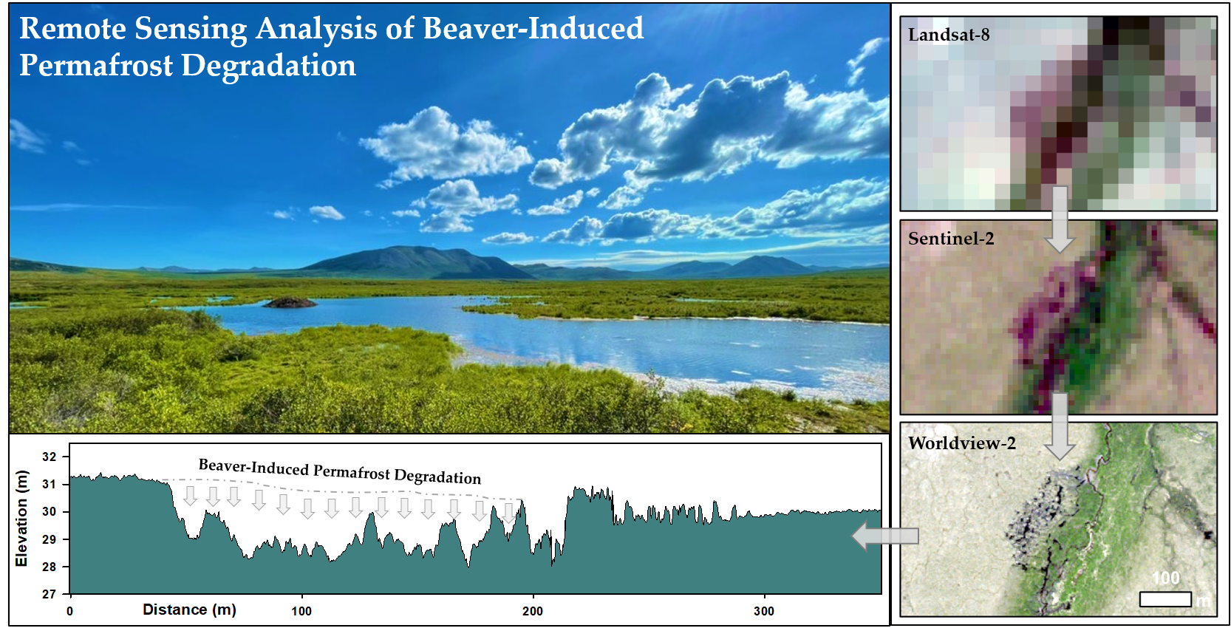
Advances in multi-dimensional remote sensing of permafrost related properties & processes
(30m)
ALT mapping using airborne Hyperspectral imaging (Zhang et al., 2021. Int. J. Appl. Earth Obs. Geoinfo. 102).
Detecting PF ground subsidence from satellite and airborne L-band InSAR (Xu et al. 2021. Earth and Space Science 8, 6).
Monitoring Postfire PF changes using Multi-freq. polarimetric SAR (Yi et al. 2021. IEEE TGRS 60).
(10m)
UAS micro-topography
(2m)
Brian Jones et al. 2021. Remote Sensing 13 (23), 4863

Slide 5
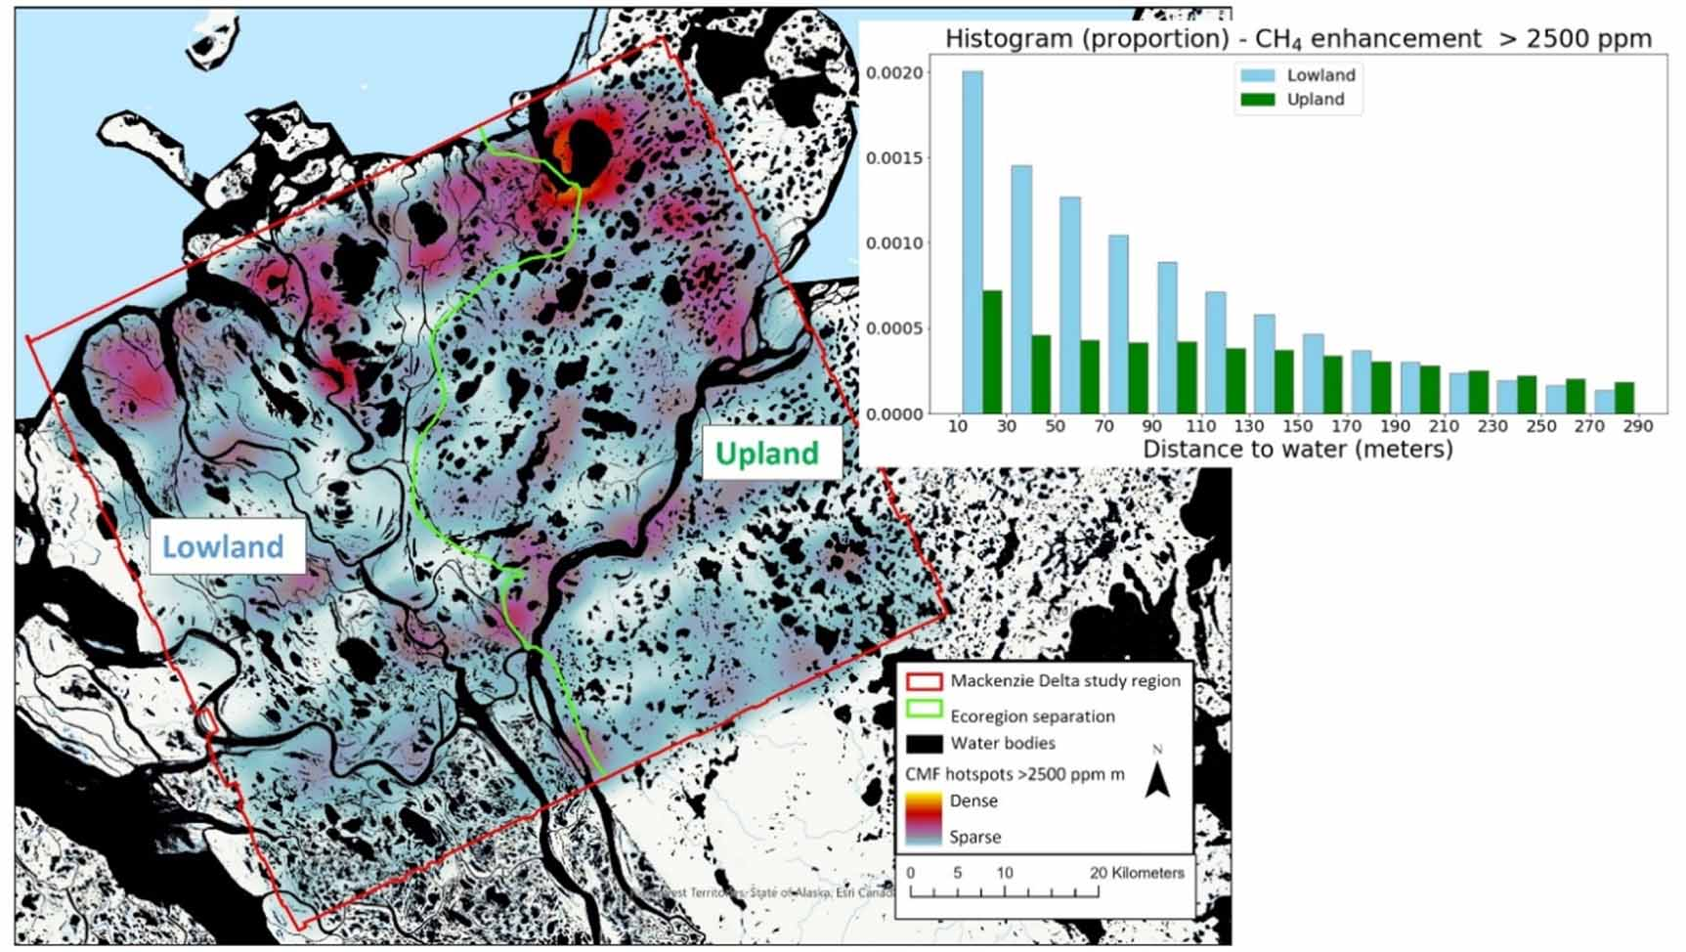
New understanding of permafrost hydrology impacts on ecosystems and C-fluxes through integrated multiscale observations and modeling
Geomorphological patterns of methane hotspots in the Mackenzie Delta informed by AVIRIS-NG airborne imaging spectroscopy.
Varying impact of snowmelt timing on tundra C-sequestration (Zona et al., 2022. Sci. Reports. 12, 1).
Linking methane emissions to actively thawing PF features (Elder et al., 2021. GBC 35, 12).
Mechanisms of PF thaw-induced LC change in peatlands (Carpino et al. 2021. Hydrol. Earth Syst. Sci. 25.
Latha Baskaran et al., 2022. ERL, 17, 1

Slide 6
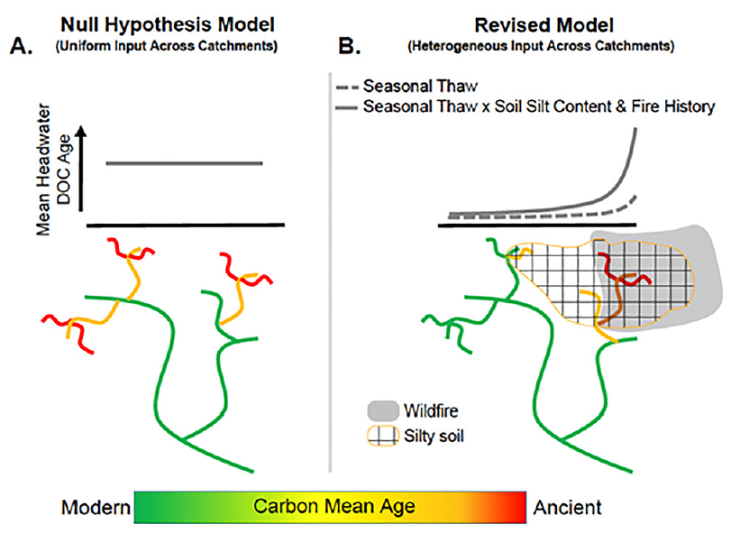
Better models and predictions of hydrologic and ecological processes in PF landscapes
Revised model of DOC loading to headwater streams in interior Alaska gained from cross-basin surveys
Resolving complex patterns and drivers of aged organic carbon export in discontinuous permafrost headwaters (Koch et al., 2022. GBC 36, 4).
Modeling Arctic basin flows and riverine nutrient loading to coastal estuaries (Rawlins, 2021. ERL, 16, 10).
Improved characterizations of tundra soil moisture and organic matter profiles (Bakian-Dogaheh et al., 2022. ERL, 17, 2).
Mechanisms of discontinuous permafrost thaw in peatlands (Devoie et al. 2021., JGR Earth Surface 126, 11).
Joshua Koch et al., 2022. GBC, 36, 4

Slide 7
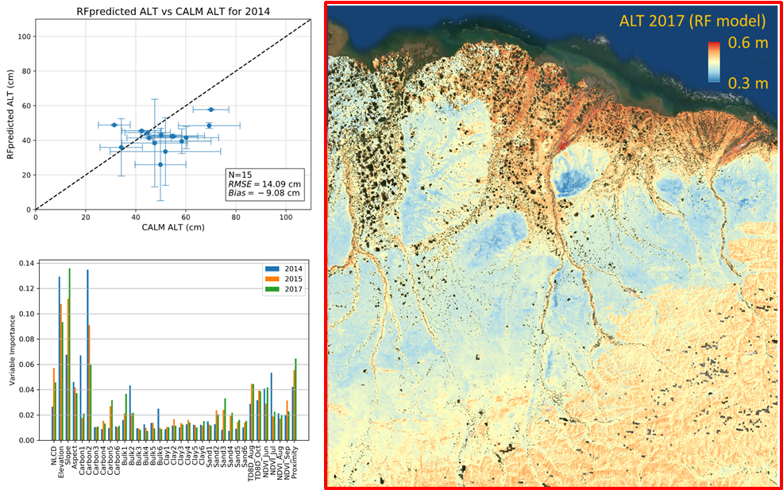
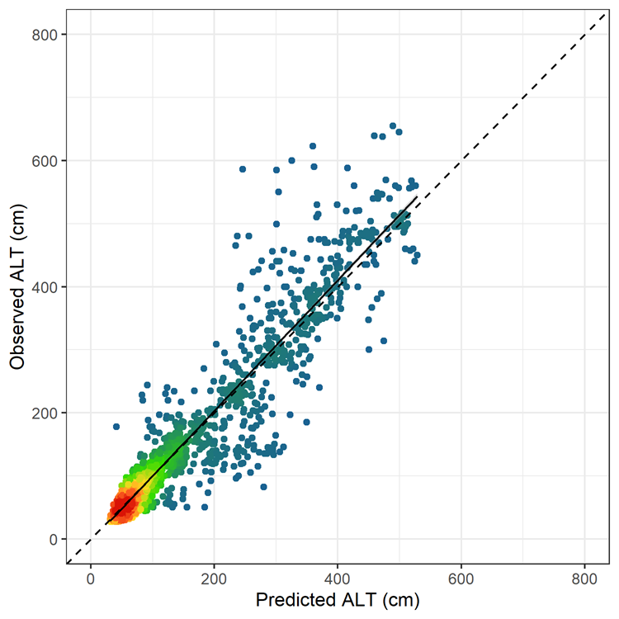
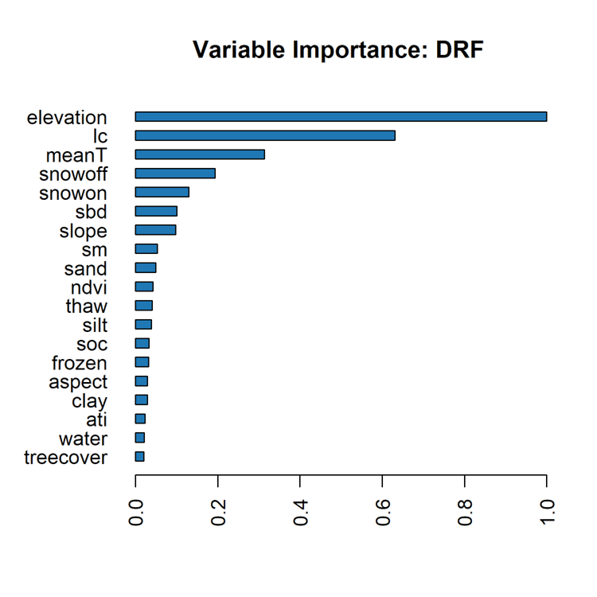
Progress on Subgroup Synthesis Activities
Active Layer Properties & Upscaling
(co-leads: Moghaddam, Kimball)
Objective: Clarify local & regional ALT patterns & key predictors; develop efficient methods for extrapolating sparse observations.
Dual Approach: 1) Northern Alaska (30m) RF extrapolations trained from P-band airborne SAR ALT retrievals (2014/15/17); 2) Pan-Arctic (1km) RF mapping trained from in situ ALT measurements (2003-2020).
Selected Findings: Relative influence of ALT predictors varies with spatial scale, but shows regional & annual consistency; Greater confidence in ALT spatial patterns than temporal trends.
Deliverables: New geospatial ALT datasets & accompanying journal publications (Whitcomb et al. & Liu et al., In prep.).
R²=0.97
RMSE=21.5 cm
Bias = 0.07 cm
ALT mean (cm; 2003-2020)

Slide 8
Looking ahead…
Phase II wrap-up (projects, data deliveries, synthesis activities) & transition to Phase III (~Fall-22)
New ERL focus issue on Permafrost Vulnerability to Climate Change (Jan-23 submission deadline)
Incl. review on Fire-Permafrost Interactions in Northwest Boreal Ecosystems (T. Jorgenson, lead)
New satellites coming online with strong ABR focus:
SWOT (~Nov-22): Surface water storage and discharge dynamics
NISAR (~Jan-23): permafrost, wetlands, biomass structure
Upcoming campaigns: ABoVE airborne (summer-22); SnowEx (Fall-22, Spring-23); SMAPVEX (Summer-22)
New cross-cutting collaborative initiatives:
Permafrost Pathways: Adaptation & mitigation strategies addressing PF thaw
Q-ARCTIC: Clarify PF feedbacks with climate change

