Slide 1
Integrating Boots-on-the-Ground Observations with the Virtual World of Models to Answer Big Science Questions Across the Arctic
Colleen Iversen On Behalf of the NGEE Arctic Team
NASA ABoVE Annual Science Team Meeting 22 May 2024

Slide 2
Acknowledgements
NGEE Arctic is supported by the Biological and Environmental Research Program in the Department of Energy’s Office of Science.
We thank our partners from the Native Communities in Alaska for allowing us to conduct our research on the traditional homelands of the Iñupiat, including the UIC Science, Mary’s Igloo, Council, Sitnasuak, and Bering Straits Native Corporations.
We also thank our Science Advisory Board as well as colleagues in Utqiaġvik and Nome, Alaska, for their insights and support.
NGEE Arctic is underscored by a foundation of open science and data sharing and a safe, inclusive project culture.

Slide 3
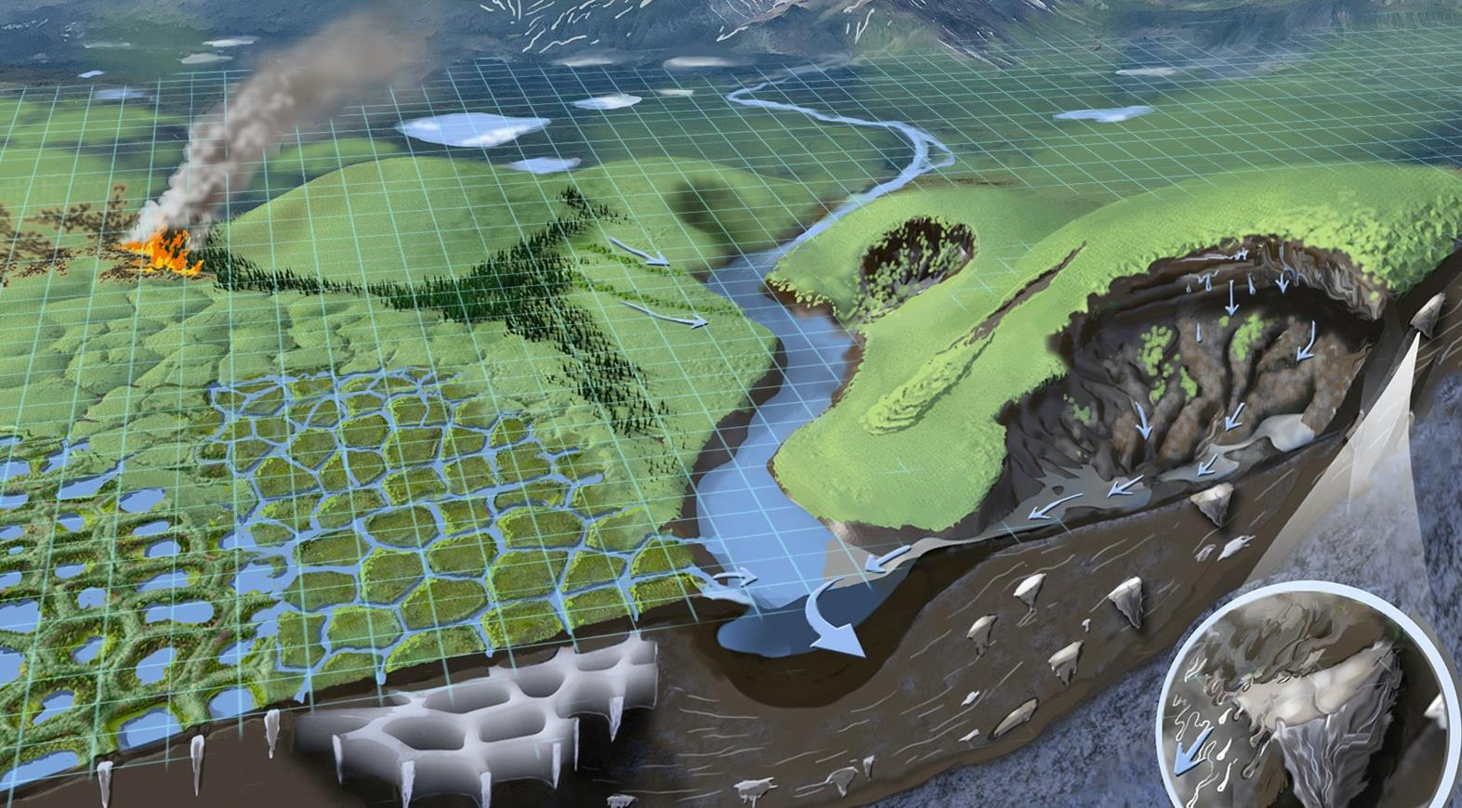
(Illustration by Victor Leshyk, ECOSS)

Slide 4
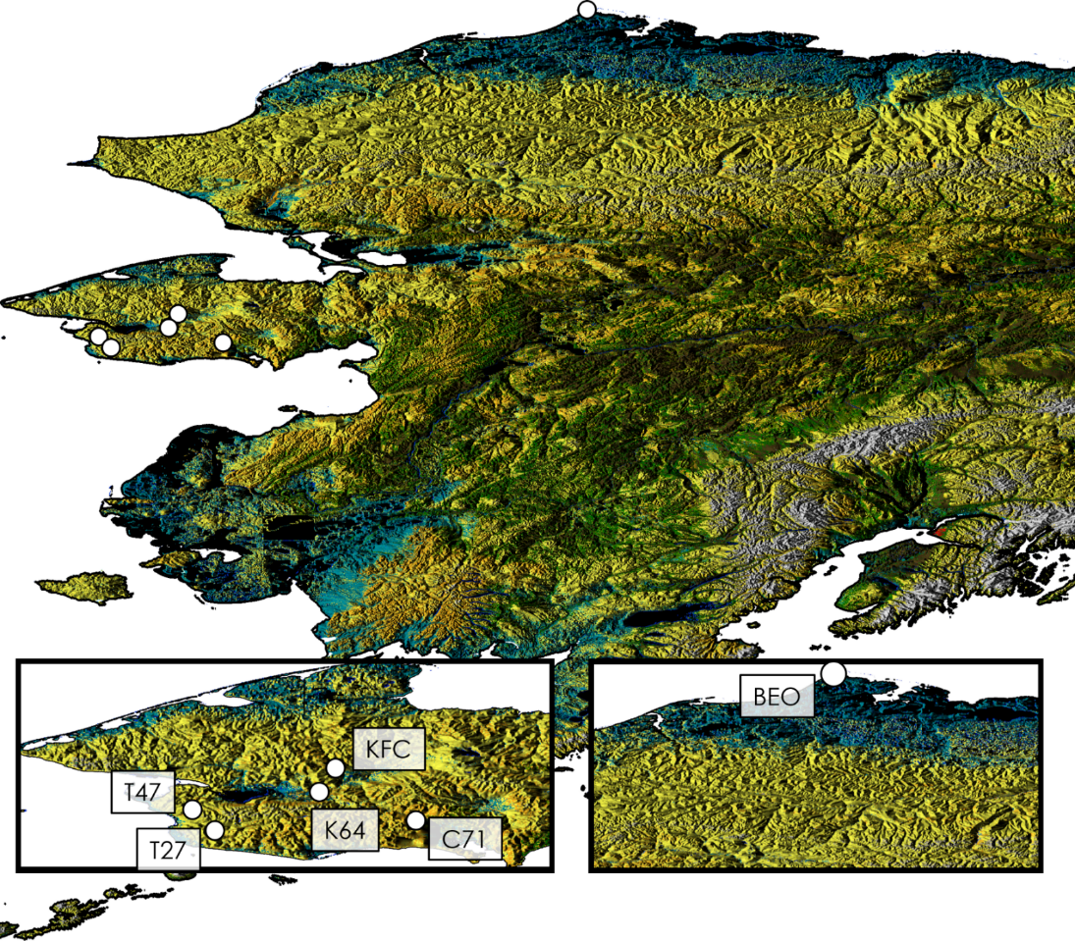
NGEE Arctic is a model-driven, multi-scale research project that leverages a decade-long foundation of model–data integration in arctic Alaska to understand and predict climate– ecosystem feedbacks across the Arctic.

Slide 5
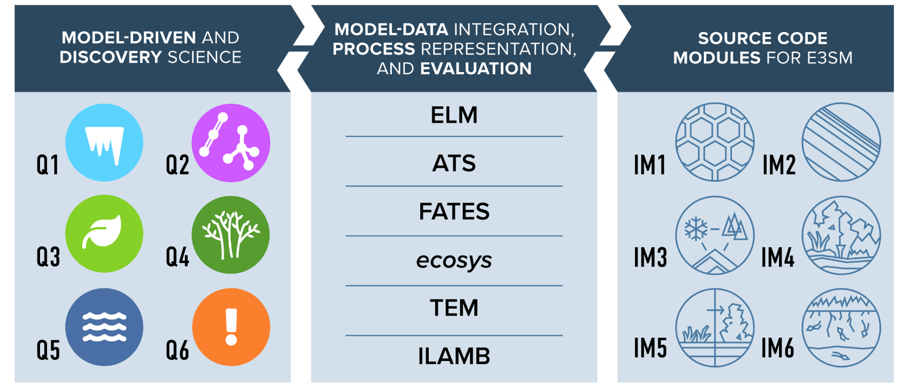
We Emphasize Collaboration Across Disciplines
Data archived at Environmental System Science Data Infrastructure for a Virtual Ecosystem (ESS-DIVE*)
*E3SM is the Department of Energy’s Energy Exascale Earth System Model; ELM is the land model.
*ESS-DIVE is a freely accessible online platform for data sharing funded by DOE.

Slide 6
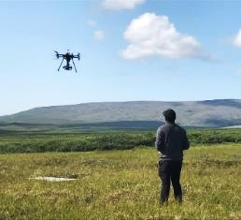
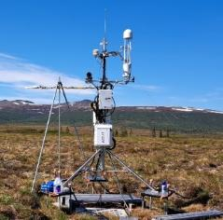
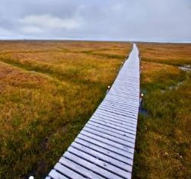
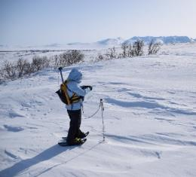
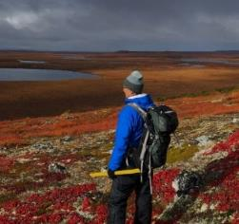
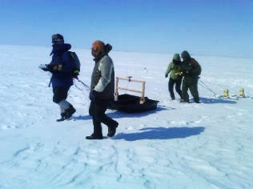
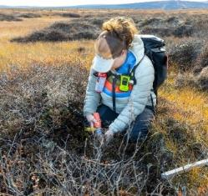
We Gratefully Conduct Science on Native Lands
Yang et al. 2023 (RSE)

Slide 7
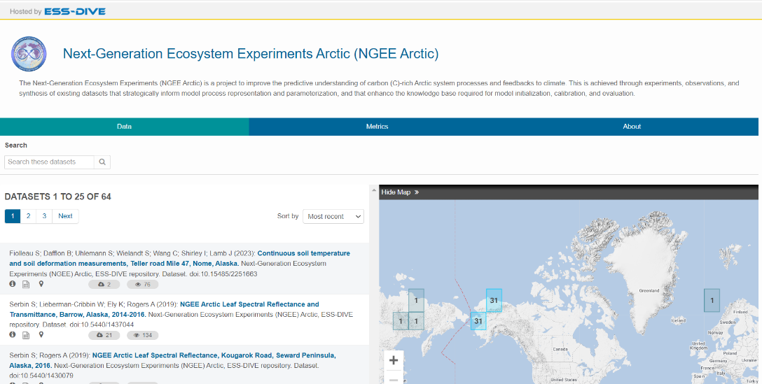
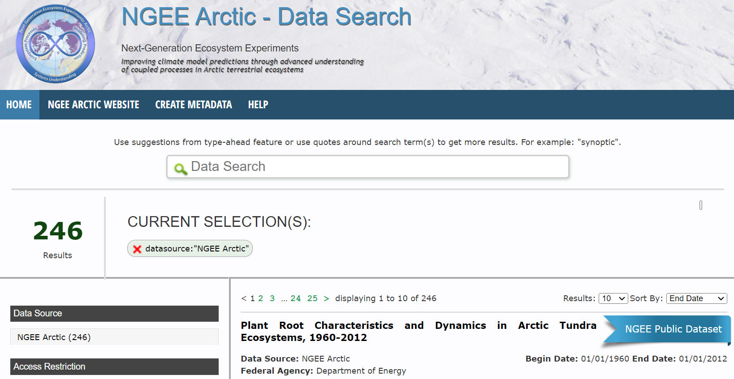
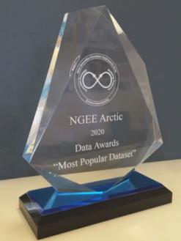
Data are Openly Shared and Publicly Available

Slide 8
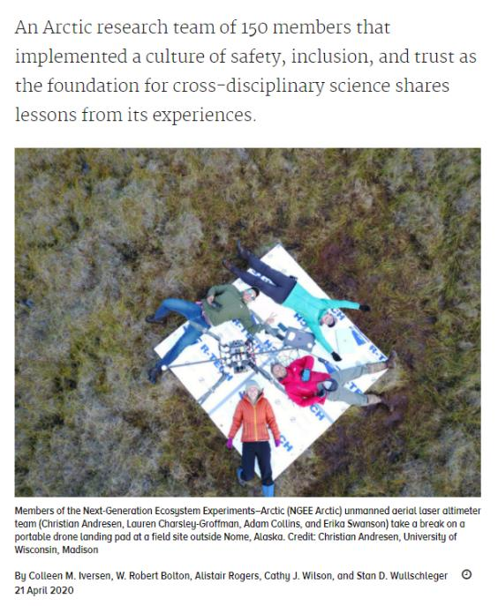
We Build a Culture of Safety, Trust in Team Science
As scientists become part of larger teams and join broader and more diverse scientific endeavors, they must all become leaders in creating cultures of safety, inclusion, and trust.
Iversen et al. 2020 (Eos)

Slide 9
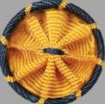
NGEE Arctic: By the Numbers
⁵ ^{institutions}
¹⁵⁰⁺ ^{people}
^{Community} ^{engagement}
³⁰⁰⁺ ^{publications}
²⁴⁰⁺ ^{datasets}
¹⁴⁰⁰
^{Unique data users}
⁸⁰⁺
^{Scientists to field}
^{Team Member awards}

Slide 10
NGEE Arctic Phases 1−4
Phase 1 (2012−2014): Modeling approach driven by the failure of current models to capture tundra processes.
Phase 2 (2015−2018): Multiscale modeling approach informed hypotheses about model priorities.
Phase 3 (2019−2024): Observations and model scaling inform integrated model modules in DOE’s E3SM land model.
Phase 4 (2025−2027): Models trained on observations from arctic Alaska will be evaluated against current observations and projected climate changes from across the Arctic.

Slide 11
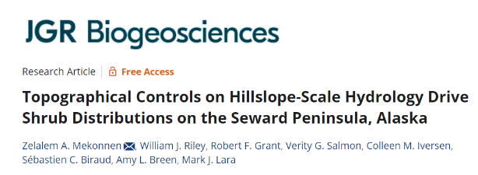
Discovery Science Improves Model Predictions

Slide 12
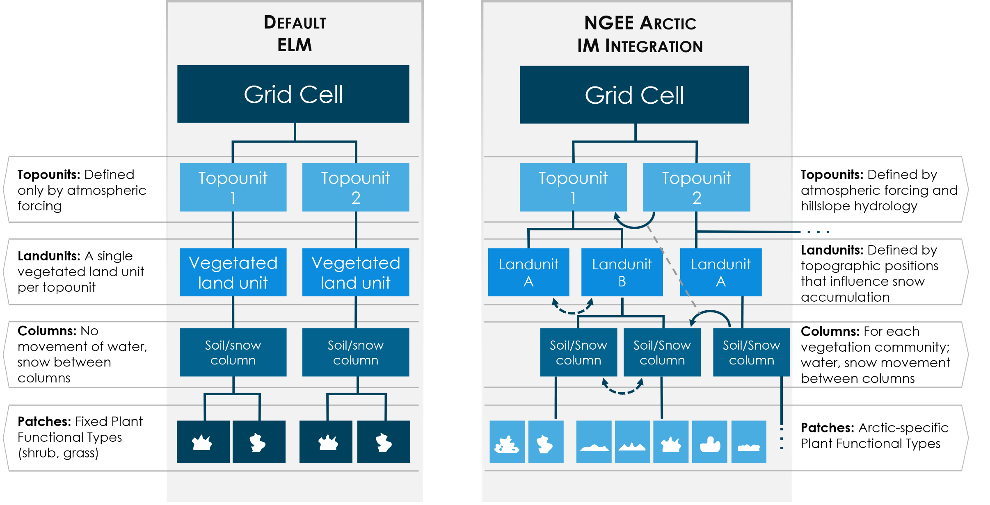
Phase 3: We Will Deliver an Arctic-Informed ELM

Slide 13
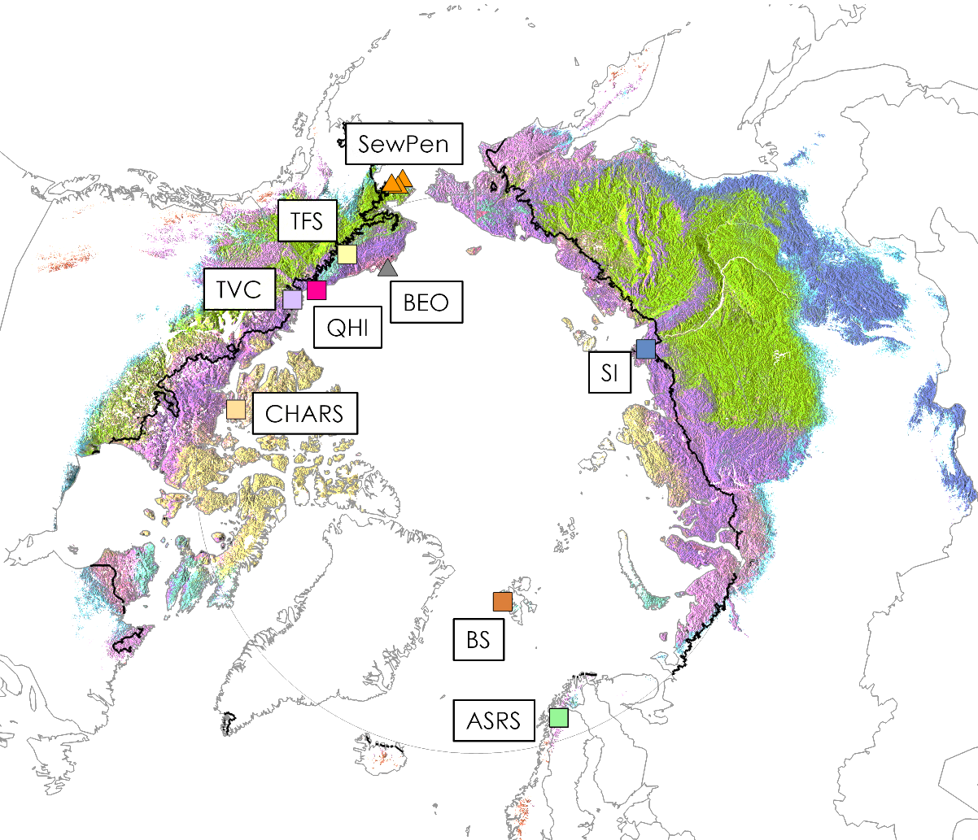
Does Our Arctic-Informed Model Accurately Predict Climate Feedbacks Across the Arctic?

Slide 14
Phase 4: Overarching Science Question:
What are the climate–ecosystem feedbacks from interacting processes across a rapidly warming Arctic?

Slide 15
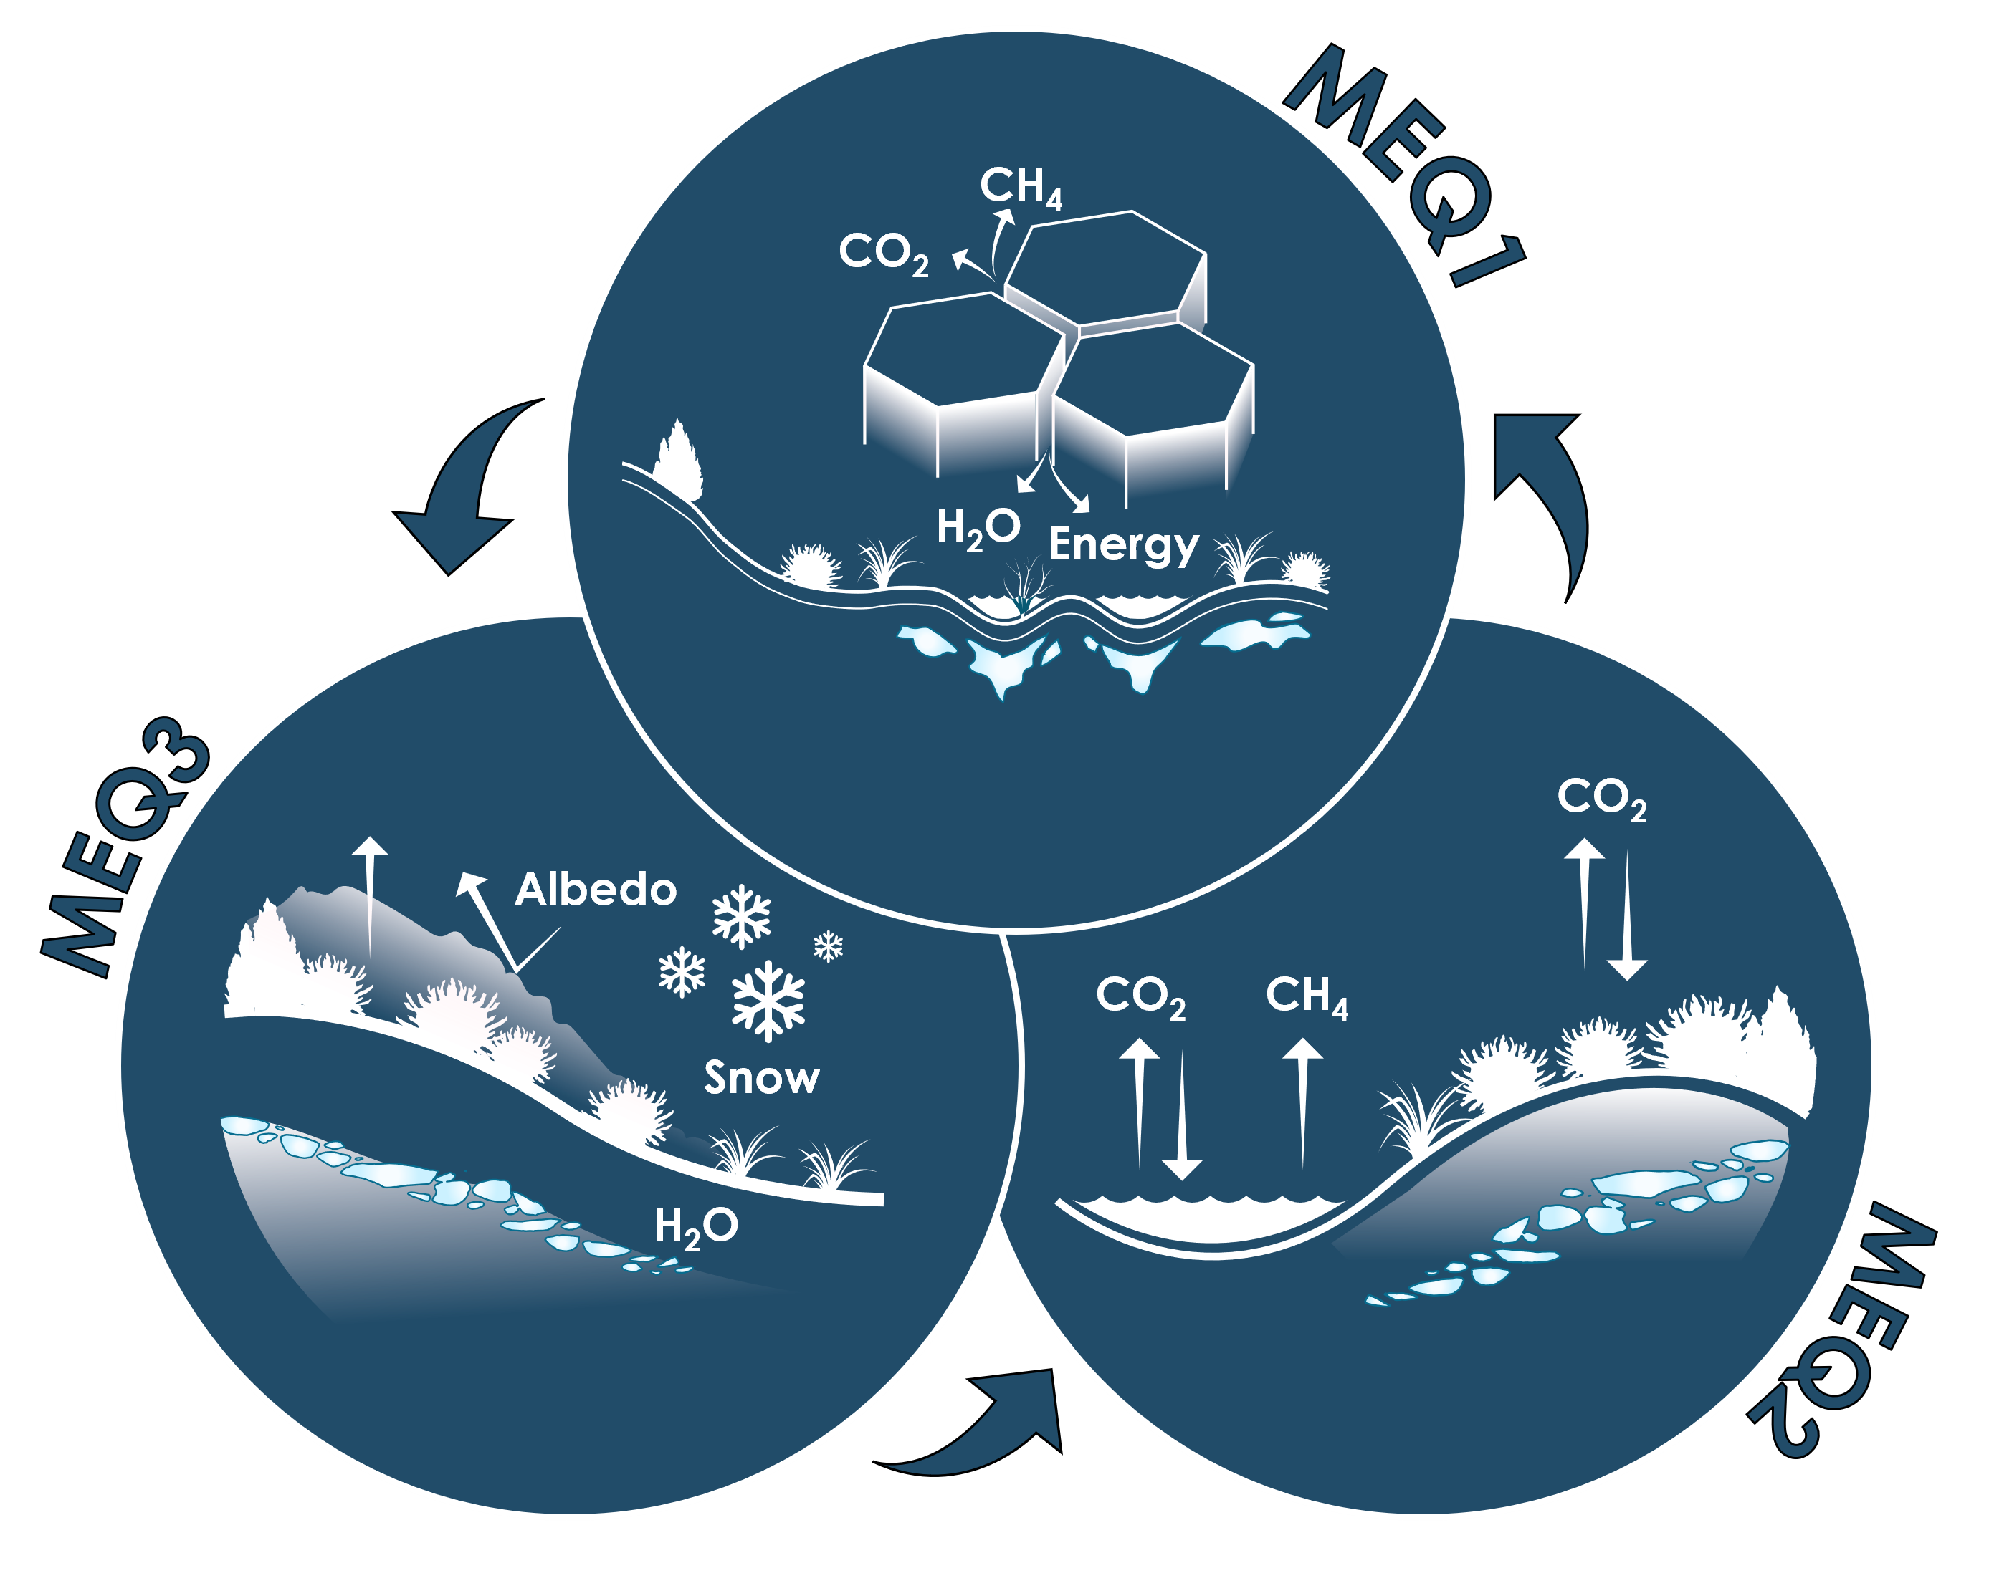
MEQs Evaluate and Inform Model Understanding

Slide 16
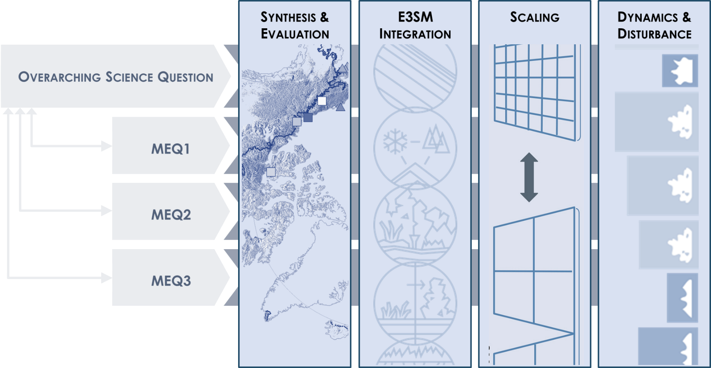
Crosscutting Science Activities Extend & Evaluate

Slide 17
Understand Global Implications of Dynamic Arctic

Slide 18
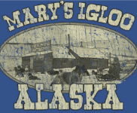
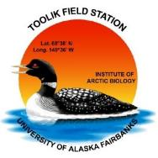
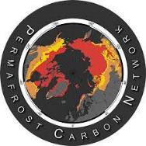
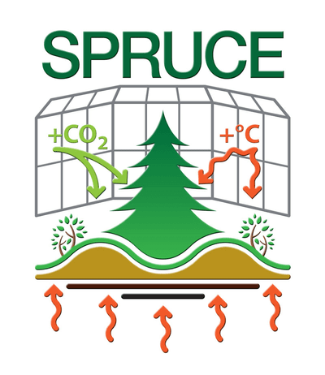
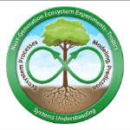
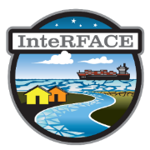
Collaborative Partnerships Across Institutions, Across the Arctic, Across Sibling Programs at DOE
Mary’s Igloo Native Corporation Council Native Corporation

Slide 19
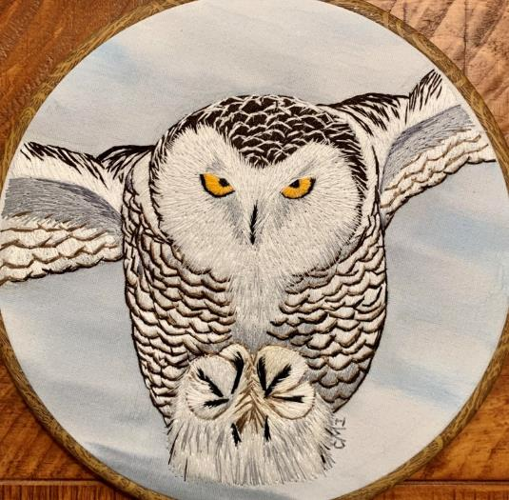
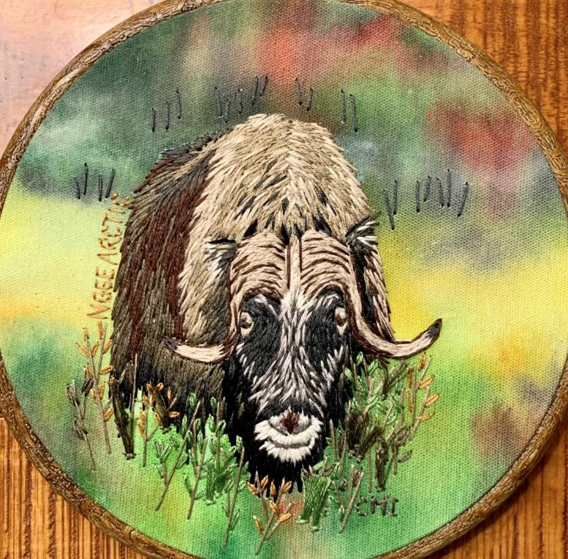
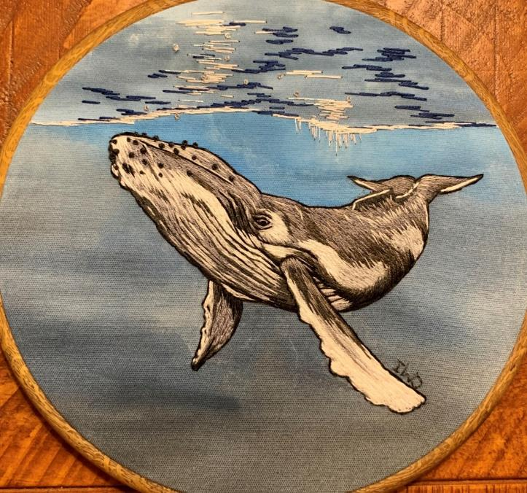
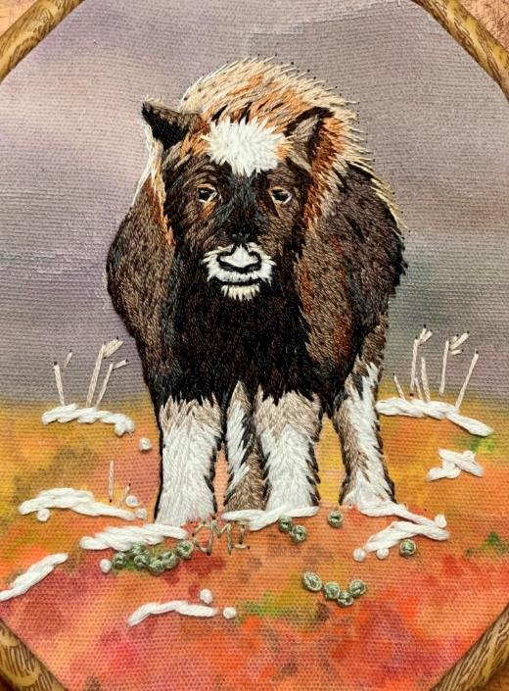
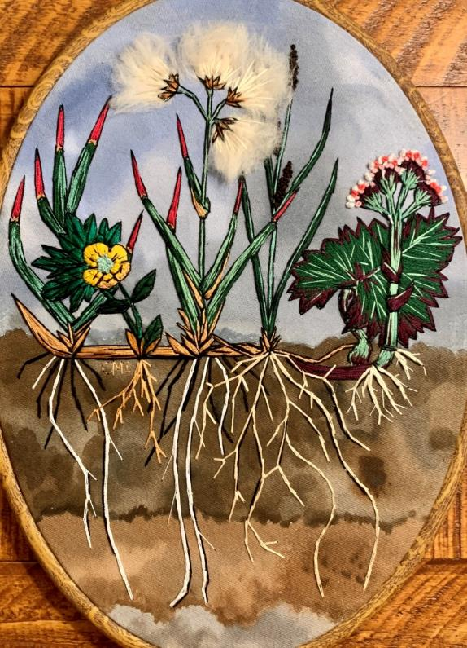
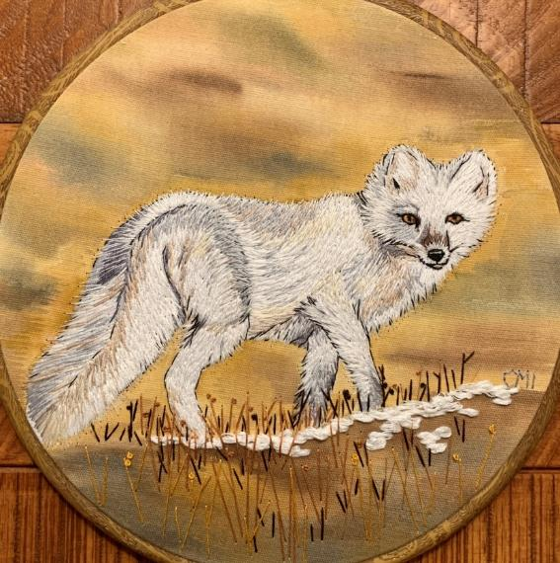
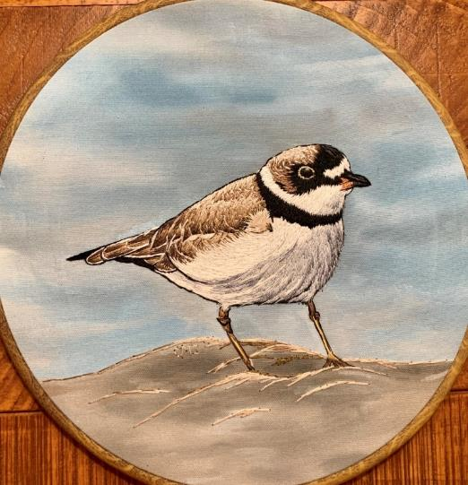
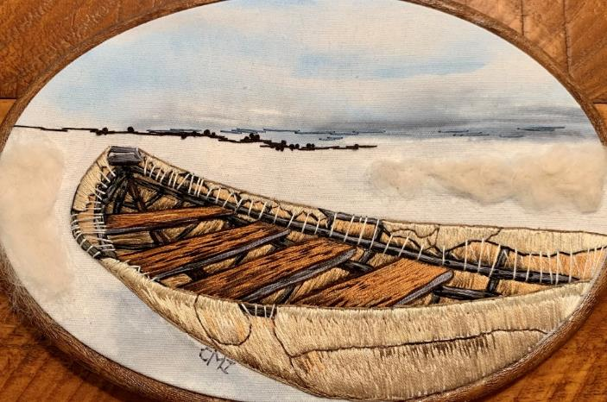
We are grateful for the time that we’ve had on the tundra and in arctic communities.

Slide 20
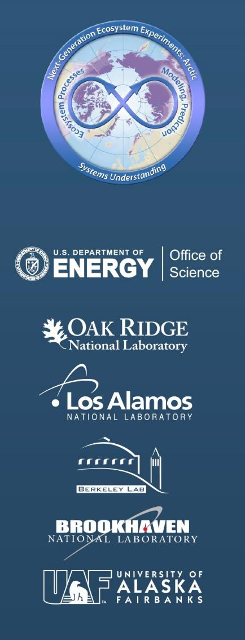
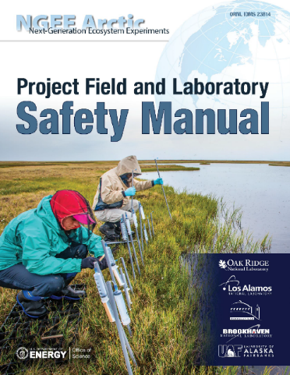
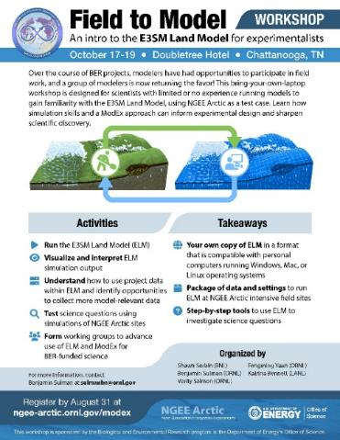
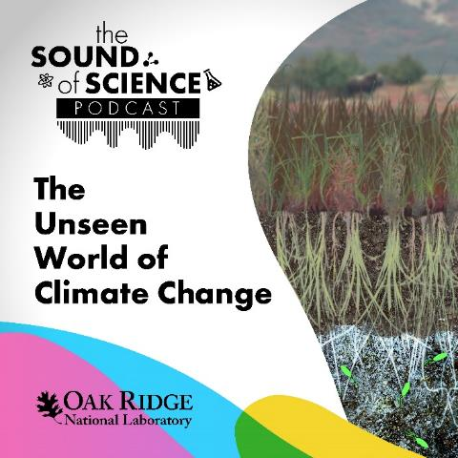
Find Out More About NGEE Arctic
Websites: ngee-arctic.ornl.gov + ess.science.energy.gov/ngee-arctic
Podcast: The Unseen World of Climate Change (Sound of Science)
extedned
extedned

