Slide 1
The cross-disciplinary, team science of NGEE Arctic
Colleen Iversen, Sue Heinz, Stan Wullschleger
(Oak Ridge National Laboratory)
~150 colleagues and collaborators
across the NGEE Arctic team
25 January 2023
(9th Annual ABoVE Science Team Meeting)

Slide 2
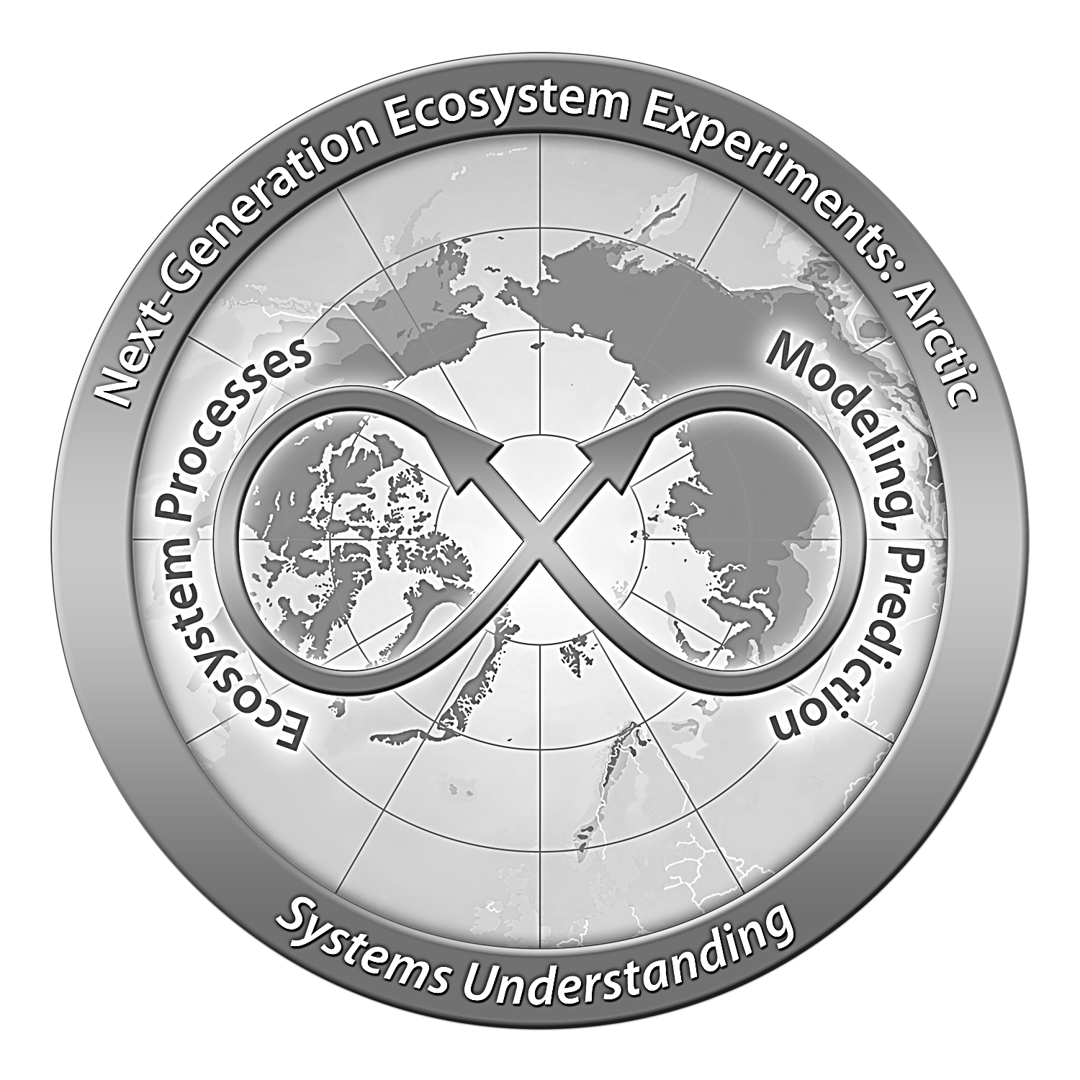
The overarching goal of NGEE Arctic project is to advance our understanding of the rapidly changing terrestrial Arctic by combining boots-on-the ground observations with the predictive power of Earth System Models.
Phase 1
2012 - 2014
Phase 2
2015 - 2019
Phase 3
2020 - 2024
Phase 4
2025 - 2027

Slide 3
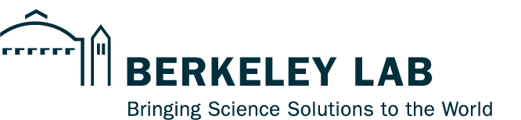




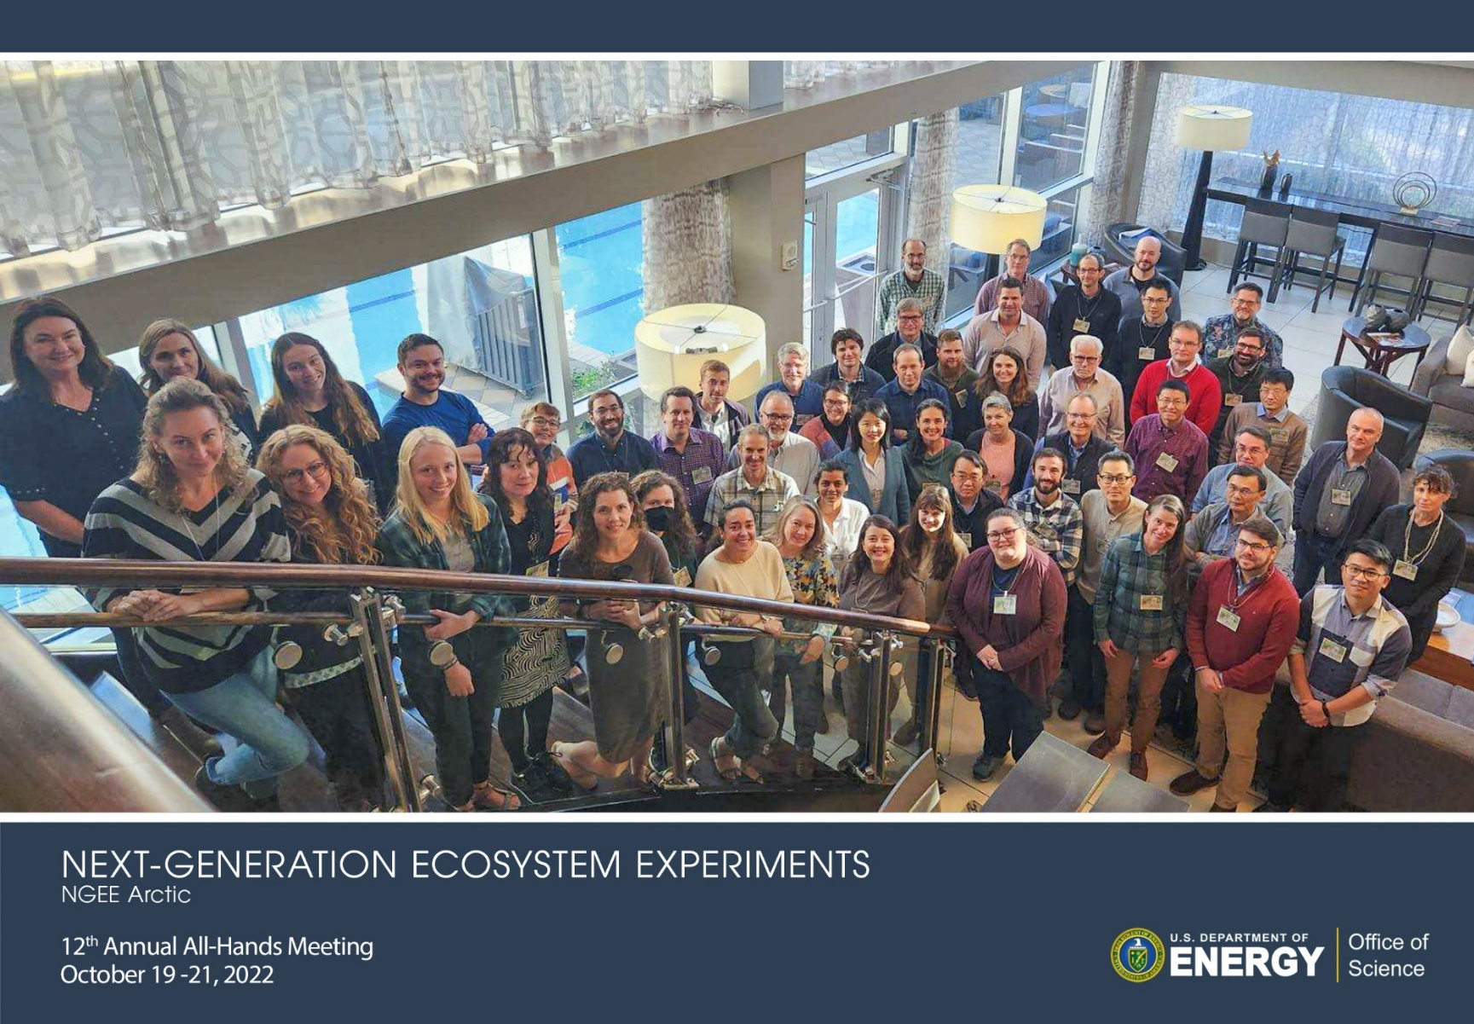
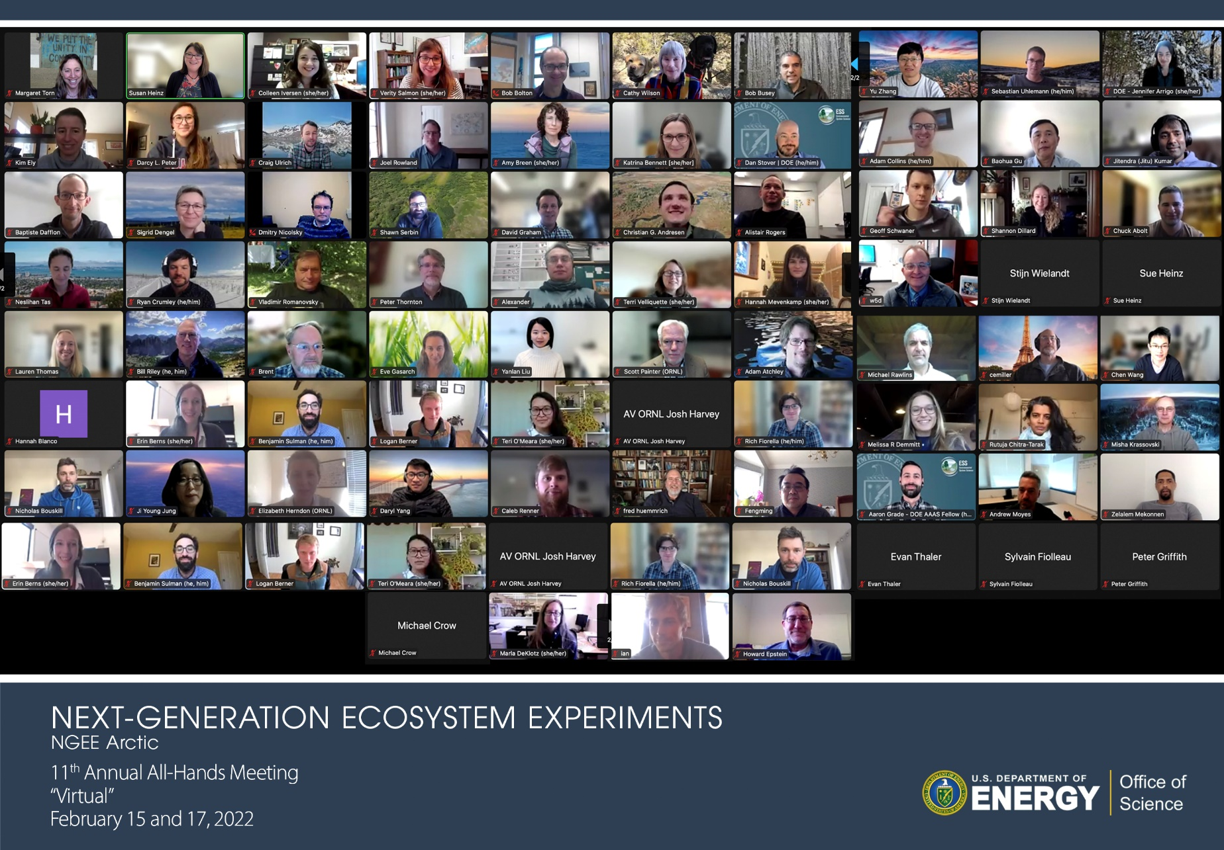


Slide 4
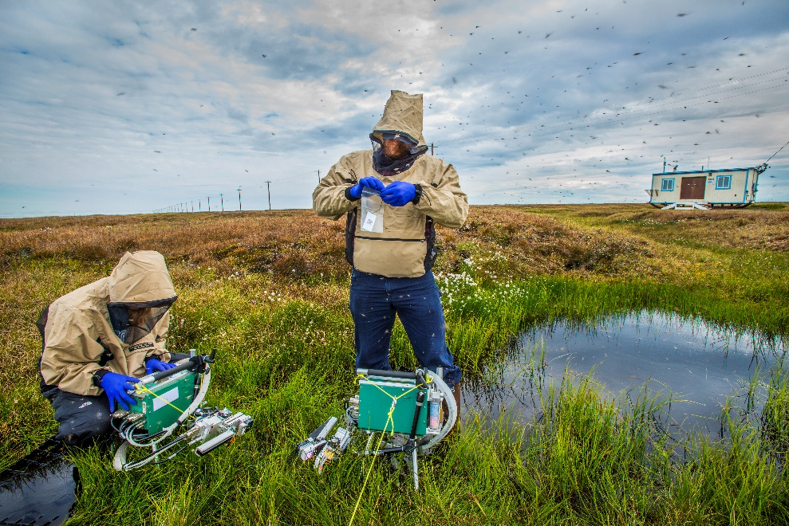
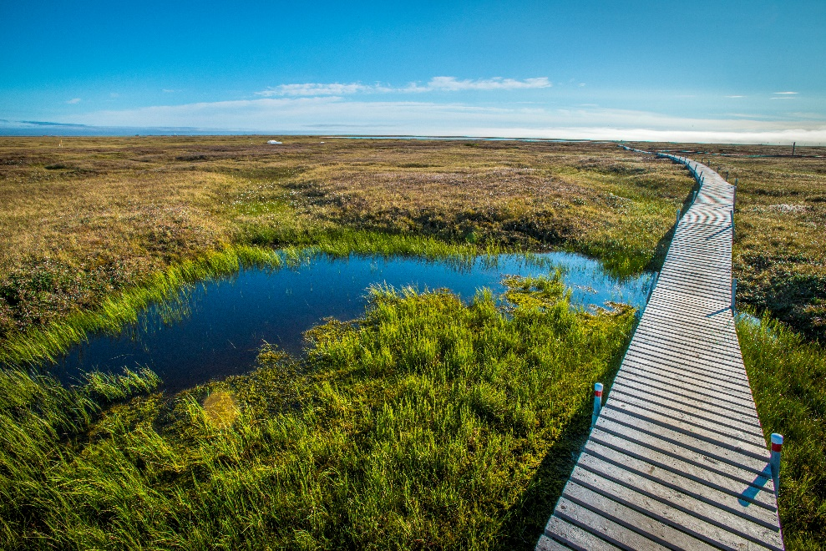
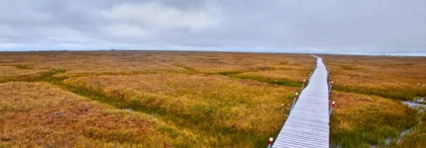
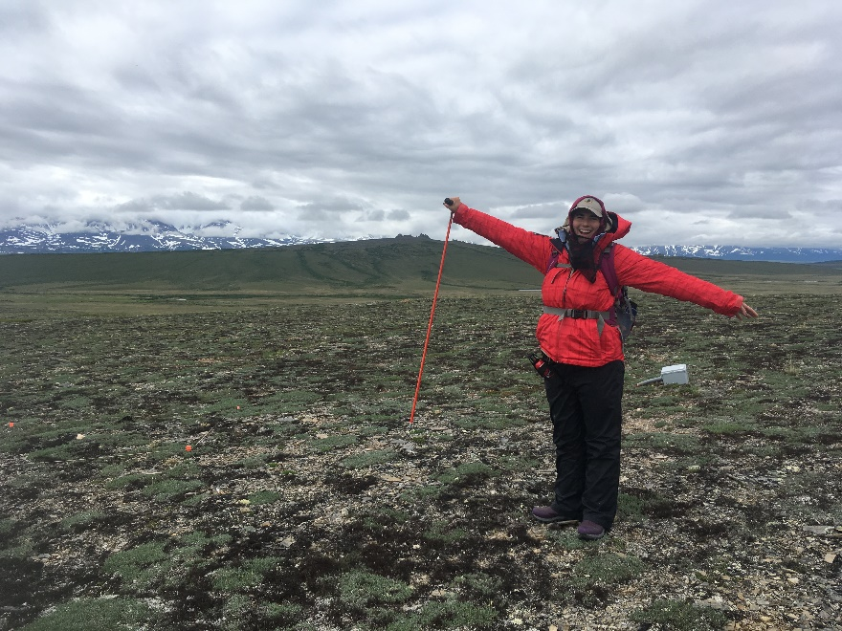
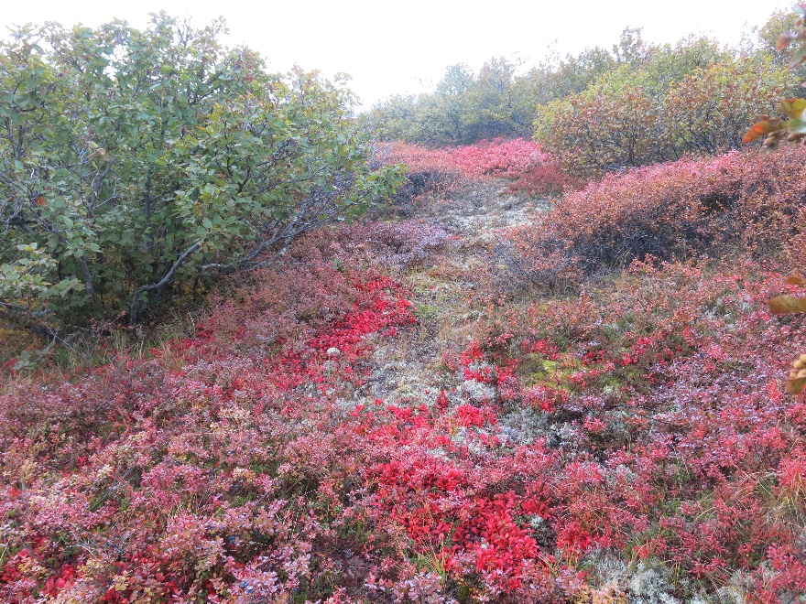
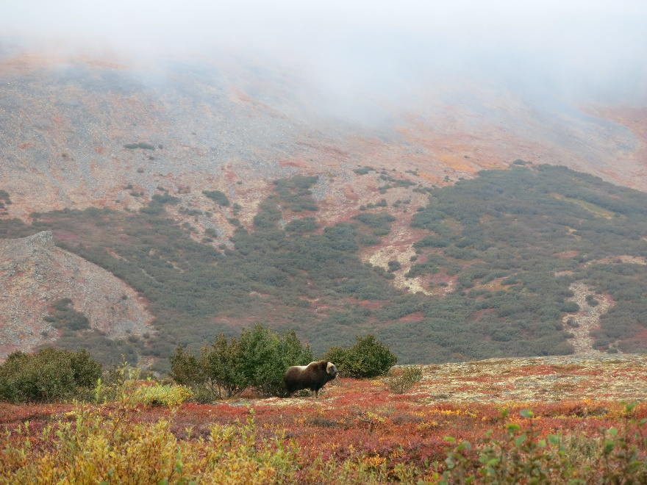
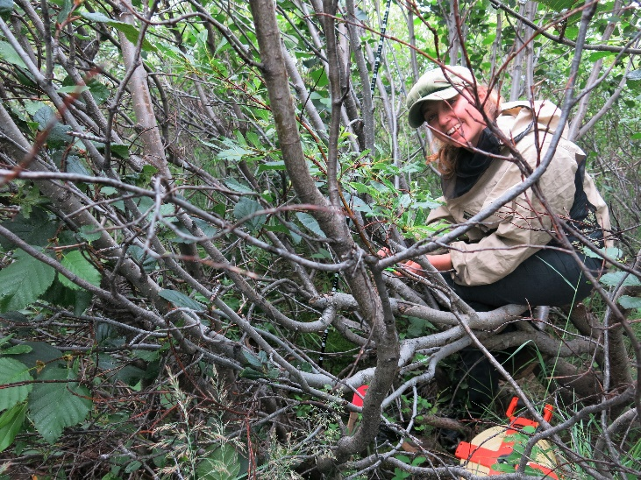
We make observations at sites underlain by continuous and cold permafrost – such as the North Slope of Alaska – as well as sites underlain by discontinuous and warmer permafrost of sites further south on the Seward Peninsula of Alaska.

Slide 5
The questions we ask in NGEE Arctic span from permafrost thaw, to shrub expansion, to the distribution of water across disturbed and evolving tundra landscapes, and we quantify the underlying hydro-biogeochemical drivers.

Slide 6
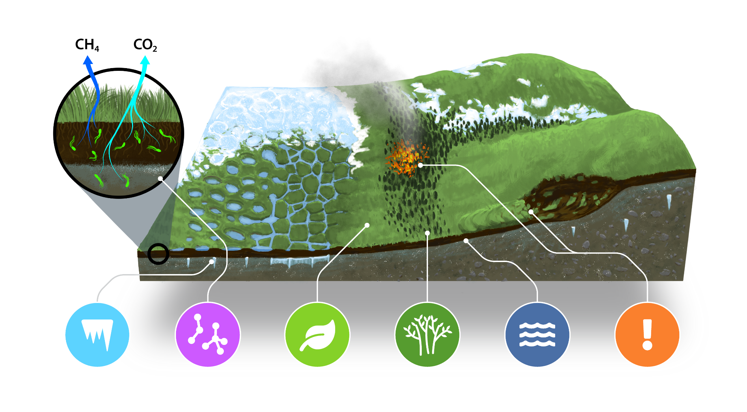
Q1 Q2 Q3 Q4 Q5 Q6
Landscape Biogeochemistry Plant traits Shrubification Hydrology Disturbance
Gradient of topography, permafrost, vegetation, and hydrology

Slide 7






Q1. How does landscape organization control permafrost evolution and associated C and nutrient fluxes in a changing environment?
Q2. What will control rates of CO₂ and CH₄ fluxes across a range of permafrost conditions?
Q3. How do plant functional traits change across environmental gradients, and what are the consequences for carbon, water, and nutrient fluxes?
Q4. What controls the distribution of shrubs, and how will shrub distributions and associated climate feedbacks shift with warming in the 21st century?
Q5. Where, when, and why will the Arctic become wetter or drier, and what are the implications for climate forcing?
Q6. What controls the vulnerability of Arctic ecosystems to disturbance, and how do disturbances alter the structure and function of these ecosystems?

Slide 8
An overarching goal of NGEE Arctic is to make scientific observations and discoveries that inform and validate model representation of the pan-Arctic.

Slide 9
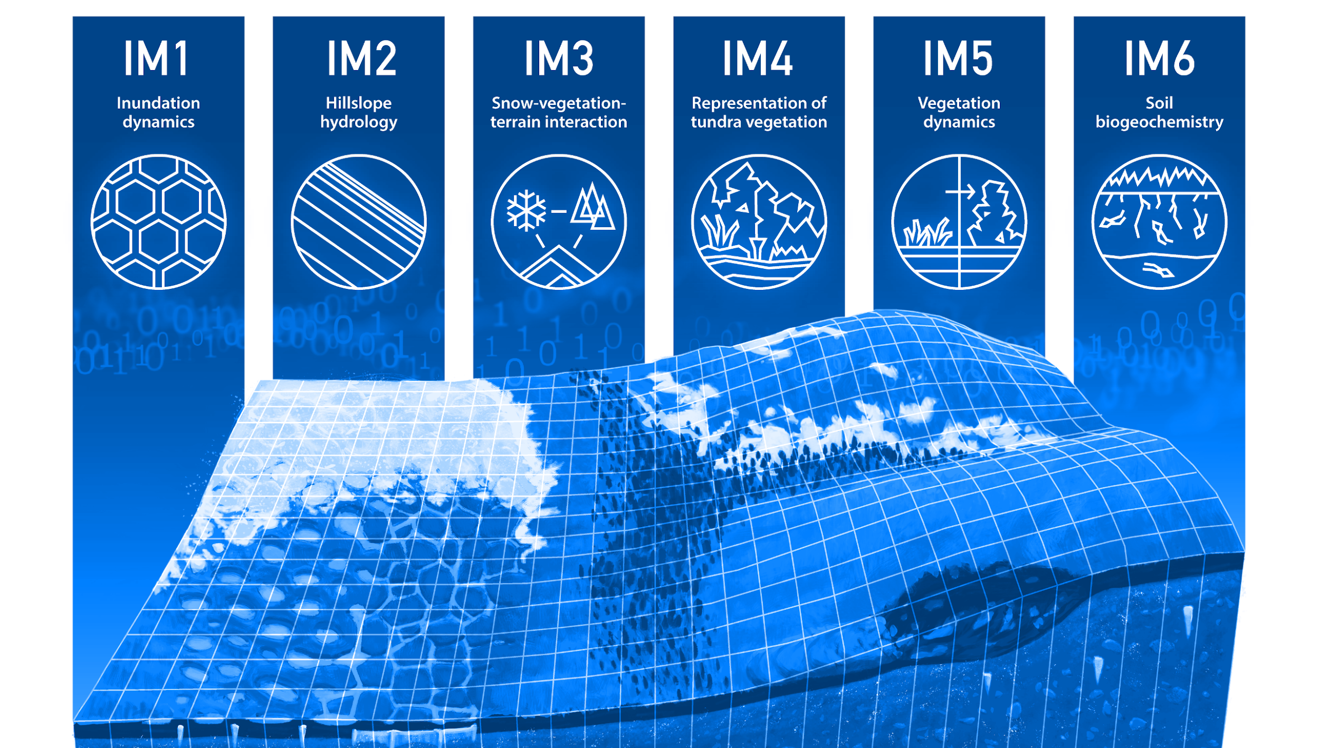

Slide 10
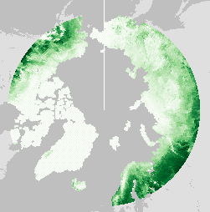
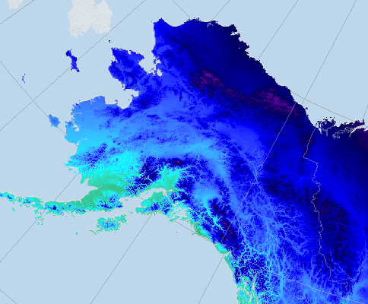
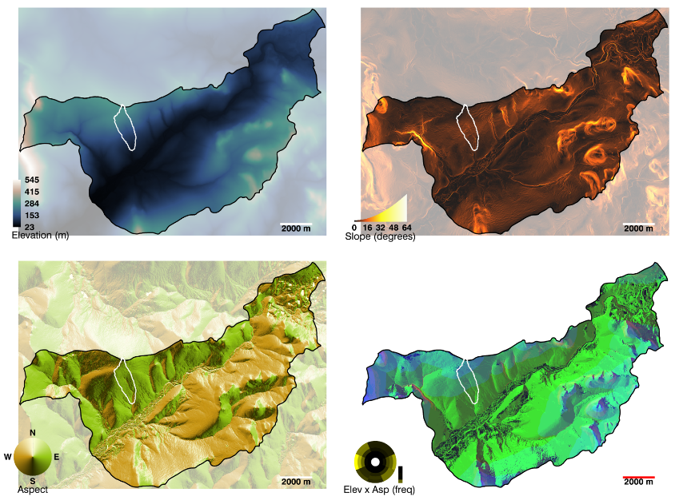
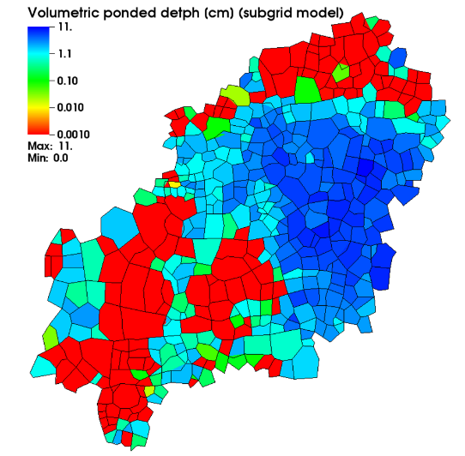
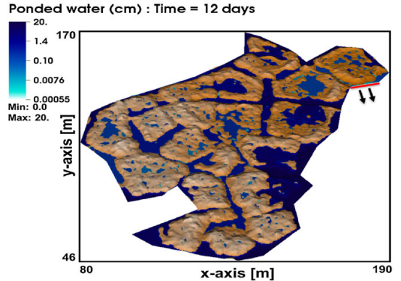

Slide 11
We bring modelers to the field with us, and modelers help us to understand the key model needs…and the scale at which they will be projected across the Arctic land surface.

Slide 12
Organized by Shawn Serbin (BNL), Benjamin Sulman (ORNL), Verity Salmon (ORNL), Fengming Yuan (ORNL), Katrina Bennett (LANL)

Slide 13
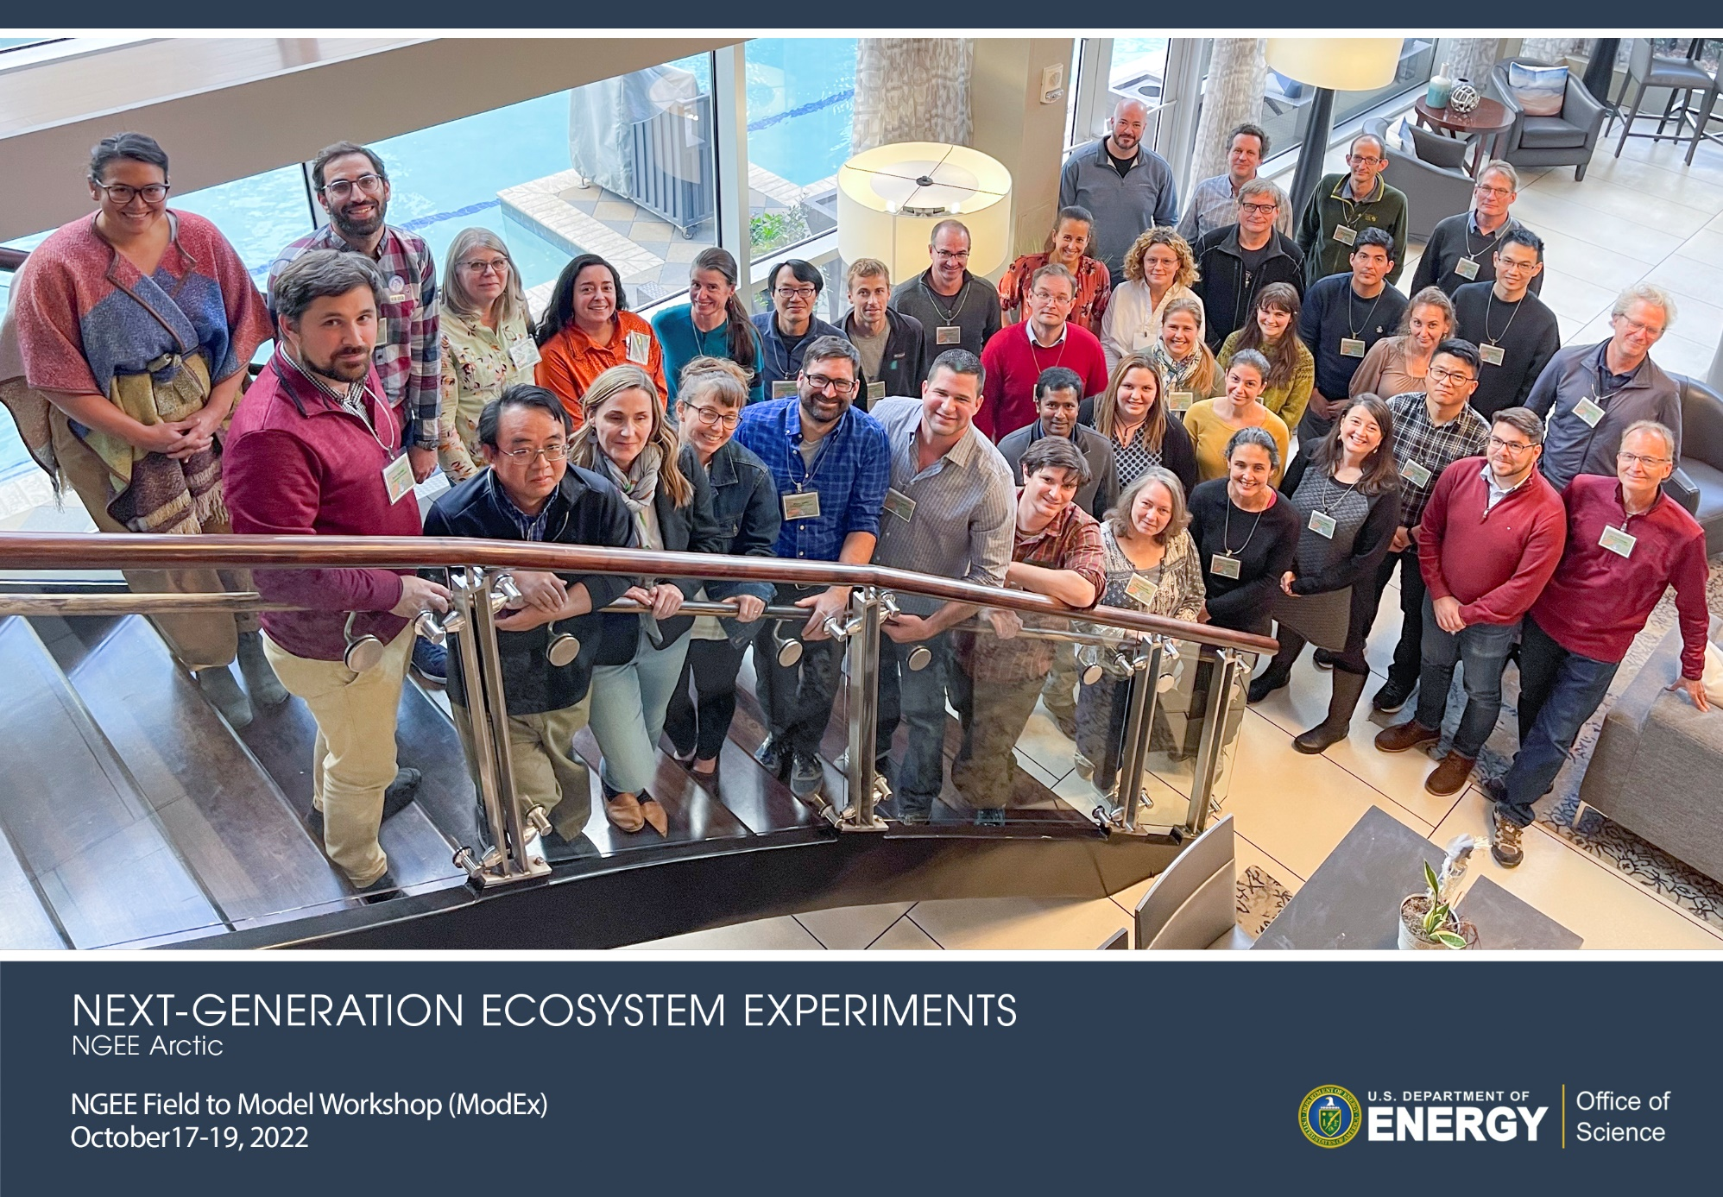

Slide 14
We implemented open and FAIR data policies early in the project, and more than 150 NGEE Arctic data sets can be freely accessed through the NGEE Arctic Data Portal.

Slide 15
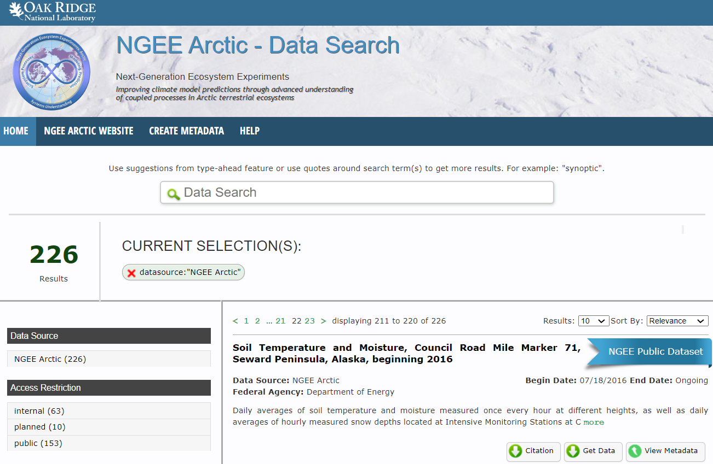
https://ngee-arctic.ornl.gov

Slide 16
We have worked to develop an inclusive project culture focused on team science that facilitates team physical and psychological safety, as well as trust and collaboration.

Slide 17
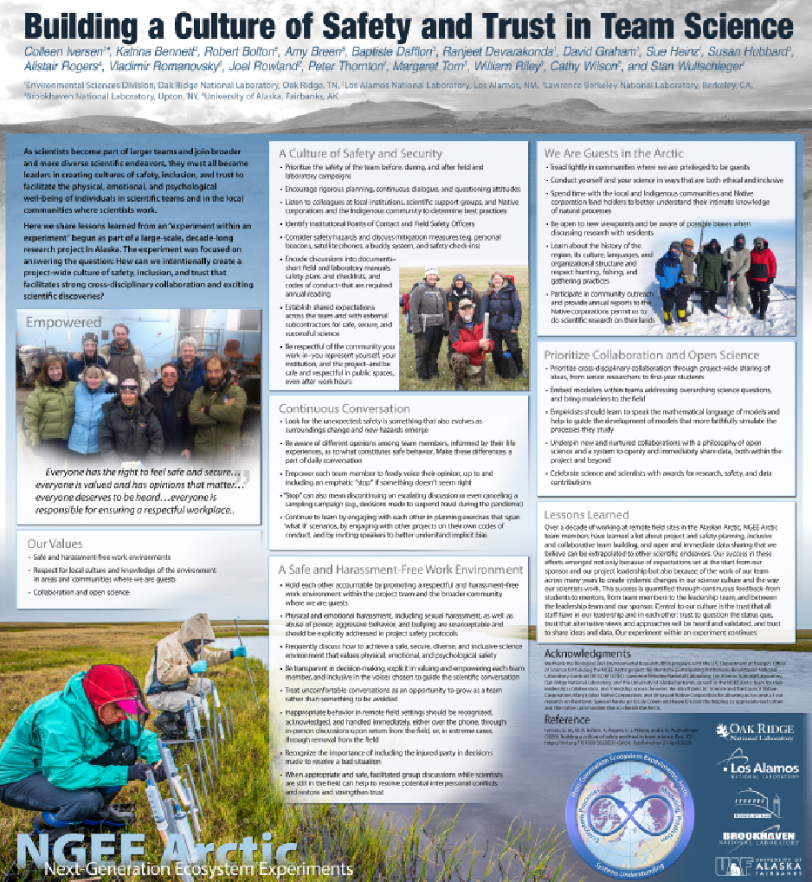

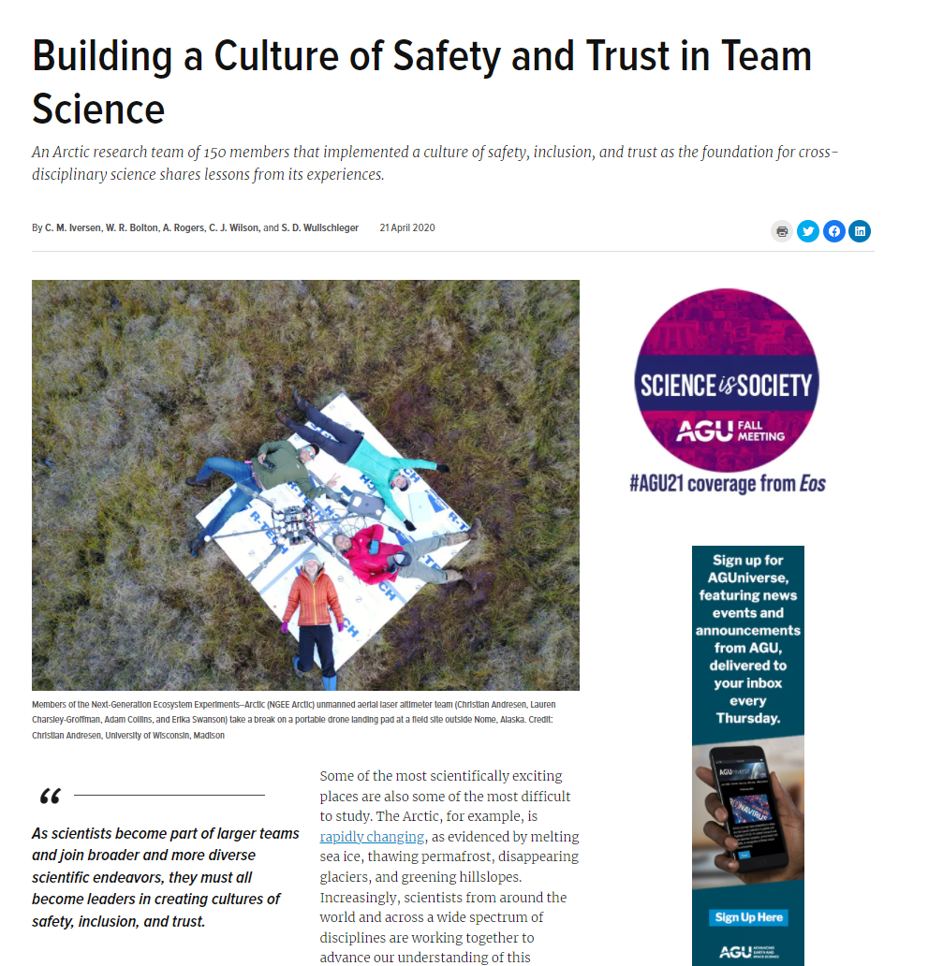
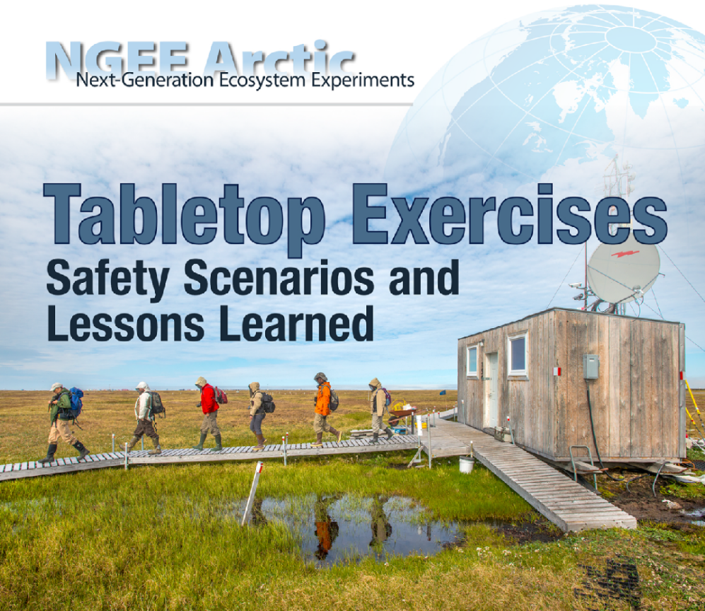
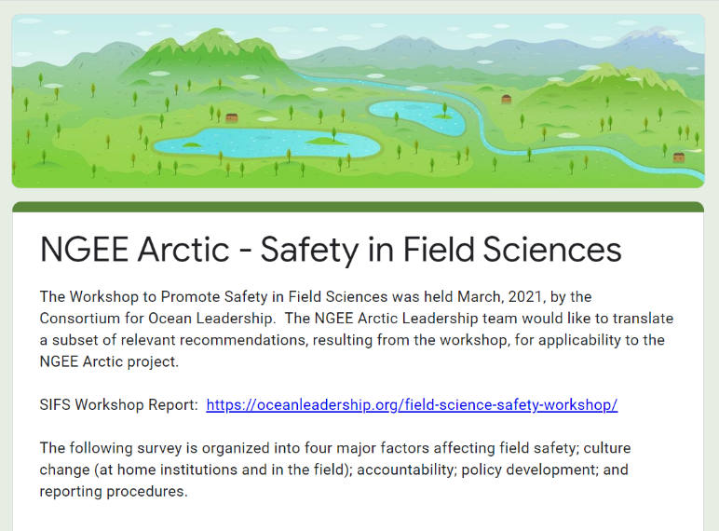

Slide 18
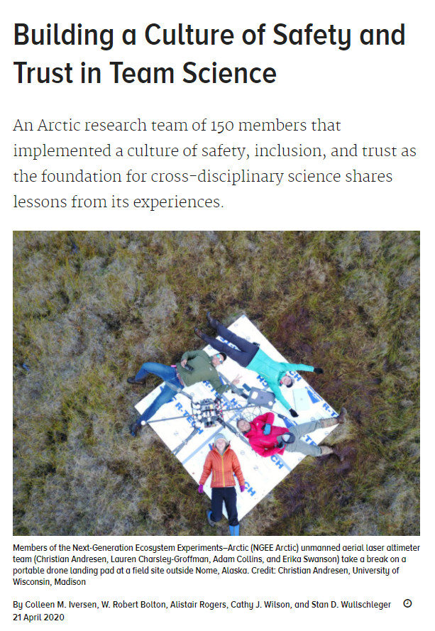
‘As scientists become part of larger teams and join broader and more diverse scientific endeavors, they must all become leaders in creating cultures of safety, inclusion, and trust.’
Iversen CM, Bolton WR, Rogers A, Wilson CJ, Wullschleger SD. 2020. Building a culture of safety and trust in team science. Eos 101.

Slide 19
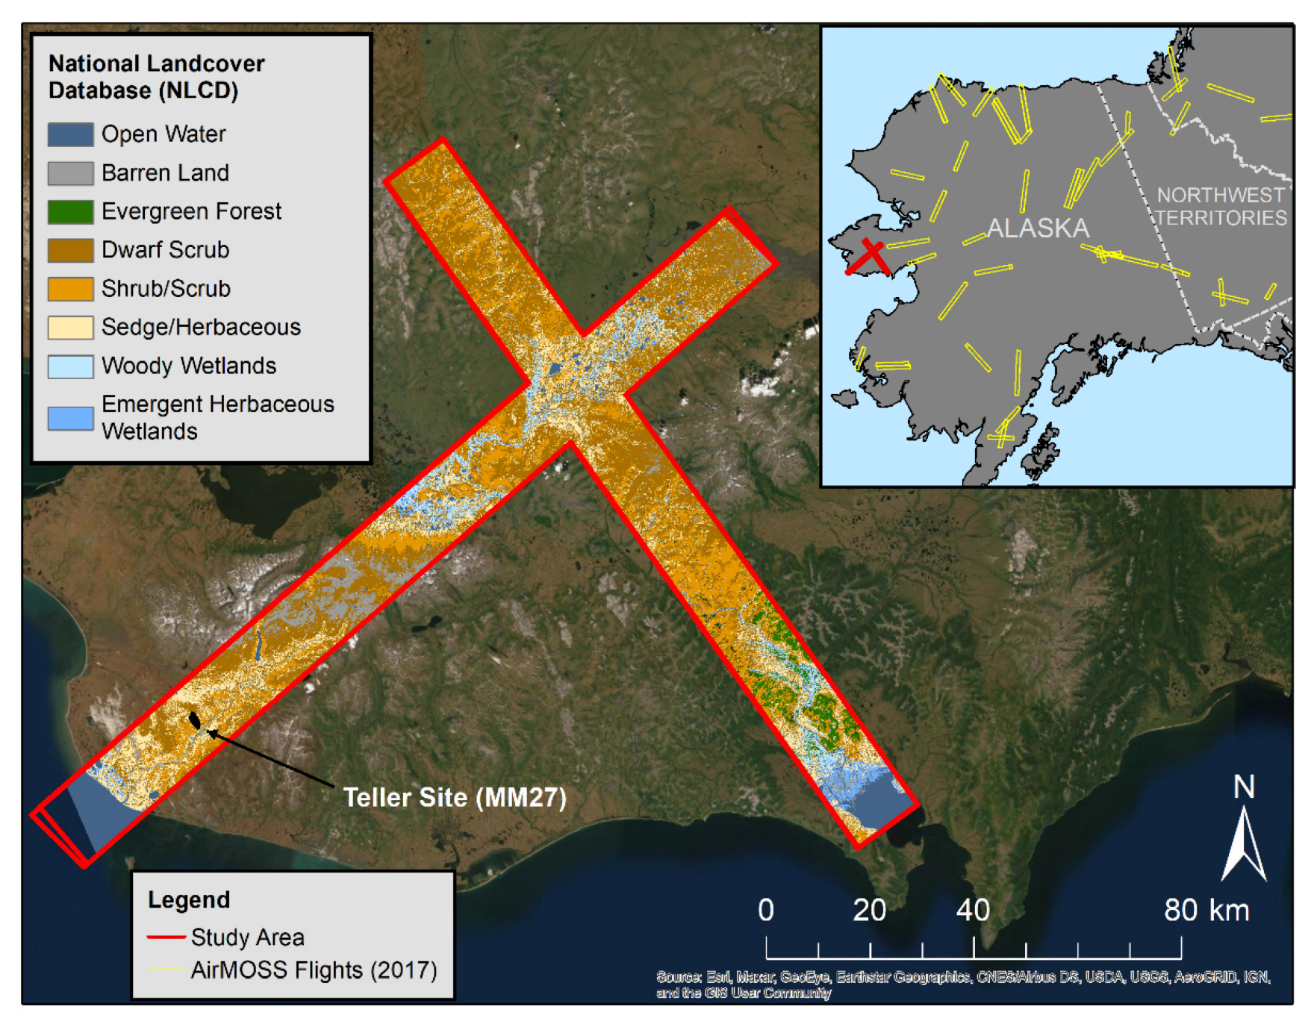
We are committed to interdisciplinary and international collaboration, including with our friends at NASA ABoVE.

Slide 20
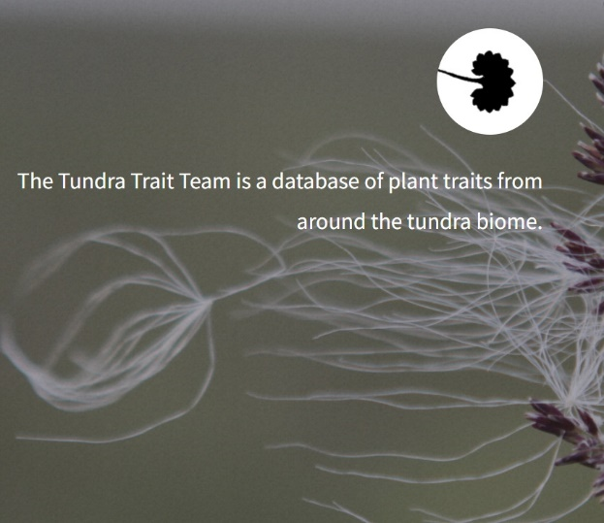

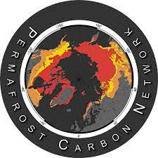




Slide 21
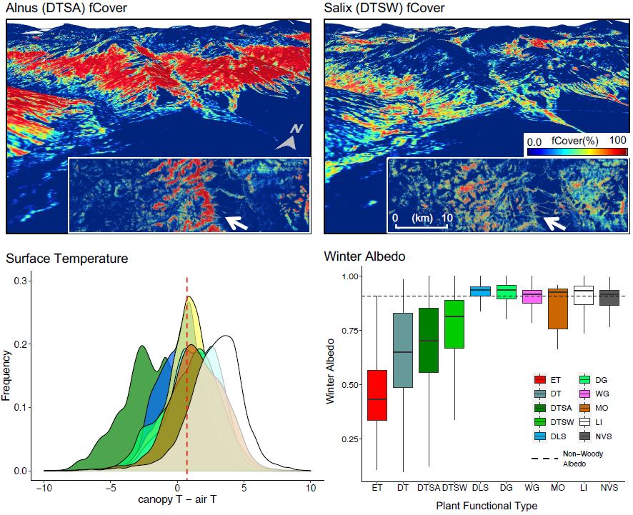
ABoVE and NGEE Arctic collaborate to…
…study drivers of tall shrub distribution and expansion using AVIRIS-NG observations
…understand near-surface soil moisture using both P- and L-Band AirMOSS SAR observations
Yang et al. 2023. Integrating very-high-resolution UAS data and airborne imaging spectroscopy to map the fractional composition of Arctic plant functional types in Western Alaska. Remote Sensing of Environment 286:113430.
Dann et al. 2022. Factors controlling a Synthetic Aperture Radar (SAR) derived root-zone soil moisture product over The Seward Peninsula of Alaska. Remote Sensing 14, 4927.

Slide 22
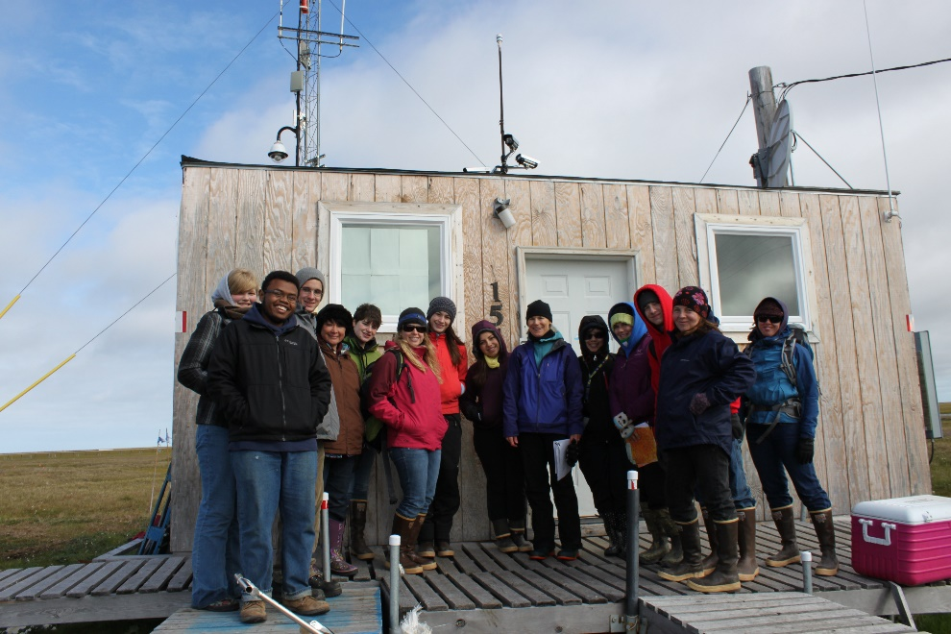
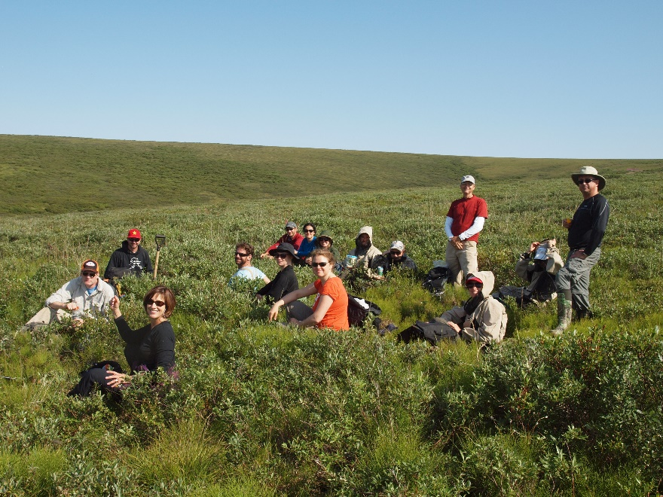
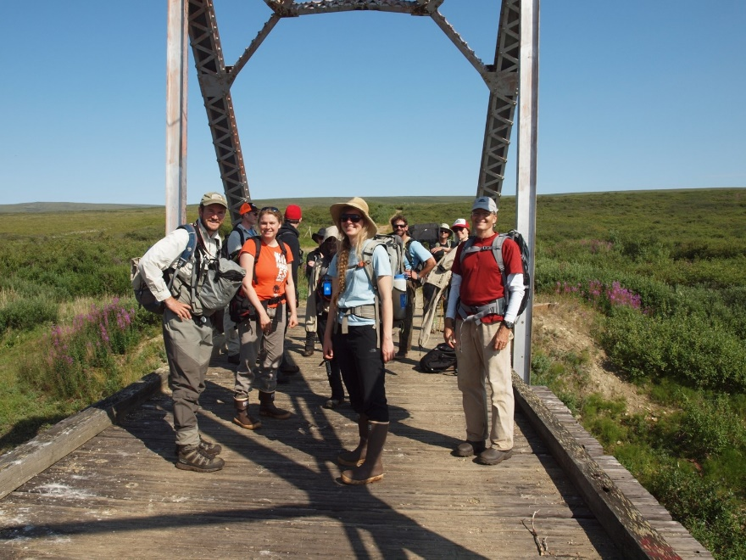
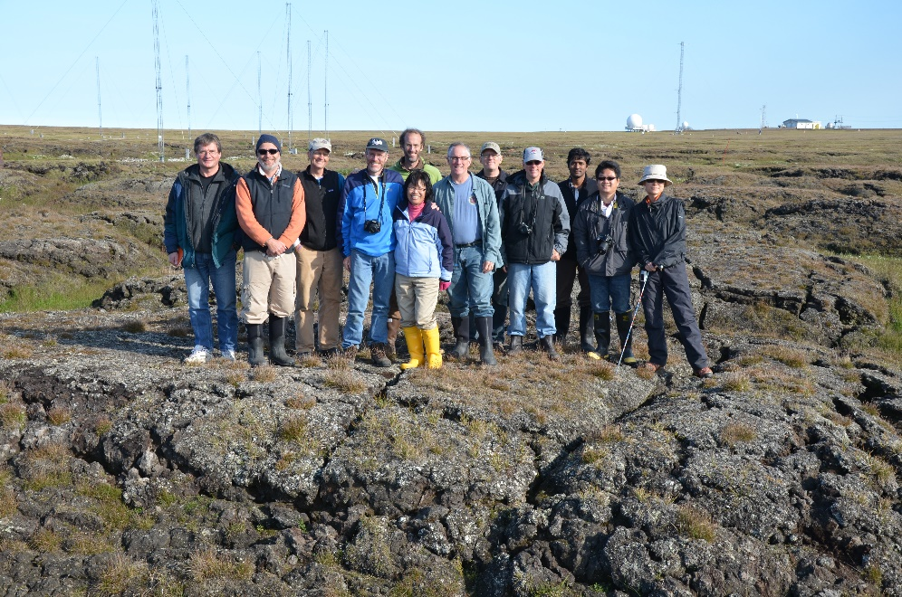
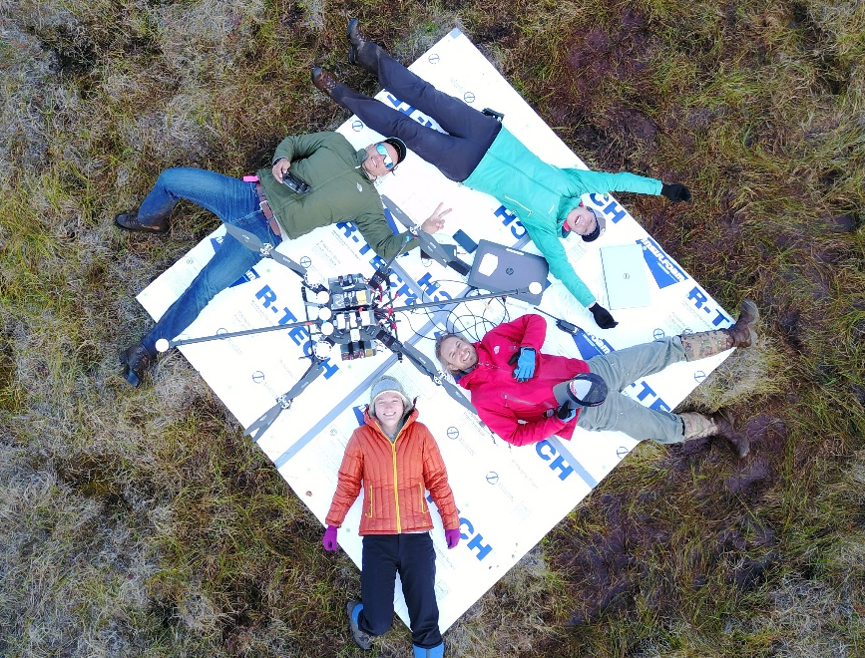
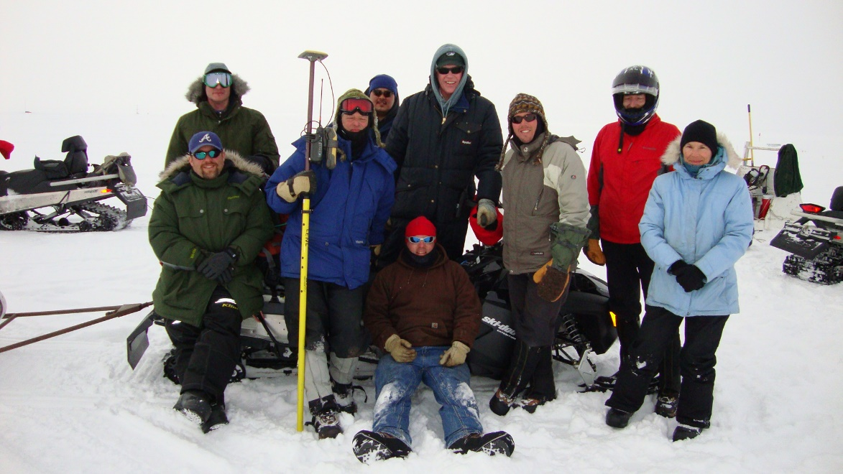
Our thanks to the NGEE Arctic team!
Notes:
We welcome new opportunities for collaboration with partners across the Arctic!

Slide 23
Our thanks to the Department of Energy!
The NGEE Arctic project is funded by the Biological and Environmental Research program within the United States’ Department of Energy’s Office of Science.

Slide 24
Our thanks to the Native Corporations!
Thank you to UIC Science, the Bering Straits Native Corporation, the Council Native Corporation, Mary’s Igloo Native Corporation, and the Sitnasuak Native Corporation for their guidance and for allowing us to conduct our research on the traditional homelands of the Iñupiat.

Slide 25
Colleen Iversen
Oak Ridge National Laboratory
Laboratory Research Director
NGEE Arctic project
https://ngee-arctic.ornl.gov
iversencm@ornl.gov
www.colleeniversen.com

