Slide 1
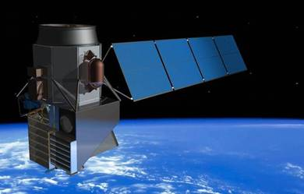
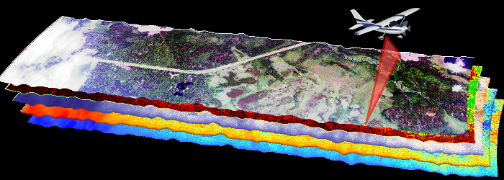
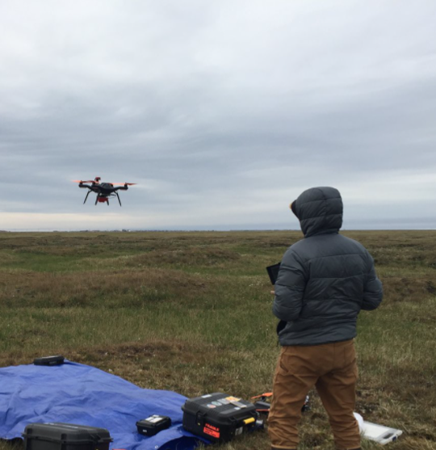
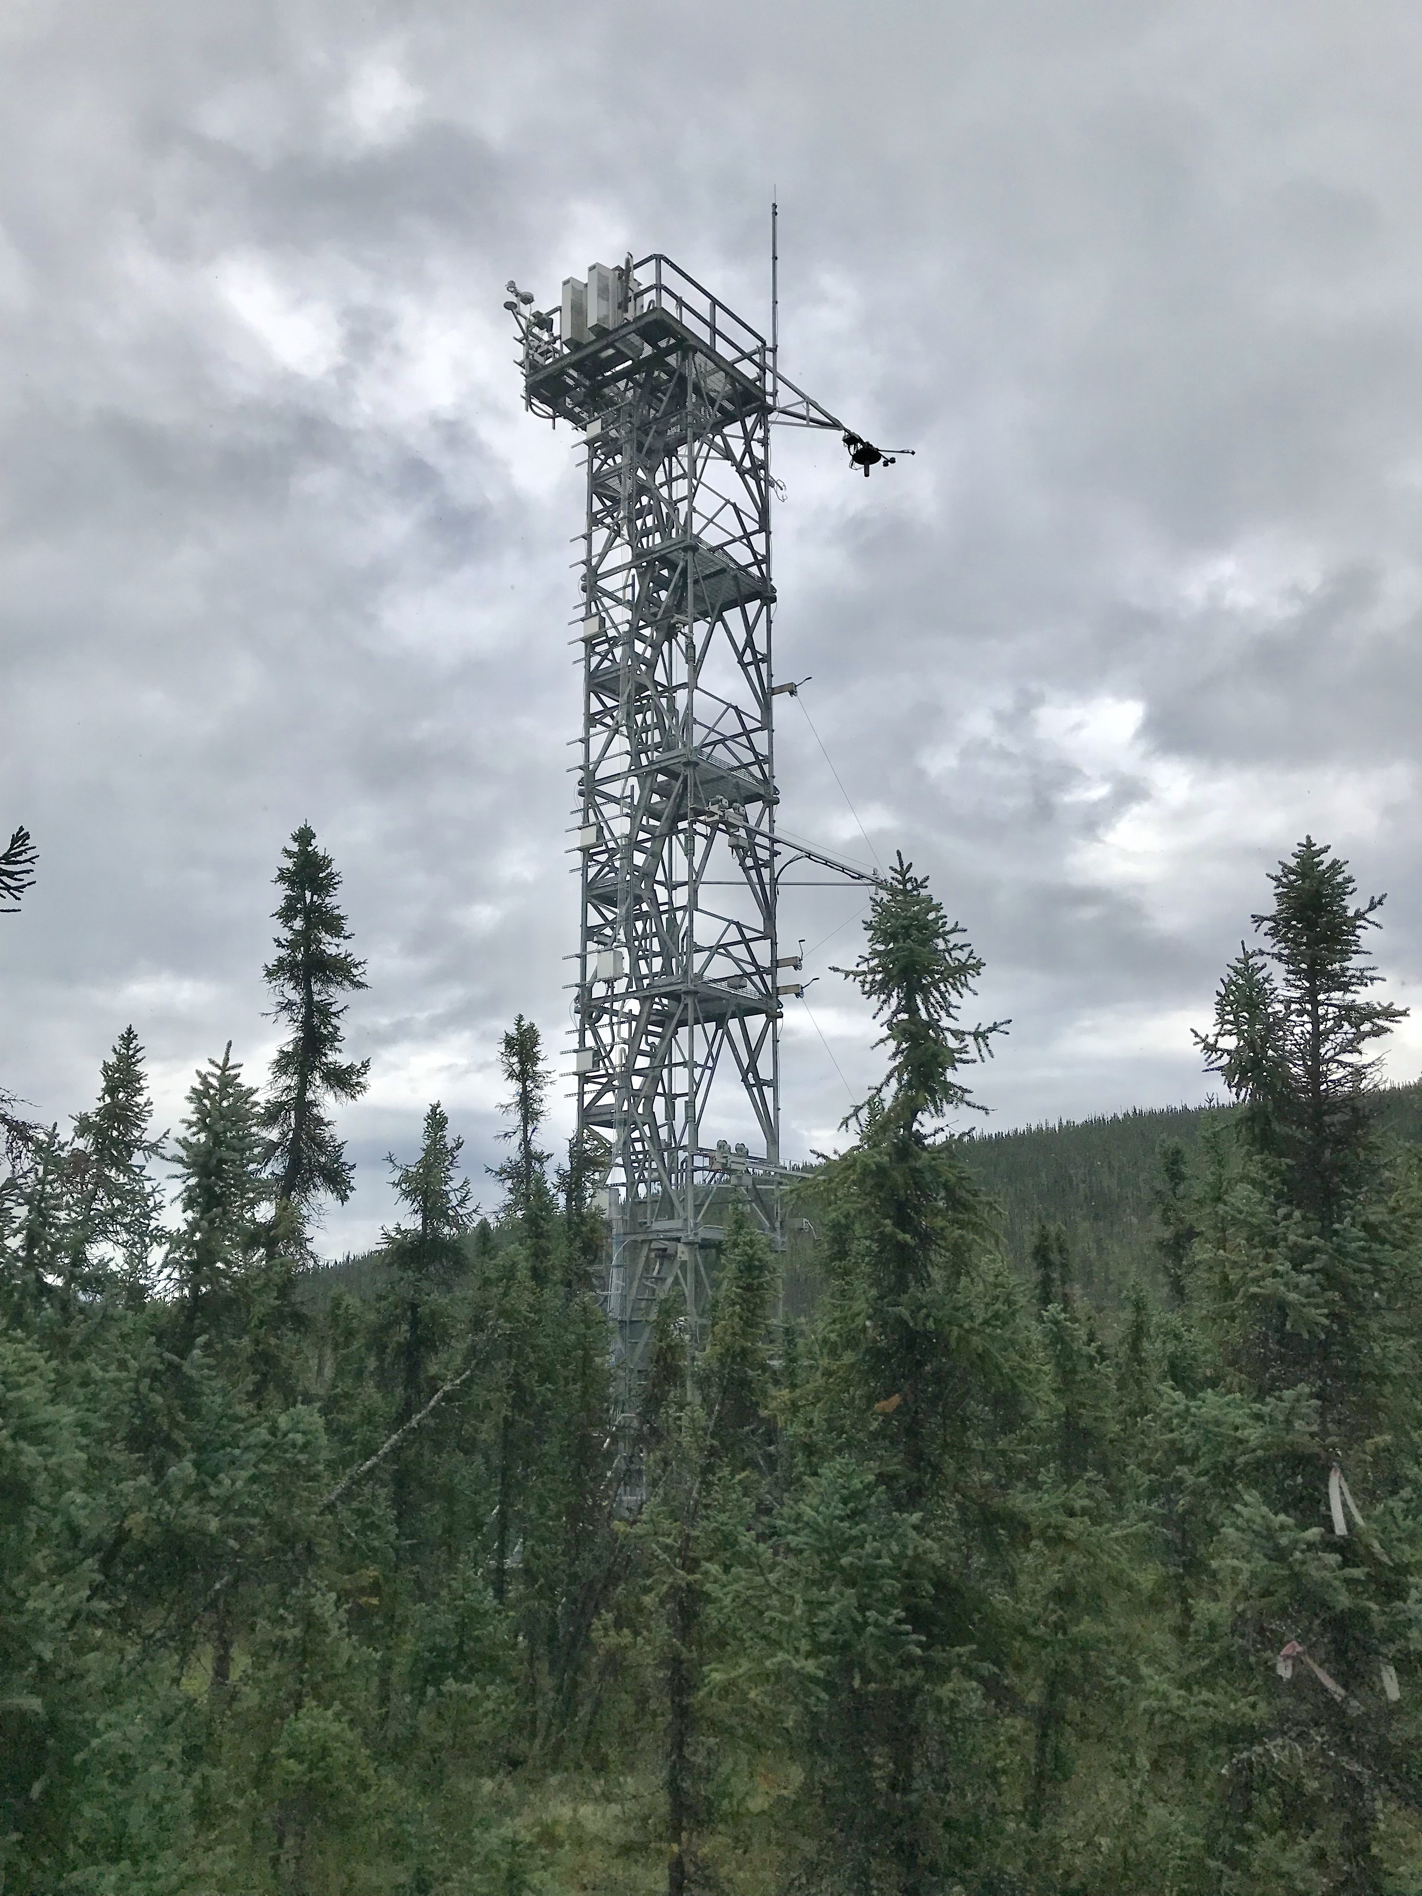
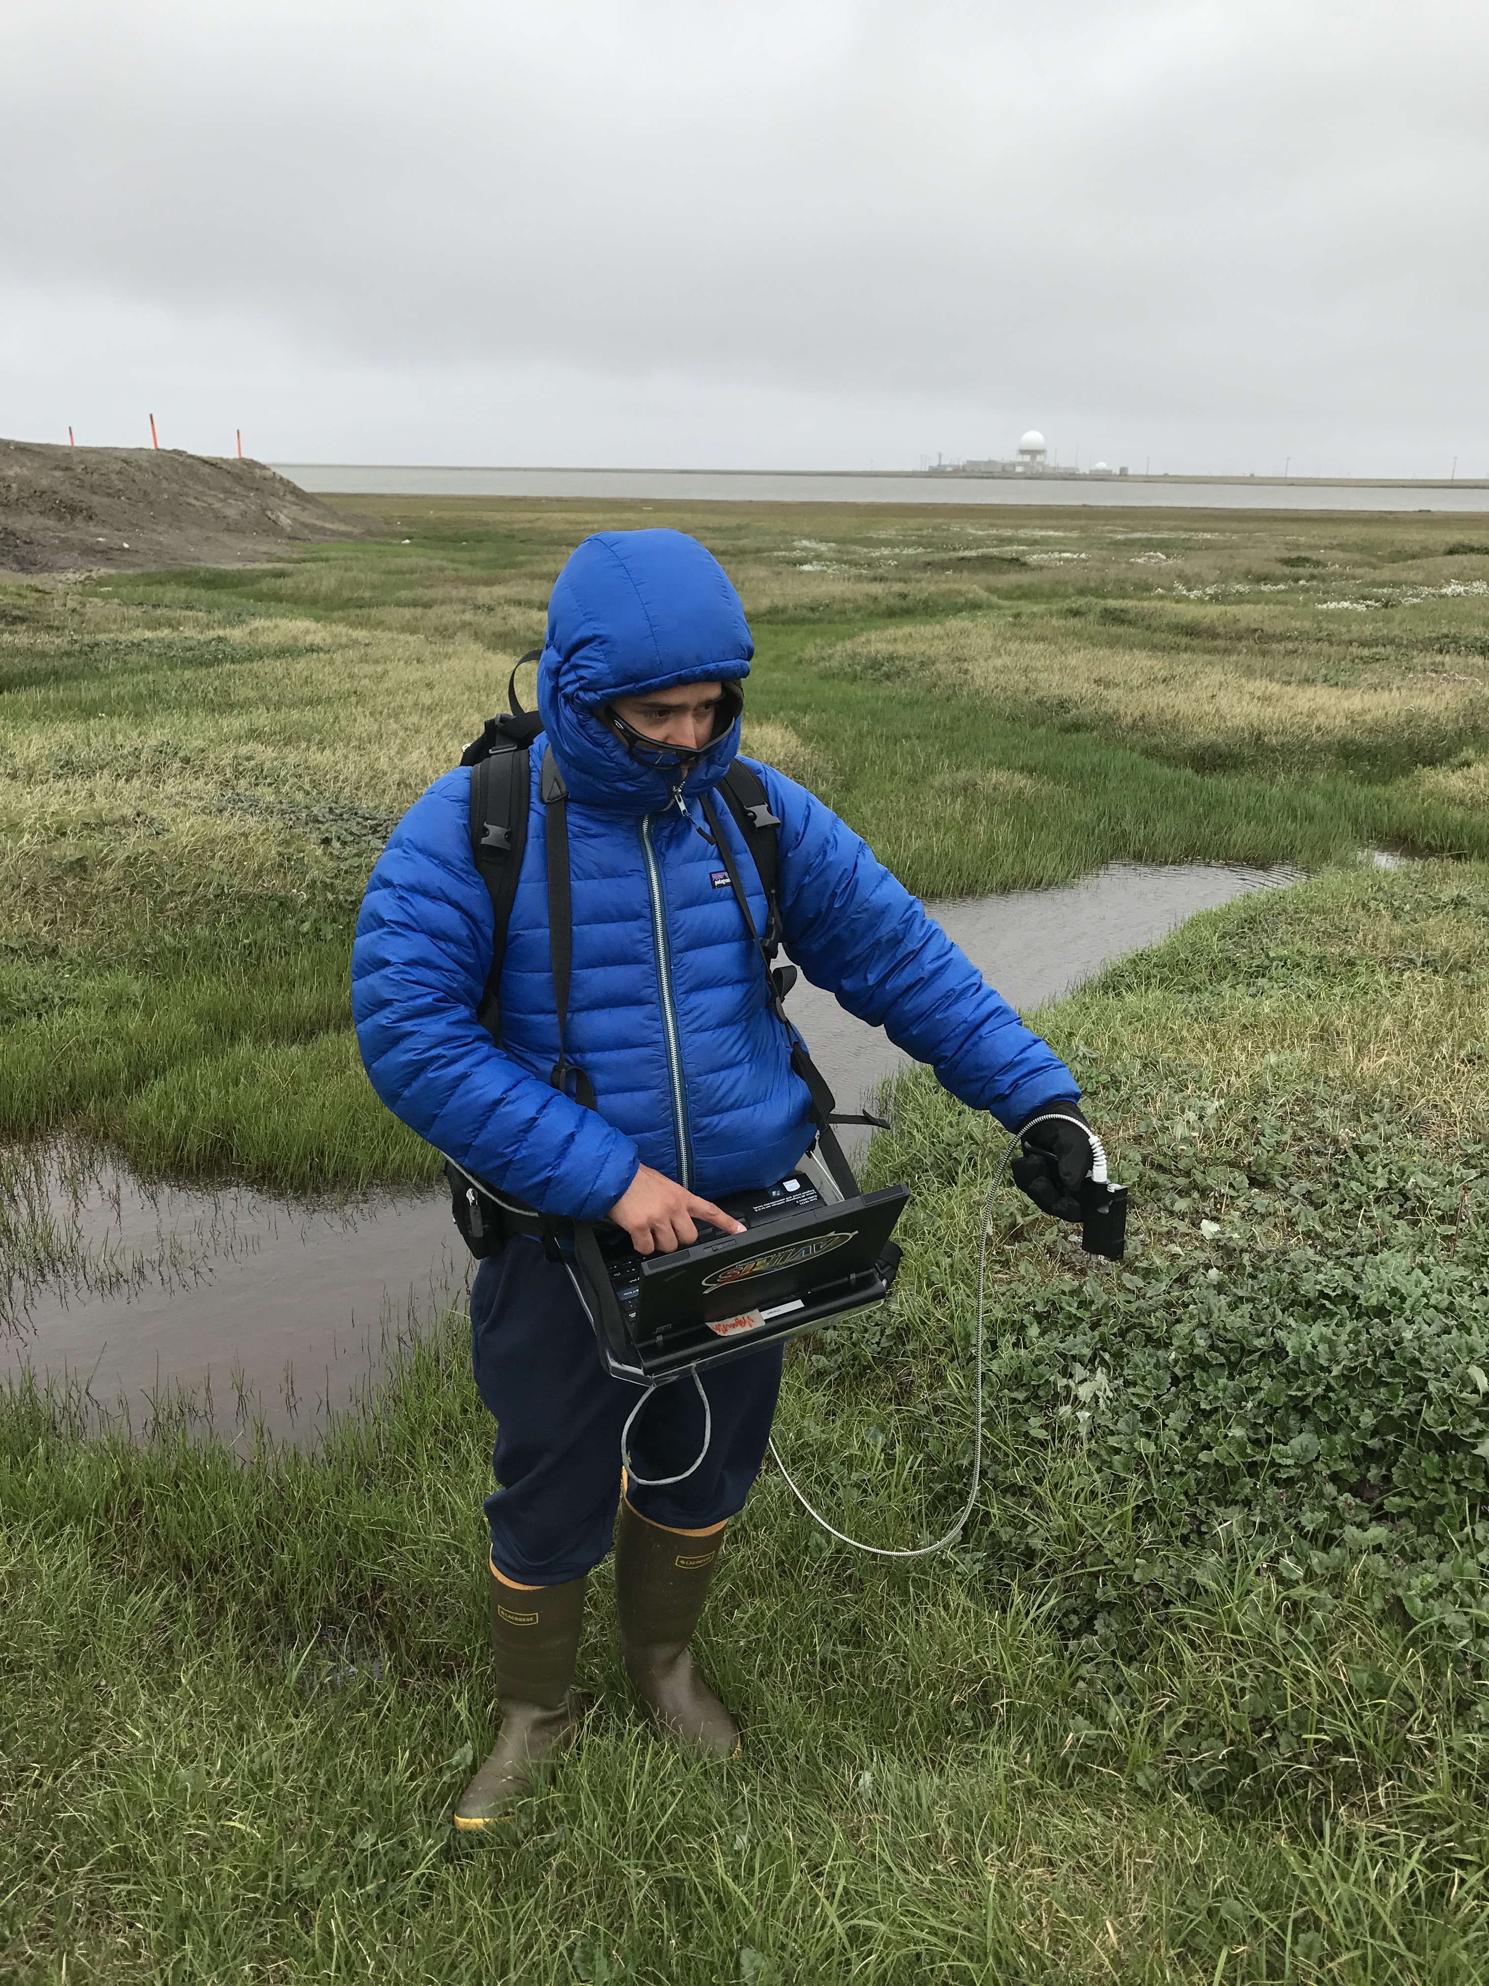
Spectral Imaging Working Group
  Chairs: Fred Huemmrich, Peter Nelson
  - 74 members
Diverse group with a variety of interests

Slide 2
We have identified some areas of interest
- Spectral scaling - addressing scaling from ground to drones to aircraft to satellite, involving processing and analysis techniques and data synthesis.
- Solar Induced Fluorescence (SIF) studies - addressing the measurement and use of solar induced fluorescence and its relationship to biophysical processes.
- Relating spectral reflectance characteristics to vegetation traits

Slide 3
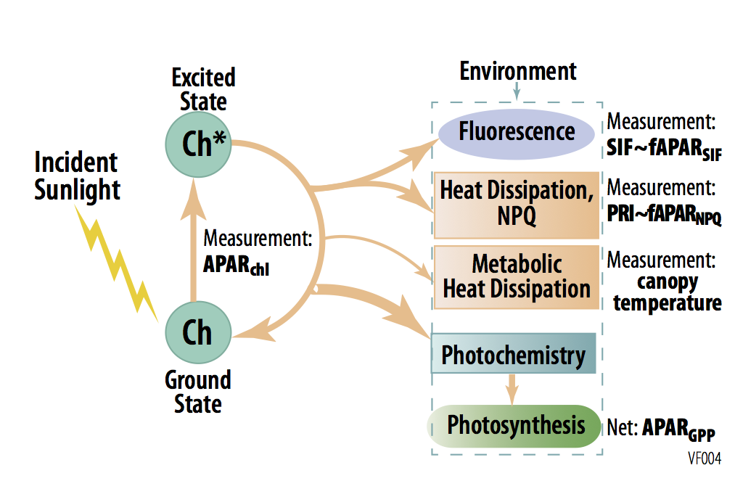
Solar Induced Fluorescence (SIF) in ABoVE
Chlorophyll fluorescence (F) at leaf level is closely linked to photosynthesis.
Canopy solar induced fluorescence (SIF) can be remotely sensed and has the potential to link to the leaf-level processes and estimate productivity at different temporal and spatial scales.
Within ABoVE investigators are examining SIF at a range of spatial scales.

Slide 4
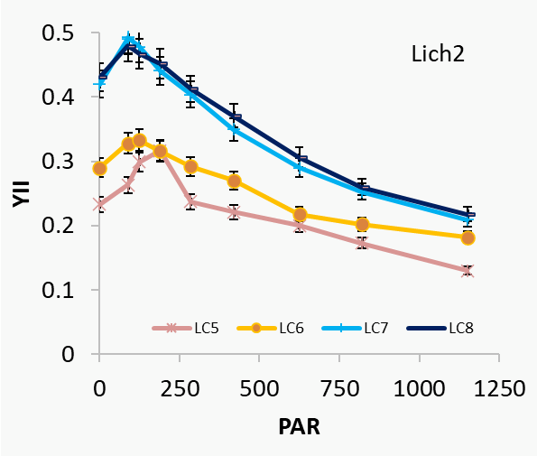
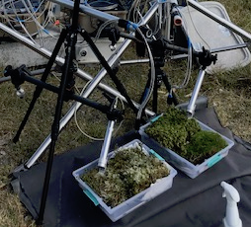
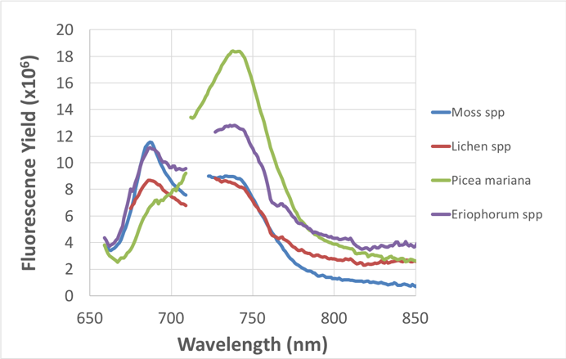
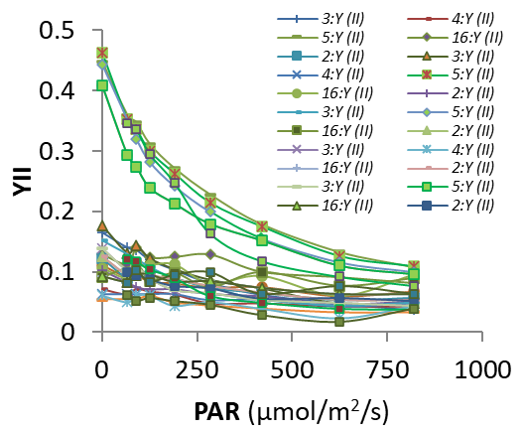
“Leaf” level measurements
Measurements of fluorescence emission spectra and light response curves are being used to parameterize the SCOPE model in collaboration with Christiaan Van der Tol and Peiqi Yang
Petya Campbell

Slide 5
Tower level measurements using PhotoSpec
  Collects time series of measurements of SIF at specific locations
Zoe Pierrat

Slide 6
Scaling SIF and Reflectance Indices from Aircraft to Satellite
Airborne (30 m): CFIS & AVIRIS-NG
Spaceborne (1000 m): TROPOMI & MODIS
^ SIF observations are much noisier at coarse spatiotemporal scale, not following landcover classes
← Spatial patterns generally aligned among variables
Andy Maguire

Slide 7
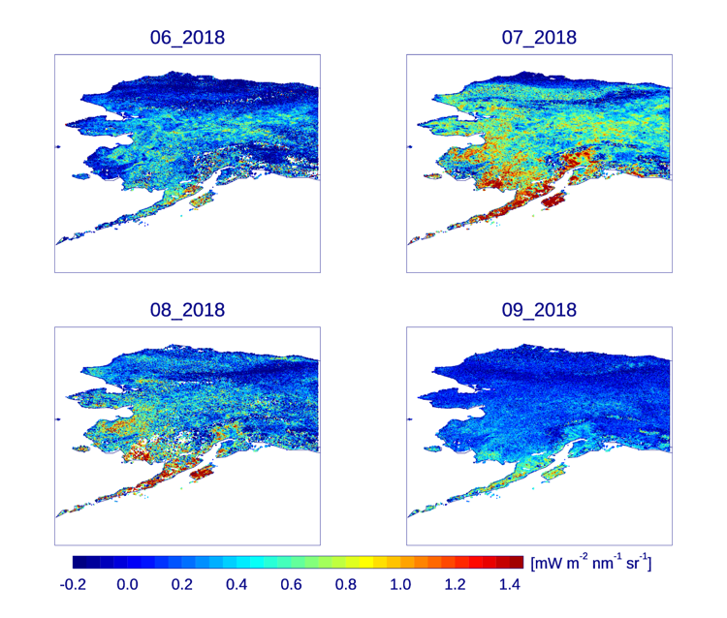
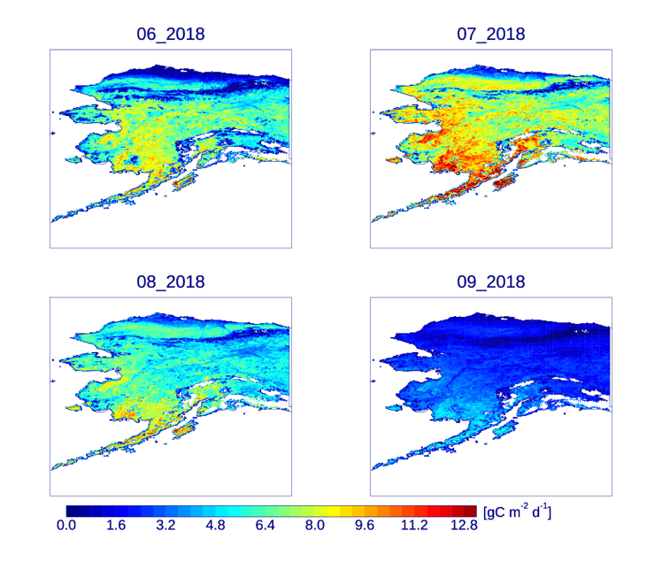
Satellite Scale SIF Studies
TROPOspheric Monitoring Instrument (TROPOMI) SIF
Productivity from MODIS
TROPOMI SIF
FluxSat Gross Primary Productivity (GPP)
(upscaling of flux towers using MODIS reflectances within a light-use efficiency model framework – Joiner et al., 2018)
Joanna Joiner & Yasuko Yoshida

Slide 8
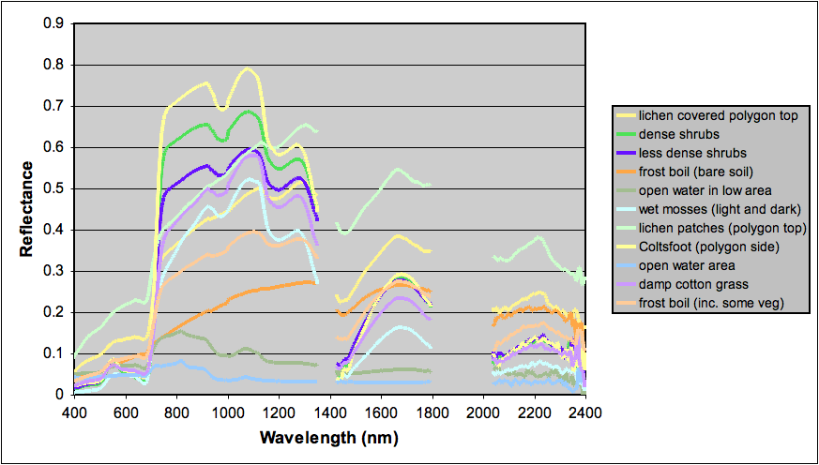
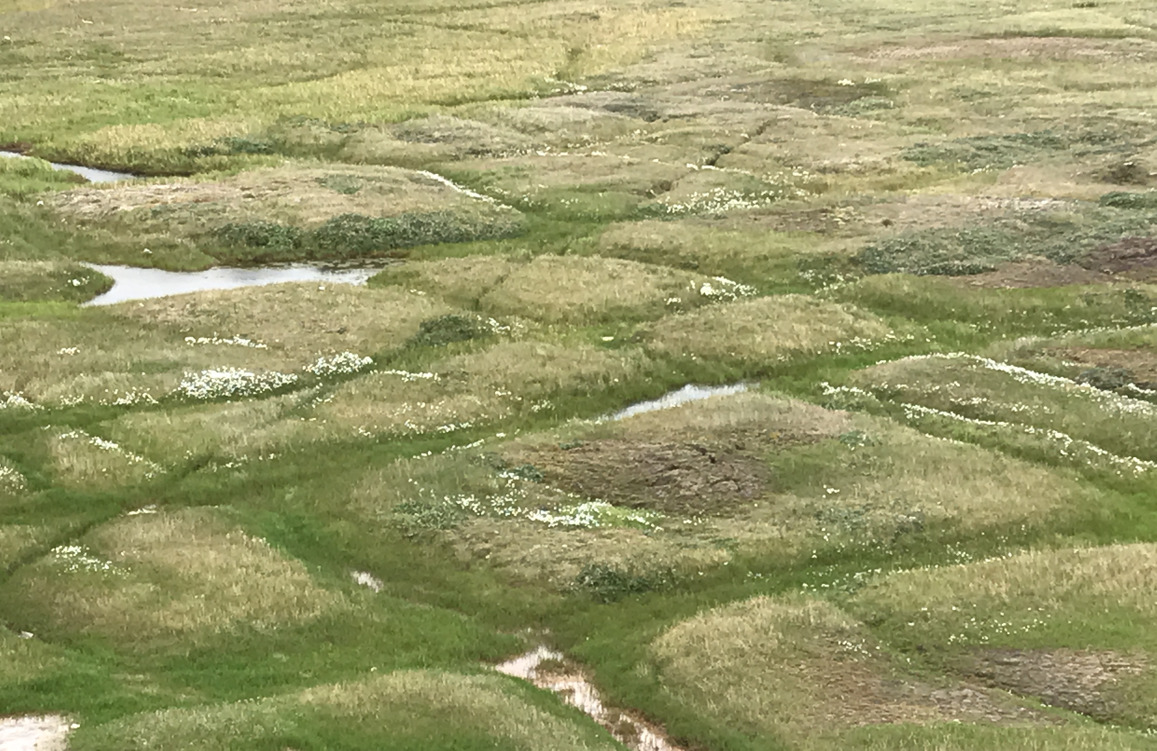
Writing paper for upcoming special issue:
Remote Sensing of Tundra Ecosystems using High Spectral Resolution Reflectance: Issues and Opportunities
For submission to JGR Biogeosciences special issue “The Earth in living color: spectroscopic and thermal imaging of the Earth: NASA’s Decadal Survey Surface Biology and Geology Designated Observable ”
Authors:
Petya Campbell
Nimrod Carmon
Scott Davidson
Howard Epstein
JJ Frost
Santonu Goswami
Robert Hollister
Fred Huemmrich
Joanna Joiner
Troy Magney
Andrew J Maguire
Jeremy May
Charles Miller
Peter Nelson
Shawn Serbin
David R Thompson
Craig Tweedie
Steven Unger
Sergio Vargas Z
Daryl Yang

Slide 9
Wang et al. (2020) New Phytologist

Slide 10
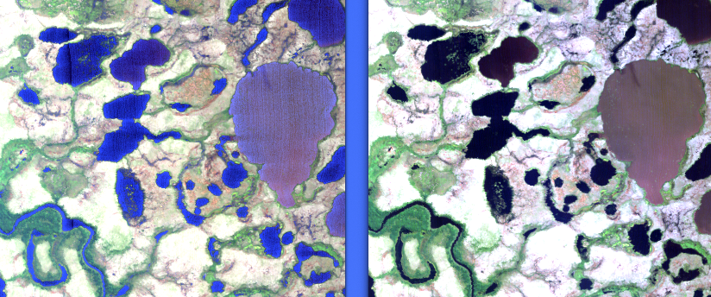
New AVIRIS-NG Surface Reflectance products
Parameter | Previous: Algebraic Inversion | New: Maximum A Posteriori
Radiative Transfer Model | 6S (scattering) HITRAN (gas absorption) | MODTRAN 6.0 / DISORT
Gas and aerosol effects | Decoupled | Coupled
Atmospheric retrieval | Sequential | Simultaneous
Aerosols | Static | Retrieved
Instrument noise | Ignored | Incorporated
Uncertainty propagation | None | Full Posteriors
Via Bayesian model inversion (Thompson et al., RSE 2018, 2019, 2020)
New
Previous
New
Water vapor
Previous
O2
Aerosols & Rayleigh
13 May 2021
david.r.thompson@jpl.nasa.gov
Notes:
Traditional atmospheric correction typically: (!) LUT generation of coefficients, (2) estimate of atmospheric state, (3) algebraic correction based on lambertian assumptions. Mature and effective; form basis of methods used in AVIRIS-NG standard products.
Several challenges to this…
limited size of state vector
Algebraic approximate solutions less accurate for extreme geometries
Uncoupled
Algebraic inversion means difficult to tease apart smooth atmospheric effects
Most inaccurate in regions of high haze, extreme water vapor causing absorption in scattering. India dataset contains pushes the frontier, excelelnt opportunity for investigating next level of precision.
Enabled by a fast radiative transfer model as an interior loop of an iterative max. a posteriori estimation

Slide 11
Wang et al. (2020) New Phytologist

Slide 12
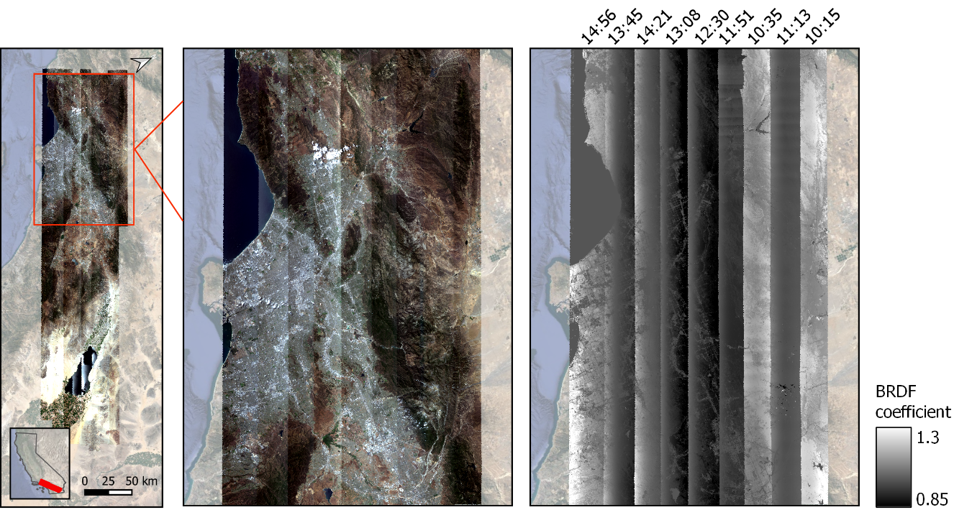
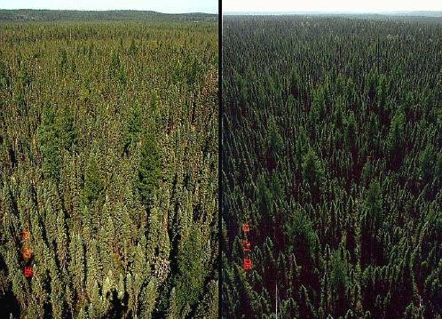
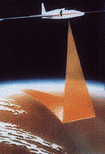
Varying sun-sensor-target geometry and land cover cause undesirable brightness differences within and across airborne flight lines
NASA JPL AVIRIS-NG
Image credit: Suniti Sanghavi

Slide 13
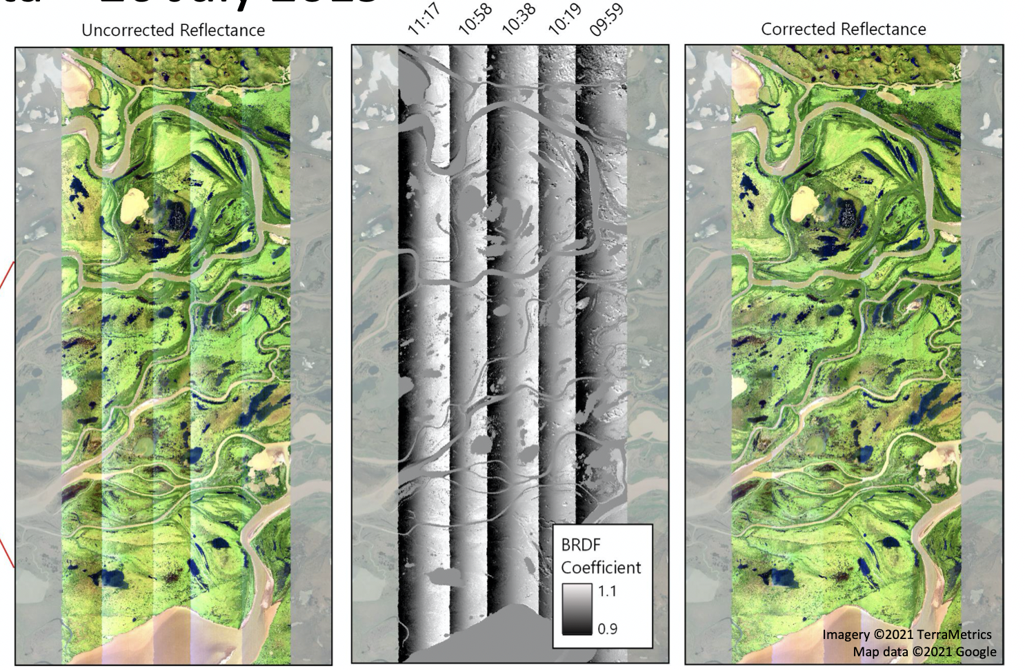
FlexBRDF concurrently removes brightness artifacts in groups of flightlines to generate seamless spectral mosaics
See talk by Natalie Queally for more details
ESSOAR Preprint available here

Slide 14
Wang et al. (2020) New Phytologist

Slide 15
Foliar samples collected at 246 field plots across 11 sites in 2019
Spectroscopic models used to predict 30 traits!
More 2022 field sampling to produce high-quality validated maps across ABoVE domain
See the talk by Kyle Kovach for more details

Slide 16
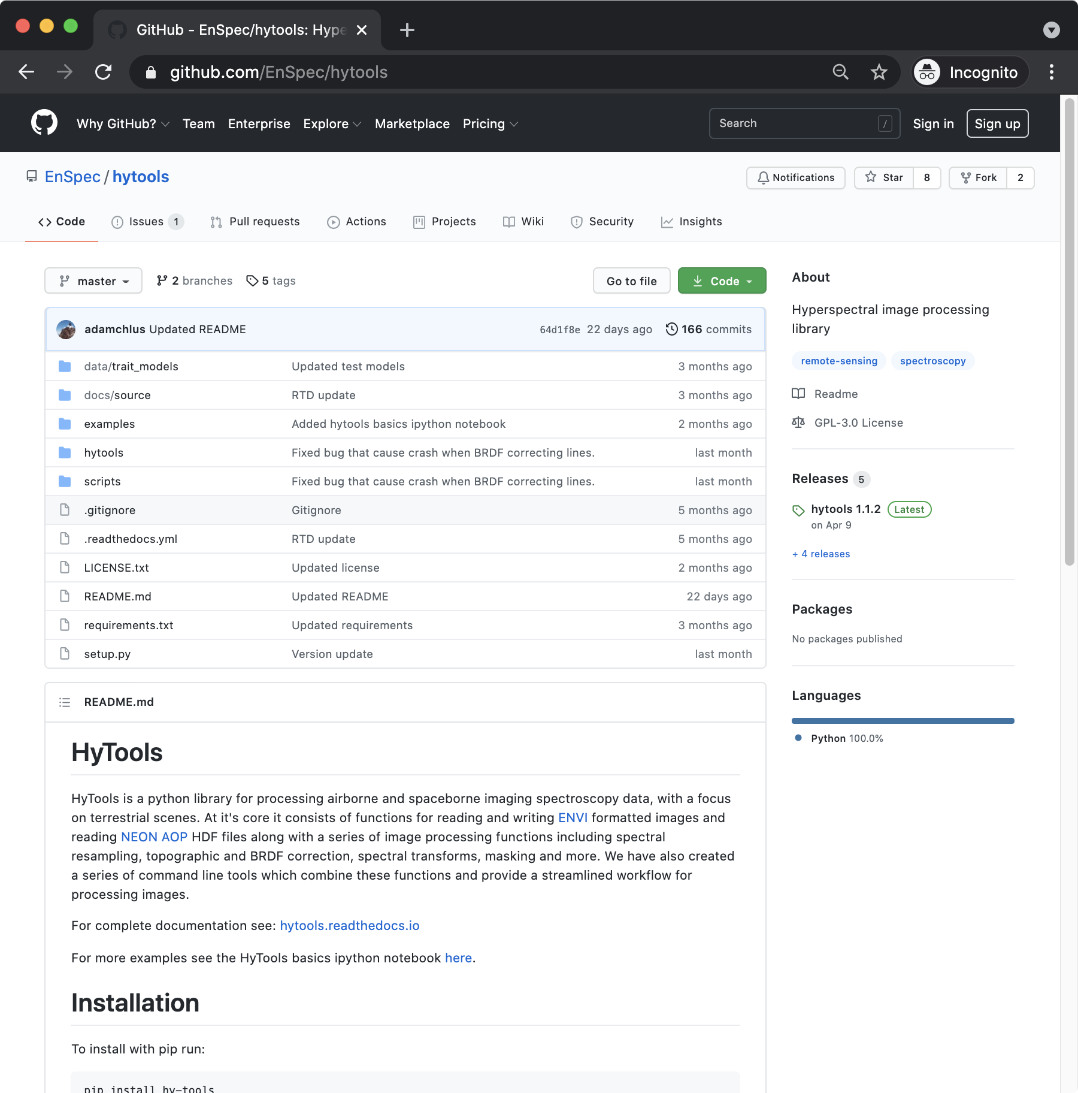
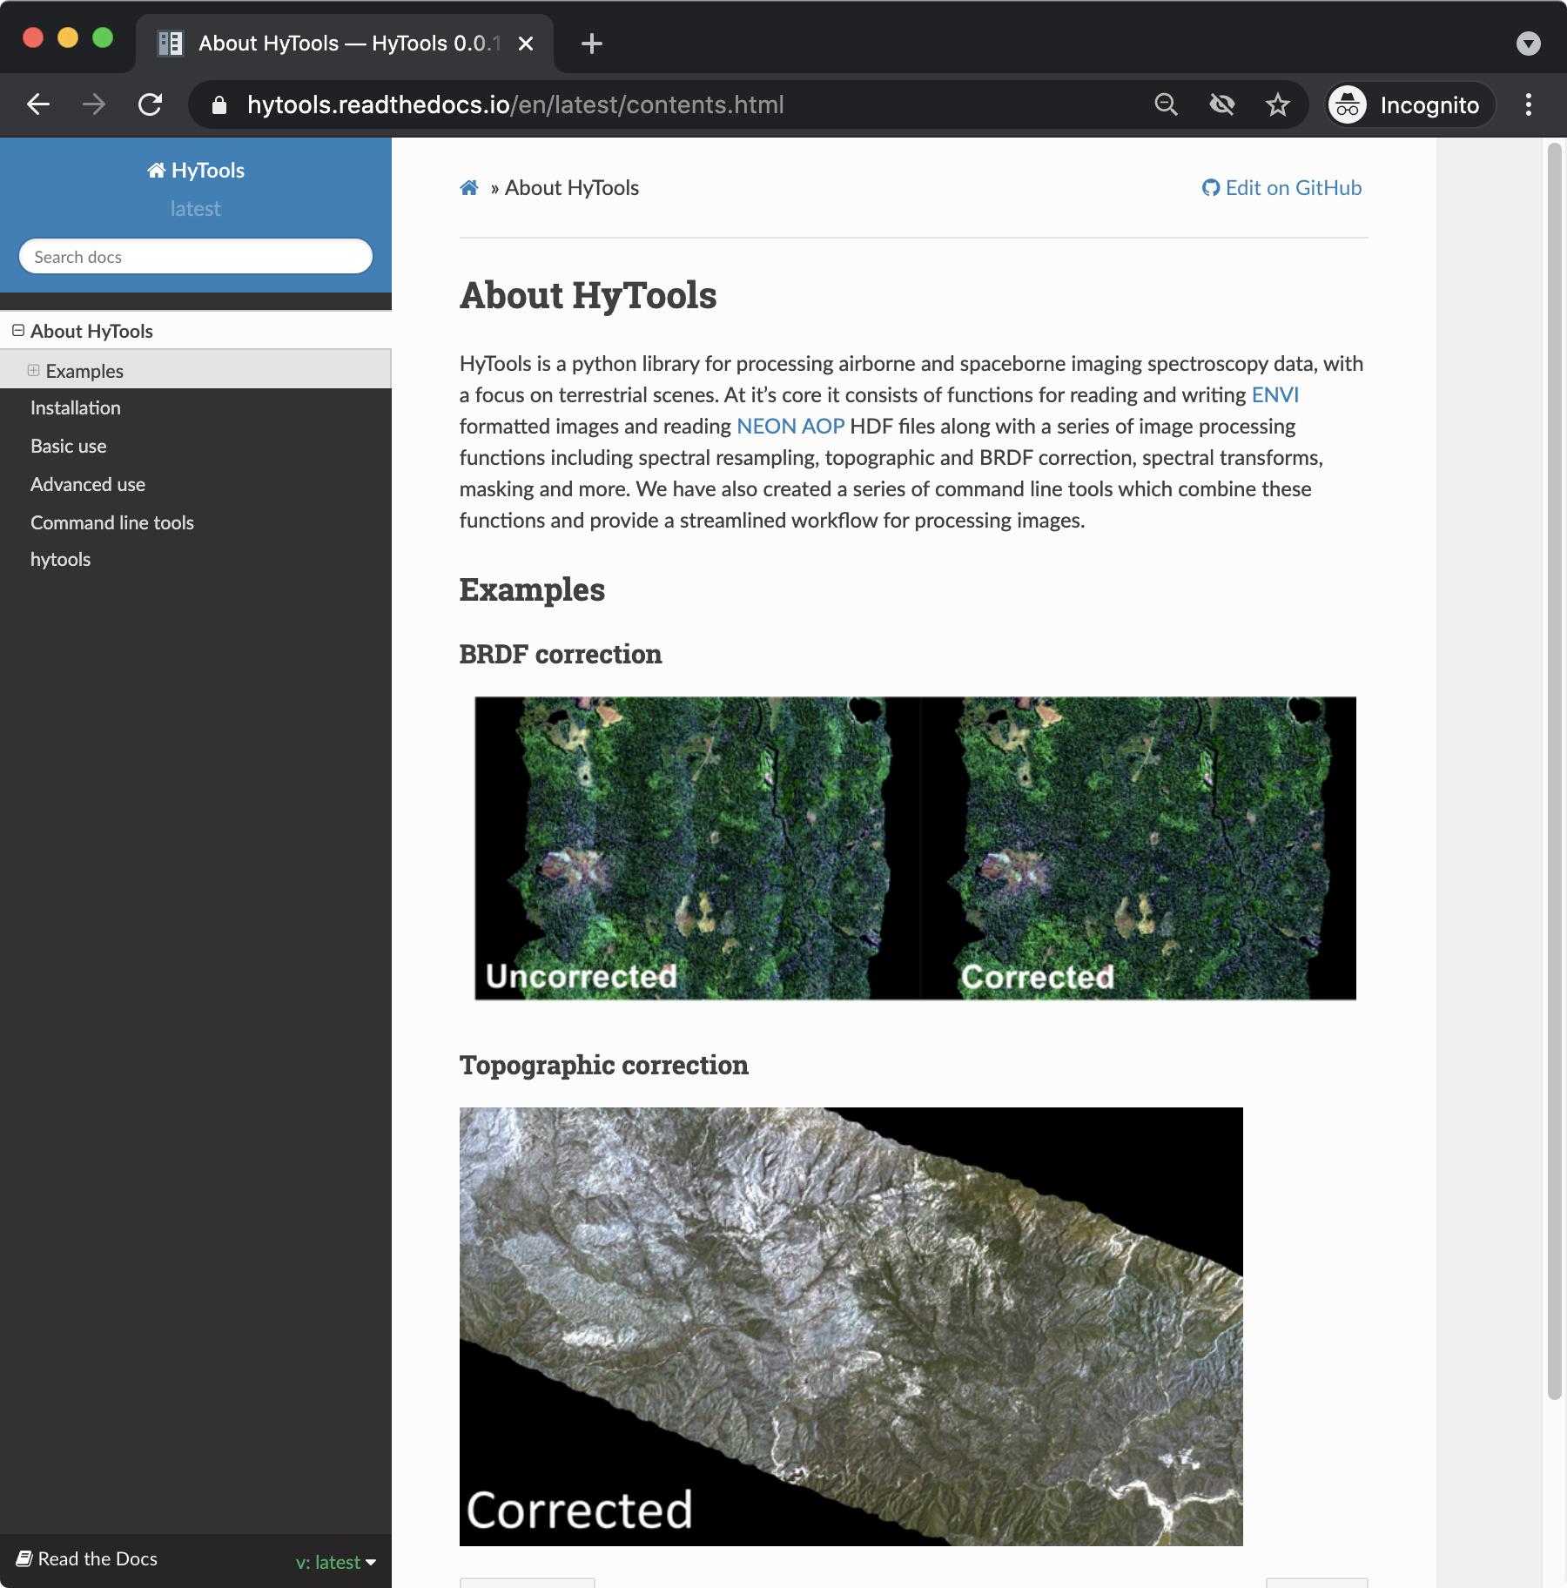
FlexBRDF, trait modeling, and other spectral tools available on Github: https://github.com/EnSpec/hytools

Slide 17
Status and outlook
New 2017-2019 ABoVE AVIRIS L2 Surface Reflectance product from Bayesian Model Inversion available early June
New 2017-2019 AVIRIS L2B BRDF/terrain-corrected Reflectance product from FlexBRDF and cloud/shadow masks available a few weeks later
Preliminary L3A trait maps are available upon request for ABoVE collaborators (ptownsend@wisconsin.edu or rpavlick@jpl.nasa.gov)
Further field sampling planned for 2022 campaign (next slide)
For ASTM8, look forward to:
  AVIRIS L3B trait diversity maps and more ecological analysis
  Full uncertainty propagation from the sensor to traits

Slide 18
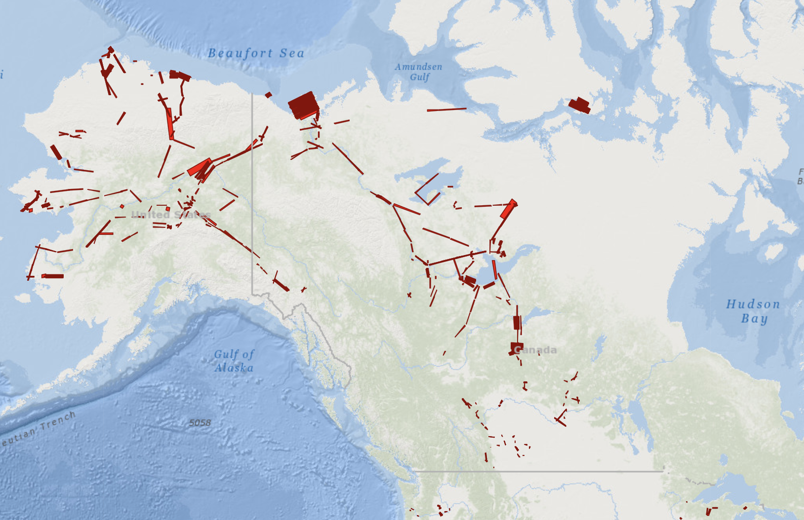
?
Plans for 2022 field season
Canadian Shield (Baker Lake)
Southwest Alaska (Bethel)
Yukon and Pacific Coast Ranges
Southern Boreal Forest (BERMS)
Great Bear Lake Transect
Victoria Island?
2019 field sampling areas
2017-2019 AVIRIS-NG
2022 notional sampling areas

