Slide 1
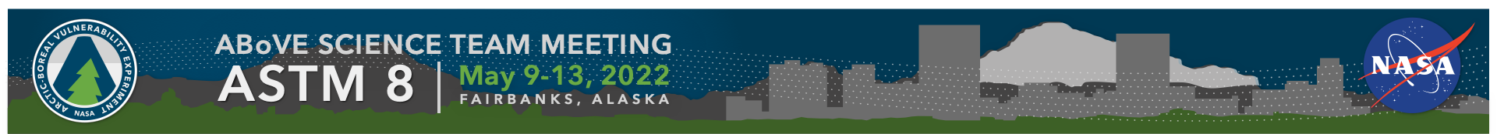
Spectral Imaging Working Group
Synthesis Activities
Co-Chairs: Peter Nelson, Fred Huemmrich

Slide 2
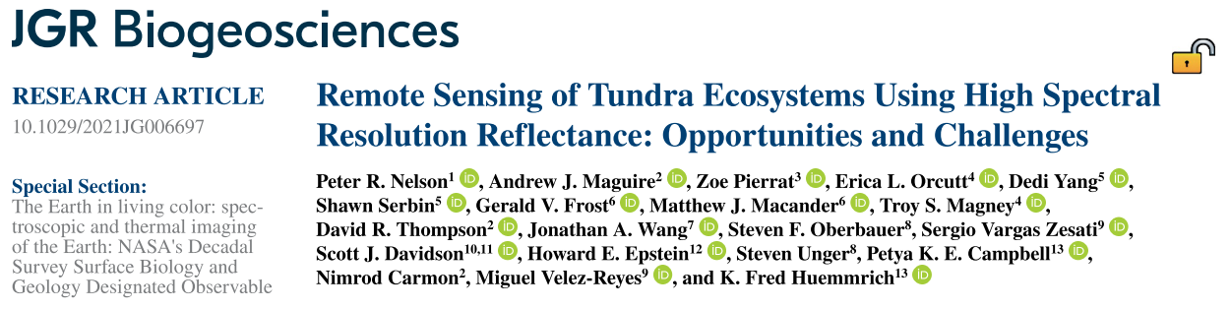
Recently published study:
Peter Nelson
Forest Ecology Director
Schoodic Institute at Acadia National Park
Andy Maguire
NASA Postdoctoral Program Fellow
Jet Propulsion Laboratory, California Institute of Technology

Slide 3
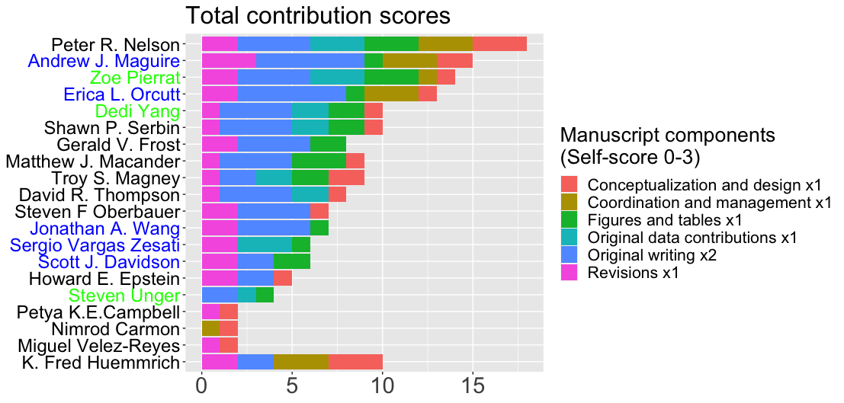
Authorship
We aimed for an inclusive writing process and had substantial input from people at all career stages
Graduate student
Postdoc
Mid/late career researcher
Notes:
Inclusive writing process
Function of the ABoVE Working Group to bring people together started the process
Someone puts out a manuscript out for the group (Fred in this case)
Lots of discussion about the elements
Lots of space for different roles (spatial, temporal, analytic, geographic, organism/process specialists)
People being open to learning about being inclusive, especially for non-PIs (post-docs and grad students)
People were supportive and willing to listen to everyone’s ideas
Wider range of people in different places in their careers
Authorship ranks were scored by individuals using the same
Finding ways to keep people involved (across time zones)
Include quotes from PR article
Survey authors about what worked/ what could be better to summarize in this presentation
Plot out scoring (anonymized) of the self-scoring authorship meeting
*we might suggest determining what authorship entails from the outset in future projects, since we wanted to be inclusive but also need to have appropriate allocation of credit

Slide 4







Introduction
Imaging spectroscopy is rapidly advancing
Current spaceborne instruments
  DESIS
  PRISMA
  EnMAP
Forthcoming spaceborne instruments
  SBG
  CHIME
Interpretation of IS data requires multi-scale observations

Slide 5
Key points:
﻿Imaging spectroscopy (IS) can help to measure critical Arctic tundra properties, physiological function, and temporal dynamics
To properly interpret IS data users must consider spectral complexity of tundra driven by composition, sensitivity to climate, and phenology

Slide 6
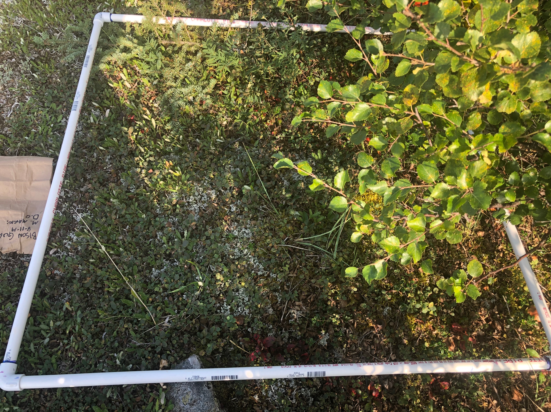
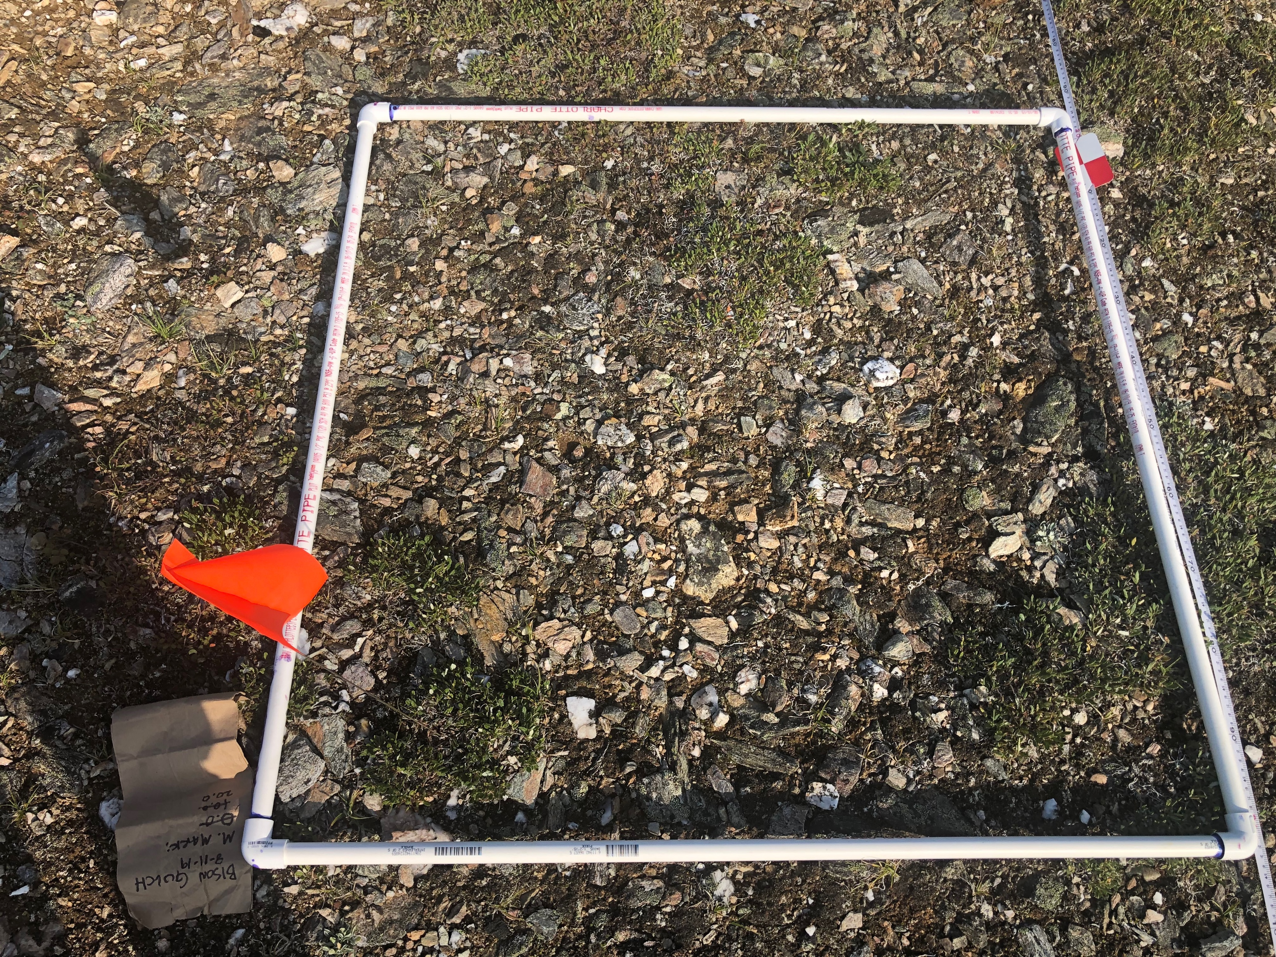
Tundra Characteristics
Tundra structure & composition is unique
Images show vegetation heterogeneity at fine spatial scales: 1 m quadrats separated by only 20 m distance
Short stature plants – “canopy” takes a different meaning
Mixed pixels, even at finest observable scales (< 1 m)
(credit: Peter Nelson)

Slide 7



Tundra Characteristics
Arctic meteorology complicates optical remote sensing
Abbreviated growing season
  Importance of the shoulder seasons
  Highly dynamic seasonality
Frequent cloud cover
High solar zenith angles
Extended snow cover season

Slide 8
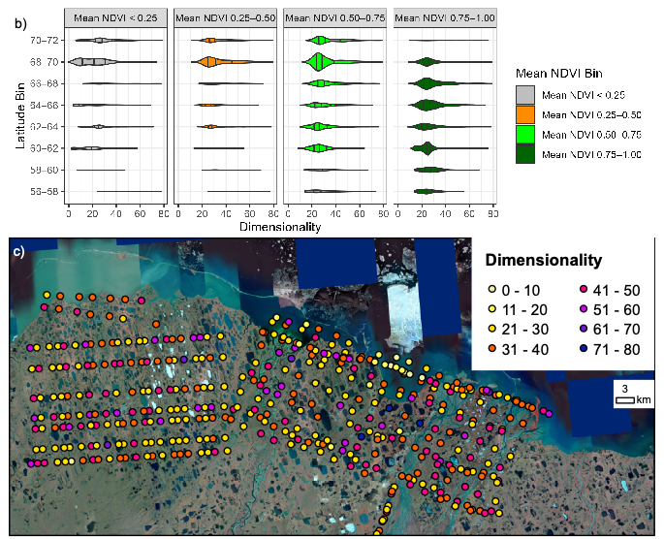
Case study: spectral complexity of tundra
Observed high dimensionality
across the sampled region,
and across NDVI gradient
Frequency distribution from the dimensionality analysis, binned by latitude and mean NDVI (b). Vertical bars in the violin plots (b) indicate the inter-quartile range and median value. Map of AVIRIS-NG segments analyzed laid over satellite imagery in the Sagavanirktok River area of Alaska [area denoted by a black box in (a)]. Colors indicate the dimensionality ranges for the different segments (c).

Slide 9
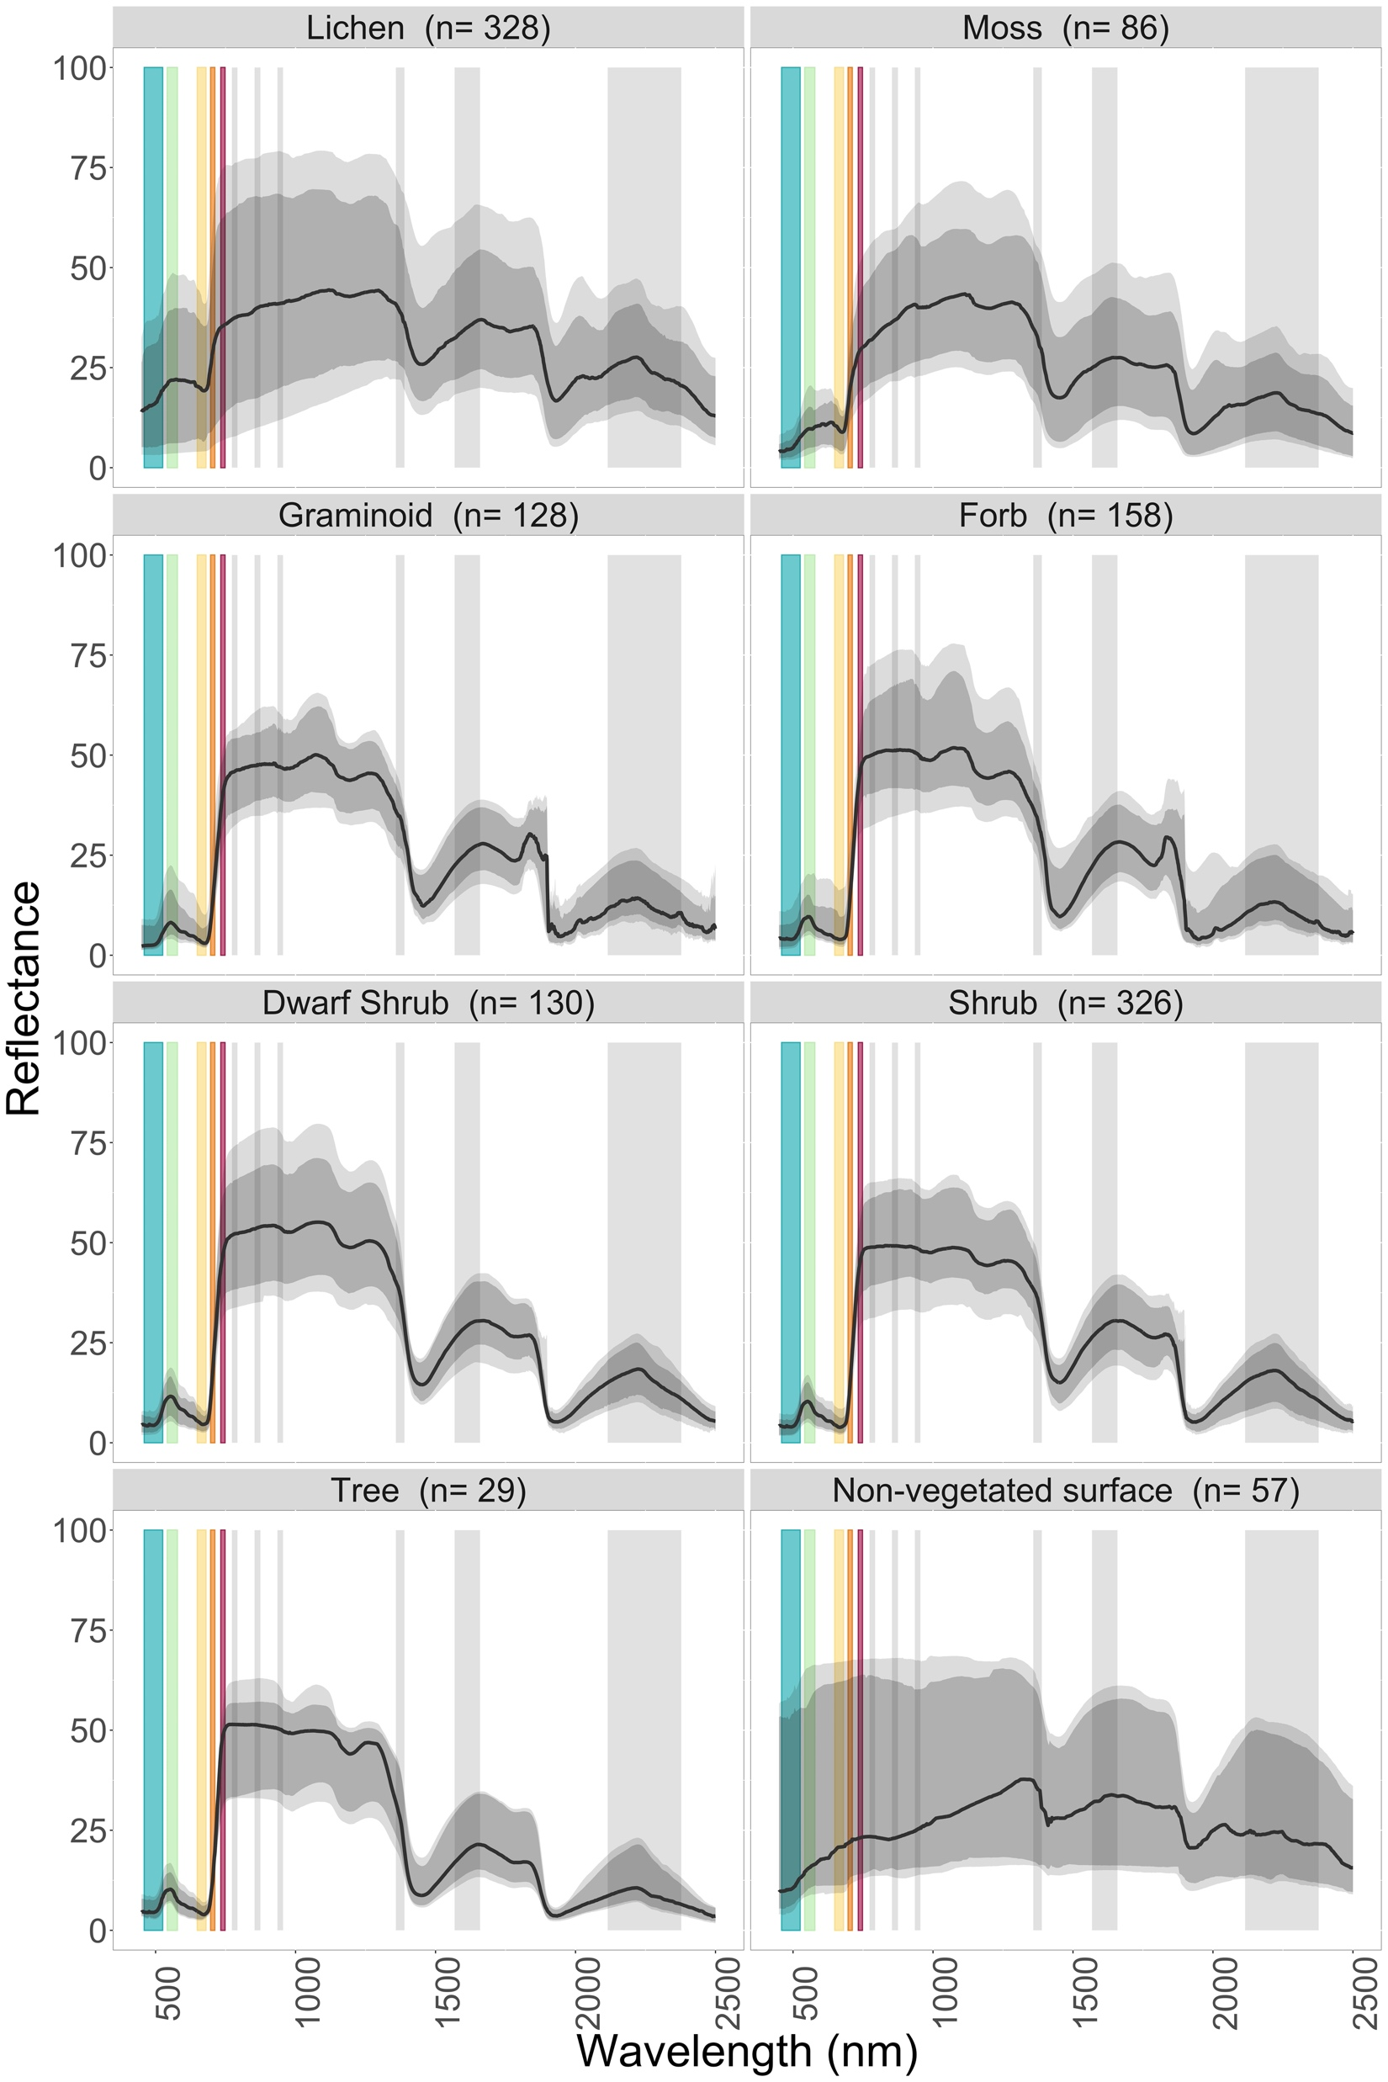
Spectral characteristics of tundra
Spectral variability among plant functional types
Vertical bars correspond to Sentinel-2 bandpasses, illustrating difference between multiband & higher spectral resolution sensor.
Nelson and Smith, 2022

Slide 10
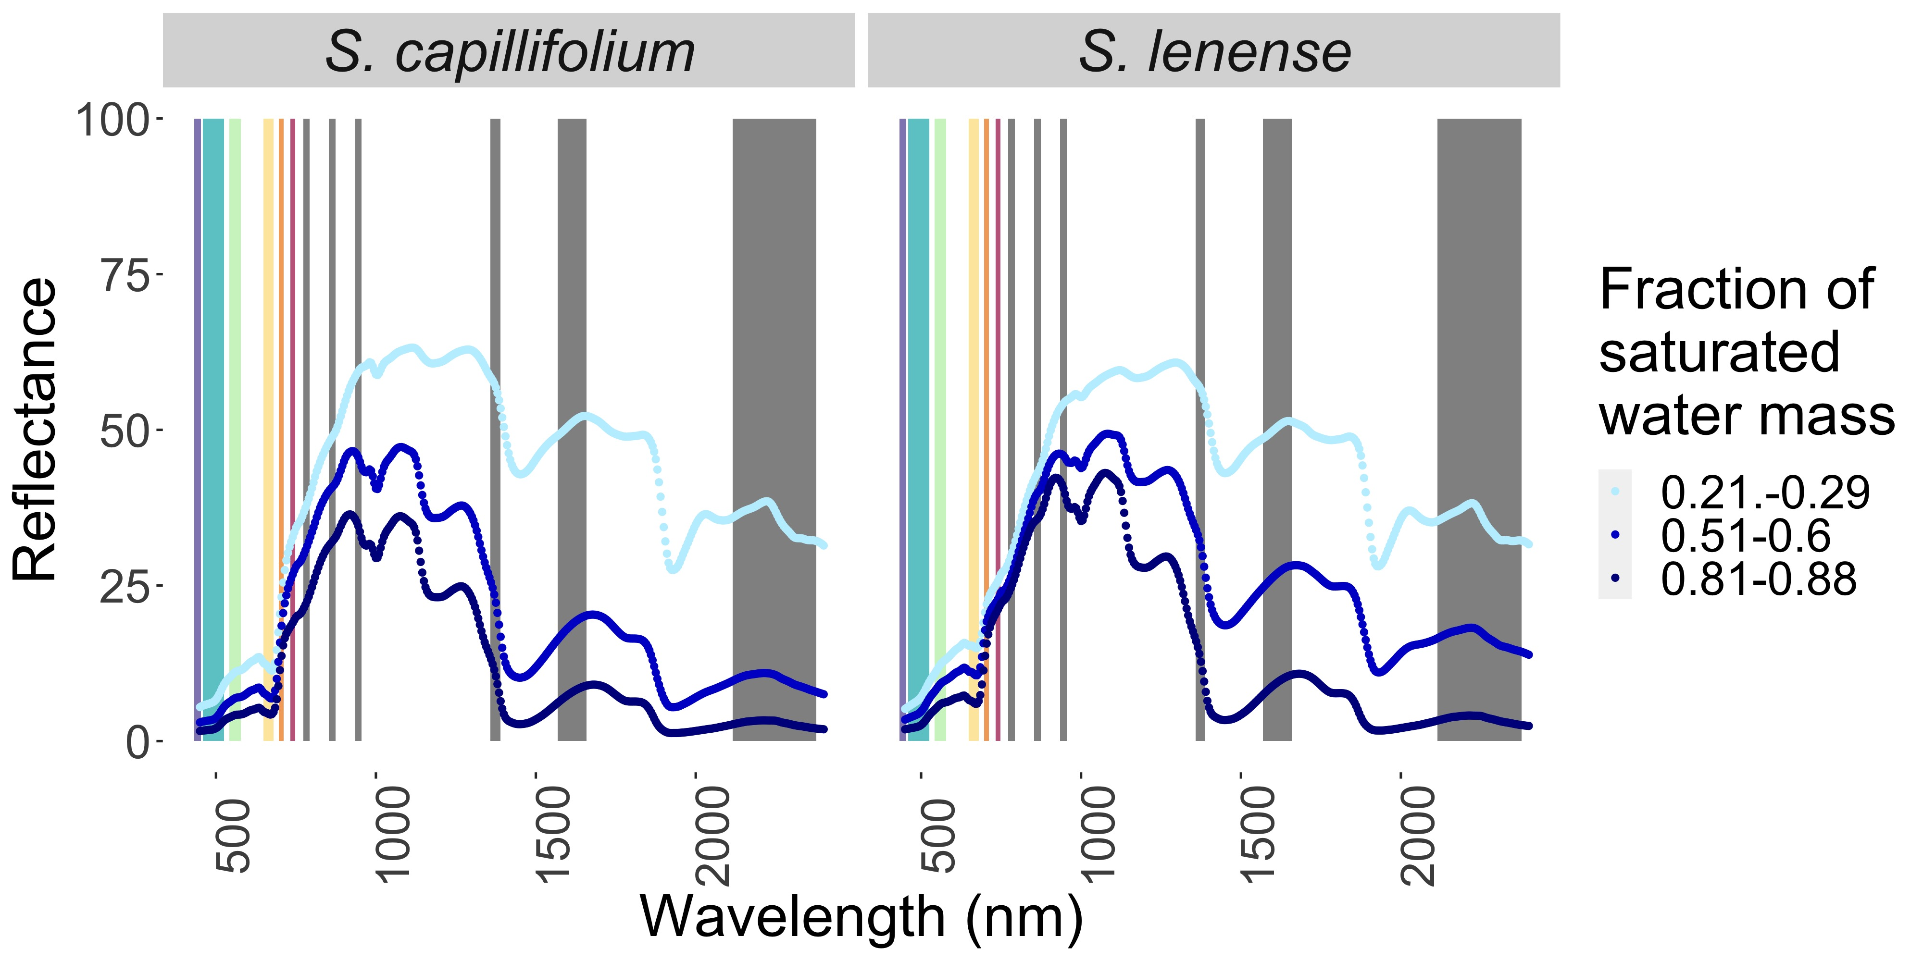
Spectral characteristics of tundra
Spectra of mosses vary with
hydration state
Unger et al., 2022
Vertical bars correspond to Sentinel-2 bandpasses, illustrating difference between multiband & higher spectral resolution sensor.

Slide 11
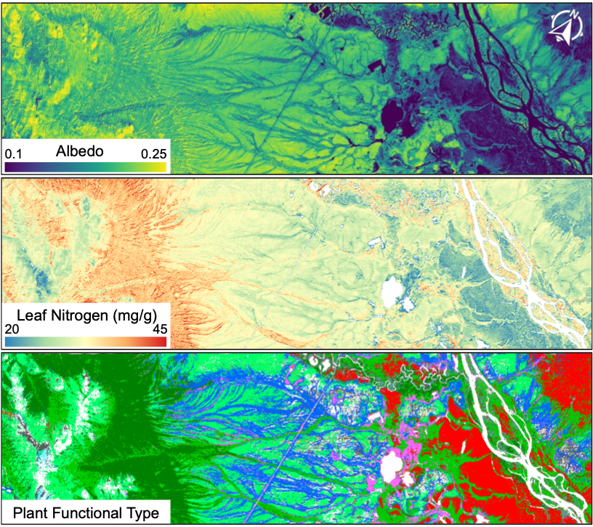
Uses of spectroscopy for tundra studies
Thematic mapping: beyond landcover classes
  Capturing the very fine-scale surface composition heterogeneity
Development of scalable algorithms for retrieval of biophysical properties and traits
  Identifying specific plant traits as well as plant functional type coverage
Improved descriptions of change
  Describe variation in vegetation growth and composition that complicates detection of long-term trends
  Identify rapid phenological changes across brief growing seasons
Serbin & Yang, 2022

Slide 12
Recommendations
Finer scale studies to inform interpretation of spaceborne observations
Leaf-canopy scale measurements inform algorithms on biophysical property retrievals
Coordinating airborne & field campaigns (esp. in shoulder season)
Long term change detection: moving beyond NDVI
Disentangle asynchronous phenologies among PFTs
Fusing multiple datasets to ameliorate gaps from low-quality observations

Slide 13
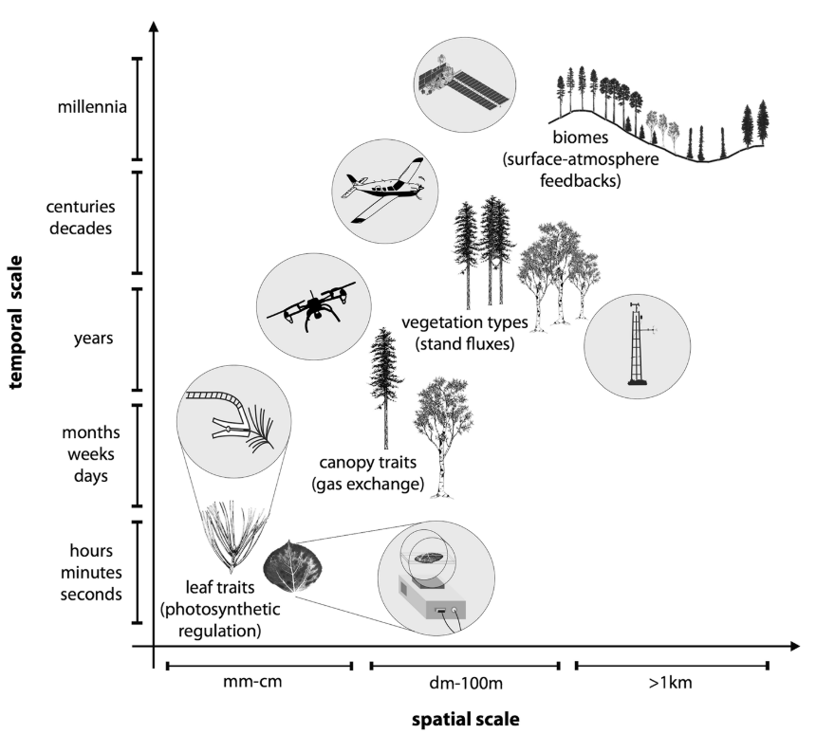
Next SIWG Synthesis Effort
We are discussing synthesis studies on scaling in optical remote sensing for high latitudes leading to another group paper
  Spatial scaling
    Do different types of landscapes have different spatial breakpoints in reflectance?
  2) Temporal scaling
    How to resolve short term responses, seasonal responses, disturbances, and multiyear green/browning trends?
  3) Spectral scaling
    What is the spectral resolution required for different types of retrievals?
  4) What are the cross-component scale dependencies?
We have been having monthly meetings, all are welcome
Gamon et al., 2019

