Slide 1
Accessing ABoVE Data
Liz Hoy, Peter Griffith - NASA Carbon Cycle and Ecosystems Office
Jim Shute, Ryan Forbes & others - NCCS Team
Bruce Wilson, Tammy Walker & others - ORNL DAAC
Mark Carroll - NASA Data Science Group and Innovation Lab
& ABoVE Science Team

Slide 2
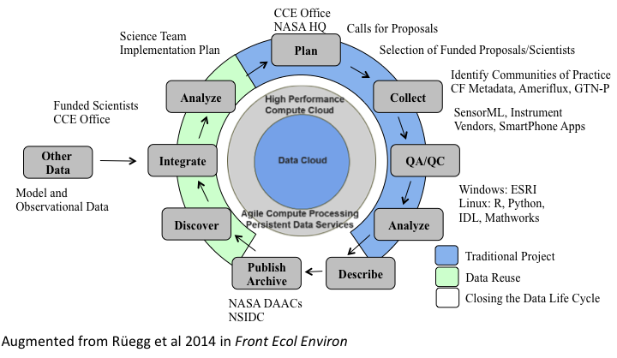

ABoVE Data Workflow
Notes:
The ABoVE science team plans and conducts field work, creates data products, and archives/publishes final data products

Slide 3
https://above.nasa.gov/data_workflow.html
Notes:
The ABoVE science team plans and conducts field work, creates data products, and archives/publishes final data products

Slide 4
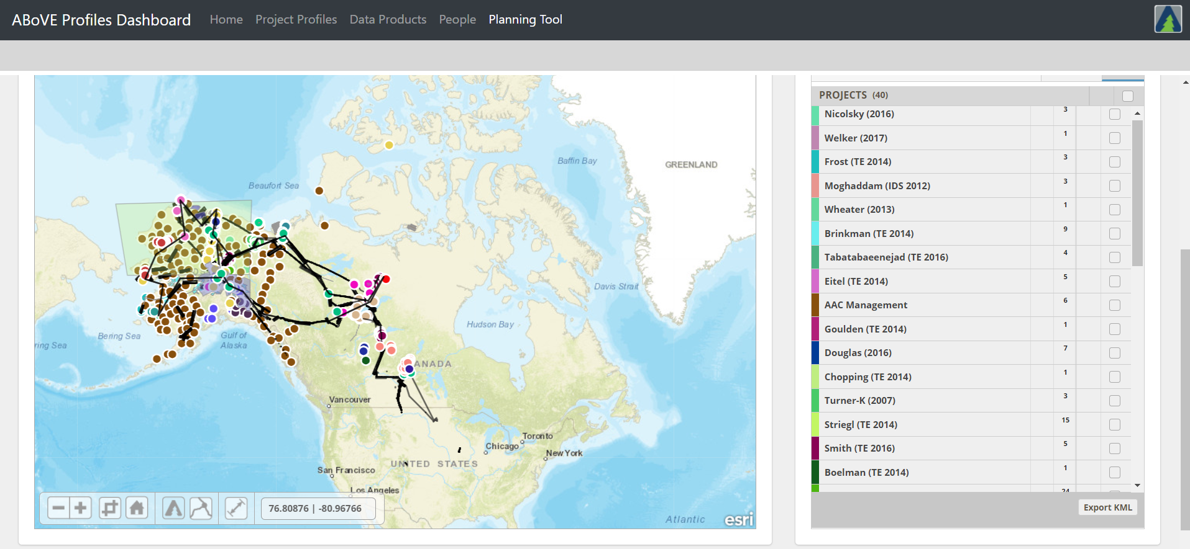
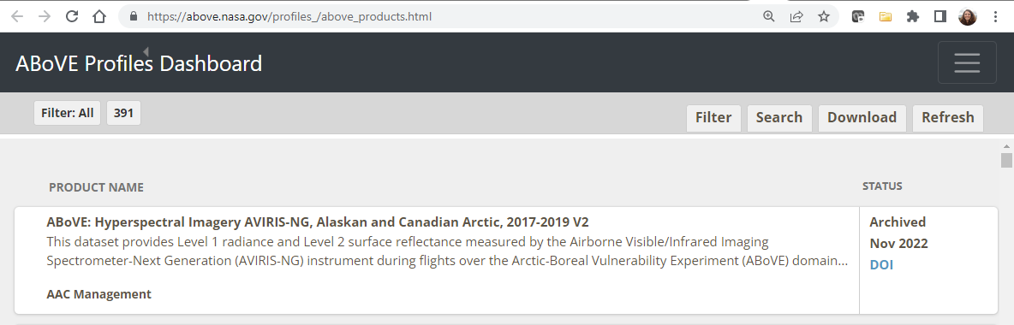
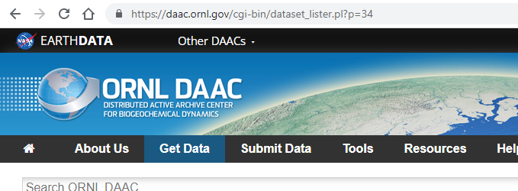
Notes:
The ABoVE science team plans and conducts field work, creates data products, and archives/publishes final data products

Slide 5
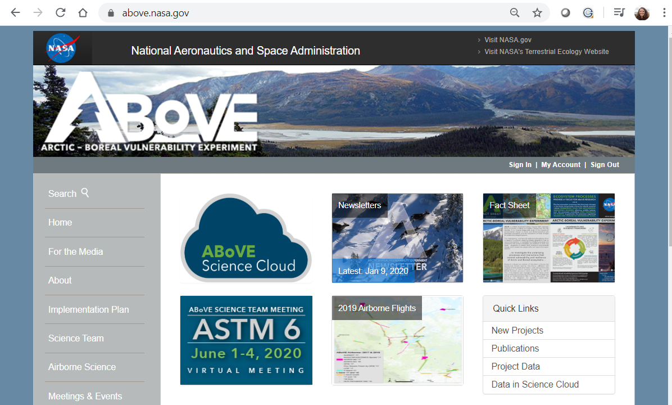


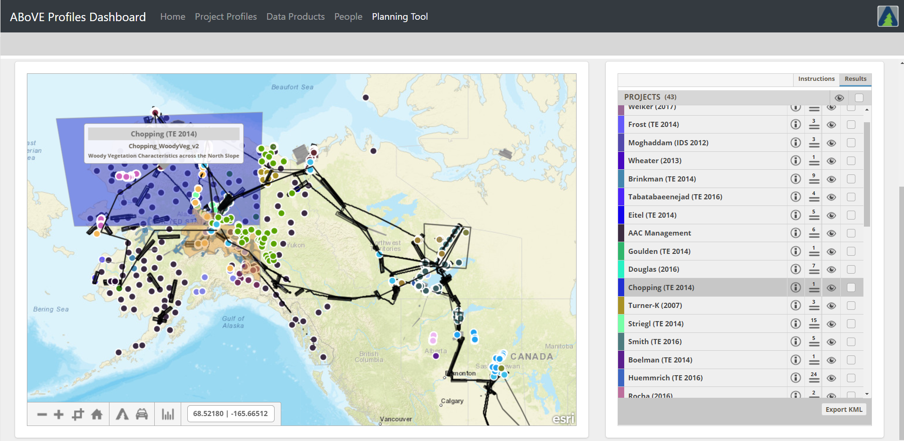


ABoVE Data Workflow
In-process
ABoVE Planning Tool

Slide 6
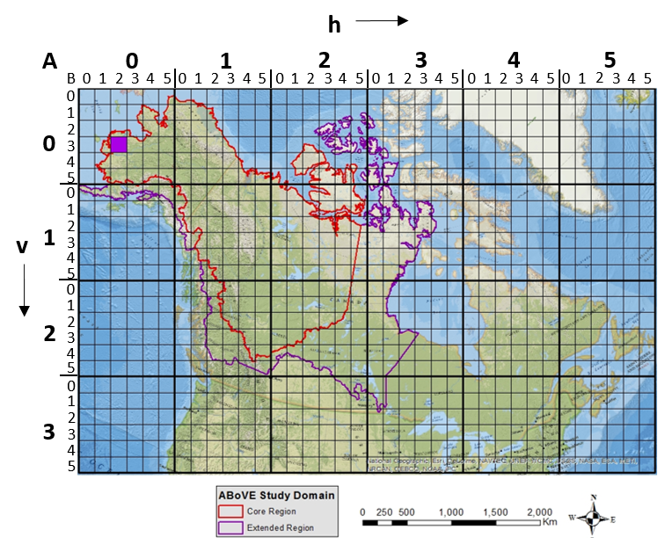
ABoVE Grid and Projection
Important to facilitate data interoperability and reduce time for individual projects
Projection: Albers Conical Equal Area
Grid (at right)
Available at the ORNL DAAC:
https://doi.org/10.3334/ORNLDAAC/1527
Notes:
Projection: Equal area projection for data fidelity, Single projection to cover the entire study region
Grid: Facilitate data interoperability, Reduce time for individual investigations, Modeled after the MODIS grid, A: 240m grid, B: 30m grid, less duplication of effort to reproject datasets for analysis, Allow data creators to align and subdivide data products, Ease of data archive

Slide 7
ABoVE Data Publication Information and Update
Bruce E. Wilson
ORNL DAAC Manager
ABoVE Science Team Meeting
January 2023
San Diego, CA

Slide 8
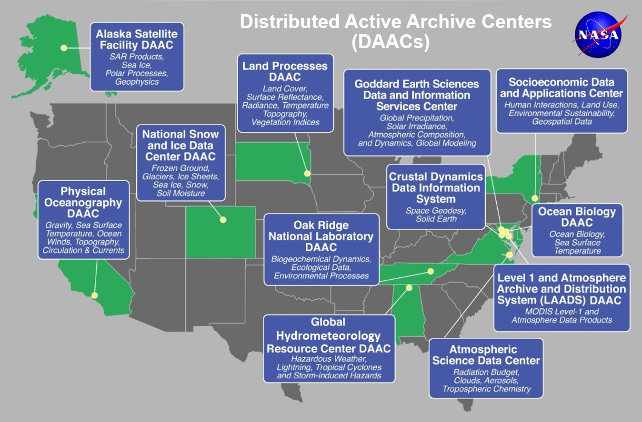
The ESDIS Project manages 12 DAACs

Slide 9
ABoVE Data is Published through 3 DAACs
ORNL DAAC
  Ground data sources
  Model and assimilation results
  Higher level airborne data products
  All AVIRIS (-C and –NG) data products (in progress)
  All MASTER data products
NSIDC DAAC
  LVIS data from the instrument team
ASF DAAC
  UAVSAR data from the instrument team

Slide 10

What do DAACs do with data?
We support science advancement by making data as FAIR as practical
Image: CC-SA4, SangyaPundir via Wikimedia commons
FAIR Principles: https://go-fair.org

Slide 11
How does the ORNL DAAC improve data FAIRness?
Publish data
  Review data for reasonableness, consistency, compliance with standards, alignment with best practices
  Develop a user guide for the data
  Assign (and maintain) the DOI and landing page
Promote, Support, Enhance, and Maintain data
  Ensure discoverability through Earthdata Search and Internet searches
  Integrate data with services (subsetting, visualization, transformation)
  Track downloads and citations of data (displayed on landing pages)
  Answer user questions where possible
  Update data formats and metadata to ensure continued reusability
  Preserve data for the long term
  Direct users to the most current version of data

Slide 12
What do we ask of you?
Familiarize yourself with the standards and best practices
  See https://daac.ornl.gov/submit/ (links to reference material)
Ask questions and let us know when things aren’t clear
  Online: https://forum.earthdata.nasa.gov
  Email: ingestlead@daac.ornl.gov (data producer questions)
  Email: uso@daac.ornl.gov (data user questions)
Get us your data as early as you can
Respond to our questions and review requests promptly
Add data publications to your CV and publication record
Let us know when we’ve done well and where we can improve
  Email: manager@daac.ornl.gov
  Any ORNL DAAC or ESDIS staff member in person

Slide 13
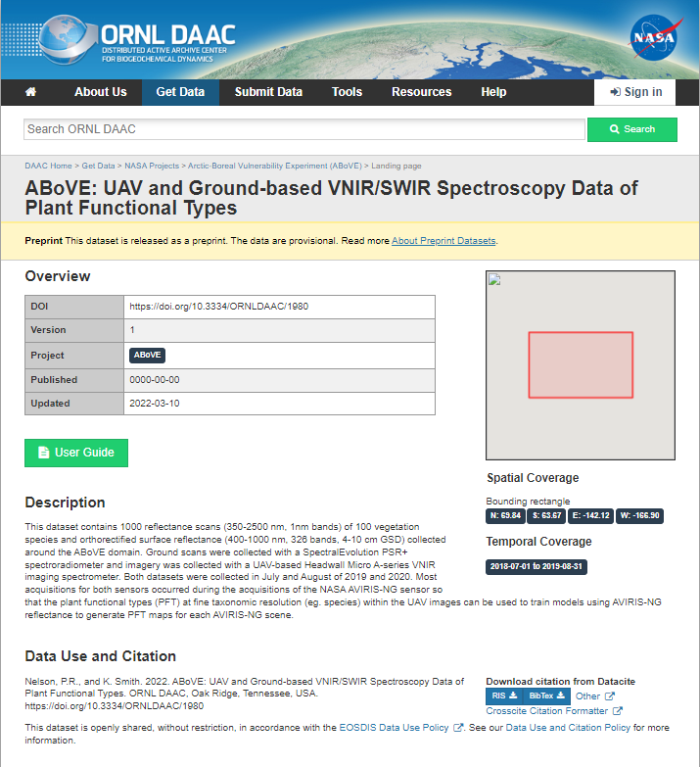
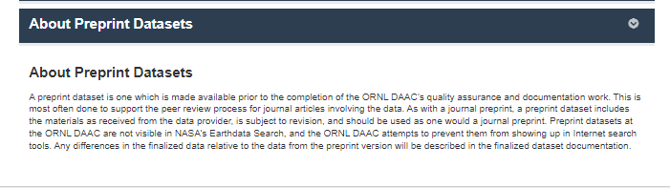
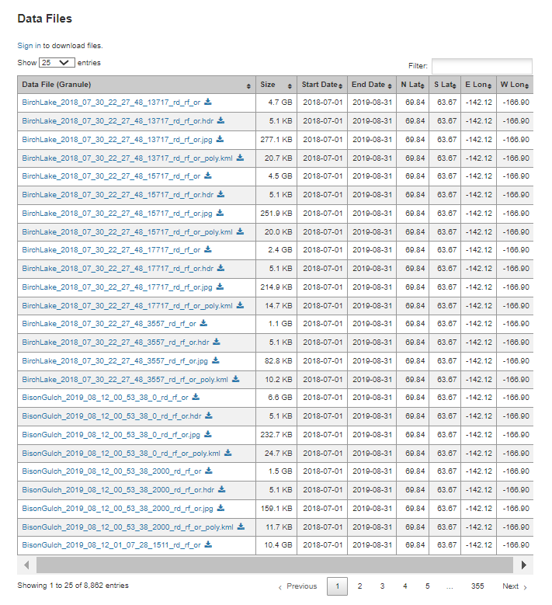
The ORNL DAAC can do Preprint Datasets, when needed
Many journals require the original data used in a manuscript be archived, and often it needs to be available for reviewers
Preprint datasets allow data to be available during the regular pub process
Preprint datasets provide:
  Landing page
  Data files as received
  Documentation you provide
  Citation
  Resolvable DOI
  Since the May 2022 ASTM we have published 9 pre-print datasets from the ABoVE project

Slide 14
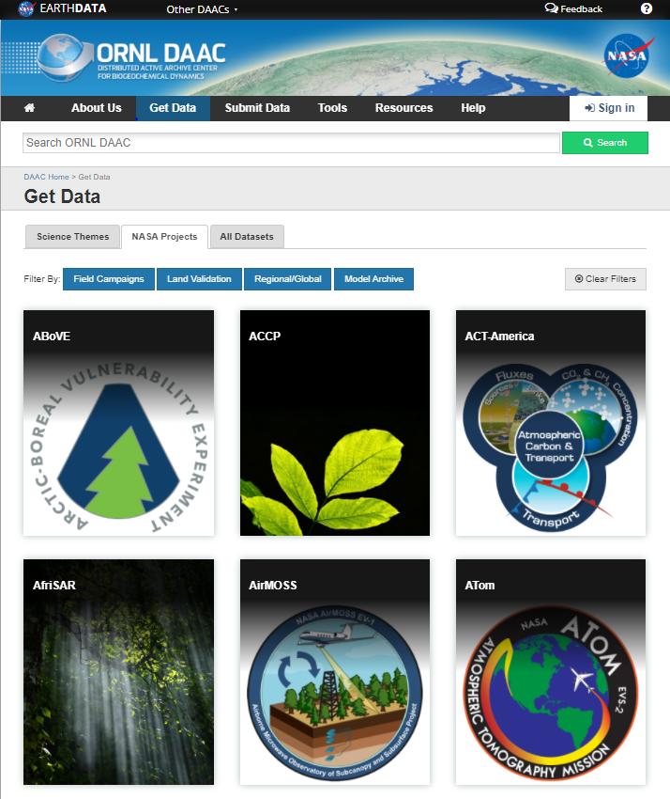
The ABoVE Project at the ORNL DAAC
https://daac.ornl.gov/above
Fiscal Year | # of Datasets | # of Files | Data Volume
FY15 | 3 | 5 | 0.08 GB
FY16 | 4 | 29 | 0.3 GB
FY17 | 27 | 1,128 | 0.5 GB
FY18 | 35 | 6,957 | 17,000 GB
FY19 | 33 | 5,880 | 17,600 GB
FY20 | 28 | 25,220 | 5,000 GB
FY21 | 19 | 20,317 | 19,000 GB
FY22 | 38 | 409,629 | 2,700 GB
FY23 Q1 | 6 | 27,183 | 17,360 GB
Total | 193 | 496,348 | ~78,000 GB
Current: 169 active datasets, 313,691 files totaling 26.5 TB

Slide 15
ABoVE is the largest ORNL DAAC project (by volume)
Project | Datasets | # Files | Data TB
ABoVE | 169 | 314K | 26.2
CMS | 98 | 708K | 23.3
Vegetation | 74 | 56K | 14.9
ACT-America | 16 | 34K | 13
GEDI | 4 | 60K | 11.5
CARVE | 26 | 21K | 6.3
Daymet | 5 | 6K | 3.9
MASTER | 90 | 29K | 3.7
…
LBA-ECO | 264 | 14K | 0.5
BOREAS | 303 | 39K | < 0.1
Since January 2015, ABoVE data have been downloaded from the ORNL DAAC 58,000 times from 12,000 unique IP addresses, with at least 97 dataset citations.

Slide 16
Most downloaded ABoVE data in calendar year 2022
ABoVE: Fractional Open Water Cover for Pan-Arctic and ABoVE-Domain Regions, 2002-2015 (399 downloads)
  Du, J., J.S. Kimball, and J.D. Watts. 2016. ABoVE: Fractional Open Water Cover for Pan-Arctic and ABoVE-Domain Regions, 2002-2015. ORNL DAAC, Oak Ridge, Tennessee, USA. https://doi.org/10.3334/ORNLDAAC/1362
ABoVE: Landsat-derived Burn Scar dNBR across Alaska and Canada, 1985-2015 (357 downloads)
  Loboda, T.V., D. Chen, J.V. Hall, and J. He. 2018. https://doi.org/10.3334/ORNLDAAC/1564
The ABCflux Database: Arctic-Boreal CO2 Flux and Site Environmental Data, 1989-2020 (292 downloads)
  Virkkala, A-M., S. Natali, B.M. Rogers, J.D. Watts, K. Savage, S.J. Connon, M.E. Mauritz-tozer, E.A.G. Schuur, D.L. Peter, C. Minions, J. Nojeim, R. Commane, C.A. Emmerton, M. Goeckede, M. Helbig, D. Holl, H. Iwata, H. Kobayashi, P. Kolari, E. Lopez-blanco, M.E. Marushchak, M. Mastepanov, L. Merbold, M. Peichl, O. Sonnentag, T. Sachs, M. Ueyama, C. Voigt, M. Aurela, J. Boike, G. Celis, N. Chae, T. Christensen, S. Bret-Harte, S. Dengel, H. Dolman, C. Edgar, B. Elberling, S.E. Euskirchen, A. Grelle, J. Hatakka, E.R. Humphreys, J. Jaerveoja, A. Kotani, L. Kutzbach, T. Laurila, A. Lohila, I. Mammarella, Y. Matsuura, G. Meyer, M.B. Nilsson, S.F. Oberbauer, S.J. Park, F.J.W. Parmentier, R. Petrov, A.S. Prokushkin, S. Zyrianov, C. Schulze, V.L. St.louis, E.S. Tuittila, J.P. Tuovinen, W. Quinton, A. Varlagin, D. Zona, and V.I. Zyryanov. 2021 https://doi.org/10.3334/ORNLDAAC/1934

Slide 17
Most downloaded ABoVE data for all time (as of end of 2022)
ABoVE: Landsat-derived Burn Scar dNBR across Alaska and Canada, 1985-2015 (1,747 downloads)
  Loboda, T.V., D. Chen, J.V. Hall, and J. He. 2018. https://doi.org/10.3334/ORNLDAAC/1564
ABoVE: Fractional Open Water Cover for Pan-Arctic and ABoVE-Domain Regions, 2002-2015 (1,692 downloads)
  Du, J., J.S. Kimball, and J.D. Watts. 2016. https://doi.org/10.3334/ORNLDAAC/1362
ABoVE: Surface Water Extent, Boreal and Tundra Regions, North America, 1991-2011 (1,519 downloads)
  Carroll, M.L., M.R. Wooten, C. Dimiceli, R.A. Sohlberg, and J.R.G. Townshend. 2016. https://doi.org/10.3334/ORNLDAAC/1324

Slide 18
Most downloaded ABoVE airborne data (as of end of 2022)
ABoVE: Hyperspectral Imagery from AVIRIS-NG, Alaskan and Canadian Arctic, 2017-2019 (1,155 downloads)
  Miller, C.E., R.O. Green, D.R. Thompson, A.K. Thorpe, M. Eastwood, I.B. Mccubbin, W. Olson-Duvall, M. Bernas, C.M. Sarture, S. Nolte, L.M. Rios, M.A. Hernandez, B.D. Bue, and S.R. Lundeen. 2019. https://doi.org/10.3334/ORNLDAAC/1569
ABoVE: Directory of Field Sites Associated with 2017 ABoVE Airborne Campaign (297 downloads)
  Hoy, E.E., P. Griffith, C.E. Miller, and ABoVE Science Team. 2018. https://doi.org/10.3334/ORNLDAAC/1582
ABoVE: Atmospheric Gas Concentrations from Airborne Flasks, Arctic-CAP, 2017 (281 downloads)
  Sweeney, C., K. McKain, B.R. Miller, and S.E. Michel. 2019. ABoVE: Atmospheric Gas Concentrations from Airborne Flasks, Arctic-CAP, 2017. ORNL DAAC, Oak Ridge, Tennessee, USA. https://doi.org/10.3334/ORNLDAAC/1717

Slide 19
Most Datasets as Lead Author (as of end of 2022)
Donald (Skip) Walker (University of Alaska, Fairbanks)
  13 as lead, 16 more as a co-author
Laura Bourgeau-Chavez (Michigan Tech Research Institute)
  6 as lead; 5 more as co-author
Tatiana Loboda (University of Maryland)
  6 as lead; 2 more as co-author

Slide 20
Dataset contributions (author or co-author) (as of end of 2022)
Brendan Rogers (Woodwell Climate Research Center): 14 datasets
Amy Breen (University of Alaska, Fairbanks): 12 datasets
Jennifer Watts (Woodwell Climate Research Center): 11 datasets
Martha Raynolds (University of Alaska, Fairbanks): 9 datasets
Kevin Schaefer (University of Colorado): 9 datasets
Susan Natali (Woodwell Climate Research Center): 9 datasets

Slide 21
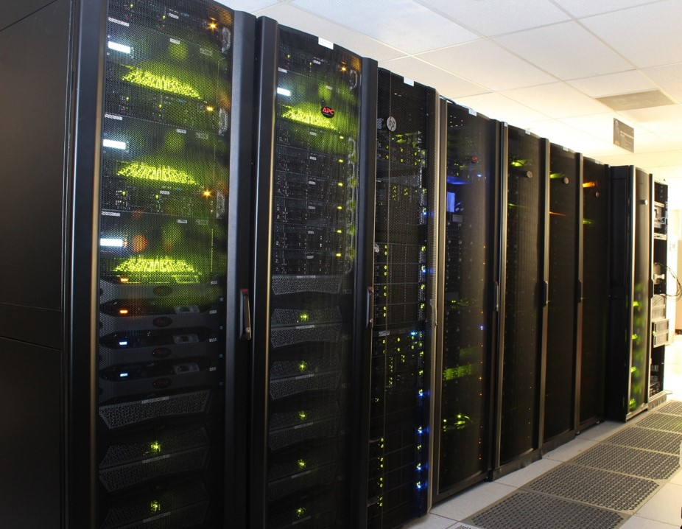
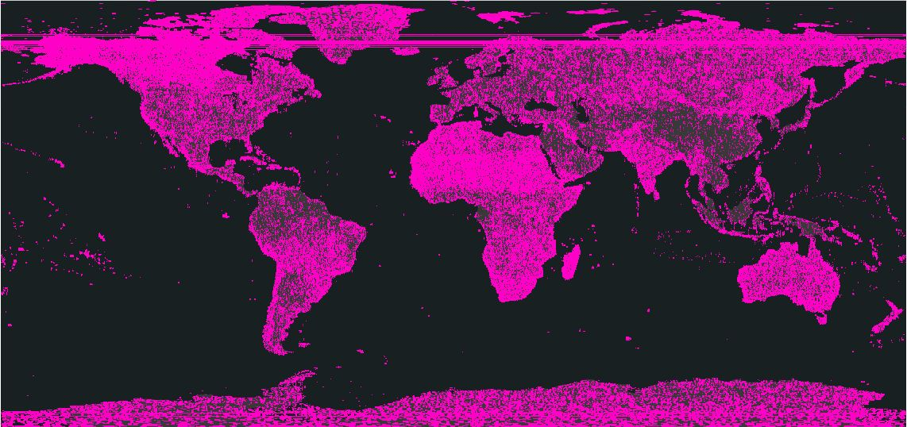
High Performance Compute for ABoVE
EXPLORE/ADAPT is the Advanced Data and Analytics PlaTform, available from the NASA Center for Climate Simulation (NCCS)
Both Linux & Windows Virtual Machines (VMs)
Incorporates storage, compute, and cloud computing capabilities
Designed for large-scale data analytics
>12 PB of Maxar Imagery Available on ADAPT
Info on ADAPT: https://www.nccs.nasa.gov/systems/ADAPT
To accessing ADAPT & Maxar Imagery: https://above.nasa.gov/sciencecloud.html?

Slide 22
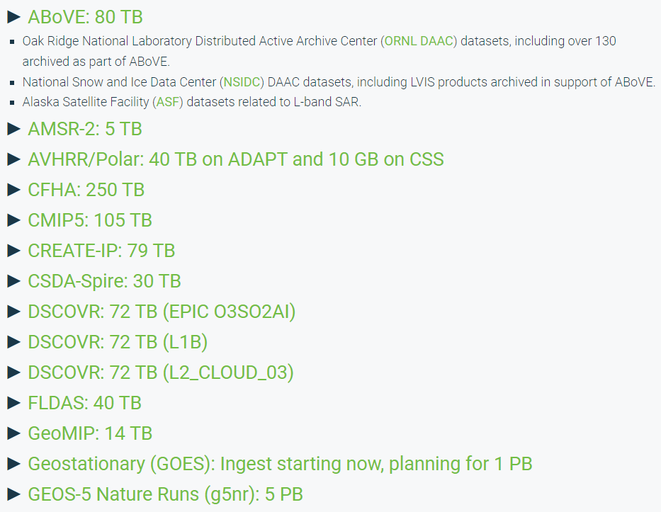
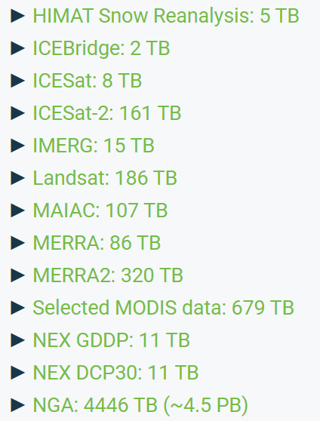
Large Data Collections on ADAPT
12

Slide 23
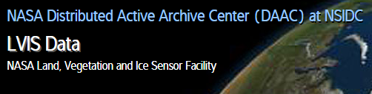
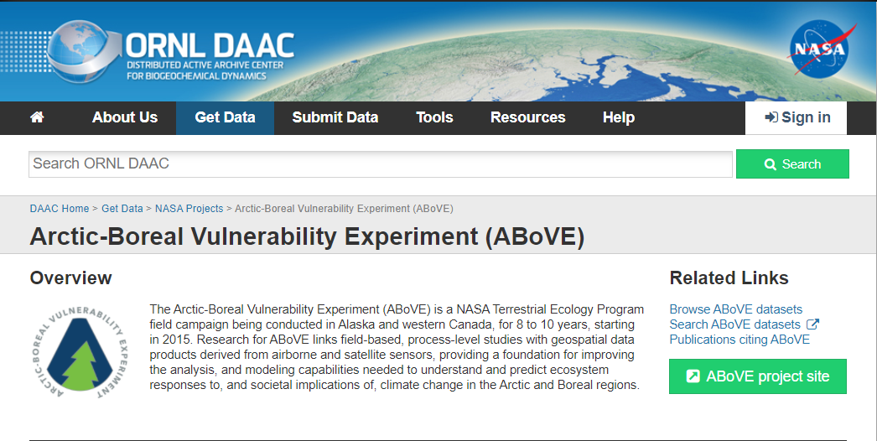
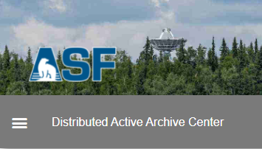



80 TB of ABoVE-Archived Data are on ADAPT
ADAPT brings together all ABoVE datasets in a single location for users.
L-Band UAVSAR Data
Notes:
ORNL DAAC has about 130 ABoVE datasets
ADAPT brings datasets in as they become available, and then we can also send the DAAC datasets as investigators finish their work. This can be important if they are developing a data product with a high data volume

Slide 24
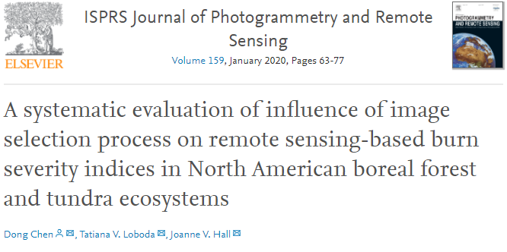
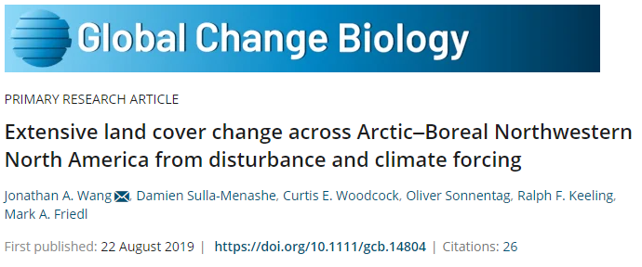
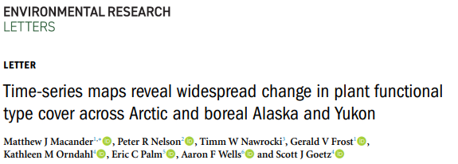
ABoVE Publications and Products Developed on EXPLORE
13 publications list the use of ADAPT in their acknowledgements (more are in-process)
39 data products using/used EXPLORE in their development (more to come)
  30 archived datasets at a NASA DAAC
  7 planned products
  2 public products

Slide 25

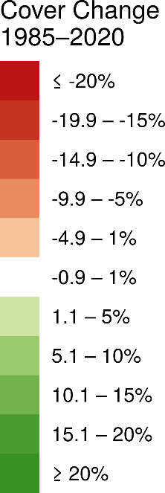
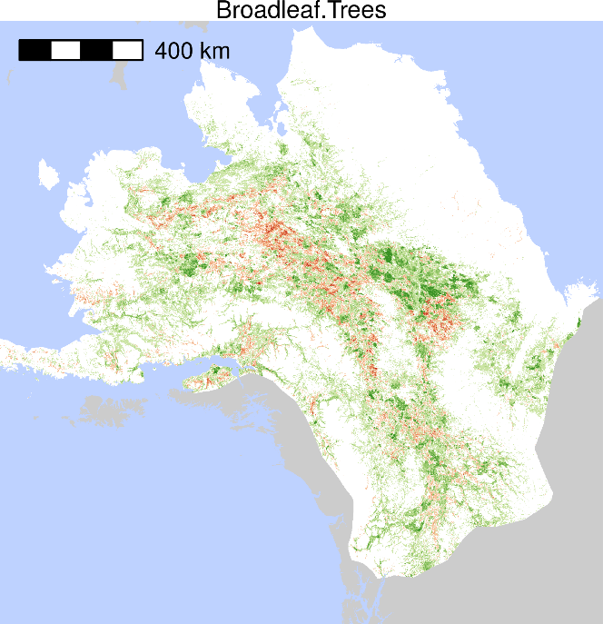
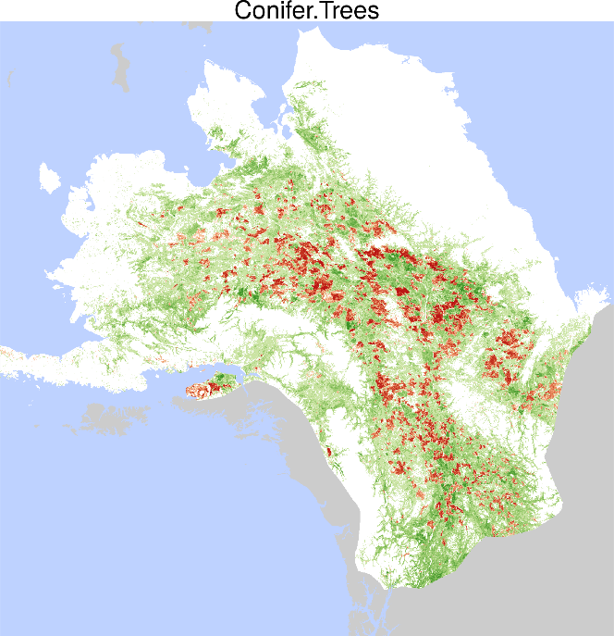
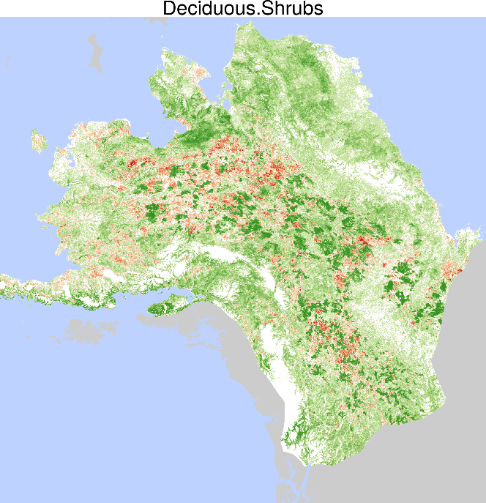
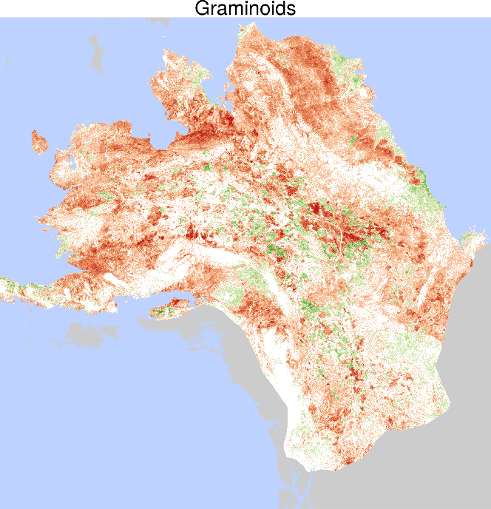
Time-series maps reveal widespread change in plant functional type cover across Arctic and boreal Alaska and Yukon
  Macander et al. (2022) Environmental Research Letters.
Documented increases in Deciduous and Evergreen Shrub, Conifer and Broadleaf Tree top cover.
Associated decreases in Graminoid and Lichen top cover with fire disturbance and shrub increases.
These changes are highly relevant to resource management applications, including wildlife habitat.
Notes:
Notes: Plant functional types (PFTs) collectively include all vascular plants within the study area as well as light macrolichens, a nonvascular class of high importance to caribou management.
We identified net increases in deciduous shrubs (3.7% of study area), evergreen shrubs (1.1%), broadleaf trees (1.0%), and conifer trees (0.9%), and net decreases in graminoids -2.2%) and light macrolichens 0.8%) over the full map area, with similar patterns across Arctic, Oroarctic, and Boreal bioclimatic zones
Despite extensive wildfire over the 1985–2020 study period, our results indicated that both broadleaf and coniferous tree cover increased throughout the domain.
Rapid increases in deciduous shrub cover after fire and throughout the domain support both post-fire pulses in shrub abundance and long-term shrub increase and canopy dominance in the absence of fire disturbance.
Graminoid top cover decreased throughout the domain, likely driven by competition from deciduous and evergreen shrubs.
Slow, steady loss of lichen is related to both increases in shrubs and associated losses from fire.
Full citation: Macander, M.J., Nelson, P.R., Nawrocki, T., Frost, G.V., Orndahl, K., Palm, E.C., Wells, A.F. and Goetz, S.J., 2022. Time-series maps reveal widespread change in plant functional type cover across arctic and boreal Alaska and Yukon. Environmental Research Letters. https://doi.org/10.1088/1748-9326/ac6965
Data: Macander, M.J., and P.R. Nelson. 2022. ABoVE: Modeled Top Cover by Plant Functional Type over Alaska and Yukon, 1985-2020. ORNL DAAC, Oak Ridge, Tennessee, USA. https://doi.org/10.3334/ORNLDAAC/2032
Grants: This study was funded by the National Aeronautics and Space Administration (NASA) Arctic Boreal Vulnerability Experiment (ABoVE) grants (NNX17AE44G and 80NSSC19M0112) to Scott Goetz.
Abstract: Widespread changes in the distribution and abundance of plant functional types (PFTs) are occurring in Arctic and boreal ecosystems due to the intensification of disturbances, such as fire, and climate-driven vegetation dynamics, such as tundra shrub expansion. To understand how these changes affect boreal and tundra ecosystems, we need to first quantify change for multiple PFTs across recent years. While landscape patches are generally composed of a mixture of PFTs, most previous moderate resolution (30-m) remote sensing analyses have mapped vegetation distribution and change within land cover categories that are based on the dominant PFT; or else the continuous distribution of one or a few PFTs, but for a single point in time. Here we map a 35-year time-series (1985–2020) of top cover (TC) for seven PFTs across a 1,770,000 km² study area in northern and central Alaska and northwestern Canada. We improve on previous methods of detecting vegetation change by modeling TC, a continuous measure of plant abundance. The PFTs collectively include all vascular plants within the study area as well as light macrolichens, a nonvascular class of high importance to caribou management. We identified net increases in deciduous shrubs (66,000 km²), evergreen shrubs (20,000 km²), broadleaf trees (17,000 km²), and conifer trees (16,000 km²), and net decreases in graminoids (-40,000 km²) and light macrolichens (-13,000 km²) over the full map area, with similar patterns across Arctic, Oroarctic, and Boreal bioclimatic zones. Model performance was assessed using spatially blocked, nested 5-fold cross-validation with overall root mean square errors ranging from 8.3–19.0%. Most net change occurred as succession or plant expansion within areas undisturbed by recent fire, though PFT TC change also clearly resulted from fire disturbance. These maps have important applications for assessment of surface energy budgets, permafrost changes, nutrient cycling, and wildlife management and movement analysis.

Slide 26
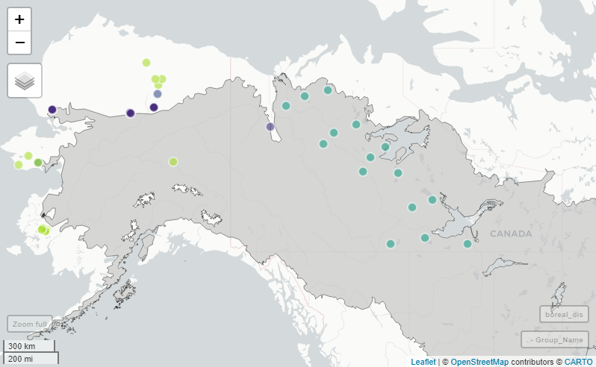
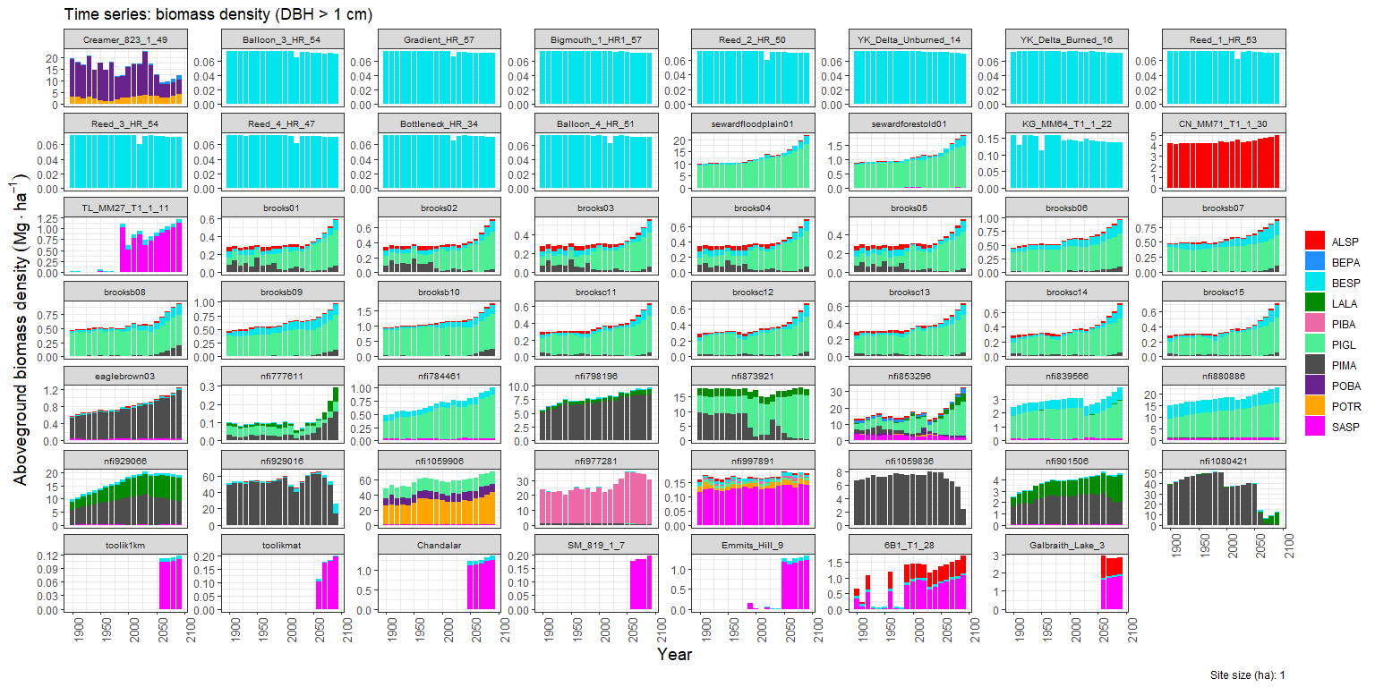
A Database of Simulated Vegetation Change at Sites Across the Taiga-Tundra Ecotone
P. Montesano, A. Armstrong (PI), B. Osmanoglu, H. Epstein, E. Heffernan, B. Gay
The forest growth model SIBBORK-TTE is run on ADAPT to track the growth of individual trees and shrubs through time (1900-2100) and across bioclimatic gradients using spatial inputs from ArcticDEM, SoilGRIDS, MERRA2, CMIP6, & NASA cloud cover
200 years of change in vegetation structure & composition at sites in the taiga-tundra ecotone
Sites of simulations in database
These simulations are assembled in a database to explore the variation in expected changes in vegetation structure and composition across the taiga-tundra ecotone in North America.

Slide 27
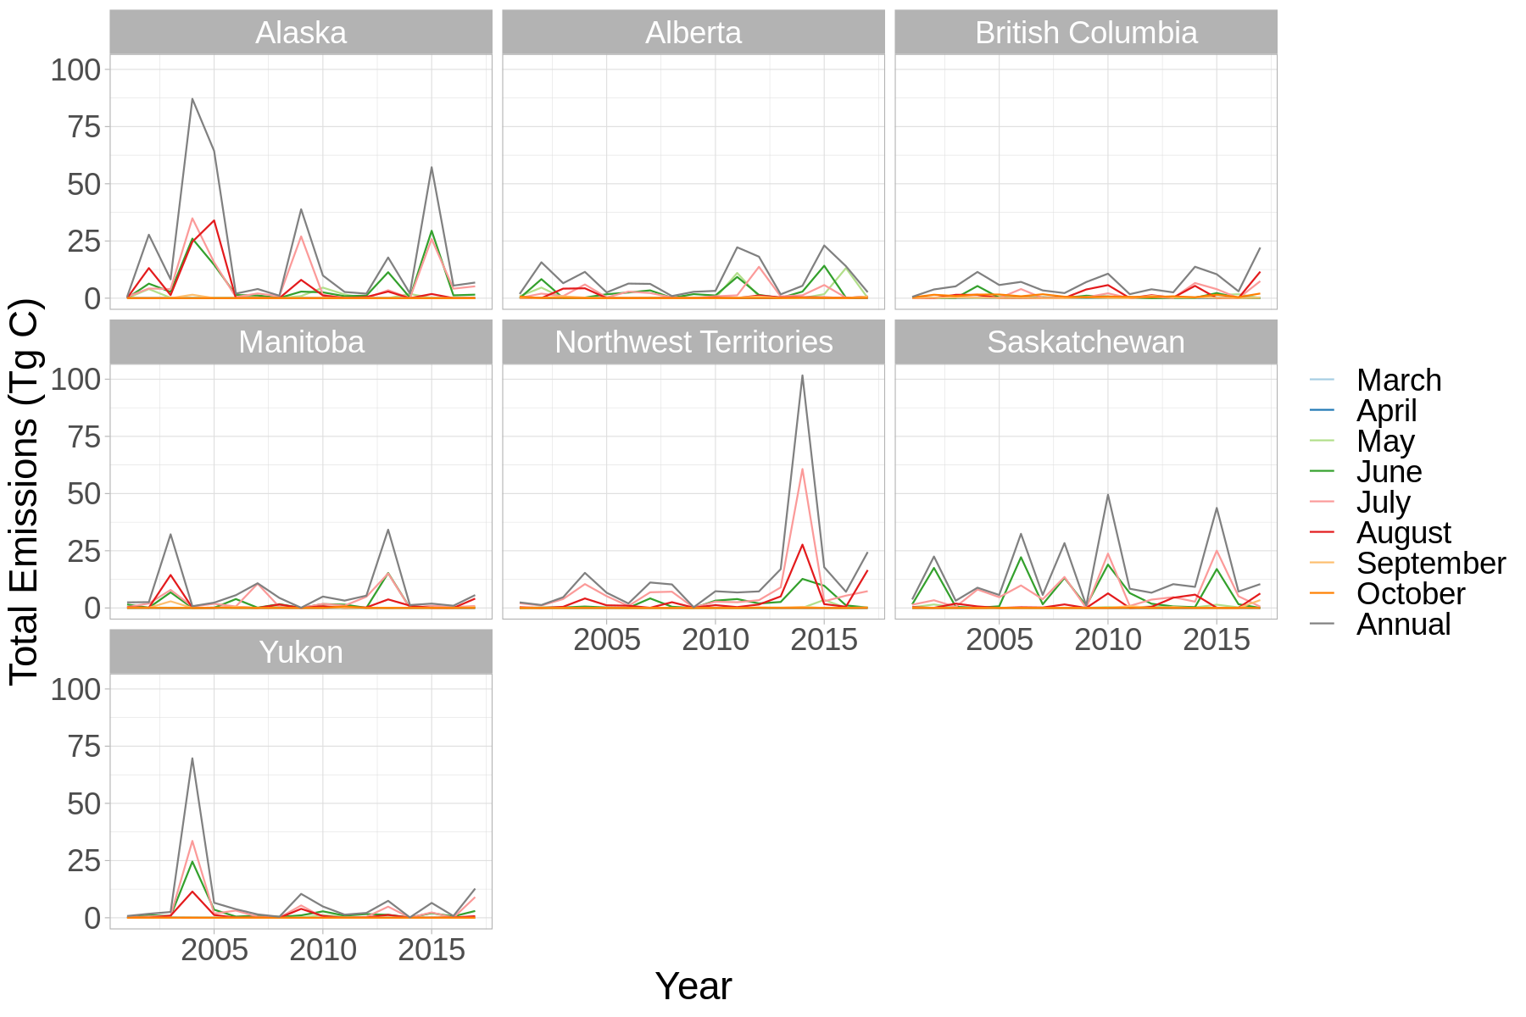
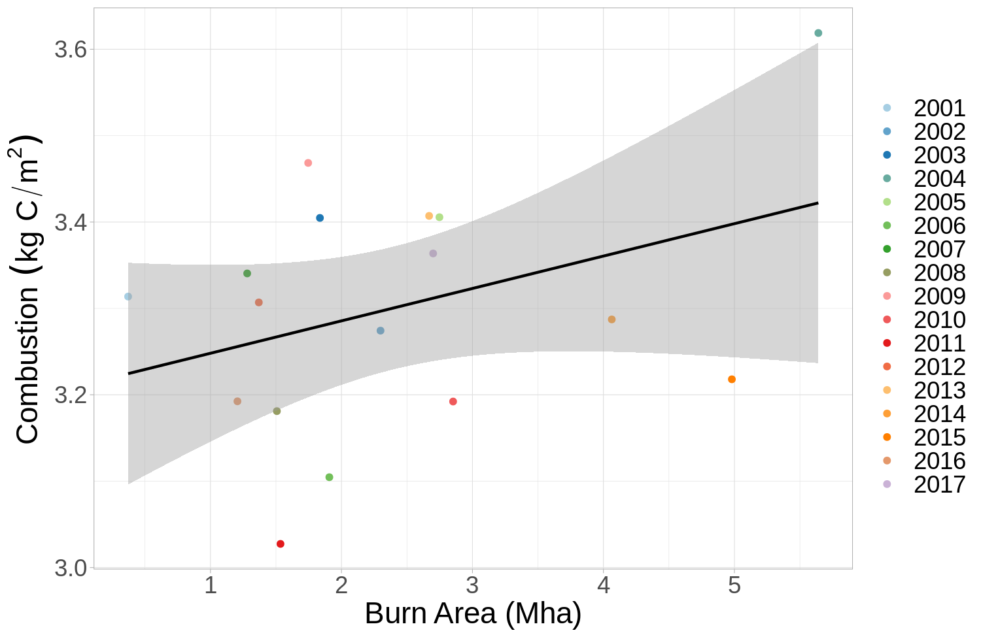
Modeling Emissions and Analyzing Variability in Burned Areas
S. Potter, B. Rogers, et al.
  Over 8,000 jobs submitted on ADAPT
  Using ORNL DAAC datasets to build a statistical model of emissions
  Using MODIS and Landsat data to identify burned areas & model carbon emissions
  Applying a combustion model to estimate carbon emissions from belowground and aboveground sources (for 2001-2019)
Notes:
Using ORNL DAAC datasets to build a statistical model of emissions and analyze spatial and temporal variability in burned area and emissions.
Planning to use JupyterNotebooks on ADAPT
ADAPT as others have described has also been an invaluable resource for me, and the paper we are working on right now is focused on identifying burned areas at the MODIS resolution across the ABoVE domain between 2001-2019, and then applying a combustion model to those pixels to get better estimates of the carbon emissions coming from both belowground and aboveground sources. The largest advantage of our new burned area product is that while the final resolution is at the MODIS 500m, we also used Landsat data to get a better idea of the vegetated fraction within the larger MODIS pixels, which can have a large influence on the total estimated burned area and is not accounted for by previous methods.
Additionally, but using this fire detection product along with field measurements of combustion other researches have put together across the ABoVE domain (https://daac.ornl.gov/ABOVE/guides/ABoVE_Plot_Data_Burned_Sites.html) we were able to build a statistical model of emissions related to a suite of covariates and then apply the predictions of these emissions to the burn product. Using this approach we have now examined both spatial and temporal variability in burned area and emissions and explored how the two are connected.

Slide 28
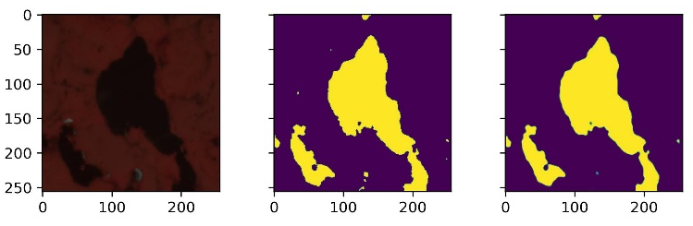
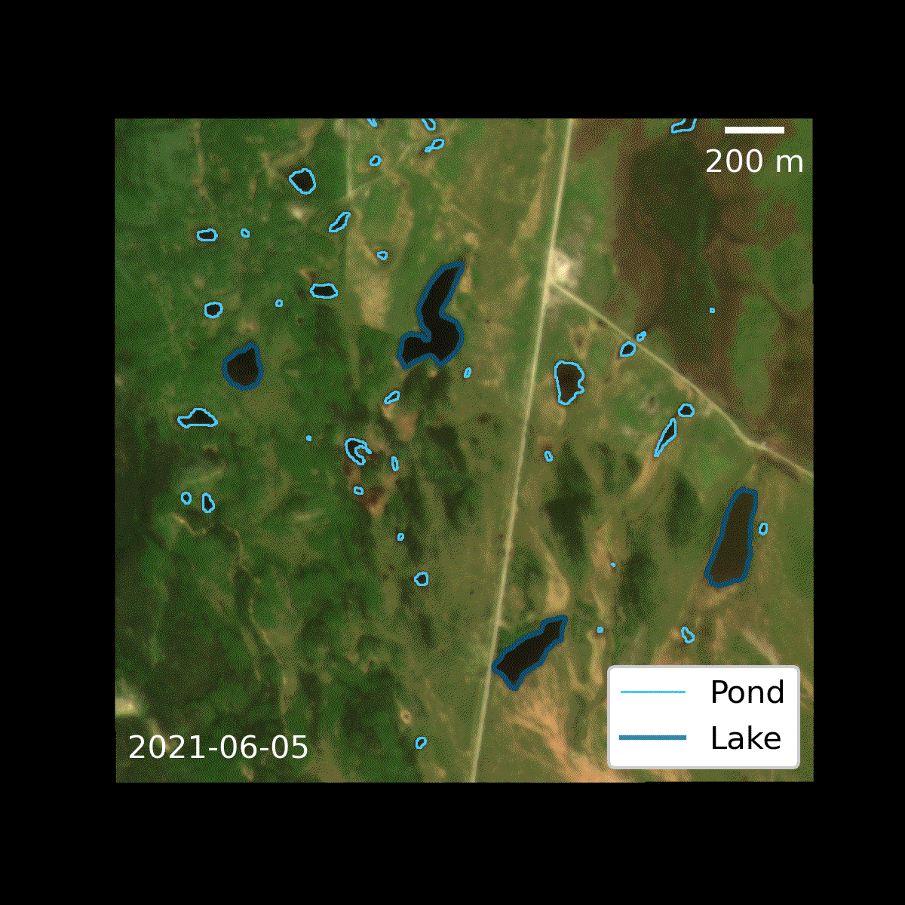
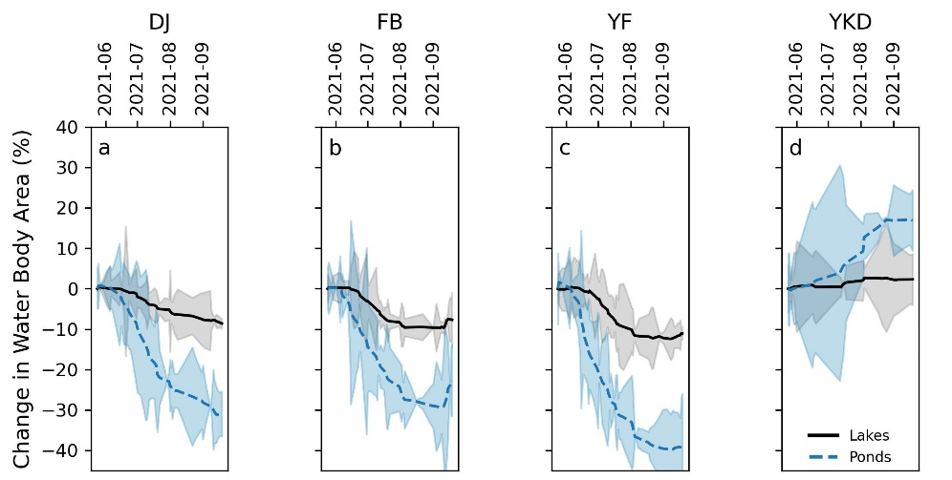





Using High-resolution Satellite Imagery and Deep Learning to Track Dynamic Seasonality in Small Water Bodies
Trained model with >13,000 hand-delineated water bodies on PRISM GPU cluster. Training data development relied heavily on 2 m Maxar WorldView imagery from NGA archive.
Mullen et al., 2023 (in review; see poster)
Deployed model on over 7,000 PlanetScope images (area ~ 3x Alaska)
Tracked small changes in lake and pond surface area at near-daily temporal resolution

Slide 29
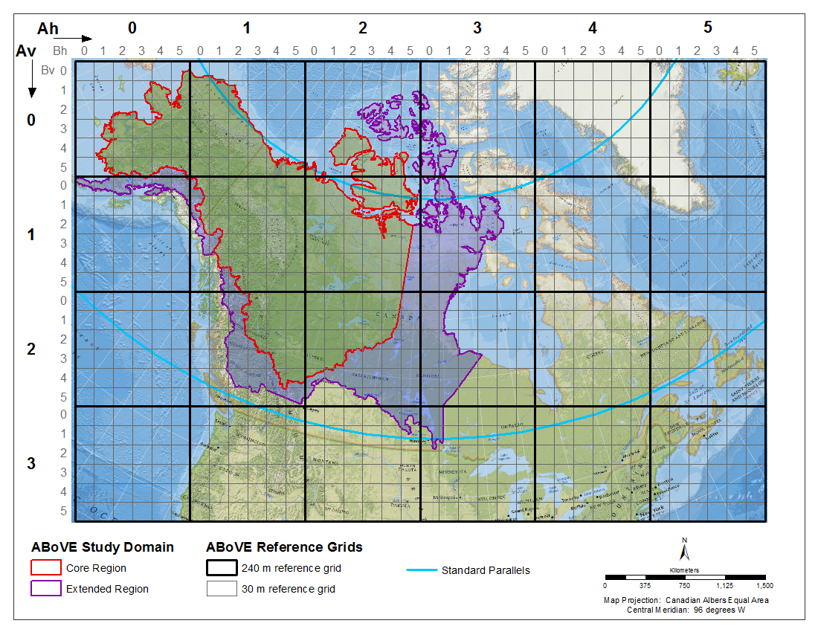
NCCS ABoVE GLAD ARD Product
Landsat Analysis Ready Data (ARD) tiles are produced from Landsat Collection 2 data by the Global Land Analysis and Discovery Lab (GLAD) at the University of Maryland.
The dataset is distributed as 16-day interval composites, with 23 intervals for each year (i.e., Interval ID 5 corresponds to DOY 65 to 80).
We have downloaded and made available the entirety of this dataset through October 2022 across the ABoVE Study domain, including the Extended Region. There is currently a total of 18TB, with more data to come.
The GLAD Landsat ARD C2 product has been gridded to the ABoVE Reference Grid at moderate resolution (B) and reprojected to Canada Albers Equal Area Conic (ESRI: 102001).
/css/above/glad.umd.edu/Collection2/GLAD_ARD/ABoVE_Grid
Table 1. Available bands
ID | Band
1 | Blue band
2 | Green band
3 | Red band
4 | NIR band
5 | SWIR1 band
6 | SWIR2 band
7 | Normalized brightness temperature
8 | Observation quality flag (QF)
ABoVE.GladARD.200511.Bh002v003.001.20220919.tif
200511 | data reference date, given by year and interval ID
Bh002v003 | position within the ABoVE reference B grid
001 | product version
20220919 | production date
Potapov, P., Hansen, M.C., Kommareddy, I., Kommareddy, A., Turubanova, S., Pickens, A., Adusei, B., Tyukavina A., and Ying, Q., 2020. Landsat analysis ready data for global land cover and land cover change mapping. Remote Sensing 12, 426; doi:10.3390/rs12030426

Slide 30
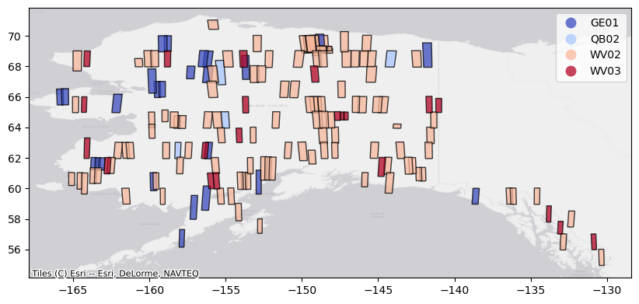
VHR Analysis Ready Data for Alaska
Source VHR
Reference SR
Workflow Key
Raw VHR image scenes
CCDC Landsat composite
Input reference SR data
Input source EVHR TOA data
Intermediate source cloudmask data
A set of 172 VHR images across Alaska for which surface reflectance was estimated with the SR-lite workflow.
Neigh et al. 2013
Zhu & Woodcock 2014
Intermediate model development data
Output SR data
Sub-routine workflows
SR-lite Container
SR-lite Result
EVHR Container
Cloud Masking
Output SR model evaluation table
TOA workflow
Input data stack workflow
SR model workflow
CNN cloud mask workflow
Output TOA VHR image strip
Output VHR cloudmask strip
clipping
re-gridding
model build
masking
model apply
Output SR Cloud-optimized GeoTiff
Neigh et al. 2019
Caraballo-Vega et al. 2022
MS bands
MS bands
MS bands
Montesano, Carrol, Neigh, Macander, Caraballo-Vega, Tamkin in prep. 2023

Slide 31



NGA Imagery Data Discovery Tool (DDT)
NASA Center for Climate Simulation (NCCS)
January 25, 2023
Jim Shute
NCCS Cloud Computing and Data Services (CCDS) Lead
james.k.shute@nasa.gov

Slide 32
NGA/Maxar Data Statistics
29.2 million images
12.8 petabytes
Sensors
  GE01 (1,948,067)
  IK01 (322,417)
  OV03 (227)
  QB02 (3,470,713)
  WV01 (6,362,592)
  WV02 (11,796,075)
  WV03 (5,234,308)
  WV04 (13,505)
Years
  1999 (10), 2000 (25,485),
  2001 (34,174), 2002 (176,934),
  2003 (260,623), 2004 (274,672),
  2005 (252,903), 2006 (309,937),
  2007 (482,251), 2008 (740,694),
  2009 (802,602), 2010 (1,197,106), 2011 (1,772,616), 2012 (1,990,030), 2013 (1,914,354), 2014 (1,753,856), 2015 (1,886,852), 2016 (2,150,556), 2017 (2,297,327), 2018 (1,923,486), 2019 (1,580,714), 2020 (2,733,255), 2021 (2,560,723), 2022 (2,021,130), 2023 (5,615)

Slide 33
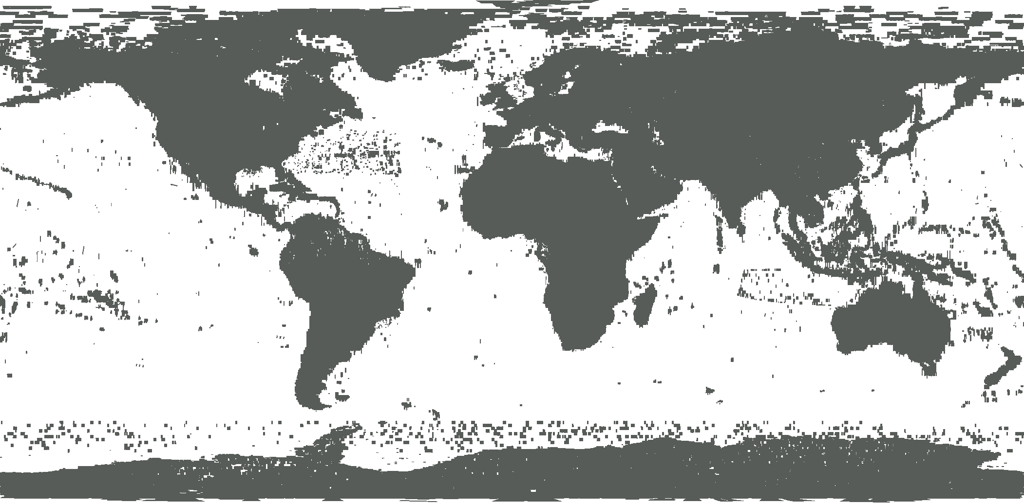
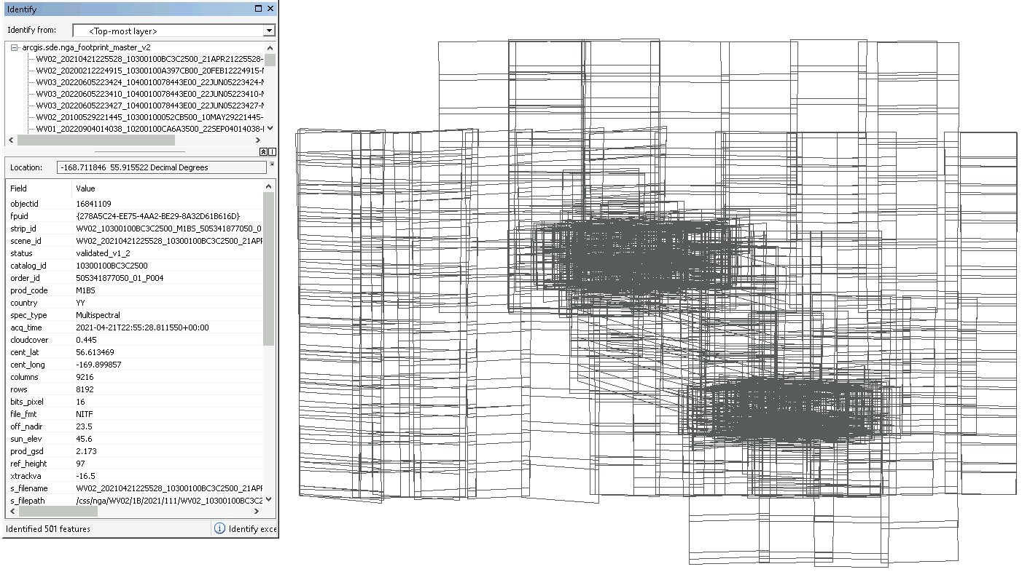
NGA/Maxar Data Coverage
501 Images

Slide 34
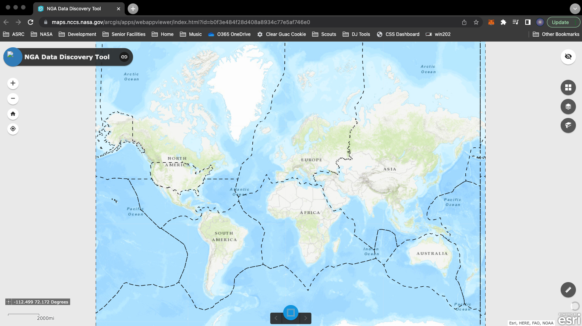
Data Discovery Tool
Global View (polygons are hidden at this scale)

Slide 35
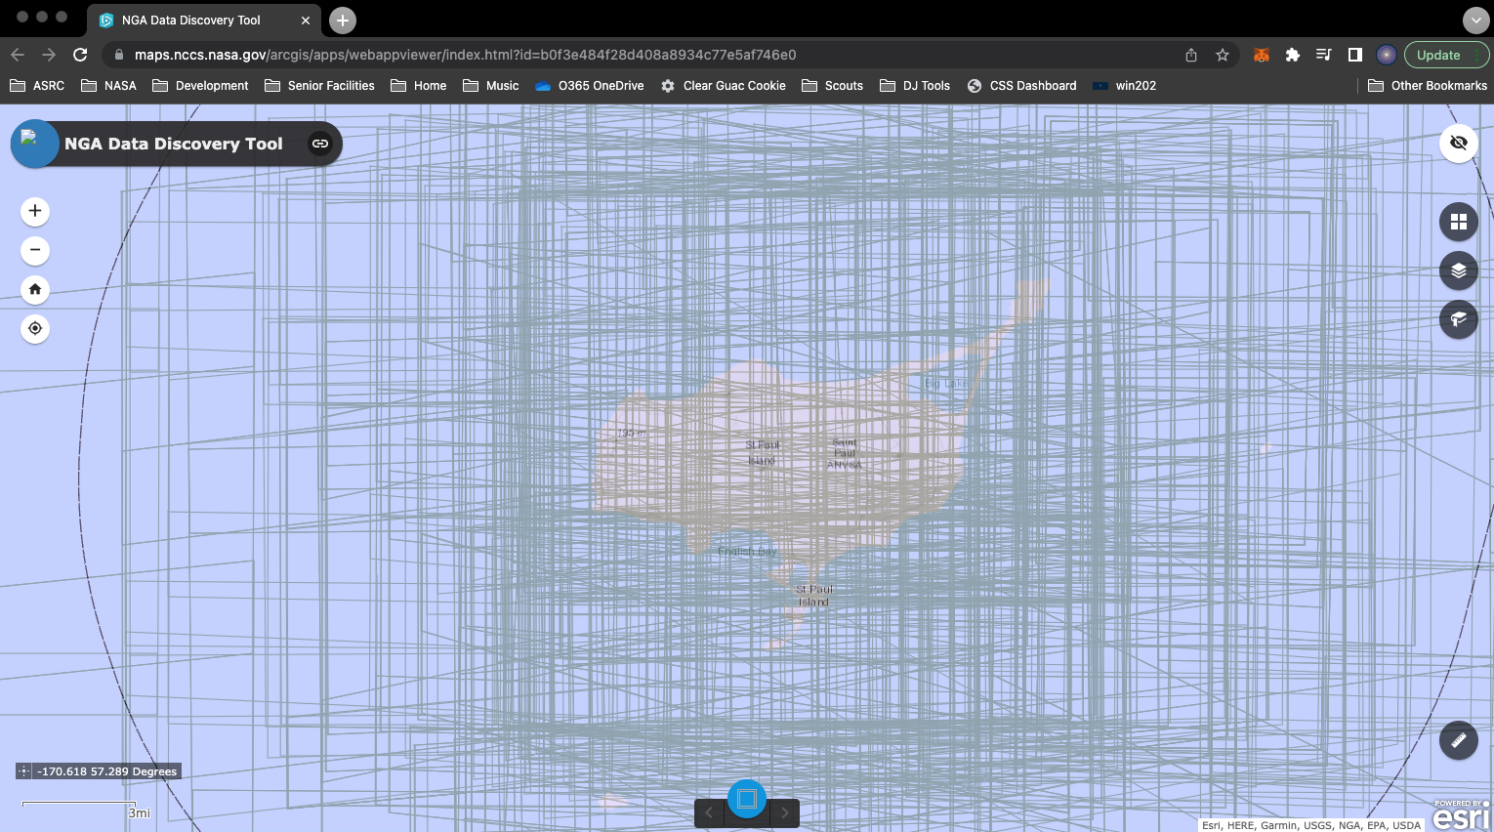
Data Discovery Tool
Zoom to area of interest (polygons enabled; reduces server impact)

Slide 36
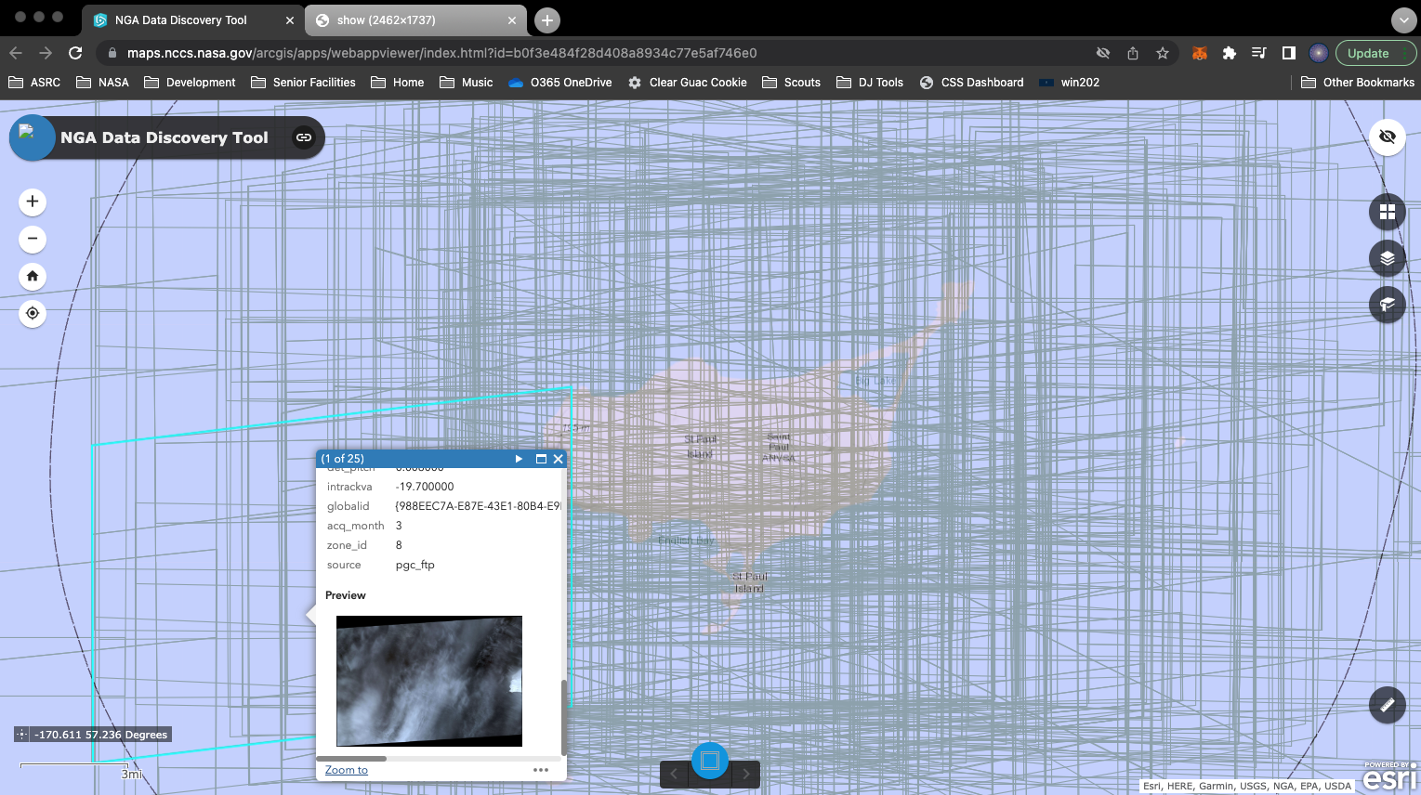
Data Discovery Tool
Click a polygon to see the attributes, to include image thumbnail

Slide 37
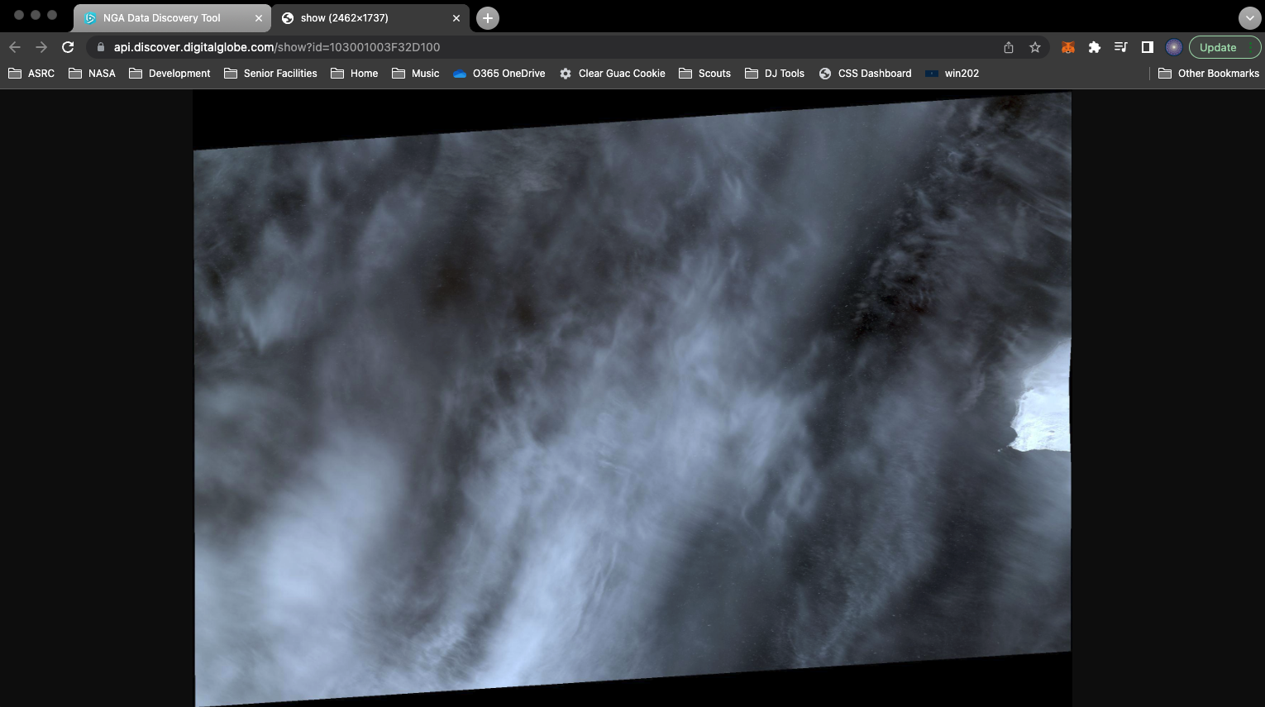
Data Discovery Tool
Click the previewurl “More info” link or the thumbnail to see the image in more detail

Slide 38
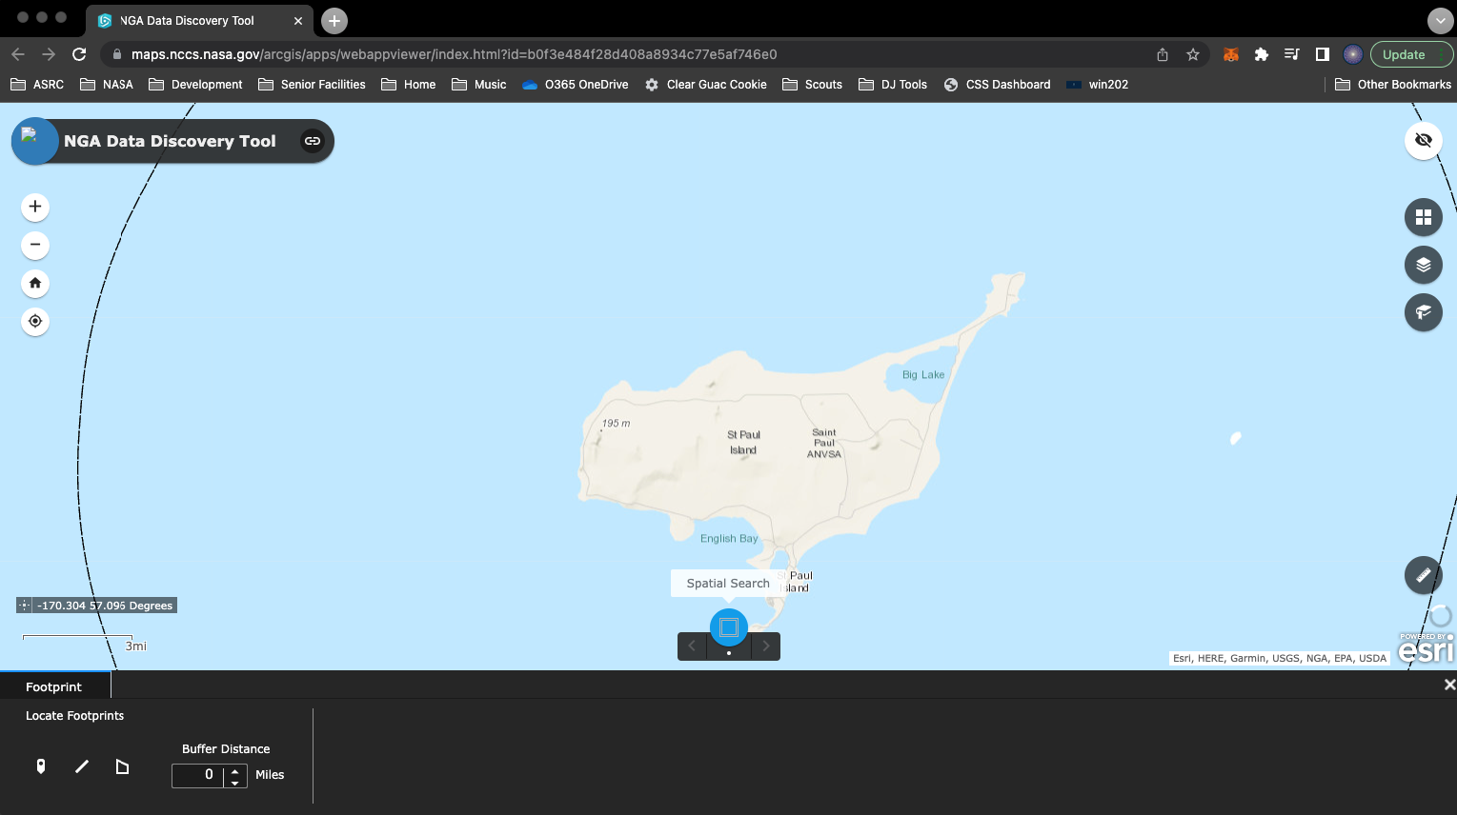
Data Discovery Tool
Click Spatial Search – select point/line/polygon, set buffer distance

Slide 39
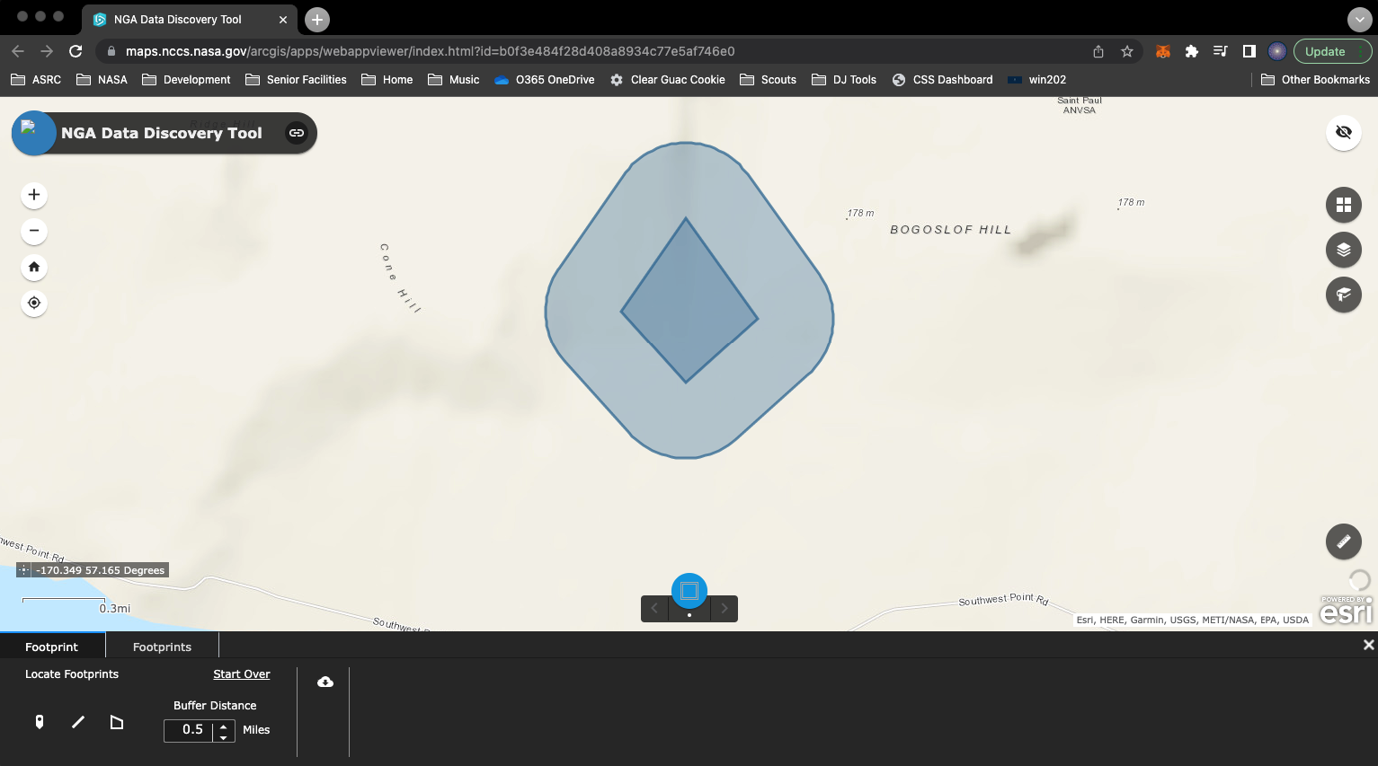
Data Discovery Tool
After selection, system will generate buffer and zoom to location

Slide 40
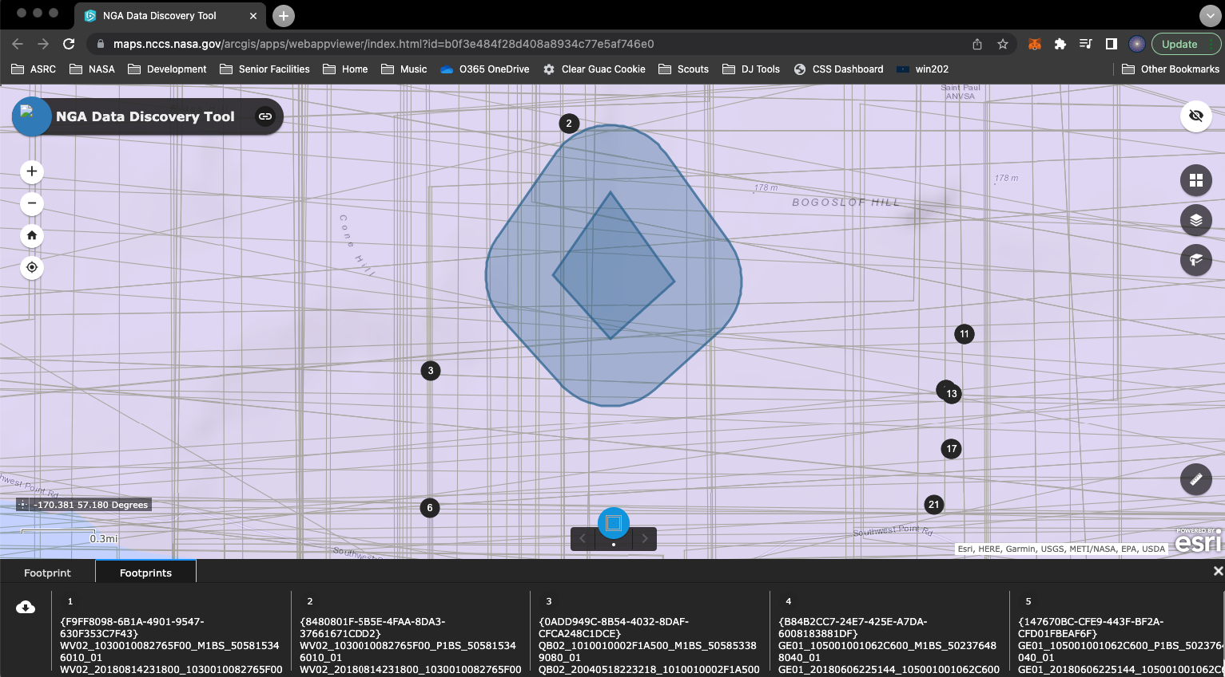
Data Discovery Tool
Click Footprints to see the images within that buffered location

Slide 41
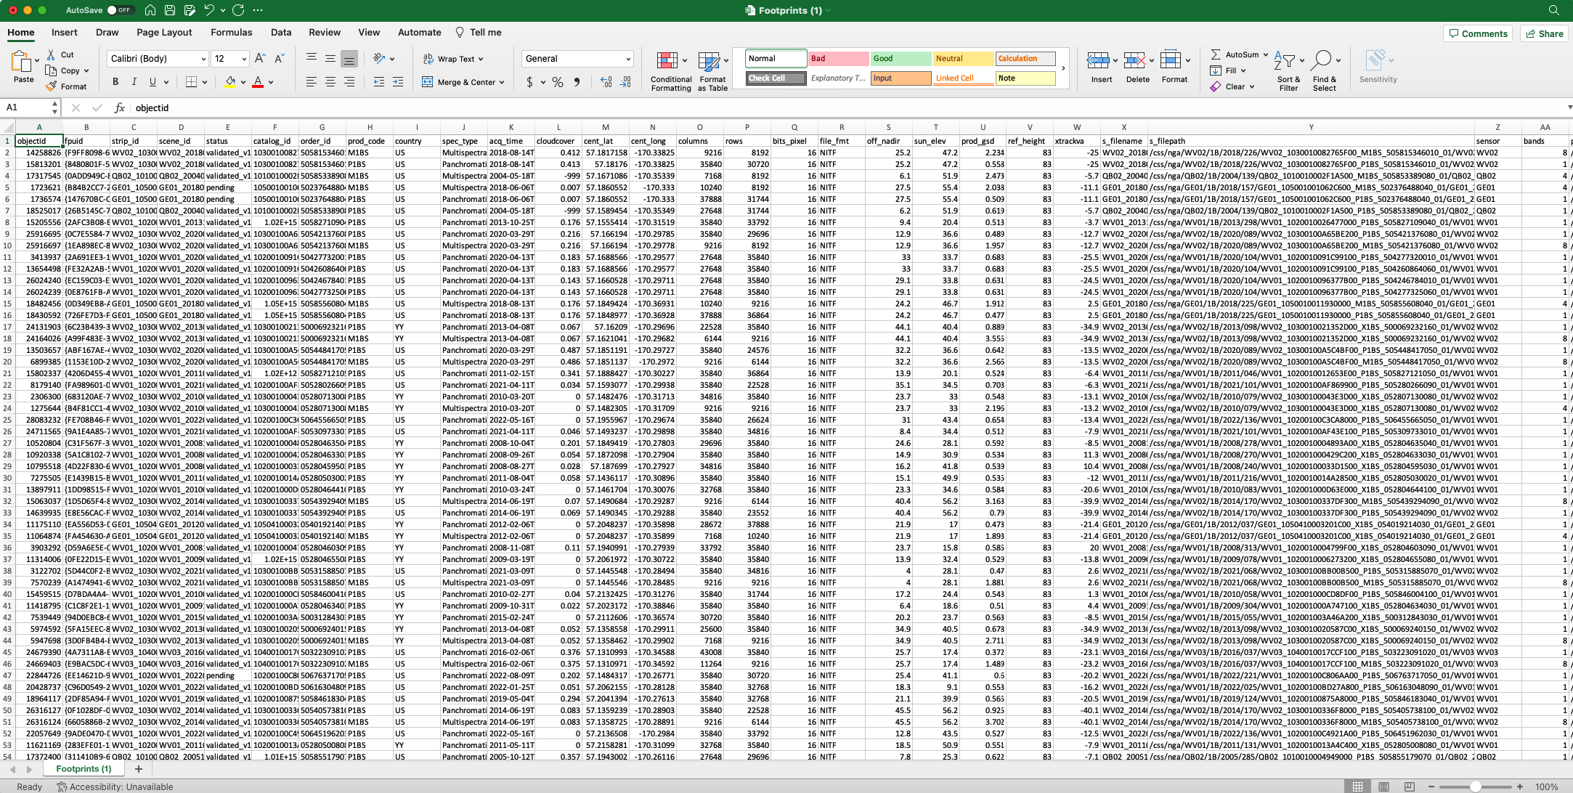
Data Discovery Tool
Click the Download button ( ) to save the results as a csv file

Slide 42
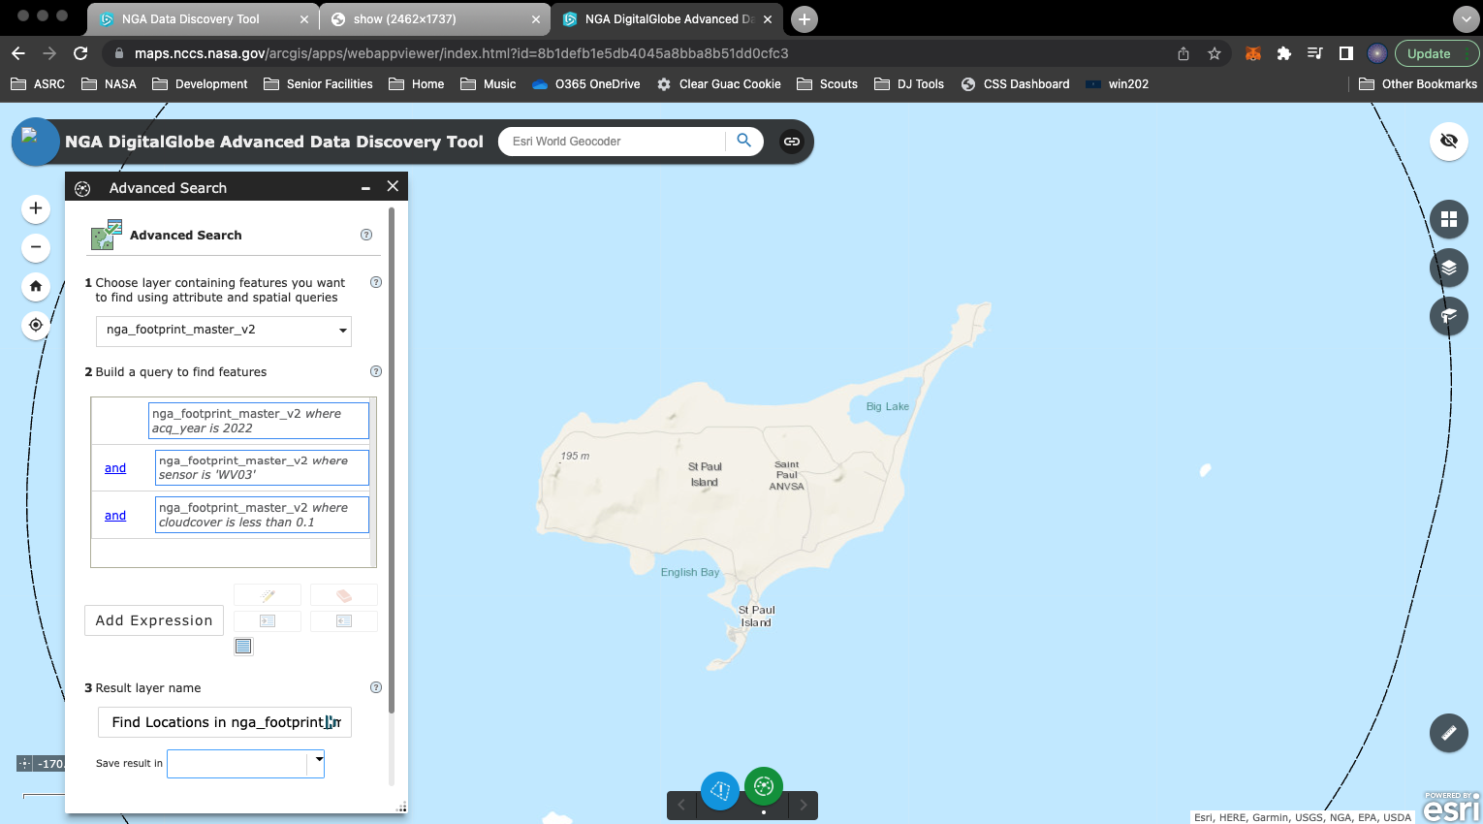
Advanced Data Discovery Tool
With Advanced Search, specify search parameters (sensor, cloudcover, etc.) and export the resulting footprint feature class

Slide 43
Questions?
Contact Information
NCCS Cloud Computing and Data Services (CCDS) Lead | Jim Shute (james.k.shute@nasa.gov)
NCCS GIS Manager | Ryan Forbes (ryan.s.forbes@nasa.gov)
NCCS Website | https://www.nccs.nasa.gov
NCCS Spatial Analytics Platform | https://maps.nccs.nasa.gov
NASA Disasters GIS Platform | https://maps.disasters.nasa.gov

Slide 44
How Do I Search For Data?
On the ABoVE Website:
  Almost 400 in-progress or completed products
  https://above.nasa.gov/profiles_/above_products.html
On the ORNL DAAC Website:
  169 published products
  https://daac.ornl.gov/cgi-bin/dataset_lister.pl?p=34
On the NASA EarthData Portal:
  215 published collections
  https://search.earthdata.nasa.gov/portal/above/search

Slide 45
Questions?

Slide 46
Backup Slides

Slide 47
ESD → ESDS → ESDIS → EOSDIS
NASA has an Earth Science Division (ESD)
ESD includes the Earth Science Data Systems (ESDS) Program
ESDS funds and directs the Earth Science Data and Information System (ESDIS) Project
ESDIS operates the Earth Observing System Data and Information System (EOSDIS)

Slide 48
ORNL DAAC’s Dataset Updates/Versions since last ASTM
Spatio-temporal appends
  Change in version number (e.g. V1 -> V1.1)
  DOI and citation remains the same
  New datafiles are just added to the existing dataset
  3 ABoVE datasets were appended
Update data values due to corrections/change in algorithms
  Change in version number (e.g. V1 -> V2)
  DOI and citation changes
  The older version is superseded by the new version
  2 ABoVE datasets have new versions (V2)

Slide 49
ABoVE Datasets Published
The 169 current ABoVE are in six subprojects:
  Airborne Science (26)
  Carbon Dynamics (15)
  Fire Disturbance (17)
  Hydrology and Permafrost (34)
  Project Standards (3)
  Vegetation (67)
  Wildlife (6)

