Slide 1
Leadership Group
Goetz, Miller, Griffith,
Larson, Hoy, Hodkinson,
Margolis, Falkowski
Special thanks to
WG Leads
ABoVE Support Office
Planning Committee
+ All who
contributed data,
results, outreach &
interpretation
ABoVE & Beyond
the call..
above.nasa.gov

Slide 2
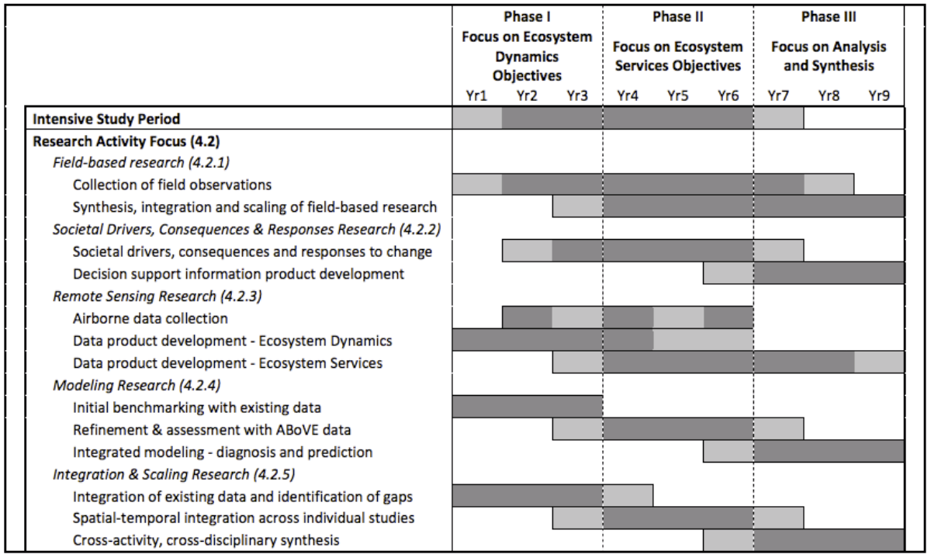
Phases & Timing of ABoVE
circa 2014 CEP
above.nasa.gov/about
ABoVE Concise Experiment Plan (2014)

Slide 3
ASTM-9 Objectives
Reports from NASA and Affiliated projects via plenary and parallel sessions & posters (emphasis on Phase-3 projects)
Presentations & discussions with partners, collaborators, stakeholders & rightsholders re: engagement & implementation
Reports, interactions & advances of Working Groups (status coming into Phase-3)
Breakout sessions to review, discuss, refine & advance integration, synthesis and modeling activities
Discuss hopes & plans for remaining airborne remote sensing
Identify any issues & consider opportunities to maximize impact
ASTM-9 San Diego
Jan 2023
above.nasa.gov

Slide 4
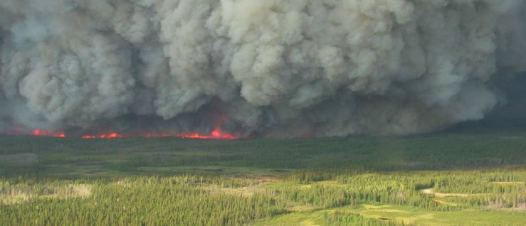
What have we accomplished thus far coming into Phase 3?
(some examples)
WG Leads will report in more detail on aspects of these..
Significant insights into Fire Disturbance dynamics and implications for
Carbon emissions (combustion), reduced C sink in AGB
Vegetation composition & successional trajectories
Associated implications for wildlife & animal movement
Fire management & disturbance interactions
ASTM-9 San Diego
Jan 2023

Slide 5
Accomplishments coming into Phase 3
Hydrology & Permafrost changes and implications
Earlier snowmelt, reduced late season tundra productivity & C uptake
Significance of C emissions outside the growing season
Source locations & timing of methane emissions
Advances in remote sensing of permafrost properties, particularly with SAR

Slide 6
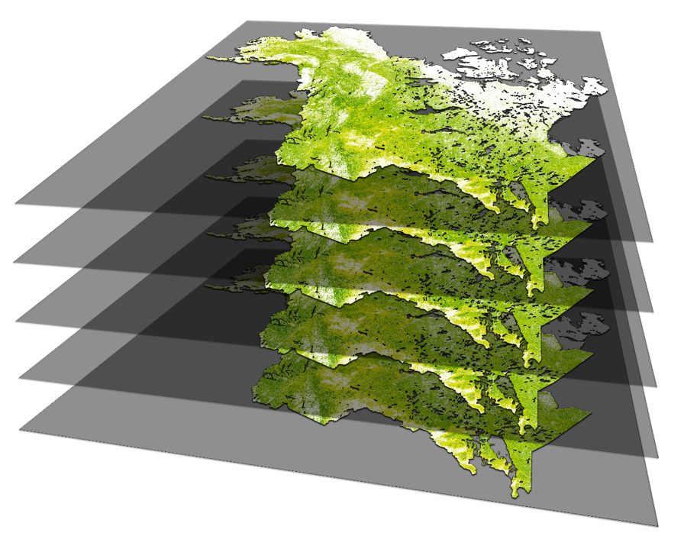
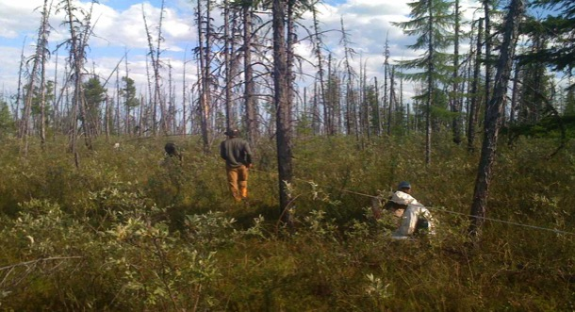
Accomplishments coming into Phase 3
Vegetation changes are widespread, in both tundra & boreal ecosystems
Largely driven by fire disturbance but unburned areas also changing (e.g. greening & browning trends; hydrology & permafrost interactions)
Advances in large area mapping of structure and aboveground biomass
Much improved ability to simulate fine scale near-future changes
Significant impacts on albedo / radiative forcing climate feedbacks
Advances in remote sensing of veg properties (Hyperspectral, SiF)
2015
2010
ASTM-9 San Diego
Jan 2023
2015
2000
1990

Slide 7
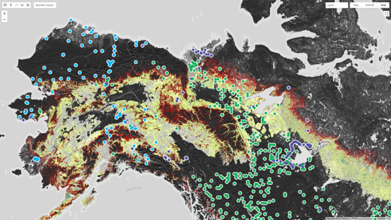
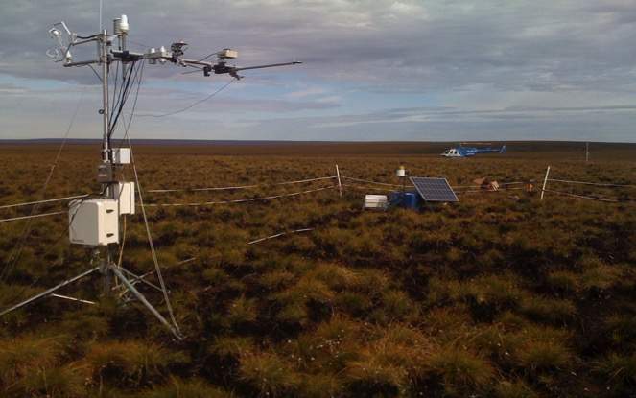
Accomplishments coming into Phase 3
Carbon dynamics are much better characterized across the ABoVE domain and beyond
Extensive stock & flux measurements / estimates (incl. for wetlands, peatlands)
Improved CO₂ flux constraints using satellite retrievals
Refined estimates of carbon balance across the ABoVE domain
Improved understanding of changing seasonal CO2 cycle amplitude
Heterogeneity of methane emissions in time and space.
ASTM-9 San Diego
Jan 2023

Slide 8
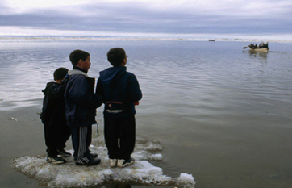
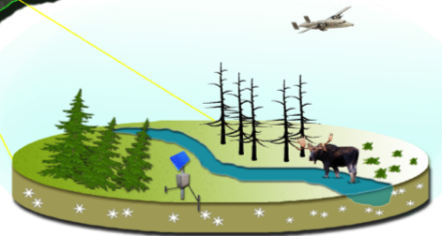
Accomplishments coming into Phase 3
Documented a great deal about how snow impacts wildlife
Changes in wetlands and lake dynamics
Modeling many aspects of the Arctic – Boreal environment (across scales)
Much more to be done on all fronts but we’ve come a long way..
ASTM-9 San Diego
Jan 2023

Slide 9
ABoVE peer-reviewed Publications thus far..
480 reported by 155 projects*
305 by NASA funded projects
(75 TE ABoVE + 48 other projects = 123)
+117 by affiliated projects (n=32)*
*Not including ABoVE Partners (NGEE-Arctic, POLAR, CFS, NEON)
30 pubs in the Nature, Science, PNAS family of journals
Please upload your publication citations to the ABoVE web site
& post MSR and WWL slides along w/your pubs.
The ABoVE ST currently has 967 members
and ~2,000 participants
(incl. resource managers, students & others following)

Slide 10
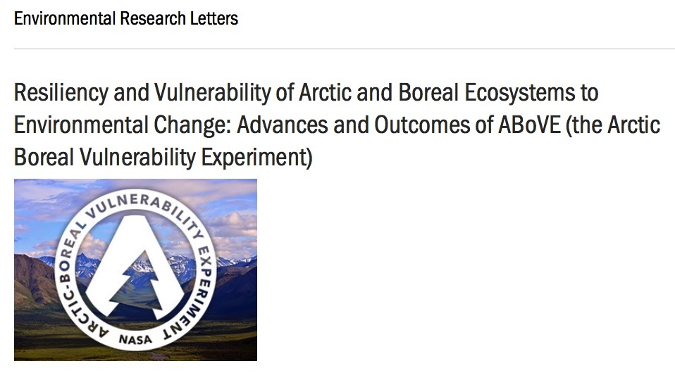
80 papers published as of Jan 2023
Others in review
Acceptance rate well above the ERL norm (IF = 6.8)
http://iopscience.iop.org/journal/1748-9326/page/ABoVE

Slide 11
Data Publications thus far..
266 Data sets archived
another 147 planned
Accessed 56,719 times by 11,854 unique users
Data archiving / publishing is critical for future research mining of
what we’ve measured and learned.
Early data release / sharing is valuable for collaborative efforts across projects and working groups, including synthesis activities
ABoVE and the DAACs have tools, resources and personnel to help you make data available.
Please take advantage of this..

