Slide 1
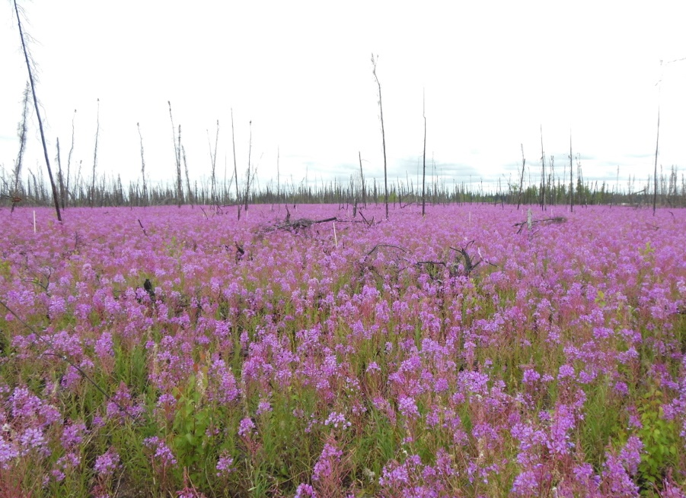
Nancy HF French, Lead
with Dong (Tony) Chen,
Laura Bourgeau-Chavez, Tatiana Loboda
Fire & Insect Disturbance Working Group
ASTM8 Presented May 2022
Photo by L Kendig

Slide 2
Fire and Insect Disturbance WG Report:
1. Previous activities of ABoVE Investigators:
Reviewed in ASTM7 presentation (not included here)
2. Current WG Activities:
Tundra Fire Synthesis overview and progress
WG logistics for participation
3. Working Group accomplishments & expected outputs
Data sets
Plans for completion under ABoVE Phase 2
Vulnerability
Resiliency
Observations
Remote
In-situ
Modeling
Mapping
Predicting

Slide 3
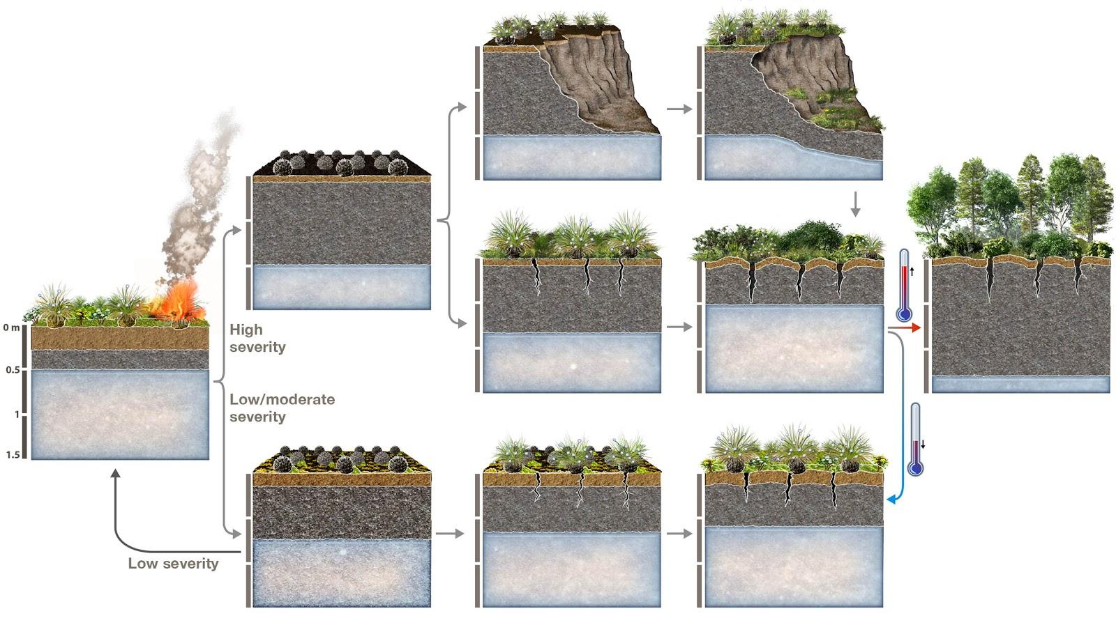
Tundra Fire Synthesis
Current focus is a Tundra Fire Synthesis: Understand the role of burn severity in post-fire site conditions and trajectories
Ideas stem from discussions during NAU workshop: Tundra was split off from Boreal due to the paucity of data on Tundra (at the time) compared to Boreal
Integrate remote sensing observations and derived metrics with field data compilation and assessment
Explore observations that allow improvement to modeling & prediction
Climate-driven changes in Tundra fire to inform land management for ecosystem services
Figure Courtesy of A. Rocha

Slide 4
Tundra Fire Synthesis: Tundra-fire related data compilation
Motivation
Field data collected in the tundra are still relatively rare and those specifically related to tundra fires are particularly scarce
While some of the data have been archived at the ORNL-DAAC, many datasets, especially those pre-dating the ABoVE era, are not and are hard to find
This presents a challenge to our collective understanding of tundra wildfires
Plan
Identify a list of existing in situ or remotely sensed datasets that are relevant to tundra wildfires
Identify model benchmark needs
Compile the datasets into a uniformed data pool which will be the foundation of our synthesis papers
The compiled data pool will be shared publicly to facilitate future scientific research and model development

Slide 5
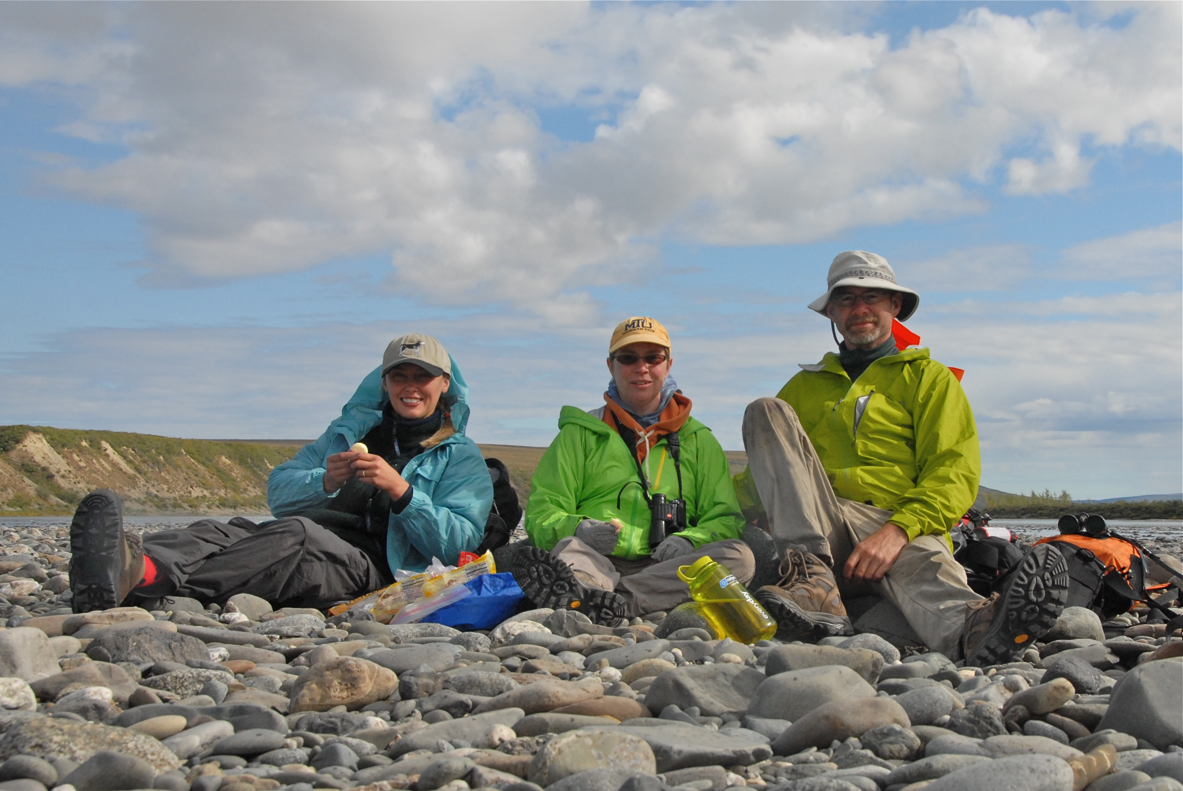
Tundra Fire Synthesis: Tundra-fire related data compilation
The compilation is currently ongoing
Link: https://tinyurl.com/2d29stbk
Variables that are included:
Burn severity
Vegetation cover
Stem count
Shrub height
Tussock-related parameters
Harvested biomass
Soil temperature/moisture
Soil PH
Water table depth
Active layer thickness
Organic soil depth
Field measured LAI
Flux data
Drone imagery

Slide 6
Tundra Fire Synthesis: Model benchmarking needs
Benchmarking Needs Document (a work in progress):
High priority measurements (from the long list on Google doc) (expressed as difference from a control over time, or as part of an experimental manipulation)
Seedling establishment & other plant response factors
Organic layer thickness and SOC
Soil moisture
Active layer depth (ALD)- including thaw slump or subsidence
Recovery of biomass by plant functional type (PFT)
N and P availability
Burn severity, C lost from plants versus soil organic carbon (SOC)
Changes in total carbon (Methane, CO2)
Site age, history, legacy conditions
Functional response benchmarks as expressed as time since burn for each of these high-priority metrics
For each of the metrics, we need:
Information on the recovery following fire
Good non-burned controls paired with each burn site observation

Slide 7
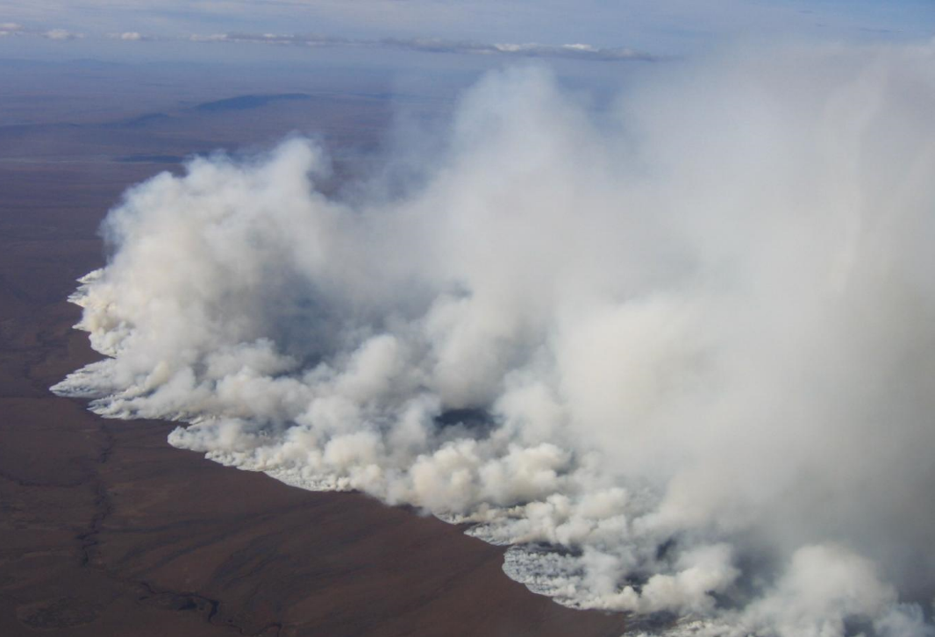
Tundra Fire Synthesis: How Can You Participate?
Meet each month. If you want to contribute, join the WG through the ABoVE website
Monthly on the first Thursday, until Nov 2022
Contribute to the discussion around observations and/or model needs
Expected outcomes by end of Phase II
Compiled tundra fire-related data pool
Synthesis paper(s) focusing on burn severity
2007 Anaktuvuk River tundra fire, North Slope, Alaska (Photo: U.S. Bureau of Land Management)

Slide 8
Fire & Insect WG Accomplishments: 22 Archived Datasets
Bourgeau-Chavez, L.L., N.H.F. French, S. Endres, L. Jenkins, M. Battaglia, E. Serocki, and M. Billmire. 2016. ABoVE: Burn Severity, Fire Progression, Landcover and Field Data, NWT, Canada, 2014. ORNL DAAC, Oak Ridge, Tennessee, USA. DOI: 10.3334/ORNLDAAC/1307
French, N.H.F., J.A. Graham, L.L. Bourgeau-Chavez, S. Grelick, and E. Whitman. 2020. ABoVE: Burn Severity of Soil Organic Matter, Northwest Territories, Canada, 2014-2015. ORNL DAAC, Oak Ridge, Tennessee, USA. DOI: 10.3334/ORNLDAAC/1694
Bourgeau-Chavez, L.L., S. Endres, L. Jenkins, M. Battaglia, E. Serocki, and M. Billmire. 2017. ABoVE: Burn Severity, Fire Progression, and Field Data, NWT, Canada, 2015-2016. ORNL DAAC, Oak Ridge, Tennessee, USA. DOI: 10.3334/ORNLDAAC/1548
Bourgeau-Chavez, L.L., J.A. Graham, S. Endres, N.H.F. French, M. Battaglia, D. Hansen, and D. Tanzer. 2019. ABoVE: Ecosystem Map, Great Slave Lake Area, Northwest Territories, Canada, 1997-2011. ORNL DAAC, Oak Ridge, Tennessee, USA. DOI: 10.3334/ORNLDAAC/1695
Bourgeau-Chavez, L.L., M. Battaglia, E.S. Kane, L.M. Cohen, and D. Tanzer. 2019. ABoVE: Post-Fire and Unburned Vegetation Community and Field Data, NWT, Canada, 2018. ORNL DAAC, Oak Ridge, Tennessee, USA. DOI: 10.3334/ORNLDAAC/1703
Schaefer, K., L.K. Clayton, M.J. Battaglia, L.L. Bourgeau-Chavez, R.H. Chen, A.C. Chen, J. Chen, K. Bakian-Dogaheh, T.A. Douglas, S.E. Grelick, G. Iwahana, E. Jafarov, L. Liu, S. Ludwig, R.J. Michaelides, M. Moghaddam, S. Natali, S.K. Panda, A.D. Parsekian, A.V. Rocha, S.R. Schaefer, T.D. Sullivan, A. Tabatabaeenejad, K. Wang, C.J. Wilson, H.A. Zebker, T. Zhang, and Y. Zhao. 2021. ABoVE: Soil Moisture and Active Layer Thickness in Alaska and NWT, Canada, 2008-2020. ORNL DAAC, Oak Ridge, Tennessee, USA. DOI: 10.3334/ORNLDAAC/1903
Bourgeau-Chavez, L.L., N.H.F. French, S. Endres, L. Jenkins, M. Battaglia, E. Serocki, and M. Billmire. 2016. ABoVE: Burn Severity, Fire Progression, Landcover and Field Data, NWT, Canada, 2014. ORNL DAAC, Oak Ridge, Tennessee, USA. DOI: 10.3334/ORNLDAAC/1307
Pu, R., Z. Li, P. Gong, I.A. Csiszar, R. Fraser, W.M. Hao, S. Kondragunta, T.V. Loboda, J.V. Hall, and V.S. Shevade. 2018. ABoVE: AVHRR-Derived Forest Fire Burned Area-Hot Spots, Alaska and Canada, 1989-2000. ORNL DAAC, Oak Ridge, Tennessee, USA. DOI: 10.3334/ORNLDAAC/1545
Loboda, T.V., D. Chen, J.V. Hall, and J. He. 2018. ABoVE: Landsat-derived Burn Scar dNBR across Alaska and Canada, 1985-2015. ORNL DAAC, Oak Ridge, Tennessee, USA. DOI: 10.3334/ORNLDAAC/1564
Loboda, T.V., E.E. Hoy, and M.L. Carroll. 2019. ABoVE: Study Domain and Standard Reference Grids, Version 2. ORNL DAAC, Oak Ridge, Tennessee, USA. DOI: 10.3334/ORNLDAAC/1527
Loboda, T.V., J.V. Hall, and A. Baer. 2017. ABoVE: Wildfire Date of Burning within Fire Scars across Alaska and Canada, 2001-2019. ORNL DAAC, Oak Ridge, Tennessee, USA. DOI: 10.3334/ORNLDAAC/1559
Loboda, T.V., J.V. Hall, A.H. Hall, and V.S. Shevade. 2017. ABoVE: Cumulative Annual Burned Area, Circumpolar High Northern Latitudes, 2001-2015. ORNL DAAC, Oak Ridge, Tennessee, USA. DOI: 10.3334/ORNLDAAC/1526
He, J., T.V. Loboda, L. Jenkins, and D. Chen. 2019. ABoVE: Distribution Maps of Wildland Fire Fuel Components across Alaskan Tundra, 2015. ORNL DAAC, Oak Ridge, Tennessee, USA. DOI: 10.3334/ORNLDAAC/1761
Walker, X.J., J.L. Baltzer, W. Laurier, S.G. Cumming, N.J. Day, S.J. Goetz, J.F. Johnstone, S. Potter, B.M. Rogers, E.A.G. Schuur, M.R. Turetsky, and M.C. Mack. 2019. ABoVE: Characterization of Carbon Dynamics in Burned Forest Plots, NWT, Canada, 2014. ORNL DAAC, Oak Ridge, Tennessee, USA. DOI: 10.3334/ORNLDAAC/1664
Walker, X.J., J.L. Baltzer, L.L. Bourgeau-Chavez, N.J. Day, W.J. De groot, C. Dieleman, E.E. Hoy, J.F. Johnstone, E.S. Kane, M.A. Parisien, S. Potter, B.M. Rogers, M.R. Turetsky, S. Veraverbeke, E. Whitman, and M.C. Mack. 2019. ABoVE: Synthesis of Burned and Unburned Forest Site Data, AK and Canada, 1983-2016. ORNL DAAC, Oak Ridge, Tennessee, USA. DOI: 10.3334/ORNLDAAC/1744
Walker, X.J., B.M. Rogers, J.L. Baltzer, S.R. Cummings, N.J. Day, S.J. Goetz, J.F. Johnstone, M.R. Turetsky, and M.C. Mack. 2018. ABoVE: Wildfire Carbon Emissions and Burned Plot Characteristics, NWT, CA, 2014-2016. ORNL DAAC, Oak Ridge, Tennessee, USA. DOI: 10.3334/ORNLDAAC/1561
Dieleman, C., B.M. Rogers, S. Veraverbeke, J.F. Johnstone, J. Laflamme, L. Gelhorn, K. Solvik, X.J. Walker, M.C. Mack, and M.R. Turetsky. 2019. ABoVE: Characterization of Burned and Unburned Boreal Forest Stands, SK, Canada, 2016. ORNL DAAC, Oak Ridge, Tennessee, USA. DOI: 10.3334/ORNLDAAC/1740
Veraverbeke, S., B.M. Rogers, M.L. Goulden, R. Jandt, C.E. Miller, E.B. Wiggins, and J.T. Randerson. 2017. ABoVE: Ignitions, burned area and emissions of fires in AK, YT, and NWT, 2001-2015. ORNL DAAC, Oak Ridge, Tennessee, USA. DOI: 10.3334/ORNLDAAC/1341
Scholten, R.C., S. Veraverbeke, R. Jandt, E.A. Miller, and B.M. Rogers. 2021. ABoVE: Ignitions, Burned Area, and Emissions of Fires in AK, YT, and NWT, 2001-2018. ORNL DAAC, Oak Ridge, Tennessee, USA. DOI: 10.3334/ORNLDAAC/1812
Solvik, K.K., S. Potter, A.M. Erb, M. Roman, C. Schaaf, Q. Sun, Z. Wang, and B.M. Rogers. 2019. ABoVE: MODIS-Derived Daily Mean Blue Sky Albedo for Northern North America, 2000-2017. ORNL DAAC, Oak Ridge, Tennessee, USA. DOI: 10.3334/ORNLDAAC/1605
Potter, S., B.M. Rogers, and C. Dieleman. 2020. ABoVE: Spatial Estimates of Carbon Combustion from Wildfires across SK, Canada, 2015. ORNL DAAC, Oak Ridge, Tennessee, USA. DOI: 10.3334/ORNLDAAC/1787
Baltzer, J. L., Day, N. J., Walker, X. J., Greene, D. F., Mack, M. C., Arseneault, D., Barnes, J., Bergeron, Y., Boucher, Y., Bourgeau-Chavez, L. L., Brown, C. D., CarriÃ¨re, S., Howard, B. K., Gauthier, S., Parisien, M. A., Reid, K. A., Rogers, B. M., Roland, C., Sirois, L., Stehn, S., Thompson, D. K., Turetsky, M. R., Whitman, E., and Johnstone, J. F.: ABoVE: Synthesis of Post-Fire Regeneration Across Boreal North America, 1989-2015, DOI: 10.3334/ORNLDAAC/1955, 2021.

Slide 9
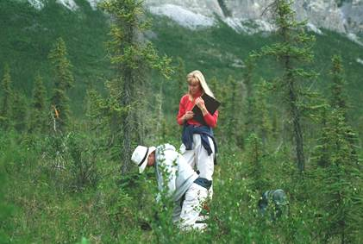
Fire & Insect WG Accomplishments: 34 Publications
Bourgeau-Chavez: 3
Loboda: 10
Mack: 8
Rogers: 13
Please add any missing pubs

Slide 10
Fire & Insect WG: Future Focus for ABoVE Phase III
??????TBD??TBD??????
Build from current data and model needs activity for all of ABoVE domain
Use what we have on boreal and tundra fire data and model improvements to inform decision-making
Discussions at the R2O workshop on Thursday
Let US Know Your Ideas!!!
??????TBD??TBD??????

Slide 11
Discussion
Fire & Insect Disturbance Working Group
ASTM8 Presented May 2022
Photo by L Kendig

