Slide 1
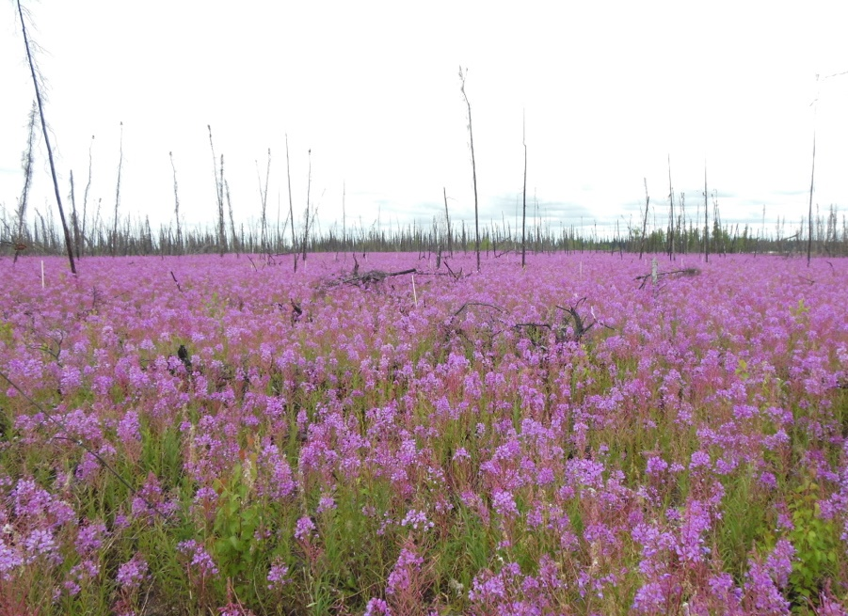
Fire & Insect Disturbance Working Group
Nancy HF French, Lead
with Dong (Tony) Chen,
Laura Bourgeau-Chavez, Tatiana Loboda
Photo by L Kendig

Slide 2
Highlights
Monthly Working Group meetings
Completed Tundra Synthesis activity (publication in progress)
Led by Dong “Tony” Chen with Seamore Zhu & Liz Hoy
Compiled data in spreadsheet, summarized & analyzed
See Poster by Seamore Zhu
(More to do on this)
Project highlights [project name (PI & year) shown]

Slide 3
Monthly WG meetings:
Google Drive materials:
https://drive.google.com/drive/folders/1__wpq-s29yxmYyiPy7UcmCkNbb4t9Tbe?usp=sharing
Webinar Presentations (monthly web meetings since Oct)
10/6/2022 | Sander Veraverbeke | Extratropical forests increasingly at risk of lightning fires
 | Max van Gerrevink | Integrated radiative forcing from fires
 | Yingtong Zhang | Mapping causal agents of disturbance in boreal and arctic ecosystems of North America using time series of Landsat data
11/3/2022 | Zelalem A Mekonnen | Wildfire exacerbates high-latitude soil carbon losses from climate warming
 | Sean M. P. Cahoon | Interactions among wildfire, forest type and landscape position are key determinants of boreal forest carbon stocks
12/1/2022 | Amy Cardinal Christianson | Centering Indigenous Voices: The Role of Fire in the Boreal Forest of North America
 | Brian Buma | Short-interval fires increasing in the Alaskan boreal forest as fire self-regulation decays across forest types
1/5/2023 | Diane C. Huebner | Retrogressive thaw slumps in the Alaskan Low Arctic may influence tundra shrub growth more strongly than climate
 | Arif Masrur | Topography, Climate and Fire History Regulate Wildfire Activity in the Alaskan Tundra

Slide 4
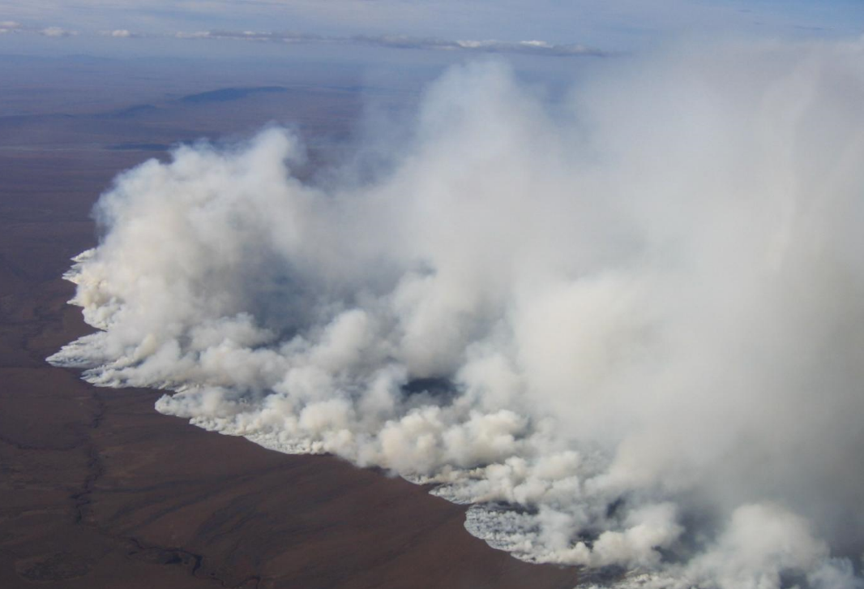
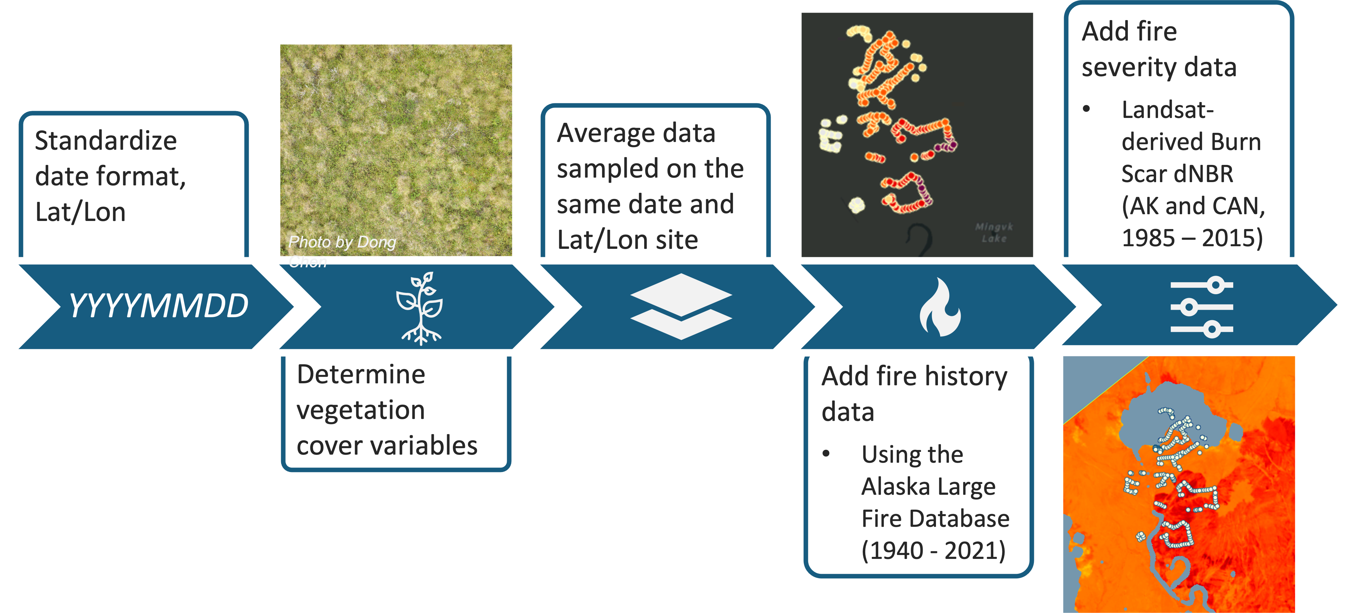
Tundra Fire Synthesis
Dong Chen, Seamore Zhu, Liz Hoy
Constructing a Database to Support the Study of ABoVE-domain Tundra Fire Dynamics
2007 Anaktuvuk River tundra fire, North Slope, Alaska (Photo: U.S. Bureau of Land Management)
See Poster presented by Seamore Zhu, Liz Hoy

Slide 5
Tundra Fire Synthesis
Dong Chen, Seamore Zhu, Liz Hoy
Constructing a Database to Support the Study of ABoVE-domain Tundra Fire Dynamics
Variables that are included:
Burn severity
Vegetation cover
Stem count
Shrub height
Tussock-related parameters
Harvested biomass
Soil temperature/moisture
Soil PH
Water table depth
Active layer thickness
Organic soil depth
Field measured LAI
Flux data
Drone imagery
197,793 data points 46 datasets 40 variables

Slide 6
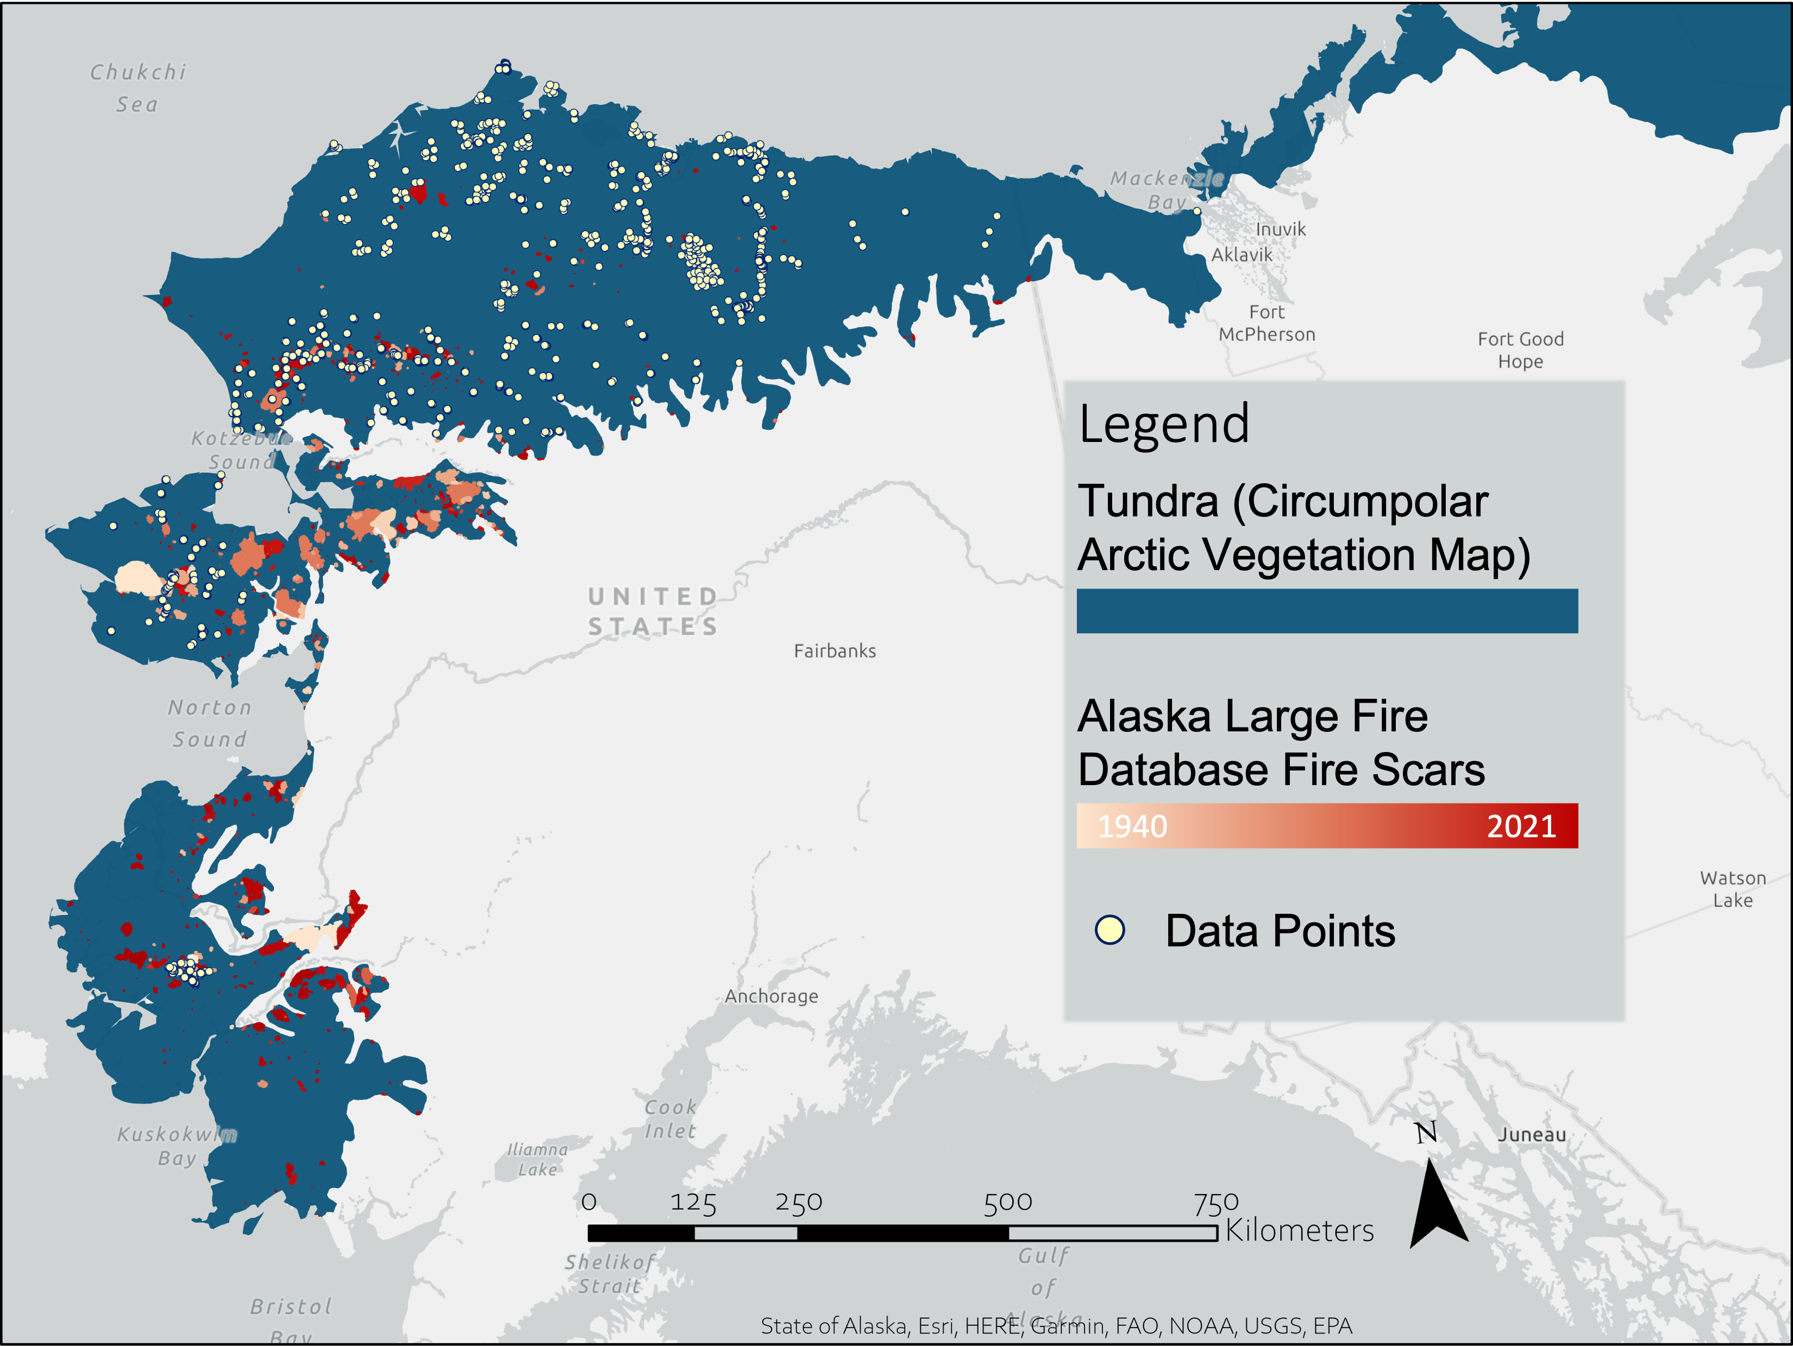
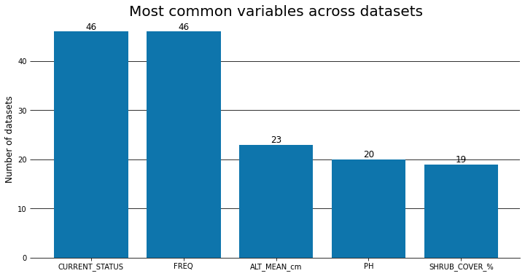
Constructing a Database to Support the Study of ABoVE-domain Tundra Fire Dynamics
197,793 data points 46 datasets 40 variables
Hello!
See Poster presented by Seamore Zhu, Liz Hoy

Slide 7
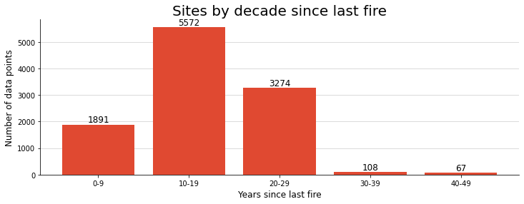
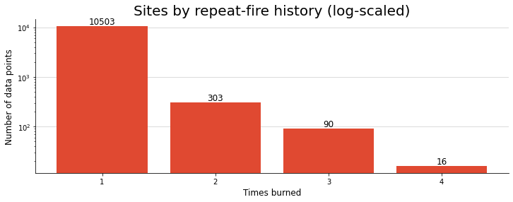
Constructing a Database to Support the Study of ABoVE-domain Tundra Fire Dynamics
197,793 data points 46 datasets 40 variables
Hello!
See Poster presented by Seamore Zhu, Liz Hoy

Slide 8
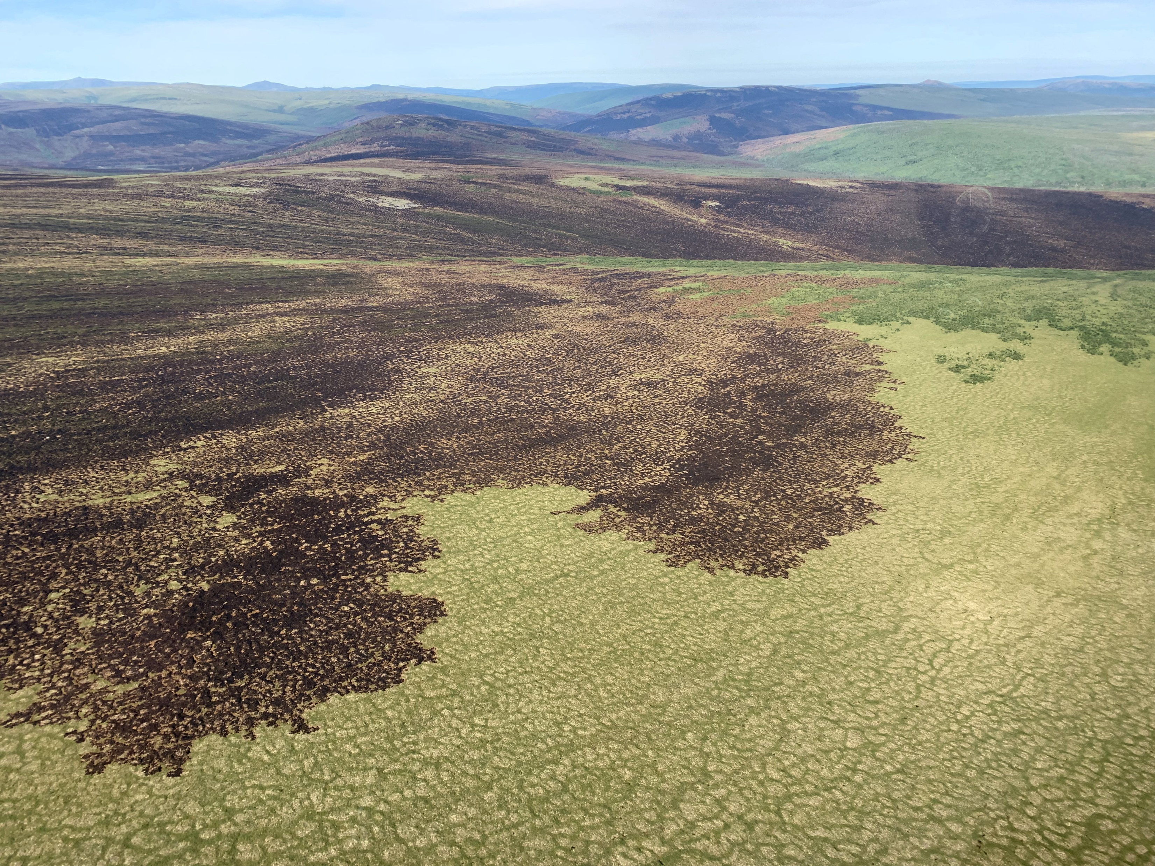
Fire in Southwest Alaska
Frost (TE 2021): Towards a Warmer, Less Frozen Future Arctic: Synthesis of Drivers, Ecosystem Responses, and Elder Observations along Bioclimatic Gradients in Western Alaska
Unprecedented 2022 fire season in southwestern Alaska drew attention from wildland fire responders and YK Delta communities:
Alaska Fire Science Consortium 2022 Fall Fire Review: Focus on Southwest Alaska: Climate and vegetation changes
Webinar for ACCAP (Alaska Center for Climate Assessment and Policy): Alaska Fire Season 2022: Focus on Southwest Alaska and Impacts on Vegetation and Fuels
Community meetings planned in St. Mary’s scheduled for Feb 7, shortly after ASTM 9

Slide 9
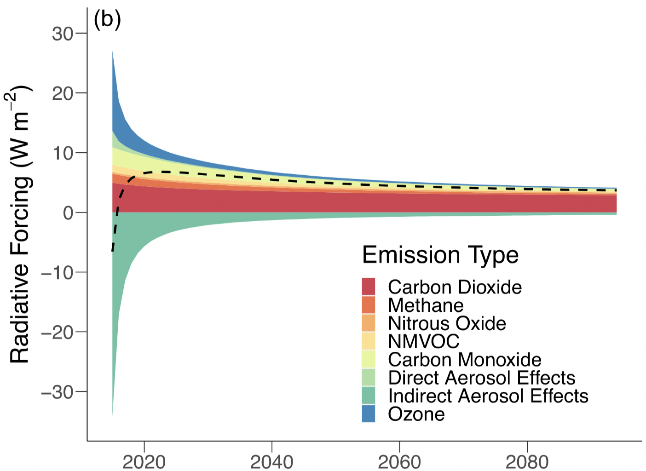
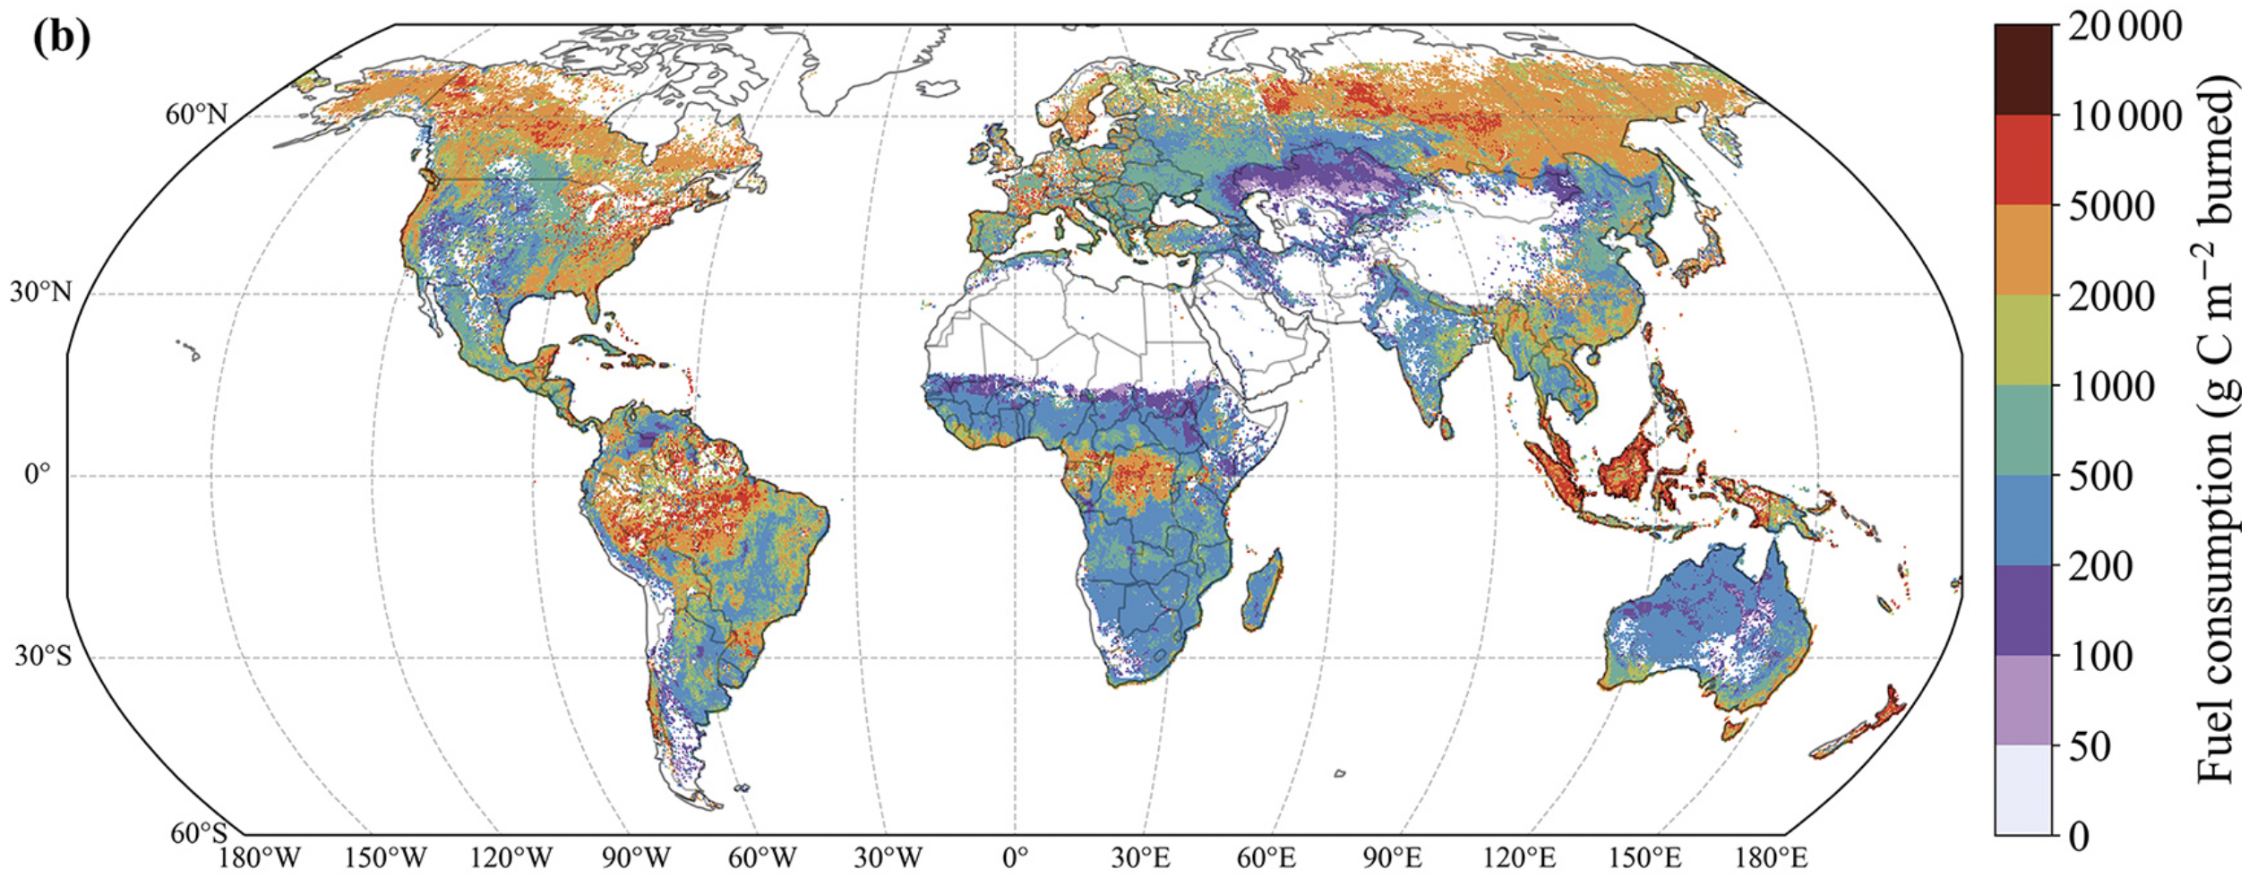
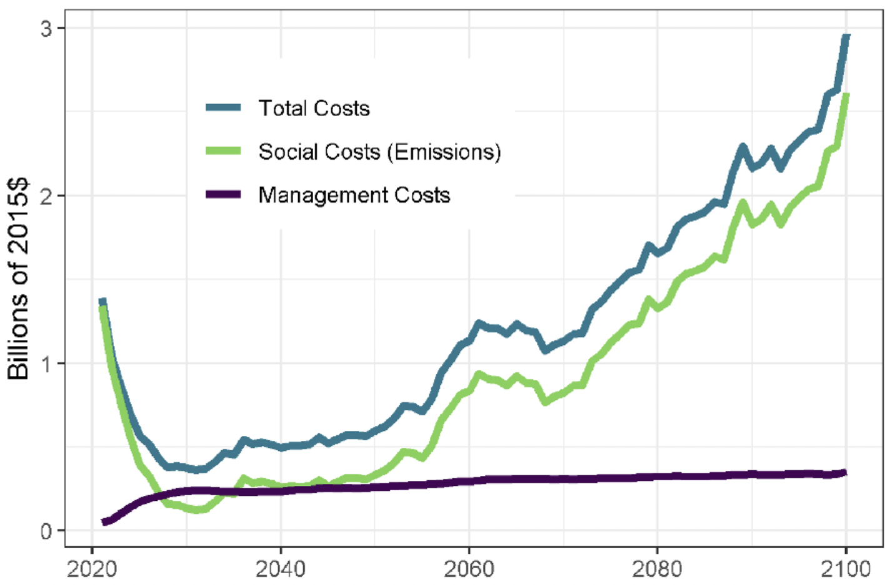
ABoVE domain burned area & combustion, 500m (ABoVE-FED; Potter et al., 2022)
Tundra combustion & radiative forcing (Moubarak et al., 2022)
Burned area mapping using deep learning, 30m (Potter et al., in prep.)
Integrated ABoVE combustion observations into global emissions database (GFED; van Wees et al., 2022)
Fire management for carbon/climate mitigation (Phillips et al., 2022; Elder et al., 2022)
Rogers (TE 2014), Natali (GBMF 2019), & Rogers (2022)

Slide 10
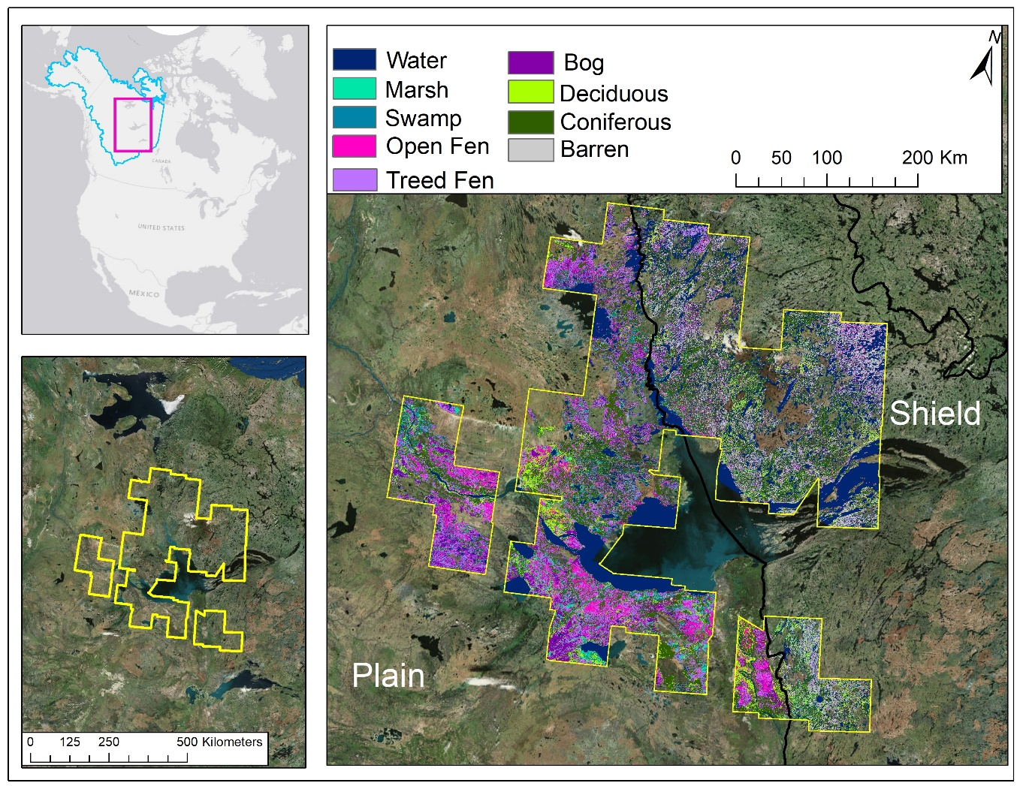
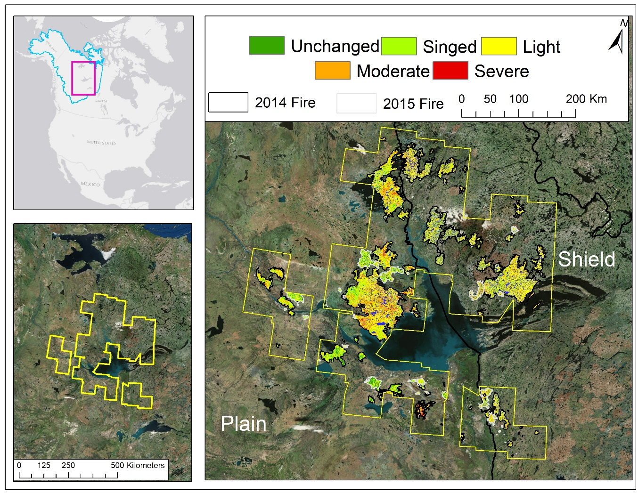
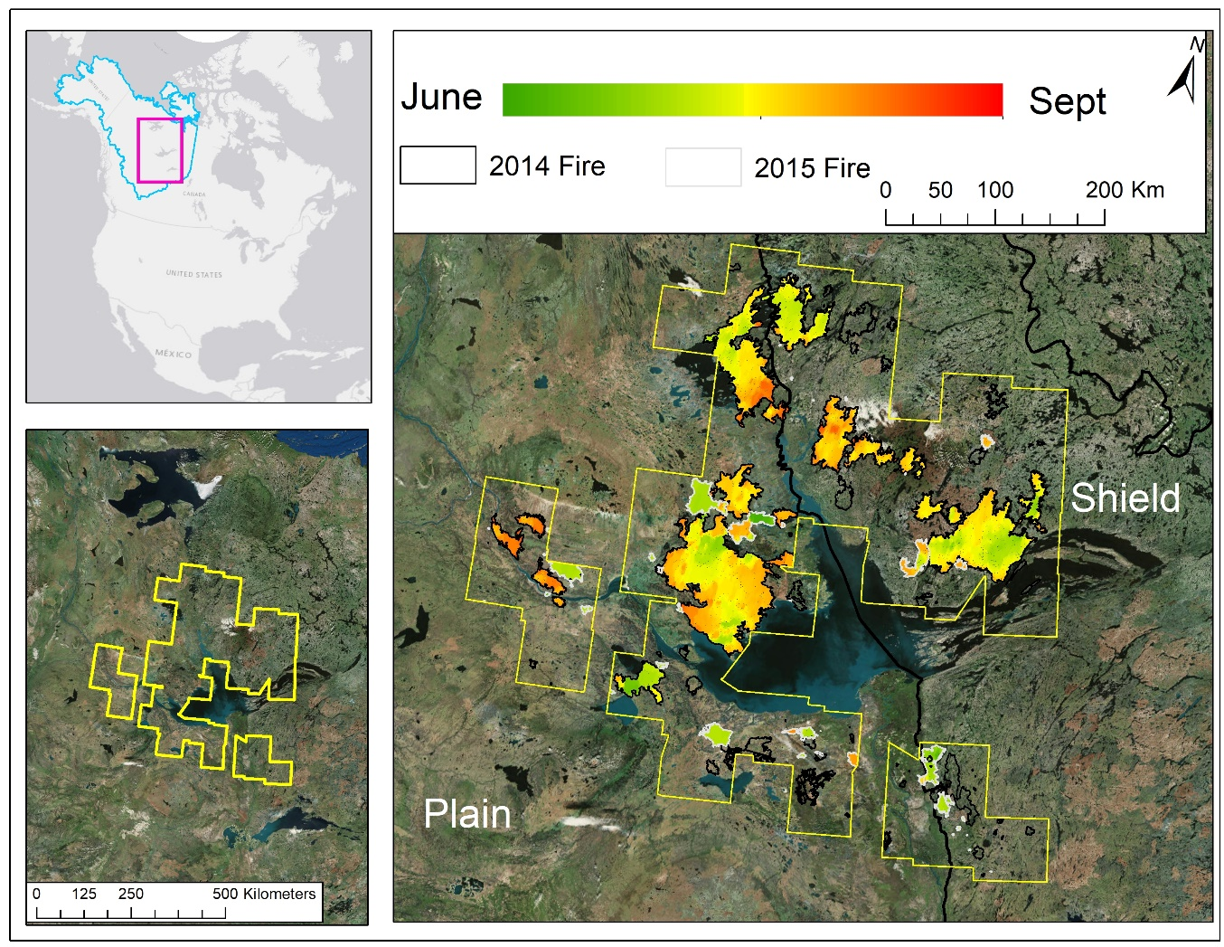
Understanding how peatlands are affected by wildfire in relation to both extent of burn and severity of burn to the organic soil (peat) layers where most of the C is stored is important
Assessing the Broadscale Effects of Wildfire Under Extreme Drought Conditions to Boreal Peatlands
Peatlands cover more than 75% of the landscape in the southern Northwest Territories, Canada where extreme drought led to widespread wildfires in 2014–2015.
To assess the wildfire effects across a 14.6 million ha study area including 136 wildfire events, we used an integration of field data collection, land cover mapping of peatland and upland ecotypes, Landsat-8-based mapping of burn severity to the soil organic layers, and MODIS-hotspot mapping of fire progression for season of burning
Fire Progression Maps from MODIS (Loboda et al. algorithm)
Organic Soil Layer (Peat) Burn Severity Maps
Peatland-Upland Ecotype Map
Bourgeau-Chavez et al. 2017 Can J. For. Res. & 2019 DAAC
French et al. 2020 Int. J. Wildland Fire, & 2020 DAAC
Bourgeau-Chavez TE-2018
Notes:
Questions: a) Are peatlands more or less susceptible to burning than upland areas during the extreme drought of 2014-15 NWT wildland fires? b) How does this vary by season, permafrost region, ecoregion, and by year?

Slide 11
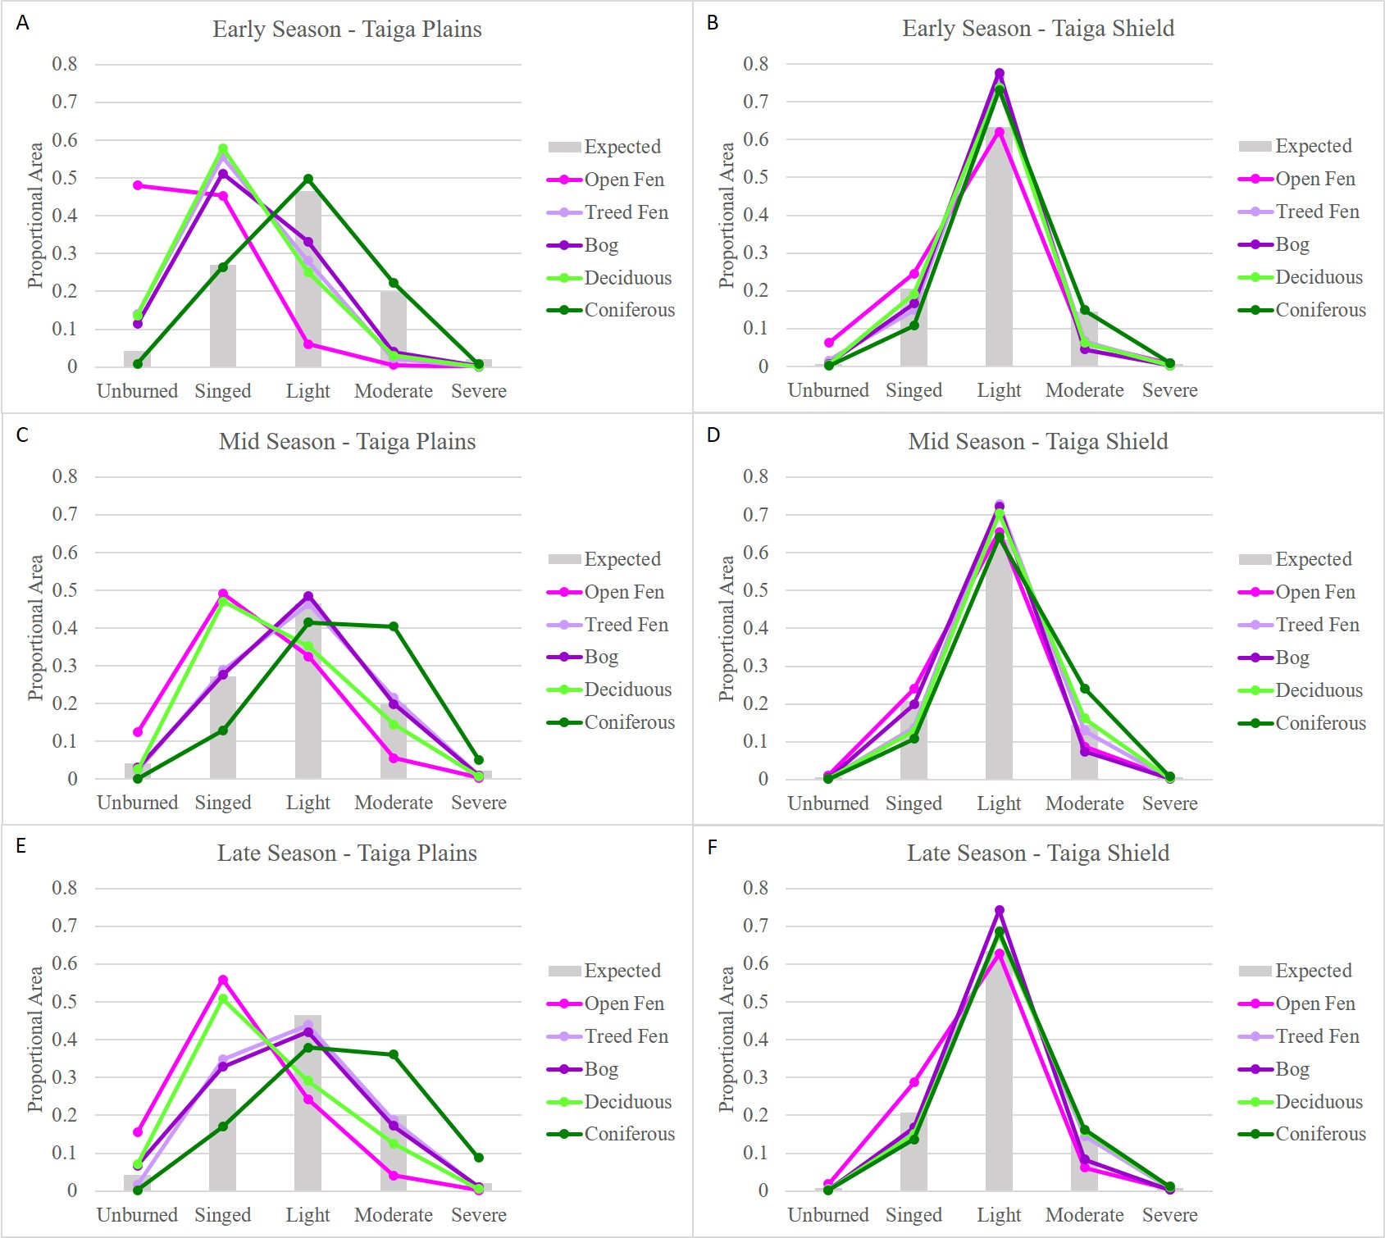
What is burning and how severely across gradients of ecoregions, ecotypes and seasonality and what ecotypes are showing resiliency?
Great Differences in Fire Effects for Taiga Plains vs. Taiga Shield
Evaluation of 136 Wildfires of Two Years (2014-15) of Extreme Drought in the Great Slave Lake Region
Based on chi-squared goodness of fit tests, we found that:
Taiga Plains: Peatlands are most resilient on the plains, where they are hydrologically well-connected to both ground water systems and larger peatland complexes. There large unburned and singed patches occurred across the landscape, and greater variability in burn severity was observed across seasons and ecotypes (left plots).
Taiga Shield: peatlands are more susceptible to wildfire, as they are smaller and hydrologically isolated by the rocky landscape. There burning affected proportionally larger peat areas with an evenness of burn severity (right plots) to the organic soil layers which may lead to less spatial diversity in post-fire recovery, making the landscape less resilient to future fire.
Burn Severity by Season for Taiga Plains and Shield
Bourgeau-Chavez LL, Graham JA, Vander Bilt DJL, and Battaglia MJ. 2022. Frontiers in Forests and Global Change. doi: 10.3389/ffgc.2022.965605
Bourgeau-Chavez TE-2018
Notes:
Understanding the tipping point of drought conditions at which the landscape becomes connected, and peatlands are susceptible to wildfire with deeper burning of the organic soil layers is important for understanding the potential future effects of climate change and projected increases in wildfire on peatlands. This is critical for C accounting and climate mitigation strategies.

Slide 12
CanFIRE Results: Peatlands are Dominant Source of C Emissions in Extreme Wildfire
Parameterized CanFIRE for peatlands using soil field ([C], depth) data from study region
Compare fire emissions contributions of peatlands vs uplands:
Uplands (deciduous forest, coniferous forest)
Peatlands (open fen, treed fen, bog)
Non-peatland wetlands (marsh, swamp)
RESULTS:
On a rate basis (Mg/ha), non-peatland wetlands emit 2x as much carbon as uplands and peatlands emit over 3x as much carbon as uplands during wildfires.
Billmire, VanderBilt, Bourgeau-Chavez LL, in prep. SEE POSTER
Bourgeau-Chavez TE-2018

Slide 13
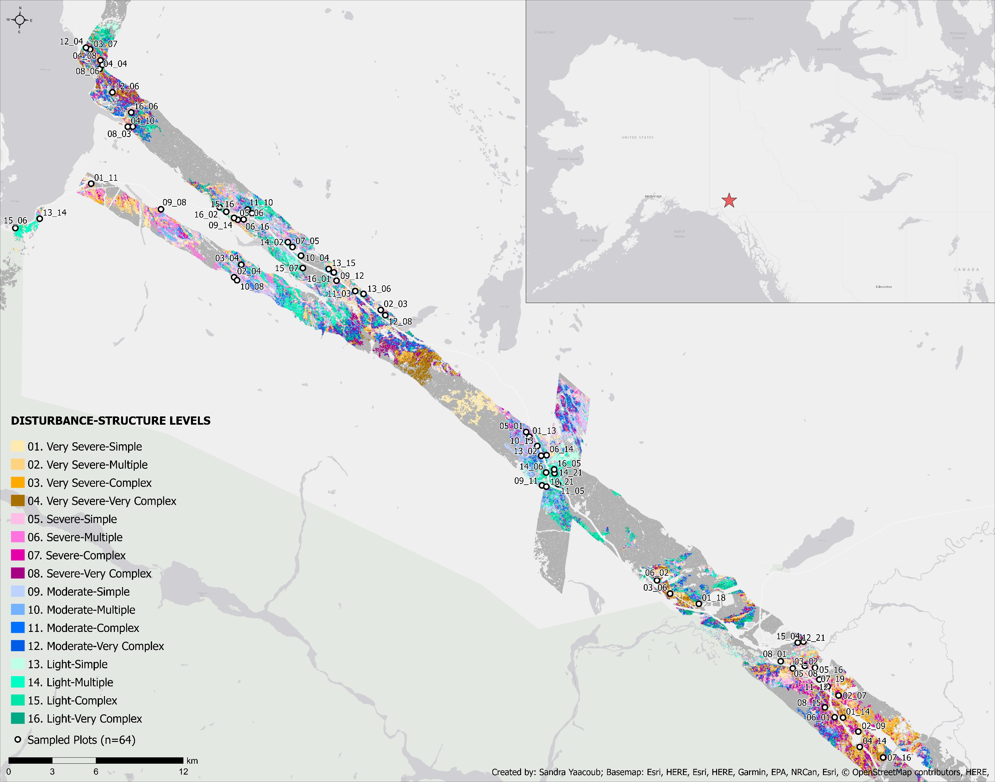
Yaacoub (NSERC 2019): Bark Beetle Project Update
2485 overstory trees were measured across 64 plots within a spruce bark beetle affected region in Kluane, Yukon. 57% were live- and 31% were dead-standing white spruce trees. The remaining 12% were deciduous.
Plot data will be used with ABoVE airborne data to model component live and dead volumes of trees.
We are also working with Yukon Forestry to incorporate their plots in these models.
Contact: s.yaacoub@queensu.ca
Notes:
Other notes:
The map shown on this slide shows a disturbance-structure classification of the landscape which was used to help guide plot selection across a variety of disturbance levels and forest structures in Kluane, Yukon.
Greyed out areas represent hard to reach locations (>1000m from a road or trail) or non-forested and recently disturbed areas (not from beetle infestations).
Disturbance levels were generated using normalized burn ratio (NBR) values from Sentinel-2 imagery.
Higher NBR values were typically associated with higher spruce mortality but sometimes also bare ground exposure or wetland areas.
Structure levels were generated using LVIS L2A complexity values.
Higher complexity values were typically associated with dense spruce forests and lower complexity values with predominantly shrub-covered areas.

Slide 14
Other Activities:
Google Drive materials:
https://drive.google.com/drive/folders/1__wpq-s29yxmYyiPy7UcmCkNbb4t9Tbe?usp=sharing
~35 Archived Products related to fire disturbance on the ABoVE website list
Developed Tundra fire model benchmarking needs document to:
Connect with data compilation results
Assess opportunities and gaps for modeling and measurements

Slide 15
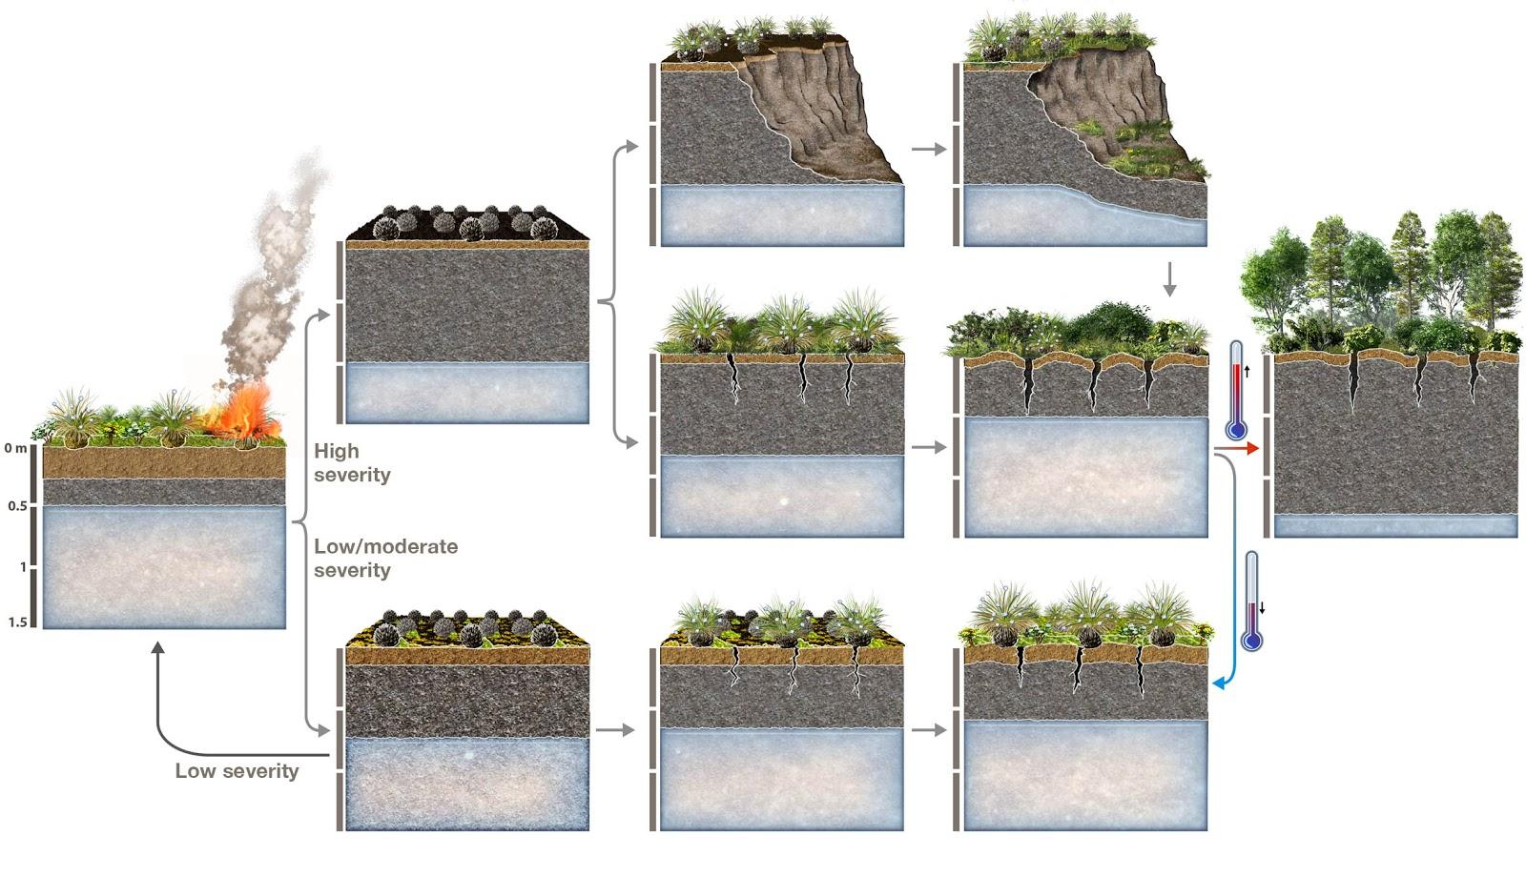
Coming Attractions: Synthesis Ideas
Synthesis ideas under discussion (from notes & survey - unfiltered):
Tundra fire combustion & regrowth (from NAU workshop)
Drivers of fire occurrence & change: lightning, climate, soil/fuel moisture (weather), shrub density
Carbon cycle & mechanisms of recovery
Fire impacts on nutrients, microbial community, climate, competition
Moisture, hydrology, permafrost interactions with fire
Post-fire impacts on permafrost (drivers, magnitude, future changes, etc.)
Effects of fire on landscape scale
Post-fire trajectories
Ecosystem succession in the tundra
Figure from A Rocha

Slide 16
Coming Attractions
Dong Chen will move into lead of the WG
Tundra data synthesis product and publication coming soon
Looking for New participants
Integrate new projects into WG
new projects please designate “disturbance” in your profile
Continuation of webinar-style meetings is one possibility
2007 Anaktuvuk River tundra fire, North Slope, Alaska (Photo: U.S. Bureau of Land Management)

