Slide 1
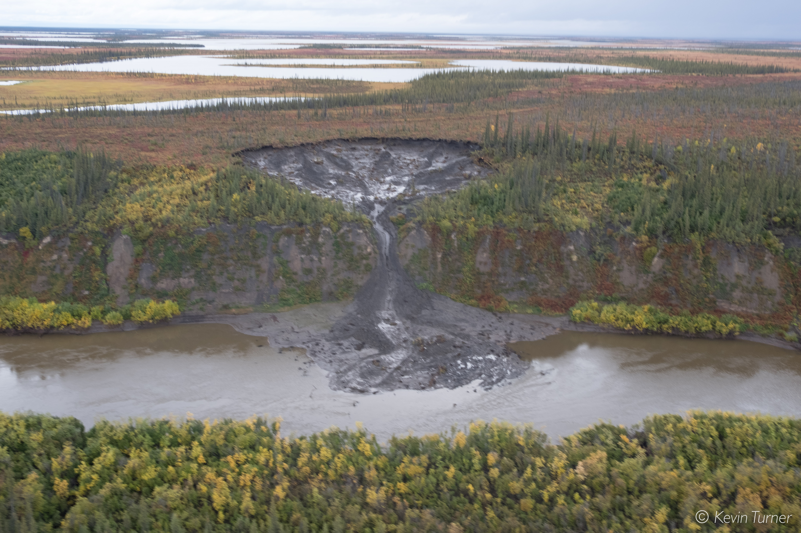
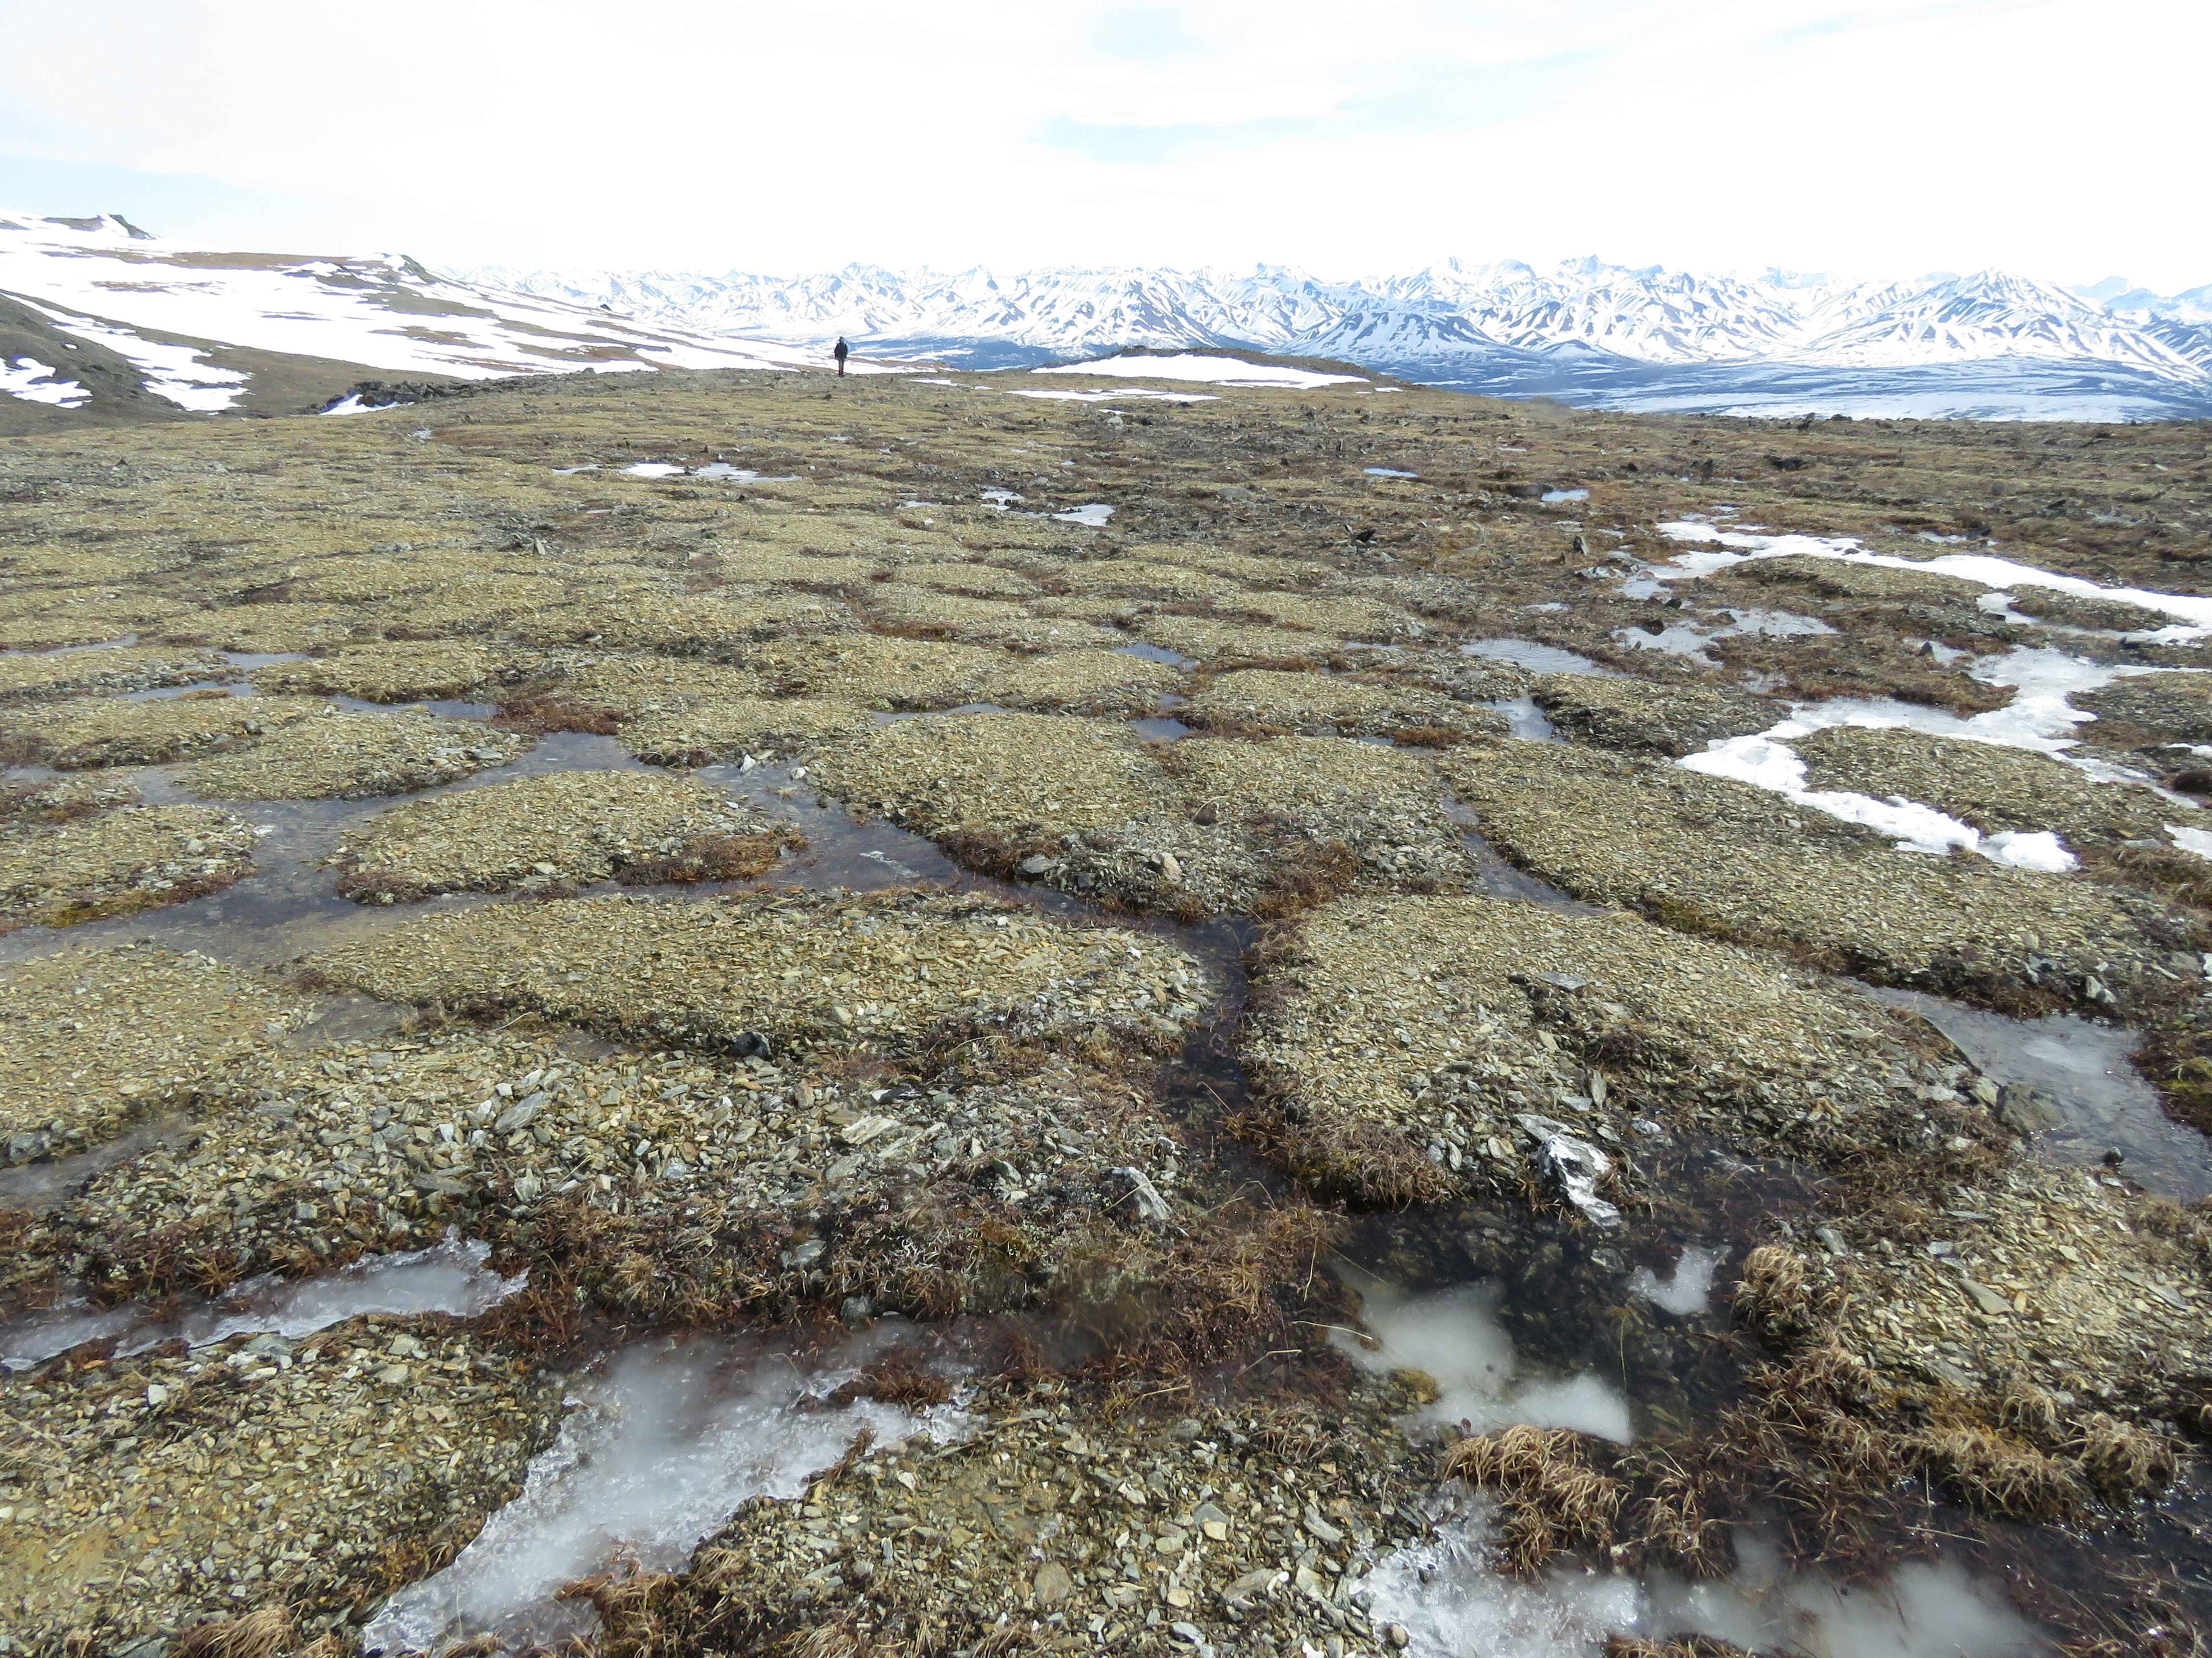
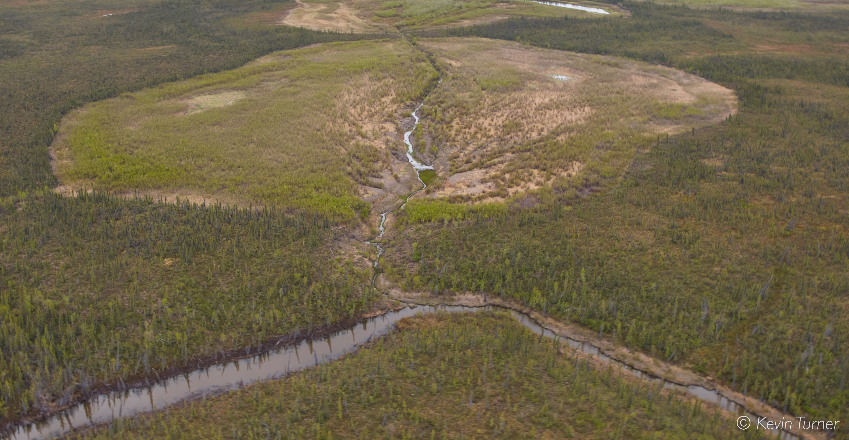
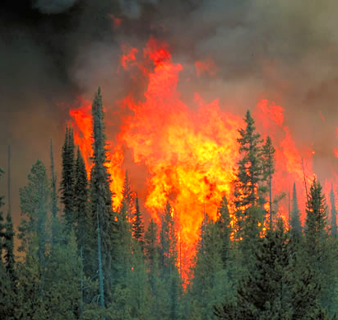
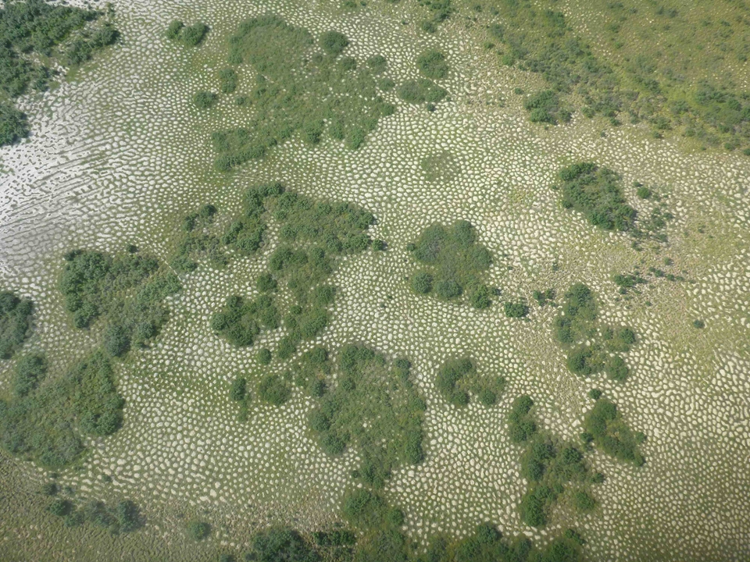
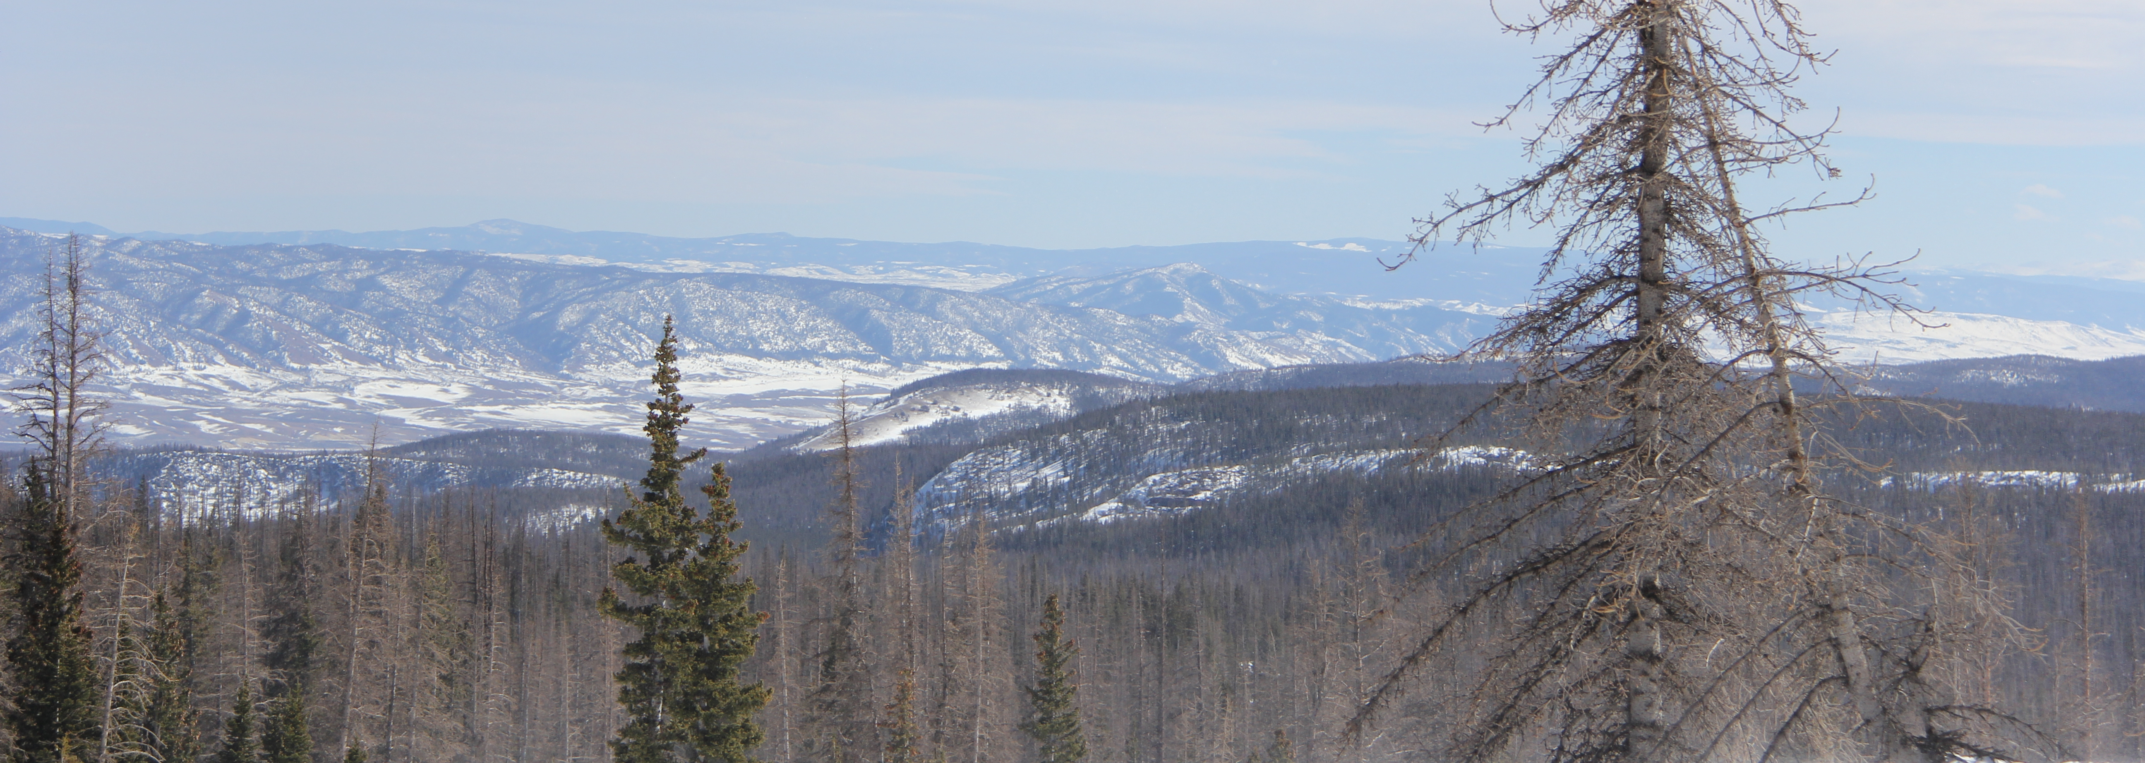
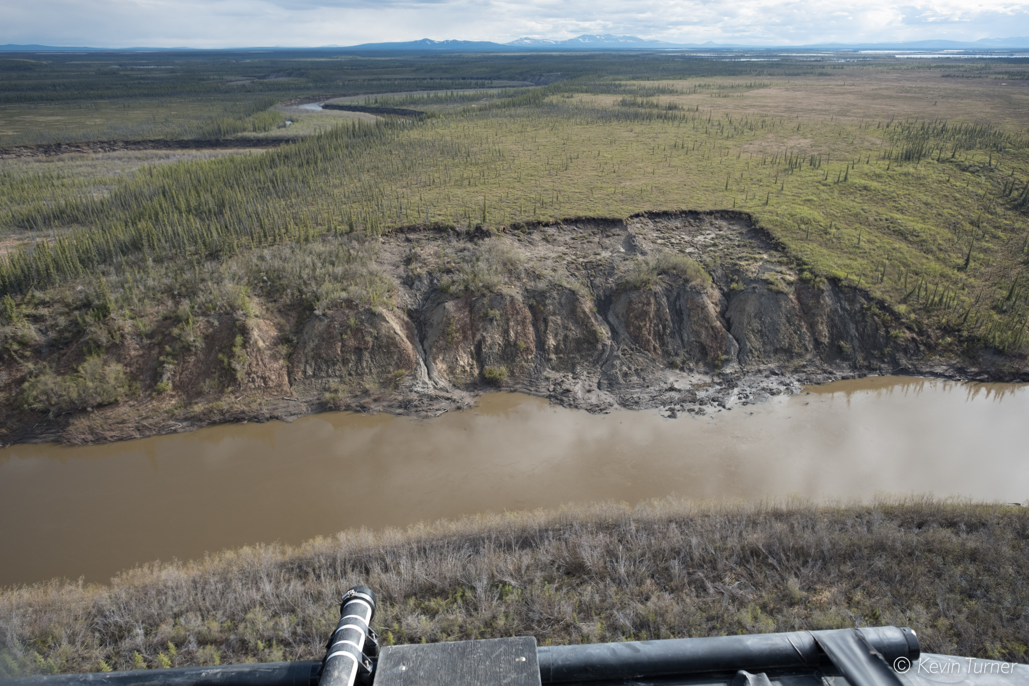
Multi-Disturbance Synthesis Working Group Updates
Adrianna Foster, Jon Wang, Brendan Rogers, Howie Epstein, Scott Davidson, JJ Frost, Elizabeth Hoy, Oliver Sonnentag, Kevin Turner, Logan Berner, Elizabeth Campbell, Guillermo Castilla, Laura Bourgeau-Chavez, Dong Tony Chen, Jinyang Du, Angela Erb, Randi Jandt, Mary Kang, Caleb Pan, Chris Potter, Tatiana Shestakova, Carolina Voigt, Scott Goetz, and many more
ABoVE Science Team Meeting 7
May 11 - 13, 2021

Slide 2
Photo credit: JJ Frost
Photo credit: Kevin Turner
Disturbances are dominant driver of vegetation dynamics in boreal & arctic systems
Photo credit: J. Frank

Slide 3
Focus of working group
Synthesis of main disturbances (natural and anthropogenic) within the North American arctic and boreal regions
Specifically
Summary of each disturbance/disturbance type, focusing on temporal dynamics of vegetation loss and recovery
Case studies for each topic/type
Additionally
Disturbance interactions and their impacts
Future needs (data, studies, tools)

Slide 4
Synthesis Groups
Group | Disturbance
Fire | Fire
Pests and Pathogens | Needleleaf defoliators
 | Broadleaf defoliators
 | Bark beetles
 | Pathogens
Permafrost & Hydrology | Thermokarst
 | Landslides & active layer detachments
 | Cryoturbation
 | Permafrost degradation
 | Lake drainage
 | Ice wedge degradation
Anthropogenic Impacts | Roads
 | Fire breaks
 | Survey & Power lines
 | Oil & gas exploration & seismic lines
 | Logging
Weather | Drought
 | Freezing Drought
 | Windthrow

Slide 5
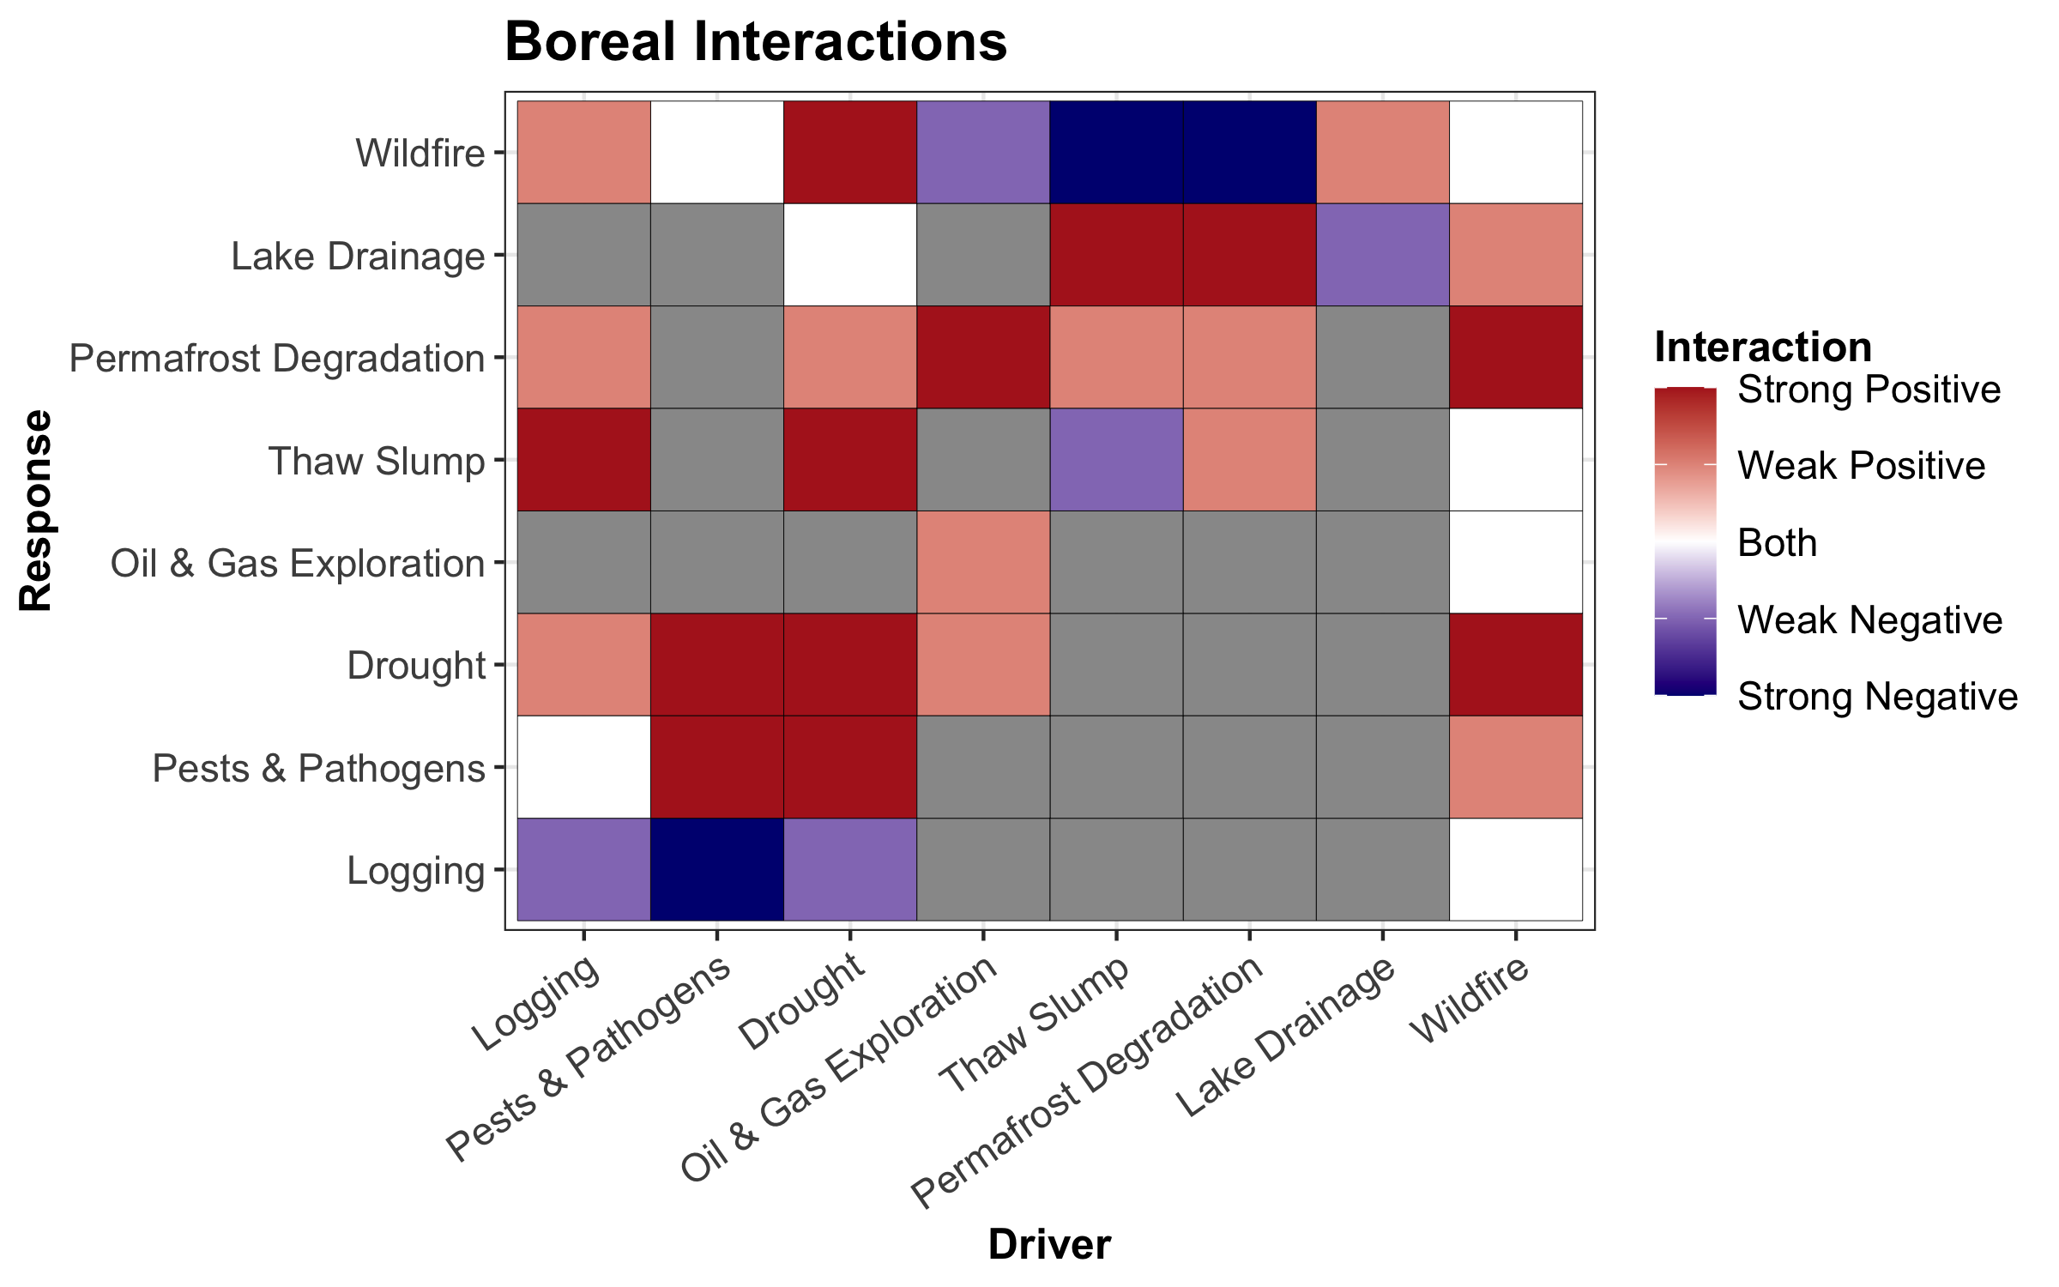
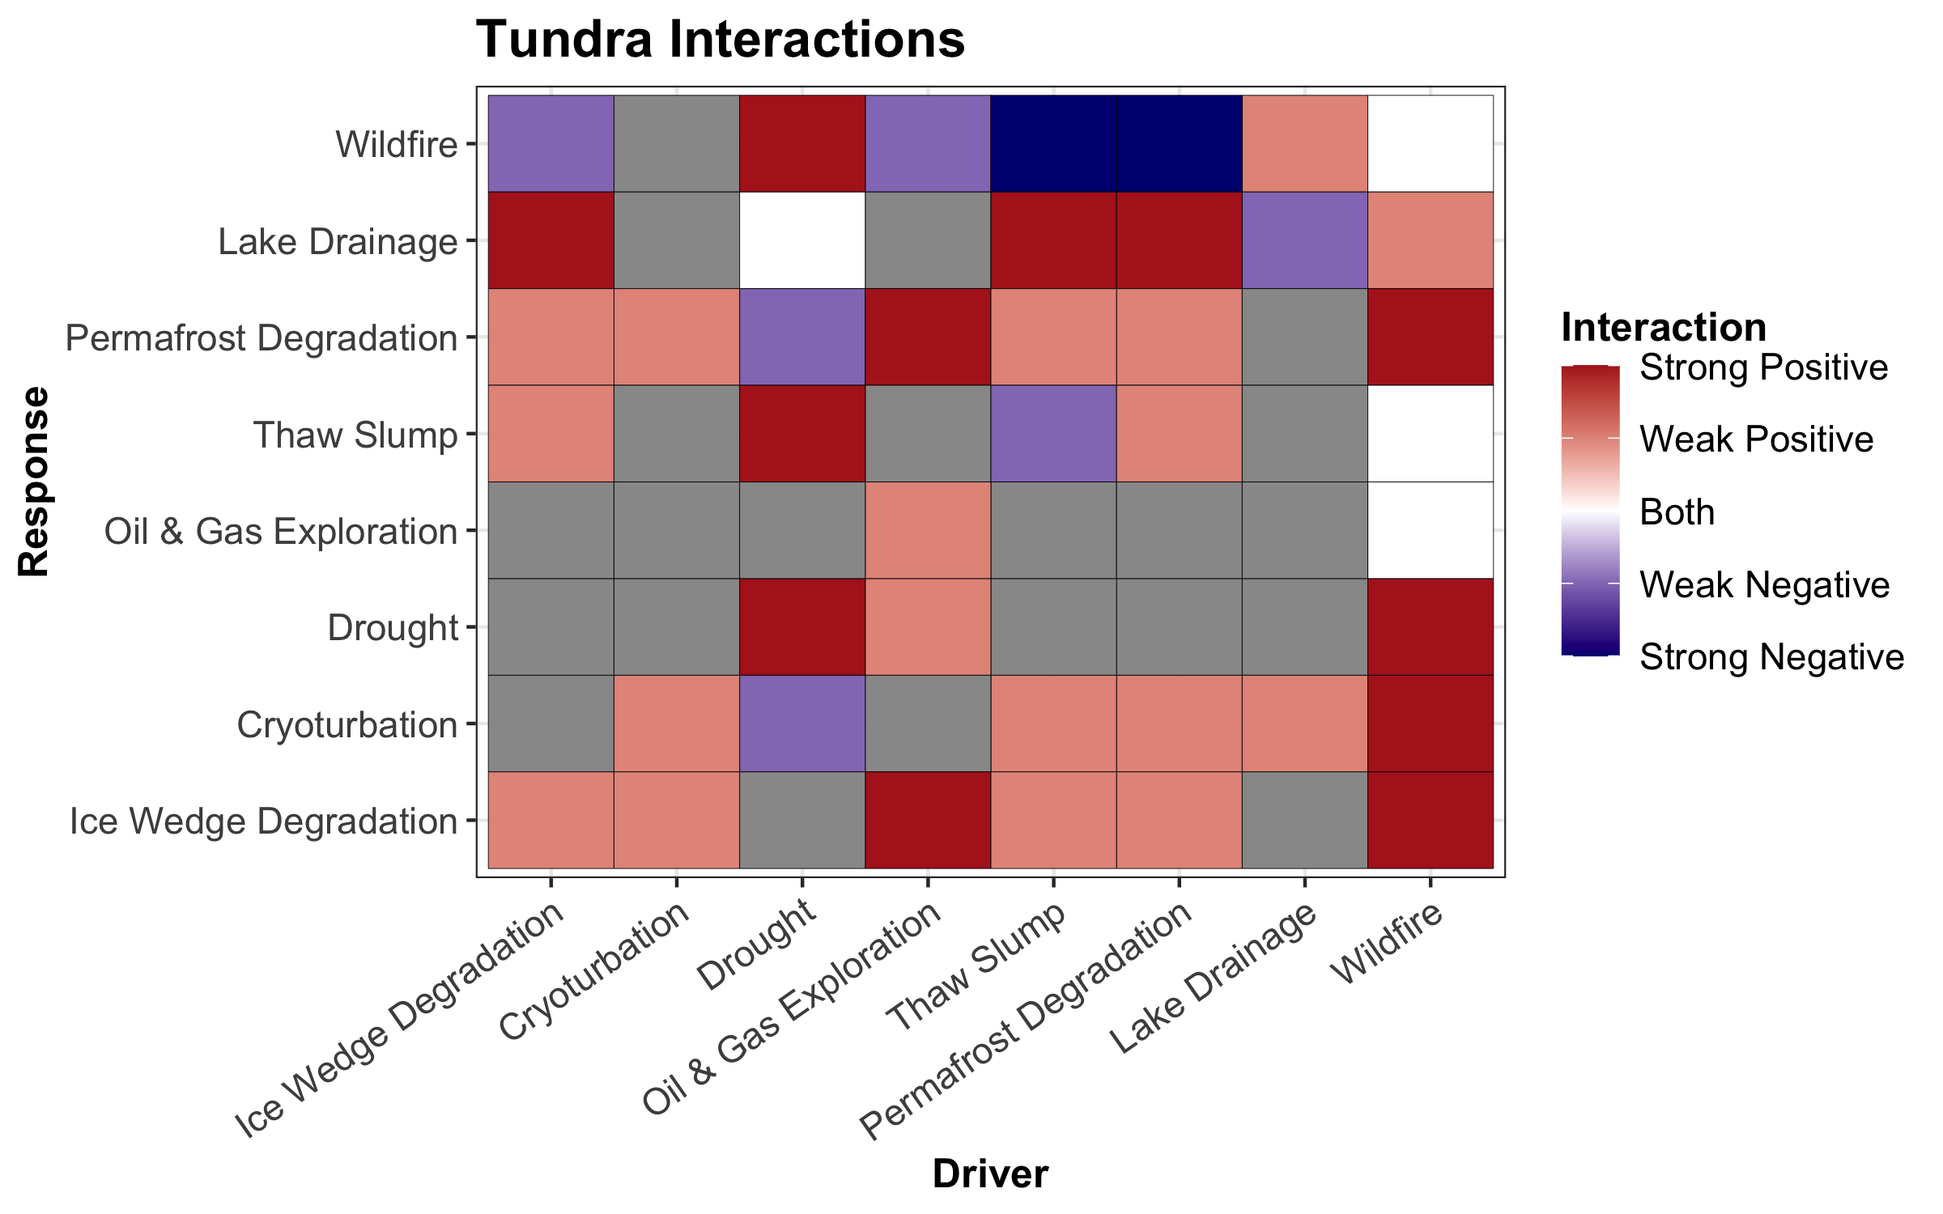
Disturbance Interactions
None/Unknown

Slide 6
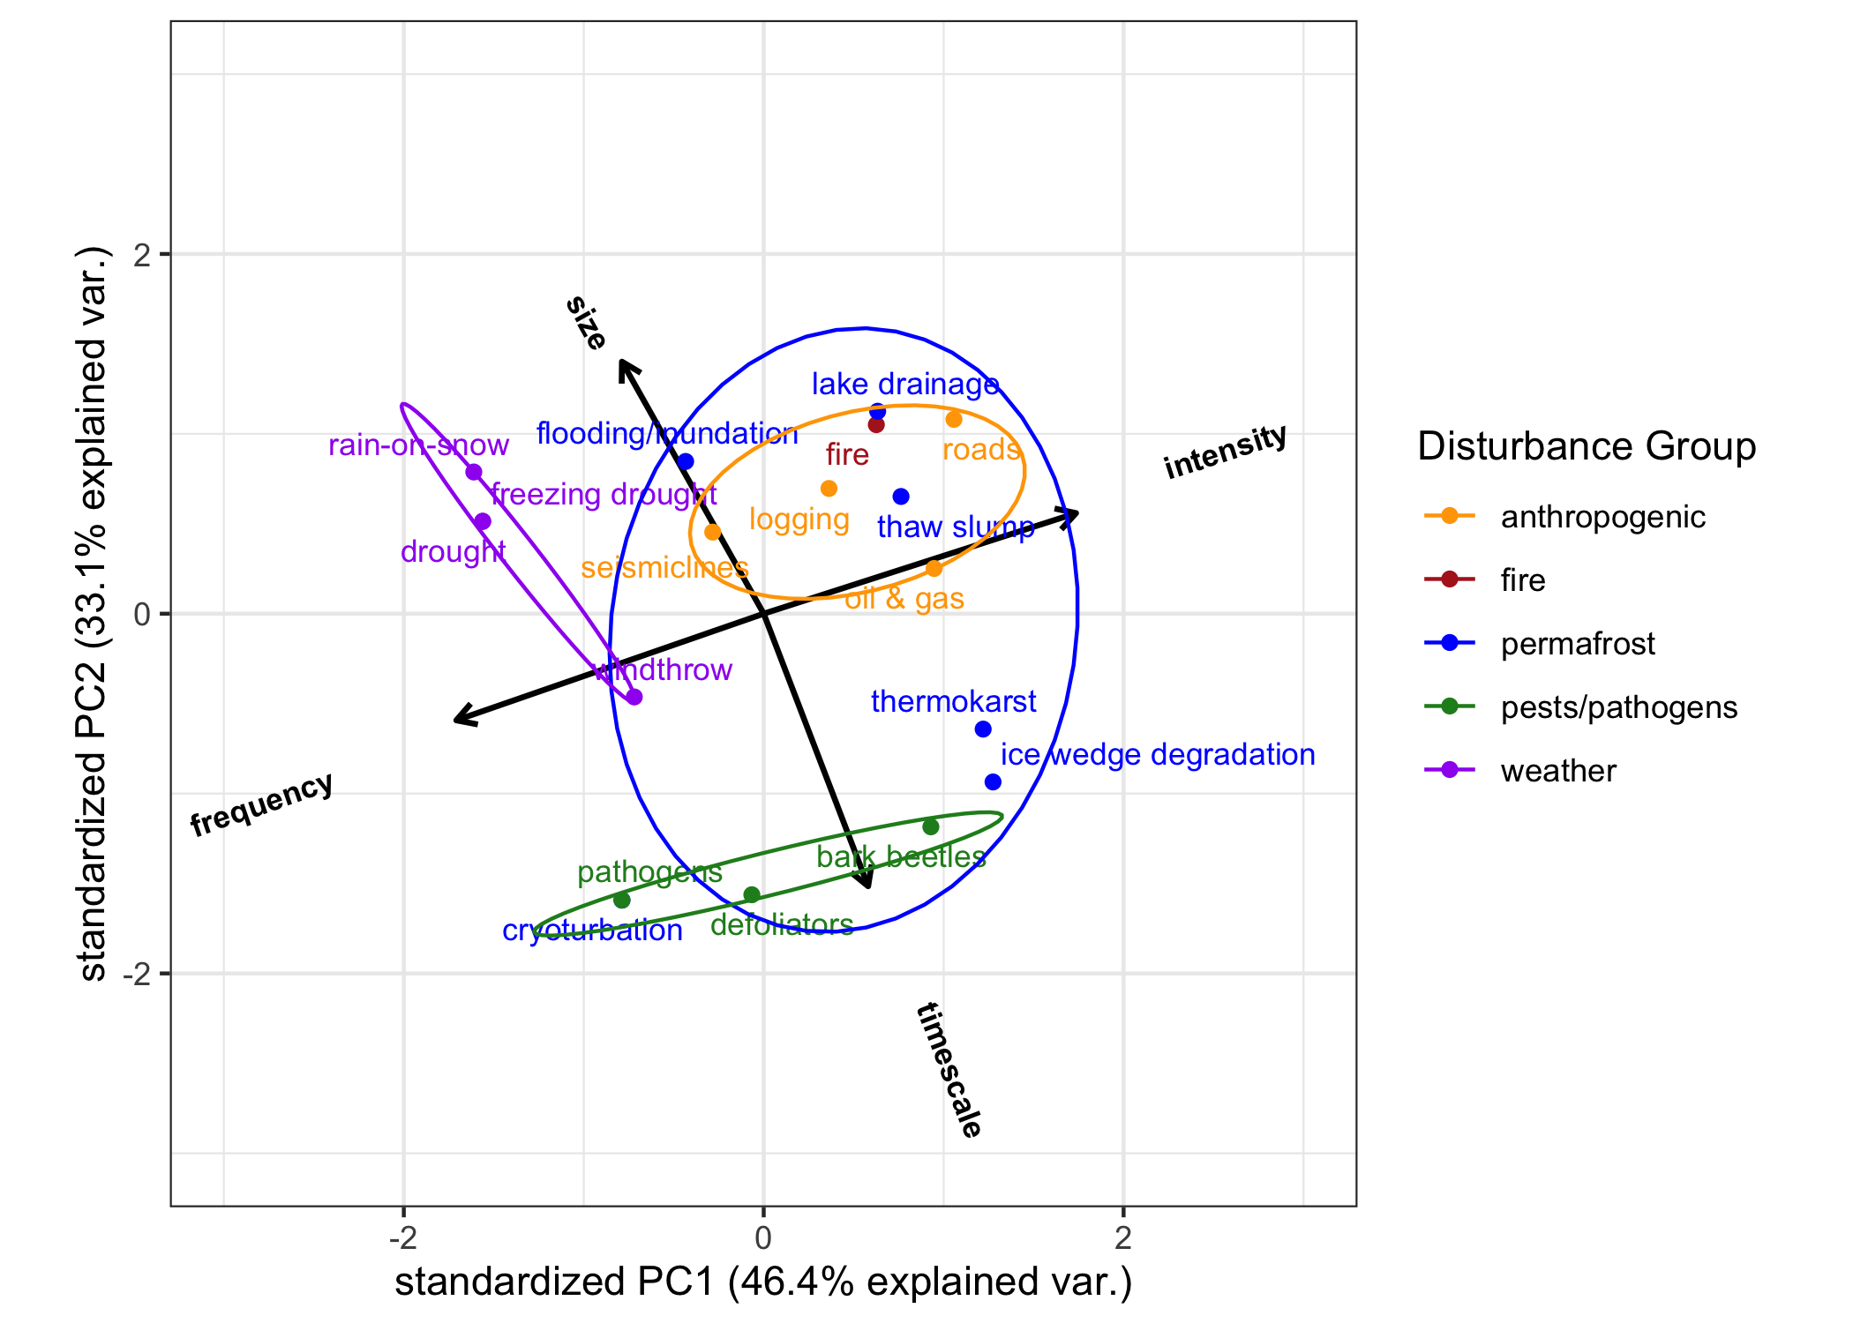
PCA
Disturbance Characteristics
Average size of an individual disturbance
1s, 10s, 100s, etc. of square meters
Typical frequency
Multi-centennial, centennial, decadal, annual
Typical intensity of disturbance
Stress, partial mortality, total mortality
Time scale of disturbance
Days, weeks, months, years, multi-years

Slide 7
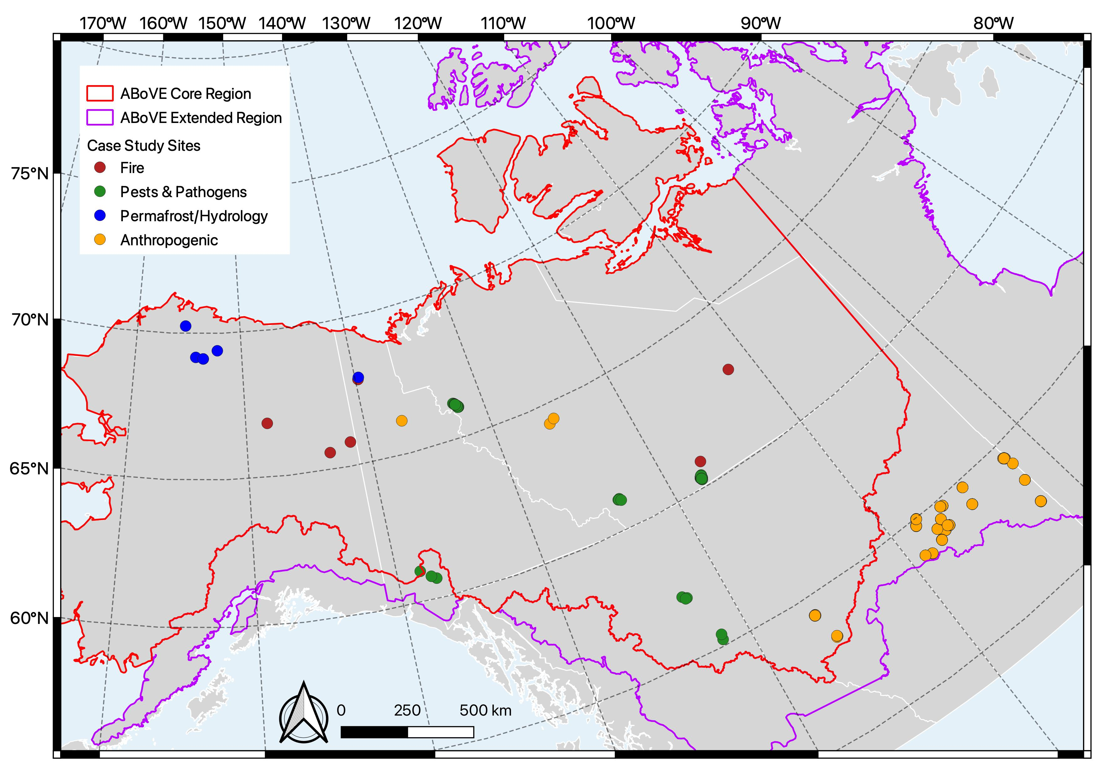
Case Studies
Disturbance Type | Number of Locations
Fire | 11
Insects | 70
Ice Wedge Degradation | 1
Cryoturbation | 2
Lake Drainage | 2
Thaw Slumps | 1
Oil & Gas Well | 3
Logging | 100
Seismic Lines | 22
Still working on compiling more case study locations

Slide 8
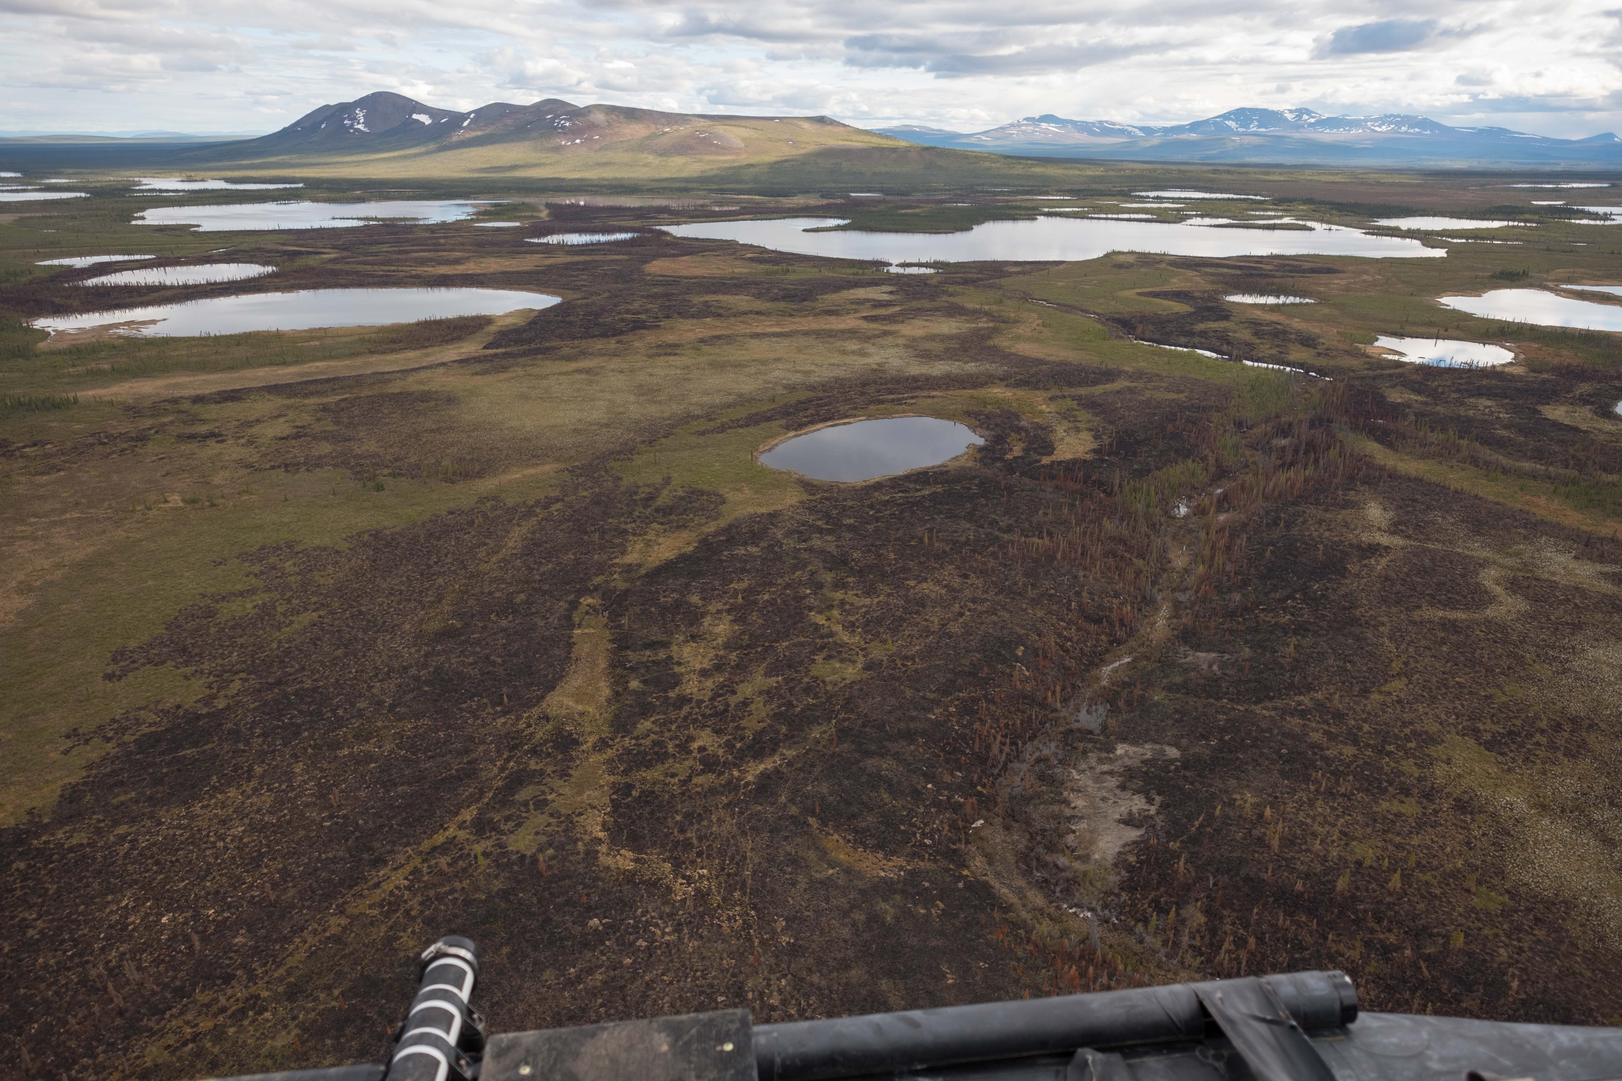
Wildfire
Very well studied
Impacts soil, vegetation regrowth, carbon stocks, climate, human health
Randi Jandt
Kevin Turner

Slide 9
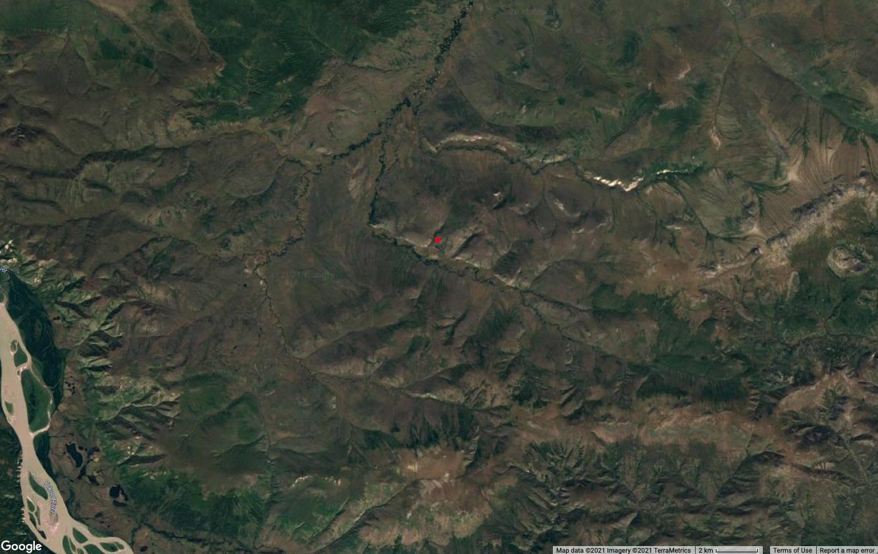
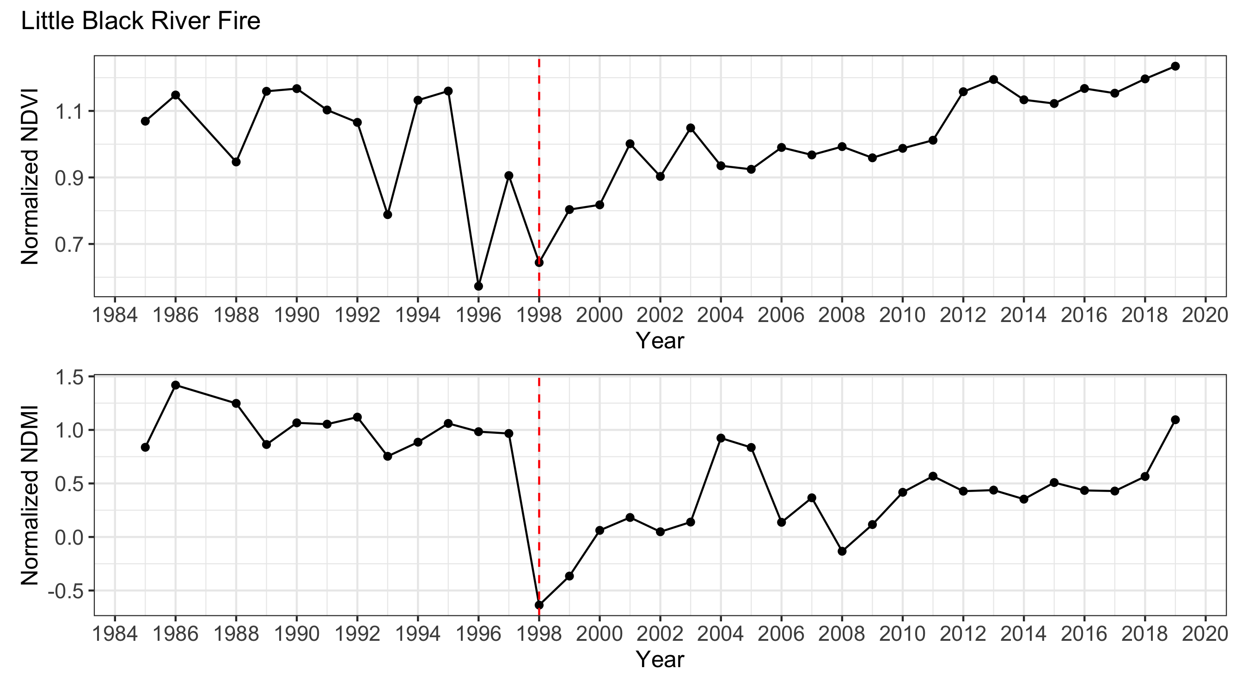
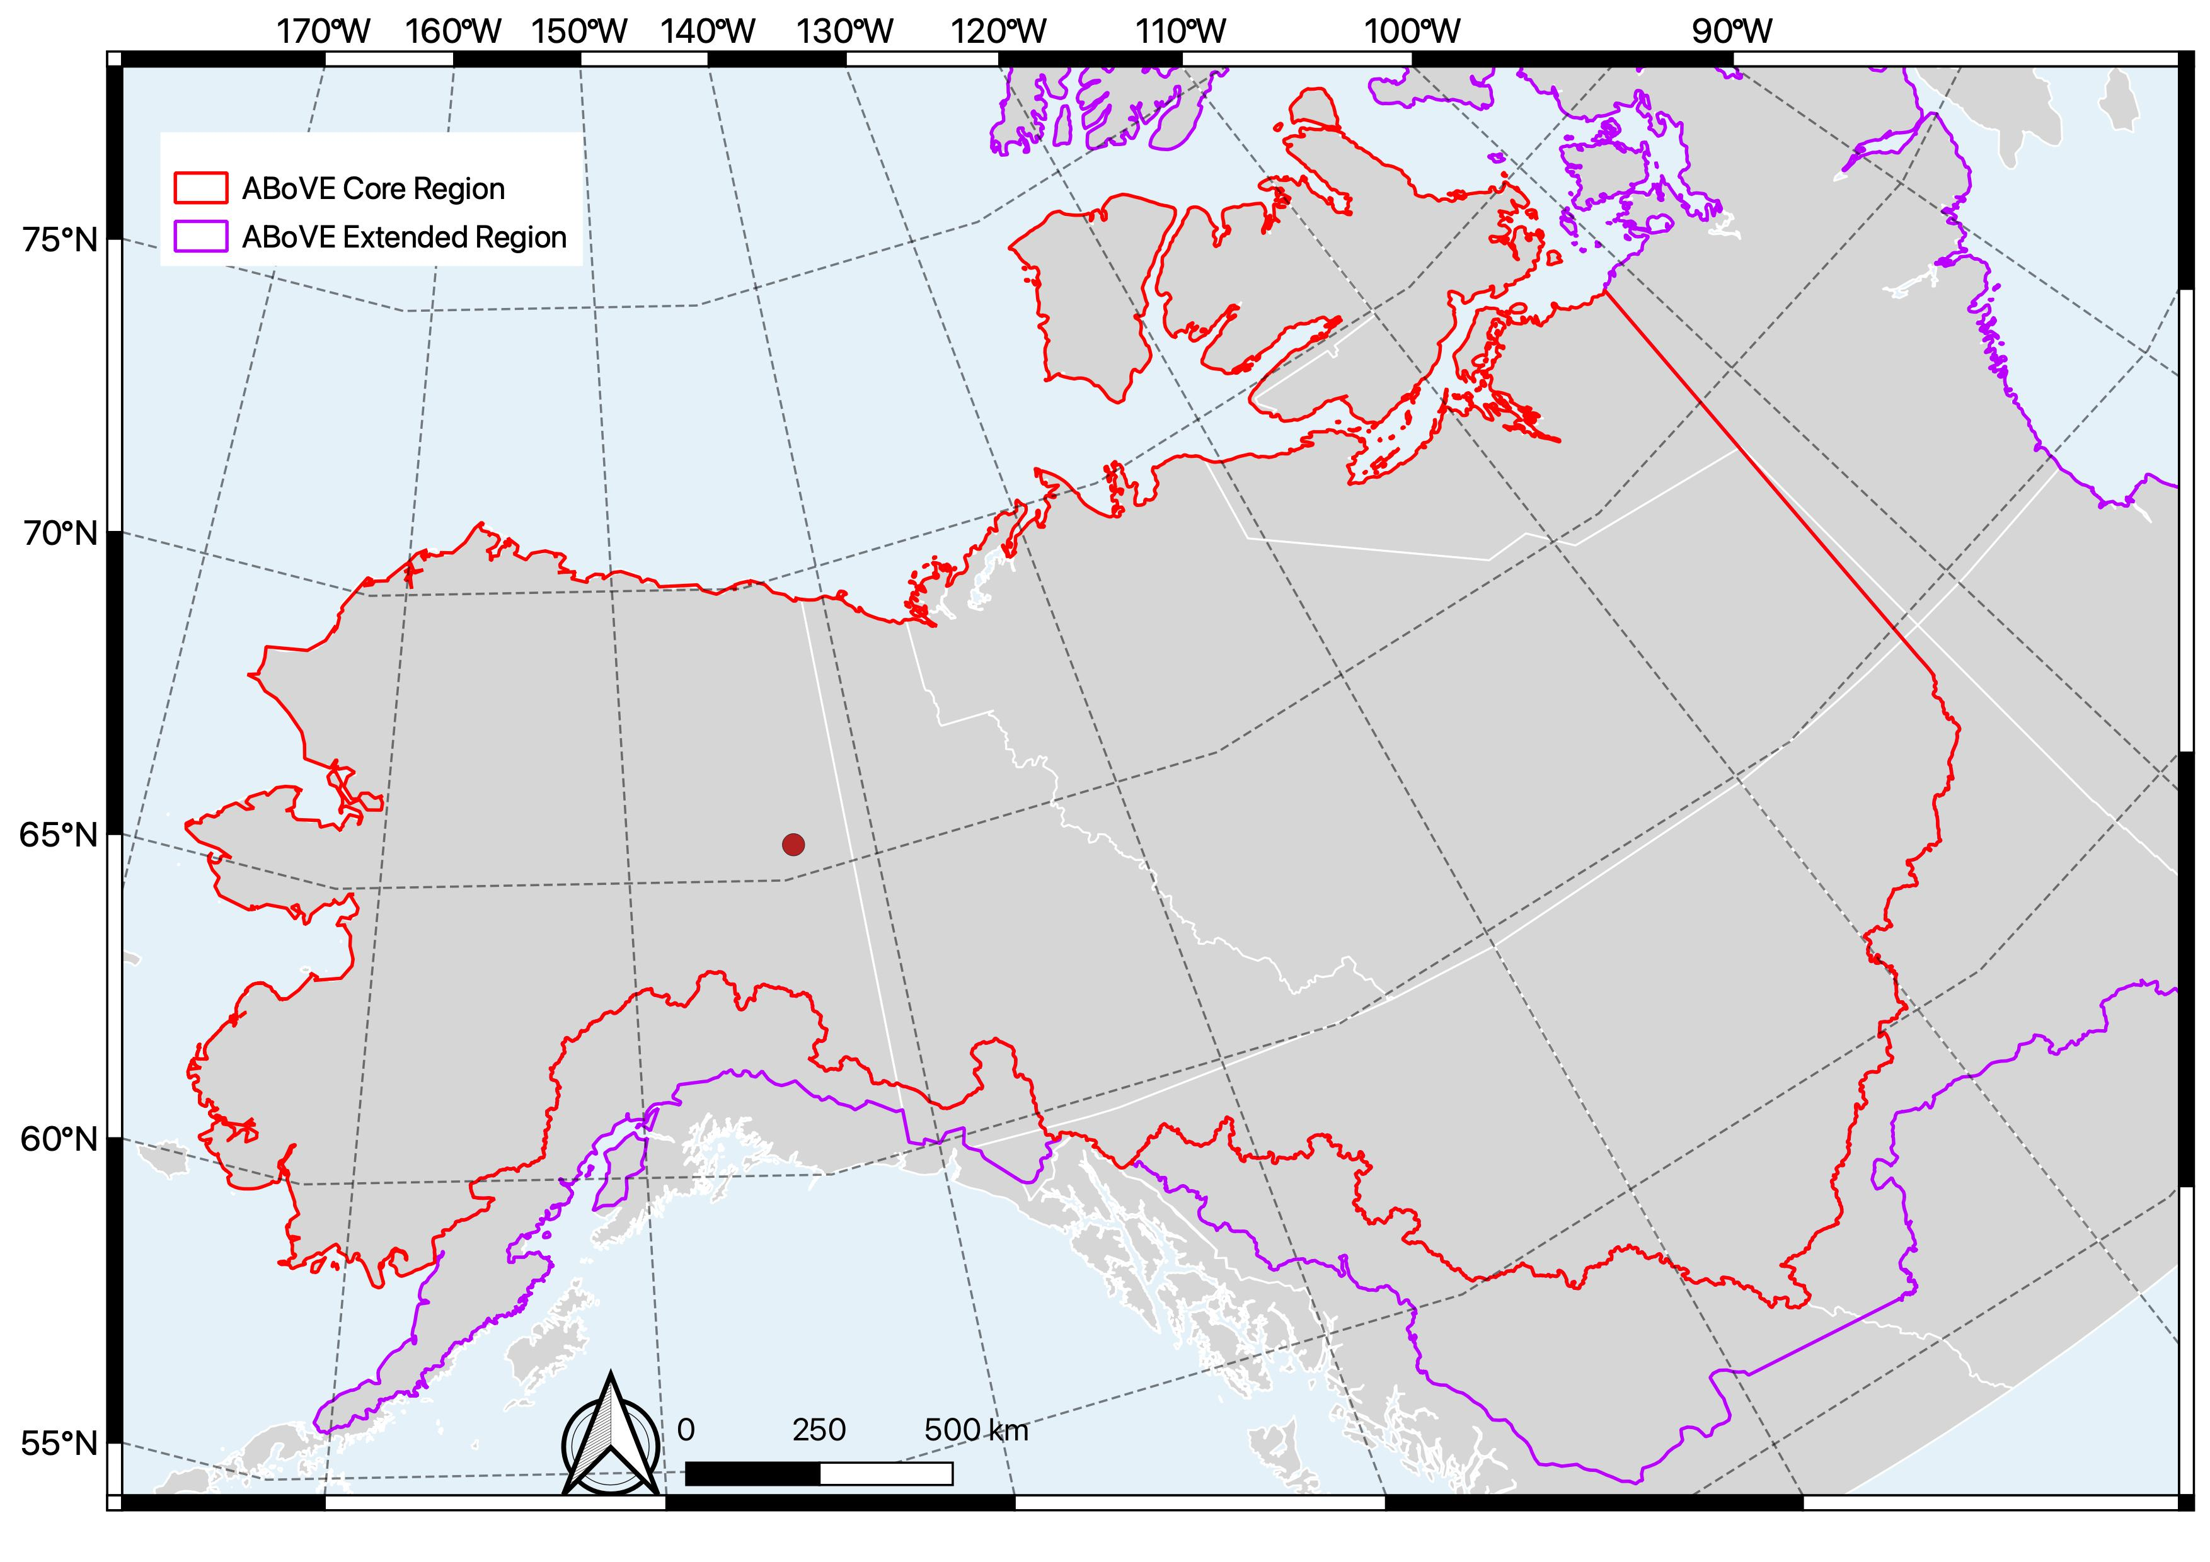
Wildfire

Slide 10
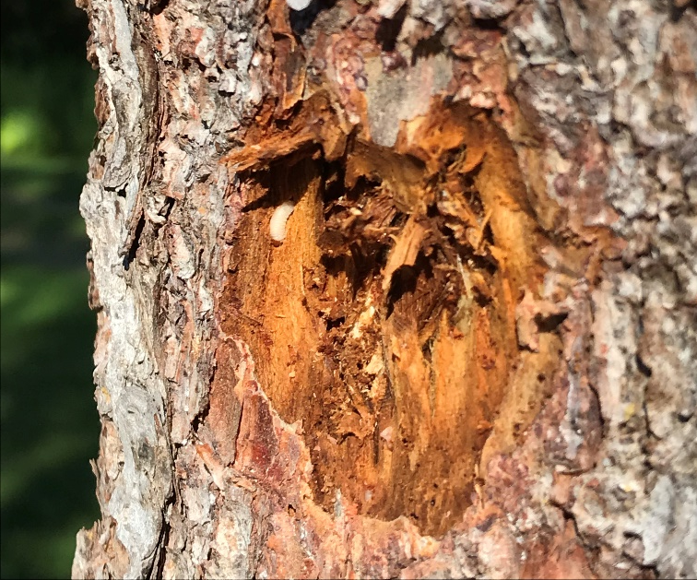
Pests & Pathogens
Broadleaf defoliators (e.g. Aspen leaf miner)
Needleleaf defoliators (e.g. Spruce budworm)
Bark beetles (e.g. Spruce beetle)
Pathogens (e.g. root rots, cankers)
Effects:
Growth reduction
Deformation
Tree mortality
J. Moan DNR-DOF
USFS
NRCAN

Slide 11
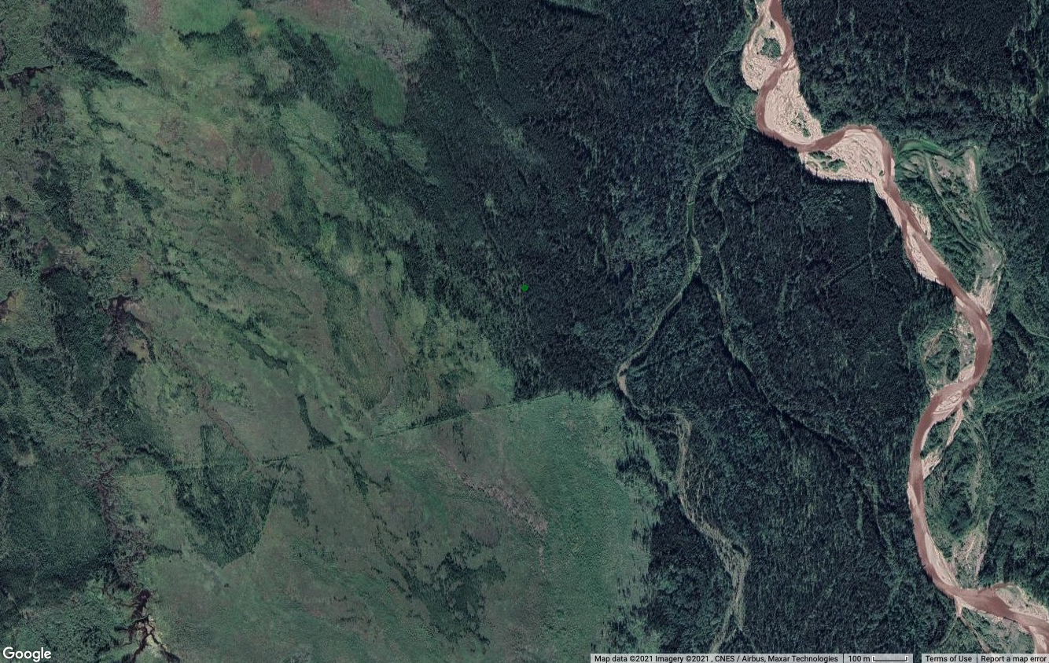
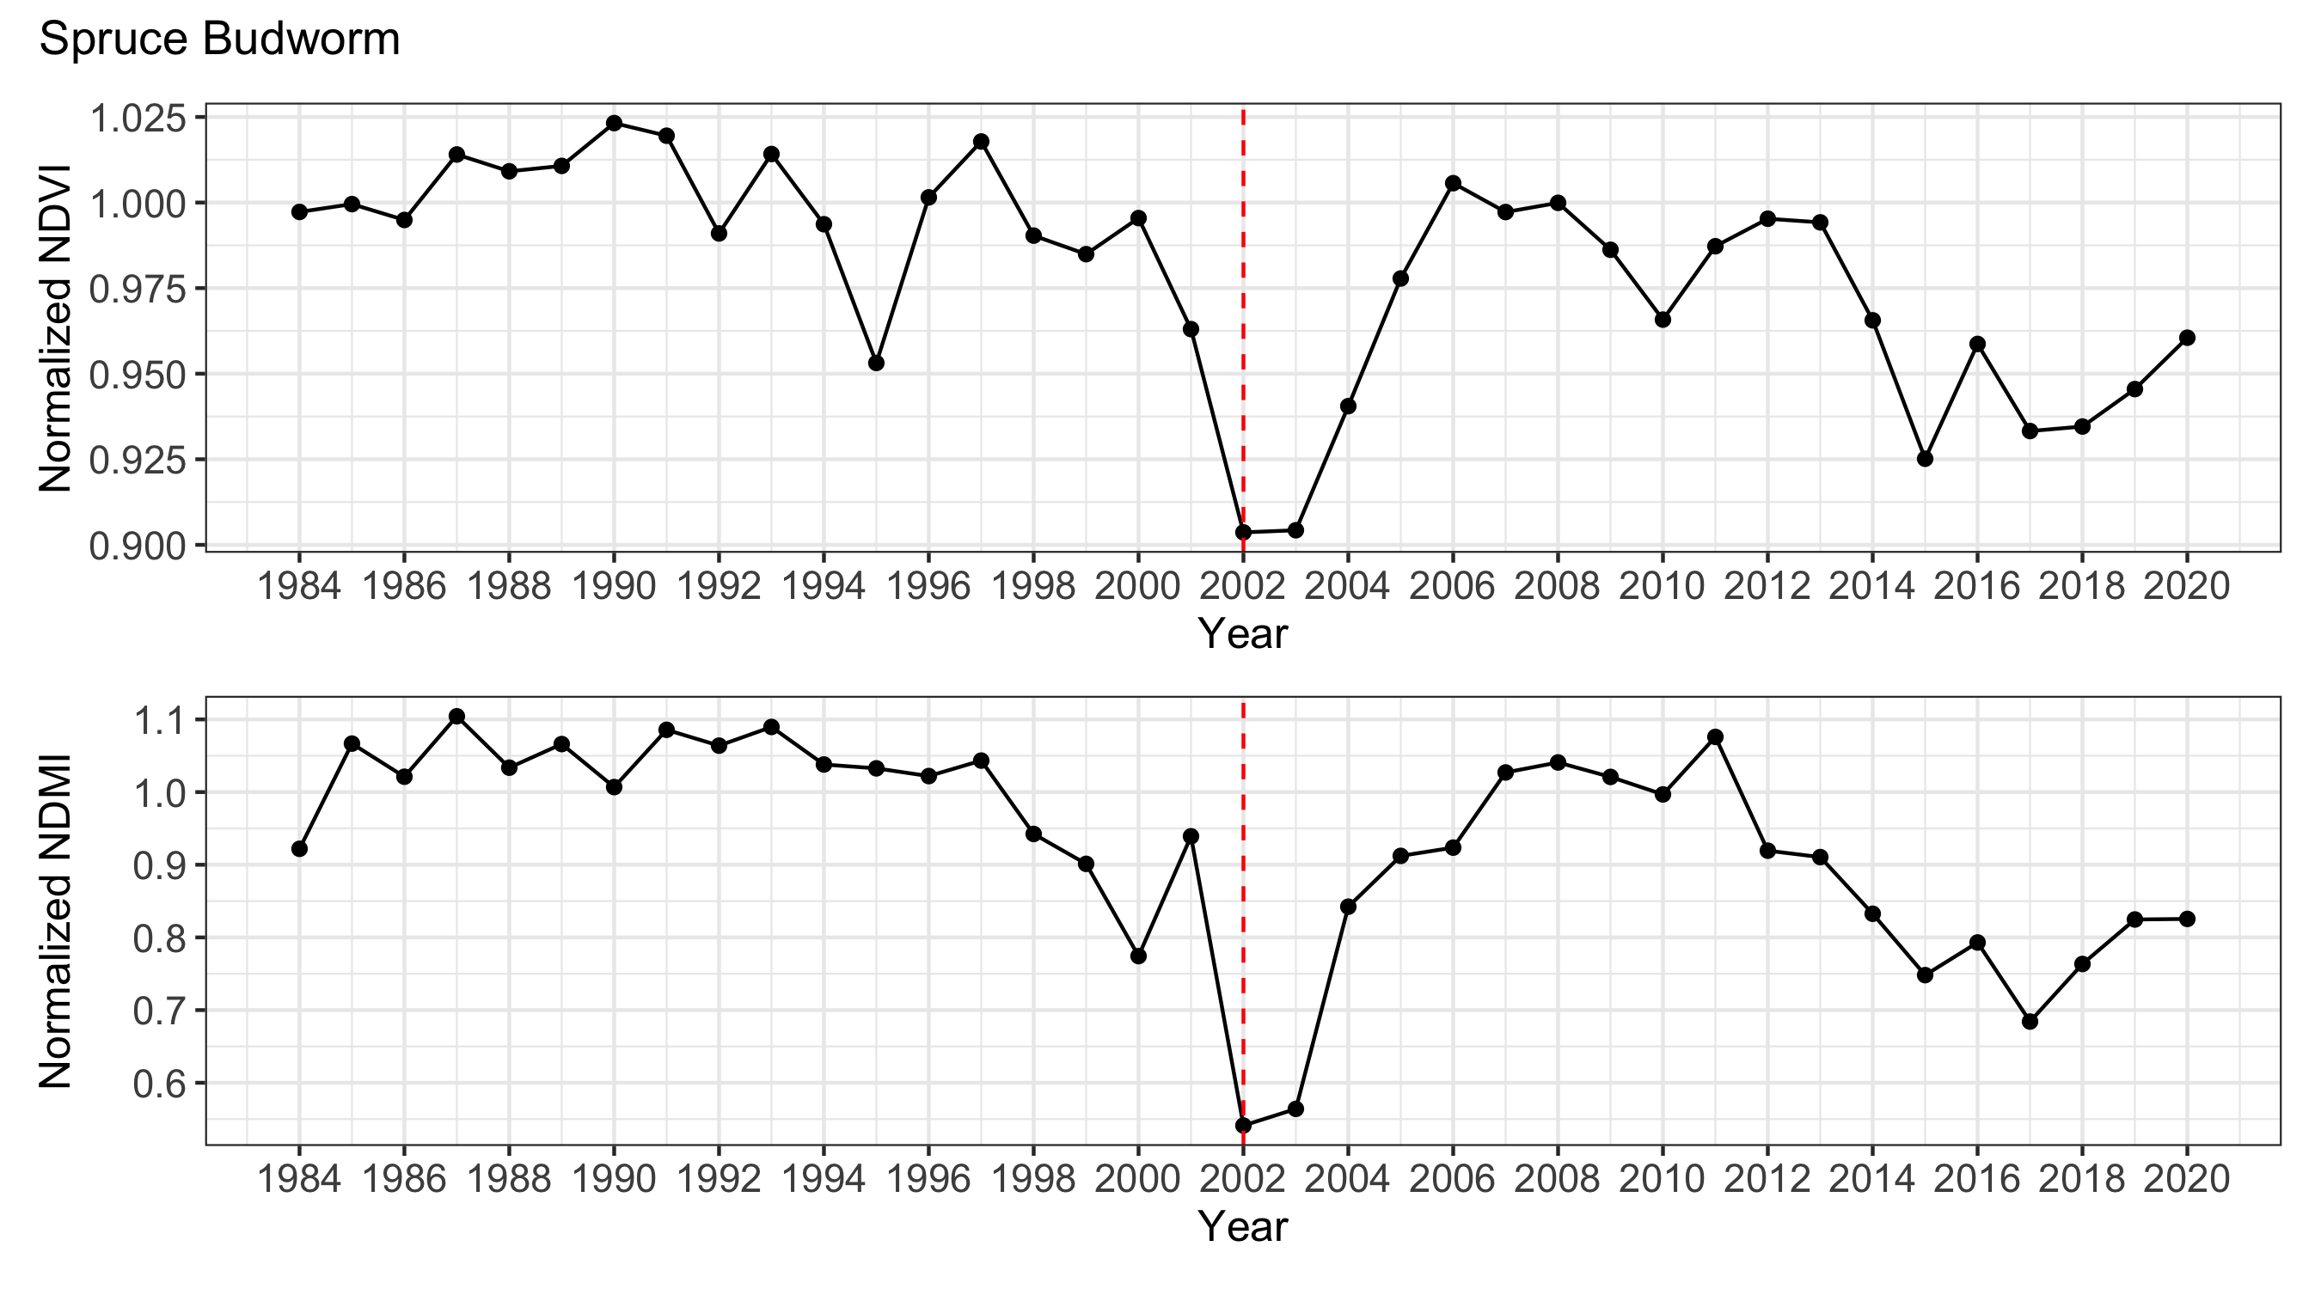
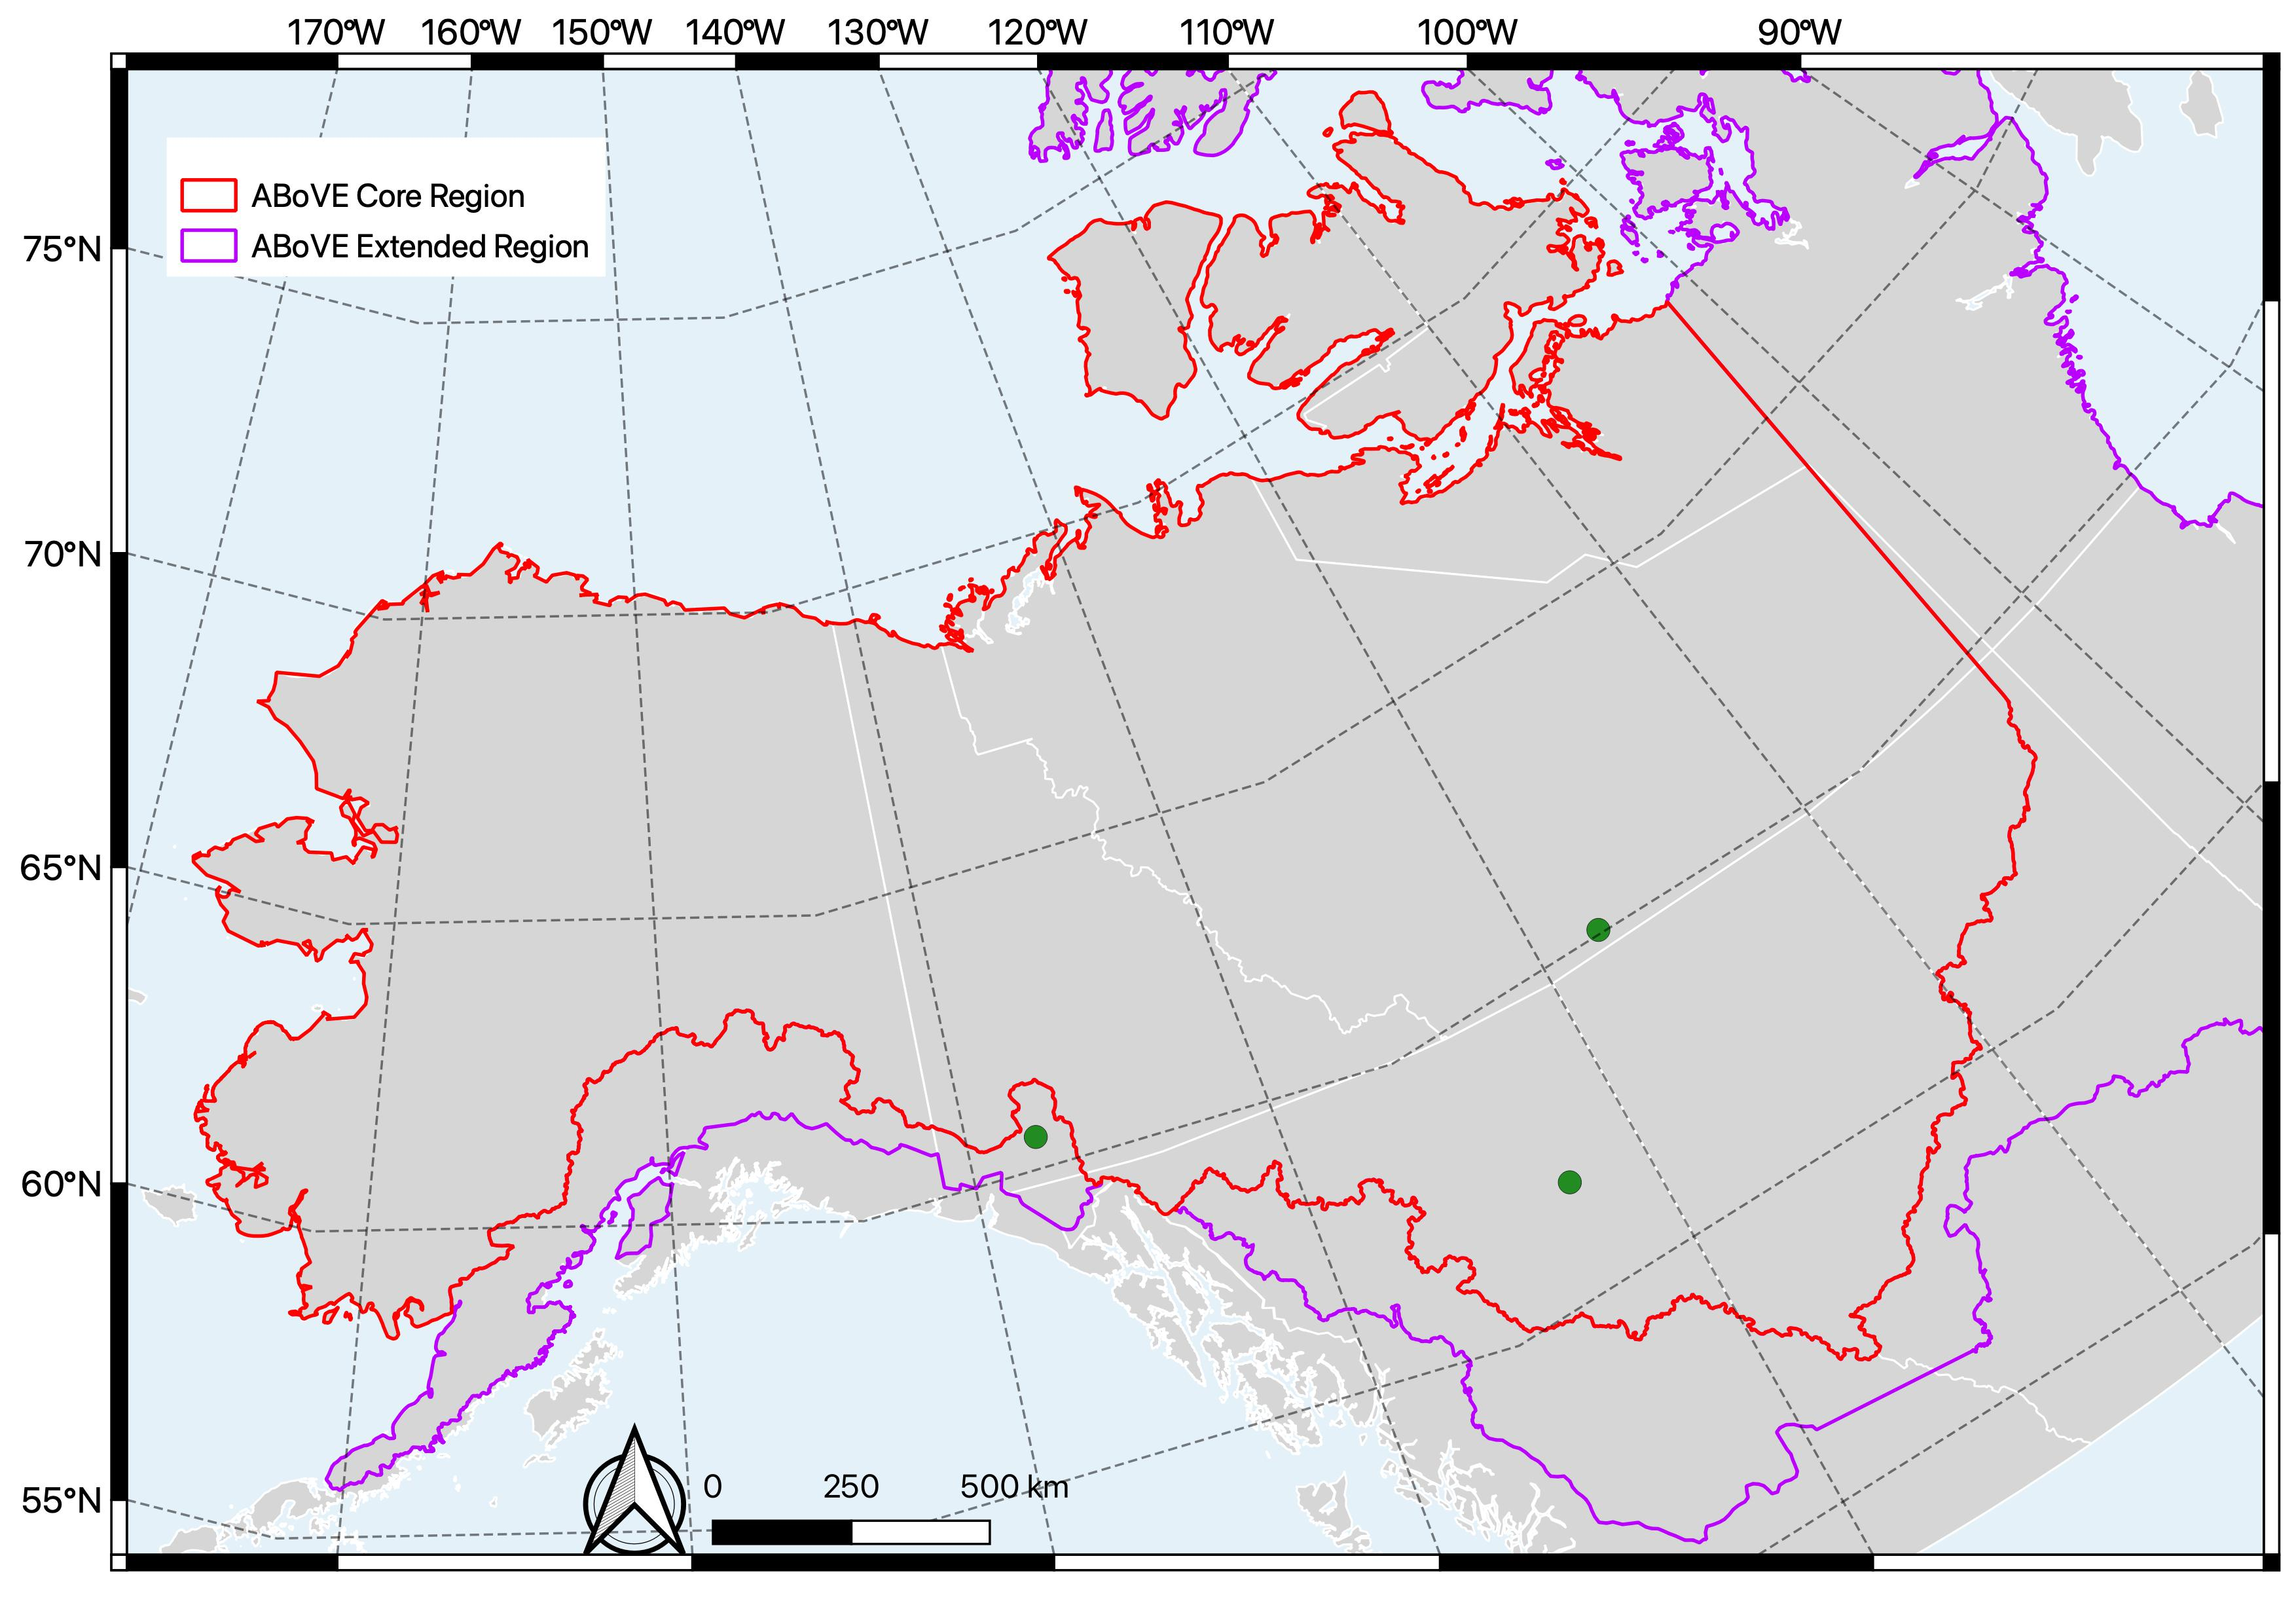
Pests & Pathogens
Spruce budworm
Spruce beetle
Mountain pine beetle

Slide 12
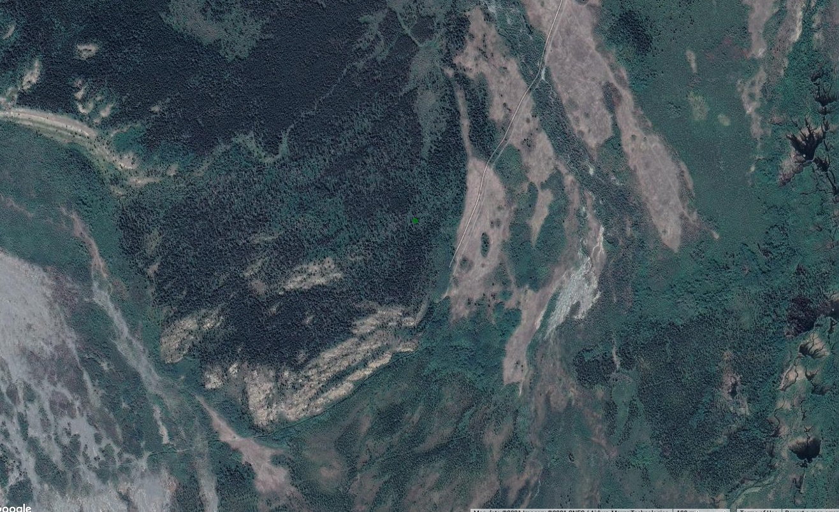
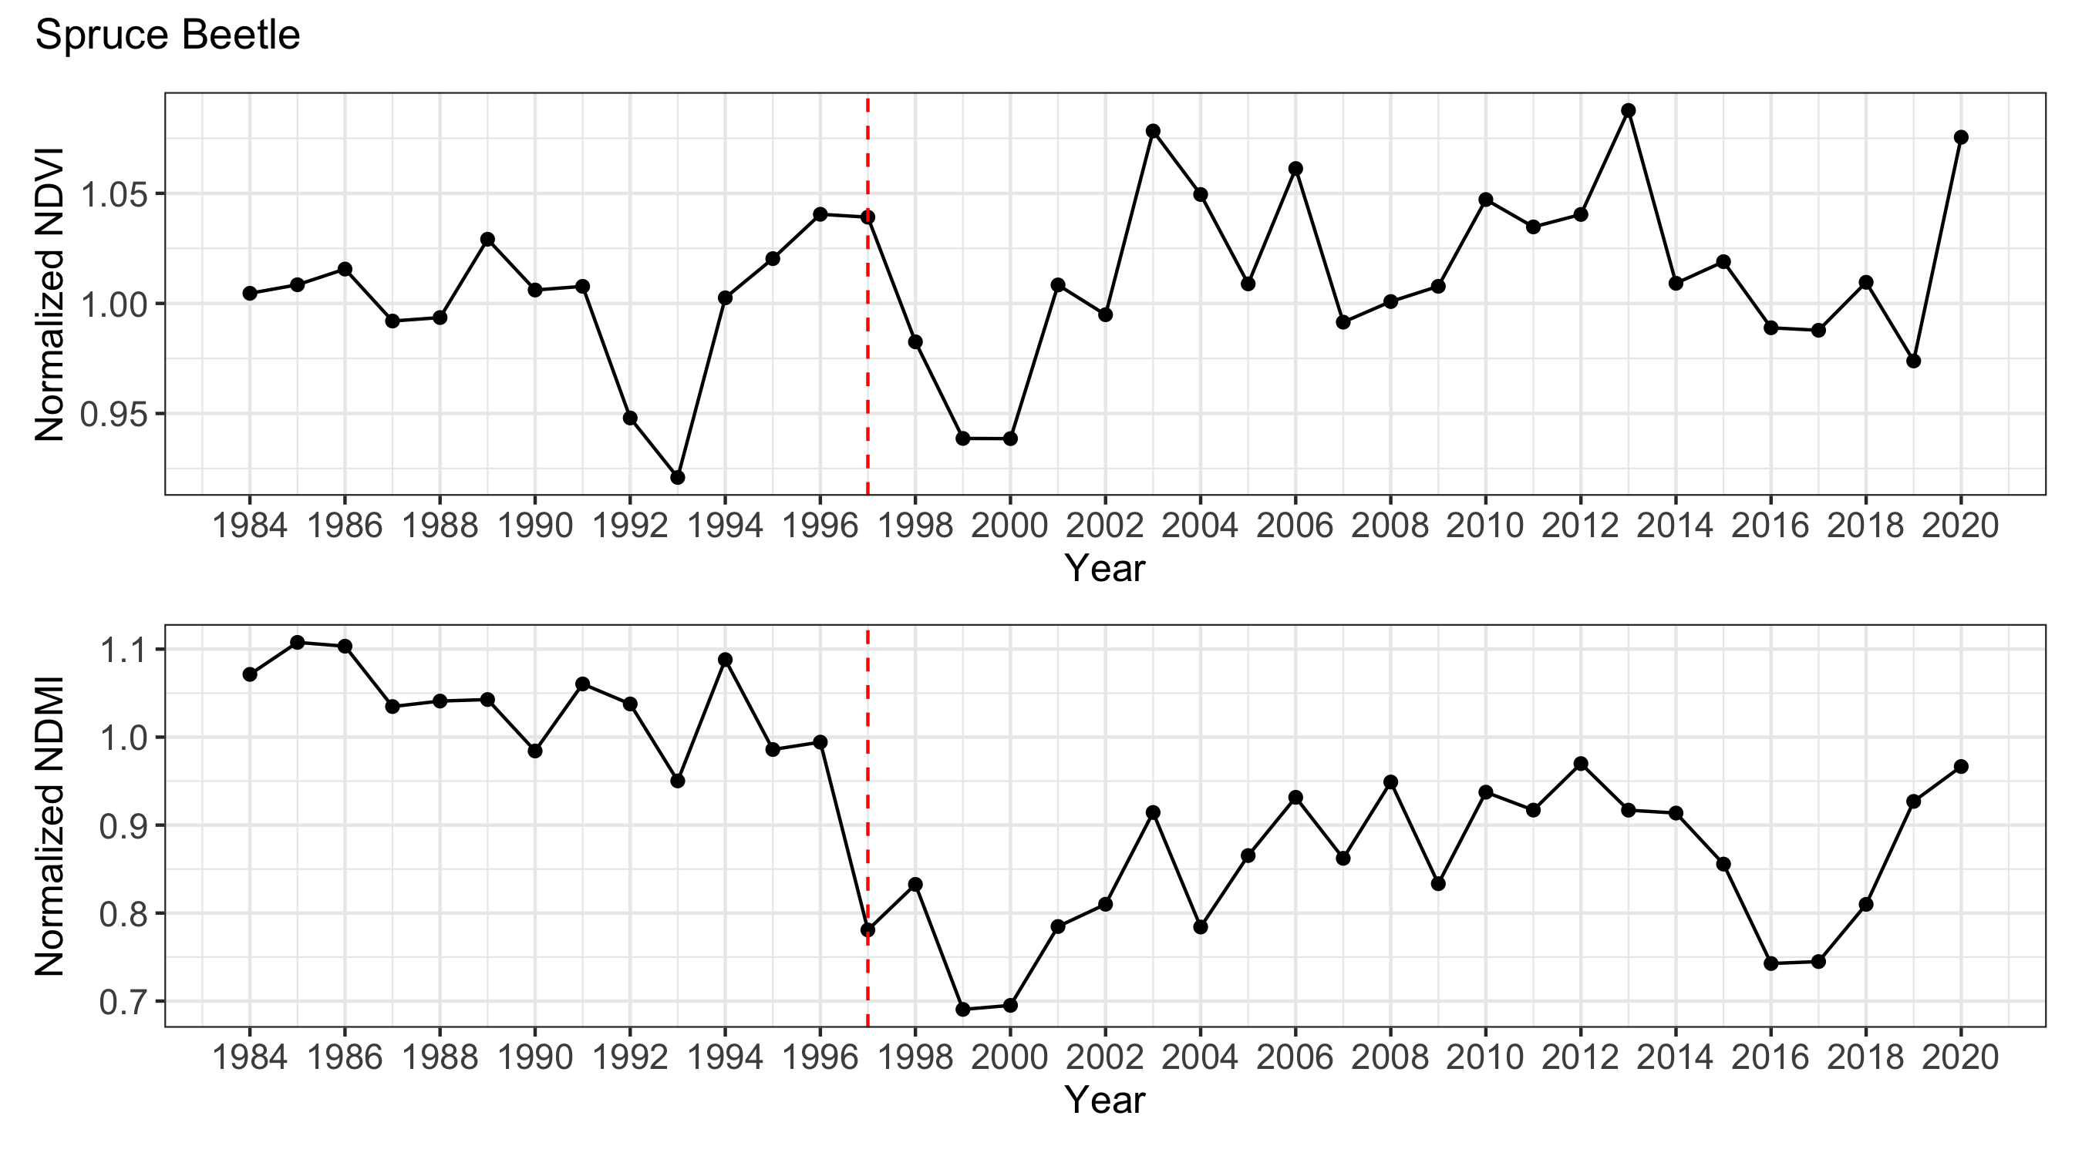
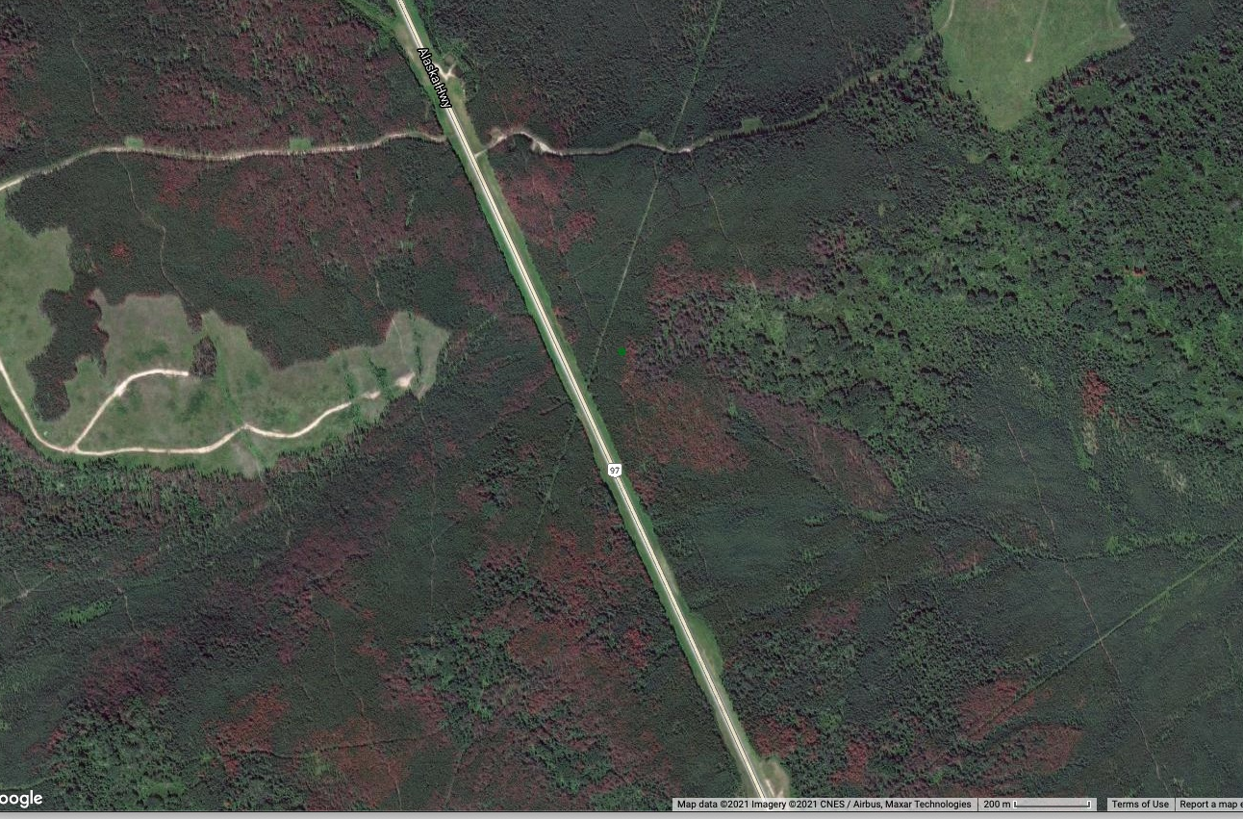
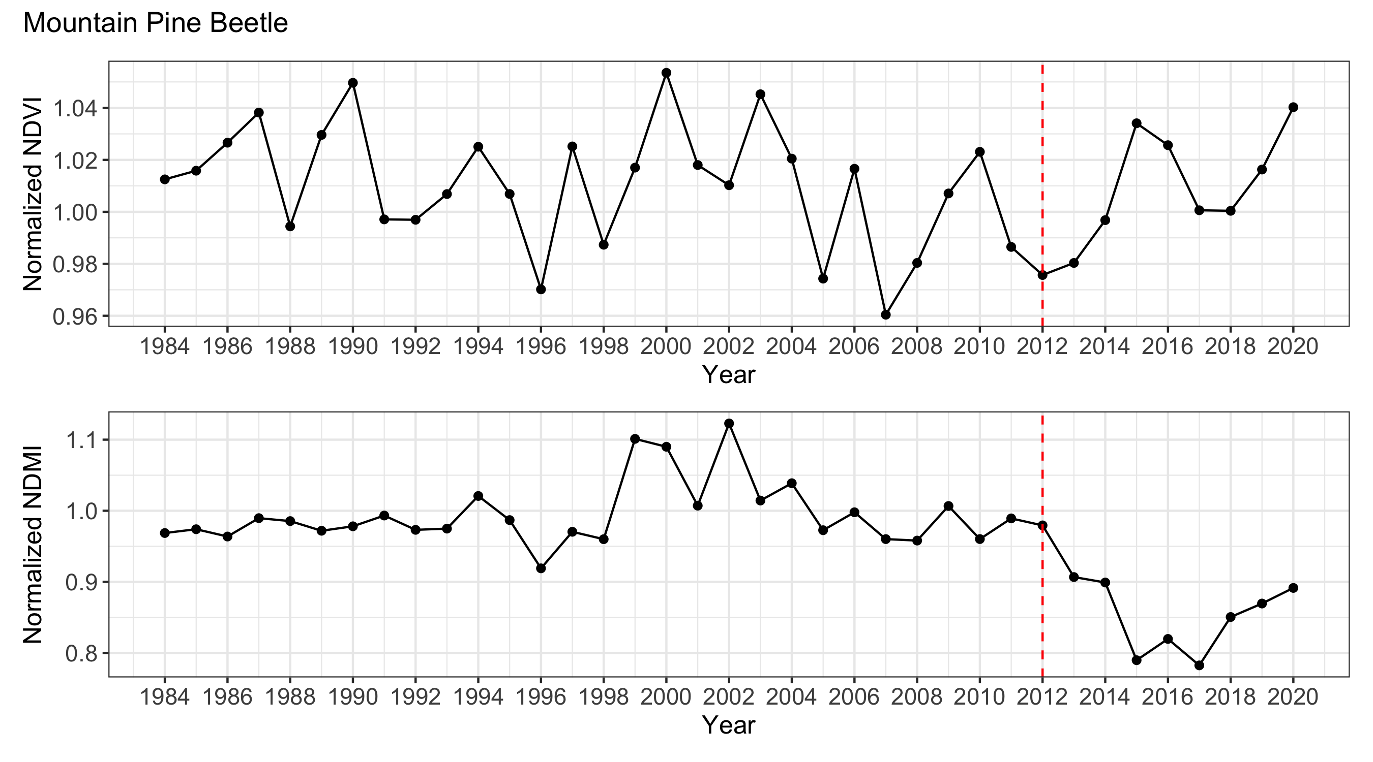
Pests & Pathogens
Spruce beetle
Spruce budworm
Spruce beetle
Mountain pine beetle
Mountain pine beetle

Slide 13
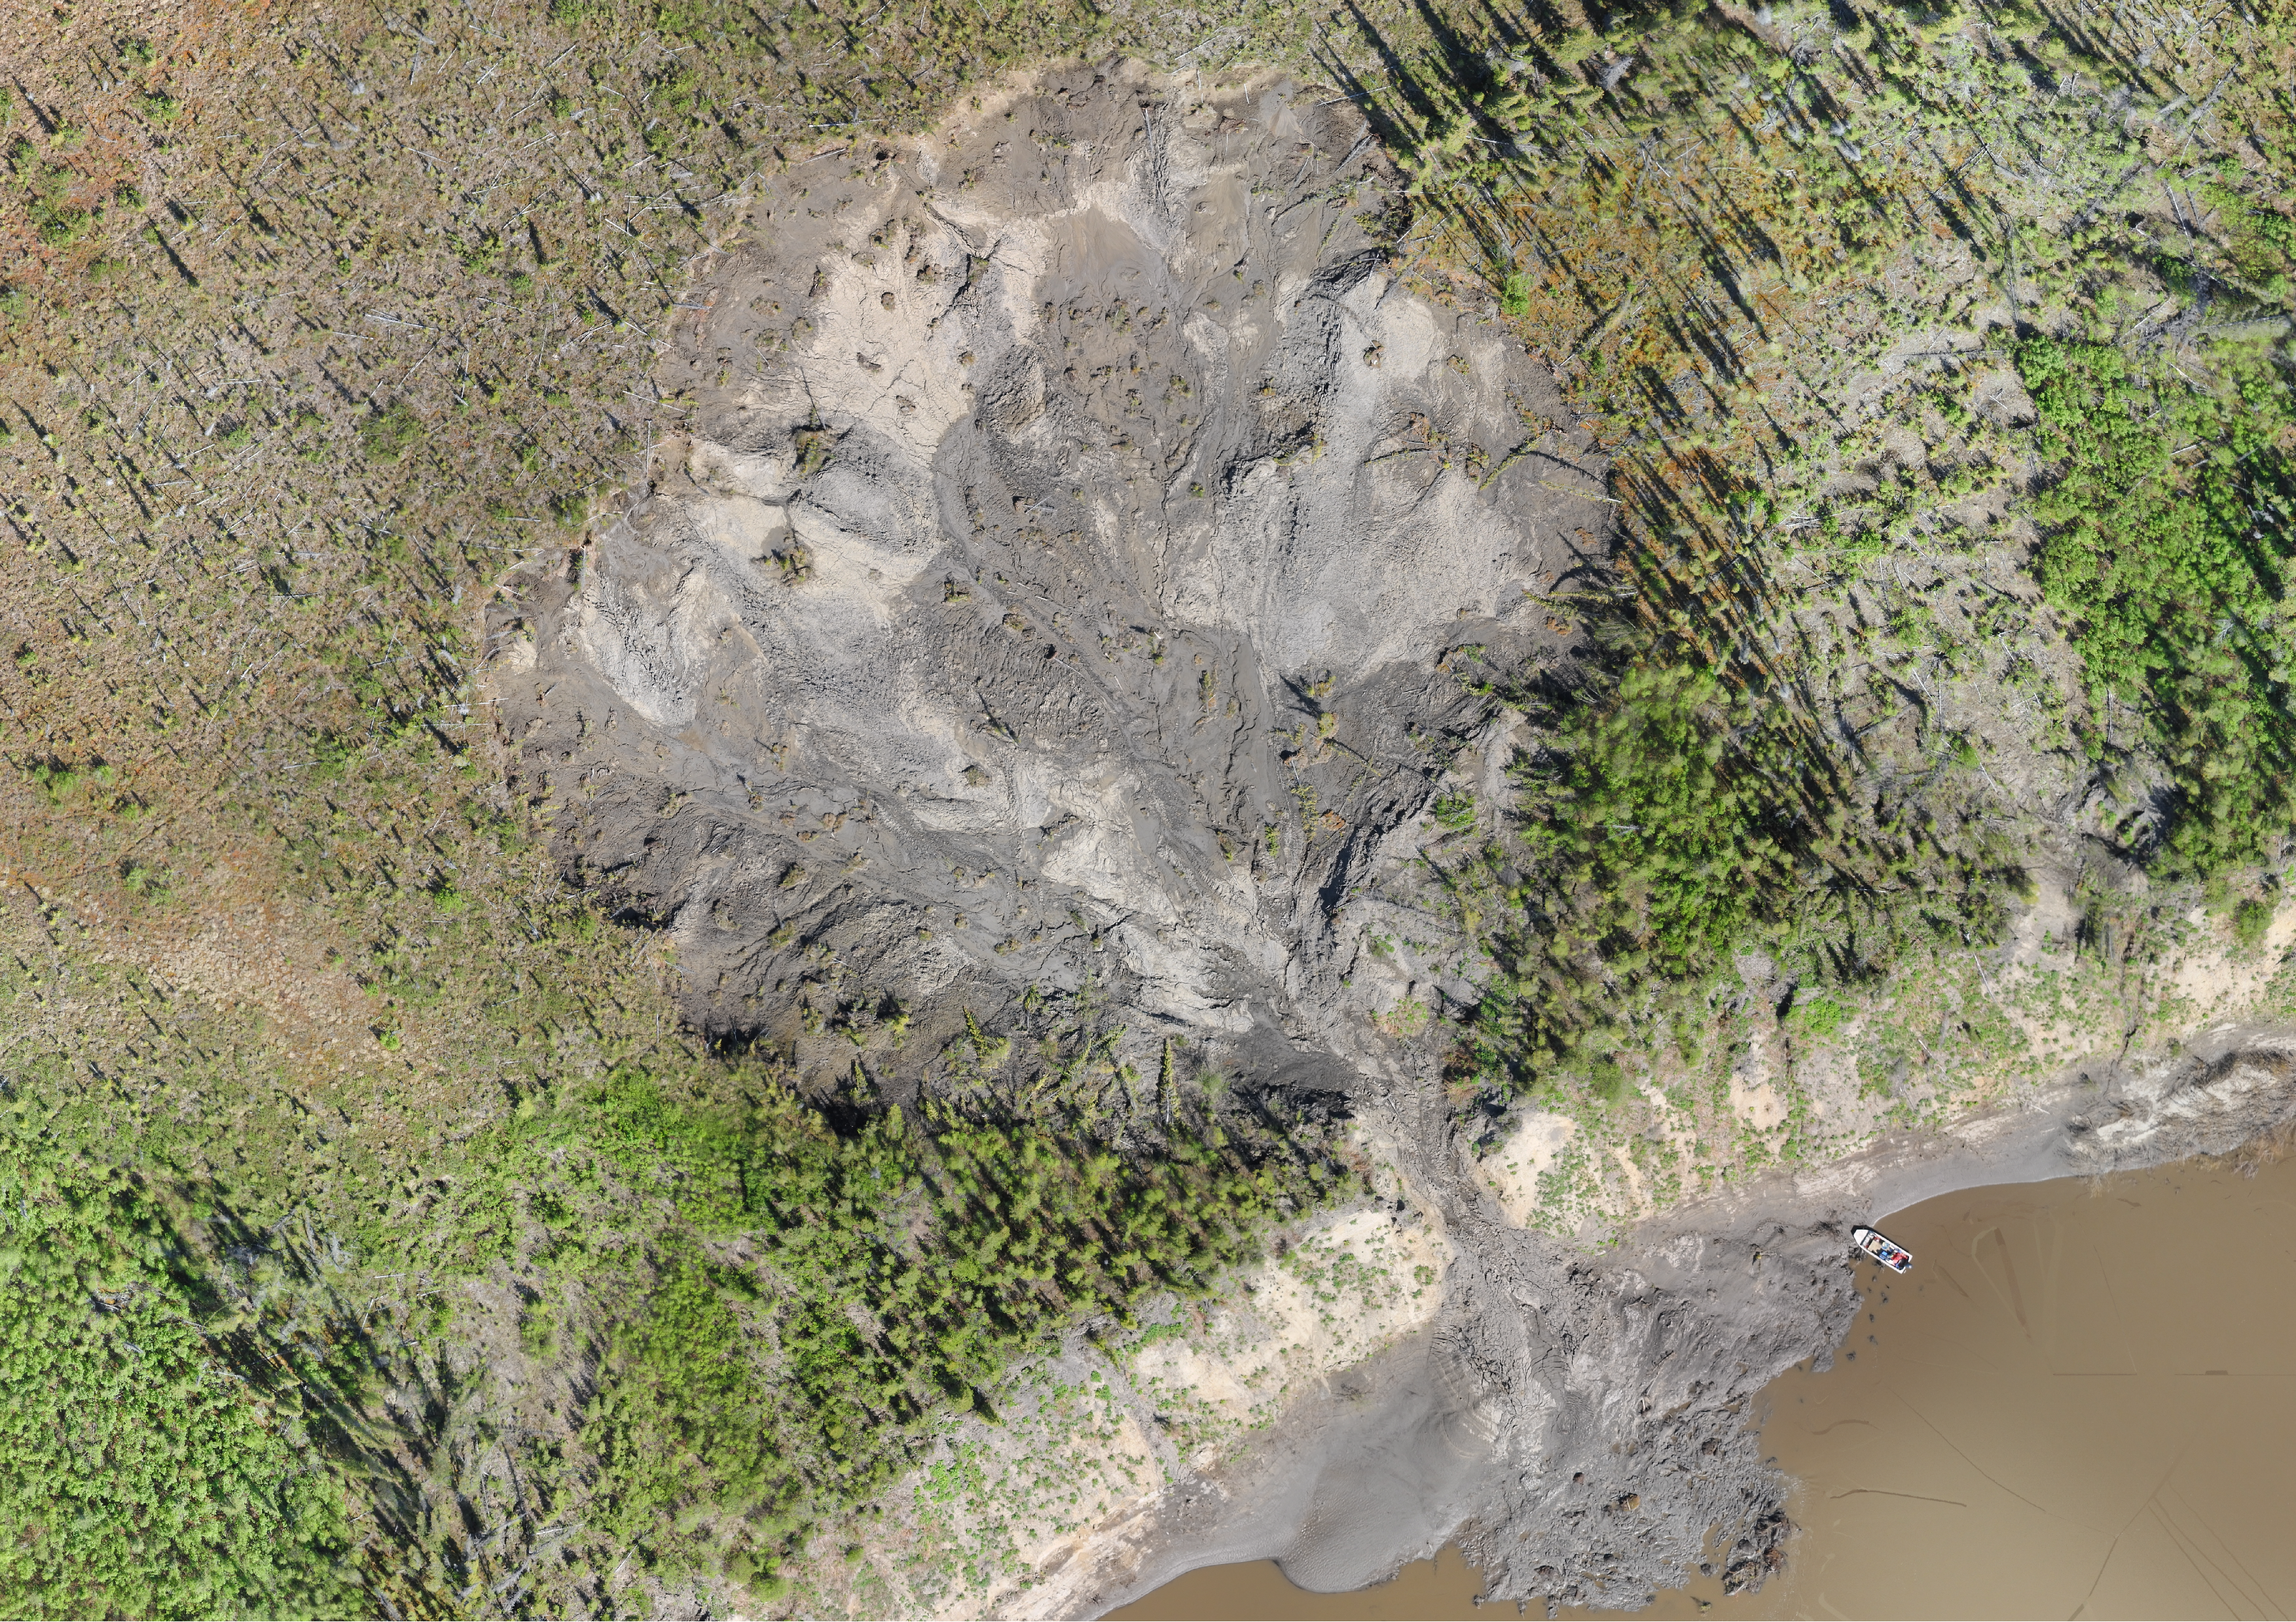
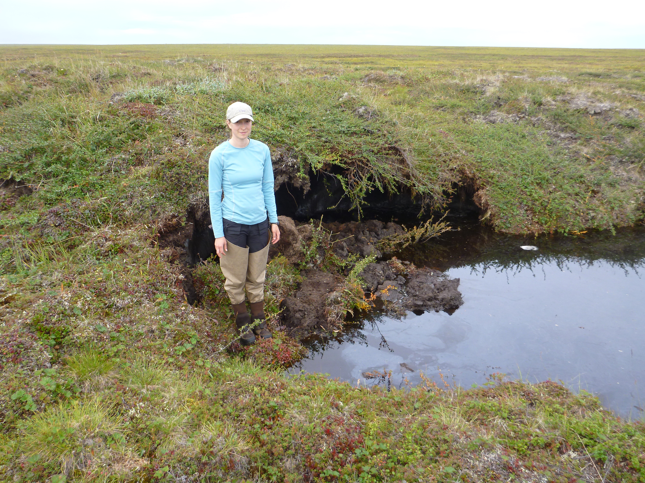
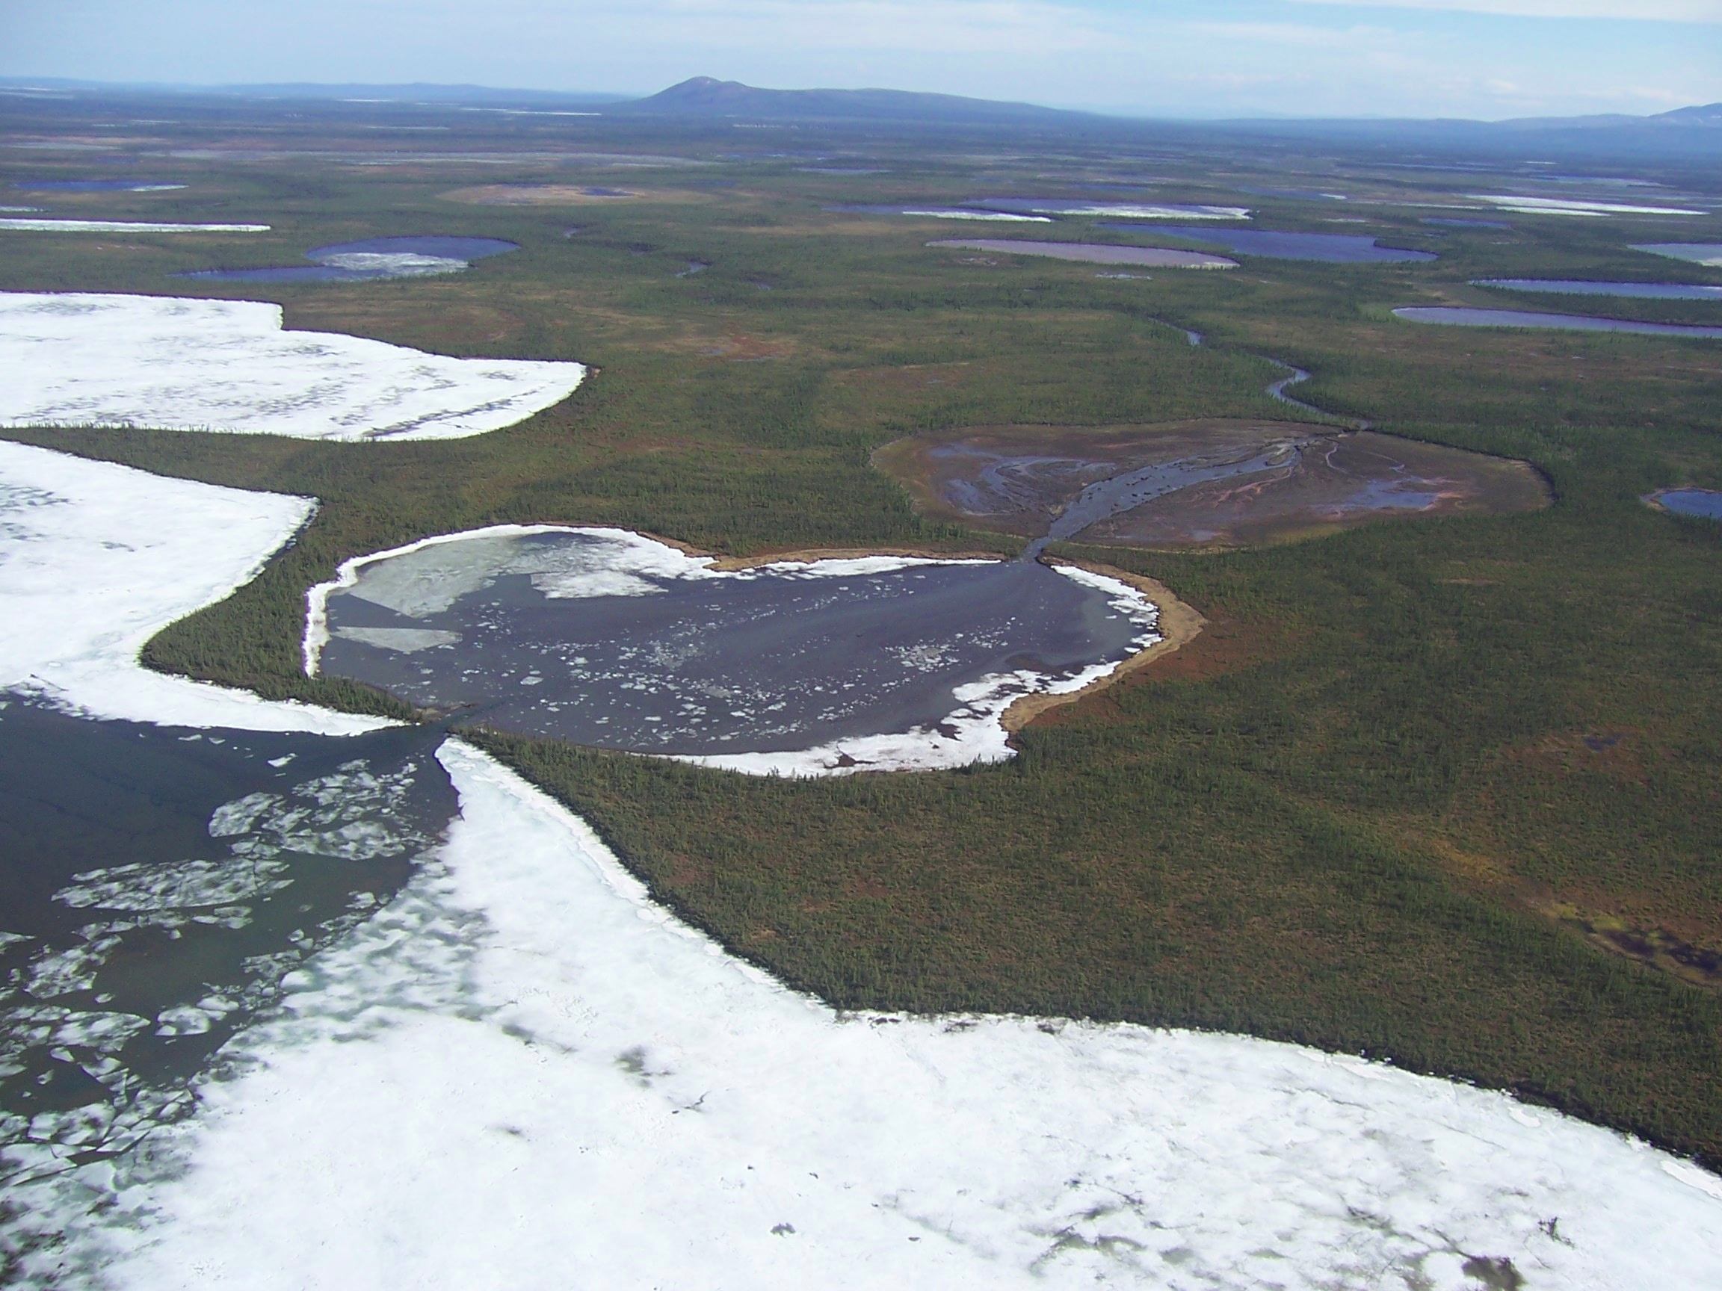
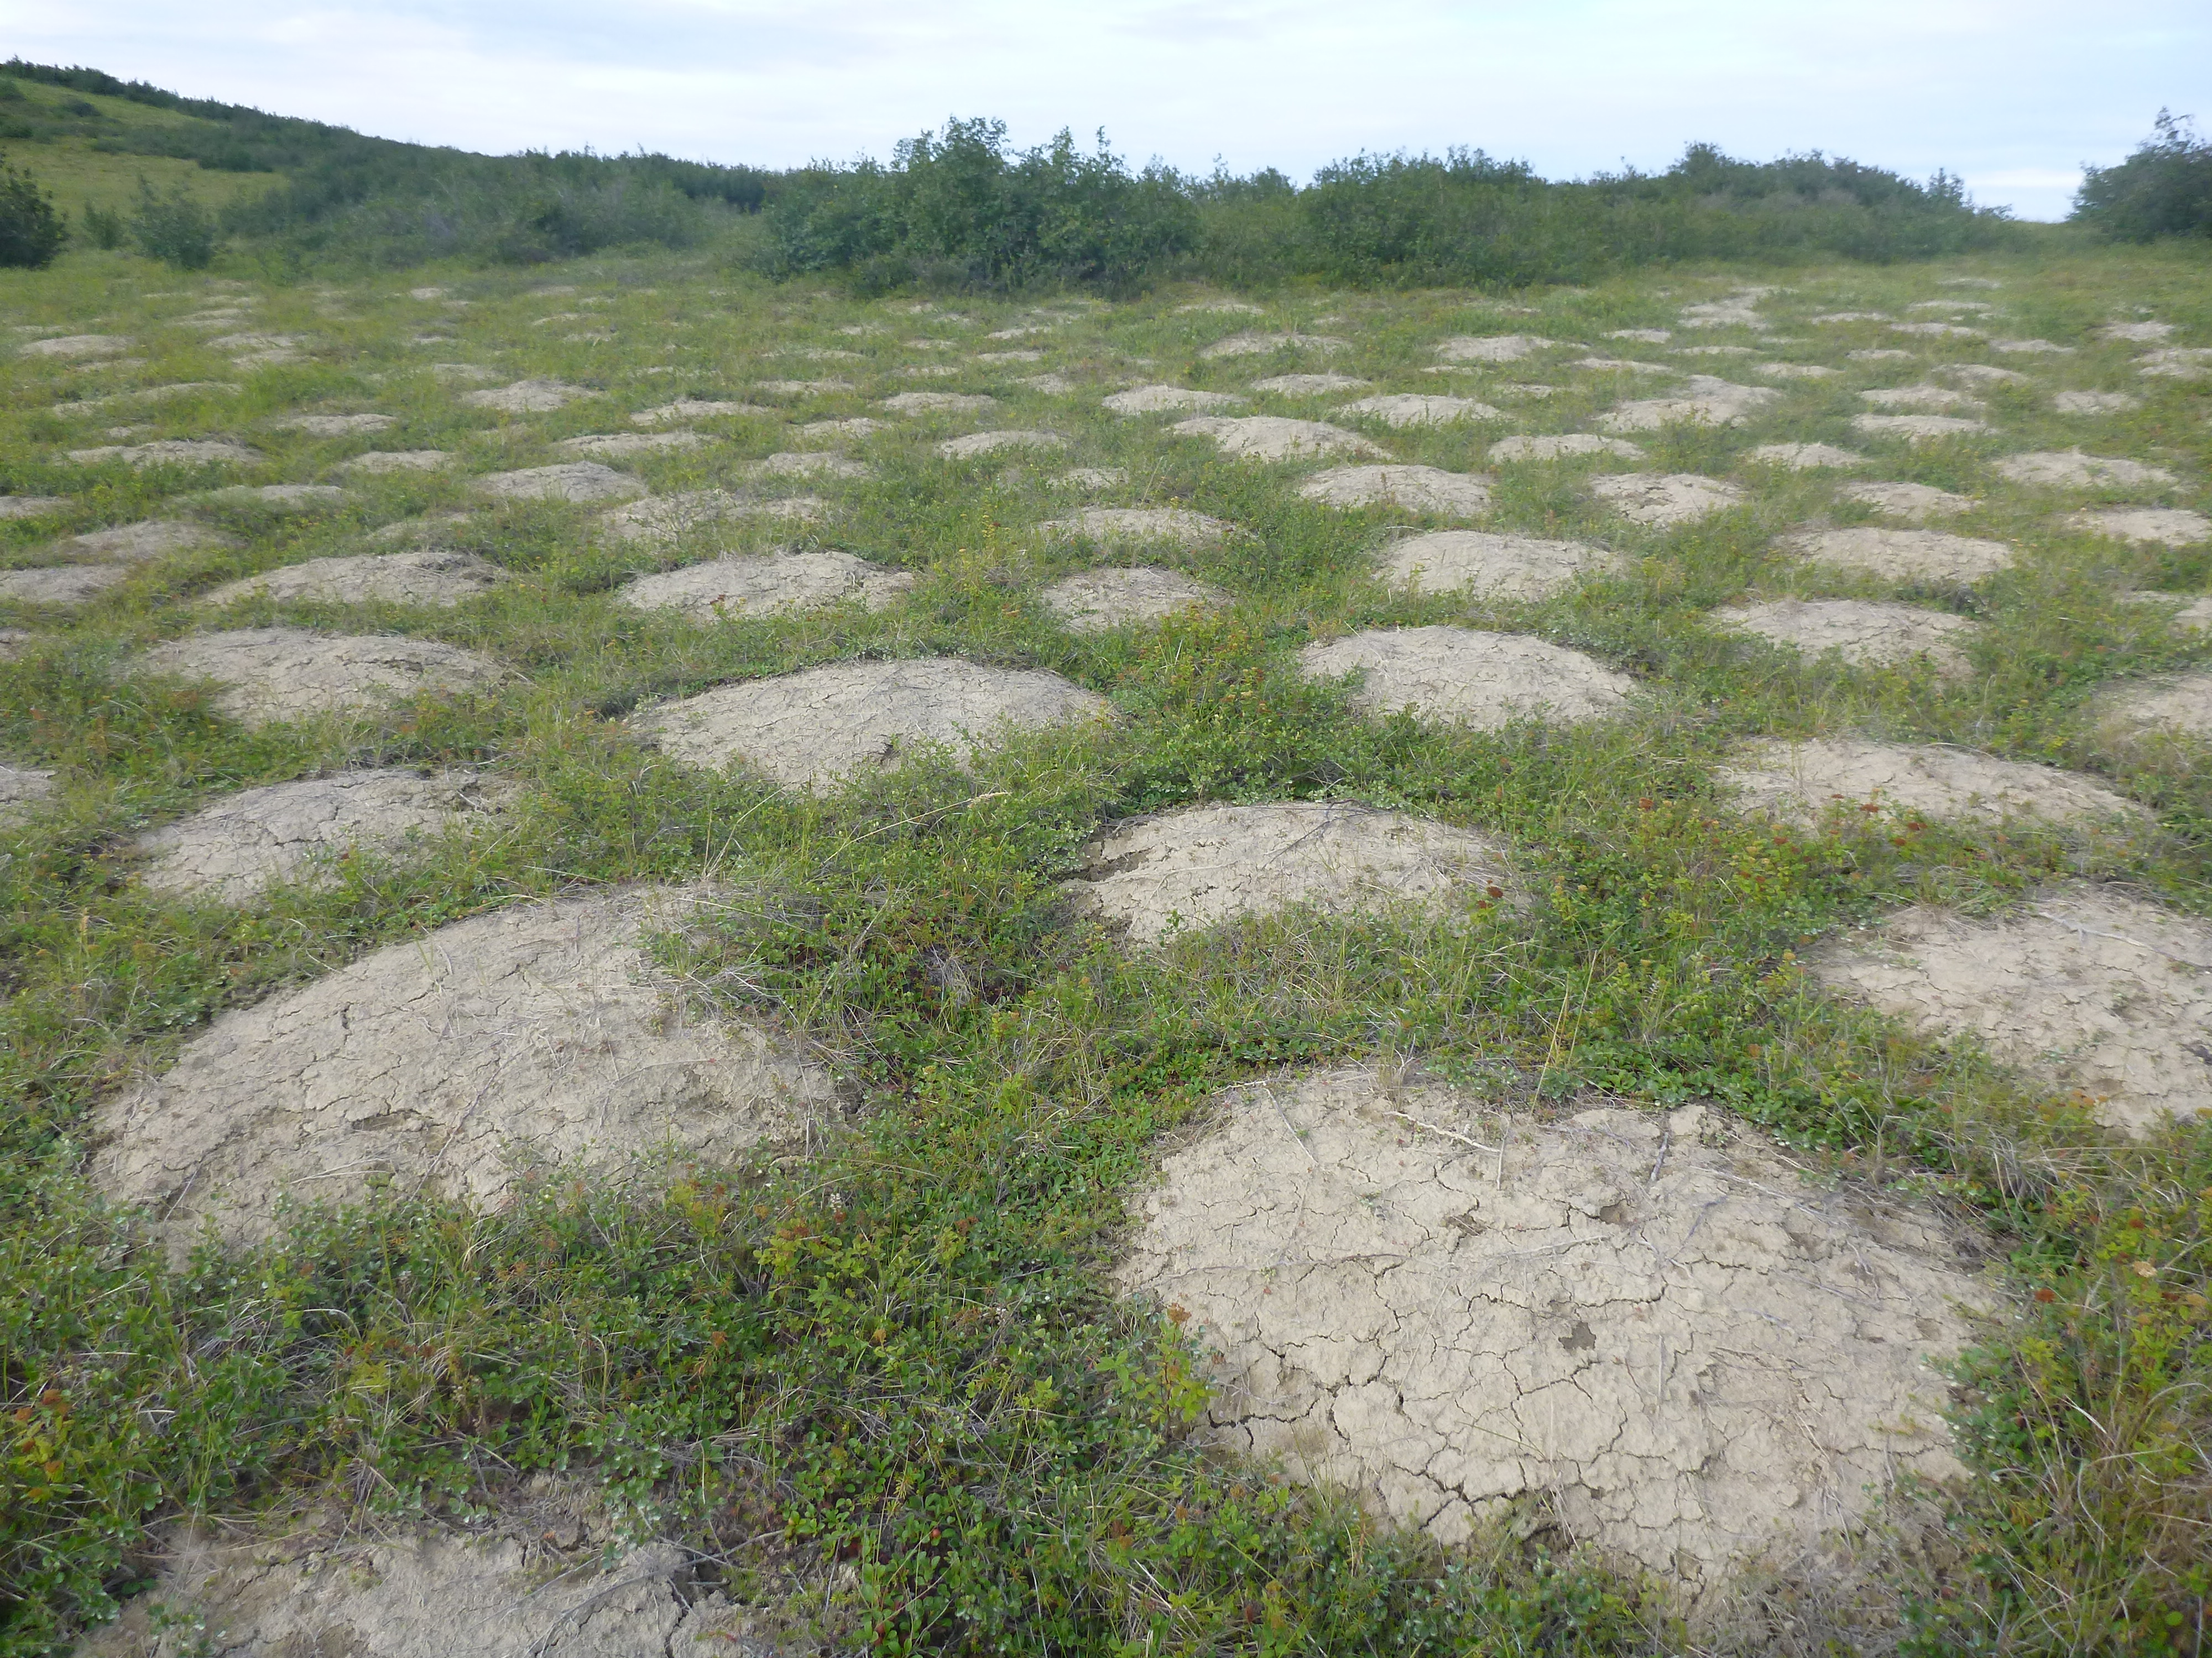
Permafrost-Related Disturbances
Kevin Turner
Many different sub-types
Impacts soil, vegetation type, carbon stocks, hydrology, & climate
Kevin Turner
JJ Frost
JJ Frost

Slide 14
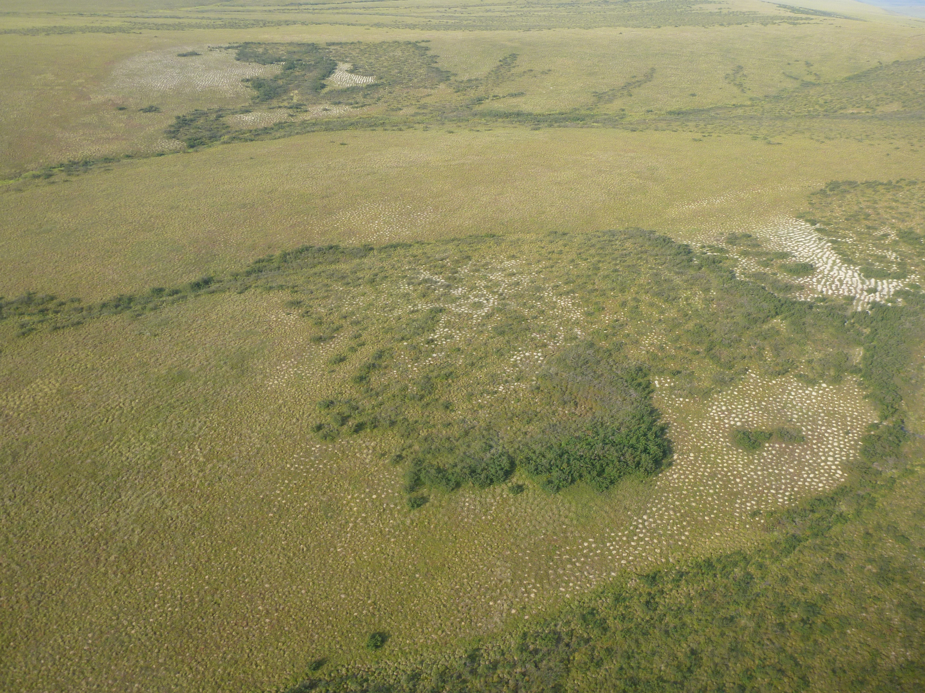
Cryoturbation
Frost-based movements of seasonally frozen materials
Surficial features – foci for ecological change
e.g. circles, frost boils
Disturbance is renewed annually and is not event-based
Fast-growing species can quickly colonize cryoturbated surfaces (esp. in Low Arctic)
Non-linear interaction with climate change
JJ Frost
JJ Frost

Slide 15
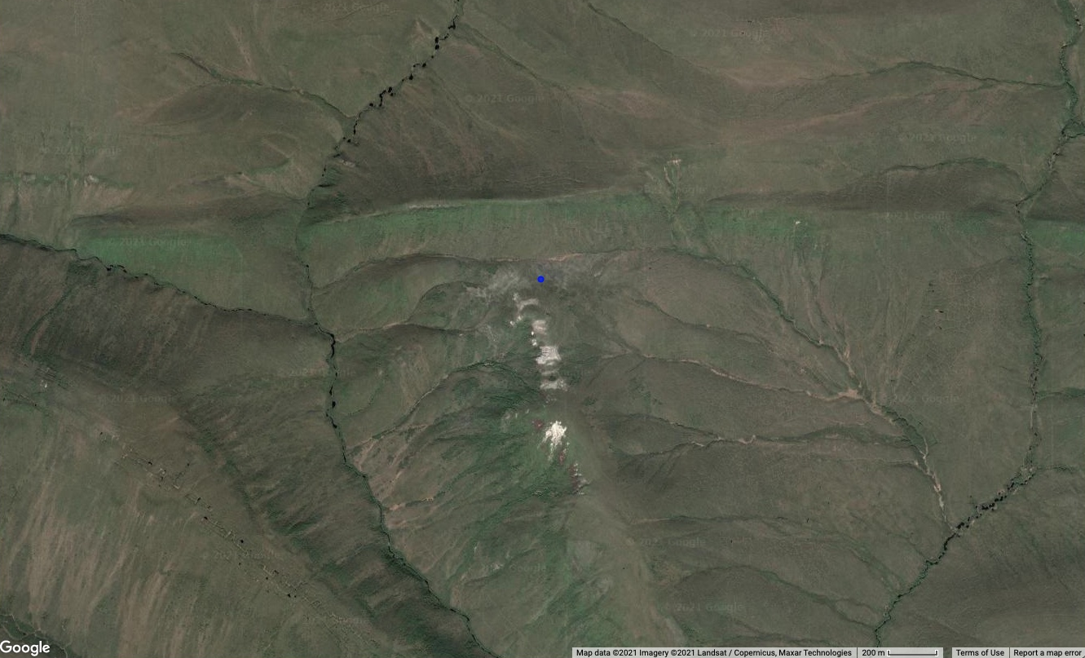
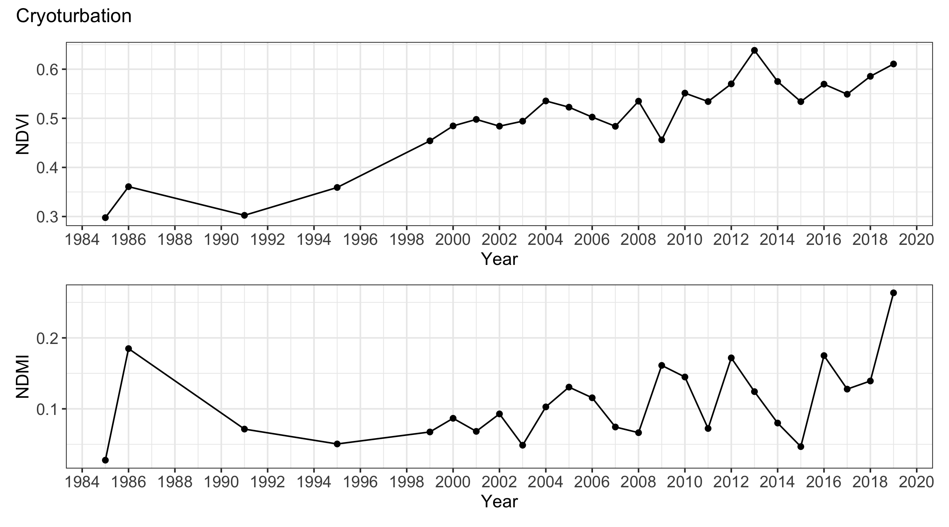
Cryoturbation

Slide 16
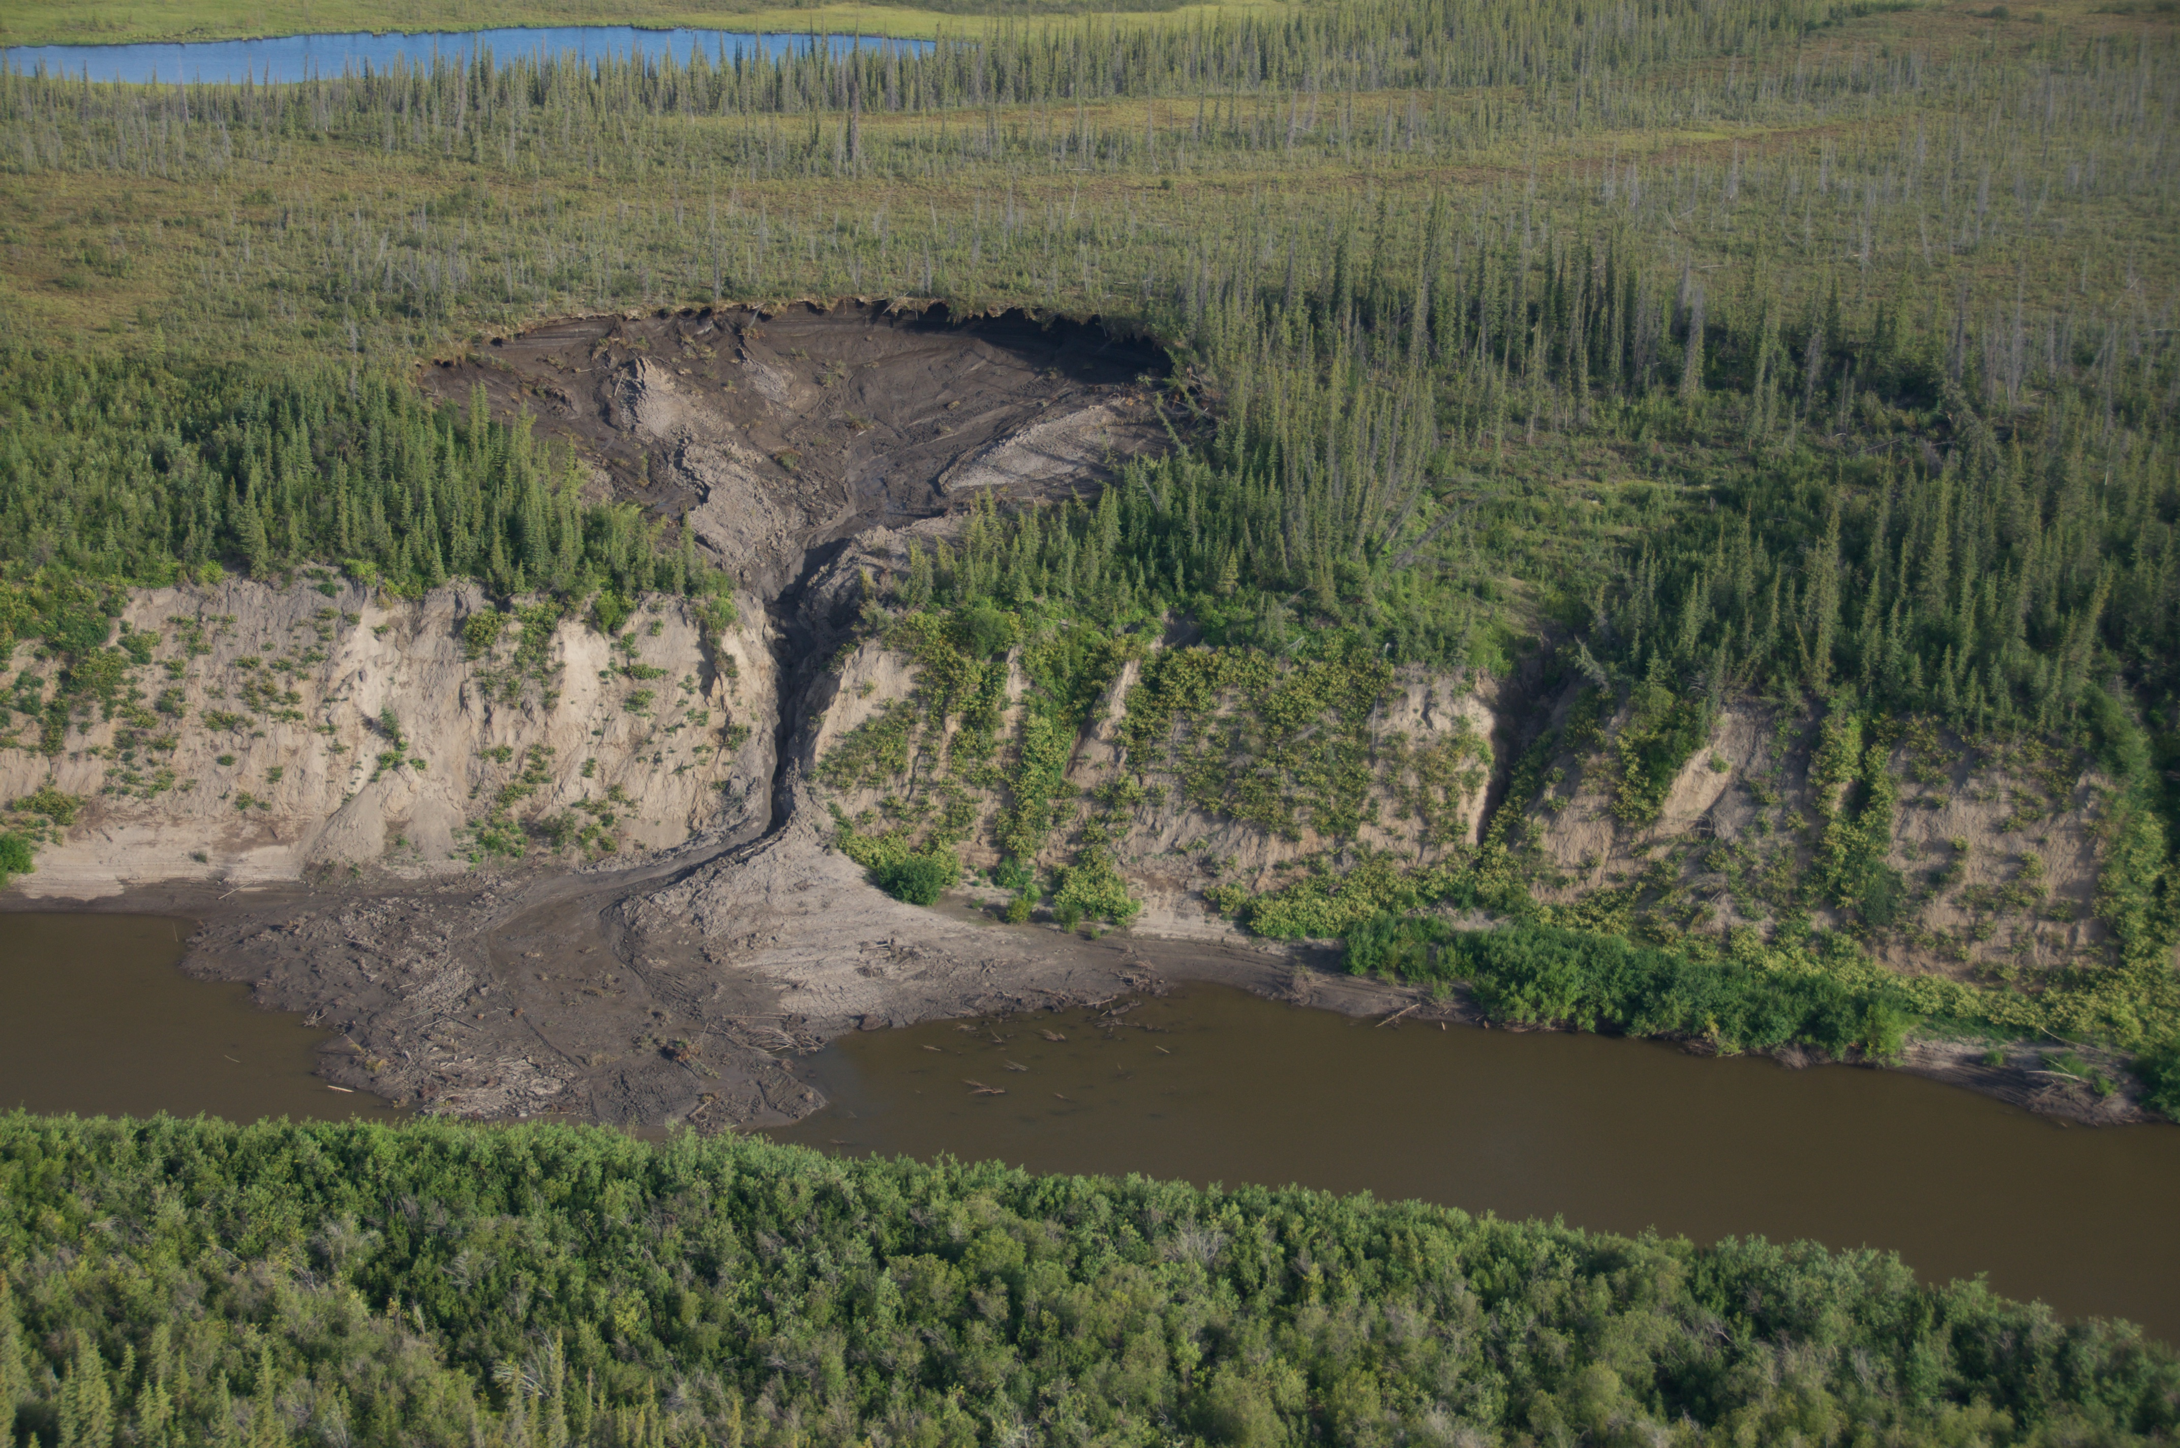
Thaw Slumps
Kevin Turner
Rapid thawing and mass wasting along a headwall
Thawed material transported by erosion, fluvial transport, mass flows
Impacts downstream environments (turbidity & nutrients) and terrestrial vegetation composition, structure, productivity
Predicted to intensify in magnitude and frequency with climate change
Kevin Turner

Slide 17
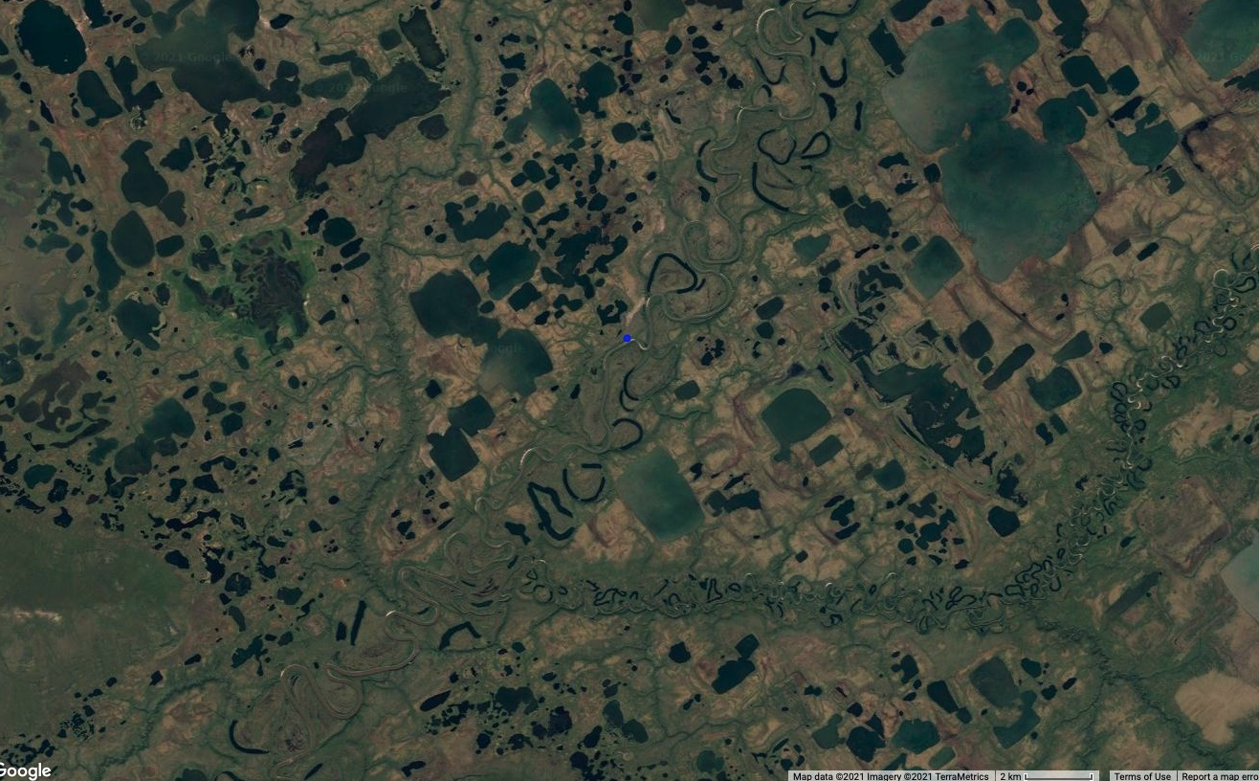
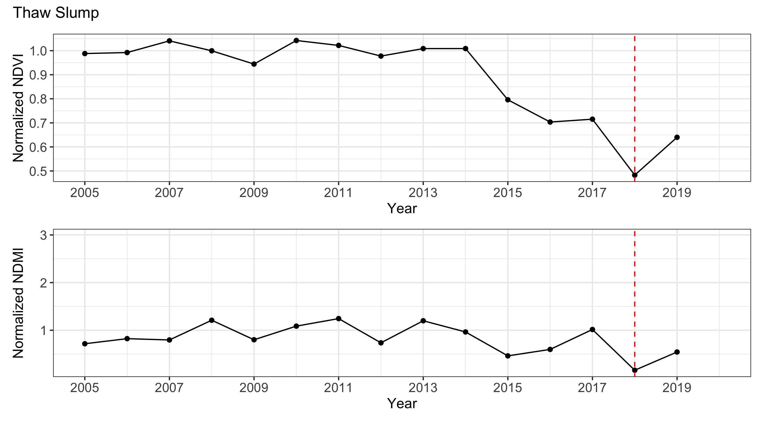
Thaw Slumps

Slide 18
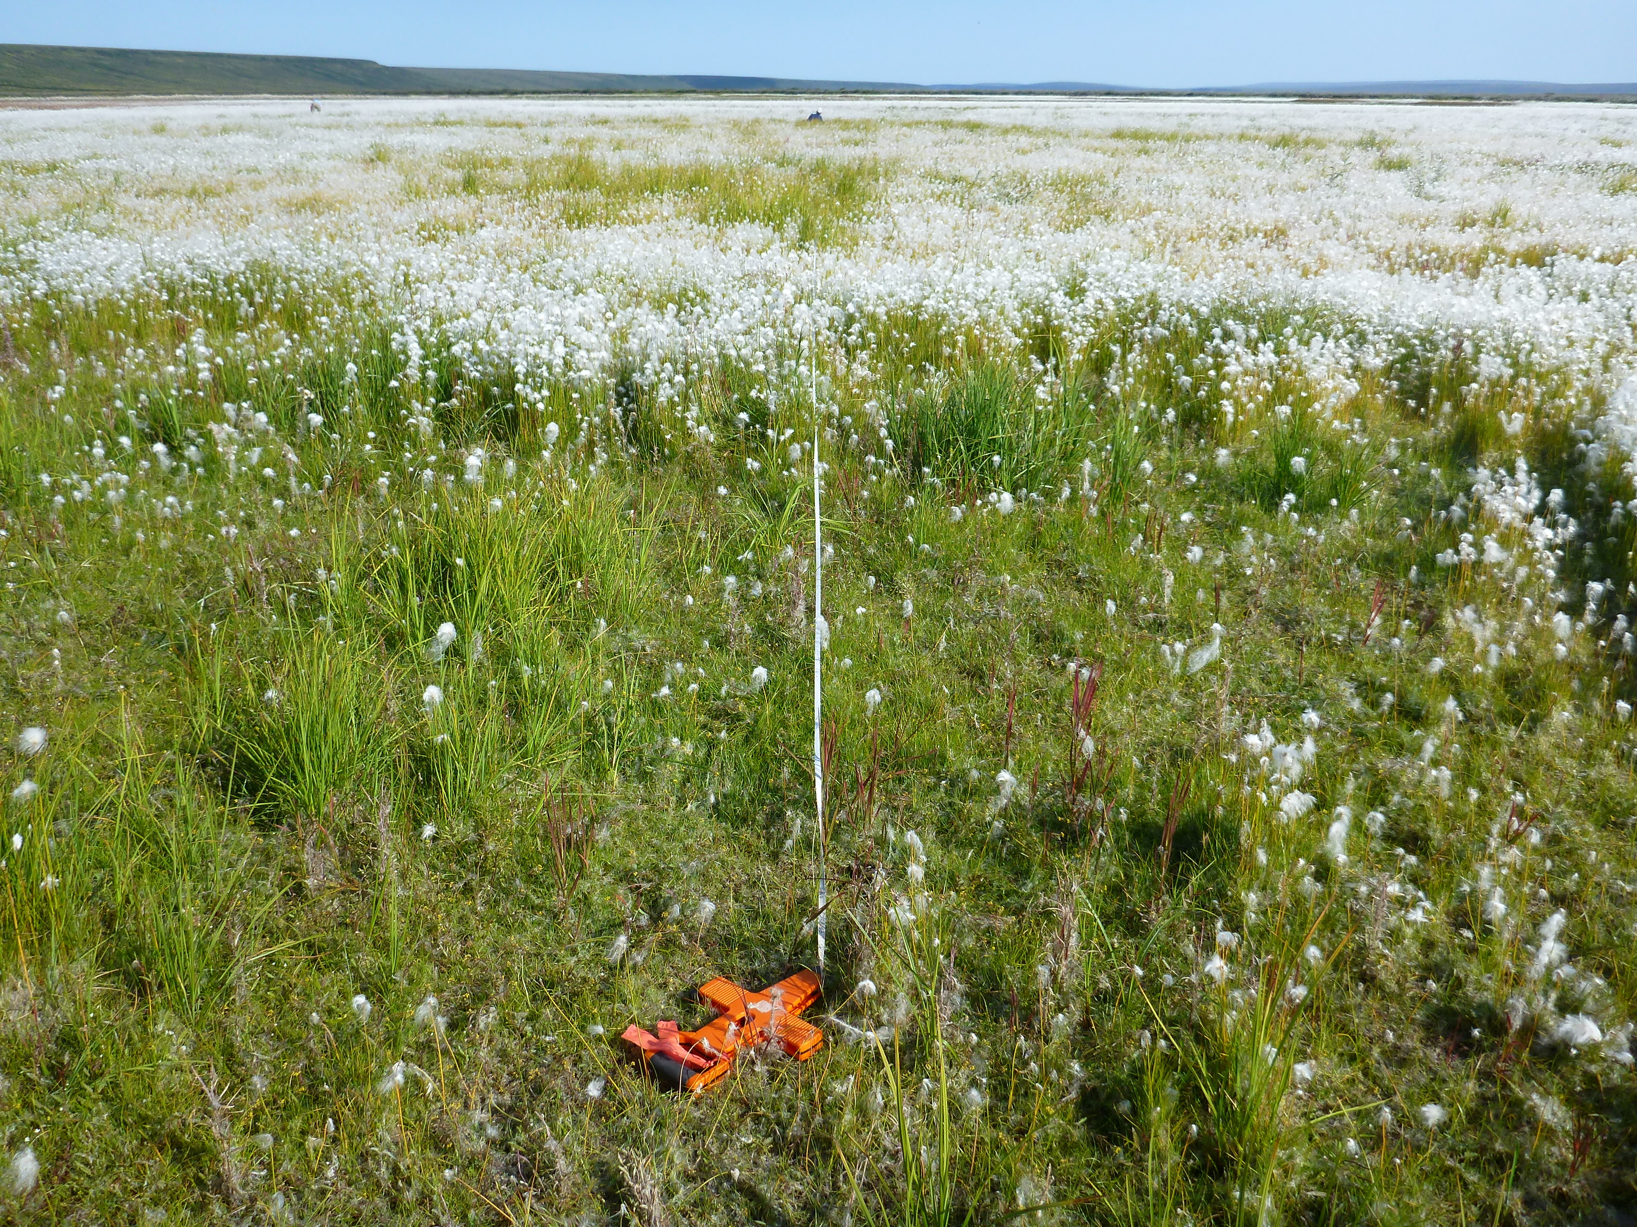
Kevin Turner
Lake Drainage
Usually abrupt loss of water from thermokarst lakes
Vegetation colonization usually rapid
Can develop new permafrost once basin has drained
Frequency of drainage events increasing in key sites
Implications for increasing C stocks, though the magnitude regionally is unknown
JJ Frost

Slide 19
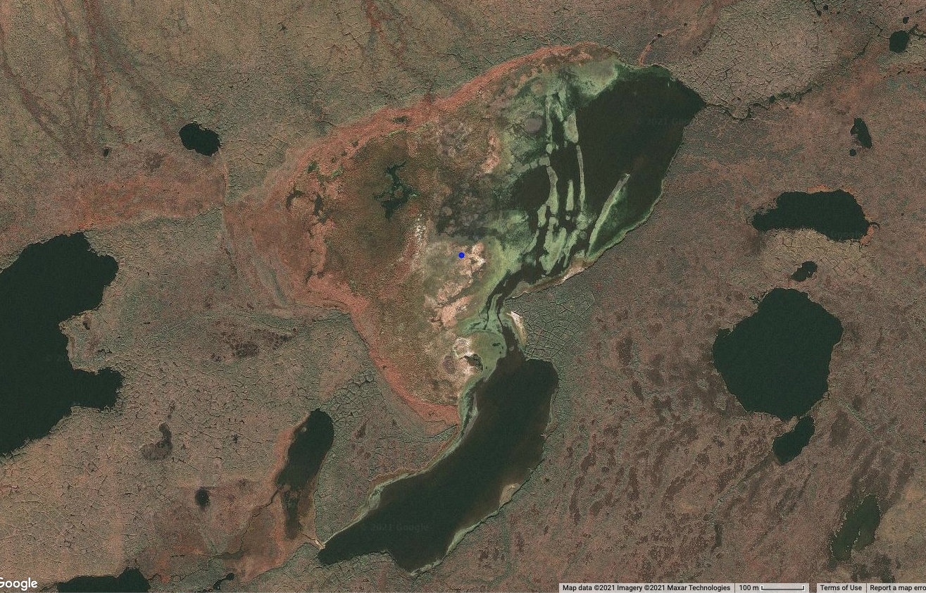
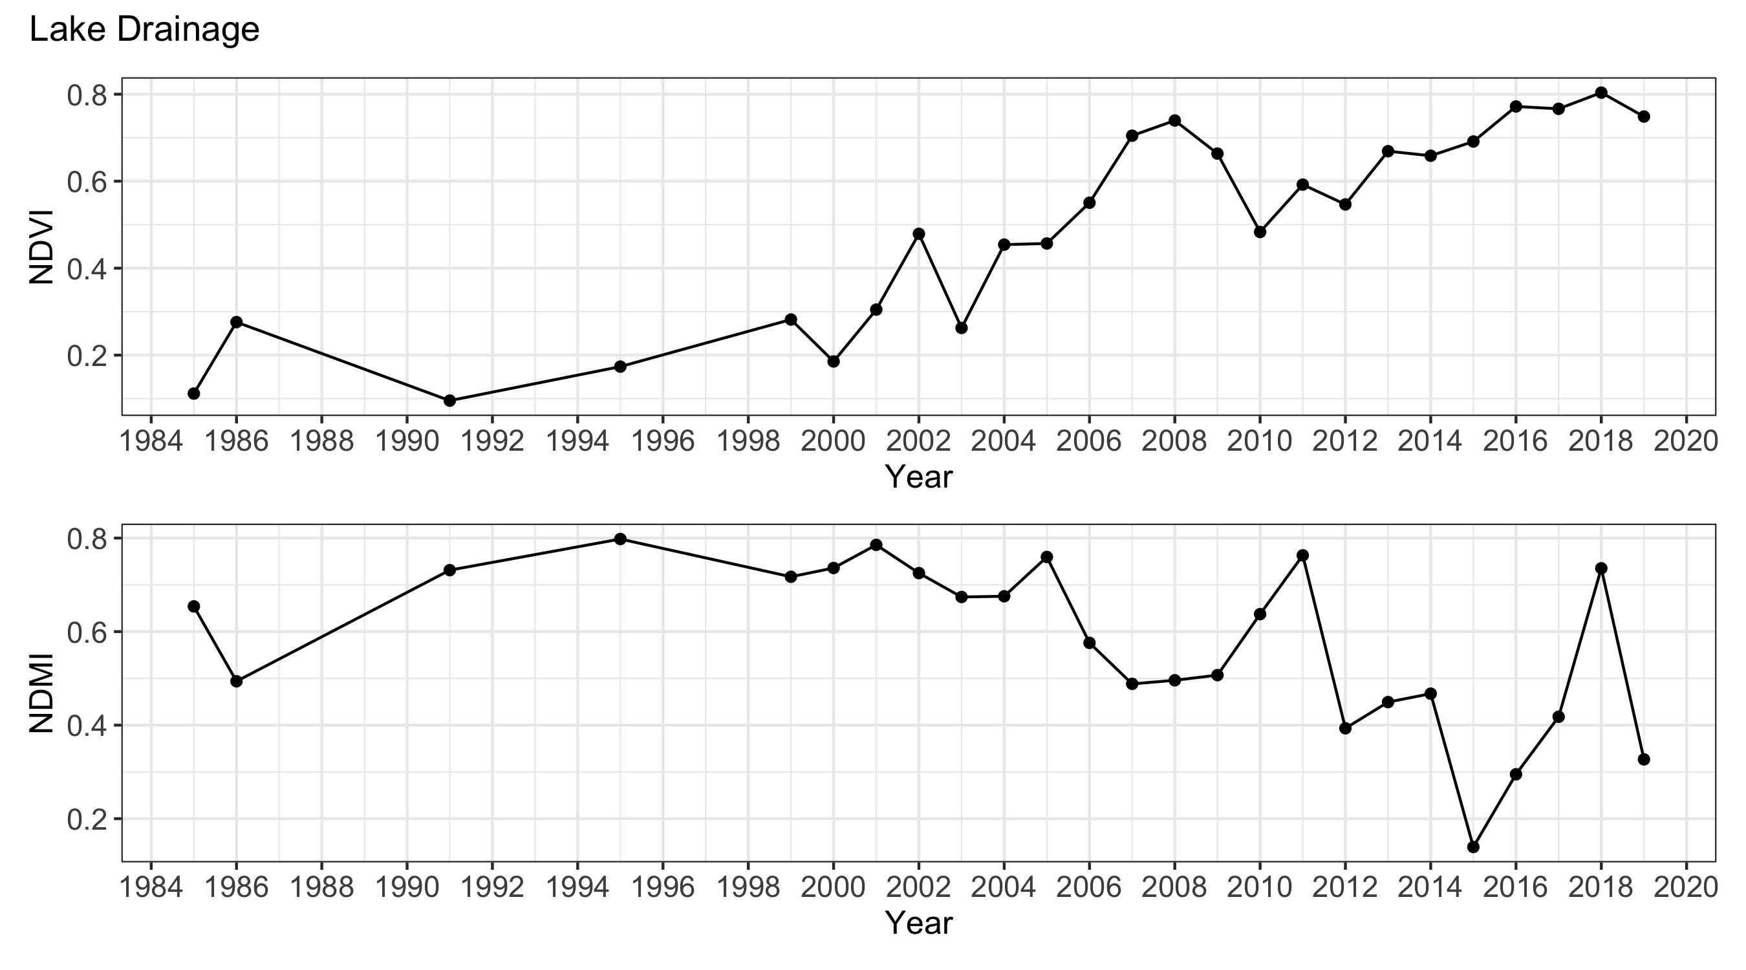
Lake Drainage

Slide 20
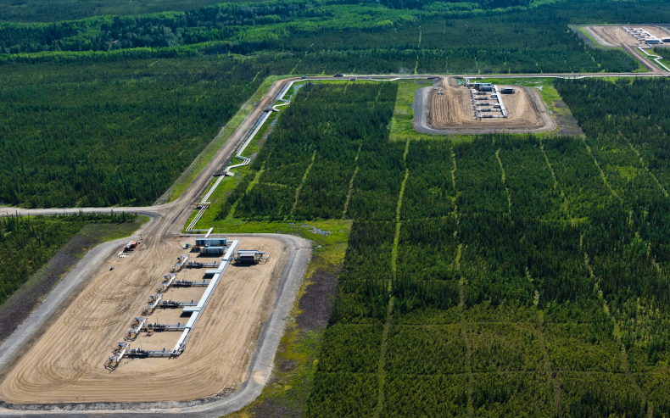
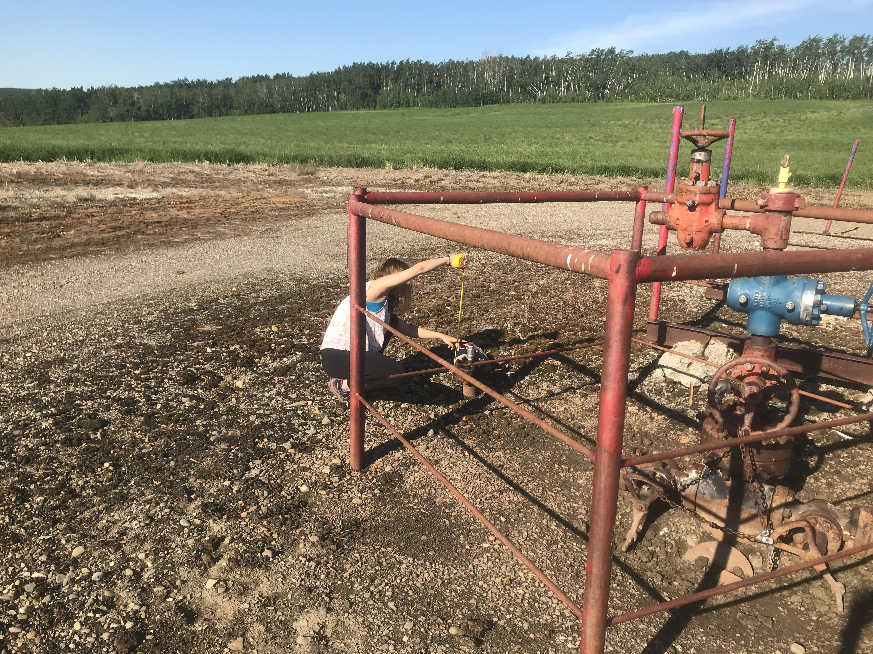
Oil & Gas Wells
In-situ extraction infrastructure
Thick mineral fill layer placed on top of landscape
Results in complete removal of vegetation and compaction of soil/peat
Disruption to hydrologic conditions surrounding well site
Athabasca Oil Corporation
Mary Kang

Slide 21
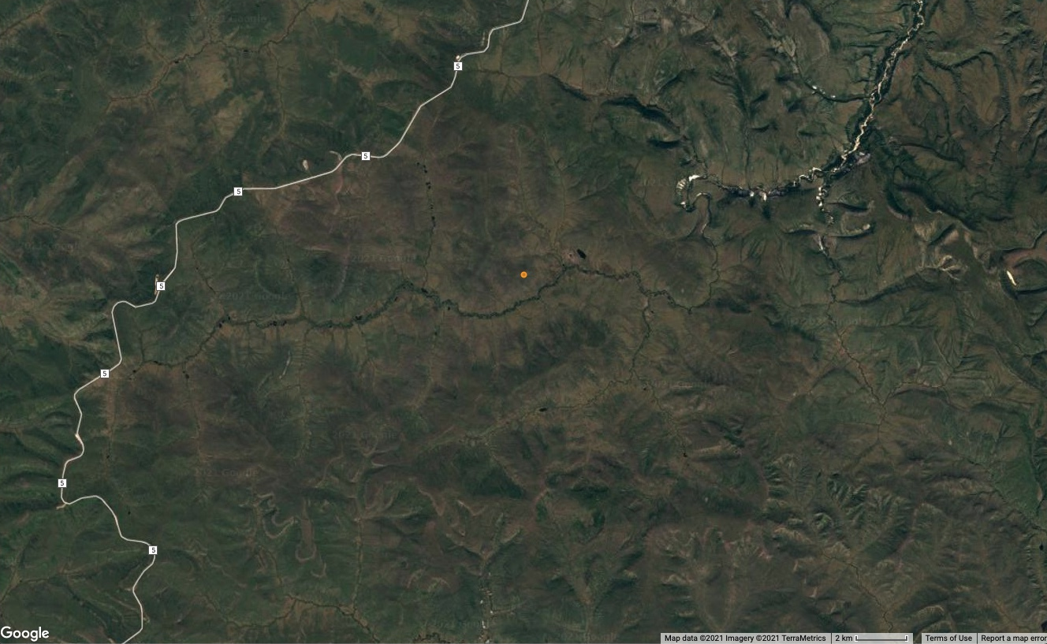
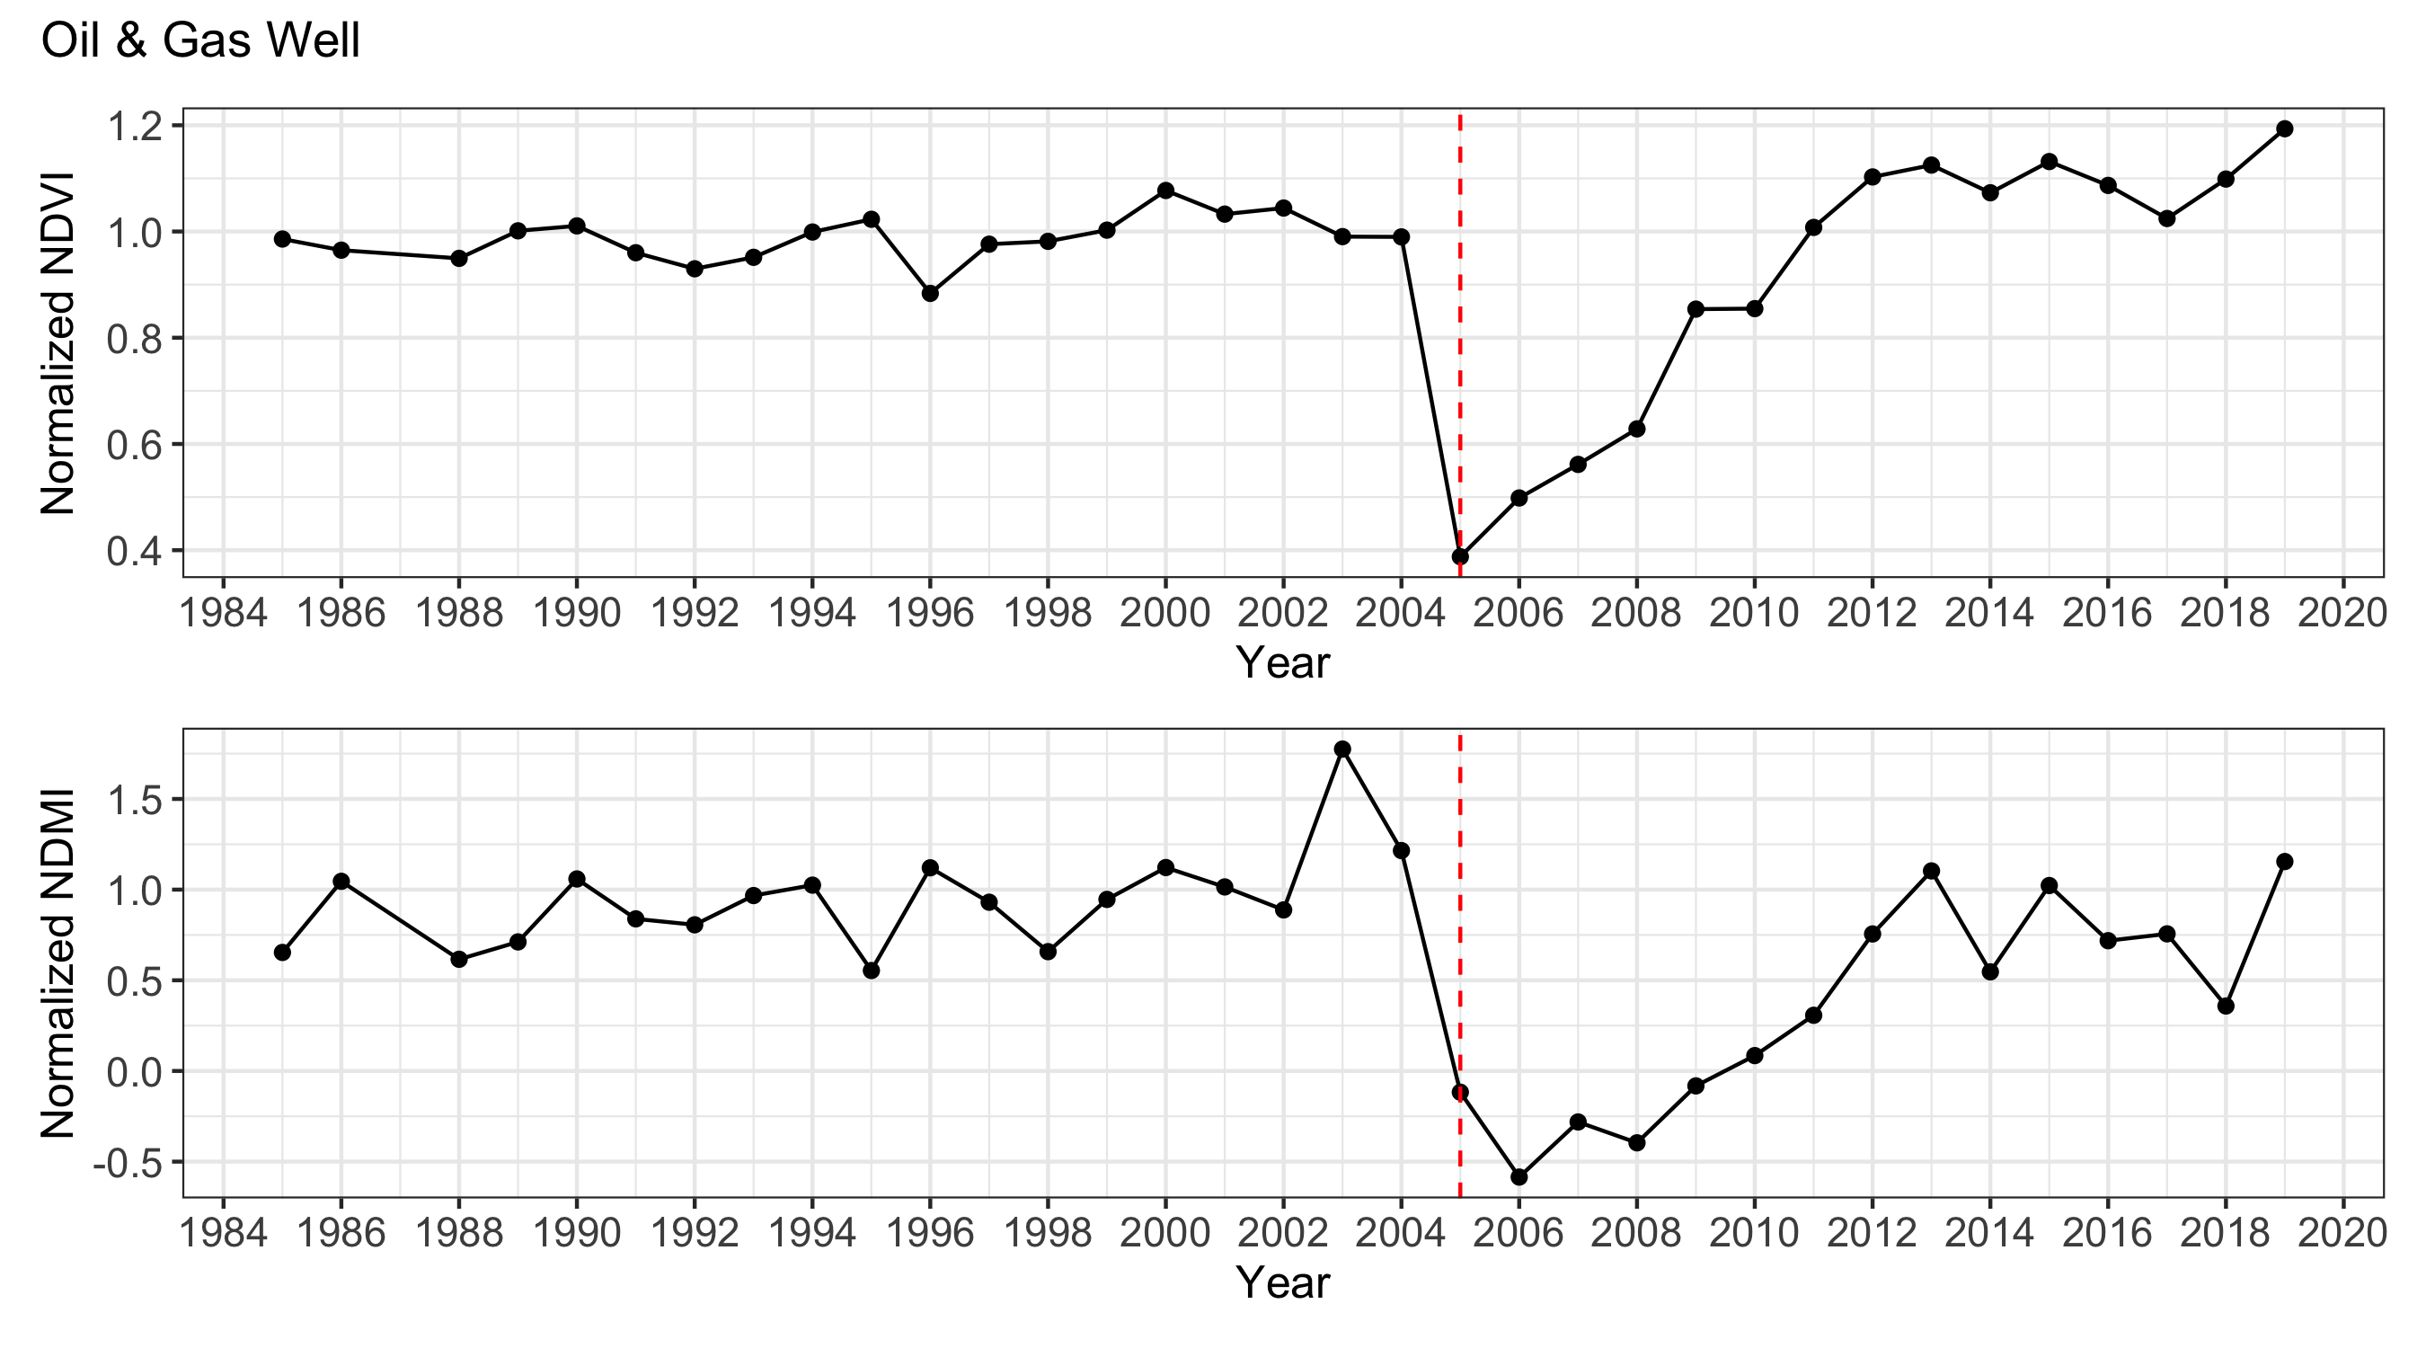
Oil & Gas Wells

Slide 22
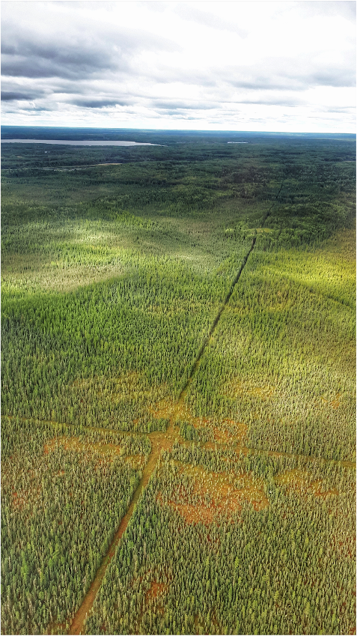
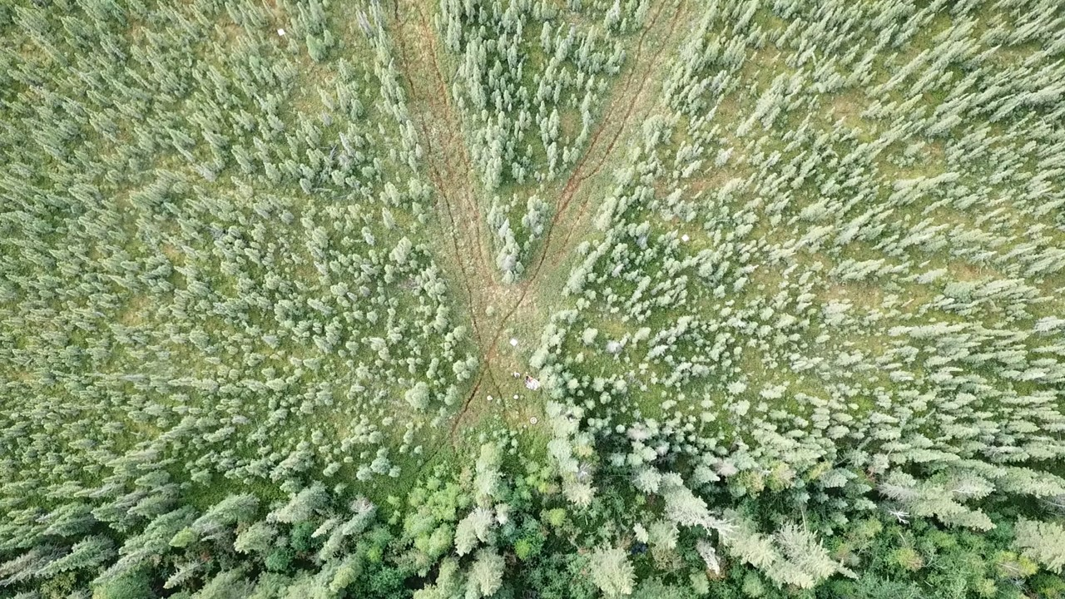
Seismic Lines
Dense network of linear clearings cut across wetlands and forests for subsurface oil & gas exploration
Removal of trees, compaction of soil, changes to hydrology – changes in ground layer vegetation
Tree recovery is poor
Largest anthropogenic disturbance across boreal and tundra ecosystems (~345,000 km in Alberta peatlands alone)

Slide 23
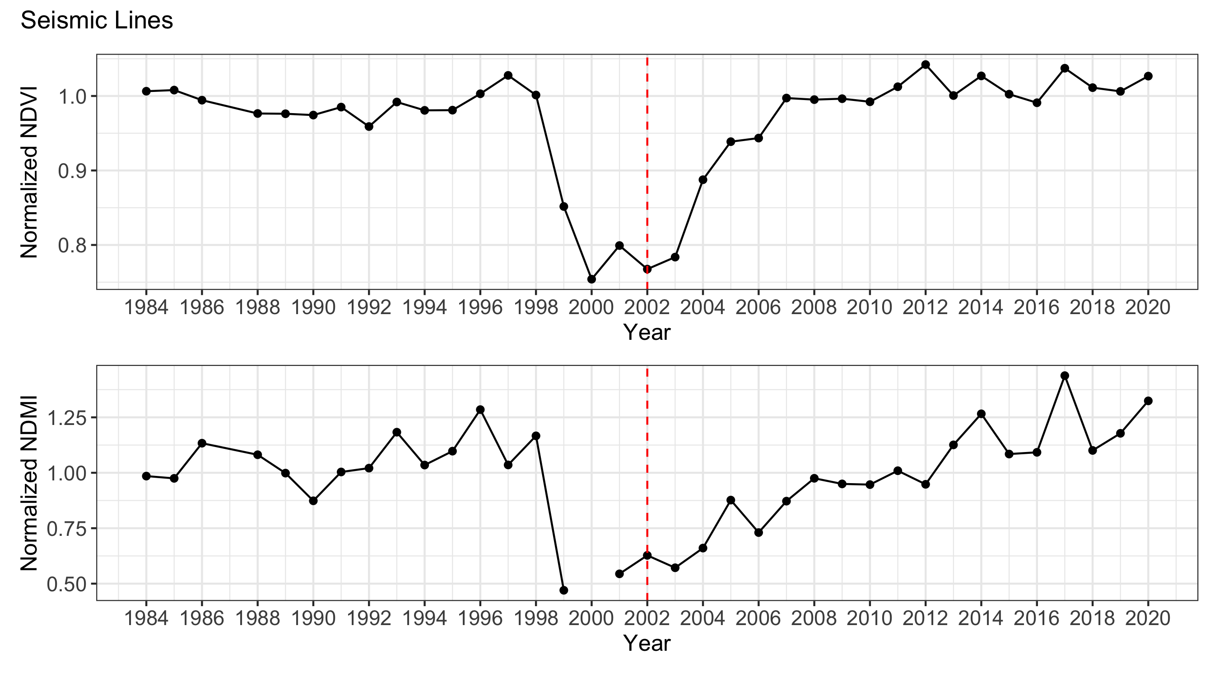
Seismic Lines

Slide 24
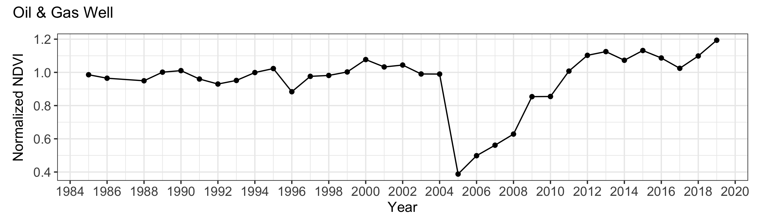
Comparing Disturbances
Post-disturbance slope
Disturbance slope & number of years

Slide 25
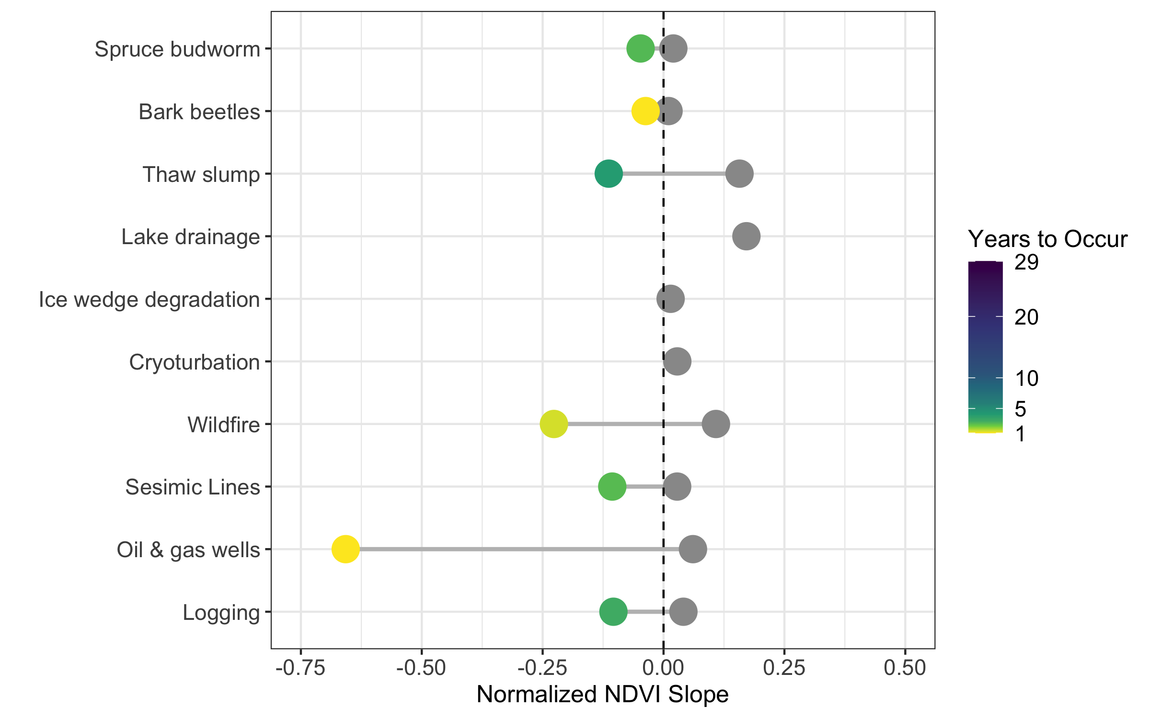
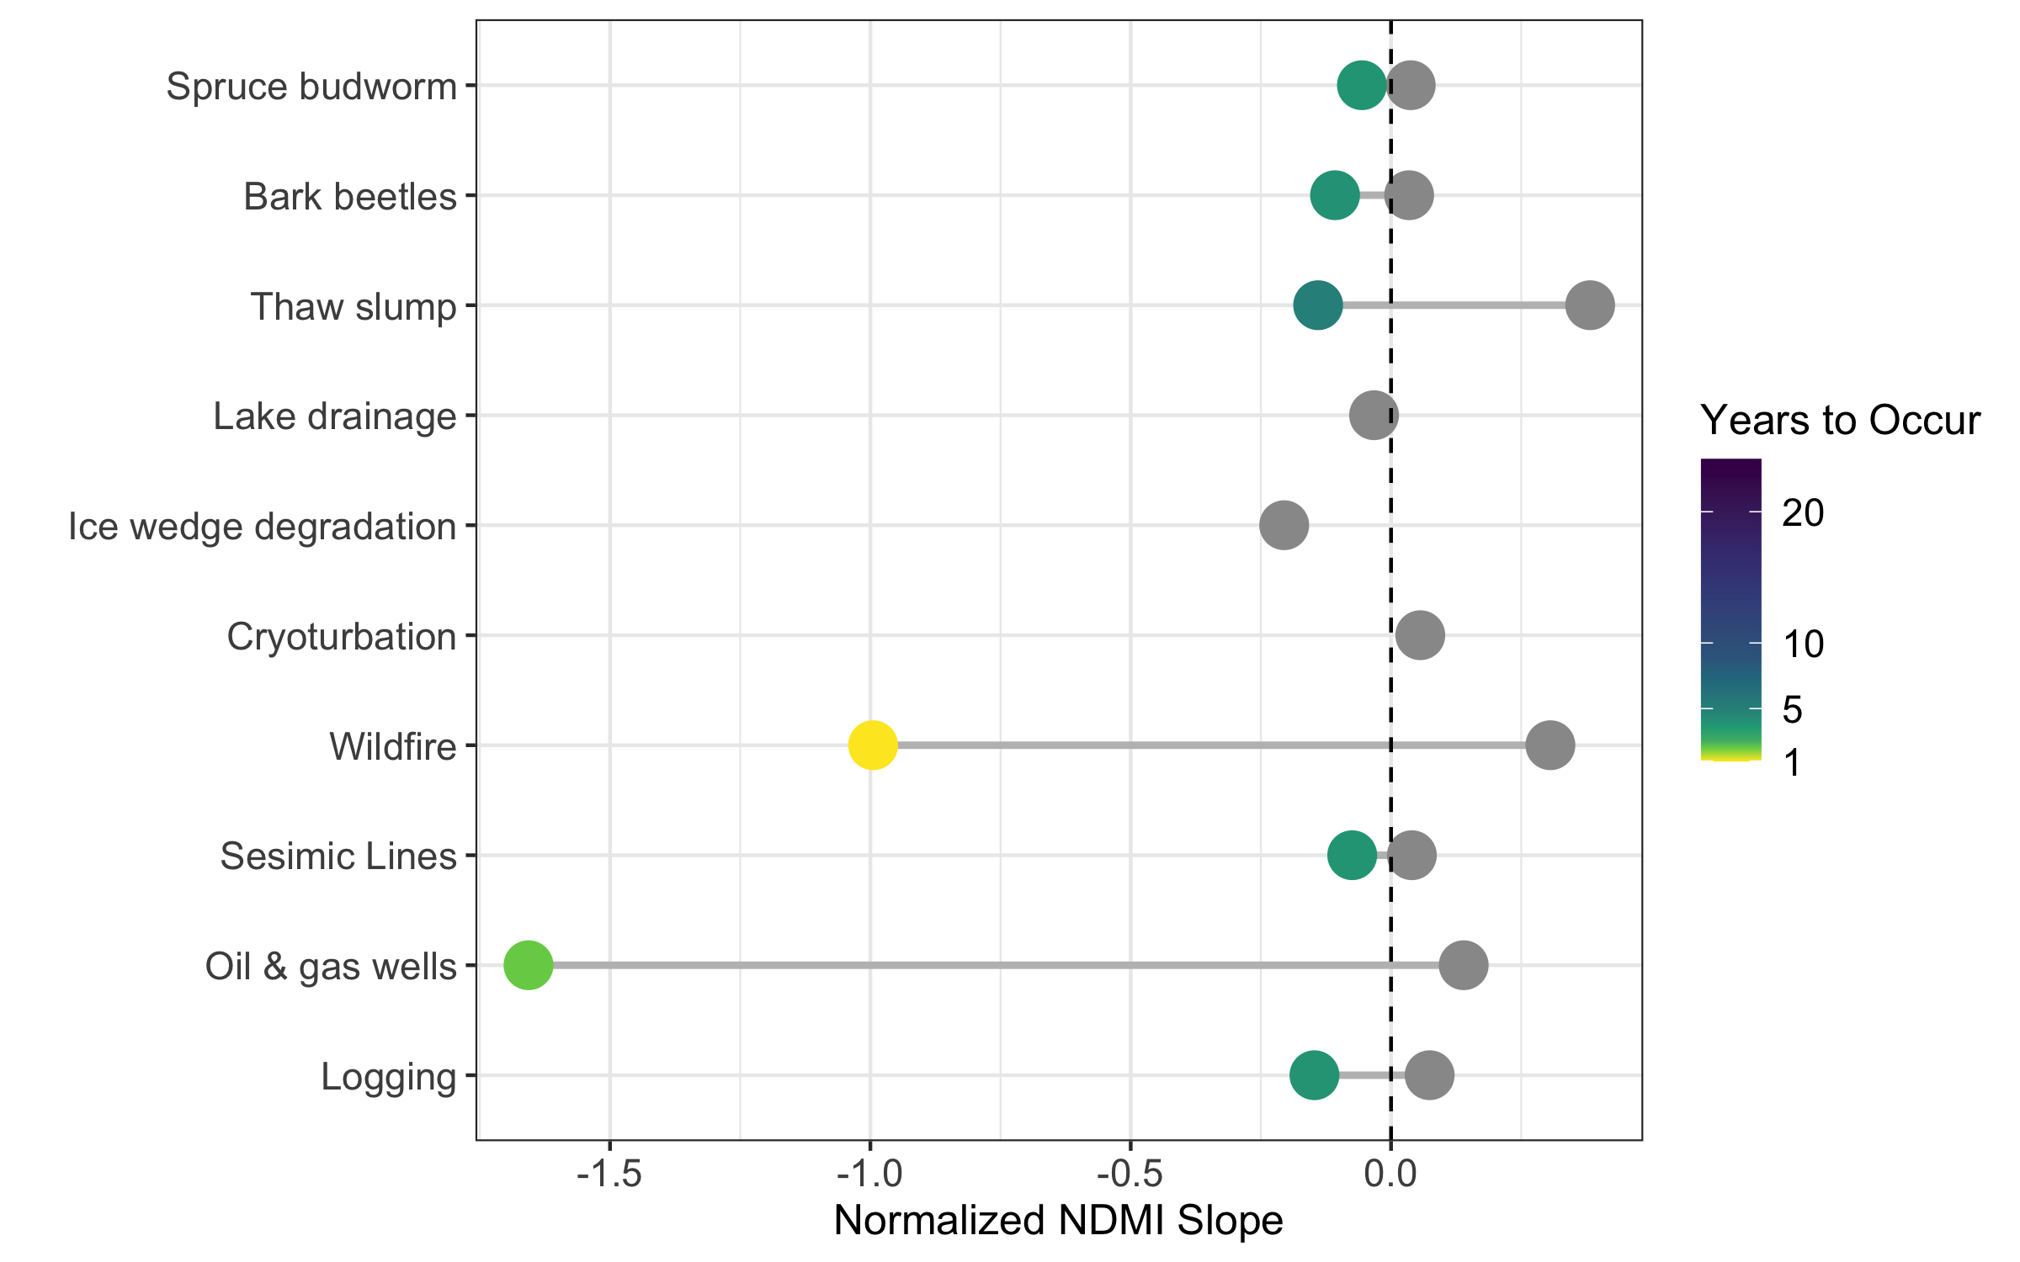
Comparing Disturbances

Slide 26
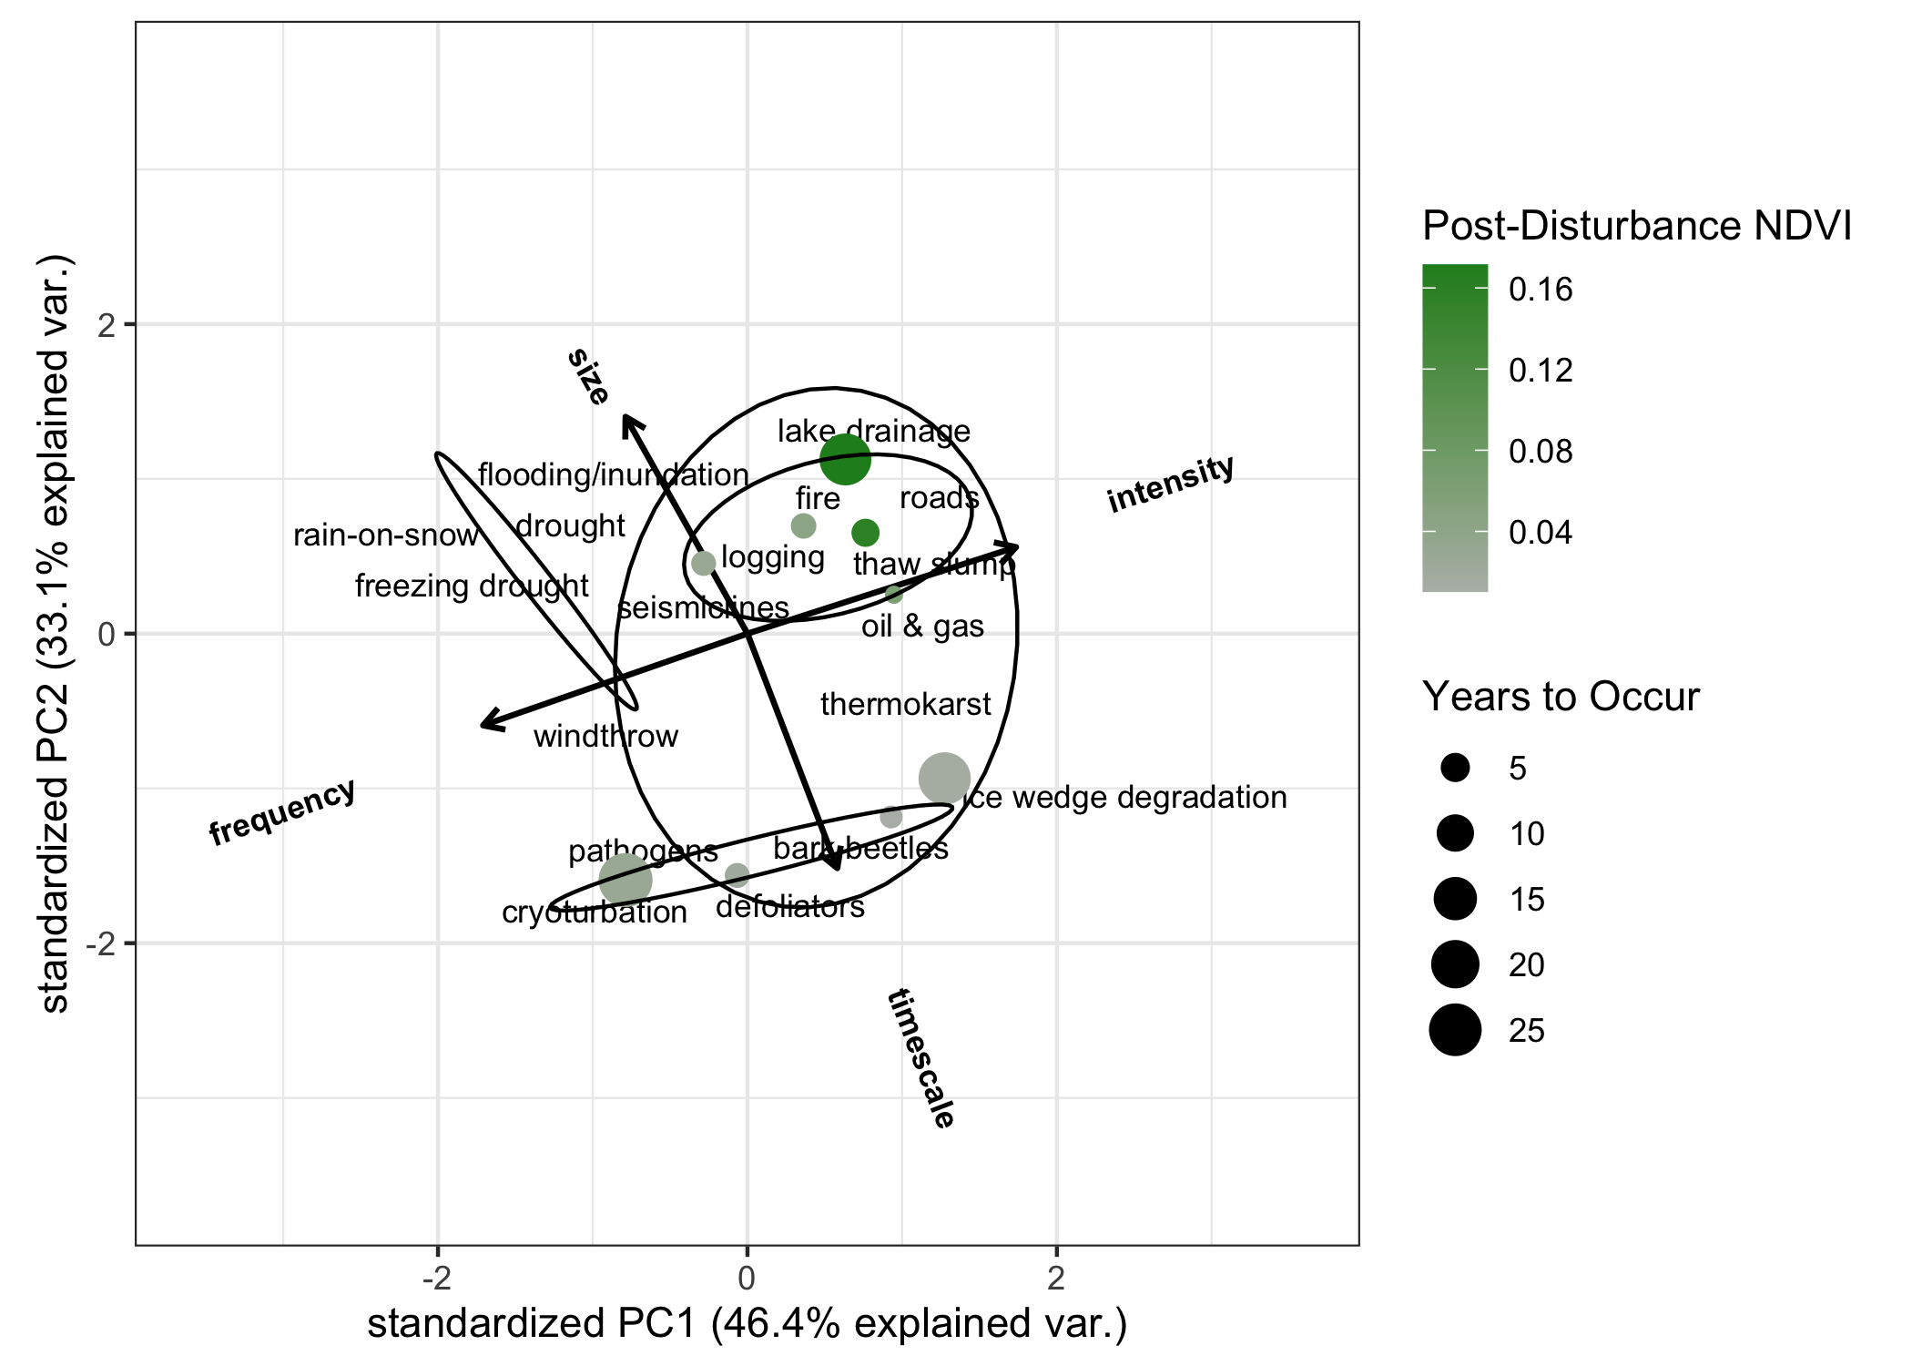
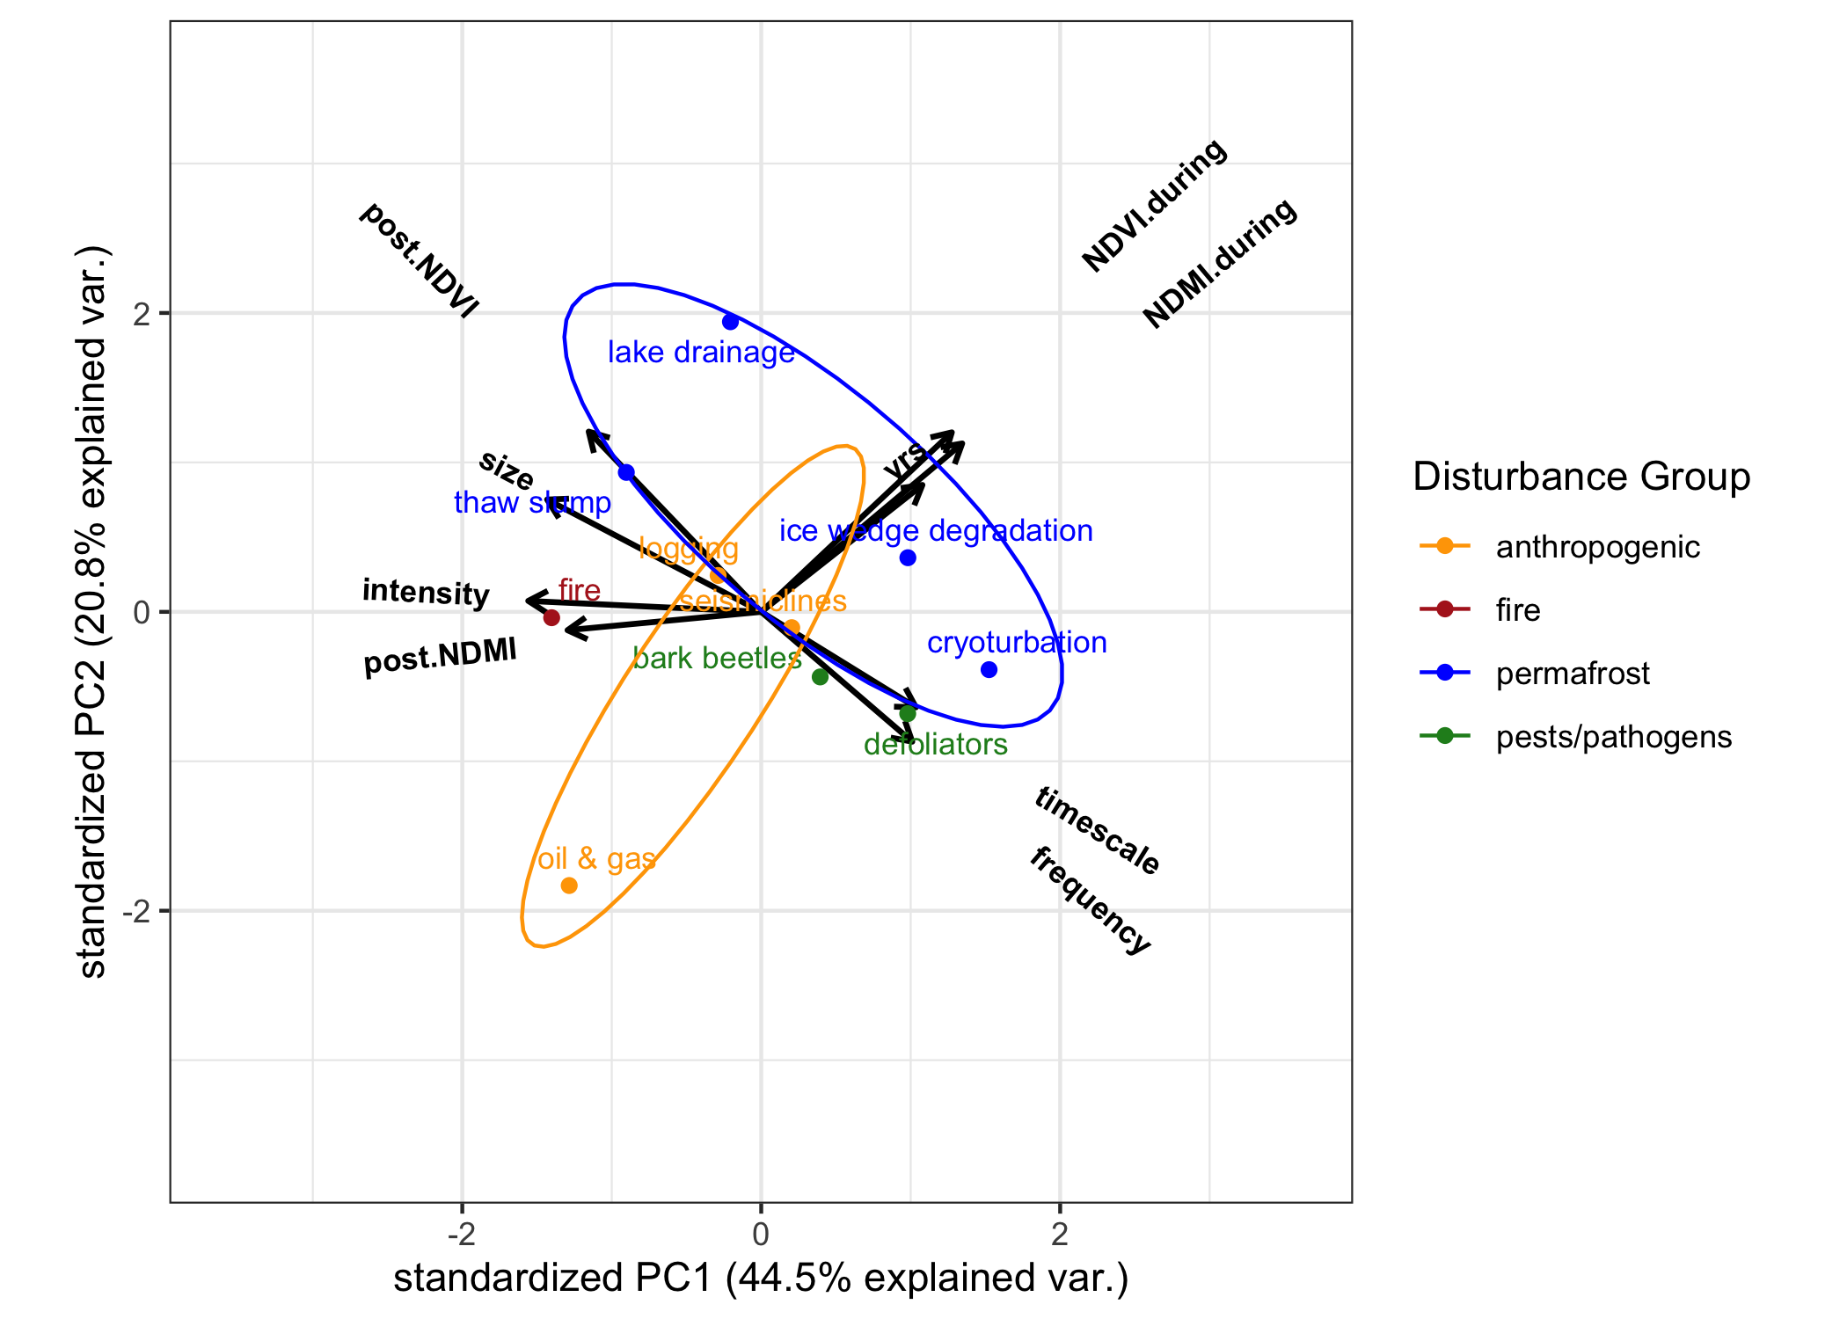
PCA Revisited

Slide 27
Conclusions and Future Work
Both time and space scales and intensity of disturbance are important
Fire is not the only important disturbance in boreal and arctic systems
Potential for interactions between disturbances will increase in future
Future Work
Finalize case study locations and analyses – need more in High Arctic
Workshop to finalize concept PCA and interactions
Submit manuscript

Slide 28
Thanks!

Slide 29
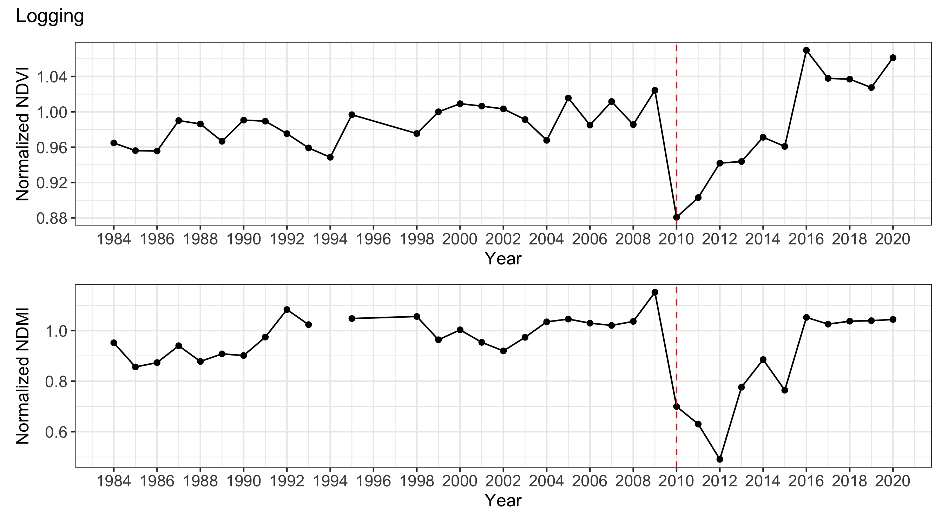
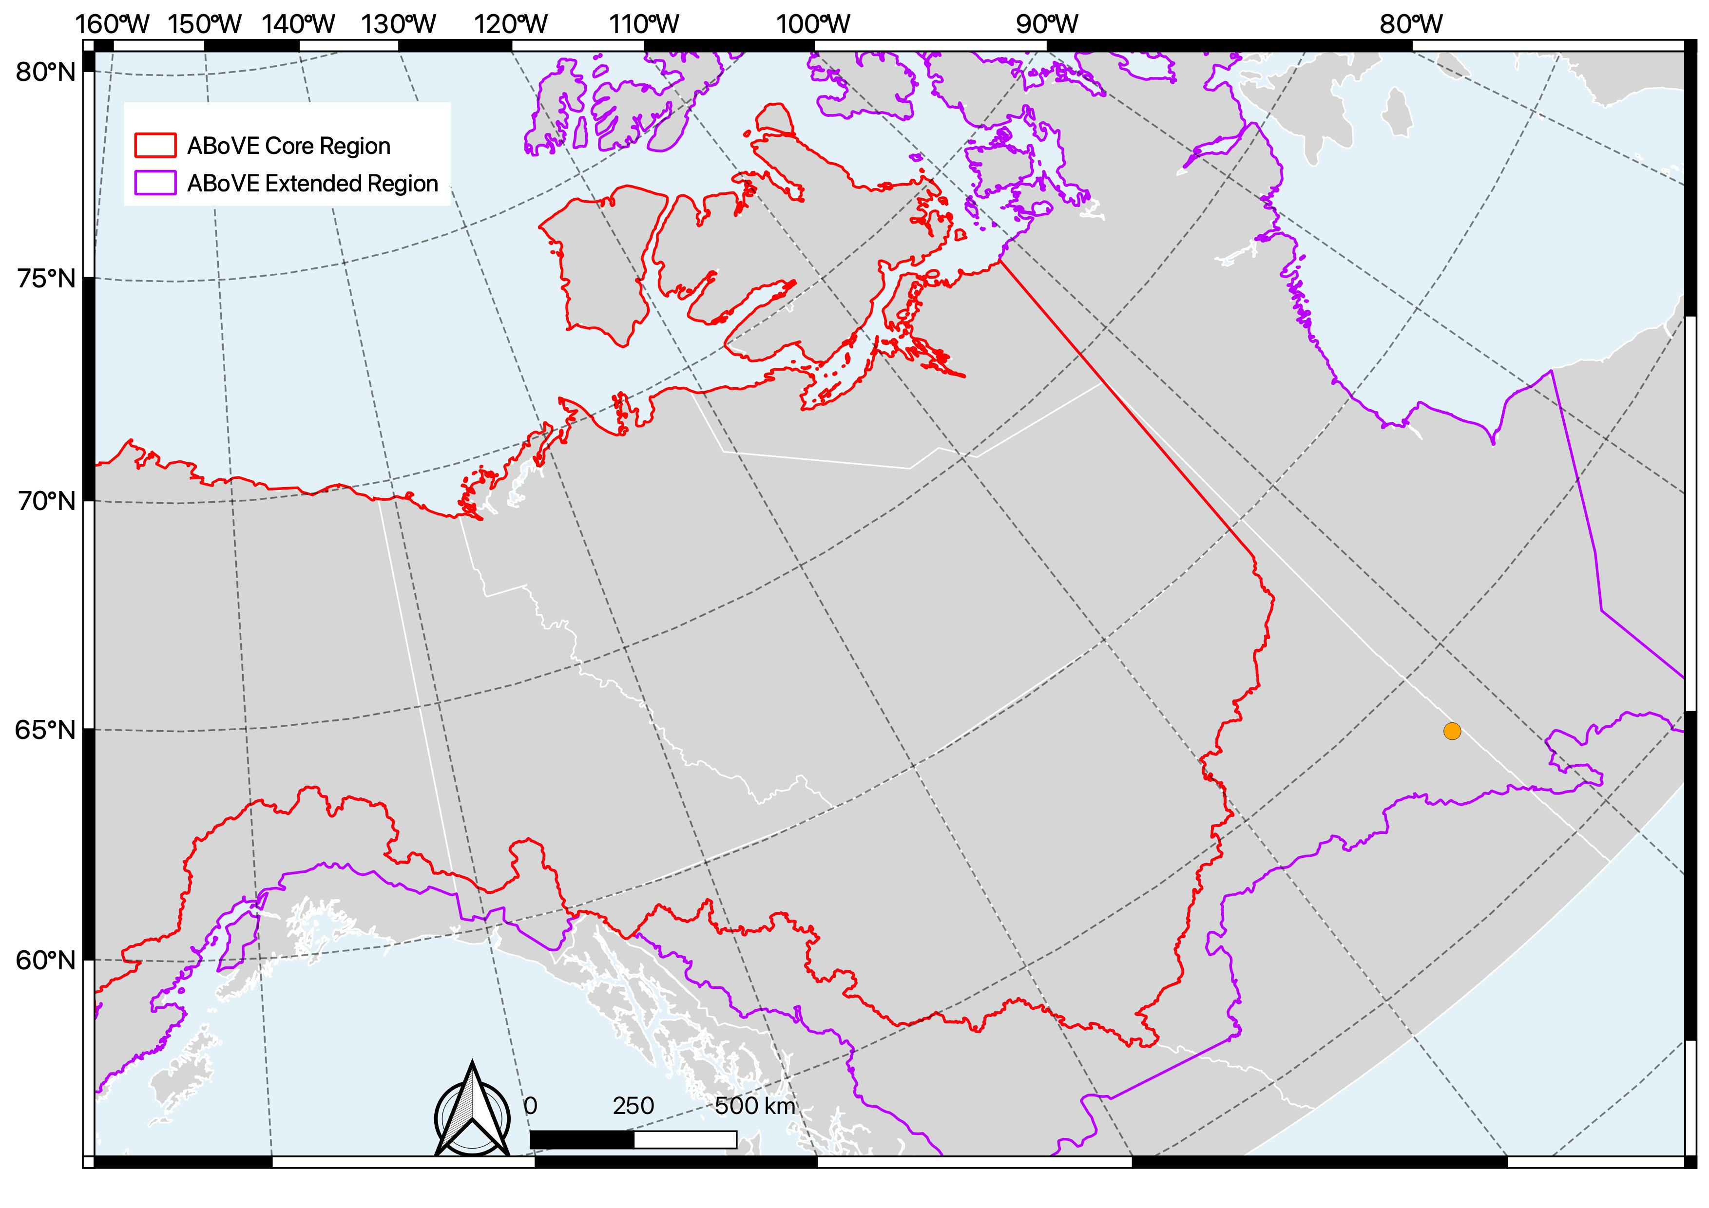
Logging

