Slide 1
National Aeronautics and Space Administration
ABoVE Modeling Working Group
Joshua B. Fisher (NASA/JPL | WG Lead)
Amanda armstrong (U.Virginia)
KAZEM BAKIAN DOGAHEH (USC)
LEAH BIRCH (WcRC)
RENATO BRAGHIERE (nasa/JPL)
BRENDAN BYRNE (nasa/JPL)
ABHISHEK CHATTERJEE (NASA/GSFC)
MIN CHEN (PNNL)
ROISIN COMMANE (COLUMBIA U.)
ADRIANNA FOSTER (NAU)
ANDY FOX (U.ARIZONA)
ANNA GAGNE-LANDMANN (U. laval)
JOHN GAMON (U.Alberta)
HéLÈNE GENET (I.ARCTIC BIOLOGY)
Scott Goetz (NAU)
Daniel Hayes (U.Maine)
JOHN HENDERSON (AER)
Lei Hu (noaa)
Deborah Huntzinger (NAU)
Elchin Jafarov (LANL)
Aleya Kaushik (noaa)
RALPH KEELING (SCRIPPS)
John Kimball (U.Montana)
ERIK LARSON (HARVARD U.)
PHIL MARSH (WILFRID LAUERIER U.)
Chip Miller (NASA/JPL)
Dave moore (u.arizona)
BILL MUNBGER (HARVARD U.)
Walt Oechel (SDSU)
NICK PARAZOO (NASA/JPL)
Mark Piper (U.Colorado)
Chris Potter (NASA/Ames)
BEN POULTER (NASA/GSFC)
David Price (NoFC)
Brendan Rogers (WcRC)
Kevin Schaefer (NSIDC)
LUKE SCHIFERL (HARVARD U.)
Christopher Schwalm (WHRC)
Hank Shugart (U.Virginia)
Jackie Shuman (U.Virginia)
Eric Stofferahn (NASA/JPL)
PETER THORNTON (ORNL)
PHIL TOWNSEND (U.WISCONSIN)
Anna virkkala (WcRC)
JENNIFER WATTS (WcRC)
Stan Wullschleger (DOE/ORNL)
Yu Zhang (CCMEO)
ZHEN ZHANG (U.MARYLAND)
Above- modeling group working.
(not the ABoVE Modeling Working Group)
National Aeronautics and Space Administration
Jet Propulsion Laboratory
California Institute of Technology
Pasadena, California
www.nasa.gov
© 2021 All rights reserved.

Slide 2
6 COURSE SYNTHESIS TOPICS
BOTTOM-UP AND TOP-DOWN MODELS
What is the carbon budget over the ABoVE domain? Can we
reconcile top-down and bottom-up estimates of C-budgets?
$ RESOLUTIONS & DOMAINS $
Abhishek Chatterjee, Brendan Byrne, Lei Hu,
Anna Virkkala, Brendan Rogers, Jennifer Watts, Josh Fisher
STATE OF ABR ECOSYSTEM PROCESSES
Some models have more “advanced” ABR process
representation than others. Differences?
$ REVIEW & ROADMAP $
Elise Heffernan, Howie Epstein, Amanda Armstrong,
Josh Fisher, Anna Virkkala, Brendan Rogers, Jennifer Watts
SUB-GRID VARIABILITY
Fine spatial resolution landscape features drive ecosystem functioning in the ABR. Approaches and impacts?
$ REMOTE SENSING → MODELING $
Jennifer Watts, Ben Poulter, Mary Farina
canva
page 1 of 2

Slide 3
6 COURSE SYNTHESIS TOPICS
INDIVIDUAL-BASED AND PFT MODELS
ABR ecosystem modeling is broadly grouped into two camps: individual-based models and PFT/trait-based models.
$ ED, UVAFME, CLM ⇿ CLM-FATES $
Adrianna Foster, Jackie Shuman, Erik Larson, Shawn Serbin
DRIVERS AND RUN PROTOCOLS
Specification paper needed on agreed-upon model drivers and run protocols for ABR model runs.
$ DAYMET, MESONET, CRU-NCEP, GSWP $
Dave Moore, Min Chen, Erik Larson, Kevin Schaefer, Nick Parazoo
ABOVE DATA FOR MODELS
Deep dive into entire ABoVE database. Extraction of functional relationships and benchmarks.
$ UNCERTAINTY, INTEGRATION $
Josh Fisher, Dan Hayes, Andy Fox, Shawn Serbin
canva
page 2 of 2

Slide 4
6 COURSE SYNTHESIS TOPICS
BOTTOM-UP AND TOP-DOWN MODELS
What is the carbon budget over the ABoVE domain? Can we
reconcile top-down and bottom-up estimates of C-budgets?
$ RESOLUTIONS & DOMAINS $
Abhishek Chatterjee, Brendan Byrne, Lei Hu,
Anna Virkkala, Brendan Rogers, Jennifer Watts, Josh Fisher
STATE OF ABR ECOSYSTEM PROCESSES
Some models have more “advanced” ABR process
representation than others. Differences?
$ REVIEW & ROADMAP $
Elise Heffernan, Howie Epstein, Amanda Armstrong,
Josh Fisher, Anna Virkkala, Brendan Rogers, Jennifer Watts
SUB-GRID VARIABILITY
Fine spatial resolution landscape features drive ecosystem functioning in the ABR. Approaches and impacts?
$ REMOTE SENSING → MODELING $
Jennifer Watts, Ben Poulter, Mary Farina
canva
page 1 of 2

Slide 5
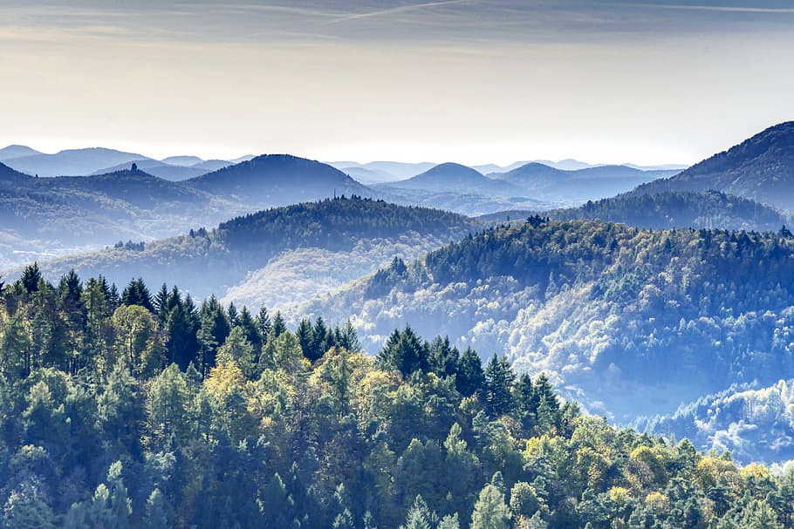
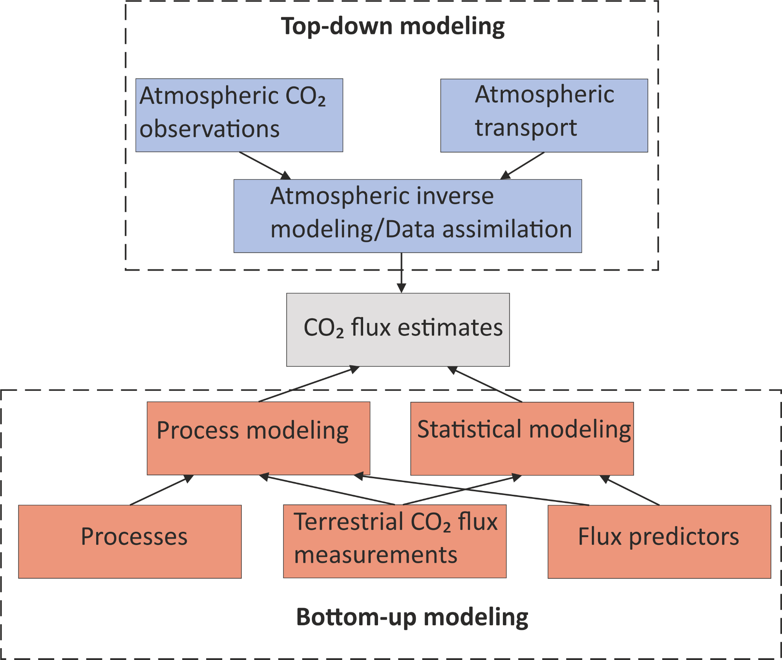
A roadmap for an improved utilization of Arctic-Boreal models used to estimate terrestrial carbon dioxide budgets
Review, survey, and guidance focusing on how process, statistical, and atmospheric inversion models can be integrated and synthesized
Anna-Maria Virkkala, Brendan Rogers, Jennifer Watts, Joshua Fisher, Abhishek Chatterjee, Lori Bruhweiler, Oliver Sonnentag, Susan Natali,
Rachael Treharne, Erin Macdonald, Howie Epstein, Amanda Armstrong, Elise Heffernan, Scott Zolkos, Jacqueline Hung, Michael Loranty,
Mathias Goeckede, Charles Miller, Sarah Shakil, Aram Kalhori, Kimberley Miner, Helene Genet, Ruth Varner, Dan Kou, Elena Blanc,
Joe Melton, Elena Blanc-Betes, Youmi Oh, Philip Pika, Mike Loranty, Hélène Genet, Wouter Hantson, Frans-Jan Parmentier

Slide 6
Reconciling top-down and bottom-up estimates of CO₂ fluxes
GPP from TRENDY vs. joint CO₂-COS inversion GPP (Hu et al.)
Constraints by OCO-2 (Chatterjee et al., Byrne et al.)
Bottom-up GPP: 1.5 to 10 Pg C yr⁻¹
Top-down GPP: 2 to 5 Pg C yr⁻¹
Top-down NEE estimates, especially when constrained by multi-sensor data, both in situ and remotely sensed, make a large correction to the bottom-up NEE estimates (see difference between blue and golden bars)
OCO-2

Slide 7
6 COURSE SYNTHESIS TOPICS
BOTTOM-UP AND TOP-DOWN MODELS
What is the carbon budget over the ABoVE domain? Can we
reconcile top-down and bottom-up estimates of C-budgets?
$ RESOLUTIONS & DOMAINS $
Abhishek Chatterjee, Brendan Byrne, Lei Hu,
Anna Virkkala, Brendan Rogers, Jennifer Watts, Josh Fisher
STATE OF ABR ECOSYSTEM PROCESSES
Some models have more “advanced” ABR process
representation than others. Differences?
$ REVIEW & ROADMAP $
Elise Heffernan, Howie Epstein, Amanda Armstrong,
Josh Fisher, Anna Virkkala, Brendan Rogers, Jennifer Watts
SUB-GRID VARIABILITY
Fine spatial resolution landscape features drive ecosystem functioning in the ABR. Approaches and impacts?
$ REMOTE SENSING → MODELING $
Jennifer Watts, Ben Poulter, Mary Farina
canva
page 1 of 2

Slide 8
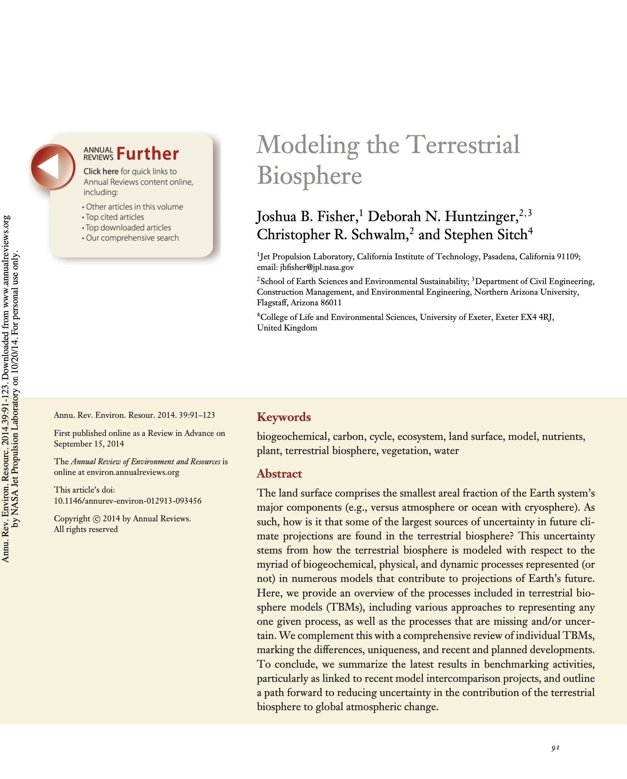
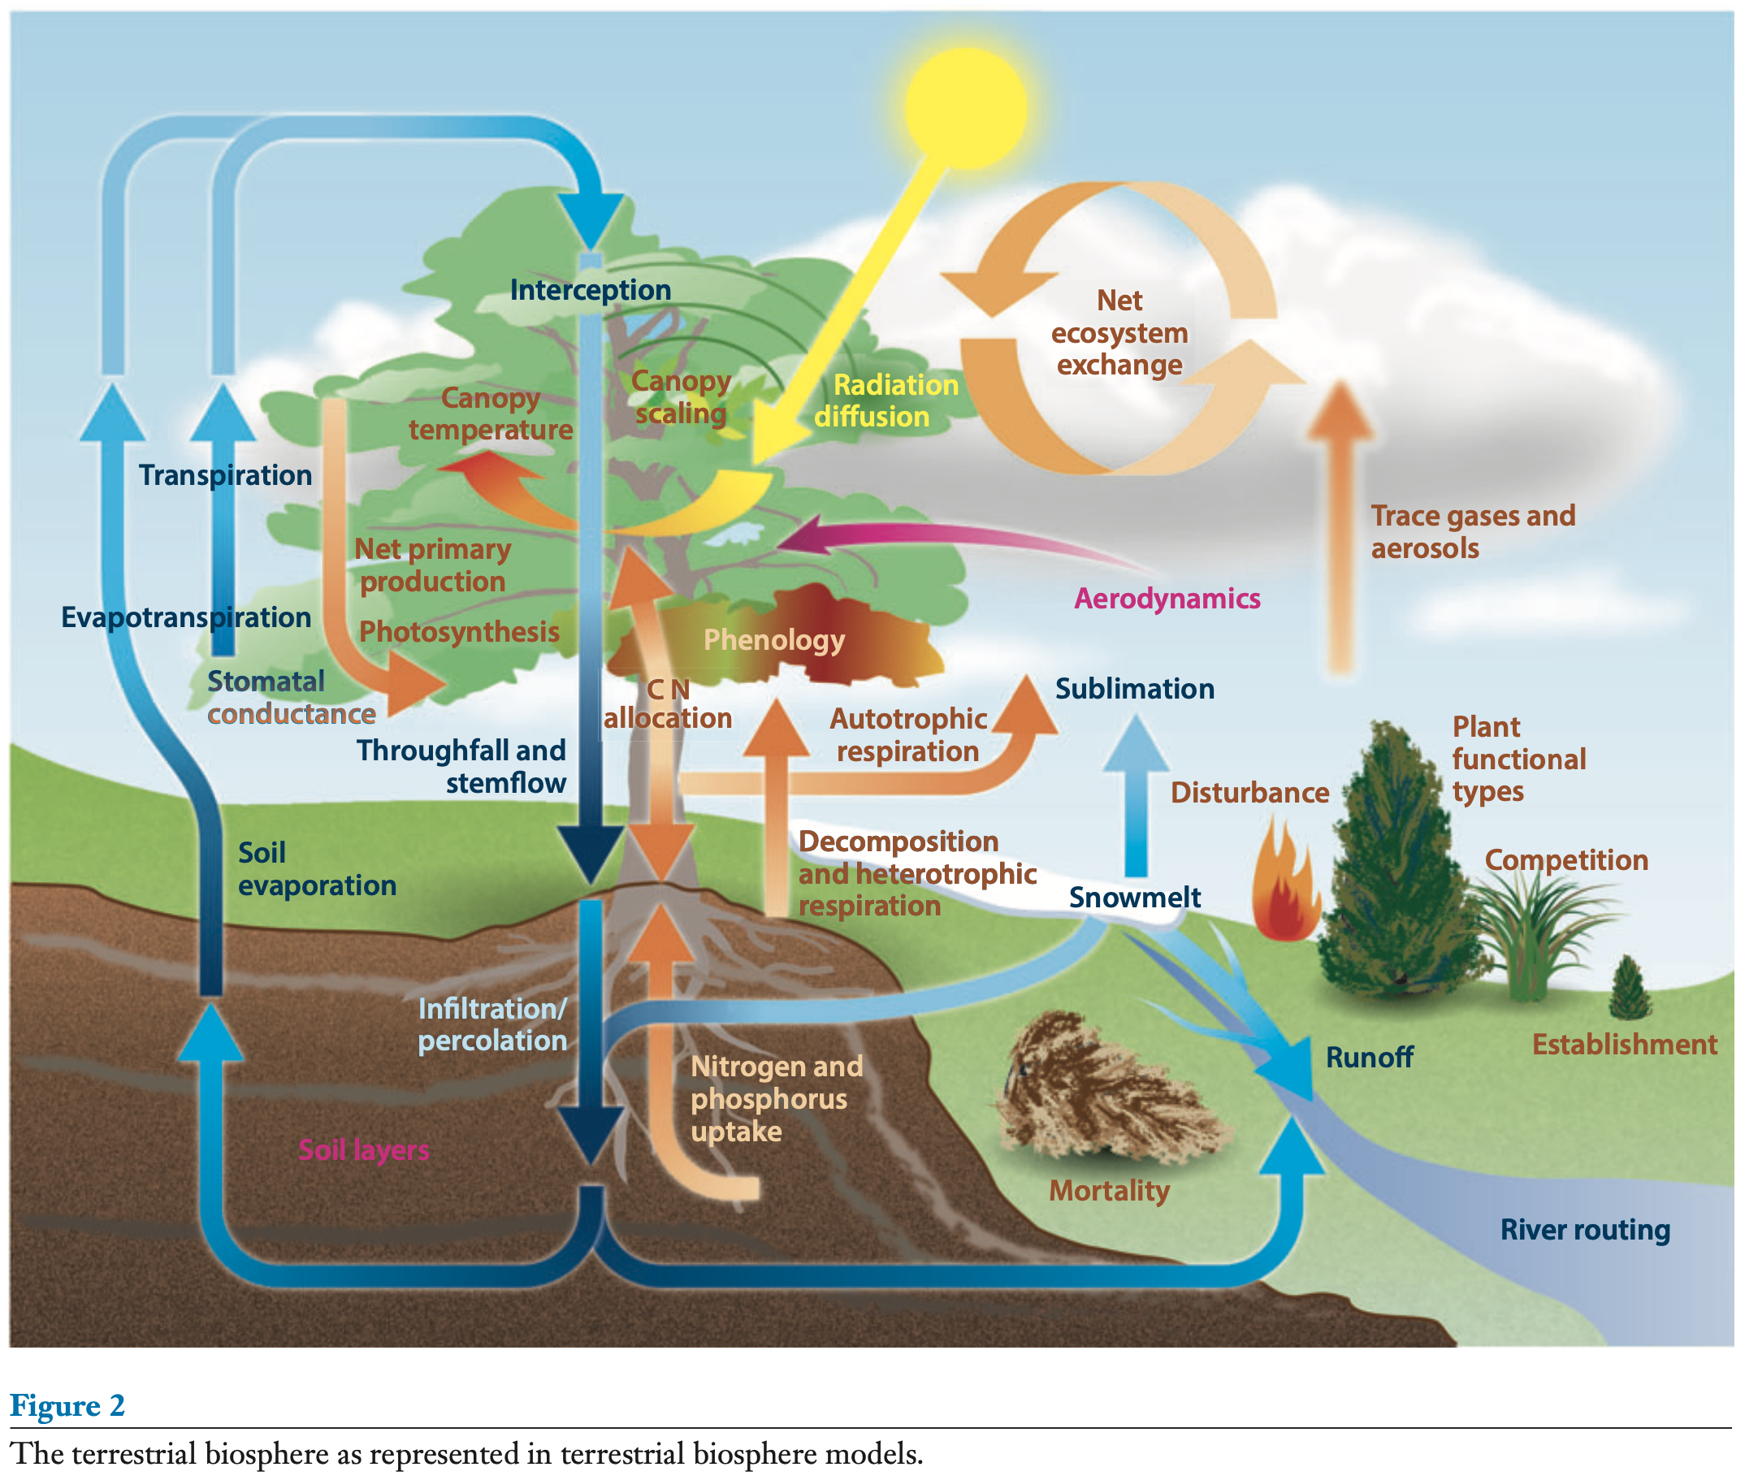
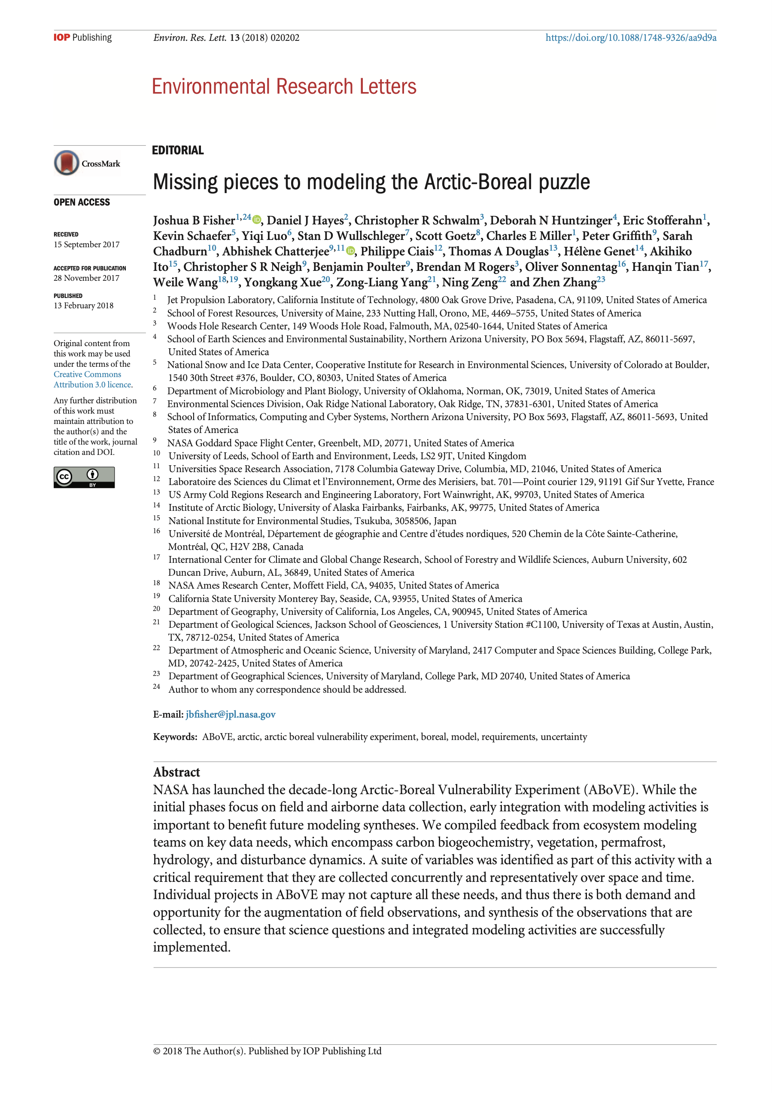

Slide 9
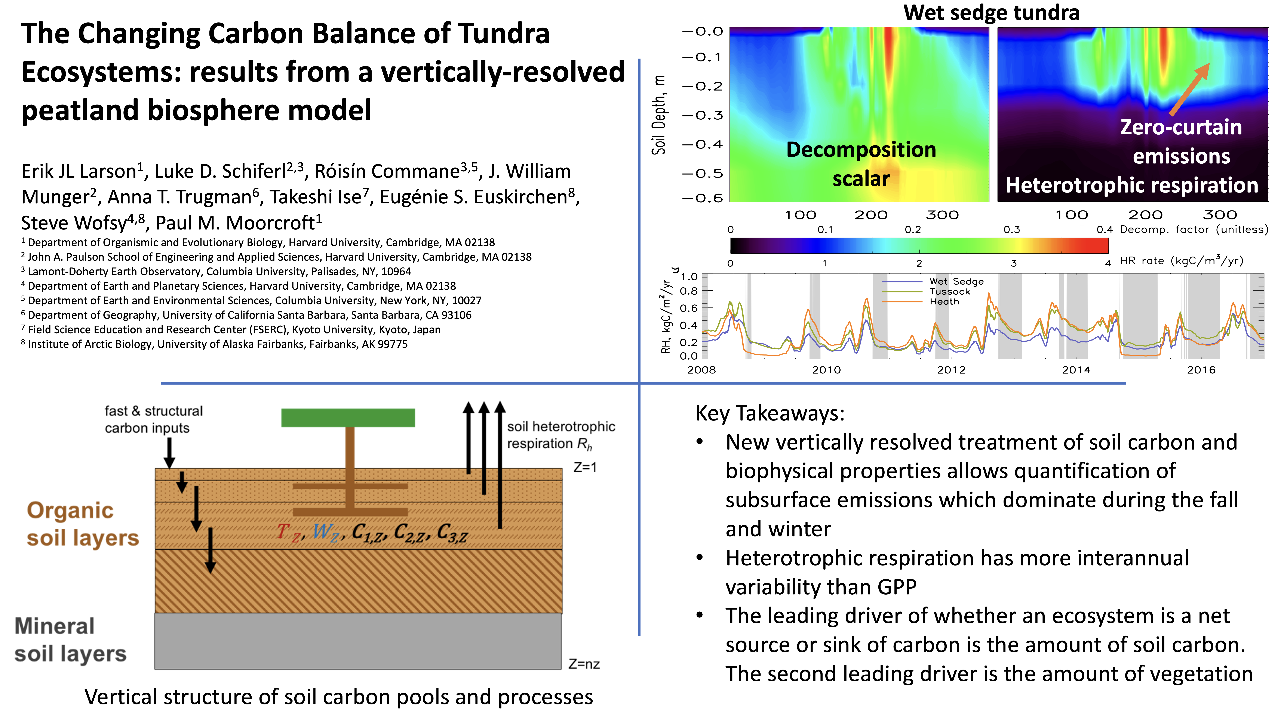

Slide 10
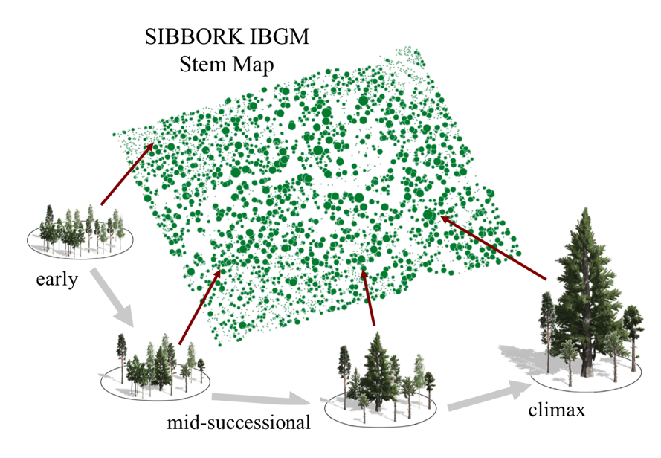
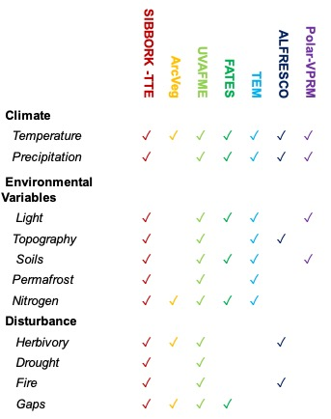
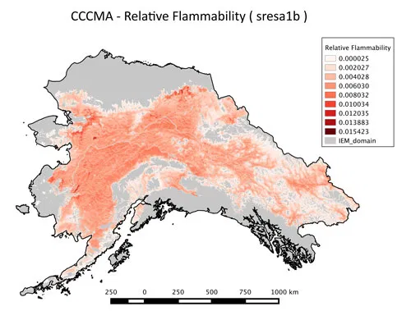
ABoVE Vegetation Dynamics Process Models review
Elise Heffernan, Amanda Armstrong, Howard Epstein, Anna Virkkala, Brendan Rogers, Jennifer Watts
Factors driving change in the arctic are not uniform/entirely understood we need a many models to tease out different scenarios
  We have to not only test different climate scenarios - but also test different mechanisms of change
Our goal is to identify pros and cons of vegetation dynamics models used in the ABoVE domain to help researchers determine which is the best fit for their project/question
Credit: Amanda Armstrong
We will be reaching out to different modeling groups this summer for extra input! We need your help!
Notes:
FOR JOSH

Slide 11
6 COURSE SYNTHESIS TOPICS
BOTTOM-UP AND TOP-DOWN MODELS
What is the carbon budget over the ABoVE domain? Can we
reconcile top-down and bottom-up estimates of C-budgets?
$ RESOLUTIONS & DOMAINS $
Abhishek Chatterjee, Brendan Byrne, Lei Hu,
Anna Virkkala, Brendan Rogers, Jennifer Watts, Josh Fisher
STATE OF ABR ECOSYSTEM PROCESSES
Some models have more “advanced” ABR process
representation than others. Differences?
$ REVIEW & ROADMAP $
Elise Heffernan, Howie Epstein, Amanda Armstrong,
Josh Fisher, Anna Virkkala, Brendan Rogers, Jennifer Watts
SUB-GRID VARIABILITY
Fine spatial resolution landscape features drive ecosystem functioning in the ABR. Approaches and impacts?
$ REMOTE SENSING → MODELING $
Jennifer Watts, Ben Poulter, Mary Farina
canva
page 1 of 2

Slide 12
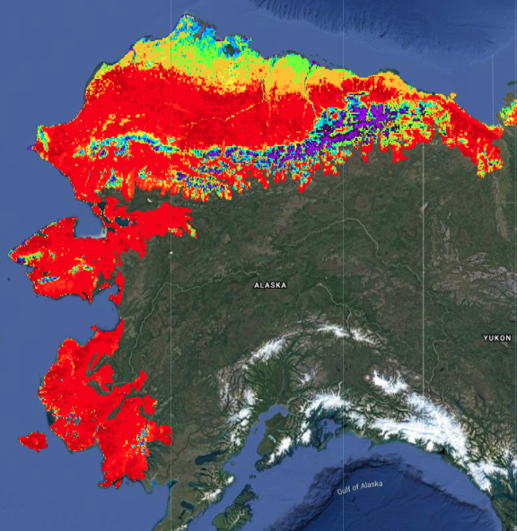
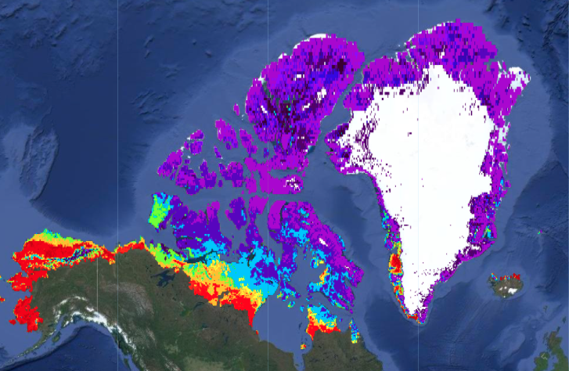
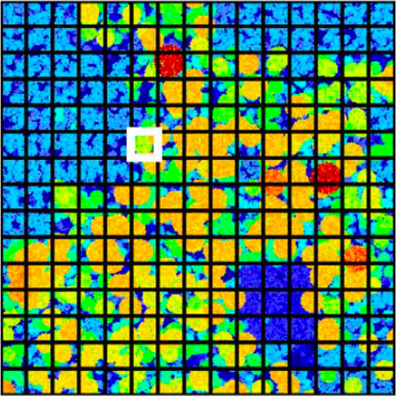
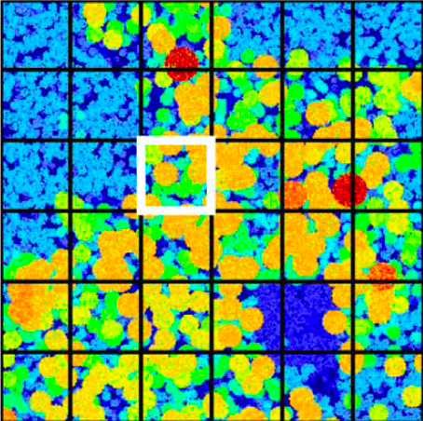
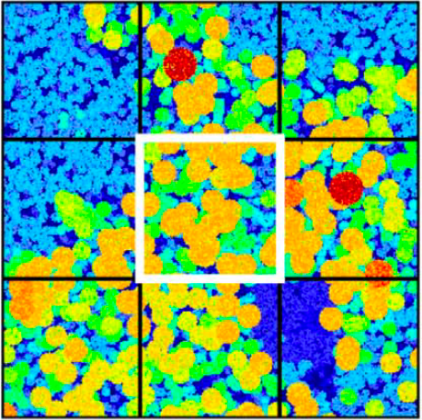
Using Model target resolution to resolve science questions
Global ecosystem model
State/Province
Regional
vegetation mapping
Individual
Local
Vegetation demographic model
Individual based gap model
Credit: Amanda Armstrong
Notes:
FOR HOWIE

Slide 13


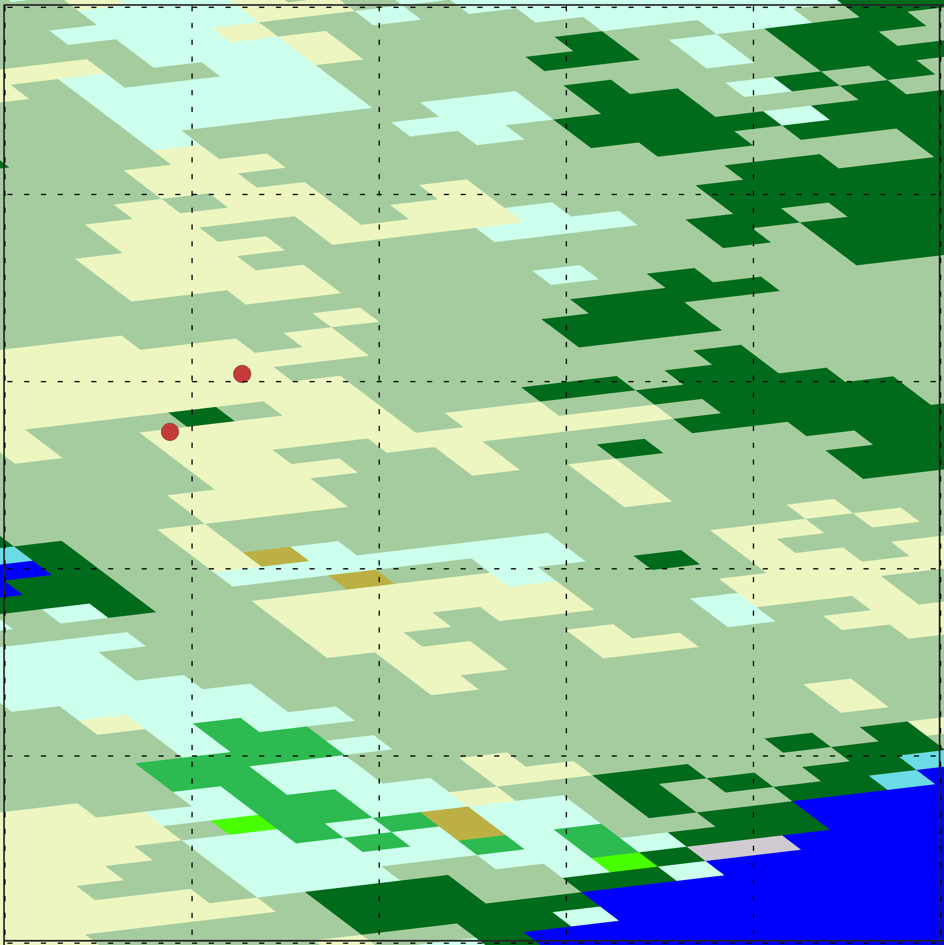
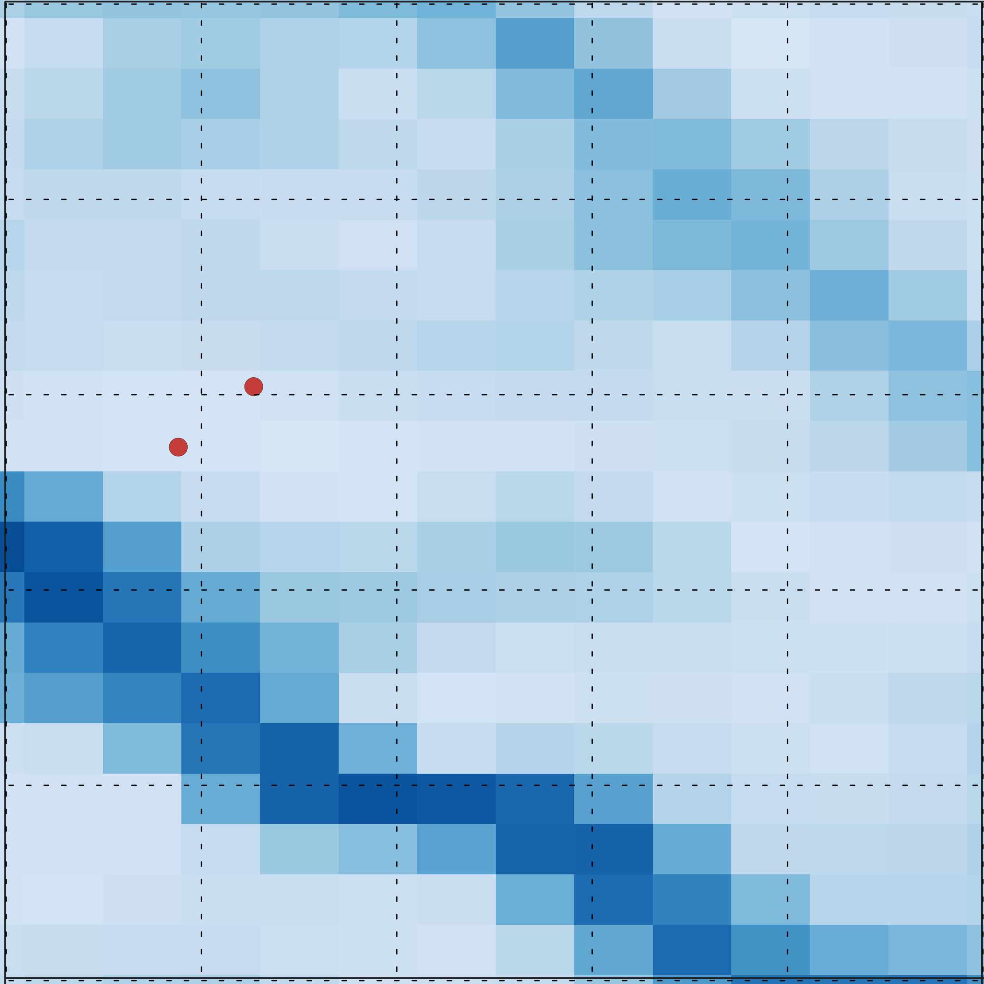
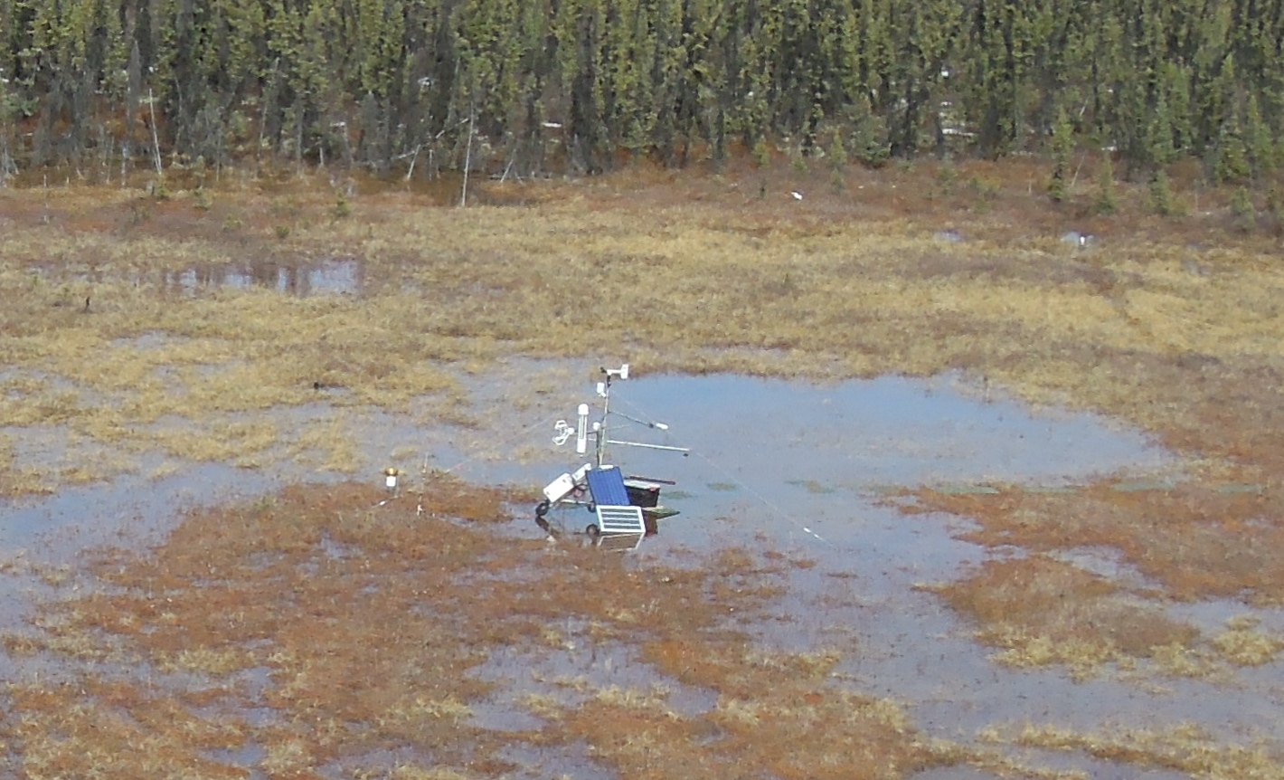
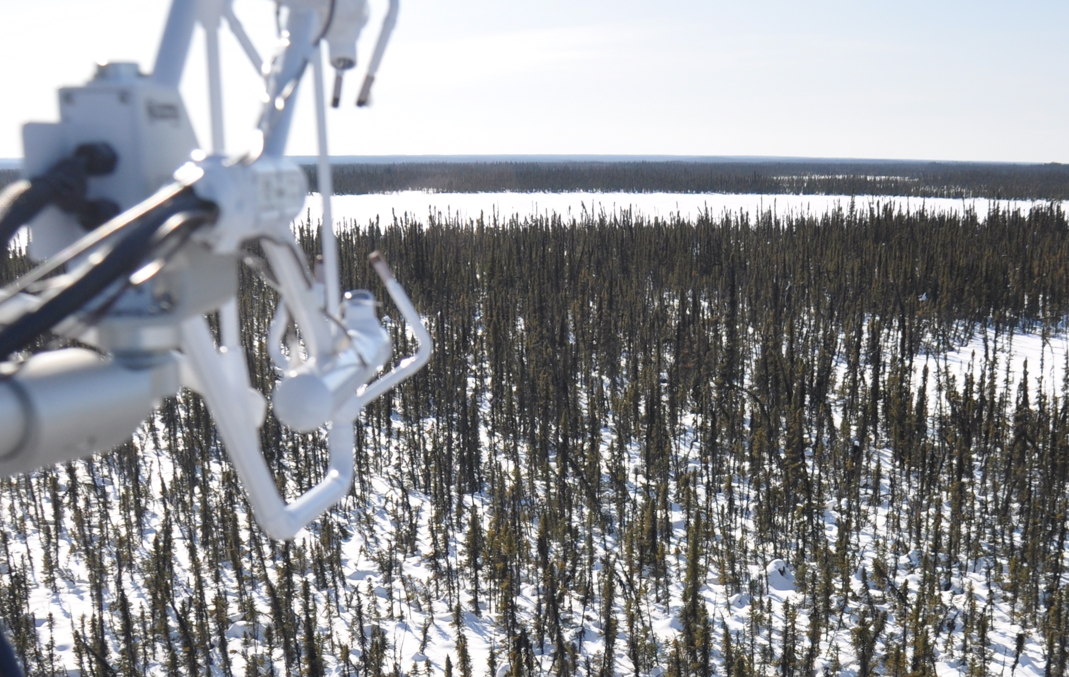
Sub-grid heterogeneity can affect the ability of ecosystem models to represent carbon cycle dynamics.
Even at 1-km, finer scale variations in vegetation type and surface wetness produce vastly different patterns of flux.
Case Study for Scotty Creek Eddy Covariance (EC) Towers
Bog (CA-SCB)
d
A) NEE
- CA-SCB
B) CH₄ emissions
- CA-SCC
A) ABoVE LC
B) CTI
d
- TCF model
CTI
gCO₂ m⁻² d⁻¹
0 50 100
Drier→
-10 -5 0 5
mgCH₄ m⁻² d⁻¹
CA-SCB
CA-SCB
Landscape (CA-SCC)
CA-SCC
CA-SCC
Apr. Jul. Oct.
Apr. Jul. Oct.
← Wetter
gCO₂ m⁻² yr⁻¹
gCH₄ m⁻² yr⁻¹
0m 200m
0m 200m
-250 -200 -150 -100 -50 0
0 2 4 6 8 10 12 14
Photo credit Oliver Sonnentag
A) Landsat-based annual land cover (Wang et al. 2019) within 1-km TCF model grid cell. B) A static compound topographic index (CTI) indicates potential gradients of landscape moisture status, but ultimately spaceborne microwave sensors capable of detecting fine scale soil moisture are needed.
The 2014 TCF NEE estimates most closely align with the bog site and are unable to distinguish between forest and sub-grid wetland.
A considerable challenge is scaling CH₄ from m² to the greater landscape without fully understanding the proportion of wet soils within the 1 km² grid.
Kimball (TE 2014); Watts (NIP 2017); Farina (FINESST 2020)
Notes:
From Mary Farina

Slide 14
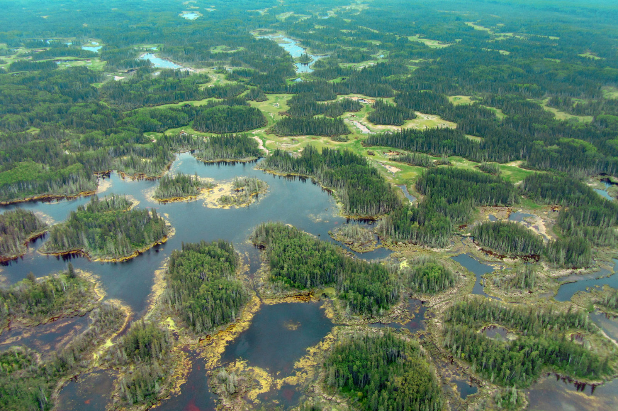
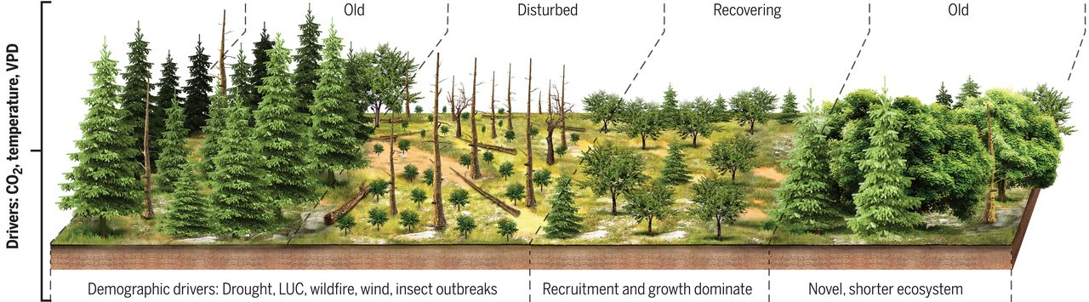
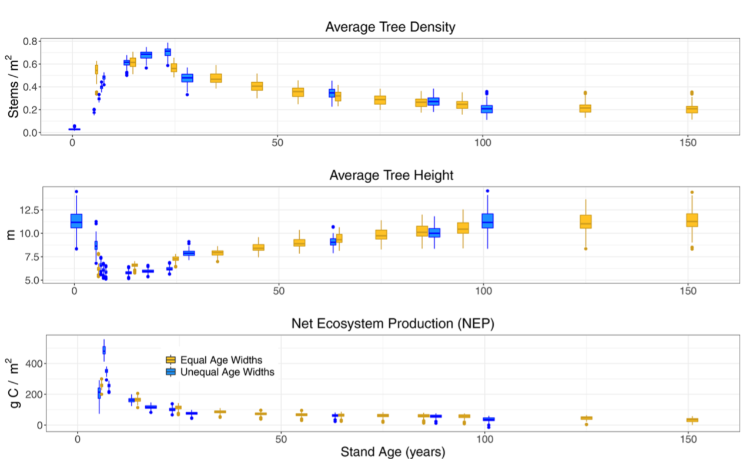
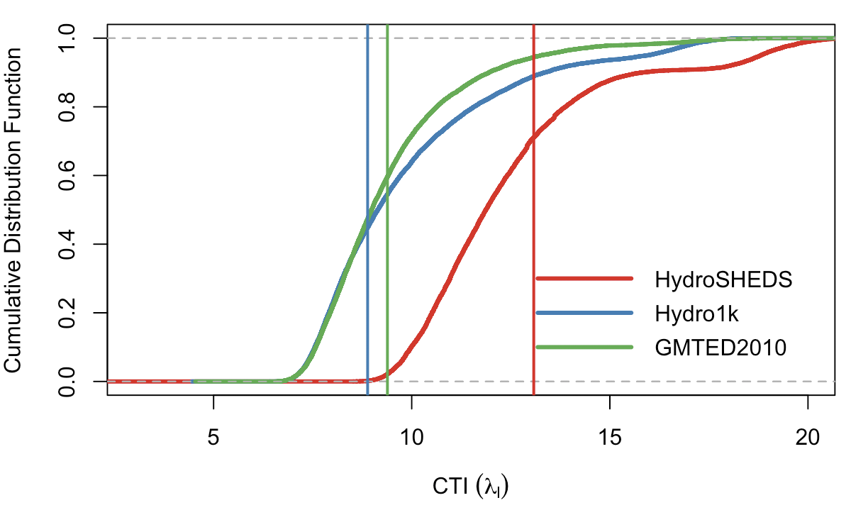
Sub-grid cell processes within the LPJ land-surface model (Ben Poulter, Leo Calle, Zhen Zhang)
Representation of forest regrowth and recovery to avoid carbon ‘dilution’ effect
Use of topographic information for simulating sub-grid cell level surface inundation using TOPMODEL
For boreal regions, sub-grid cell model structure improves carbon dynamics following fire
and enables simulations of wetland methane emissions.
DEMs
Topography Index
Calle & Poulter (2021), McDowell et al. (2020)
Zhang et al. (2019)

Slide 15
6 COURSE SYNTHESIS TOPICS
INDIVIDUAL-BASED AND PFT MODELS
ABR ecosystem modeling is broadly grouped into two camps: individual-based models and PFT/trait-based models.
$ ED, UVAFME, CLM ⇿ CLM-FATES $
Adrianna Foster, Jackie Shuman, Erik Larson, Shawn Serbin
DRIVERS AND RUN PROTOCOLS
Specification paper needed on agreed-upon model drivers and run protocols for ABR model runs.
$ DAYMET, MESONET, CRU-NCEP, GSWP $
Dave Moore, Min Chen, Erik Larson, Kevin Schaefer, Nick Parazoo
ABOVE DATA FOR MODELS
Deep dive into entire ABoVE database. Extraction of functional relationships and benchmarks.
$ UNCERTAINTY, INTEGRATION $
Josh Fisher, Dan Hayes, Andy Fox, Shawn Serbin
canva
page 2 of 2

Slide 16


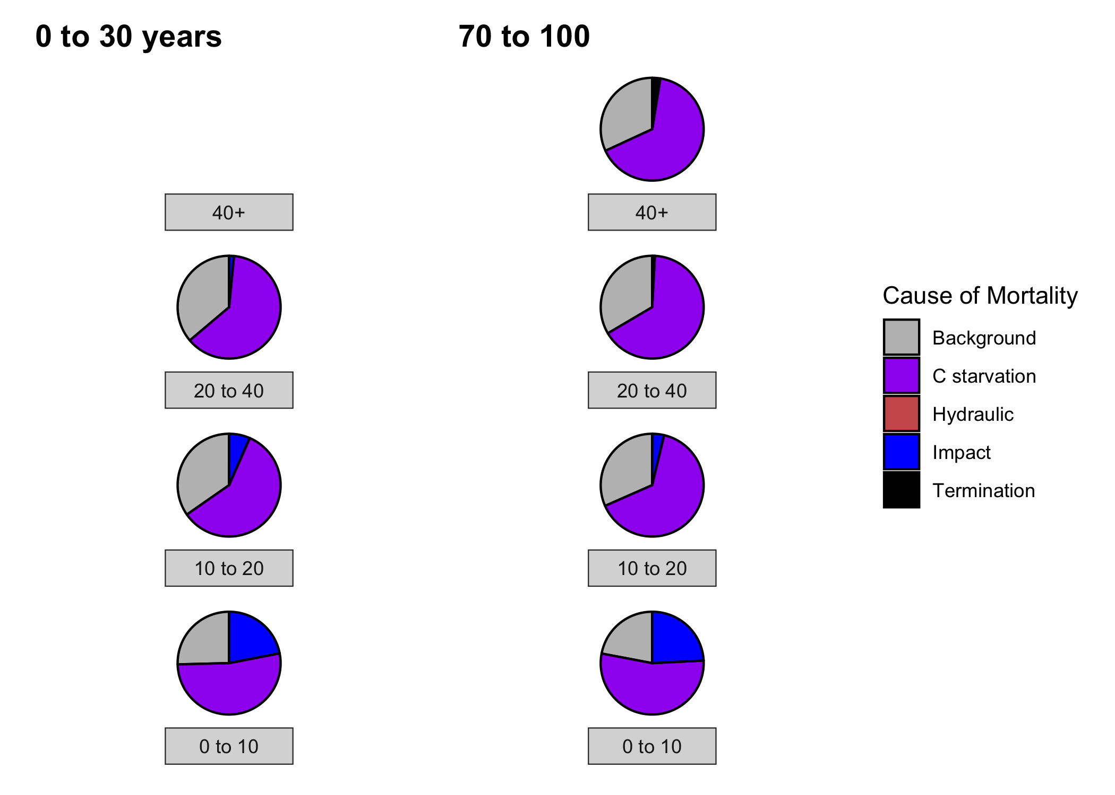
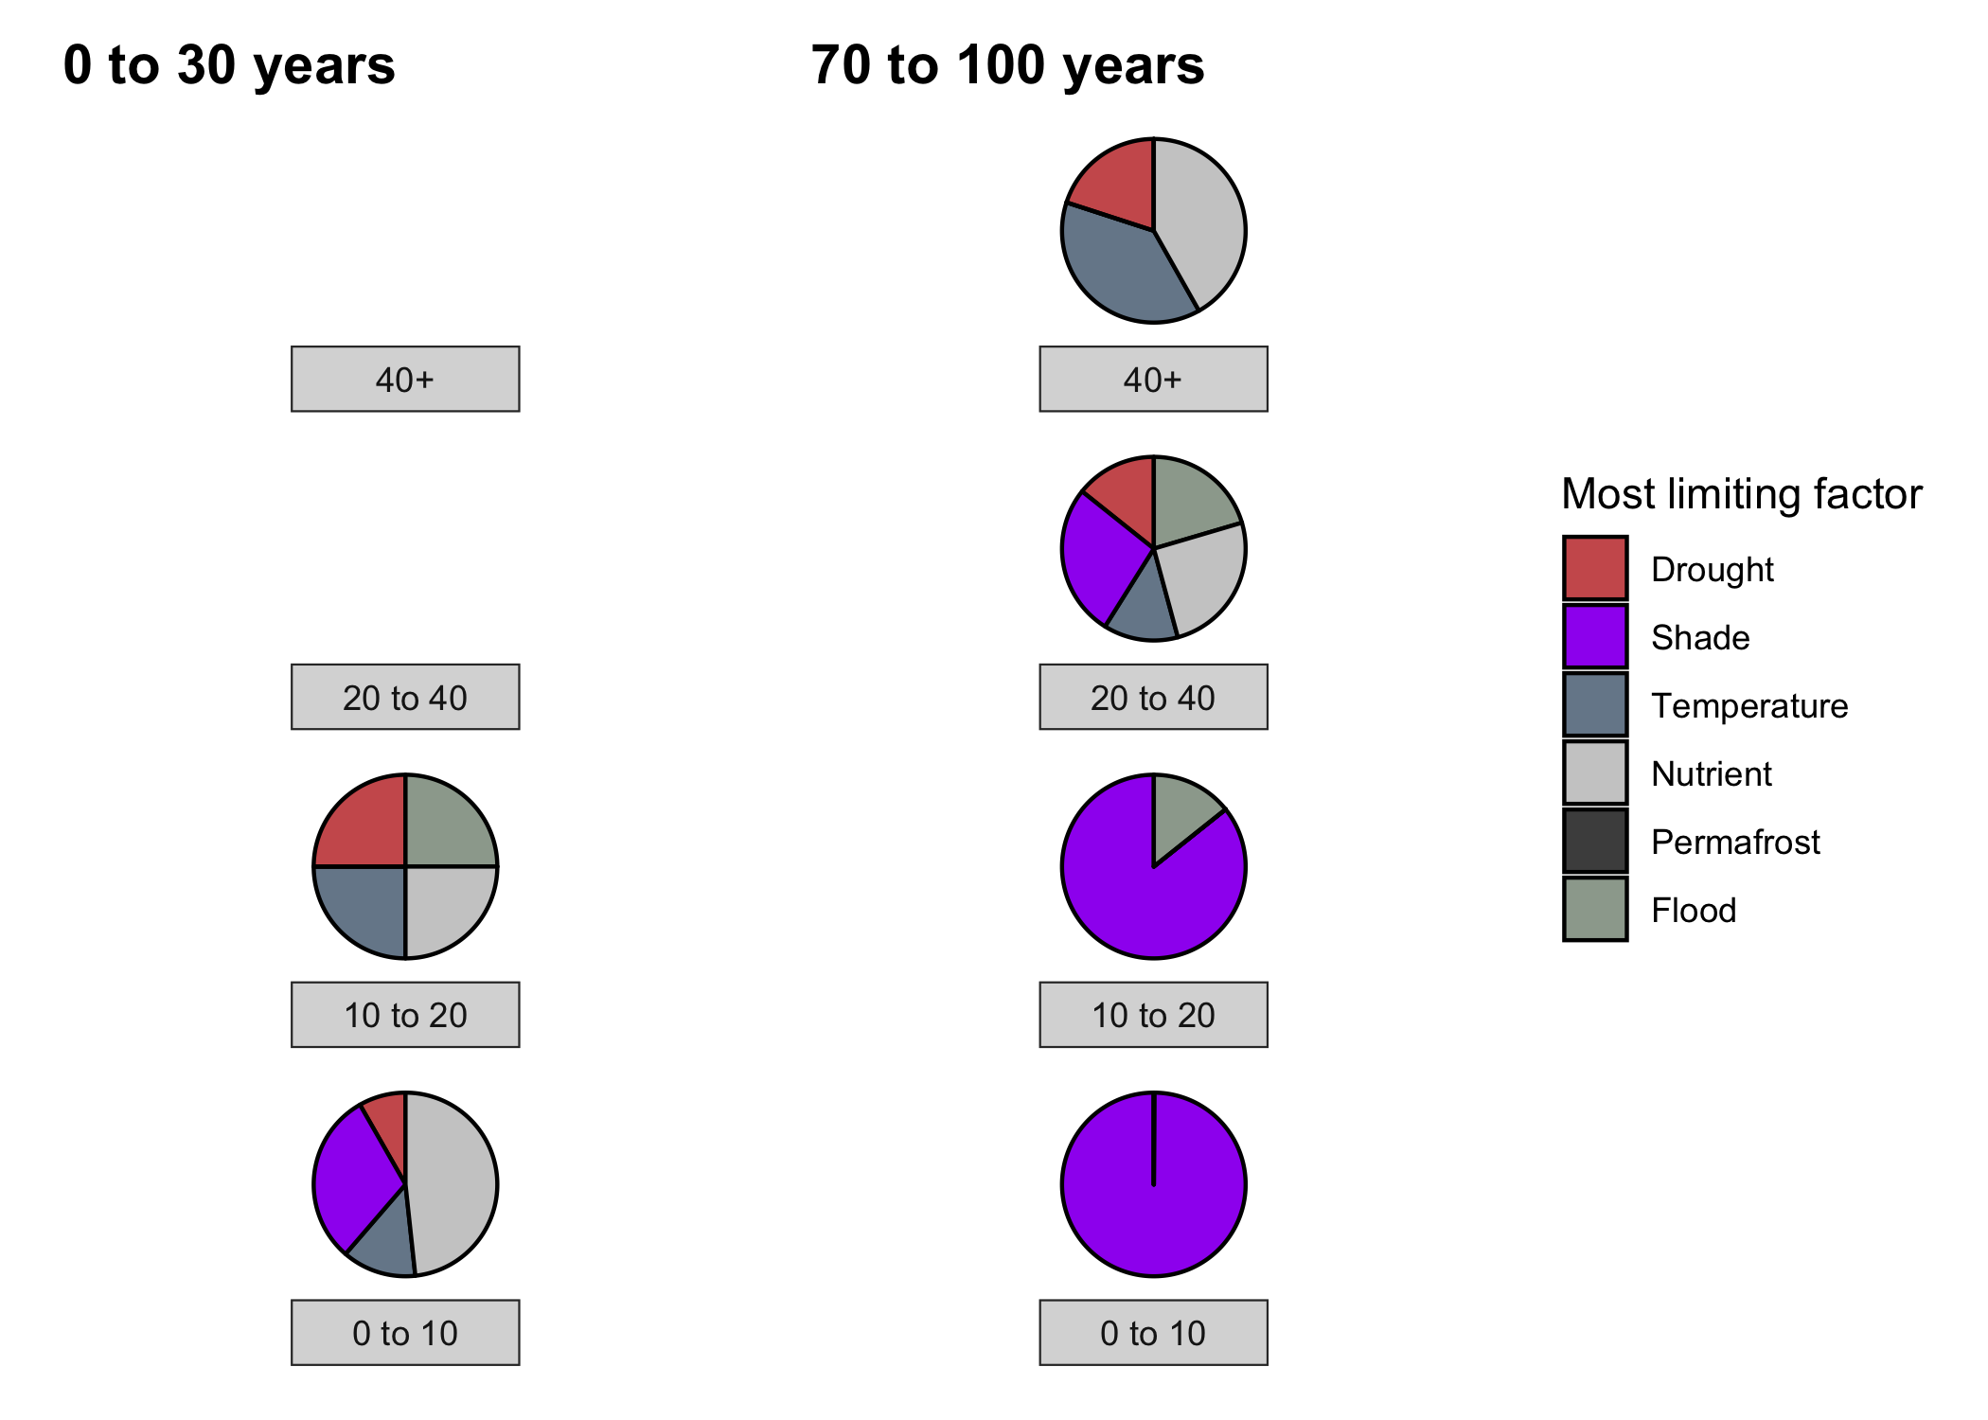
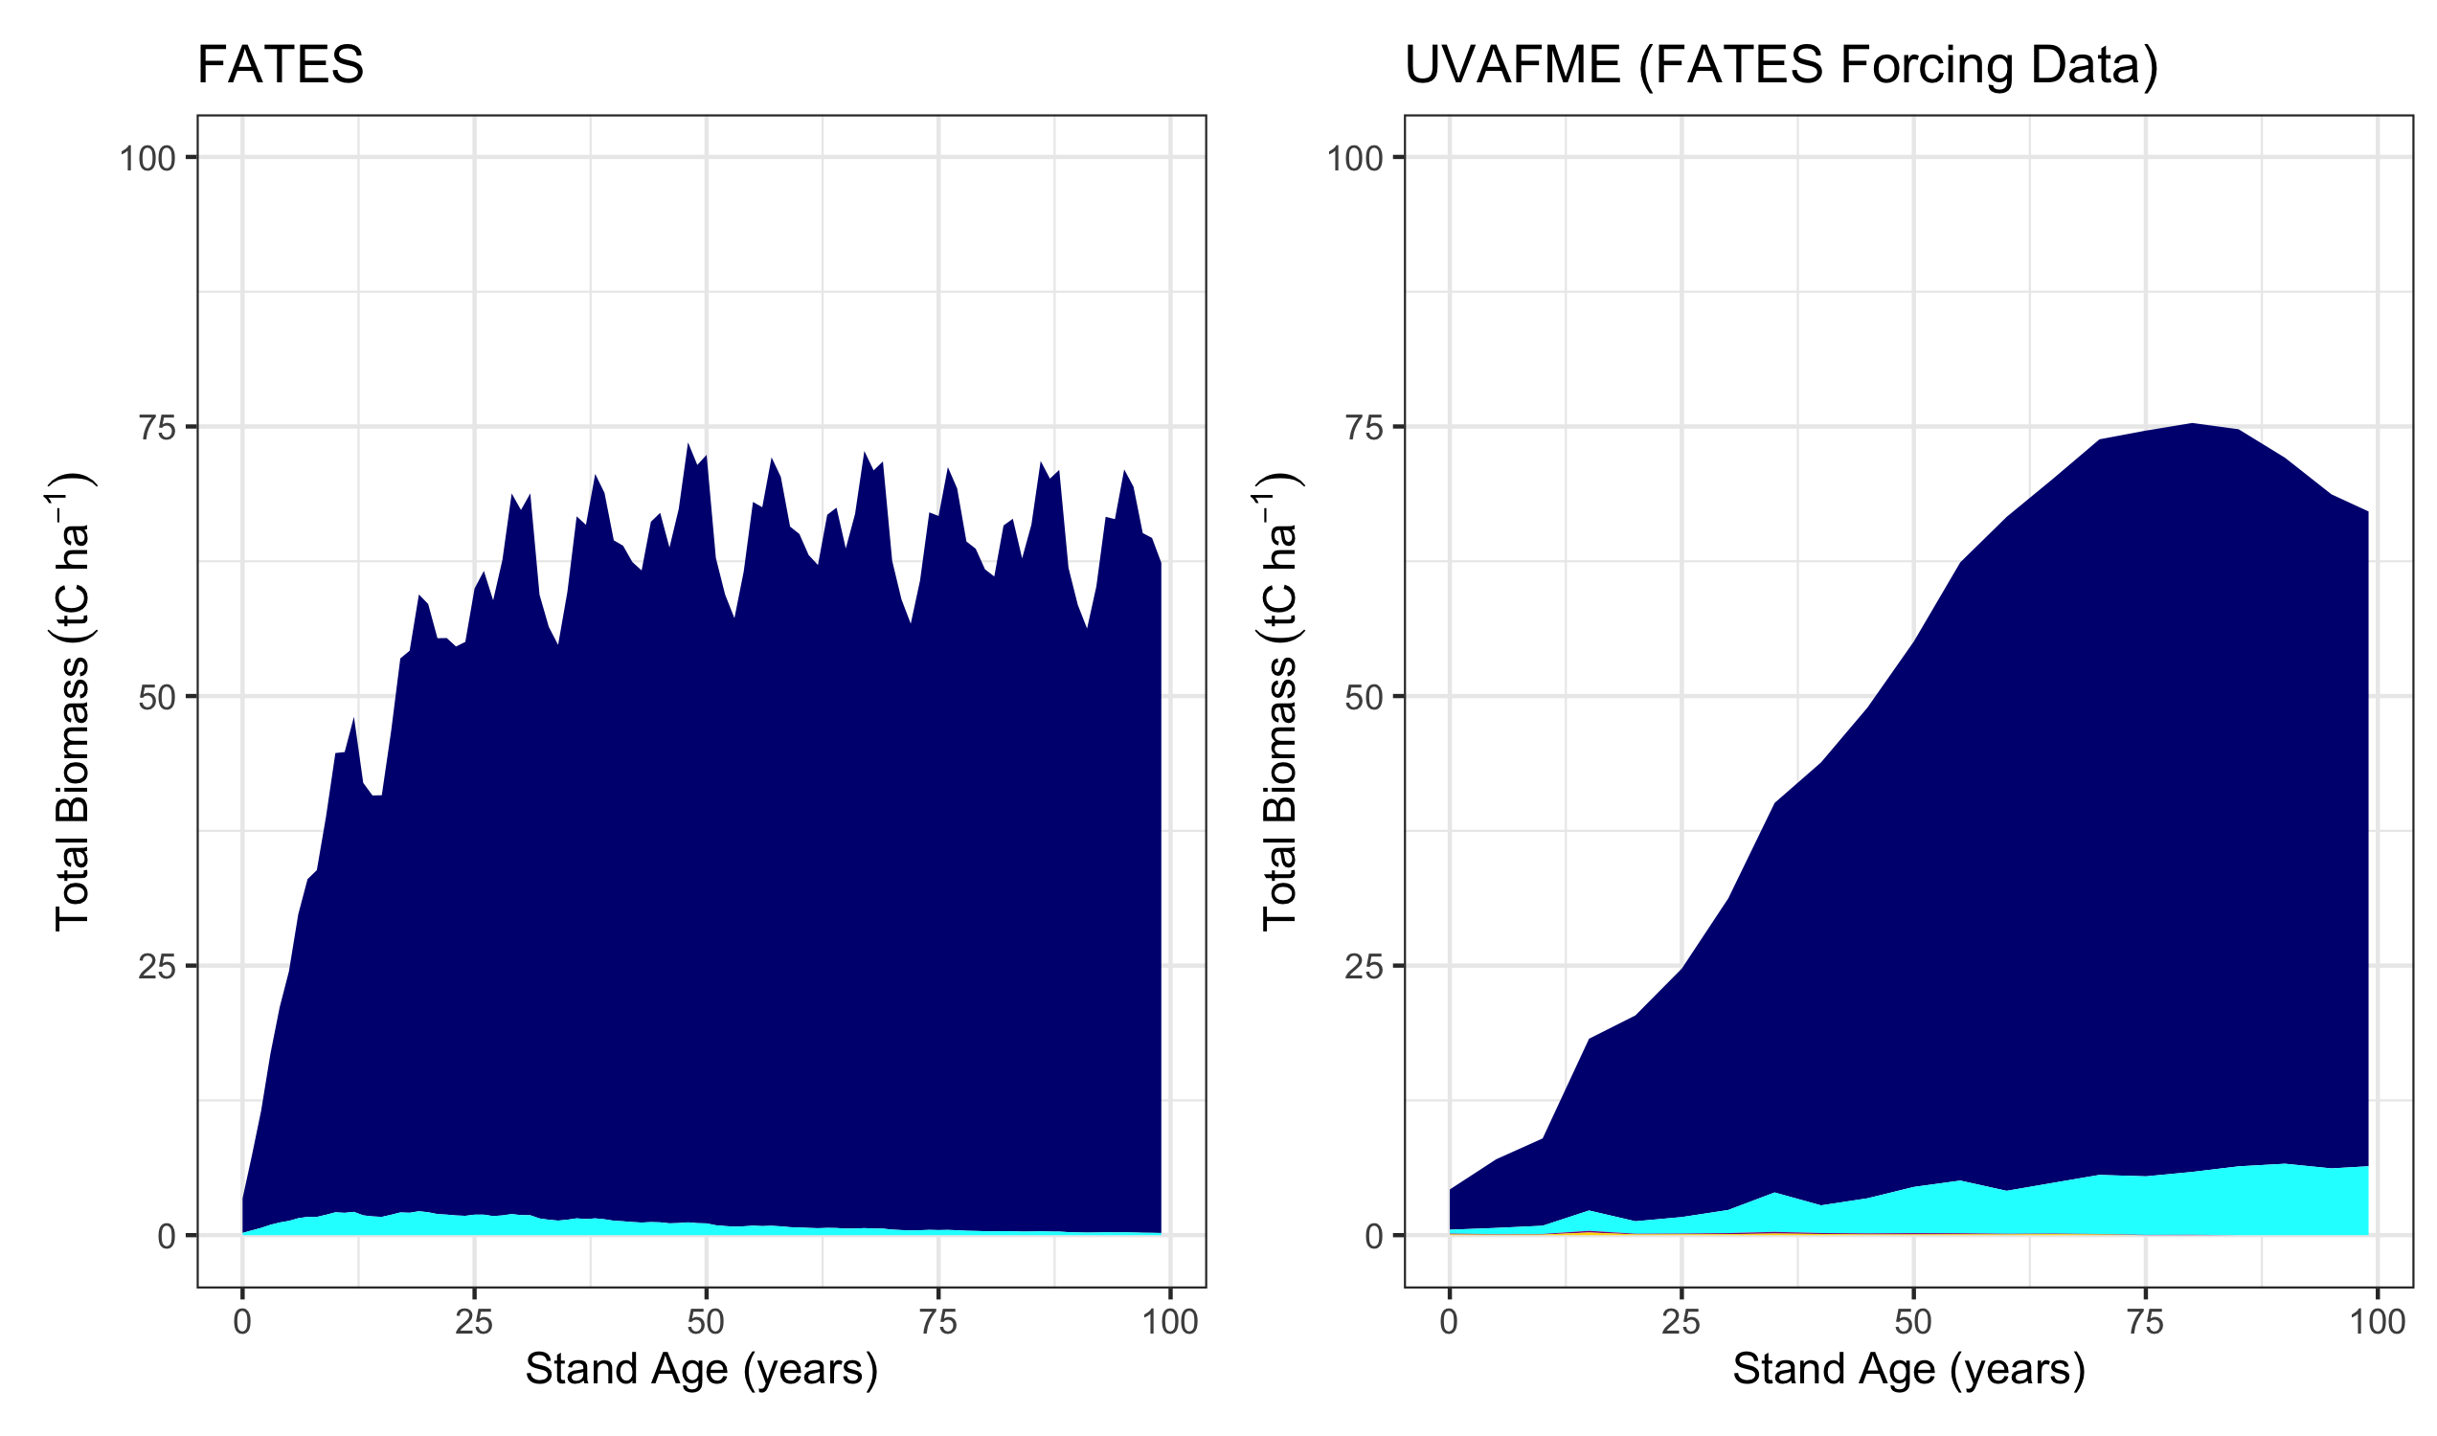
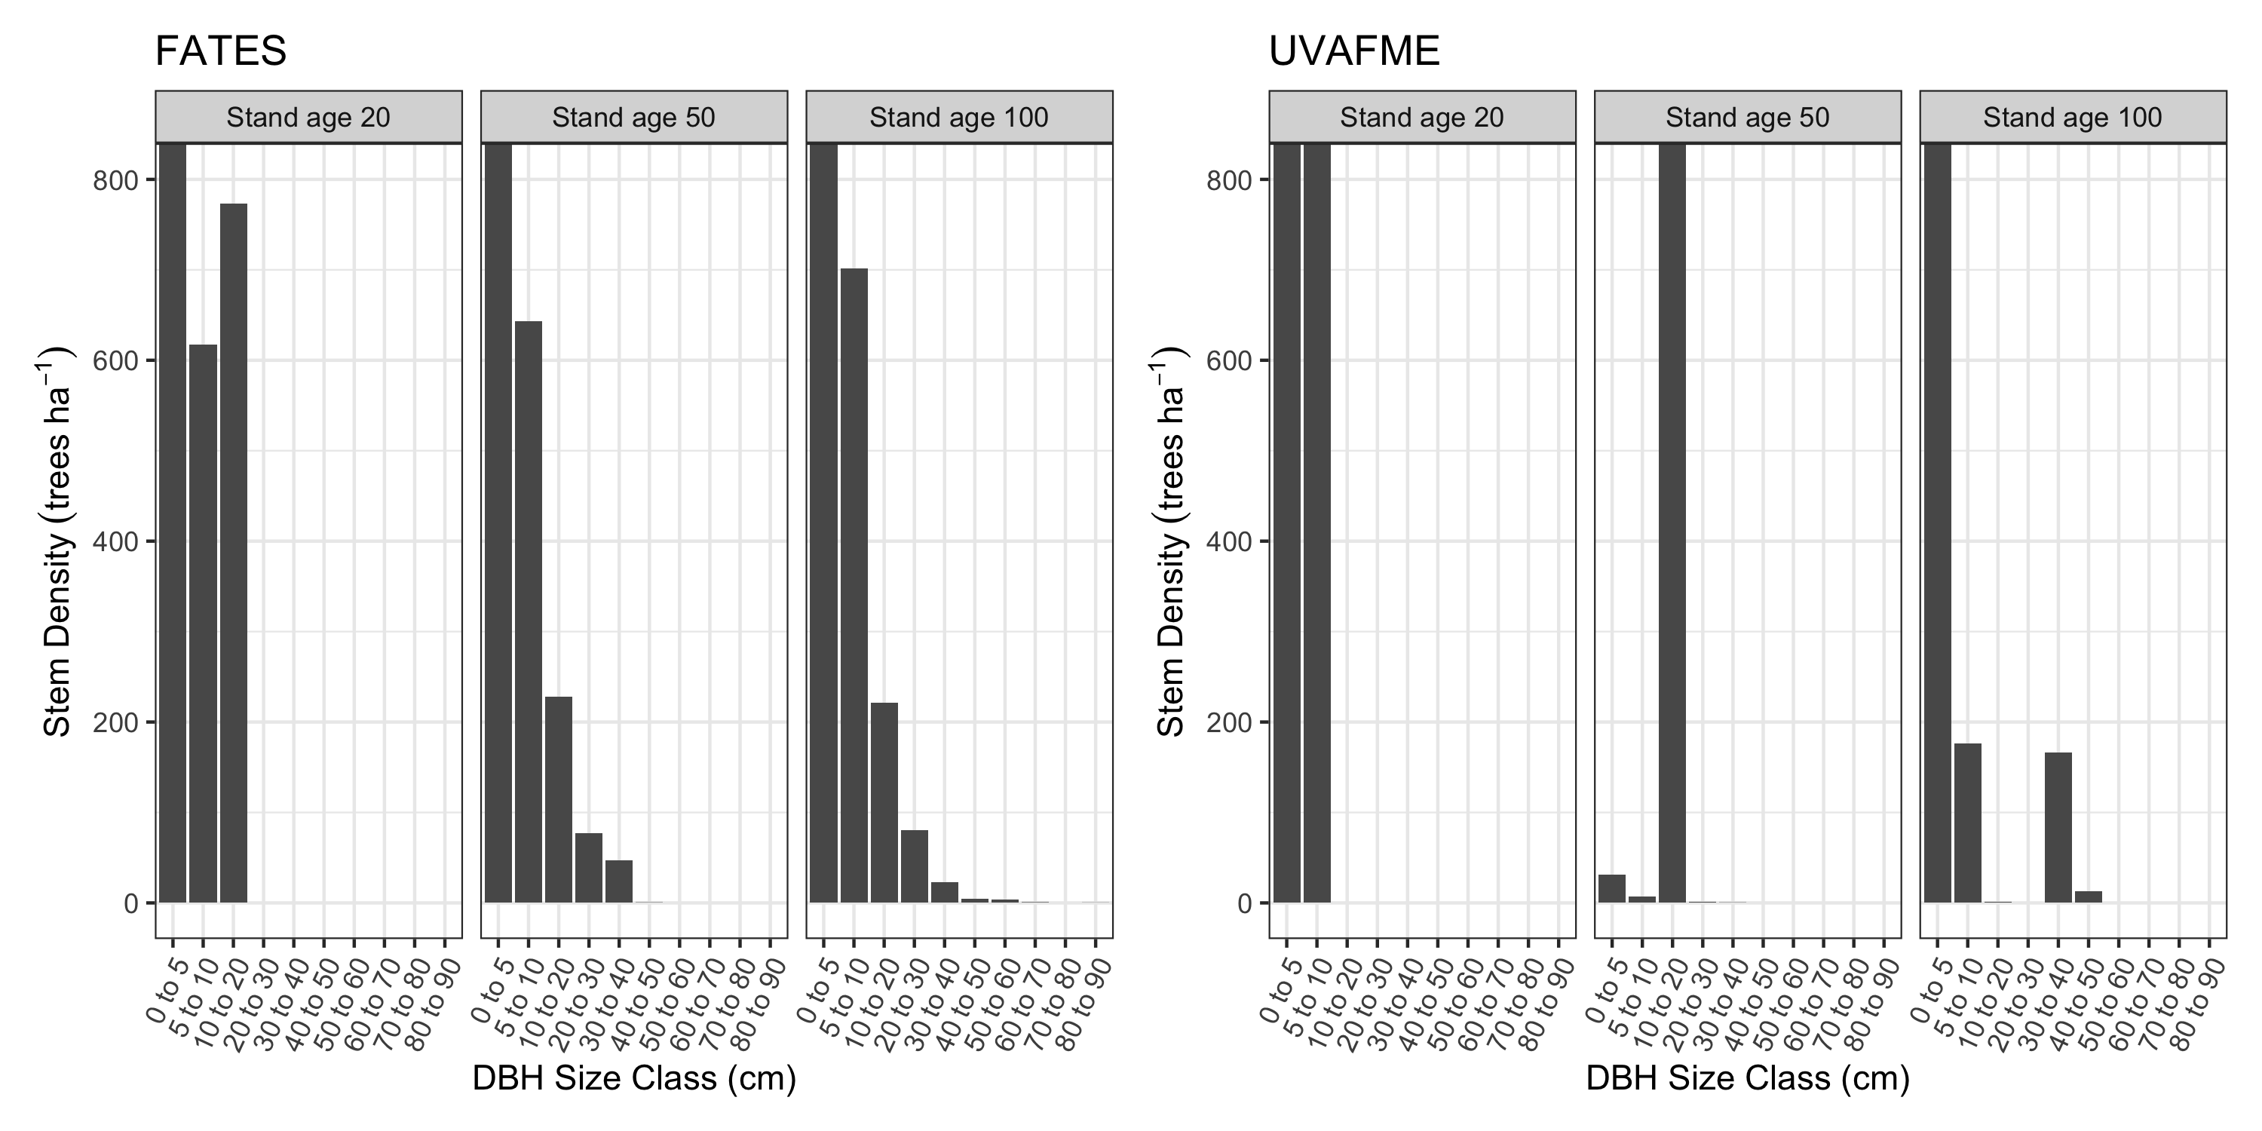
Adrianna Foster, Jacquelyn Shuman
UVAFME
FATES
Mortality drivers
FATES
Stand Age
Stand Age
Young
Old
Young
Old
FATES and UVAFME predict similar biomass trajectories but differ in underlying mortality drivers and stand structure
DBH Size Class (cm) FATES
DBH Size Class (cm) UVAFME
FATES: small trees dominate stands
UVAFME: mixed sizes for older stand ages
black spruce
black spruce
Jack pine
DBH Size class (cm)
DBH Size class (cm)
Notes:
UVAFME (and other Individual based models) use a monte carlo style ensemble of independent patches that operate at the individual tree scale. Soil patches are also independent. So usually around 200 of these pictures here. The forest landscape is then the average across independent patches.FATES uses patches that summarize the dynamics onto a grid cell through creation, aggregation and degradation. FATES has a shared soil column across patches. FATES has distinct patches with many cohorts (limit of 150 cohorts) (groups of similarly sized trees) represented by the colored popsicle stick trees in the picture. Similar patches fuse for computational efficiency.
So FATES is really capitalizing on the average and this aggregation across similar patches. This is why we are comparing the two models. They should be telling the same story, since FATES cohorts should be a depiction of an average from the individual based model. If they are not telling the same story, then UVAFME can help delineate where there is a potential breakdown.
Other differences are that FATES is daily/sub-daily for growth and allocation through photosynthesis. UVAFME operates annually capturing diameter growth increments.
We are hoping to use UVAFME as sort of a "large eddy simulator" for FATES, where we are simplifying many of the processes that are in FATES (i.e. photosynthesis, time scales, etc.), but keeping the more complex parts of UVAFME (i.e. individual trees). UVAFME is able to be run very quickly across broad regions, so we can quickly create verification data for FATES, test new PFT combinations, and test out new model developments (e.g. new fire processes) with UVAFME while we are also improving FATES.

Slide 17
6 COURSE SYNTHESIS TOPICS
INDIVIDUAL-BASED AND PFT MODELS
ABR ecosystem modeling is broadly grouped into two camps: individual-based models and PFT/trait-based models.
$ ED, UVAFME, CLM ⇿ CLM-FATES $
Adrianna Foster, Jackie Shuman, Erik Larson, Shawn Serbin
DRIVERS AND RUN PROTOCOLS
Specification paper needed on agreed-upon model drivers and run protocols for ABR model runs.
$ DAYMET, MESONET, CRU-NCEP, GSWP $
Dave Moore, Min Chen, Erik Larson, Kevin Schaefer, Nick Parazoo
ABOVE DATA FOR MODELS
Deep dive into entire ABoVE database. Extraction of functional relationships and benchmarks.
$ UNCERTAINTY, INTEGRATION $
Josh Fisher, Dan Hayes, Andy Fox, Shawn Serbin
canva
page 2 of 2

Slide 18
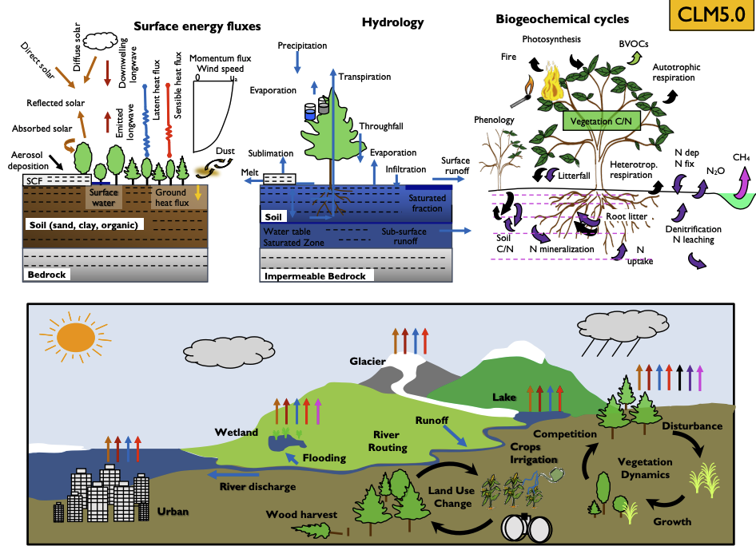
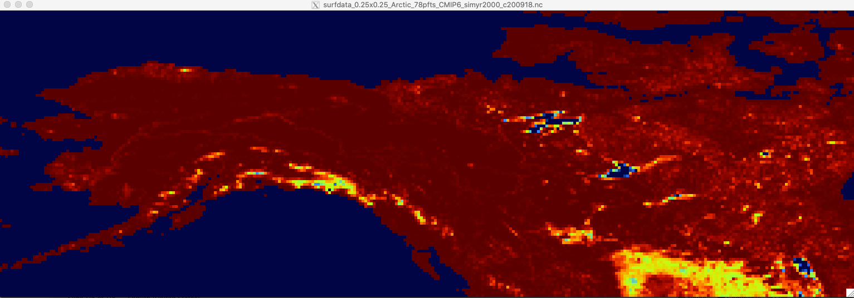
High-Res Regional DART-CLM Experiment Setup
Community Land Model
  Model : PPE-ctsm5.1.dev012
  Resolution: 0.25 degree
  Forcing Data: CAM6 reanalysis forcing data (0.9x1.25 degree)
  Number of Ensembles: 80
  Time : 2011 Jan to 2019 December
  Model Mode: BGC-CROP
Generate 0.25-deg surface dataset
The right bottom figure shows one variable in the surface dataset
Spin up model for 1080 years
Start from the default model initial condition and use the new forcing to spin the model up until the carbon equilibrium is reached
(0.25-deg percent of natural vegetation)
Generate ensemble spread
All the ensemble starts from the same initial condition achieved by the spin-up, and cycle for several rounds.
Investigate observation to assimilate
MODIS LAI (8-day, 500m in the same period)
Wang’s Biomass (annual, 30m, only covers shrub and forest area in the region)

Slide 19
Modeling experiments on the impacts at different levels of climate change (Min Chen)
Focused period: 2015-2100
Climate Change Scenarios: SSP126, SSP245, SSP370, SSP585
Forcing Data: Bias-corrected climate projections from the Inter-Sectoral Impact Model Intercomparison Project (ISIMIP)
  Daily data was originally provided, and we have downscaled to 6-hourly time scale
Modeling Experiments
  Optimized model with ABoVE data vs unoptimized model
  Spatial domain: global
  Output variables: Net Ecosystem Productivity/Exchange, Albedo, Net methane flux, fire carbon emission if available
  Output temporal resolution: annual

Slide 20
SIF-MIP (Parazoo, Orcutt)
Our MIP goal is more of a tower synthesis focused on SIF and GPP modeling across ABoVE flux towers. Our basic protocol, following our study at Niwot Ridge, is below:
1. Focus on evergreen sites in Alaska and Canada, with minimum of 1 site (PFF) and others if possible (OBS, TVC, SCC, DEJU, BON)
2. Use standardized meteorological forcing from towers (provided by Erica), and set PFT = ENF if available
3. Output APAR, Top of Canopy SIF at 740 nm, and GPP every hour from 2017 on (corresponding with CFIS, Photospec, and TROPOMI SIF data). Other state variables are encouraged!
4. Within model experiments are welcome and encouraged (e.g., with / without data assimilation, different process representation, etc)
5. Spinup and data constraints (e.g., prescribed vegetation) at PI discretion

Slide 21
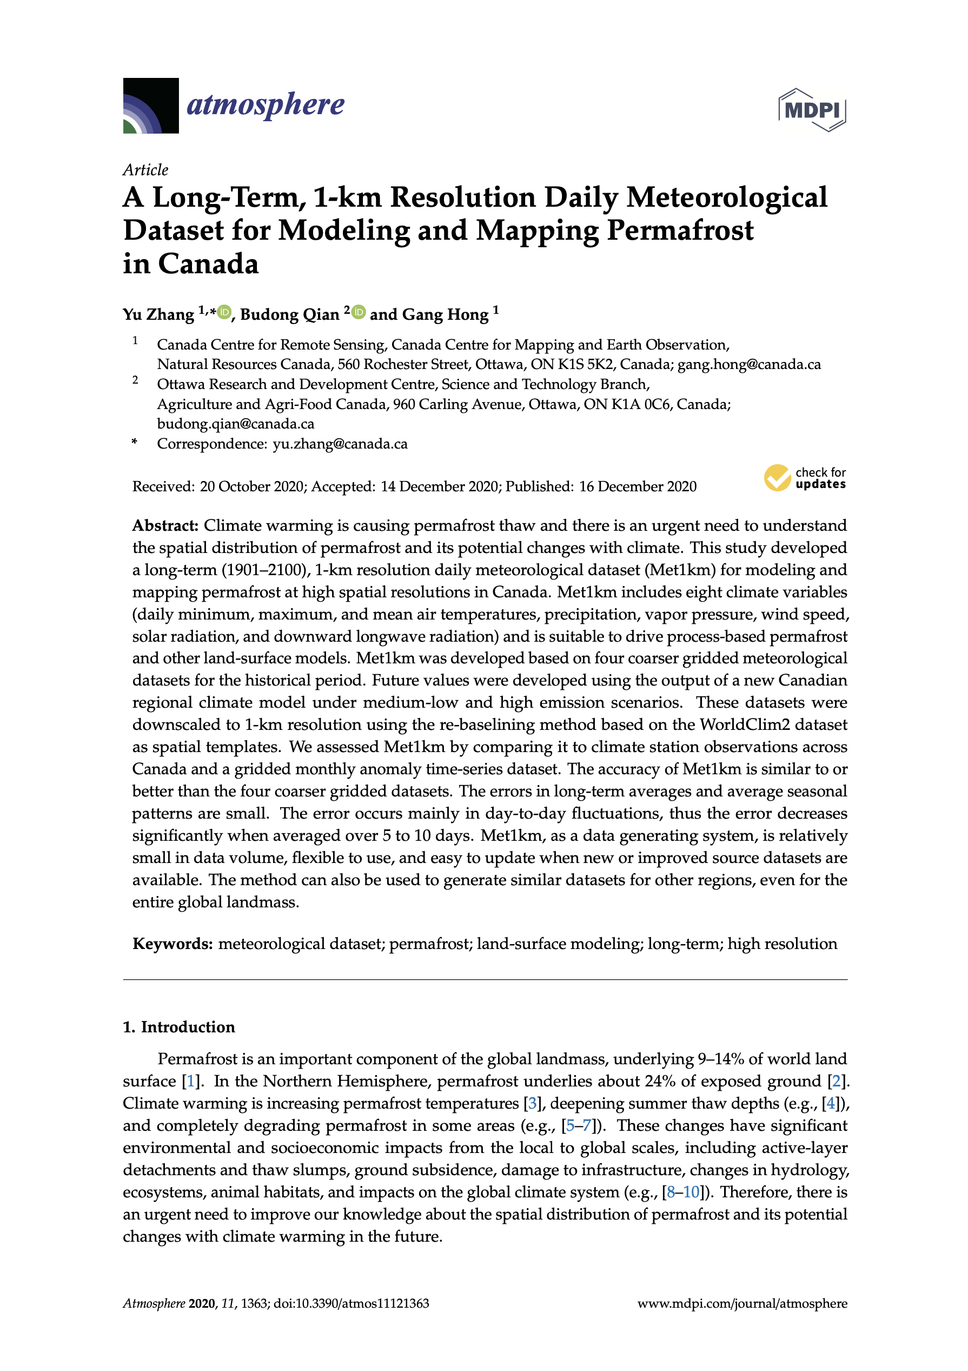
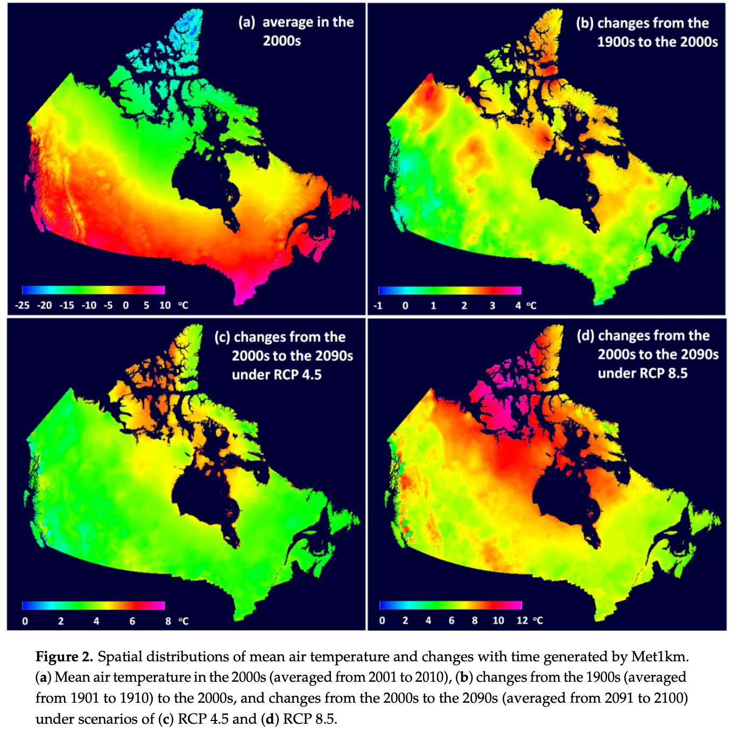
Daily meteorological dataset from 1901 to 2100 at 1-km resolution with eight climate variables (Met1km) for modelling and mapping permafrost in Canada (Alaska is included but not assessed) (Zhang et al., 2020).

Slide 22
6 COURSE SYNTHESIS TOPICS
INDIVIDUAL-BASED AND PFT MODELS
ABR ecosystem modeling is broadly grouped into two camps: individual-based models and PFT/trait-based models.
$ ED, UVAFME, CLM ⇿ CLM-FATES $
Adrianna Foster, Jackie Shuman, Erik Larson, Shawn Serbin
DRIVERS AND RUN PROTOCOLS
Specification paper needed on agreed-upon model drivers and run protocols for ABR model runs.
$ DAYMET, MESONET, CRU-NCEP, GSWP $
Dave Moore, Min Chen, Erik Larson, Kevin Schaefer, Nick Parazoo
ABOVE DATA FOR MODELS
Deep dive into entire ABoVE database. Extraction of functional relationships and benchmarks.
$ UNCERTAINTY, INTEGRATION $
Josh Fisher, Dan Hayes, Andy Fox, Shawn Serbin
canva
page 2 of 2

Slide 23
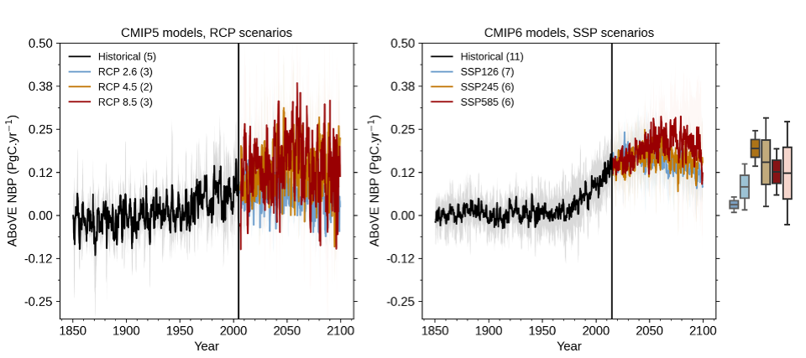
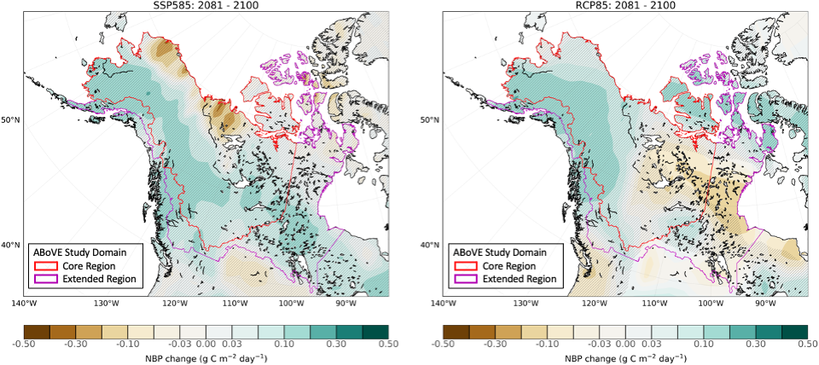
CMIP6 carbon cycle uncertainties in Arctic-Boreal ecosystems
Renato K. Braghiere, Joshua B. Fisher, Cody Nguyen, Gina M. Gerlich

Slide 24
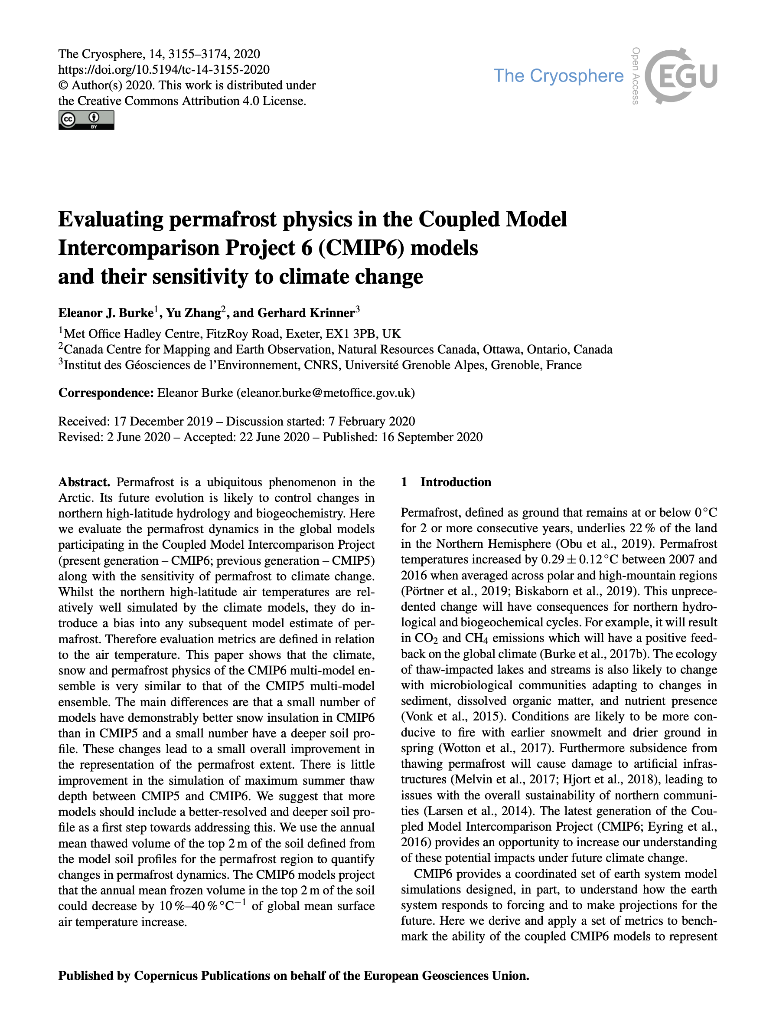
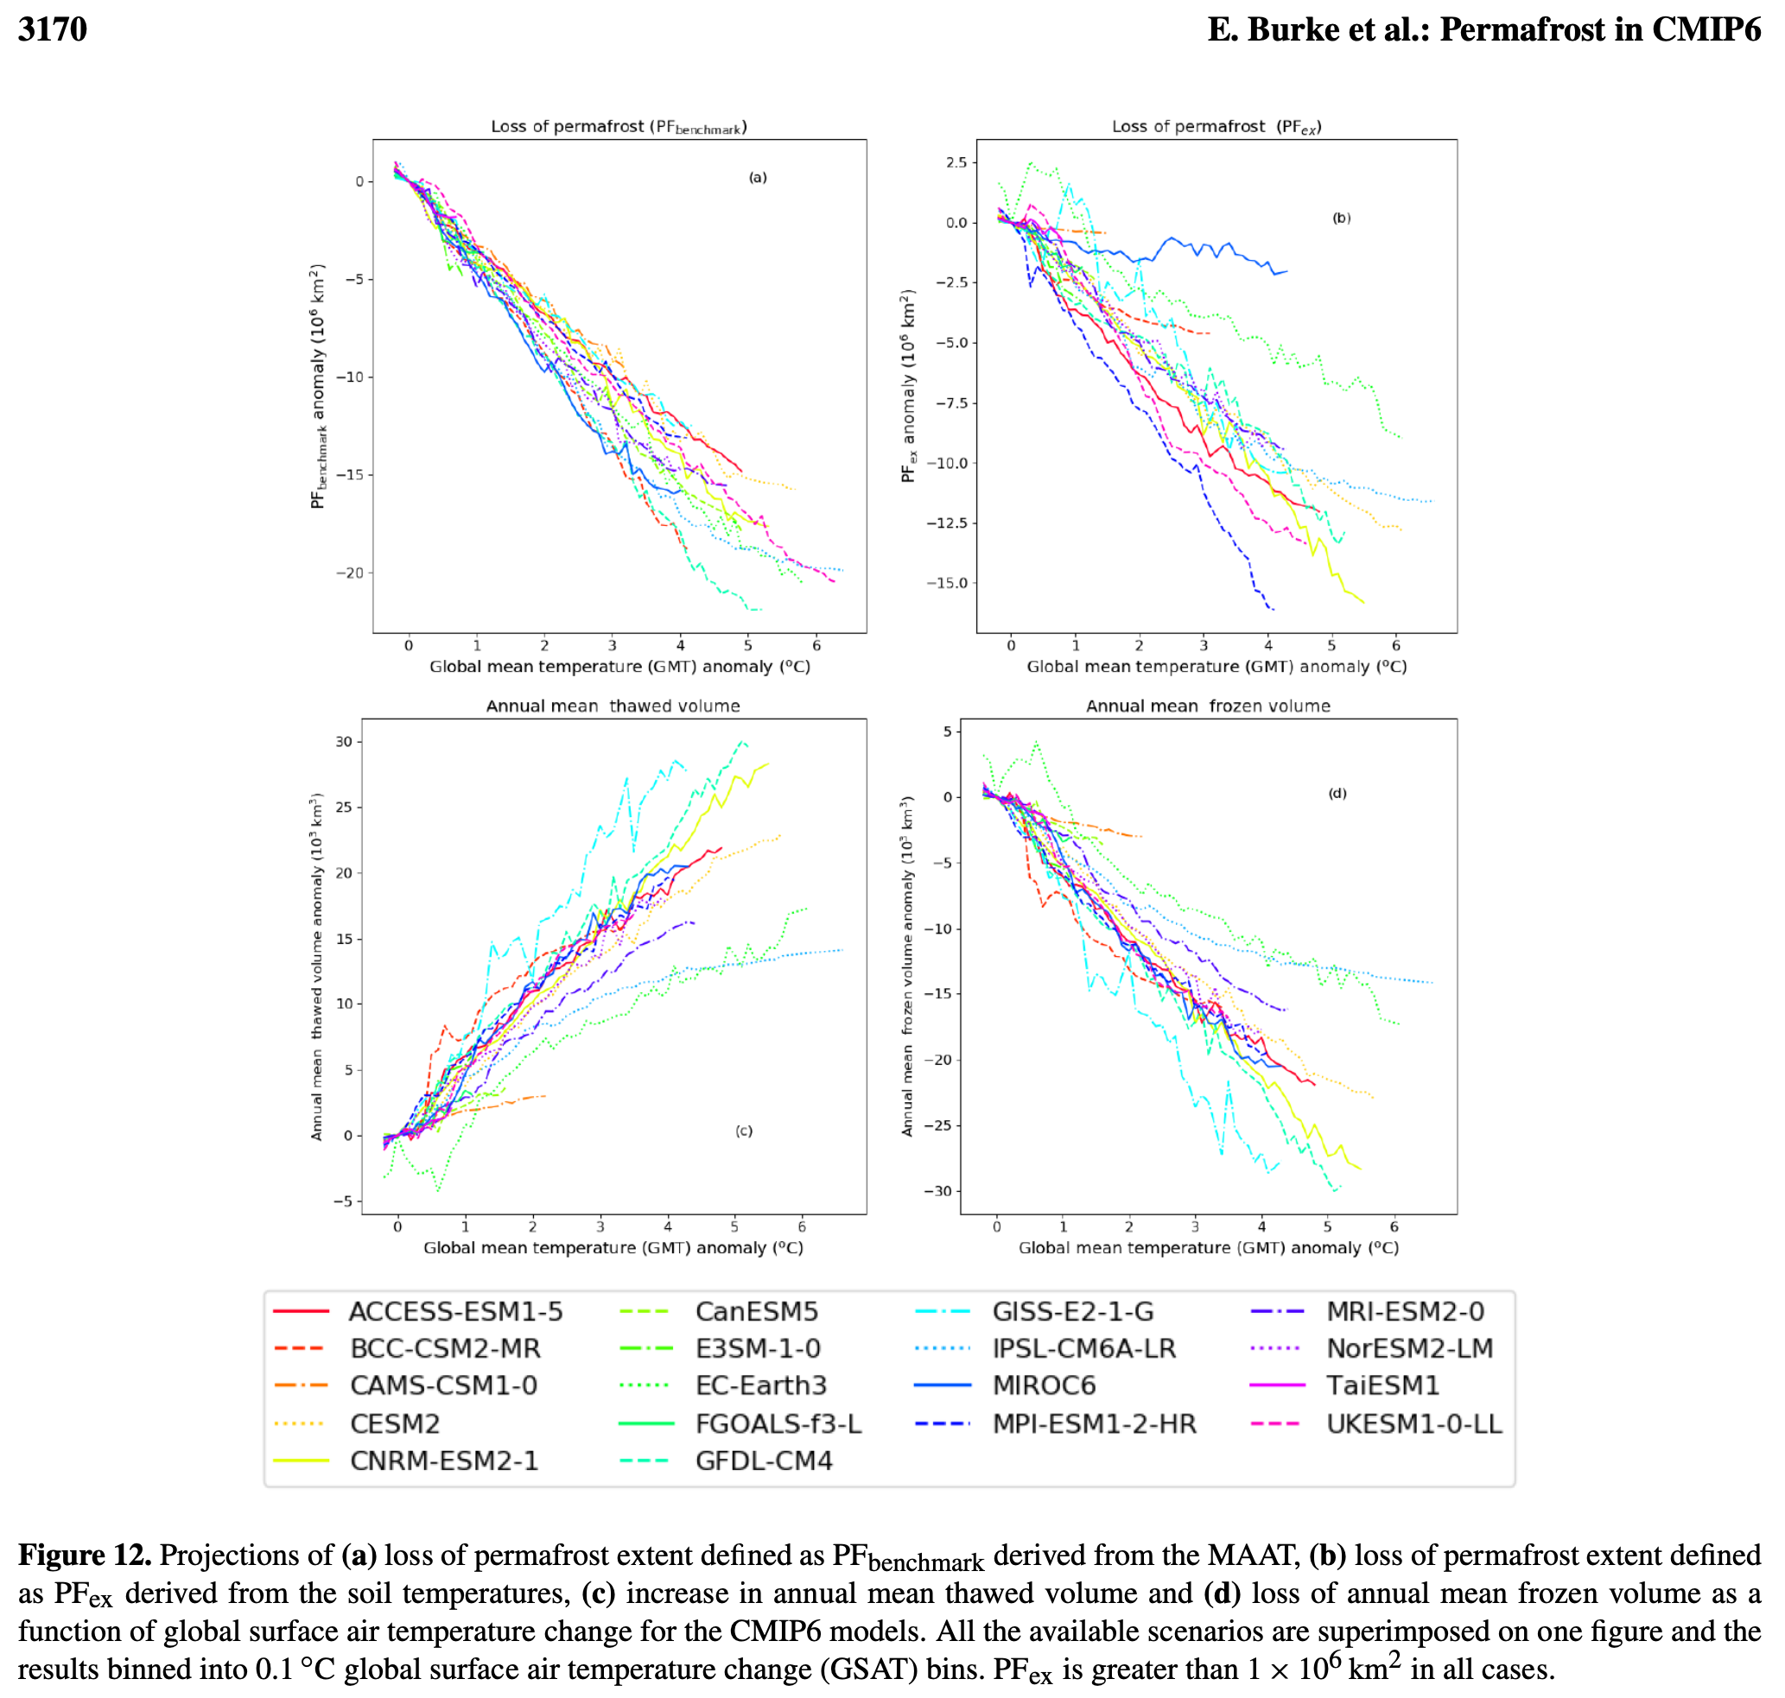
Evaluated permafrost simulations in 18 global climate models in CMIP6. The present global climate models are very similar to the previous generation (CMIP5) in permafrost simulations with some improvements in snow insulation, ground profile, and permafrost extent (Burke et al., 2020).

Slide 25
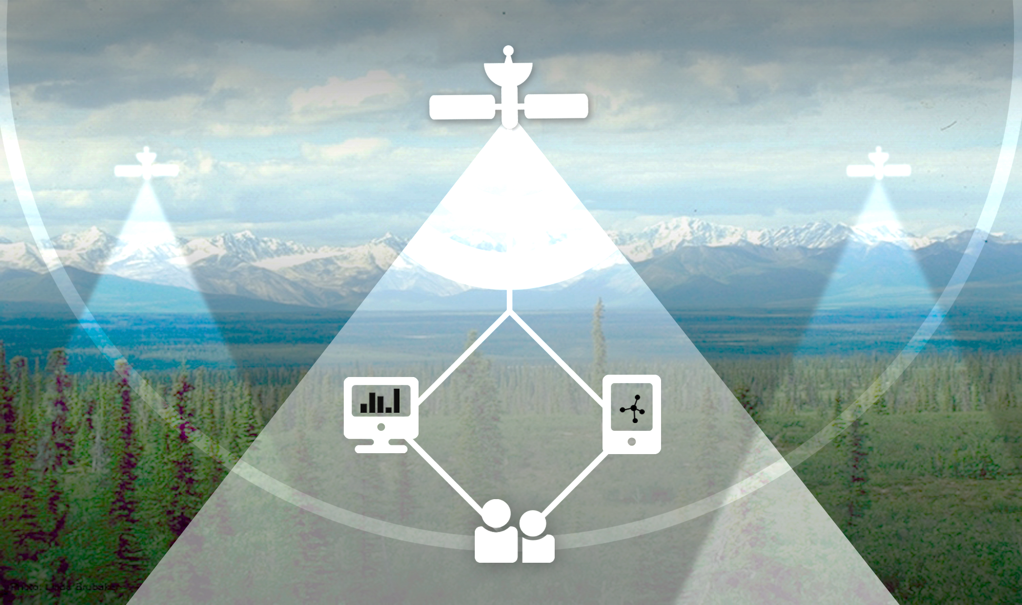
The NASA ABoVE Database:
Uncovering Functional Responses Among the Hundreds of In Situ, Airborne, and Satellite Datasets
Joshua B. Fisher
Cody Nguyen, Gina Gerlich, Renato Braghiere, Daniel Hayes, Wouter Hantson, Deborah N. Huntzinger,
ABoVE Data Contributors
Notes:
Bridge
Bridge to future

Slide 26
Notes:
A live list of measurements being collected in ABoVE as of this writing can be found online (above.nasa.gov/cgi-bin/above_meas.pl). Synthesis activities across projects, especially, can help integrate datasets within modeling frameworks.

Slide 27
Data-to-model: scaling
Notes:
A particular strength of ABoVE for modeling is that there is a concerted effort to scale up site level data through airborne and satellite observations (see: above.nasa.gov/images/Scaling%20Diagram_169.jpg). This allows an improved direct comparison between the coarse model pixels and the ground data.

Slide 28
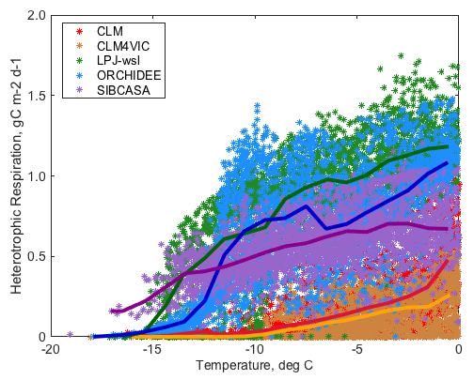
Functional Relationships
Huntzinger, Schaefer

Slide 29
Functional Relationships from the ABoVE Database
6 Airborne Science
6 Carbon Dynamics
9 Fire Disturbance
13 Hydrology & Permafrost
41 Vegetation
3 Wildlife
> 5000 variables

Slide 30
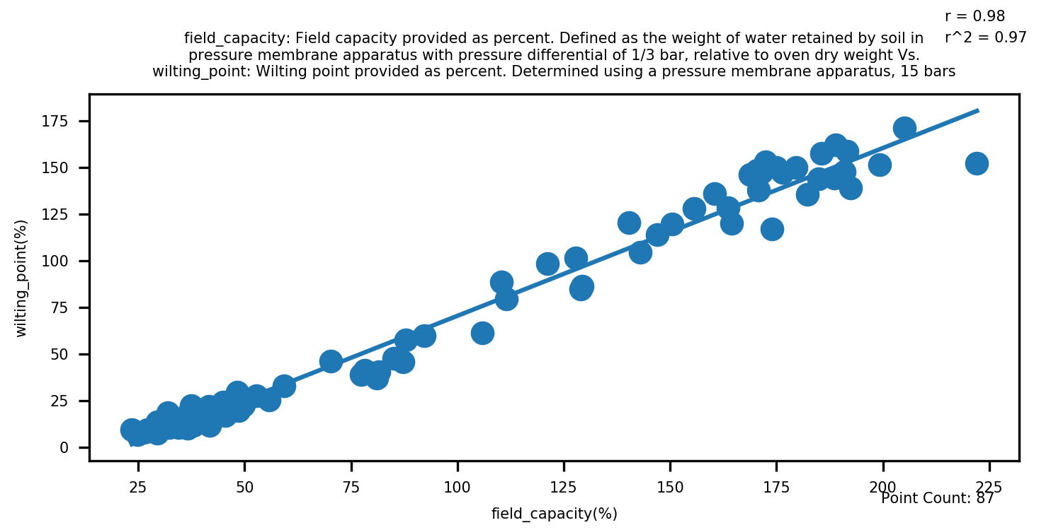
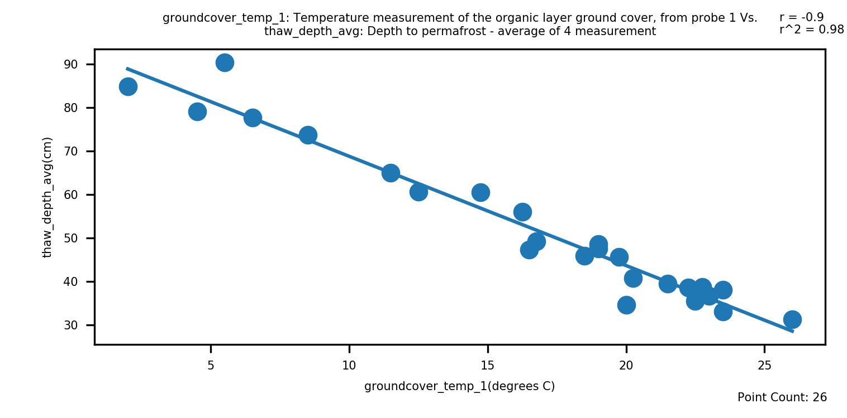
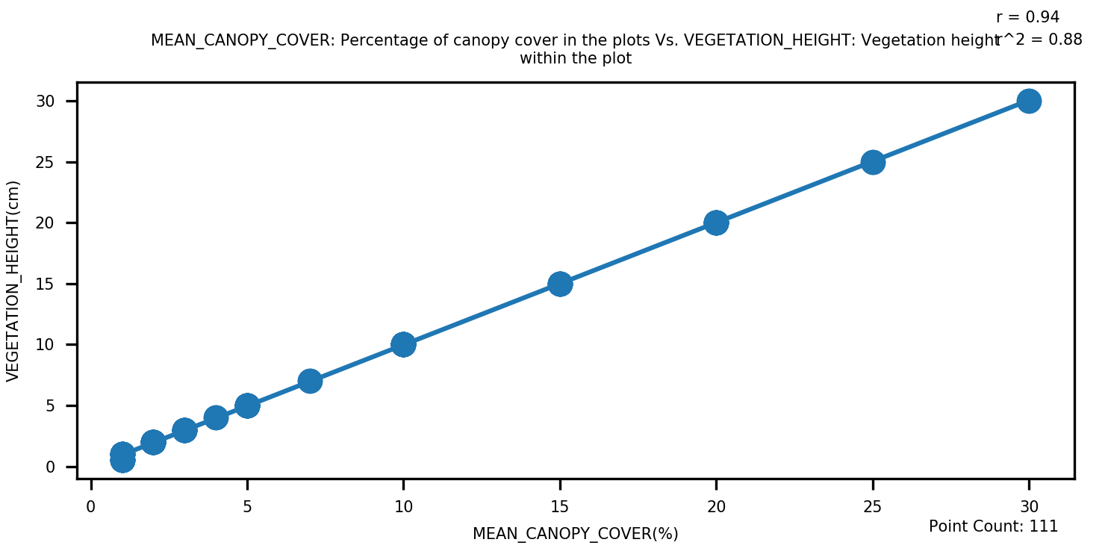
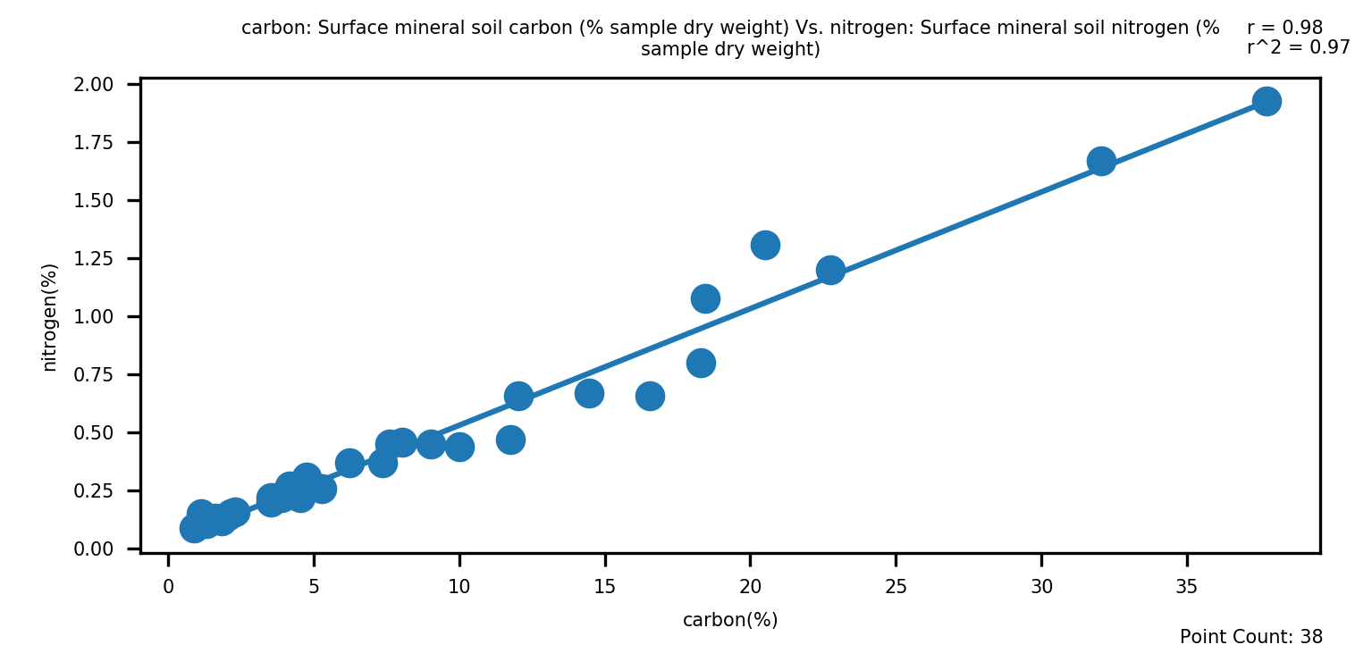
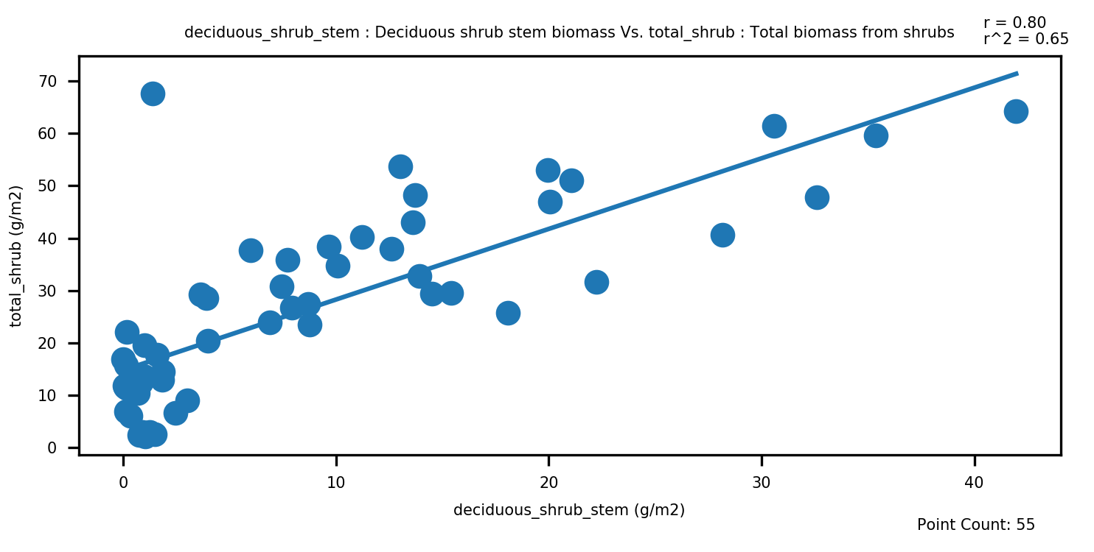
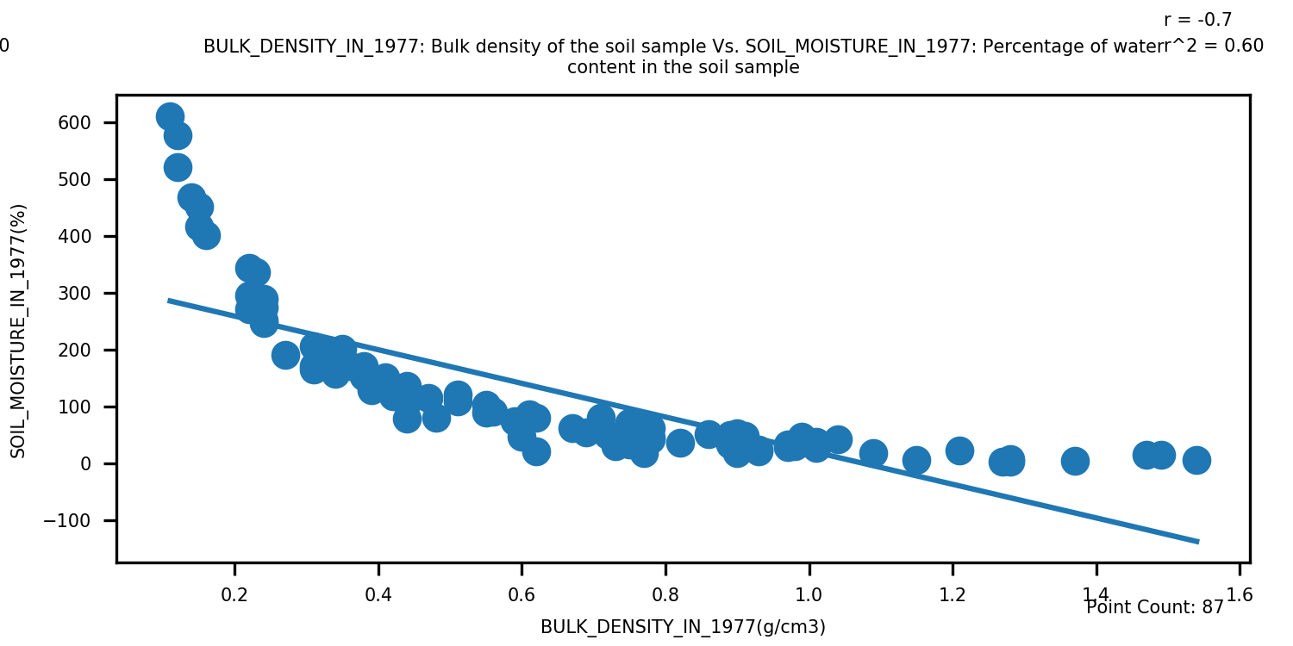
field capacity vs. wilting point | ground temperature vs. thaw depth | canopy cover vs. vegetation height
Hydrology | Permafrost | Vegetation Dynamics
soil carbon vs. soil nitrogen | stem biomass vs. total biomass | bulk density vs. soil moisture
Biogeochemistry | Carbon Allocation | Non-linear Physical Properties

Slide 31
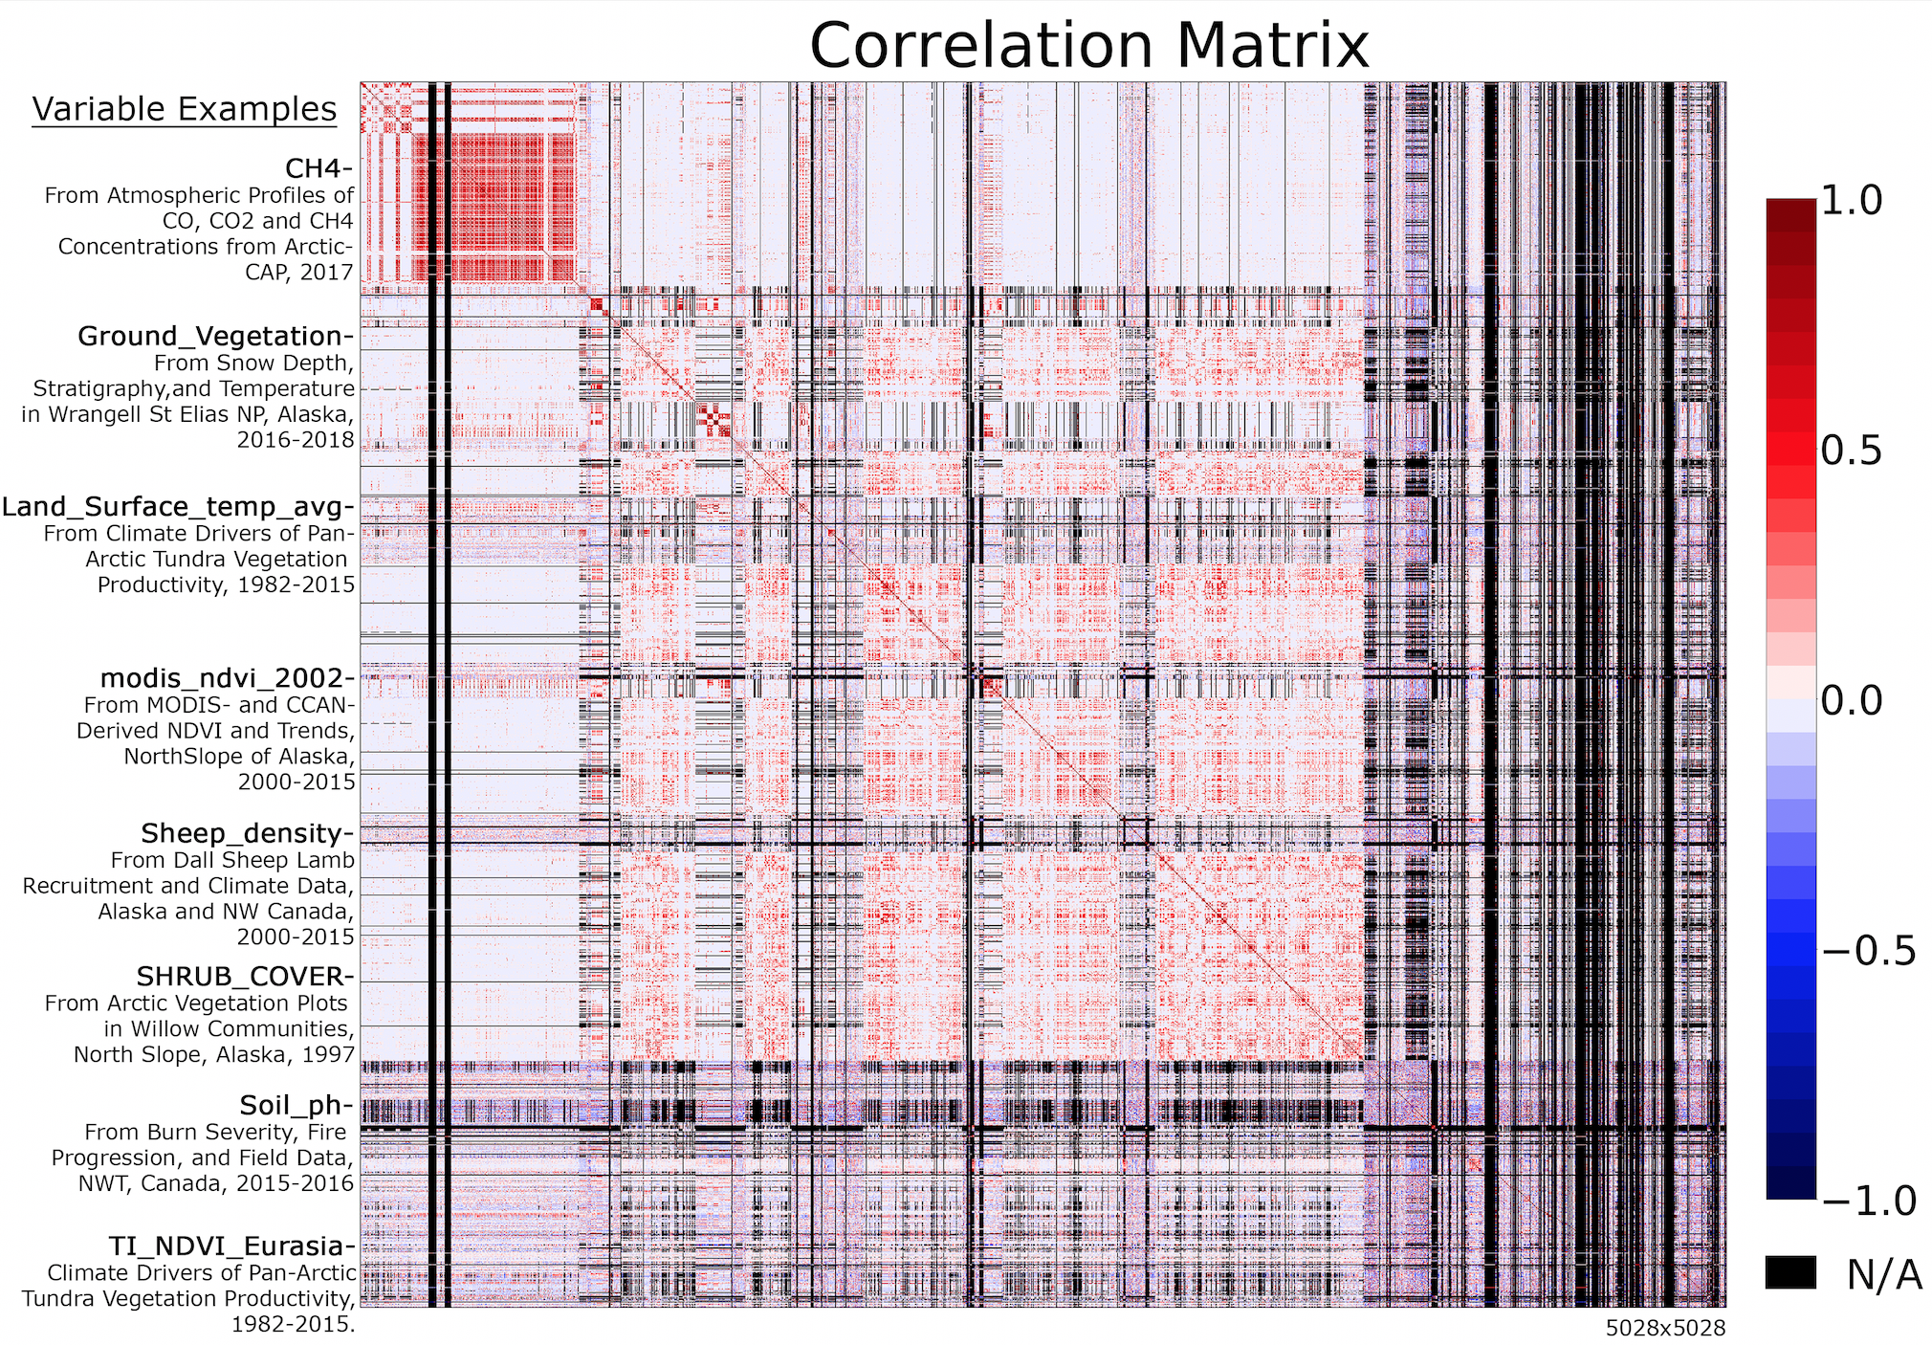

Slide 32
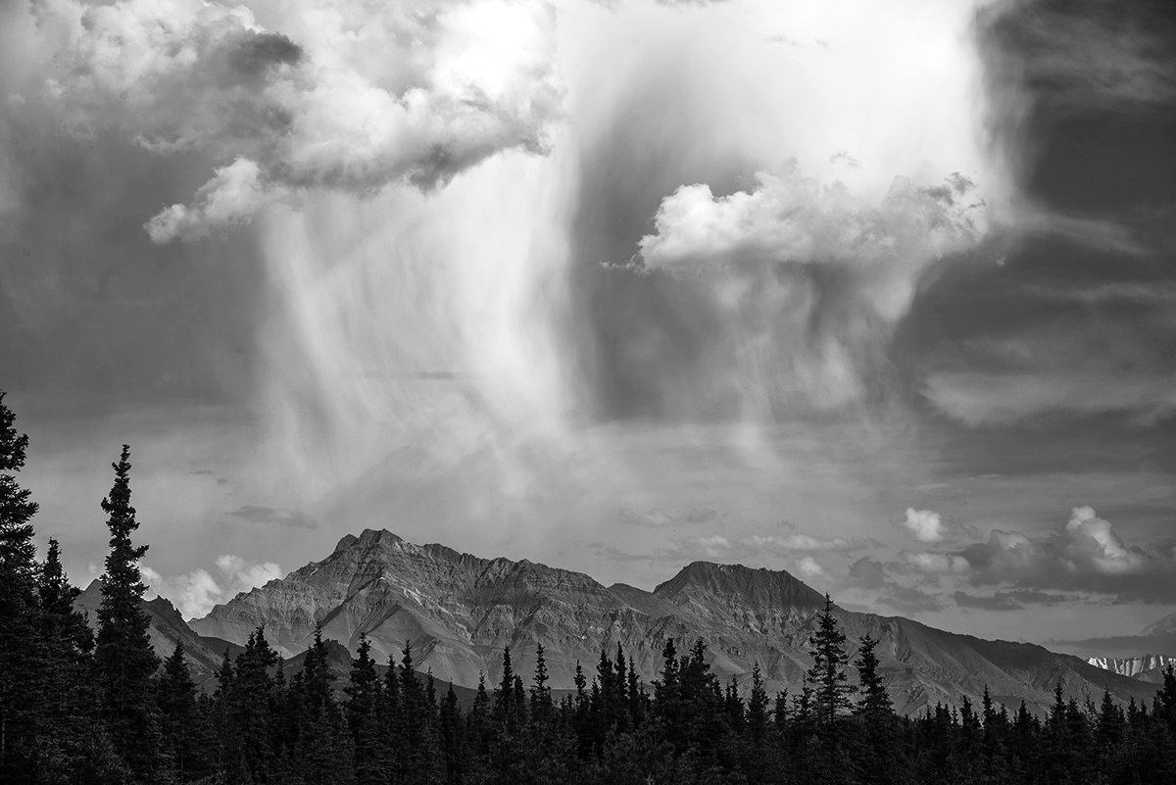
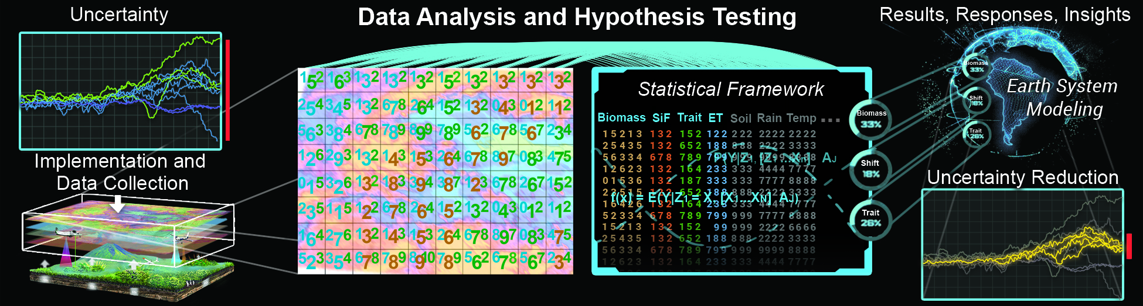
Integration of Functional Relationships into Earth System Models

Slide 33

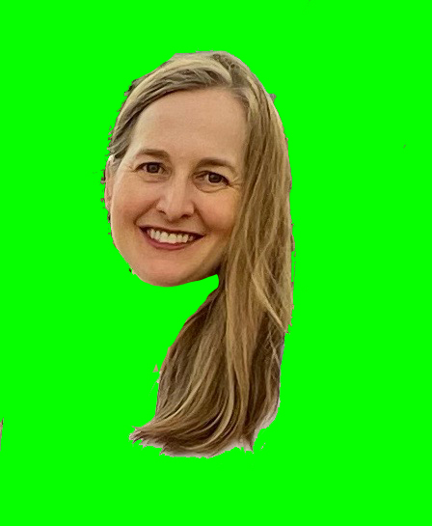
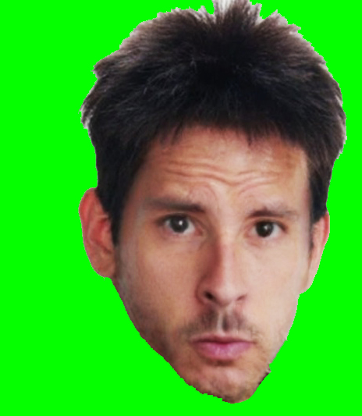
ABoVE Modeling Working Group
Joshua B. Fisher (NASA/JPL | WG Lead)
Amanda armstrong (U.Virginia)
KAZEM BAKIAN DOGAHEH (USC)
LEAH BIRCH (WcRC)
RENATO BRAGHIERE (nasa/JPL)
BRENDAN BYRNE (nasa/JPL)
ABHISHEK CHATTERJEE (NASA/GSFC)
MIN CHEN (PNNL)
ROISIN COMMANE (COLUMBIA U.)
ADRIANNA FOSTER (NAU)
ANDY FOX (U.ARIZONA)
ANNA GAGNE-LANDMANN (U. laval)
JOHN GAMON (U.Alberta)
HéLÈNE GENET (I.ARCTIC BIOLOGY)
Scott Goetz (NAU)
Daniel Hayes (U.Maine)
JOHN HENDERSON (AER)
Lei Hu (noaa)
Deborah Huntzinger (NAU)
Elchin Jafarov (LANL)
Aleya Kaushik (noaa)
RALPH KEELING (SCRIPPS)
John Kimball (U.Montana)
ERIK LARSON (HARVARD U.)
PHIL MARSH (WILFRID LAUERIER U.)
Chip Miller (NASA/JPL)
Dave moore (u.arizona)
BILL MUNBGER (HARVARD U.)
Walt Oechel (SDSU)
NICK PARAZOO (NASA/JPL)
Mark Piper (U.Colorado)
Chris Potter (NASA/Ames)
BEN POULTER (NASA/GSFC)
David Price (NoFC)
Brendan Rogers (WcRC)
Kevin Schaefer (NSIDC)
LUKE SCHIFERL (HARVARD U.)
Christopher Schwalm (WHRC)
Hank Shugart (U.Virginia)
Jackie Shuman (U.Virginia)
Eric Stofferahn (NASA/JPL)
PETER THORNTON (ORNL)
PHIL TOWNSEND (U.WISCONSIN)
Anna virkkala (WcRC)
JENNIFER WATTS (WcRC)
Stan Wullschleger (DOE/ORNL)
Yu Zhang (CCMEO)
ZHEN ZHANG (U.MARYLAND)
Above- modeling group working.
(not the ABoVE Modeling Working Group)

