Slide 1
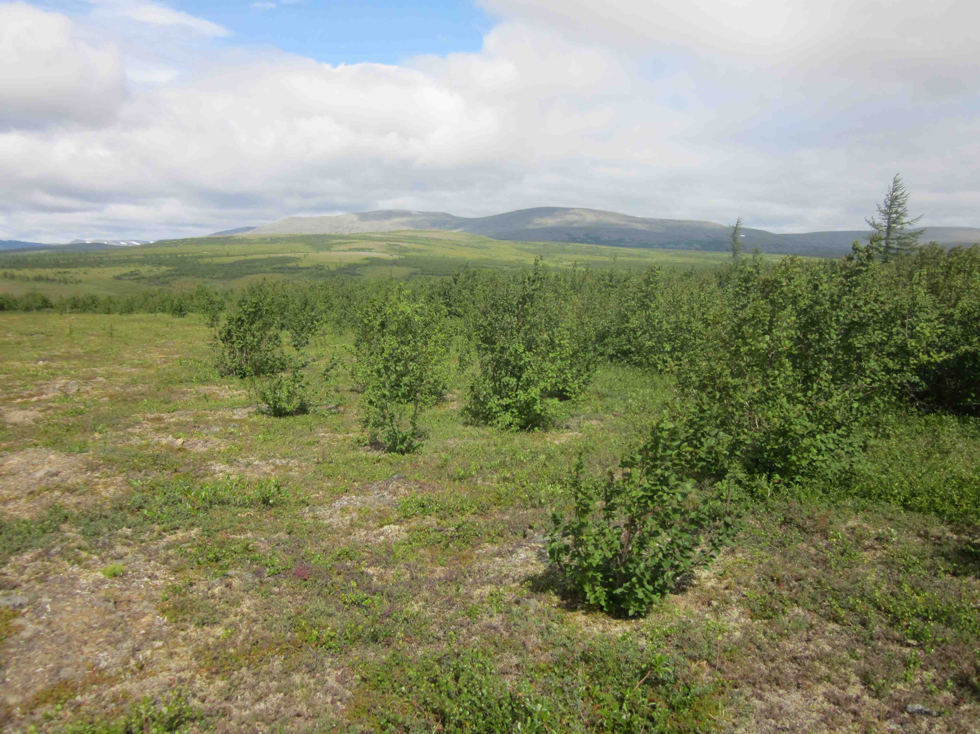
VEGETATION DYNAMICS WORKING GROUP
Howard Epstein and Brendan Rogers
28 WG projects as primary discipline
(16 funded directly by ABoVE)
19 WG projects as secondary discipline
(6 funded directly by ABoVE)
90 research team members
Total number of publications: 84
Total number of paper citations: 2321
Total number of data products: 48

Slide 2
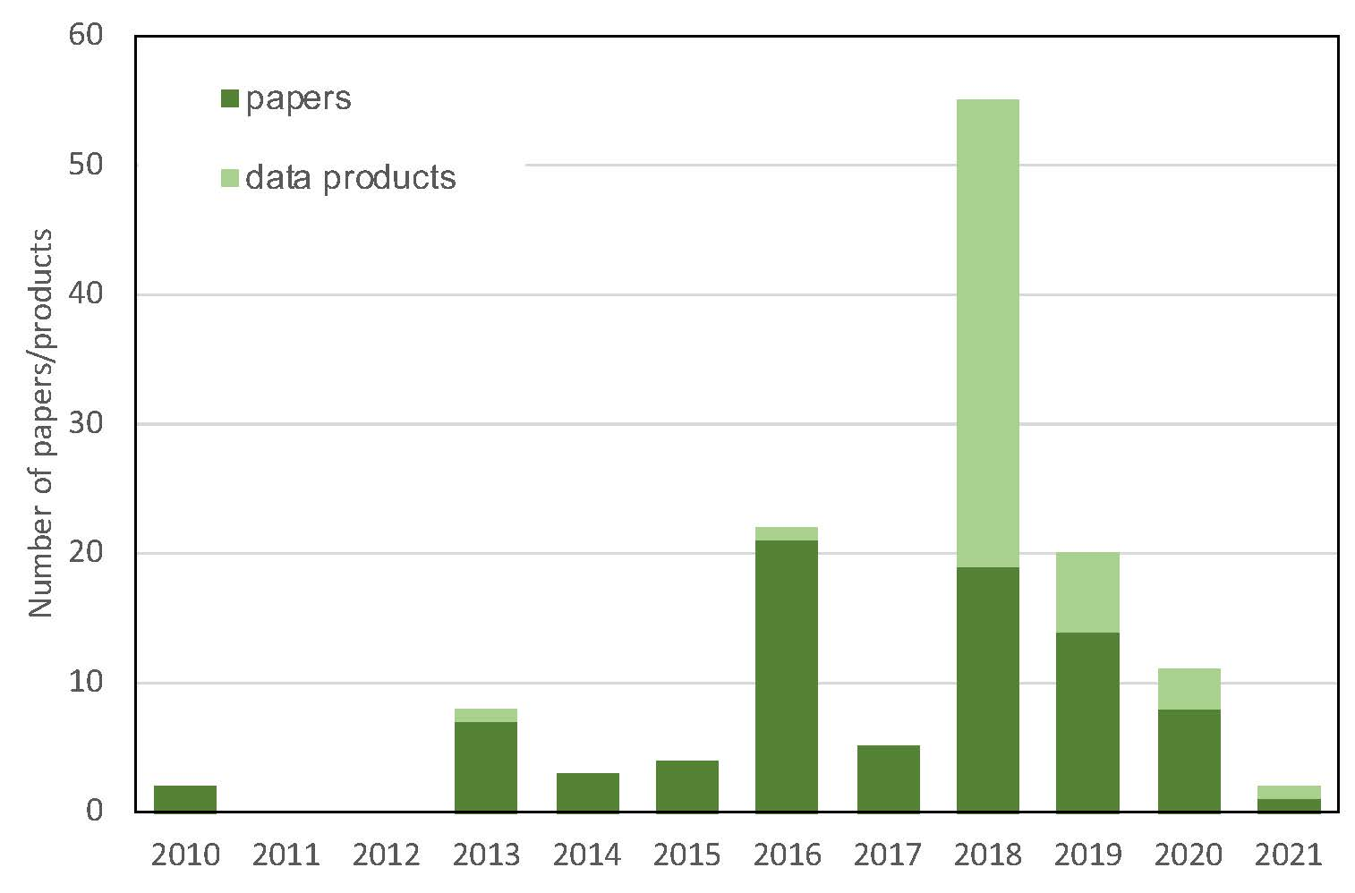

Slide 3
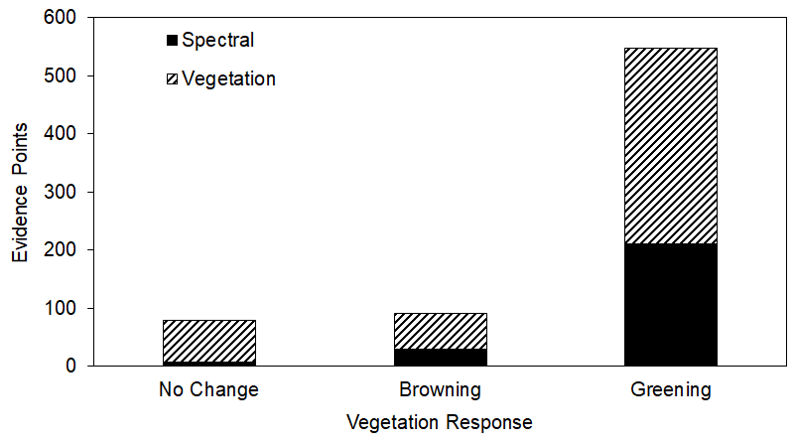
Arctic Tundra Greening and Browning Literature Synthesis
Purpose: Synthesize the 1999-2020 knowledge base on the drivers of Arctic greening and browning and identify knowledge gaps
Progress:
318 papers covering 1999-2018 have been reviewed
95 studies met the selection criteria
35 from Web of Science search
60 from review of those Web of Science papers’ reference sections
721 evidence points have been generated from these 95 studies
Notes:
A total of 318 papers covering 1999-2018 have been reviewed. Of these, 95 papers have met the selection criteria for inclusion.
Selection criteria include if the study occurred above or within a 50-km buffer of the tree line, if it was an experimental or observational study (i.e., no modelling or paleo studies), and if there was a vegetation response directly linked to a driver.
35 of these papers came from a Web of Science search, and 60 have come from reviewing those paper’s reference sections.
In total, 721 evidence points have been generated from these 95 papers.
Greening evidence points are associated with a significant increase in vegetation productivity reported as an increase in aboveground biomass/vegetation cover, NDVI, shifts in community composition such as shrubification, photosynthetic rate, reproductive success, etc.
Browning evidence points are associated with a significant decrease in vegetation productivity.
No change evidence points are logged when change in vegetation productivity was reported as insignificant.
Spectral and vegetation indicates how the greening, browning, or no change result was measured. Spectral results were determined through the use of remote sensing, while vegetation results were measured in the field.

Slide 4
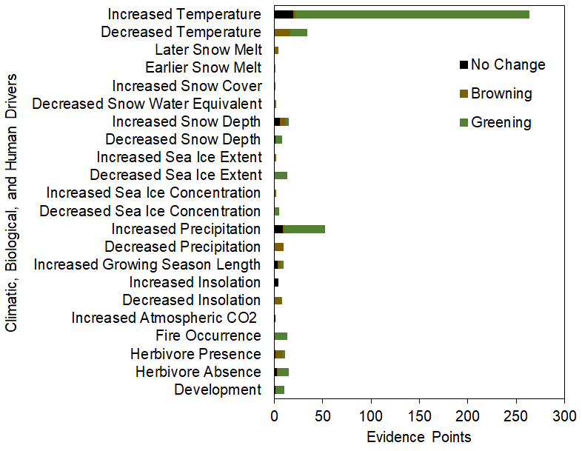
Notes:
This graph displays the climatic, biological, and human drivers considered and the number of evidence points associated with each.
Overall, the most common driver analyzed was increased temperature, which was associated with greening.

Slide 5
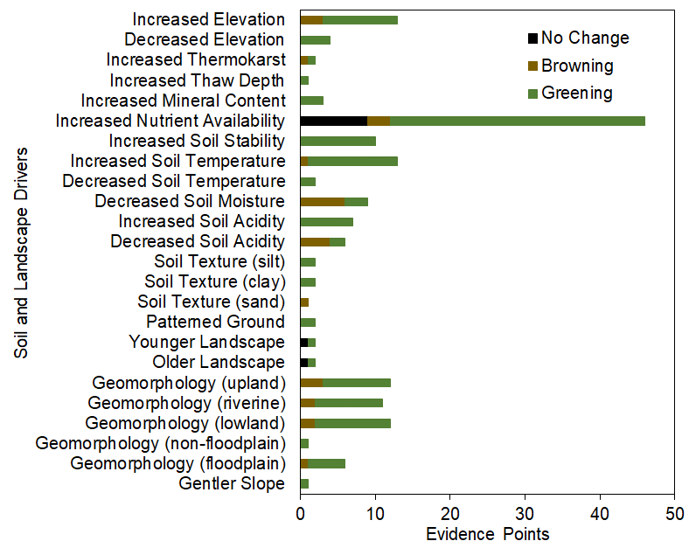
Notes:
This graph displays the soil and landscape drivers considered and the number of evidence points associated with each.
Of these drivers, increased nutrient availability was the most analyzed, and was most often associated with greening.

Slide 6
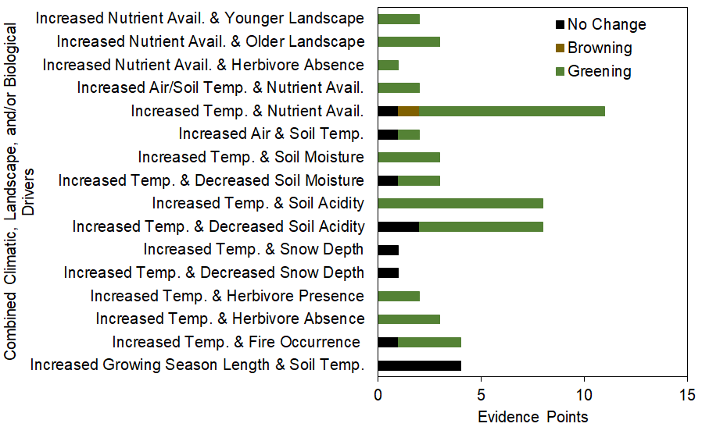
Notes:
This graph displays combinations of the drivers considered and the number of evidence points associated with each.
Of the combined drivers, the most commonly analyzed was increased temperature and nutrient availability.

Slide 7



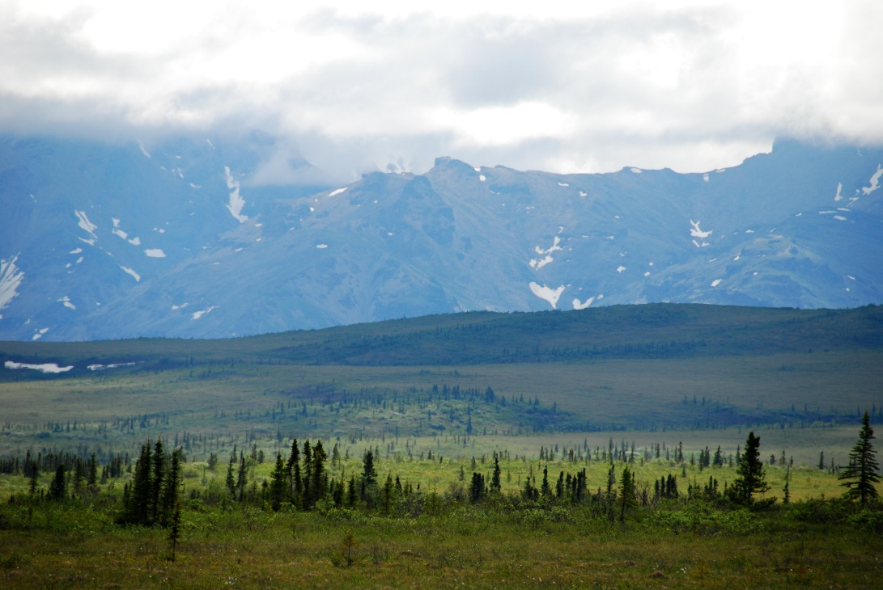
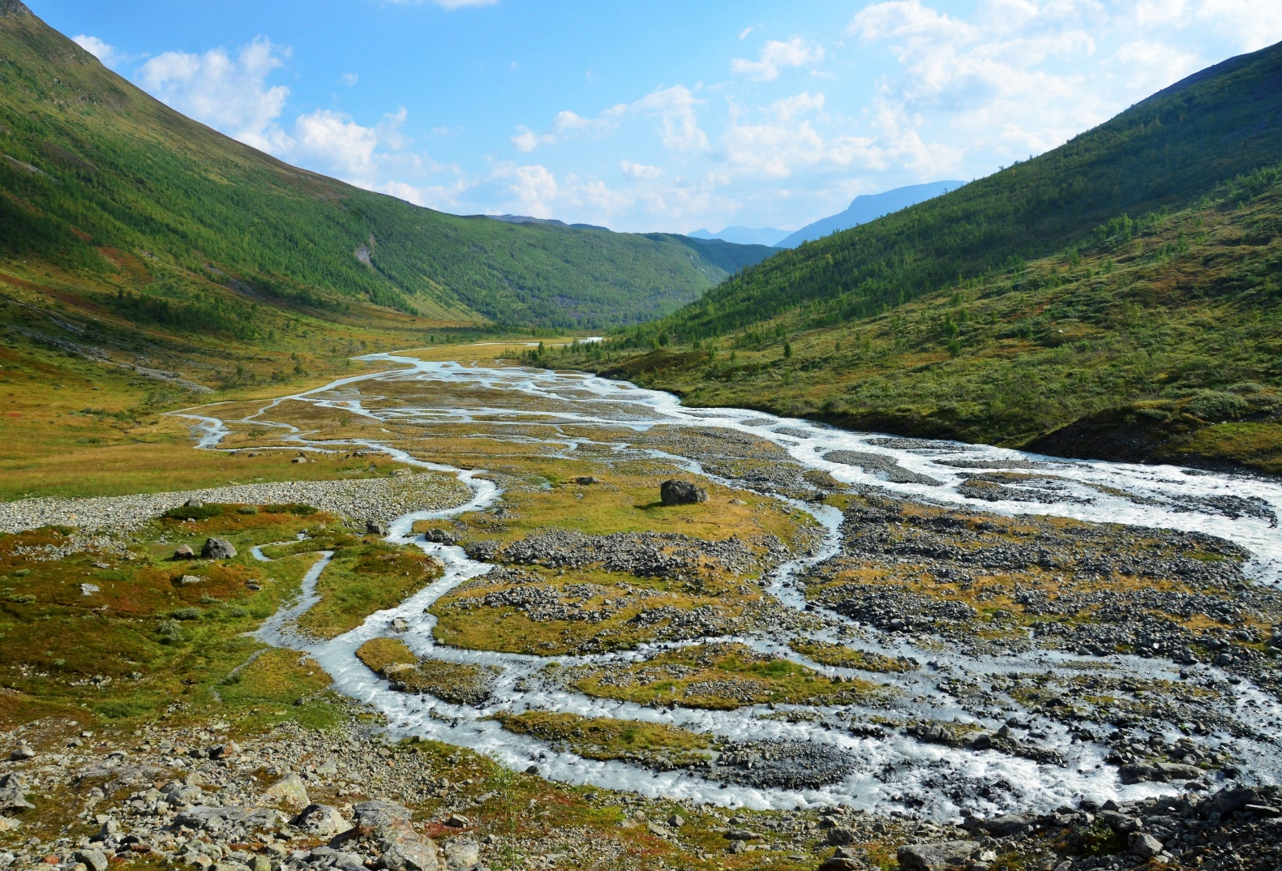
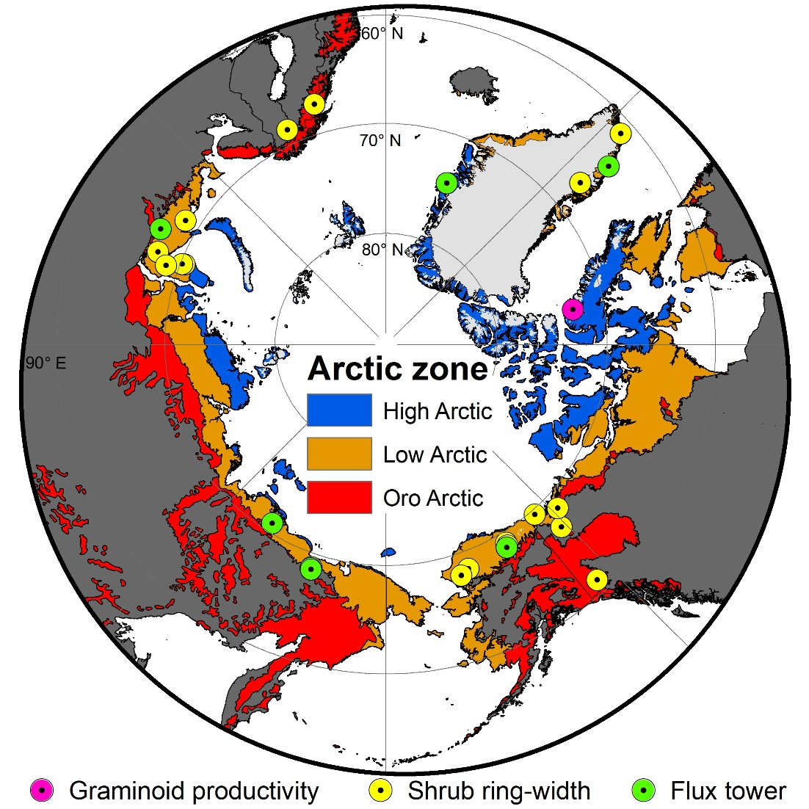
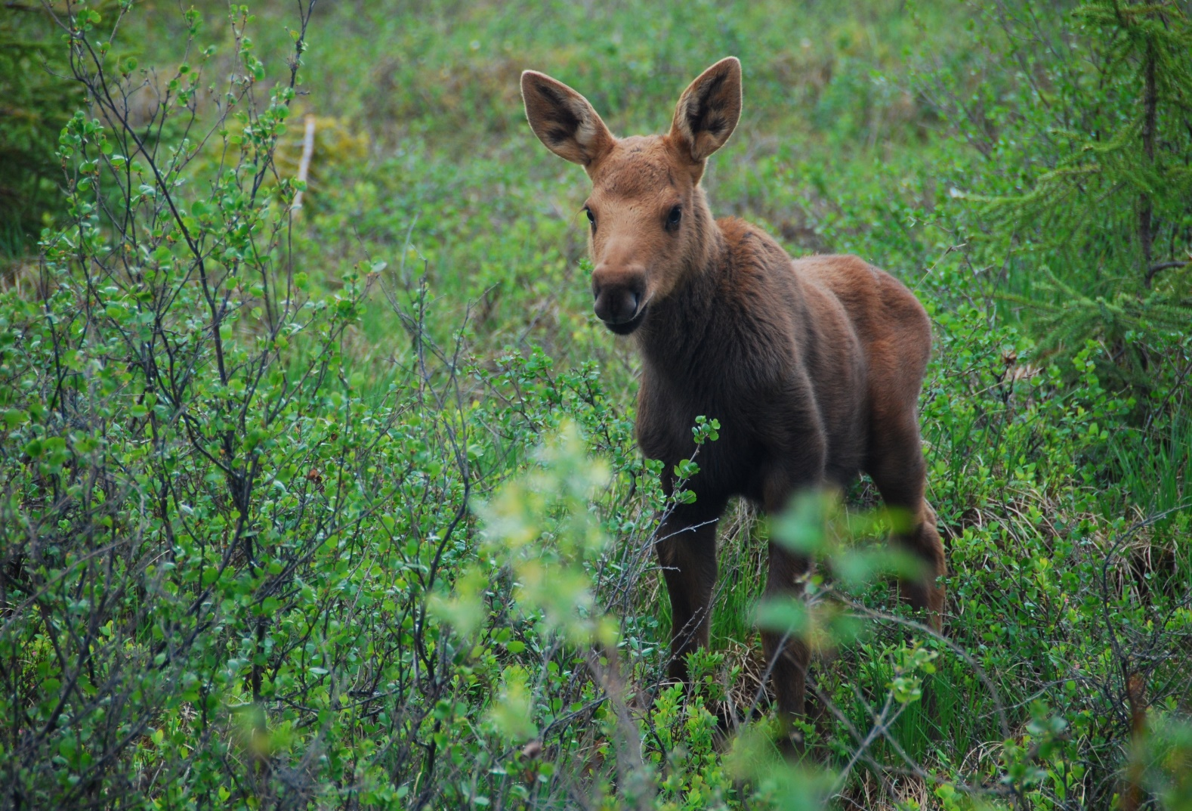
Summer warming explains widespread but not uniform greening in the Arctic tundra biome
Logan Berner, Richard Massey, Patrick Jantz, Bruce Forbes, Marc Macias-Fauria, Isla Myers-Smith, Timo Kumpula, Gilles Gauthier, Laia Andreu-Hayles, Ben Gaglioti, Pat Burns, Pentii Zetterberg, Rosanne D'Arrigo, and Scott Goetz (2020) Nature Communications, https://doi.org/10.1038/s41467-020-18479-5
What we did
Why it matters
We used Landsat + environ. data to:
Evaluate trends in tundra greenness at sites across the Arctic
Attribute tundra greenness trends to environmental change
Validate satellite observations using field measurements
Arctic greening affects:
climate by impacting ecosystem carbon cycling and energy balance
wildlife by altering forage and shelter availability
humans by altering tundra ecosystem services, travel, and feedback to global climate

Slide 8
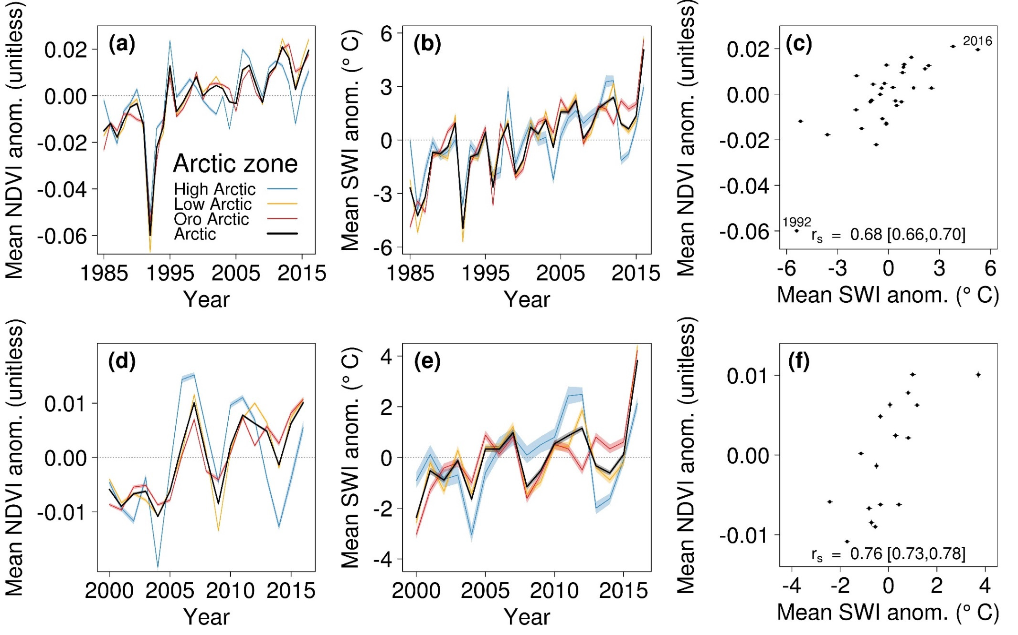
16-31% significant “greening”
< 4% significant “browning”

Slide 9
Arctic tundra shrubification:
A review of mechanisms and impacts
on ecosystem carbon balance
Climate, soil moisture, snow, topography, permafrost thaw, nutrient dynamics, disturbance & herbivory may lead to the expansion of shrubs, which mediate net ecosystem C exchange.
Mekonnen et al. 2021 Env. Res. Letters 16:053001
Notes:
Schematic diagram that shows key climatic and environmental controls on tundra shrub expansion. The figure shows a complex set of soil–plant–atmosphere interactions driven by (1) climate change (increase in surface air temperature, precipitation and atmospheric (CO2)), (2) soil moisture and snow dynamics, (3) topography, (4) permafrost thaw, (5) nutrient dynamics, (6) disturbance (e.g. wildfire), and (7) herbivory, and interactions among these factors. These drivers may alter vegetation composition and lead to the expansion of shrubs. Shrub expansion and its effects on snowpack dynamics, litter inputs, permafrost degradation, and surface energy budgets may also affect net ecosystem carbon exchanges. Signs (±) on the arrows represent increases or decreases.

Slide 10
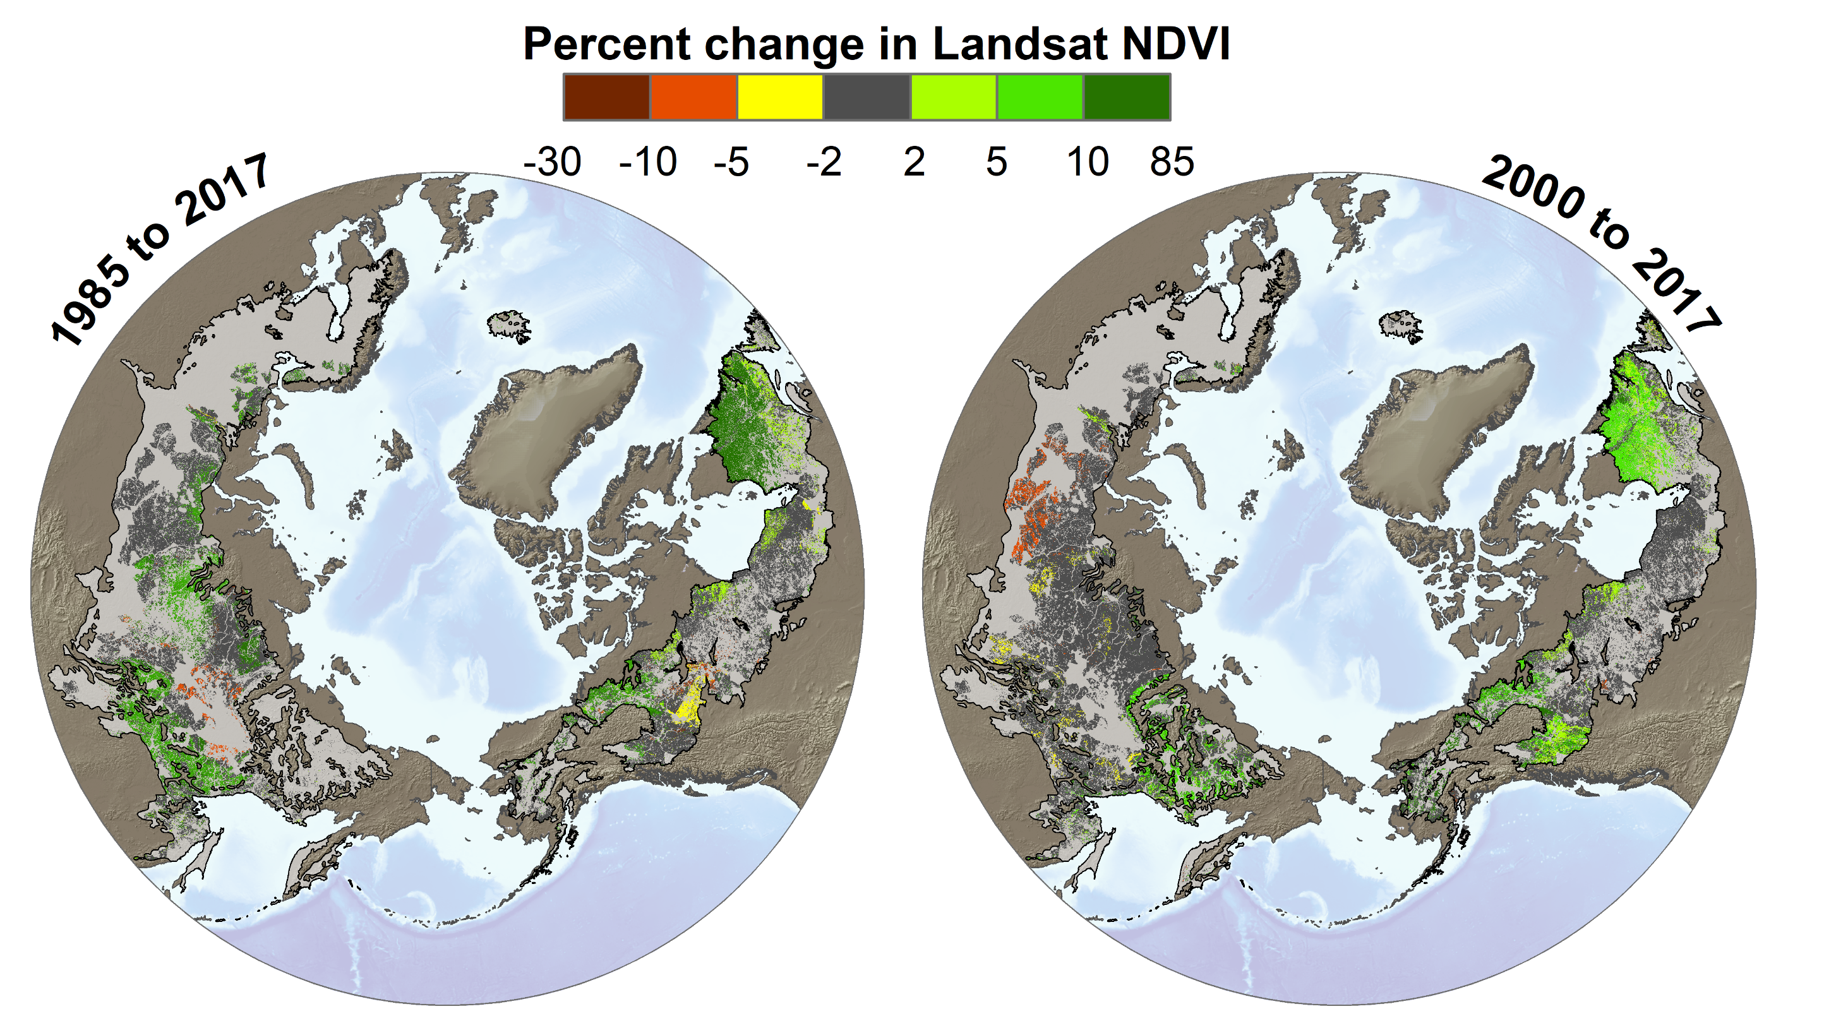
Boreal greening and browning
Berner and Goetz (in prep.)

Slide 11
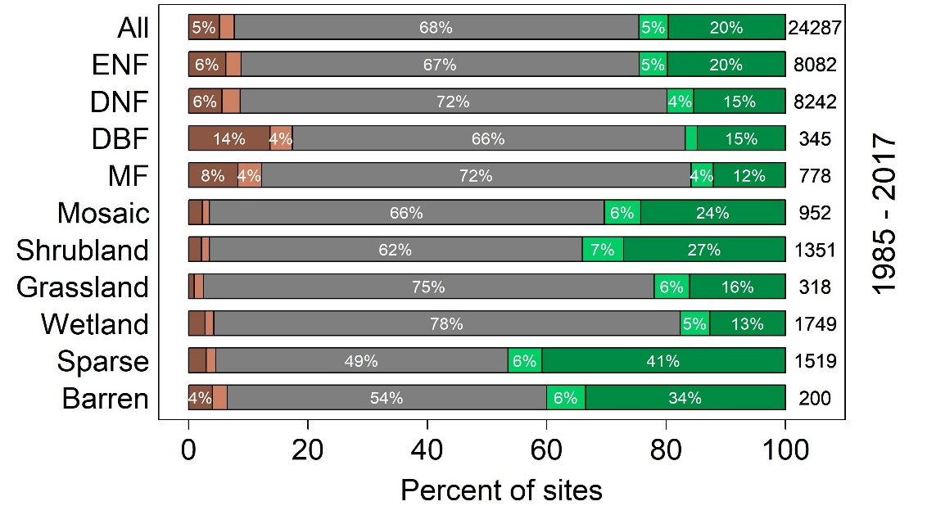
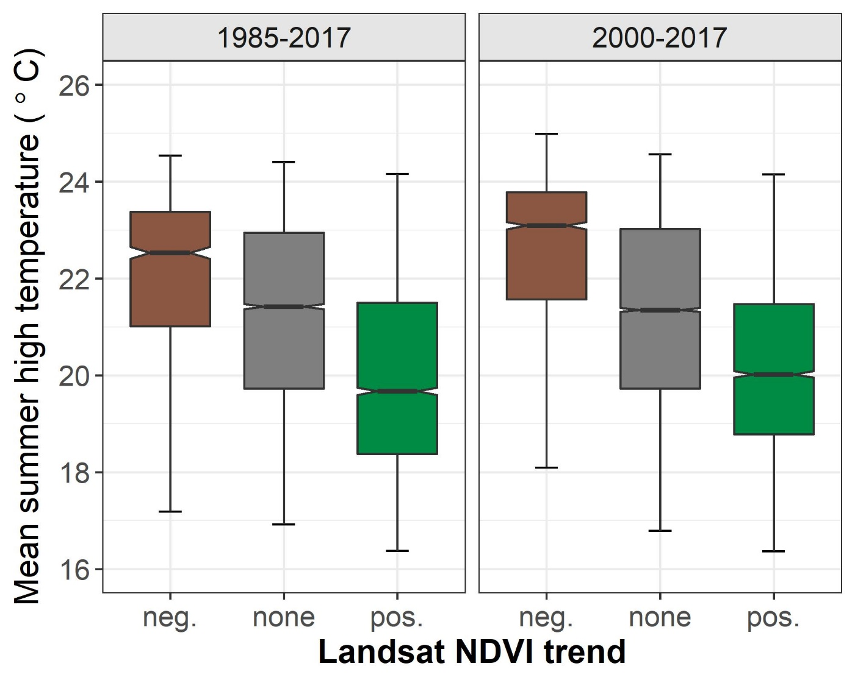
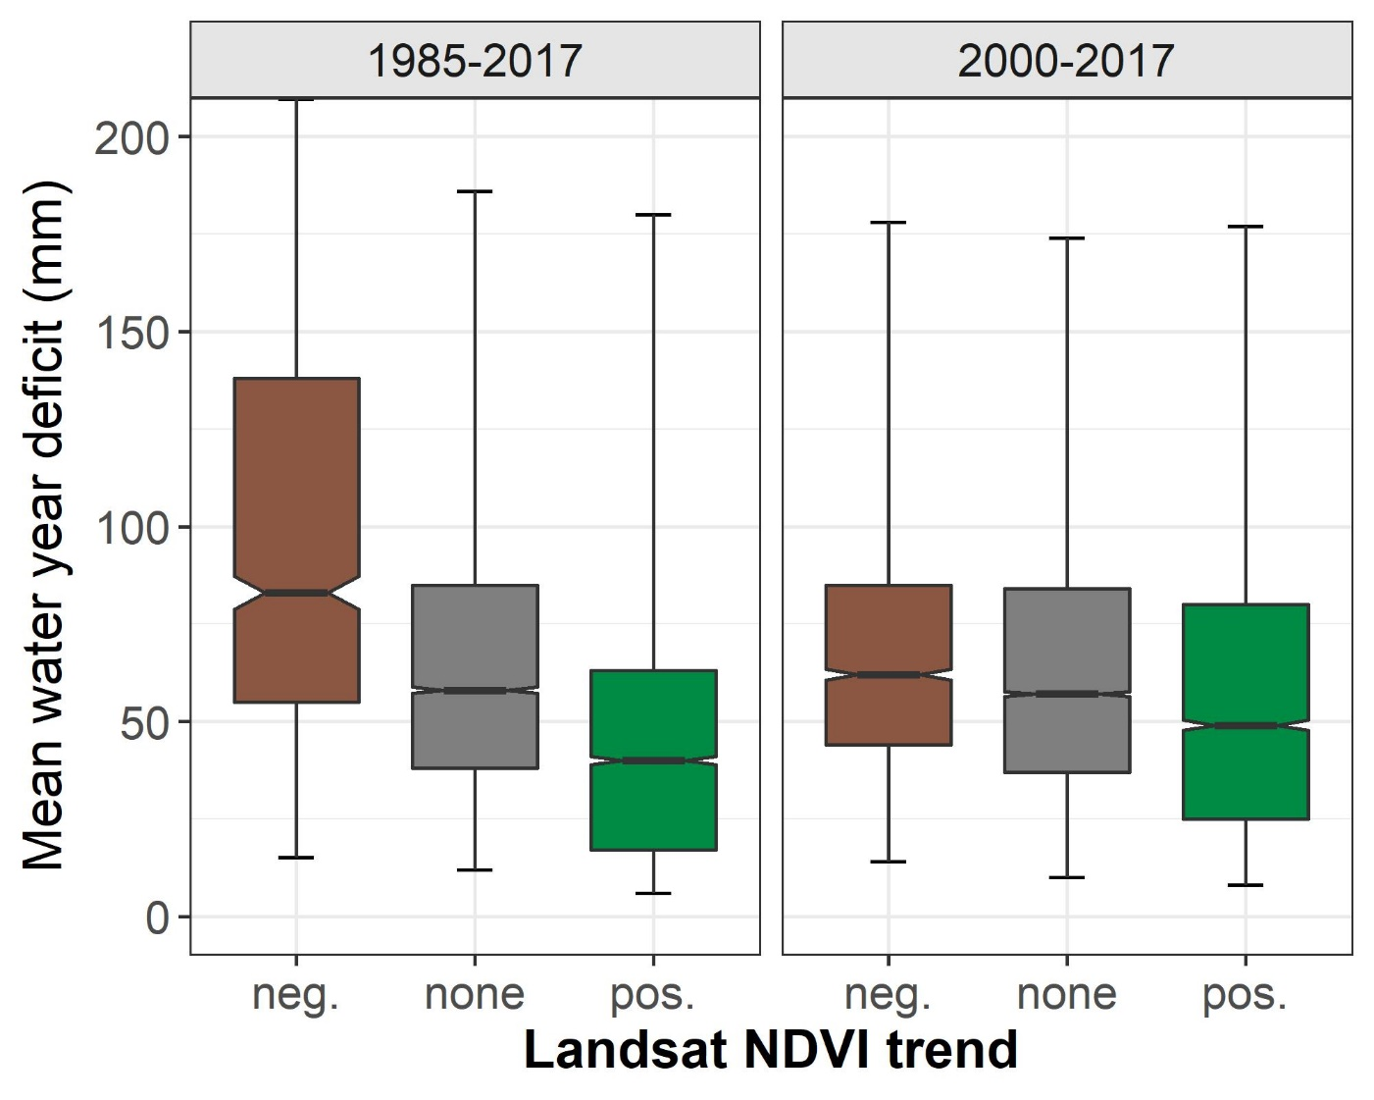
More greening than browning
Browning in warmer areas
Browning in drier areas

Slide 12
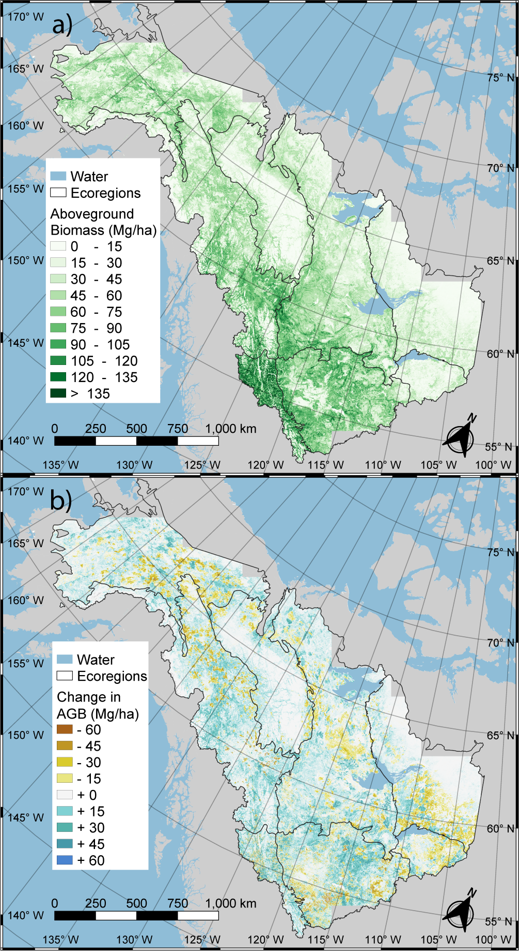
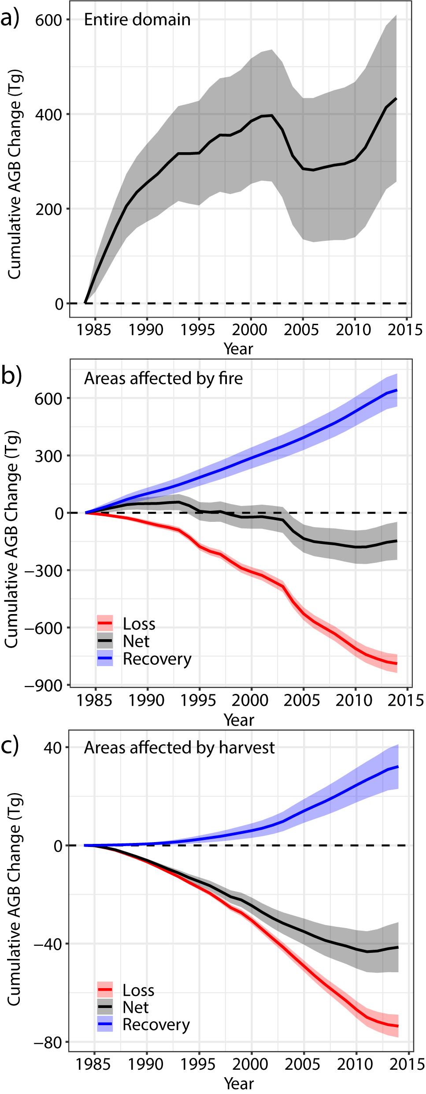
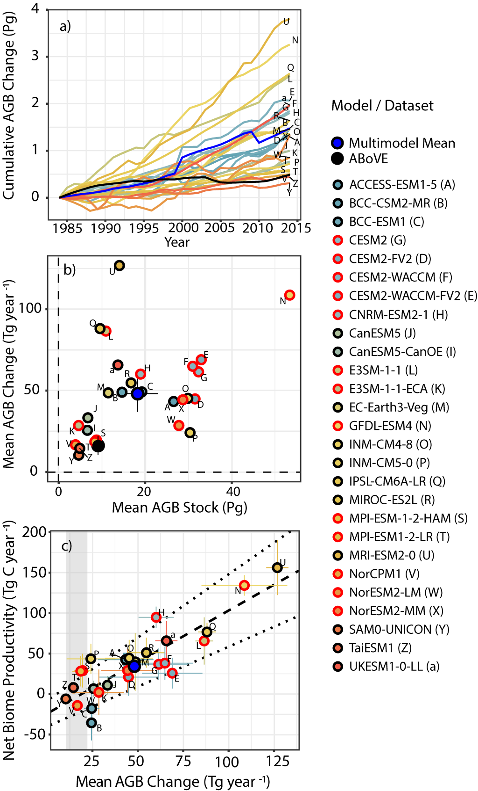
Disturbance suppresses the aboveground carbon sink in North American boreal forests
Jonathan A. Wang^{1,2} *, Alessandro Baccini^{2,3}, Mary Farina^{3,4}, James T. Randerson¹, Mark A. Friedl²
¹University of California, Irvine ²Boston University ³The Woodwell Climate Research Center ⁴Montana State University
Published in Nature Climate Change
https://doi.org/10.1038/s41558-021-01027-4
Key points:
Landsat and ICESat-based annual maps of aboveground biomass (AGB) (1984 – 2014, boreal ABoVE Core Domain)
Net gain of AGB (+434 ± 176 Tg), including reductions due to fire (-176 ± 99 Tg) and harvest (-42 ± 10 Tg)
AGB dynamics increasingly driven by disturbance and recovery, rather than climate or other global change (e.g. CO₂ fertilization)
Earth system models overestimate AGB/carbon gain by a factor of three, due to poor representation of fire disturbance
Data available at ORNL DAAC
(https://doi.org/10.3334/ORNLDAAC/1808)
Maps of AGB stocks and change
Interannual AGB dynamics
Earth system models comparison

Slide 13
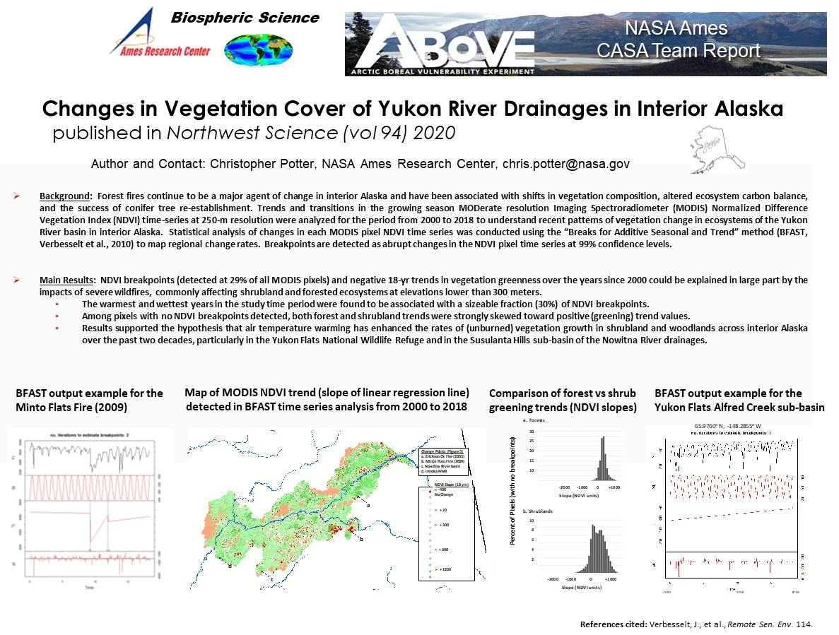

Slide 14

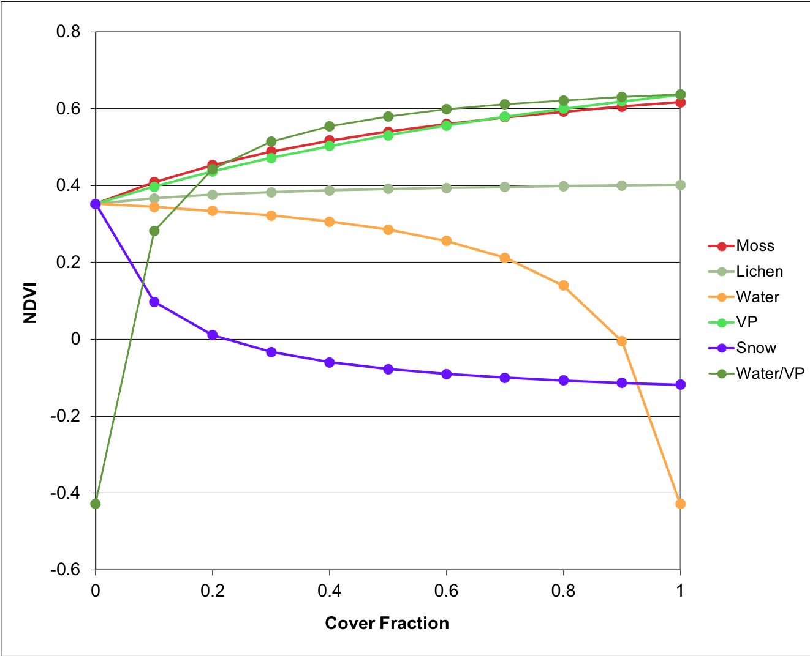
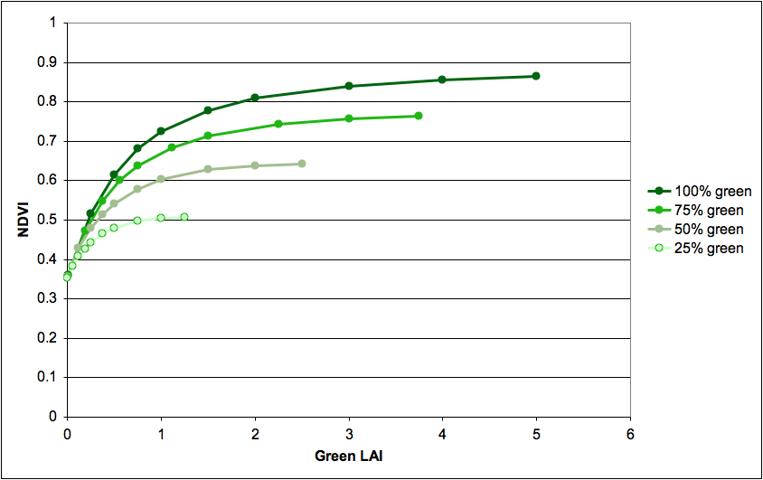
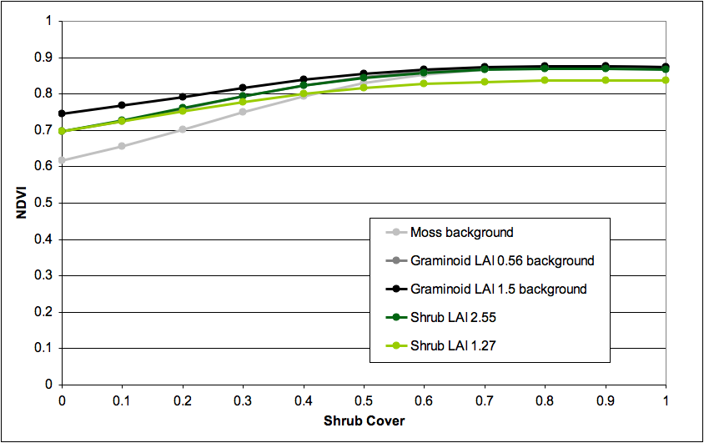
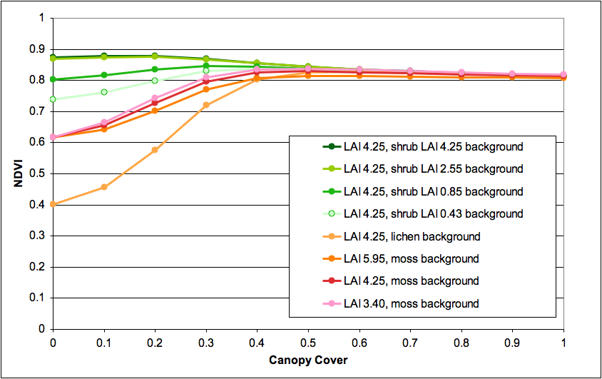
Canopy Reflectance Models Illustrate Varying NDVI Responses to Change in High Latitude Ecosystems
K.F. Huemmrich, Sergio Vargas Zesati, Petya Campbell and Craig Tweedie
Accepted in Ecological Applications
NDVI is a commonly used descriptor of high latitude ecological change
However, there are non-linearities in NDVI response that complicates interpretation of ecological change
In this study, models were used to examine NDVI response in a number of change scenarios
  Models included linear mixture model, turbid media radiative transfer model (SAIL), and a hybrid model (GeoSail).
The simulations showed inconsistent NDVI responses.
Clear increases in NDVI are generally associated with increases in LAI and plant cover.
  At higher values of LAI, the change in NDVI per unit change in LAI decreases
There was very little change in spruce forest NDVI where crown cover is >50% and at the tundra-taiga ecotone with transitions from shrub tundra to spruce woodland which may bias the interpretation of greening/browning trends in boreal forests.
Fraction of standing dead material in graminoid tundra affect NDVI.
Variations in water or snow coverage produced outsized nonbiological NDVI responses.

Slide 15
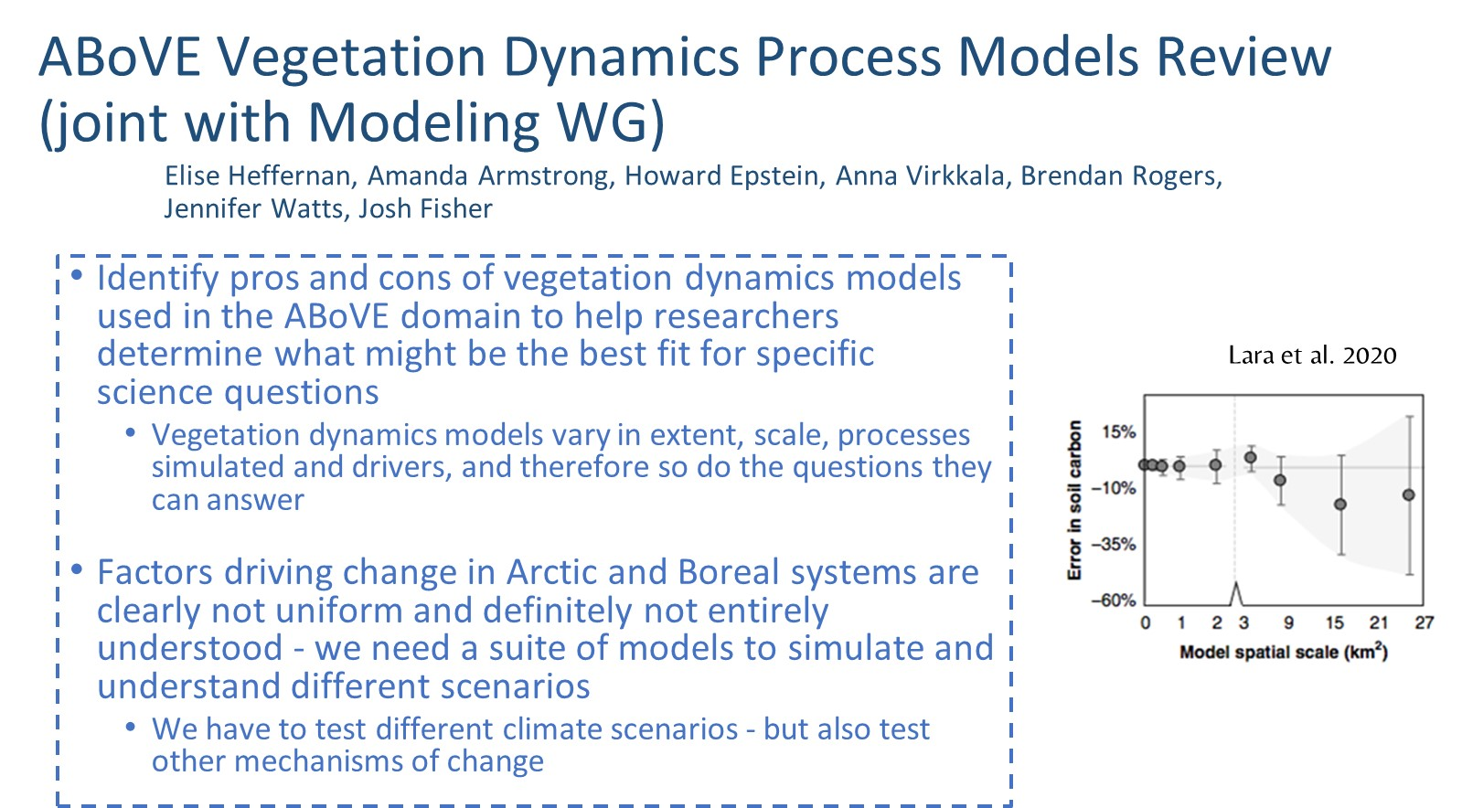

Slide 16
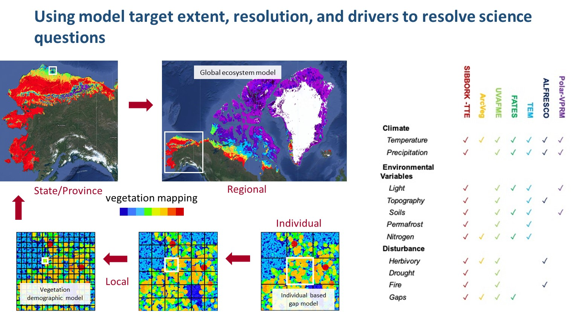

Slide 17
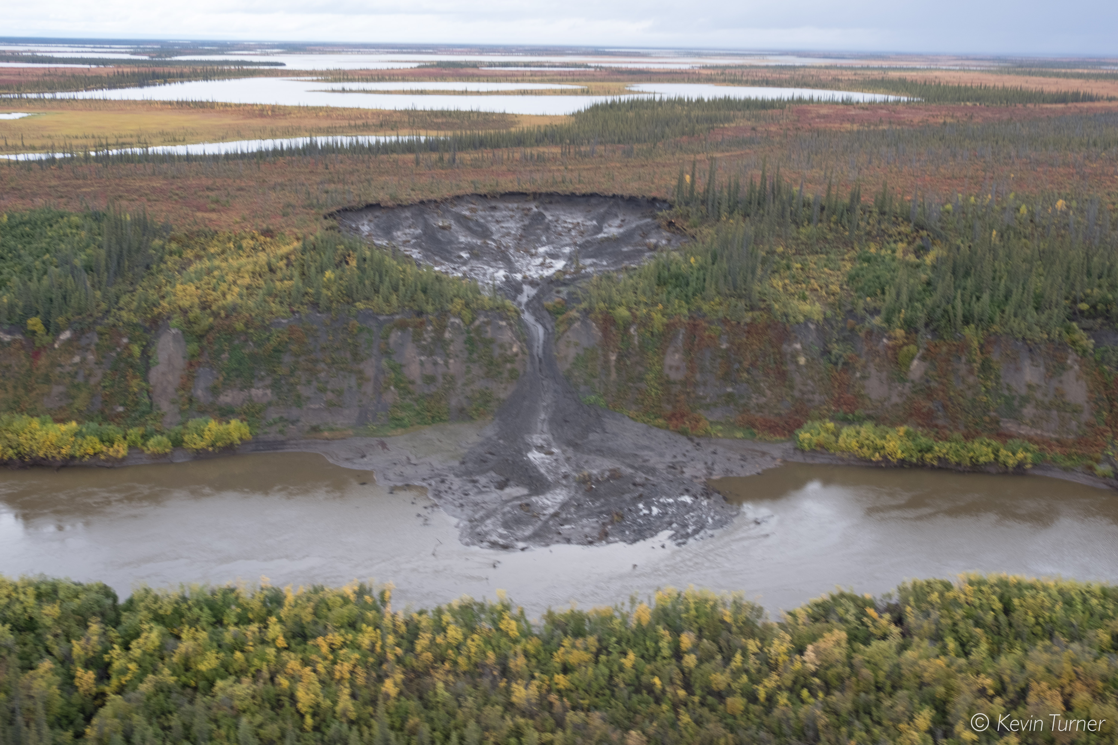
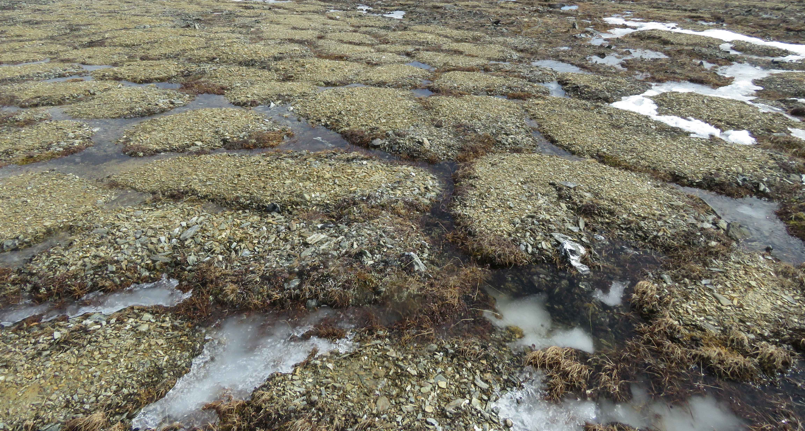
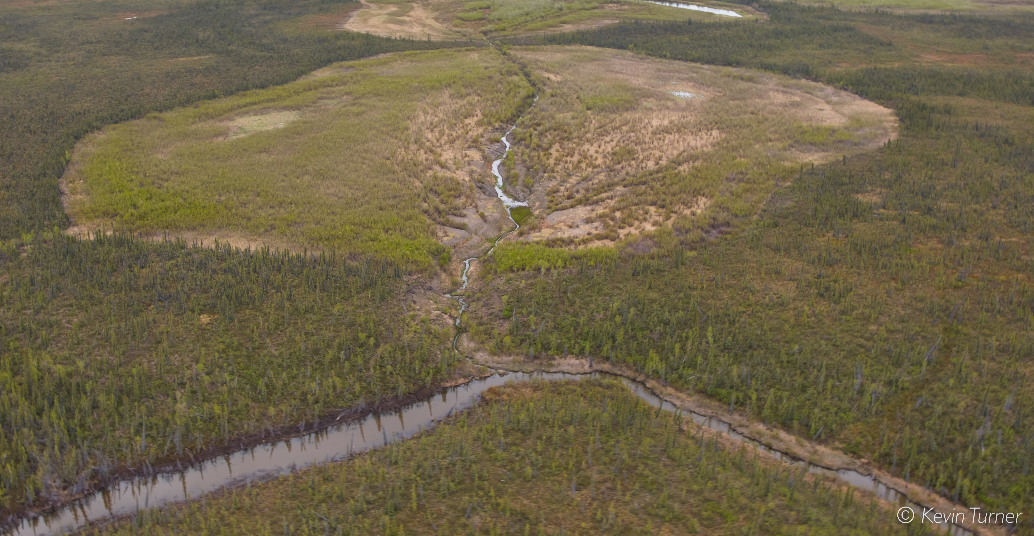
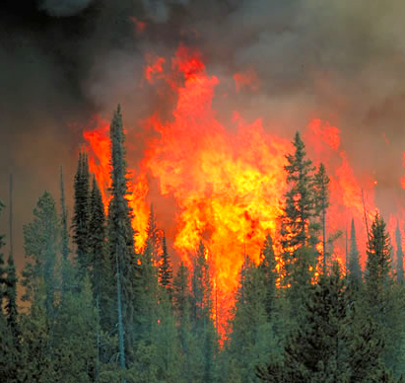
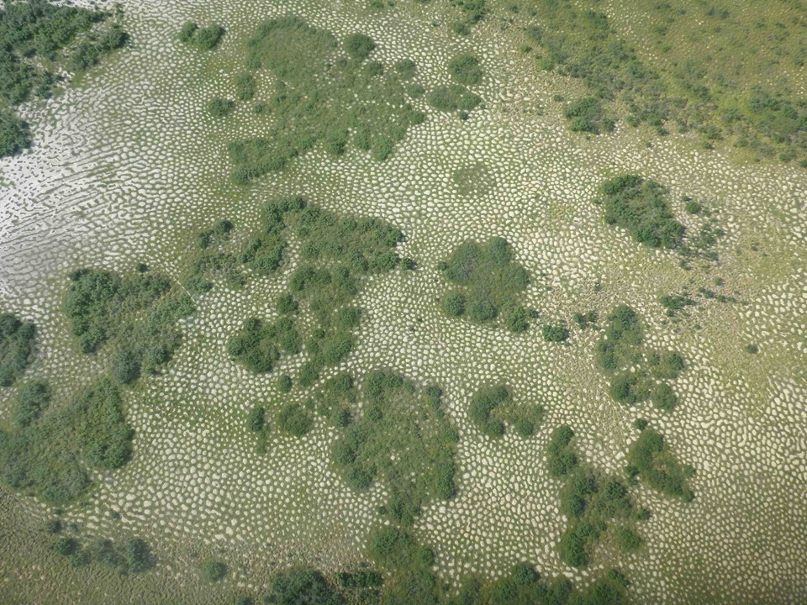
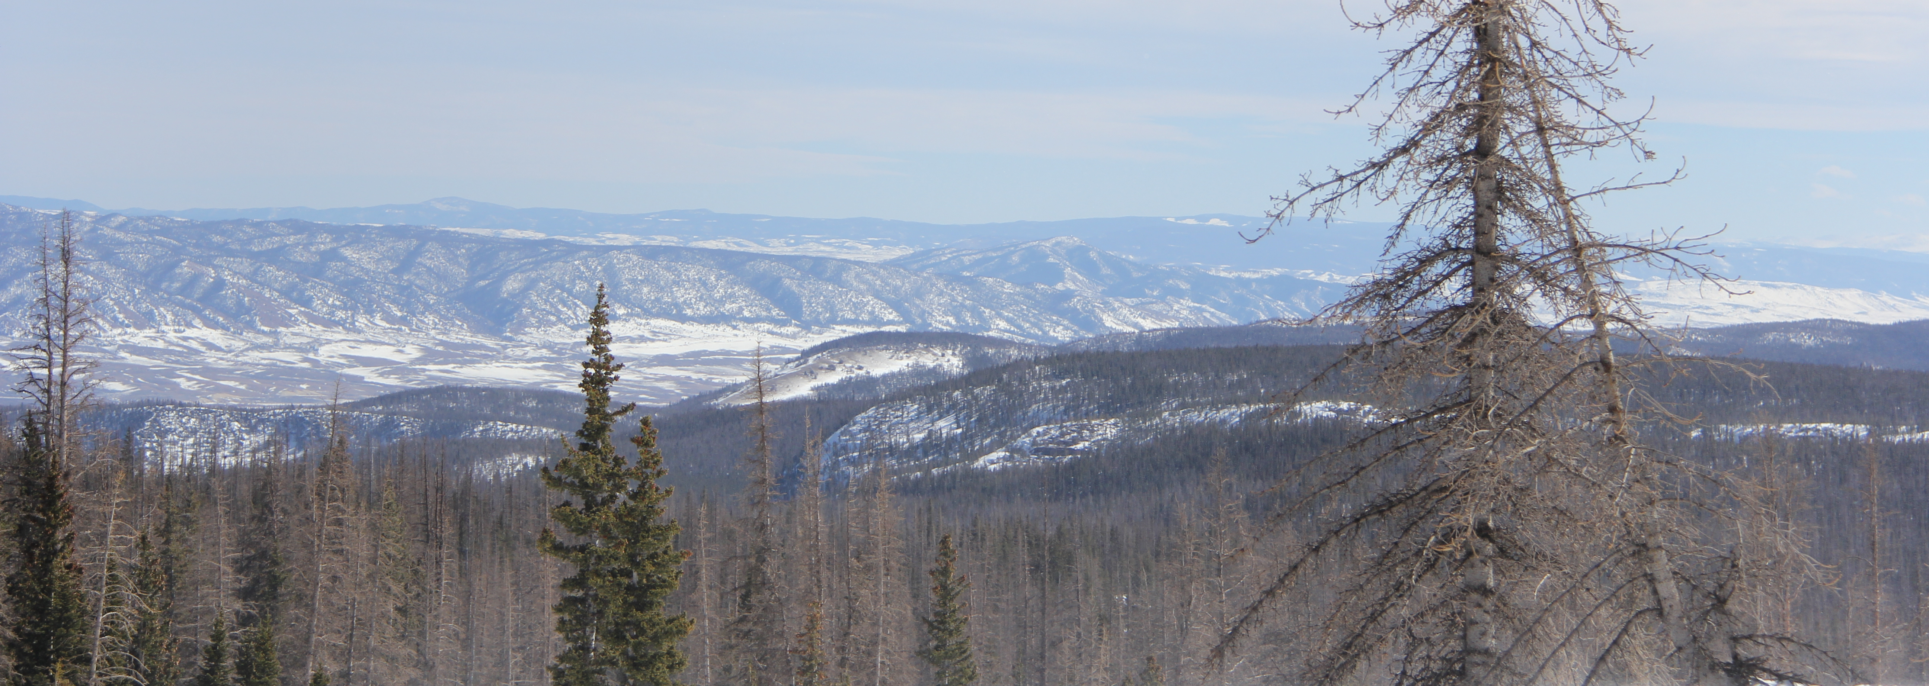
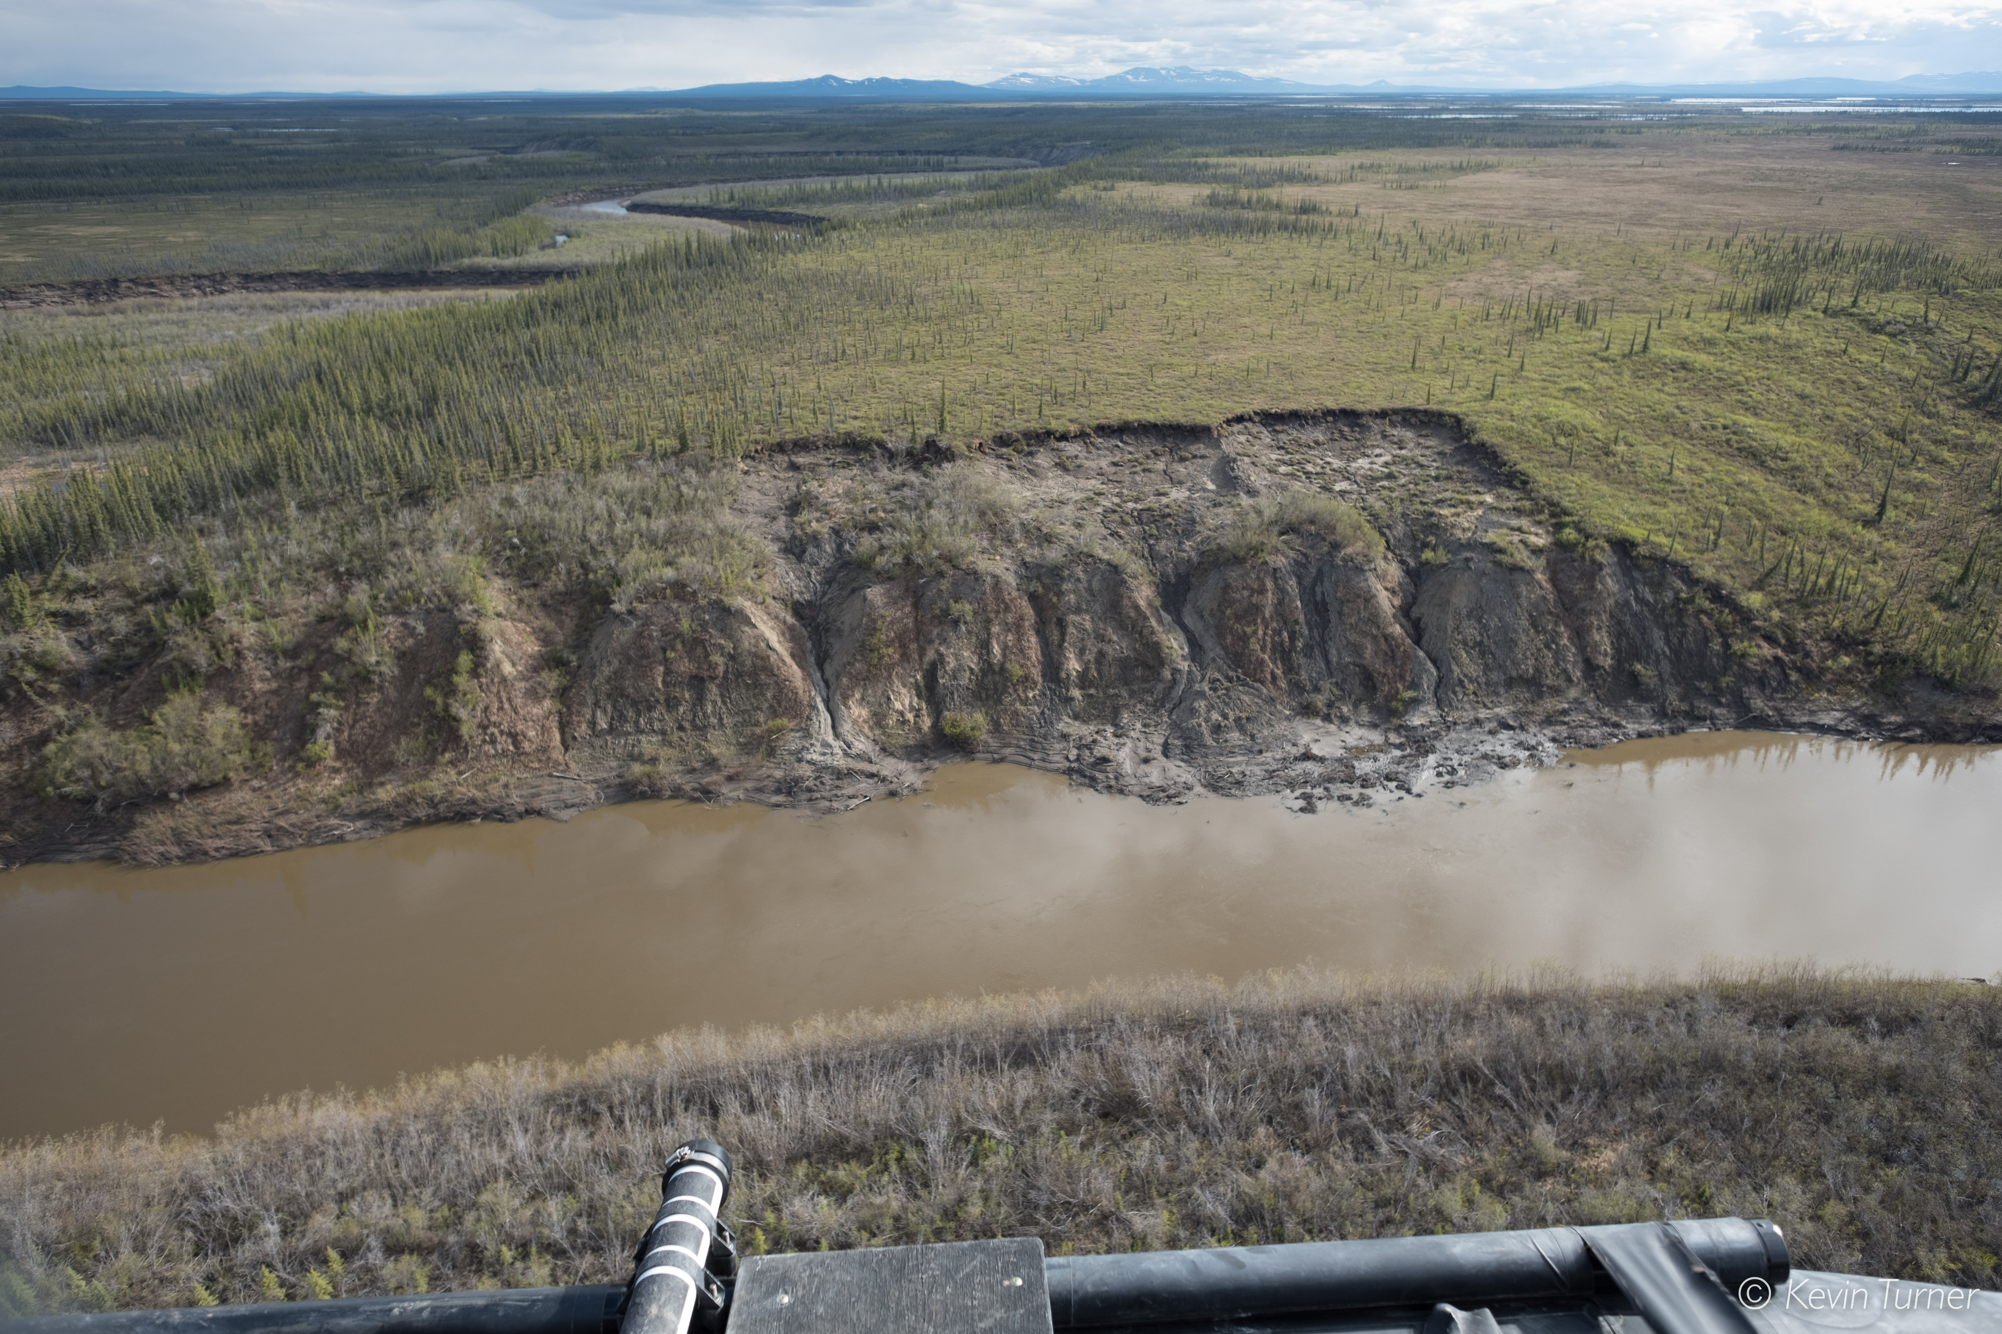
Multi-Disturbance Synthesis
Adrianna Foster, Jon Wang, Brendan Rogers, Howie Epstein, Scott Davidson, JJ Frost, Elizabeth Hoy, Oliver Sonnentag, Kevin Turner, Logan Berner, Elizabeth Campbell, Guillermo Castilla, Laura Bourgeau-Chavez, Dong Tony Chen, Jinyang Du, Angela Erb, Randi Jandt, Mary Kang, Caleb Pan, Chris Potter, Tatiana Shestakova, Carolina Voigt, Scott Goetz, and many more

