Slide 1
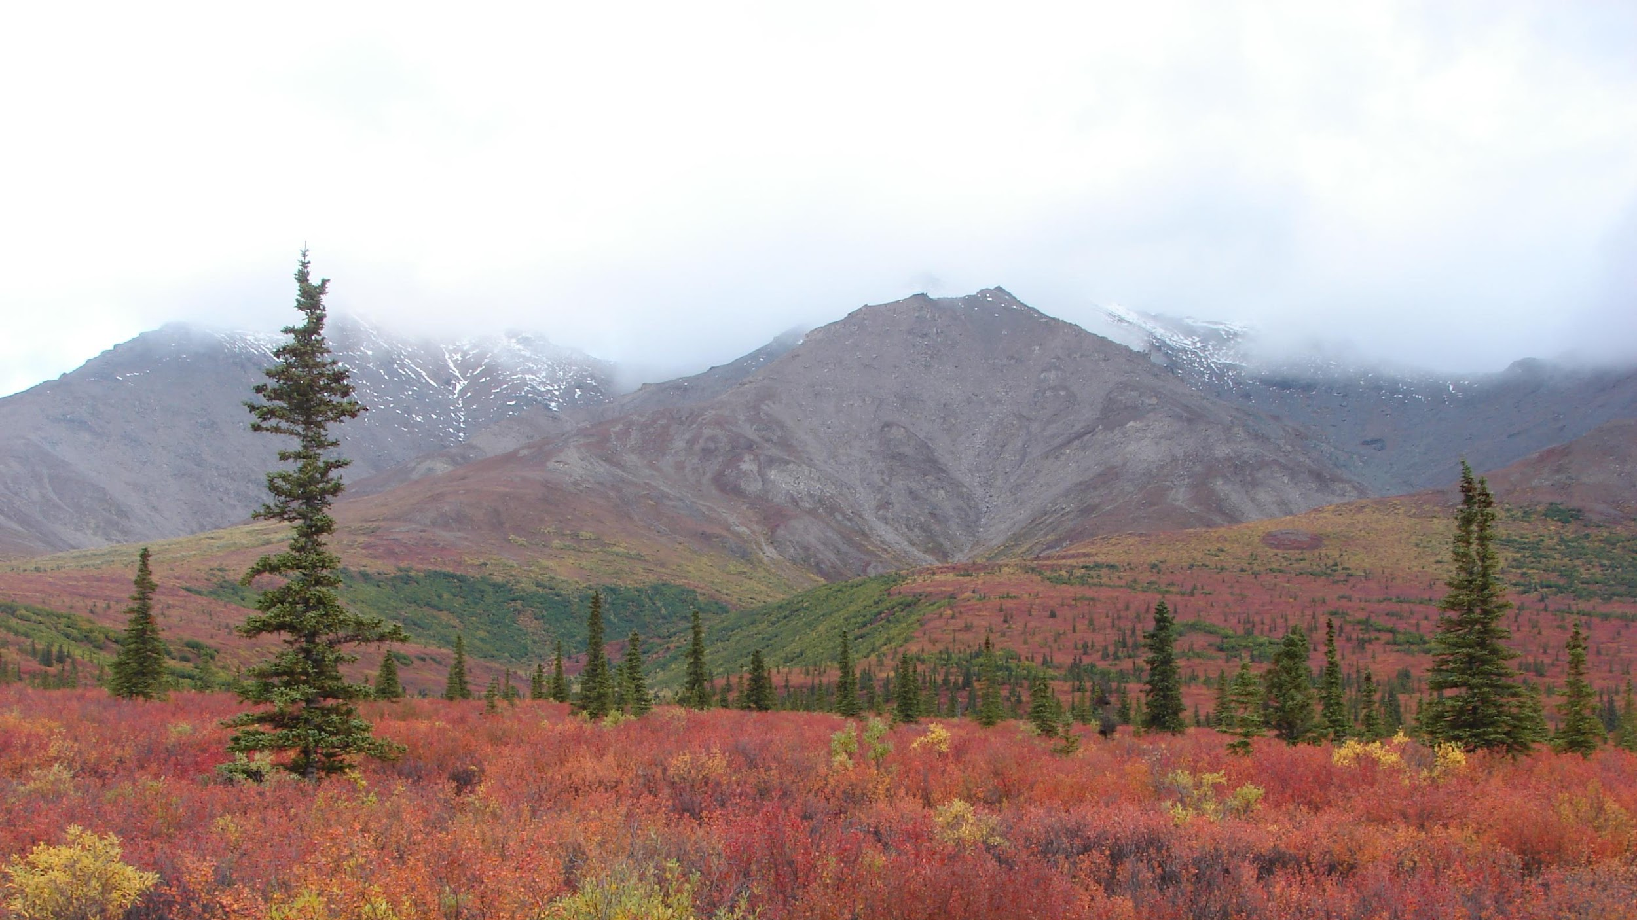

Vegetation Dynamics & Distribution Working Group Updates
ABoVE Science Team Meeting 8
May 10, 2022
Brendan Rogers & Howie Epstein

Slide 2
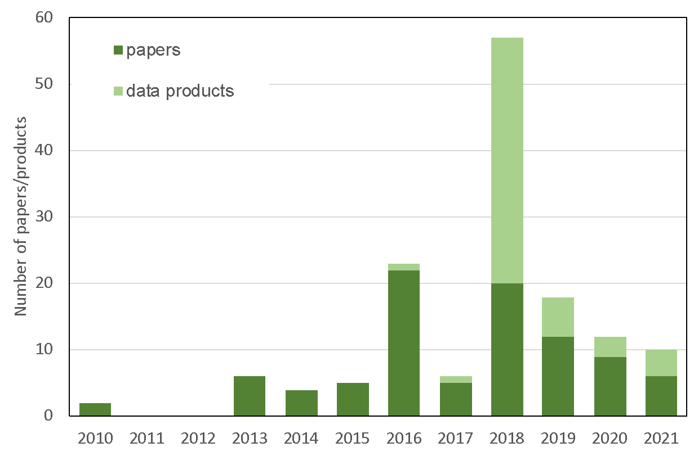
28 primary projects
20 secondary projects
94 members
For primary projects
97 papers
5299 citations
52 data products

Slide 3
Emergent themes
Mapping & understanding disturbances, greenness/browning trends, biomass, and land cover
Plant physiology, function, demographics, and relationships to remote sensing
Post-disturbance recovery
How greening / browning trends are related to wildfires, pests, climate, and forest demographics
Interactions between changing vegetation, permafrost, and hydrology
Linking forest structure to function
Ecosystem modeling to project dynamics

Slide 4
Syntheses

Slide 5
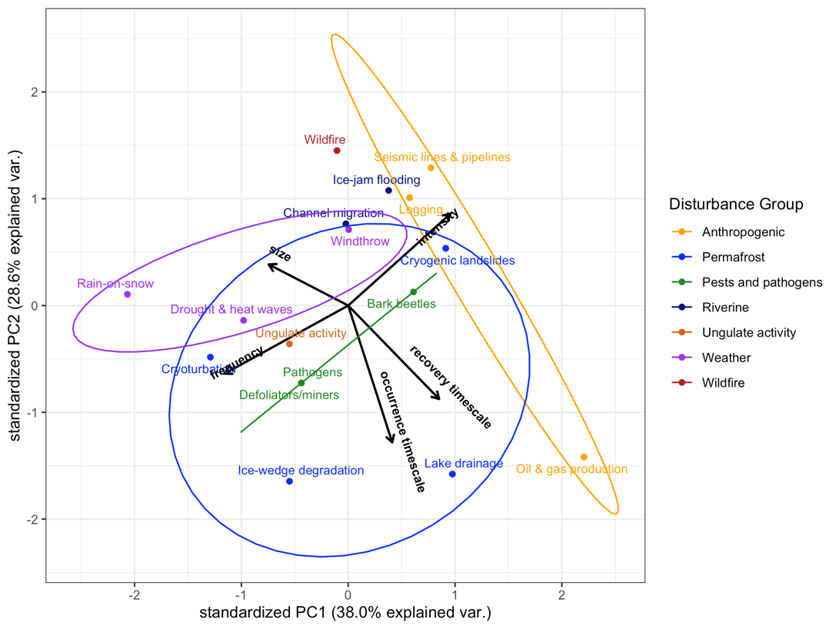
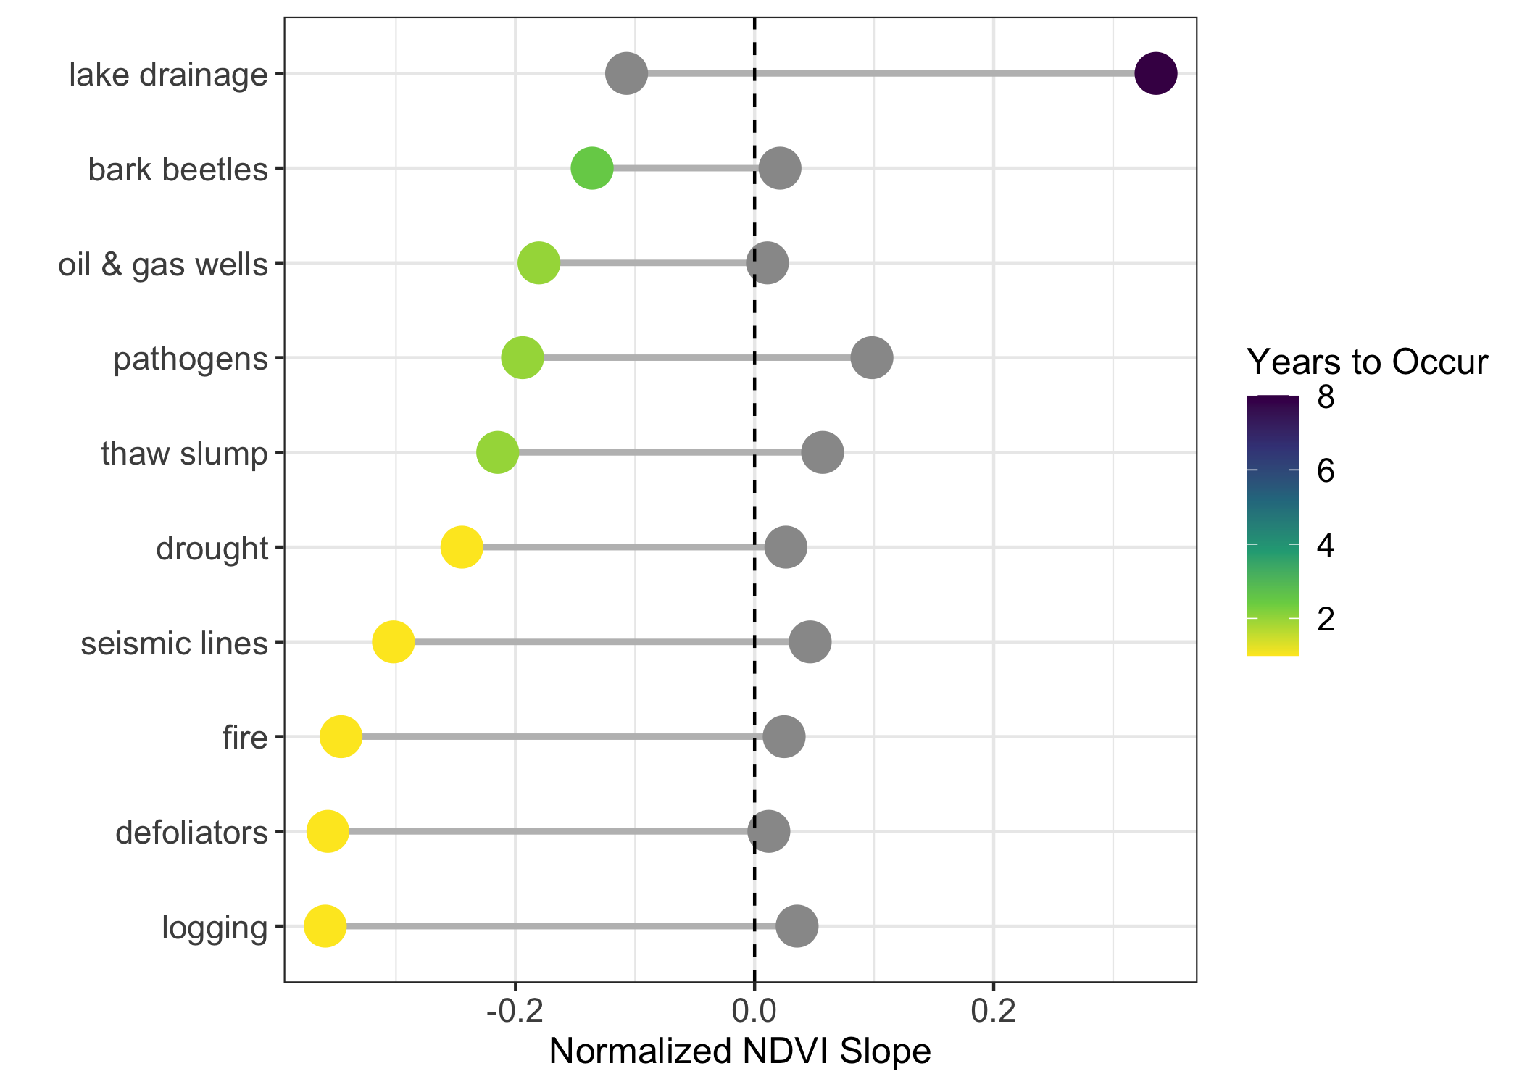
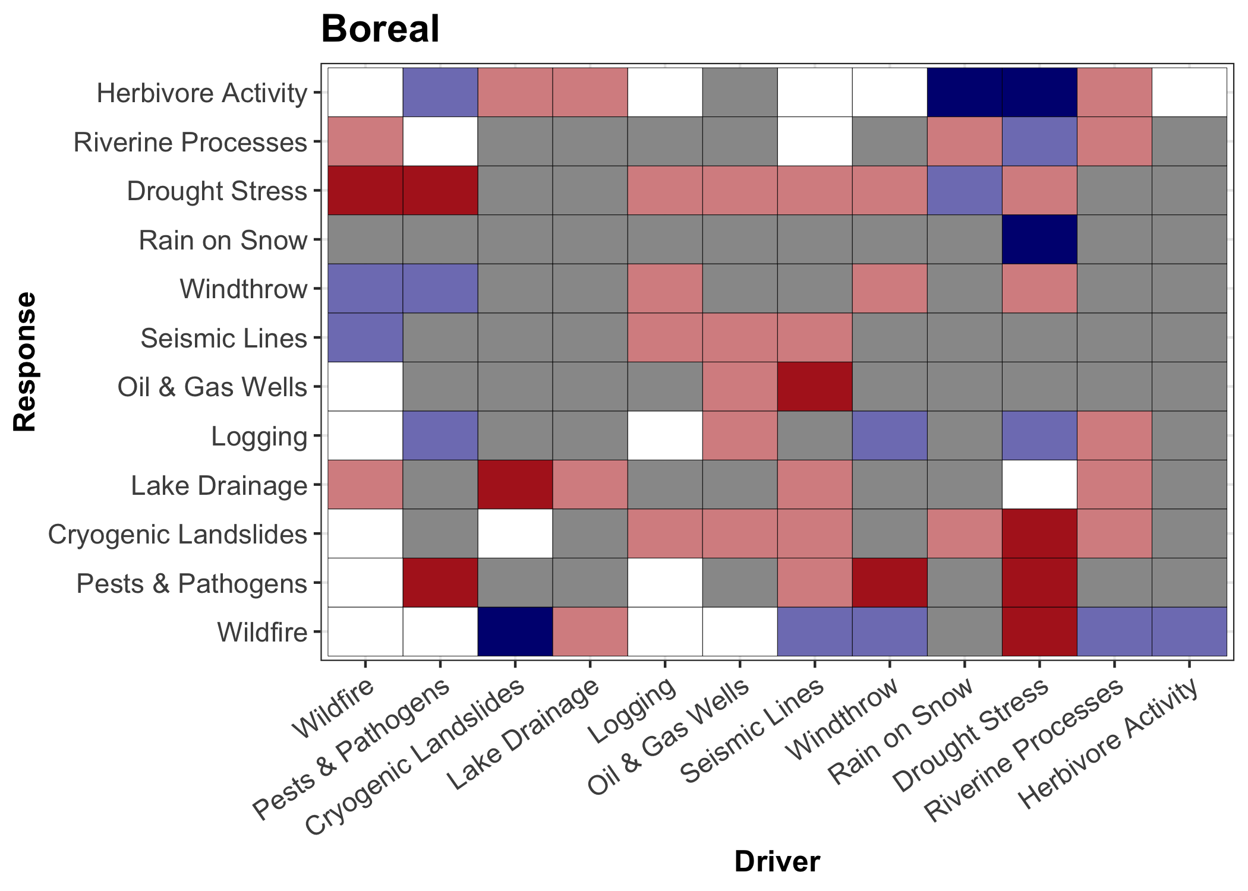
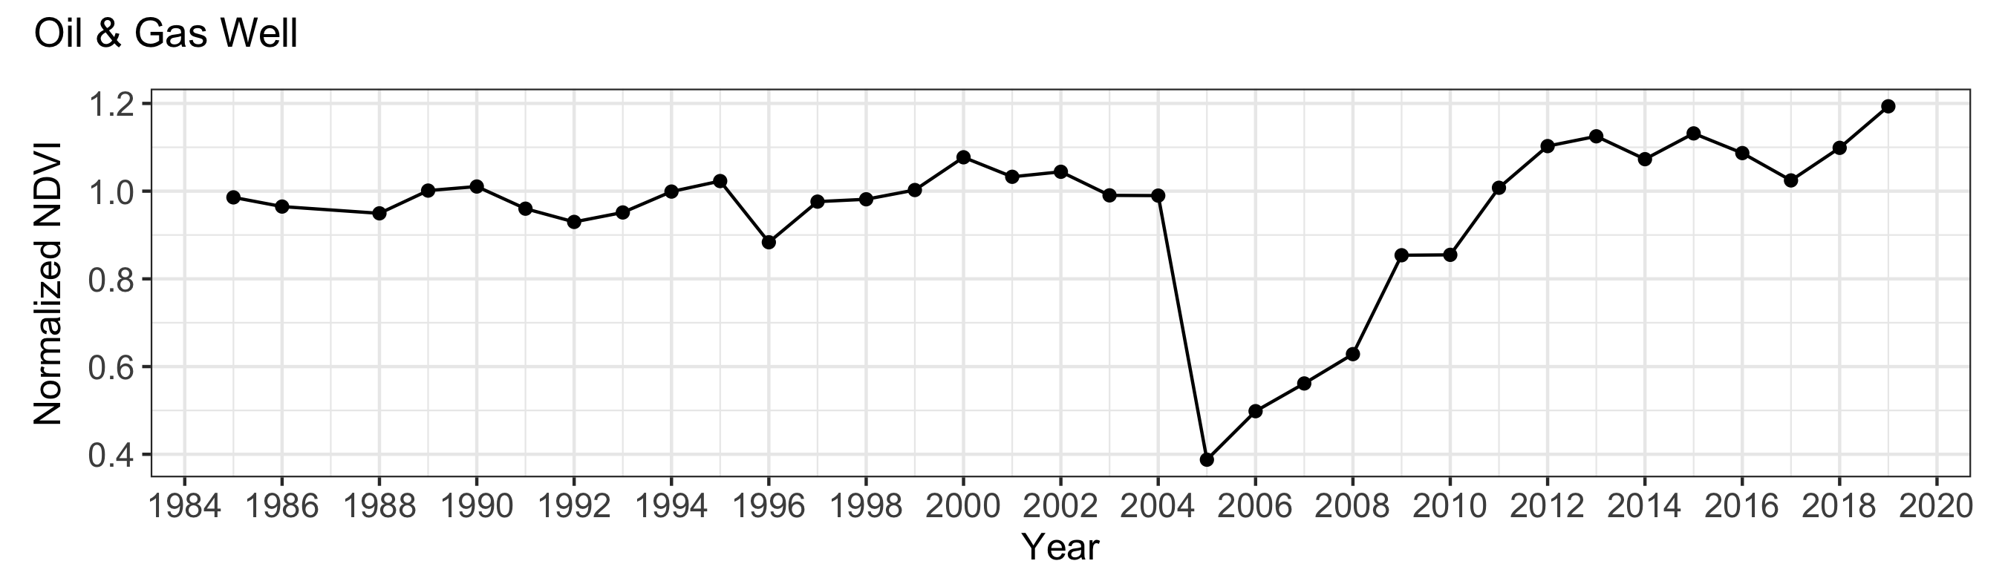
Multi-Disturbance Working Group
Synthesis of major North American Arctic-Boreal disturbances
Focus on interactions and spatiotemporal characteristics
Case studies showing vegetation loss and recovery (NDVI and NDMI)
Spatiotemporal characteristics
Comparing vegetation impacts
Trajectories of change
Interactions

Slide 6
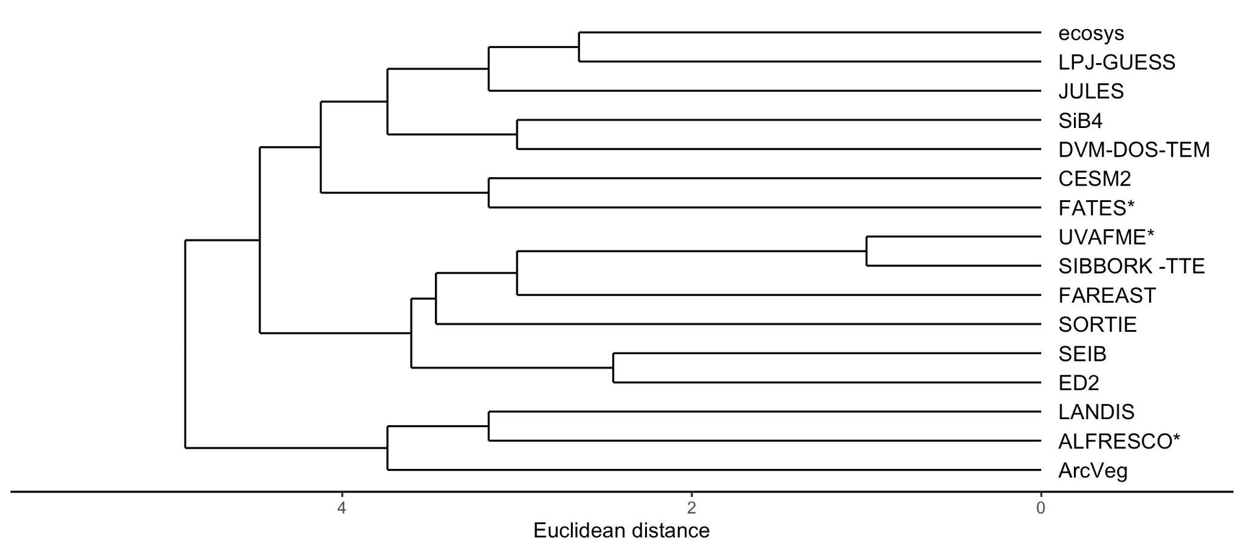
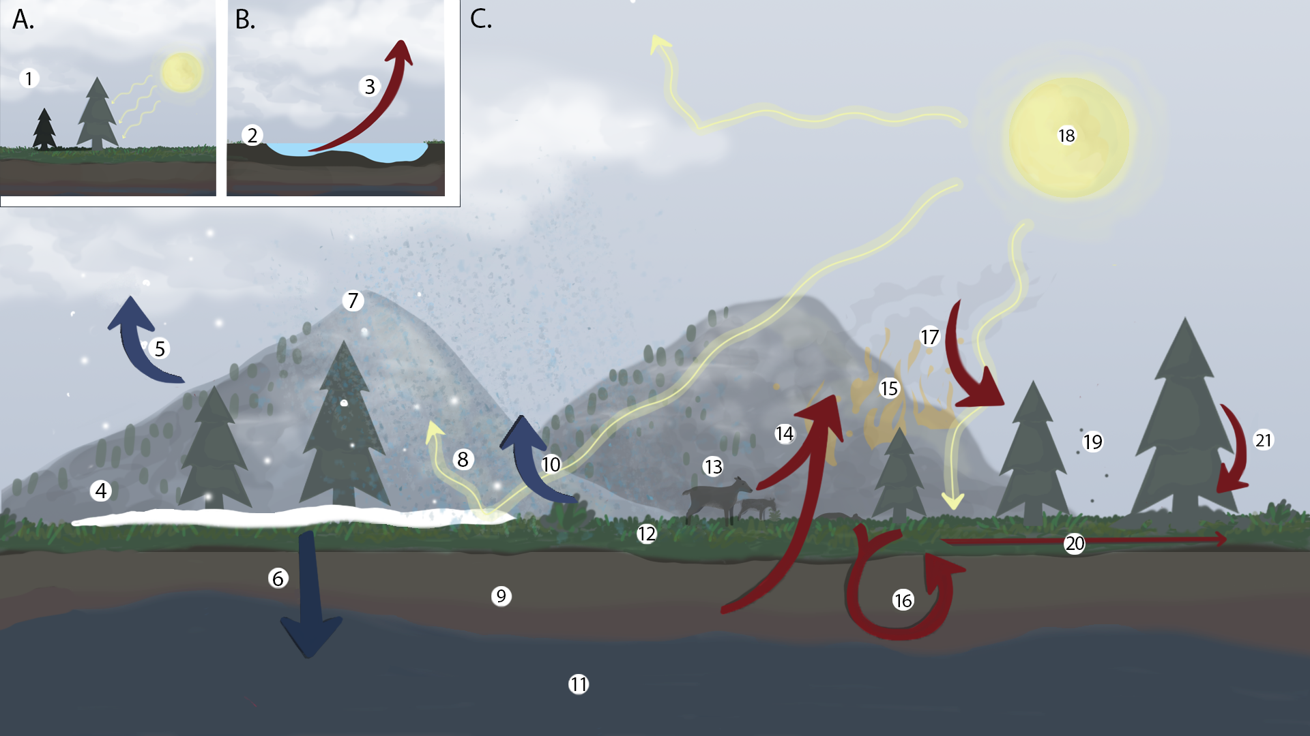
Synthesis of Dynamic Vegetation Models for Arctic-Boreal Zone Research
Dynamic vegetation models (DVM) are used to project vegetation community composition changes under future Arctic conditions
However, the array of DVMs is large and each one covers different processes
Aim to simplify our understanding of the utility of different DVMs and the plant community properties and ecosystem processes are represented by each model
Developed a tree diagram of model relatedness, using model properties
Heffernan, Epstein, Armstrong, Rogers, Lutz, Virkkala
© Shelby Lawton

Slide 7
Individual contributions: Boreal

Slide 8
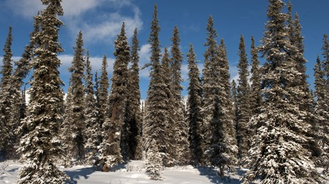
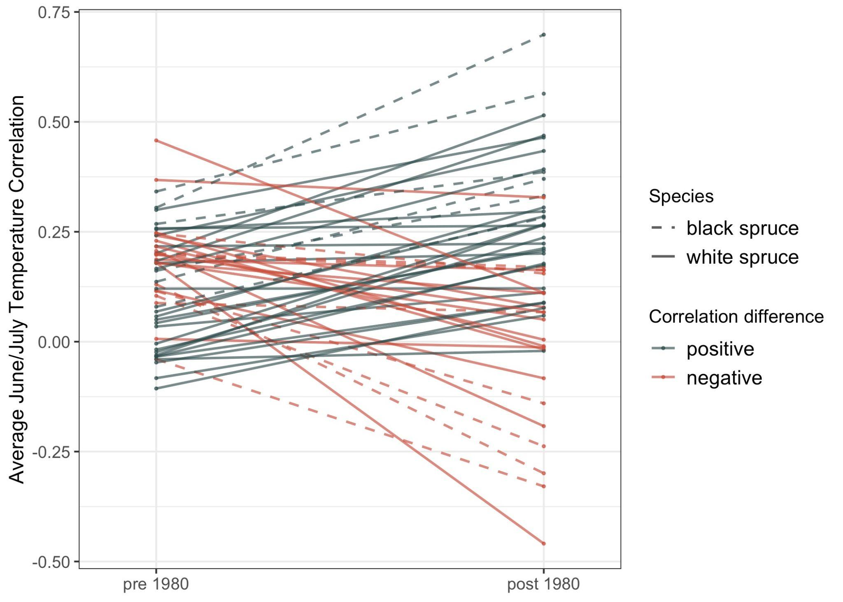
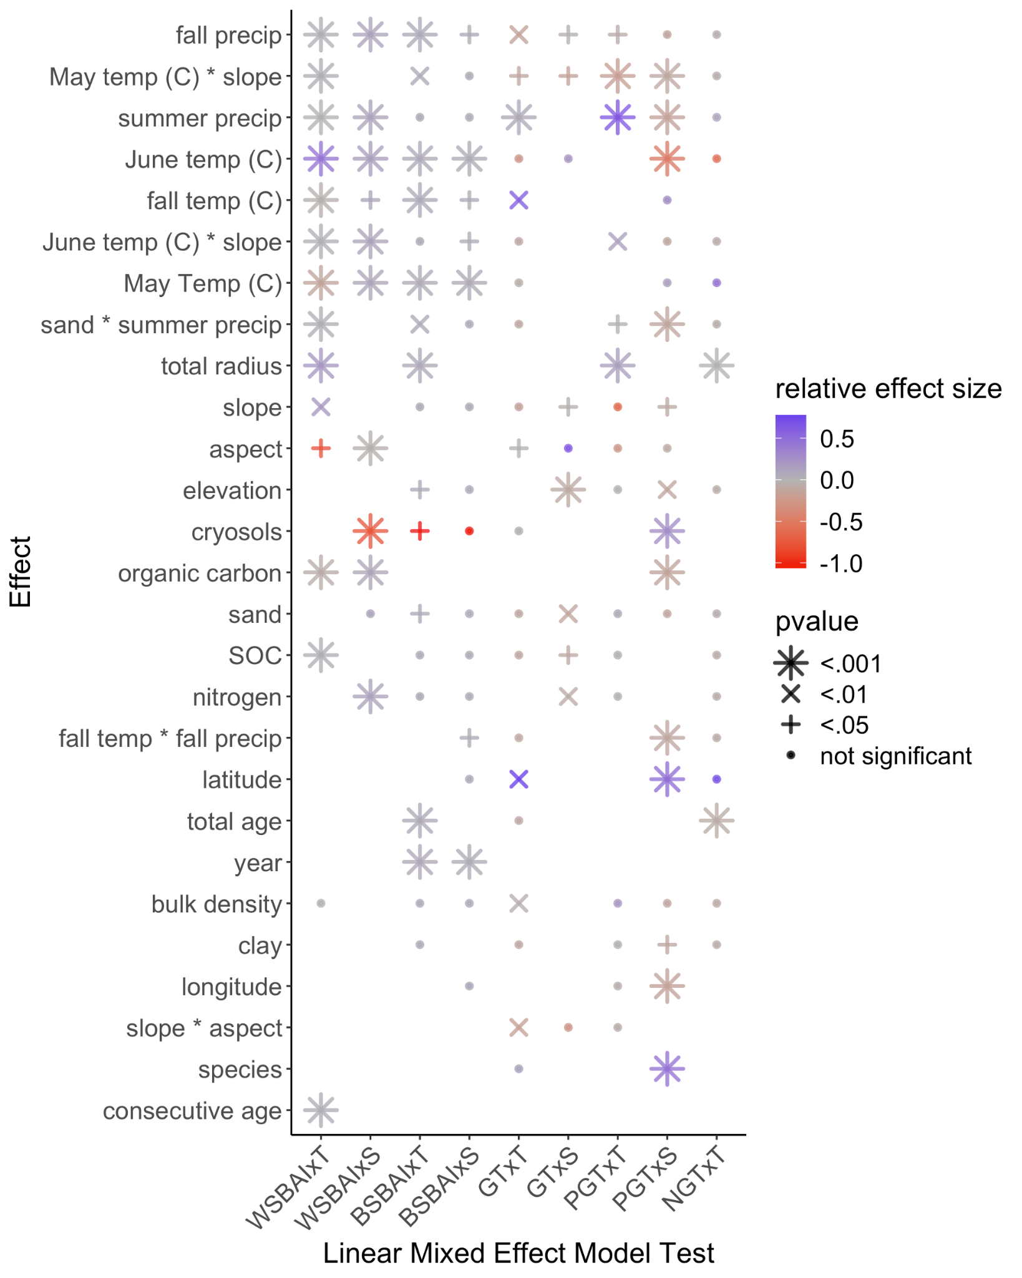
Drivers of growth in boreal Alaska and Canada from a tree ring perspective
NOAA International Tree Ring Data Bank and Arctic Data Center
Divergence problem (differential tree growth responses to past and more recent temperature dynamics) are not universal and are better assessed on a site- and species-specific basis.
Statistical models reveal a complicated picture with soil characteristics playing an important role in moderating the effects of climate on tree growth
Bulzoni, Heffernan, et al.
(see poster)
Notes:
I want another graph or something pretty in here

Slide 9



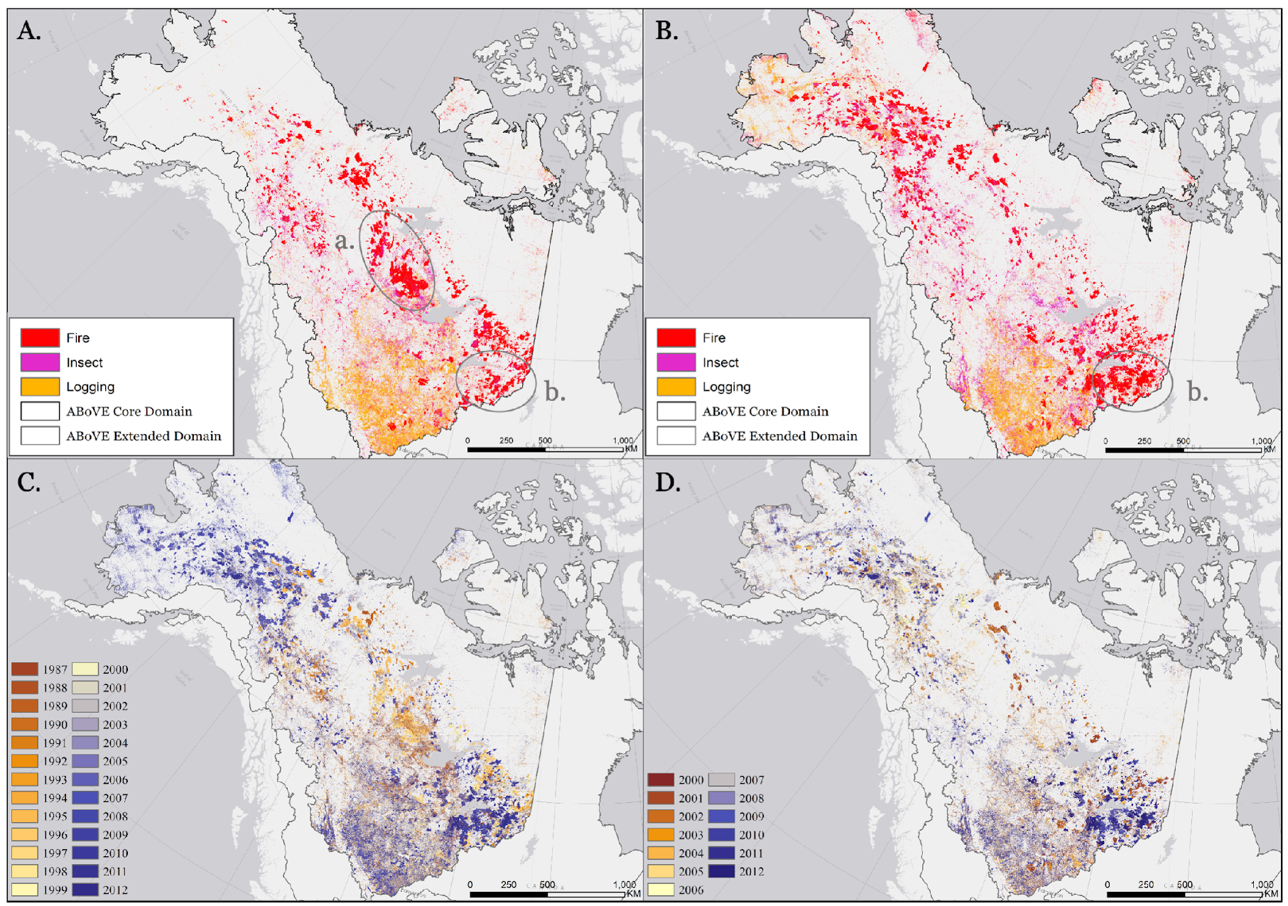
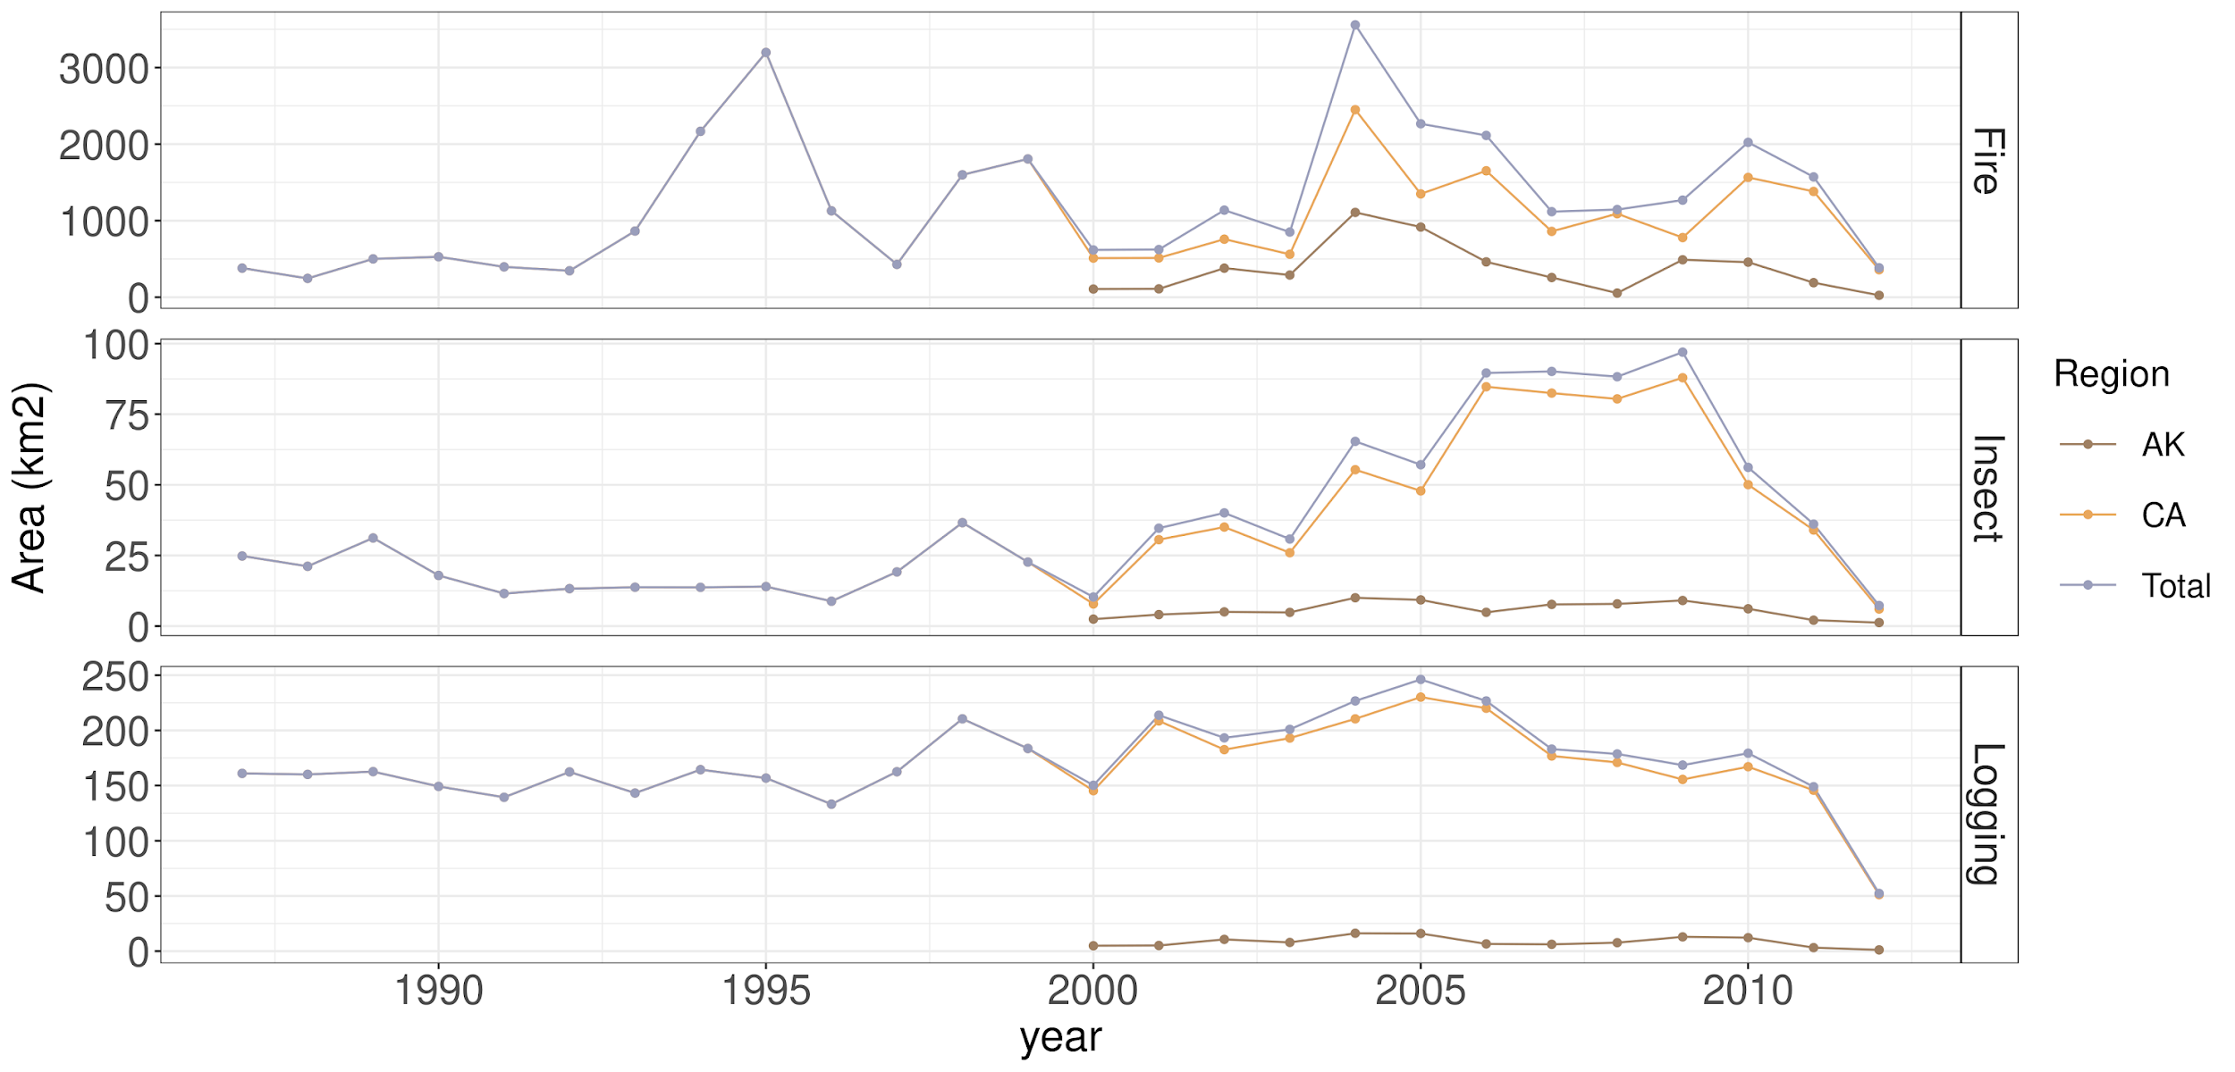
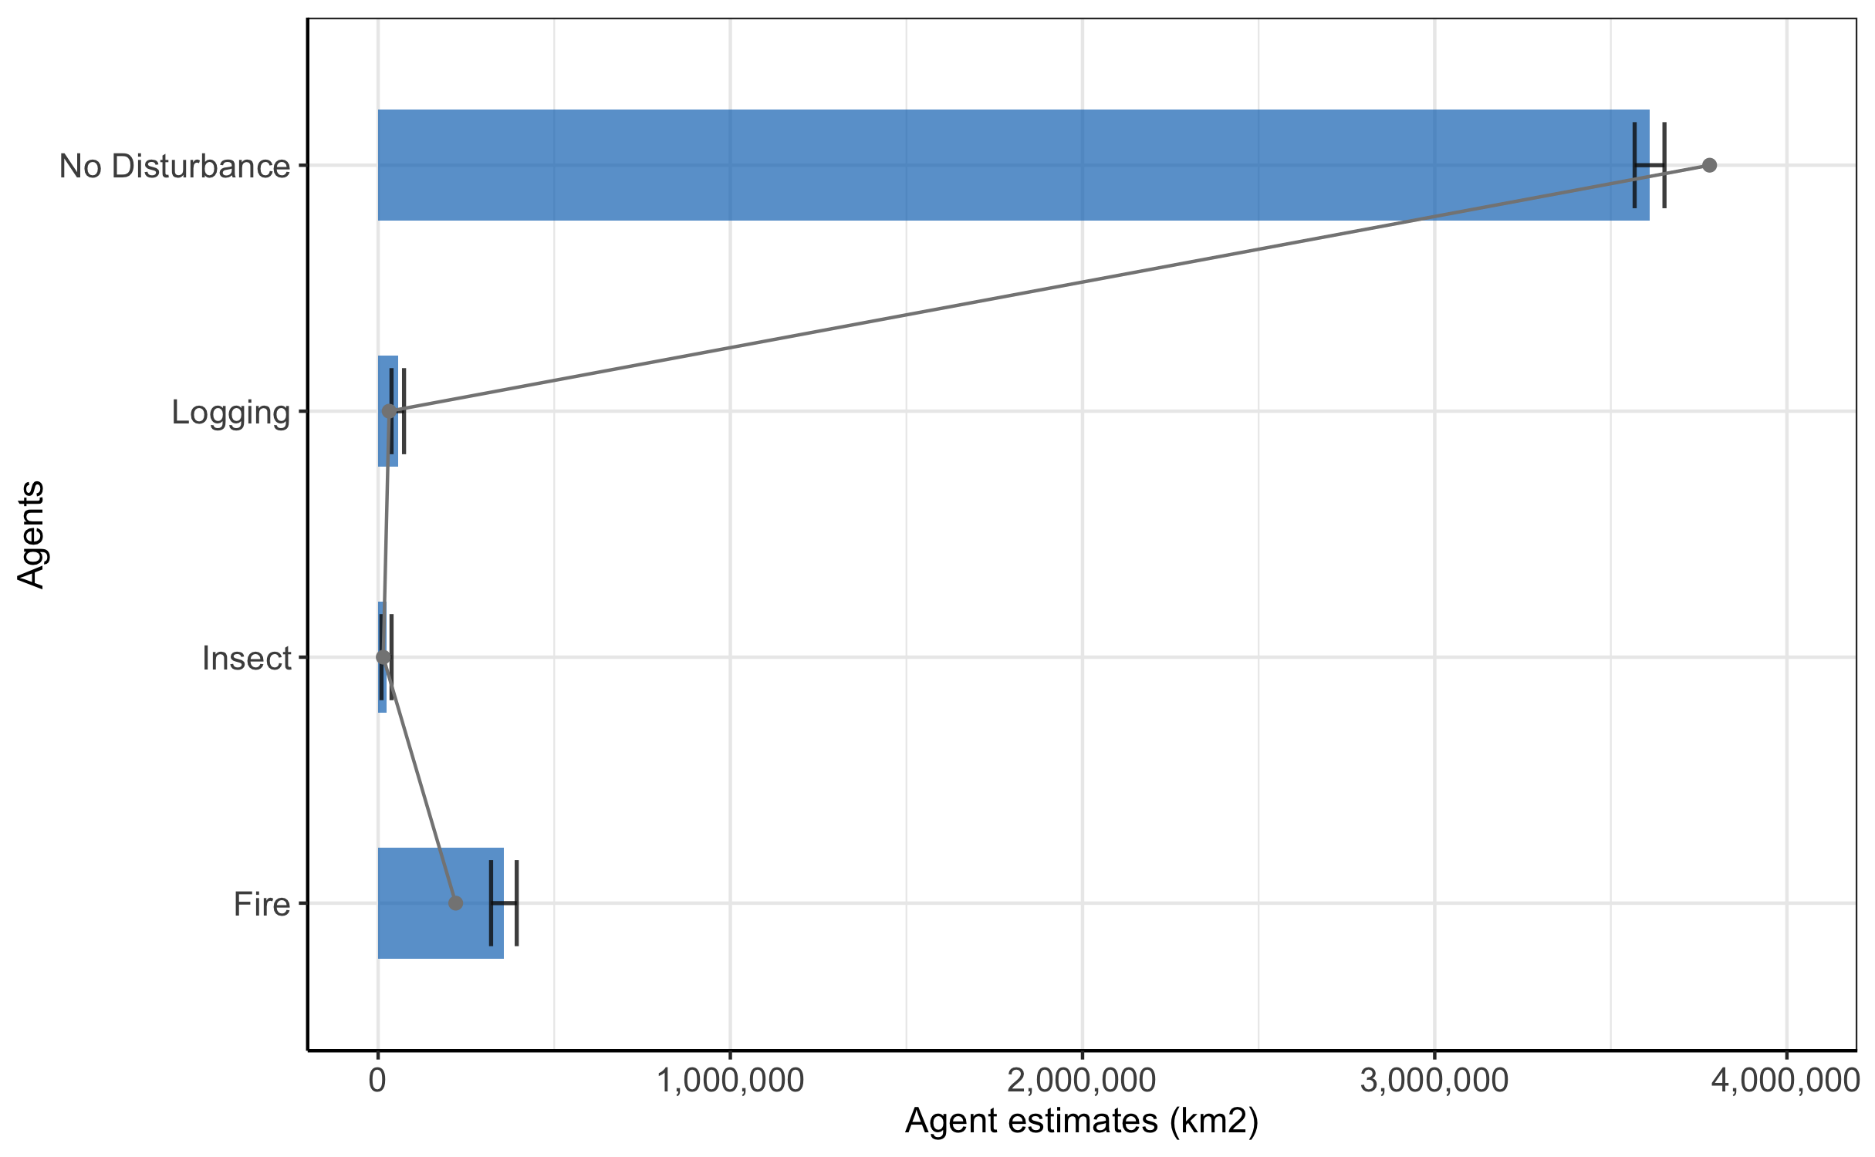
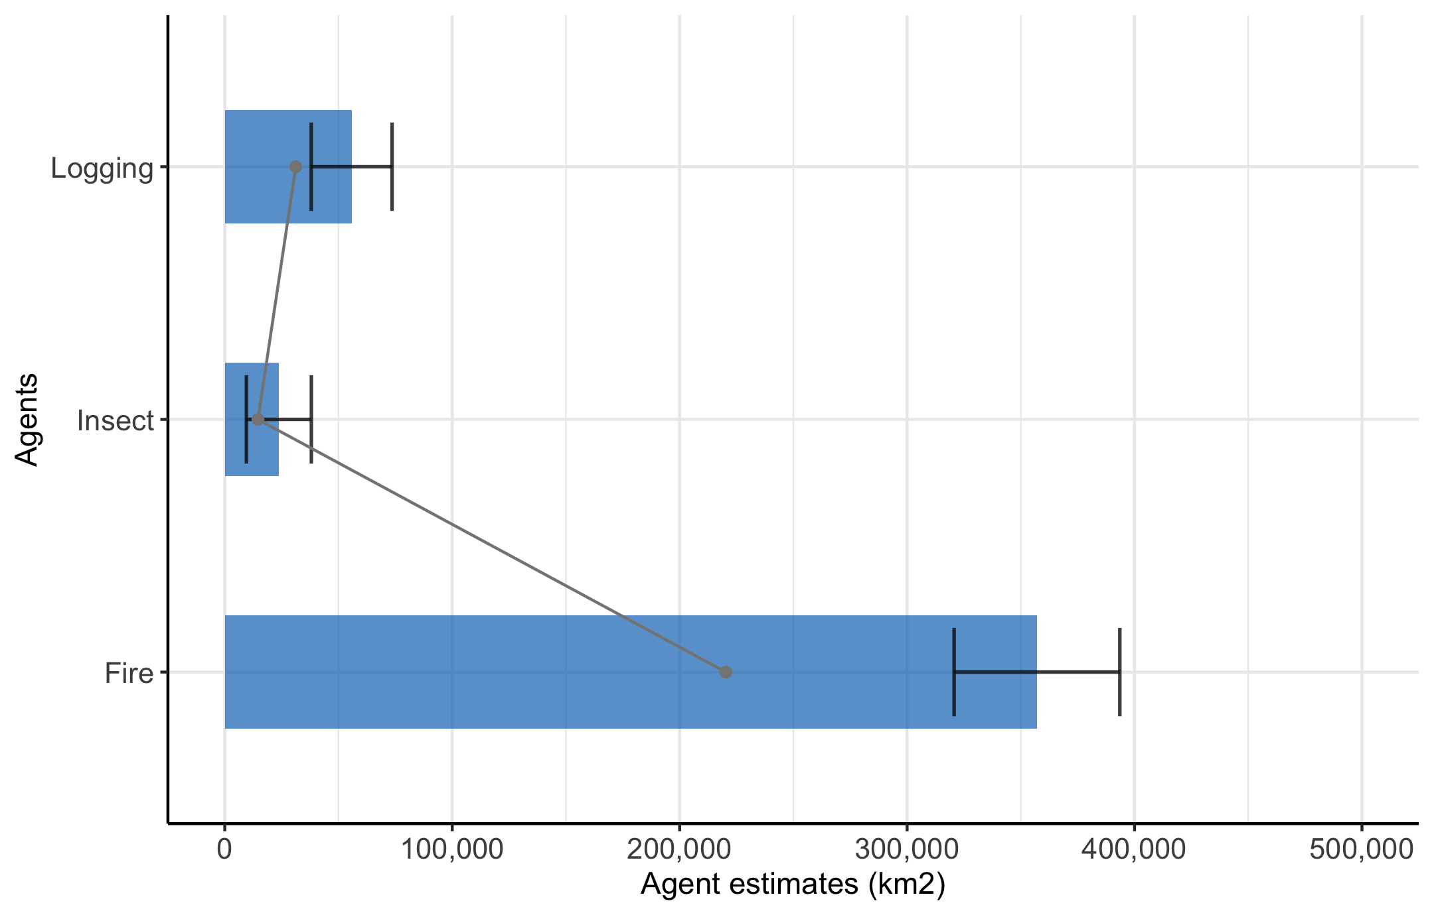
Causal Agents of Disturbance for ABoVE Core Domain (1987-2012)
7.2% of ABoVE core domain has been disturbed from 1987 to 2012
33.6 % of the disturbance occurred in forested ecosystems
Fire overall plays the dominant role across the entire ABoVE study region
Pest damage may keep increasing but we need to extend our study period
(Zhang et al., 2022, RSE)
Notes:
From Curtis Woodcock
Datasets: Zhang, Y., C.E. Woodcock, S. Chen, J. Wang, D. Sulla-Menashe, Z. Zuo, P. Olofsson, Y. Wang, and M.A. Friedl. 2022. ABoVE: Landsat-derived Annual Disturbance Agents Across ABoVE Core Domain, 1987-2012. ORNL DAAC, Oak Ridge, Tennessee, USA. https://doi.org/10.3334/ORNLDAAC/1924
Paper: Zhang, Y., Woodcock, C.E., Chen, S., Wang, J.A., Sulla-Menashe, D., Zuo, Z., Olofsson, P., Wang, Y. and Friedl, M.A., 2022. Mapping causal agents of disturbance in boreal and arctic ecosystems of North America using time series of Landsat data. Remote Sensing of Environment, 272, p.112935. https://doi.org/10.1016/j.rse.2022.112935

Slide 10
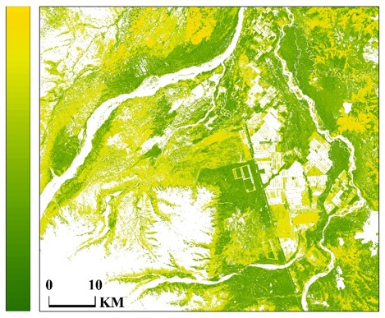
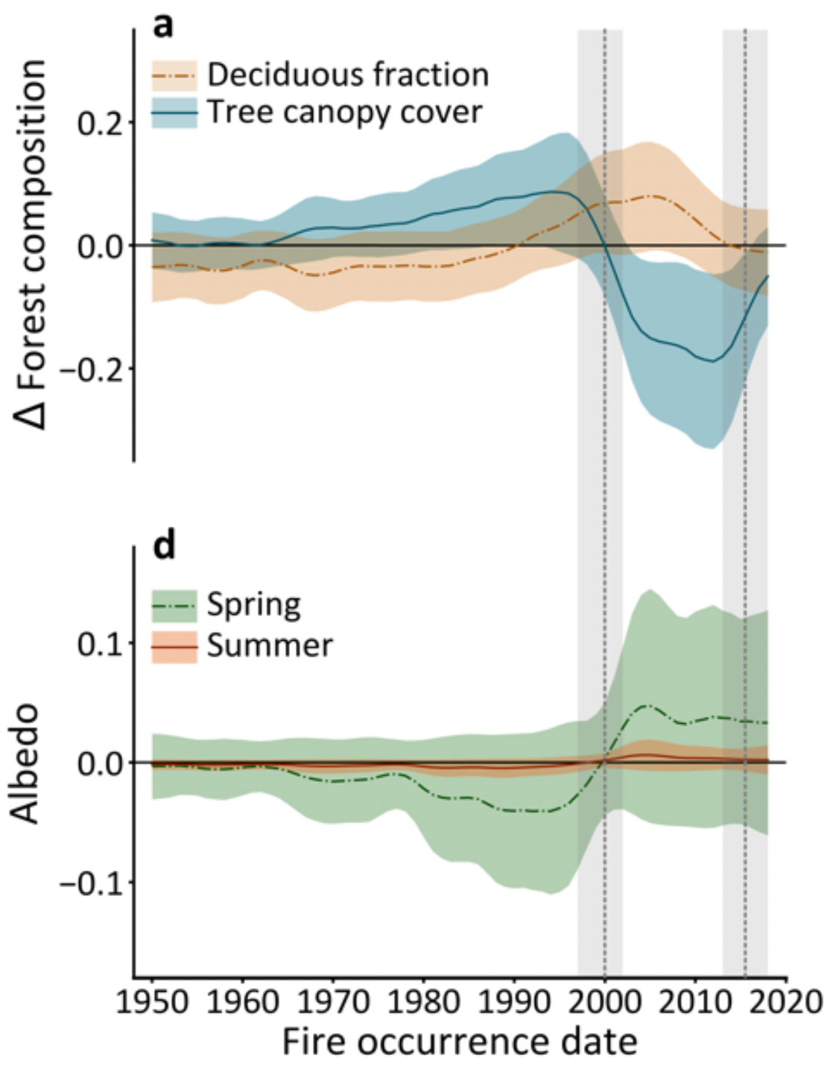
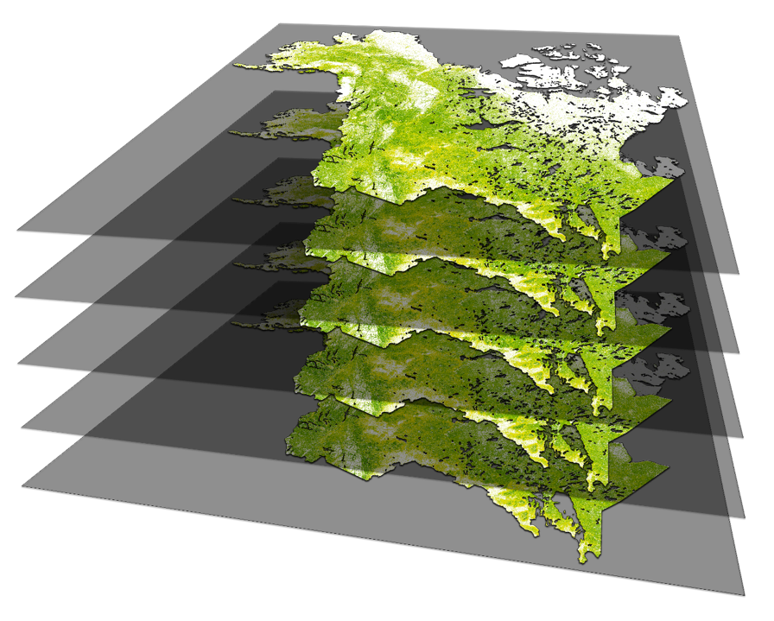
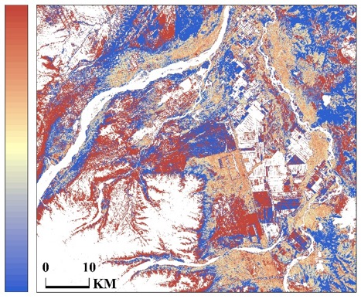
Mappping deciduous fraction time and its impact on albedo
100
N
Deciduous fraction
0
Fort Greely, AK
2015
45
2010
2005
2000
Uncertainty
1992
0
Massey et al. (in revision)
Goetz (TE 2014, 2018) and Rogers (CARBON 2016) projects
Notes:
Using a Random Forest regressor, and ground samples from multiple networks, we computed multi-year time-series of deciduous fraction maps for the nominal years 1992, 2000, 2005, 2010, and 2015. These deciduous fraction maps represent 5 years centered around the nominal year, except in the case of 1990 where the map represents 10 years. Deciduous fraction ranged between 0 and 100.
In addition to the deciduous fraction maps we also produced uncertainty layers for each nominal year. The uncertainty of the per-pixel deciduous map represents the standard deviation of the individual tree outputs in the Random forest regressor. The uncertainty values typically ranged between 0 to 45.
In the figure on the left we have the 2010 deciduous fraction map showing the area around Fort Greely in Alaska. Here we can see the uncertainty is high when the deciduous fraction is near around 50. But it is generally low with close to 100 or close to 0 per-pixel deciduous fraction.
It is interesting to note that the sites of some of the well known fires in this area have high deciduous fraction than the unburnt areas, that are evergreen.

Slide 11
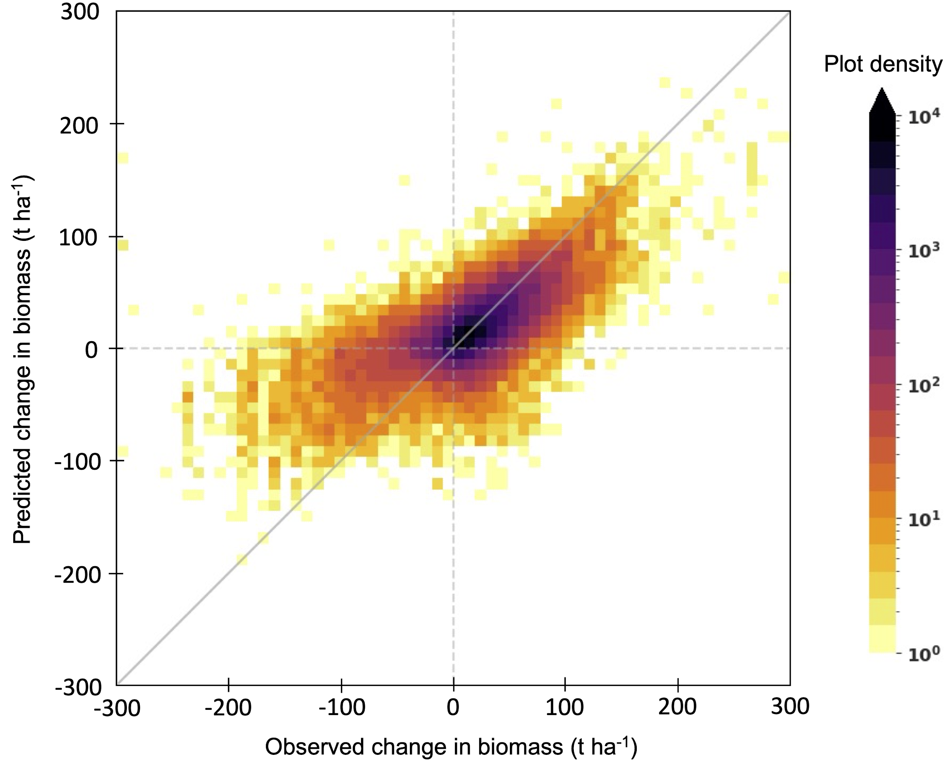
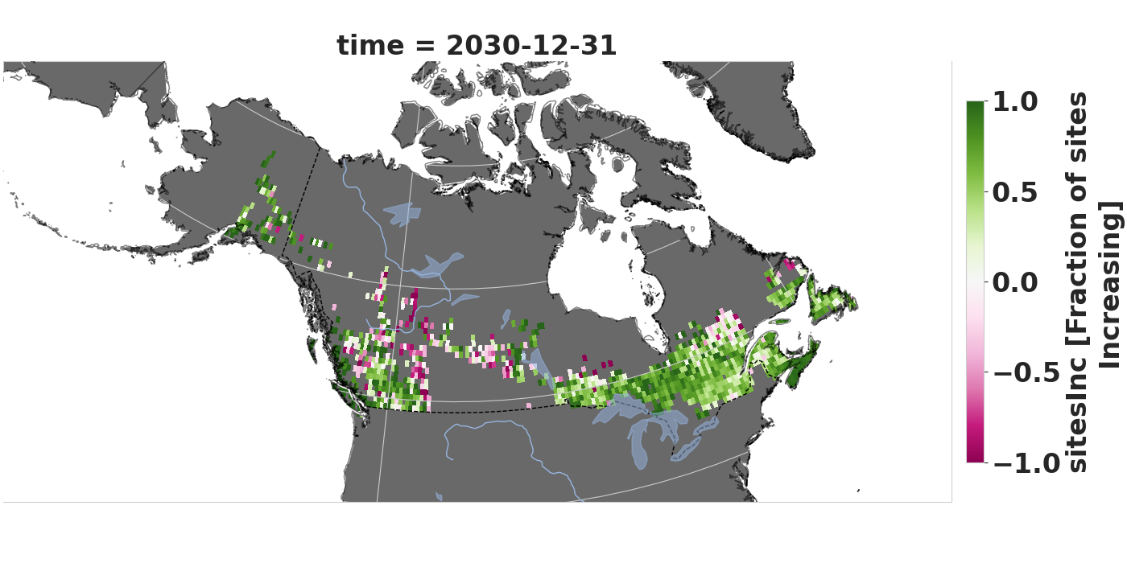
The predictability of near-term forest biomass change in boreal North America
Goetz TE (2018), Burrell et al. (in prep.)
% sites increasing biomass by 2030
0
25
50
75
100
Compiled a database of ~20,000 forest inventory plots with repeat measurements from 13 agencies across Canada & AK
Extreme gradient boosted regression to predict changes in biomass up to 30 years into the future
Models can predict biomass gain robustly 20 to 30 years into the future and non-disturbance loss (i.e., excluding fire, harvest) 5 to 15 years
Biomass gains are expected across much of the continent, with the exception of mortality in southwestern Canada

Slide 12


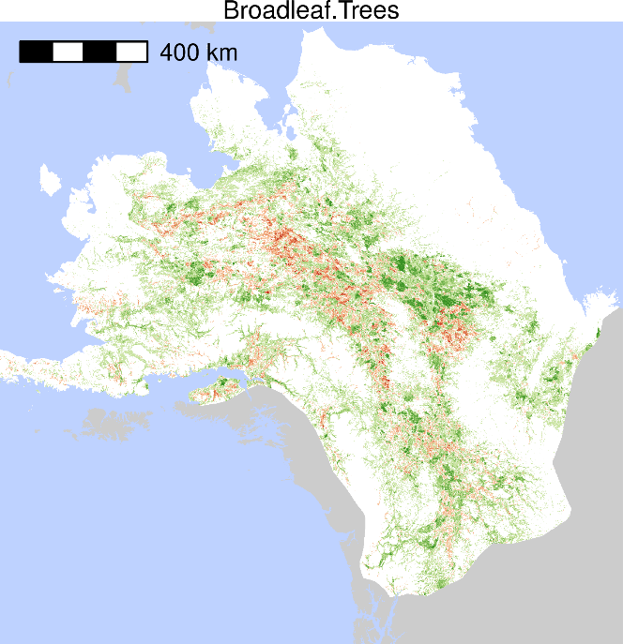
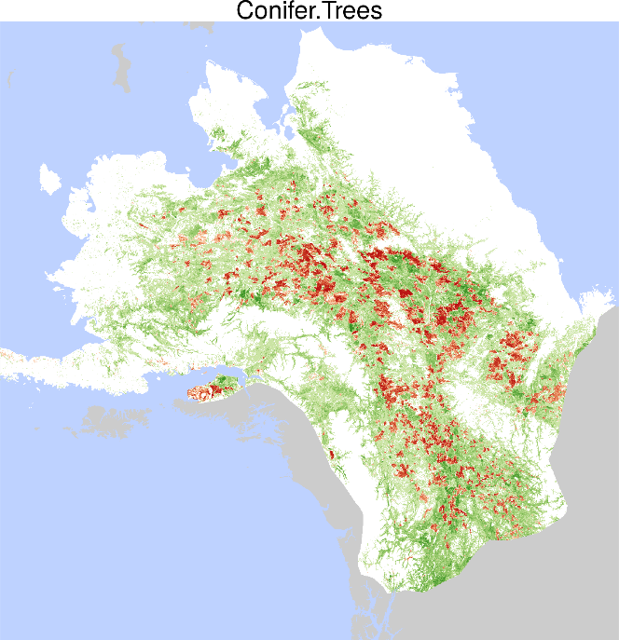
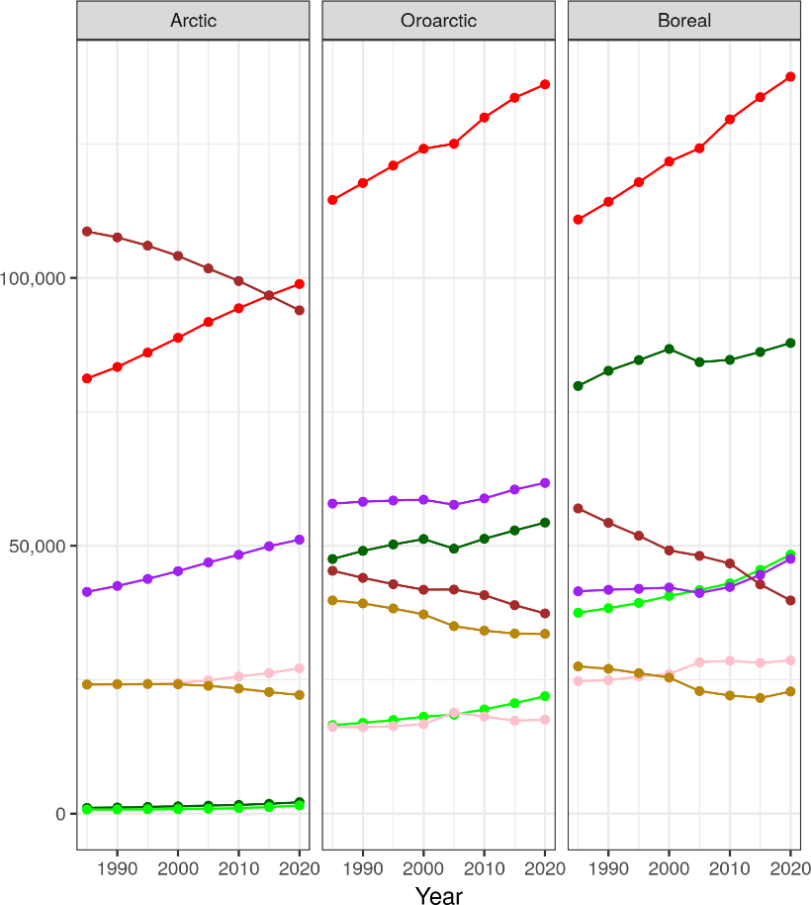
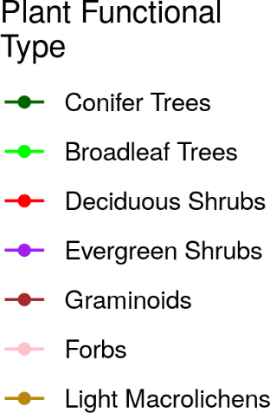
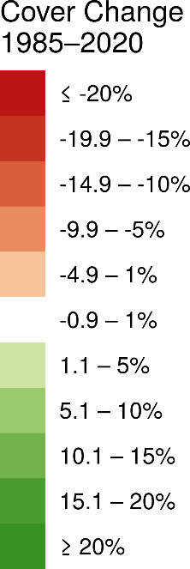

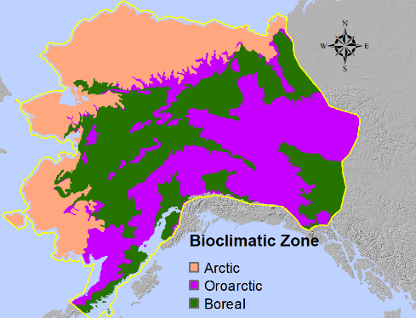
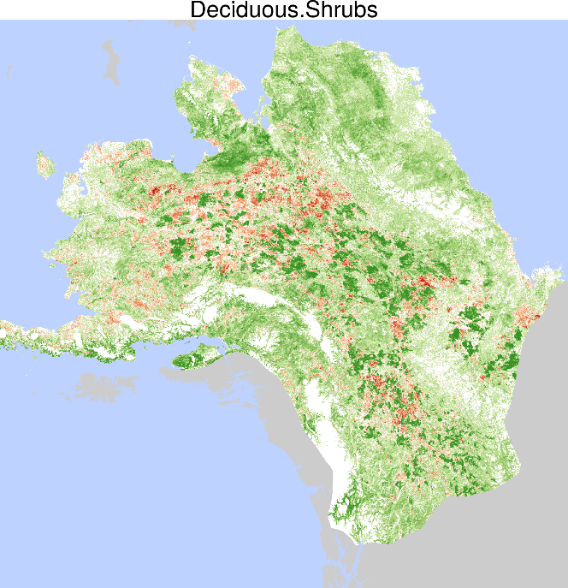
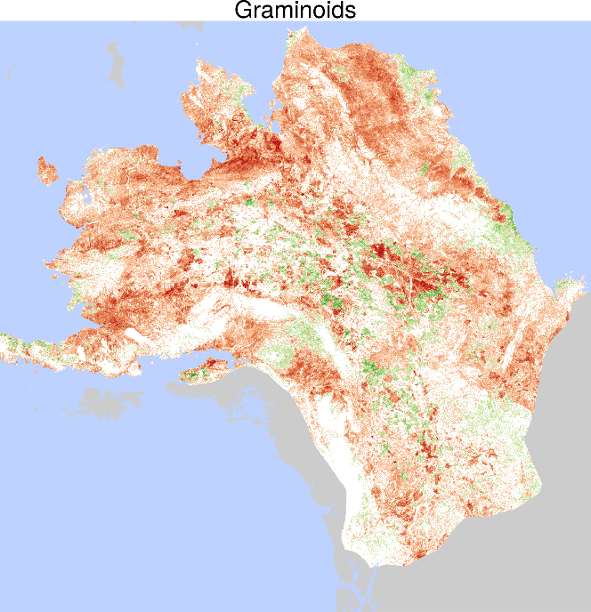
Time-series maps reveal widespread change in plant functional type cover across Arctic and boreal Alaska and Yukon
  Matthew Macander et al. (2022) Environmental Research Letters.
(a)
(b)
Increases in Deciduous and Evergreen Shrub, Conifer and Broadleaf Tree top cover.
Decrease in Graminoid and Lichen top cover, associated with shrub increase and fire.
Many applications with very high utility for wildlife movement analyses.
Notes:
Notes: Plant functional types (PFTs) collectively include all vascular plants within the study area as well as light macrolichens, a nonvascular class of high importance to caribou management.
We identified net increases in deciduous shrubs (3.7% of study area), evergreen shrubs (1.1%), broadleaf trees (1.0%), and conifer trees (0.9%), and net decreases in graminoids -2.2%) and light macrolichens 0.8%) over the full map area, with similar patterns across Arctic, Oroarctic, and Boreal bioclimatic zones
Despite extensive wildfire over the 1985–2020 study period, our results indicated that both broadleaf and coniferous tree cover increased throughout the domain.
Rapid increases in deciduous shrub cover after fire and throughout the domain support both post-fire pulses in shrub abundance and long-term shrub increase and canopy dominance in the absence of fire disturbance.
Graminoid top cover decreased throughout the domain, likely driven by competition from deciduous and evergreen shrubs.
Slow, steady loss of lichen is related to both increases in shrubs and associated losses from fire.
Full citation: Macander, M.J., Nelson, P.R., Nawrocki, T., Frost, G.V., Orndahl, K., Palm, E.C., Wells, A.F. and Goetz, S.J., 2022. Time-series maps reveal widespread change in plant functional type cover across arctic and boreal Alaska and Yukon. Environmental Research Letters. https://doi.org/10.1088/1748-9326/ac6965
Data: Macander, M.J., and P.R. Nelson. 2022. ABoVE: Modeled Top Cover by Plant Functional Type over Alaska and Yukon, 1985-2020. ORNL DAAC, Oak Ridge, Tennessee, USA. https://doi.org/10.3334/ORNLDAAC/2032
Grants: This study was funded by the National Aeronautics and Space Administration (NASA) Arctic Boreal Vulnerability Experiment (ABoVE) grants (NNX17AE44G and 80NSSC19M0112) to Scott Goetz.
Abstract: Widespread changes in the distribution and abundance of plant functional types (PFTs) are occurring in Arctic and boreal ecosystems due to the intensification of disturbances, such as fire, and climate-driven vegetation dynamics, such as tundra shrub expansion. To understand how these changes affect boreal and tundra ecosystems, we need to first quantify change for multiple PFTs across recent years. While landscape patches are generally composed of a mixture of PFTs, most previous moderate resolution (30-m) remote sensing analyses have mapped vegetation distribution and change within land cover categories that are based on the dominant PFT; or else the continuous distribution of one or a few PFTs, but for a single point in time. Here we map a 35-year time-series (1985–2020) of top cover (TC) for seven PFTs across a 1.77 x 106 km² study area in northern and central Alaska and northwestern Canada. We improve on previous methods of detecting vegetation change by modeling TC, a continuous measure of plant abundance. The PFTs collectively include all vascular plants within the study area as well as light macrolichens, a nonvascular class of high importance to caribou management. We identified net increases in deciduous shrubs (66 x 103 km²), evergreen shrubs (20 x 103 km²), broadleaf trees (17 x 103 km²), and conifer trees (16 x 103 km²), and net decreases in graminoids (-40 x 103 km²) and light macrolichens (-13 x 103 km²) over the full map area, with similar patterns across Arctic, Oroarctic, and Boreal bioclimatic zones. Model performance was assessed using spatially blocked, nested 5-fold cross-validation with overall root mean square errors ranging from 8.3–19.0%. Most net change occurred as succession or plant expansion within areas undisturbed by recent fire, though PFT TC change also clearly resulted from fire disturbance. These maps have important applications for assessment of surface energy budgets, permafrost changes, nutrient cycling, and wildlife management and movement analysis.

Slide 13
Individual contributions: Tundra-taiga ecotone

Slide 14


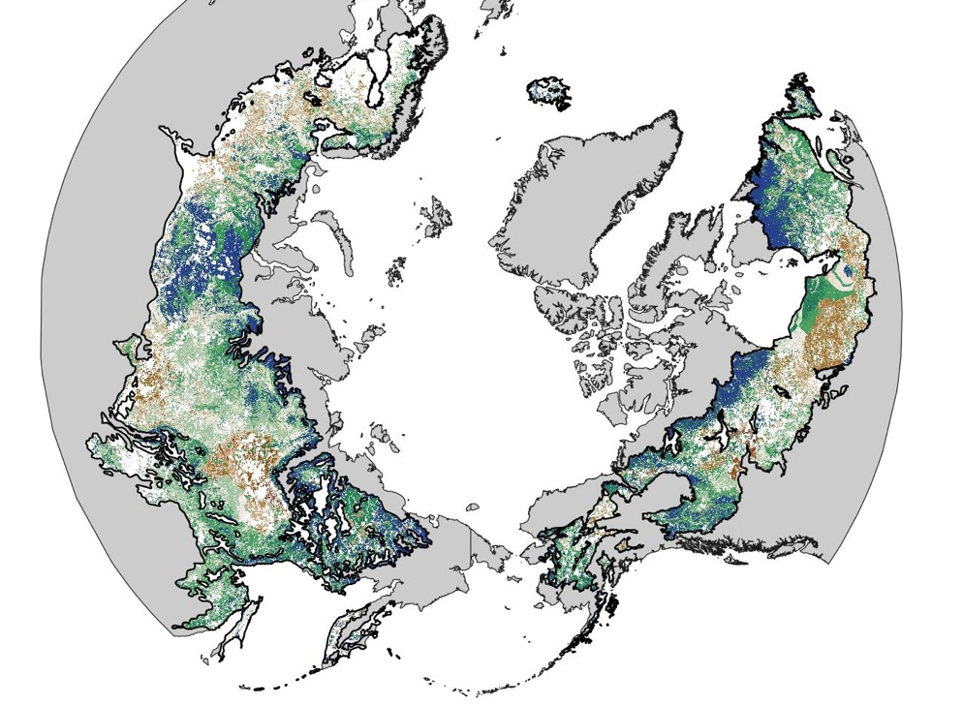
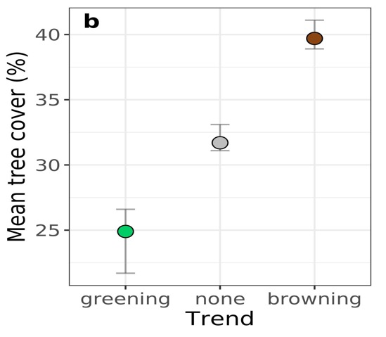
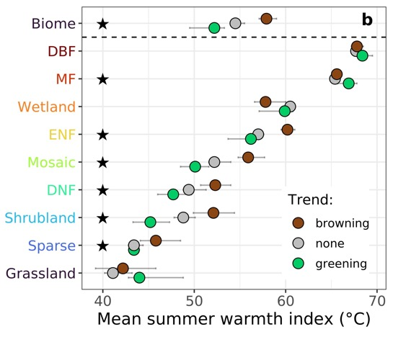
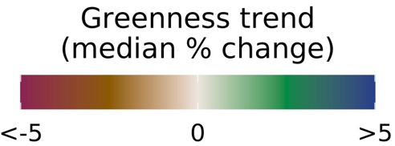
Satellite observations document trends consistent with a boreal forest biome shift
  Logan Berner and Scott Goetz (2022), Global Change Biology
(a)
(b)
Consistent with a biome shift, the Landsat satellites show widespread greening in the forest-tundra ecotone from 2000-2019, along with browning in more southern regions (a)
(c)
Greening occurred in areas with lower tree cover (b) and mean summer temperatures (c)
Notes:
Notes: Annual maximum vegetation greenness increased (greened) at 38 [29, 42] % and 22 [15, 26] % of sample sites from 1985 to 2019 and 2000 to 2019, whereas vegetation greenness decreased (browned) at 13 [9, 15] % and 15 [13, 19] % of sample sites during these periods [95% CI].
Greening was about 3.0 and 1.5 times more common than browning during these periods
Greening primarily occurred in cold sparsely treed areas with high soil nitrogen and moderate summer warming, while browning primarily occurred in the climatically warmest margins of both the boreal forest biome and major forest types (e.g., evergreen conifer forests), especially in densely treed areas where summers became warmer and drier.
Full citation: Berner, L. T and Goetz, S. J.: Satellite observations document trends consistent with a boreal forest biome shift. Global Change Biology, In Press
Grants: This study was funded by the National Aeronautics and Space Administration (NASA) Arctic Boreal Vulnerability Experiment (ABoVE) and Carbon Cycle Science grants (NNX17AE44G, 80NSSC19M0112, and NNX17AE13G) to Scott Goetz.
Abstract: The boreal forest biome is a major component of Earth’s biosphere and climate system that is projected to shift northward due to continued climate change over the coming century. Indicators of a biome shift will likely first be evident along the climatic margins of the boreal forest and include changes in vegetation productivity, mortality, and recruitment, as well as overall vegetation greenness. However, the extent to which a biome shift is already underway remains unclear because of the local nature of most field studies, sparsity of systematic ground-based ecological monitoring, and reliance on coarse resolution satellite observations. Here, we evaluated indicators of a boreal forest biome shift using four decades of moderate resolution (30 m) satellite observations and biogeoclimatic spatial datasets. Specifically, we quantified inter-annual trends in annual maximum vegetation greenness using an ensemble of vegetation indices derived from Landsat observations at 100,000 sample sites in areas without signs of recent disturbance. We found vegetation greenness increased (greening) at 38 [29, 42] % and 22 [15, 26] % of sample sites from 1985 to 2019 and 2000 to 2019, whereas vegetation greenness decreased (browning) at 13 [9, 15] % and 15 [13, 19] % of sample sites during these respective periods [95% Monte Carlo confidence intervals]. Greening was thus 3.0 [2.6, 3.5] and 1.5 [0.8, 2.0] times more common than browning and primarily occurred in cold sparsely treed areas with high soil nitrogen and moderate summer warming. Conversely, browning primarily occurred in the climatically warmest margins of both the boreal forest biome and major forest types (e.g., evergreen conifer forests), especially in densely treed areas where summers became warmer and drier. These macroecological trends reflect underlying shifts in vegetation productivity, mortality and recruitment that are consistent with early stages of a boreal biome shift.

Slide 15
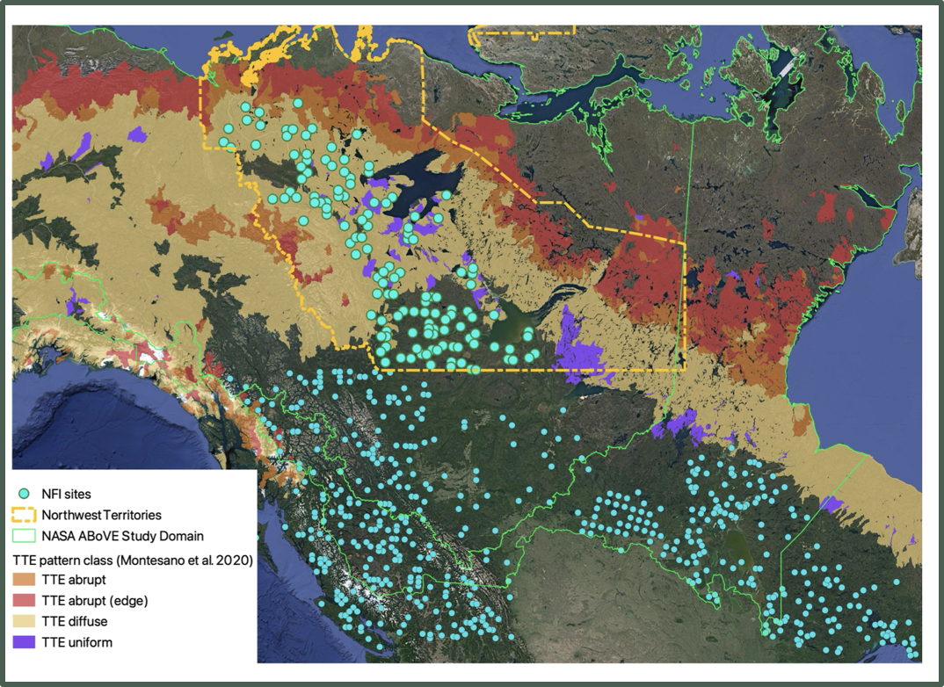

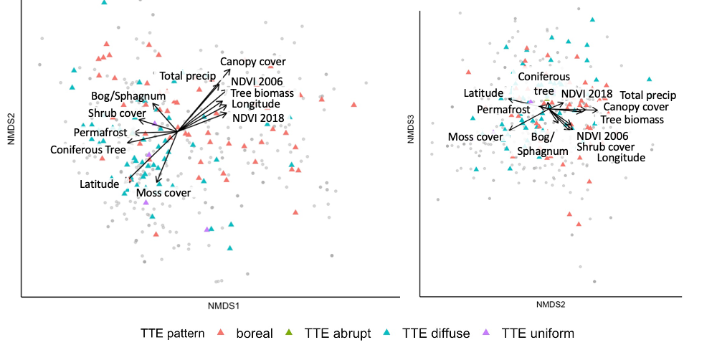
Insights into PFT growth drivers from Canada’s National Forest Inventory Data
Used NFI percent cover data to assess community composition along environmental gradients
Physical site structure variables (such as cover and biomass) had greater importance with regard to spatial heterogeneity when all PFTs were analyzed together, but climate variables influenced individual PFTs more (e.g. tall shrubs)
Long-term climate is likely to shift the composition of boreal and tundra-taiga ecotone communities
Heffernan et al.

Slide 16
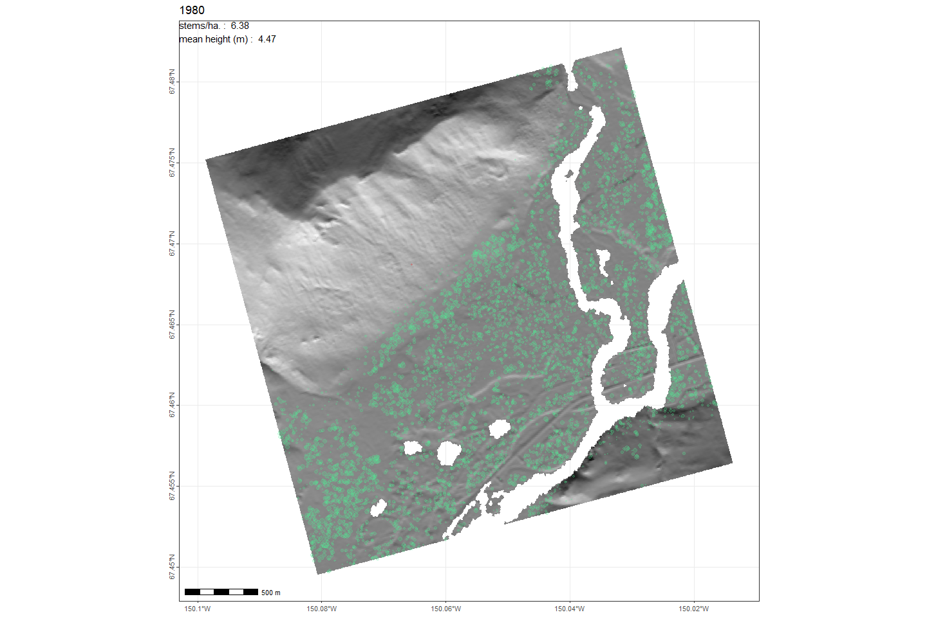
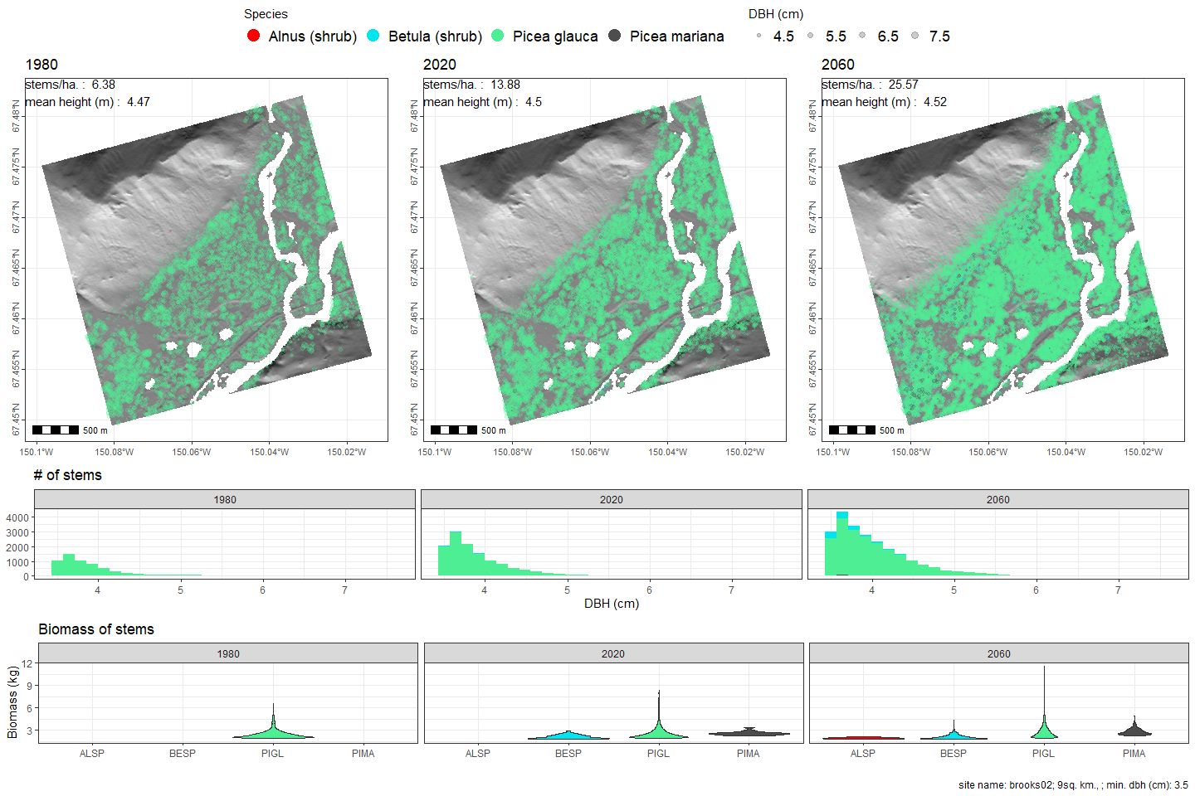
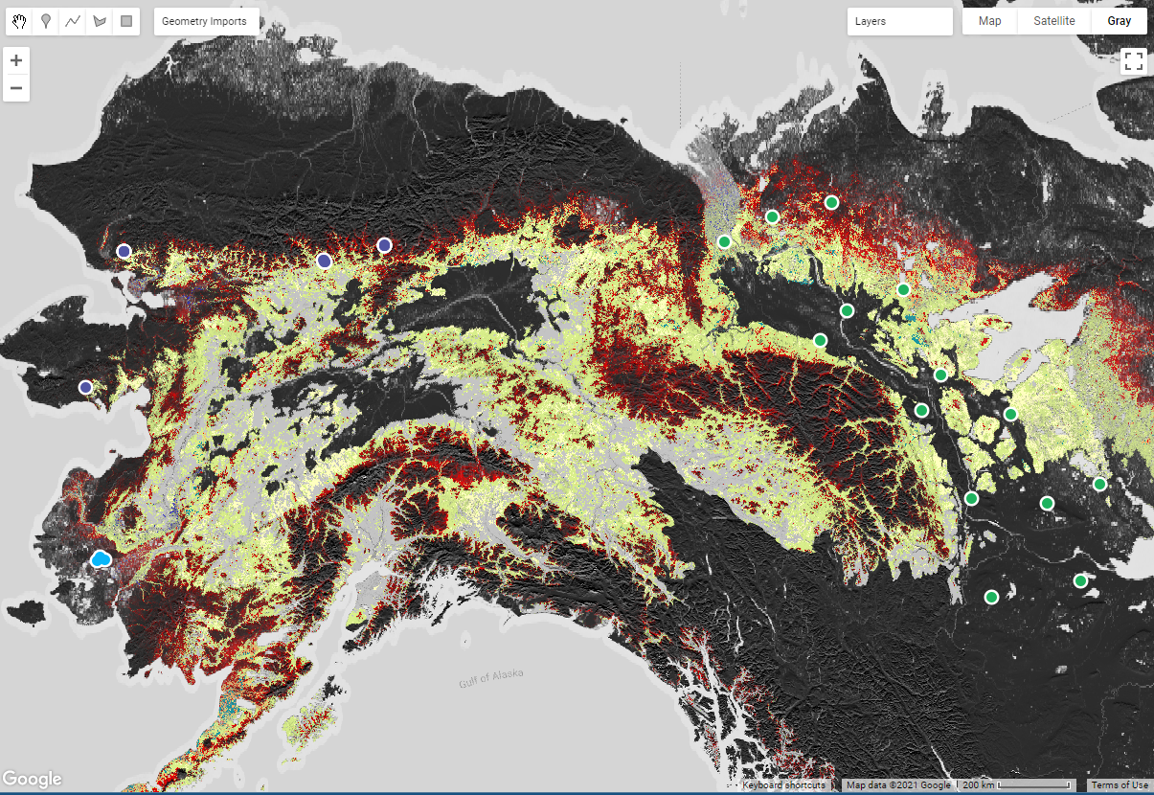
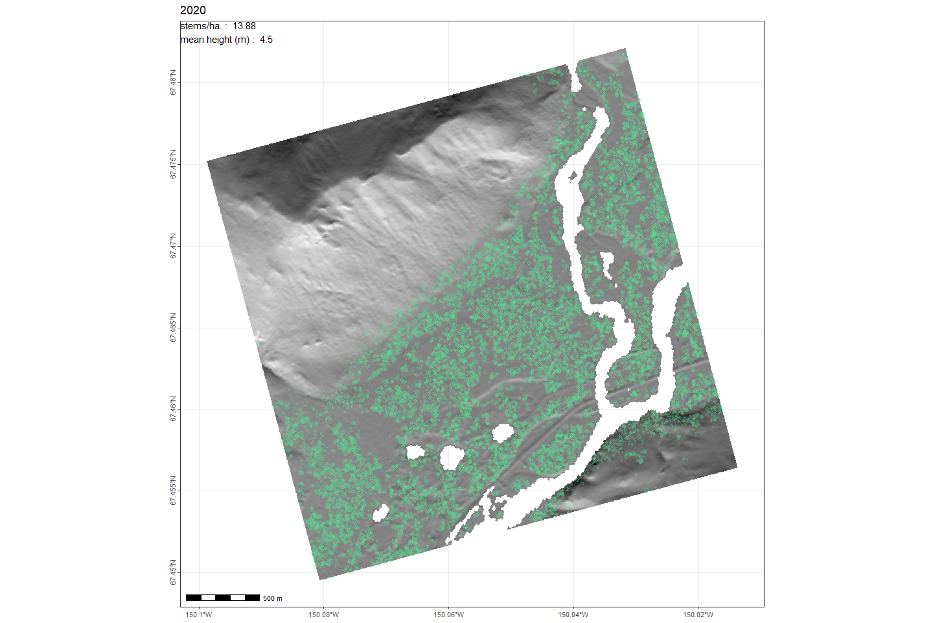
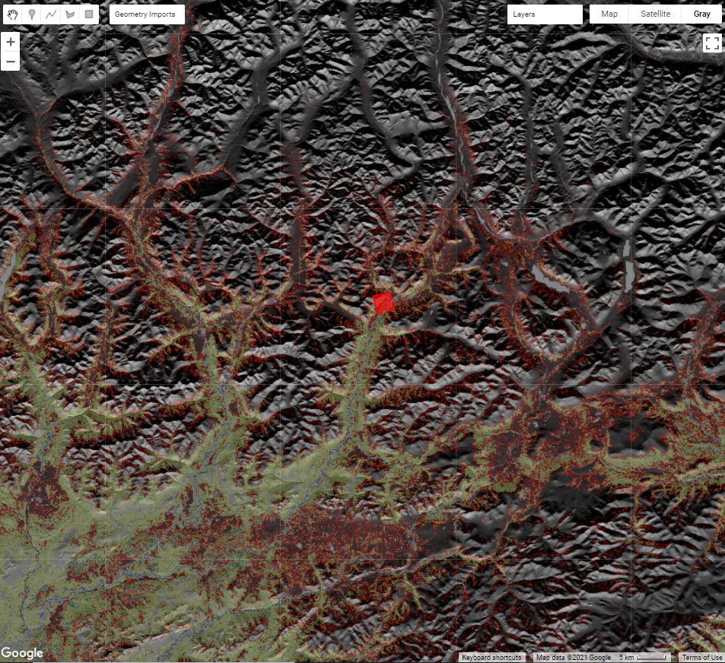
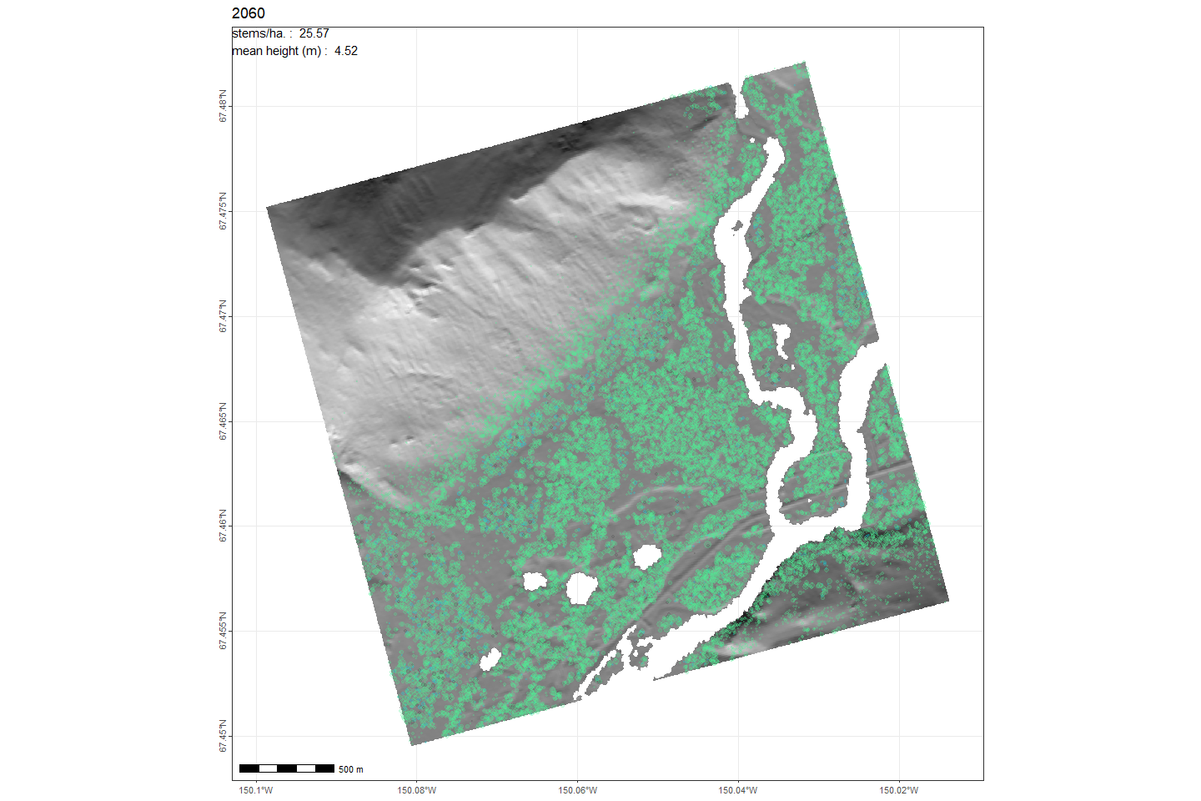




1980
Predicting the Magnitude, Variability, and Rate of Change at the Intersection of Arctic and Boreal Ecosystem
Amanda Armstrong (PI), Paul M. Montesano, Batuhan Osmanoglu, Howard Epstein, Kenneth J. Ranson, Herman H. Shugart, Elise Heffernan
2020
We’ve enhanced a spatially-explicit individual-based gap model (SIBBORK-TTE) to run with input derived from multi-scale gridded products (climate, soils, topography)
We’ve validated simulations of forest structure & composition for focal sites with forest inventory data
We’re building a database of simulations to statistically examine the variation in change at sites spread across a broad geographic domain in & near the taiga-tundra ecotone.
2060
SIBBORK-TTE Land Cover Updates Brooks Range

Slide 17
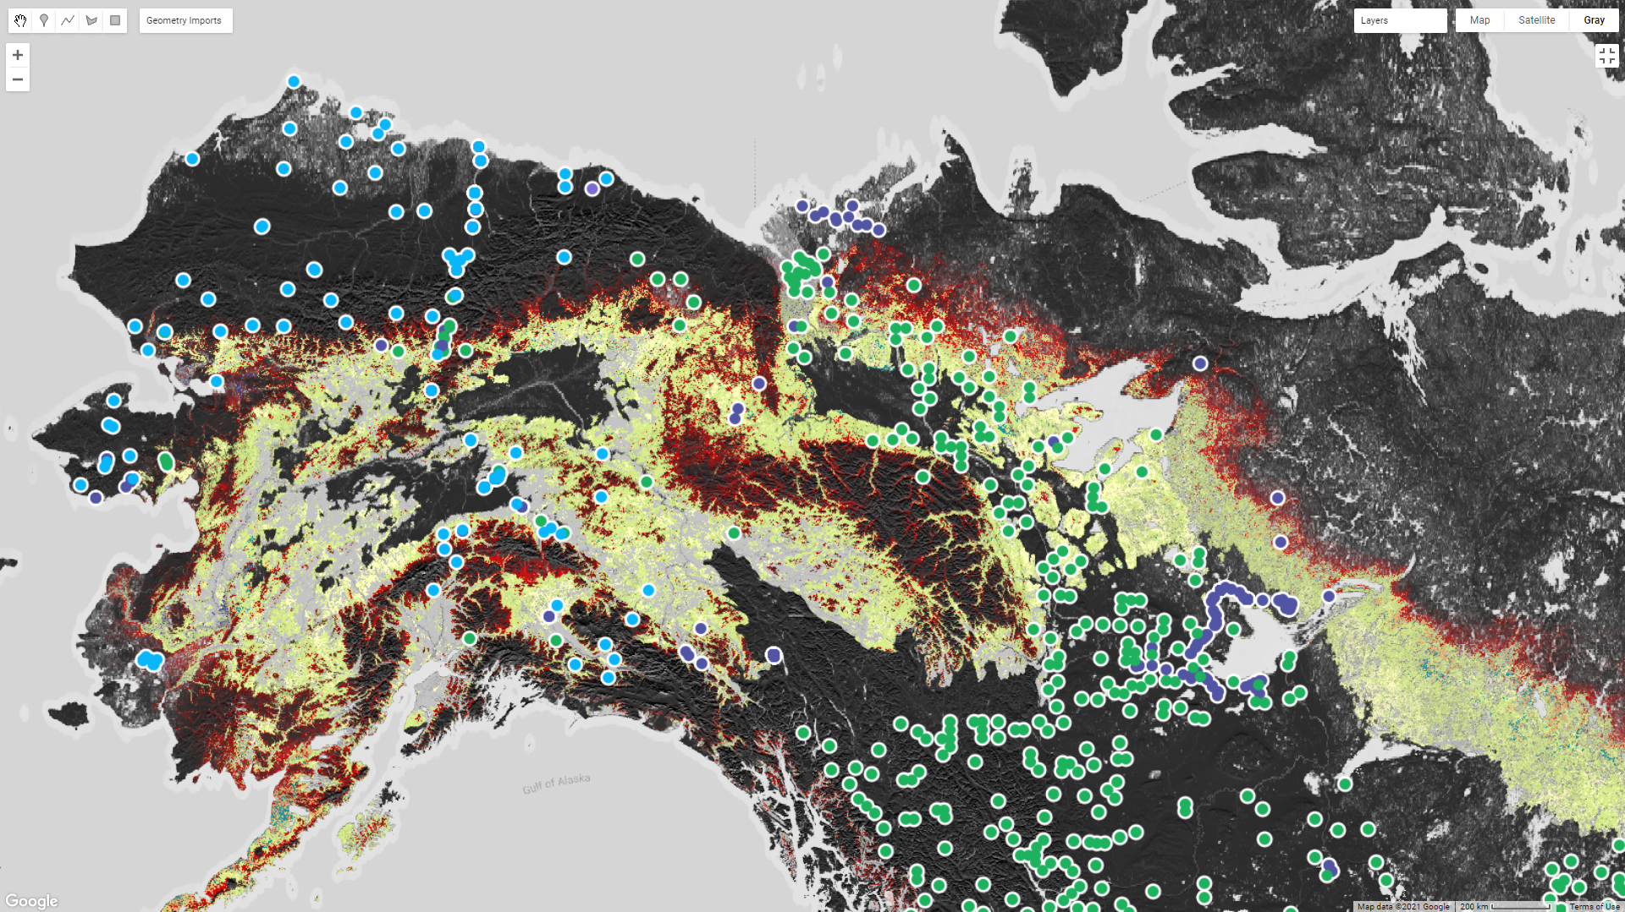
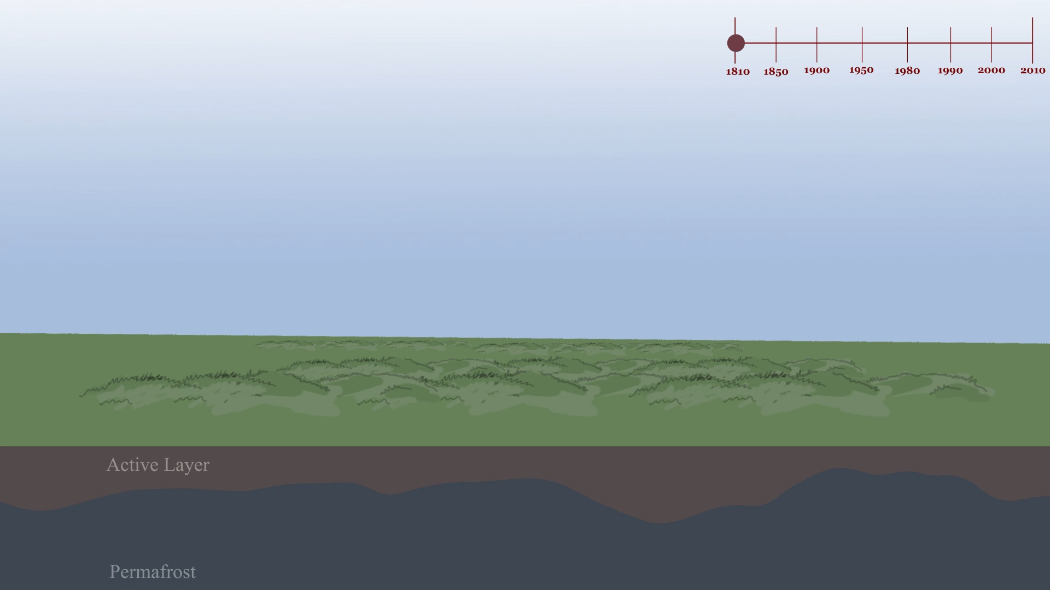
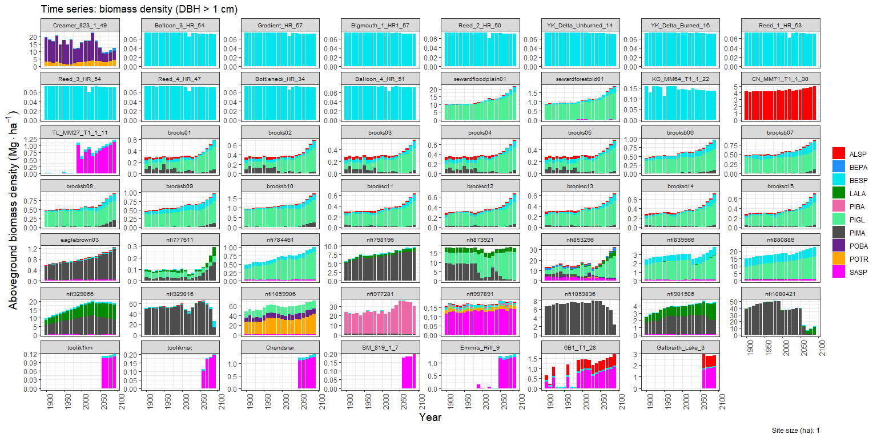
Predicting the Magnitude, Variability, and Rate of Change at the Intersection of Arctic and Boreal Ecosystem
Amanda Armstrong (PI), Paul M. Montesano, Batuhan Osmanoglu, Howard Epstein, Kenneth J. Ranson, Herman H. Shugart, Elise Heffernan
Model runs across TTE sites show heterogeneity driven by climate, topography, soils and disturbance factors.
Active Layer
Permafrost
1900
1950
2050
2000
2100
Year
animation credit: Shelby Lawton, UVA student (shelbyartworks.com)

Slide 18
Individual contributions: Arctic and alpine tundra)

Slide 19
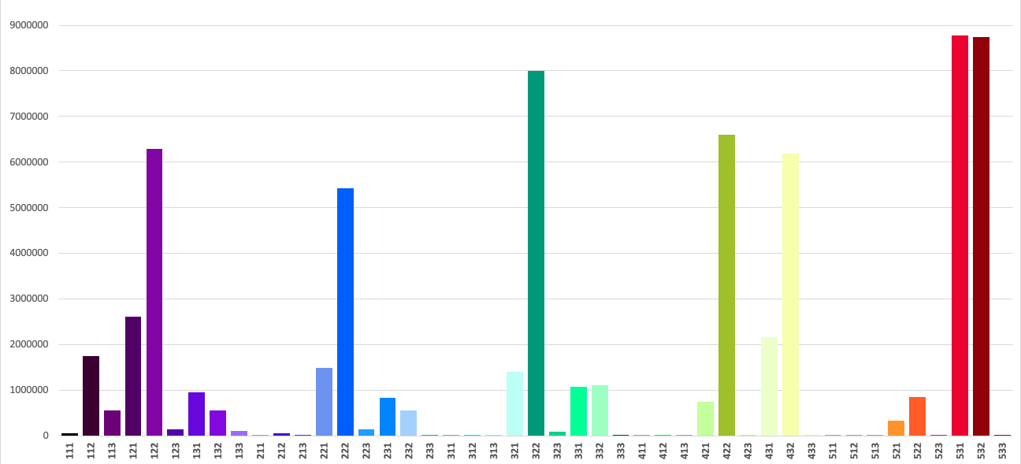
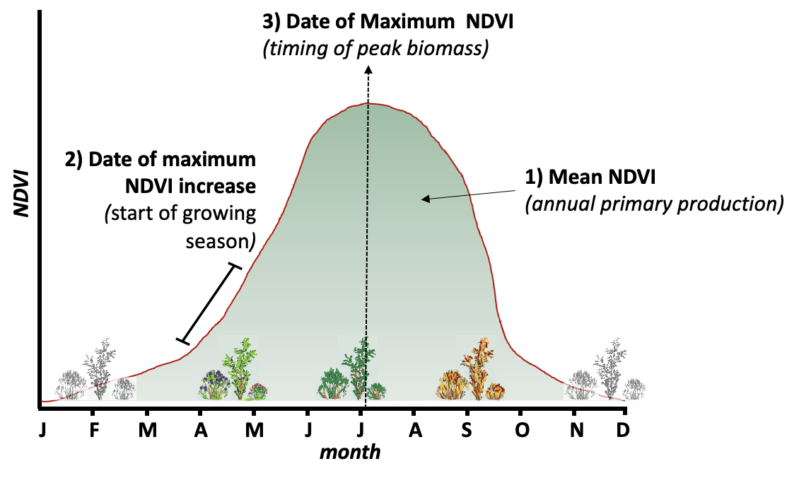
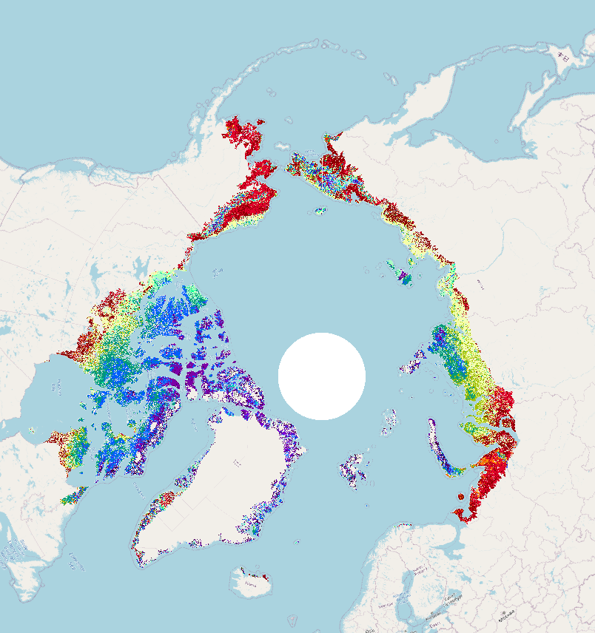
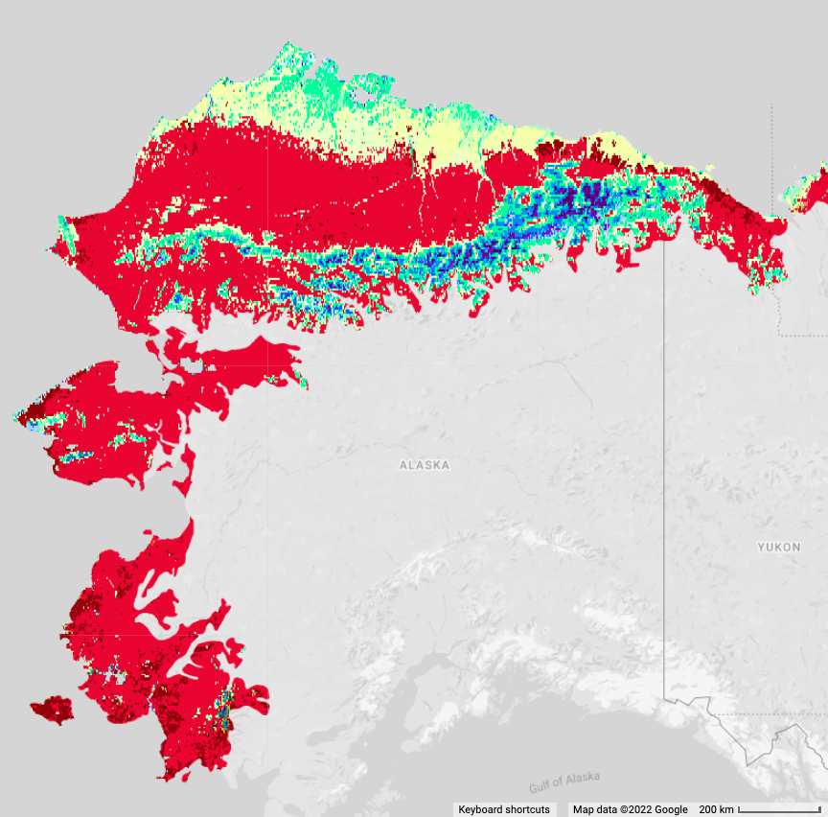
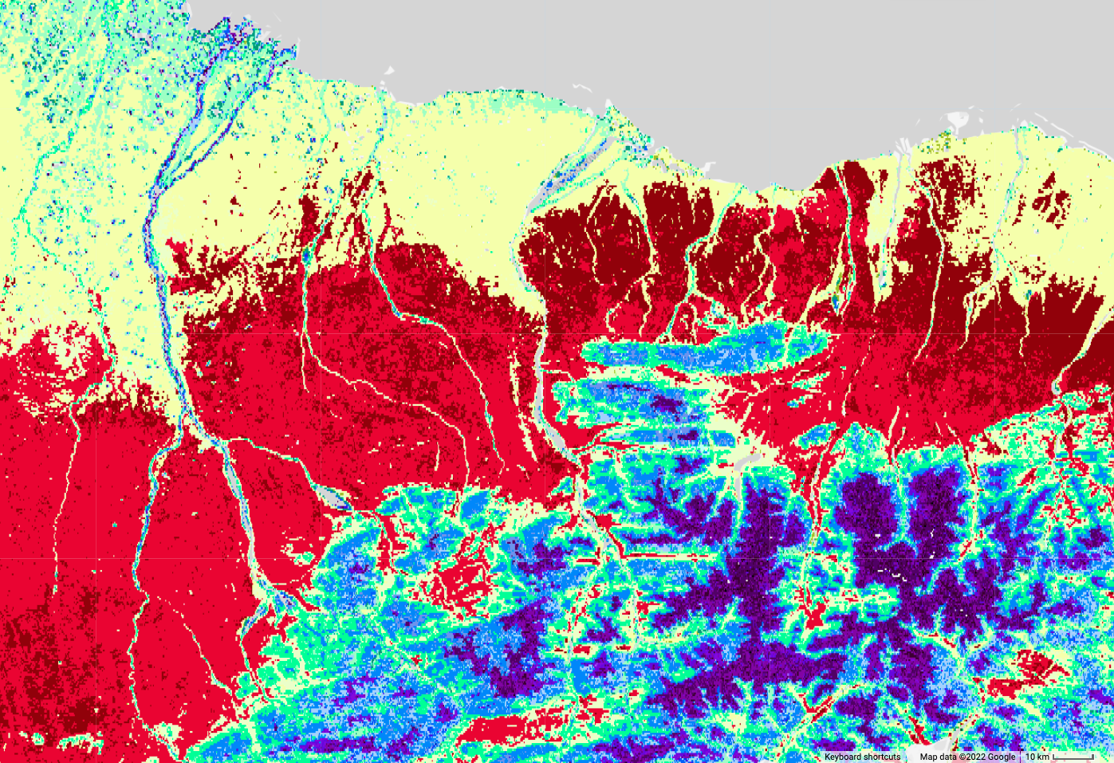
Ecosystem Functional Types of the circumpolar arctic tundra based on the seasonal dynamics of vegetation productivity
CAVM EFT Histogram
3 ecosystem functional attributes used to determined ecosystem functional types (EFTs) by explaining the highest proportion of variance in growing season NDVI
EFTs highlight high functional heterogeneity across CAVM and in areas of strong elevational gradient

Slide 20
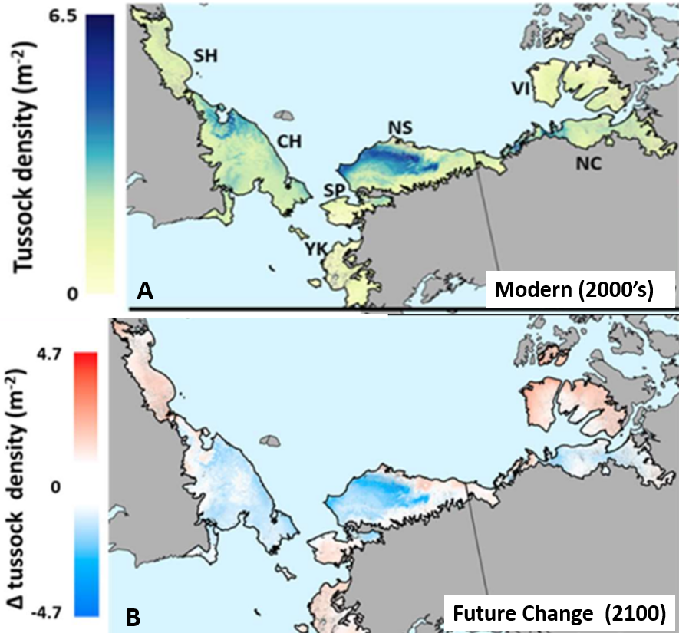


Cottongrass Tussocks as a foundation species for Arctic C stocks
Background: Foundation species have disproportionate impacts on ecosystem function and C cycling. Cottongrass tussock (Eriophroum vaginatum) is a foundation species with unique C storage abilities and a unique sensitivity to climate.
Methods & Satellite Products: We combined field measurements, MODIS products, climate and C cycling projections, and satellite derived GIS layers to estimate climate change impacts on tussock abundance/density and C stocks across ABoVE domain.
Main Findings: Cottongrass tussocks enhanced soil organic C storage up to 44%. Tussock density declined by ~30-40% on the North Slope of Alaska since 1980. Future climate induced range shifts of this species will have large and previously unquantified impacts on regional ecosystem C stocks.
Notes:
From Adrian Rocha

Slide 21






Implications of alder shrub expansion on soil properties in alpine tundra in Interior Alaska
A Welch, SA Pedron, RG Jespersen, Y Khazindar, NM Fiore, M Goulden, B. Martinez, X. Xu, CI Czimczik (In Prep.) NNX15AU16A
All sites are undergoing shrub expansion by alder (N₂-fixation)
Positive NDVI_{max} trends (2000-2020)
Alders are young (average 9-34 yrs), 93% established after 1980
Alders are growing more rapidly
Fire may be accelerating shrub expansion
alder
alder
Brooks Range
Koyukuk
3x30 m transects, 5 sites
Biomass surveys &
Dendrochronology,
Soil analyses
fire
fire
fire
Finger Mnt.
Yukon
Notes:
From Claudia Czimczik
Expansion of woody, deciduous shrubs is being documented across the Arctic. Here, we studied the implications of alder expansion on soil properties in Interior Alaska.

Slide 22


Impacts of increasing alder biomass and cover
A Welch, SA Pedron, RG Jespersen, Y Khazindar, NM Fiore, M Goulden, B. Martinez, X. Xu, CI Czimczik (In Prep.) NNX15AU16A
Vegetation
Less lichen cover
  More lichen = lower NDVI_{max}
More moss cover & more bare ground
Soil
Thinner O horizons and thus lower surface soils C & N stocks
(O horizons + upper mineral 10-30 cm)
No effect on summer thaw depth
alder
Alder expansion results in lower total ecosystem C storage.
Increasing alder cover (biomass) accelerates decomposition
of organic soil horizons.
Soil C losses are not compensated by C storage in live alder biomass.

