Slide 1









Canadian Forest Service Update
NASA ABoVE ASTM10, Boulder CO, May 22 2024
Guillermo Castilla
Remote Sensing research scientist, Northern Forestry Centre, Edmonton

Slide 2
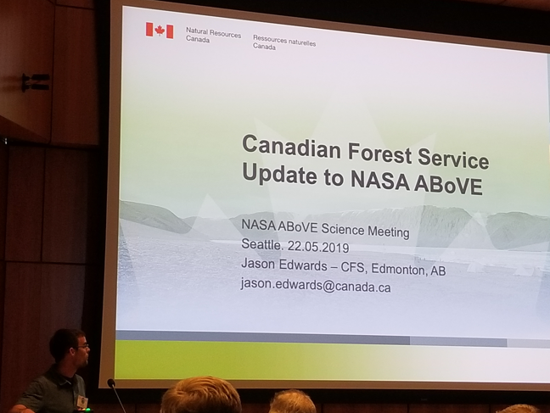

Jason Edwards, Oct 2 1978 – Nov 4 2023
Notes:
As many of you know, our colleague and friend Jason Edwards died unexpectedly and suddenly last November. Jason was the CFS liason to ABoVE and attended many of the Science Team meetings to report on the CFS research efforts relevant to ABoVE researchers. The photo on left was from the 2019 ASTM in La Jolla. That was the last time Jason presented in person in this forum.

Slide 3

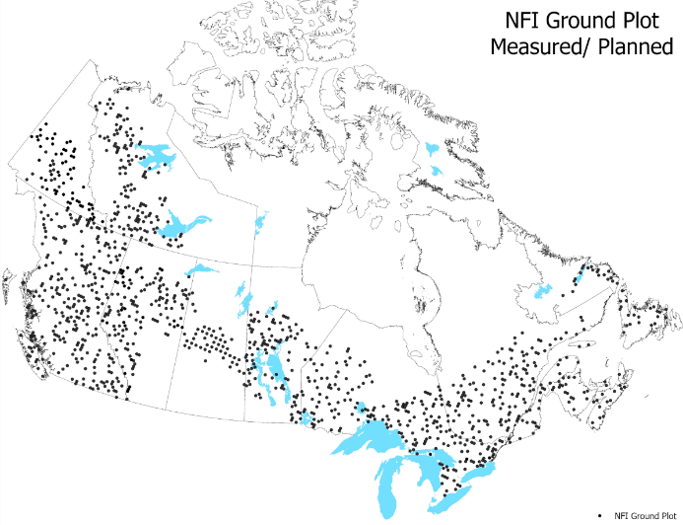
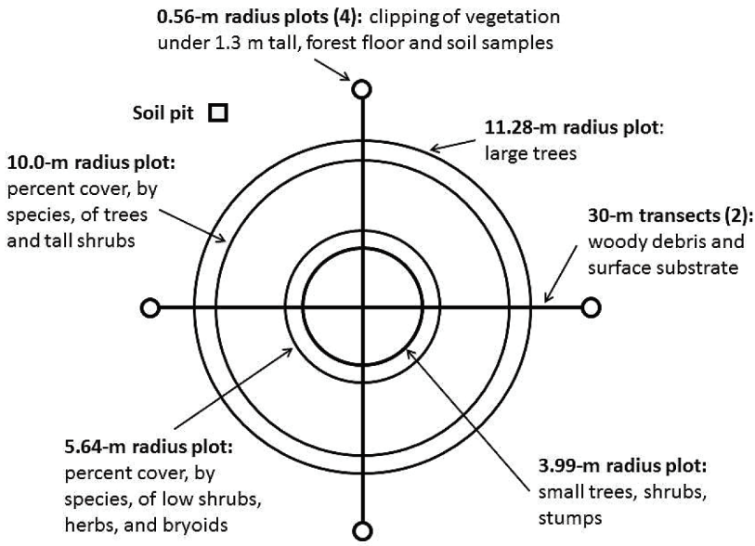
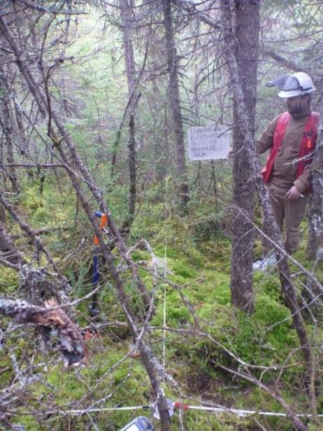
Ground Plot Program
Danielle Main, Danielle.Main@nrcan-rncan.gc.ca
Notes:
Ground plots. In 2023, YT had 13 plots (all establishment) and NT had 11 plots (10 were 2nd remeasurement and 1 establishment). NT has 137 plots with 135 available to download on the NFI website. YT has 70 plots forecasted, but 24 measured to date. – not used for for Canada’s reporting requirements regarding forest area estimates but for tracking change in forest attributes in NFI reporting units.

Slide 4
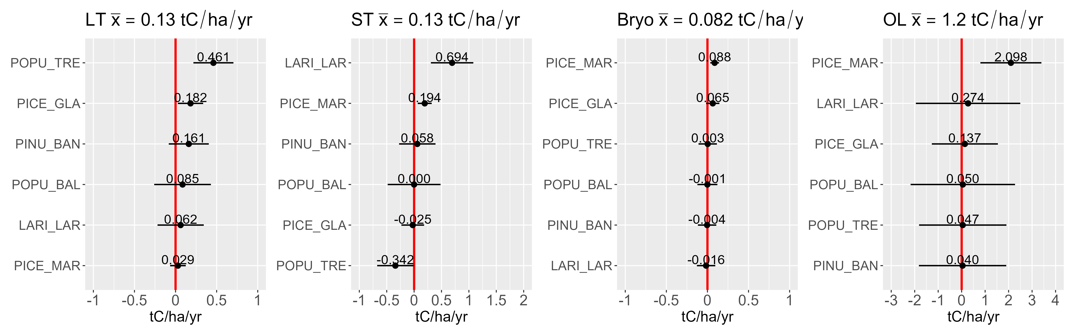
Rates of change in C stocks across Taiga Plains: NFI remeasurements
C stocks in large trees (LT), small trees (ST), bryophytes (Bryo), and organic soil layer (OL) increased significantly between 2004 and 2014
Patterns in C change differed by dominant species:
  Picea mariana: ST↑, Bryo ↑, OL ↑
  Populus tremuloides: LT ↑, ST↓
  Larix laricina: ST ↑
  Picea glauca: LT ↑
n=42
n=42
n=39
n=26
Hararuk et al., in prep.
Notes:
Here is an example of application of NFI grounds plot data to C fluxes in the TPE, by my CFS Edmonton colleague Sasha Hararuk. She used data from undisturbed NFI plots initially measured in 2004 and then in 2014 to estimate the rate of change in four C pools in the Taiga Plains ecozone. Two interesting findings are that the rate of C accumulation is similar between the large tree and the small tree pools (DBH threshold 9 cm), and accumulation in those two pools is about 10 times slower than in the soil organic layer pool, although uncertainty in this pool is higher, especially for upland.

Slide 5


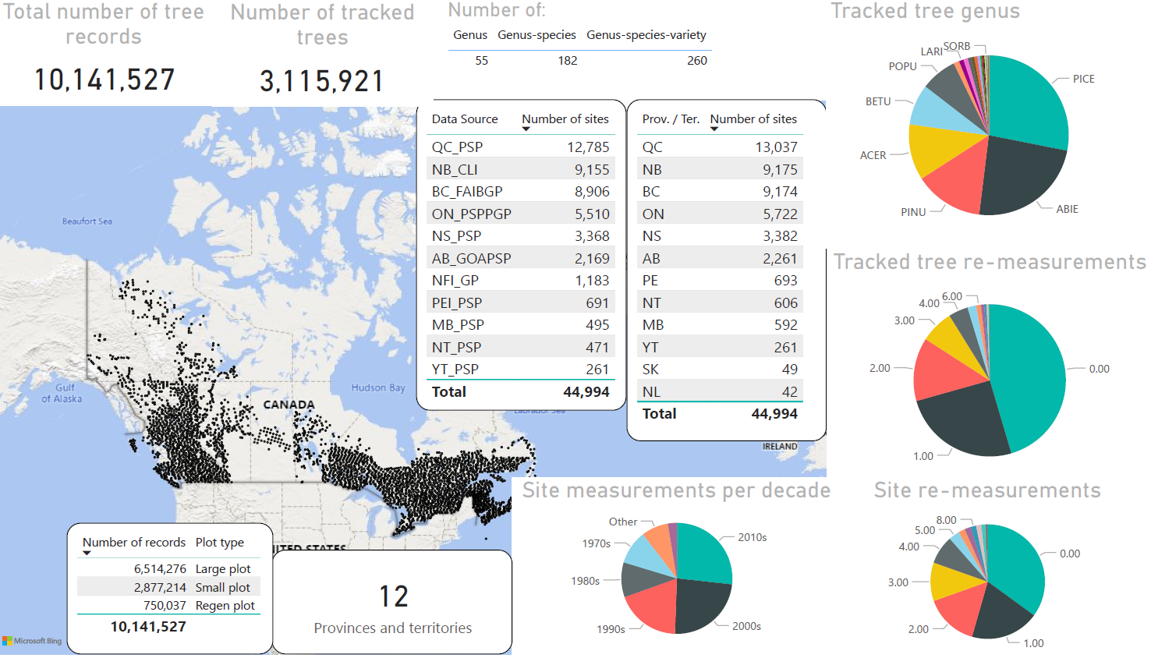





Multi-Agency Ground Plot (MAGPlot) database
You can find these data through Canada’s Open Science and Data Platform
Agglomerating pan-Canadian forest sampling data
# of tree records 10,141,527
# of tracked trees 3,115,921
# of sites (plots) 44,994
Includes information on:
Data source
Site information
Site treatment
Site disturbance
tree measurements
Tree conditions
…
Requests: nfisupport@nfis.org
5
Notes:
Multi-Agency Ground plot database (MAGPlot)
Pan-Canadian assembly and harmonization of forest ground sample data (e.g. PSPs)
Over 8,300,000 tree records assembled (~42,000 individual plots, including NFI plots)
Expected users: growth and yield, 2BT, biodiversity, impact assessment
Both MAGPlot and CASFRI have accessible data products since last month. Discoverable through FedGeospatialPortal and OpenSciDataPlatform, viewable through NFIS.
Ground plot sites from NFI, NWT, AB and other jurisdictions require a signed data use agreement with the contributing jurisdiction, contact nfisupport@nfis.org for data requests.

Slide 6
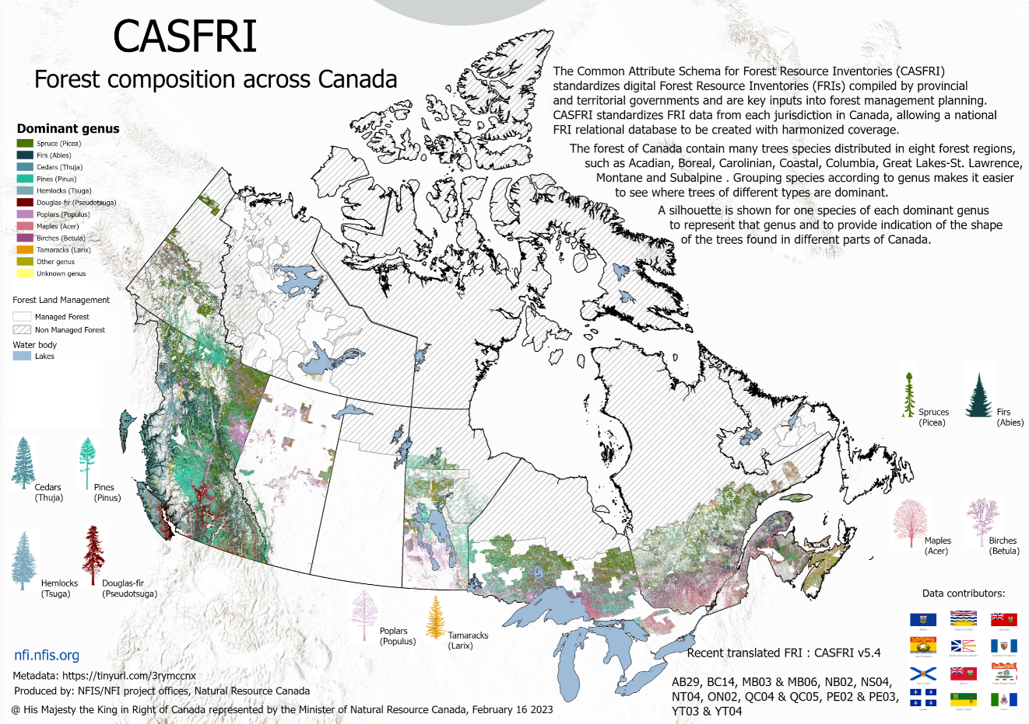
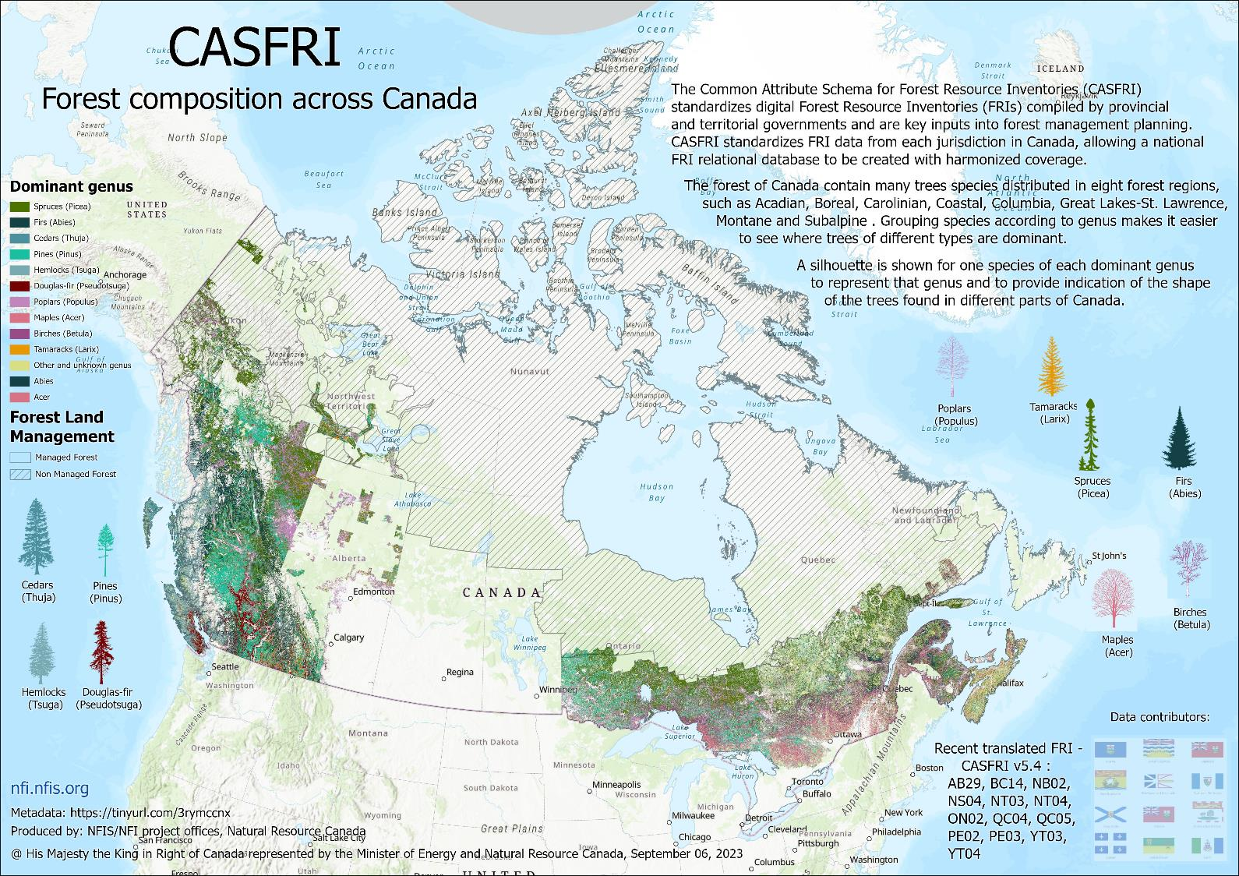
6
Notes:
P/Ts invest massive efforts in collecting their own Forest Resource Inventories (FRI) and permanent sample plot (PSP) datasets to support their own forest management needs. But until now there was no operational ongoing, effort to make this data FAIR nationally and on an ongoing basis (evergreen).
Data sharing issues, plot design, standards are different
244 GB of forest resource inventory
Common Attribute Schema for Forest Resource Inventory (CASFRI)
Pan-Canadian assembly and harmonization of forest resource inventory data (polygonal forest inventory
Over 600M ha of inventory (multiple inventories over time)
Expected users: Carbon modelling, biodiversity, impact assessment

Slide 7
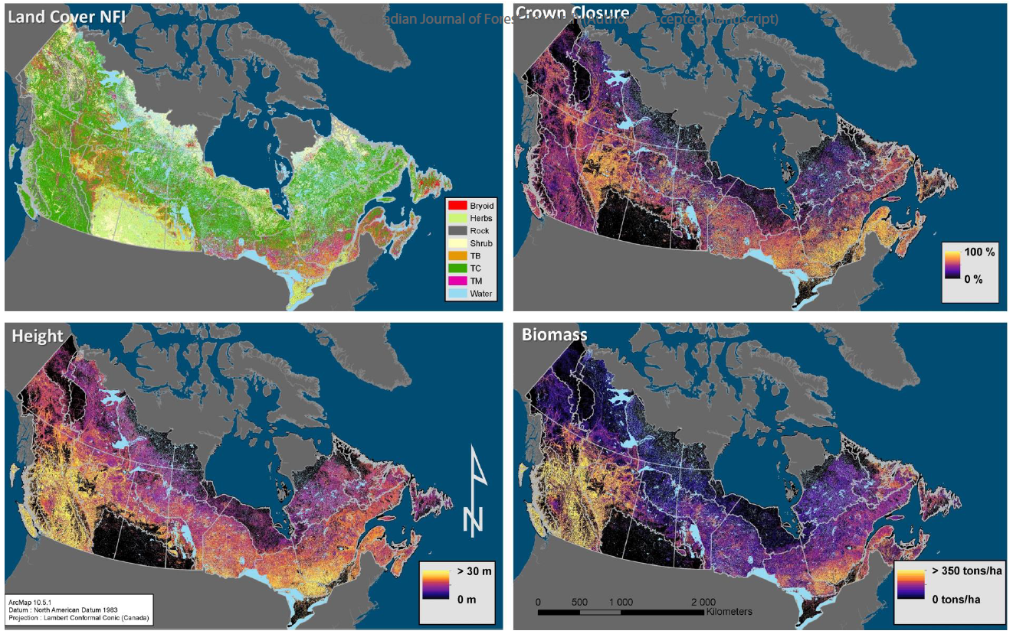
Map products: SCANFI – Spatialized CAnadian National Forest Inventory
c.2020 30m rasters of forest attributes (land cover type, canopy height, crown closure, aboveground tree biomass, main species composition) for all of Canada’s non-arctic ecozones using Landsat summer and winter imagery as main predictors and NFI photoplot data for training
Various independent datasets for validation used
Methods: https://cdnsciencepub.com/doi/10.1139/cjfr-2023-0118
Data: https://open.canada.ca/data/en/dataset/18e6a919-53fd-41ce-b4e2-44a9707c52dc
Notes:
SCANFI was developed by Luc Guindon et al. to provide a current, spatially-explicit estimate of forest attributes, using a consistent data source and methodology across all provincial boundaries and territories. SCANFI is the first coherent 30m Canadian wall-to-wall map of tree structure and species composition and opens novel opportunities for a plethora of studies in a number of areas, such as forest economics, fire science and ecology.
NFI land cover class values: Land cover classes include Water, Rock, Bryoid, Herbs, Shrub, Treed broadleaf, Treed mixed and Treed conifer
Tree species cover (%): estimated as the proportion of the canopy covered by each tree species, currently for main conifer species individually and for broadleaf species as a whole.

Slide 8
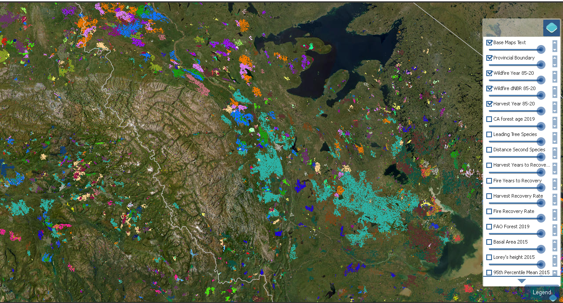
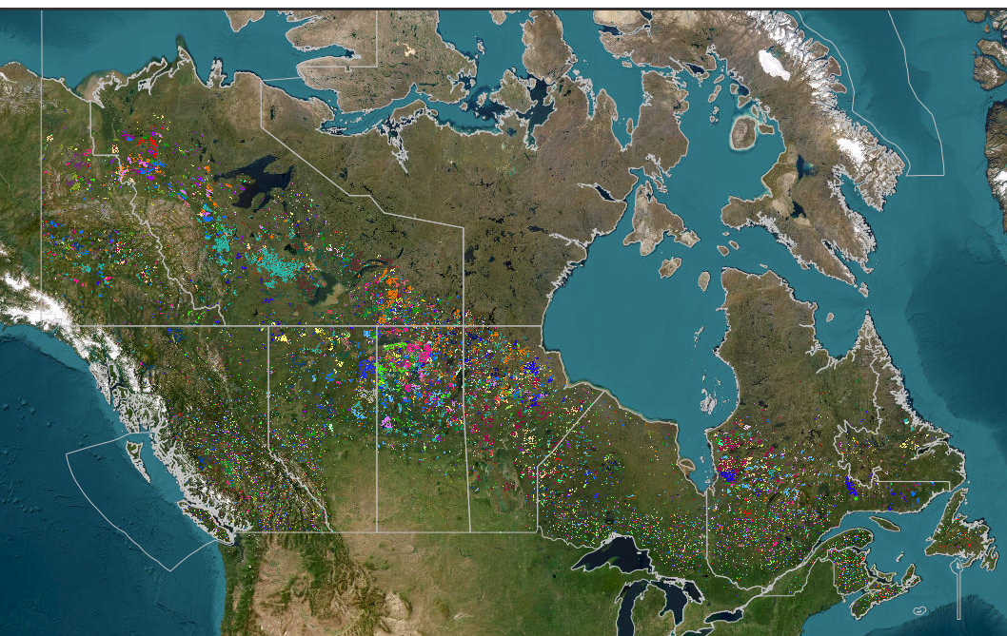
Open data for Canada’s forest ecosystems
National Terrestrial Ecosystem Monitoring System (NTEMS)
Status and trends
> 650 million Ha
From 1985 forward
Forest inventory and carbon relevant attributes
Products include:
  Land cover
  Species
  Biomass
  Canopy height & cover
  Change (harvest, wildfire)
  Forest recovery
🔗 https://opendata.nfis.org/mapserver/nfis-change_eng.html
Notes:
The National Terrestrial Ecosystem Monitoring System (NTEMS) was developed by mt CFS colleagues Txomin Hermosilla, Mike Wulder and others using data from the Landsat series of satellites and cloud computing. NTEMS recreates the history of Canada's forests since 1985 at a higher level of spatial and categorical detail than ever before.

Slide 9
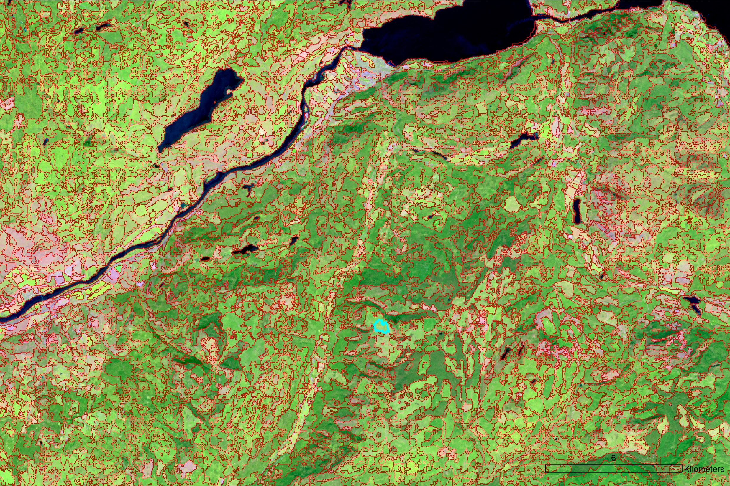
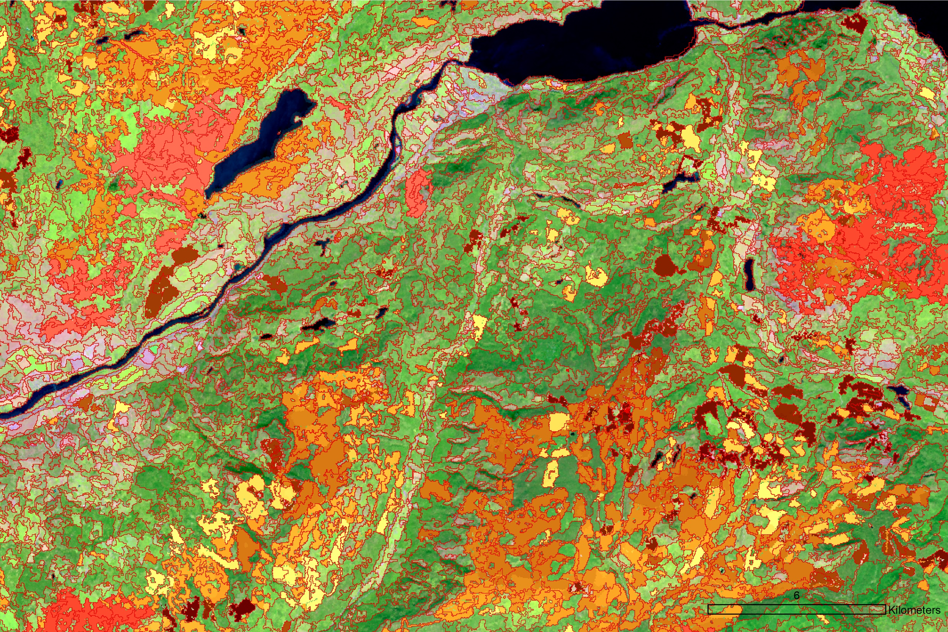
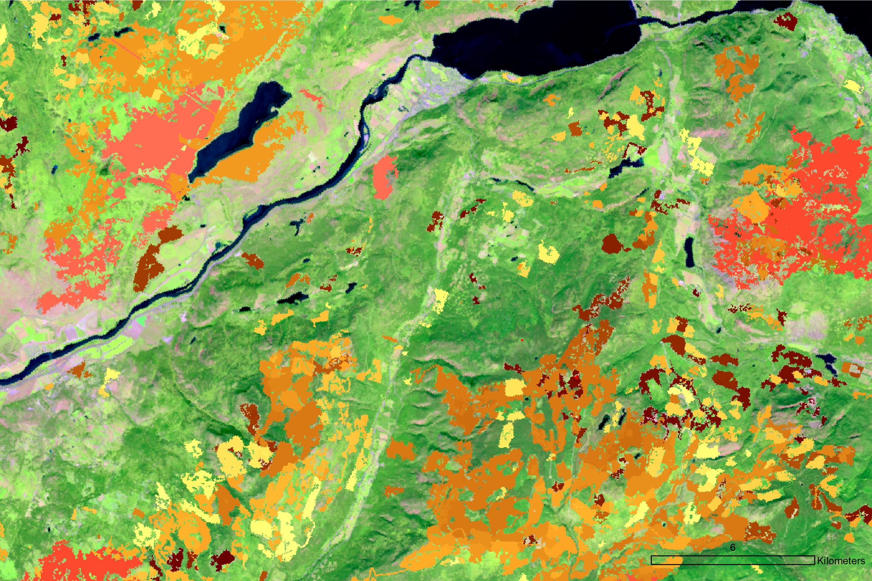
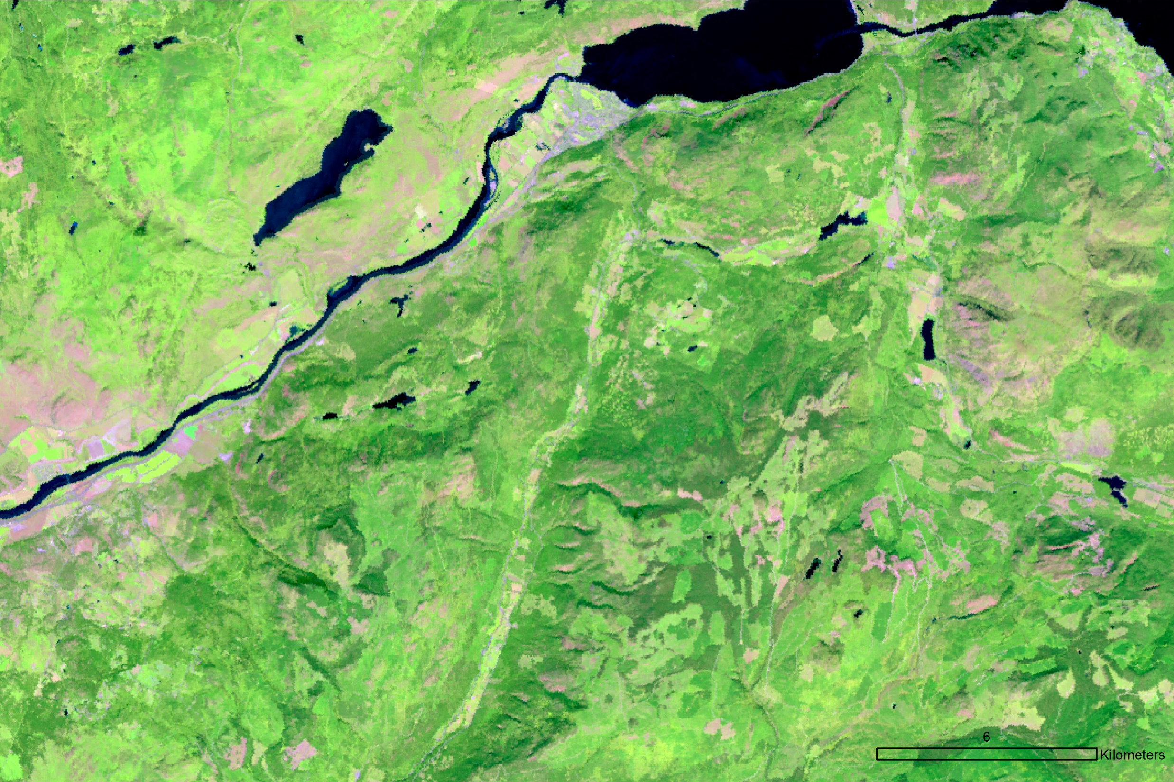

Satellite-Based Forest Inventory (SBFI c.2020) generation process https://doi.org/10.1093/forestry/cpad065
Population of attribute fields
IDs
Geometry
Stratification (Jurisdiction, ecozones)
Disturbance
Recovery
Forest structure
Forest age
Tree species
SBFI partitions the 650 Mha of Canada’s forested ecosystems into over 25 millions of polygons (25.9 ha on average).
SBFI provides a spatial framework to generalize remotely sensed products across jurisdictional and management boundaries
Inputs
  Landsat composites: R, NIR, SWIR1
  Type and year of disturbance
Segmentation
  Multiresolution segmentation algorithm
  Polygons with homogenous conditions
Segmentation refinement
  MMU = 5 pix (0.45 ha)
  Combination of adjacent water-dominated polygons
Notes:
This is the latest product in NTEMS.
The 1st step was image segmentation of a 5 channel image (1st 3 channels are BAP 2020 composites of Landsat b4, b5, and b7, channel 4 is year of last harvest and channel 5 is year of last fire. Segments smaller than the MMU (0.45ha - 5 Landsat pixels) were merged to the neighbouring segment with which they shared the most of their perimeter. Then each segment/polygon is assigned a bunch of attributes, namely LC, leading species (up to 5 species with their %occupancy), disturbance and recovery attributes, and metrics (min, max, med, mean and stddev) for canopy height, lorey's h, canopy cover, basal area, agb, vol, and age (from the NTEMS rasters available from NFIS).

Slide 10
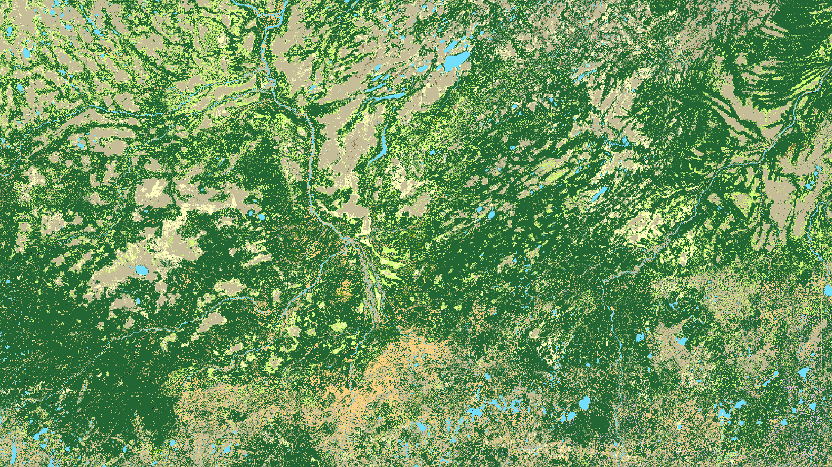
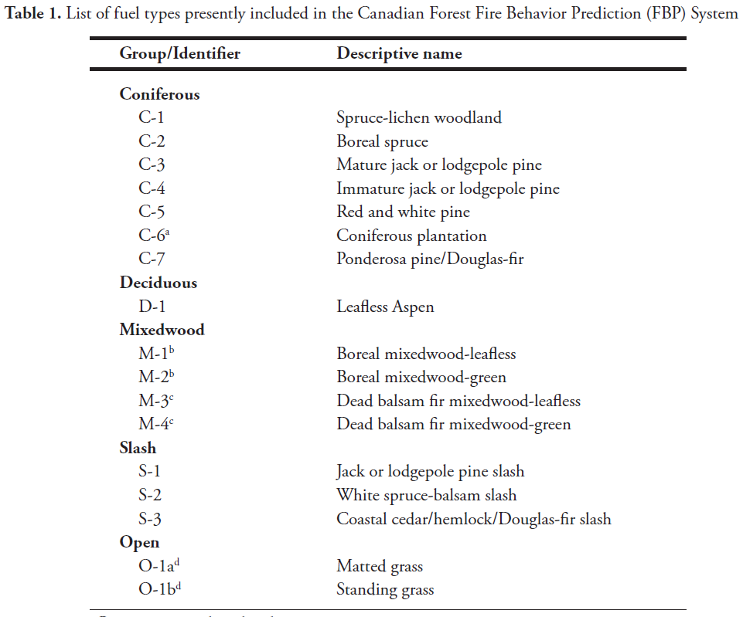
Forest Fuel map products
NFI
Northern Forests fuel Mapping (NorthForM)
Current CFFDRS FBP Fuels
(1 layer, 16 fuel types)
Next-Gen CFFDRS FBP Fuels
(~16 fuel attributes layers)
Notes:
This new initiative, called the Northern Forest fuels Mapping program (NorthForM), 24 MCAD across 5 years, aims at enhancing wildfire hazard assessment informing community actions to improve their wildfire resilience, especially for communities in northern Canada. In particular, it will produce fuel maps at 30 m spatial resolution, both current Fire Behaviour Prediction (FBP) fuel types (left table) and NG-CFFDRS Fuel Attributes (right table)

Slide 11
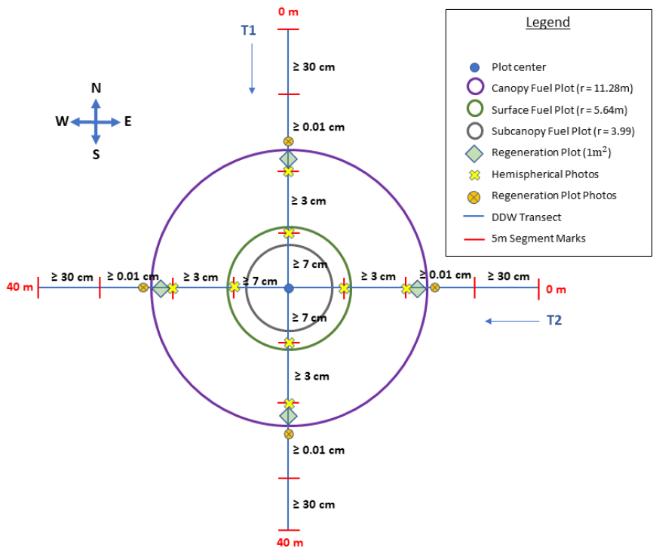
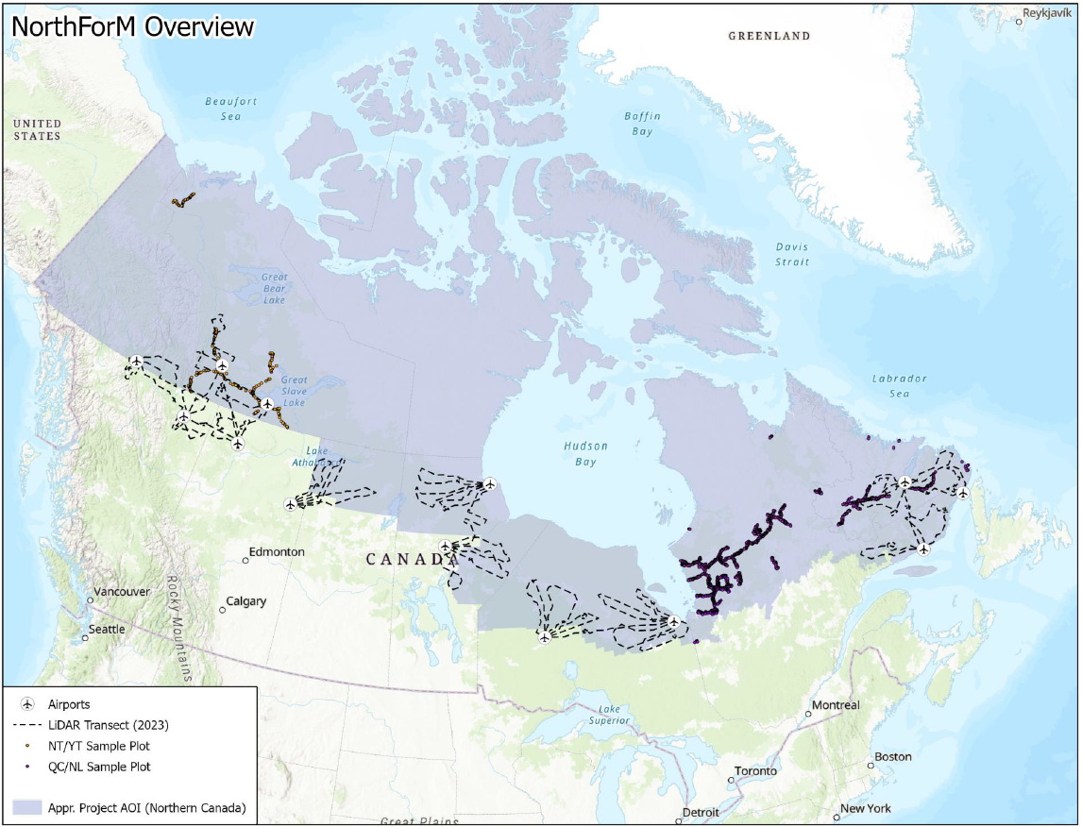
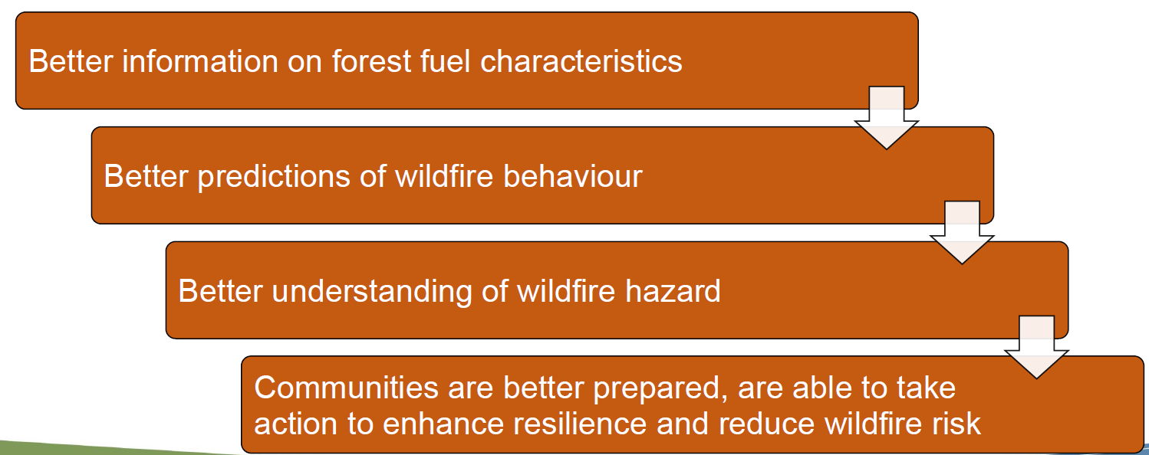
Notes:
NorthForM is establishing hundreds of FI plots (layout in top left corner) across different boreal ecozones. In addition, it is acquiring airborne lidar over those plots and along thousands of kilometers of transects. The plots will be used to develop ALS models, which will then be applied along the transects to create reference data for satellite-based mapping.

Slide 12
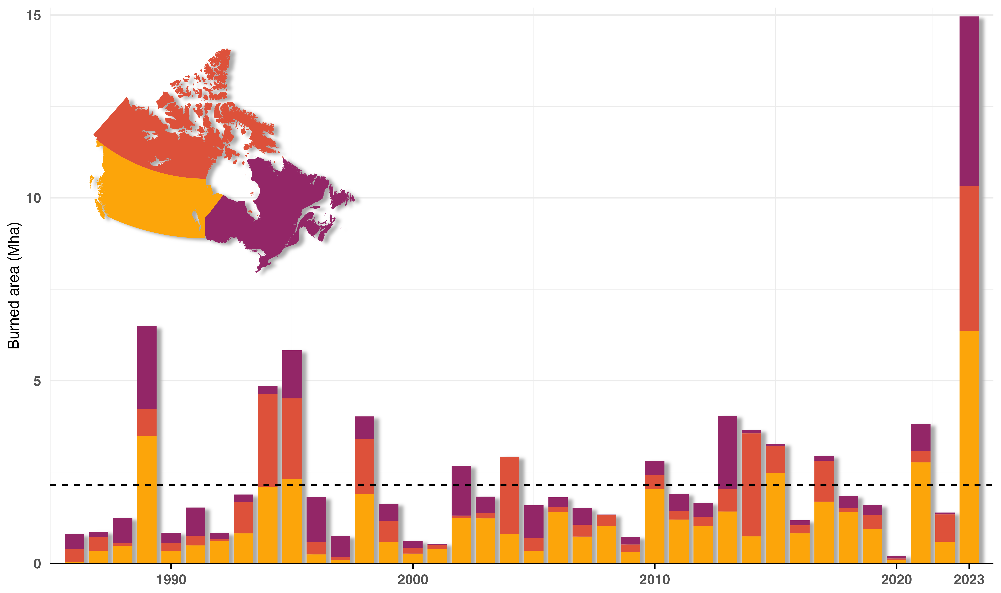
The 2023 Wildfire Season
15 Mha burned, more than doubling previous record (in satellite era)
232,000 people evacuated
Widespread smoke impacts with ~1400 air quality alerts in June alone
Fire management strained, at maximum natural preparedness level for 120 days continuously
2023 May-Oct temperatures 2.2C above normal
Drivers of large area burned: early snowmelt across country, early season drought, extreme fire weather.
Signficant short-interval reburn (10 times historical norm)
20 largest fires responsible for half area burned
Details in preprint: https://essopenarchive.org/doi/full/10.22541/essoar.170914412.27504349/v1
Notes:
Continuing with the wildfire theme, as you know, the 2023 fire season in Canada was unprecedented, with 15 Mha burned. There is a paper in review in Nature Communications that describes causes and impacts, a preprint of which is available in the link below.

Slide 13
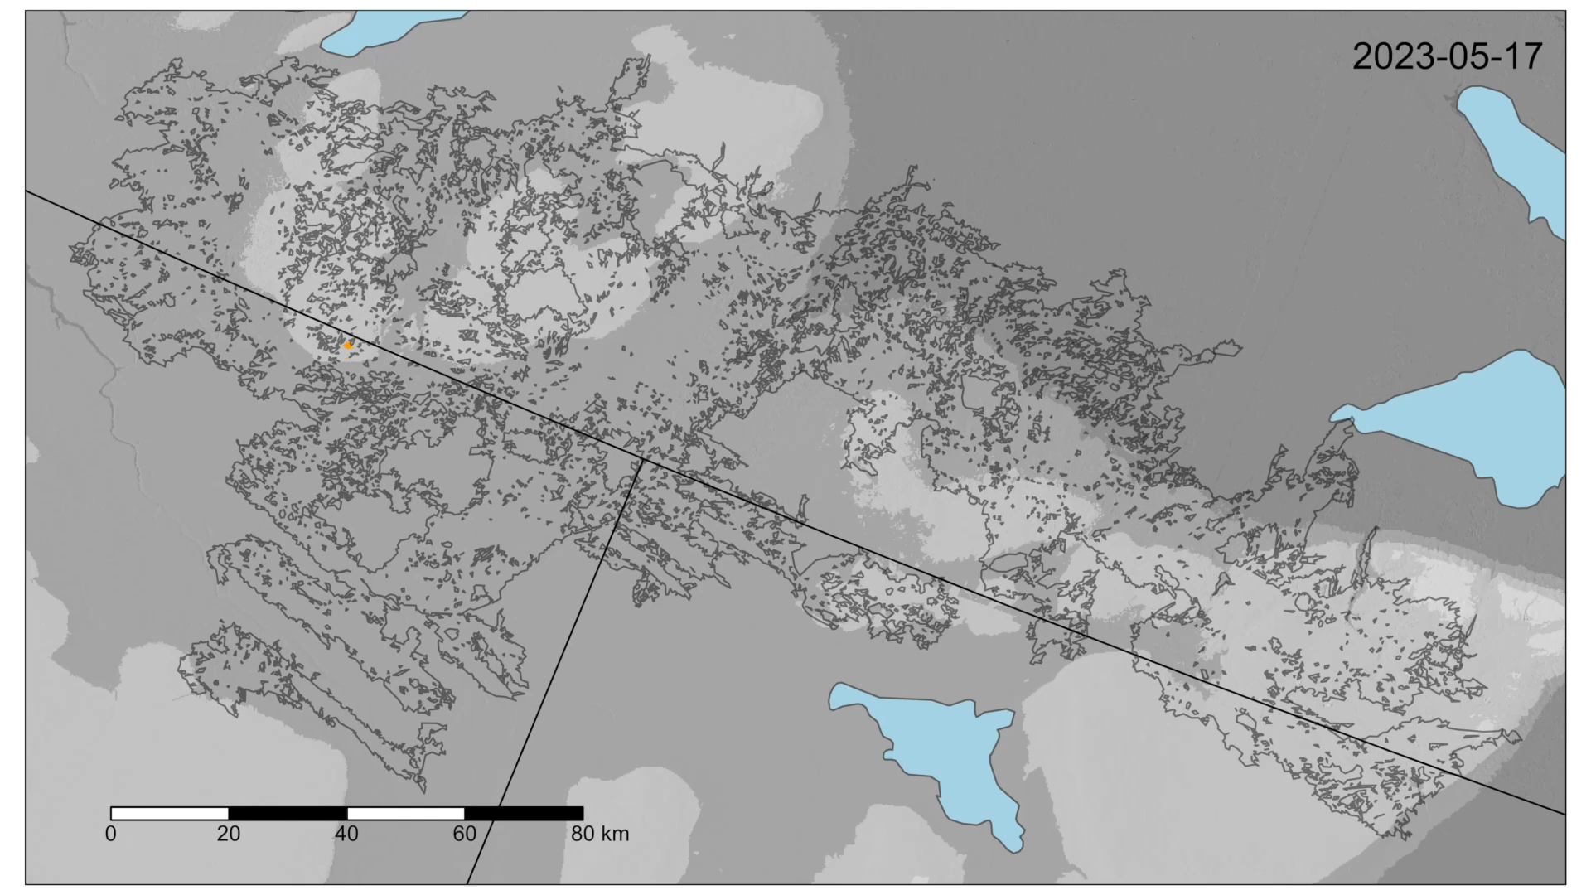
The border fire complex
Notes:
This is one of the largest fire events in the season, the border fire complex along the border between NWT and BC&AB. It started in May and ended up in September with some periods of inactivity. It burned over a million acres.

Slide 14

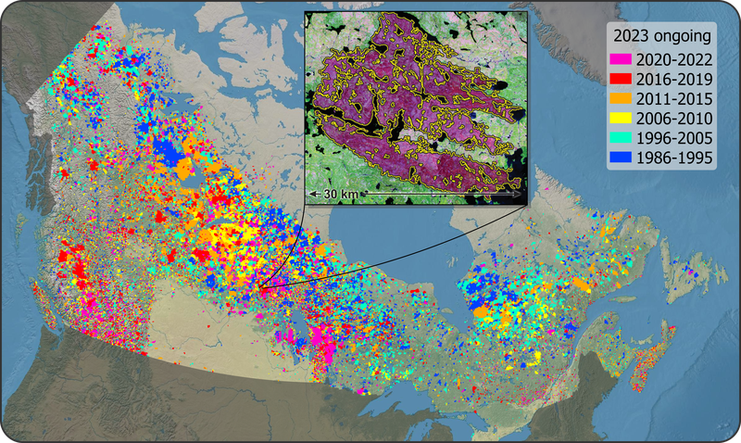
National Burned Area Composite (NBAC)
Creates annual wildfire maps for:
Canada’s National Forest Carbon Monitoring, Accounting and Reporting System (NFCMARS)
CFS Forest Systems Information & Technology Enhancement (ForSITE) Program
Area burned reporting for Northwest Territories and Manitoba
Distribution on the Canadian Wildland Fire Information System
New research activities:
Extending fire maps back to 1972
Burn severity
Notes:
Many of you already use NBAC. I wanted to let you now that very soon you will be able to download from CWFIS an extended time series of NBAC that goes all the way back to 1972. My teammate Rob Skakun did this using Landsat MSS, making NBAC the longest satellite-based time series of burned area, now 52 years long. In the new release, NBAC will also include information on burn severity. Both the MSS mapping and the burn severity attribution will be described in two upcoming papers.

Slide 15
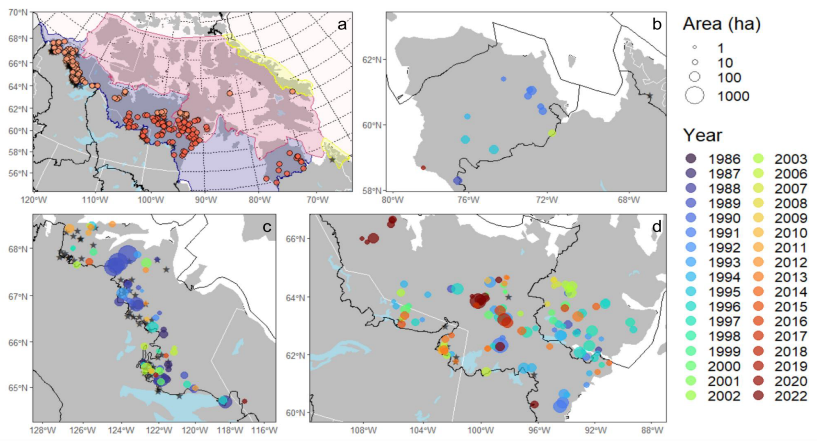
Mapping Undetected Tundra Fires in Canada
Novel methodology to map tundra fires, and resulting dataset
>200 new fires mapped & added to NBAC
Fires were unlikely to have detected satellite hotspots
https://www.mdpi.com/2072-4292/16/2/230 Hethcoat et al., 2024
Notes:
Another novelty in NBAC is that it now includes fires in the tundra, thanks to a new study by Matt Heathcoat and others including Rob Skakun . The tundra dataset was mostly produced in Google Earth Engine, with postprocessing in QGIS and R. In the figure in panel A, all dots are new fires, underlying black stars (hard to see) are existing tundra fires that were already in NBAC. Rest of panel shows closeups of three regions. Size of dot indicates fire size, and colour goes from blue (1986) to green (2000) to red (2022).
From 2012 - 2022 (both viirs and modis active)
25 fires had hotspots from both sensors
7 were modis only
2 were viirs only
46 had no hotspots detected at all

Slide 16
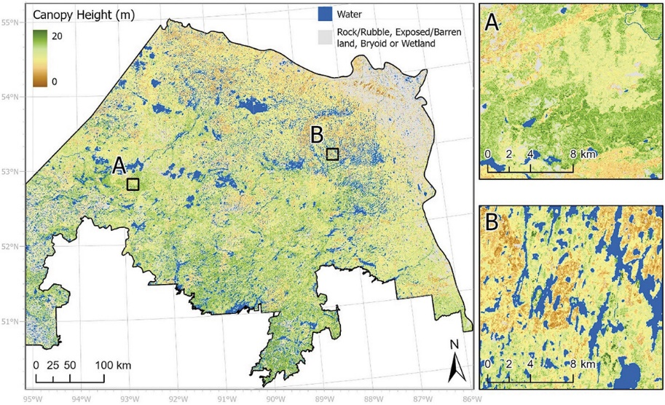
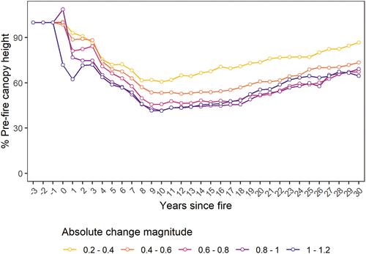
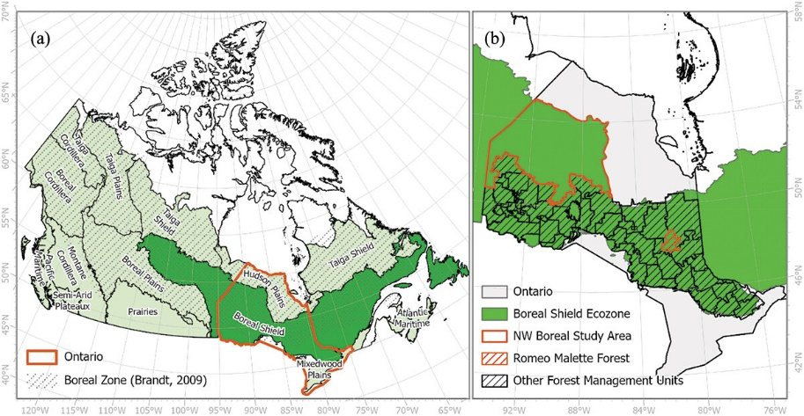
Characterizing post-fire northern boreal forest height dynamics
ICESat-2 measures of canopy height extended across space and time using Landsat time series data (imputation) in a fire-prone, unmanaged area of northern boreal forest in Ontario.
Validation of canopy heights using reserved ICESat-2 (rRMSD = 33.9%) and coincident single photon lidar (SPL) data (rRMSD = 25.8%).
Observed post-fire height dynamics are consistent to those reported in previous boreal studies using ALS data (Bolton et al., 2015, 2017).
Canopy height decreased 8–10 years post fire and recovered between 60% and 85% of pre-fire canopy height within 30 YSF.
Height recovery was positively associated with change magnitude ; higher severity fires took longer for full height recovery (> 50 years).
      Queinnec, M., Coops, N.C., White, J.C. 2024. Characterizing post-fire northern boreal forest height dynamics. International Journal of Remote Sensing, 45(7): 2182-2207. https://doi.org/10.1080/01431161.2024.2326534
Notes:
Last fire-related item, this one on post-fire recovery. It’s outside the AboVE domain, but the methods could be replicated there. My CFS colleague Joanne White and her UBC co-authors derived a time series of canopy heights at 30 m that provides insights on post-fire height recovery in northern unmanaged forests. The study provides evidence of the progressive falling of snags in the 10 years after the fire, which is thereafter offset by the growing young trees (top right graph)

Slide 17
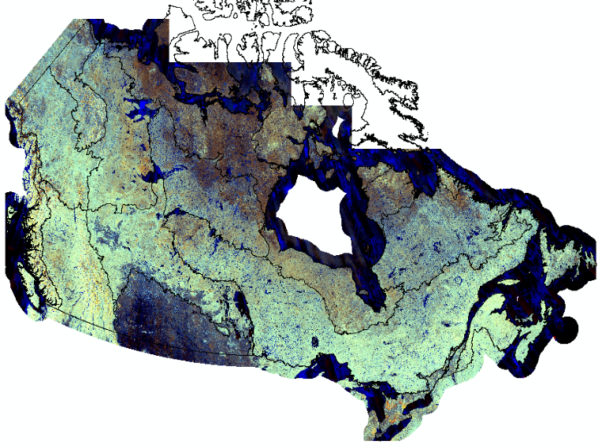
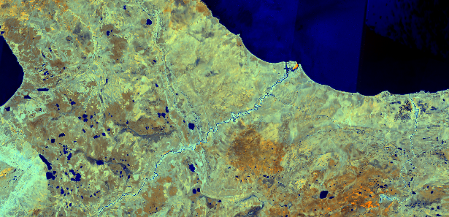
Canada’s PALSAR-2 L-band dual-polarized radar backscatter summer composite, circa 2020
New NRCan/CFS open dataset at:
https://open.canada.ca/data/en/dataset/8ec4ee78-9240-4bd0-9c97-d3a27829e209
Temporal compositing (score-weighted average) + temp/spatial speckle filtering of
HH, HV, HV/HH and RFDI from initial JAXA’s Global PALSAR/PALSAR-2 Mosaics v1
(2015-2020, GEE collection)
Disturbances (clear-cut, fires) taken into account
Outperforms any initial yearly PALSAR-2 mosaic in northern boreal (v1 & v2)
Limitations due to temporal averaging and residual artifacts in NW Canada (PALSAR-2 BOS)
Next: updating to circa 2022 using JAXA’s PALSAR-2 Mosaics v2
Dataset citation:
Beaudoin, A., Villemaire, P., Gignac, C., Tolszczuk, S., Guindon, L., Pontone, N., Millard, C. (2024). Canada’s PALSAR-2 dual-polarized L-band radar summer backscatter composite, circa 2020. Natural Resources Canada, Canadian Forest Service, Laurentian Forestry Centre, Quebec, Canada. https://doi.org/10.23687/8ec4ee78-9240-4bd0-9c97-d3a27829e209
Initial Global Palsar/Palsar-2 Mosaics: © JAXA
PALSAR-2 L-band summer composite: © NRCan
Hay River zoom-in
Improved national wetland mapping & PALSAR compositing method:
Pontone, N., Millard, K., Thompson, D., Guindon, L., Beaudoin, A. (2024). A hierarchical, Multi-Sensor Framework for Peatland Sub-Class and Vegetation Mapping Throughout the Canadian Boreal Forest. Remote Sensing in Ecology and Conservation. https://doi.org/10.1002/rse2.384
Link to wetland map: https://zenodo.org/records/10627580
POC for questions and reporting dataset usefulness:
andre.beaudoin@nrcan-rncan.gc.ca
Notes:
In addition of raster products with forest information, CFS also produces RS data derivatives. Here is a raster product you may be interested, a PALSAR-2 composite of summer 2020 that my CFS colleague Andre Beaudoin and team created, which is available from open.Canada.ca like others I described earlier. We plan to use it within the MVI project in which we are creating new set of forest attributes rasters for the Taiga plains ecozone. This palsar composite is especially suited for wetland mapping.

Slide 18

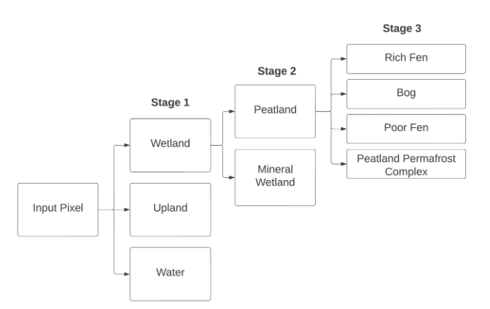
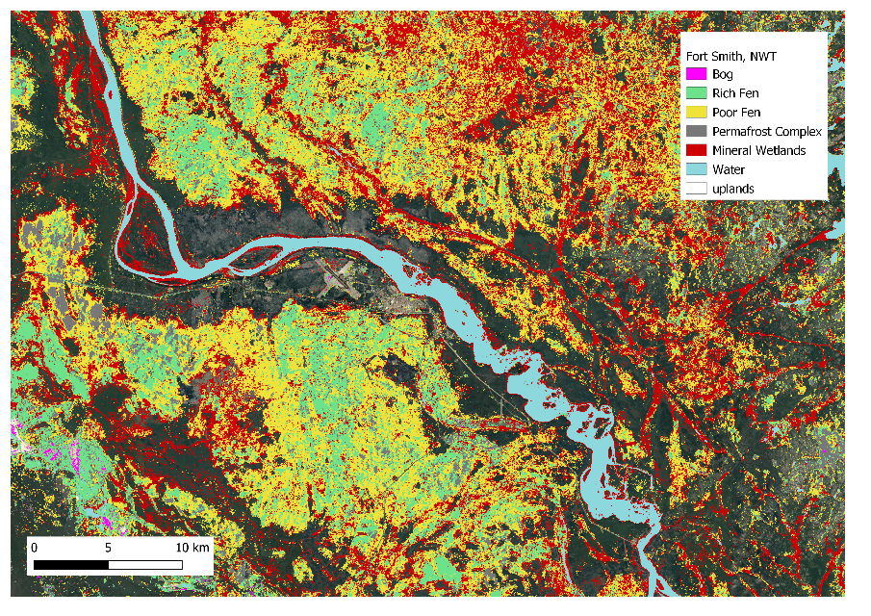
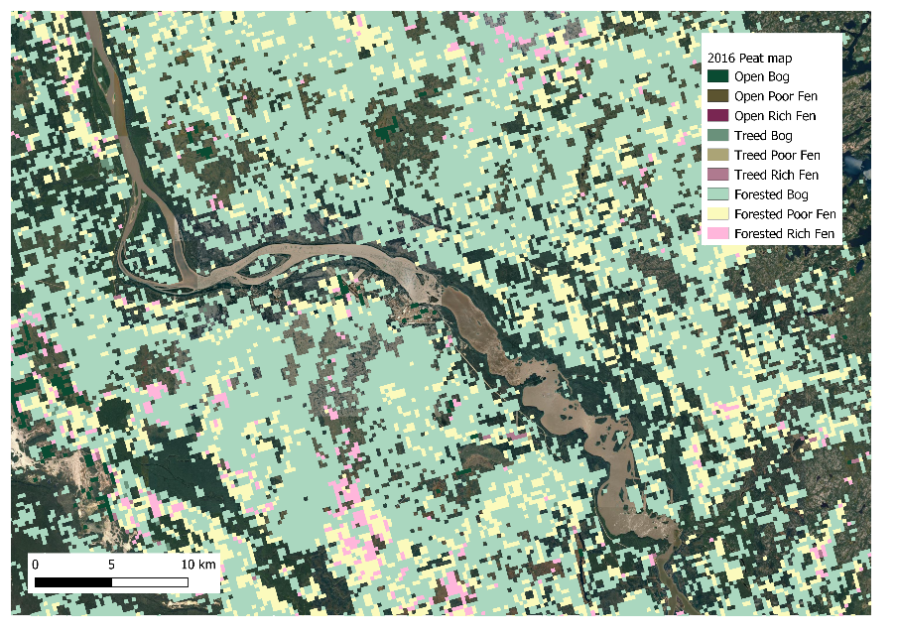
https://zenodo.org/records/10627580
Pontone et al 2024
Remote Sensing in Ecology and Conservation
doi: 10.1002/rse2.384
Thompson et al 2016 Forest Ecol Mgmt
doi:10.1016/j.foreco.2016.03.056
30-m coverage across all of Canadian boreal/taiga ecozones
Multispectral plus L and C-band SAR
Important delineation of permafrost complexes and poor vs rich fen
Aligned with classification used in peatland national greenhouse gas inventory to UNFCCC
Notes:
In fact, it was used in this new product that may also interest you, a new wetland map Canada-wide with 5 wetland classes. You can see on the left a detail of the map near Fort Smith NWT and compare it with a preexisting wetland map. The oval shows that the new map can really resolve those peatland edge areas. The older peat map flagged it as a mixed peatland/upland area, but the new map in fact maps it correctly it as upland forest (whoevee has visited For Smith will know this)

Slide 19
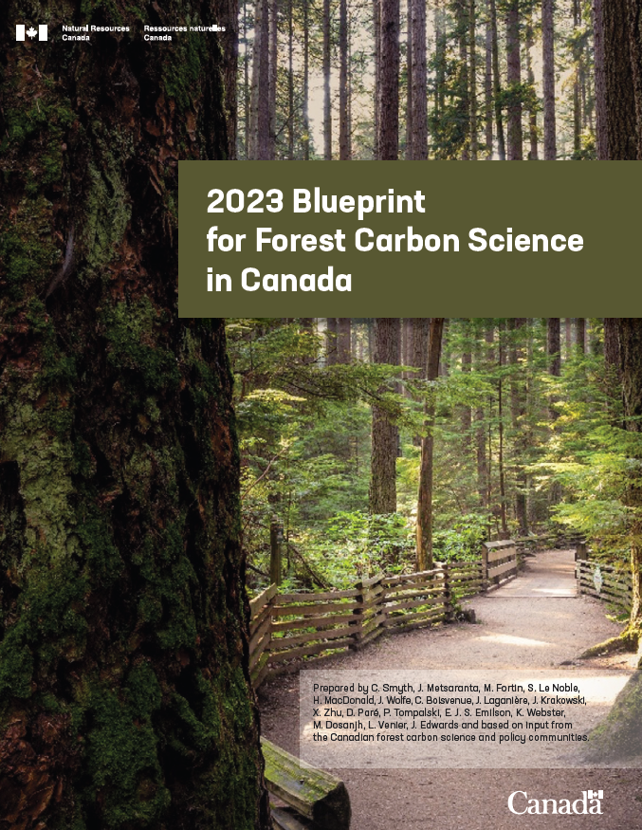
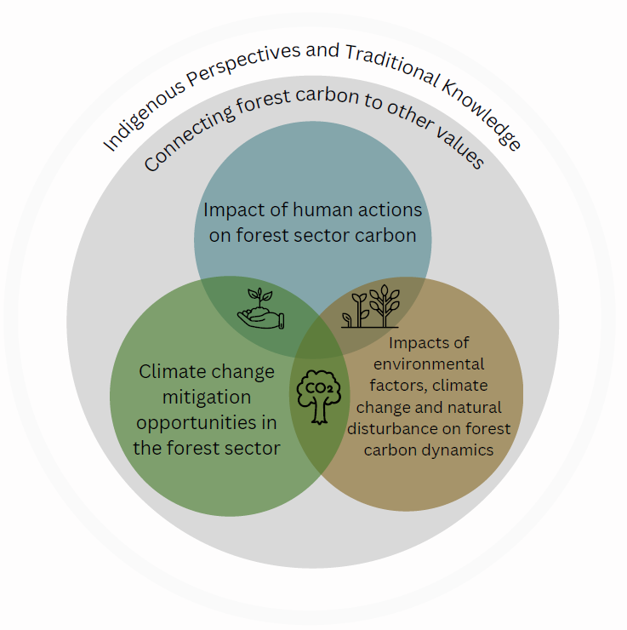
Forest Carbon Blueprint Update​
https://publications.gc.ca/collections/collection_2024/rncan-nrcan/ Fo4-43-2024-eng.pdf
Notes:
And now a couple of items to wrap up. There is a new Blueprint for forest C science in Canada that was recently published. The original blueprint is from 2012, and since then advances in forest carbon science have supported policy and forest management decisions.
The updated blueprint:​
Takes stock of progress over the past 10 years​
Identifies policy-relevant research priorities to orient activities of research organizations and guide research-funding decisions​ across the Canadian forest carbon science and policy communities.

Slide 20

Climate Sensitive Growth and Yield Modelling Initiative
Mo
ALL aspects of sustainable forest management in Canada require projections of future of wood quantity, quality, biomass (carbon), habitat, etc.
With a changing climate, there is a risk that these projections are no longer reliable.
Carbon estimation and reporting (NFCMARS)
National forest inventory
National wood supply
“Growth and Yield”: predictions of tree growth, tree mortality and recruitment generated using input data and a series of component equations (models) that produce outputs for indicators of interest such as wood volume, biomass, ecosystem production, harvested wood products.
“Climate Sensitive”: the ability of a growth and yield model to consider in its projections the impacts of changes in climate and other environmental conditions, such as temperature, precipitation, water balance, increases in atmospheric CO₂ concentration and atmospheric nitrogen deposition.
Empirical models
Process models
Hybrid models
Notes:
And finally, an update about the Climate Sensitive Growth and Yield Modelling Initiative. Growth and yield models are used to project future forest conditions and estimate quantities such as wood volume, biomass and C. However, most models currently used in Canada do not adequately account for climate and other environmental variables, which limits their effectiveness under a changing climate.
Internal CFS climate sensitive growth modelling steering committee that has met regularly since 2020
Regular on-going meetings with inter-provincial working group for information sharing (since 2020)

Slide 21
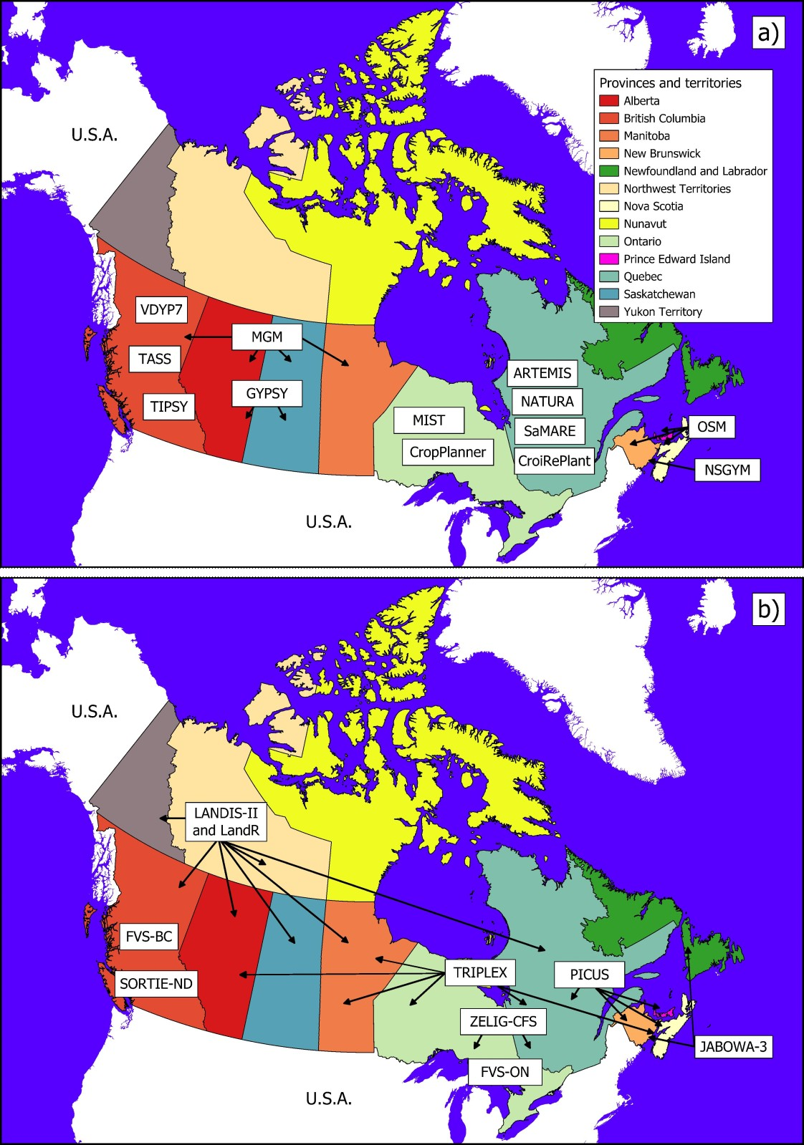
Current Status in Canada
Comprehensive (190 references) technical review paper called Climate Sensitive Growth and Yield Models in Canadian Forestry: Challenges and Opportunities [Available at The Forestry Chronicle, DOI 10.5558/tfc2024-005]
,We have developed A Strategic Plan for the Advancement of National Climate Sensitive Growth and Yield Modelling in Canada [Coming soon as a CCFM report]
1. No climate sensitivity:
The model assumes a static climate (9 out of 15 models)
2. Indirect or average climate sensitivity:
One or many explanatory variables of the model are expressed as a function of climate variables or use average climate variables in their equations. (6 of 15 models, 4 more could be modified
3. Annual climate sensitivity:
One or many model components directly rely on annual or intra-annual climate variables. (all process or hybrid models)
Notes:
Geographical coverage of the models (a) currently approved by provincial and
territorial agencies for the management of publicly-owned forests, and (b) previously
supported by provincial and territorial agencies or used in the context of research
projects. None of the currently approved models (top figure) have annual climate sensitivity,
and the majority only have indirect climate sensitivity (through e.g. the site index)

