Slide 1
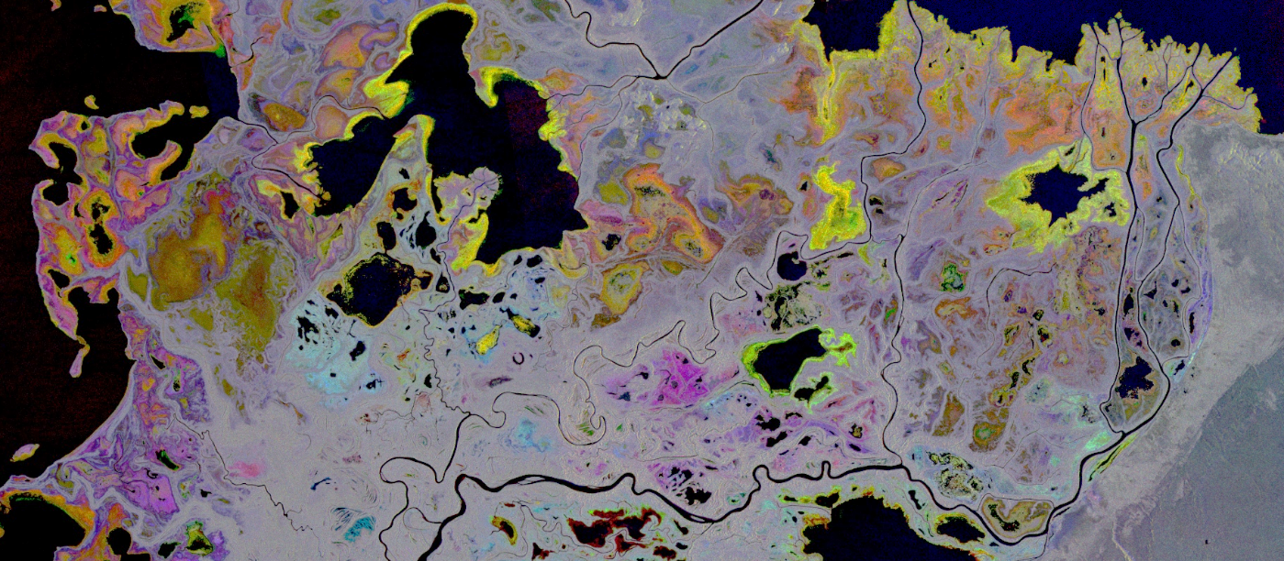
ABoVE Wetlands Working Group

Slide 2
Working Group - Formed at ASTM6 – 34 members, 9 ABoVE Projects directly involved with Wetland Dynamics
(Butman TE2018, Striegl 2014, French TE2018, Smith TE2016, Bourgeau-Chavez TE2014,18, Miller TE 2014, 2018, Douglas USACE 2018, )
Goal: to synthesize data for understanding regional wetland conditions and change and to identify data gaps.
Approach: to coordinate, collaborate, and understand the ABoVE domain related wetland research including wetland type mapping, monitoring, and process modeling.
Cross Cutting Objectives: Link wetland dynamics to Hydrology & Permafrost, Carbon, Wildfire, and Vegetation WGs.

Slide 3
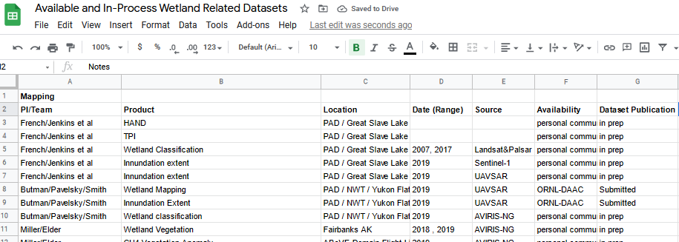
Annual Activities Summary:
  Conducted quarterly speaker series with involvement from all affiliated ABoVE Projects (5 projects and 3 Canadian partner orgs.
  Continue to maintain a database on wetland related datasets from ABoVE project
  Coordinating with Carbon Monitoring Systems ‘Wet Carbon’ working group.
    Campbell et al ERL 2022: A review of carbon monitoring in wet carbon systems using remote sensing

Slide 4
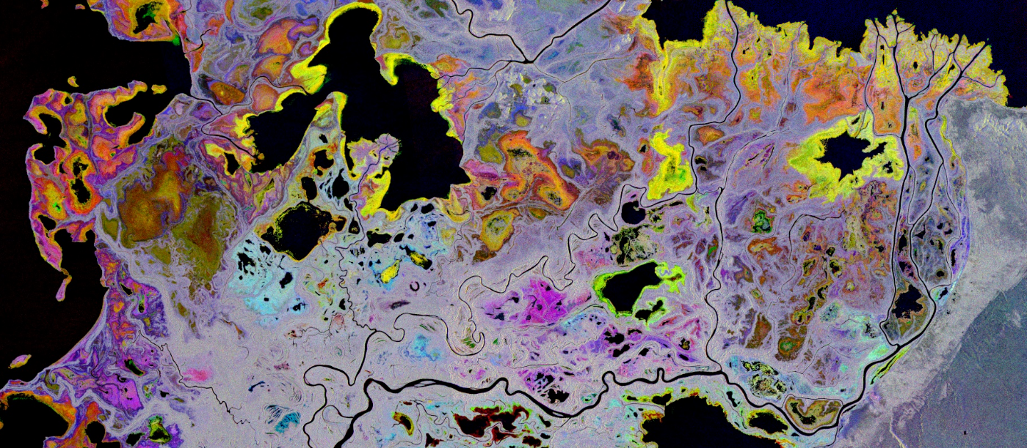
Research Highlights: Mapping

Slide 5
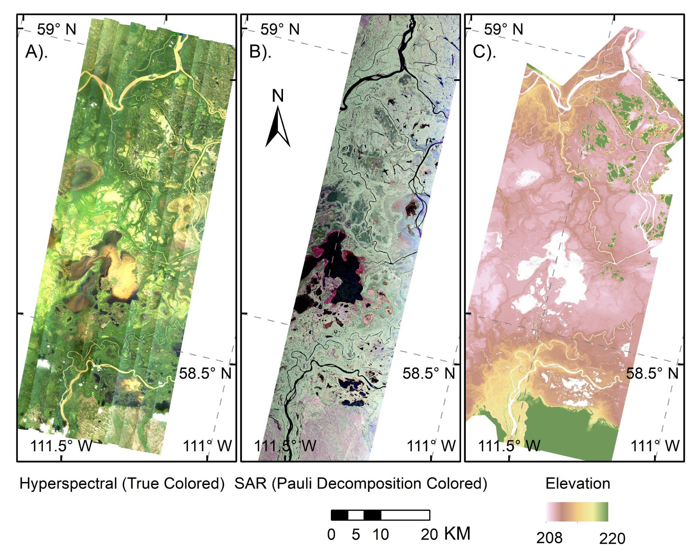
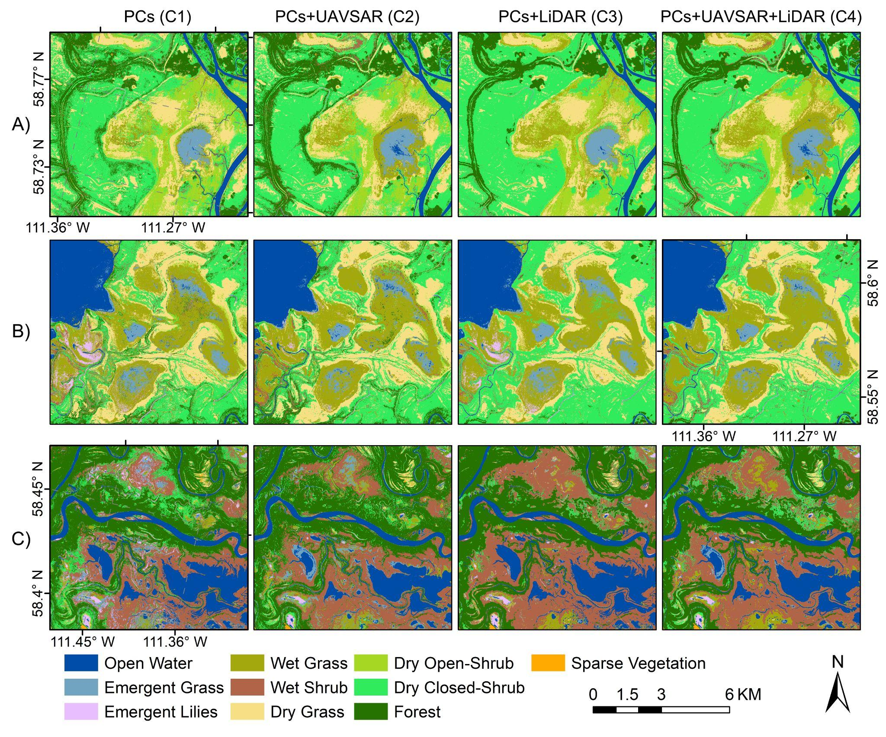
PAD Wetland Vegetation Community mapping from NASA’s airborne AVIRIS-NG and UAVSAR instruments, and UAV-LiDAR data
Chao Wang, PhD Candidate, UNC Chapel Hill
A
B
C
Cloud-based workflow on GEE enables efficient processing of airborne AVIRIS-NG hyperspatial imagery
Butman TE 2018
Notes:
Research highlight abstract titled "Characterization of wetland vegetation communities from airborne AVIRIS-NG, UAVSAR, and LiDAR data across the Peace-Athabasca Delta, Canada"
Right Panel: Vegetation community distributions and inundation hotspots for three subregions of the PAD. A) Rochers Depression; B) Mamawi Lake near Embarras River; C) Athabasca River east of the Embarras River distributary.
We used co-located airborne three-sensor data to map wetland vegetation communities
Inclusion at least 2 of 3 multi-sensor data increases accuracy to any one of them

Slide 6
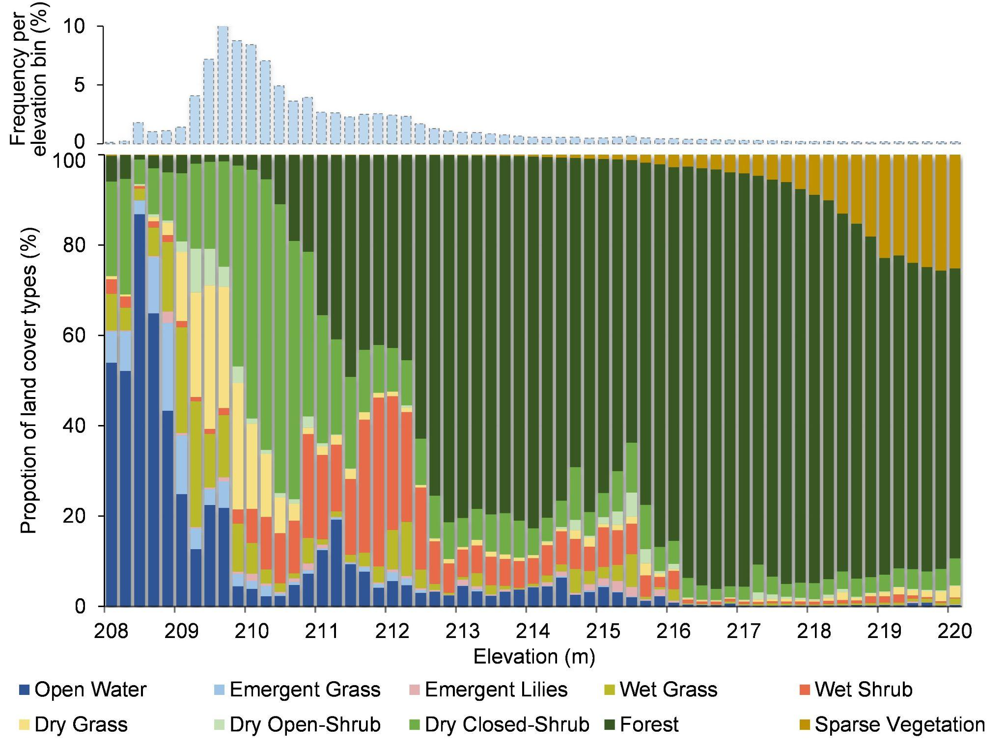
Chao Wang, PhD Candidate, UNC Chapel Hill
Comparison to existing maps shows potential to support ecological applications.
With an increase of 1.8 m from the lowest elevation (~208 m), the proportion of open surface water and emergent vegetation classes decreases from over 60% to less than 7.1%. (Wang et. al. Submitted RSE 2022)
Butman TE 2018
Notes:
The right panel is Fractional vegetation coverage of the PAD, separated by 0.2m elevation bin.
Wetland land cover classifications A) our classification C1; B) Alberta Ground Cover Classification (Sanchez-Azofeifa et al. 2005), circa 2000; C.) the ESA WorldCover (Zanaga et al. 2021) in 2020; D and E.) XGBoost-based and CNN-based land cover classification (DeLancey et al. 2020) in 2018; F.) Canada harmonized land cover map (Li et al. 2021) in 2015; G.) Forest land cover map for Canada’s forested ecosystems (Hermosilla et al. 2022) in 2019.

Slide 7
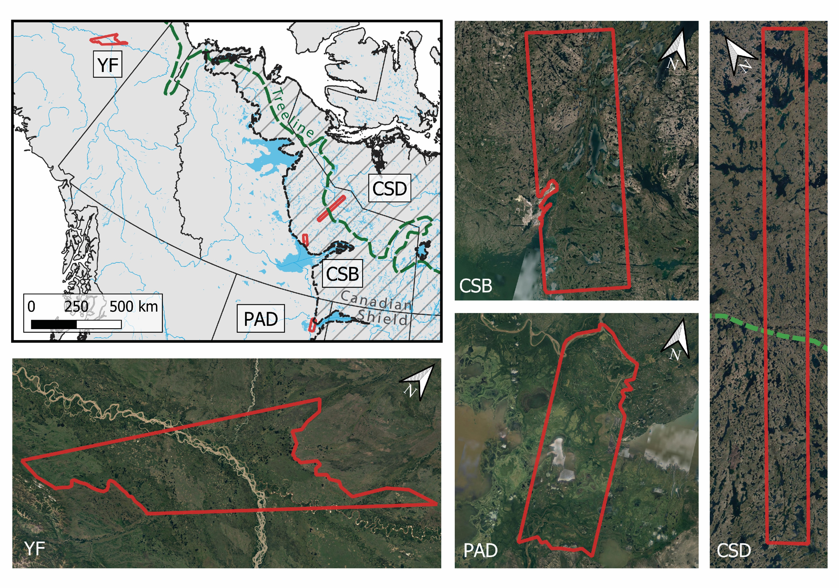
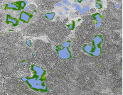
Ethan Kyzivat (PhD Candidate Brown University): mapping lake emergent aquatic vegetation from UAVSAR
Four study areas on both sides of the boreal tree line
Emergent aquatic vegetation is more prevalent in the southern and lowland sites
Example lake vegetation maps for Yukon Flats, AK
Butman TE 2018, Smith 2016
Notes:
Methods: 1. Landcover classification focused on inundation from airborne SAR 2. Calculate emergent macrophyte area of each lake 3. Methane flux chamber measurements over open water and littoral vegetation. 56 additional paired open water and emergent vegetated zone flux measurements from 20 papers. 4. Sensitivity calculation for impacts of emergent macrophyte area and flux

Slide 8
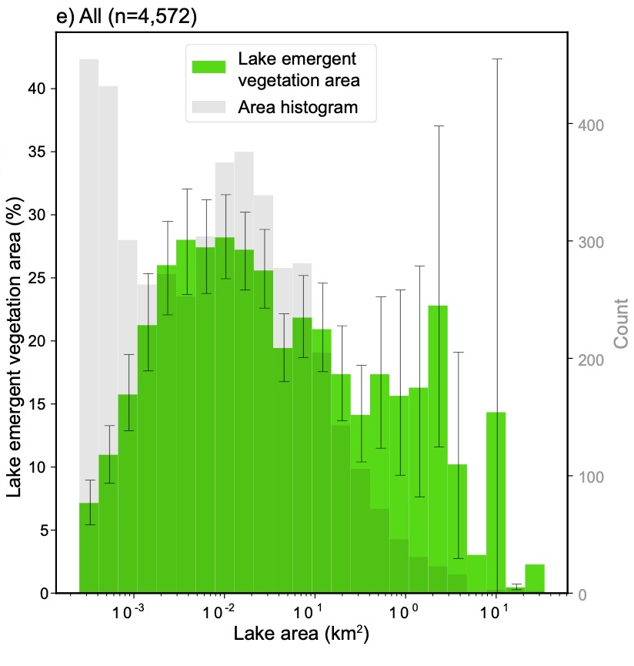
Ethan Kyzivat (PhD Candidate Brown University): mapping lake emergent aquatic vegetation from UAVSAR
Emergent vegetation coverage is generally greater in smaller lakes
Accounting for methane flux from emergent vegetation within lakes increases upscaling estimate by 21 [18-25]%
Kyzivat et al., ORNL DAAC 2021
Kyzivat et al., in revision at JGR: Biogeosciences
Butman TE 2018, Smith 2016
Notes:
Lake vegetation makes up 16% of lake area on average. Methane flux is significantly greater from emergent vegetation zones than from open water. On average, emergent vegetation zones emit 6x more methane than open water, or 16x from arctic-boreal regions only. Even so, no consistent relationship between lake area and emergent macrophyte coverage across all sites.

Slide 9
Research Highlights: Carbon

Slide 10
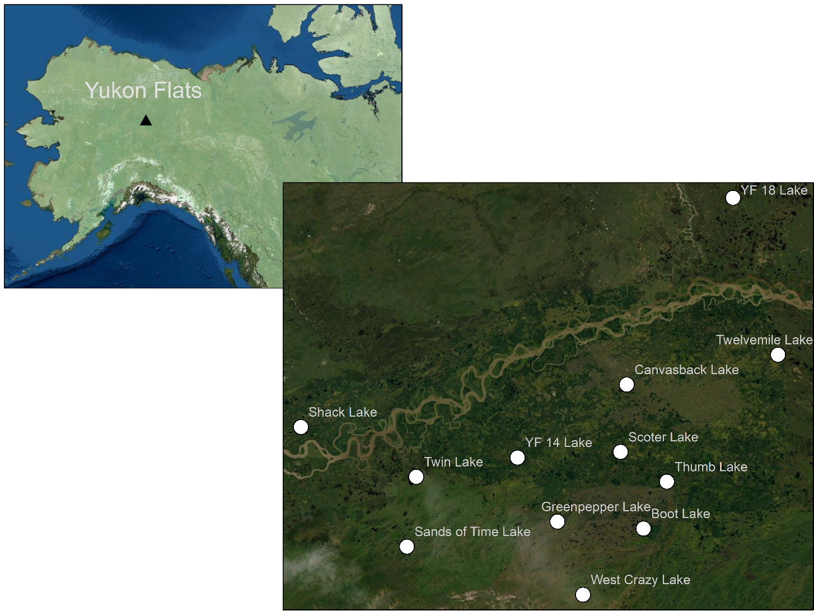
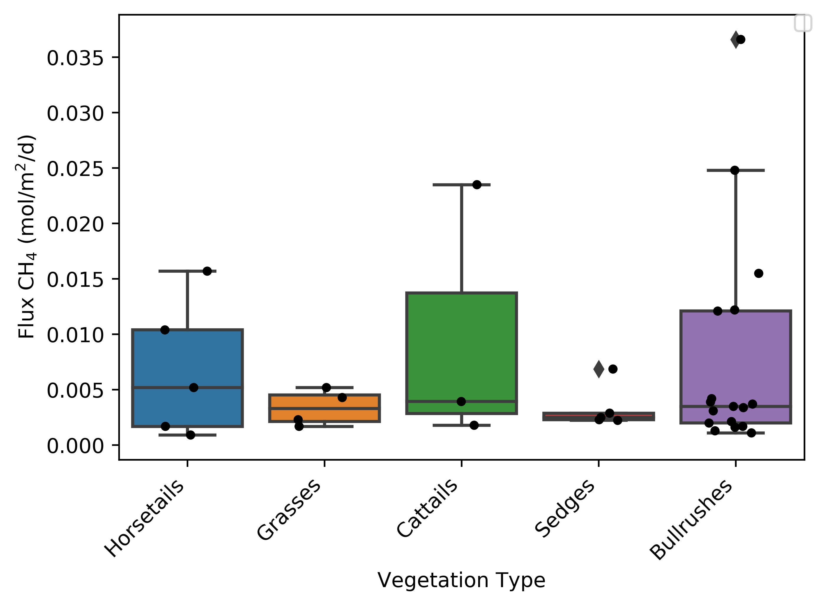
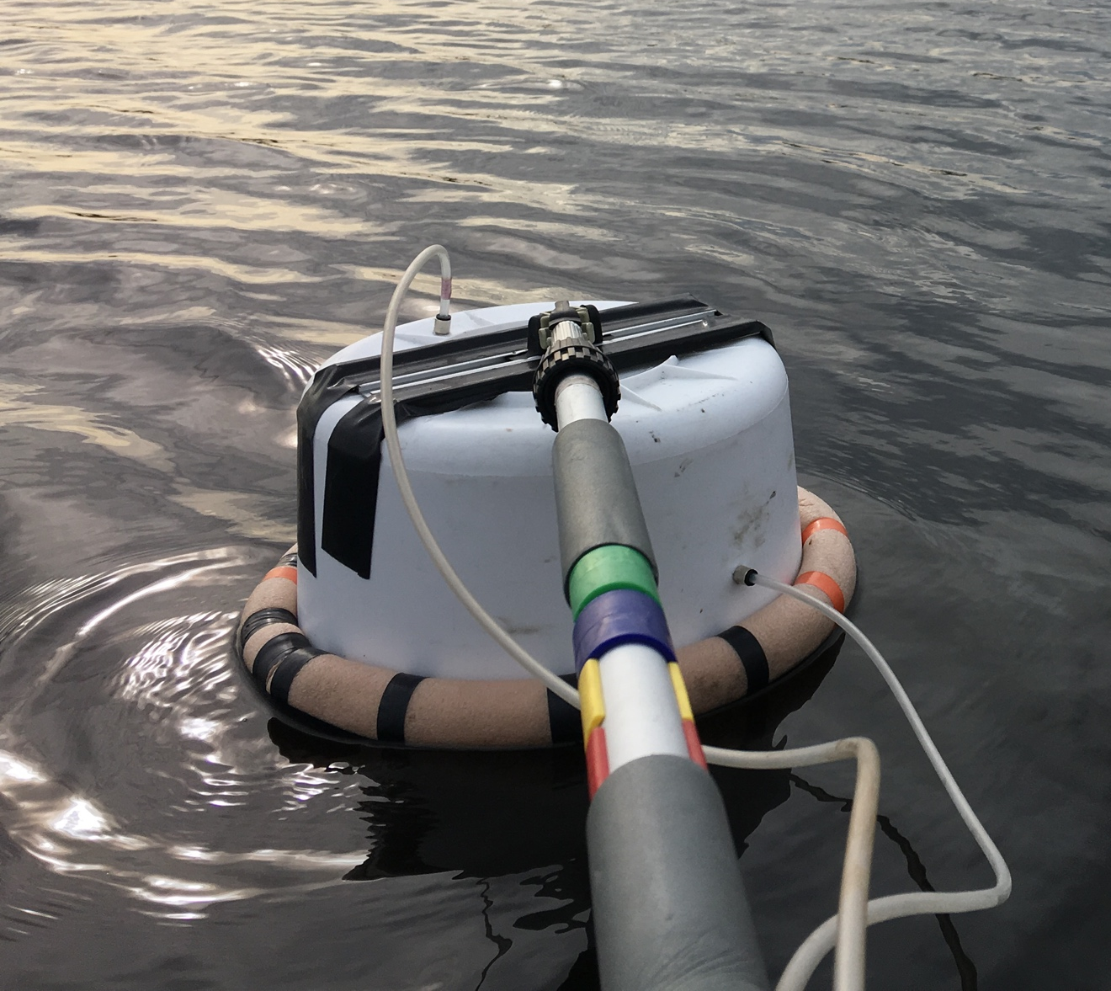
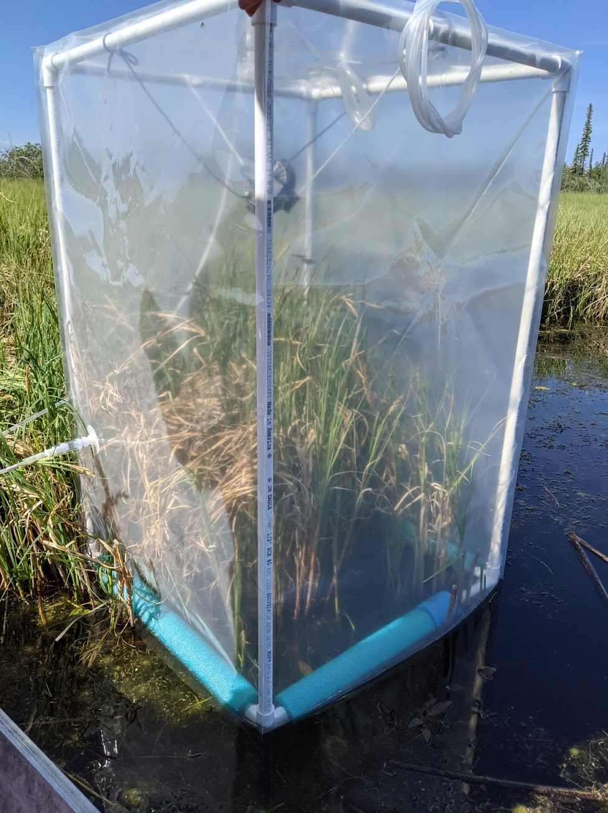
Vegetation Comparison 2021
Fenix Garcia-Tigreros – Postdoc University of Washington
Open water
Emergent vegetation
Butman TE 2018
Notes:
This boxplot shows flux variability based on vegetation types.
We find the Bulrushes, cattail and horsetail seem to be better methane conduits than sedges and grasses.
Highlighting that vegetation type plays an important role in plant-mediated methane transport.
Bullrushes – Canvaback
Horsetails – Greenpepper, YF18, YF14
Cattails – Thumb, Shack, Greenpepper

Slide 11
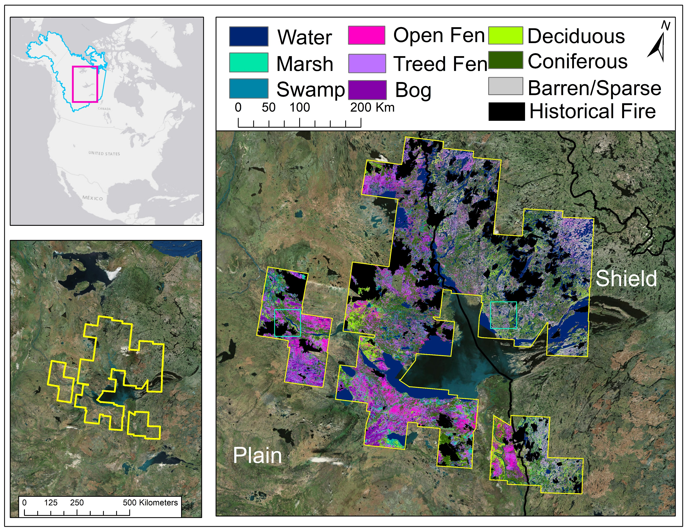
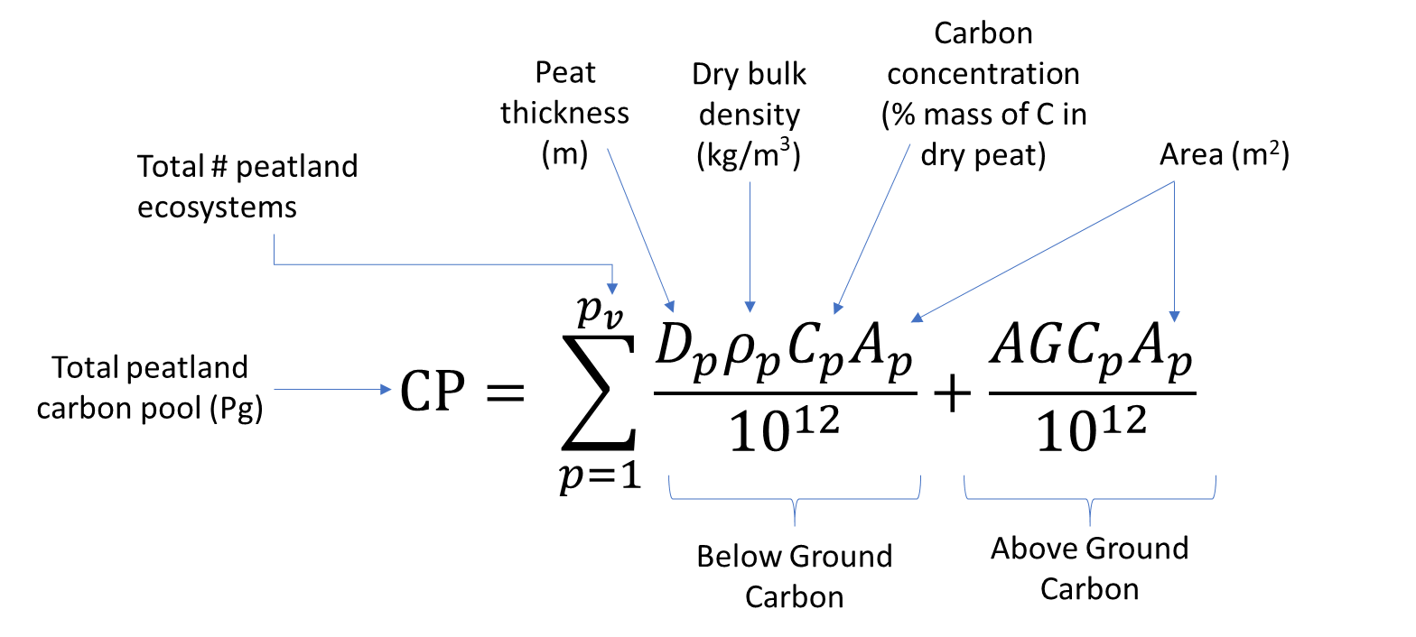
Estimating C Stocks in Peatlands – Great Slave Lake Area
Ecosystem | Area (km²)
Bog | 9266
Treed Fen | 16811
Open Fen | 7929
There is a data gap in our current knowledge of the geospatial distribution, type and extent of C rich peatlands across the globe.
Accurate mapping of peatland ecotypes with high resolution (<30 m) sensors linked with field data allows for reduced uncertainties in estimates of the distribution of C stocks.
We developed high accuracy peatland maps for the Great Slave Lake region using a combination of multi-temporal SAR and optical remote sensing in a machine learning classifier
We estimate C stocks using the maps with field data of above and belowground biomass, peat depths and bulk density using the equation from Page et al 2011 Global Change Biology
Overall Accuracy: 90%
Bourgeau-Chavez et al 2017 CJRS, 2019 (DAAC)
Bourgeau-Chavez TE2014, 2018

Slide 12
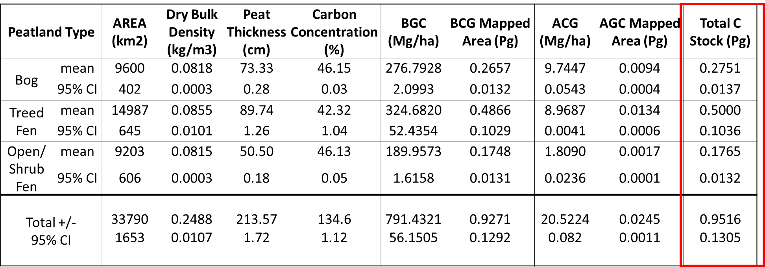
Great Slave Lake Region Carbon Stock Estimates
Adjusted area and CI was estimated using error matrix and % of landcover on the map after Olofsson et al. 2013 RSE
Results show 951.6 Tg of C is stored in the peatlands around Great Slave Lake +/- 130.5 Tg, with treed fens contributing the most, both in above and belowground C
Next steps are to estimate C emissions from CanFIRE for fire-affected peatlands
  Belowground emissions for 11 of the largest wildfires were 3.5 times greater for peatlands (16.3 Mg/ha) than for uplands (4.7 Mg/ha). Aboveground emissions are likely greater for the uplands and will be needed to complete the analysis.
Bourgeau-Chavez TE2014, 2018

Slide 13
Research Highlights: Hydrology

Slide 14
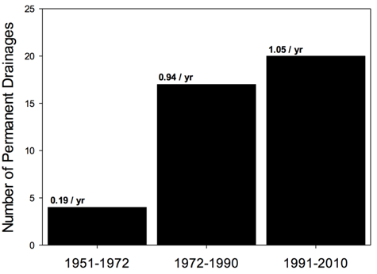
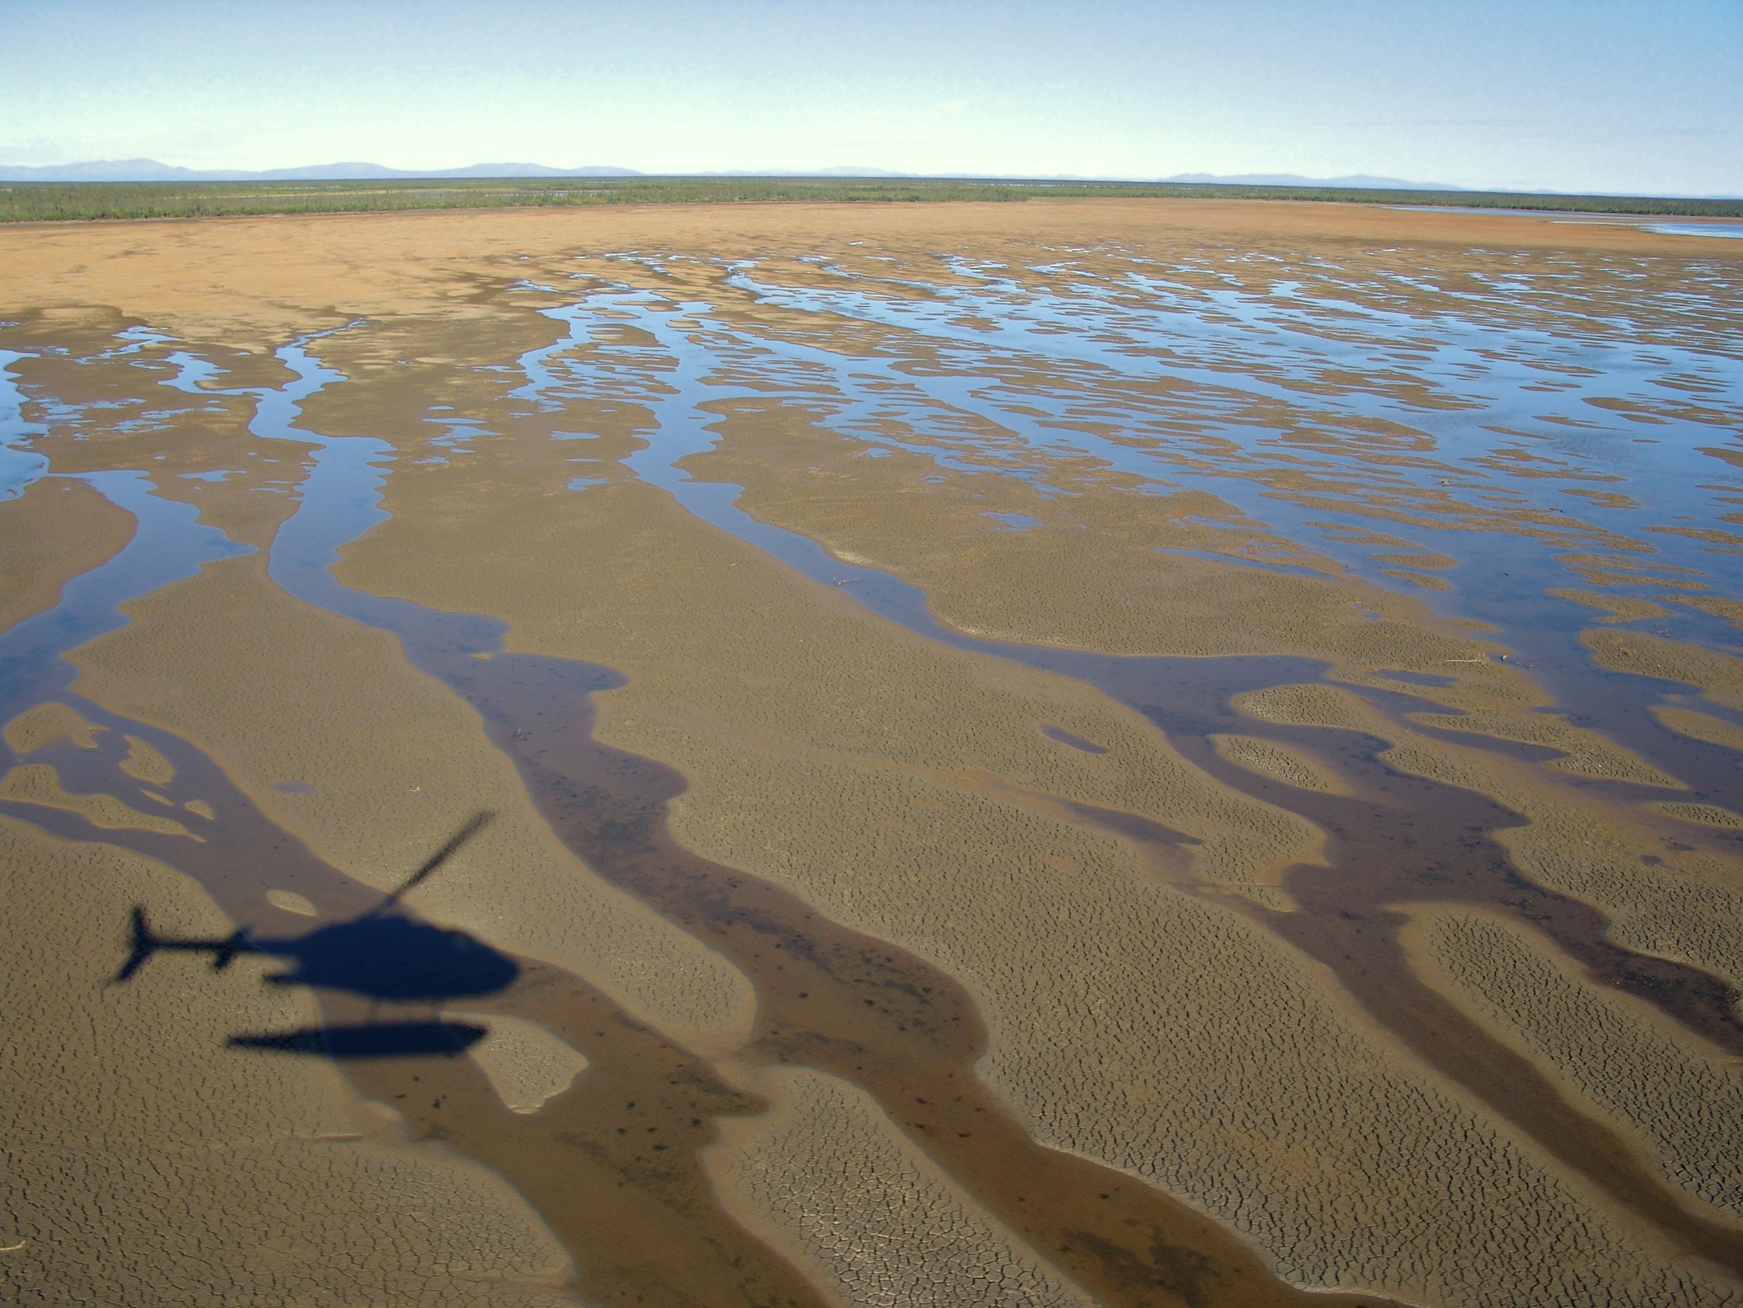
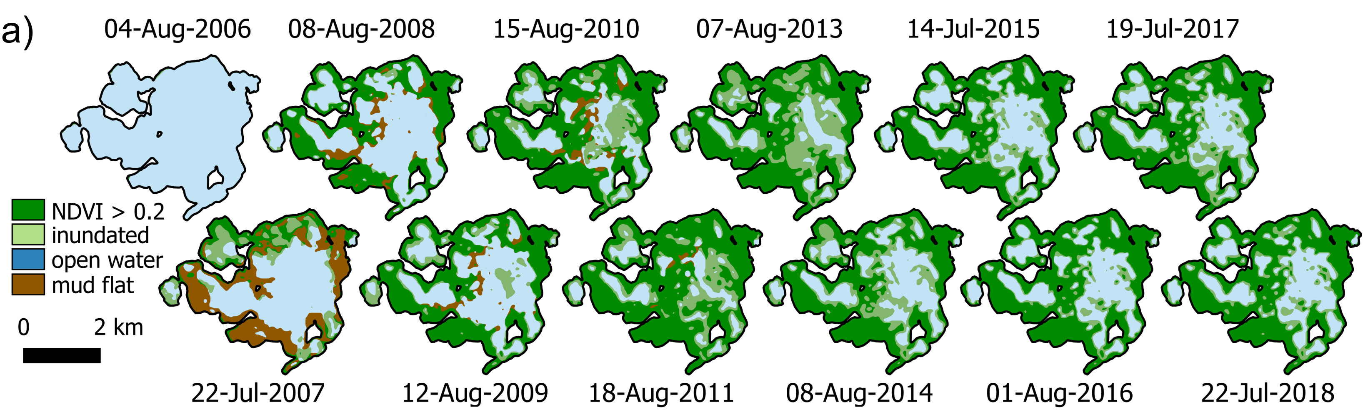
Previous
Lantz and Turner, 2015, JGR, https://agupubs.onlinelibrary.wiley.com/doi/10.1002/2014JG002744
  Lake drainage frequency increasing in Old Crow Flats (1951 – 2010)
Turner et al., 2022, Arctic Science, https://cdnsciencepub.com/doi/abs/10.1139/AS-2020-0022
  Monitoring spatial and hydroecological responses of a drained thermokarst lake
Ongoing
Evaluating lake drainage frequency and magnitude since 2007
  Are lake drainage events linked to enhanced wetness across (connectivity) across Old Crow Flats?

Slide 15



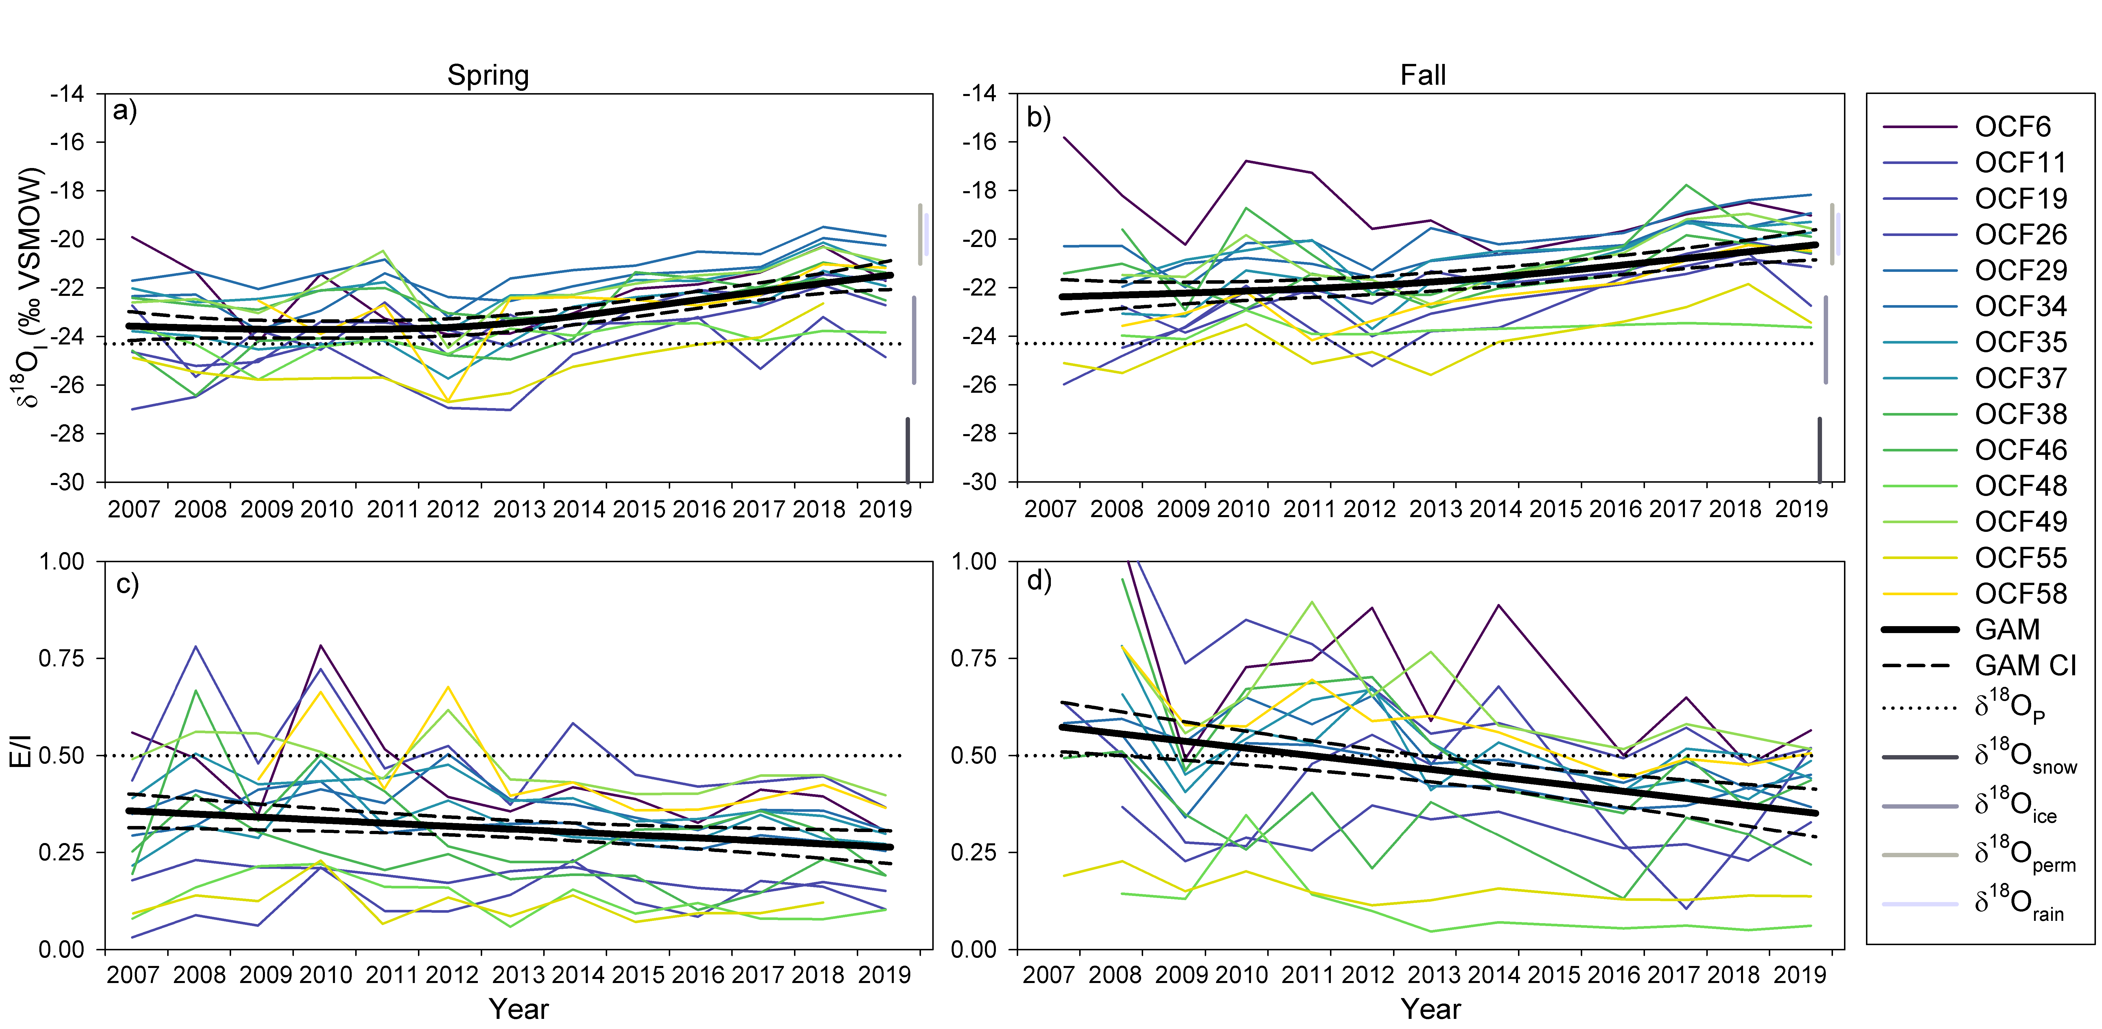
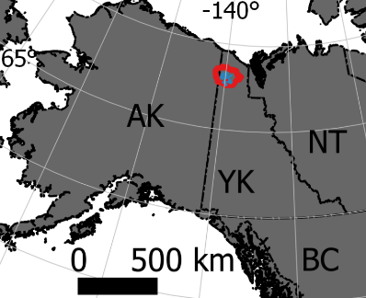

Wetland-related research updates from Old Crow Flats, Yukon, Canada
(Kevin Turner and group)
Previous
MacDonald et al., 2021, ERL, https://iopscience.iop.org/article/10.1088/1748-9326/ac3533
  Rainfall is increasing significantly in most lakes
  Indication of increased precipitation, hydrological connectivity
rainfall
snowmelt
evaporation
Ongoing
Kay et al., in prep.
  Downstream (creek/river) geochemistry being influenced by enhanced hydrological connectivity

Slide 16
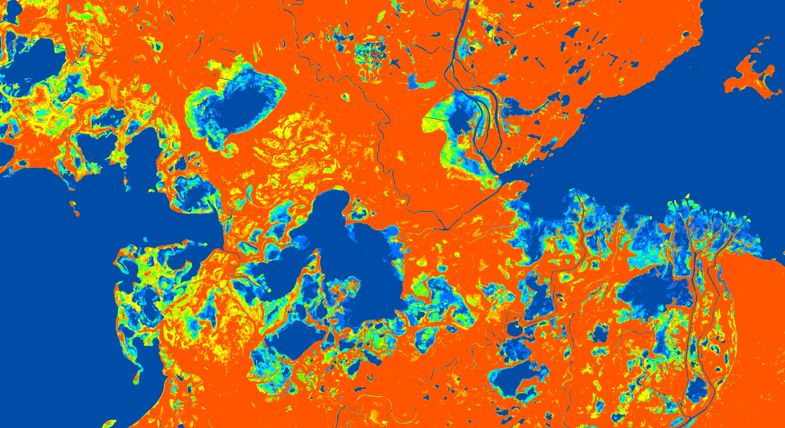

Inundation Classification
Sentinel-1 C-band SAR backscatter images; Summer 2017 to 2020; 8 images in each year
Peace-Athabasca Delta –2017

Slide 17
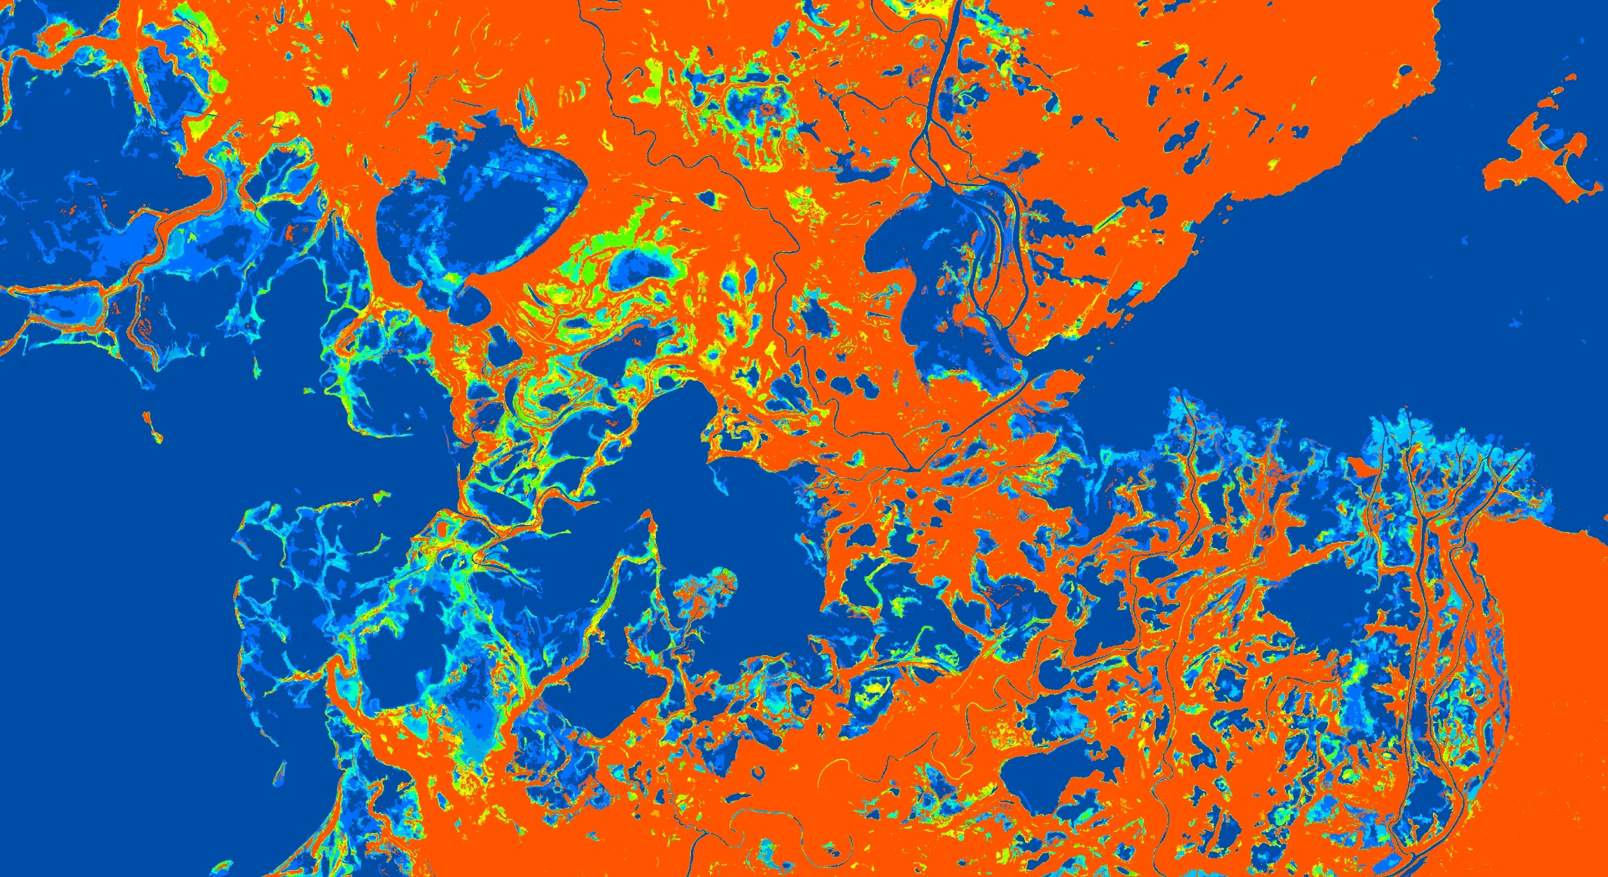
Sentinel-1 C-band SAR backscatter images; Summer 2017 to 2020; 8 images in each year
Inundation Classification
Peace-Athabasca Delta –2020

Slide 18
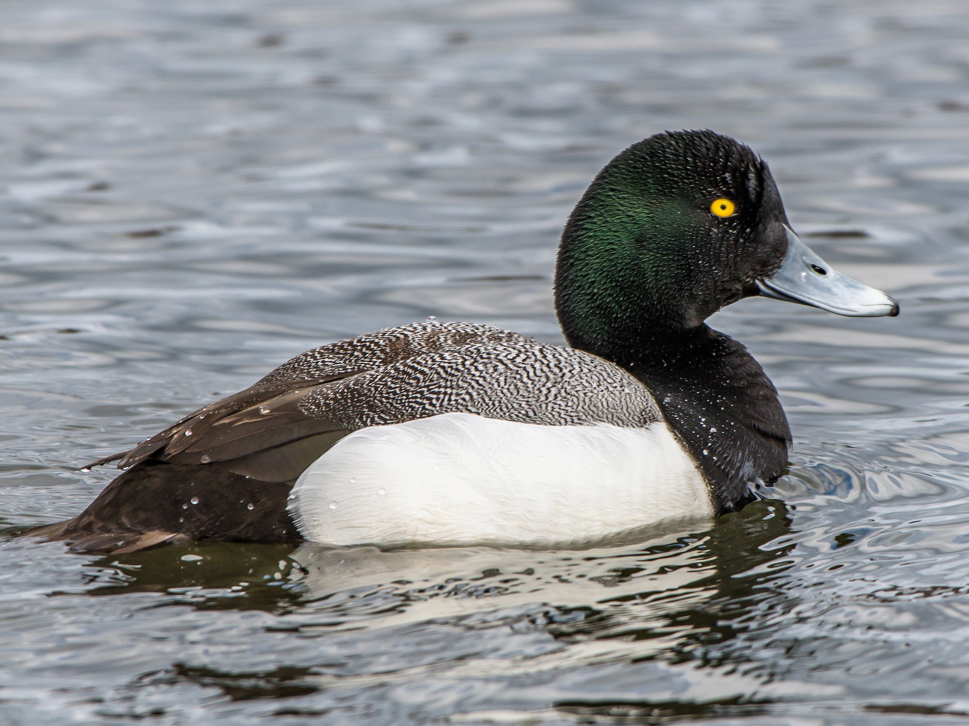
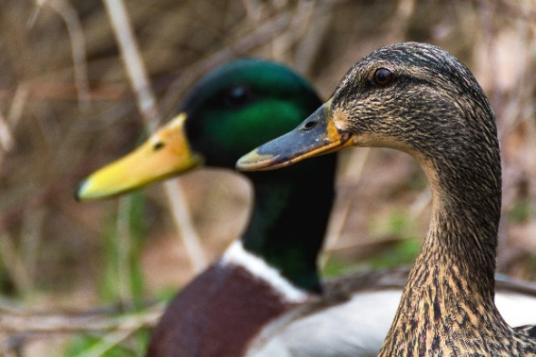
Waterfowl Habitat Assessments
Objectives:
Provide proof of concept for
using inundation in boreal waterfowl modeling and
assess inundation status additivity to current modeling efforts
Data:
Waterfowl Breeding Population (BPOP) and Habitat Survey waterfowl data
Landcover data (ABoVE and DUC)
Inundated area/pond counts
2017 to 2019 (ABoVE)
Approach:
Preliminary modeling
– Understand habitat classifications
Time Invariant modeling
– Determine baseline habitat model
Time Variant modeling
– Understand inundation
Results:
Ponds are important for Dabblers but not Divers
Inundation appreciably adds to time-invariant Diver model
Time-specific open water (200 m) adds to time-invariant models for Dabblers
Greater Scaup (diver)
Mallard (dabbler)
Notes:
Waterfowl habitat modeling proof of concept conducted by Ducks Unlimited Canada partners
DUC co-developed wetland mapping (shown last year) and is assessing the type and inundation maps to improve approaches to habitat suitability mapping
Preliminary results are shown here
More information at talk by Nancy French & Kevin Smith (this meeting)

Slide 19


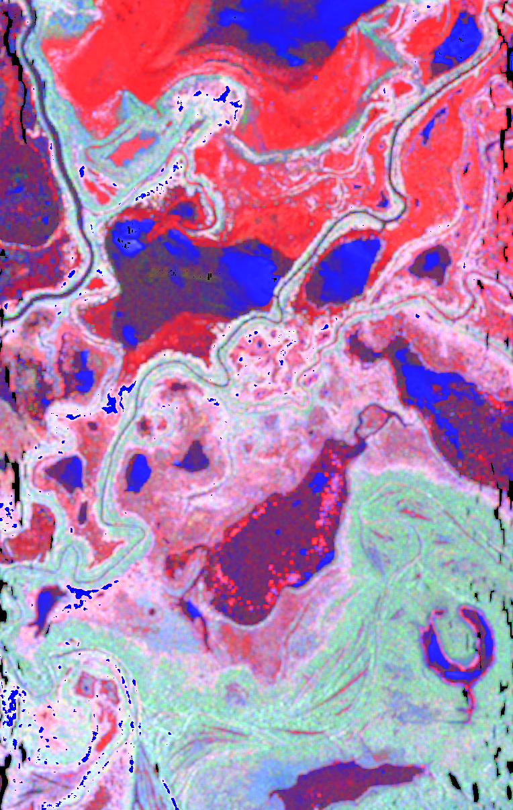
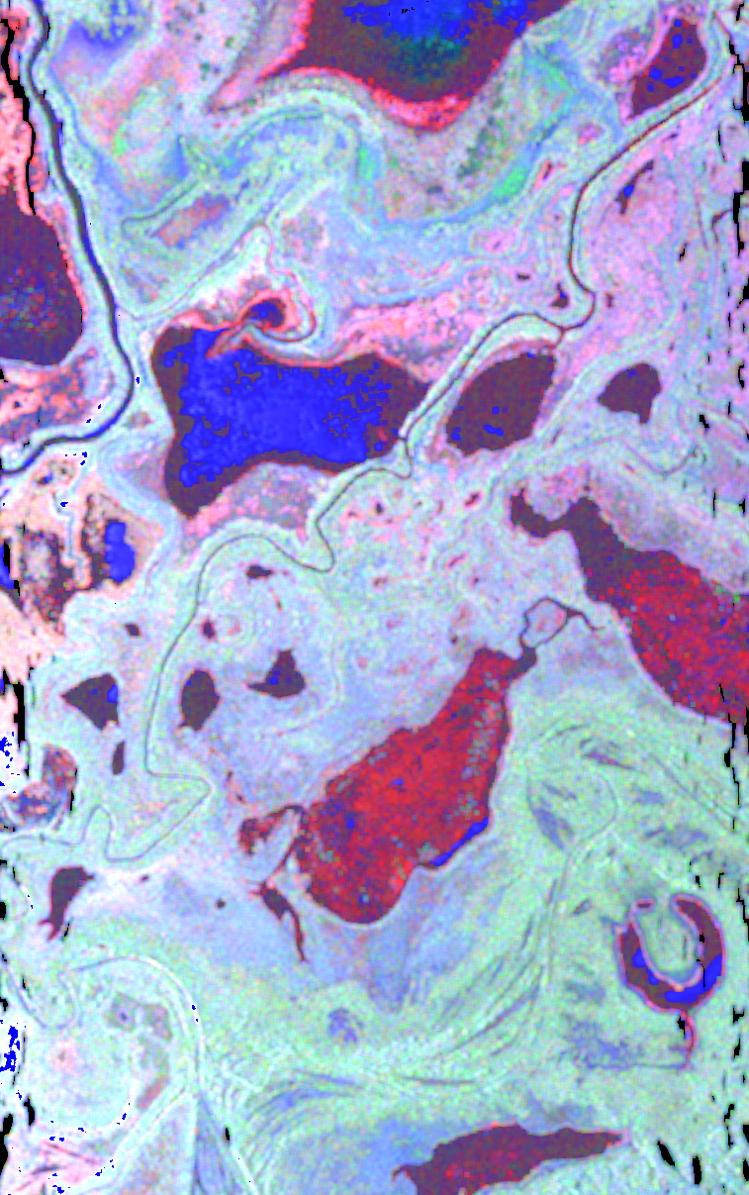
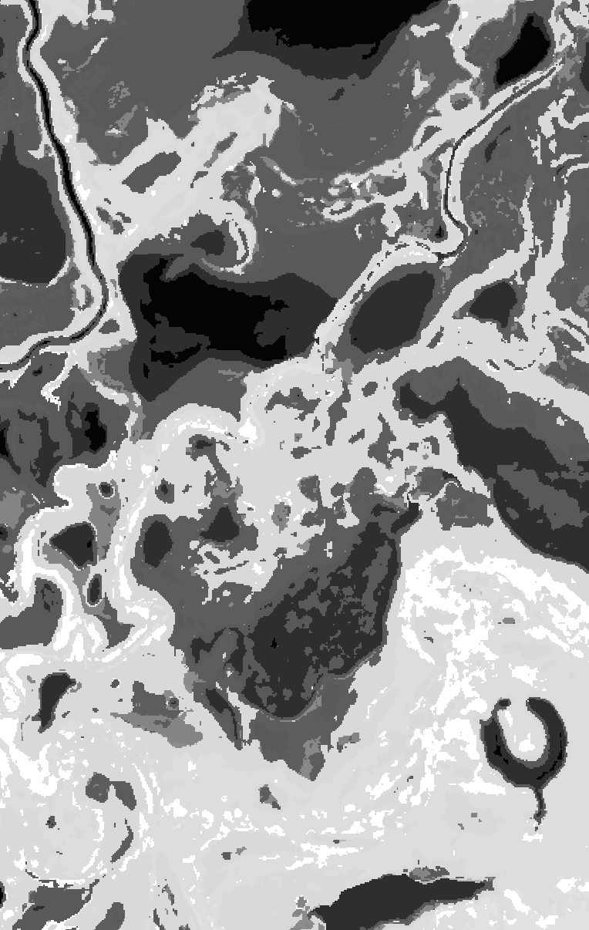

Sept 8, 2017
ABoVE: Wetland Type 2017
June 13, 2017
Assessing inundation dynamics within vegetation classes using L-band UAVSAR data
Veg
Class ID
Double Bounce
(inundated vegetation)
Volume Scatter
(forest)
Surface Scatter
(open water)
Notes:
Slides provided by Bruce Chapman, JPL. This work is building inundation product algorithms for upcoming NISAR Mission
L—Band UAVSAR provides quad-pol data for exploring vegetation structure
Interaction of microwave energy with different vegetation structures can be derived from this data
Assessed the microwave signatures by vegetation type to determine the mechanisms of radar interactions
RESULTS:
High Surface Scatter for open water and aquatic bed (expected over open water)
Lower double bounce and larger volume scatter for marsh, fen, bog

Slide 20
Looking ahead…
Phase 2 Field Campaigns summer 2022 for mapping validation
Comparison of wetland map products for user communities (Carbon, Vegetation Change, Habitat, Indigenous Communities)
Evaluation and Synthesis of inundation products as part of the ABoVE Effort
Collaborate with Carbon Cycling WG on Wetland influence on carbon stocks and flux.
Phase 3 and Preparation for NISAR, SWOT missions for large scale wetland mapping.

Slide 21
Thank you to all of the contributors!
Questions?

