Slide 1
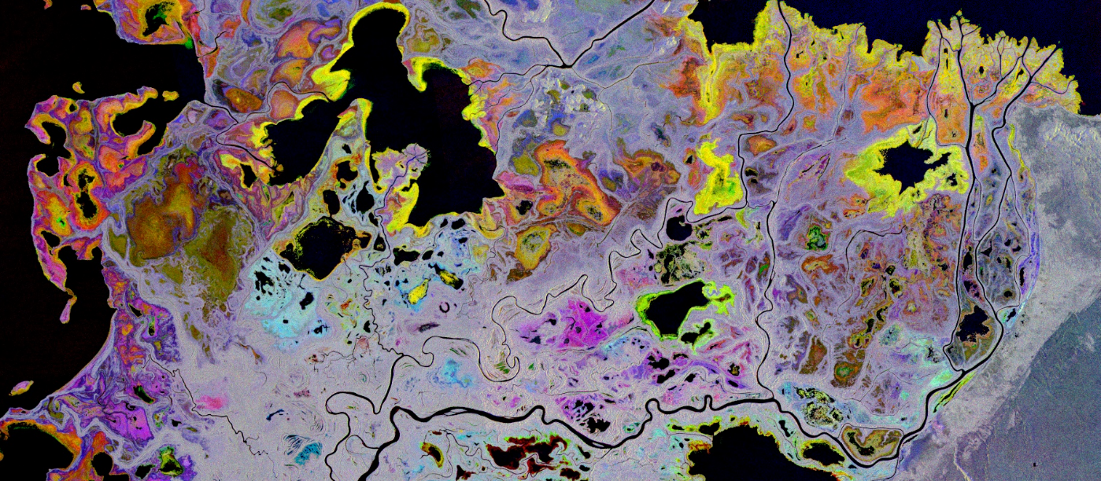
ABoVE Wetlands Working Group

Slide 2
NEW Working Group - Formed at ASTM6 – 30 members – 4 ABoVE Projects
(Butman TE2018, French TE2018, Smith TE2016, Bourgeau-Chavez TE2014,18)
Cross-over with Hydrology, Carbon, Wildfire, Vegetation WGs
Goal: to synthesize data for understanding regional wetland conditions and change and to identify data gaps.
Approach: to coordinate, collaborate, and understand the ABoVE domain related wetland research including wetland type mapping, monitoring, and process modeling.
Immediate objective: to identify common field and remote sensing methodologies and techniques in order to efficiently pool data and other resources and coordinate product development.
First quarterly meeting was March 17, focused on work being done in the PAD – Wetland Waterfowl habitat project (PI French); Inundation and C-flux project (PI Butman) – 3 presentations on mapping wetland ecotypes (AVIRIS, UAVSAR, and multi-season, multi-sensor satellite SAR-Optical approach)
Presentations by CMS wet carbon review team, and overview of airborne campaign collections by Chip Miller
Next June 16 quarterly will focus on inundation monitoring with C- and L-band SAR. Bruce Chapman will present on the L-band UAVSAR algorithm approach; Mike Battaglia will present on C-band SAR S-1/Radarsat-2, Valentin Poncos will present on C-band, Radarsat-2, Chang Huang will present on C-band S-1

Slide 3
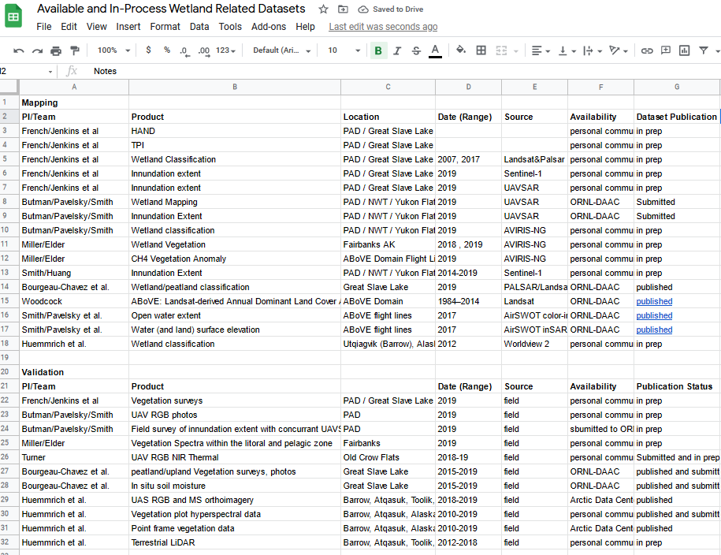
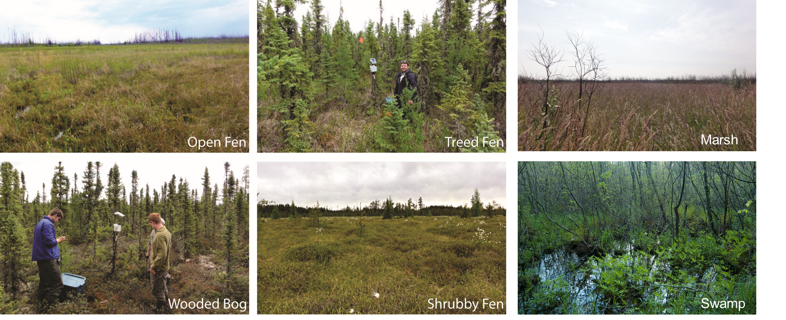

Slide 4
Importance of this Wetland Working Group
4-6 % of the global landscape are wetlands, major contributors to C cycling, water filtration, habitat and due to their dynamic nature - highly vulnerable to climate change and anthropogenic change
plant productivity is high and high-water tables impede decomposition, these systems can store large quantities of C and rapidly respond to changing conditions
Although wetlands are globally important C sinks, the magnitudes and rates of change in wetland C reservoirs are largely unknown because of uncertainties in wetland area and distribution
Our ability to represent wetland C storage and flux processes in carbon models is currently limited, with best estimates of contemporary methane emissions from wetlands vary drastically depending on what model or method is used (Fisher et al., 2014).
One of the largest drivers of this uncertainty is a data gap in the accurate identification and mapping of the distribution and type of wetlands in these high northern latitudes (HNL), as recently called out as a critical data gap at the “Arctic-Boreal C-Flux Upscaling Workshop” hosted by Woodwell Climate Research Center (October 2020).
Global-based maps are highly inaccurate with respect to wetlands in HNL regions and national inventories are lacking, incomplete, or have high uncertainty.
There is a data gap in our current knowledge of the geospatial distribution, type and extent of C rich peatlands and other wetlands across the globe.
Accurate mapping of wetland ecotypes with high resolution (<30 m) sensors linked with field data are needed to reduce uncertainties in estimates of the distribution of C stocks, and monitoring of PFT, water table and inundation patterns (through space and time) are needed.

Slide 5
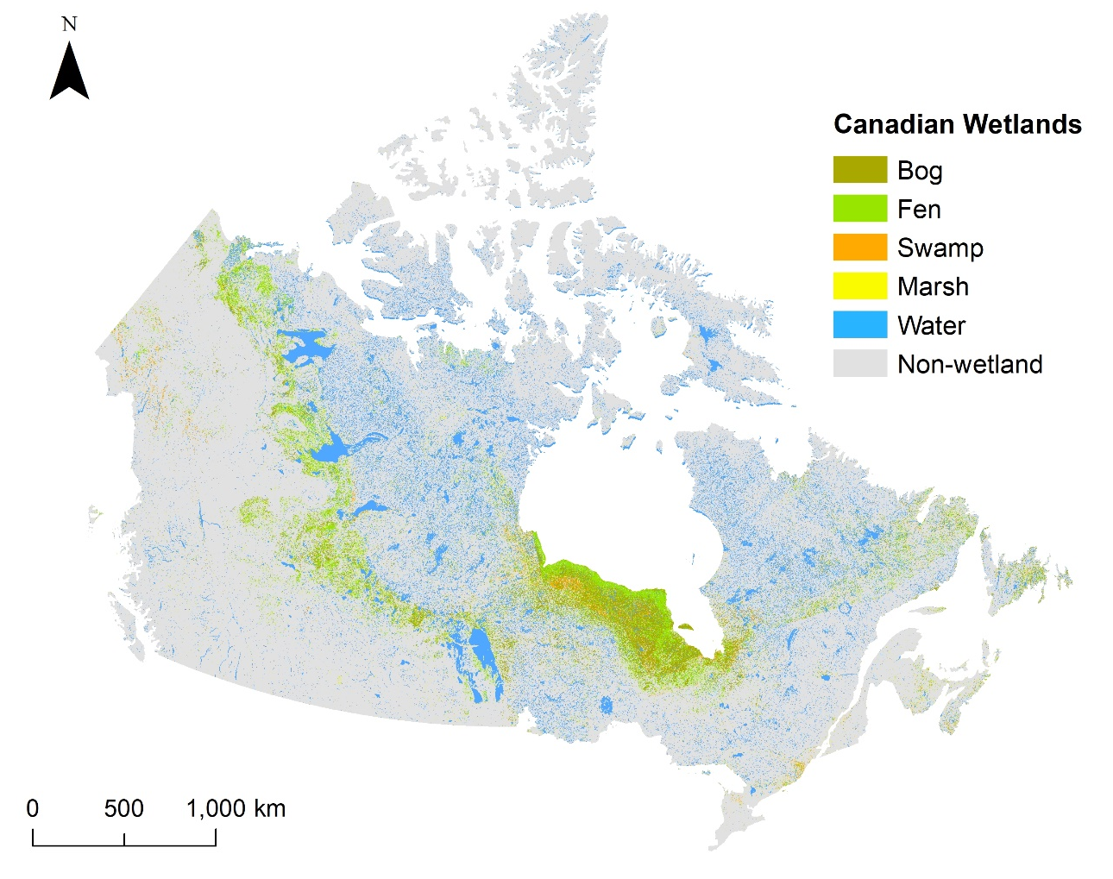
Wetlands in ABoVE Domain
Existing maps are not geospatially explicit (e.g. Tarnocai) or they are coarse or the classes are not appropriate (e.g. MODIS vegetation maps), or the maps have been produced with scant field data and class accuracy is low in many locations, or they are incomplete (Alaska NWI)
Mahdianpari et al. in submission, CWIM3
Notes:
Percent Cover of Peatlands across the NASA ABoVE Core Study area based on Hugelius’ soil database (Schuur et al. 2015), using mapped areas of Histel (permafrost organic soils) and Histosol (unfrozen organic soils) to estimate peatland area. Tarnocai’s (2006) peatland map of Canada was used to fill in a data gap for the southeastern most portion.

Slide 6
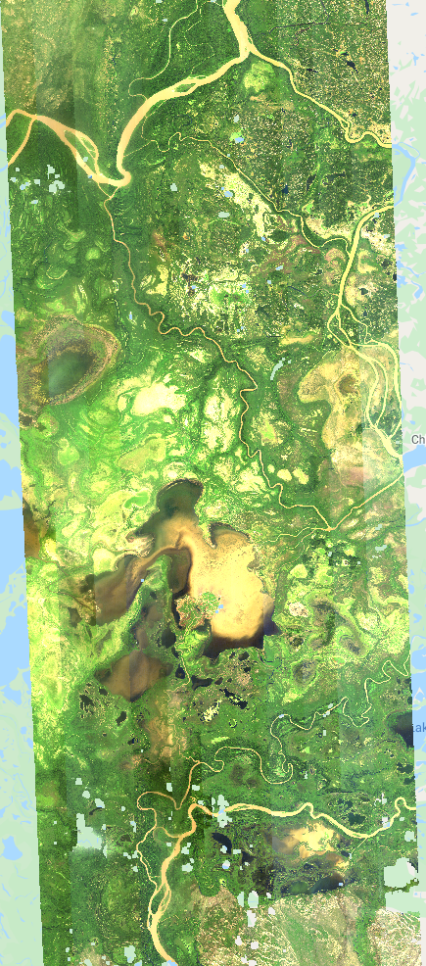
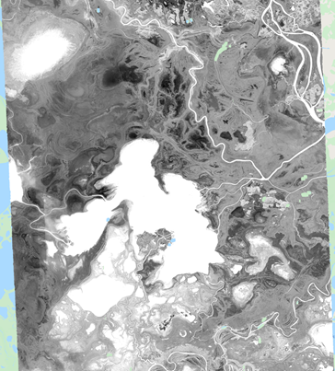
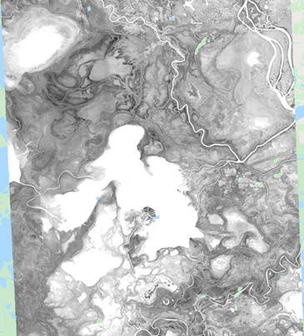
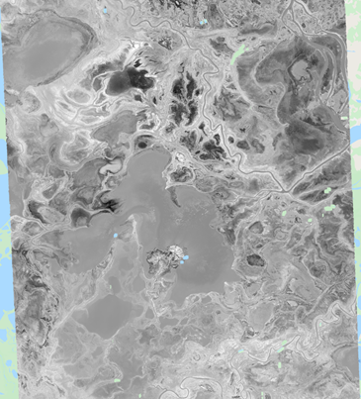
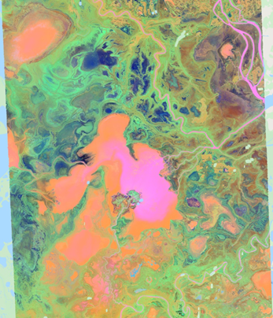
Chao Wang (Butman TE2018)
PAD Wetland Mapping from NASA’s AVIRIS-NG Hyperspectral Instrument
Developed a cloud-based workflow on GEE
Cloud/shadow detection
Kernel BRDF correction
leveling flightlines for mosaic
Spectral indices calculation
PCA transform
See presentation by Wang in Wetlands Session for details
Weyermann et al., 2015
PC1
PC2
PC3
PC1, 2, 3 composite
BRDF-Corr (Ross-Li model)
Notes:
BRDF: bidirectional reflectance distribution function
PCA: Principal component analysis
PC: Principal component
PVE: proportion of variance explained

Slide 7
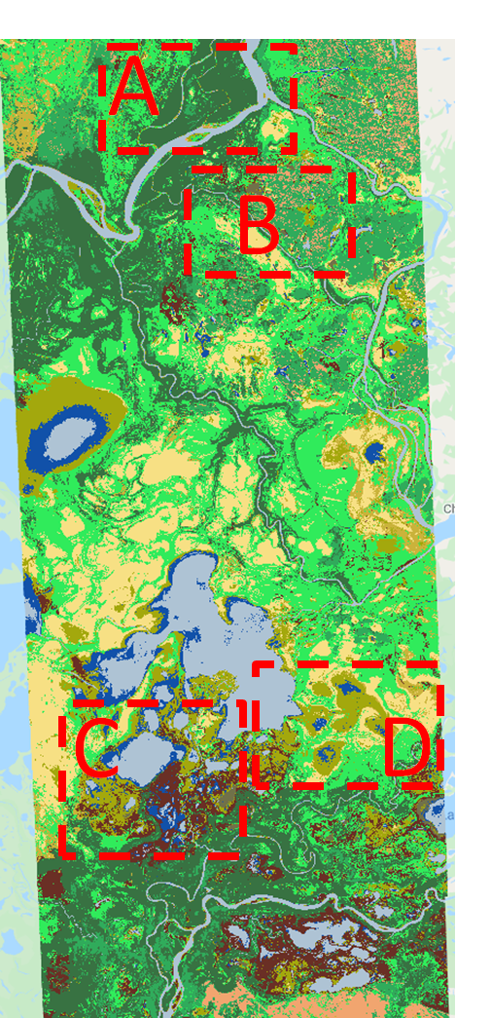
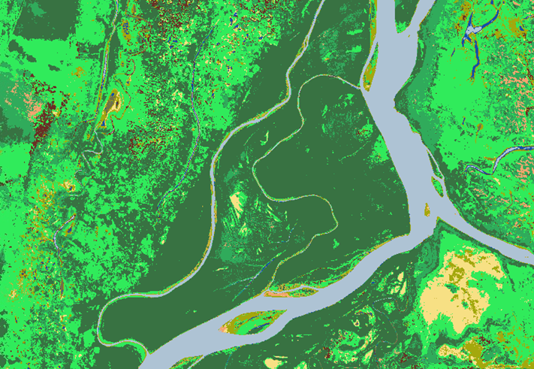
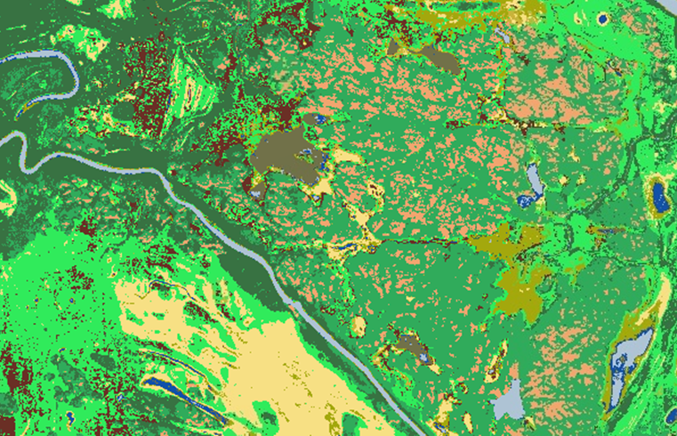
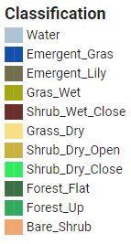
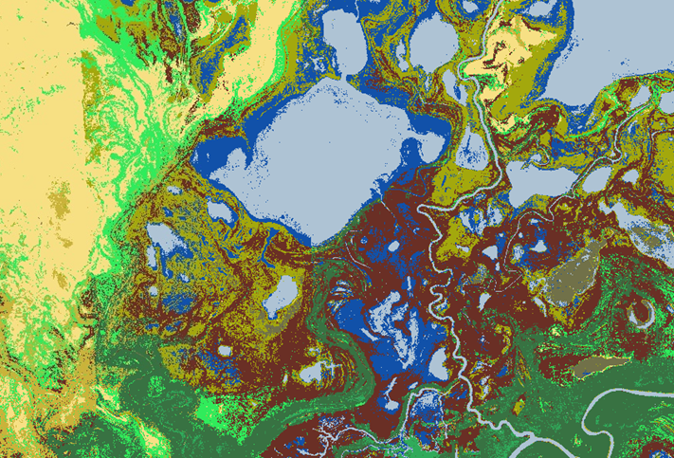
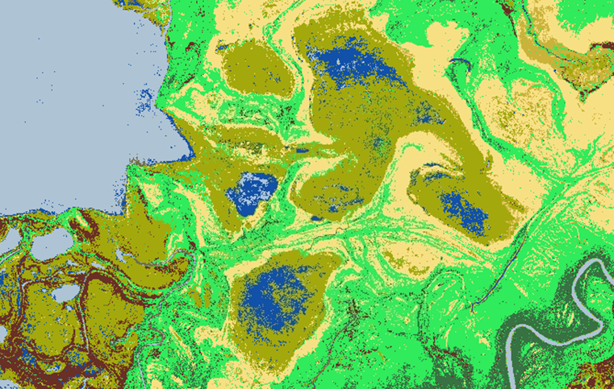
Chao Wang (Butman TE2018)
A
B
C
D
overall accuracy 91%.
Wetland land cover maps over the PAD

Slide 8
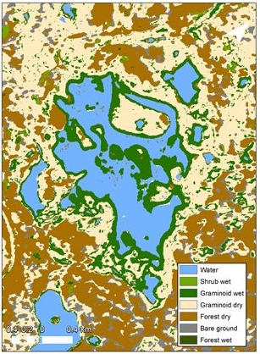
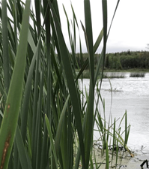
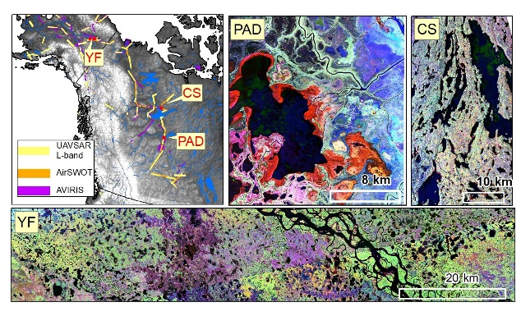
UAVSAR Lake and wetland classification for Yukon Flats, Peace-Athabasca Delta, and Canadian Shield, 2017-2019
Ethan Kyzivat - Butman- TE2018
Motivation
Wetlands are the largest environmental source of methane, followed by lakes and rivers.
Emergent wetland plants can act as conduits to the atmosphere for methane produced in lake sediments. They also excrete carbon compounds that are preferentially consumed by methane-producing bacteria and can only grow in water < 3m deep, where oxidation of water column methane is less impactful.
Approach
UAVSAR L-band flown for ABoVE airborne campaign
introduce a percent vegetation metric for lakes and wetlands that can approximate the coverage of the littoral zone
perform an upscaling sensitivity analysis by modifying the open water and vegetated partitioning
3 study regions

Slide 9
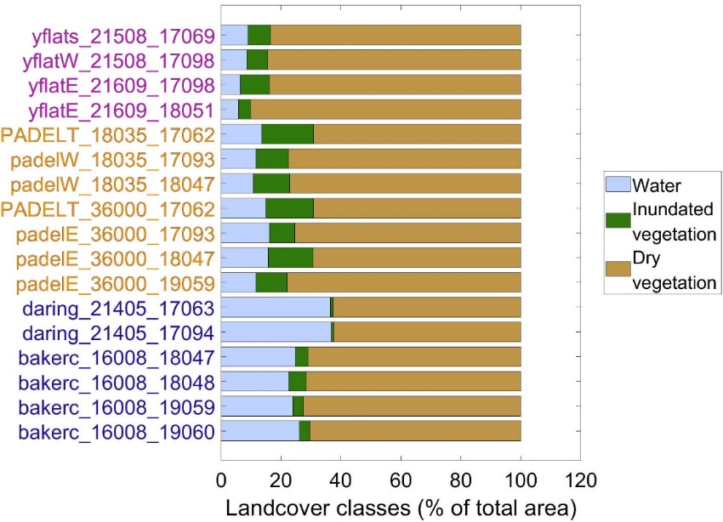
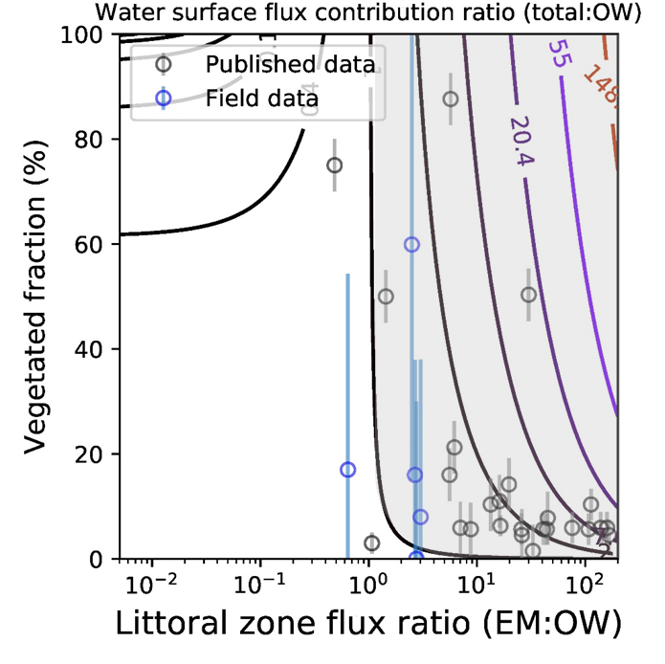
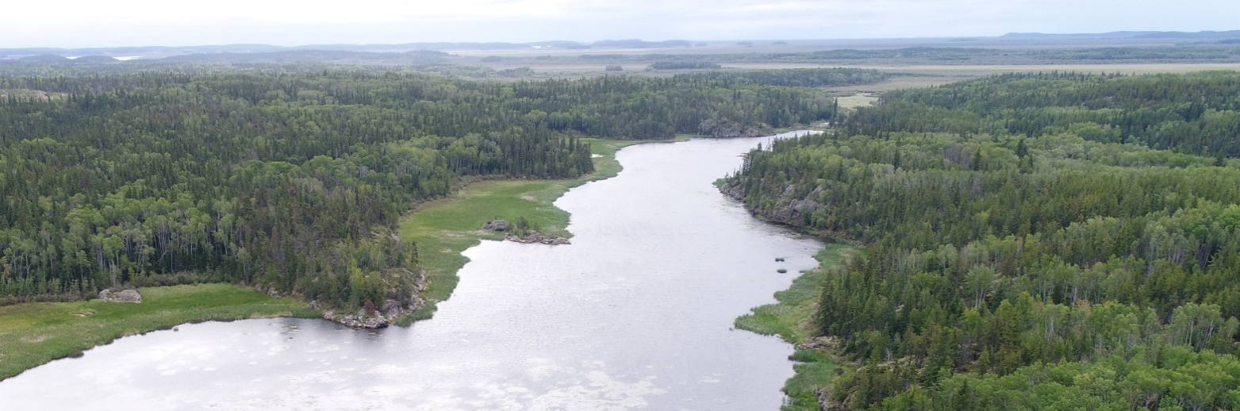
Accounting for Vegetated Lake/Wetland Surfaces Impacts Methane Upscaling
Ethan Kyzivat - Butman- TE2018
UAVSAR inundation maps: emergent aquatic vegetation coverage varies more regionally than it does for any region over time.
Emergent Vegetation more extensive in lowland/deltaic environments (PAD, Yukon Flats) than shield/tundra (Canadian Shield).
Fluxes from vegetated wetlands are significant during the growing season and generally exceed water surface fluxes.
Most flux measurements show that explicitly accounting for littoral zones would produce whole-lake values that are 1 to ~15x larger, and this trend holds in both the field data as well as the literature.
7.5
2.8
1.0
Time
Vegetated littoral zones
Chinowey’s Lake, Peace-Athabasca Delta, Alberta
Notes:
Key to reading the bottom right figure:
Sensitivity of total lake CH₄ flux to the area and flux of the littoral zone. Y axis is the lake vegetated fraction. X axis is the ratio of typical methane fluxes between emergent aquatic plants and open water surfaces. Contours are a unitless ratio of (littoral/vegetatation + open water)/(open water) fluxes. The shaded area shows the feature space where total lake methane emissions would be greater if vegetated areas were included (amount greater is indicated by contour lines). Most measurement points are located such that explicitly accounting for littoral zones would produce whole-lake values that are 1 to ~15x larger, and this trend holds in both the PAD field data as well as studies from the literature.

Slide 10
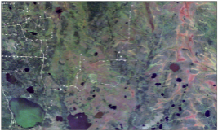
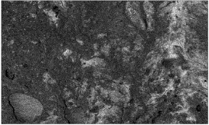
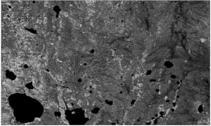
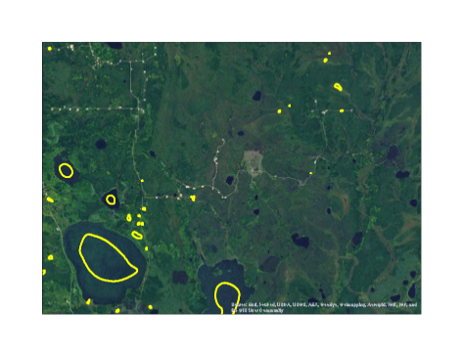
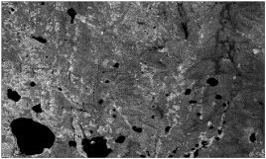
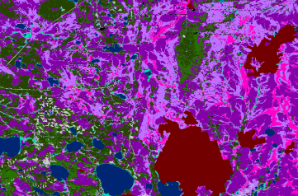
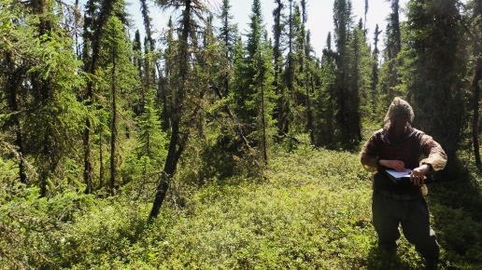
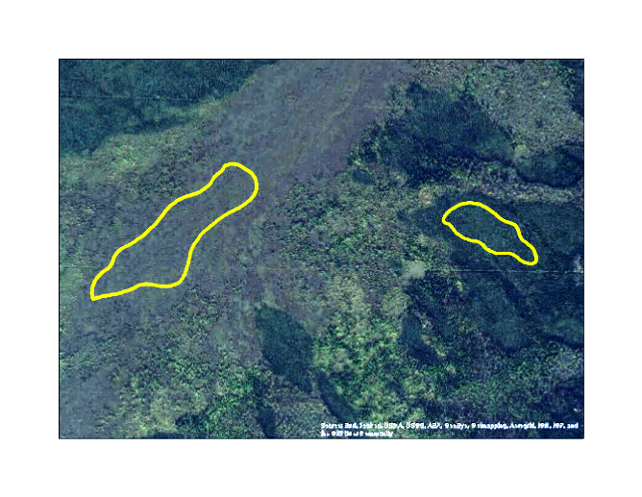
Bourgeau-Chavez TE2014, French TE2018
SAR-Optical Wetland Mapping
Landsat and PALSAR multi-date imagery
Image classification (Random Forests) is trained and validated with field-data and aerial-image interpretation of the wetland types
Outputs heavily dependent on quality input data
This method has been used successfully to map wetlands in this area in previous studies (Bourgeau-Chavez et al. 2017).
Image Stack
Landsat Multi-Date
stack
Random Forests Classifier
Training/ Validation
SAR Multi-Date stack
40 m x 50 m plots
Field
Data
Classified Image
Aerial Image
Interpretation

Slide 11
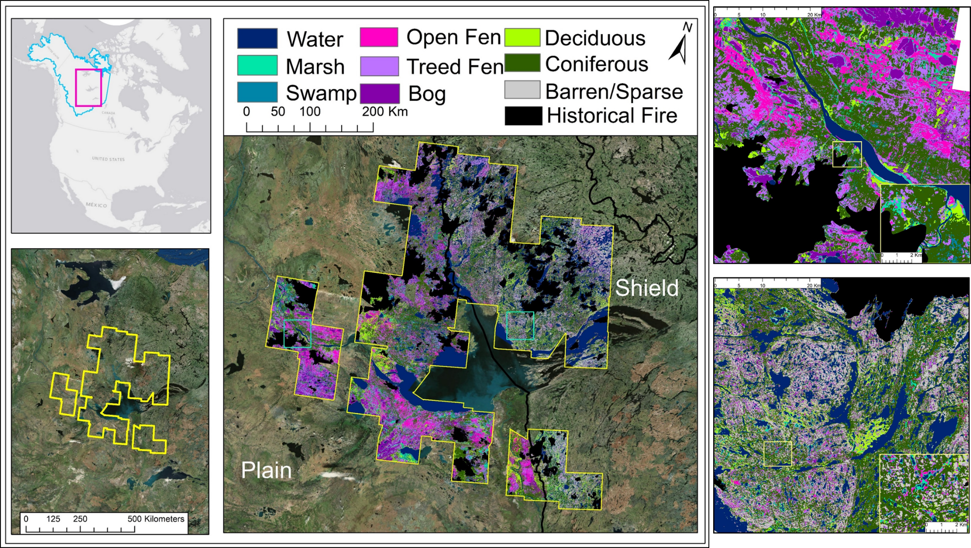
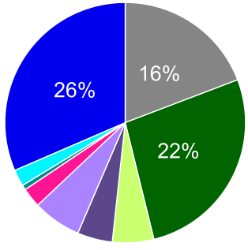
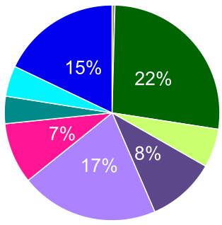
NWT Peatland-Upland Ecotype Map
Bourgeau-Chavez TE2014
Circa 2007-2010 Imagery
1.37 million hectares mapped,
Based on: Field data and Multi-season SAR and Landsat
Overall Accuracy 94% All classes > 85% user accuracy, (except swamp = 73%)
Shield
Plains

Slide 12
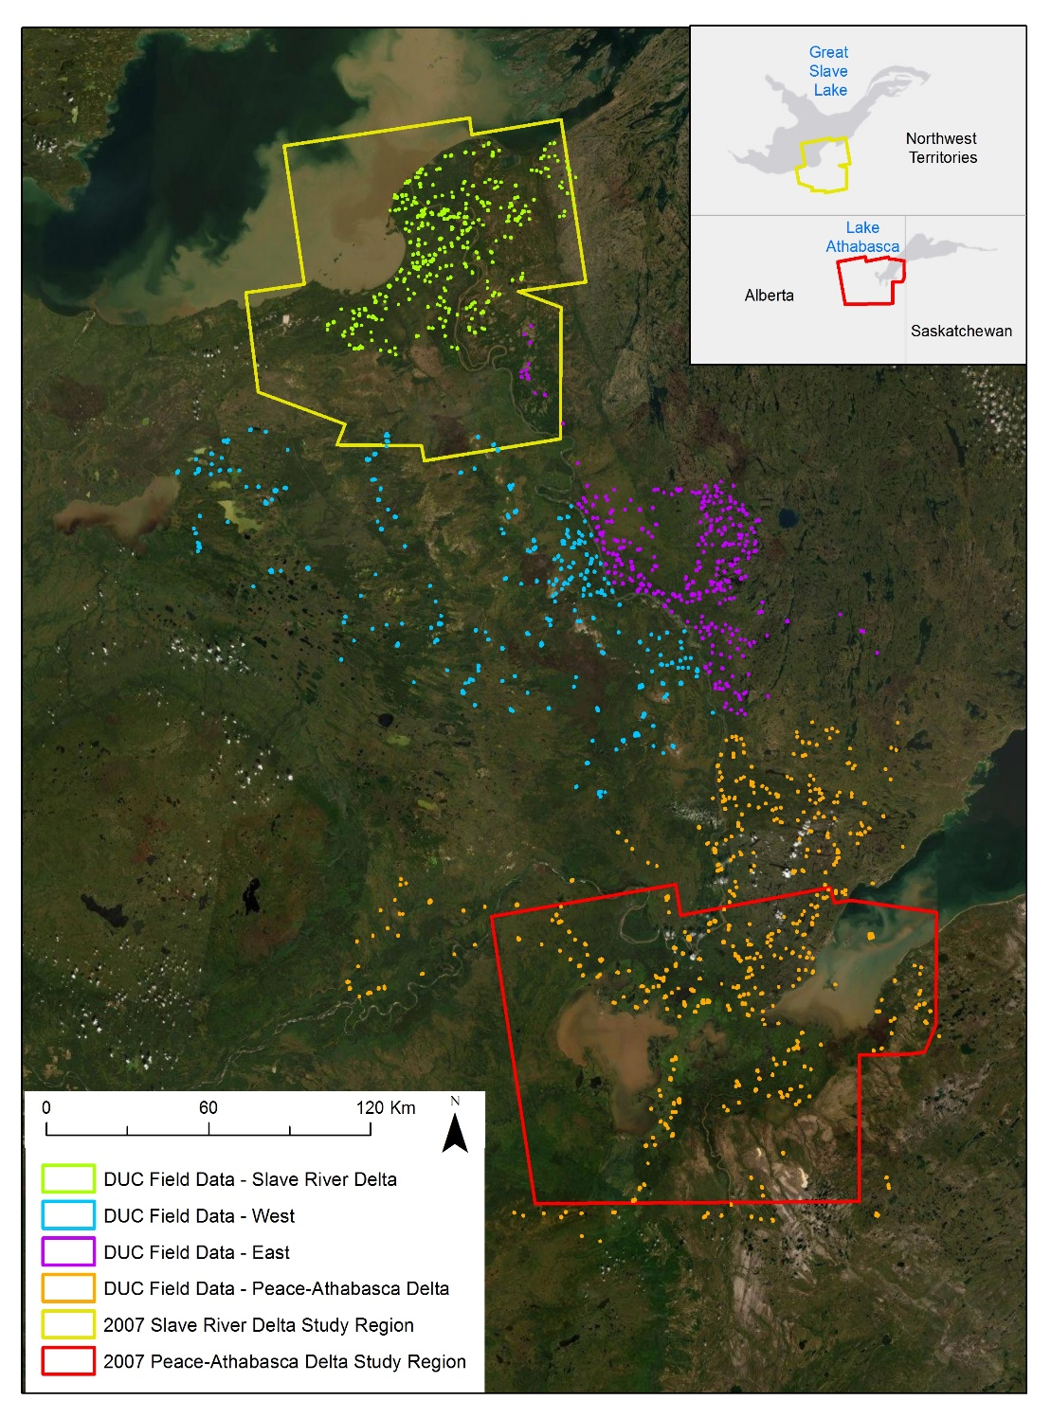
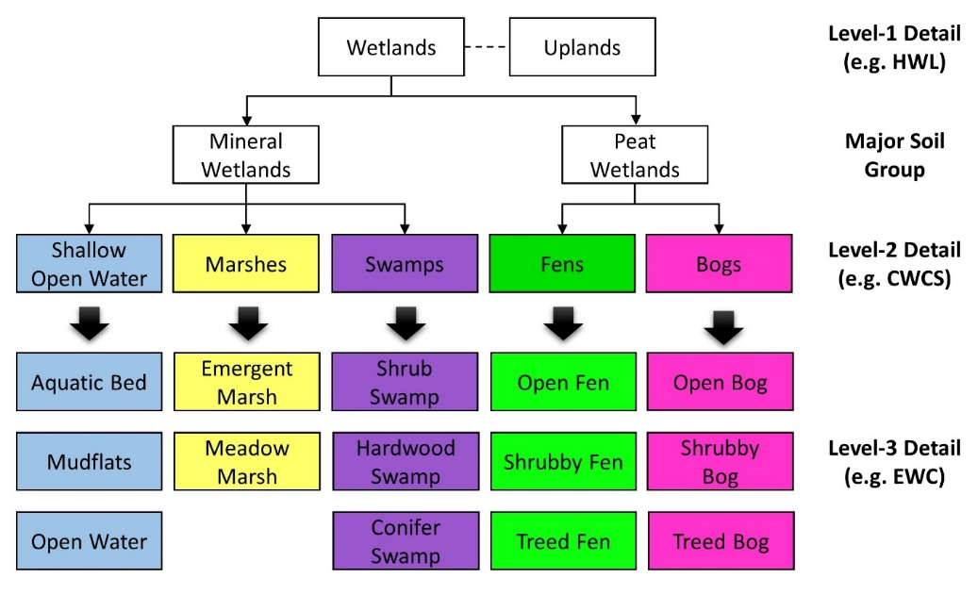
Slave River Delta (SRD) and Peace-Athabasca Delta (PAD) Mapping
French TE2018
Focusing on wetland types critical for waterfowl habitat (modified Enhanced Wetland Classification)
Maps being created for 2 time periods to assess changes in habitat from c. 2007 to c. 2017

Slide 13
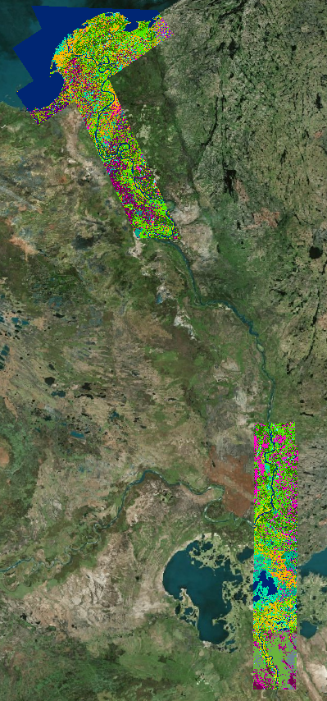
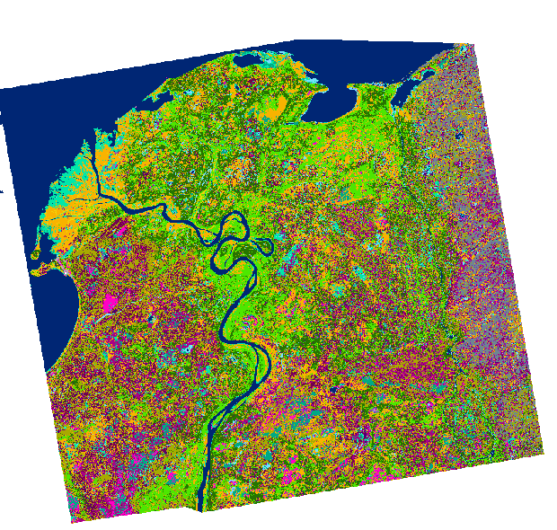
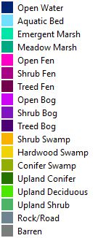
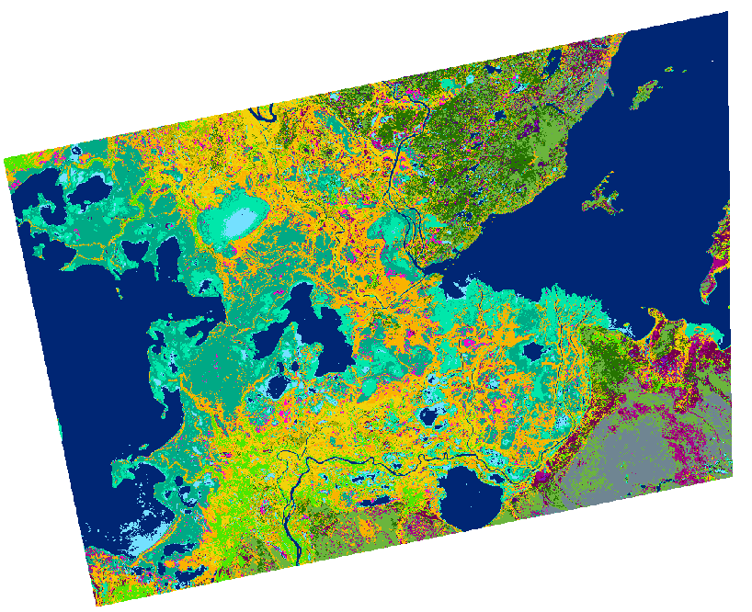
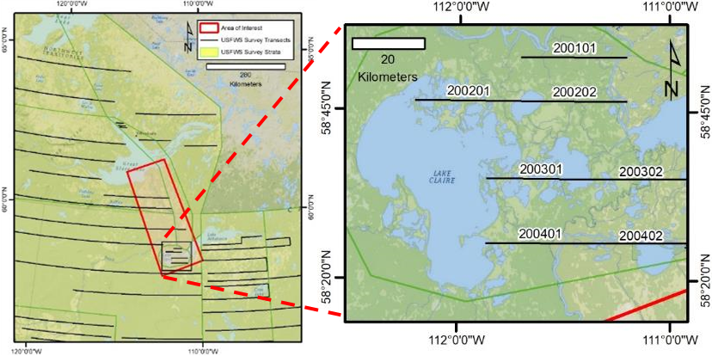
2017 Maps
French TE2018
Initial stacks with UAVSAR data for L-band component
PALSAR-2 downloaded to expand map coverage to overlap with DUC bird survey transect

Slide 14
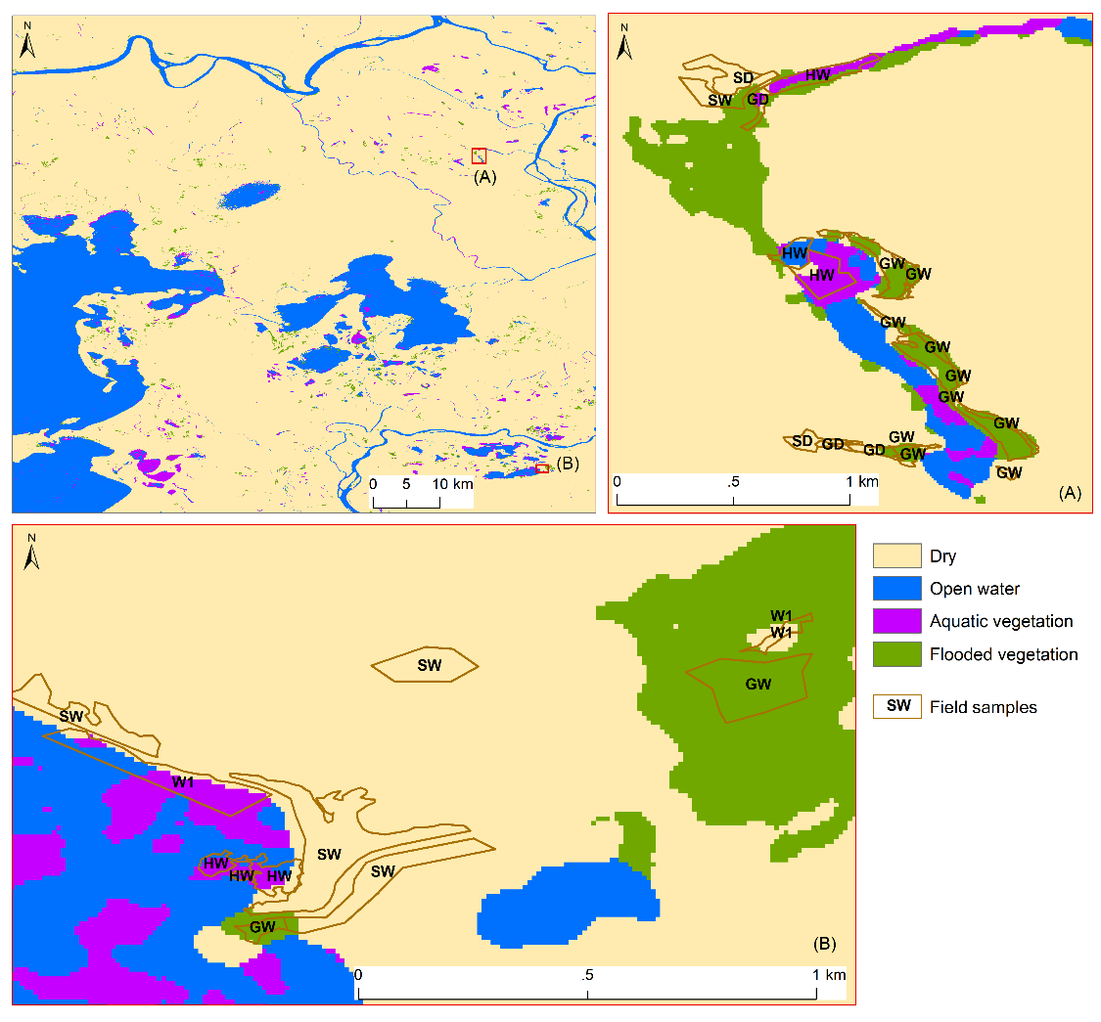
Tracking transient Arctic-Boreal Wetland Inundation from Sentinel-1 SAR
Chang Huang, (Butman-TE2018, Smith- TE2014)
Developed a two-step modified decision-tree method with time series Sentinel-1 C-band SAR
  map and monitor wetland inundation, including open water bodies, aquatic vegetation and flooded vegetation.
Validation with contemporaneous in situ field mapping, and a multi-temporal Landsat-derived surface water product at two ABoVE sites (PAD and Yukon Flats)
PAD inundation and wetland map 2019-08-15
Inundation extent matches most of the ground truth polygons.
Wet savannah (SW) and wet forest (FW) could not be detected.
Sand bars (BA) were misclassified as Open water.
Adjusted overall accuracy is over 90% for both sites.
Temporal inundation variation is consistent with observed water level variation.
Inundation frequency overall matches with JRC water occurrence.

Slide 15
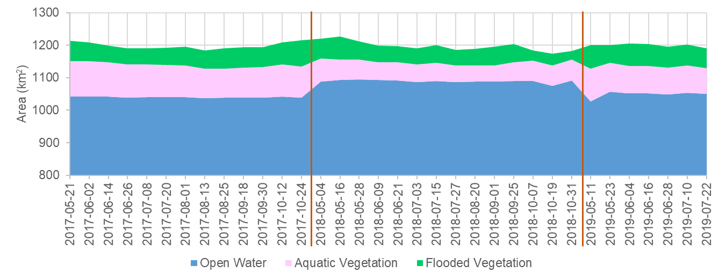
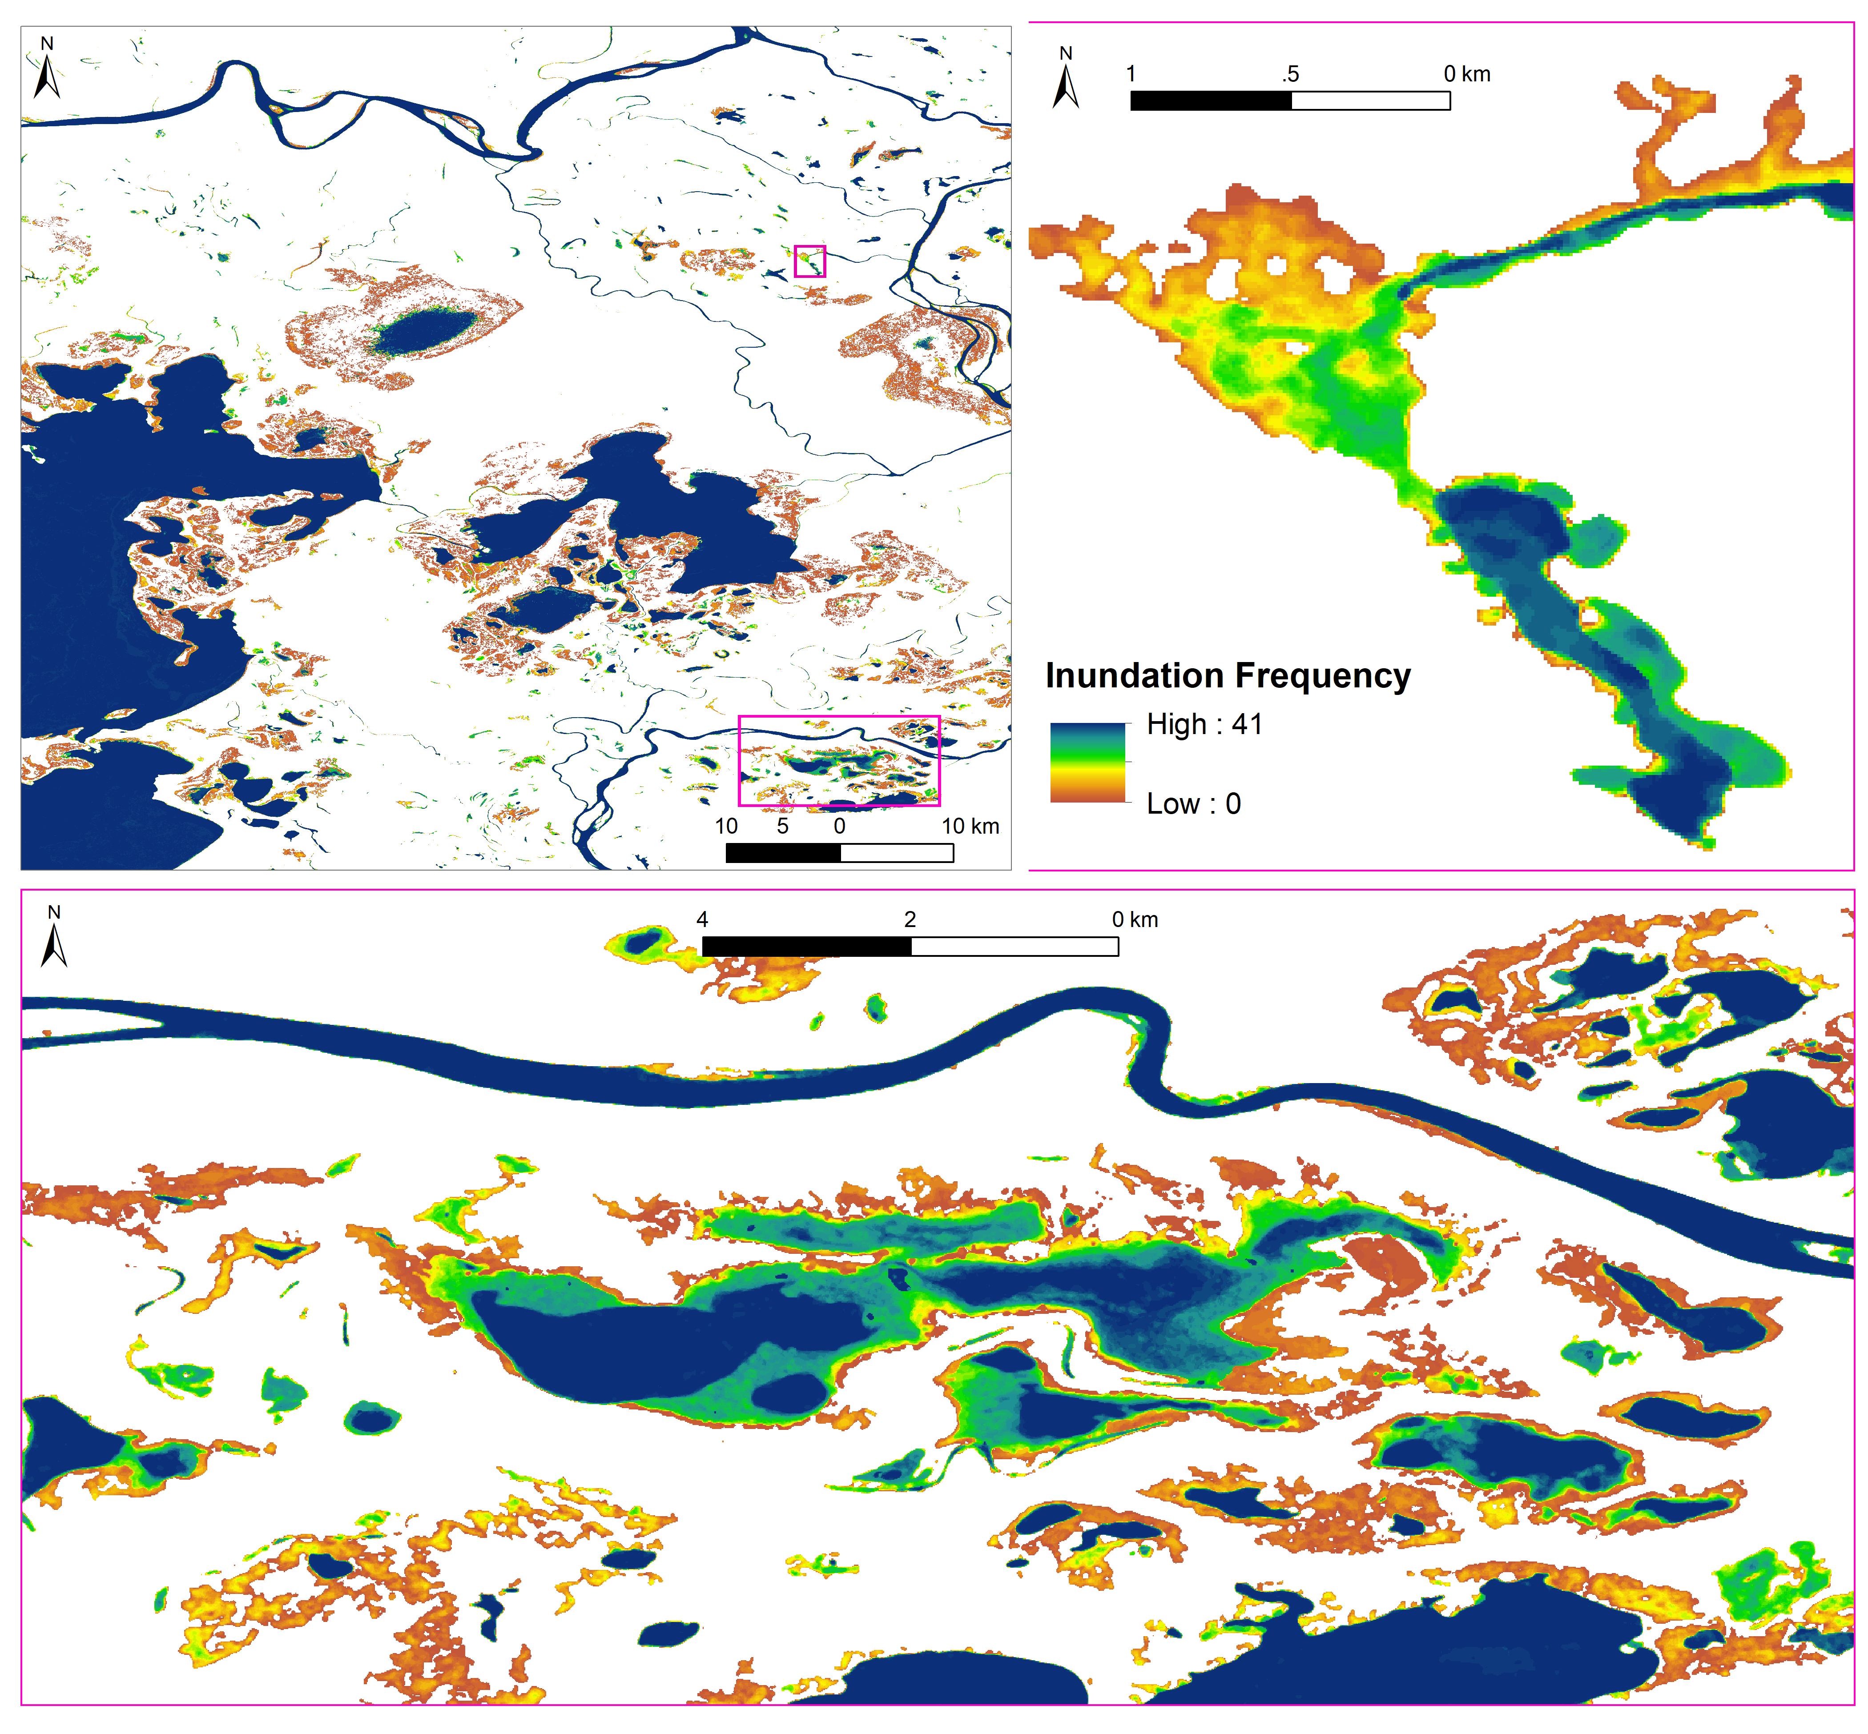
Spatio-Temporal Inundation Dynamics
Chang Huang, (Butman-TE2018, Smith- TE2014)
PAD inundation frequency and statistics from 2017-2019
Perennial inundated area (Open water + Aquatic vegetation) is relatively stable.
Inundation frequency decreases from open water to its periphery, verifying our conceptual framework.
Statistically, inundation area in Yukon Flats (10.72%~12.13%) seems smaller but more varied than that in PAD (18.02%~18.79%).
Maximum inundation extent in Yukon Flats (12.87%) is not as extensive as that in PAD (24.50%).

Slide 16
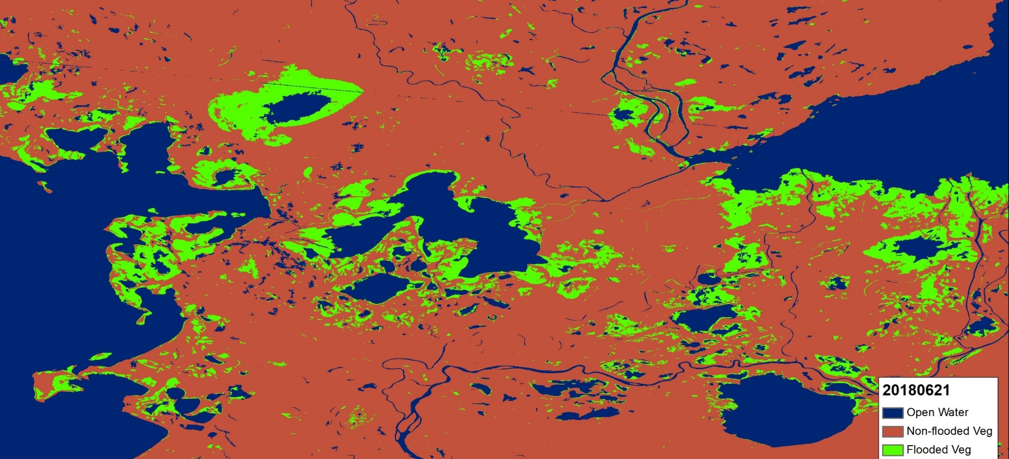
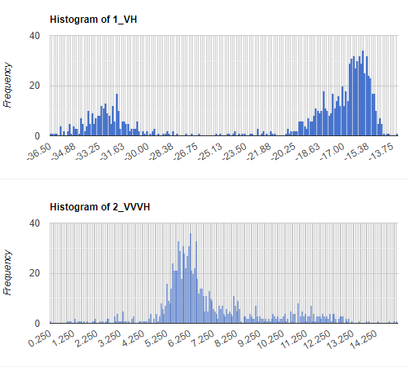
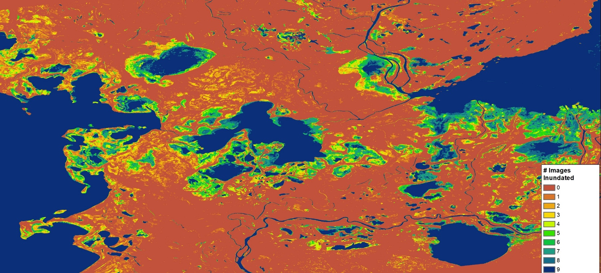
Sentinel-1 SAR-based Surface Water and Wetland Inundation Mapping
French – TE2018
GEE, PDFs of each image used to determine thresholds for mapping Open Water vs. Land from VH and thresholds for inundated vegetation from VV/VH ratio
Image segmentation objects are created to apply the thresholds to more accurately map the boundaries
Single Date Inundation Product 6/21/18
Seasonal Inundation Product 2018
See presentation by Battaglia in Wetlands Session for details

Slide 17
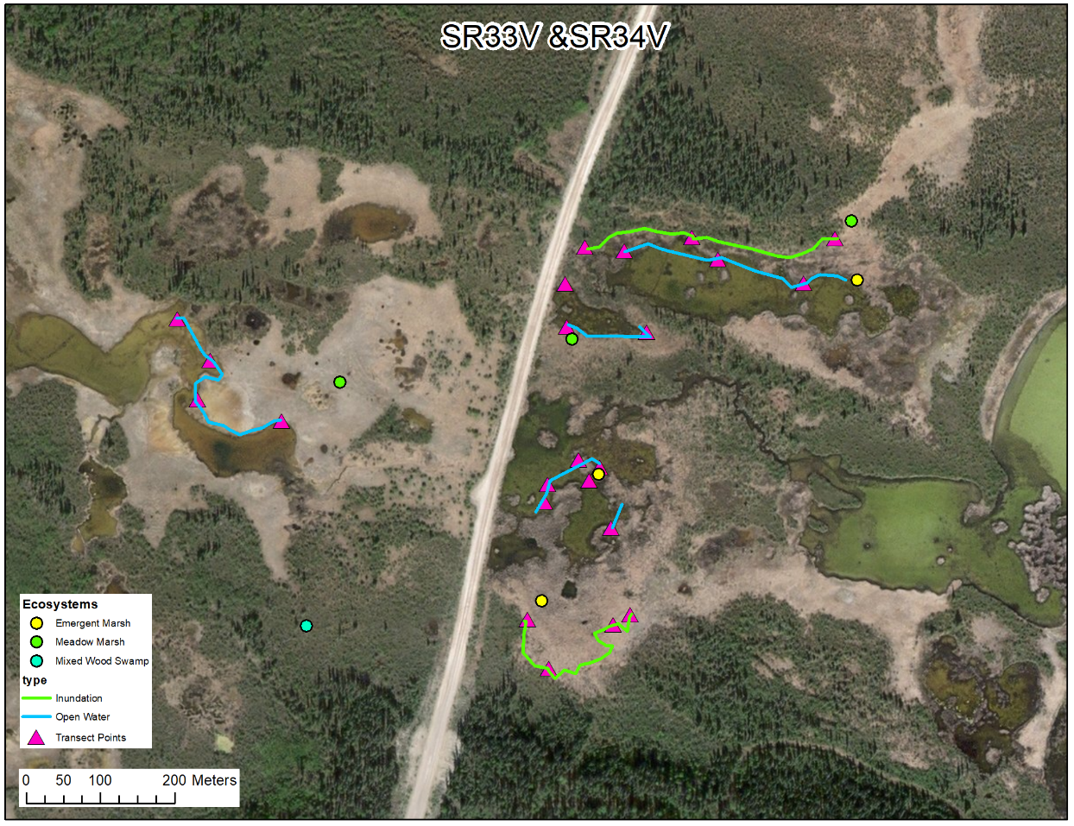
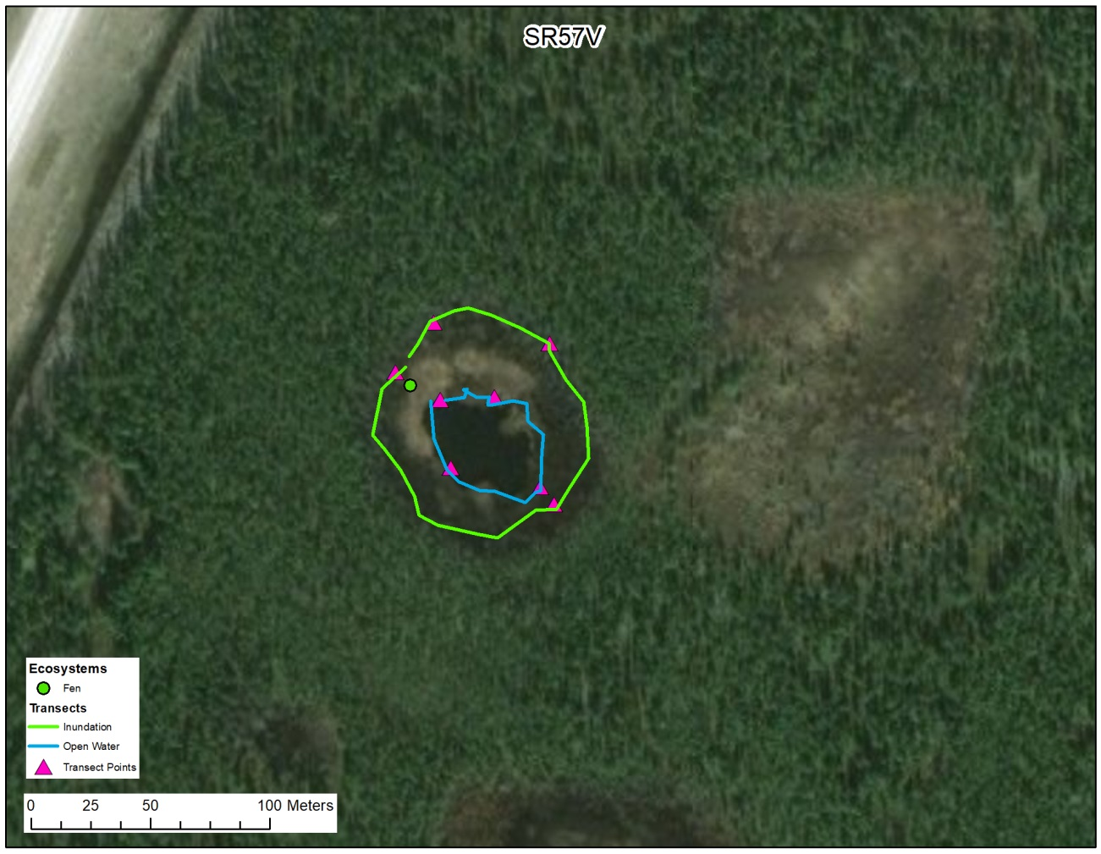
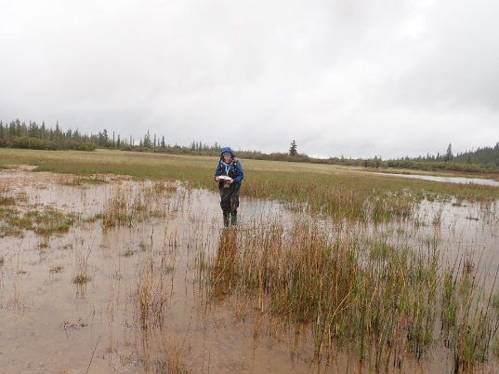
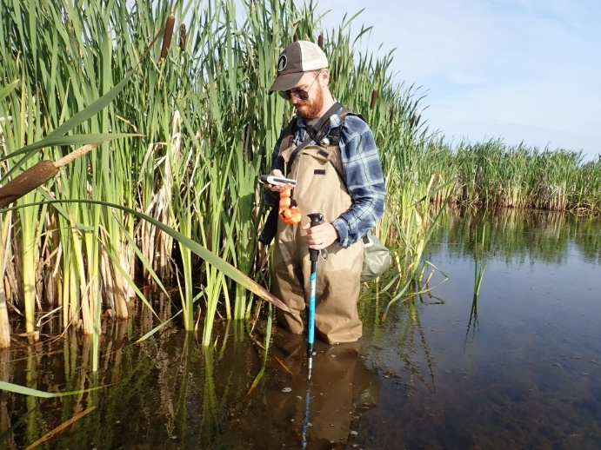
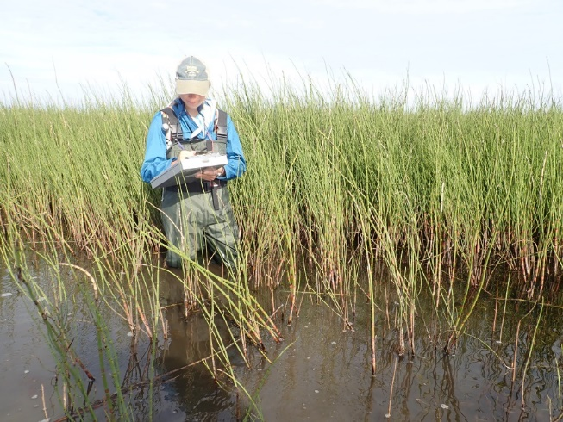
Inundation Map Validation: Field Data – protocol from Pavelsky & Smith – Duplicated for French team
Smith TE2016, Butman TE2018, French TE2018
Summer 2019, field teams in Northwest Territories collecting in-situ data on inundation extent

Slide 18



Chapman, French TE2018
UAVSAR polarimetric Decomposition
Scaled by total power
Preliminary Vegetation classes from
Satellite SAR-Optical
Overlay product
Assessments of several areas in the PAD and SRD show that preliminary vegetation classes have good correspondence with UAVSAR results
Will use these results to calibrate the classification algorithm, and identify the inundation classes in all the selected UAVSAR flight lines.
Swamp
Emergent
Not
Flood
Water
Aquatic
Bed
Flooded
Emergent
Emergent
Dbl
Vol
Odd
Aquatic
Bed
Upland

Slide 19


Other Relevant Maps
Woodcock-TE2014
Landsat-derived Annual Dominant Land Cover Across ABoVE Core Domain, 1984-2014
Focus on Forest Change but also mapped wetland types Fen, Bog, Littoral zone
Caution: Not corrected for short-term changes in climate that may impact the spectral appearance of certain areas. For example, droughts may result in wetlands appearing drier, and subsequently being briefly classified as shrubs. Caution is advised when utilizing the wetland data for this reason (Wang et al., 2019).

Slide 20





Other Relevant Maps
Huemmrich TE2014
Two map products from 0.5 m WV2 for North Slope:
Tundra veg communities (7 classes)
Wetlands map (18 classes)
  Utqiaġvik (formerly known as Barrow) peninsula on NS of AK ~1,700 km²
  Cowardian Classification of National Wetlands Inventory (NWI)
  Supervised Maximum Likelihood (SML) Classification approach
  Accuracy of 77% (Kappa Coefficient = 0.73)
  Based on a set of 482 independent ground-truth locations
Palustrine Emergent Classes
Christian Andresen (UW-Madison) & Sergio Vargas Zesati & Craig Tweedie (UTEP)
1. Tundra Veg Communities Map
2. Wetlands Map
Legend
Andresen et al (2017)

Slide 21
NEXT STEPS
Next June 16 quarterly will focus on inundation monitoring with C- and L-band SAR. Bruce Chapman will present on the L-band UAVSAR algorithm approach; Mike Battaglia will present on C-band SAR S-1/Radarsat-2, Valentin Poncos will present on C-band, Radarsat-2, Chang Huang will present on C-band S-1
Join the WG if you have interest or data to share
Contact Laura Bourgeau-Chavez or David Butman – co-Leads
We will be discussing possible synthesis activities in upcoming quarterly webinars

