Slide 1
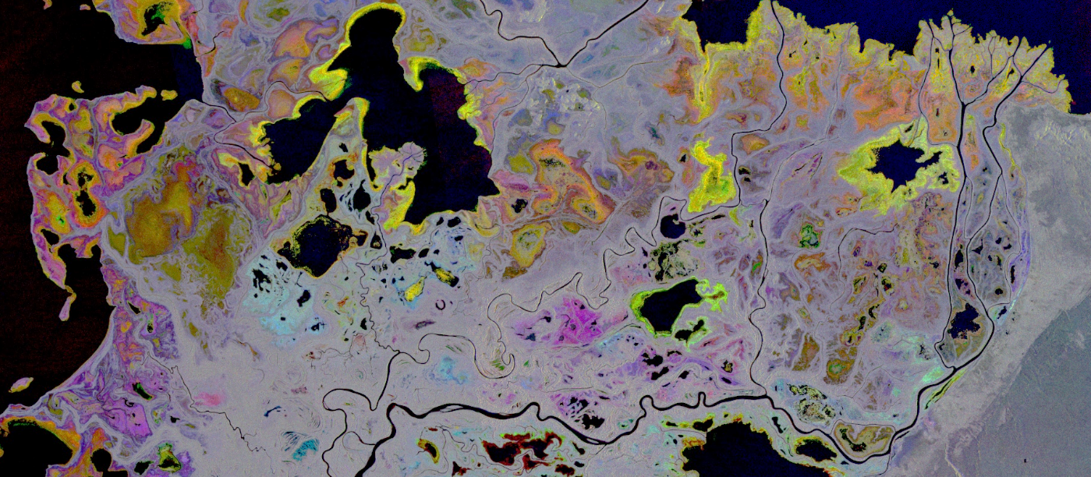
ABoVE Wetlands Working Group

Slide 2
Working Group - Formed at ASTM6 – grown from 30 original to 37 members,
ABoVE Projects that have been directly involved with Wetland WG
Bourgeau-Chavez TE2014, TE2018, Butman TE2018, French TE2018, C. Miller TE2014, TE2018,
Smith TE2016, Turner NSERC
1
New ABoVE wetland projects 2021
Bourgeau-Chavez TE2021, Butman TE2021, French 2021, S. Miller TE2021, Tape TE2021, Watts TE2021
Cross-over with Hydrology, Carbon, Wildfire, Vegetation WGs
Working Group
Goal: to synthesize data for understanding regional wetland conditions and change and to identify data gaps.
Approach: to coordinate, collaborate, and understand the ABoVE domain related wetland research including wetland type mapping, monitoring, and process modeling.
Cross Cutting Objectives: Link wetland dynamics to Hydrology & Permafrost, Carbon, Wildfire, and Vegetation WGs.
Notes:
Douglas USACE 2018, Stiegl

Slide 3
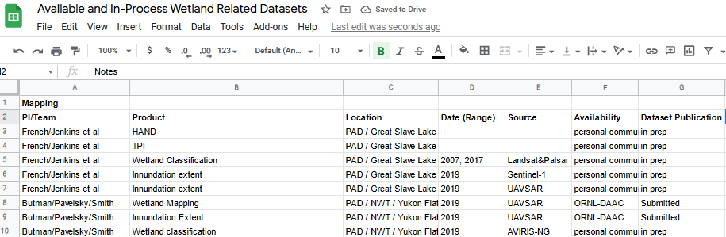
Annual Activities Summary:
  Quarterly speaker series with involvement from all affiliated ABoVE Projects (projects and Canadian partner orgs)
  Presentation in August from Carbon Monitoring Systems ‘Wet Carbon’ working group on recent publication
    Campbell et al ERL 2022: A review of carbon monitoring in wet carbon systems using remote sensing
  Presentation in Oct by Dr. Frank Ahern on recent publication on the anomalies sometimes encountered with SAR decompositions from wetlands: SAR Polarimetric Phase Differences in Wetlands: Information and Mis-Information
  Continue to maintain a database on wetland related datasets from ABoVE project
Notes:
Dr. Ahern talked about his recent publication describing instances where decompositions mis-label double bounce as single bounce, due to thresholding that does not consideran abrupt change in the phase difference between the HH and VV backscatter that occurs around the Brewster angle of the emergent vegetation.

Slide 4
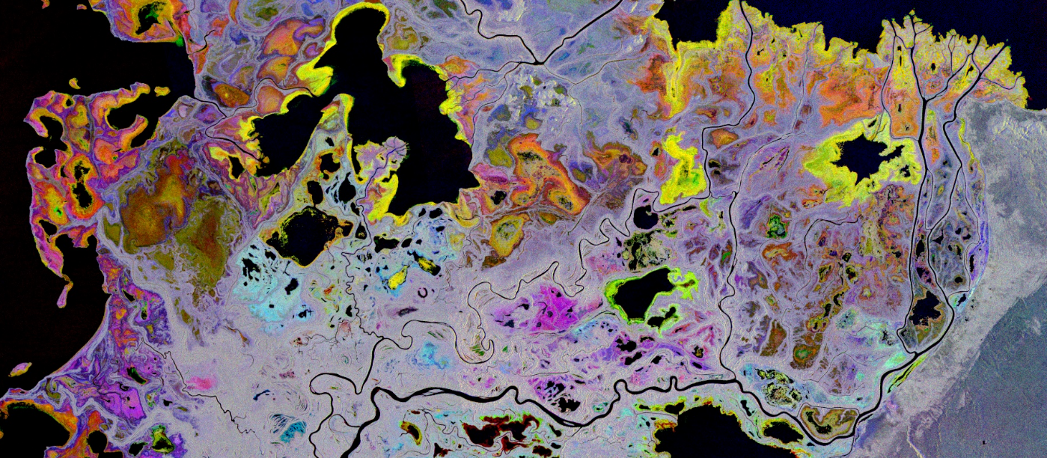
Research Highlights: Mapping

Slide 5
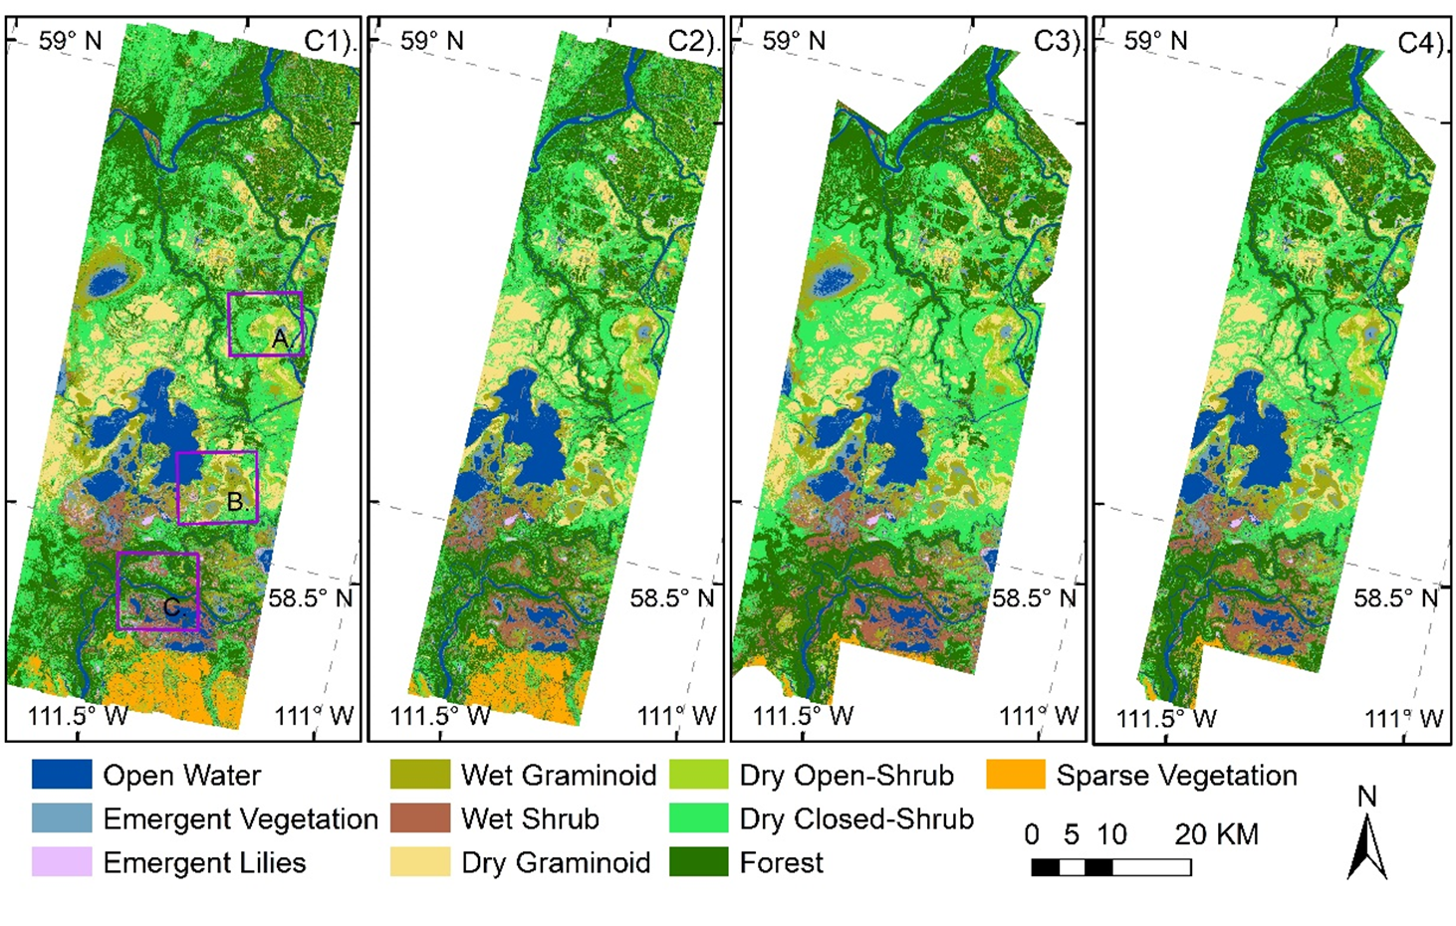
Wetland land cover maps over the PAD
Butman TE 2018, Smith 2016
Obj: Explore capability of tracking dynamic wetland vegetation communities with airborne AVIRIS-NG, UAVSAR, UAV LiDAR, and PlanetScope data in Peace-Athabasca Delta
The C4. multi-sensor model (93.5%) has highest Overall Accuracy
C1.AVIRIS-NG (87.9%), C2.AVIRIS & UAVSAR (65.6%)
C3.AVIRIS & LiDAR (75.9%), or
Wang et. al. in revision RSE 2022

Slide 6
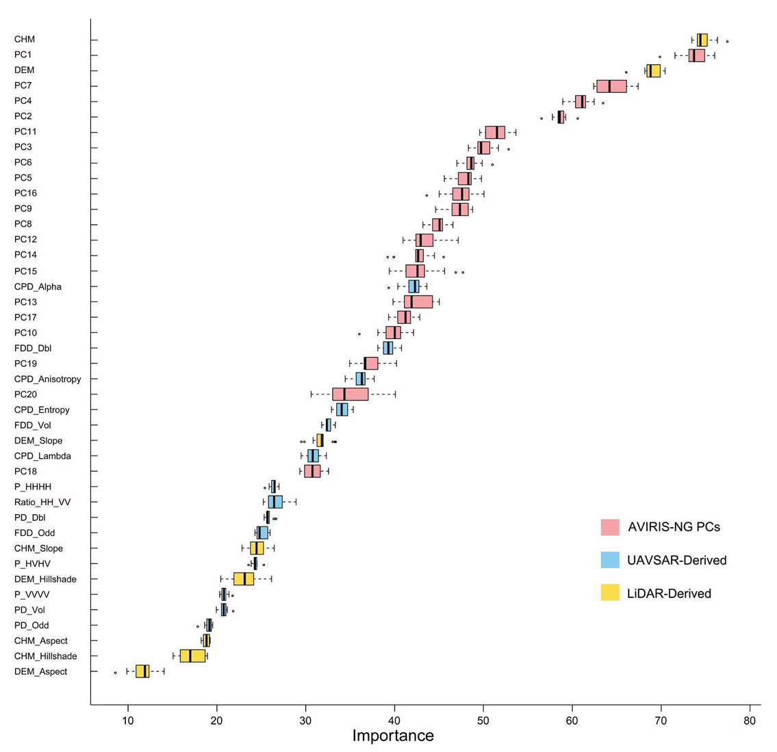
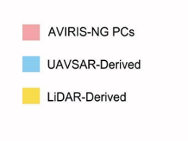
Butman TE 2018, Smith 2016
Features importance
LiDAR-derived Canopy Height, AVIRIS-NG-derived PC1, and LiDAR-derived Elevation rank as the first three important features.
Decomposition features from UAVSAR also play important role then linear polarized backscattered features.
Wang et. al. in revision RSE 2022

Slide 7
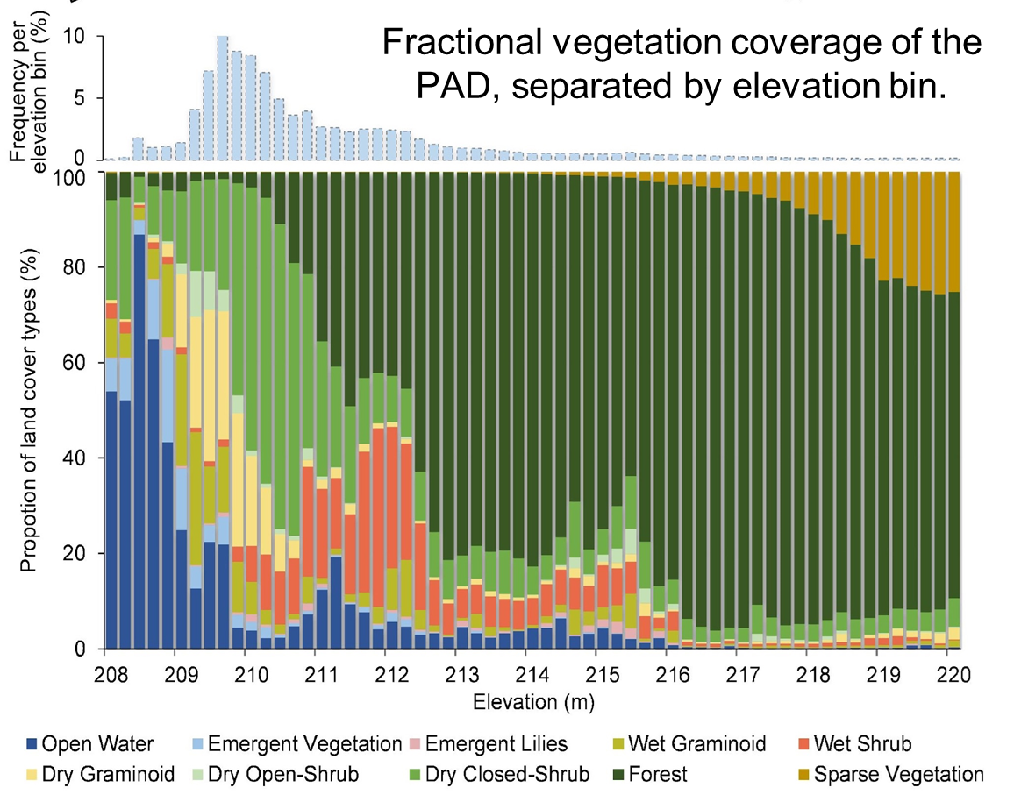
Butman TE 2018, Smith 2016
The proportion of vegetation community composition shows a clear elevation gradient across the littoral zone
With 1.8 m increase from the lowest elevation (~208 m), the proportion of open water and emergent vegetation classes decreases from over 60% to less than 7.1%.
Wang et. al. in revision RSE 2022

Slide 8
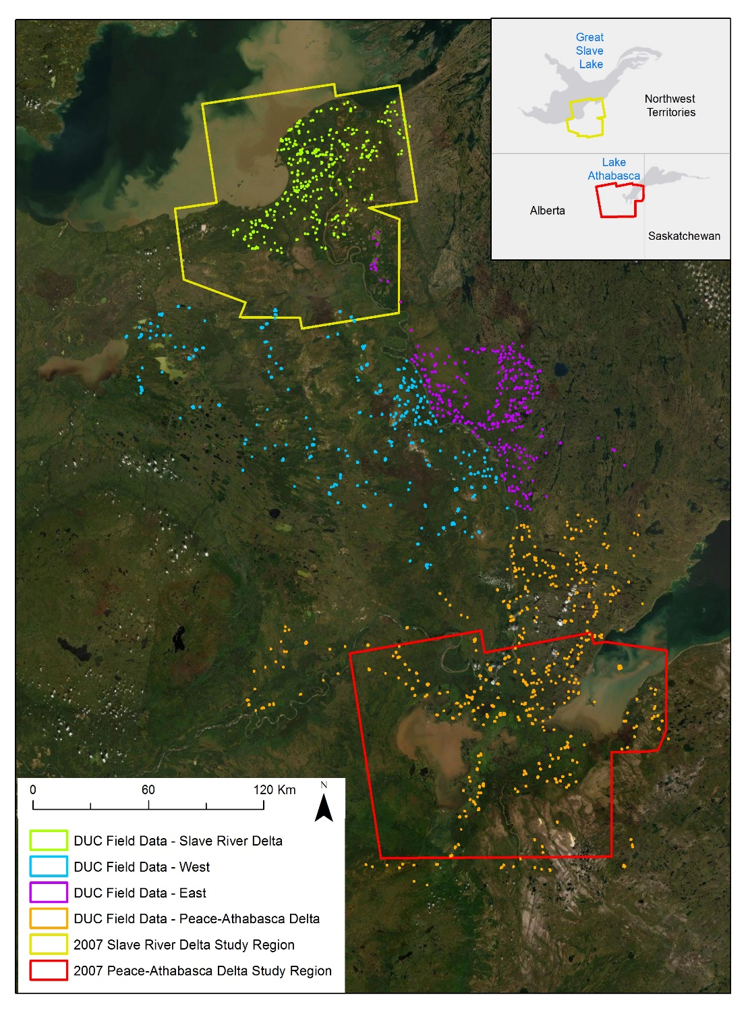
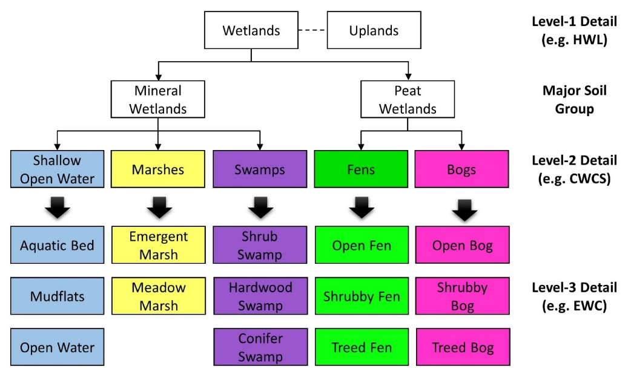
Slave River Delta (SRD) and Peace-Athabasca Delta (PAD) Mapping
French TE2018
Focusing on wetland types critical for waterfowl habitat (modified Enhanced Wetland Classification)
Maps being created for 2 time periods to assess changes in habitat from c. 2007 to c. 2017
SEE POSTER: by Vander Bilt,Mapping Wetland Type and Seasonal Inundation using SAR

Slide 9




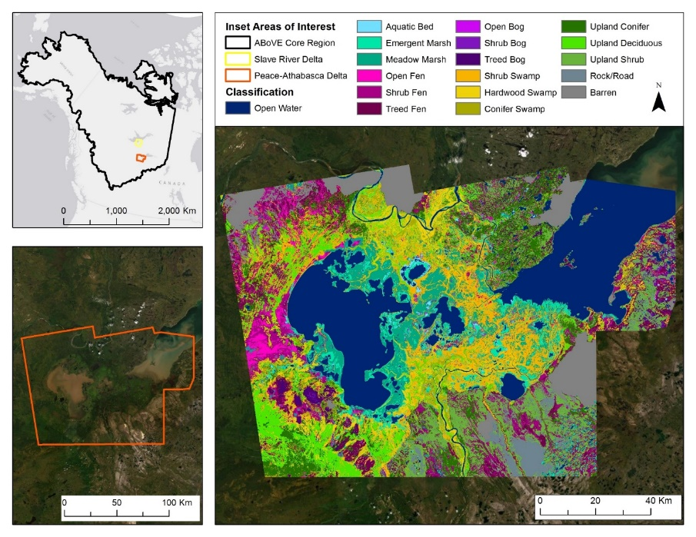
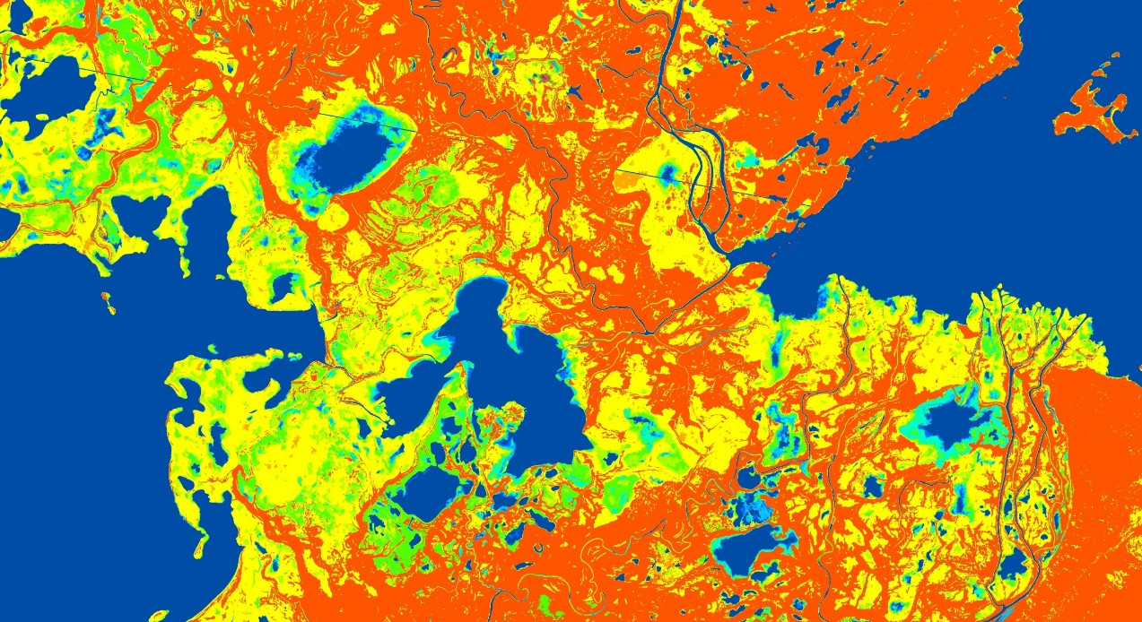
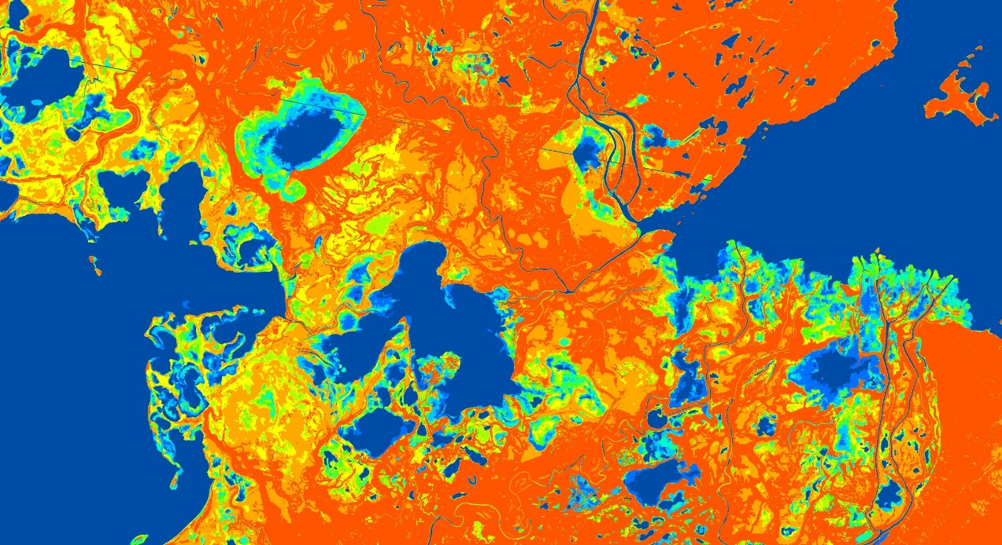
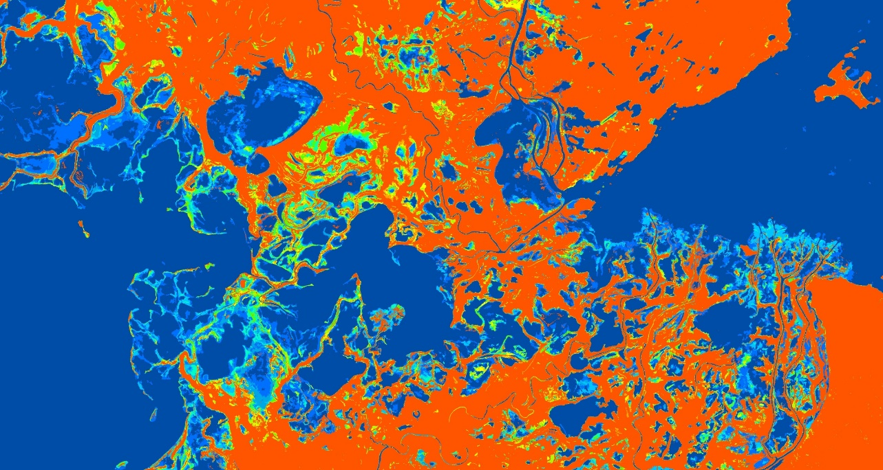
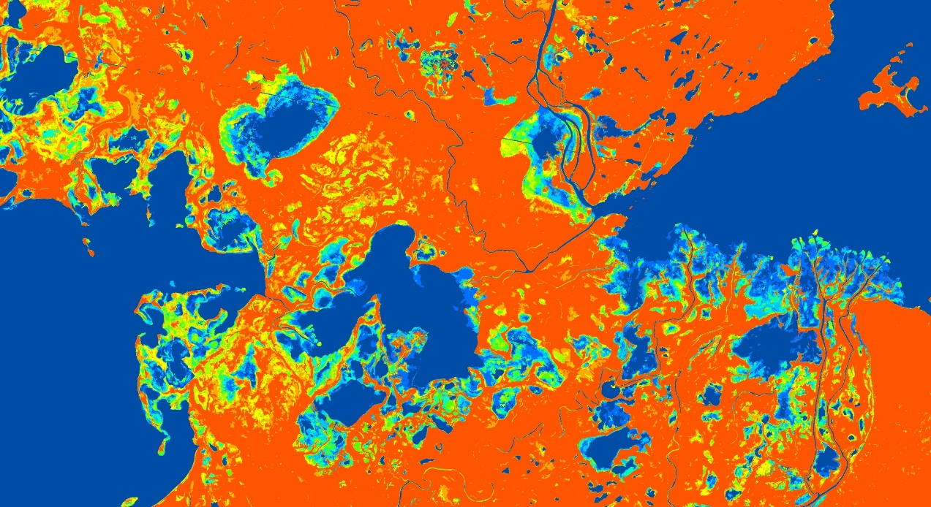
Wetland Type and Inundation Dynamics
Peace-Athabasca Delta, Canada
French TE 2018
Mapping wetland type and extent critical for waterfowl habitat
Left: Wetland type maps created using a machine learning approach with Landsat and L-band SAR to assess changes in duck habitat.
Below: SAR-derived annual inundation products using C-band
SAR (Sentinel-1). Colors represent count of inundation days.
Open water count
2020
2018
2019
2017
Animated figure
Waterfowl Habitat Assessments
Integrating Waterfowl Breeding Population (BPOP) and Habitat Survey waterfowl data into habitat models with products shown here from 2017 to 2019. Remote sensing data and in particular inundation products are improving habitat modeling.
See Feb 22 Wetland WG webinar by PI French for details on habitat modeling methods and results.
Notes:
Remote sensing-derived maps of wetlands developed for the NASA ABoVE Wetlands for Waterfowl project, Nancy French, PI (team information below)
LEFT: Wetland type maps were made for c. 2007 and 2017 to assess decadal wetland type change. The method uses Landsat ETM and ALOS L-band SAR with ancillary data layers in a Random Forest classifier trained with field and high-resolution imagery. Similar methods have been employed in wetland landscapes around the world (Florida, South America, Great Lakes, western US mountains) and is described in Bourgeau-Chavez et al. 2017 and Battaglia et al. 2021 (see below).
RIGHT: Annual wetland extent (inundation state) mapped using Sentinel-1 C-band SAR using all available images for each year (in this case, 8 images/yr). SAR provides a more clear indication of wetland extent (distinguishing between upland and wetland) than optical imaging due to its ability to penetrate short-stature vegetation that in optical images are mapped as green vegetation. [NOTE: the slide includes maps for 4 years (2017 to 2020) and are displayed as an animated figure]
PROJECT TEAM:
Nancy HF French¹, PI (nhfrench@mtu.edu)
Liza Jenkins¹, Michael Battaglia¹, Laura Bourgeau-Chavez¹, Kevin Smith², Bruce Chapman³,
Michael Merchant² ,Jeremy Graham¹, Dorthea Leisman¹, Andrew Poley¹
¹ Michigan Tech Research Institute, ² Ducks Unlimited Canada, ³ NASA JPL
REFERENCES:
Bourgeau-Chavez, L.L., Endres, S., Powell, R., Battaglia, M.J., Benscoter, B., Turetsky, M., Kasischke, E.S. and Banda, E., 2017. Mapping boreal peatland ecosystem types from multitemporal radar and optical satellite imagery. Canadian Journal of Forest Research, 47(4), pp.545-559.
Battaglia, M.J., Banks, S., Behnamian, A., Bourgeau-Chavez, L., Brisco, B., Corcoran, J., Chen, Z., Huberty, B., Klassen, J., Knight, J. and Morin, P., 2021. Multi-source eo for dynamic wetland mapping and monitoring in the great lakes basin. Remote Sensing, 13(4), p.599.

Slide 10
Research Highlights: Carbon

Slide 11
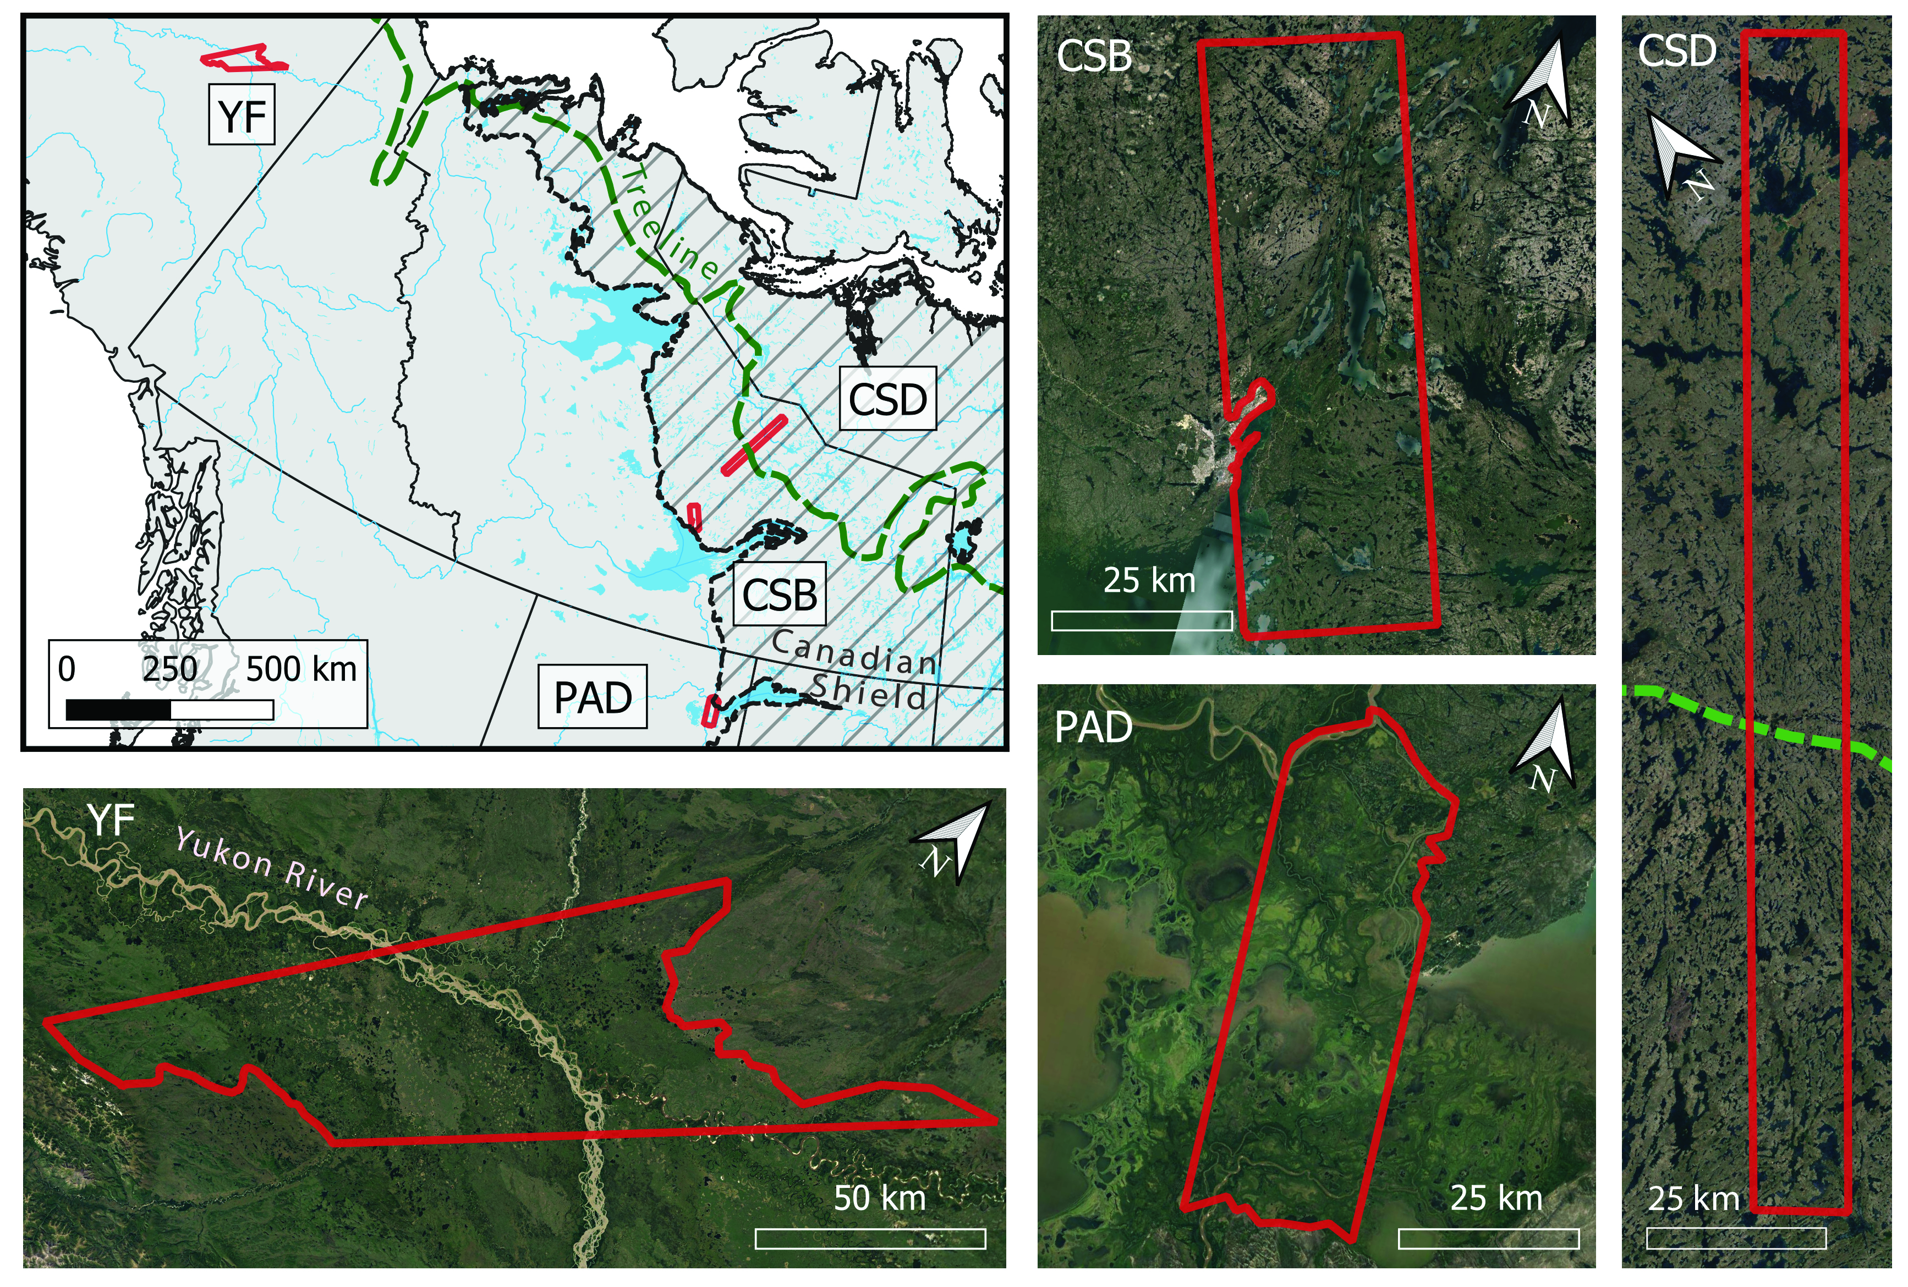
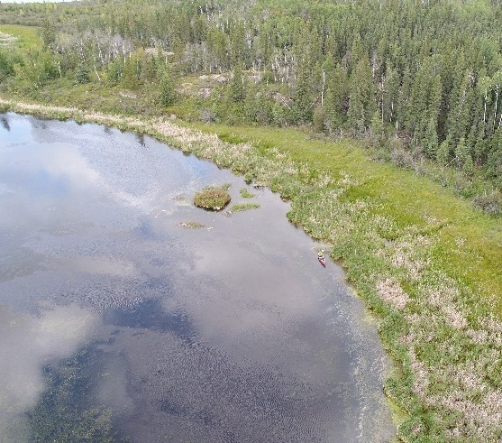
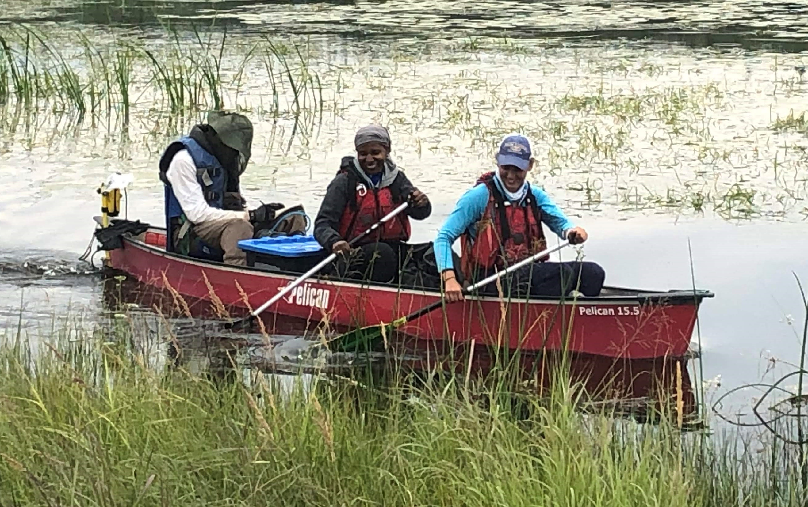

Butman TE 2018, Smith 2016
The Importance of Lake Vegetation for Arctic-Boreal Methane Emissions
Kyzivat, E.D., Smith, L.C., Garcia-Tigreros, F., et al. (2022), JGR: Biogeosciences, doi: 10.1029/2021JG006635
What we did
Why it matters
Accounting for vegetation could increase emissions estimates from Arctic-boreal lakes by +21%.
These uncounted emissions are equivalent to 9% of all natural emissions from these Arctic-boreal landscapes.
We combined ABoVE airborne UAVSAR mapping with field measurements of vegetated and open-water methane emissions.
Above: The study domain crosses climate gradients and the Northern tree line and is derived from 20 UAVSAR scenes. Lake vegetation can be detected by radar remote sensing if it emerges above the water.
Notes:
Left photo note: Ethan Kyzivat is in a red canoe taking gas flux measurements in the mid-right of this UAV photo (credit: Jessica Fayne).
Above, center: Location map of study areas (YF = Yukon Flats; CSD = Canadian
Shield, Daring Lake; CSB = Canadian Shield, Baker Creek; PAD =
Peace-Athabasca Delta). Study area boundaries (red polygons) are derived
from intersecting UAVSAR airborne flight coverage with physiographic
boundaries.
Award Information:
This research was supported by the NASA Terrestrial Ecology Program (NNH18ZDA001N-Task A4.) under NASA Award number 80NSSC19M0104.
Additional funding was provided by NASA FINESST (grant number 80NSSC19K1361); NASA SWOT Science Team (grant numbers 80NSSC20K1144 and NNX16AH83G), and the US Geological Survey (USGS) LandCarbon Program.
This research supported the NASA Terrestrial Ecology Arctic-Boreal Vulnerability Experiment
Resources supporting this work were provided by the NASA High-End Computing (HEC) Program through the NASA Center for Climate Simulation (NCCS) at Goddard Space Flight Center via the ABoVE Science Cloud.
Citation:
Kyzivat, E. D., Smith, L. C., Garcia-Tigreros, F., Huang, C., Wang, C., Langhorst, T., Fayne, J. v, Harlan, M. E., Ishitsuka, Y., Feng, D., Dolan, W., Pitcher, L. H., Wickland, K. P., Dornblaser, M. M., Striegl, R. G., Pavelsky, T. M., Butman, D. E., & Gleason, C. J. (2022). The Importance of Lake Emergent Aquatic Vegetation for Estimating Arctic-Boreal Methane Emissions. Journal of Geophysical Research: Biogeosciences, 127(6), e2021JG006635. https://doi.org/10.1029/2021JG006635

Slide 12
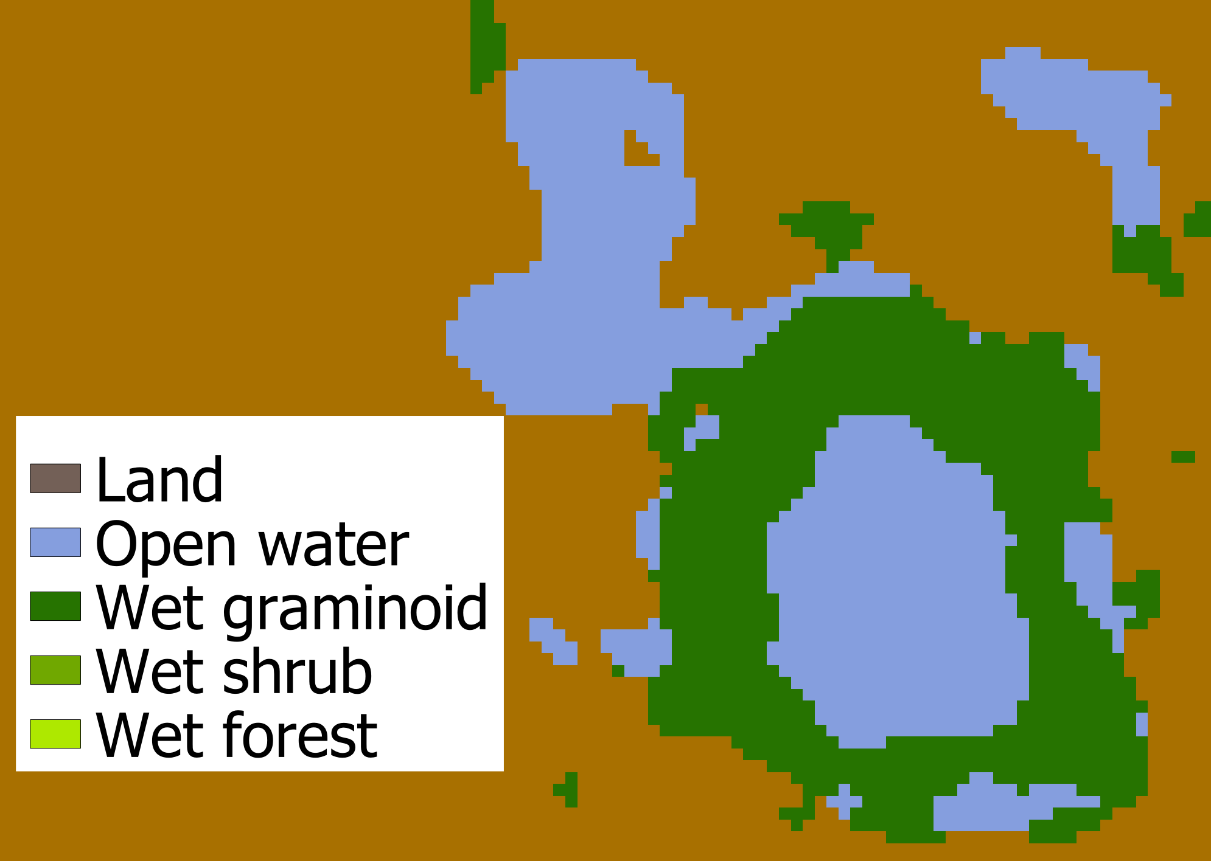
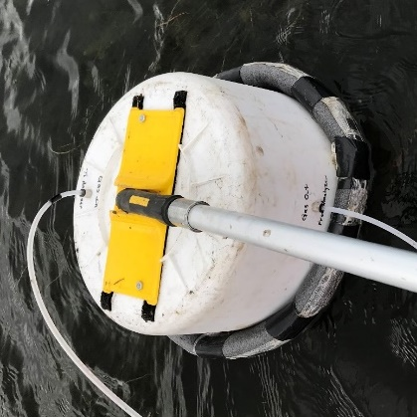
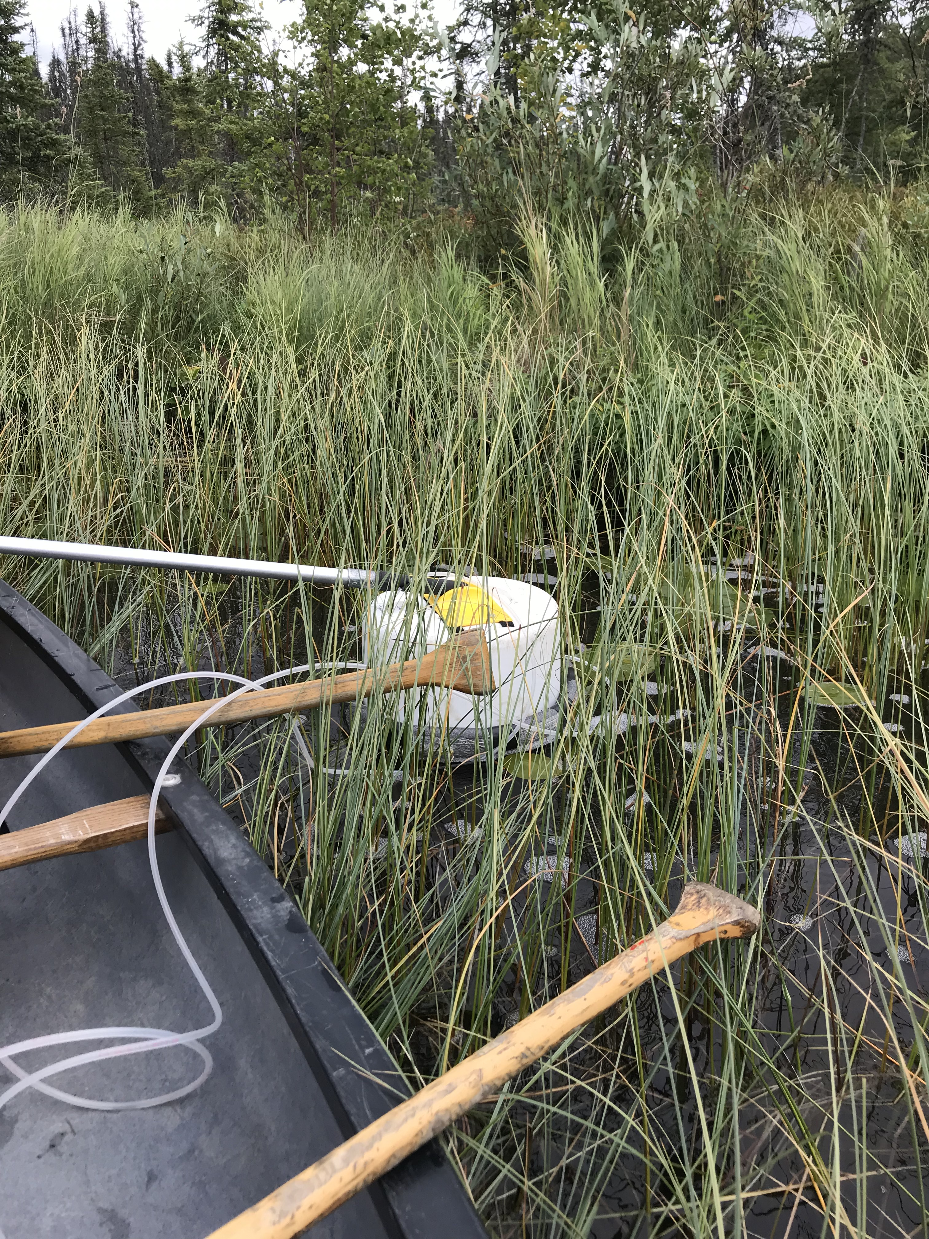



Approach
Butman TE 2018, Smith 2016
Classify aquatic vegetation from UAVSAR and calculate lake vegetated percent
Measure/compile CH₄ chamber fluxes from open water and emergent vegetation
Simple upscaling calculation for impacts of vegetation area and flux
A_{scene}
$$f_{1}$$
$$f_{2}$$
$$f_{3}$$
Above: Example lake (black outline) showing a zone of wet graminoid (grass-like) vegetation covering > 50% of its surface area.
Above: CH₄ fluxes from open water (left) and vegetated (right) lake zones were measured at 15 lakes in the Peace-Athabasca Delta during July/Aug. 2019.
Above: Schematic showing flux upscaling by lake zone type (f₁,..f₃) and area. This estimate is then compared to a case with no knowledge of fluxes for each zone.
Kyzivat et al. 2022 JGR

Slide 13
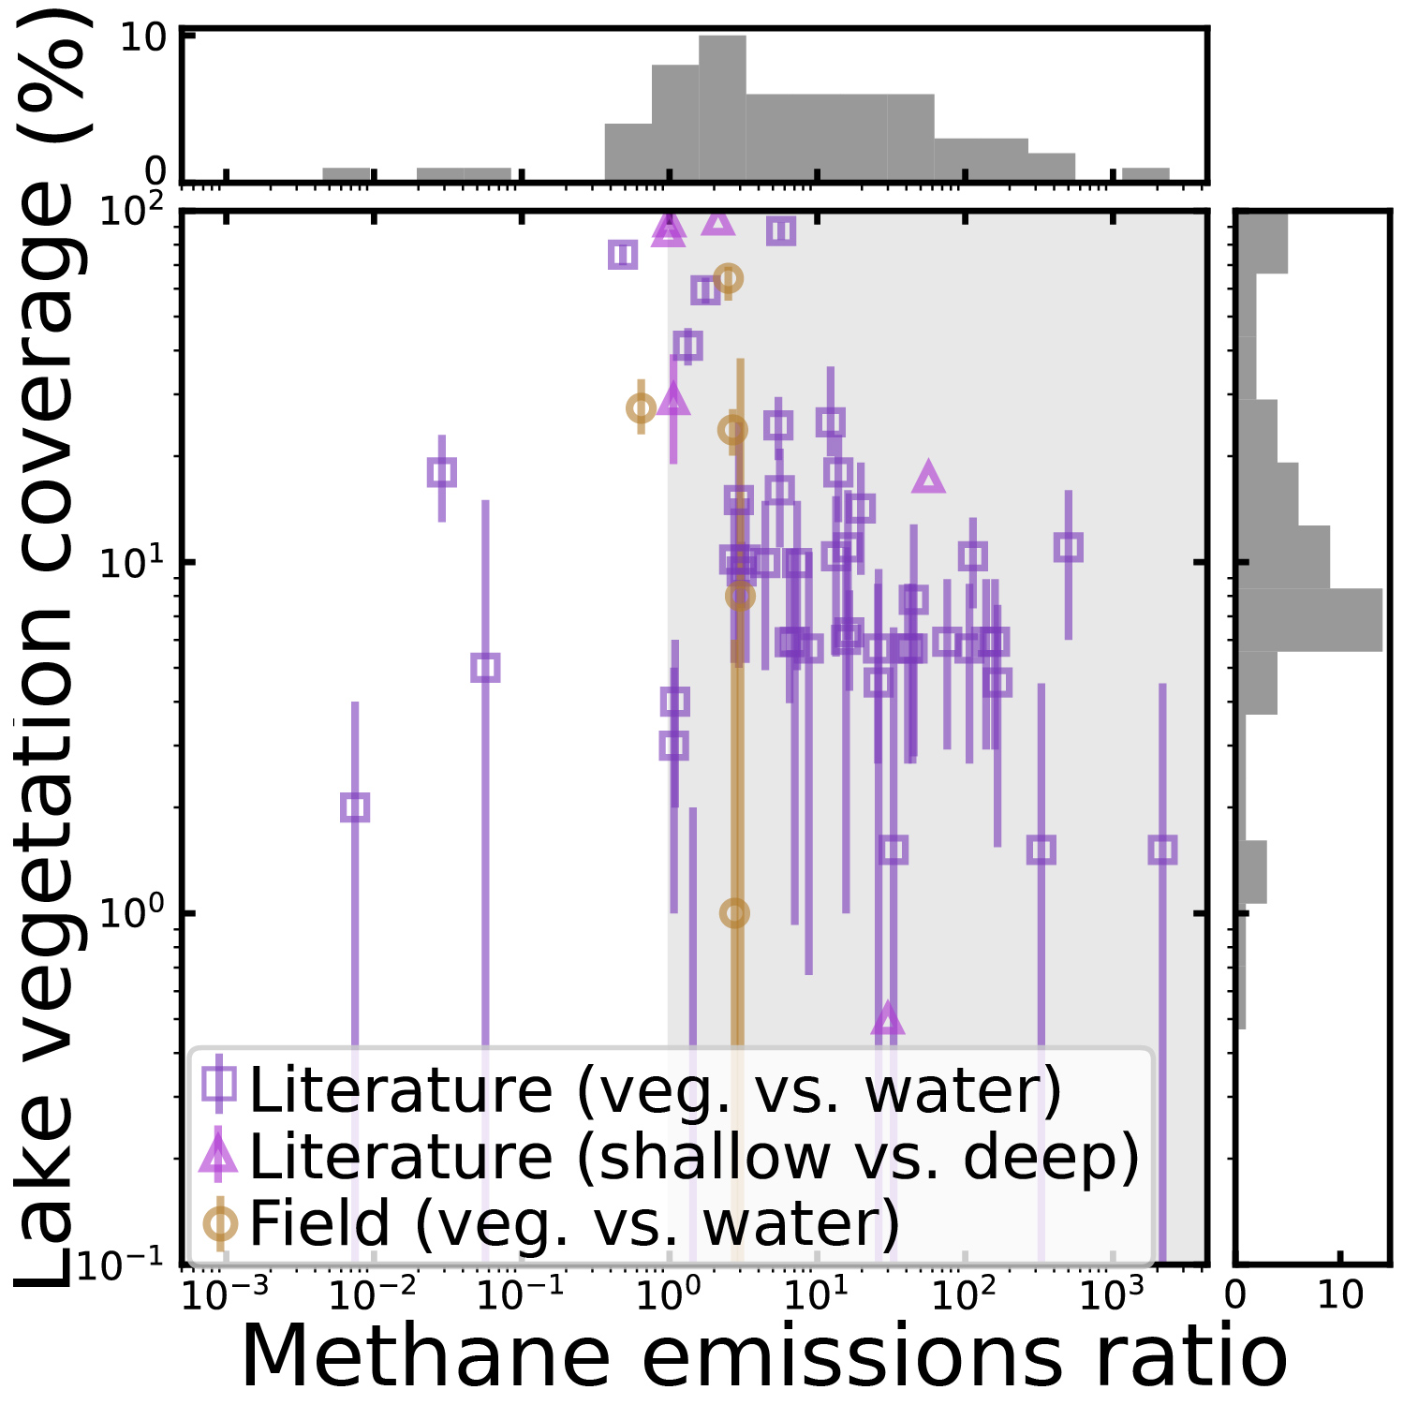
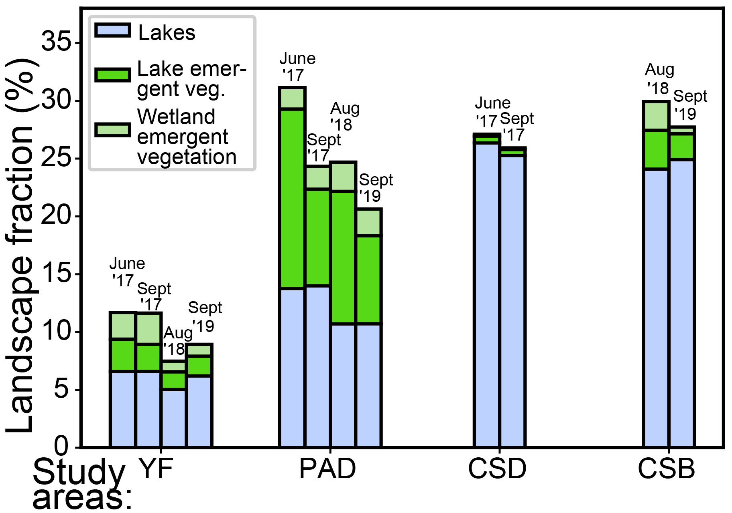
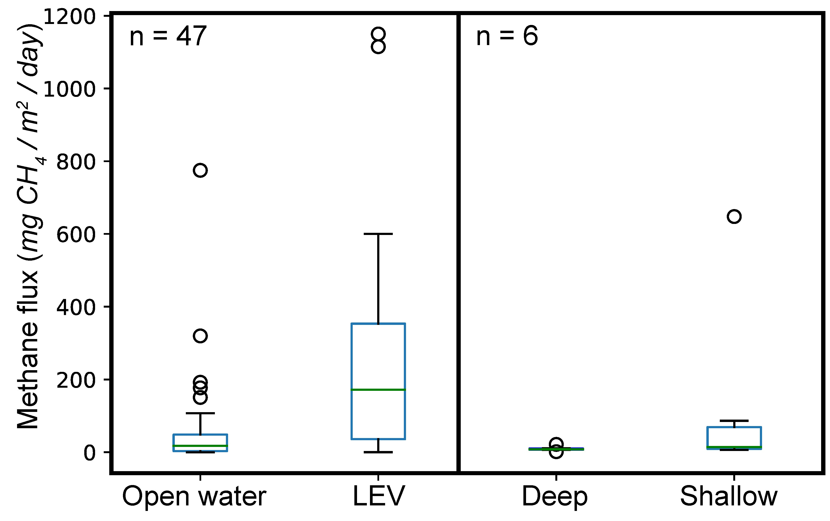
Results
Butman TE 2018, Smith 2016
Landscape coverage of lakes and aquatic vegetation
Unit methane flux per area for different lake zones
Knowing coverage and flux permits upscaling comparison
Kyzivat et al. 2022 JGR
Lake vegetation varies regionally from 1 to 59 % of lake area and seasonally to a lesser degree
Accounting for vegetation could increase emissions estimates from Arctic-boreal lakes by +21%.
Aquatic vegetation emits ~6x more methane than open water per unit area
Notes:
LEV = Lake emergent vegetation
YF = Yukon Flats; CSD = Canadian Shield, Daring Lake; CSB = Canadian Shield, Baker Creek; PAD = Peace-Athabasca Delta
Mean lake vegetation coverage is ~16%.
Aquatic vegetation ratio is 16x from Arctic-boreal regions only.
Error margin for the +21% increase number is [18-25]%, based on 10,000 bootstrapped samples.

Slide 14
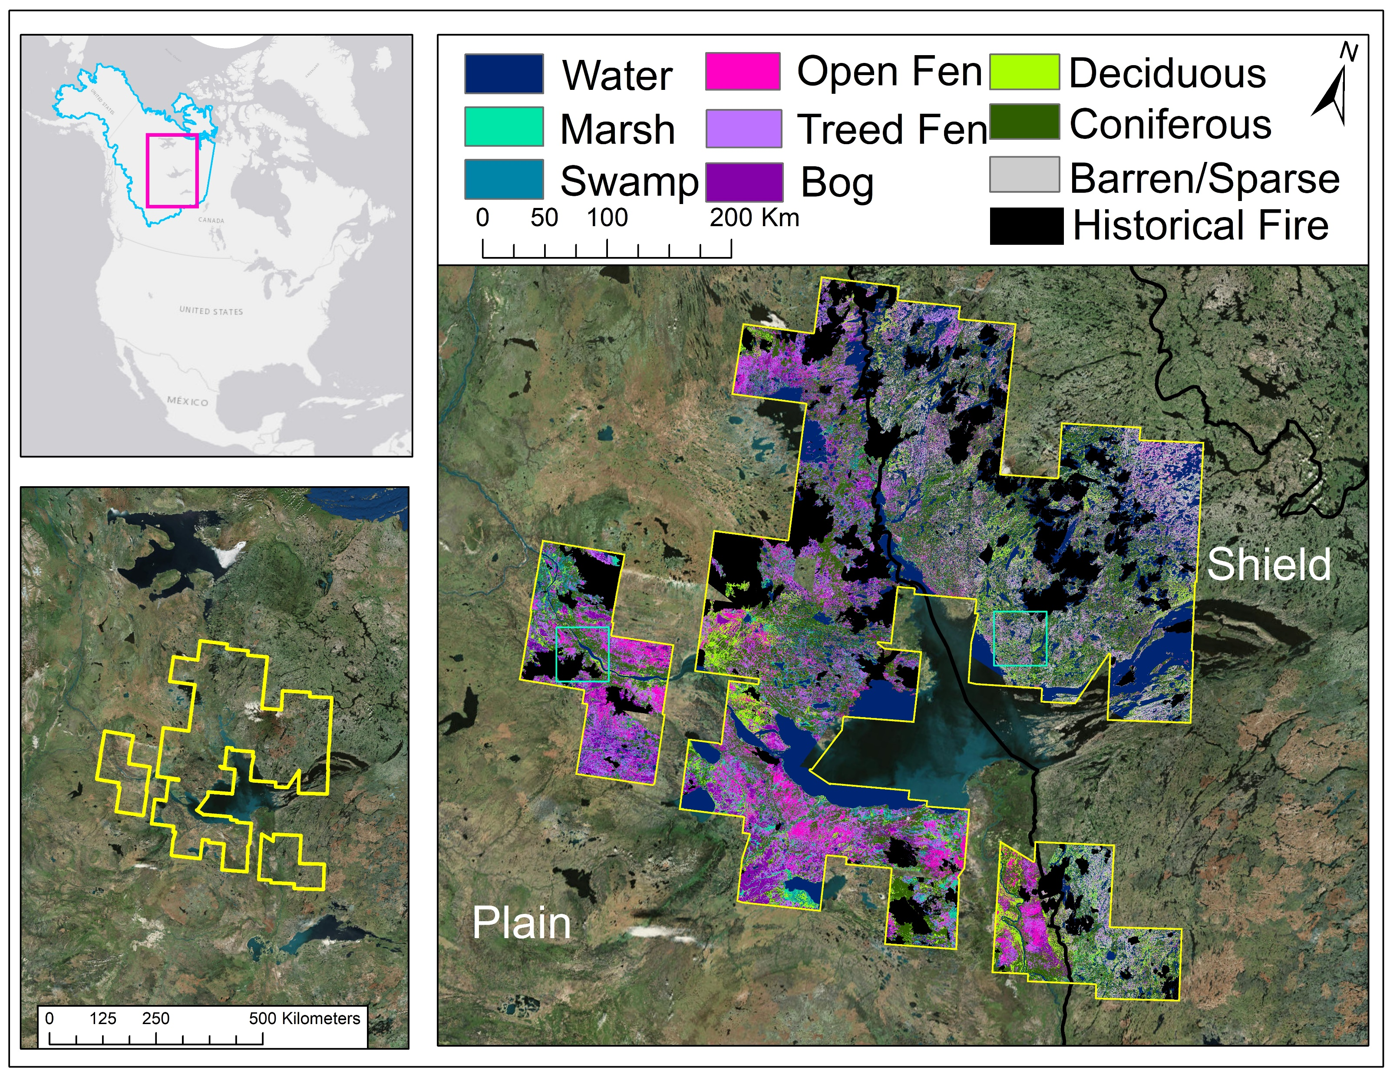
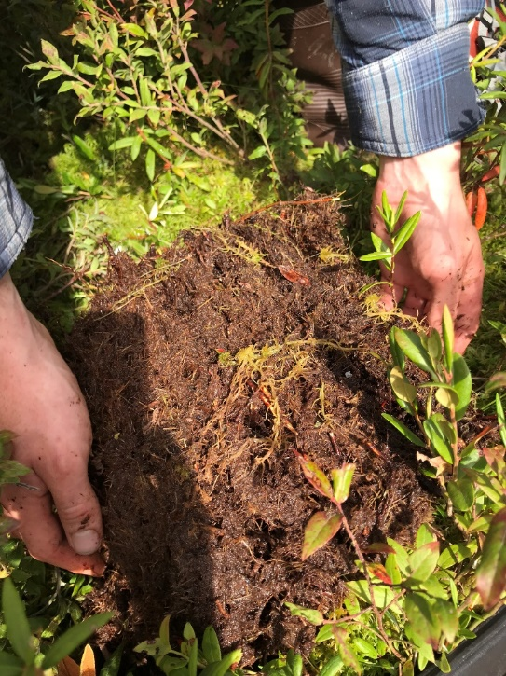
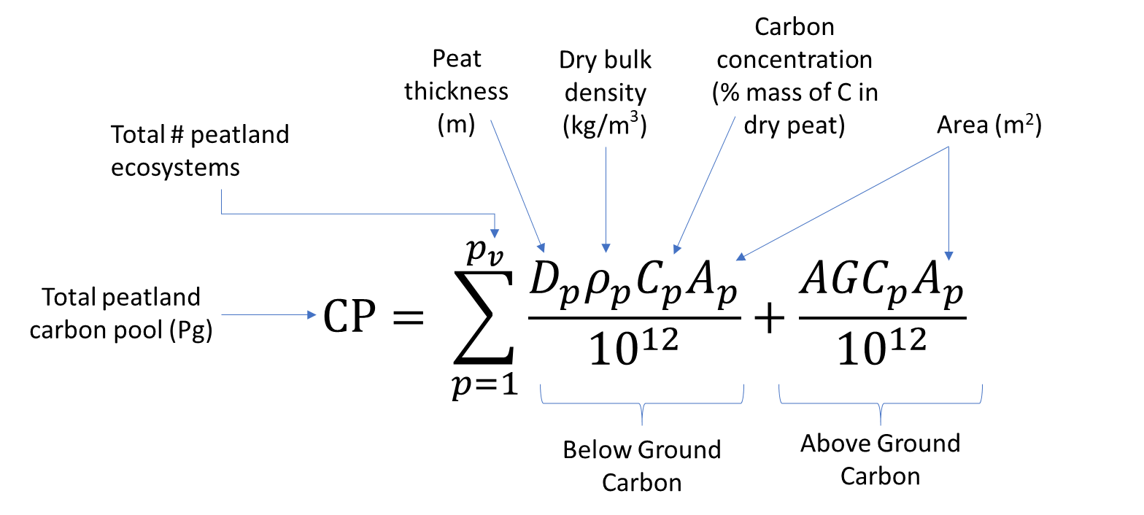
Estimating C Stocks in Peatlands – Great Slave Lake Area
Bourgeau-Chavez TE2014, 2018
Ecosystem | Area (km²)
Bog | 9266
Treed Fen | 16811
Open Fen | 7929
There is a data gap in our current knowledge of the geospatial distribution, type and extent of C rich peatlands across the globe.
Accurate mapping of peatland ecotypes with high resolution (<30 m) sensors linked with field data allows for reduced uncertainties in estimates of the distribution of C stocks.
We developed high accuracy peatland maps for the Great Slave Lake region using a combination of multi-temporal SAR and optical remote sensing in a machine learning classifier
We estimate C stocks using the maps with field data of above and belowground biomass, peat depths and bulk density using the equation from Page et al 2011 Global Change Biology
SEE POSTER: by Vander Bilt
Overall Accuracy: 94%
Bourgeau-Chavez et al 2017 CJRS, 2019 (DAAC)

Slide 15
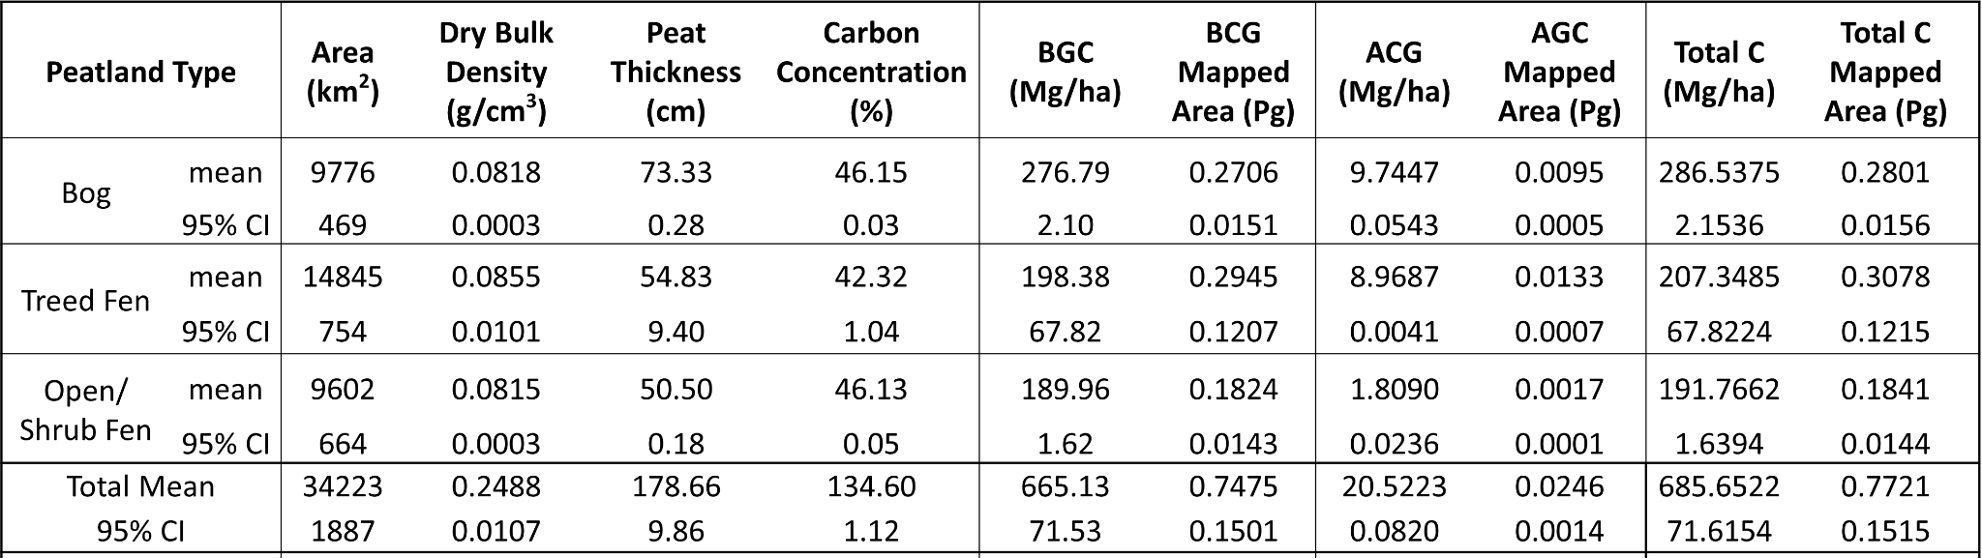
Bourgeau-Chavez TE2014, 2018
Preliminary NWT Peatland Carbon Stock Estimates
Adjusted area and CI was estimated using map error matrix and % of landcover on the map after Olofsson et al. 2013 RSE
Results show 772 Tg +/- 152 Tgof C is stored in the peatlands around Great Slave Lake, with treed fens contributing the most, both in above and belowground total C
On a per ha basis, bogs are contributing the most both in above and belowground C
Estimates in the literature are highly variable and region specific, field data are critical to improved accounting
Billmire, Vander Bilt and Bourgeau-Chavez in prep.

Slide 16
Research Highlights: Hydrology

Slide 17
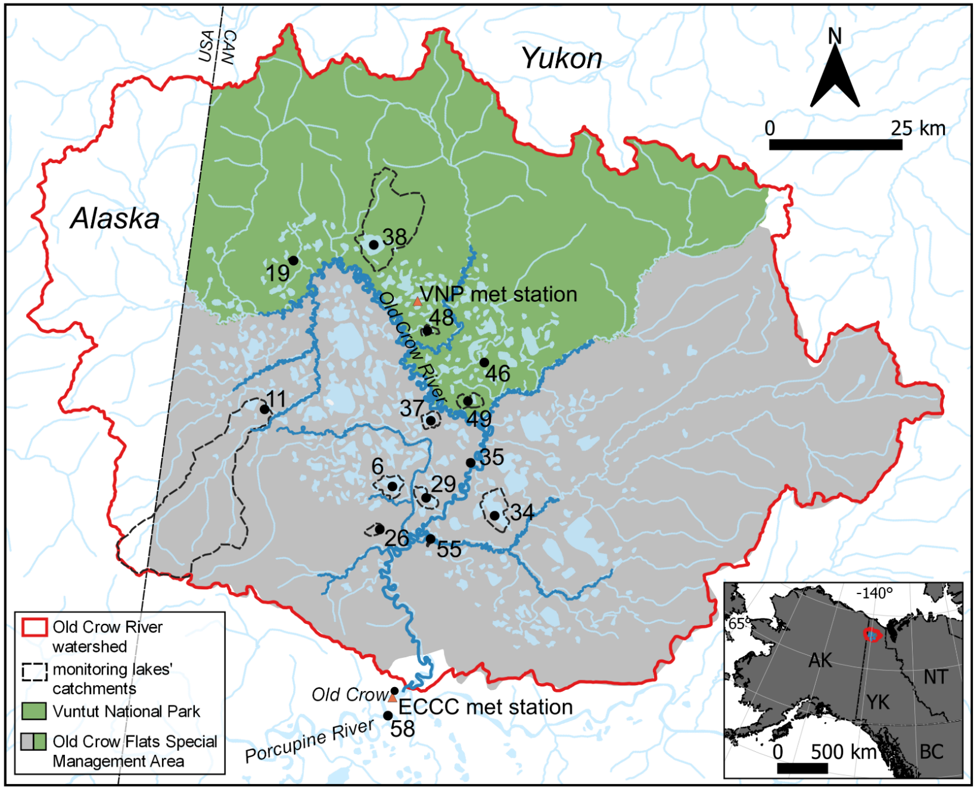
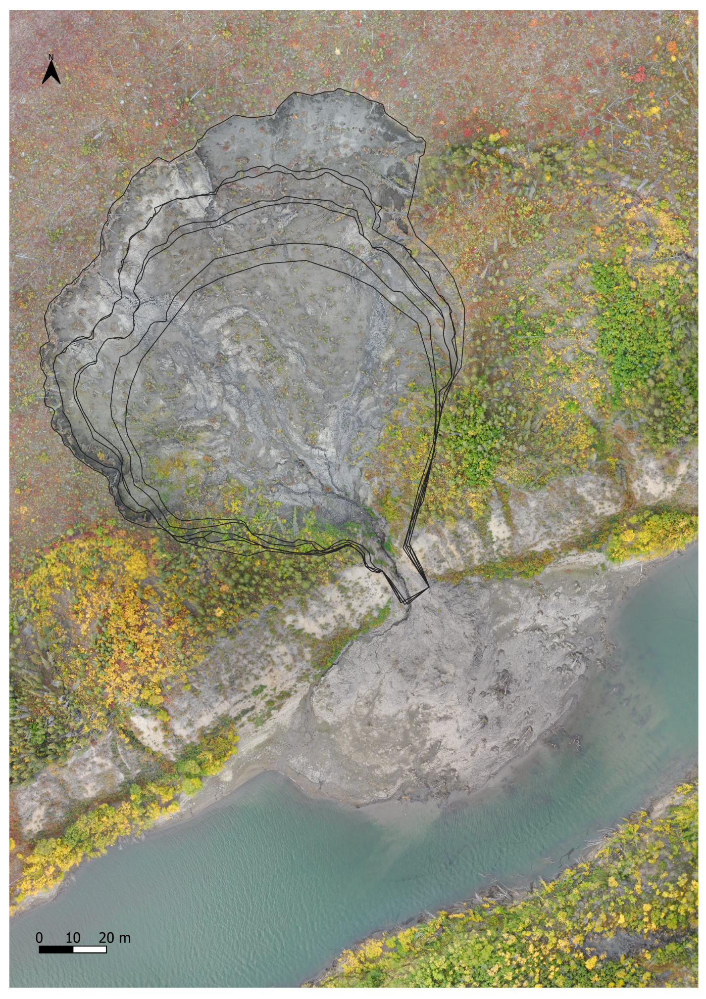
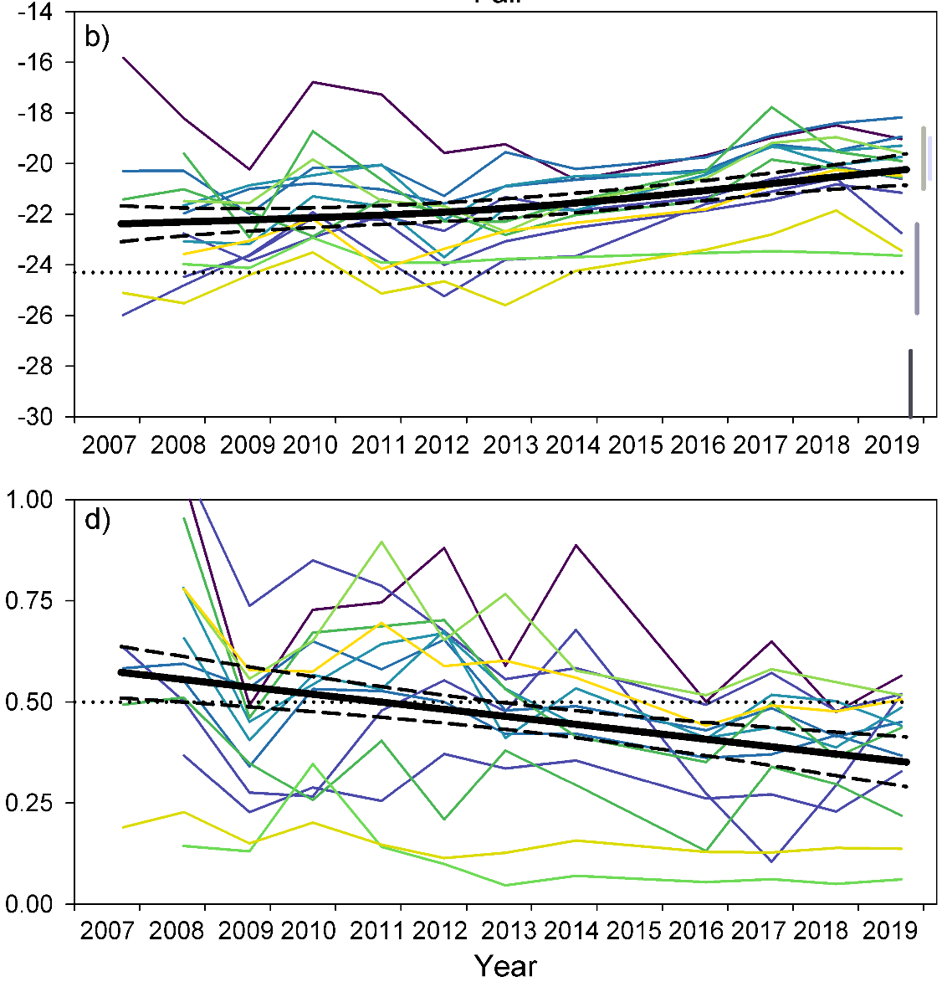
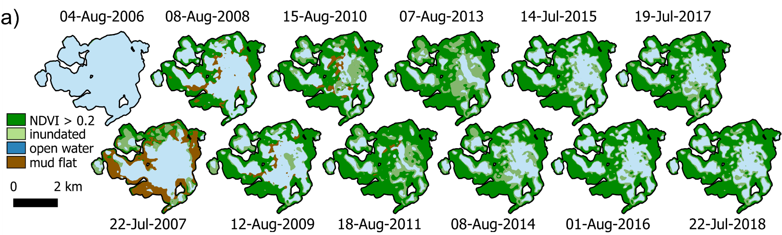
Detecting landscape change and impacts on surface water biogeochemistry in Old Crow Flats, Yukon, Canada
[Kevin Turner, Brock University]
Turner et al. 2021. Remote Sensing.
Thaw slump geomorphology, sediment C and N, and tracking seasonal and inter-annual change with drones.
Publications we are building on:
2021
MacDonald et al. 2021. Env. Res. Lett.
Isotopic evidence of increasing water abundance and lake hydrological change in Old Crow Flats, Yukon, Canada.
2016
rainfall
Turner et al. 2022. Arctic Science.
Monitoring 13 years of drastic catchment change and the hydroecological responses of a drained lake.
snowmelt
evaporation

Slide 18
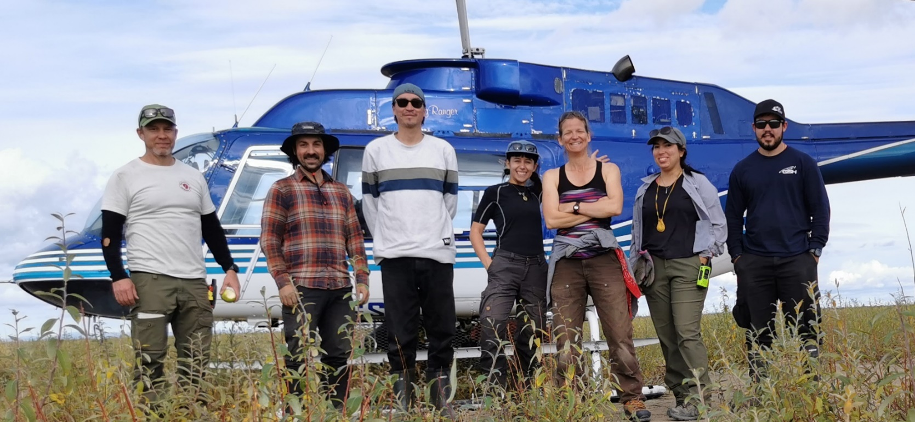

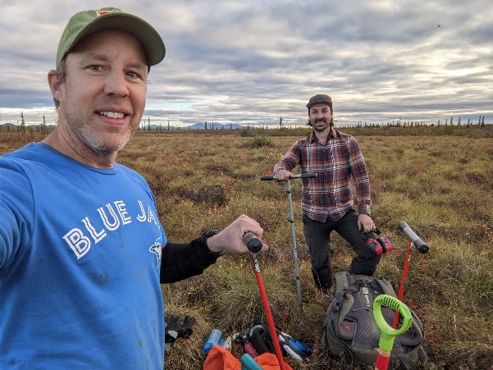
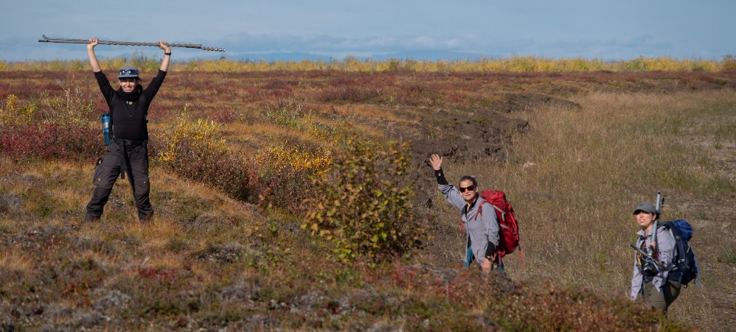
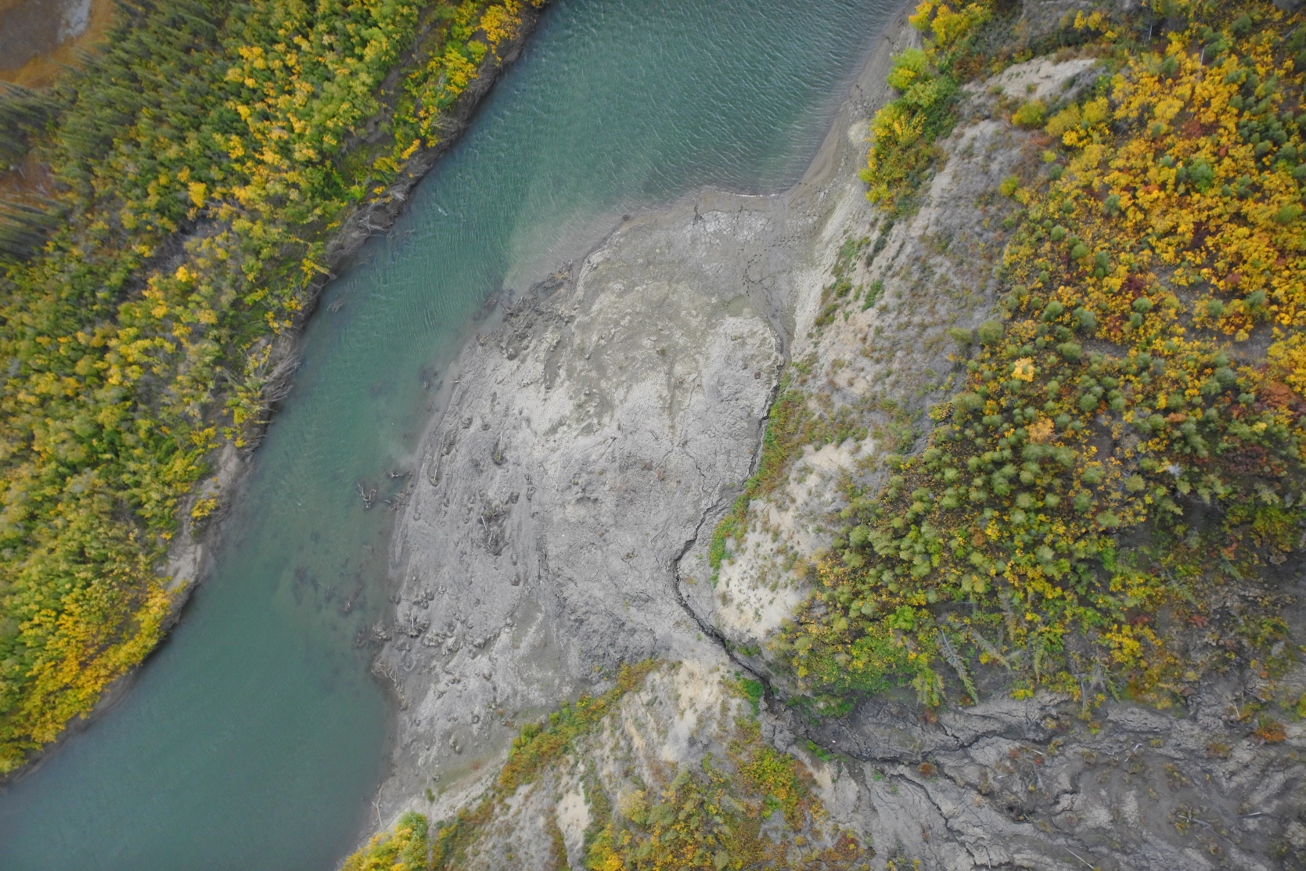
Field season 2022
(collab. with Polar Knowledge Can., Parks Can.)
June trip
  Lake (n=14) and river (n=24) water sampling (for geochem)
  Slump survey (repeat drone and LiDAR)
August/September trip
  Lake and river water sampling
  Slump survey (repeat drone and LiDAR)
  Active layer thaw depth survey (repeat of 6 plots)
  New drained lake site (drone survey)
Key updates
Rivers are showing increasing rainfall trend and shifting carbon source. Kay et al. x 2 in prep.
The slump continues to grow after six years
  Only impacts downstream during high flow or heavy rainfall
ALTD, soil moisture data (2017-18, 2022) submitted to Nordicana D (doi forthcoming).
Community-researcher meeting Feb. 2 – Feb. 4, 2023

Slide 19
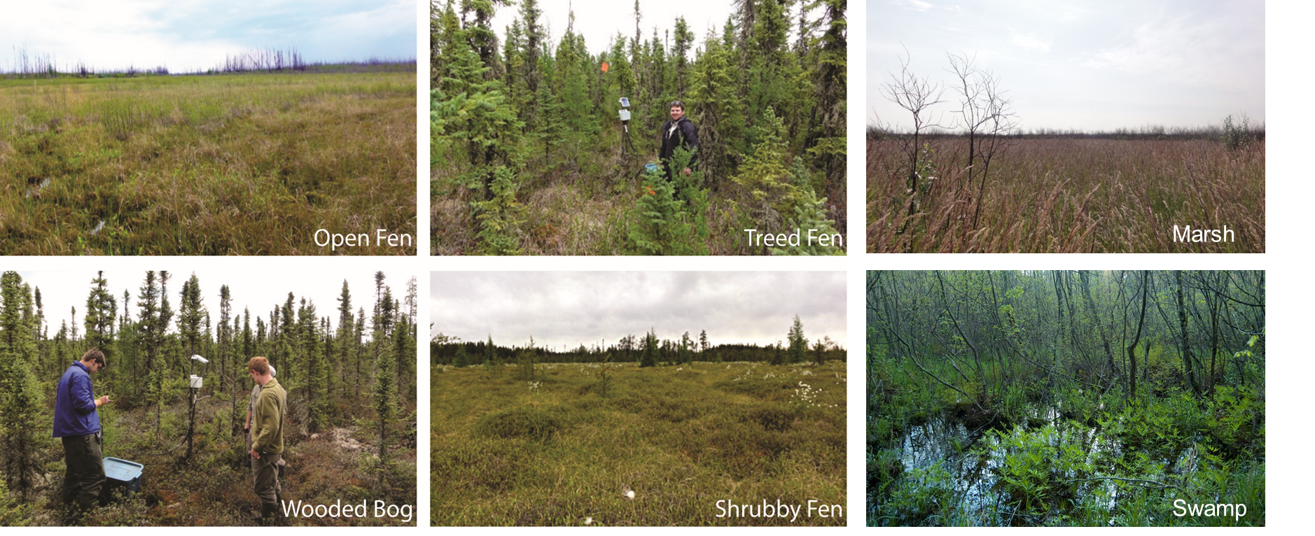
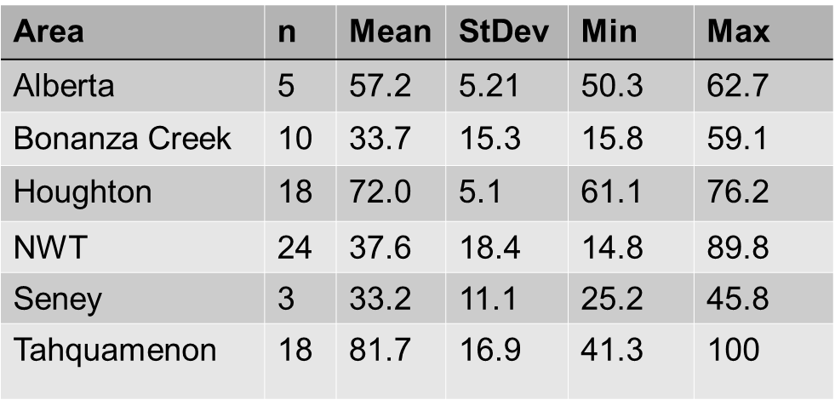
Bourgeau-Chavez TE2014, 2018
Treed Peatland Soil Moisture Monitoring with Radarsat-2 C-band SAR
To build a robust model, we:
Chose sites in different regions of the boreal zone to work on algorithm development (initial locations are red dots) – later adding additional sites in MI, Alberta and NWT – (green dots)
Measured soil moisture at 6, 12 and 20 cm depths with TDR probes calibrated to the organic soils
Sampled tree and shrub density and biomass for every site – to understand their contributions, attenuation
Tested data with different incidence angles to see if
there was a limitation
Focused on polarimetric discriminators and
decompositions to account for varying vegetation
and surface roughness as well as SAR backscatter
Evaluated MLR and General Additive Models
VMC range 15-100%
Focus on forested and unforested peatlands separately
Moisture-sampled from 78 treed boreal peatland (bogs and fens) field sites – 1-4 ha site size
Bourgeau-Chavez, Graham, Vander Bilt in prep. RSE

Slide 20
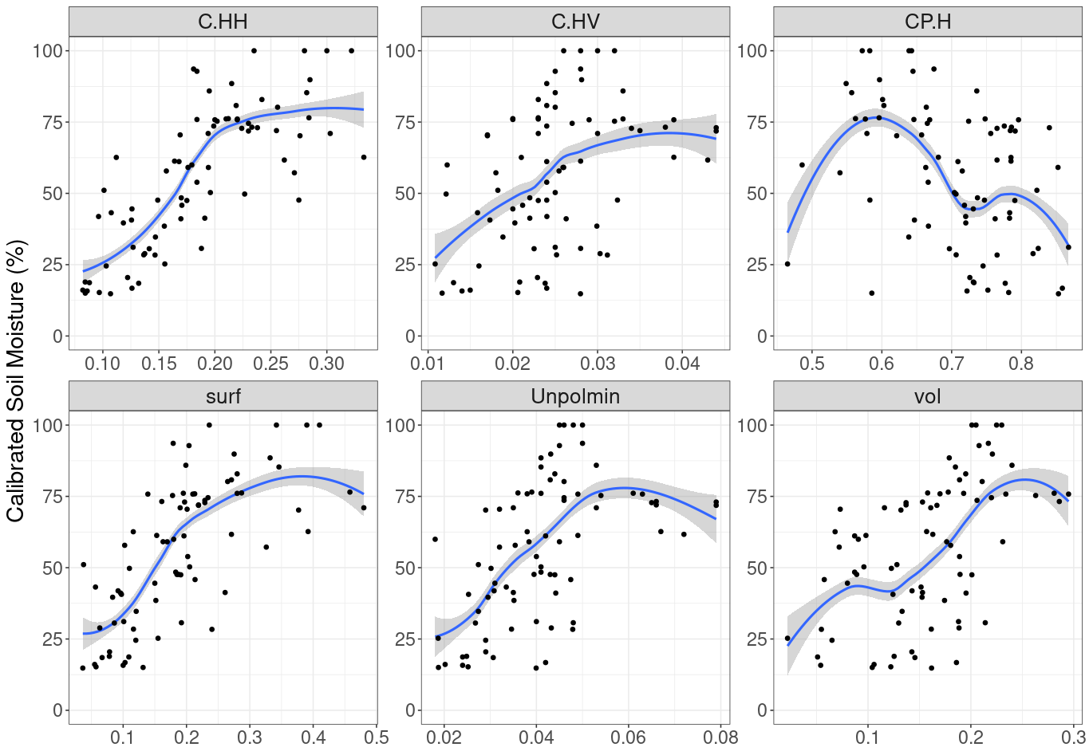
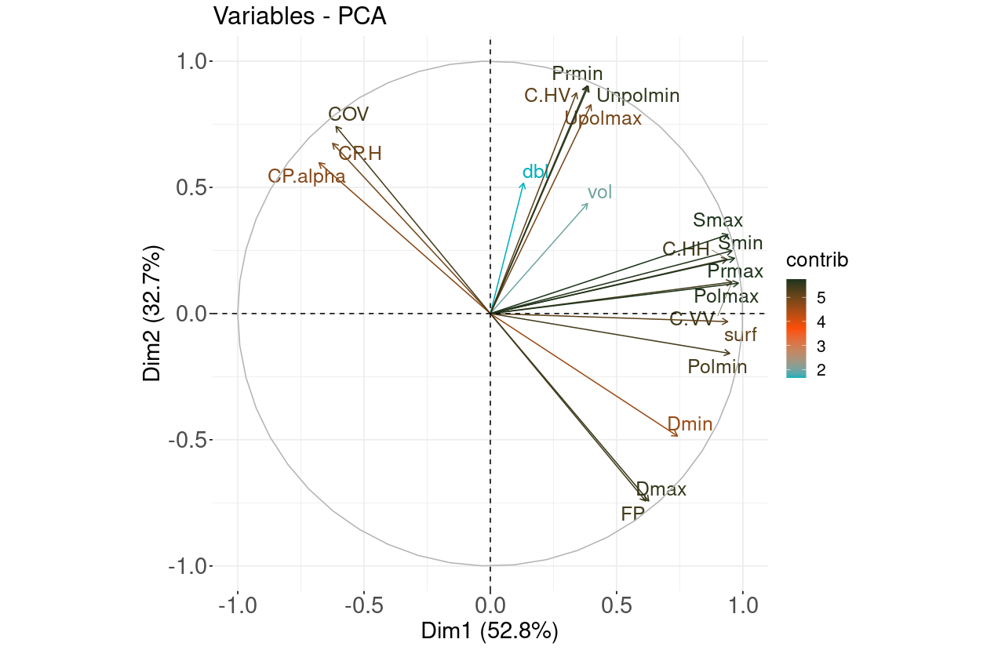
Testing GAM for Full Dataset
Bourgeau-Chavez TE2014, 2018
Example plots when pooling together data from 6 different regions
Bourgeau-Chavez, Graham, Vander Bilt in prep. RSE

Slide 21
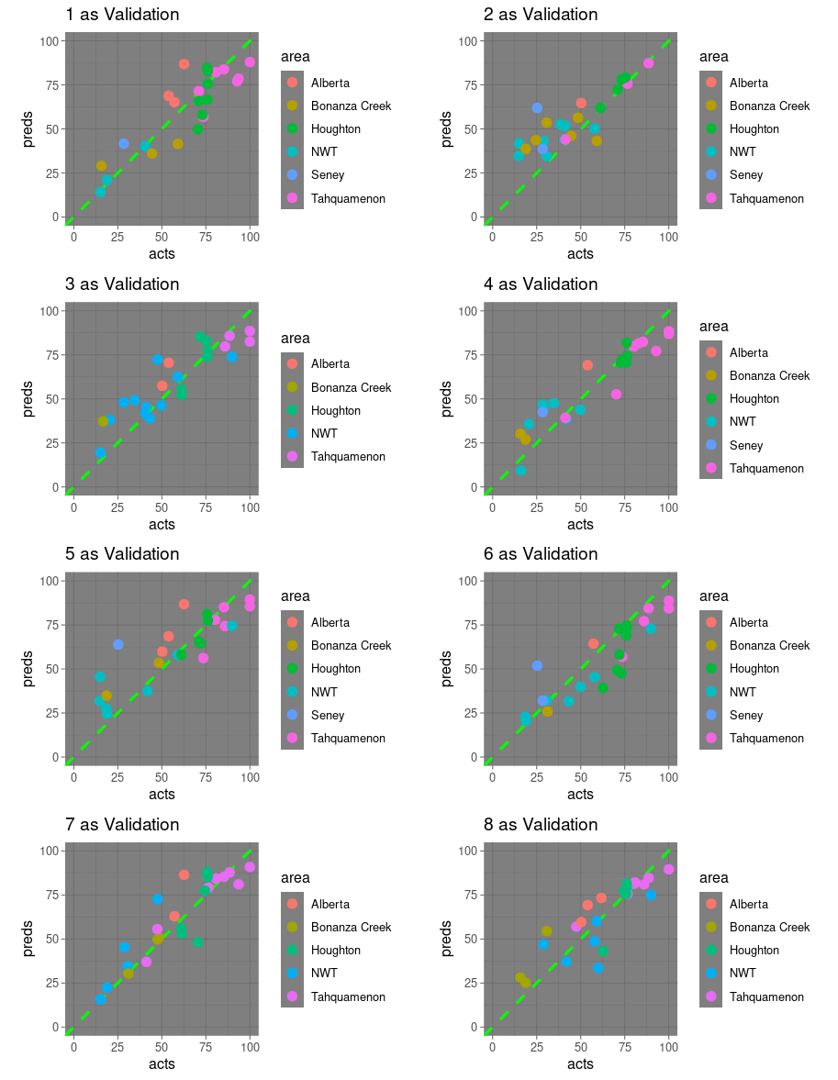
Treed Peatland Soil Moisture Monitoring with Radarsat-2 C-band SAR
Bourgeau-Chavez TE2014, 2018
Predicted vs. Actual 12 cm Moisture
Conducted a 70/30 Cross validation 8 times to validate 3 parameter GAM model: CP.alpha, dbl and Unpolmin
ubRMSE 11.6% VMC Mean Deviance explained 0.74 Val-R² 0.77
  Findings:
  We found incidence angles <30⁰ to be best suited to retrieval of moisture at C-band
  C-band SAR is best correlated to 12 cm soil moisture depth (from surface down)
  Ensuring that datasets have the full range of moisture possible in peatlands (basically 0-100) is crucial in developing a robust algorithm
  Using data from a range of peatland types and conditions was key to building the robust algorithm (this only took 9 years of fieldwork in remote regions!)
Bourgeau-Chavez, Graham, Vander Bilt in prep. RSE
Notes:
More field data would improve statistical power and reduce the ubRMSE which ideally would be closer to 5% (we are at 11%) – field data and imagery have been limited
L-band is showing much greater capability than C-band across a variety of canopy covers – NASA’s NISAR L-band mission will allow us to develop algorithms for a geographically rich dataset, although alternatives to polarimetric SAR will need to be developed

Slide 22
Looking ahead…
Phase 3 new projects and new WG members
Looking for a new WG lead
Comparison of wetland products for user communities (Carbon, Vegetation Change, Habitat, Indigenous Communities)
Discussion of possible Synthesis activities, e.g. inundation products as part of the ABoVE Effort
Collaborate with Carbon Cycling WG on Wetland influence on carbon stocks and flux
Preparation for NISAR, SWOT missions for large scale wetland mapping
Feb 22, 2023 Next WG webinar. Dr. Nancy French will present on the results of the waterfowl habitat remote sensing and field assessment with DUC from her Phase 2 project

Slide 23
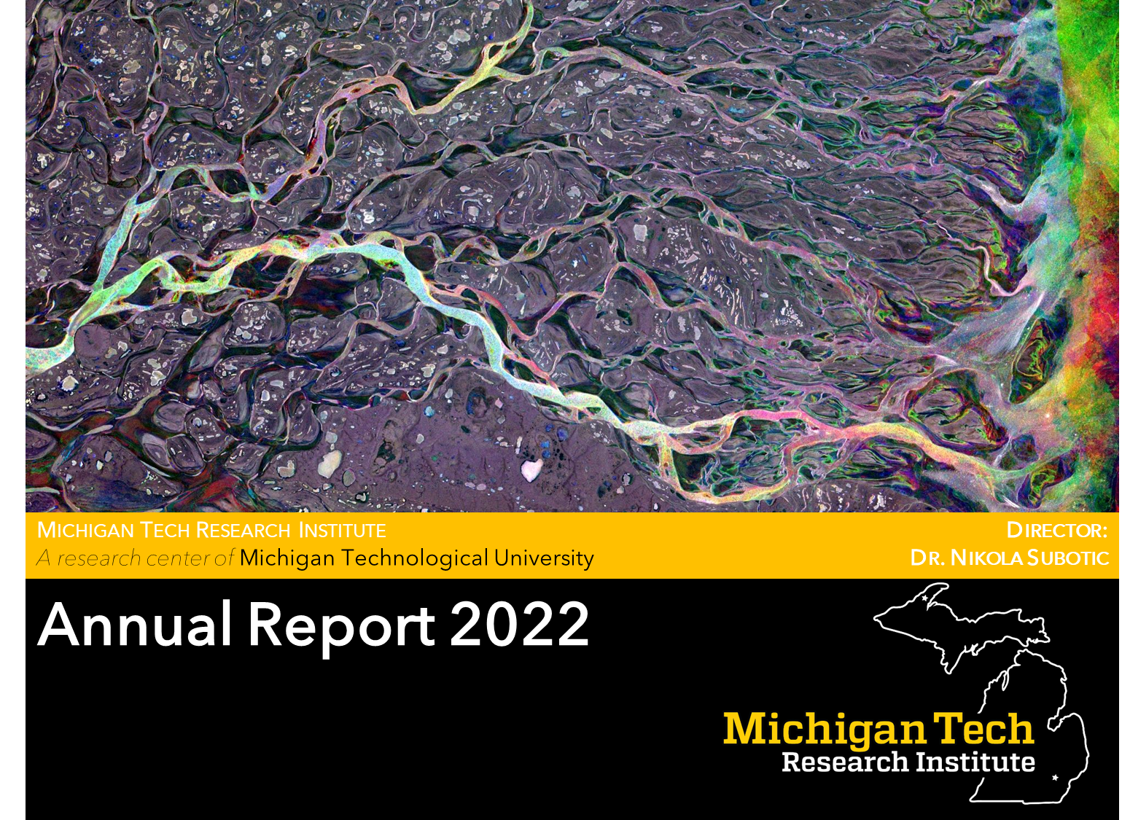
Thank you to all of the contributors!
Questions?

