Slide 1
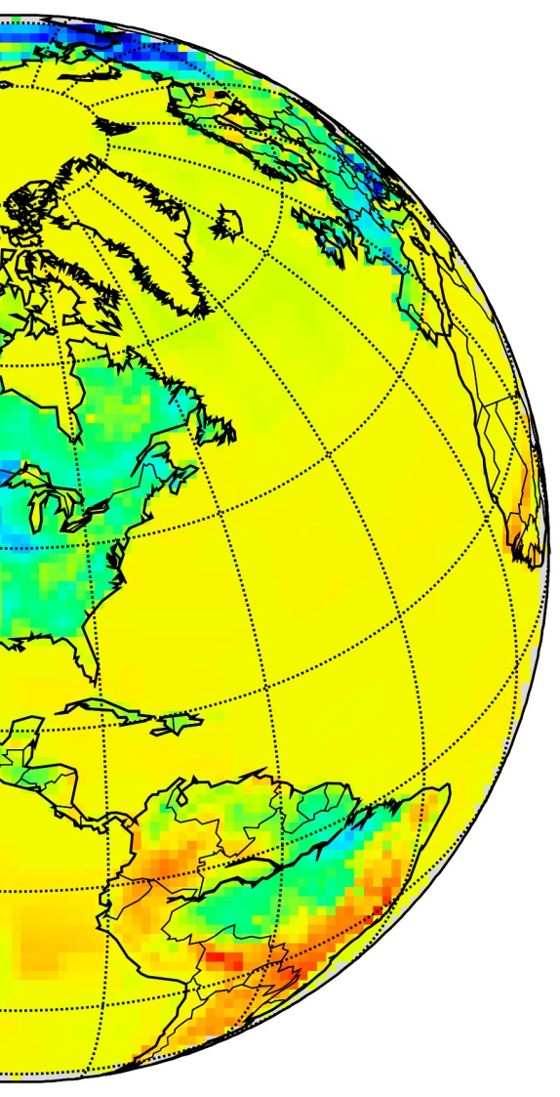
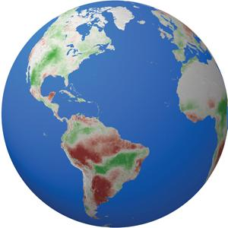
Global Respiration Comparison (ResCom): evaluation of satellite constrained top-down and bottom-up respiration estimates and their relationship with model simulations
Elizabeth Smith, U Delaware
Arthur Endsley, U Montana
Ash Ballantyne, Ben Bond-Lamberty & Rodrigo Vargas
Zhihua Liu, U Montana

Slide 2
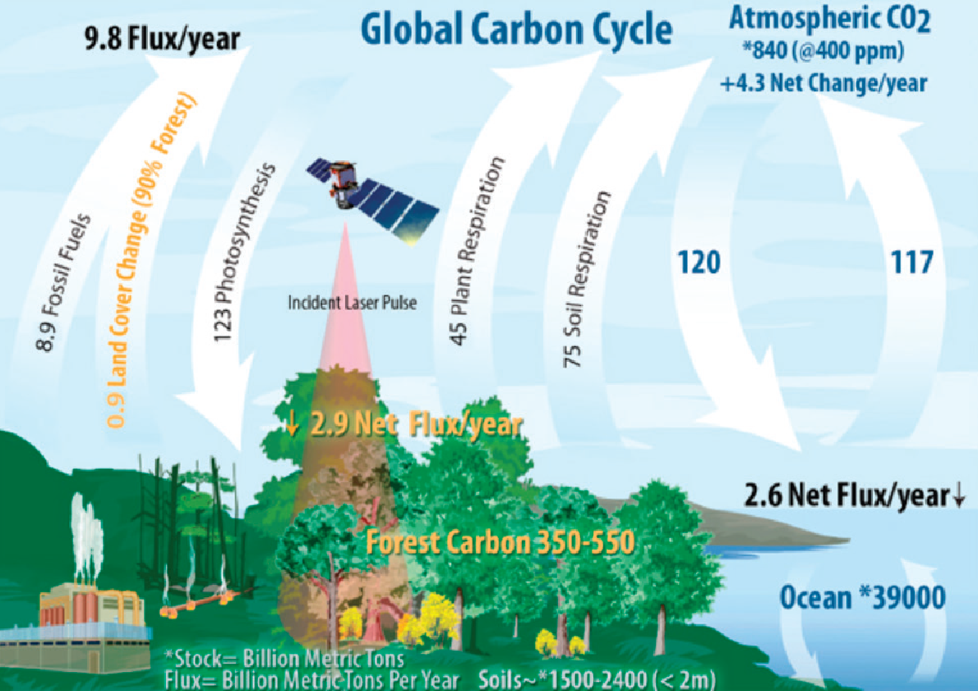
Global Fluxes and their uncertainties
Gross Primary Productivity (GPP):
GPP 123 ± 8 PgC/yr (6.5% CV)
Soil respiration
75 +/- 15 PgC/yr (20% CV)

Slide 3
Global Respiration Comparison (ResCom): project questions and objectives
What are the current mean annual estimates of top-down (↓R ) and bottom-up respiration (↑R ) and how well do these estimates compare with each other?
Can the spatial and temporal resolutions of our ↑R and ↓R estimates be improved by additional in situ measurements, remote sensing observations and novel ML approaches to reveal important temporal and regional mismatches attributable to carbon cycle processes?
How well do our newly derived spatially and temporally explicit estimates of ↑R_{h} and ↓R_{h} compare with historical and future simulations of R_{h} from the latest DGVM and ESM simulations?

Slide 4
Partitioning respiration fluxes by process
Ra
By process:
TER = Ra + Rh
Rh

Slide 5
Partitioning respiration fluxes by origin
R_{ag}
By Origin:
TER = R_{ag} + R_{bg}
R_{bg}

Slide 6
Partitioning respiration fluxes by process & origin
Ra_{ag}
Rh_{ag}
By Process & Origin
TER = (Ra_{ag} + Ra_{bg}) (Rh_{ag} + Rh_{bg})
Ra_{bg}
Rh_{bg}

Slide 7
105 (+/- 0.7) 96.9 (+/- 0.7)
Top-down vs Bottom-up TER estimates mean
TER (PgC/yr)

Slide 8
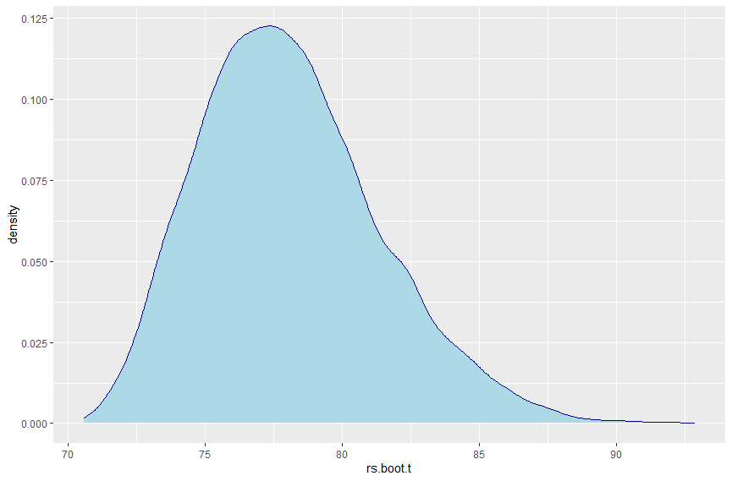
77.8 +/- 3.2 PgC/yr
Bottom-up R_{bg} estimates mean
R_{bg} (PgC/yr)

Slide 9
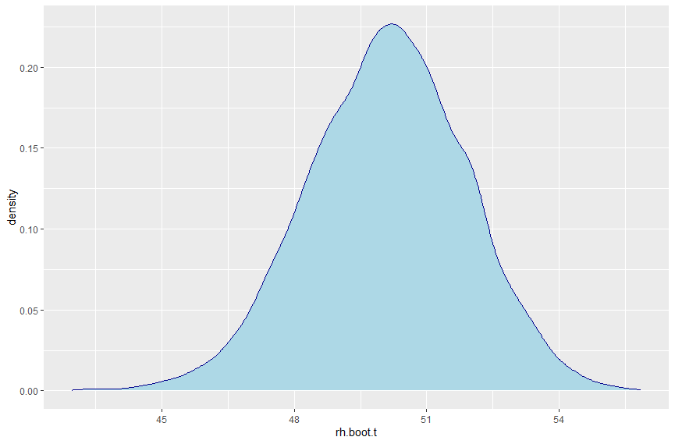
50.1 +/- 1.8 PgC/yr
Bottom-up soil heterotrophic respiration Rh_{bg}
Rh_{bg} (PgC/yr)

Slide 10
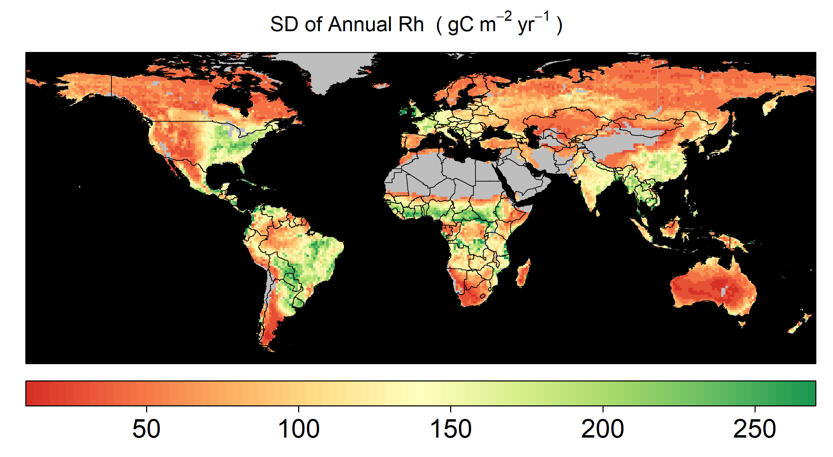
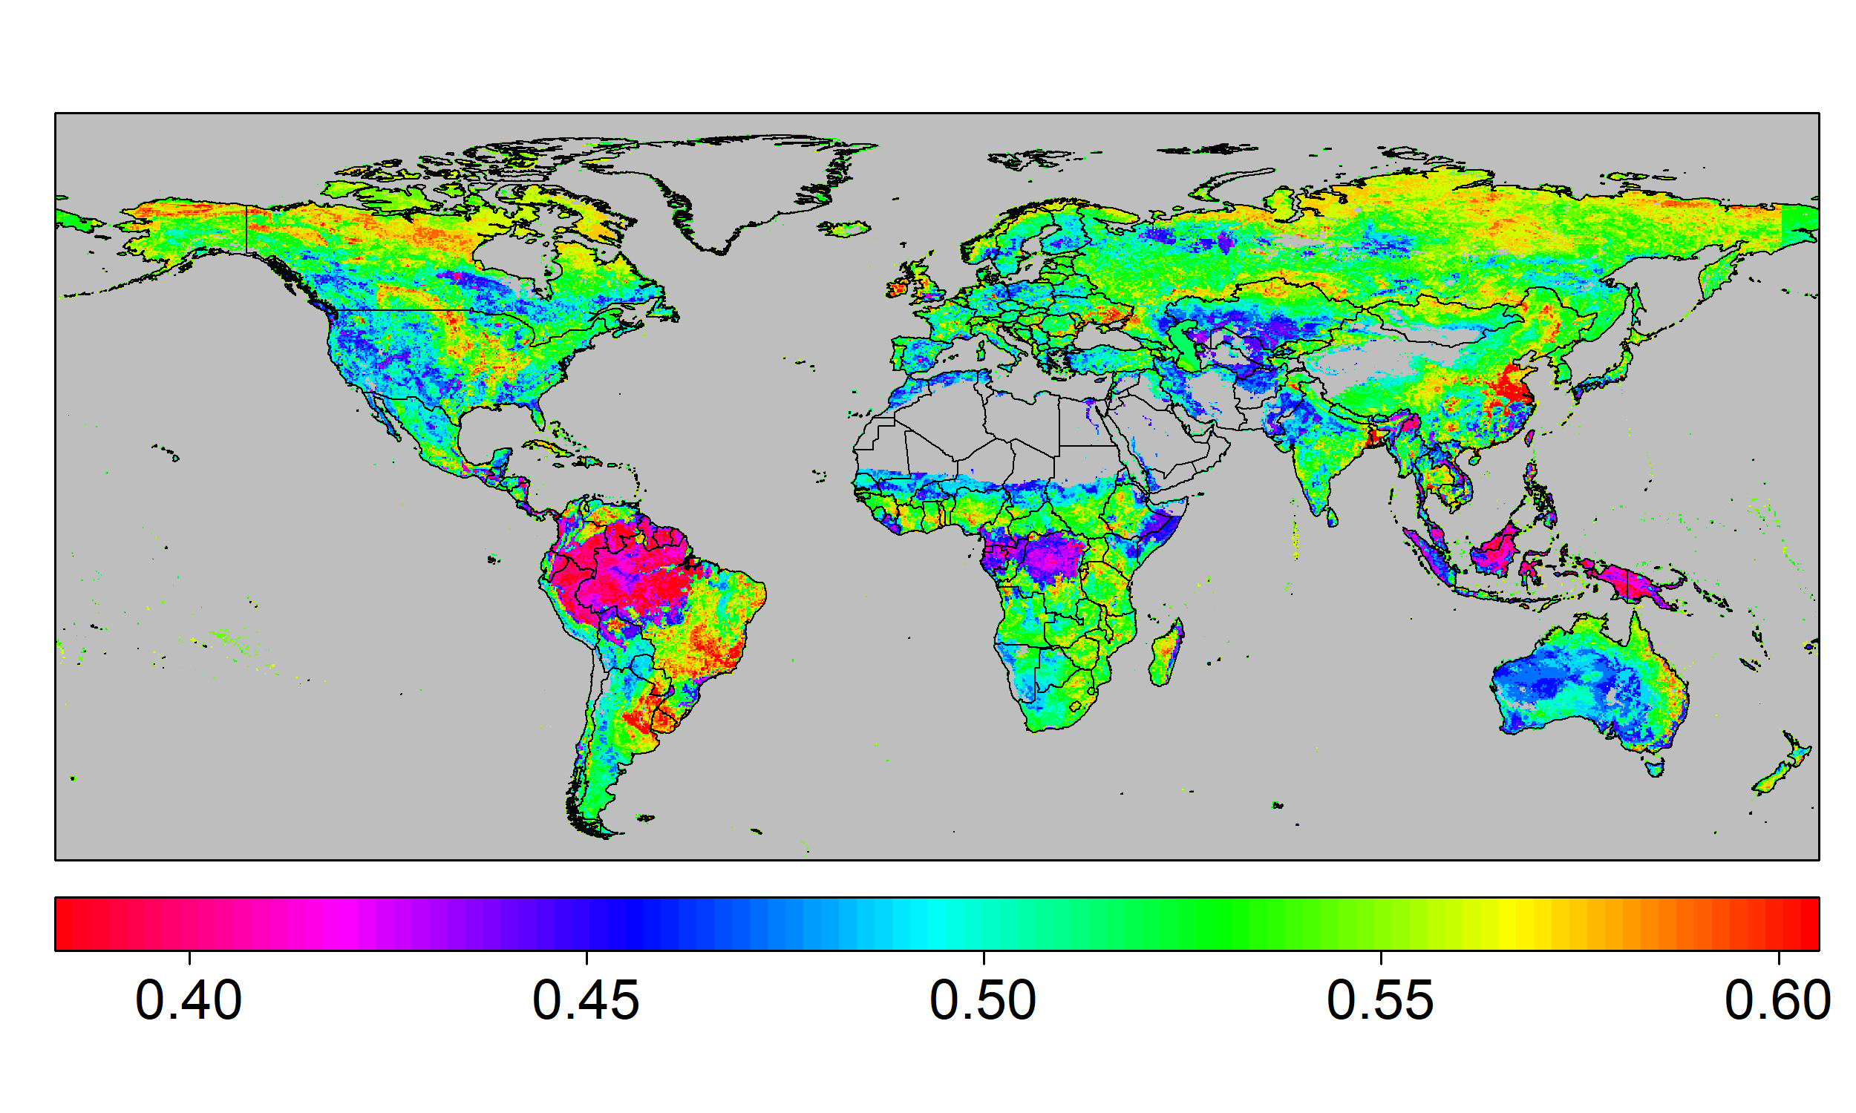
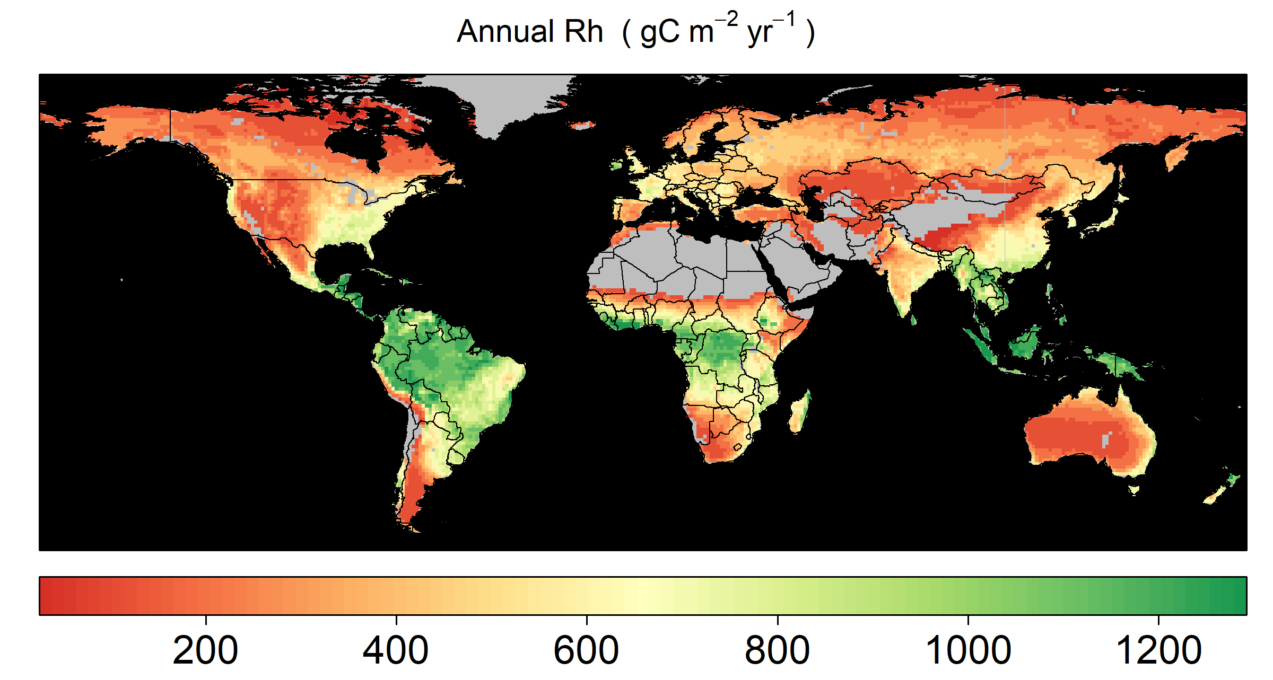
Top-down estimates of Rh using observations of terrestrial carbon fluxes and carbon use efficiency (CUE) Poster: 1-41
Poster: 1-41
Rh = GPP – Ra - NBP
Ra = GPP*(1- CUE)
CUE Map
Generated using suite of observational biophysical variables and Random Forest algorithm trained with in-situ CUE observations (n = 353 site-years)
GPP and NBP data
Annual GPP and NBP was based on climatological mean (2000-2015) from ensemble mean of different observations of GPP (n = 3) and NBP (n=5) dataset.
Rh: 52.76±10.43 PgC yr-1
Annual CUE map using Random Forest algorithm
Annual mean and SD of Rh estimated Top-down method.

Slide 11
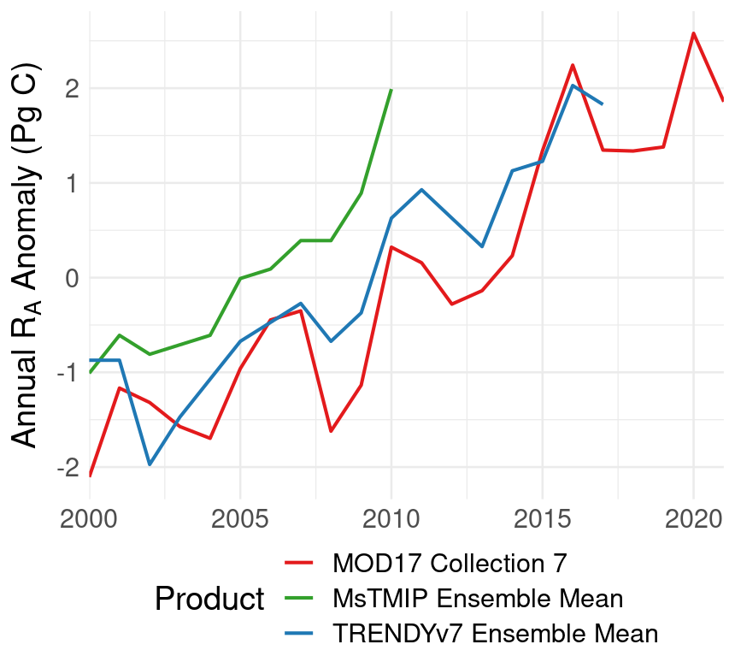
Top-down estimates of Ra using MODIS compared to model ensembles
Bottom-up and satellite-based models predict R_{A} trend of 0.19-0.25 PgC year⁻², likely due to increasing GPP.
Product | Period | Annual R_{A} (Pg C year⁻¹)
MODIS MOD17 Collection 7* | 2000-2018 | 70.0 ± 1.2
TRENDYv7** Ensemble Mean | 2000-2017 | 65.1 ± 1.1
MsTMIP† Ensemble Mean | 2000-2010 | 58.3 ± 0.8
*Endsley et al. (In Review, JGR: Biogeosciences); **Le Quéré et al. (2018); †Huntzinger et al. (2013)

Slide 12
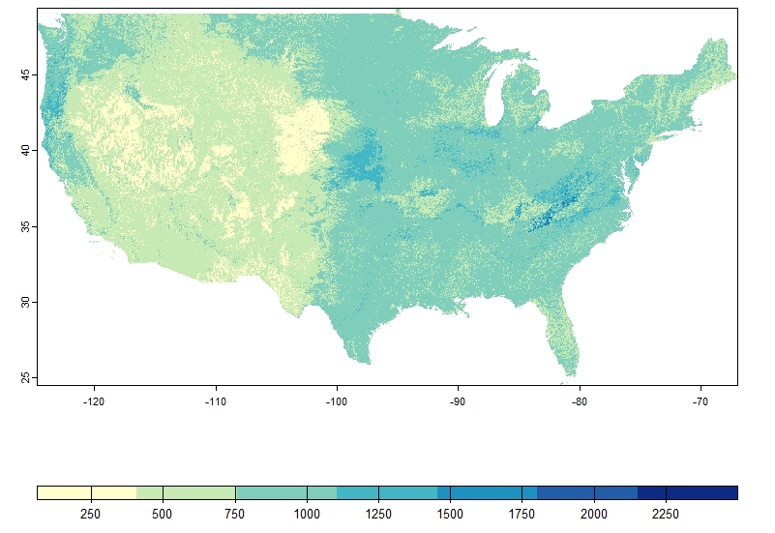
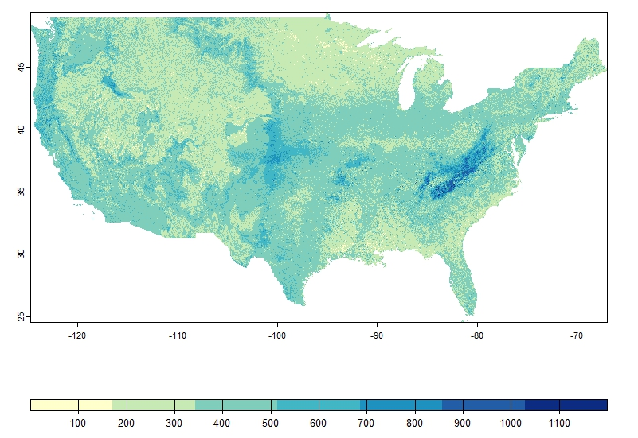
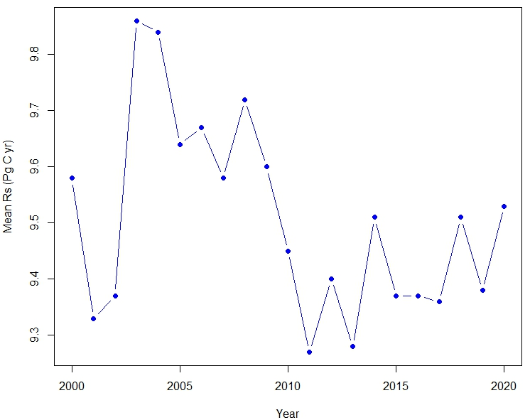
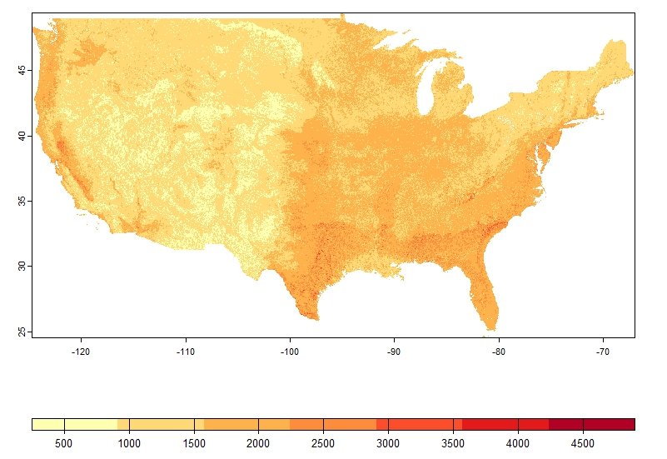
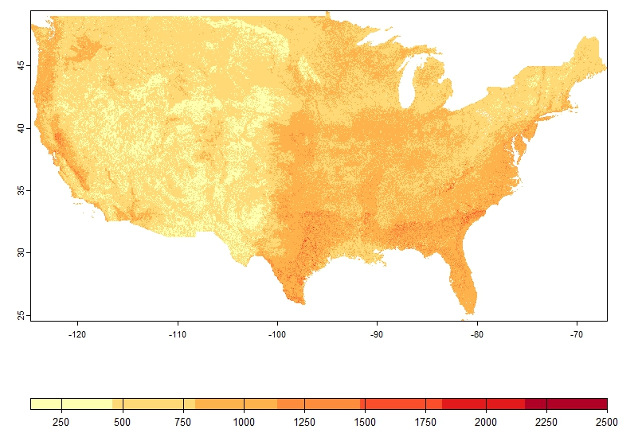
Spatial Variability and uncertainty in soil respiration
Conterminous United States (Poster 3-26)
Rs Spatial Variability Map
Generated using static and dynamic drivers in a quantile regression approach trained with Rs observations from SRDB (n=1, 056)
Rs Uncertainty Map
Generated using 90% prediction interval
Temporal Trend
Mean annual Rs from 2000-2020
Mean Annual Rs (g C m⁻² yr⁻¹)
Standard Deviation Annual Rs (g C m⁻² yr⁻¹)
Annual Rs Uncertainty (g C m⁻² yr⁻¹)
Standard Deviation Annual Rs Uncertainty (g C m⁻² yr⁻¹)

Slide 13
Partitioning respiration fluxes by process & origin
Ra_{ag}
By Process
TER = (Ra) + (Rh)
100 < 70 + 50
Rh_{ag}
Ra_{bg}
Rh_{bg}

Slide 14
Partitioning respiration fluxes by process & origin
Ra_{ag}
By Process
TER = (Ra) + (Rh)
100 < 70 + 50
Rh_{ag}
Ra_{bg}
Rh_{bg}
By Process & Origin
TER = (Ra_{ag} + Ra_{bg}) (Rh_{ag} + Rh_{bg})
100 = (28.1 + 31.9) (1 + 39)

Slide 15
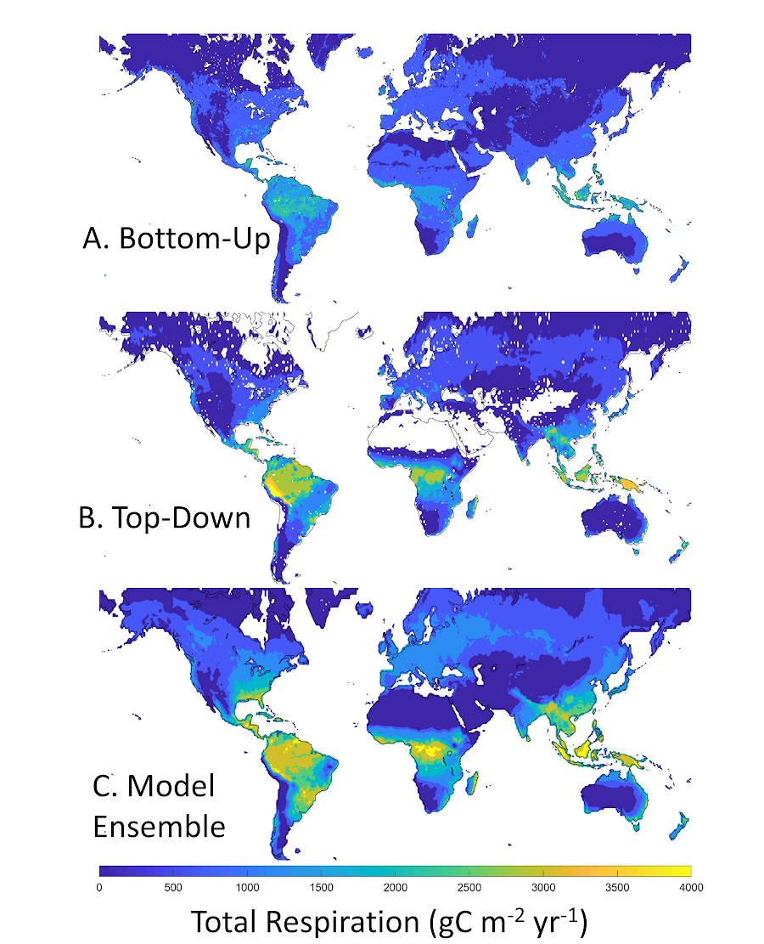
Next steps: comparing spatial and temporal patterns

Slide 16
Next steps: comparing spatial and temporal patterns

