Slide 1
TOPOGRAPHIC MAPPING OF SURFACE WATER DRAINAGE PATTERN AND HYDROLOGICAL CONNECTIVITY ON THE CANADIAN SHIELD
Nimisha A. Wagle¹, Laurence C. Smith¹, Jessica V. Fayne²
¹Brown University
²UCLA
ABoVE Science Team Meeting #8
May 11-M, 2022
Funded by the NASA Terrestrial Hydrology Program grant 80NSSC20K0429

Slide 2
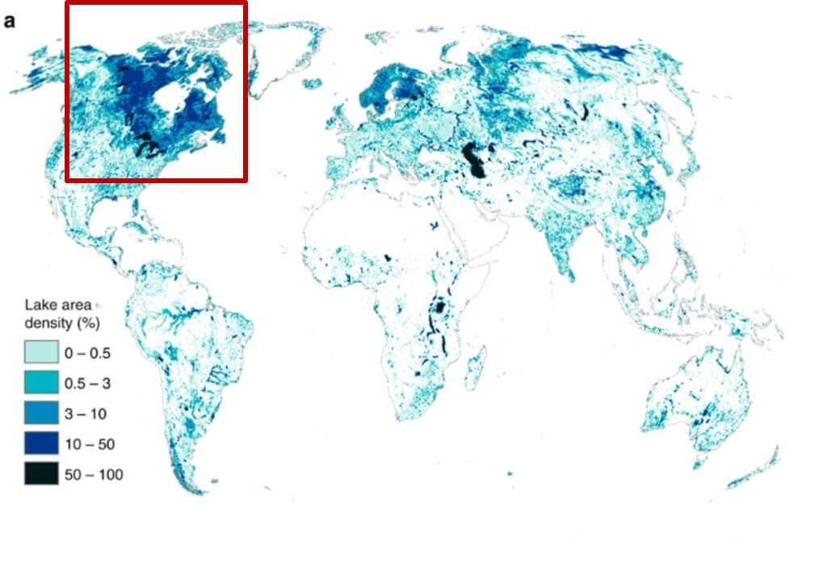
Why study the surface drainage pattern of the Canadian Shield?
Lake area density map
World’s highest lake density and many topographic depressions
Projected future wetter conditions may alter surface drainage pattern and increase hydrological connectivity
Overarching Research Question:
How may a future, wetter Arctic climate affect the surface drainage pattern of the Canadian Shield?
Source: Messager et. al, 2016

Slide 3
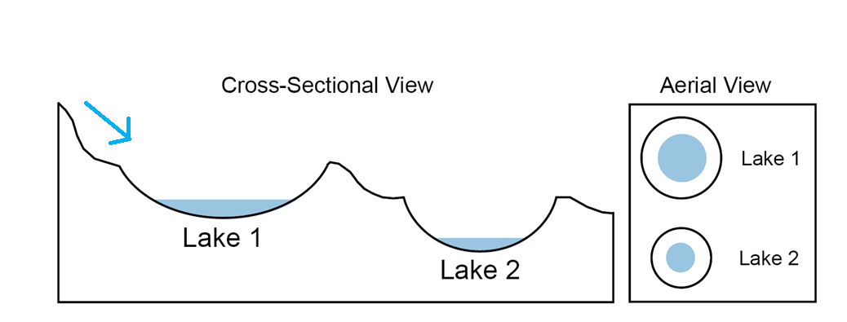
Fill-and-Spill hydrology
Canadian shield surface hydrology relies on “fill-and-spill” (Spence and Woo, 2003; 2006)
Fill-and-spill hydrology is a critical control on downstream flow patterns and river discharge

Slide 4
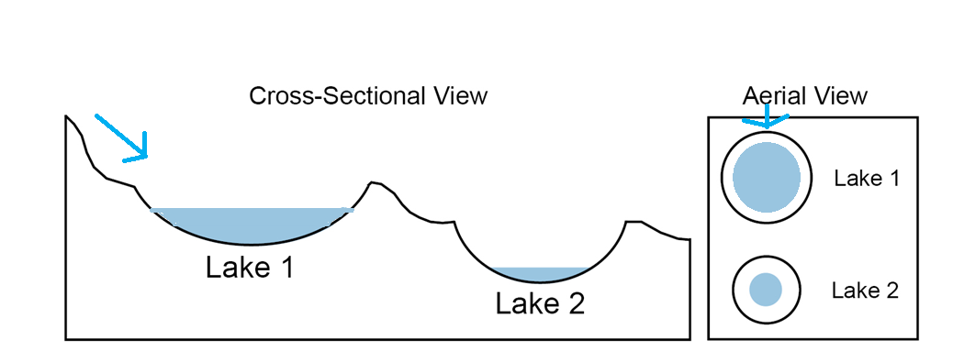
Fill-and-Spill hydrology
Canadian shield surface hydrology relies on “fill-and-spill” (Spence and Woo, 2003; 2006)
Fill-and-spill hydrology is a critical control on downstream flow patterns and river discharge

Slide 5
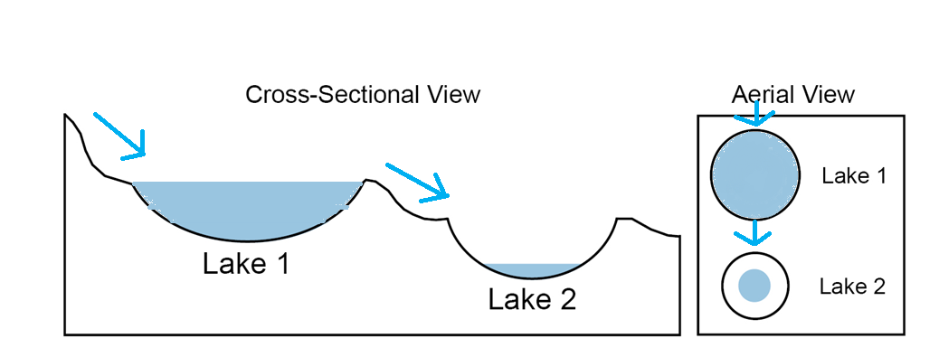
Fill-and-Spill hydrology
Canadian shield surface hydrology relies on “fill-and-spill” (Spence and Woo, 2003; 2006)
Fill-and-spill hydrology is a critical control on downstream flow patterns and river discharge

Slide 6
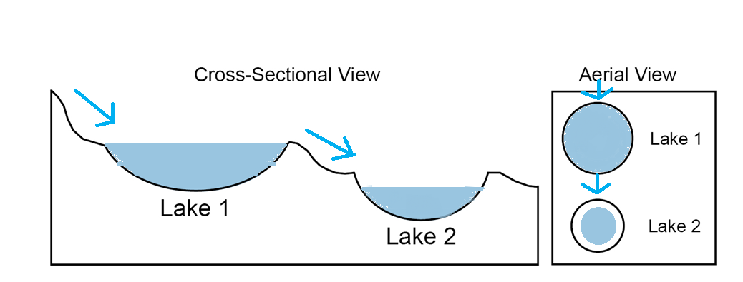
Fill-and-Spill hydrology
Canadian shield surface hydrology relies on “fill-and-spill” (Spence and Woo, 2003; 2006)
Fill-and-spill hydrology is a critical control on downstream flow patterns and river discharge

Slide 7
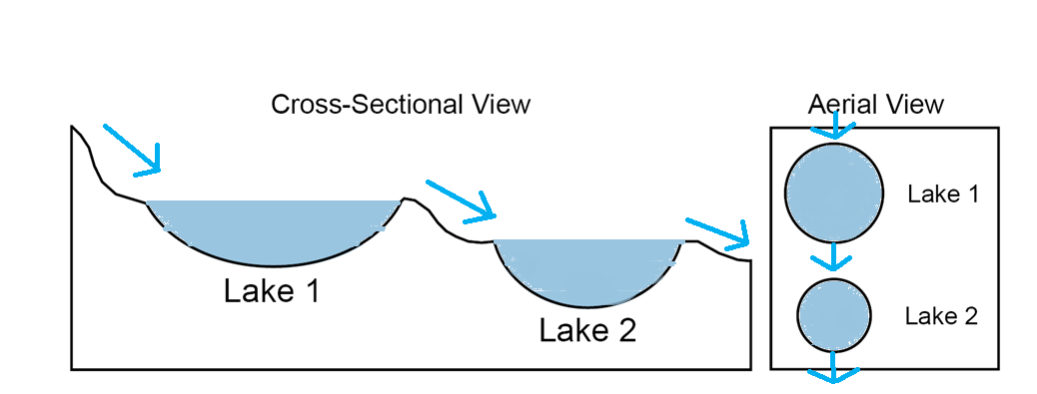
Fill-and-Spill hydrology
Canadian shield surface hydrology relies on “fill-and-spill” (Spence and Woo, 2003; 2006)
Fill-and-spill hydrology is a critical control on downstream flow patterns and river discharge

Slide 8
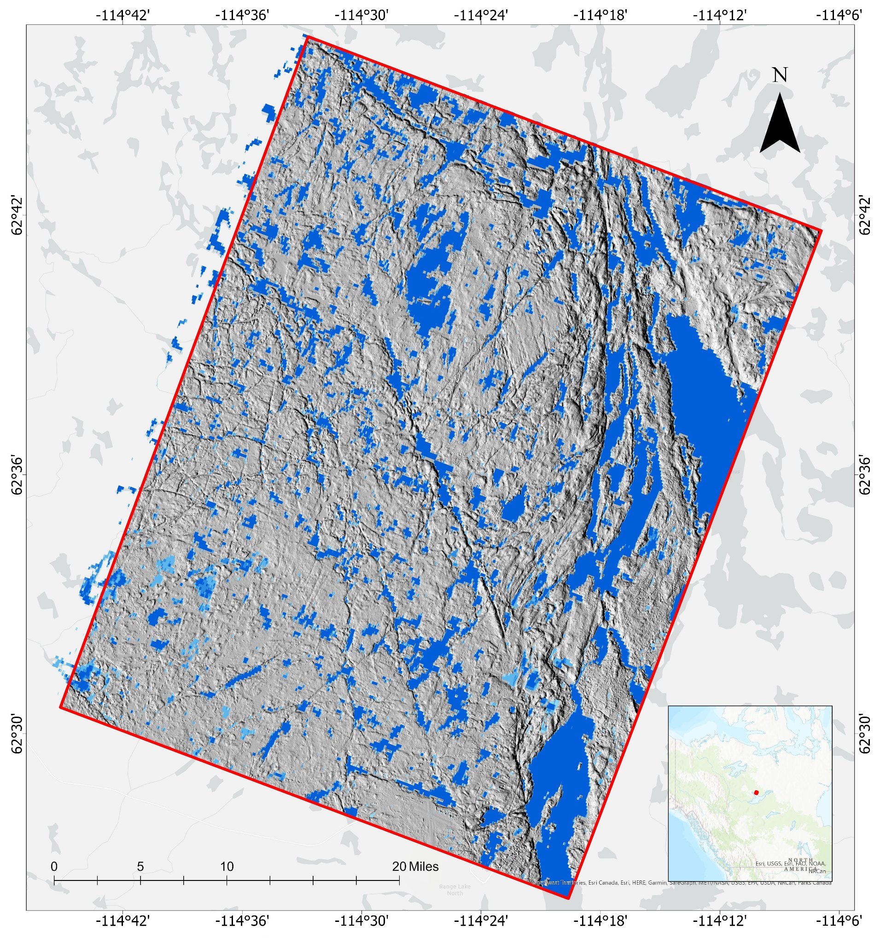
Initial work area: Baker Creek, N.W.T.
Located in the sub-Arctic Canadian Shield near Yellowknife, N.W.T.
Fill-and spill hydrology is well documented (e.g. Spence and Woo, 2003; 2006; Spence, 2018)
Well-imaged by high resolution DEMs (ArcticDEM)
Notes:
Large changes in topography, vegetation, winter snow accumulation, local hydrology and surficial geology over short distances result in abrupt transitions from permafrost to non-permafrost conditions.

Slide 9
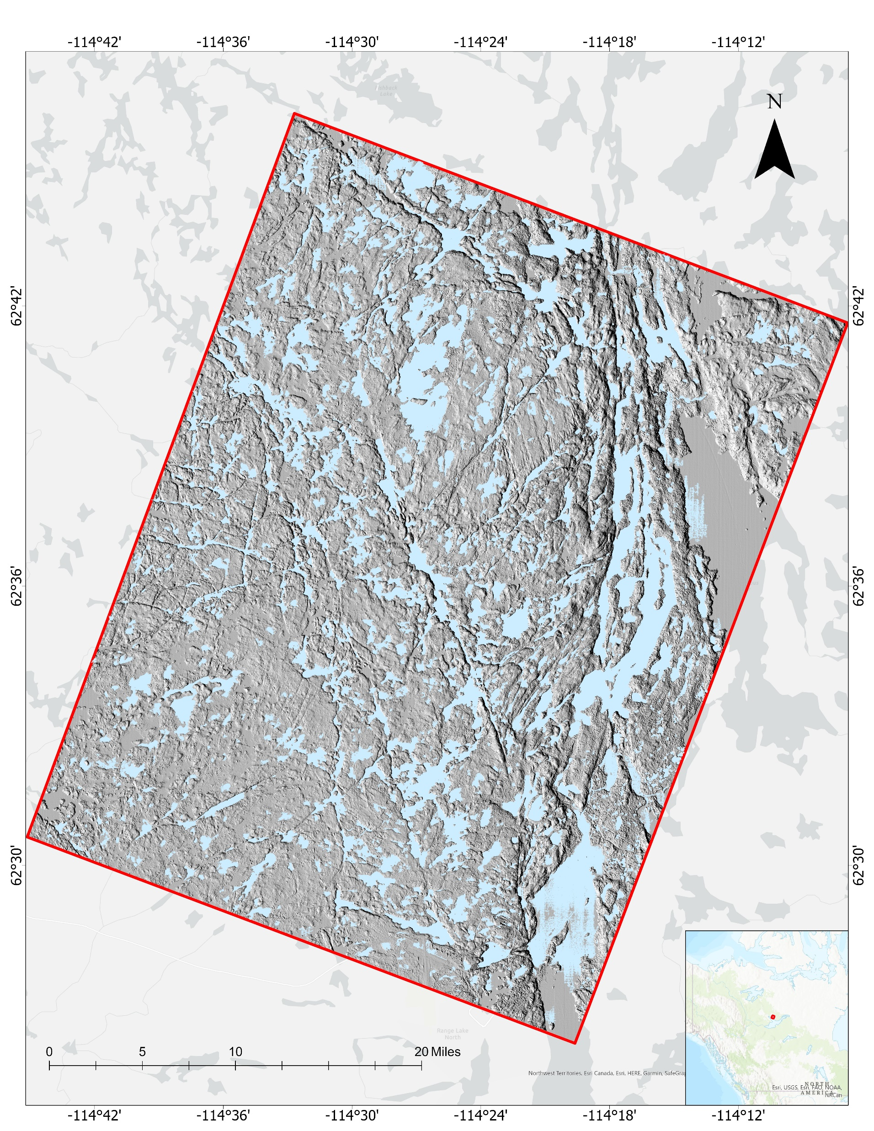
Methodology and data
Methods
Depression storage
Methods
Subtract filled ArcticDEM from Original ArcticDEM
Map drainage patterns for different inundation depths using least cost path
Determine relationship between landscape scale depression storage and assumed inundation depth

Slide 10
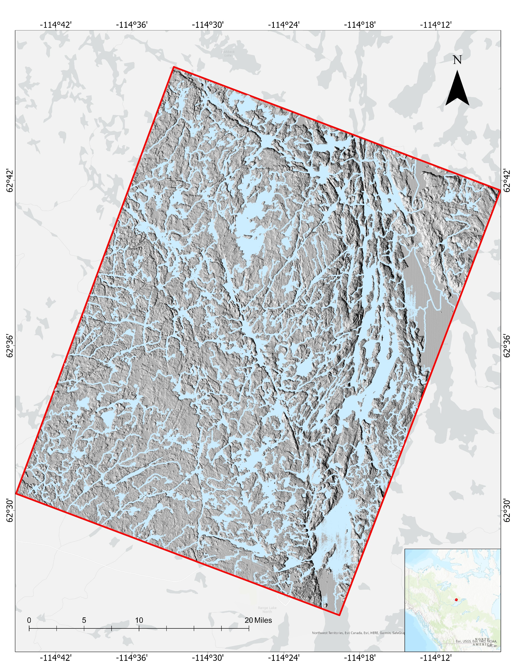
Methodology and data
Drainage pattern
Methods
Subtract filled ArcticDEM from Original ArcticDEM
Map drainage patterns for different inundation depths using least cost path
Determine relationship between landscape scale depression storage and assumed inundation depth

Slide 11
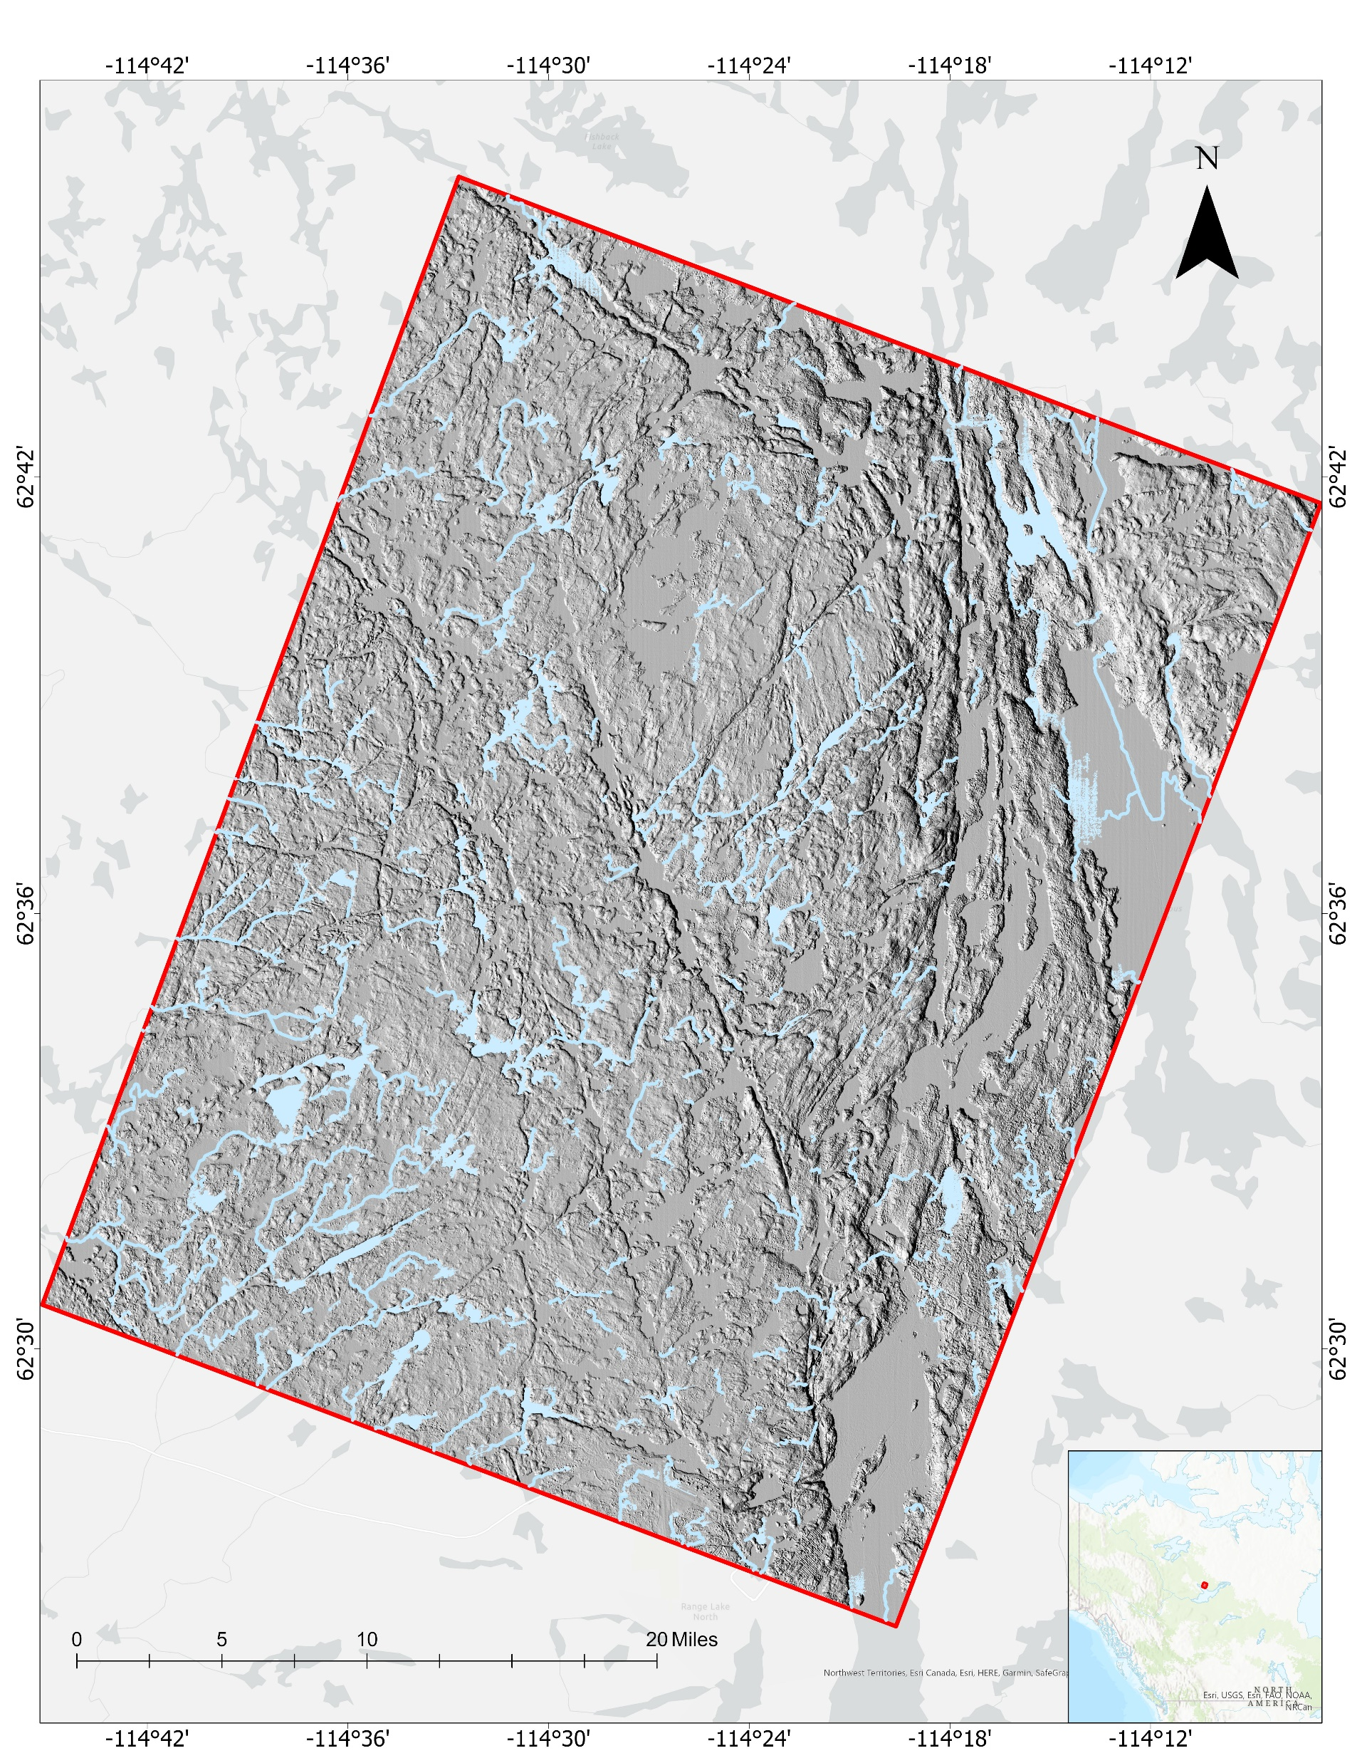
Results:
Inundation = +10 cm

Slide 12
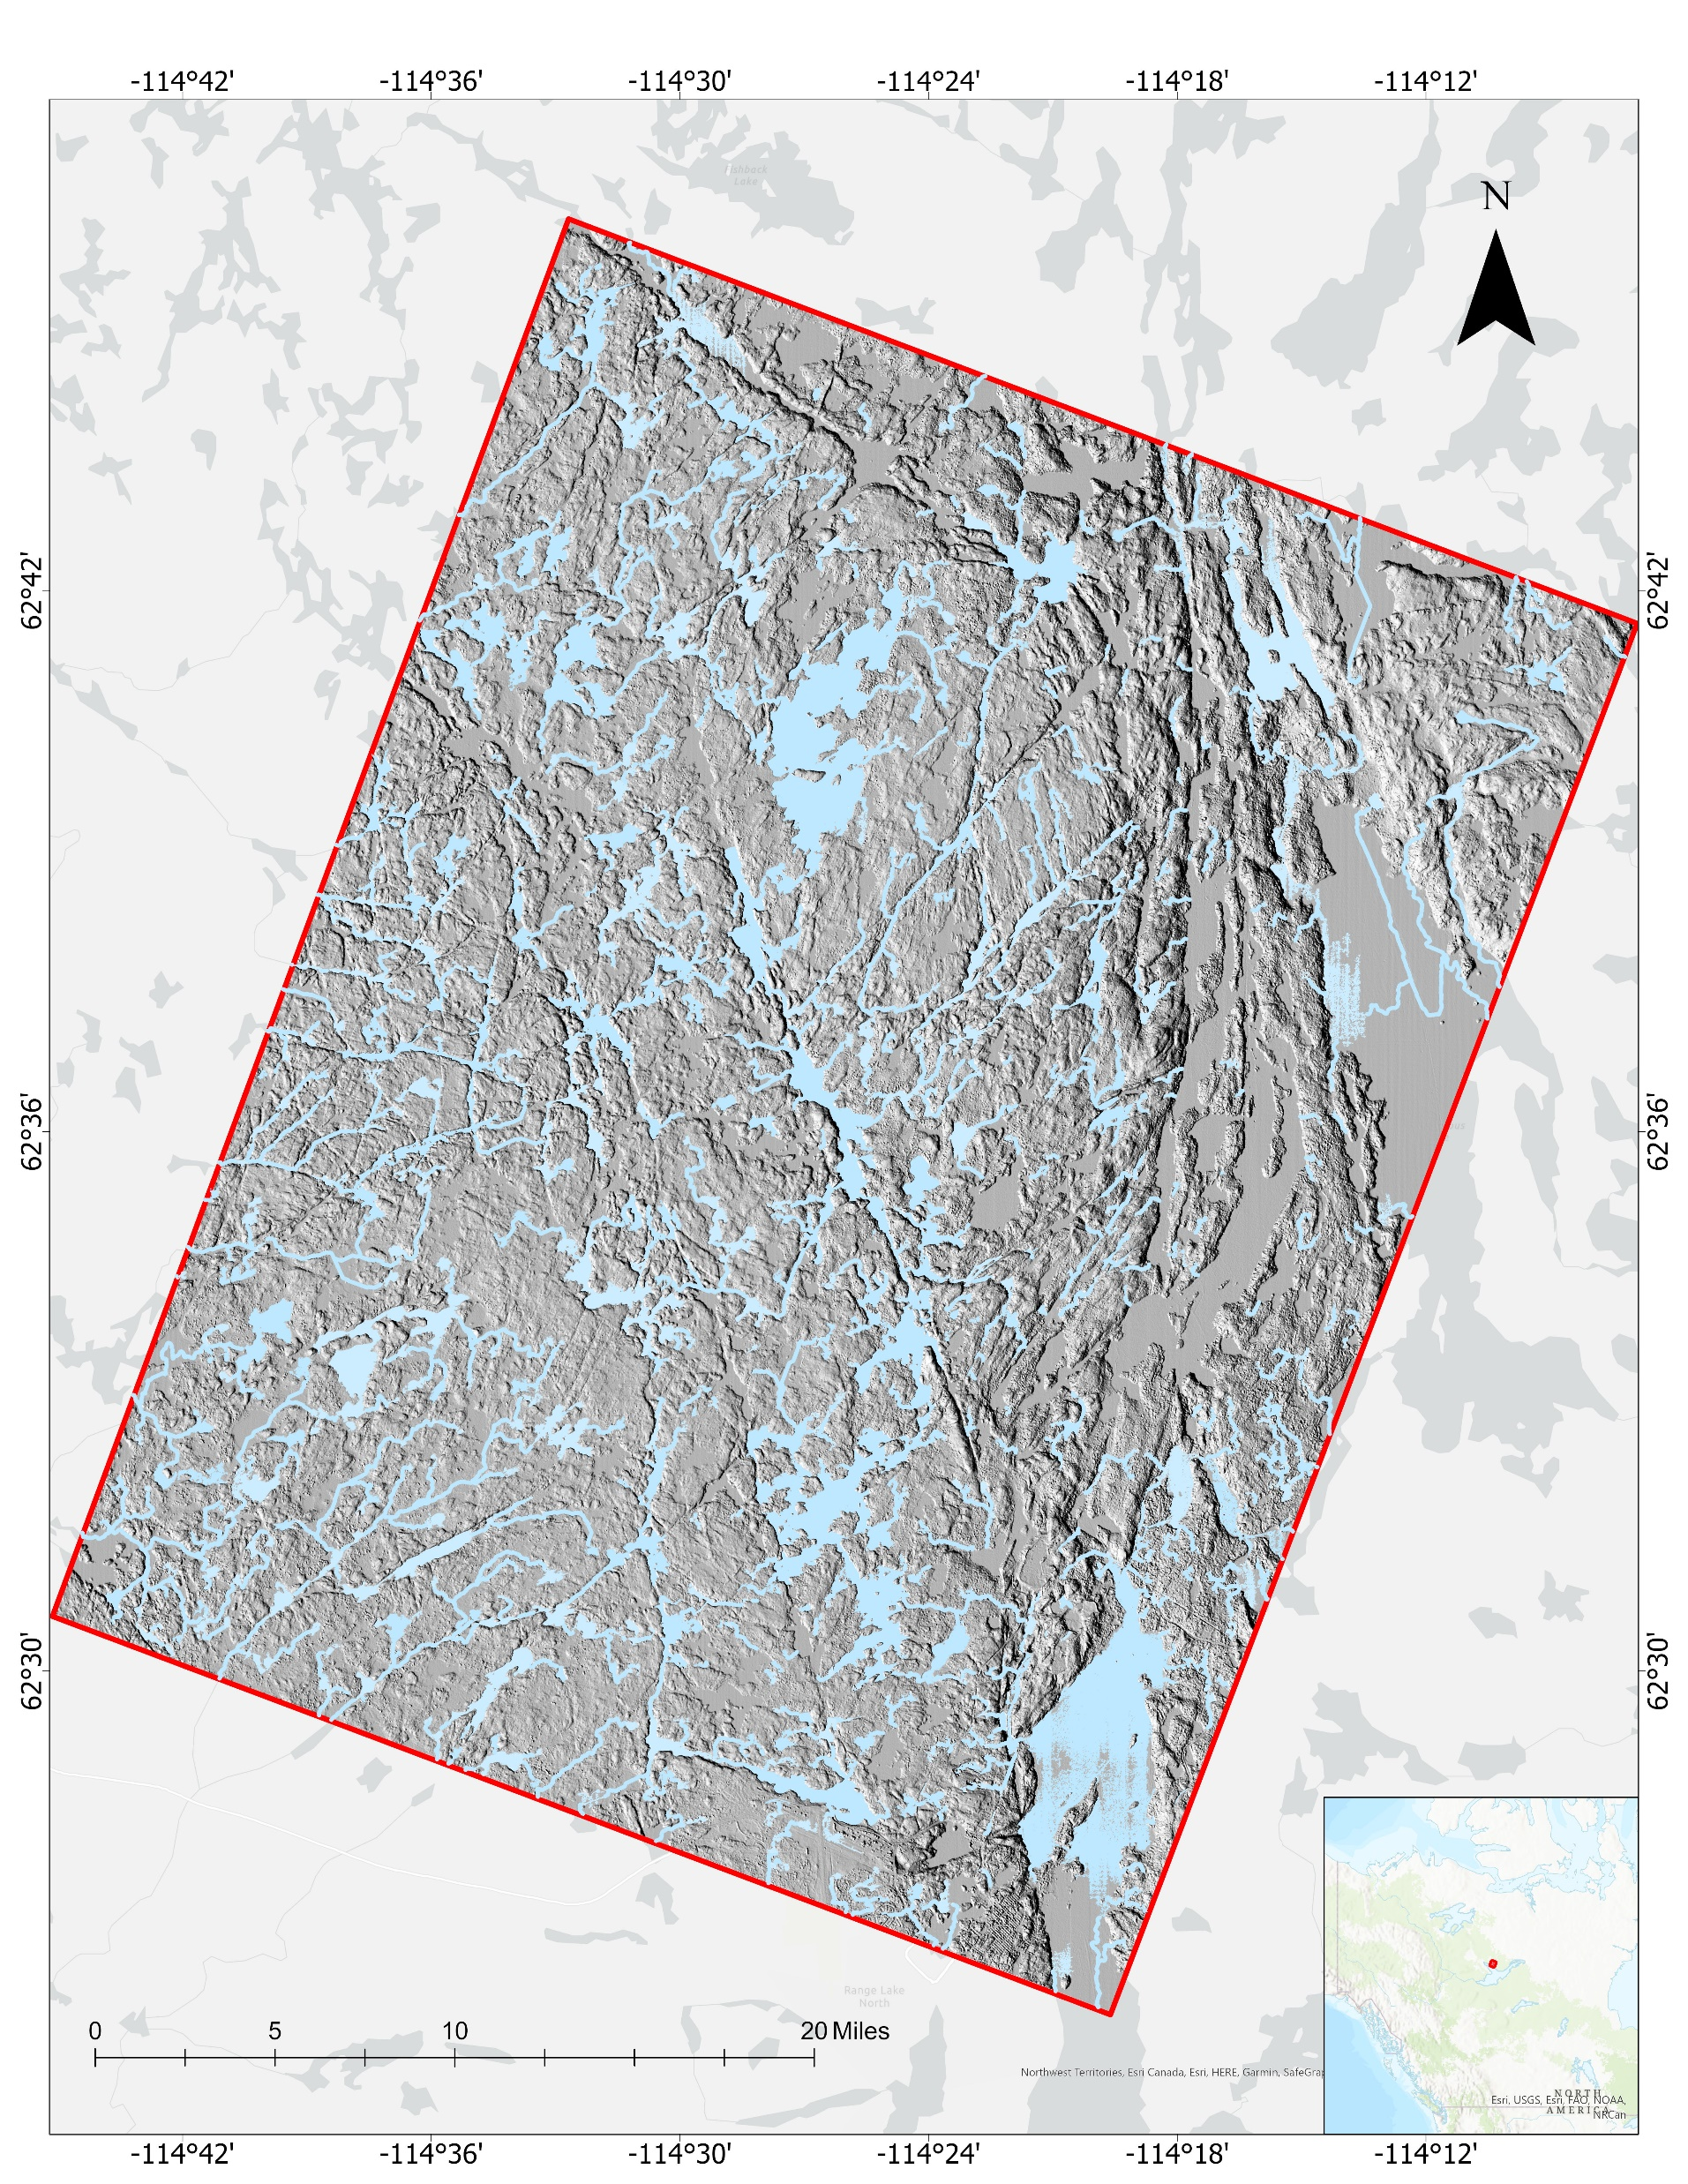
Results:
Inundation = +20 cm

Slide 13
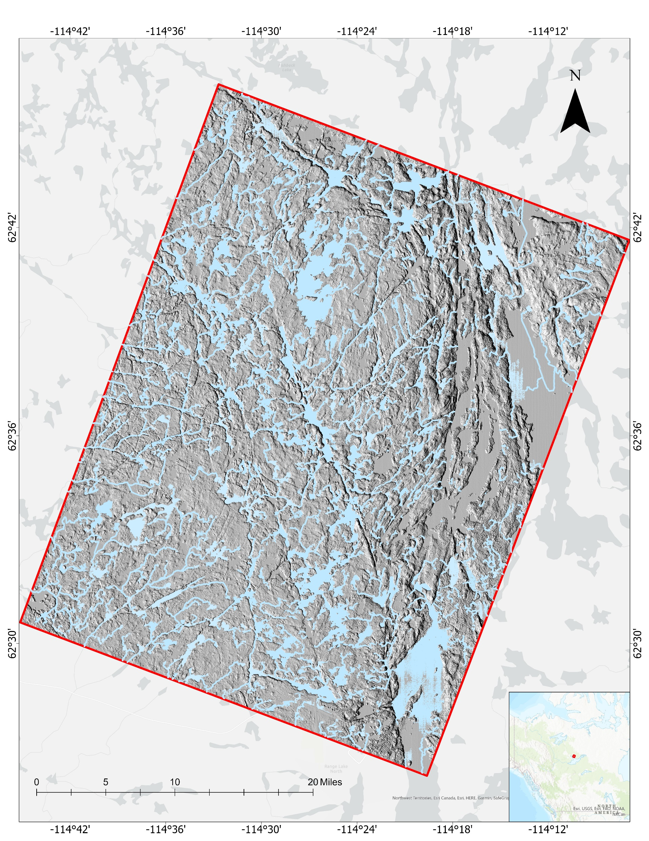
Results:
Inundation = +30 cm

Slide 14
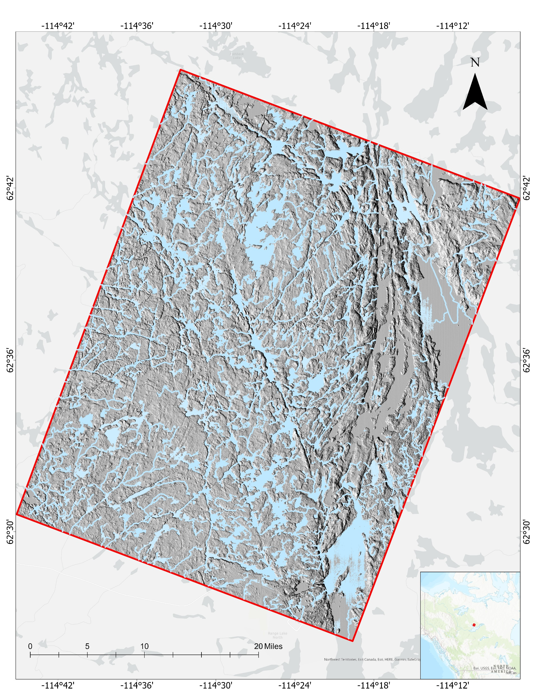
Results:
Inundation = +50 cm

Slide 15
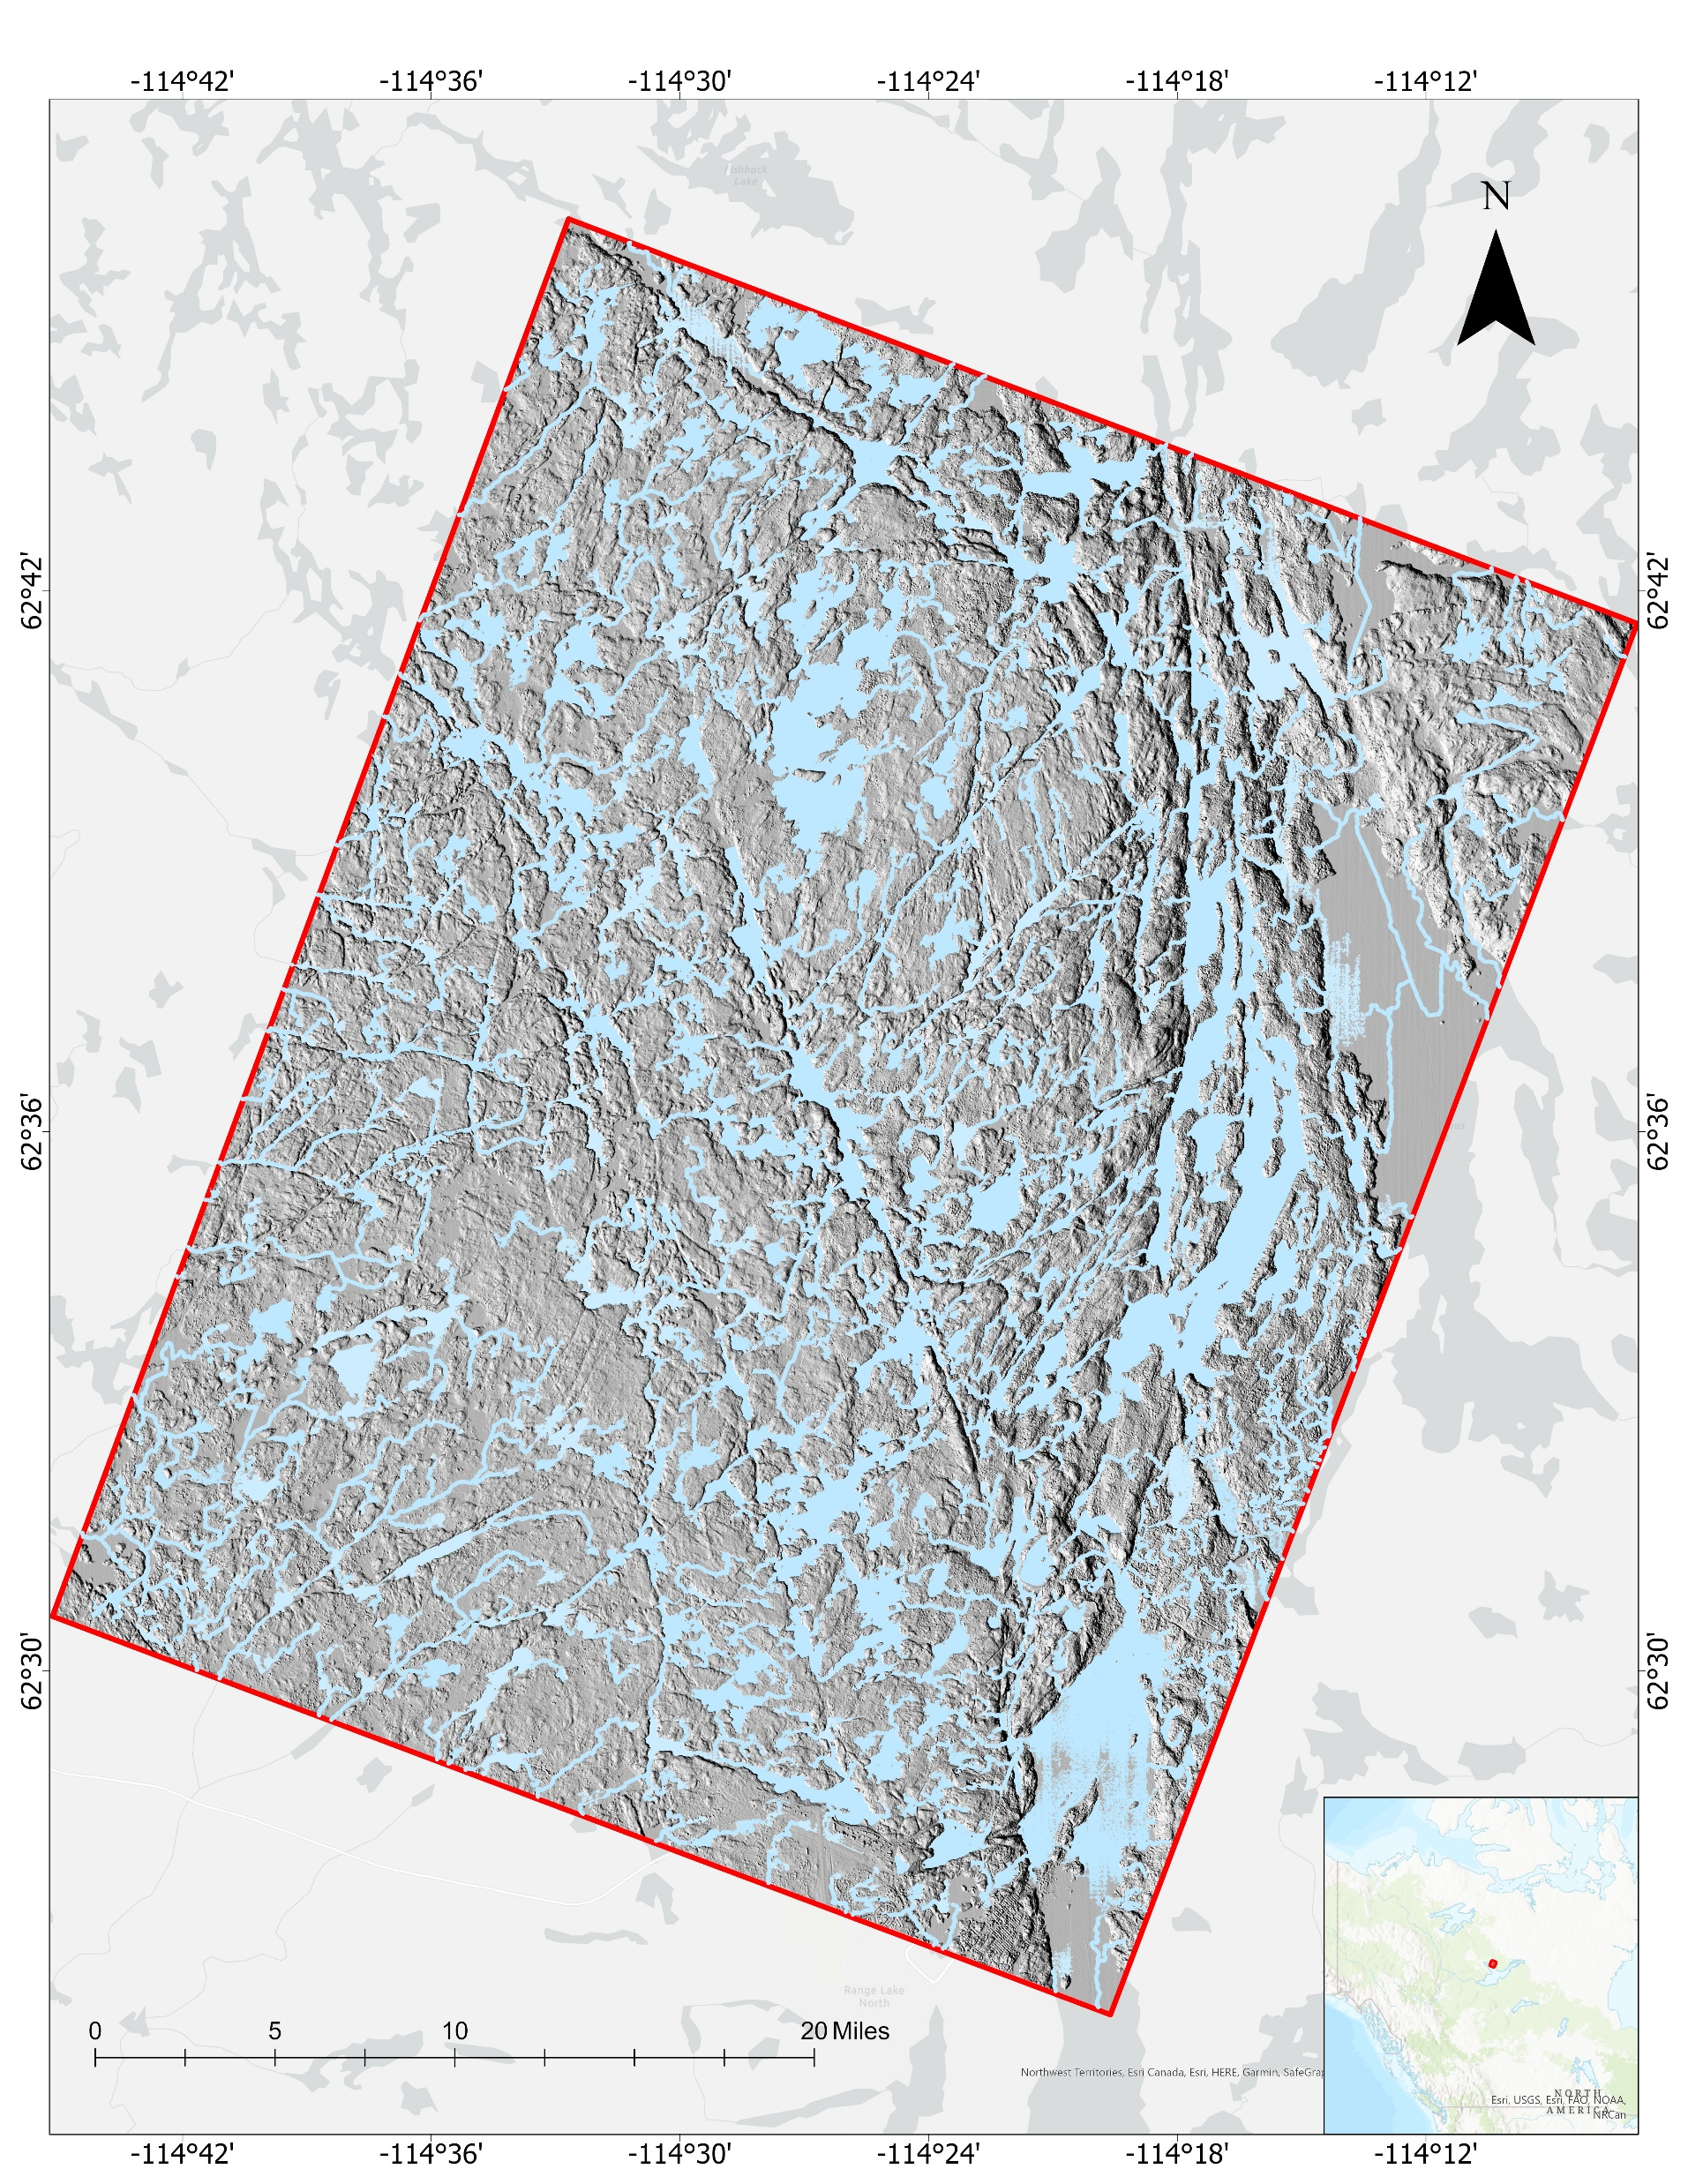
Results:
Inundation = +100 cm

Slide 16
Depression storage volumes and surface areas for different assumed inundation depths
Depression storage largely filled by~50 cm

Slide 17
Hydrological connectivity increases with inundation depth
Lake connectivity largely complete by~50 cm

Slide 18
Conclusions
Surface water drainage pattern of the Canadian Shield can be readily modelled using high resolution DEMs
Just ~20 cm increase in regional water balance would cause a 70 percent increase in the number of Baker Creek’s topographic depressions experiencing fill-and-spill hydrology. The number of interconnected lakes would increase by 835 (+70%)
A ~50 cm increase in regional water balance would cause almost 100 percent increase in the number of Baker Creek’s topographic depressions experiencing fill-and-spill hydrology. The number of interconnected lakes would increase by 1189 (+99%)
Many new streams would be formed but the overall drainage pattern is stable (up to +1 m inundation depth)
We conclude that Canadian Shield surface water depression storage and hydrological connectivity is highly sensitive to future changes in regional water balance
Future work will explore the potential sensitivity of CS drainage patterns to changing future water balance as projected by regional climate models
Funded by the NASA Terrestrial Hydrology Program grant 80NSSC20K0429
for questions contact nimisha_wagle@brown.edu

