Slide 1
Characterization and temporal analysis of
SAR-detected superseeps near Utqiaġvik, AK
Natalie Tyler¹, Melanie Engram¹, Hilary Nyström¹, Guido Grosse^{2,3}, and Katey Walter Anthony¹
¹ Water and Environmental Research Center, University of Alaska Fairbanks,
Fairbanks, AK, USA
² Alfred Wegener Institute Helmholtz Centre for Polar and Marine Research,
Permafrost Research Section, Potsdam, Germany
³ University of Potsdam, Institute of Geosciences, Potsdam, Germany

Slide 2
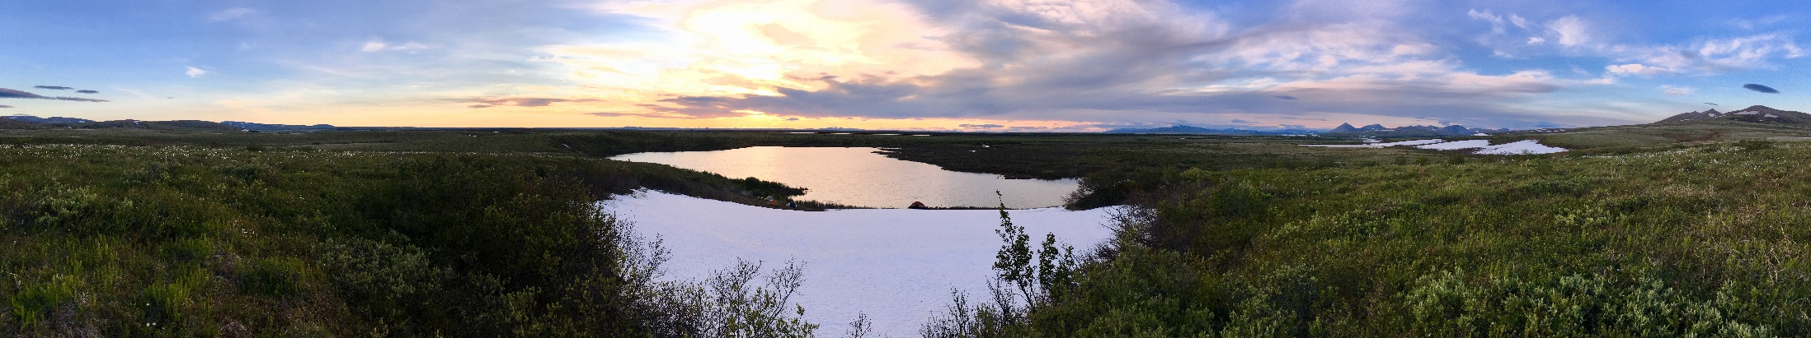
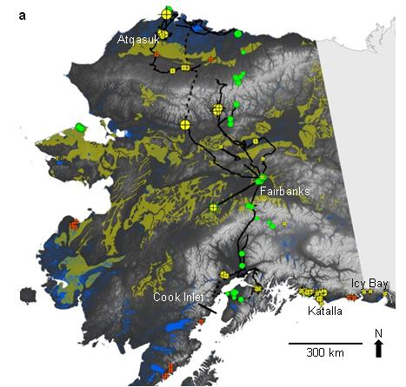
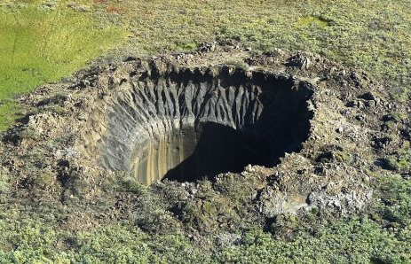
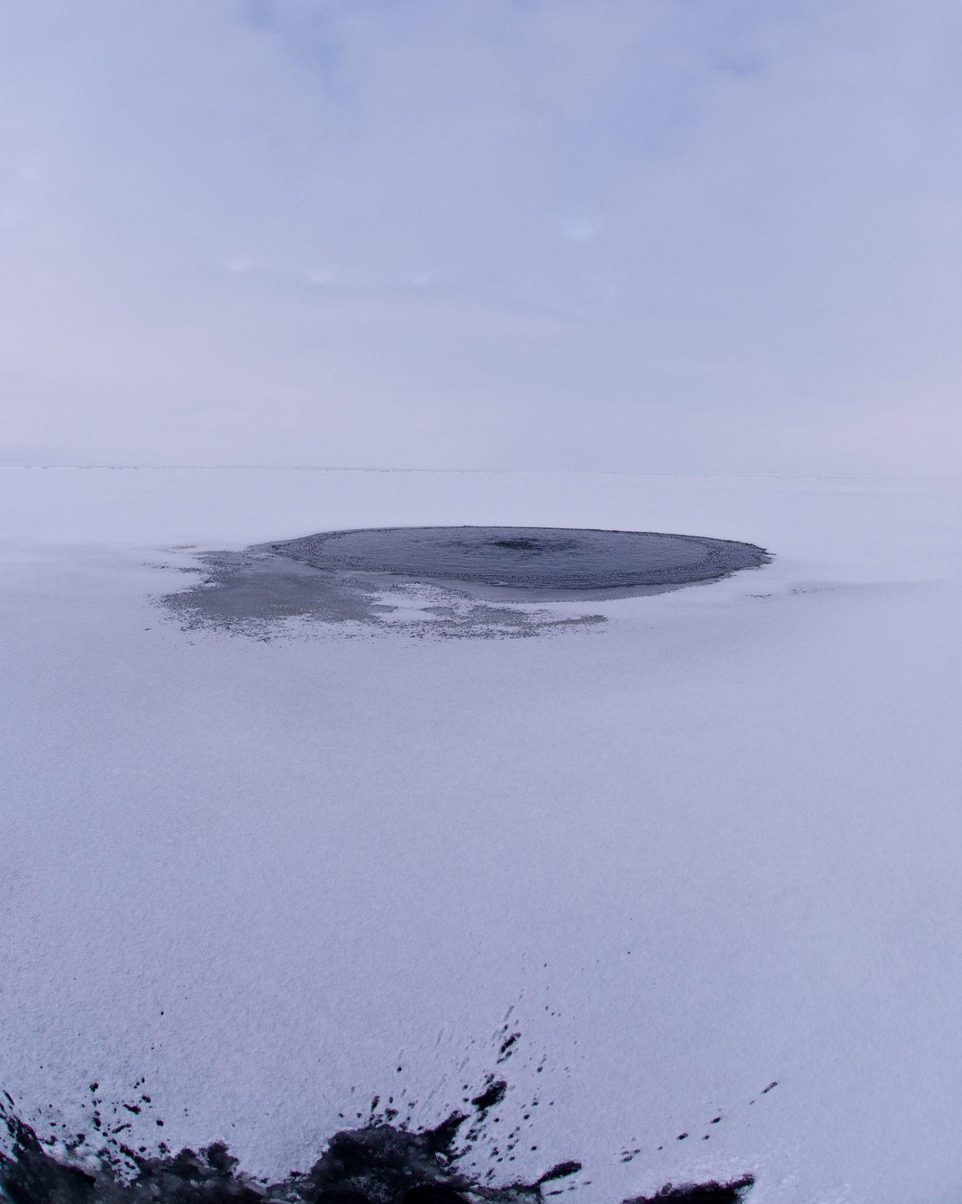
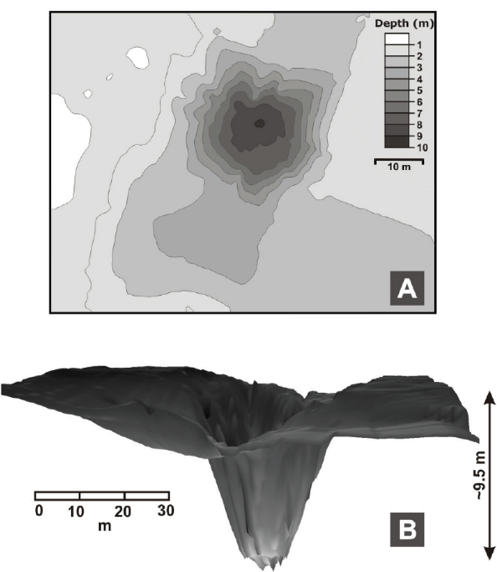
Methane hydrate & geologic CH₄ emissions
~2 Tg CH₄ yr⁻¹
Esieh L.
Vasily Bogoyavlensky | AFP | Aug. 25, 2014 Yamal Pen.
(Walter Anthony et al. 2012)
(Thalasso et al. 2020)
(Sullivan et al., 2021)
11 tons CH₄ d⁻¹
800 household energy needs
(Bowen et al. 2008)

Slide 3
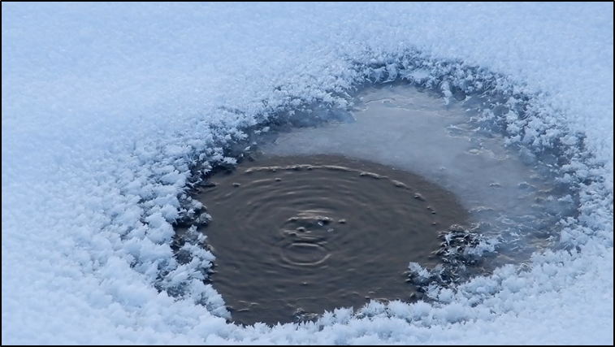
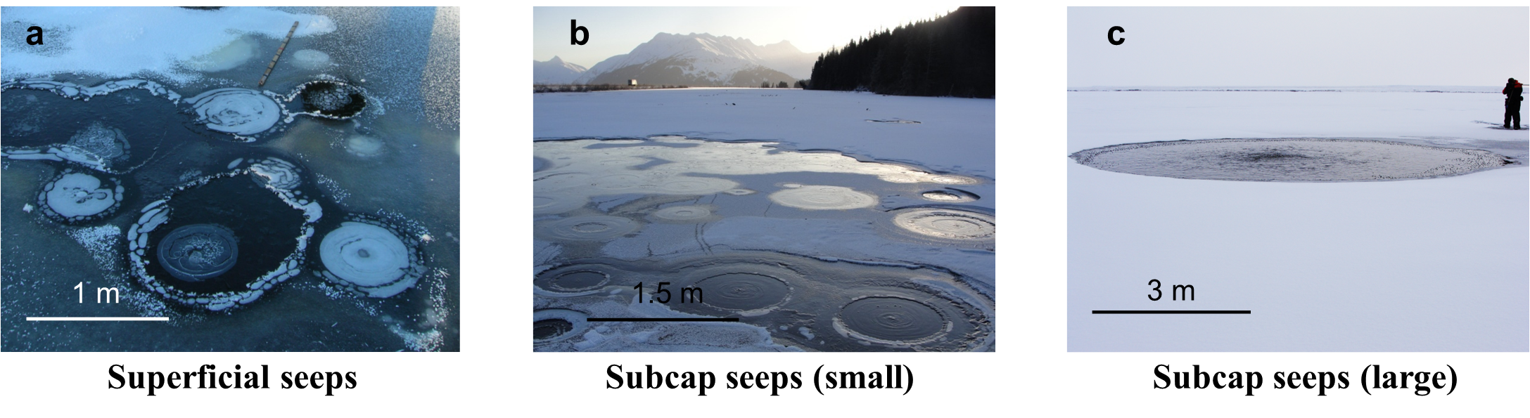
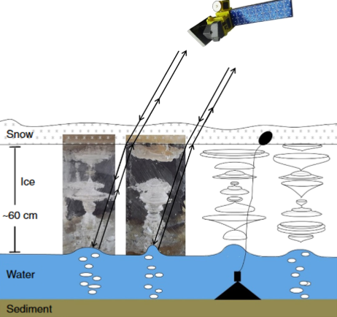
Background
Sukok Lake – Utqiaġvik
(Walter Anthony et al., 2012)
(Engram et al., 2020)
Lake Qalluuraq – Atqasuk
Methane produced by microbes in lake sediments is quantifiable with SAR.
Seep bubbles trapped in winter lake ice create high backscatter.
However, this approach did not target larger seeps associated with geologic methane sources (ex. hydrocarbons, coal bed methane).
3 m
(Walter Anthony et al., 2012)

Slide 4
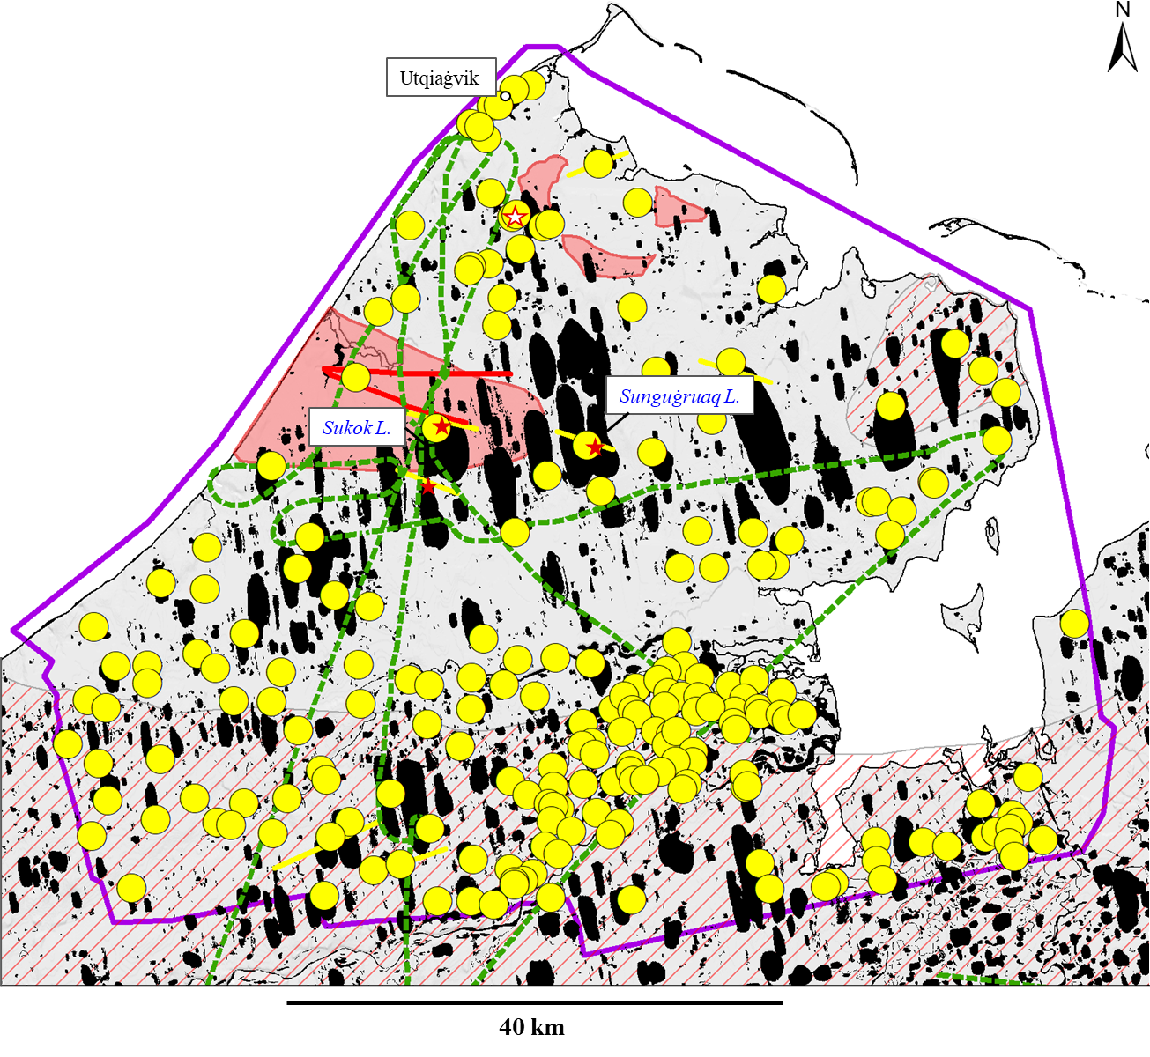
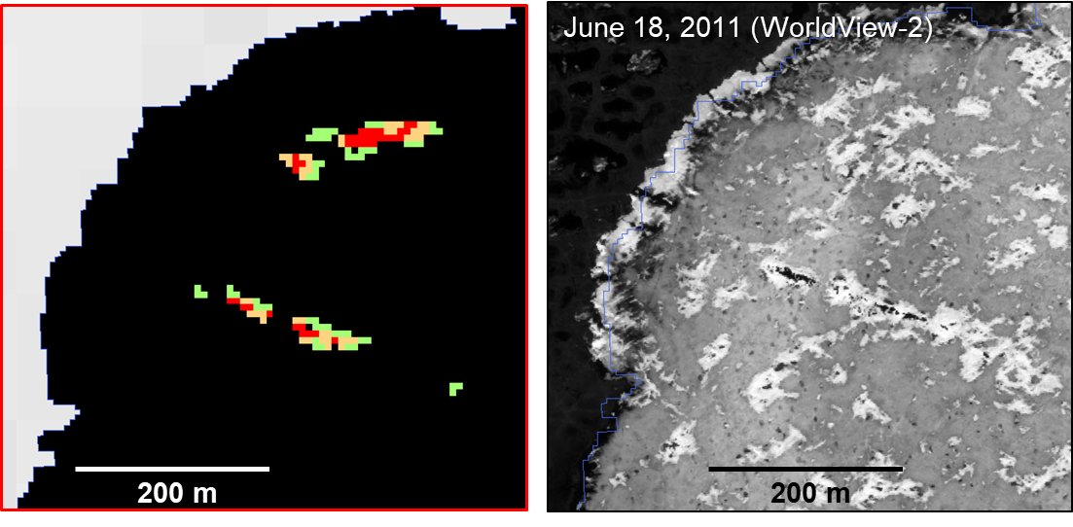
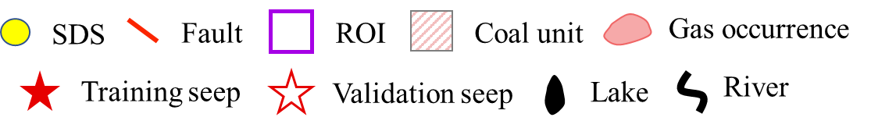
Background
L-Band SAR product
In the Utqiaġvik region, we detected 209 high-confidence SAR-detected potential superseep (SDS) sites.
… are they new?

Slide 5
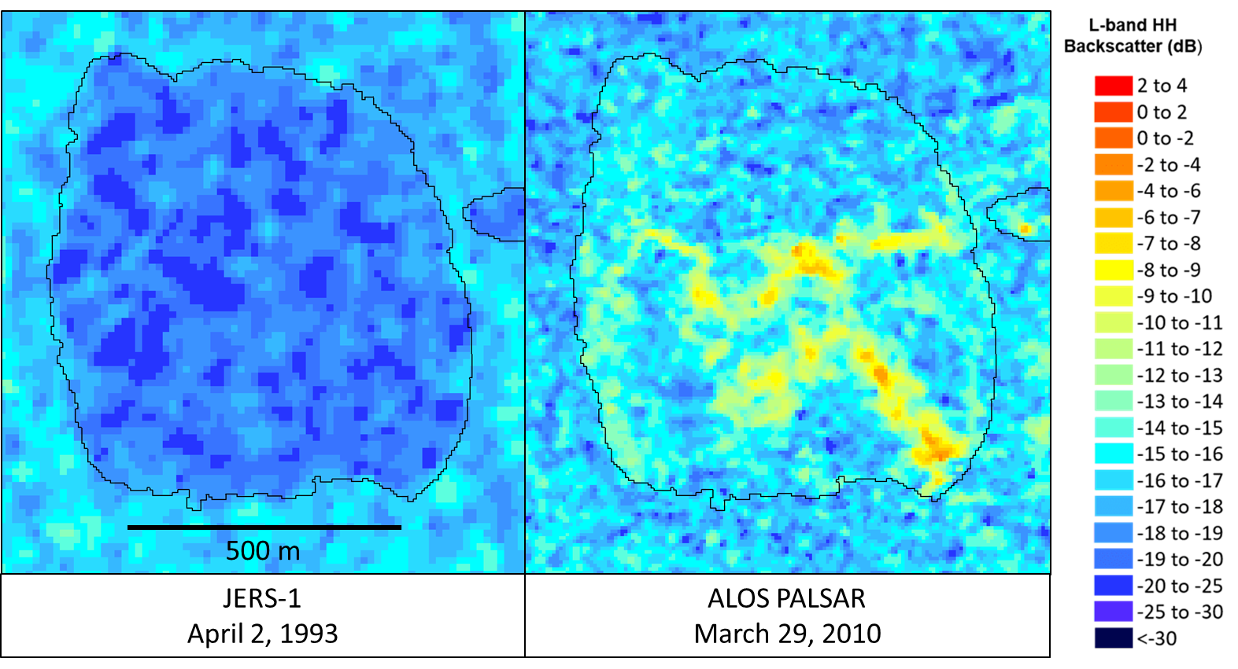
Historical analysis
Gull Lake
Seep
Some SDS visible in newer SAR imagery (2006-2011), but not in older SAR imagery (1992-1998).

Slide 6
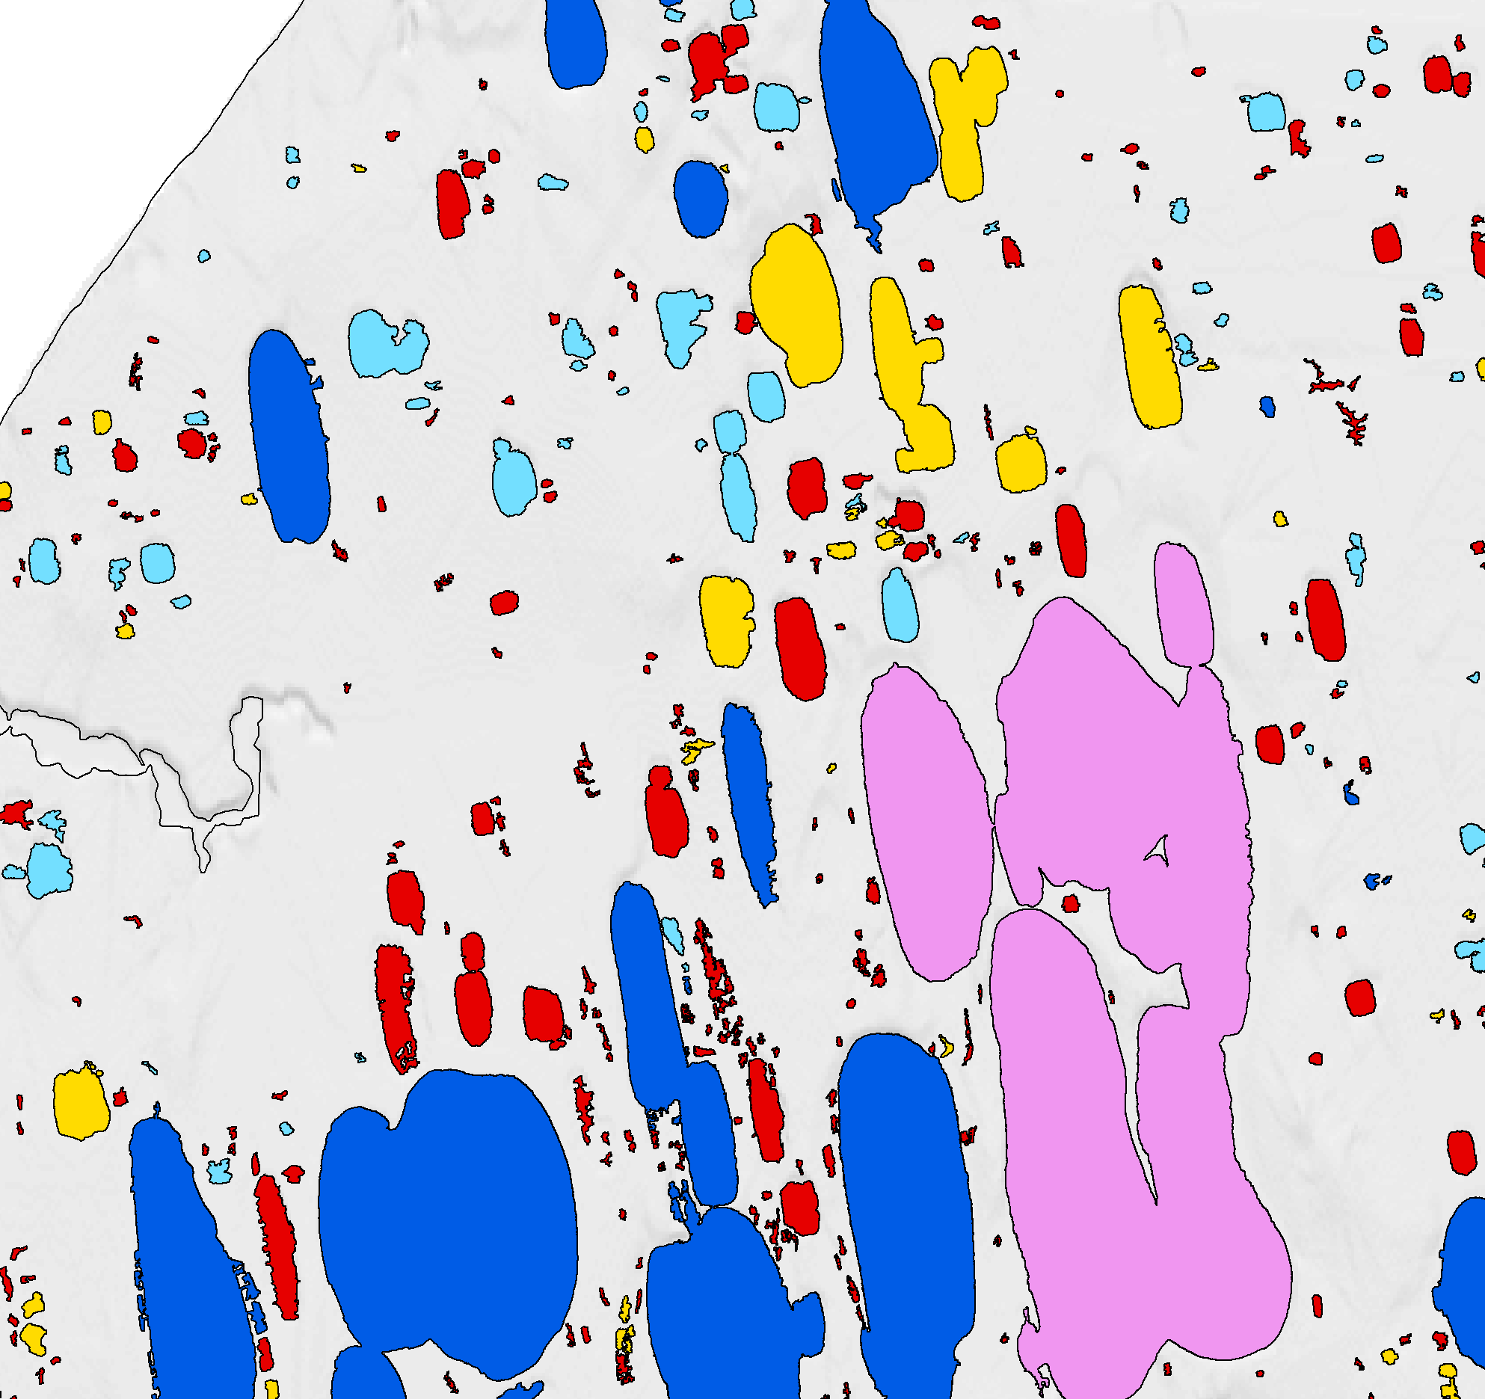
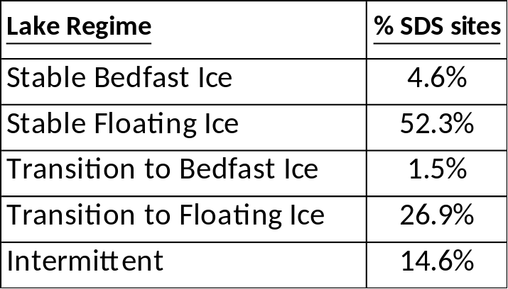
Historical analysis
BI
FI
TRANS-FI
TRANS-BI
INT
Majority of SDS sites located within lakes with stable floating ice or lakes that transitioned to floating ice.
(Engram et al., 2018)

Slide 7
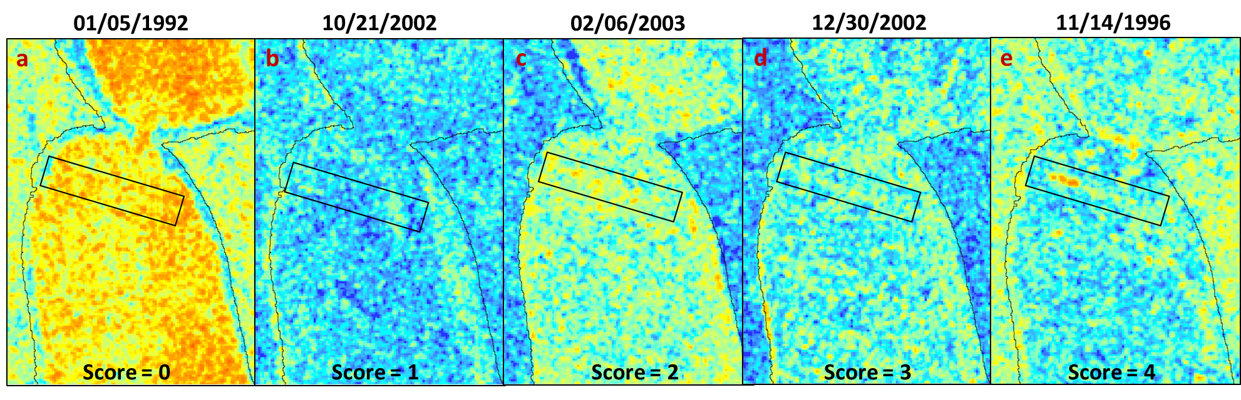
Moving forward
Manual visual analysis of C-band SAR throughout ice covers.
Assign score for SDS in each scene based on visibility.
C-band VV
Backscatter (dB)

Slide 8
Conclusion
Hundreds of potential superseeps have been detected with SAR, some of which were confirmed via field work and optical remote sensing.
Pilot study results have shown that some of these superseeps may be new and associated with talik development due to changes in lake ice regimes.
Future/ongoing efforts will focus on characterization and classification of superseep types and exploring the use of C-band as a co-temporal confirmation tool with L-band SAR.

Slide 9
Thank you!
Funding
NASA ABoVE NNH18ZDA001N-TE. PI K. Walter Anthony (JPL P.I. Charles Miller). “Characterizing Microtopographic Hot-spots and
Landscape-scale Methane Emissions Across the ABoVE Domain"
NASA FINESST 80NSSC21K1595 (P.I. Katey Walter Anthony, F.I. Natalie Tyler) “Remote sensing methane superseeps in Alaska"

