Slide 1
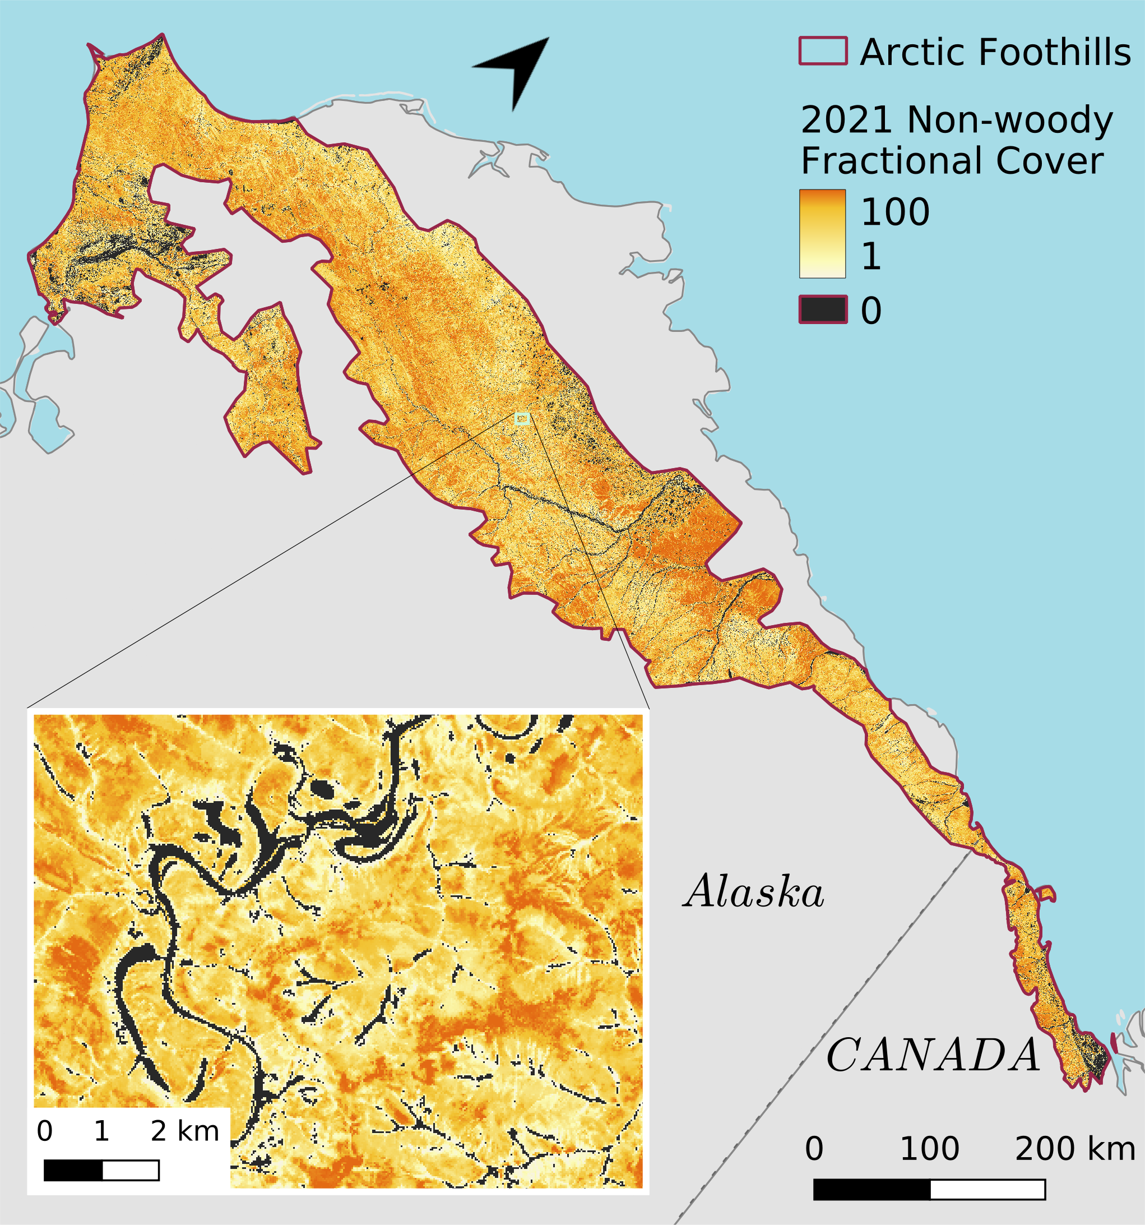
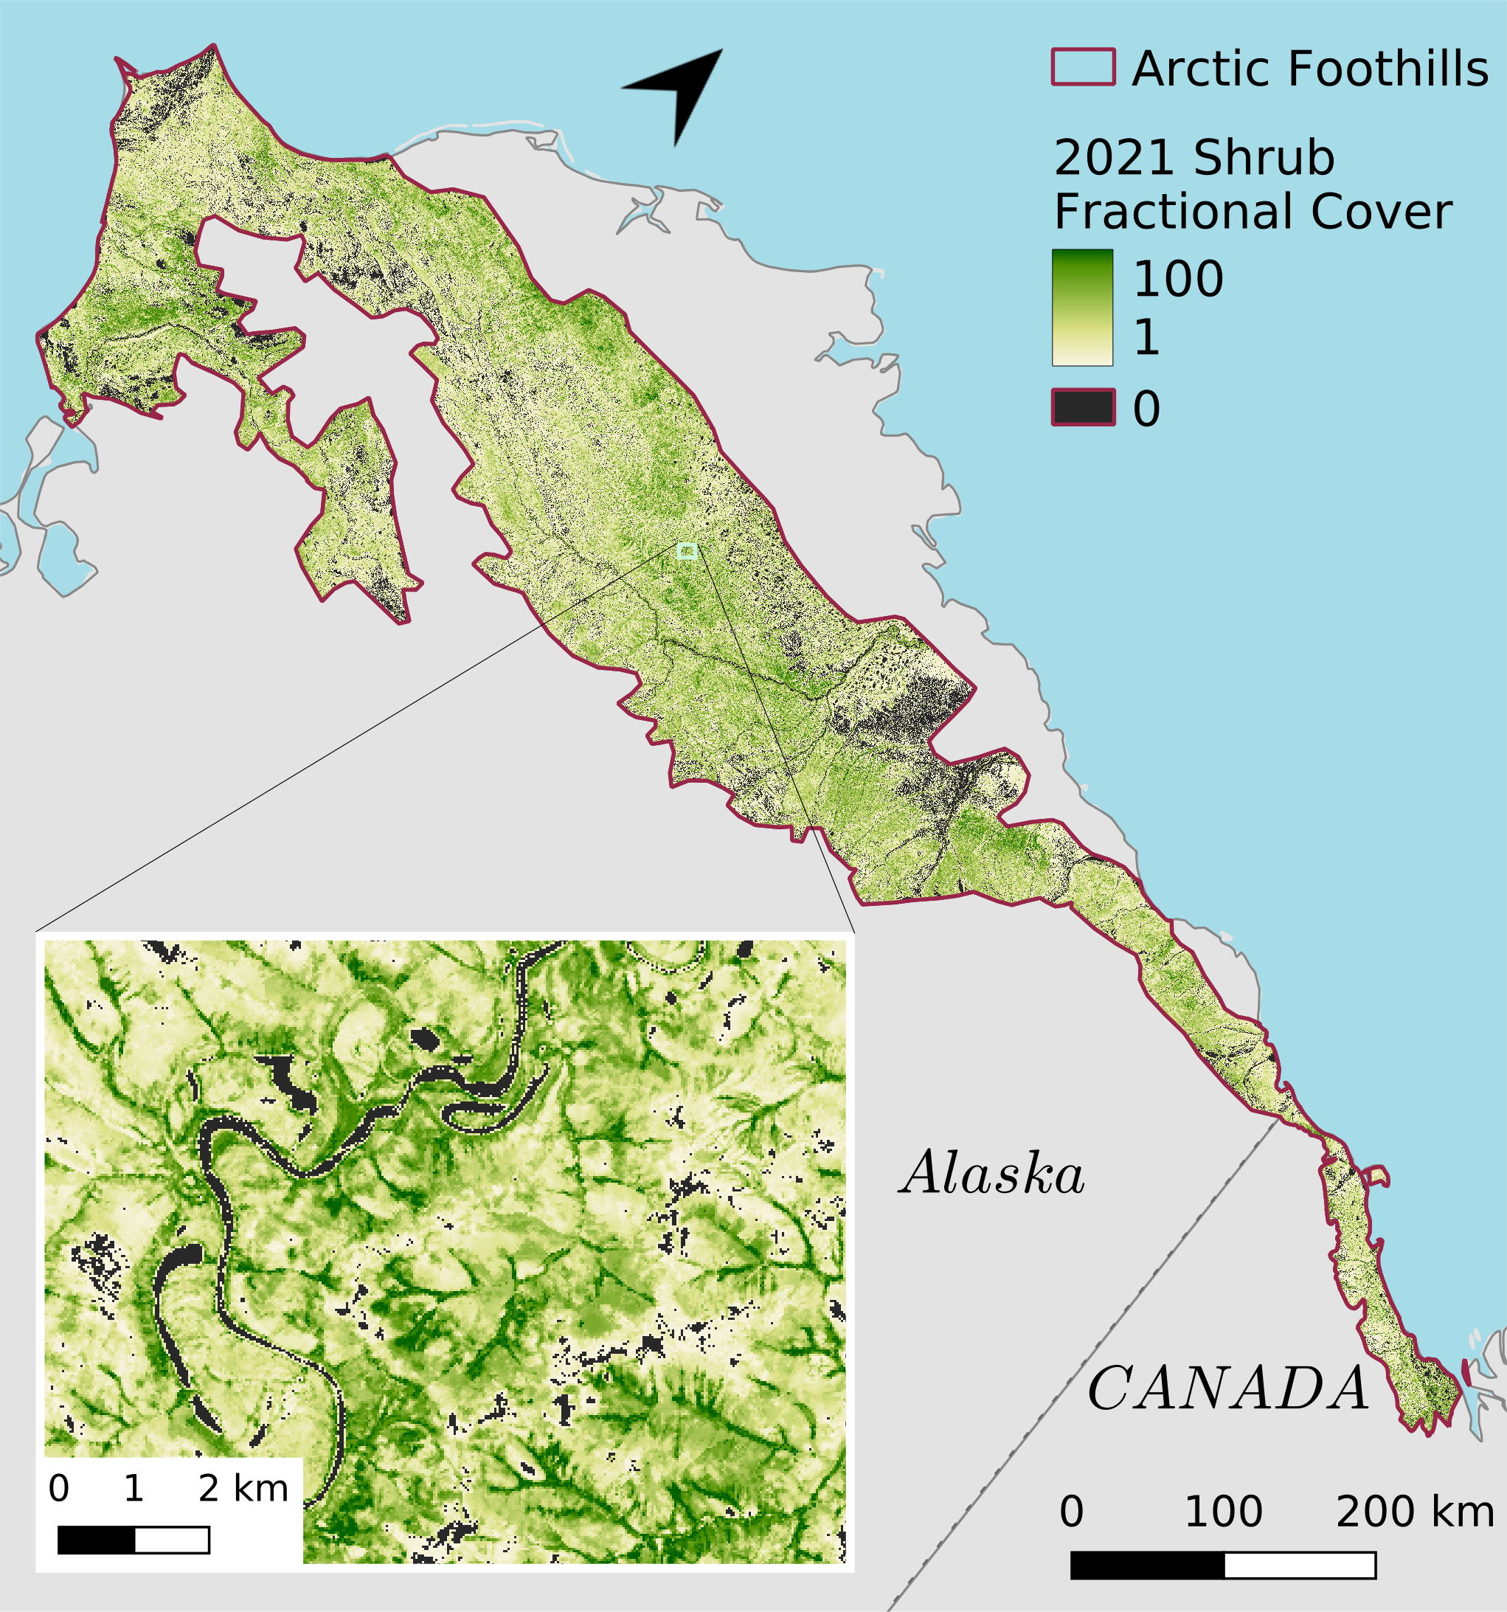
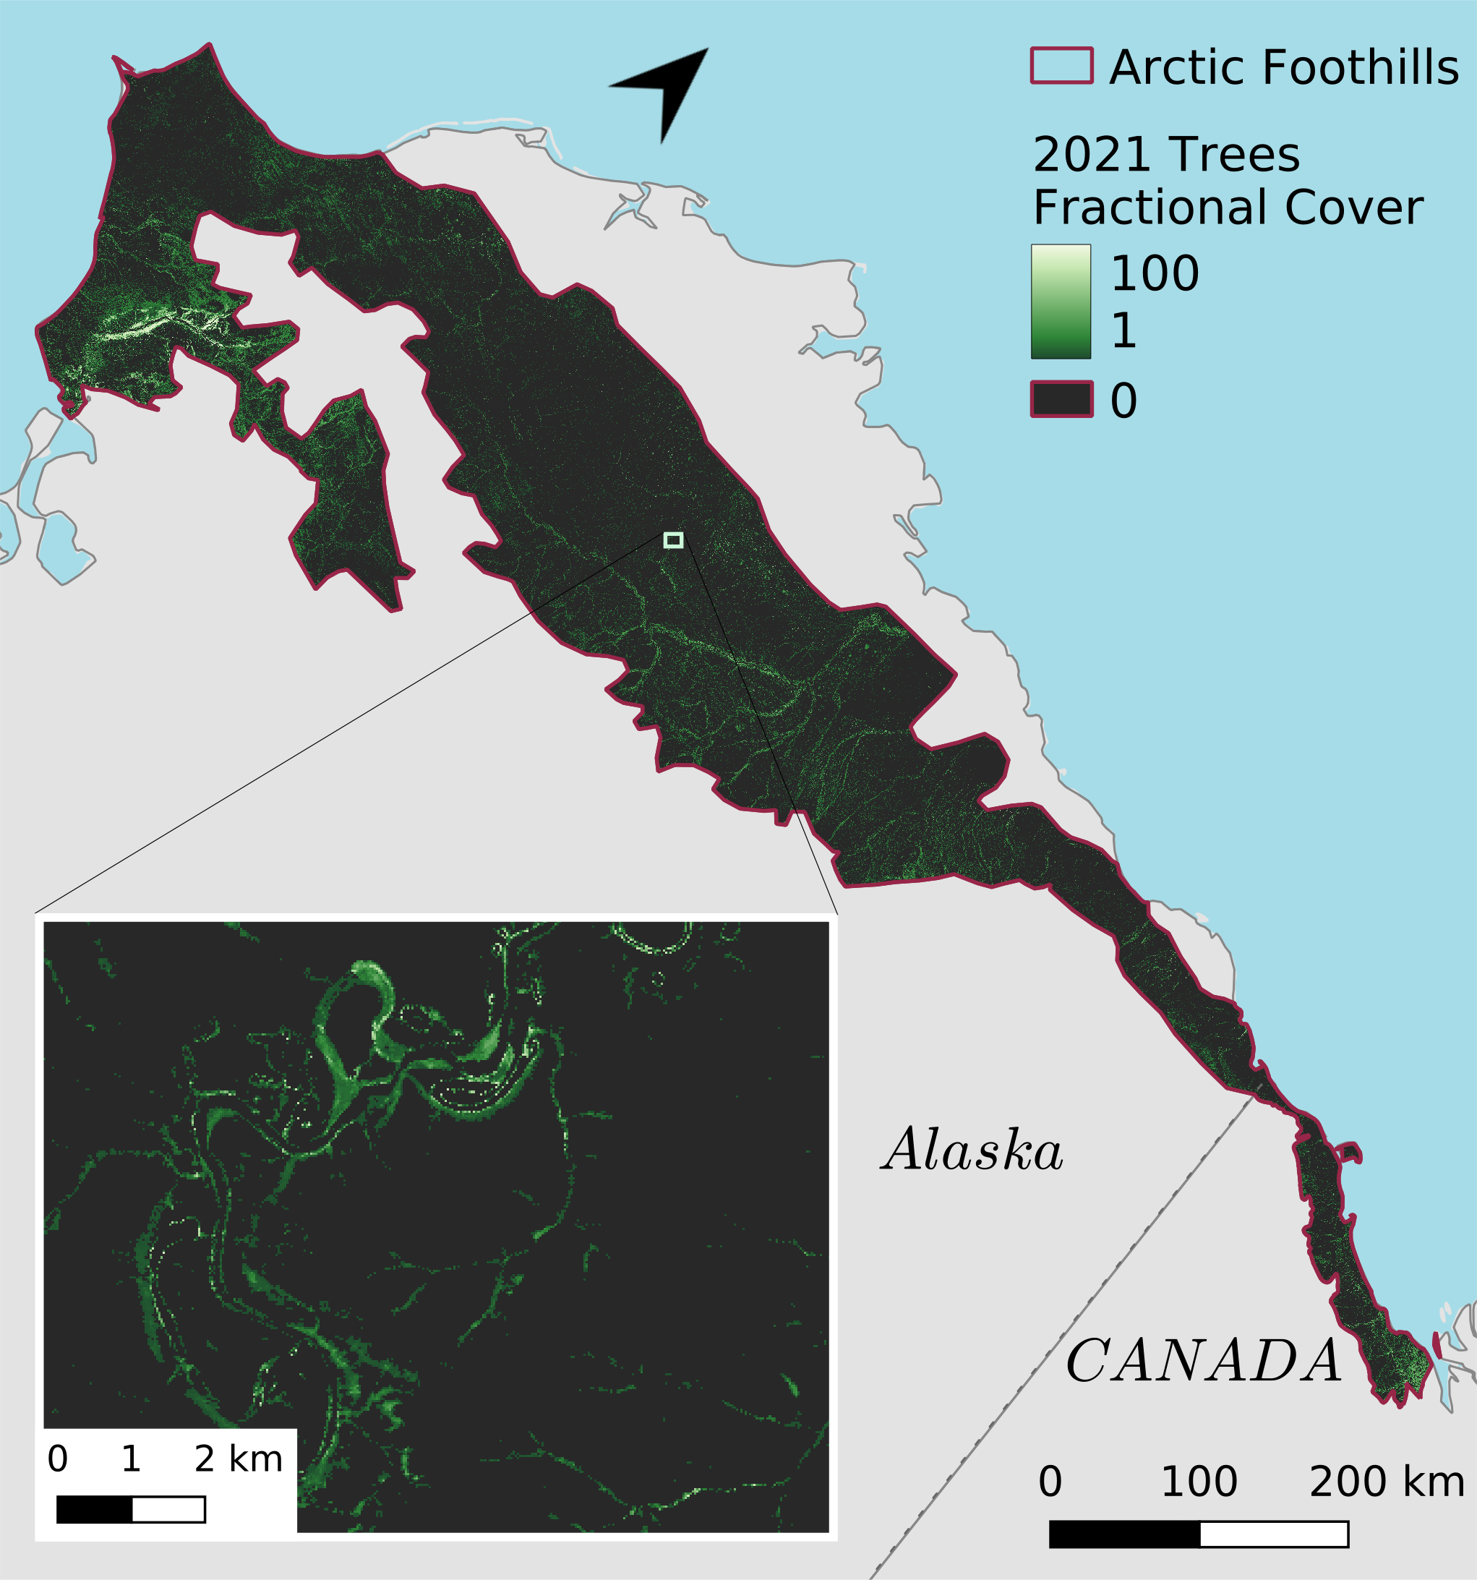
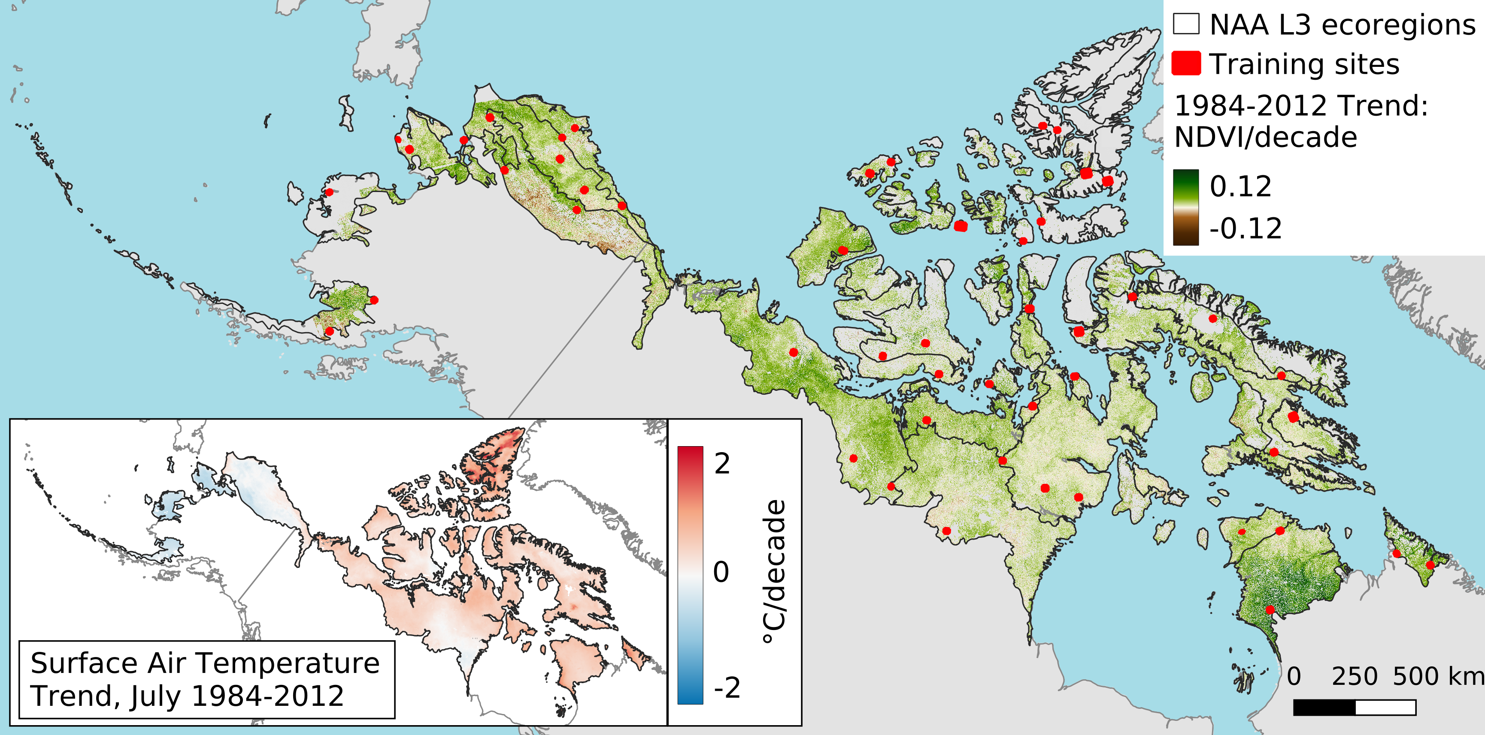
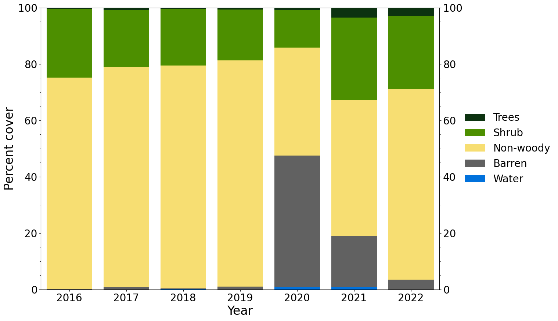
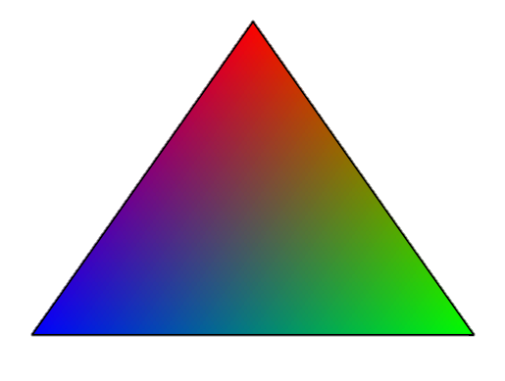
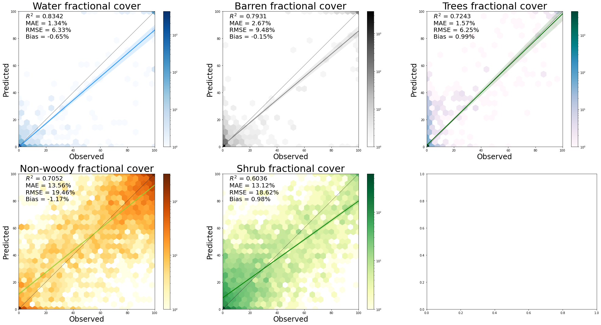
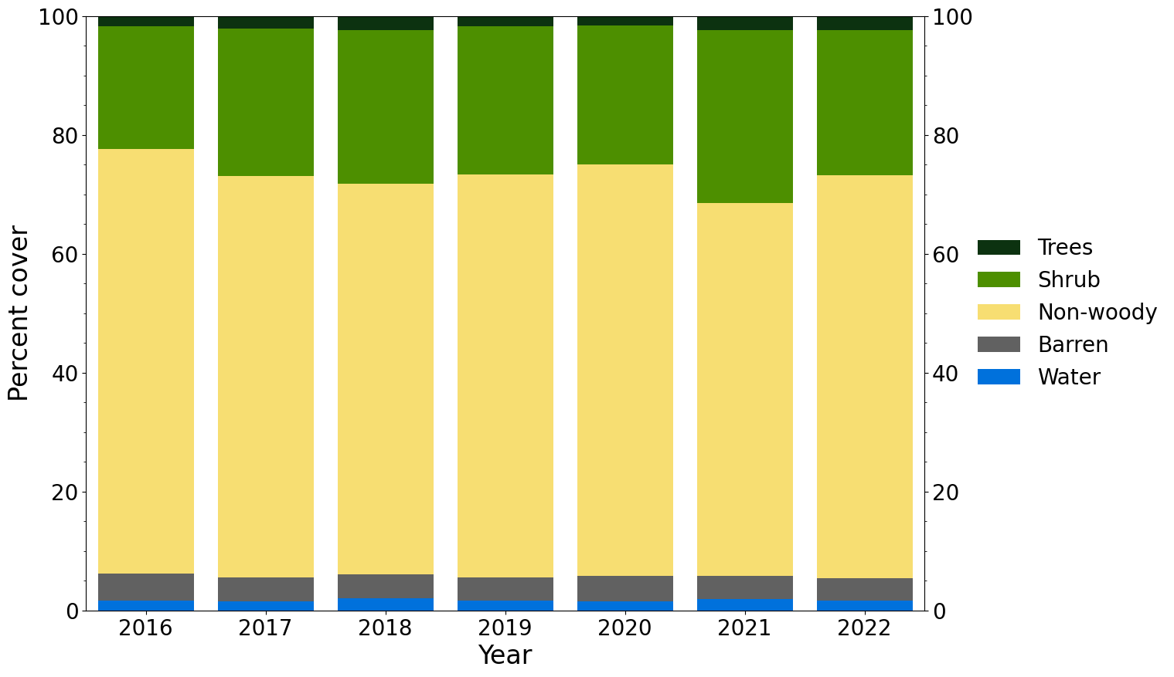
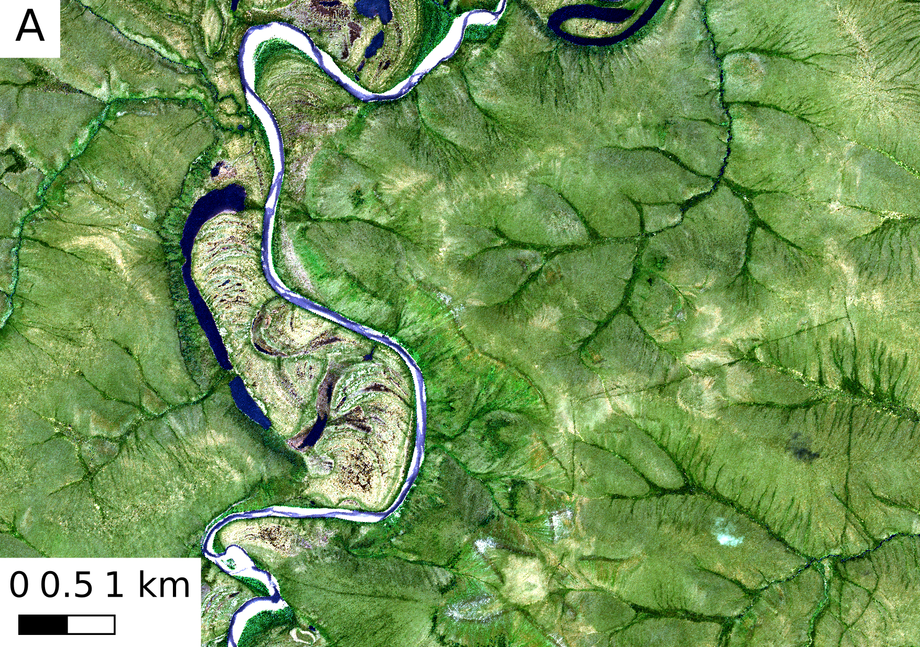
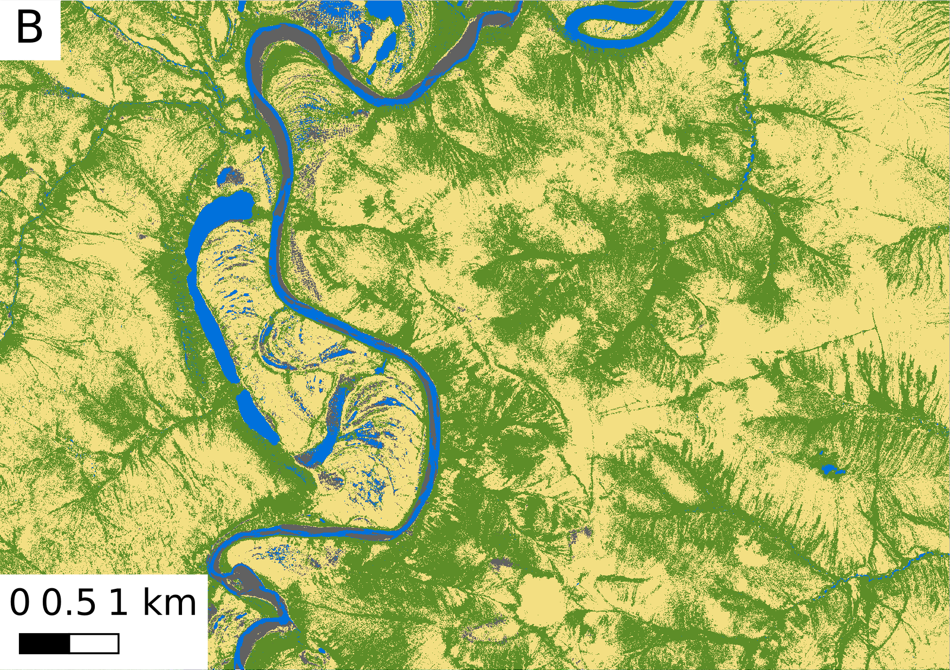
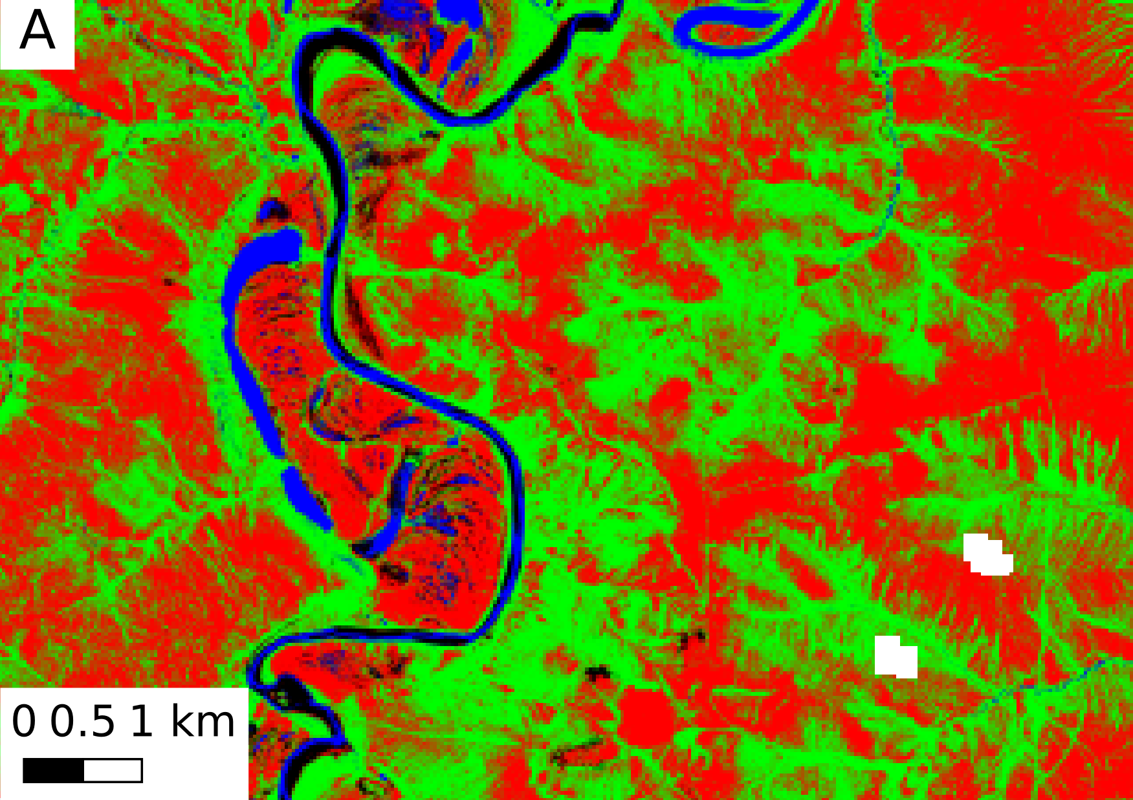
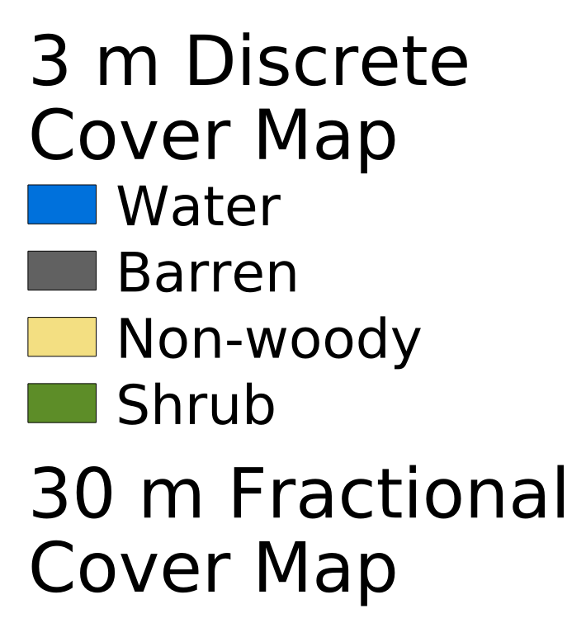
Subpixel Mapping of Arctic Vegetation Change from Harmonized
Landsat Sentinel-2 and Commercial Satellite Imagery
Xiaoran (Seamore) Zhu¹, Jonathan A. Wang², Sophia Stonebrook¹, Mark A. Friedl¹
¹Department of Earth and Environment, Boston University; ²School of Biological Sciences, University of Utah; Contact: seamorez@bu.edu
Introduction
Results and Analysis
Motivation:
Arctic ecosystems have experienced rapid warming in recent decades, which is driving widespread shifts in vegetation cover and composition, along with concomitant changes in vegetation spectral greenness. In order to interpret the ecological meaning of spectral greening and browning, it is important to connect observed trends and changes to quantifiable metrics of vegetation change.
Challenges:
Heterogeneity of vegetation at fine spatial scales and spectral similarities between different plant functional types (PFTs)
Lack of in-situ vegetation cover data across the Arctic tundra domain
Addressing the challenges:
Using Harmonized Landsat Sentinel-2 (HLS) data, we created a new framework that uses synthetic spectral features derived from land surface phenology (LSP) to model annual 30 m fractional cover of different cover types (trees, shrub, non-woody, barren, and water)
To train and validate our models, we created high-spatial resolution maps of vegetation cover using Maxar imagery, which we then up-sampled to create maps of 30 m fractional cover
Our results demonstrate that LSP can be used to accurately map and capture changes in fractional cover over time. This will allow us to tie phenological trends to changes in vegetation cover.
Data and Study Region
Fig. 4 (above) 2021 results with inset maps
Features:
Non-woody
Arctic Foothills
50PCGI | Peak | 50PCGD | DEM
Blue | Blue | Blue | Elev.
Green | Green | Green | Slope
Red | Red | Red | Aspect
NIR | NIR | NIR
SWIR1 | SWIR1 | SWIR1
SWIR2 | SWIR2 | SWIR2
EVI2 | EVI2 | EVI2
TCG | TCG | TCG
TCW | TCW | TCW
TCB | TCB | TCB
Trees
Barren
Shrub
2020
Fig. 1 Study Region and Period (spectral greening from Ju & Masek, 2016; T trend from ERA5-Land):
North American Arctic; current results for Arctic Foothills (NA Level 3 ecoregion); 2016-22
Classified 30 m training maps:
Discrete classifications for four 3 m Maxar images were created via supervised machine learning
Classifications were assessed and sampled to 30 m fractional cover training maps
Fig. 5 Fractional cover change before and after the late 2019 Aupuk Creek Fire
Fractional Cover Modeling
ML Regression models for each cover type
ML Regression models for each cover type
ML Regression models for each cover type
ML Regression models for each cover type
ML Regression models for each cover type
Bias correction
Fig. 2 (left)
Synthetic spectra were extracted from points on the phenological curve
Normalization
Predict across study region
Fig. 6 Assessment scatter plots for fractional cover models
Fig. 7 Time series for total cover in the Arctic Foothills
Highlights and Next Steps
A
B
C
Synthetic spectra generated from HLS land surface phenology were used to model fractional cover for the first time
Results show promise for using 3 m imagery from Maxar and Planet to train fractional cover models at 30 m resolution
Annual fractional cover for the entire North American Arctic will be modeled
A smoothing procedure (e.g. BCP detection) will be applied to smooth annual noise and quantify fractional change
Fractional cover change will be analyzed in relation to phenological changes, climate change, and disturbances
Non-woody
Acknowledgements
Water
Shrub
©2020, Maxar, USG Plus
©2020, Maxar, USG Plus
Barren
We gratefully acknowledge funding support for this research from NASA Grants #80NSSC24K0047 and #80NSSC23K0140
Maxar imagery was retrieved through the ABoVE Science Cloud
Fig. 3 3 m true color (A), 3 m discrete classification (B), and upscaled 30 m fractional cover map (C) corresponding to the inset map in Fig. 4

