Slide 1
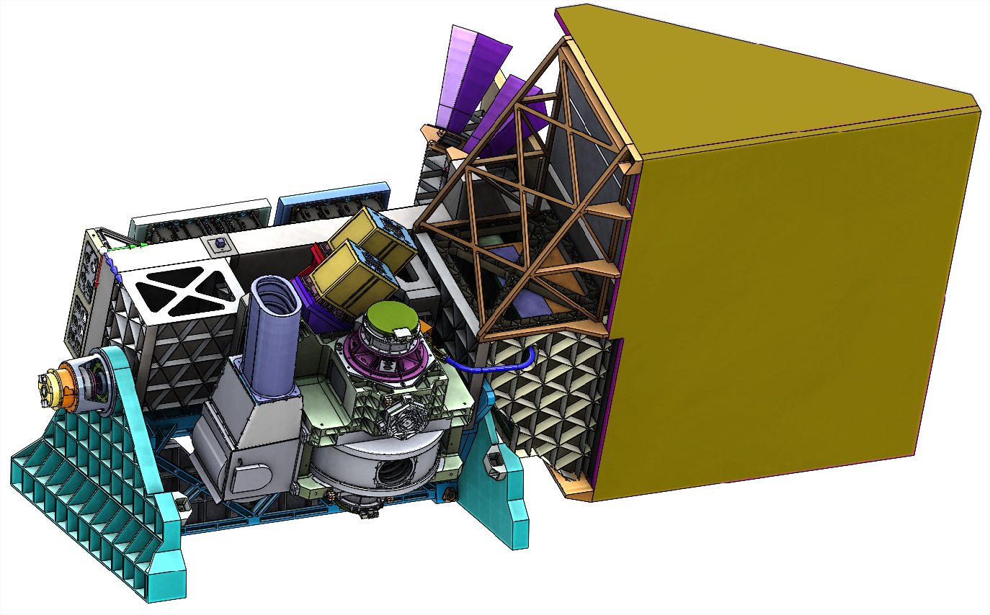
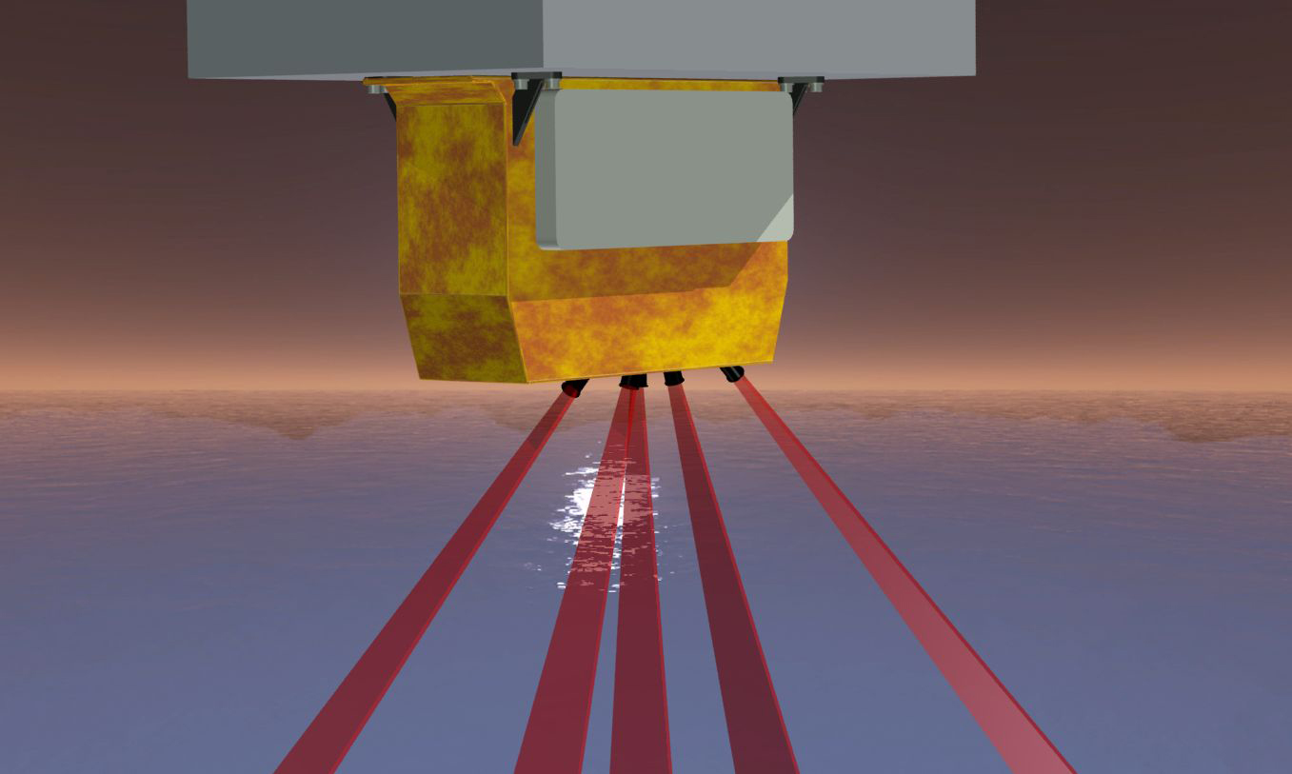
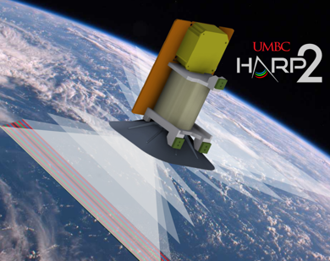
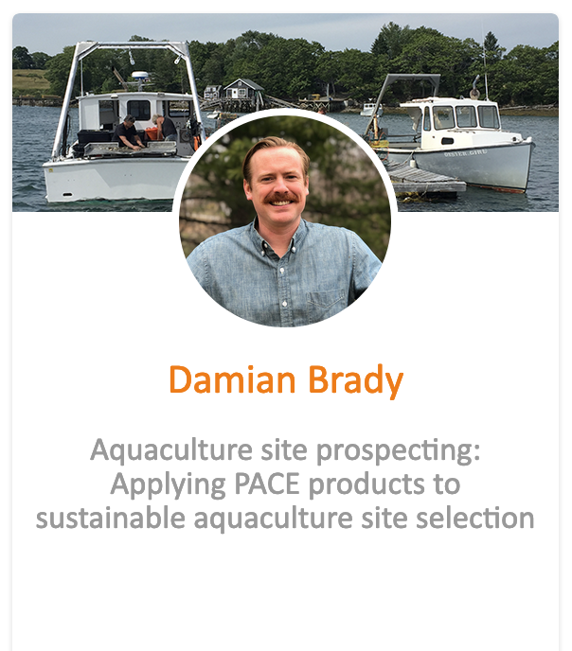
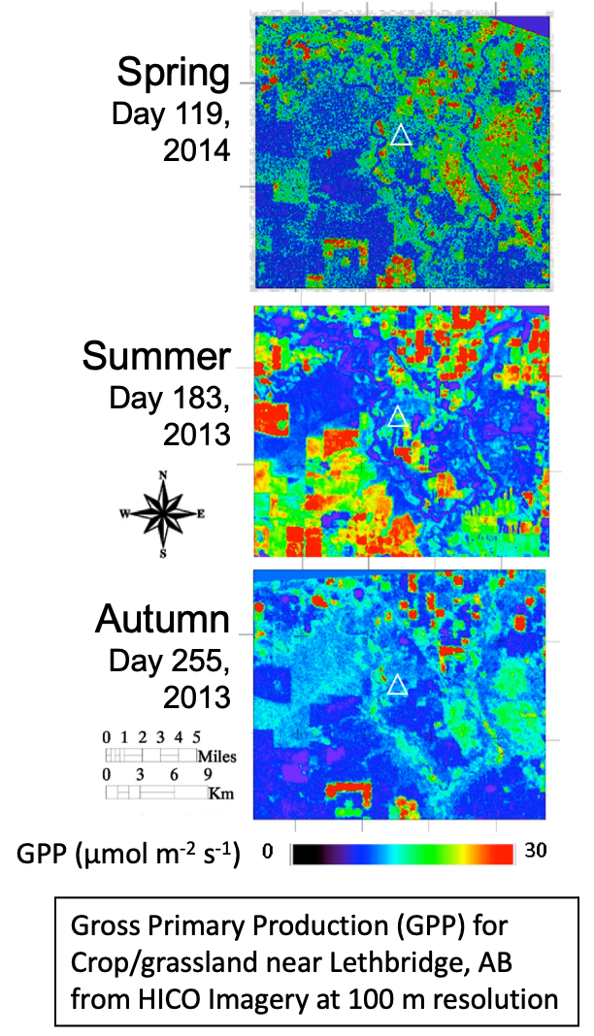
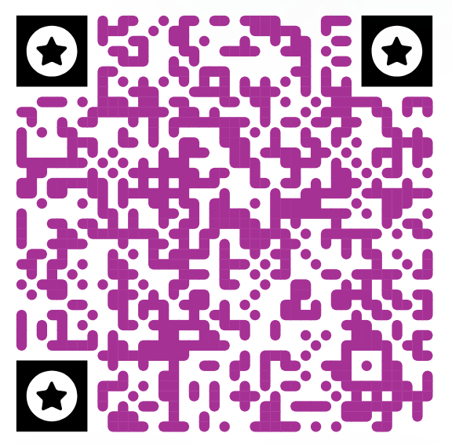
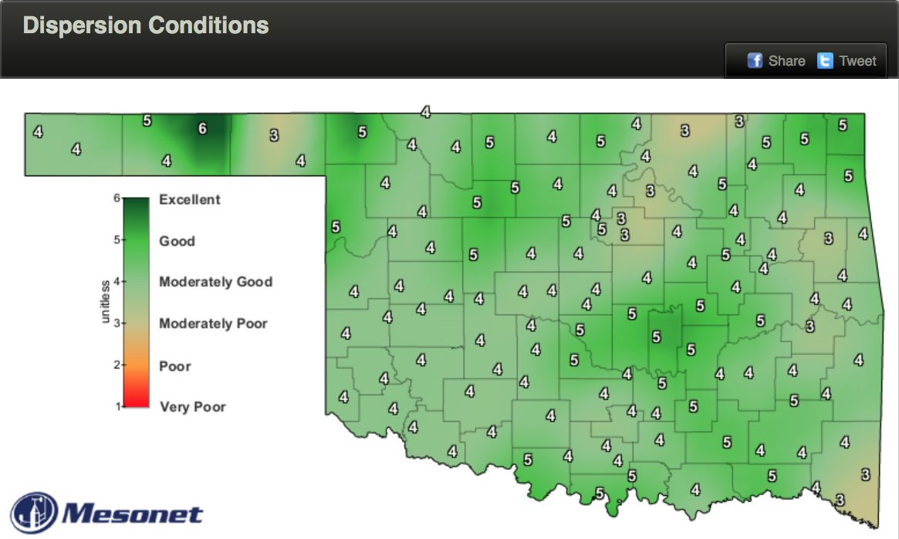
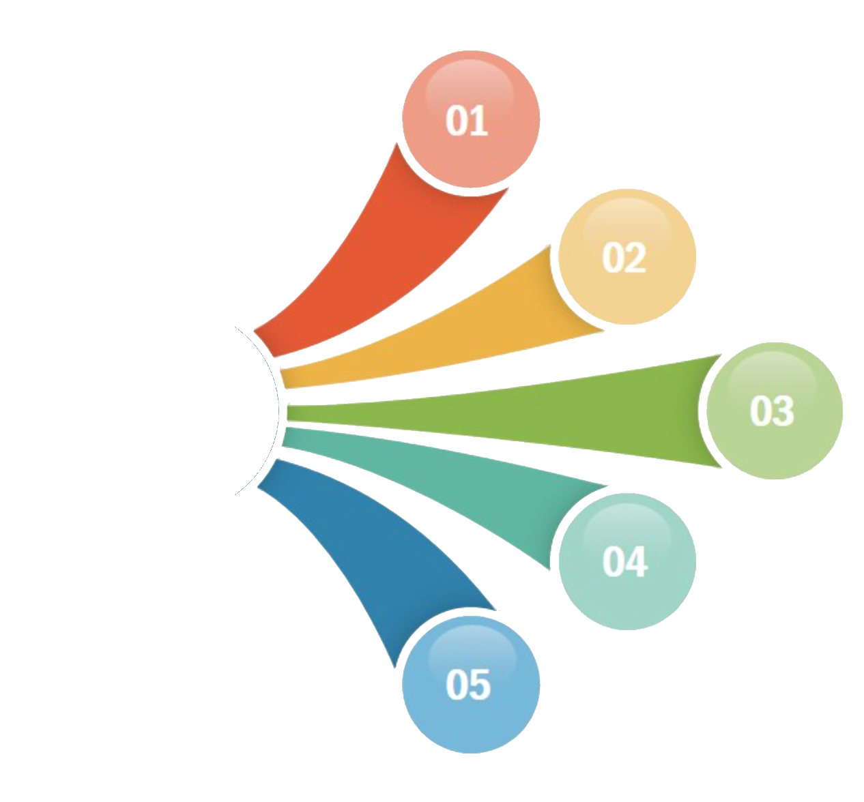
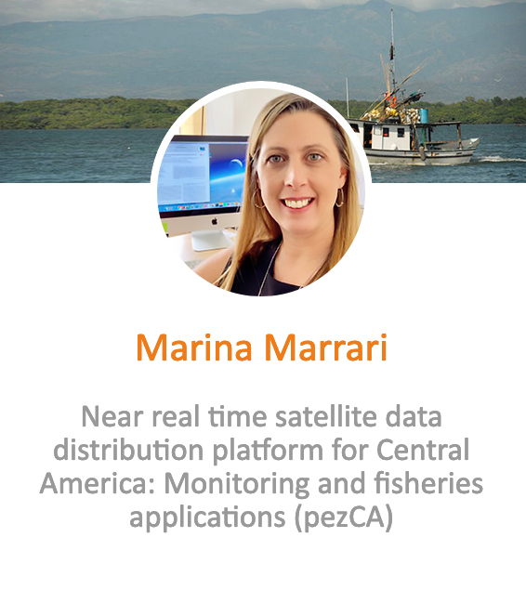
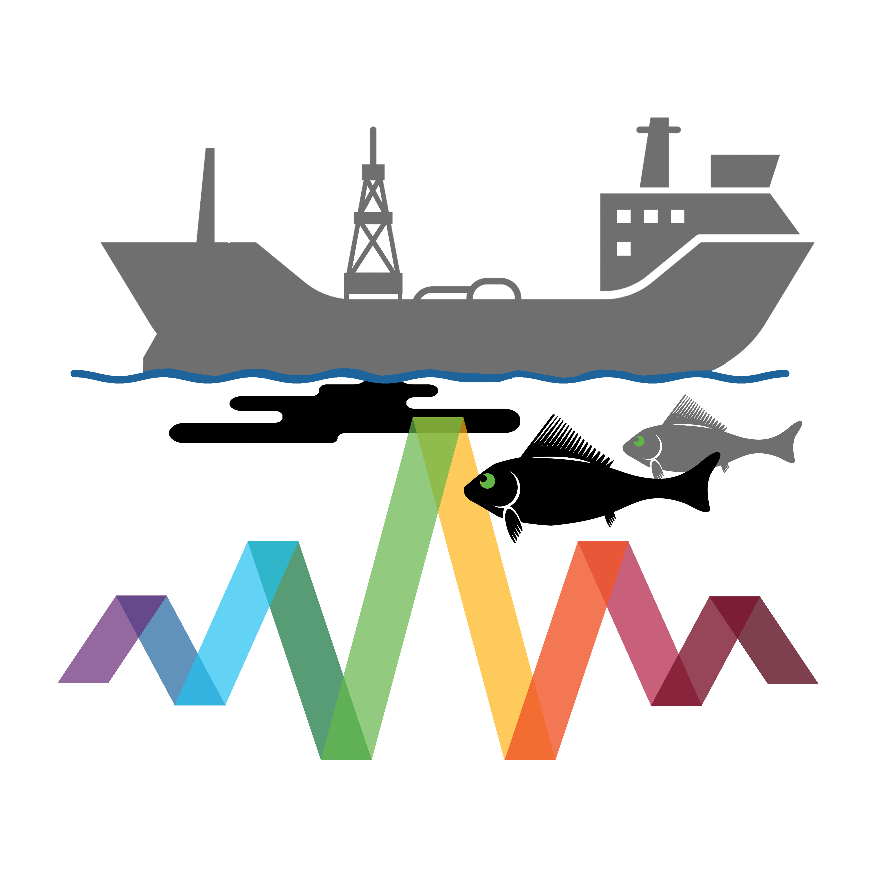
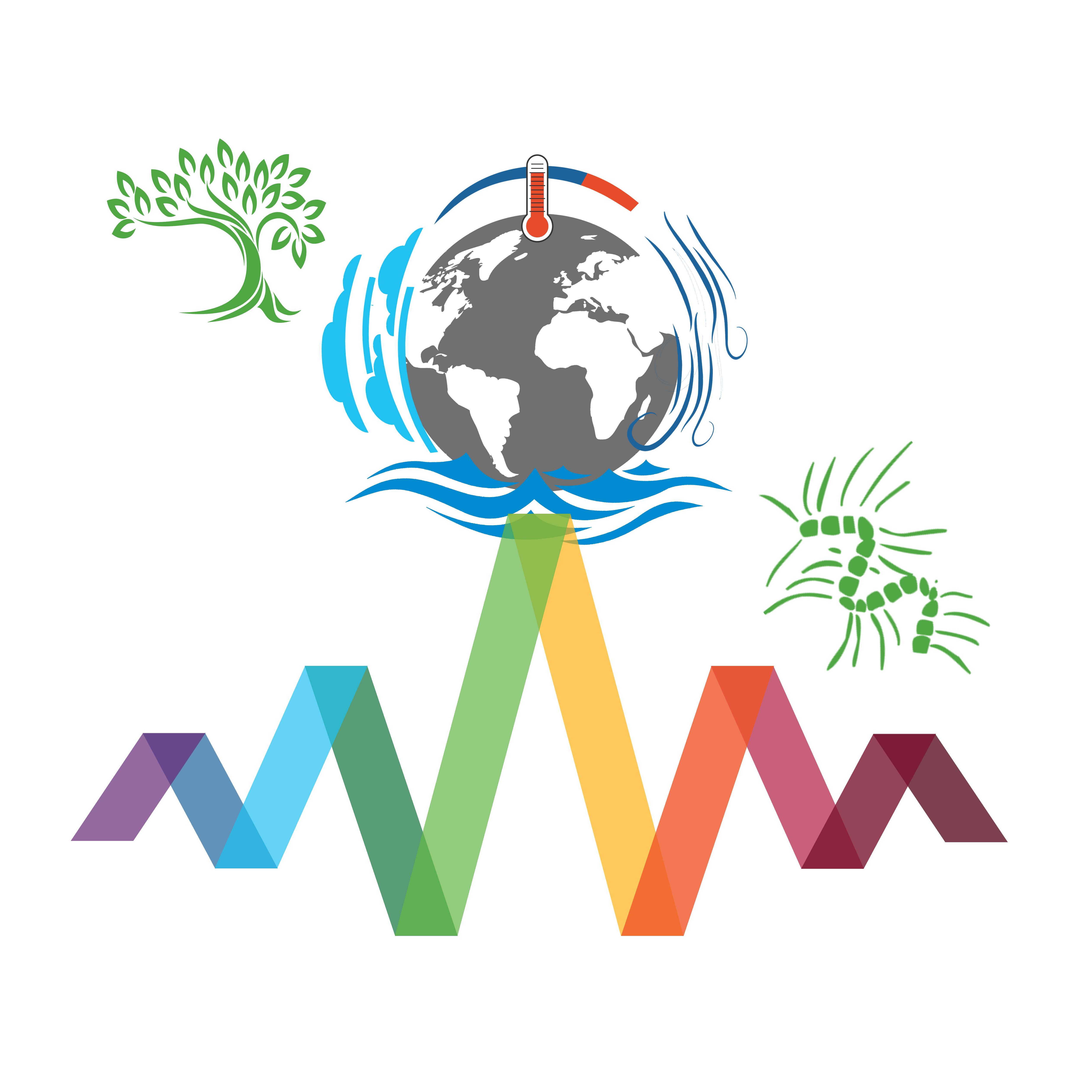
Ocean, atmosphere, and terrestrial applications of Plankton, Aerosol, Cloud, and Ocean Ecosystem (PACE) Mission to meet the needs of the carbon cycle & ecosystems user communities
PACE-applications@oceancolor.gsfc.nasa.gov
Erin Urquhart^{1,2}, Natasha Sadoff^{1,2}, Antonio Mannino¹; (¹NASA Goddard Space Flight Center; ²SSAI)
Background: the Plankton, Aerosol, Cloud, and Ocean Ecosystem (PACE) Mission
PACE, expected to launch in early 2024, will extend and improve NASA’s 20-plus years of global satellite observations enabling new global hyperspectral and polarimetric observations of the global ocean, atmosphere, terrestrial ecosystems, and earth system climate change impacts. PACE will continue NASA’s multi-decade, global record of satellite ocean color, terrestrial and land ecosystems, and clouds and atmospheric aerosol particles observations from SeaWiFS, MODIS, MISR, and VIIRS; and provide new measurements of aerosols, clouds, aquatic biology, terrestrial ecology, and biogeochemistry through the spectral resolution of the Ocean Color Instrument (OCI) and multi-angle polarimetry. PACE will enhance decision-making in terrestrial/land resource management and water resource management. It will also continue key measurements related to air quality and climate from heritage missions.
Key Mission Characteristics:
Hyperspectral ocean color instrument (OCI) – 345-890 nm in 5 nm steps – plus, SWIR bands @ 940, 1038, 1250, 1378, 1615, 2130, & 2260 nm
Two contributed multi-angle polarimeters (HARP2 & SPEXone)
2-day global coverage to solar & sensor zenith angles of 75º & 60º
Sun-synchronous, polar orbit with an Equatorial crossing time of 13:00
Spatial resolution of 1km² (OCI) and 2-4km² (HARP2 & SPEXone)
Class C (limited redundancy) for 3 years of operations & 10 years of fuel
PACE Applications Program
The goal of the PACE Applications Program is to foster new partnerships and innovative thinking that will generate inventive solutions that aid society, including in ocean and coastal management. Goals include:
Address community user needs & concerns with PACE data products
Grow relevance & sustainability of PACE
Demonstrate the societal value & utility of PACE
Applications are user-driven innovative uses of NASA PACE data products to complement and improve decision-making activities and provide practical solutions to meet societal needs. Applied Research provides fundamental knowledge of how PACE data products may be scaled & integrated into users’ policy, business, and management activities to improve decision-making.
OCI
SPEXone
Informing Applications with PACE
PACE Applications Activities
Partnership Development, User Engagement, and Outreach
Connecting with partner organizations, communities, and/or networks during conferences, workshops, and other events virtually and in-person
Presenting on the PACE Applications Program and sharing information
Early Adopter Program & Community of Practice
Community-specific Focus Sessions and Surveys
Engaging with members of the science community
through community focus sessions, surveys, & assessments
Annual Application Workshops
Facilitating annual applications workshops to share PACE mission updates, identify and explore end user needs, identify new partnerships and applications, and foster community engagement and discussion
Integrated PACE products can address questions of terrestrial ecosystem diversity, biochemistry, & function:
PACE will enable sustainable aquaculture site selection for the Gulf of Maine. Sea scallop aquaculture is a promising field of bivalve aquaculture due to large sea scallop trade deficit and the potential market for cultured sea scallops. PACE resolution would be optimal for site selection tools for these species if we can relate phytoplankton size to feeding rates.
Plant type distribution described through spectral unmixing. Affects animal species distributions (caribou., and ecosystem response to climate change and thawing permafrost)
Biochemistry based on spectral analysis, such as PLSR, responds to environmental conditions (soil nutrients, water availability)
Ecosystem function derived from plant types and biochemistry shows the spatial patterns in productivity over an area (vs. a single vegetation type considered in models)
Working with researchers and decision-makers to promote applied science and applications research designed to scale and integrate PACE data into policy, business, and management activities that benefit society and inform decision making
PACE will provide atmospheric measurements (such as total column aerosol amount, aerosol layer height, & aerosol optical depth), which can benefit & inform:
Estimating particulate matter (PM) for air quality & health advisories
The impact of aerosols on the climate
The location, altitude, and magnitude of particulate matter such as wildfire smoke or volcanic ash
Huemmrich et al. 2016
JOIN US
PACE will enable development of water quality & HAB monitoring tools in Pacific Central America. PACE will represent a valuable source of operational ocean color data and will expand the products available, soon to include operational products for red tide detection & monitoring in collaboration with coastal communities.
Mesonet map showing dispersion conditions over Oklahoma, or the ability of the atmosphere to dilute airborne particles (i.e. smoke, pollution, pesticides). Higher dispersion means faster atmospheric dilution is likely.

