Slide 1
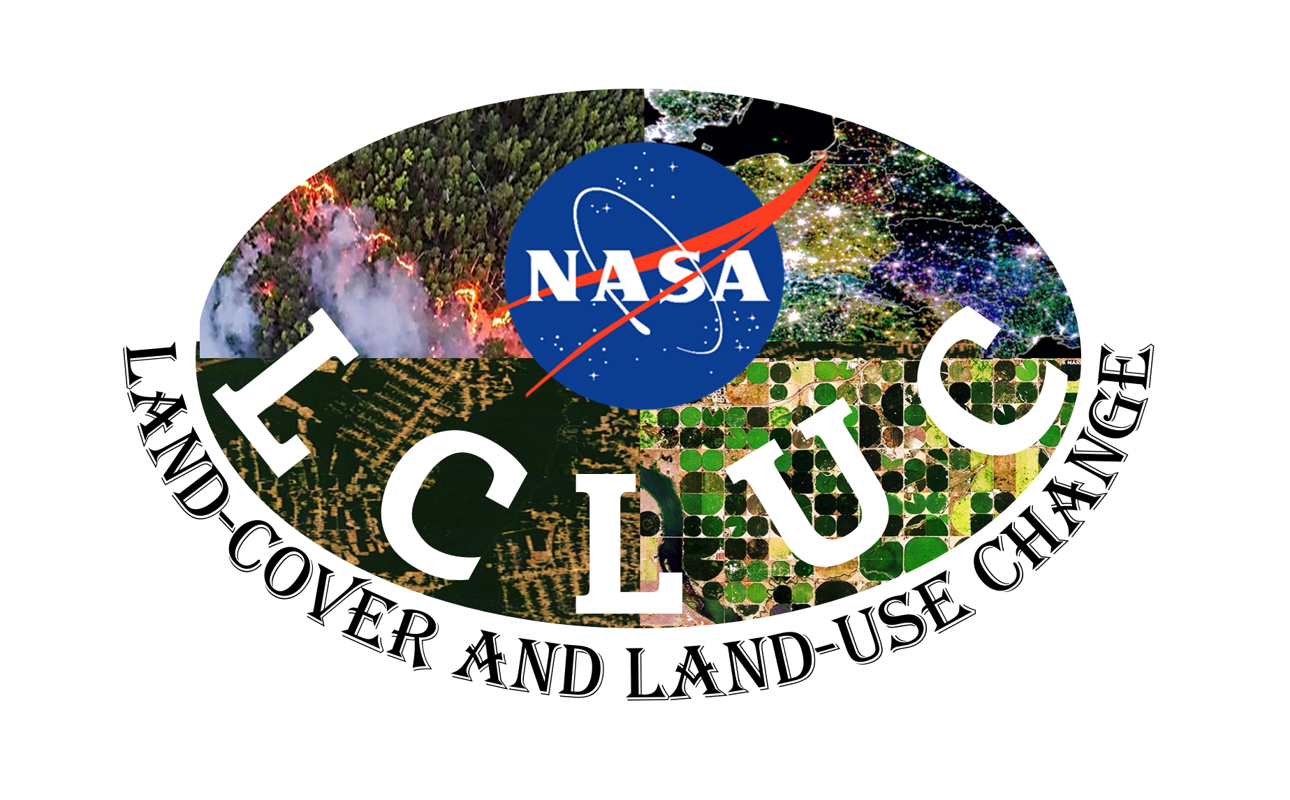
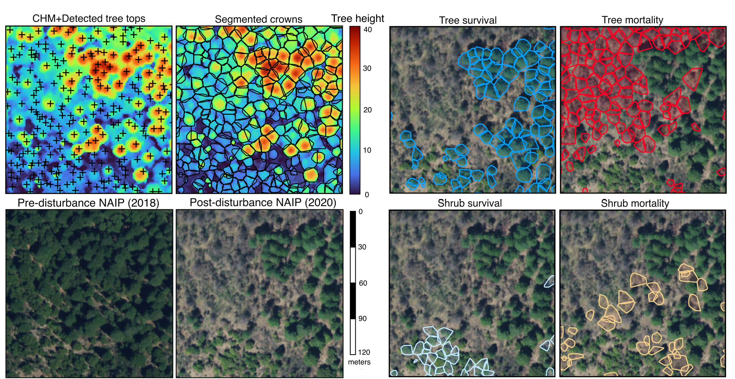
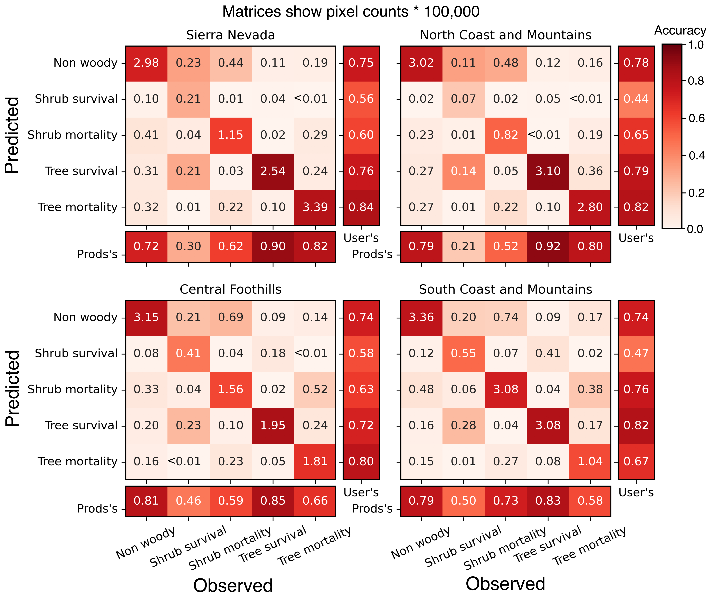
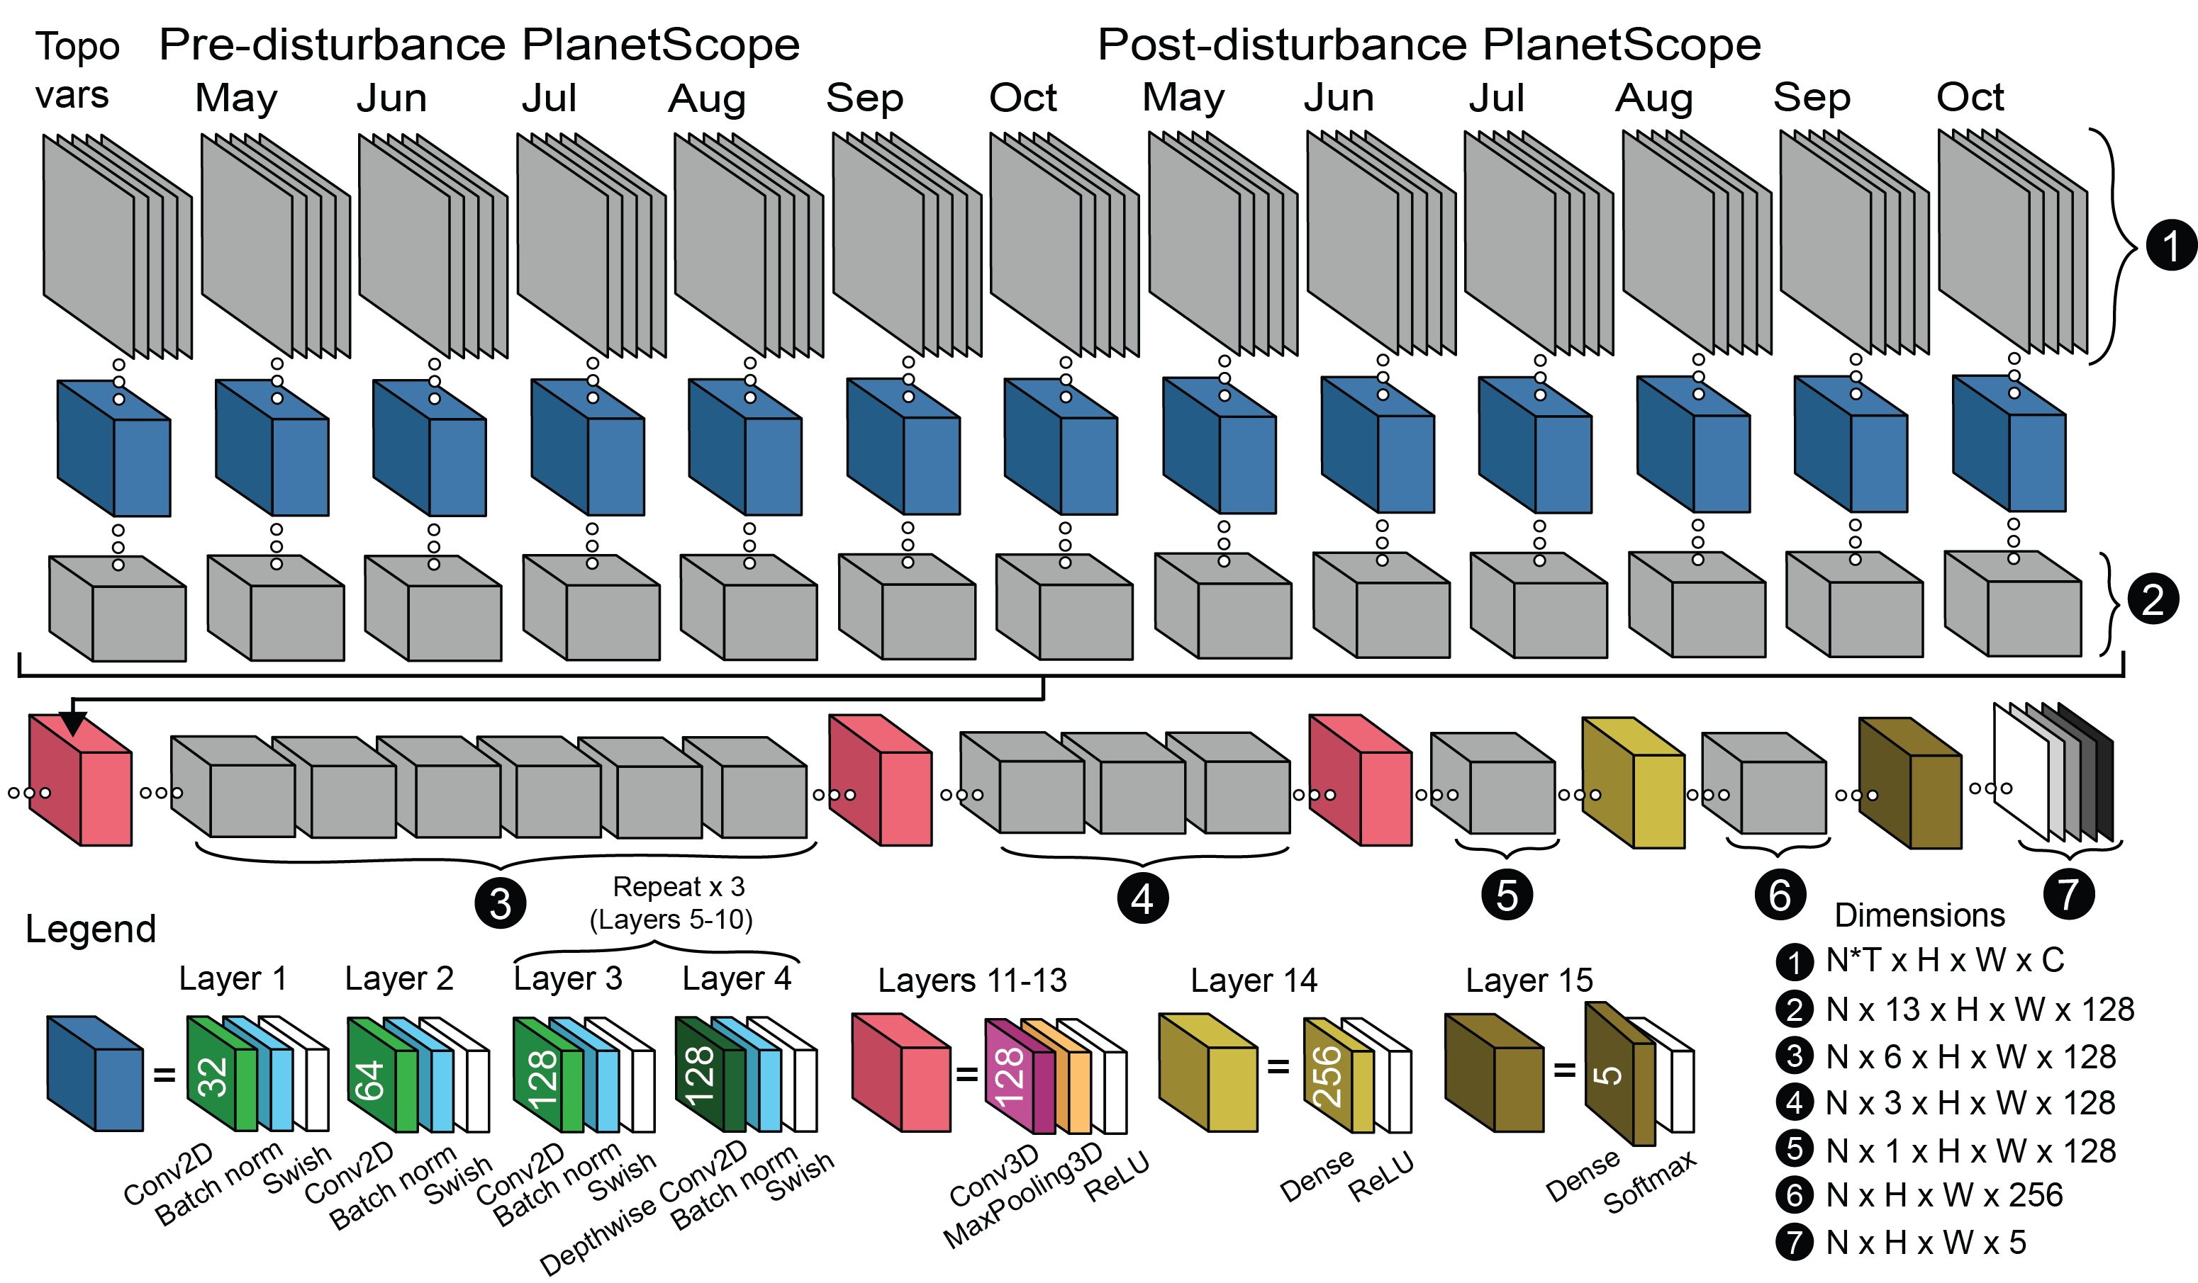
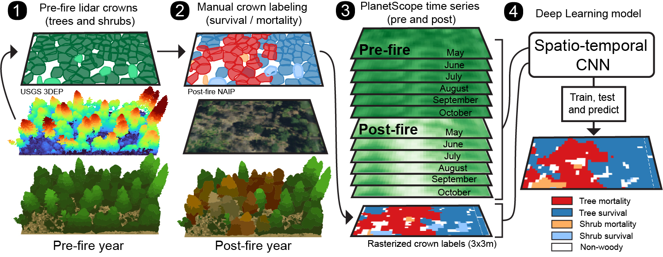
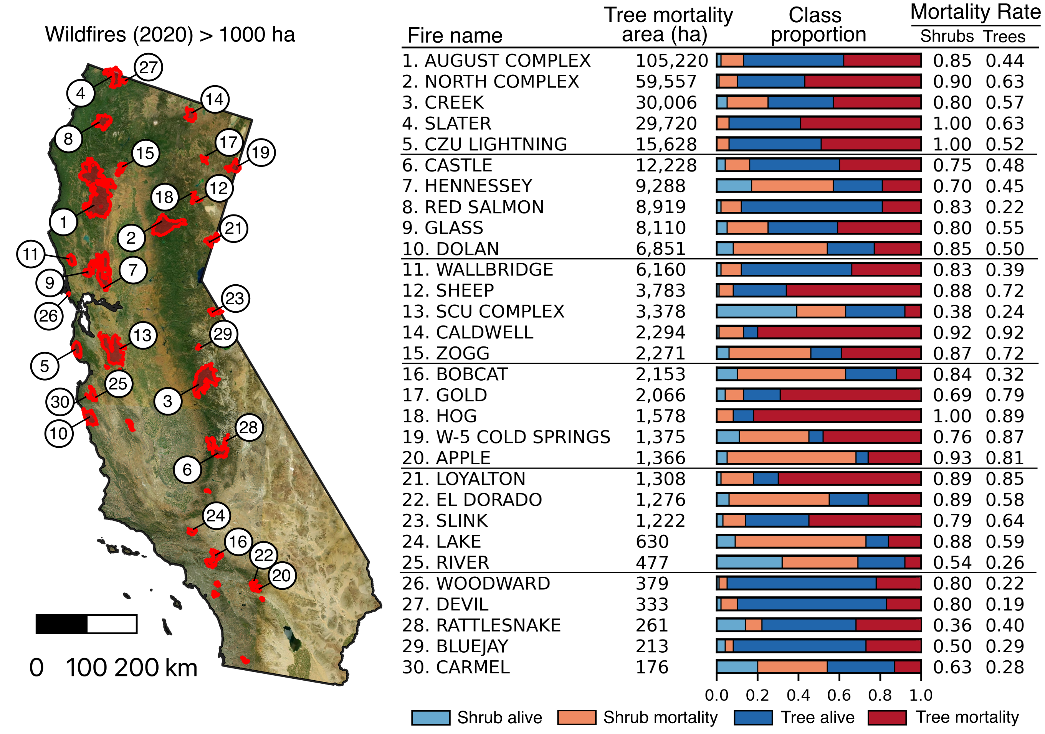
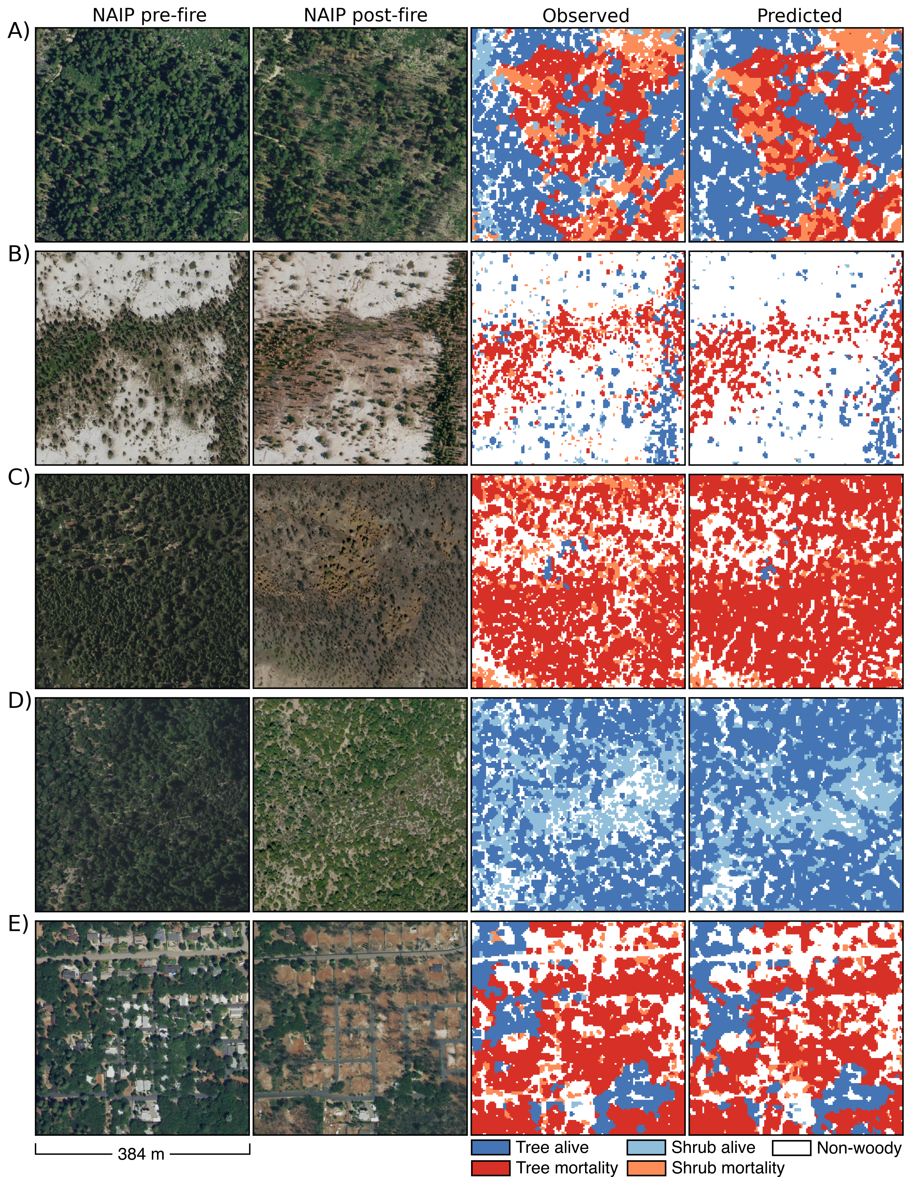
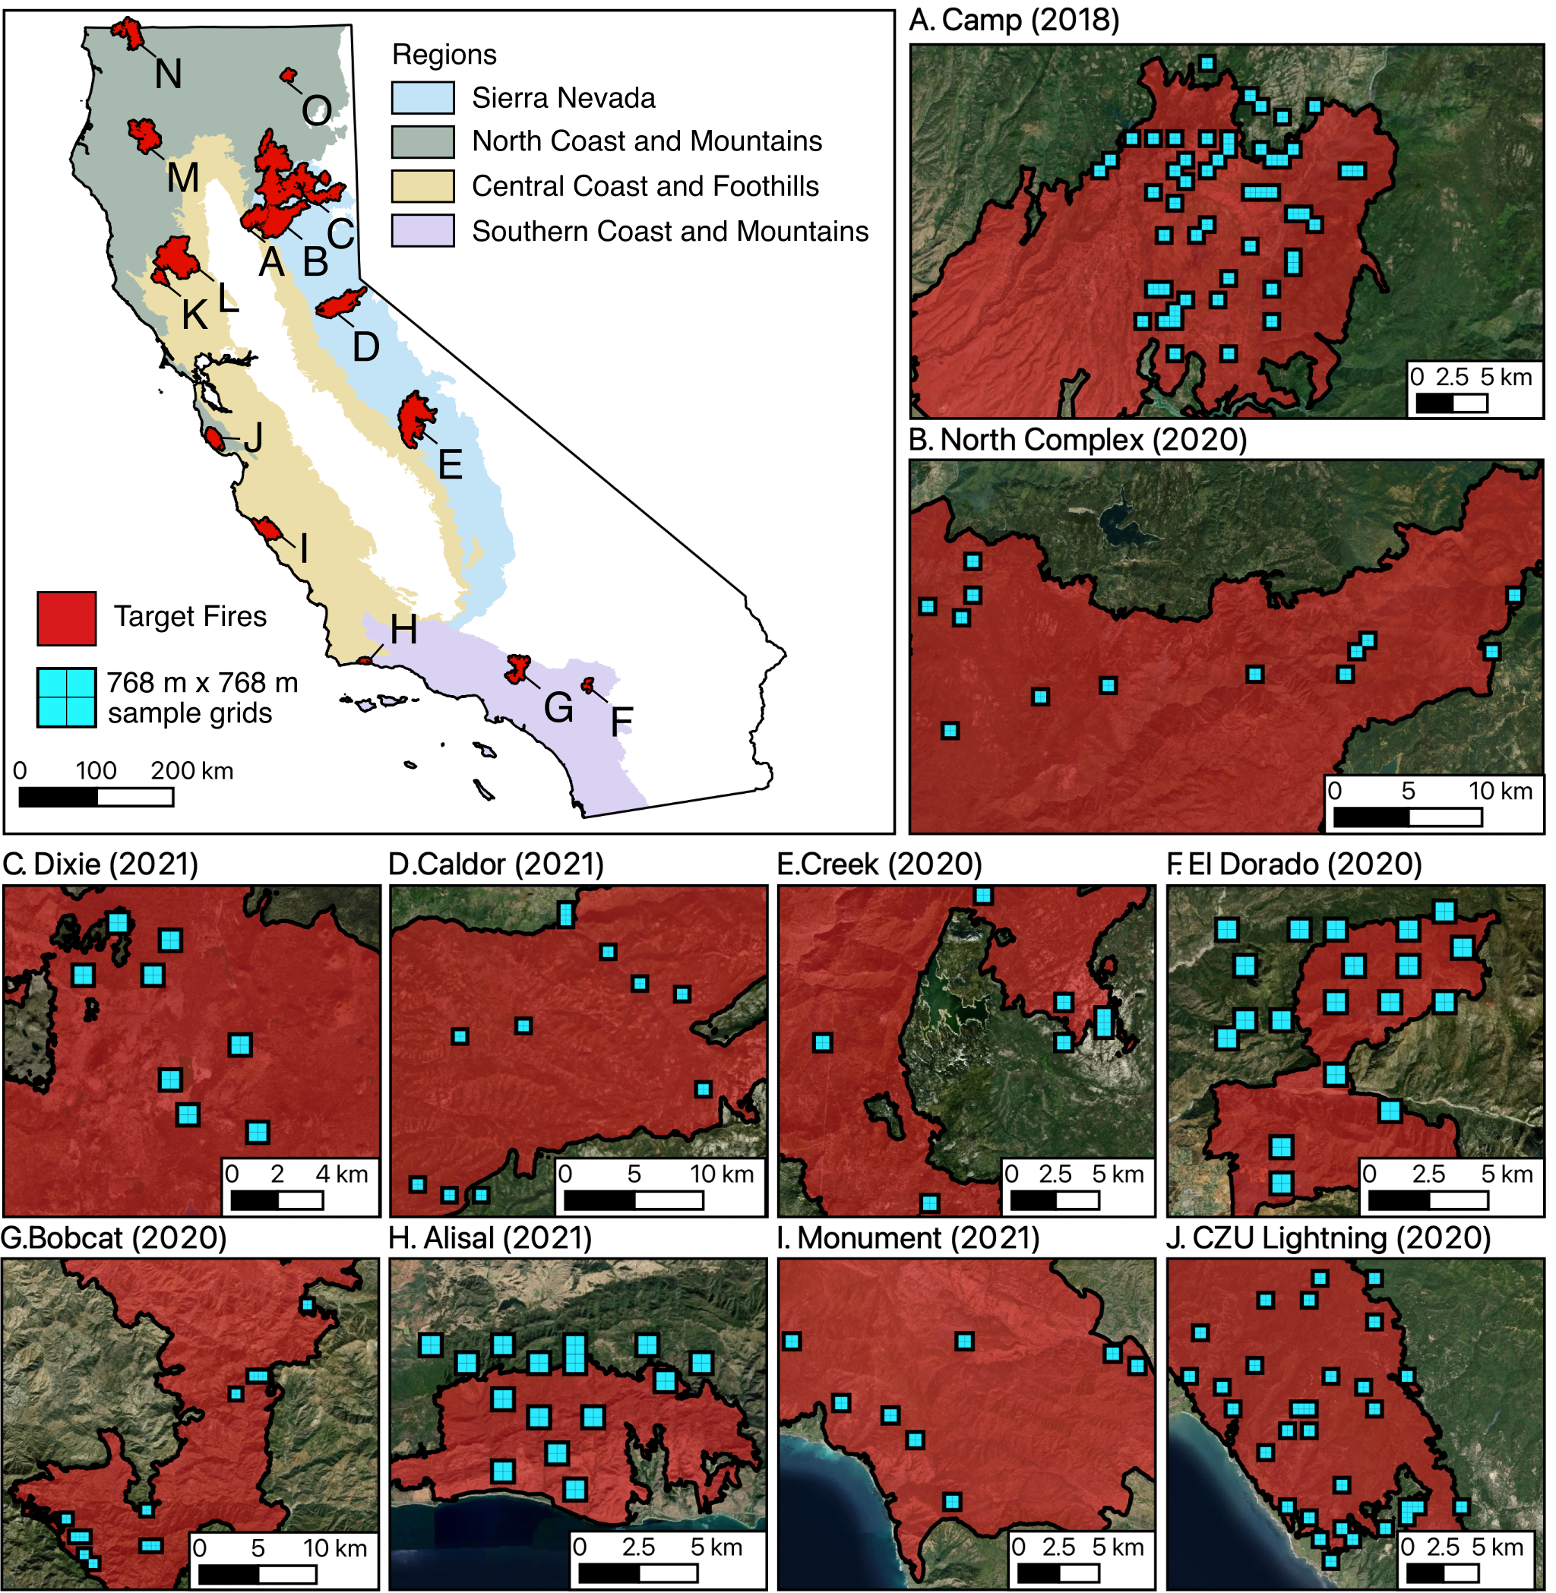
Satellite detection of crown-scale tree mortality and survival from California wildfires
Dan J. Dixon^{1*}, Yunzhe Zhu¹, and Yufang Jin¹ ¹Department of Land, Air and Water Resources, University of California, Davis, Davis, 95616, CA, USA
Introduction
Pre-fire lidar data were processed to generate segmented crown polygons, which were overlaid with post-fire NAIP aerial imagery to manually assign survival and mortality labels (Fig. 3).
The ST-CNN performs semantic segmentation into five classes: tree survival, tree mortality, shrub survival, shrub mortality, and non-woody with 3m resolution imagery (Fig. 4).
The ST-CNN can detect heterogeneous patterns of tree-level mortality and survival when comparing predicted and observed scenes (Fig. 5).
Error matrices show high and stable performance on tree survival and tree mortality notably in Sierra Nevada and North Coast and Mountains (Fig. 6), and reduced performance in sparser Foothills and Southern California.
Applied to all wildfires (n=42, 1.6Mha burn area) from 2020, results show diverse tree mortality and survival outcomes by fire across the state (Fig. 7).
Mapping forest disturbances is paramount to carbon monitoring, estimating environmental drivers, and developing strategies to enhance forest resilience. Existing products from Landsat and Sentinel-2 have improved our understanding of large-scale disturbance patterns; however, their relatively coarse spatial resolution (10 to 30-m) leads to the use of mixed pixels which constrains their application for estimating fine-scale tree-level outcomes (e.g., mortality or survival). PlanetScope multispectral imagery at 3-m and near-daily frequency offers new capabilities to detect and monitor tree-level events across landscapes.
The objectives of this research are to 1) Develop a machine learning framework to detect tree mortality at 3-m spatial resolution following forest disturbance with PlanetScope satellite imagery; 2) Apply the framework to regions affected by wildfire in California and quantify model performance; and 3) Deploy the model for state-wide tree mortality and survival detection from all large wildfires in California during 2020 (n = 42, burn area = ~1.6 M ha).
Fig. 3. Illustration of the semi-automatic crown mortality and survival labeling process. Shown is an example canopy height model derived from USGS 3DEP aerial lidar with detected tree tops and automatically segmented crown polygons. Labeling is done via visual inspection in a GIS.
Fig. 4. Spatio-temporal deep learning architecture to predict crown-scale tree mortality from PlanetScope pre- and post-disturbance monthly time series and topographic information. Blue boxes represent 2D convolutional Layers 1-10. Pink boxes represent temporal 3D convolutional Layers 11-13. Yellow and brown boxes show dense Layers 14 and 15 (See legend).
Methods and Data
Fig. 6: Error matrices of observed (columns) and predicted (rows) 3-m pixel counts *100,000 for five classes sourced from 328 independent test scenes, covering 15 wildfires and four ecoregions in California.
Results
Fig. 1. Workflow to detect crown-scale tree mortality following fire disturbance with pre-fire lidar, post-fire NAIP aerial imagery (0.6 m), PlanetScope model inputs, and a Spatio-temporal deep learning model.
We propose a framework to develop and validate a Spatio-Temporal CNN (ST-CNN) to detect crown-scale tree mortality with PlanetScope time series (Fig. 1). Included is a semi-automatic canopy labeling workflow which uses pre-disturbance lidar-derived crowns (Step 1) and post-disturbance aerial imagery to manually label survival and mortality (Step 2). This methodology streamlines label generation to provide hundreds of thousands of diverse tree crown footprints from different species, crown sizes, and survival and mortality outcomes. Step 3 depicts the assembly of predictor variables from monthly PlanetScope 3 x 3 m imagery with five bands (RGB/NIR + NDVI), and Step 4 shows the ST-CNN model training and testing.
Scenes were sampled from 15 wildfires between 2018 and 2021 across California ecoregions (Fig. 2). Each scene equals a 384 x 384-m block or 128 x 128 PlanetScope pixel image.
In total, we collected 1,000 scenes containing >1.8M tree and shrub crowns labeled as mortality or survival following wildfire.
Scenes were selected that contain pre-fire USGS 3D Elevation Program aerial lidar (within four years of the fire).
Given PlanetScope daily imagery at 3m resolution are available from 2017-present, we sampled from fires from 2018-2021.
Fig. 7. A map of all wildfires > 1000 ha in 2020 (n=42) and a sorted list (top 30) of predicted tree mortality area (ha) within each fire perimeter. Also shown are 0-1 proportional area stacked bar plots of tree and shrub alive/mortality excluding non-woody pixels as well as tree and shrub mortality rates.
Visualize all model predictions via the Google Earth Engine supported web app: http://bit.ly/tree-mortality-ca
Conclusions and Future Directions
Crown-scale mortality and survival are discernable with PlanetScope 3-m imagery, and the model is ready for state-wide prediction on all fires 2017-present. Model outputs support fine-scale reporting of post-fire impacts and interrogation of tree-level mortality drivers, including surrounding forest 3D structure / forest management strategies.
Future steps include the expansion of training data to improve accuracy in sparse forest environments, and for tree mortality detection from drought and insect damage. The model architecture and data outputs will be made freely available to expand to new regions.
Fig. 2. Sample locations within and adjacent to 15 wildfires from four ecoregions in California from 2018-2021 used for model training, validation and testing. 384 x 384 m (128 x 128 PlanetScope pixels) samples were collected as quadrants within larger 768 x 768 m (256 x 256 PlanetScope pixels) sample grids (blue).
Funding
Fig. 5. Four example 384 x 384-m test scenes showing NAIP aerial imagery (0.6-m, RGB) pre- and post-fire, observed and predicted thematic rasters at 3-m spatial resolution (128 x 128 pixels). Scenes are sourced from the following fires: A) Camp (Sierra); B) Creek (Sierra); C) El Dorado (Southern Mountains); D) Camp (Sierra).
This research was funded by NASA Land Cover and Land Use Change Program (grant #80NSSC21K0295) and the California Strategic Growth Council under the Innovation Center for Advancing Ecosystem Climate Solutions.
*Corresponding Author: djdixon@ucdavis.edu (Manuscript currently under review as of April 2023)

