Slide 1
Developing a Data-Driven Model to Minimize Adjacency Effects in Landsat-8 Imagery
Chris Begeman & Nima Pahlevan
Science Systems and Applications Inc.
NASA Goddard Space Flight Center

Slide 2
Outline
Background
Aquatic Remote Sensing
Adjacency Effects
Characteriz-ation
Drivers
Preliminary Assessment
Model Development
Design
Training
Conclusions
Testing
Conclusions
Future Works
2
Notes:
Quantitative optical remote sensing of seas and oceans has come a long ways since its beginning in 1978

Slide 3
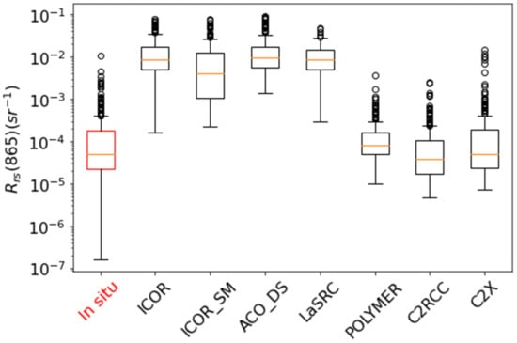
Background: Aquatic Remote Sensing
Atmospheric Correction (AC) is important to aquatic remote sensing
Current AC methods result in ~30% uncertainty
Large portion of uncertainties come from Adjacency Effects (AE)
In situ Rrs compared to Rrs retrieved from different atmospheric correction models on Landsat 8 ^{[1]}
3
Notes:
Many Current methods of AC don’t take AE into account.
Graph shows the differences between one study

Slide 4
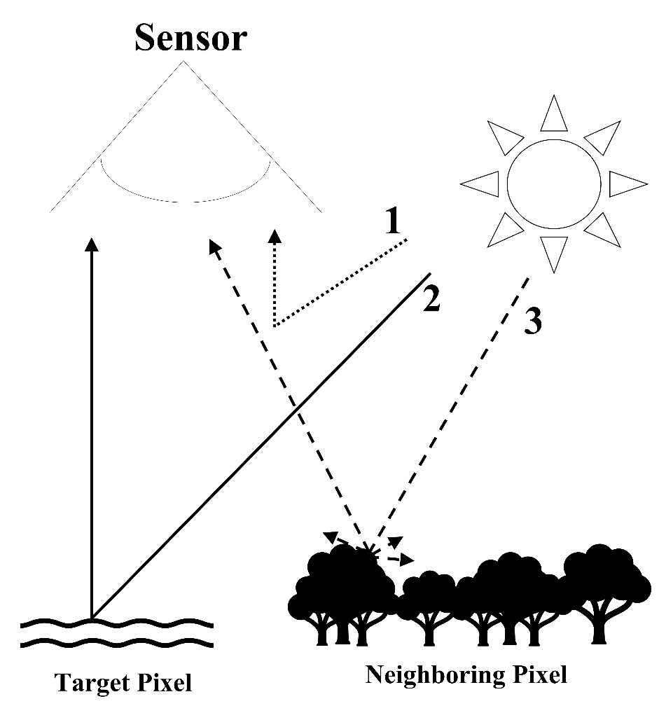
Background: Adjacency Effects
At sensor measurements are affected by multiple sources
Atmospheric Scattering ^{[2]}
Target reflectance
Neighboring Pixel Scattering, or Adjacency Effects (AE)^{[3]}
4

Slide 5
Outline
Background
Aquatic Remote Sensing
Adjacency Effects
Characteriz-ation
Drivers
Preliminary Assessment
Model Development
Design
Training
Conclusions
Testing
Conclusions
Future Works
5
Notes:
Quantitative optical remote sensing of seas and oceans has come a long ways since its beginning in 1978

Slide 6
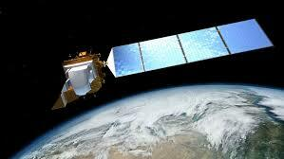
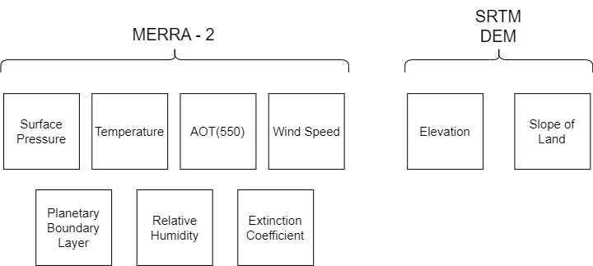
Characterization: Datasets
Oρtical imagery
Landsat-8/OLI
Small viewing angles
Easy to work with
Top of Atmosphere Reflectance (ρ_{t})
Source:
Google Earth Engine (GEE)
Landsat 8 ^{[4]}
Ancillary Data
6
Notes:
MERRA’s pressure, temperature, wind speed, humidity, AOT, and Extinction Coefficient
SRTM’s elevation data and slope as a product of elevation

Slide 7
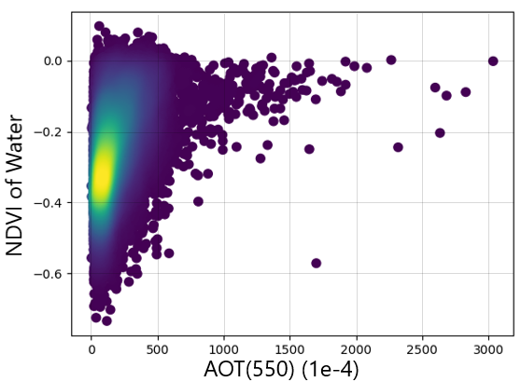
Characterization: Adjacency Effect Drivers
Specific drivers of AE were uncovered through two main methods:
Data Correlations
Simulations done by others ^{[5]}
High water vegetation index (NDVI) indicates AE from vegetation
Water NDVI vs AOT(550) shows that AOT has a nonlinear effect
7
Notes:
Simulations done by others show shoreline distance to have the greatest effect on AE

Slide 8
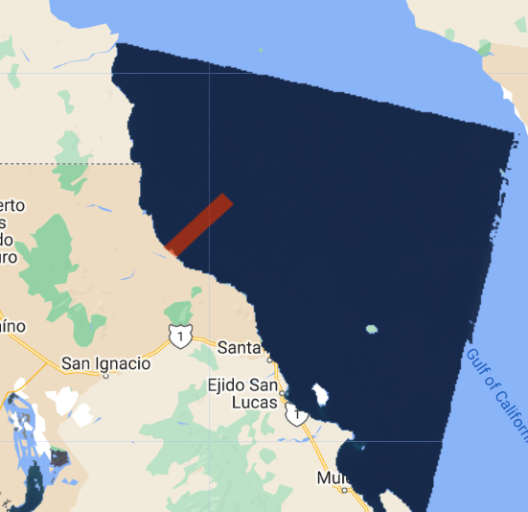
Characterization: Preliminary Assessment
Locate and identify adjacency effects
Process for acquiring AE:
Cloud filter images
Temporally average ρ_{t} over 4 years
Average pixels with same shoreline distances
Plot the ρ_{t} averages vs shoreline distance to examine AE
Cloud filtered Temporal Average of Gulf of California image
8
Notes:
Reasons for this:
Wanted to see the magnitude of some of the AE
Compare with simulation data to see how close they agree
Provides a baseline for correction amongst training data

Slide 9
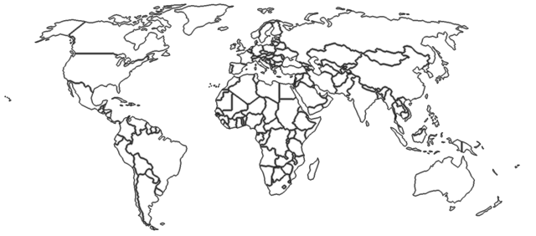
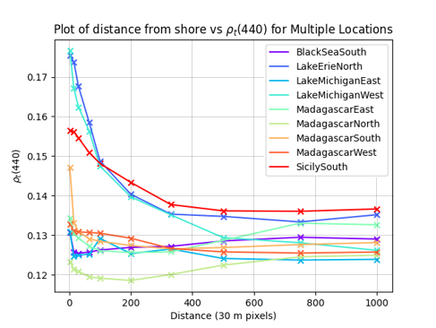
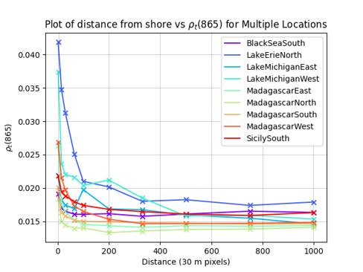
Characterization: Preliminary Assessment
9
Notes:
AE are present in every band. Depending on the land cover type
The ρt(440) values are the most affected by AE
Many locations are still largely affected by AE up to ~330 pixels (~10 km)
Other locations are hardly affected by AE

Slide 10
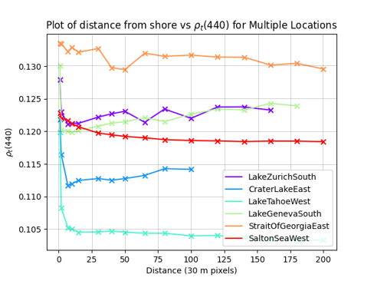
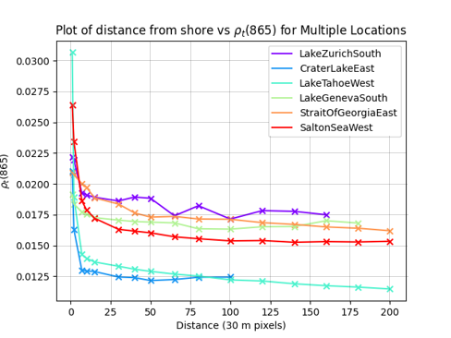
Characterization: Preliminary Assessment (smaller scale)
10
Notes:
The ρt(440) values are the least affected by AE as they contain the most signal
Many locations are still largely affected by AE up to ~330 pixels (~10 km)
Due to how small some of the lakes are it is hard to gauge what an unaffected pixel is for them
Certain locations were chosen to coincide with other studies
Salton Sea
Lake Zurich
Lake Geneva

Slide 11
Outline
Background
Aquatic Remote Sensing
Adjacency Effects
Characteriz-ation
Drivers
Preliminary Assessment
Model Development
Design
Training
Conclusions
Testing
Conclusions
Future Works
11
Notes:
Quantitative optical remote sensing of seas and oceans has come a long ways since its beginning in 1978

Slide 12
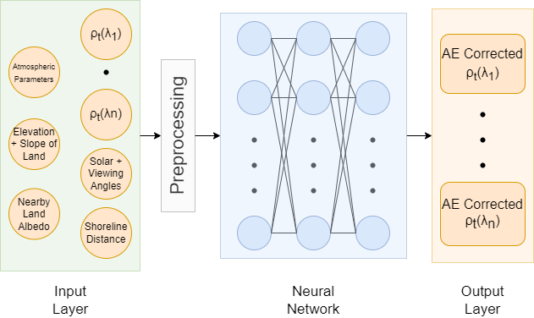
Model Development: Mixture Density Model
12
Notes:
all the potential drivers are incorporated as input
Neural networks are data hungry and are good at modeling non-linearities that may not be captured in physics based approaches
primary assumption of this work, i.e., spatial homogenity of waters

Slide 13
Model Development: Training
Used Landsat 8 imagery spanning the globe
Images were screened for clouds
Over 2 million data points acquired over the years 2018 & 2020
Filtered down to 750,000 data points
Location of Training data used for modeling
13
Notes:
Year of archive
Google Earth Engine logo

Slide 14
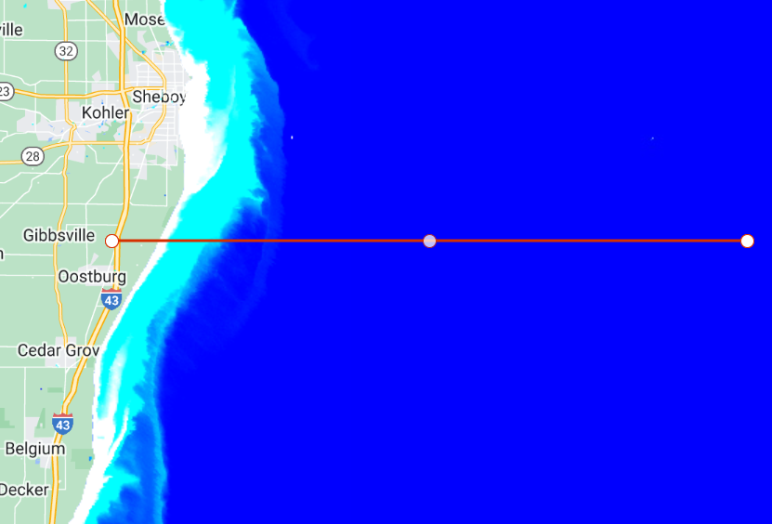
Model Testing: Lake Michigan
Test model on unseen data
Cloud free image
Tests data without interference
Plotted both ρ_{t} and AE corrected reflectance (ρ_{AEC})
Red line is the test area
Stretched True Color Image of Lake Michigan
14
Notes:
Contained a cloud free area
North-South shoreline may differ from East-West shoreline

Slide 15
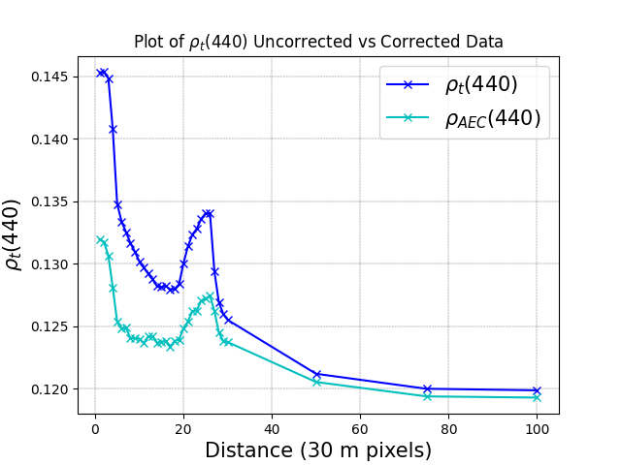
Model Testing: Corrected vs Uncorrected Lake Michigan
Percent Difference: 9.65%
Percent Difference: 0.487%
15
Notes:
AE are removed and data begin to converge around distances beyond 40 pixels
The spectral shape is kept intact through the use of this model and can be used to measure Chl-a and other such lake health measurements

Slide 16
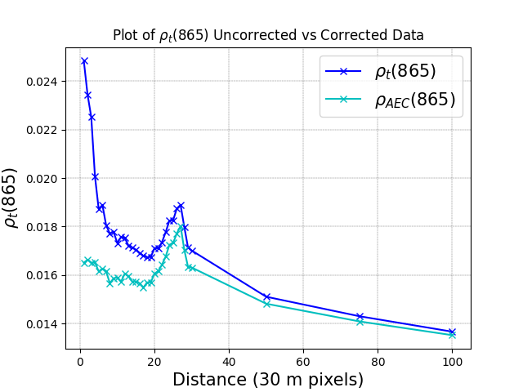
Model Testing: Corrected vs Uncorrected Lake Michigan
Percent Difference: 40.24%
Percent Difference: 1.05%
16
Notes:
AE are removed and data begin to converge around distances beyond 40 pixels
The spectral shape is kept intact through the use of this model and can be used to measure Chl-a and other such lake health measurements

Slide 17
Testing: Multi-Image Percent Difference
Testing was done on 10 different scenes at 10 different locations
Percent Difference Table for corrected vs uncorrected
 | Min % Diff | Max % Diff | Ave % Diff for 1 pixel Distance
ρ_{t}(440) | 0.468 | 12.1 | 2.34
ρ_{t}(480) | 0.676 | 22.8 | 5.30
ρ_{t}(560) | 0.802 | 57.7 | 15.2
ρ_{t}(655) | 1.65 | 84.5 | 15.96
ρ_{t}(865) | 0.798 | 51.2 | 14.33
17
Notes:
Pt(560) – pt(865) have large amounts of AE and account for at max an 84.5% difference between original and estimated AE removed
Makes sense with vegetation being the largest contributor adjacency effects
There are corrections in every band

Slide 18
Outline
Background
Aquatic Remote Sensing
Adjacency Effects
Characteriz-ation
Drivers
Preliminary Assessment
Model Development
Design
Training
Conclusions
Testing
Conclusions
Future Works
18
Notes:
Quantitative optical remote sensing of seas and oceans has come a long ways since its beginning in 1978

Slide 19
Conclusions
Conclusions
Encouraging initial results observed for an operational model to reduce the impacts of AE in L8 imagery
Maximum % difference of 84%
Intended to work in all situations
A potential method for the removal of AE for future in-water products
Future Work
Implement Rayleigh correction to improve model performance
Quantitively assess the performance using matchups
Global AERONET-OC
GLORIA
19
Notes:
Just state remote sensing of water quality program here as acknowledgement

Slide 20
Sources
[1] Pan, Y.; Bélanger, S.; Huot, Y. Evaluation of Atmospheric Correction Algorithms over Lakes for High-Resolution Multispectral Imagery: Implications of Adjacency Effect. Remote Sens. 2022, 14, 2979. https://doi.org/10.3390/rs14132979
[2] Bryan A. Franz, Sean W. Bailey, Norman Kuring, P. Jeremy Werdell, "Ocean color measurements with the Operational Land Imager on Landsat-8: implementation and evaluation in SeaDAS," J. Appl. Rem. Sens. 9(1) 096070 (25 March 2015) https://doi.org/10.1117/1.JRS.9.096070
[3] Otterman J, Fraser RS. Adjacency effects on imaging by surface reflection and atmospheric scattering: cross radiance to zenith. Appl Opt. 1979 Aug 15;18(16):2852-60. doi: 10.1364/AO.18.002852. PMID: 20212762.
[4] https://www.usgs.gov/landsat-missions/landsat-8
[5] Bulgarelli, Barbara, and Giuseppe Zibordi. "On the detectability of adjacency effects in ocean color remote sensing of mid-latitude coastal environments by SeaWiFS, MODIS-A, MERIS, OLCI, OLI and MSI." Remote sensing of environment 209 (2018): 423-438.
20

Slide 21
Questions?

Slide 22
 | Aerosol Optical Depth |  | Relative Humidity (Mass fraction) |  | Planetary Boundary layer (m) |  | Nearby Land Reflectance ρt(865)
 | 0.02 – 0.06 | 0.06 – 0.1 | 0 - 0.004 | 0.004 – 0.008 | 0 - 1000 | 1000+ | 0.1 - 0.2 | 0.2 - 0.3
ρ_{t}(440) | 0.639 | 3.81 | 0.604 | 3.20 | 0.638 | 3.83 | 0.604 | 3.19
ρ_{t}(480) | 1.25 | 8.26 | 1.02 | 7.03 | 1.24 | 8.32 | 1.02 | 7.00
ρ_{t}(560) | 2.92 | 23.1 | 1.93 | 19.9 | 2.91 | 23.3 | 1.93 | 19.7
ρ_{t}(655) | 3.60 | 21.9 | 3.07 | 18.7 | 3.58 | 22.1 | 3.07 | 18.6
ρ_{t}(865) | 3.45 | 11.4 | 2.51 | 10.58 | 3.43 | 11.5 | 2.51 | 10.5

Slide 23
Model Parameters
Iterations: 4000
Hidden Layers: 10
Neuron Count: 700
Learning Rate: 1e-4
Activation Function: Relu
Scaler: MinMax

Slide 24
Objectives
Characterization: Identify the association of Adjacency Affects (AE) with its drivers across inland and nearshore coastal waters
Correction: Create a model that will correct for AE before atmospheric correction
Validation: Apply and validate said model to all water types including inland lakes and coastal waters

Slide 25
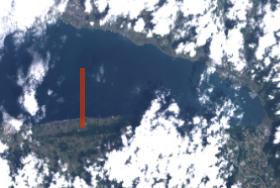
Model Testing: Lake Geneva
Next test site: Lake Geneva
Smaller Lake
Cloudier image to test how model reacts
Tests a near worst case atmosphere
Lake Geneva Test Image
17

Slide 26
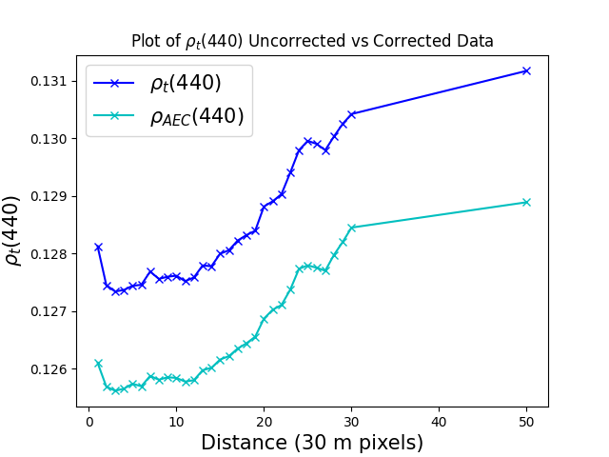
Testing: Corrected vs Uncorrected Lake Geneva
Percent Difference: 1.75%
Percent Difference: 1.59%
18
Notes:
AE are removed while keeping the integrity of the differences between areas of water
Clouds can also cause AE making the estimated AE larger at longer distances
The addition to the AOD values caused by cloudy atmospheres also add to the estimated AE values

Slide 27
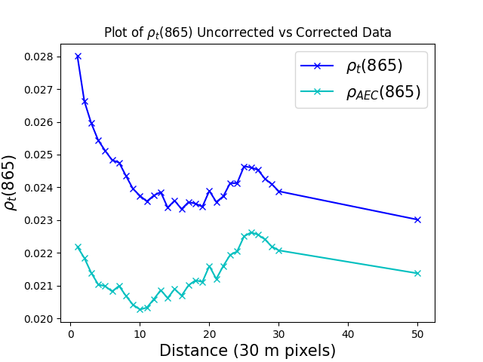
Testing: Corrected vs Uncorrected Lake Geneva
Percent Difference: 23.2%
Percent Difference: 7.39%
19
Notes:
AE are removed while keeping the integrity of the differences between areas of water
Clouds can also cause AE making the estimated AE larger at longer distances
The addition to the AOD values caused by cloudy atmospheres also add to the estimated AE values
Multiple factors affect the large difference at 50 pixel difference including clouds and Lake size

